Slide 1
2023 CCS Clinical Practice Update on Management of the Patient with a Prolonged QT Interval
Thursday October 26, 2023

Slide 2
© Canadian Cardiovascular Society. 2023. All rights reserved.
Distribution, transmission or republication is strictly prohibited without the prior written permission of the Canadian Cardiovascular Society.
For medical institution internal education or training (i.e. grand rounds, medical college/classroom education, etc.), kindly consider and implement the following:
Include the citation for the Canadian Journal of Cardiology
Add ‘Reproduced with permission from the Canadian Cardiovascular Society. [insert year].’
Avoid use of CCS logos or trademarks on slides, tools or publications that are not the property of the CCS
Do not modify the slide content and, the layout and CCS branding on the Guideline-related slides
Guideline recommendations must be reproduced exactly as published
For an industry supported or involved program, permissions are required:
If content is published in the Canadian Journal of Cardiology, permissions must be sought through our publisher Elsevier (www.onlinecjc.com)
If content is property of the CCS, contact guidelines@ccs.ca

Slide 3
© Canadian Cardiovascular Society. 2023. All rights reserved.
These slides were presented at Vascular 2023 in Montreal, Quebec on October 26, 2023. Find this session On Demand on the Vascular 2023 platform.
© Canadian Cardiovascular Society. 2023. All rights reserved.

Slide 4
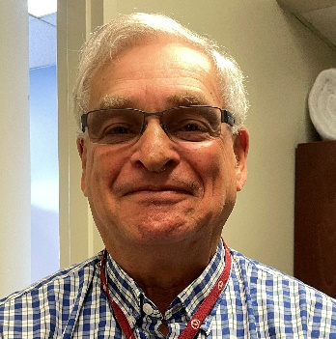
SPEAKERS
Ciorsti MacIntyre MD
(CoChair)
Dalhousie University & Mayo Clinic
Martin S. Green MD
University of Ottawa Heart Institute
Andrew D. Krahn MD
University of British Columbia
Thomas M. Roston MD PhD
University of British Columbia
Notes:
Place in alpha order

Slide 5
OVERALL LEARNING OBJECTIVES
At the completion of this activity, participants should be able to:
Understand when and how to manually measure the QT interval rather than rely on the automated ECG machine derived QT interval
Be able to investigate a patient with suspected congenital Long QT Syndrome (LQTS)
Know how to manage congenital and acquired LQTS
Recognize medications that cause acquired LQTS

Slide 6
Introduction
Ciorsti MacIntyre MD

Slide 7
PROGRAM DISCLOSURE OF COMMERCIAL SUPPORT
C. MacIntyre
I have/do not have relationships with for-profit and not-for-profit organizations over the past two years:
NATURE OF RELATIONSHIP | NAME OF THE FOR-PROFIT OR NOT-FOR-PROFIT ORGANIZATION | DESCRIPTION OF RELATIONSHIP
Any direct financial payments including receipt of honoraria | X | X
Membership on advisory boards or speakers’ bureaus | X | X
Funded grants of clinical trials | X | X
Patents on a drug, product or device | X | X
All other investments/relationship that could be seen as having the potential to influence the content of the educational activity | X | X

Slide 8
INTRODUCTION
Physicians are frequently faced with patients with borderline or significant QT prolongation
Prolongation of the QTc is associated with increased risk of torsades de pointes (TdP) and ventricular fibrillation
Accurate diagnosis of both congenital and acquired LQTS is essential to ensure accurate diagnosis and initiation of appropriate treatment strategies

Slide 9
2023 CCS CLINICAL PRACTICE UPDATE ON MANAGEMENT OF THE PATIENT WITH A PROLONGED QT INTERVAL
Canadian Journal of Cardiology 39 (2023) 1285 - 1301
Ross A. Davies, MD (co-chair)
Virginie Beauséjour Ladouceur, MCDM
Martin S. Green, MD
Jacqueline Joza ,MD, MSc
David N. Juurlink, MD, PhD
Andrew D. Krahn, MD
M. Sean McMurtry, Md, PhD
Jason D. Roberts, MD, MAS
Thomas M. Roston, MD, PhD
Shubhayan Sanatani, MD
Christian Steinberg, MD
Ciorsti MacIntyre, MD (co-chair)
Practical Tips:
Measurement of the QT interval
Diagnosis of congenital and acquired LQTS
Management of the patient with the prolonged QT

Slide 10
Goals for this session:
ECG pearls when evaluating the QT interval
Congenital LQTS Diagnosis
Congenital LQTS Treatment
TdP Management
Acquired LQTS

Slide 11
ECG measurement and understanding of the QT interval
Martin S. Green MD

Slide 12
PROGRAM DISCLOSURE OF COMMERCIAL SUPPORT
M. GREEN
I have/do not have relationships with for-profit and not-for-profit organizations over the past two years:
NATURE OF RELATIONSHIP | NAME OF THE FOR-PROFIT OR NOT-FOR-PROFIT ORGANIZATION | DESCRIPTION OF RELATIONSHIP | MITIGATION OF BIAS
Any direct financial payments including receipt of honoraria | Medtronic Canada | Speaker Honoraria | No relation
Membership on advisory boards or speakers’ bureaus | X | X
Funded grants of clinical trials | X | X
Patents on a drug, product or device | X | X
All other investments/relationship that could be seen as having the potential to influence the content of the educational activity | X | X

Slide 13
LEARNING OBJECTIVES
At the completion of this section, participants should be able to:
Understand when and how to manually measure the QT interval rather than rely on the automated ECG machine derived QT interval

Slide 14
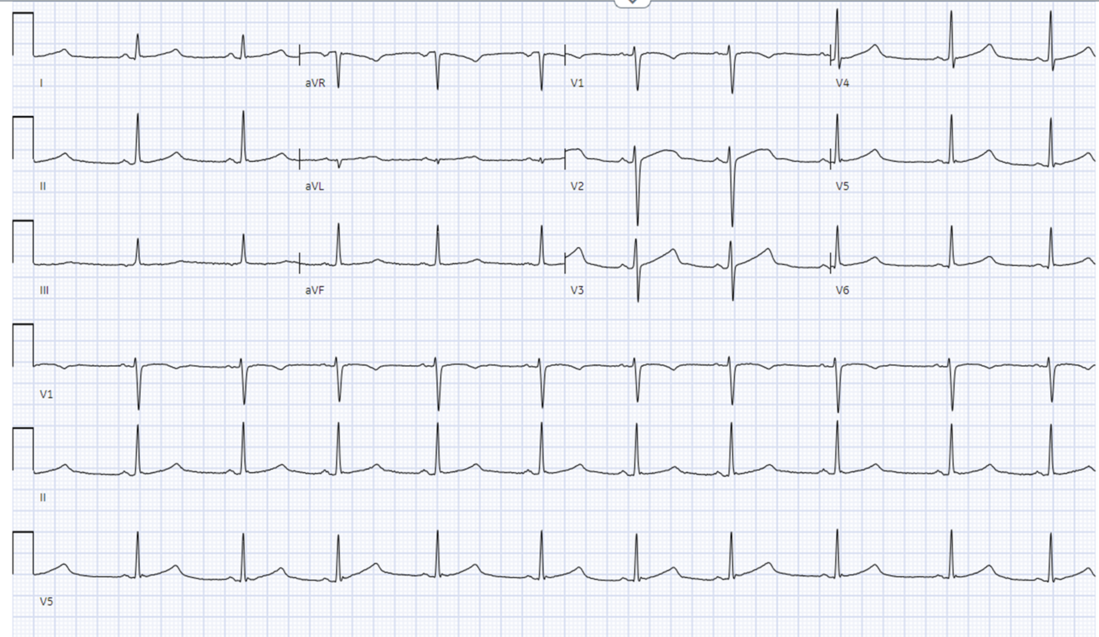
23-year-old woman presents with episode of syncope
QTc = 470 ms

Slide 15
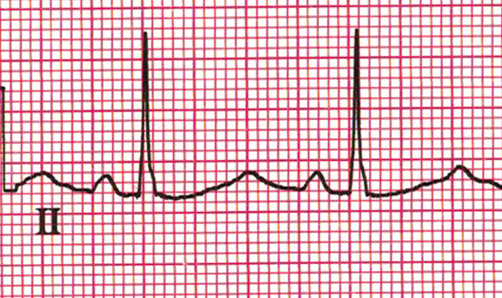
Measuring the QT – Tangent Method
Draw the tangent to the steepest slope of the T wave
Identify the baseline
Identify the QRS onset
Identify intersection of tangent line with baseline
520 ms at 70 bpm – QTc 571 ms

Slide 16
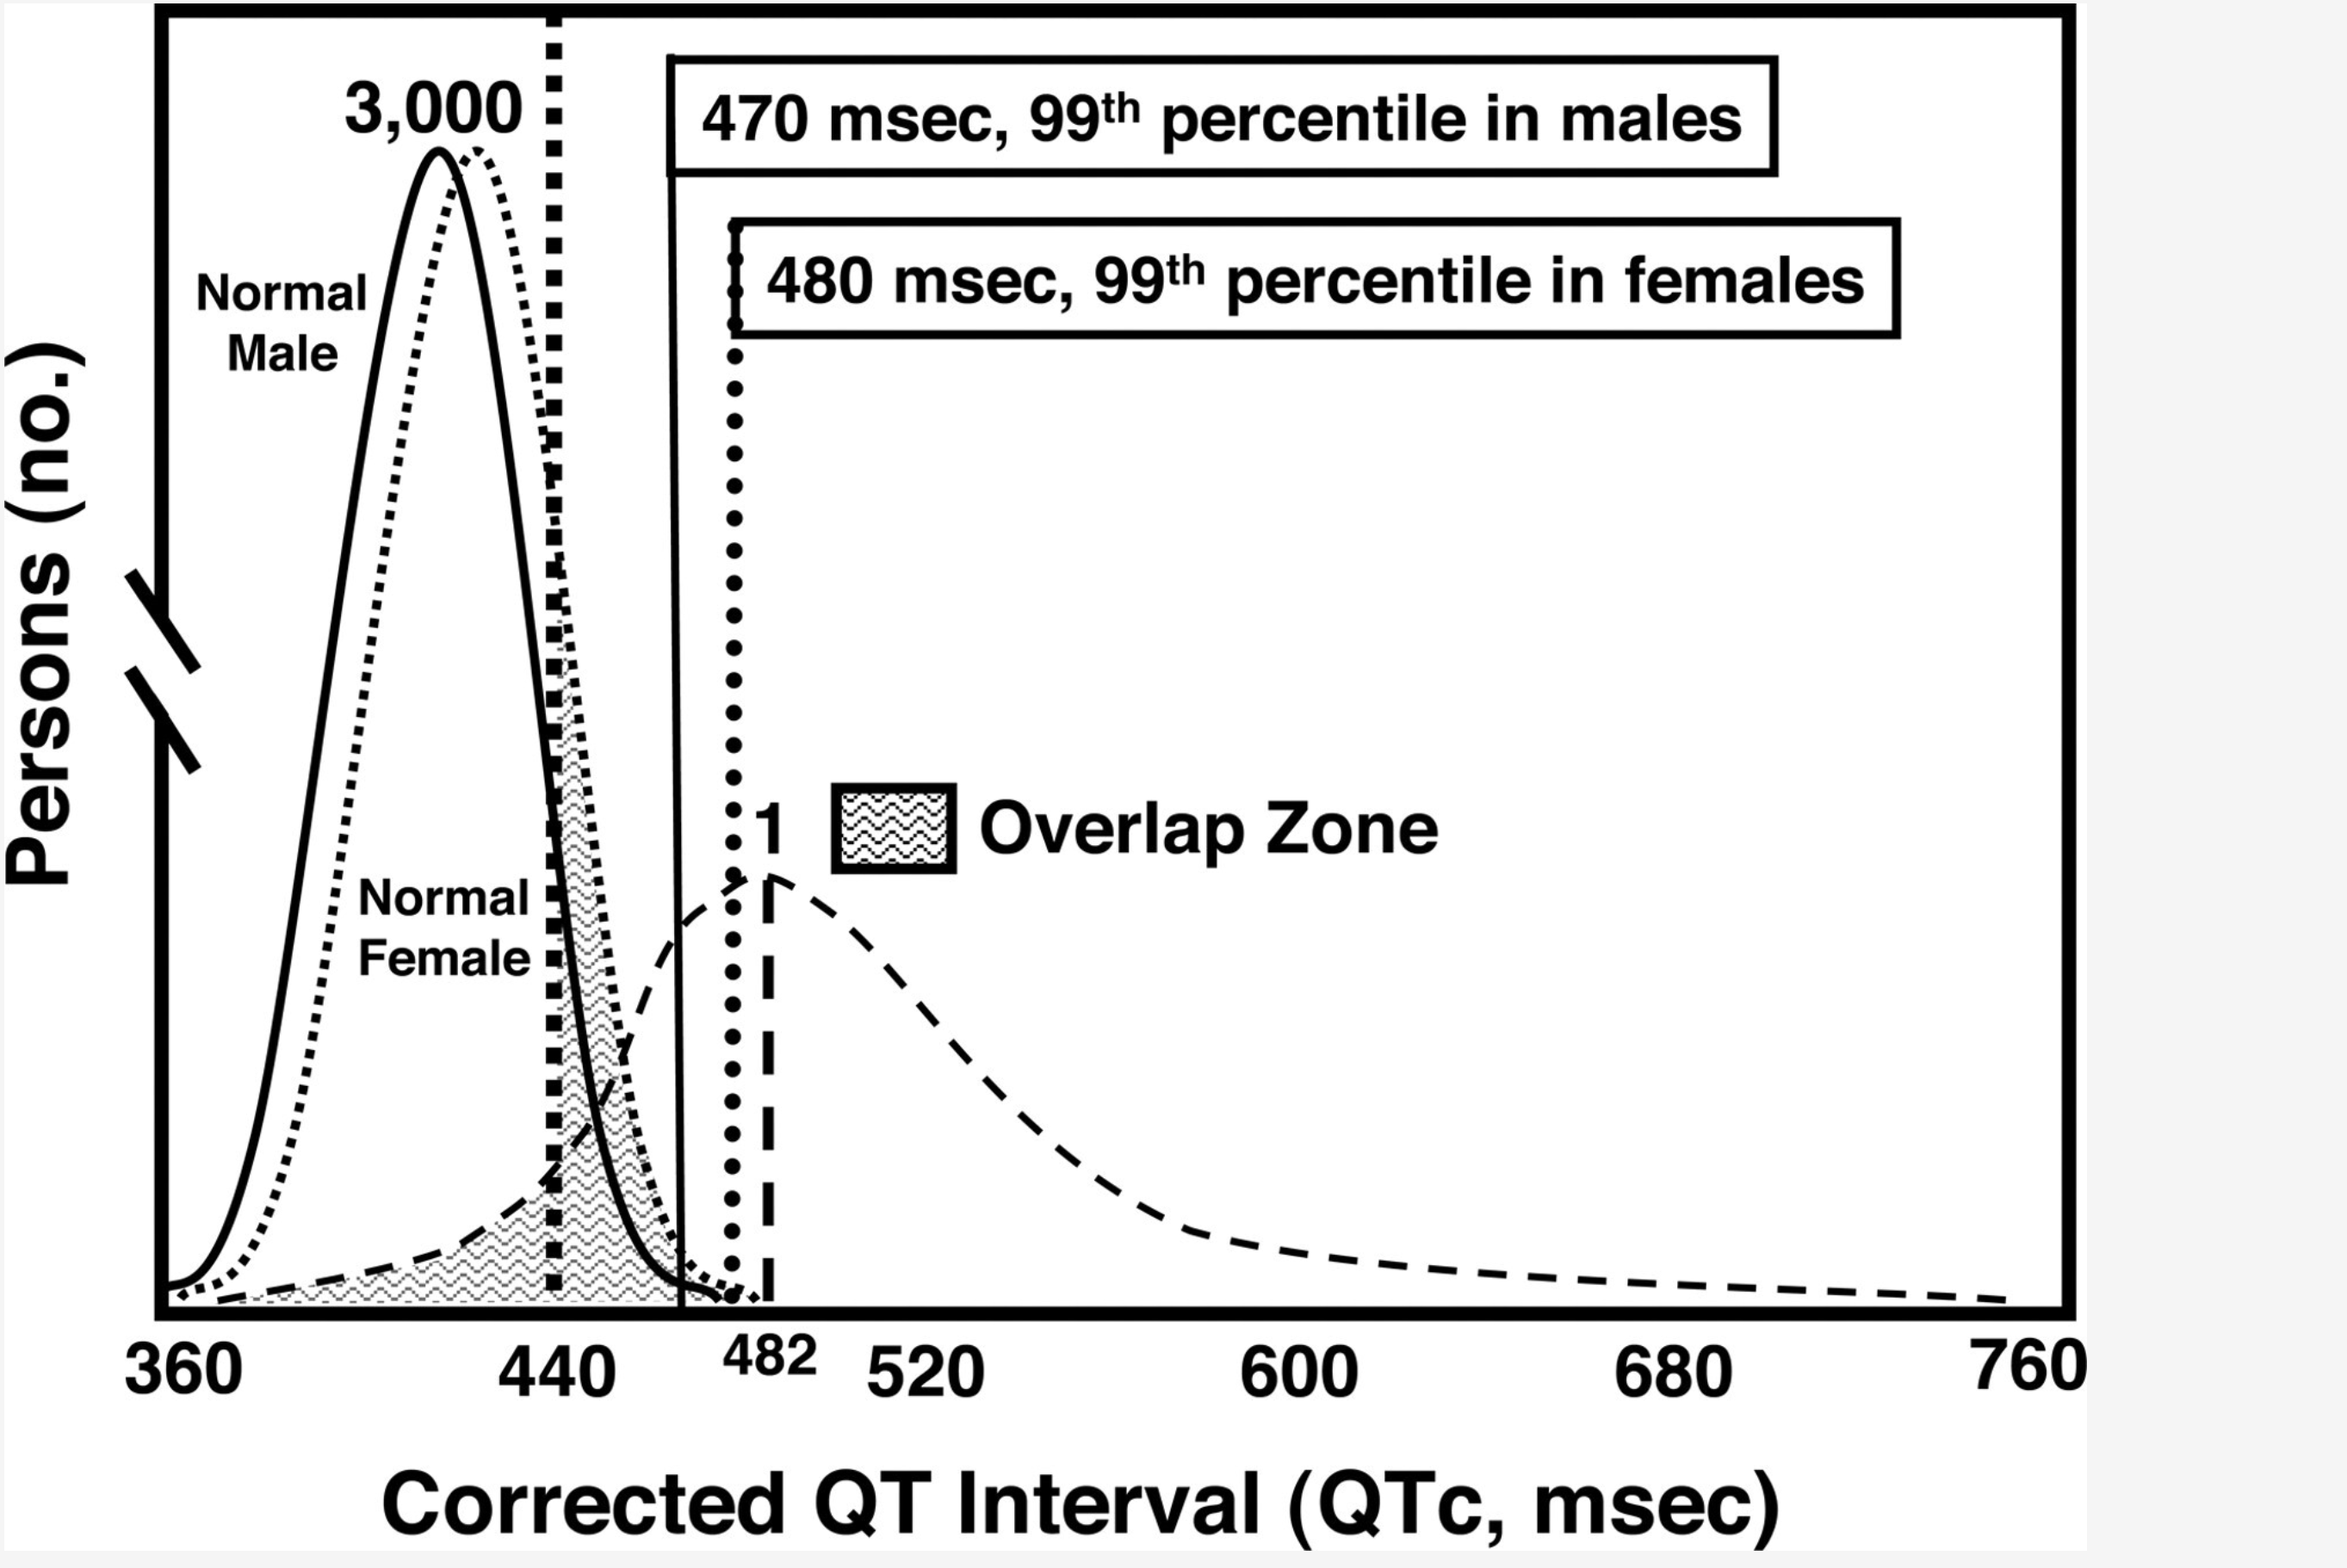
Defining the Normal QT interval – Overlap with LQTS

Slide 17
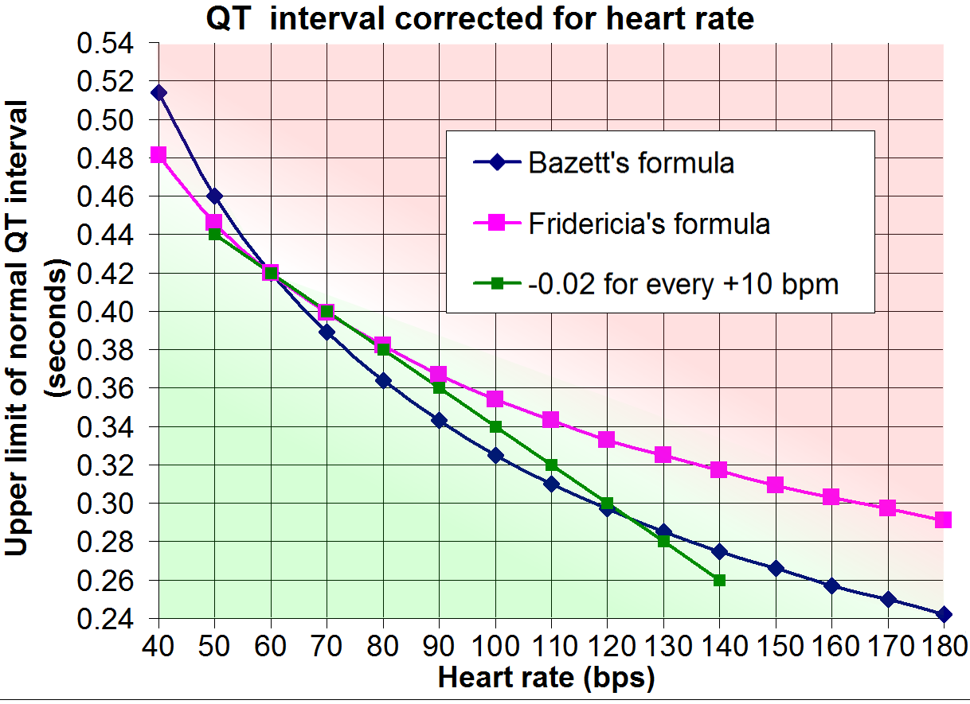
Correcting the QT interval for heart rate
1. Bazett: QTcB = QT/RR^{1/2}. (HR<100 bpm)
2. Fridericia: QTcF = QT/RR^{1/3}. (HR>100 bpm)
3. Framingham: QTcFram = QT+ 0.154*(1−RR)

Slide 18
Let’s get back to our patient: 23-year-old woman with syncope

Slide 19
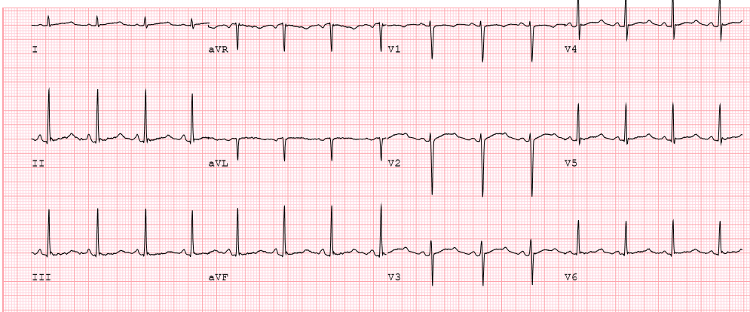
Let’s get back to our patient:
LQT2: secondary hump on T wave brought out by standing or early exercise
QT = 460 ms; QTcb = 566 ms

Slide 20
QT Interval Summary
The QT interval may be difficult to measure, and the computer interpretation is often incorrect
There is an overlap in QT intervals between the normal population and those with Long QT syndrome
In the Long QT syndrome population, the exercise ECG can often expose abnormal QT behaviour not seen at rest

Slide 21
Congenital LQTS diagnosis
Andrew Krahn MD FCCS

Slide 22
PROGRAM DISCLOSURE OF COMMERCIAL SUPPORT
A. KRAHN
I have/do not have relationships with for-profit and not-for-profit organizations over the past two years:
NATURE OF RELATIONSHIP | NAME OF THE FOR-PROFIT OR NOT-FOR-PROFIT ORGANIZATION | DESCRIPTION OF RELATIONSHIP
Any direct financial payments including receipt of honoraria | X | X
Membership on advisory boards or speakers’ bureaus | X | X
Funded grants of clinical trials | X | X
Patents on a drug, product or device | X | X
All other investments/relationship that could be seen as having the potential to influence the content of the educational activity | X | X
Notes:
Within the past two years, I have not had an affiliation (financial or otherwise) with a commercial organization that may have a direct or indirect connection to the content of my presentation

Slide 23
LEARNING OBJECTIVES
At the completion of this section, participants should be able to:
Be able to investigate a patient with suspected congenital Long QT Syndrome (cLQTS)

Slide 24
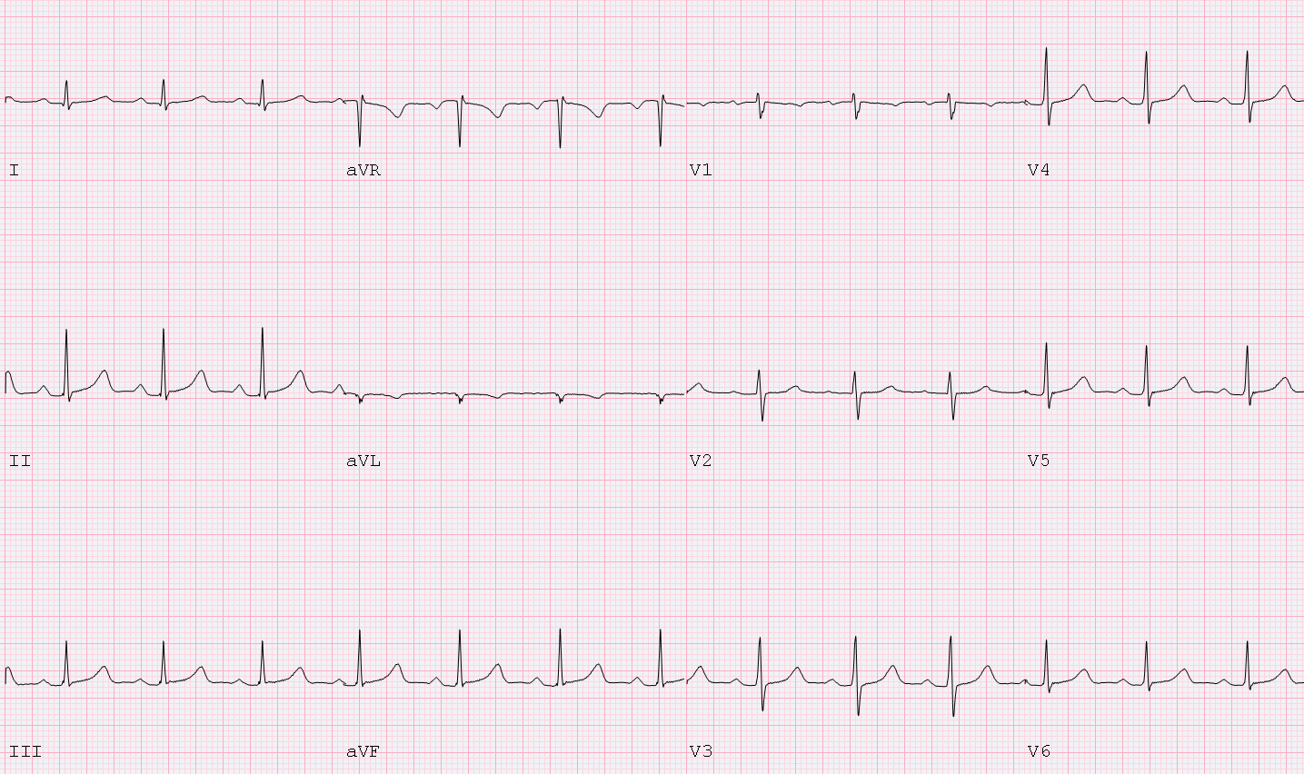
Case Presentation
20-year-old male
Uncle in China died many years ago in his 20s (no autopsy)
AED nearby, resuscitated from VF
Cooled in ICU, normal recovery
Day 2 echocardiogram mild LV dysfunction
CT angiogram normal coronary anatomy
What further tests are needed?

Slide 25
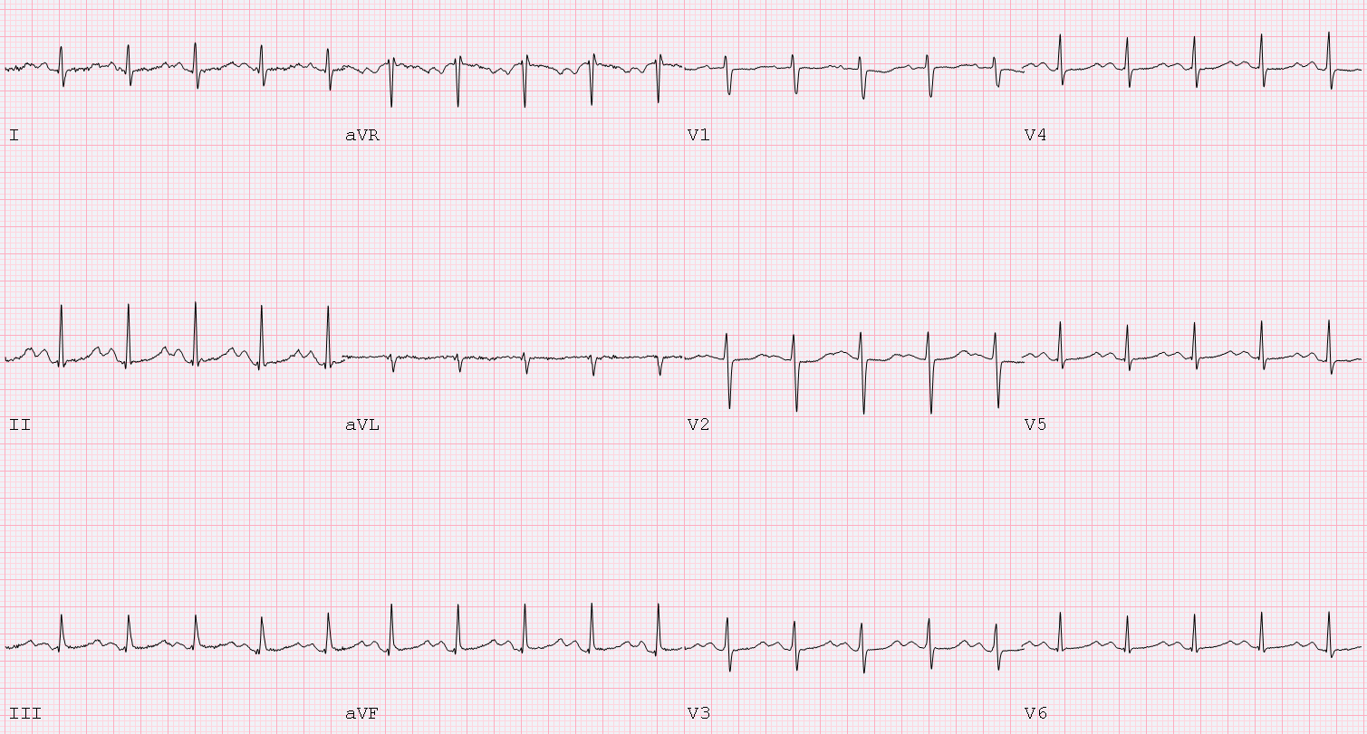
Exercise Test to Provoke a Diagnosis – Early Exercise

Slide 26
Diagnosing cLQTS
The three most common genetic forms of cLQTS syndrome have distinct T wave morphologies
Assess baseline ECG after stopping reversible QT interval prolonging factors
Serial ECGs over time can be helpful: regression to the mean
The primary diagnostic test in suspected cLQTS is an exercise test
Evaluate morphology, QT adaptation, focus on the standing ECG and recovery for highest yield (4-minute recovery is the key measure)
Pattern of shortening and T wave pattern predict genotype

Slide 27
“QT” Exercise Test
Bruce, Modified Bruce Protocol
Frequent ECGs: supine and standing, every minute during exercise and recovery
Extend recovery to 6 minutes for adults, 10 minutes for children
Immediate post exercise 12 lead ECG
supine
standing
start
exercise
peak
recovery
ECG
ECG
ECG
ECG
ECG
ECG
ECG
ECG
ECG
ECG
ECG
ECG
ECG
ECG

Slide 28
Diagnosing cLQTS
Additional key factors:
Personal and family history including context of events:
Drowning/swimming, auditory events, emotion, sleep
Epinephrine challenge out of favour: 20% false positive rate, and difficulty interpreting the provoked ECG response, seldom done

Slide 29
Genetic Testing - Logistics
I strongly recommend you get good at this OR partner with an expert
3 major genes, 14 much less common genes with less compelling evidence
The core person in the process is a genetic counsellor (or equivalent)
Counsel and consent, blood or sputum/cheek swab
Sent to labs in your province, the US or Europe
Cost $1000-1500 for index case (proband). $0-300 for family members.
Total time 1-5 months

Slide 30
cLQTS Diagnosis Summary
cLQTS is a clinical diagnosis informed by history, family context, resting and exercise ECG, and genetic testing
Expert clinics across the country are keen to partner with you to care for patients and families (www.heartsinrhythm.ca)

Slide 31
LQTS/Tdp Management
Thomas M. Roston MD PhD

Slide 32
PROGRAM DISCLOSURE OF COMMERCIAL SUPPORT
T. ROSTON
I have/do not have relationships with for-profit and not-for-profit organizations over the past two years:
NATURE OF RELATIONSHIP | NAME OF THE FOR-PROFIT OR NOT-FOR-PROFIT ORGANIZATION | DESCRIPTION OF RELATIONSHIP | MITOGATION TO BIAS
Any direct financial payments including receipt of honoraria | Cardurion Pharmaceuticals | Consultant | COI reviewed by CCS
Membership on advisory boards or speakers’ bureaus | X | X
Funded grants of clinical trials | X | X
Patents on a drug, product or device | X | X
All other investments/relationship that could be seen as having the potential to influence the content of the educational activity | X | X

Slide 33
LEARNING OBJECTIVES
At the completion of this section, participants should be able to:
Know how to manage congenital and acquired LQTS
Recognize medications that cause acquired LQTS

Slide 34
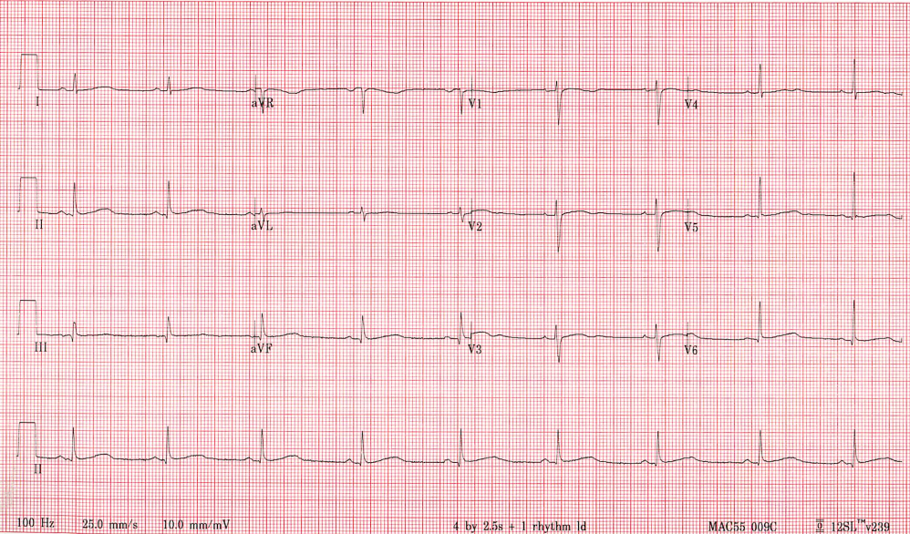
Case Presentation
26-year-old male
ER visit for viral URTI symptoms → routine ECG ordered
QTc (Bazett): 490 ms
Unexplained exertional syncope remotely – never assessed
Not on medications, normal electrolytes
Maternal grandfather had SCD at 31 while working on oil rig, circumstances unknown

Slide 35
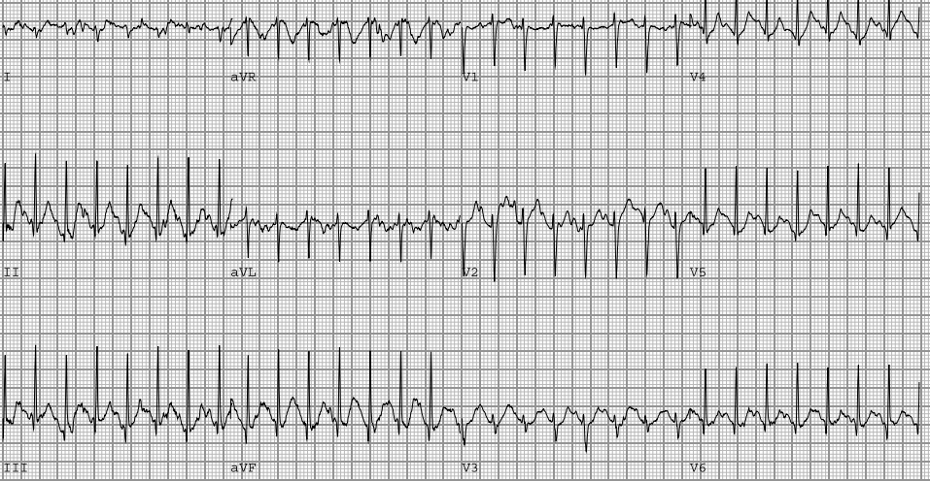
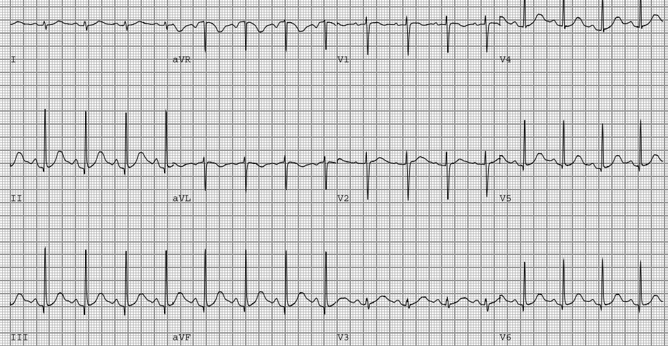
Cardiac Clinic Visit → Exercise Test
4 min recovery QTc = 503 ms
Peak exercise – stage 6

Slide 36
POLL: Aside from avoiding QT prolonging factors, what is the next best step in therapy?
Answer: (B) Nadolol
Non-selective beta-blockers, particularly nadolol, are the recommended first line treatment for cLQTS, particularly in those with symptoms or significant QT prolongation.
ICDs are rarely necessary.
Metoprolol
Nadolol
Sotalol
ICD implant
Observation only
Metoprolol
Nadolol
Sotalol
ICD implant
Observation only
Notes:
Answer: (B) Nadolol
Non-selective beta-blockers, particularly nadolol, are the recommended first line treatment for cLQTS, particularly in those with symptoms or significant QT prolongation.
ICDs are rarely necessary

Slide 37
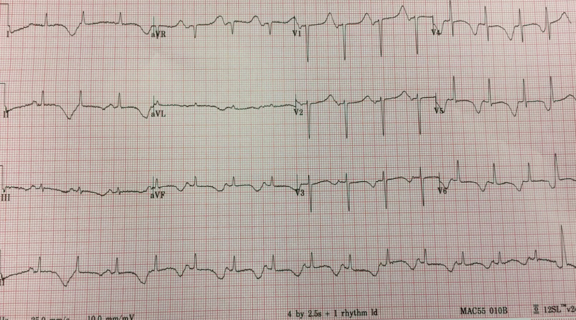
Case Presentation
55-year-old female
History of depression & polysubstance use disorder, recent visit for UTI
Chronic use of fluoxetine, methadone, gabapentin, and recently started ciprofloxacin
Presents to ER by ambulance for syncope while seated at breakfast table
QTc >600 ms with normal electrolytes
Frequent runs of non-sustained torsades de pointes on monitor

Slide 38
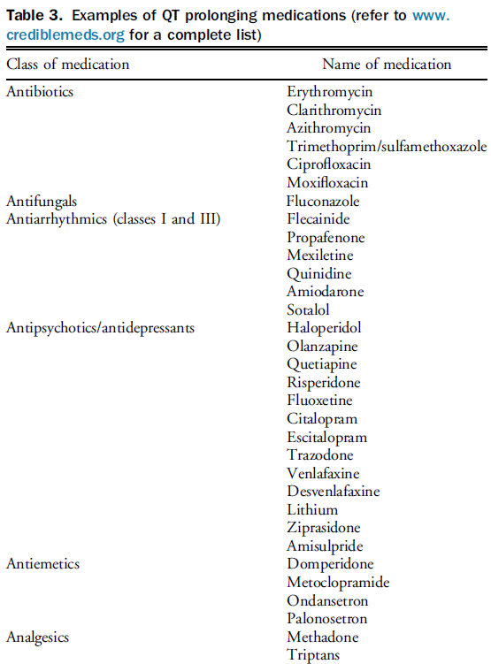
POLL: Which drug is unlikely to be implicated in this presentation of TdP?
Fluoxetine
Ciprofloxacin
Gabapentin
Methadone
Fluoxetine
Ciprofloxacin
Gabapentin
Methadone
Answer: (C) Gabapentin
Many SSRIs, methadone, and FQ antibiotics are high risk for causing aLQTS, especially when combined
See CredibleMeds.org (also app)
Davies et al. CJC, 2023

Slide 39
POLL: In this patient, which of the following is not clinically indicated?
Consider temporary transvenous pacing
Empiric IV magnesium sulfate administration
Transition from methadone to suboxone
Urgent IV amiodarone administration
Transition from ciprofloxacin to amoxicillin
Consider temporary transvenous pacing
Empiric IV magnesium sulfate administration
Transition from methadone to suboxone
Urgent IV amiodarone administration
Transition from ciprofloxacin to amoxicillin
Answer: (D) Amiodarone
Temporary TVP, IV MgSO4, and avoidance of QT prolonging meds are all reasonable in TdP from aLQTS
Amiodarone may cause further QT prolongation, bradycardia, R-on-T, and TdP

Slide 40
POLL: At hospital discharge, the QTc is normal but the patient wants to remain on an anti-depressant. Which agent would be safest to use instead of fluoxetine?
Citalopram
Escitalopram
Paroxetine
Citalopram
Escitalopram
Paroxetine
Answer: (C) Paroxetine
Davies et al. CJC, 2023 in press

Slide 41
LQTS/TdP Management Summary
Most cases of cLQTS can be safely managed with nadolol (or propranolol), as well as avoidance of QT prolonging factors
Remember that many of the “anti-” drugs are associated with QT prolongation (e.g. antibiotics, antidepressants, anti-emetics etc.)
To reduce the risk of aLQTS:
Use the least QT prolonging agent in susceptible individuals
Correct reversible QT factors
Avoid prescribing multiple QT prolonging agents simultaneously
Management of aLQTS varies depending on the seriousness of the presentation, but should always prompt electrolyte correction and re-evaluation of implicated medication(s), with consideration for changing to the “least” QT prolonging options if therapy cannot be stopped → F/U ECG is suggested

Slide 42
Acquired LQTS
Ciorsti MacIntyre MD

Slide 43
Acquired LQTS
aLQTS results from an acquired alteration in cardiac ion channels that INCREASE the action potential duration
Most aLQTS arises from:
QT prolonging medications (that block the I_{kr} ion channel)
And/Or
Electrolyte abnormalities

Slide 44
Culprits for aLQTS
Increased Risk for TdP:
QTc > 500 msec
QTc increases > 50-70 msec (especially when rapid)
Women
Elderly
Underlying structural heart disease
Electrolyte Abnormalities
Hypokalemia
Hypomagnesemia
Hypocalcemia
Severe Bradycardia
Sinus bradycardia
AV block
Hypo- or hyper-thyroidism
Hypothermia
Medications “the antis”
Antibiotics (macrolides, fluoroquinolones)
Antifungals
Antiarrhythmics
Antidepressants
Antipsychotics
Antiemetics
Analgesics (e.g. Methadone, triptans)
Miscellaneous (e.g. Loperamide, hydroxychloroquine)

Slide 45
Case Presentation
52-year-old man with opioid use disorder
Takes methadone 80 mg daily
The baseline QTc is 480 msec
He develops significant depression and requires treatment
POLL:
Which of the following is MOST likely to predispose him to TdP?
Paroxetine
Bupropion
Citalopram
Sertraline

Slide 46
Case Presentation
52-year-old man with opioid use disorder
Takes methadone 80 mg daily
The baseline QTc is 480 msec
He develops significant depression and requires treatment
POLL:
Which of the following is MOST likely to predispose him to TdP?
Paroxetine
Bupropion
Citalopram
Sertraline

Slide 47
Important Intraclass Differences
There are important intraclass differences among QT prolonging medications
Among the Selective Serotonin Reuptake Inhibitor (SSRI) antidepressants:
Risk is highest with citalopram
Risk is negligible with paroxetine and sertraline
Consider an ECG if initiating a QT prolonging agent in patients already receiving a QT prolonging medication or if risk factors for QT prolongation (e.g. concomitant use of a diuretic)

Slide 48
POLL:
24-year-old woman with congenital LQTS requires antibiotic therapy for a complex infection. Which of the following is LEAST likely to predispose the patient to TdP?
Clarithromycin
Azithromycin
Erythromycin
Moxifloxacin
Notes:
Audience response question

Slide 49
POLL:
24-year-old woman with congenital LQTS requires antibiotic therapy for a complex infection. Which of the following is LEAST likely to predispose the patient to TdP?
Clarithromycin
Azithromycin
Erythromycin
Moxifloxacin
Notes:
Audience response question

Slide 50
There are also intraclass differences among antibiotics
Among macrolide antibiotics – highest risk with erythromycin and lowest with azithromycin
It is still important to consider whether a safe alternative is an option (e.g. penicillin or cephalosporin)

Slide 51
Acquired LQTS Summary
There are multiple potential contributing factors to acquired QT prolongation (e.g. medications, electrolyte abnormalities, hypothermia)
Risk of TdP is Increased in the setting of:
QTc above 500 msec
Rapid increase in the QTc
Female/Elderly/Structural heart disease
If possible, choose “safer alternatives” but when forced to choose a medication with QT prolonging potential try to choose medications with less QT prolonging potential (remember the intraclass differences)

Slide 52
Conclusions
Ciorsti MacIntyre MD

Slide 53
Conclusions
Accurate measurement of the QT interval is important
Use lead II or V5; “teach the tangent; avoid the tail”
QTc values above 480 msec should be considered abnormal; a QTc above 500 msec is associated with an increased risk of TdP
QT prolongation can be congenital or acquired
Consider cLQTS if red flags on testing, in the history or in the family history
A normal ECG in a family member is not sufficient to exclude a diagnosis of LQTS!
Nadolol is the preferred beta blocker in cLQTS management
Important to remember the overarching principles of management as well:
Avoidance of QT prolonging medications (www.crediblemeds.org)
Attention to fluid and electrolyte status

Slide 54
Expert clinics across the country are keen to partner with you to care for patients and families (www.heartsinrhythm.ca)

Slide 55
Thank you
Find this session On Demand on the Vascular 2023 platform
On Demand includes almost every Vascular 2023 scientific and educational session. Look for the symbol to find all On Demand content available.

