Slide 1
Implementing Multimodality Neuroprognostication in the Post Cardiac Arrest Patient
October 26, 2023

Slide 2
© Canadian Cardiovascular Society. 2023. All rights reserved.
Distribution, transmission or republication is strictly prohibited without the prior written permission of the Canadian Cardiovascular Society.
For medical institution internal education or training (i.e. grand rounds, medical college/classroom education, etc.), kindly consider and implement the following:
  Include the citation for the Canadian Journal of Cardiology
  Add ‘Reproduced with permission from the Canadian Cardiovascular Society. [insert year].’
  Avoid use of CCS logos or trademarks on slides, tools or publications that are not the property of the CCS
  Do not modify the slide content and, the layout and CCS branding on the Guideline-related slides
  Guideline recommendations must be reproduced exactly as published
For an industry supported or involved program, permissions are required:
  If content is published in the Canadian Journal of Cardiology, permissions must be sought through our publisher Elsevier (www.onlinecjc.com)
  If content is property of the CCS, contact guidelines@ccs.ca

Slide 3
© Canadian Cardiovascular Society. 2023. All rights reserved.
These slides were presented at Vascular 2023 in Montreal, Quebec on October 28, 2023. Find this session On Demand on the Vascular 2023 platform.
Reference: Fordyce CB, Kramer AH, et al. Canadian Journal of Cardiology, DOI: 10.1016/j.cjca.2022.12.014. Copyright © 2023 Canadian Cardiovascular Society. All rights reserved.
© Canadian Cardiovascular Society. 2023. All rights reserved.

Slide 4
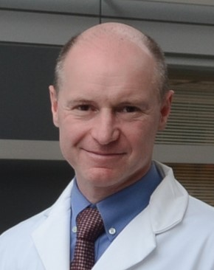
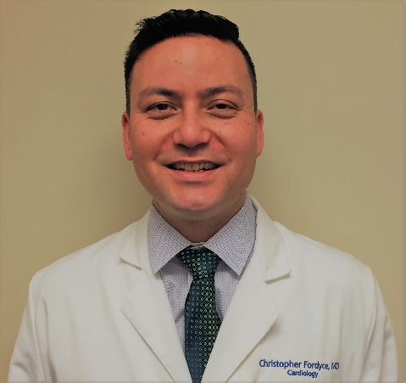

Speakers
Andreas Kramer (Co-Chair)
MD MSc
University of Calgary
Critical Care
Christopher Fordyce
(Co-Chair)
MD MHS MSc
University of British Columbia
Cardiology
Emilie Belley-Côté
(Methods Expert)
MD PhD
McMaster University
Cardiology/Critical Care
Notes:
Place in alpha order

Slide 5


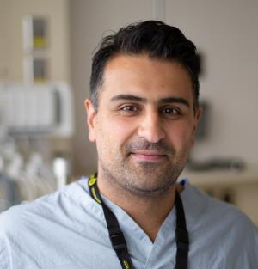

Speakers (continued)
Craig Ainsworth
MD
McMaster University
Cardiology/Critical Care
Julie Kromm
MD
University of Calgary
Neurology/Critical Care
Mypinder Sekhon
MD PhD
University of British Columbia
Critical Care
Sean van Diepen
MD MSc
University of Alberta
Cardiology/Critical Care
Planning Committee:
Christopher Overgaard, MD, MSc, University of Toronto, Cardiology
Gary Hunter, MD, University of Saskatchewan, Neurology
Damon Scales, MD, PhD, University of Toronto, Critical Care

Slide 6
Conflict of Interest*
 | Any direct financial payments including receipt of honoraria | Membership on advisory boards or speaker’s bureaus | Funded grants or clinical trials | Mitigation of Bias
C. Fordyce | Bayer, Novo Nordisk, Boehringer Ingelheim, Sanofi, Novartis, New Amsterdam, HLS therapeutics | Bayer, Novo Nordisk, Boehringer Ingelheim, Novartis, New Amsterdam, HLS therapeutics | Bayer, Amgen, Novartis | Outside scope of this work
A. Kramer | None | None | None | N/A
M. Sekhon | None | None | None | N/A
E. Belley-Côté | None | None | None | N/A
C. Ainsworth | None | None | None | N/A
J. Kromm | None | None | None | N/A
S. van Diepen | None | None | None | N/A
C. Overgaard | None | None | None | N/A
G. Hunter | None | None | None | N/A
D. Scales | None | None | None | N/A
*Relationships with for-profit/not-for-profit organizations last 2 years

Slide 7
Overall Learning Objectives
At the completion of this activity, participants should be able to:
Identify the key diagnostic modalities used for neuroprognostication following cardiac arrest
Understand the influence of confounding factors and timing when using diagnostic modalities for neuroprognostication
Integrate multimodal neuroprognostication into the routine care of the post cardiac arrest patient.

Slide 9
Clinical Case
Dr. M. Sekhon

Slide 10
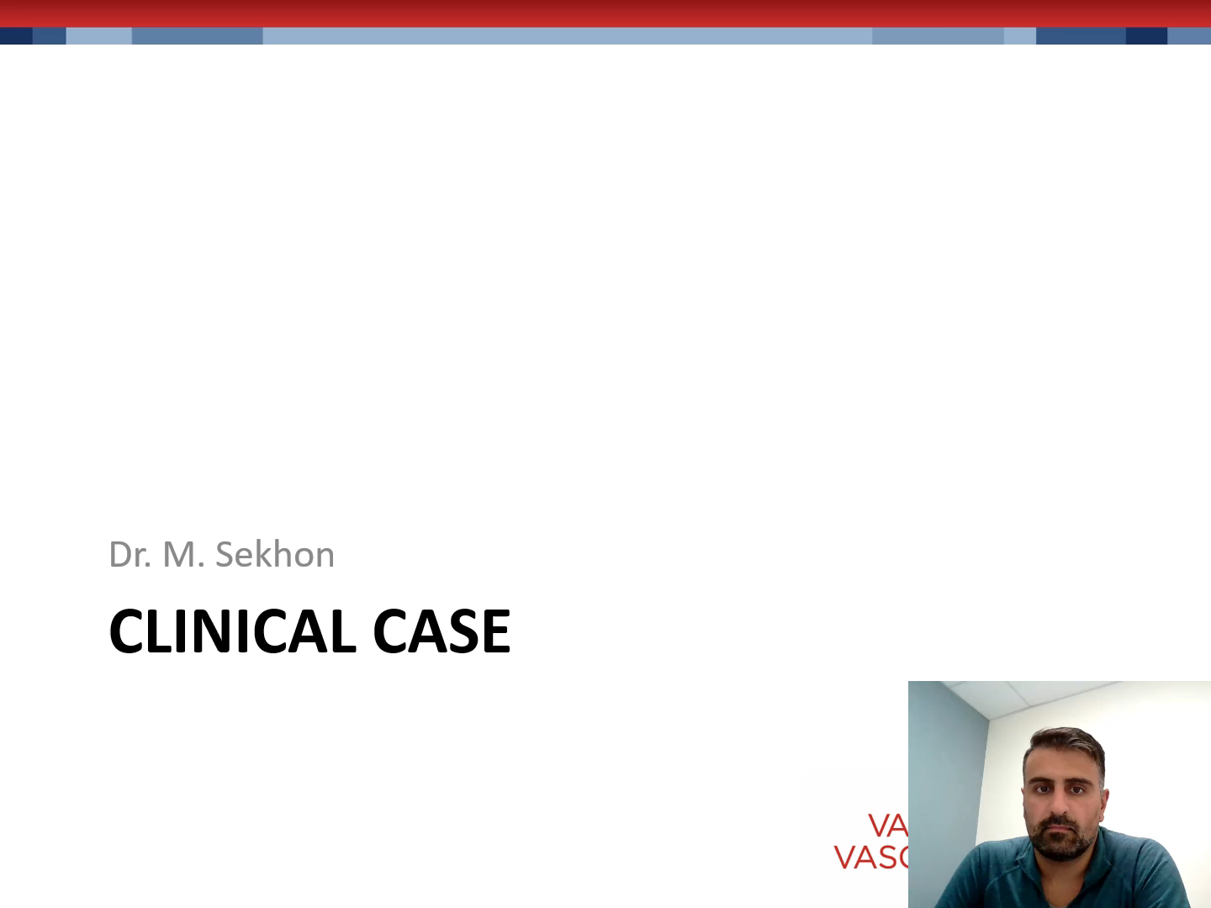

Slide 11
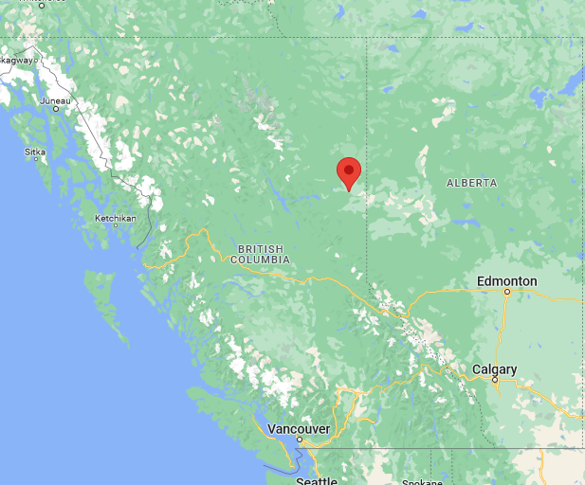
Clinical Case
22-year-old male from Fort St. John, BC
PMHx: None
Fam Hx: No cardiac history or sudden cardiac death
Social Hx: Forest fire fighter, occasional alcohol, no illicit drugs

Slide 12
Clinical Case (cont’d)
Single vehicle motor vehicle collision outside of Ft. St. John, BC
Upon extraction, VF arrest with 35 min prior to ROSC
Prolonged hypotension and hypoxemia at Ft. St. John Hospital
Injuries:
  Blunt chest injury with bilateral pulmonary contusions and myocardial contusion
  Type II odontoid fracture

Slide 13
Clinical Case (cont’d)
22-year-old male
Day 1
  Pupils 3/3 and reactive
  Sedated with Propofol
  TTM – 35 to 36ºC
  MAP ~ 70’s. Norepinephrine o to 10mcg/min
  Initial lactate 13.2 mmol/L
  ECG – No ischemic changes.
  ECHO – low normal LV function. No regional wall motion abnormalities. No significant valvular disease.

Slide 14
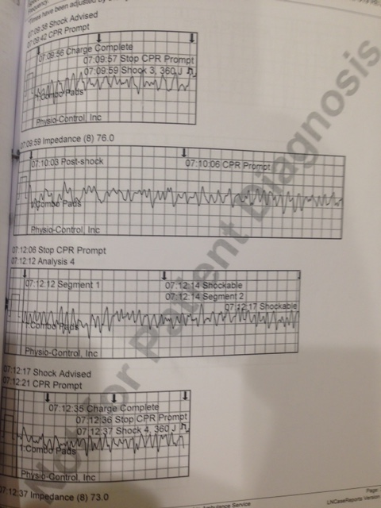
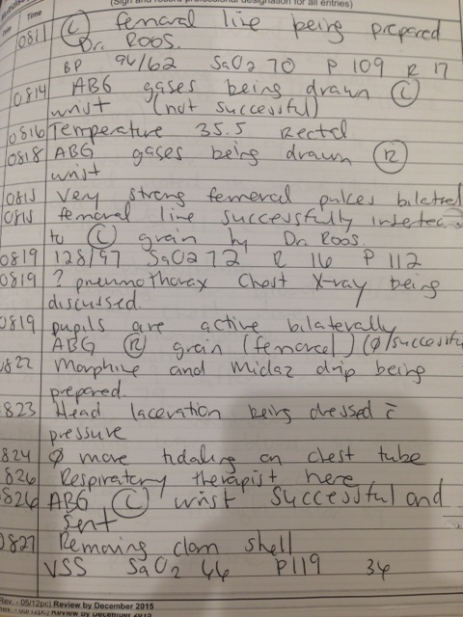
Clinical Case (cont’d)

Slide 15
Circumstances following a cardiac arrest /neurological exam
Dr. E. Belley-Côté

Slide 16
What is the likelihood of this patient surviving with good neurological recovery?.
10%
25%
40%
70%
Don’t know
Notes:
Underlining that in this patient - this is a question of can we prognosticate within the first 24h - not an epidemiological statistic.

Slide 17
Circumstances immediately or following cardiac arrest

Slide 18
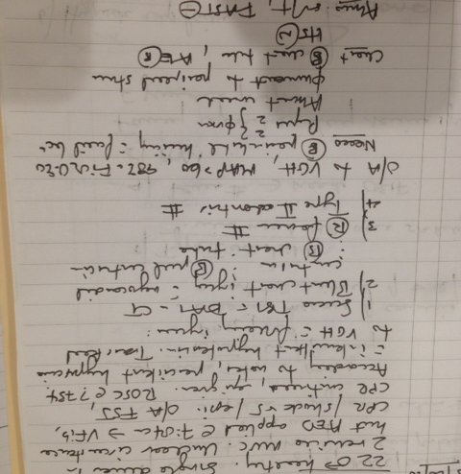
Clinical Case: Day 1
Pupils 2 mm; not reactive
Absent corneals
No movement to peripheral stimuli
Notes:
Pupils 2 mm not reactive
Absent corneals
No movement to peripheral

Slide 19
All of the following are true concerning the neurological exam to prognosticate except:
GCS motor score of 1-2 should be used to conclude poor prognosis
The physical examination is a mandatory neuroprognostic modality
Absent pupillary light reflexes after 72 hours are predictive of poor outcome
Absent corneal reflexes after 72 hours may be used to predict poor outcome
Sedatives, opioids, and neuromuscular blockers should have sufficient time to clear
Notes:
Underlining this patient - this is a question of can we prognosticate within the first 24h not an epidemiological statistic

Slide 20
Neurological exam

Slide 21
Neuroimaging
Dr. A. Kramer

Slide 22
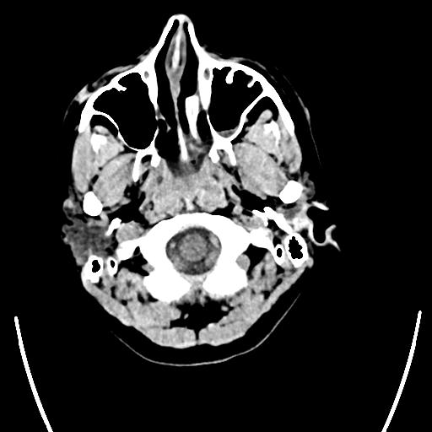
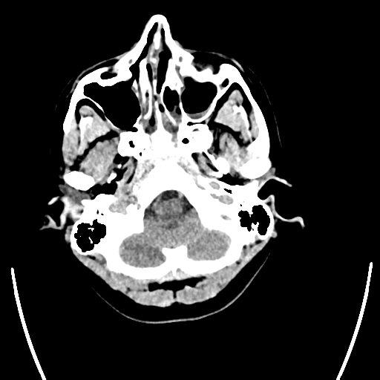
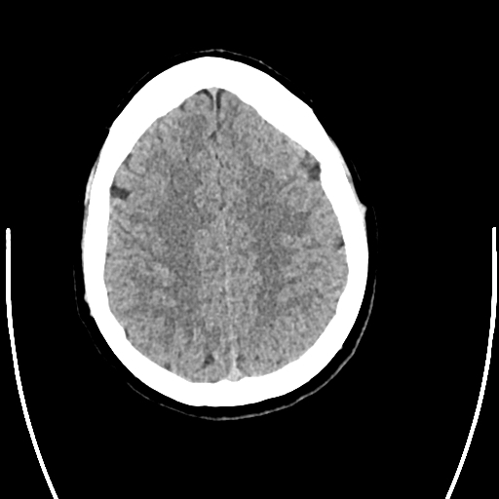
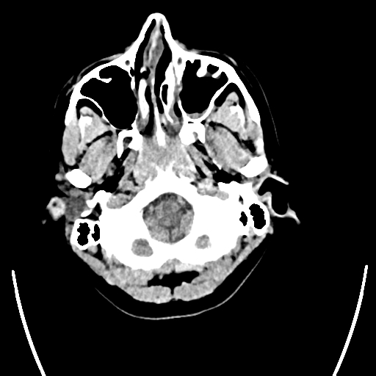
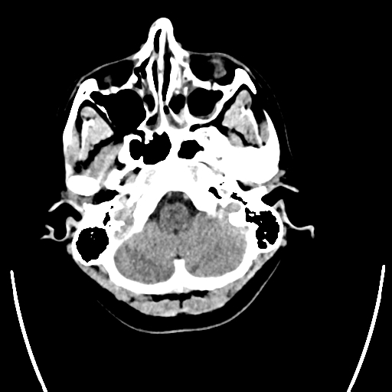
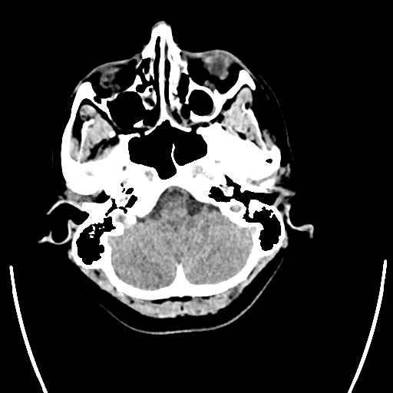
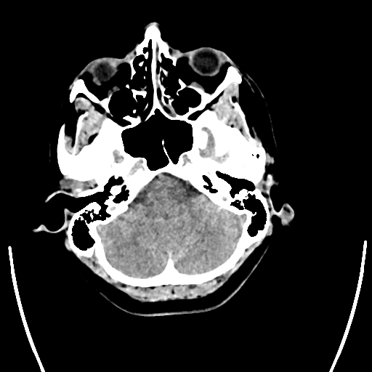
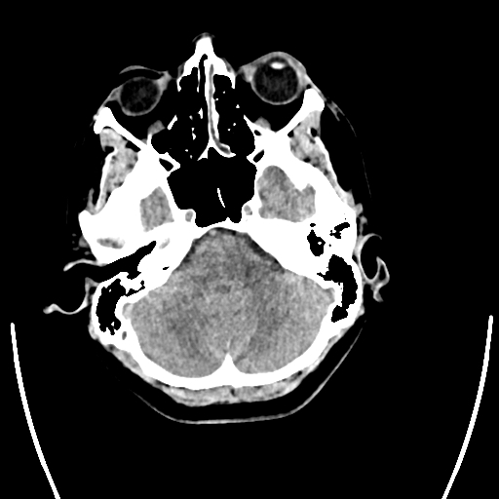
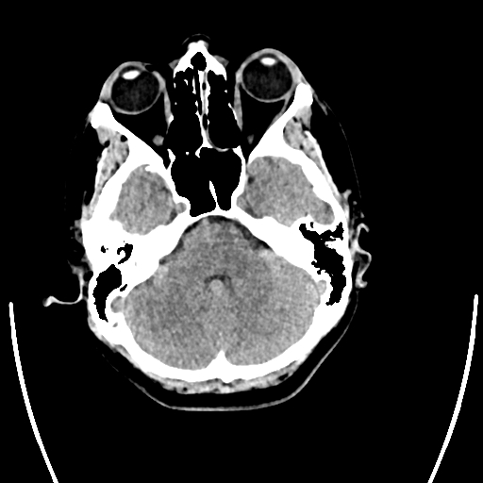
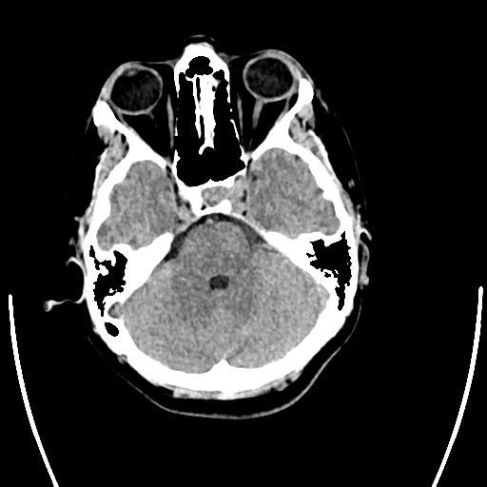
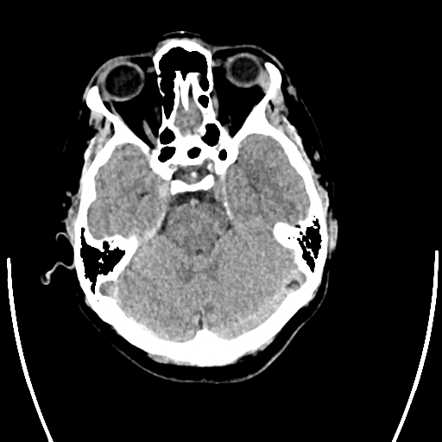
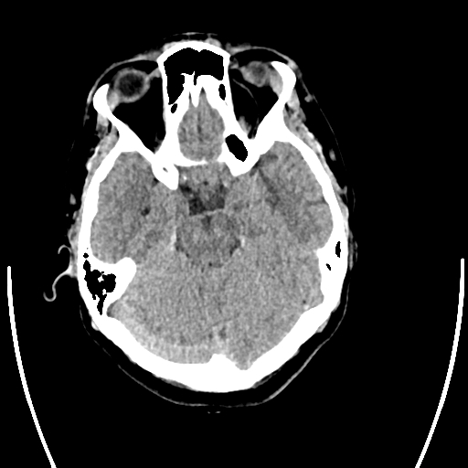
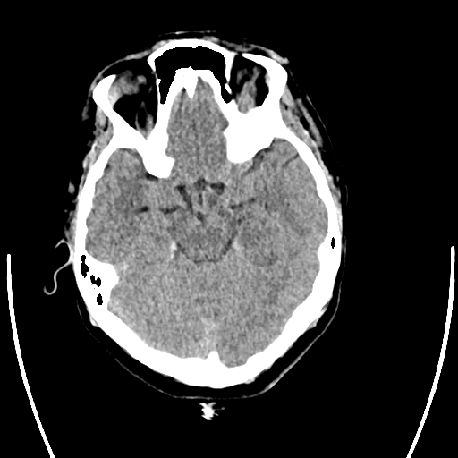
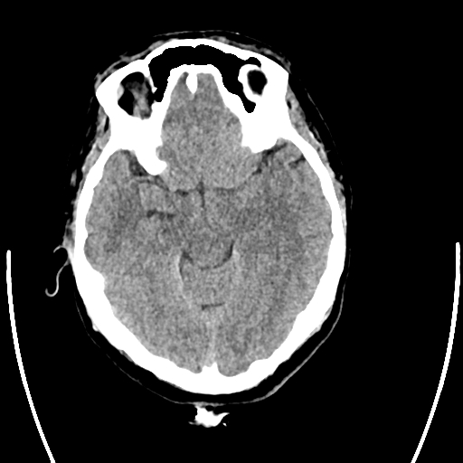
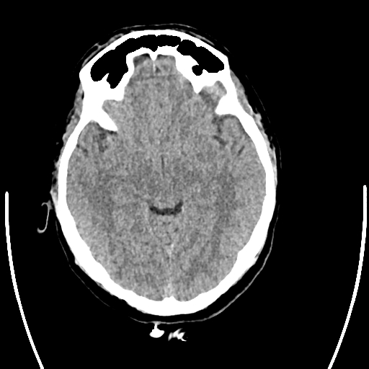
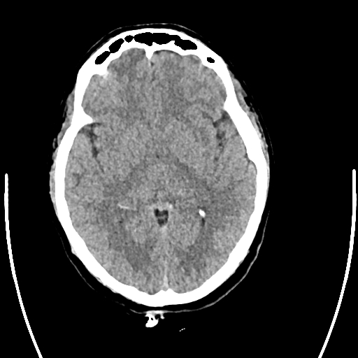
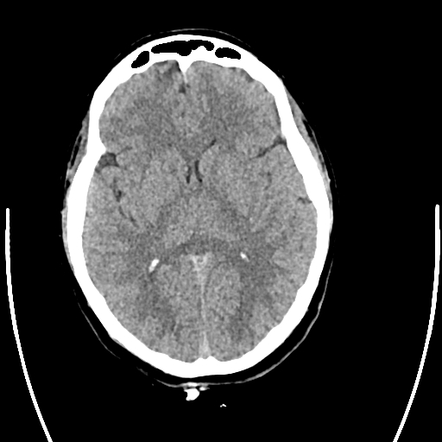
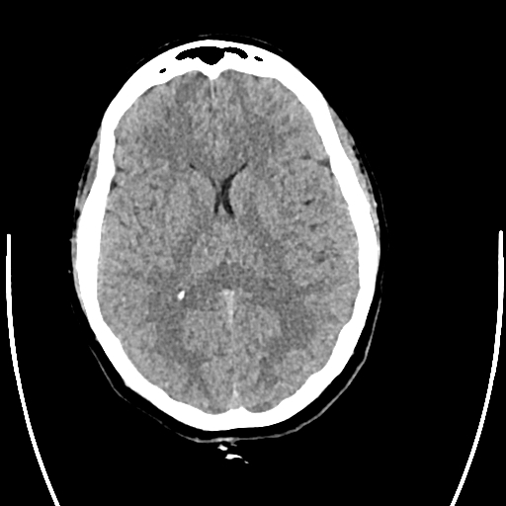

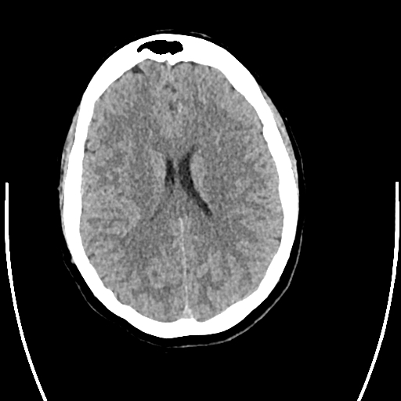
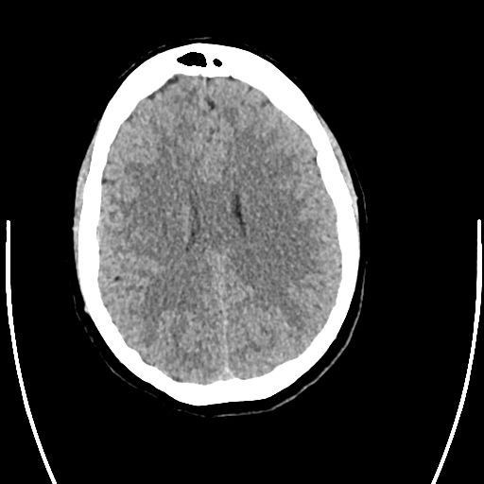
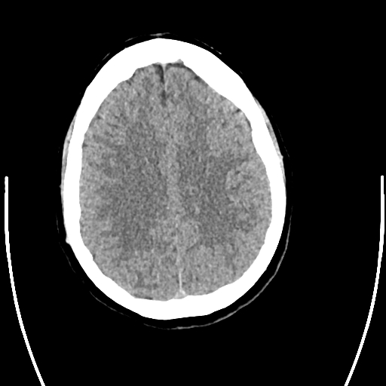
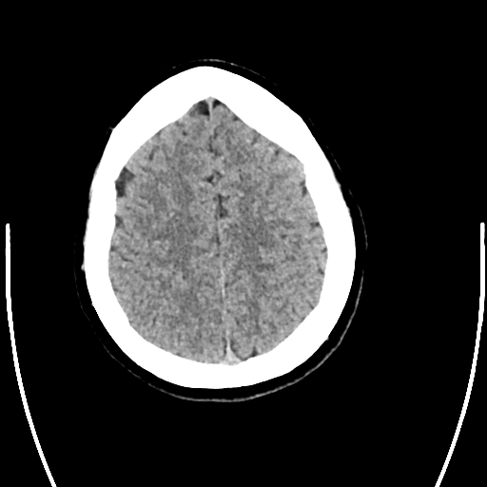
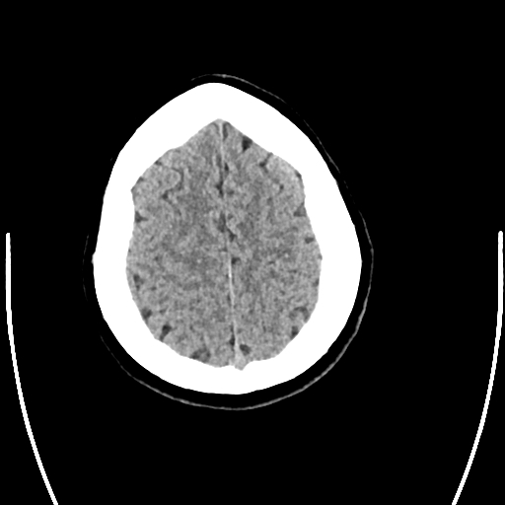
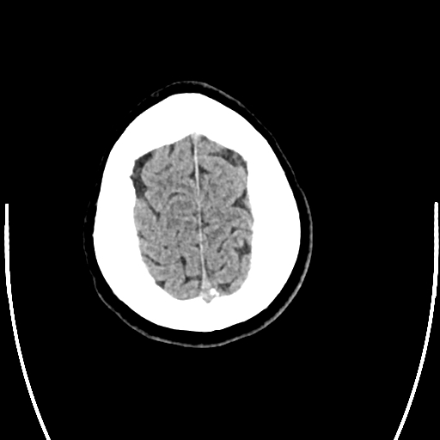
Clinical Case: Day 1 CT Head

Slide 23
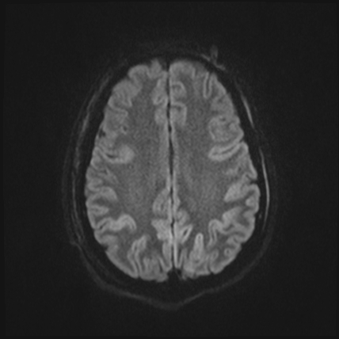
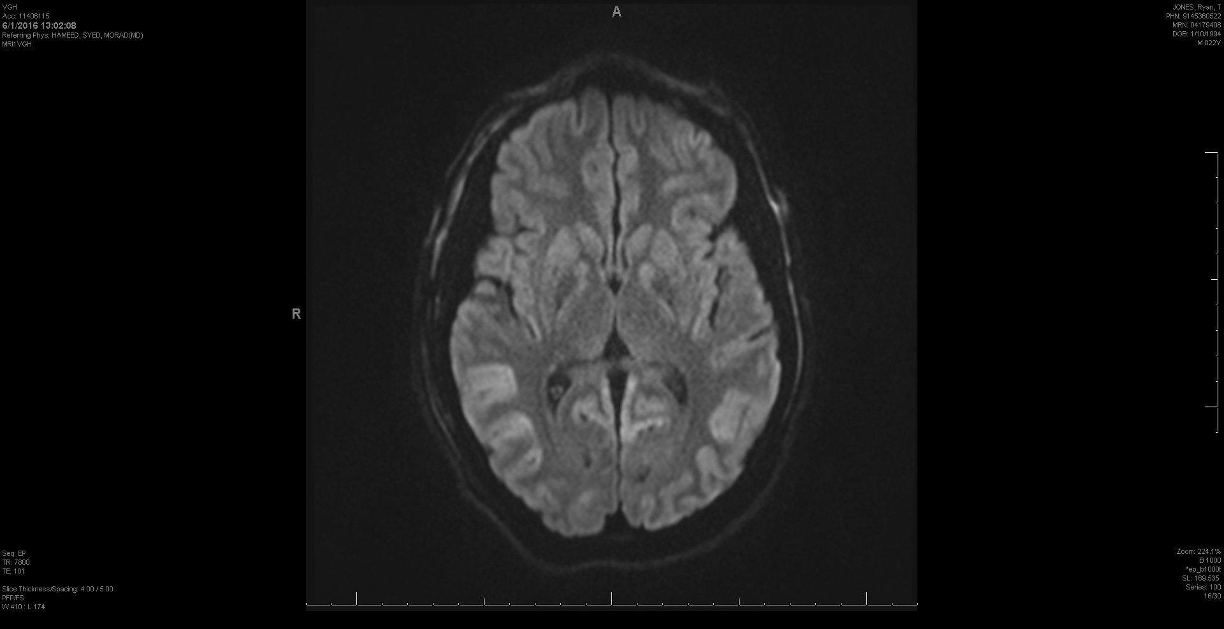
Clinical Case: Day 6 MRI Head

Slide 24
When should neuroimaging be performed to guide prognosis?
CT within 24 hours
CT within 72 hours
MRI within 72 hours
MRI within 1 week
Both B and D are correct

Slide 25
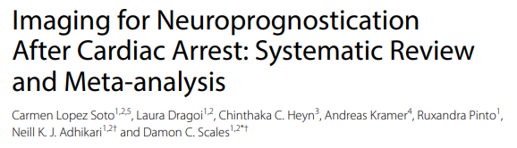
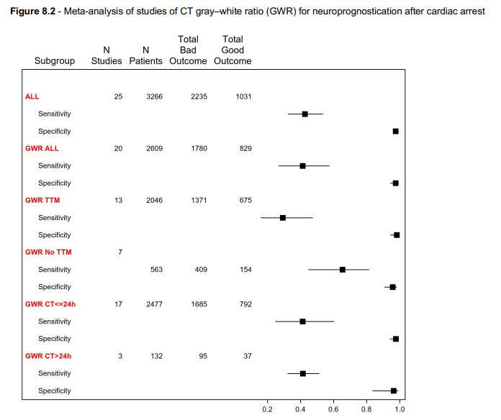
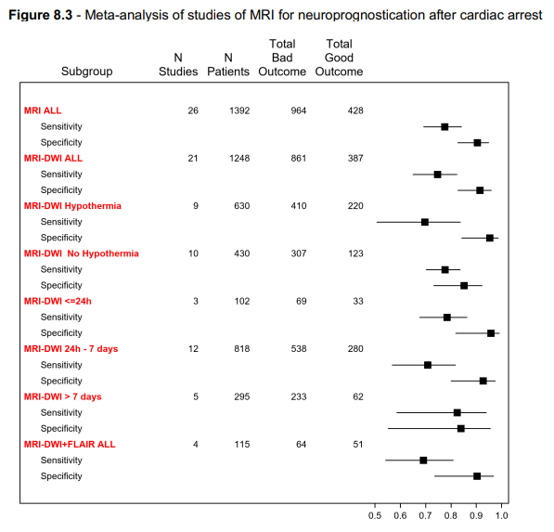

Slide 26
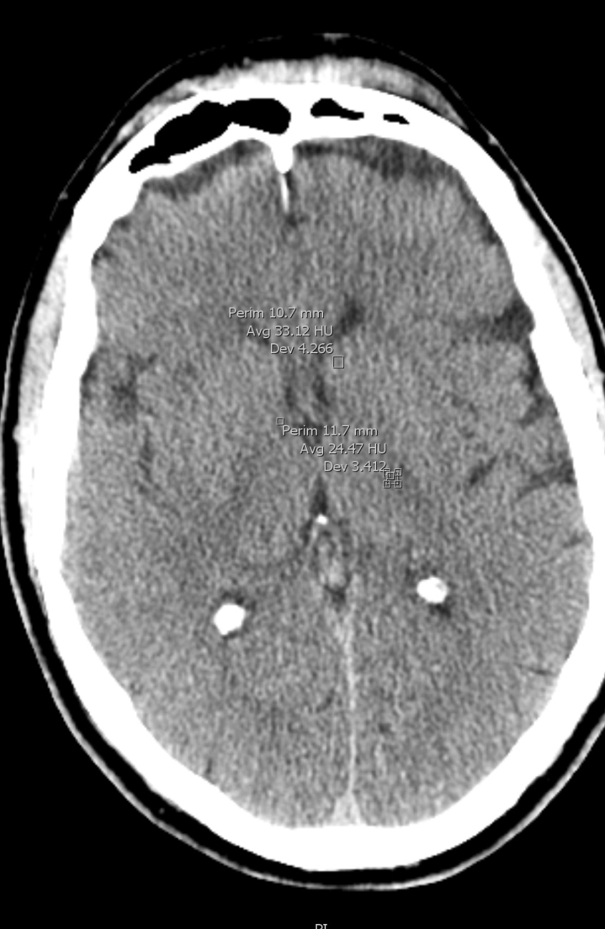
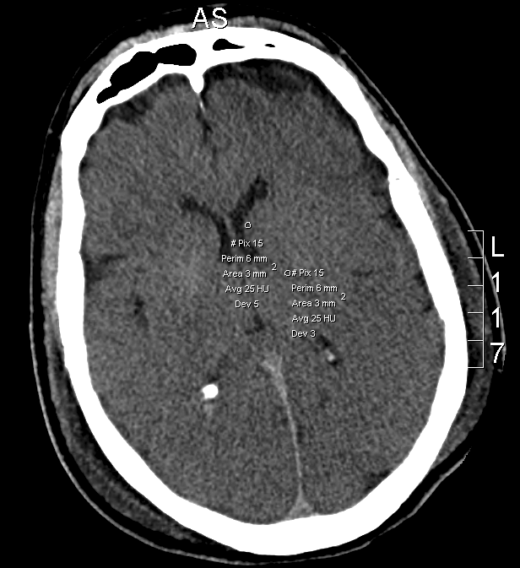
CT in Hypoxic-Ischemic Brain Injury
*33
* 25
* 24.5
* 25
Admission Day 3

Slide 27
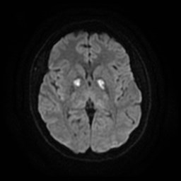
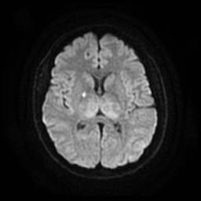
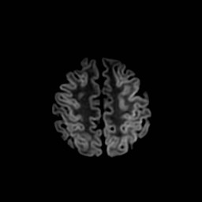
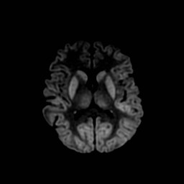
MRI in Hypoxic-Ischemic Brain Injury
Small-moderate volume of DWI signal
change (deep grey matter only)
CPC 2
Large volume of DWI signal change (extensive cortex and deep grey matter)
CPC 5

Slide 28
Neuroimaging

Slide 29
Myoclonus and seizures
Dr. C. Ainsworth

Slide 30
Which of the following is true?
Status epilepticus alone uniformly portends a poor prognosis
Status epilepticus should be treated (sedatives, antiseizure medications) while awaiting other neuroprognostic modalities
Status myoclonus alone uniformly portends a poor prognosis
Both A and C are correct
Both A and B are correct

Slide 31
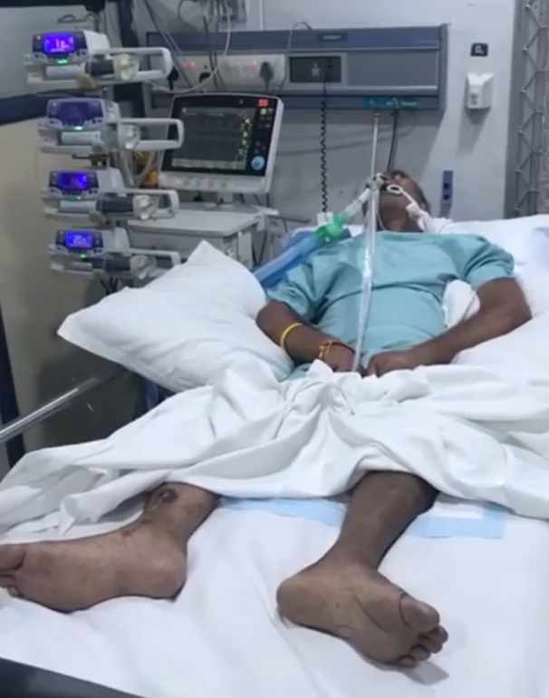
Myoclonus
Myoclonus: sudden, brief, shock-like hyperkinetic jerking movements. Witnessed in 16-37% of patients post-CA. Often masked by sedation or NMBAs.
Status Myoclonus: continuous, generalized/ multifocal myoclonus lasting >30 minutes. Definitions inconsistent in studies.
Lance-Adams syndrome: chronic, more benign, stimulus or action induced myoclonus that persists after patients awaken and improve neurologically.
Source: https://www.youtube.com/watch?v=68gywnyeCl8

Slide 32
Status Myoclonus
Crit Care Med 2014;42:1919-1930.

Slide 33
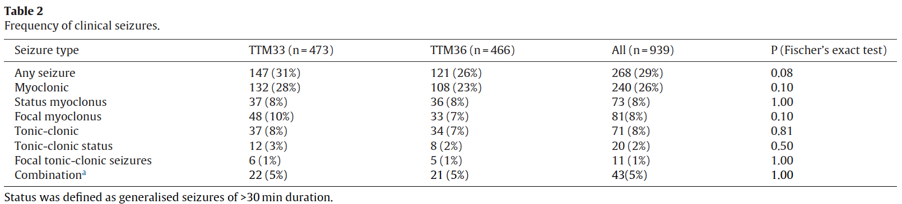
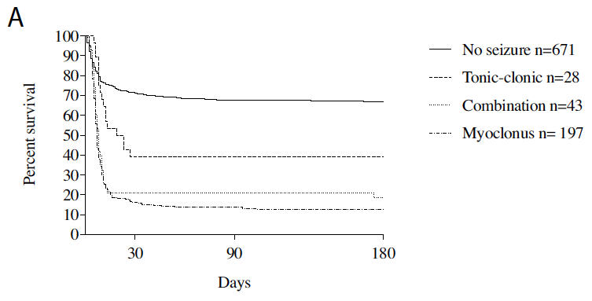
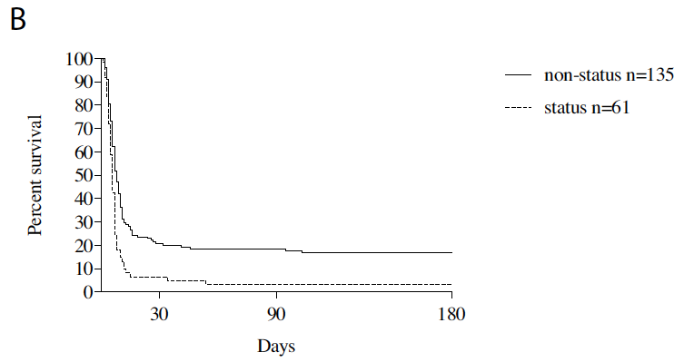
Status Myoclonus
Resuscitation 2017;114:146-151.

Slide 34
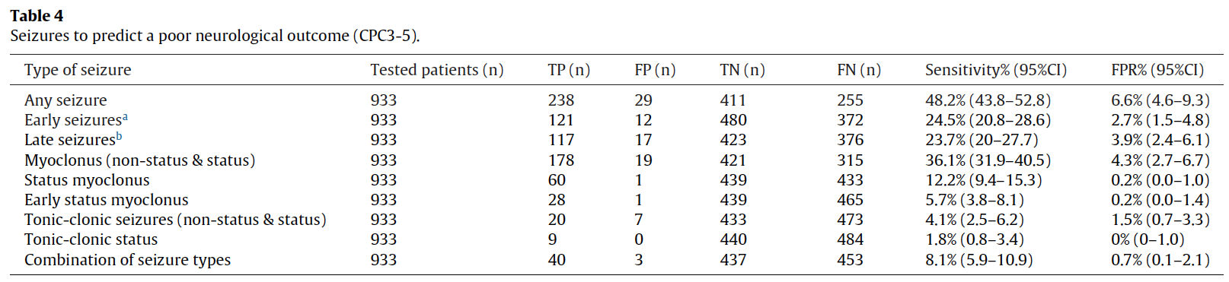
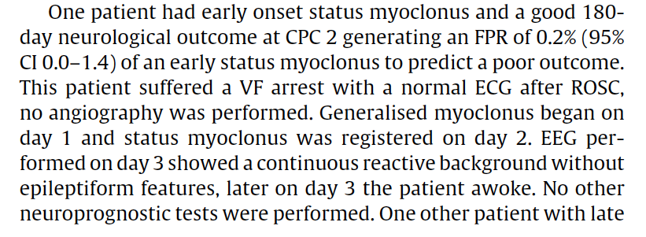
Status Myoclonus
Resuscitation 2017;114:146-151.

Slide 35
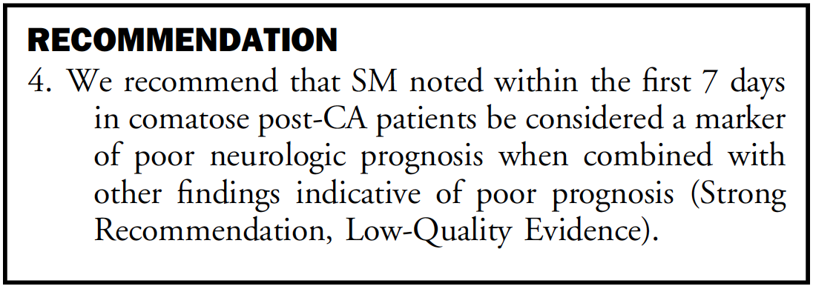

Status Myoclonus
Patients with myoclonus often remain sedated or are examined when sedation has been paused briefly because of concern for ongoing seizures, patient-ventilator dyssynchrony from myoclonic jerks, or family or healthcare worker distress from witnessing ongoing myoclonus. Treatment with non-sedating anti-seizure drugs may allow sedation to be weaned, facilitating proper neurologic assessment.

Slide 36

Status Epilepticus
Electrographic Status Epilepticus: ACNS terminology → electrographic seizures >10 continuous min OR >20% of any 60-min period.
Status Epilepticus: variable definitions in studies and witnessed in 3-44% of patients. Most seizures are non-convulsive and often masked by sedatives and NMBAs → EEG key for diagnosis.

Slide 37

Status Epilepticus
Electrographic Status Epilepticus: ACNS terminology → electrographic seizures >10 continuous min OR >20% of any 60-min period.
Status Epilepticus: variable definitions in studies and witnessed in 3-44% of patients. Most seizures are non-convulsive and often masked by sedatives and NMBAs → EEG key for diagnosis.

Slide 38
Status Epilepticus
Resuscitation 2013;84:1324-1338.

Slide 39
Status Epilepticus
Resuscitation 2017;114:146-151.

Slide 40


Status Epilepticus
Epilepsy & Behavior 2015;49:173-177.

Slide 41

Status Epilepticus
Epilepsy & Behavior 2015;49:173-177.

Slide 42


Status Epilepticus
The majority of patients with SE have poor outcomes, however, the FPR is too high to be used in isolation, especially when the EEG demonstrates a continuous background.

Slide 43

Clinical Case: EEG Day #4
Electrographic status epilepticus
(Continuous background)

Slide 44
Neurophysiological testing
Dr. J. Kromm

Slide 45
Which of the following is true?
An EEG should be considered beyond 72h among comatose patients
The absence of EEG reactivity is highly sensitive and could be used to indicate a poor prognosis
Bilateral absent N20 potentials on SSEP are highly specific to indicate a poor prognosis
All of the above
None of the above

Slide 46



EEG and SSEPs
EEG
SSEP
An electroencephalography (EEG) records brain activity and can detect seizures and other abnormalities suggestive of brain dysfunction/damage.
Somatosensory evoked potential (SSEP) record the transmission of a sensory stimulus from the sensing nerve to the brain and thus test the integrity of this pathway.

Slide 47

Neurophysiological testing
Synchronous Burst Suppression >24hrs
Non-synchronous Burst Suppression >24hrs

Slide 48


Neurophysiological testing
Suppression > 72hrs
GPDs + Suppressed Background >24hrs

Slide 49
Neurophysiological testing

Slide 50

Neurophysiological testing

Slide 51
Multimodality Neuroprognostication
Dr. S. van Diepen

Slide 52
Clinical Case: In-hospital course
Day 1 to 9: Invasive monitoring guided care
  Day 6: Sedation withheld; weak withdrawal x 4; brainstem intact
Day 32: Discharged from ICU
Day 34: E2, no movement to stimulation
Day 45: E3, flexion posturing x 4
Day 60: E4, non-purposeful movement, vocalizations and outbursts
Day 70: make eye contact, localize, repeating words

Slide 53
Which of the following is true?
Definitive neuroprognostication should occur by Day 5 following ROSC
A single modality is sufficient for accurate neuroprognostication but only if it is highly specific
Confounders to neuroprognostication (i.e., sedation, infection) should only be considered within the first 48h following ROSC
≥ 2 modalities indicating poor prognosis is associated with a low false positive rate
Serum biomarkers (i.e., NSE) should be used routinely for neuroprognostication

Slide 54
Multimodal Studies
Evaluated 31 papers that combined neuroprognostication modalities including;
  Clinical examination, EEG, Somatosensory evoked potentials, Neuroimaging and/or Biomarkers
Factors contributing to low methodologic quality
  Lacked of a reference gold standard for withdrawal of life sustaining therapy
  Lack of test blinding
  Verification bias
  Test selection bias
  Lack of control populations
  Differential timing of tests and outcomes between studies
  Single center and retrospective designs

Slide 55
Representative Study # 1
Single center prospective cohort of n=134 adult pts with OHCA
Oddi CCM 2014
Notes:
Test results were unblinded and subject to positive verification bias

Slide 56
Representative Study # 1
Prospective Series n=346 pts with cardiac arrest from 7 centers
All underwent SSEP, CT and EEG
Only underwent WLST after death by neurologic criteria
Scarpino Resus 2019
Notes:
malignant EEG (non-reactive or burst suppression)
Grade 2 SSEP bilaterally or unilaterally absent N20 response

Slide 57

Recommendation

Slide 58
Integrated Neuroprognostication Approach
Fordyce CJC 2022

Slide 59
Conclusions
Neuroprognostication should be protocolized and multimodal
Early withdrawal-of-care recommendations should be based adverse prognostic findings from 2+ modalities

Slide 60

Clinical Case: Recovery
In-hospital (2016)
ECHO: Normal
Discharged with ICD – cannot exclude idiopathic VF as primary etiology of arrest
Today (2023)
Remains seizure free and weaned down to 2 anti-epileptics (lacosamide and levetiracetam)
Working as a forest firefighter
Used with patient permission

Slide 61


Article available on ccs.ca or CJC online
Click here to access CCS Guidelines and Clinical Practice Update Library
Notes:
https://ccs.ca/guidelines-and-clinical-practice-update-library/

Slide 62

Thank you
Find this session On Demand on the Vascular 2023 platform
On Demand includes almost every Vascular 2023 scientific and educational session. Look for the symbol to find all On Demand content available.

