Slide 1
MYOCARDIAL INFARCTION WITH NO OBSTRUCTIVE CORONARY ARTERY DISEASE (MINOCA): CCS/CWHHA CLINICAL PRACTICE UPDATE 2023
October 26, 2023

Slide 2
© Canadian Cardiovascular Society. 2023. All rights reserved.
Distribution, transmission or republication is strictly prohibited without the prior written permission of the Canadian Cardiovascular Society.
For medical institution internal education or training (i.e. grand rounds, medical college/classroom education, etc.), kindly consider and implement the following:
Include the citation for the Canadian Journal of Cardiology
Add ‘Reproduced with permission from the Canadian Cardiovascular Society. [insert year].’
Avoid use of CCS logos or trademarks on slides, tools or publications that are not the property of the CCS
Do not modify the slide content and, the layout and CCS branding on the Guideline-related slides
Guideline recommendations must be reproduced exactly as published
For an industry supported or involved program, permissions are required:
If content is published in the Canadian Journal of Cardiology, permissions must be sought through our publisher Elsevier (www.onlinecjc.com)
If content is property of the CCS, contact guidelines@ccs.ca

Slide 3
© Canadian Cardiovascular Society. 2023. All rights reserved.
These slides were presented at Vascular 2023 in Montreal, Quebec on October 26, 2023. Find this session On Demand on the Vascular 2023 platform.
© Canadian Cardiovascular Society. 2023. All rights reserved.

Slide 4
SPEAKERS
Christine Pacheco, MD MSC FRCPC
Hôpital Pierre-Boucher, Centre Hospitalier de l'Université de Montréal (CHUM)
Université de Montréal
Alexandra Bastiany, MD
Thunder Bay Regional Health Sciences Centre
Northern Ontario School of Medicine (NOSM)
Judy Luu, MD PhD FRCPC
McGill University
Sharon Mulvagh, MD FRCPC FACC FASE FAHA
Dalhousie University
Mayo Clinic
Notes:
Place in alpha order

Slide 5
OVERALL LEARNING OBJECTIVES
At the completion of this activity, participants should be able to:
Discuss pathophysiology and epidemiology of MINOCA;
Demonstrate comprehension of invasive and non-invasive diagnostic algorithms of MINOCA;
Determine appropriately tailored management for patients with MINOCA.

Slide 6
PROGRAM DISCLOSURE OF COMMERCIAL SUPPORT
Christine Pacheco MD MSc
I have/do not have relationships with for-profit and not-for-profit organizations over the past two years:
NATURE OF RELATIONSHIP | NAME OF THE FOR-PROFIT OR NOT-FOR-PROFIT ORGANIZATION | DESCRIPTION OF RELATIONSHIP | MITIGATION TO BIAS
Any direct financial payments including receipt of honoraria | Novartis, KYE pharmaceuticals | Honoraria | Novartis – no relation to CPU; KYE – COI reviewed by CCS to determine no sign. impact
Membership on advisory boards or speakers’ bureaus | KYE pharmaceuticals | Advisory Board Member | KYE – COI reviewed by CCS to determine no sign. impact
Funded grants of clinical trials | Novartis | Research funding | No relation to CPU
Patents on a drug, product or device
All other investments/relationship that could be seen as having the potential to influence the content of the educational activity

Slide 7
Introduction
Myocardial infarction (MI) with no obstructive coronary artery disease (MINOCA) represents 6-15% of MI.
MINOCA is an encompassing, heterogenous, preliminary, umbrella diagnosis.
Emerging evidence currently supports a more expansive, comprehensive diagnostic and therapeutic clinical approach to MINOCA.
Notes:
highlighting the need for an up-to-date review and summary of recent data for today’s cardiovascular clinician.
The current document will summarize the epidemiology, clinical presentation, diagnostic work-up, and treatment of underlying causes of MINOCA. Other international cardiovascular societies have previously published position statements on MINOCA.(10,11) The present document summarizes data gathered through an updated systematic review, viewed from the perspective of unique aspects and challenges within the Canadian healthcare landscape.

Slide 8
Panel Members
Co-chairs: Thais Coutinho, Christine Pacheco
Guidelines Committee Liaison: Jonathan Howlett
CCS Staff Lead: Stephanie Hong
Alexandra Bastiany – ON
Rob Beanlands – ON
Kevin Boczar – ON
Martha Gulati – ON
Shuangbo Liu – MB
Judy Luu – AB
Sharon Mulvagh – NS
Amelie Paquin – ON
Jacqueline Saw – BC
Tara Sedlak – BC

Slide 9
About the Canadian Women’s Heart Health Alliance
Launched in 2018: Canadian Women’s Heart Health Alliance is aimed at disseminating education and best practices re: Women’s cardiovascular health among healthcare providers
Goal: To eliminate knowledge gaps re: specific cardiovascular issues and practice considerations in women, thereby improving the health of Canadian women
Advocacy
Training and Education
Health Systems
and Policy
Knowledge Translation and Mobilization
CWHHA.CA
Notes:
Cardiovascular disease (CVD) continues to be a leading cause of death in Canadian women. Sex and gender differences and disparities with respect to CVD awareness, development, identification and treatment persist.
The Canadian Women’s Heart Health Alliance was established in 2018 as a network of experts and advocates to develop and disseminate evidence-informed strategies to transform clinical practice and enhance collaborative action on women’s cardiovascular health in Canada.
The National Alliance is aimed at disseminating education and best practices re: Women’s cardiovascular health among healthcare providers
Goal: To eliminate knowledge gaps re: specific cardiovascular issues and practice considerations in women, thereby improving the health of Canadian women
Consultations with stakeholders from across Canada helped identify the four main areas of focus for the Alliance: Knowledge Translation and Mobilization, Training and Education, Advocacy, and Health Systems and Policy.

Slide 10
Pathophysiology and epidemiology OF MINOCA
Sharon Mulvagh, MD

Slide 11
PROGRAM DISCLOSURE OF COMMERCIAL SUPPORT
Sharon Mulvagh MD FRCPC FACC FASE FAHA
I have/do not have relationships with for-profit and not-for-profit organizations over the past two years:
NATURE OF RELATIONSHIP | NAME OF THE FOR-PROFIT OR NOT-FOR-PROFIT ORGANIZATION | DESCRIPTION OF RELATIONSHIP | MITIGATION OF BIAS
Any direct financial payments including receipt of honoraria | Novo Nordisk, Lantheus Medical Imaging | Honoraria | No relationship
Membership on advisory boards or speakers’ bureaus | Novo Nordisk, Lantheus Medical Imaging | Steering Committee Member, Advisory Board Member | No relationship
Funded grants of clinical trials | CIHR, HSFC, Dalhousie University | Research funding | No relationship
Patents on a drug, product or device
All other investments/relationship that could be seen as having the potential to influence the content of the educational activity

Slide 12
LEARNING OBJECTIVES
At the completion of this section, participants should be able to:
Review the definition of MINOCA
Discuss the epidemiology and sex disparities
Understand the pathophysiology

Slide 13
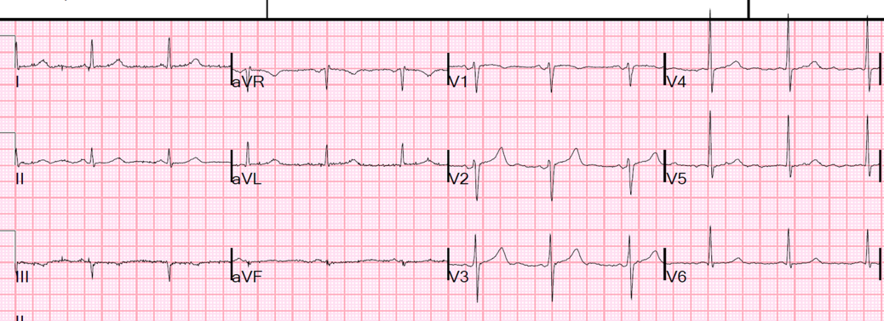
Clinical Presentation
52 year old female
dyspnea, chest discomfort - “indigestion”
Medical history - rheumatoid arthritis, depression
Initial high sensitivity Troponin = 15 ng/L (normal < 14 ng/L)
Repeat hsTn at 3 hours = 200 ng/L
“Normal” coronary angiogram - plaque

Slide 14
A man with an MI is >2X as likely to have a coronary artery blockage as a women
“You’ve had a heart attack, but your heart arteries are normal”
Well, then, WHY did I have a heart attack?
The Heartbreak of MINOCA!
Notes:
Men have higher rates of plaque rupture in the setting of AMI, while for women, plaque rupture accounts for approximately 55% of AMI. Plaque erosion is more common in women than man, in particular younger women. Spontaneous coronary artery dissection is a rare cause of AMI, found more often among women than men, particularly among young women.

Slide 15
MINOCA - definition
MI without significant (>50%) coronary artery stenosis
4th Universal Definition of MI
a heterogenous group of ischemic CV disorders
includes both atherosclerotic and non-atherosclerotic etiologies
Underlying etiology can be identified in majority of cases
Excludes non-ischemic causes (myocarditis, Takotsubo)
Categorization: diagnostic pathways
Differentiation from INOCA (Ischemia with No Obstructive Coronary Arteries) :
MINOCA = myocardial tissue damage
INOCA= presence of clinical evidence of ischemia in INOCA.
Thygesen K, Circulation 2018;138:e618-e651
Reynolds HR et al Circulation 2021;143:624-640
Notes:
MINOCA is defined as MI, as per the 4th Universal Definition of MI (14), without significant coronary artery stenosis (i.e > 50%) on coronary angiography. The cut-off threshold of 50% diameter stenosis for defining “obstructive CAD” in MINOCA is based on historical studies evaluating coronary flow limitation in the presence of increasing degrees of stenosis(15)

Slide 16
MINOCA - Epidemiology
6-15% of all MI’s - More common in NSTEMI vs STEMI
Mean age 55 years
>2X as common in women vs men
In a younger (<55 years) cohort of acute MI patients:
Women 5X more likely than men to have MINOCA
Compared to obstructive CAD:
less likely to have hyperlipidemia
other CV risk factors similarly prevalent
Prognosis: not benign
Pasupathy S et al. Circulation 2015;131:861-70
Safdar B et al. J Am Heart Assoc 2018;7; e009174
Notes:
MINOCA is defined as MI, as per the 4th Universal Definition of MI (14), without significant coronary artery stenosis (i.e > 50%) on coronary angiography. The cut-off threshold of 50% diameter stenosis for defining “obstructive CAD” in MINOCA is based on historical studies evaluating coronary flow limitation in the presence of increasing degrees of stenosis(15)

Slide 17
“Paradox” Women w/ ACS are 2X more likely to have “normal” coronary arteries vs. Men
STEMI
NSTEMI
UA
Hochman JS et al. NEJM 1999
JS et al. JAMA 2009
p<0.02 for all comparisons
Notes:
Although obstructive atherosclerotic disease of the epicardial
coronary arteries remains the basic cause of acute
myocardial infarction (AMI) in both sexes, plaque characteristics
differ for women, and recent data have suggested a
greater role of microvascular disease in the pathophysiology
of coronary events among women.6 Despite being older and
having a greater risk factor burden and a greater symptom
burden of angina and consequent morbidity and mortality,
women paradoxically have less severe obstructive disease
of their epicardial coronary arteries at elective angiography
than men.7
Men have higher rates of plaque rupture in the setting of AMI, while for women, plaque rupture accounts for approximately 55% of AMI. Plaque erosion is more common in women than man, in particular younger women. Spontaneous coronary artery dissection is a rare cause of AMI, found more often among women than men, particularly among young women.

Slide 18
MINOCA - Pathophysiology
Tamis-Holland et al, 2019, Circulation, 139(18): e891-e908
Pasupathy et al. 2015. Circulation, 131(10): 861
MINOCA CPU Update
Notes:
Pathophysiology of MINOCA
Understanding the underlying MINOCA pathophysiology is necessary to optimize clinical management. MINOCA can be a result of coronary plaque disruption, thromboembolism, vasospasm, microvascular dysfunction, and spontaneous coronary artery dissection (SCAD).
Atherosclerotic causes account for approximately two-thirds of MINOCA, and most commonly include plaque disruption due to rupture, erosion and calcific nodules, all of which can result in thrombus formation and distal thromboembolization (10)­­­­­­. In these patients, the pathophysiology and risk factor profile is similar to MI-CAD.
Non-atherosclerotic, coronary causes include epicardial coronary vasospasm, thromboembolism, SCAD, and coronary microvascular dysfunction (CMD). Coronary vasospasm is a result of hyperreactivity within the vascular smooth muscle, in the epicardial and/or microvascular vessels. Coronary vasospasm can occur spontaneously or due to vascular smooth muscle hyper-reactivity in response to endogenous or exogenous allergens (Kounis syndrome)(18), drugs (i.e. 5-fluorouracil), toxins (i.e. cocaine), or tumors (i.e. pheochromocytoma). It is characterized by chest pain responsive to nitroglycerin with transient ECG changes, and more than 90% angiographic vasoconstriction with provocative testing with acetylcholine or ergonovine(19,20). Smoking is a risk factor for coronary vasospasm. Racial differences in vasomotor reactivity have also been described.(21)
SCAD is frequently associated with fibromuscular dysplasia (25-86% prevalence); however inherited arteriopathies such as vascular Ehlers-Danlos syndrome and Marfan syndrome are infrequently reported (<5%) as the underlying cause for SCAD.(22)
Coronary thromboembolism is an uncommon cause of MINOCA occurring in <3% of reported cases.(23) It can often affect the microcirculation and thus may not be seen on a diagnostic angiogram, resulting in underdiagnosis. Emboli can occur from thrombi formation within the coronary epicardial artery or within systemic arteries.(24) Such thromboemboli can result from hereditary or acquired causes.(24)(1)
Coronary Microvascular Dysfunction (CMD) encompasses impaired vasodilation, increased vasoconstriction, a combination of both, or even microvascular remodeling which alters coronary flow reserve (CFR) (25-27).
CLICK:
MINOCA must also be distinguished from nonischemic “mimickers” such as myocarditis and stress-induced (Takotsubo) cardiomyopathy
The definition of MINOCA does not include myocardial injury and subsequent infarction from non-ischemic causes, such as Takotsubo syndrome and myocarditis, entities which also characteristically demonstrate no significant obstructive CAD at the time of angiography.
Similarly, Type 2 MI – due to supply-demand imbalances, such as tachyarrhythmia, sepsis, anemia or hypotension, are not considered MINOCA.

Slide 19
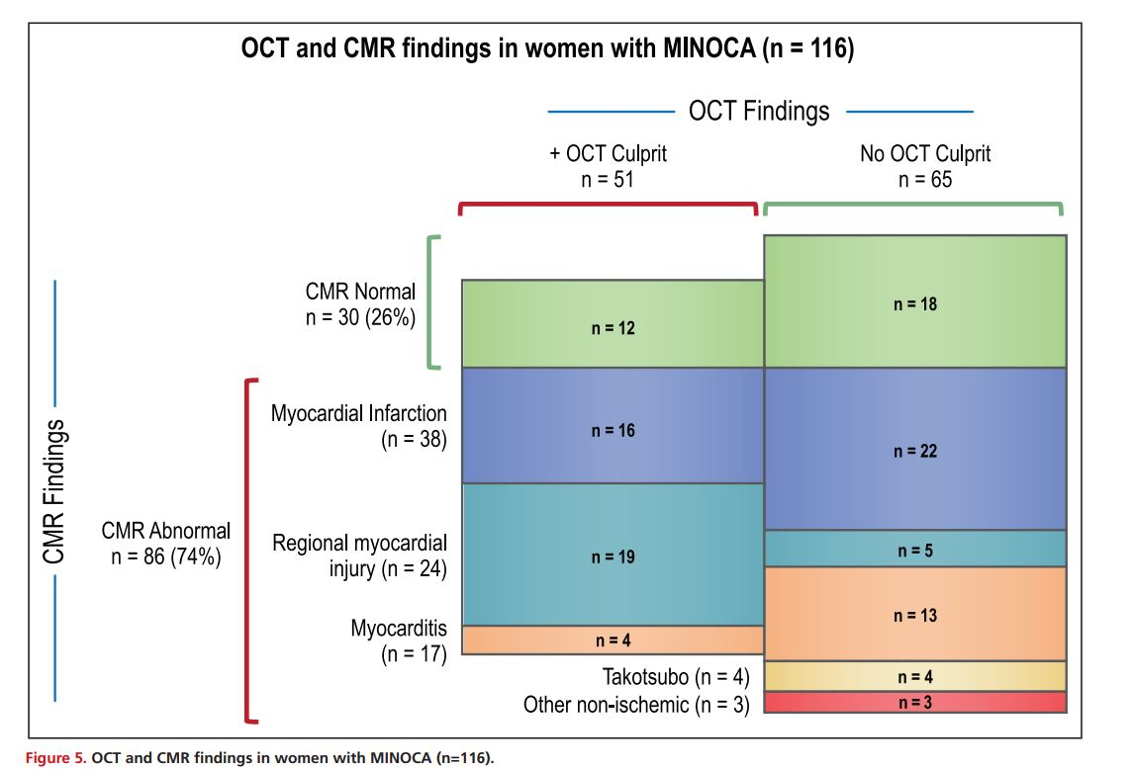
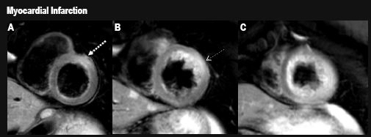
MINOCA: Determining Pathophysiology HARP (Women’s Heart Attack Research Program)
n = 301 Women with AMI: 170 MINOCA 145 OCT, 116 CMR
OCT
46%
CMR
73%
OCT
85%
63.8% ischemic
20.7% nonischemic
15.5% no mechanism
CMR
no etiology determined 15%
Reynolds H et al. Circulation 2021;143:624-640
Notes:
BACKGROUND: Myocardial infarction with nonobstructive coronary arteries (MINOCA) occurs in 6% to 15% of myocardial infarctions (MIs) and disproportionately affects women. Scientific statements recommend multimodality imaging in MINOCA to define the underlying cause. We performed coronary optical coherence tomography (OCT) and cardiac magnetic resonance (CMR) imaging to assess mechanisms of MINOCA. METHODS: In this prospective, multicenter, international, observational study, we enrolled women with a clinical diagnosis of myocardial infarction. If invasive coronary angiography revealed
Although the precise prevalence of each of the underlying MINOCA causes have not been well-established, report from the Heart Attack Research Program (HARP) study has provided some estimations.

Slide 20
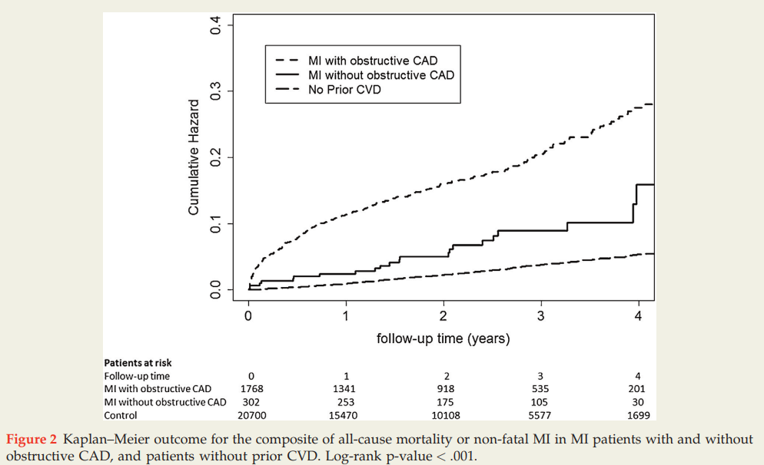
MINOCA – Prognosis
Single-center study -2070 AMI pts (15% MINOCA); 10 yr f/u
~ 1/3 mortality/non-fatal MI of those w/ obstructive CAD (4.6% vs 14.3%)
2x mortality/non-fatal MI vs. no ASCVD - (4.6% vs 2.2%)
Barr PR, et al. Heart Lung Circ 2018;27:165-174
Notes:
Non-obstructive coronary artery disease (CAD) on coronary angiography after myocardial infarction (MI) is associated with a lower risk of adverse outcomes, but the prognosis may not be benign. Our aim was to assess outcomes in MI with and without obstructive CAD, and in an age and sex matched comparison cohort without known cardiovascular disease. Methods We performed a single centre analysis of consecutive patients undergoing coronary angiography for MI between 2007 and 2012. Patients were classified into those with obstructive CAD ( 50% epicardial coronary artery stenosis) and those without obstructive CAD (< 0.001), more likely to be women (50% vs 23%, p < 0.001), to be of Maori or Pacific vs. European ethnicity (p < 0.001), more likely to be lifelong non-smokers (46% v 38%, p = 0.02), non-diabetic (80 v 73%, p < 0.01), have no ST-segment deviation (78% v 46%, p < 0.001), and have a low risk Global Registry of Acute Coronary Events acute coronary syndrome (GRACE ACS) score (54 v 35%, p < 0.001). They were also less likely to receive ‘triple therapy’ secondary prevention medications (81% v 94%, p < 0.0001). The cumulative two-year Kaplan-Maier composite outcome of mortality or nonfatal MI was 14.3% for MI with obstructive CAD, 4.6% for MI without obstructive disease, and 2.2% for patients without prior CVD (p < 0.001). Conclusion Myocardial infarction without obstructive coronary disease is common (1 in 7 patients) and is not clinically benign, with an adverse outcome rate double that of age and sex matched patients without CVD

Slide 21
Diagnostic Investigations FOR MINOCA
Judy Luu, MD PhD

Slide 22
PROGRAM DISCLOSURE OF COMMERCIAL SUPPORT
Judy Luu MD PhD
I have/do not have relationships with for-profit and not-for-profit organizations over the past two years:
NATURE OF RELATIONSHIP | NAME OF THE FOR-PROFIT OR NOT-FOR-PROFIT ORGANIZATION | DESCRIPTION OF RELATIONSHIP
Any direct financial payments including receipt of honoraria | McGill University Health Centre | No relation to topic
Membership on advisory boards or speakers’ bureaus | X | X
Funded grants of clinical trials | X | X
Patents on a drug, product or device | X | X
All other investments/relationship that could be seen as having the potential to influence the content of the educational activity | X | X

Slide 23
LEARNING OBJECTIVES
At the completion of this section, participants should be able to:
Demonstrate comprehension of invasive and non-invasive diagnostic algorithms of MINOCA

Slide 24
Diagnostic Pathway for MINOCA
Multimodality imaging is essential for MINOCA workup and often necessary to determine underlying etiology.
Choice of imaging modalities depend on clinical factors, medical center expertise, and availability/accessibility.

Slide 25
Diagnostic Pathway for MINOCA (Part 1)

Slide 26
Index Coronary Angio (reported normal)
45F with arm numbness, chest pain (HS-trops 3000)

Slide 27
Index Coronary Angio (reported normal)

Slide 29
Transthoracic Echocardiography

Slide 30
Diagnostic Pathway for MINOCA (Part 2)

Slide 31
Cardiac MRI (within 7 days)

Slide 32
Tissue Characterization
T1 Map
(Fibrosis)
T2-weighted images (edema)

Slide 33
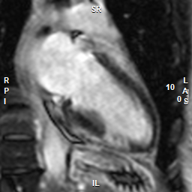
Late Gadolinium Enhancement (ischemic scar pattern)

Slide 34
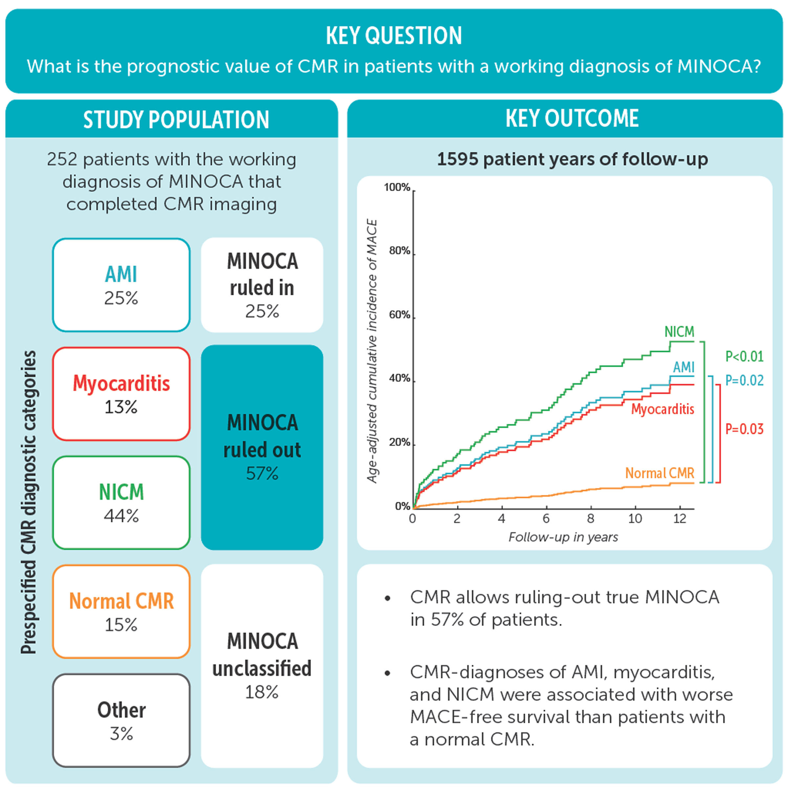
Prognosis—Value of CMR
Konst R, Kim, R et Circulation: CV Imaging 2023; 16 DOI:10.1161
Notes:
Patients with a working diagnosis of myocardial infarction with unobstructed coronary arteries (MINOCA) represent a heterogeneous cohort. The prognosis could vary substantially depending on the underlying cause. Although cardiac magnetic resonance (CMR) is considered a key diagnostic tool in these patients, there are limited data linking the CMR diagnosis with the outcome.
METHODS:
This study is a prospective outcomes registry of consecutive patients presenting with a working diagnosis of MINOCA who were clinically referred for CMR at an academic hospital from October 2003 to February 2020. We assessed the relationships between the prespecified CMR diagnoses of acute myocardial infarction (AMI), myocarditis, nonischemic cardiomyopathy (NICM), normal CMR study, and major adverse cardiac events (MACEs).
RESULTS:
Of 252 patients, the CMR diagnosis was AMI in 63 (25%), myocarditis in 33 (13%), NICM in 111 (44%), normal CMR in 37 (15%), and other diagnoses in 8 (3%). A specific nonischemic cause was diagnosed allowing true MINOCA to be ruled-out in 57% of the cohort. During up to 10 years of follow-up (1595 patient-years), MACE occurred in 84 patients (33%), which included 64 deaths (25%). The unadjusted cumulative 10-year rate of MACE was 47% in AMI, 24% in myocarditis, 50% in NICM, and 3.5% in patients with a normal CMR (Log-rank P<0.001). The CMR diagnosis provided incremental prognostic value over clinical factors including age, gender, coronary artery disease risk factors, presentation with ST-elevation, and peak troponin (incremental χ² 17.9, P<0.001); and patients with diagnoses of AMI, myocarditis, and NICM had worse MACE-free survival than patients with a normal CMR.
CONCLUSIONS:
In patients with a working diagnosis of MINOCA, CMR allows ruling-out true MINOCA in over half of the patients. CMR diagnoses of AMI, myocarditis, and NICM are associated with worse MACE-free survival, whereas a normal CMR study portends a benign prognosis.

Slide 35
Diagnostic Pathway for MINOCA (Part 2)

Slide 36
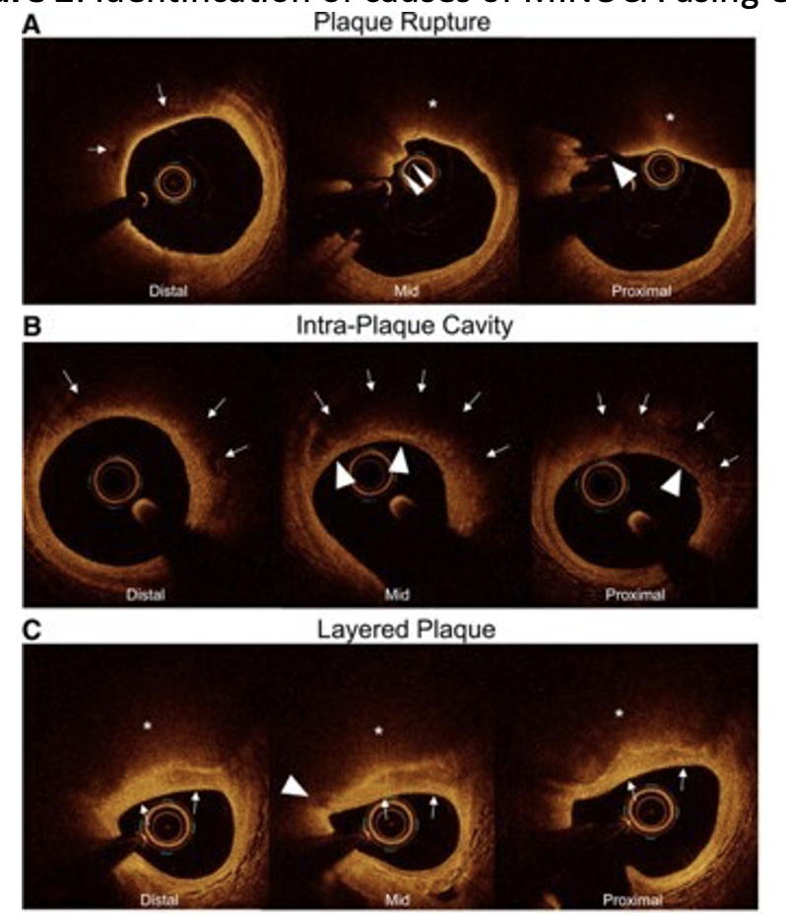
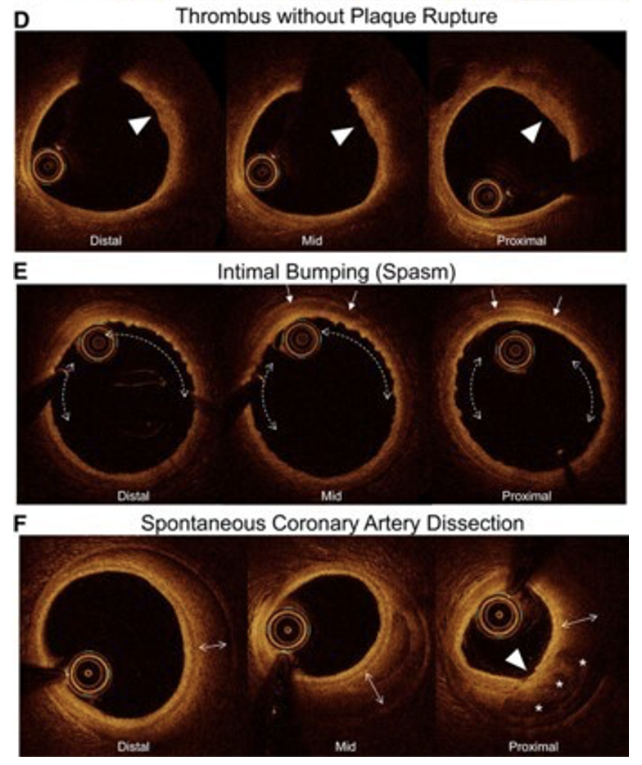
Reprinted from, Circulation, 143/7, Reynolds HR, Maehara A, Kwong RY et al. Coronary Optical Coherence Tomography and Cardiac Magnetic Resonance Imaging to Determine Underlying Causes of Myocardial Infarction With Nonobstructive Coronary Arteries in Women, 624-640, 2021, with permission from Wolters Kluwer Health, Inc.

Slide 37
Blinded, 3rd party review of coronary angio
Type 2 SCAD of RPDA

Slide 39
TREATMENT OF MINOCA
Alexandra Bastiany, MD FRCPC DRCPSC

Slide 40
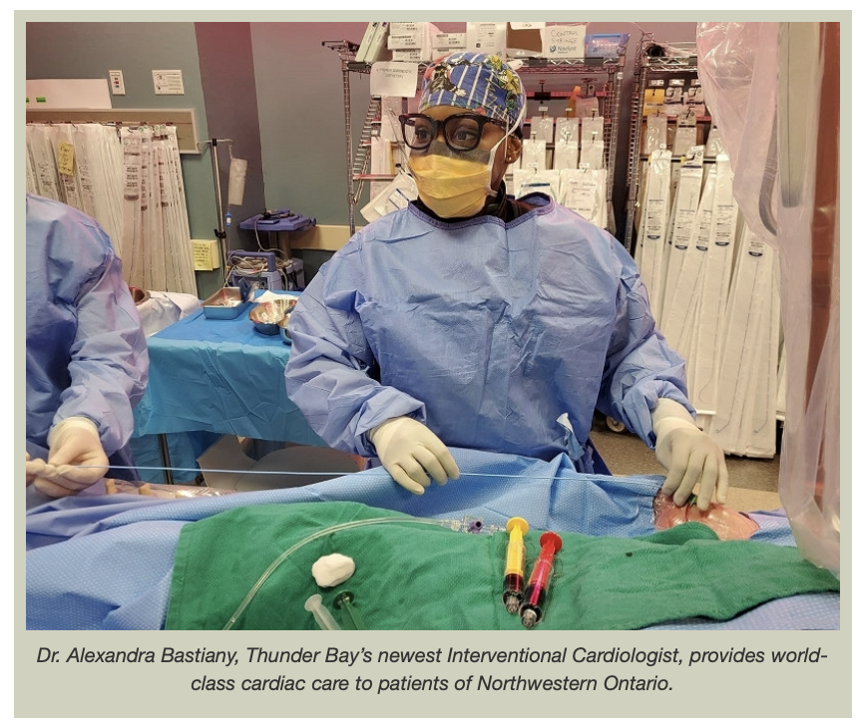
PROGRAM DISCLOSURE OF COMMERCIAL SUPPORT
Alexandra Bastiany MD
I have/do not have relationships with for-profit and not-for-profit organizations over the past two years:
NATURE OF RELATIONSHIP | NAME OF THE FOR-PROFIT OR NOT-FOR-PROFIT ORGANIZATION | DESCRIPTION OF RELATIONSHIP
Any direct financial payments including receipt of honoraria | x | x
Membership on advisory boards or speakers’ bureaus | x | x
Funded grants of clinical trials | x | x
Patents on a drug, product or device | x | x
All other investments/relationship that could be seen as having the potential to influence the content of the educational activity | x | x
Notes:
I DO NOT have any relevant financial relationships to disclose.

Slide 41
LEARNING OBJECTIVES
At the completion of this section, participants should be able to:
Determine appropriately tailored management for patients with MINOCA.

Slide 42
NON-Pharmacological treatment strategies for MINOCA

Slide 43
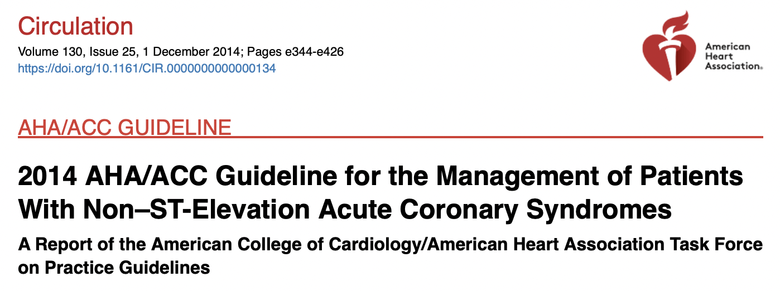
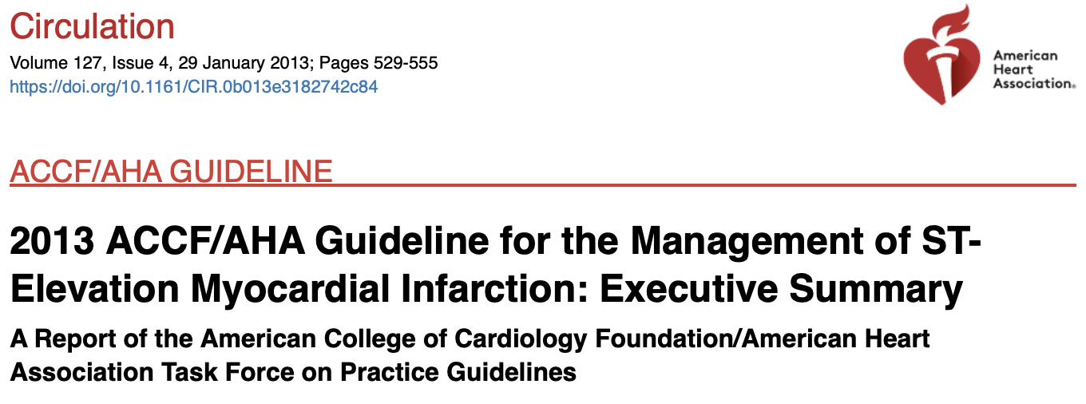
Non-pharmacological treatment strategies: Cardiac rehab and lifestyle counselling
Amsterdam et al. JACC 2014.
O’Gara et al. Catheter Cardiovasc Interv 2013.
Notes:
Referral to a cardiac rehabilitation (CR) program is a class I indication for patients with ACS.(51,52)
Evidence in the specific context of MINOCA is limited.

Slide 44
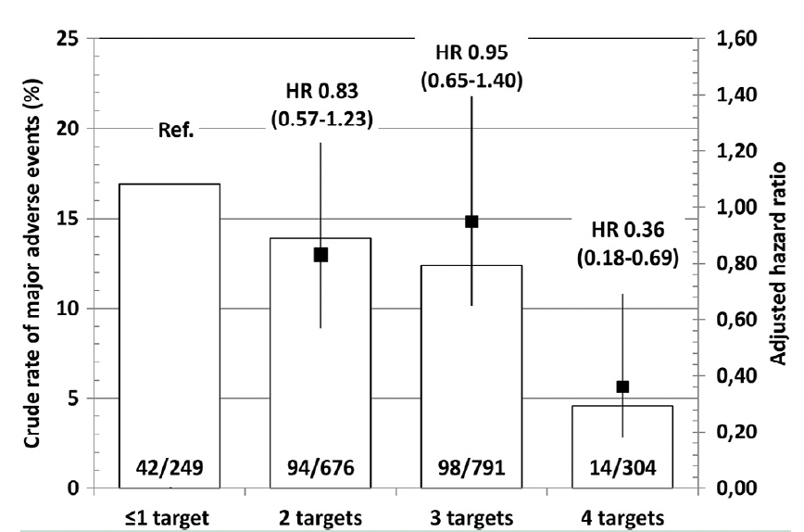
Non-pharmacological treatment strategies: Cardiac rehab and lifestyle counselling
Subgroup analysis of SWEDEHEART registry
Targets: sBP < 140 mmHg, LDL-C at target, nonsmoking, cardiac rehab program
Lower major adverse events when targets reached
LDL-C
Exercise training (rehab)
Eggers et al. The American Journal of Medicine 2018.
Notes:
In the subgroup analysis of the SWEDEHEART registry, achieving lipid targets and participation in exercise rehabilitation were significant and independent predictors of favorable cardiovascular outcomes.(54)
Figure 2 Crude rates and adjusted risks of major adverse events
in myocardial infarction patients with nonobstructive coronary arteries
in relation to the number of achieved of secondary preventive
targets. The secondary prevention targets included systolic blood
pressure <140 mm Hg, low-density lipoprotein cholesterol levels
in the target range, self-reported nonsmoking, and participation
in exercise training within a cardiac rehabilitation program. The
numbers at the bottom of the bars indicate the total numbers of
patients per category and those experiencing a major adverse event.
Patients in group 1 who achieved any of the secondary prevention
targets had numerically lower major adverse event
rates compared with those in whom these targets were not
reached (Table 2; Figure 2).
In multivariable-adjusted Cox models, these differences were statistically significant for achieving low-density lipoprotein cholesterol levels in the target range (32% risk reduction) and participation in exercise training (23% risk reduction).

Slide 45
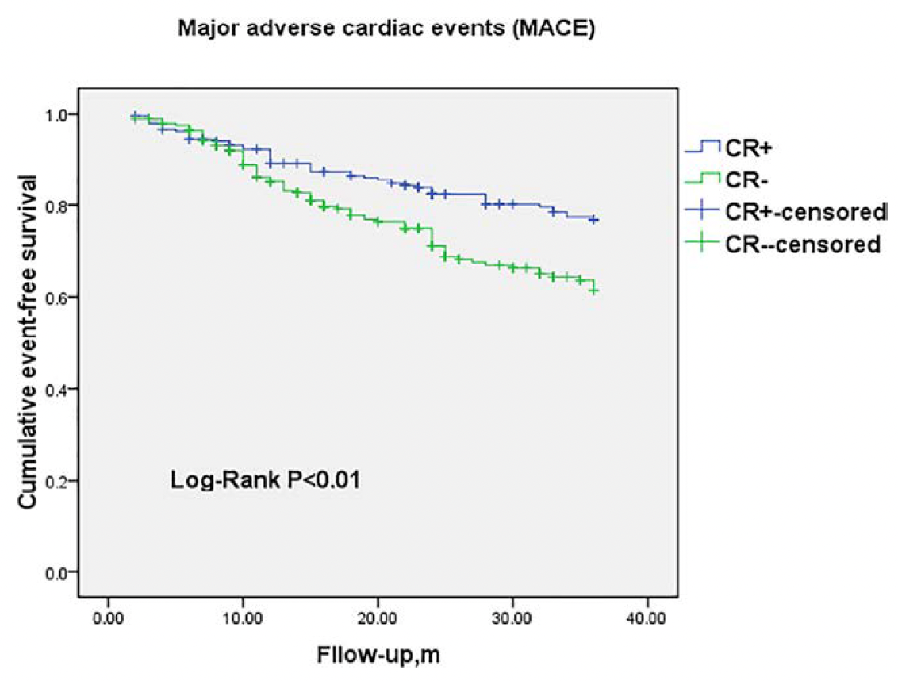
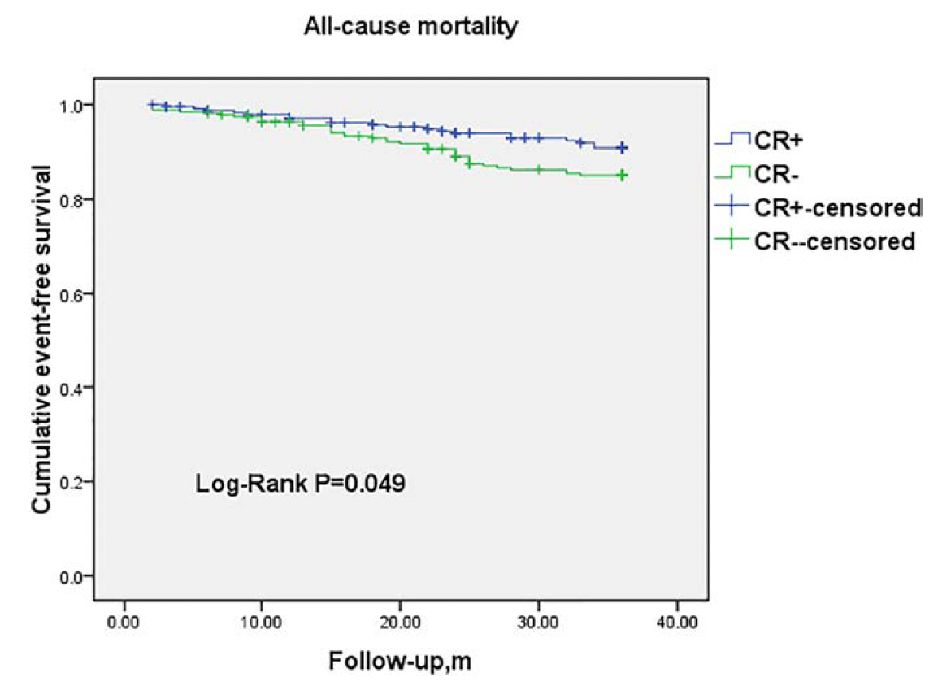
Non-pharmacological treatment strategies: Cardiac rehab and lifestyle counselling
RCT evaluating the efficacy of cardiac rehab
3-year home-based moderate intensity program
He et al. International Journal of Cardiol 2020.
Notes:
One RCT evaluated the efficacy of CR, involving a 3-year home-based moderate intensity program, in 524 patients hospitalized for MINOCA.(55) Results revealed a significant reduction in all-cause mortality and MACE, and improvement in SF-36 questionnaire and peak VO2.
Patients in group 1 who achieved any of the secondary prevention
targets had numerically lower major adverse event
rates compared with those in whom these targets were not
reached (Table 2; Figure 2). In multivariable-adjusted Cox
models, these differences were statistically significant for
achieving low-density lipoprotein cholesterol levels in the target
range (32% risk reduction) and participation in exercise training
(23% risk reduction).

Slide 46
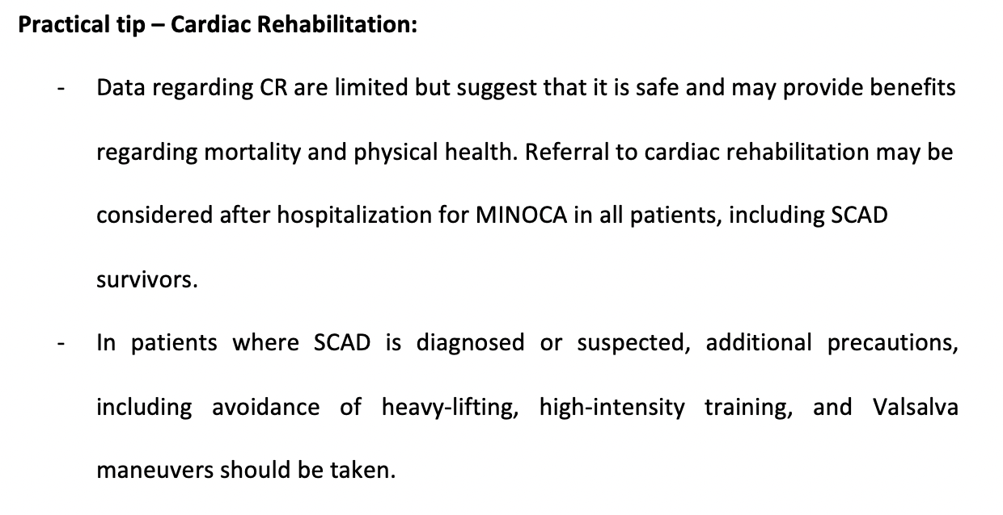

Slide 47
Pharmacological treatment strategies for MINOCA
Notes:
All patients presenting with suspected ACS should be treated according to published guidelines, until investigations have excluded obstructive CAD and other non-ischemic causes of troponin elevation.(51,61-63) In about 15% of cases, the exact underlying mechanism leading to MINOCA cannot be confirmed and therapy should be individualized to patients’ risk profiles and most probable diagnosis
There are currently no data from randomized trials evaluating the efficacy of secondary prevention therapy in patients with MINOCA. Observational studies have focused on the use of angiotensin system inhibitors (ACEI or ARB), statins, beta-blockers, and antiplatelet therapy following MINOCA.

Slide 48
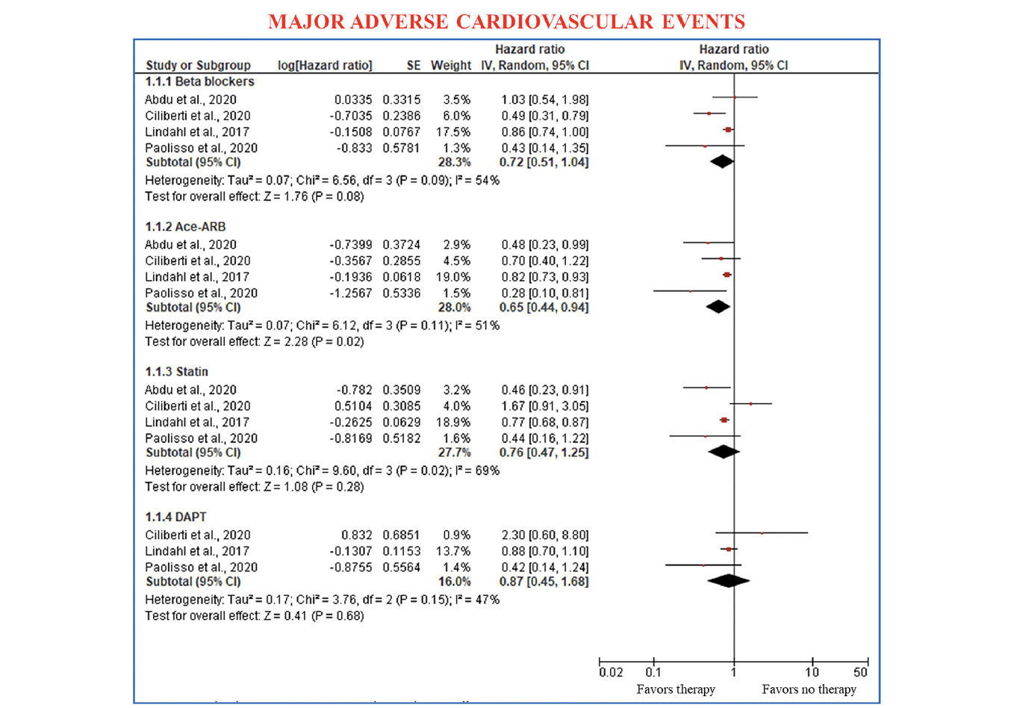
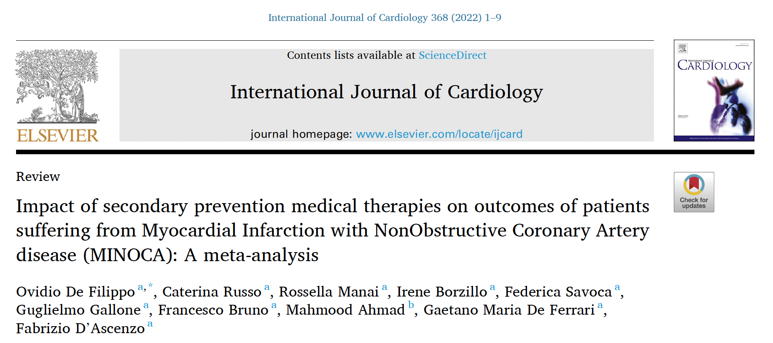
Pharmacological treatment strategies: 1. Angiotensin system inhibitors
Low use in MINOCA patients
NO RCT, but many observational studies…
Notes:
Clear benefits of ACEi in the context of MI
However, Low use for MINOCA patients (30% versus 30%)
There are no RCTs examining the effect of ACEI/ARB on outcomes, however 7 observational studies have examined outcomes in patients post-MINOCA.(65,68-73) One study showed no difference in outcomes in patients on ACEI/ARB following discharge(68) however 4 studies demonstrated reduced MACE (HRs 0.29-0.82).(65,69,71,74) and 3 observational studies showed reduced all-cause death (HRs 0.20-0.38).(65,72,73) A recent meta-analysis including 5 of these 7 studies pooling 10,546 patients with MINOCA concluded that ACEI/ARB use was associated to reduced MACE (HR 0.65, 0.44–0.94) but not the risk of death (HR 0.48, 0.20–1.14) at 36 months follow-up.(75)

Slide 49
Pharmacological treatment strategies 2. Statins
Possible benefit in MINOCA
ASCVD risk factors
Frequent cause of MINOCA is plaque disruption
Benefit in the presence of non-obstructive CAD
Subgroup analysis of SWEDEHEART registry
Targets: sBP < 140 mmHg, LDL-C at target, nonsmoking, cardiac rehab program
Lower MACE when targets reached
differences were statistically significant for achieving LDL-C levels in the target range (32% risk reduction)
Eggers et al. The American Journal of Medicine 2018.
Notes:
In theory, statins may be beneficial in patients with MINOCA, as ASCVD risk factors are prevalent in this population. The most frequently reported cause of MINOCA is plaque disruption, for which statins are likely to provide benefit.(5-7) Especially relevant in the presence of non-obstructive CAD, statins limit progression and facilitate regression of atherosclerotic plaque.(78) Further, the favorable effects of statins on endothelial function, oxidative stress and inflammation could provide benefit for several of the underlying etiologies of MINOCA
MACE: all-cause mortality, MI, hospitalization for heart failure and stroke

Slide 50
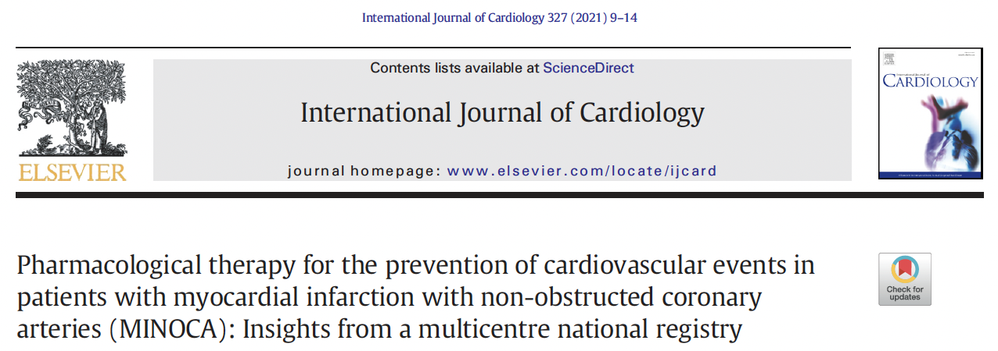
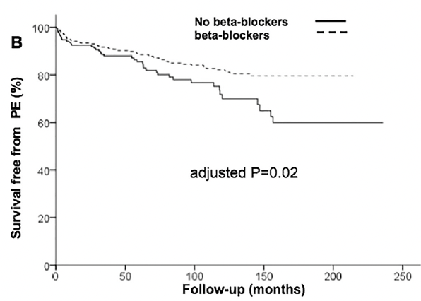
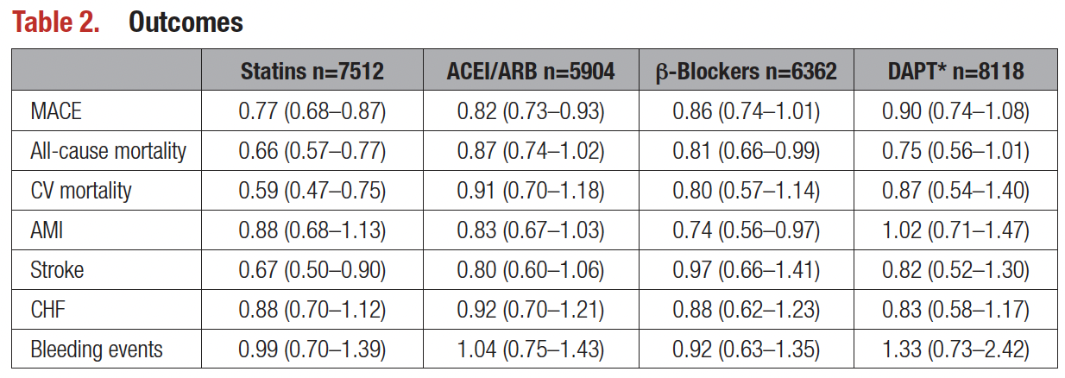
Pharmacological treatment strategies: 3. Beta-blockers
Inconsistent observational studies results
Most studies showed NO BENEFIT
Notes:
In contrast, in a retrospective analysis of the Italian MINOCA cohort by Ciliberti et al, beta-blockers were associated with a 50% reduction of MACE with an adjusted HR of 0.49 [95%CI 0.31-0.79].(68) The benefit seemed similar across subgroups of sex, age, diabetes and LV function.
SWEDEHEART registry: In the SWEDEHEART registry (n=7,512), beta-blockers only showed a trend for reduced risk of MACE (HR 0.86 [95%CI 0.74-1.01]), defined as all-cause mortality or hospitalization for MI, ischemic stroke or heart failure.(70) However, their prescription at the time of hospital discharge was associated with lower all-cause mortality (HR 0.81 [95%CI 0.66-0.99]) and lower recurrence of MI (HR 0.74 [95%CI 0.56-0.97]).

Slide 51
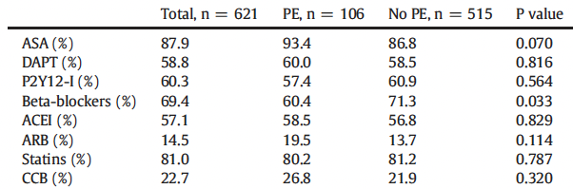
Pharmacological treatment strategies 4. Antiplatelet agents
Largest study addressing antiplatelet therapy in MINOCA
621 patients (343 i.e., 55% female)
Notes:
The largest study addressing antiplatelet therapy in MINOCA was composed of a highly heterogenous population, demonstrated that 66% of 9466 patients received DAPT, and revealed a null effect of DAPT on MACE.
Possible harm of using aspirin

Slide 53
Cause-specific treatment of MINOCA

Slide 55
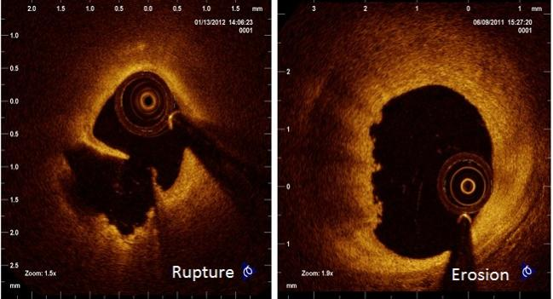
Plaque rupture
Similar to MI-CAD
Common pathophysiology
Notes:
The treatment of MINOCA caused by plaque disruption or erosion will be similar to MI-CAD considering the common pathophysiology.
There are no data looking specifically into the treatment of MINOCAs due to coronary embolism. Anticoagulation is recommended in patients with atrial fibrillation,(123) suspected or diagnosed prosthetic valve thrombosis(124), or intracardiac thrombus.(125) When paradoxical embolism is suspected, patent foramen ovale or atrial septal defect closure may be indicated.(126,127)

Slide 56
Coronary microvascular disease
Current literature in the context of INOCA
Kunadian et al. EuroIntervention 2020.

Slide 58
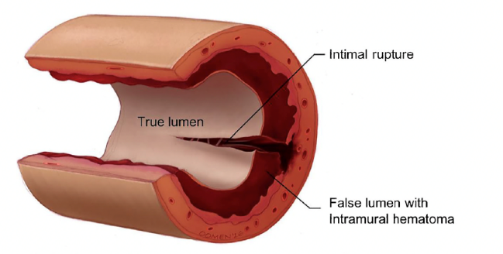
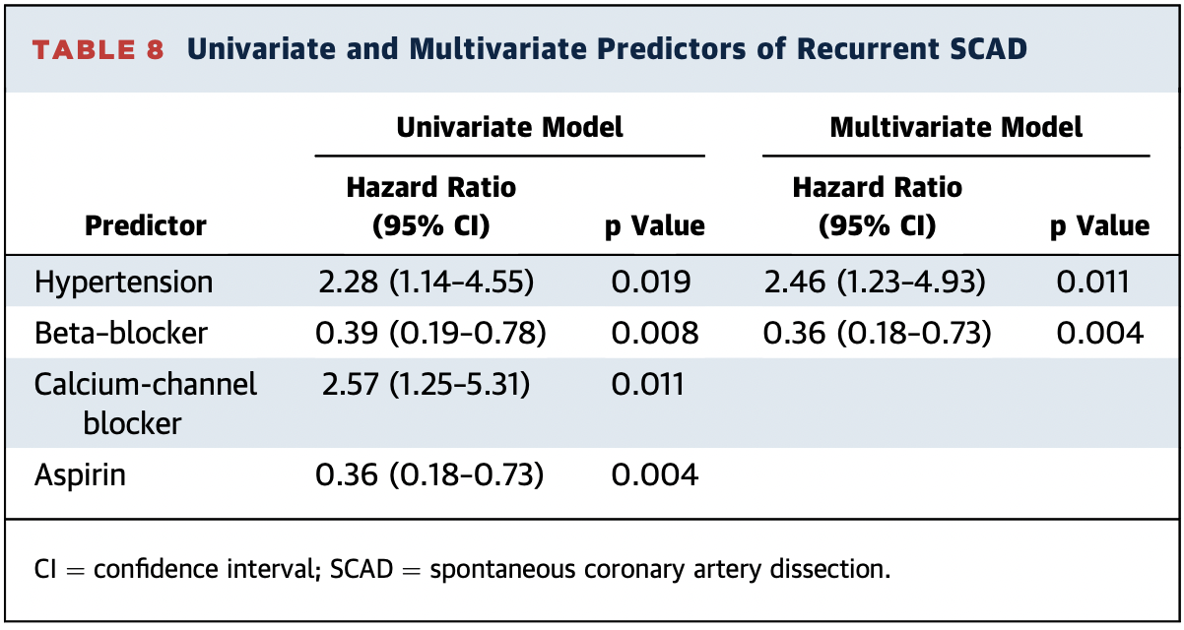
SCAD management
No guidelines considering the lack of RCTs
Aspirin and beta-blockers are the cornerstone of the medical treatment
Benefit of DAPT remains uncertain, and may be a risk factor for increased bleeding
common practice is to maintain patients on lifelong aspirin, as well as clopidogrel for 12 months
Saw et al. JACC 2017.
Notes:
A conservative approach is strongly suggested because coronary intervention and stenting tend to cause propagation of the dissection and outcomes are acceptable with medical management. In 70–97% of cases, there is angiographic healing of SCAD,(106-109) and management aligns with these important concepts.
No standard guidelines on the treatment of SCAD, considering the lack of randomized clinical trials
Regarding the prognosis, in-hospital and long-term survival has been shown to be excellent. However, the risk of the recurrence of acute events has been reported to be high (10% at 1 year… 27% at 5 years).
MINOCA CPU:
In patients presenting with SCAD, hypertension was found to be a risk factor for recurrent disease (HR 2.28 [95% CI, 1.14-4.55] p = 0.019) and should be optimally managed.(112) The role of ACEI/ARB in SCAD is currently being studied in the SAFER-SCAD trial (Statin and Angiotensin-converting Enzyme Inhibitor on Symptoms in Patients With SCAD; NCT02008786). Moreover, SCAD patients with significant left ventricular dysfunction (ejection fraction less than 40%) and those with hypertension, diabetes mellitus, or stable CKD should be started on an ACEI (Class 1 indication) or an ARB (Class IIa).(51,61,87)
Statins may be associated with a higher recurrence of SCAD, as shown in a small retrospective study.(121) Given that the proportion of patients with atherosclerotic SCAD is unknown,(111,122) lipid-lowering therapy should only be prescribed to patients with an indication as per the most recent guidelines.(88)
Practical tip – Treatment of MINOCA secondary to SCAD:
Aspirin and beta-blocker should be considered for patients with SCAD.
The role of DAPT is uncertain.
Patients should receive an ACEI (or ARB), and a statin only if there is a clear indication as per the most recent guidelines.

Slide 60
Coronary vasospasm
Kunadian et al. EuroIntervention 2020.
Notes:
The mainstay of therapy in coronary vasospasm includes CCB(98) and nitrates.(99)

Slide 62
Thank you!
Merci!

Slide 63
Thank you
Find this session On Demand on the Vascular 2023 platform.
On Demand includes almost every Vascular 2023 scientific and educational session. Look for this symbol to find all On Demand content available.

