Slide 1
GUIDELINES ON THE FITNESS TO DRIVE WITH CARDIOVASCULAR DISEASE
Chris Simpson MD for Peter G. Guerra, MD, CM, FCCS
Thursday, October 26, 2023

Slide 2
© Canadian Cardiovascular Society. 2023. All rights reserved.
Distribution, transmission or republication is strictly prohibited without the prior written permission of the Canadian Cardiovascular Society.
For medical institution internal education or training (i.e. grand rounds, medical college/classroom education, etc.), kindly consider and implement the following:
  Include the citation for the Canadian Journal of Cardiology
  Add ‘Reproduced with permission from the Canadian Cardiovascular Society. [insert year].’
  Avoid use of CCS logos or trademarks on slides, tools or publications that are not the property of the CCS
  Do not modify the slide content and, the layout and CCS branding on the Guideline-related slides
  Guideline recommendations must be reproduced exactly as published
For an industry supported or involved program, permissions are required:
  If content is published in the Canadian Journal of Cardiology, permissions must be sought through our publisher Elsevier (www.onlinecjc.com)
  If content is property of the CCS, contact guidelines@ccs.ca

Slide 3
© Canadian Cardiovascular Society. 2023. All rights reserved.
These slides were presented at Vascular 2023 in Montreal, Quebec on October 26, 2023. Find this session On Demand on the Vascular 2023 platform.
Reference: Guerra P, Simpson C, Van Spall H, et al. Canadian Journal of Cardiology, DOI: https://doi.org/10.1016/j.cjca.2023.09.033. Copyright © 2023 Canadian Cardiovascular Society. All rights reserved.
© Canadian Cardiovascular Society. 2023. All rights reserved.

Slide 4
OVERALL LEARNING OBJECTIVES
At the completion of this activity, participants should be able to:
Understand the risk of sudden incapacitation associated with different cardiovascular diagnoses;
Provide pragmatic driving recommendations to private versus commercial drivers; and
Incorporate patients' values and preferences in making driving recommendations.

Slide 5
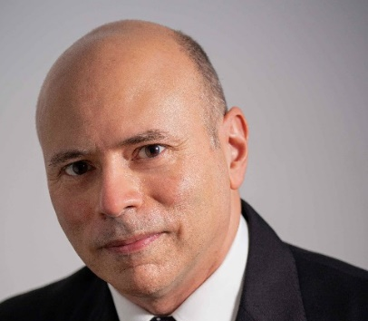
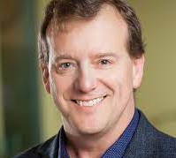
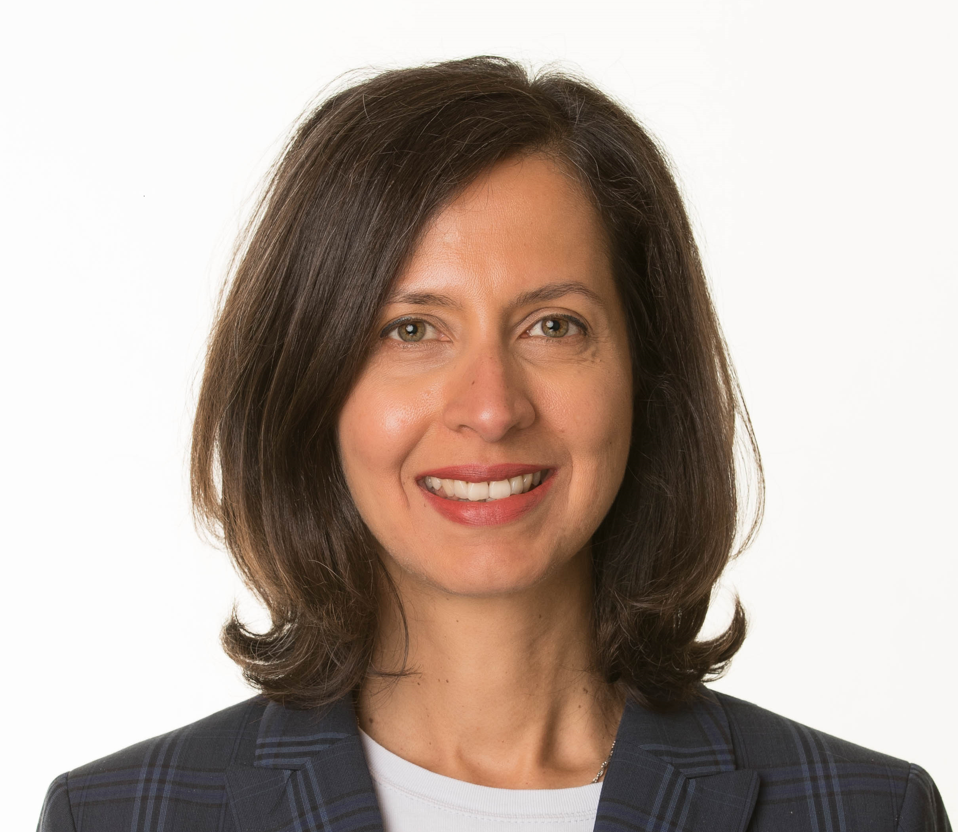
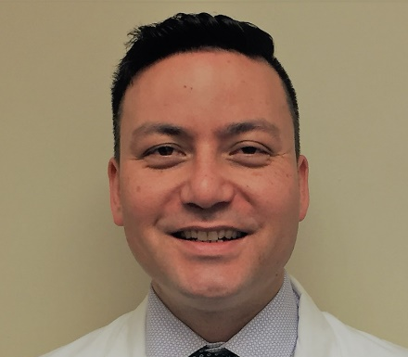
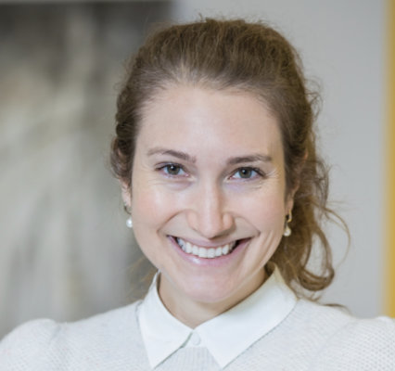
Speakers
Peter G. Guerra, MD CM
Institut de Cardiologie de Montréal
Christopher S. Simpson MD
Queen’s University
Harriette Van Spall MD MPH
McMaster University
Christopher B. Fordyce MD
University of British Columbia
Julia Cadrin-Tourigny MD PhD
Montreal Heart Institute
Notes:
Place in alpha order

Slide 6
PROGRAM DISCLOSURE OF COMMERCIAL SUPPORT
 | Any direct financial payments including receipt of honoraria | Membership on advisory boards or speakers’ bureaus | Funded grants of clinical trials | Patents on a drug, product or device | All other investments/relationship that could be seen as having the potential to influence the content of the educational activity | Mitigation of Bias
I have/do not have relationships with for-profit and not-for-profit organizations over the past two years:
Peter G. Guerra | No relationships
Christopher S. Simpson | No relationships
Harriette Van Spall | Roche | None | None | None | None | No relationship to this Guideline
Christopher B. Fordyce | Bayer, Novo Nordisk, Boehringer Ingelheim, Sanofi, Novartis, New Amsterdam, HLS therapeutics | Bayer, Novo Nordisk, Boehringer Ingelheim, Novartis, New Amsterdam, HLS therapeutics | Bayer, Amgen, Novartis |  |  | No relationship to this Guideline
Julia Cadrin-Tourigny | Bayer, BMS Pfizer | Tenaya, Lexeo | None | None | None | No relationship to this Guideline

Slide 7
Welcome
2023 CCS Guidelines on the Fitness to Drive
Co-Chairs: Peter G. Guerra, MDª, Christopher S. Simpson, MD^{b}, Harriette G.C. Van Spall, MD MPH^{c}.
Writing Panel: Anita W. Asgar, MD, MScª, Phyllis Billia, PhD, MD^{d}, Julia Cadrin-Tourigny, MDª, Santabhanu Chakrabarti MBBS MD^{f}, Christopher C. Cheung, MD, MPH^{e}, Annie Dore MDª, Christopher B. Fordyce, MD, MHS, MSc^{f}, Pishoy Gouda, MBBCh^{g}, Ansar Hassan, MD^{h}, Andrew Krahn, MD^{f}, Jessica G.Y. Luc, MD^{f}, Susanna Mak MD, PhD^{i}, Sean McMurtry MD, PhD^{g}, Colleen Norris, PhD, MSc, RN^{g}, Francois Philippon MD^{j}, John Sapp MD^{k}, Robert Sheldon MD, PhD^{l}, Candice Silversides, MD^{d}, Christian Steinberg MD^{j}, David A. Wood MD^{f}

Slide 8
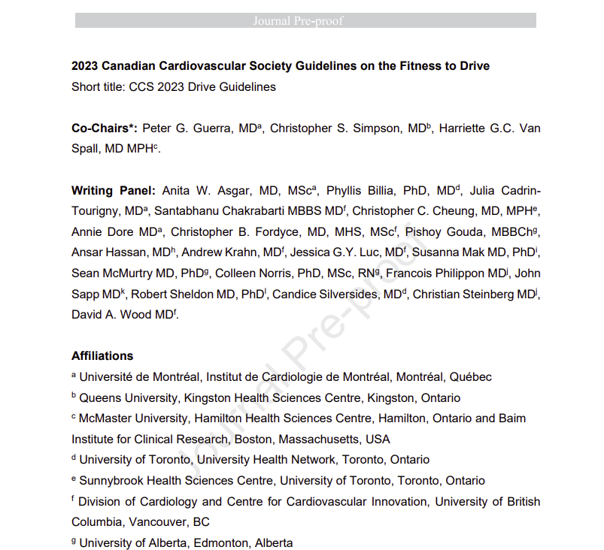
Guideline Publication Information
Article-in-press release October 10 2023
Final publication winter 2024
This is a PDF file of an article that has undergone enhancements after acceptance, such as the addition of a cover page and metadata, and formatting for readability, but it is not yet the definitive version of record. This version will undergo additional copyediting, typesetting and review before it is published in its final form, but we are providing this version to give early visibility of the article. Please note that, during the production process, errors may be discovered which could affect the content, and all legal disclaimers that apply to the journal pertains.

Slide 9
History, principles, legislation
Chris Simpson MD

Slide 10
PROGRAM DISCLOSURE OF COMMERCIAL SUPPORT
 | Any direct financial payments including receipt of honoraria | Membership on advisory boards or speakers’ bureaus | Funded grants of clinical trials | Patents on a drug, product or device | All other investments/relationship that could be seen as having the potential to influence the content of the educational activity | Mitigation of Bias
I have/do not have relationships with for-profit and not-for-profit organizations over the past two years:
Christopher S. Simpson | No relationships

Slide 11

Highway Traffic Act
Regulation 462 (177.1)
Every legally qualified medical practitioner shall report to the Registrar the name, address and clinical condition of every person 16 years of age or over attending upon the medical practitioner for medical services, who in the opinion of such practitioner is suffering from a condition that may make it dangerous for such a person to operate a motor vehicle

Slide 12
The Nature of Risk
Risk as a technical or scientific concept
  Physicians, scientists, technologists, nurses
Risk as a social or cultural concept
  Society
  Dependent on cultural and political biases
  Judgments about risk are a social comment

Slide 13
Assessment of Risk
RH = TD x V x SCI x Ac
  RH = Risk of harm to other road users posed by the driver with heart disease
  TD = Time spent behind the wheel or distance driven in a given time period
  V = Constant for type of vehicle driven
  SCI = Risk of sudden cardiac incapacitation
  Ac = Probability that such an event will result in a fatal or injury-producing accident

Slide 14
RH = TD x V x SCI x Ac
Fewer than 2% of reported incidents of driver sudden death or loss of consciousness have resulted in injury or death to other road users or bystanders
Therefore, Ac = 0.02 for all drivers

Slide 15
RH = TD x V x SCI x Ac
Truckers are involved in 2% of all road accidents, but in 7.2% of fatal accidents
0.02 / 0.072 = 0.28
Therefore, if V = 1 for a commercial
driver, then V = 0.28 for a private driver

Slide 16
RH = TD x V x SCI x Ac
Average private driver spends 4% of his or her time behind the wheel
Average commercial driver spends 25% of his or her time behind the wheel
TD = 0.04 for a private driver
TD = 0.25 for a commercial driver

Slide 17
RH = TD x V x SCI x Ac
Driver of a heavy truck, post MI x 3 mos. generally regarded as safe to drive IF:
  Functional Class I
  Negative EST at 7 METS
  No disqualifying ventricular arrhythmias
But cannot be assigned a risk lower than 1% of a cardiac death in the next year

Slide 18
Setting a Standard
RH = TD x V x SCI x Ac
For such an individual, SCI = 0.01
Substituting:
  RH = 0.25 x 1 x 0.01 x 0.02
  = 0.00005
Allowing such an individual on the road is associated with a risk of death or injury to others of 1 in 20,000. This level of risk appears to be acceptable in Canada

Slide 19
The Private Driver
RH = TD x V x SCI x Ac
0.00005 = 0.04 x 0.28 x SCI x 0.02
SCI = 0.22
The private driver with a 22% risk of a suddenly incapacitating cardiac event in the next year poses no greater risk to public safety than the commercial driver with a 1% risk

Slide 20
Coronary Artery Disease
Christopher Fordyce, MD, MHS, MSc
Associate Professor
University of British Columbia

Slide 21
PROGRAM DISCLOSURE OF COMMERCIAL SUPPORT
I have/do not have relationships with for-profit and not-for-profit organizations over the past two years:
NATURE OF RELATIONSHIP | NAME OF THE FOR-PROFIT OR NOT-FOR-PROFIT ORGANIZATION | DESCRIPTION OF RELATIONSHIP
Any direct financial payments including receipt of honoraria | Bayer, Novo Nordisk, Boehringer Ingelheim, Sanofi, Novartis, New Amsterdam, HLS therapeutics | Outside of scope of work
Membership on advisory boards or speakers’ bureaus | Bayer, Novo Nordisk, Boehringer Ingelheim, Novartis, New Amsterdam, HLS therapeutics | Outside of scope of work
Funded grants of clinical trials | Canadian Institutes of Health Research GeneSolve BC Michael Smith Foundation for Health Research Bayer, Amgen, Novartis | Outside of scope of work
Patents on a drug, product or device
All other investments/relationship that could be seen as having the potential to influence the content of the educational activity

Slide 22
Case: Chronic CAD
55 yo male
PMH: DM and dyslipidemia
Medications: Ramipril 5 mg daily, Metformin 500 mg BID, Rosuvastatin 20 mg daily
HPI: 2 month history of chest pain with walking > 2 blocks or > 1 flight of stairs
CCTA: 70-99% dRCA; 25-49% mLAD
Bisoprolol 5 mg daily and NTG patch 0.4mg/h added with chest pain resolution
Rosuvastatin increased to 40 mg daily and ASA added

Slide 23
Chronic CAD: Poll #1
What is this patient’s driving restrictions?
No restrictions for private or commercial driving
No restrictions for private driving; 1 month commercial driving restriction
1 month restriction for private driving; 3 month restriction for commercial driving
1 month restriction for private and commercial driving
None of the above

Slide 24
Case (cont’d): Chronic CAD
60 yo male
PMH: DM, dyslipidemia, obstructive CAD per CCTA five years earlier
Medications: ASA, Ramipril 5 mg daily, Metformin 500 mg BID, Rosuvastatin 40 mg daily, Bisoprolol 5 mg daily and NTG patch 0.4mg/h
HPI: 2 month history of CCS I to III angina, not responsive to anti-anginal uptitration
Cardiac catheterization: 70% mRCA; 70% pLAD; 40% pLCx
ECHO: LVEF 60%, no significant valvular disase
CABG x 2 (LIMA-LAD; SVG-RCA)

Slide 25
Chronic CAD: Poll #2
What is this patient’s driving restrictions?
No restrictions for private or commercial driving
No restrictions for private driving; 1 month commercial driving restriction
1 month restriction for private driving; 3 month restriction for commercial driving
1 month restriction for private and commercial driving
None of the above

Slide 26
Case (cont’d): Chronic CAD
65 yo male
PMH: DM, dyslipidemia, CABG x 2 five years earlier
Presents with inferolateral STEMI
PCI to occluded LCx; grafts otherwise patent
LVEF 45% with regional WMAs

Slide 27
Contemporary rates of SCD post-MI
Faxen, JACC 2020
Notes:
Type of ACS (STEMI vs NSTEMI) did not independently predict SCD
In the contemporary SWEDEHEART registry, the rate of SCD was approximately 0.2% after 1 month and remained similar at 3 months [13]. This suggests that the rate of SCD between 1 and 3 months was far below the 0.083%/month (1% annually / 12 months) acceptable threshold and favors an easing of driving restrictions in the subgroup of post-MI patients with LVEF > 40%.

Slide 28
Acute Coronary Syndrome: Poll #3
What is this patient’s driving restrictions?
No restrictions for private or commercial driving
1 month restriction for private driving; 3 month restriction for commercial driving
1 month restriction for private and commercial driving
2 week restriction for private driving; 1 month restriction for commercial driving
None of the above

Slide 29
Summary: Coronary Artery Disease
Condition | Private Driving | Commercial Driving
Chronic CAD
Stable angina/asymptomatic CAD | No restriction* | No restriction*
PCI (non-ACS) | 48 hours | 48 hours
CABG Surgery | 1 month | 3 months
ACS: PCI performed
STEMI/NSTEMI: LVEF < 40% | 1 month | 3 months
STEMI/NSTEMI: LVEF > 40% | 2 weeks | 4 weeks
Unstable Angina | 48 hours | 7 days
ACS: PCI not performed
STEMI/NSTEMI | 1 month | 3 months
Unstable Angina | 7 days | 1 month
*Except non-revascularized left main disease (≥50% commercial, ≥70% private)

Slide 30
Arrhythmias and Devices
Julia Cadrin-Tourigny MD PhD

Slide 31
PROGRAM DISCLOSURE OF COMMERCIAL SUPPORT
 | Any direct financial payments including receipt of honoraria | Membership on advisory boards or speakers’ bureaus | Funded grants of clinical trials | Patents on a drug, product or device | All other investments/relationship that could be seen as having the potential to influence the content of the educational activity | Mitigation of Bias
I have/do not have relationships with for-profit and not-for-profit organizations over the past two years:
Julia Cadrin-Tourigny | Bayer, BMS Pfizer | Tenaya, Lexeo | None | None | None | No relationship to this Guideline

Slide 32
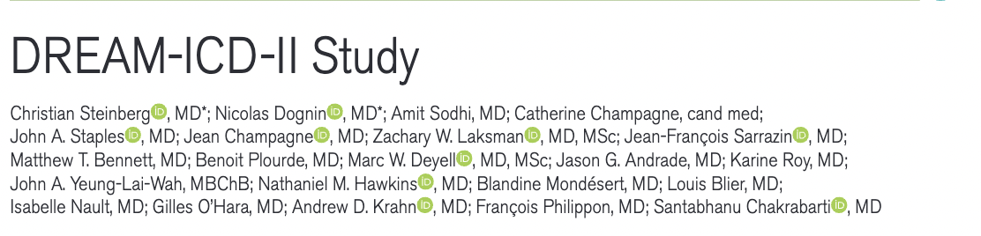
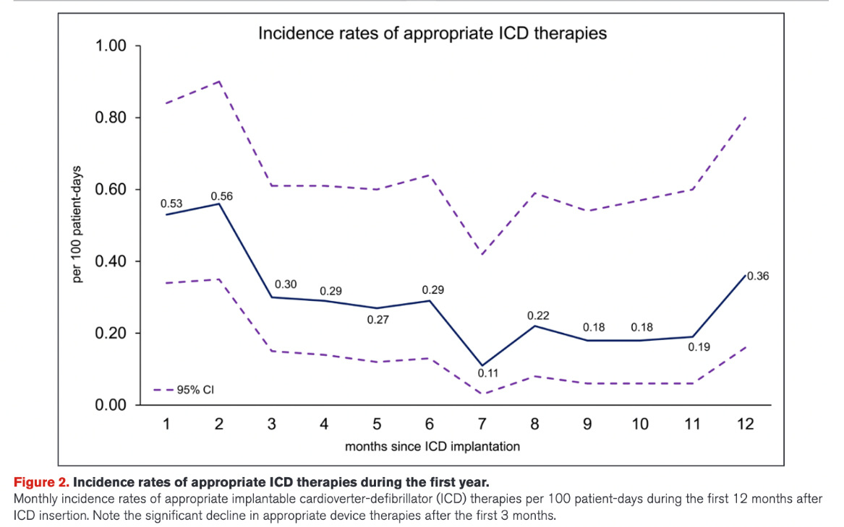
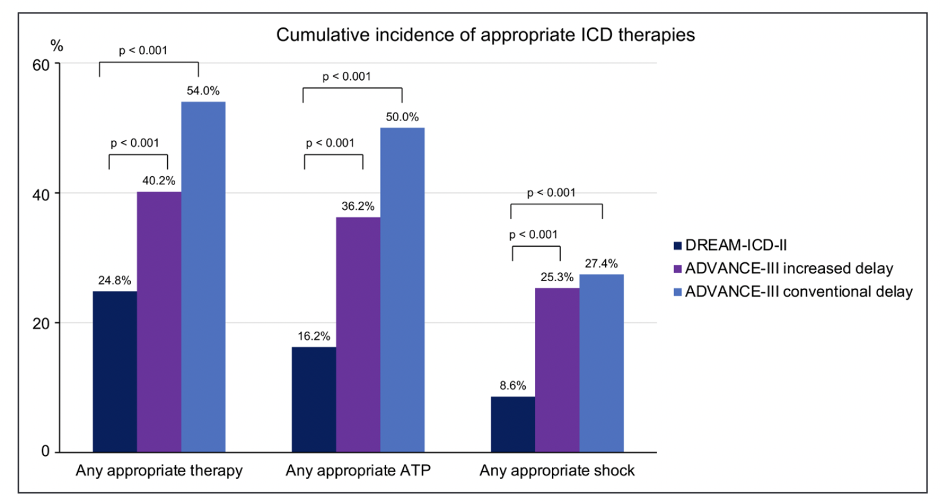
New Data!
N= 721, secondary prevention ICD recipients
Cumulative incidence of appropriate ICD therapies highest
< 90 days (34.4%)
Steinberg et al. Circulation 2022

Slide 33
Pacemaker and ICD condition | Private driving | Commercial driving
Primary prophylaxis ICD (Trans-venous or sub-cutaneous) | 1 week after implant | Disqualified
Secondary prophylaxis ICD: VT/VF with impaired consciousness | 3 months after implant/ last incapacitating event | Disqualified
Secondary prophylaxis: VT without impaired consciousness | 1 week after implant / last event | Disqualified
Electrical Storm (≥ 3 VT or VF events in 24 hours) | Disqualified for 3-6 months, depends on severity/expert opinion | Disqualified
Pacemaker: impairment of consciousness/high grade AV block | 1 week | 1 week
Pacemaker: NO impairment of consciousness/high grade AV block | No restriction | No restriction
Generator change: ICD Generator change: Pacemaker | No restriction No restriction | Disqualified No restriction
Genetics: cardiomyopathies/channelopathies | No restriction if asymptomatic 3 months: syncope/VT/VF/SCA | Disqualified if annual risk > 1%/expert opinion

Slide 34
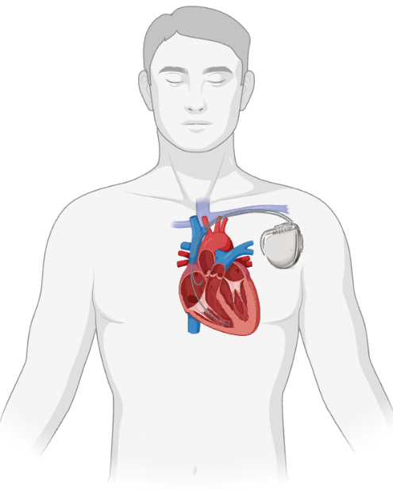
An ICD story
55 yo male, truck driver
PMH: Coronary artery disease with STEMI 6 months ago
LVEF: 30% (Medical therapy optimized > 3 months ago)
ECG: Sinus rhythm, 60 bpm, narrow QRS
Primary prevention single chamber ICD recommended
Trans-venous ICD is implanted

Slide 35
Primary prevention ICD: Poll #1
What is this patient’s driving restrictions after ICD implant?
No restrictions for private or commercial driving
No restrictions for private driving; 1 month commercial driving restriction
1 week restriction for private driving; commercial driving disqualified
1 month restriction for private; 12 month commercial driving
None of the above

Slide 36
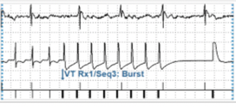
Case (cont’d): Now, VT
57 yo male
PMH: Coronary artery disease/Prior anterior STEMI
LVEF: 30%
ECG: Sinus rhythm, 60 bpm, narrow QRS
Received a Trans-venous ICD 2 years ago, followed with remote monitoring
Alert: Received Anti-tachycardia pacing (ATP)
for VT at 190 Bpm yesterday afternoon
Patient called: Asymptomatic

Slide 37
VT on ICD: Poll #2
What is this patient’s driving restrictions?
No restrictions for private driving
Private driving is disqualified
1 week restriction for private driving
1 month restriction for private driving
3 month restriction for private driving

Slide 38
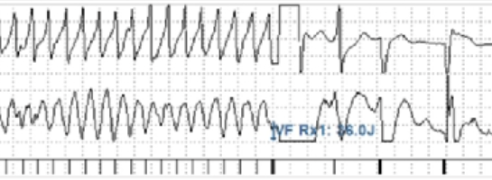
Case (cont’d): Now VF
59 yo male
PMH: Coronary artery disease/Prior anterior STEMI
LVEF: 30%
ECG: Sinus rhythm, 60 bpm, narrow QRS
Received a Trans-venous ICD 4 years ago, followed with remote monitoring
Consults in the ER for syncope
ICD interrogation reveals ICD shock for VF

Slide 39
VF on ICD: Poll #3
What is this patient’s driving restrictions?
Private driving is disqualified
1 week restriction for private driving
3 month restriction for private driving
6 month restriction for private driving

Slide 40
Case (cont’d): time for a change
67 yo male
PMH: Coronary artery disease/Prior STEMI
LVEF: 30%
ECG: Sinus rhythm, 60 bpm, narrow QRS
Received a Trans-venous ICD 12 years ago,
Generator change

Slide 41
Case (cont’d): time for a change
67 yo male
PMH: Coronary artery disease/Prior STEMI
LVEF: 30%
ECG: Sinus rhythm, 60 bpm, narrow QRS
Received a Trans-venous ICD 12 years ago
Generator change
No restriction (for private driving)

Slide 42
Heart Failure
Harriette G.C. Van Spall MD MPH
Associate Professor of Medicine
McMaster University

Slide 43
PROGRAM DISCLOSURE OF COMMERCIAL SUPPORT
 | Any direct financial payments including receipt of honoraria | Membership on advisory boards or speakers’ bureaus | Funded grants of clinical trials | Patents on a drug, product or device | All other investments/relationship that could be seen as having the potential to influence the content of the educational activity | Mitigation of Bias
I have/do not have relationships with for-profit and not-for-profit organizations over the past two years:
Harriette Van Spall | Roche | None | None | None | None | No relationship to this Guideline

Slide 44
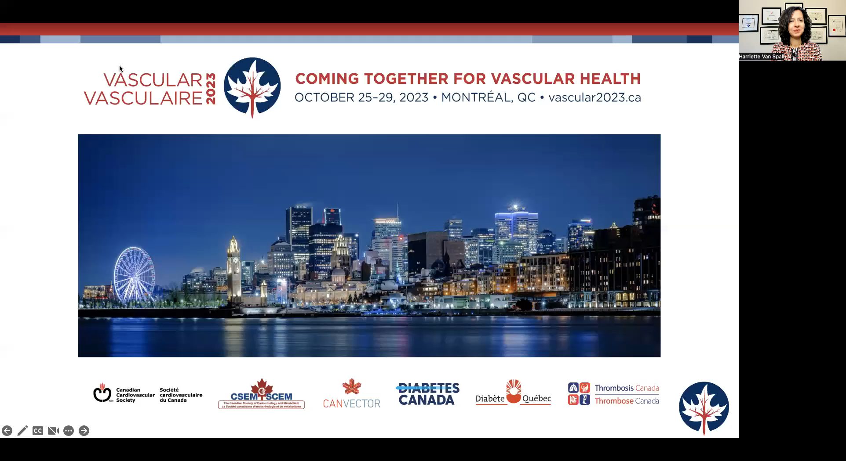
Play

Slide 45
Panel Discussion
Christopher S. Simpson MD
Queen’s University
Christopher B. Fordyce MD
University of British Columbia
Julia Cadrin-Tourigny MD
Montreal Heart Institute

Slide 46
Knowledge Translation Program
Knowledge translation (KT) activities in 2024 will include:
Digital upload to ccs.ca and the iCCS Apps
Communication strategy to CCS members and external stakeholders
Implementation in the CMA Driver’s Guide
Implementation in the CCMTA National Safety Code for Driver Safety
Guidelines Day CPD session – February 2024

Slide 47
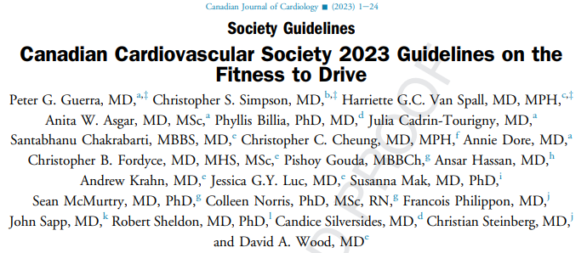

Article available as Article-in-Press on CJC online or at ccs.ca
Click here to access CCS Guidelines and Clinical Practice Update Library
Notes:
https://ccs.ca/guidelines-and-clinical-practice-update-library/

Slide 48

Thank you
Find this session On Demand on the Vascular 2023 platform
On Demand includes almost every Vascular 2023 scientific and educational session. Look for the symbol to find all On Demand content available.

Slide 49

OBJECTIVES
At the completion of this section, participants should be able to:
Have a framework to guide recommendations regarding driving in people living with heart failure
To appreciate the different recommendations with commercial versus personal driving

Slide 50
Case 1
58 F being discharged after hospitalization for Heart Failure
Past history of HFrEF (2018)
  Chemotherapy induced, on target dose GDMT
  Had primary prophylactic ICD inserted 1 year ago
In-hospital Echo
  Mildly dilated LV, global dysfunction, LVEF 35%, Grade II diastolic dysfunction, mild pulmonary hypertension, normal RV
Being discharged on oral therapy
  No rest dyspnea or orthopnea, but has dyspnea on climbing 1 flight of stairs or walking 1-2 blocks on flat surface
School bus driving? Private vehicle driving?

Slide 51
Heart Failure (HF)
Cardiac Death in HF
Pump failure
Sudden Cardiac Death (SCD) / Incapacitation (SCI)
  relevant to driving, typically ventricular arrhythmias
Acceptable annual risk of SCD / SCI
Private drivers = 22%
Commercial drivers = 1%
Van Spall HGC, Lee SF, Xie F, et al. JAMA 2019; 321(8): 753-61.
Lombardi C, Peveri G, Cani D, et al. ESC Heart Fail 2020; 7(5): 2650-61
Desai AS, Jhund PS, Claggett BL, et al. JAMA cardiology 2022; 7(12): 1227-34

Slide 52
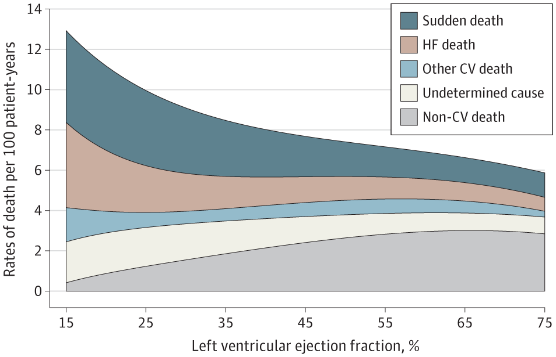
Heart Failure (HF)
Rates of SCD in HF increase with
↓ LVEF
  In stable ambulatory patients with HF and
    LVEF < 40%, SCD rate = 3.0 / 100 patient years
    LVEF > 50%, SCD rate = 1.3 / 100 patient y↑ears
↑ NYHA class
  NYHA IV, HFrEF, on inotropes - 1 – 2 % mortality per week
  NYHA IV, HFrEF, no inotropes - 35% mortality at 3 months, with 50% related to SCD
  NYHA III and HFrEF – 12-27% mortality at 1 year, with 30-50% related to SCD
Van Spall HGC, Lee SF, Xie F, et al. JAMA 2019; 321(8): 753-61.
Lombardi C, Peveri G, Cani D, et al. ESC Heart Fail 2020; 7(5): 2650-61
Desai AS, Jhund PS, Claggett BL, et al. JAMA cardiology 2022; 7(12): 1227-34

Slide 53
Heart Failure | Private Driving | Commercial Driving
NYHA class I | No restriction | No restriction if EF > 30%
NYHA class II | No restriction | No restriction if EF > 30%
NYHA class III | No restriction | Disqualified
NYHA class IV | Disqualified | Disqualified
Intermittent outpatient inotropes | Disqualified | Disqualified

Slide 54
Heart Failure
Heart Failure | Private Driving | Commercial Driving
LVAD | May resume driving if: At least 2 months post-implant and; NYHA class I-II Otherwise disqualified | Disqualified
Heart Transplant | May resume driving if: At least 6 weeks after discharge and; NYHA Class I or II and; On stable immunosuppression therapy and; Undergoing annual reassessment Otherwise disqualified | May resume driving if: At least 6 months after discharge and; NYHA Class I and; EF > 50% and; Undergoing annual reassessment which includes testing to rule out active ischemia Otherwise disqualified

Slide 55
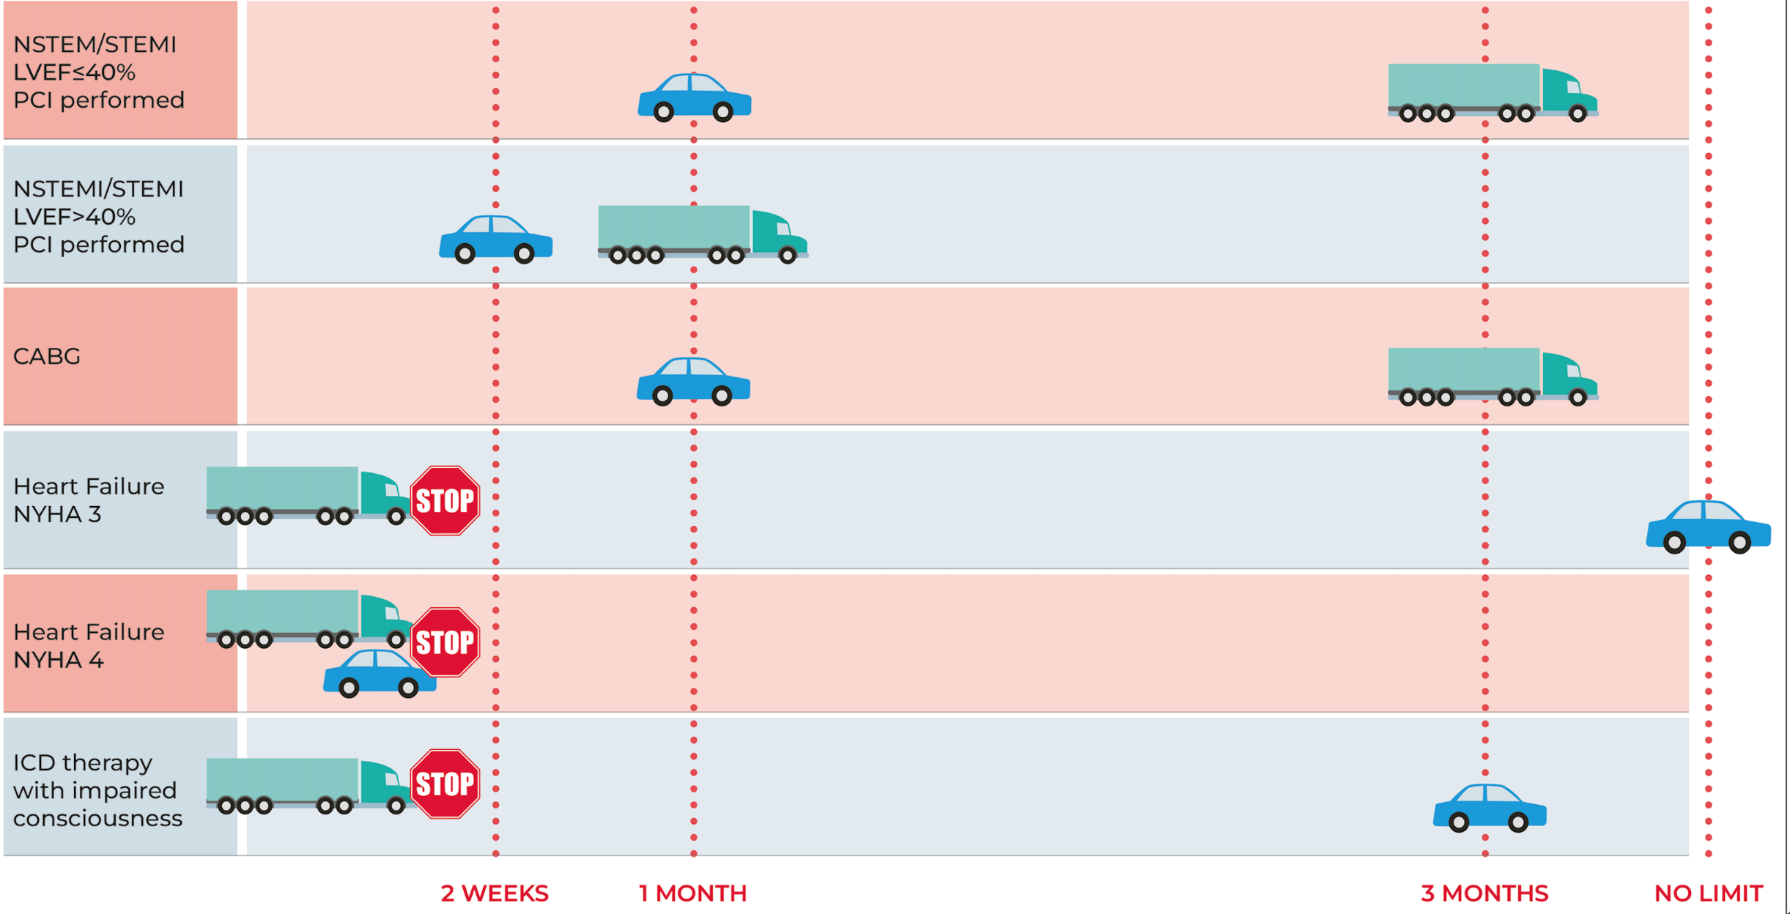
Commercial and personal driving recommendations
Or LVEF < 30%

Slide 56
Back to Case 1
58 F being discharged after hospitalization for Heart Failure
Past history of HFrEF (2018)
  Chemotherapy induced, on target dose GDMT
  Had primary prophylactic ICD inserted 1 year ago (non-issue)
In-hospital Echo
  Mildly dilated LV, global dysfunction, LVEF 35%, Grade II diastolic dysfunction, mild pulmonary hypertension, normal RV
Being discharged on oral therapy
  No rest dyspnea or orthopnea, but has dyspnea on climbing 1 flight of stairs or walking 1-2 blocks on flat surface (NYHA III)
🚫 School bus driving ✅ Private vehicle driving

