Slide 1
Canadian Cardiovascular Society / Canadian Association Of Interventional Cardiology Focused Update Of The Guidelines For The Use Of Antiplatelet Therapy
October 26, 2023

Slide 2
© Canadian Cardiovascular Society. 2023. All rights reserved.
Distribution, transmission or republication is strictly prohibited without the prior written permission of the Canadian Cardiovascular Society.
For medical institution internal education or training (i.e. grand rounds, medical college/classroom education, etc.), kindly consider and implement the following:
Include the citation for the Canadian Journal of Cardiology
Add ‘Reproduced with permission from the Canadian Cardiovascular Society. [insert year].’
Avoid use of CCS logos or trademarks on slides, tools or publications that are not the property of the CCS
Do not modify the slide content and, the layout and CCS branding on the Guideline-related slides
Guideline recommendations must be reproduced exactly as published
For an industry supported or involved program, permissions are required:
If content is published in the Canadian Journal of Cardiology, permissions must be sought through our publisher Elsevier (www.onlinecjc.com)
If content is property of the CCS, contact guidelines@ccs.ca
© Canadian Cardiovascular Society. 2023. All rights reserved.

Slide 3
© Canadian Cardiovascular Society. 2023. All rights reserved.
These slides were presented at Vascular 2023 in Montreal, Quebec on October 28, 2023. Find this session On Demand on the Vascular 2023 platform.
Reference: Bainey K, Marquis-Gravel G, Belley-Cote E, et al. Canadian Journal of Cardiology, DOI: https://doi.org/10.1016/j.cjca.2023.10.013.
© Canadian Cardiovascular Society. 2023. All rights reserved.

Slide 4
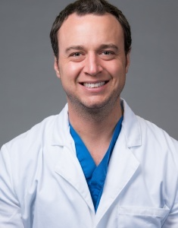
CO-CHAIRS
Headshot
Kevin R. Bainey, MD, MSc
Mazankowski Alberta Heart Institute
University of Alberta
Guillaume Marquis-Gravel, MD, MSc
Montreal Heart Institute
Université de Montréal
Notes:
Place in alpha order

Slide 5
Previous co-chairs
CCS methodologists
Shamir R. Mehta, MD, MSc
Population Health Research Institute, McMaster University, Hamilton Health Sciences
Jean-François Tanguay, MD
Montreal Heart Institute
Université de Montréal
Emilie Belley-Côté, MD, PhD
Population Health Research Institute, McMaster University, Hamilton Health Sciences
Ricky D. Turgeon, PharmD
University of British Columbia
St. Paul’s Hospital PHARM-HF Clinic

Slide 6
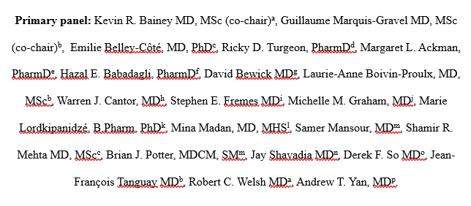
PRIMARY PANEL MEMBERS

Slide 7
SECONDARY PANEL MEMBERS

Slide 8
Conflict of Interest
 | Any direct financial payments including receipt of honoraria | Membership on advisory boards or speaker’s bureaus | Funded grants or clinical trials
Kevin Bainey | None | None | AstraZeneca, Bayer, Boston Scientific
Guillaume Marquis-Gravel | None | Novartis, JAMP Pharma, Servier, KYE, Pharmascience, Boston Scientific,, Bayer, KYE, HLS | Bayer, Boston Scientific
David Bewick​ | None​ | N/A​ | None​
Laurie-Anne Boivin-Proulx​ | None​ | None​ | None​
Stephen Fremes​ | None​ | Polypid​ | Boston Scientific; Medtronic; CIHR-ODIN (1 month ticagrelor + aspirin vs aspirin for graft patency)

Slide 9
Conflict of Interest (continued)
 | Any direct financial payments including receipt of honoraria | Membership on advisory boards or speaker’s bureaus | Funded grants or clinical trials
Marie Lordkipanidzé​ | None​ | Stago​ | PhaseBio Pharmaceuticals Inc
Shamir Mehta​ | None​ | ​ | Abbott, Amgen, Bristol-Myers Squibb, Janssen
Samer Mansour | None | Pfizer, HLS, Sanofi, Amgen, Boehringer Ingelheim and Novartis | Abbott Vascular, Amgen, AstraZeneca, Bayer, Novartis
Jean-François Tanguay​ | None​ | JAMP pharma, HLS, Novartis​ | Abbott Vascular, BioPhase, MicroPort, Novartis
Robert C. Welsh ​ | None​ | Bayer, Novartis ​ | Astra Zeneca

Slide 10
Overall Learning Objectives
1. At the end of this session, participants will be able to prescribe antiplatelet agents in both the primary and secondary prevention setting according to the best updated evidence.
2. Participants will be able to prescribe antiplatelet agents based on the best evidence in the vulnerable populations of patients with ACS treated medically without PCI, and in patients at high bleeding risk (HBR) undergoing PCI (including patients on OAC for AF).
3. Participants will be able to prescribe antiplatelet agents based on the best evidence in patients undergoing CABG.

Slide 11
Guidelines development
Co-chairs invited by the CCS guidelines committee
Primary and secondary panel appointed by co-chairs
COI collected and available
Topics selected by co-chairs + primary panel in the form of PICO questions
NEW: Systematic review + meta-analysis for all PICO questions
Grading of Recommendations, Assessment, Development, and Evaluation (GRADE) approach
75% agreement required for all recommendations
Final manuscript reviewed by secondary panel, guidelines committee and the Canadian Journal of Cardiology

Slide 12
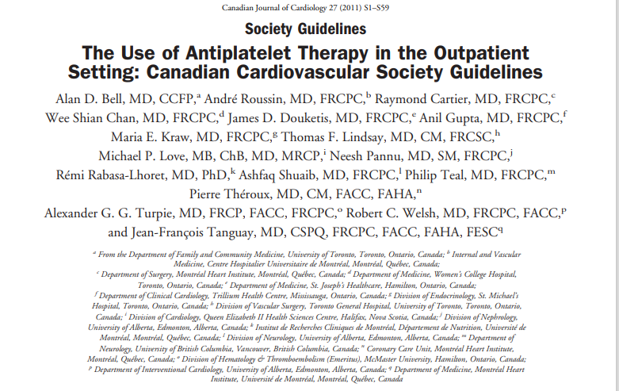
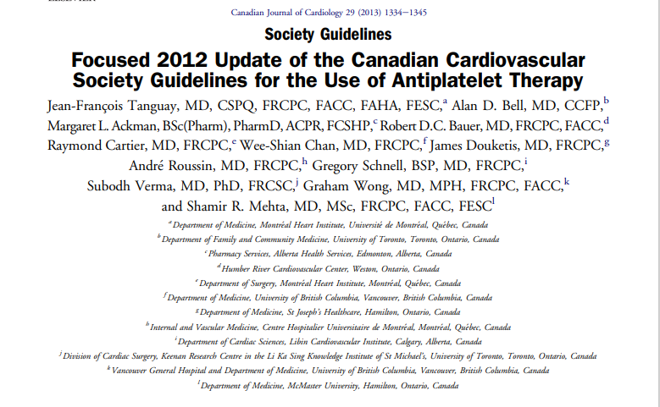
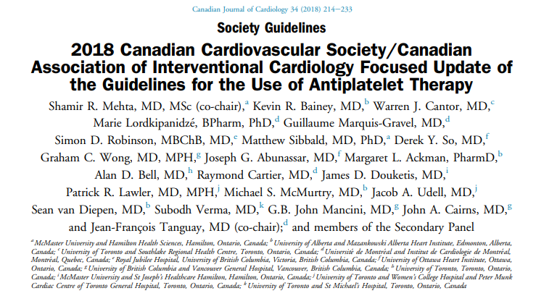
CJC 2011

Slide 13
ATP for secondary prevention
ACS
PCI
CABG
PAD
Beyond 1 year
ATP for primary prevention
Diabetes
CJC 2011

Slide 14
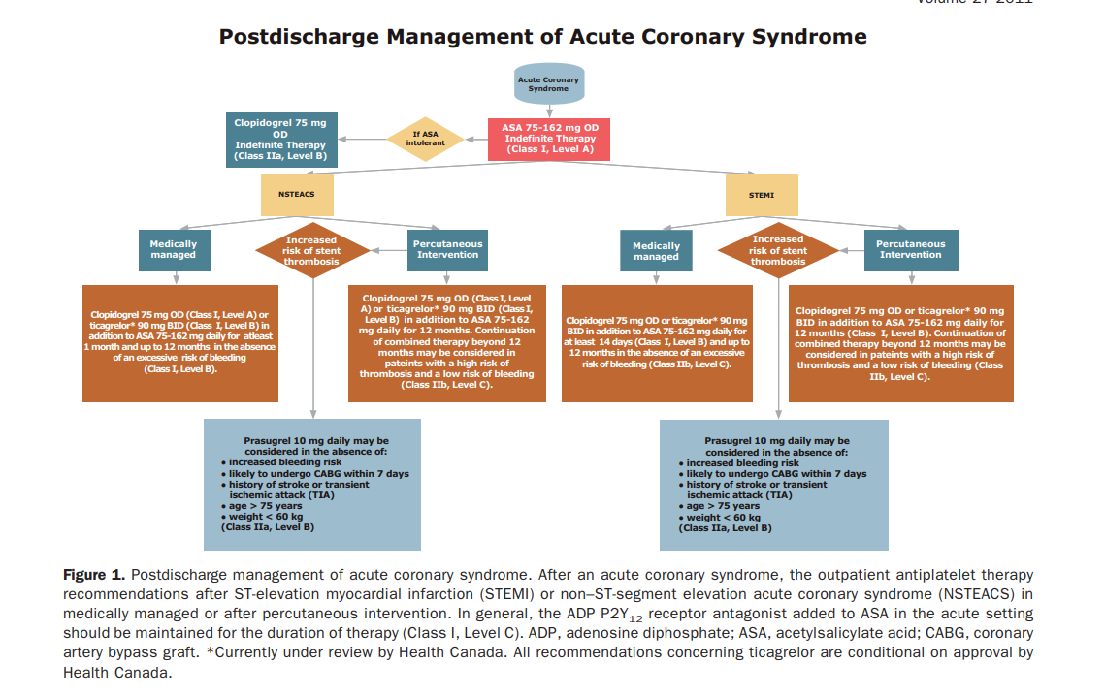
CJC 2011

Slide 15
CJC 2012

Slide 16
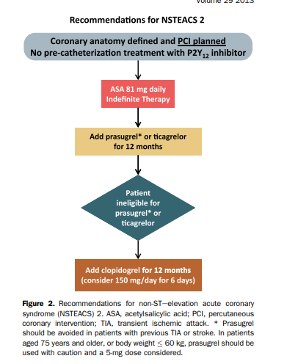
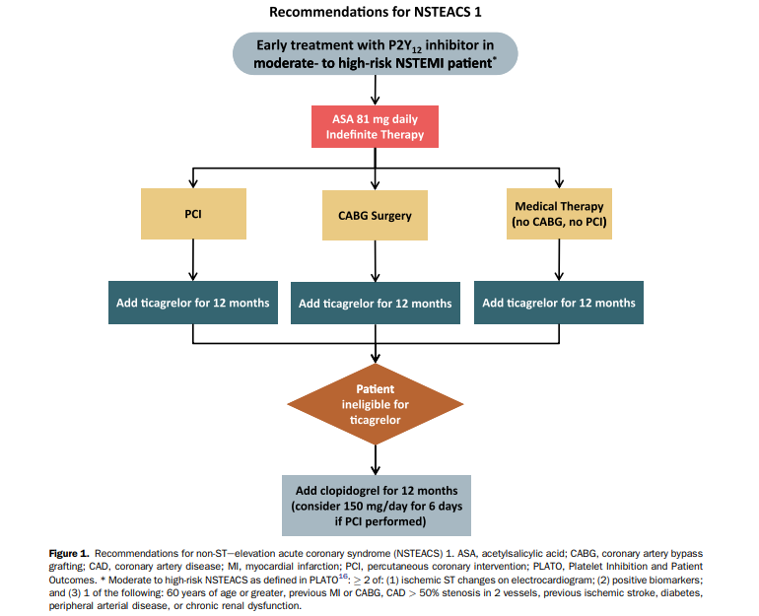
CJC 2012

Slide 17
CJC 2018

Slide 19
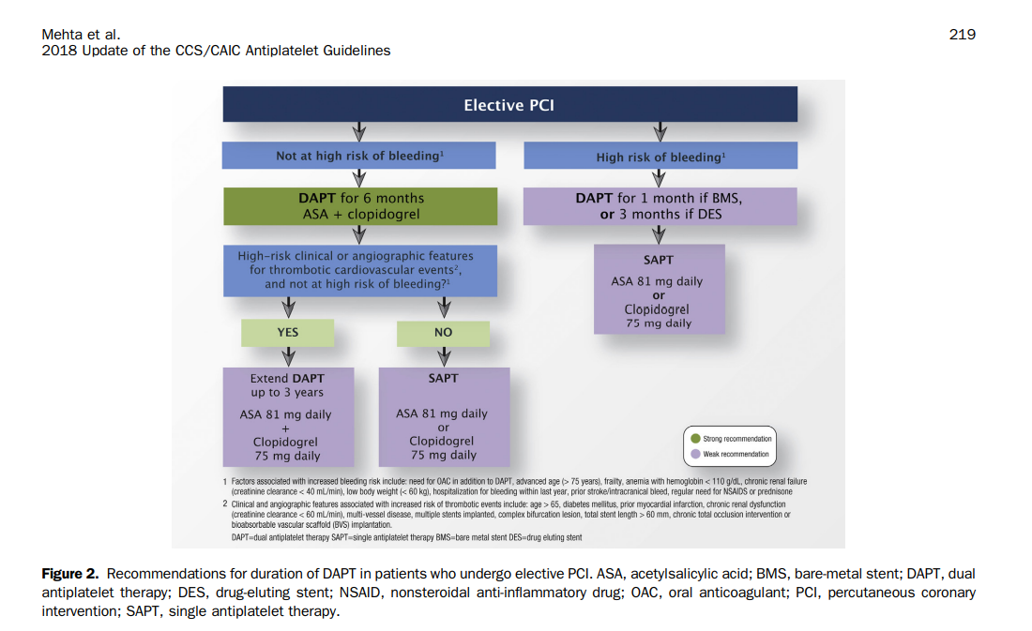

Slide 20
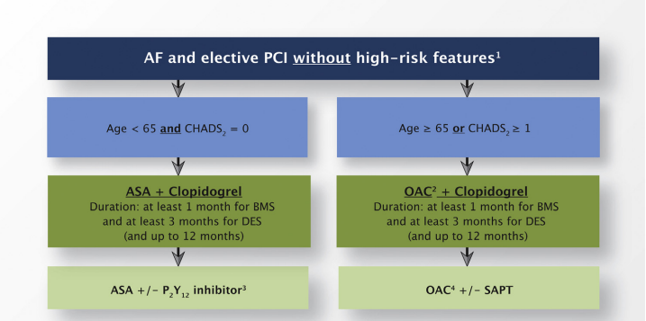
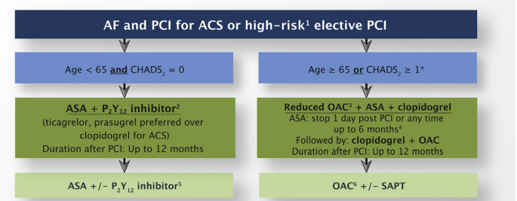
CJC 2018

Slide 21
Aspirin in primary prevention OF ASCVD

Slide 22
Speakers
Co-leads:
-Dr. Brian J Potter
-Dr. Marie-Lordkipanidzé
Marie Lordkipanidzé, BPharm, PhD
Canada Research Chair in Platelets as biomarkers and vectors
Université de Montréal
Montreal Heart Institute

Slide 23
Conflict of Interest
 | Any direct financial payments including receipt of honoraria | Membership on advisory boards or speaker’s bureaus | Funded grants or clinical trials
Marie Lordkipanidzé | None | Stago | PhaseBio Pharmaceuticals Inc

Slide 24
Case presentation
53 y.o. male seen in outpatient clinic
Previous medical history:
No established ASCVD
Hypertension (BP = 130/84) treated with ramipril 5 mg once daily
History of smoking, stopped 3 years ago
Alcohol: occasional
Waist circumference : 105 cm
Weight : 90 kg, Height : 1,80 m → BMI= 27,8 kg/m²
Family history: Father had MI at age 57, and mother had angina starting at age 51
Blood lipids:
Total cholesterol : 6,6 mmol/L
LDL : 4,8 mmol/L
HDL : 0,96 mmol/L
TG : 3,9 mmol/L
Fasting glucose : 6,3 mmol/L
No history of bleeding
Estimated CV risk:
Framingham: 34-43%
ACC/AHA ASCVD: 15%
Cardiovascular age: 72 y.o.
Moderate to high risk

Slide 25
Survey
Would you initiate ASA in primary prevention in this patient?
Yes
No
Not right away, would attempt cardiovascular risk management first
It would depend on patient preferences

Slide 26
Recommendation
We recommend against the routine use of ASA for primary prevention of ASCVD regardless of sex, age or diabetes, in patients without atherosclerotic cardiovascular disease (Strong recommendation; High quality of evidence)

Slide 27
Best practice statement
The use of ASA for primary prevention of ASCVD may be appropriate in certain individuals deemed to be at high ASCVD risk but with low bleeding risk in the context of a patient-centered, informed, shared decision-making process

Slide 28
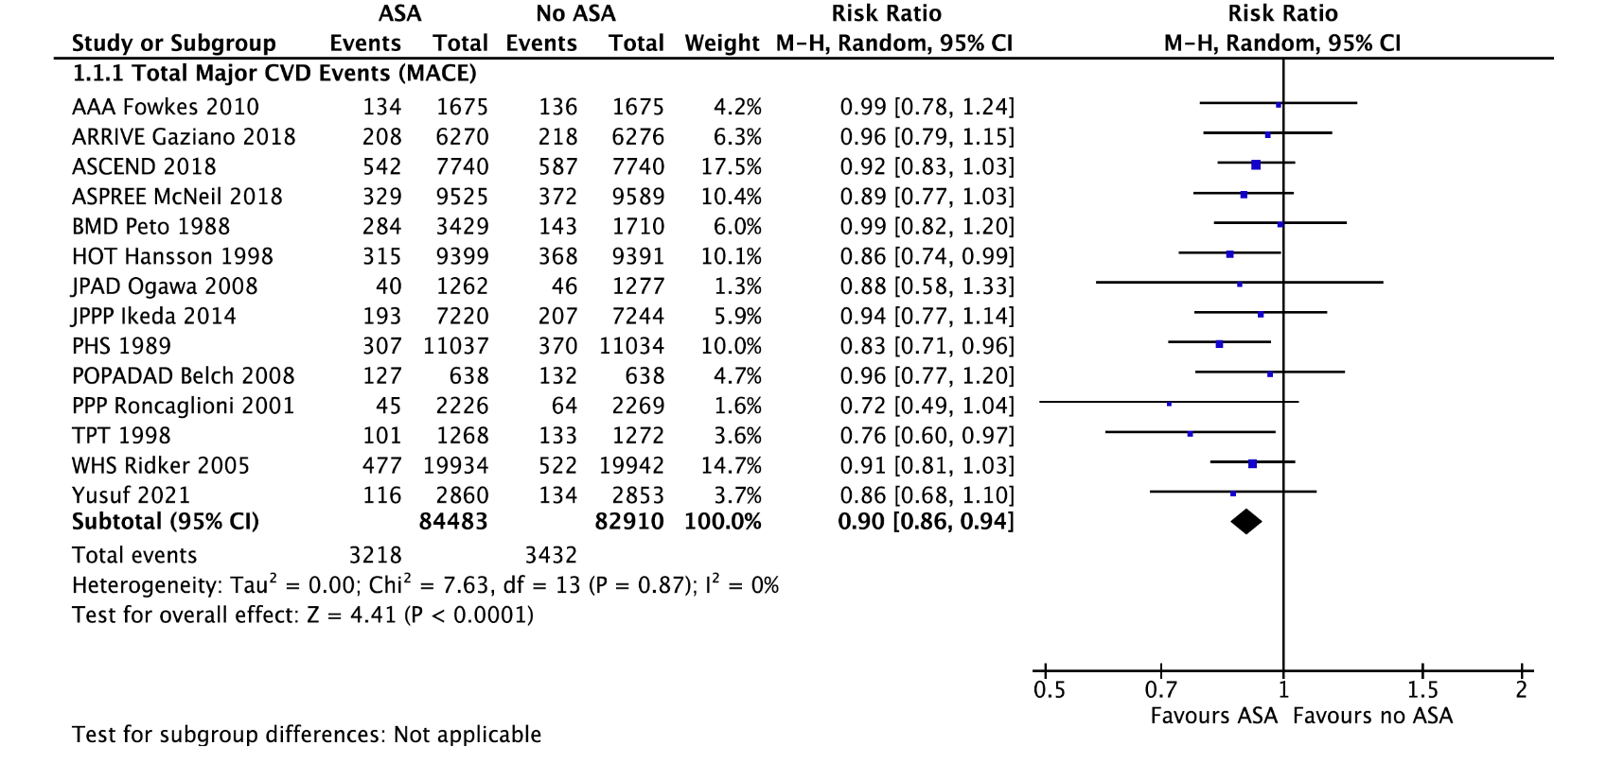
Consistent reduction in major adverse cardiac events
mainly driven by a ↓ in non-fatal MI
 ↓ in all-cause mortality
Laferrière et al. CJC Open 2023; doi: 10.1016/j.cjco.2023.08.011

Slide 29
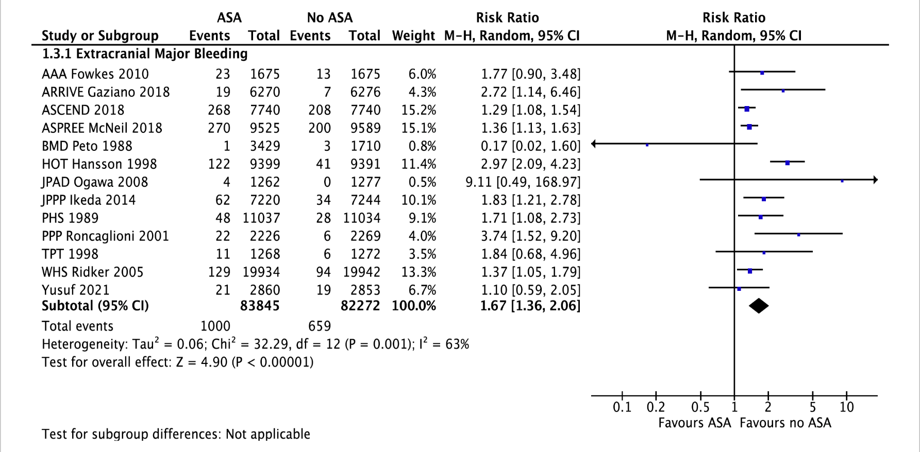
Benefit may be offset by major bleeding
Laferrière et al. CJC Open 2023; doi: 10.1016/j.cjco.2023.08.011

Slide 30
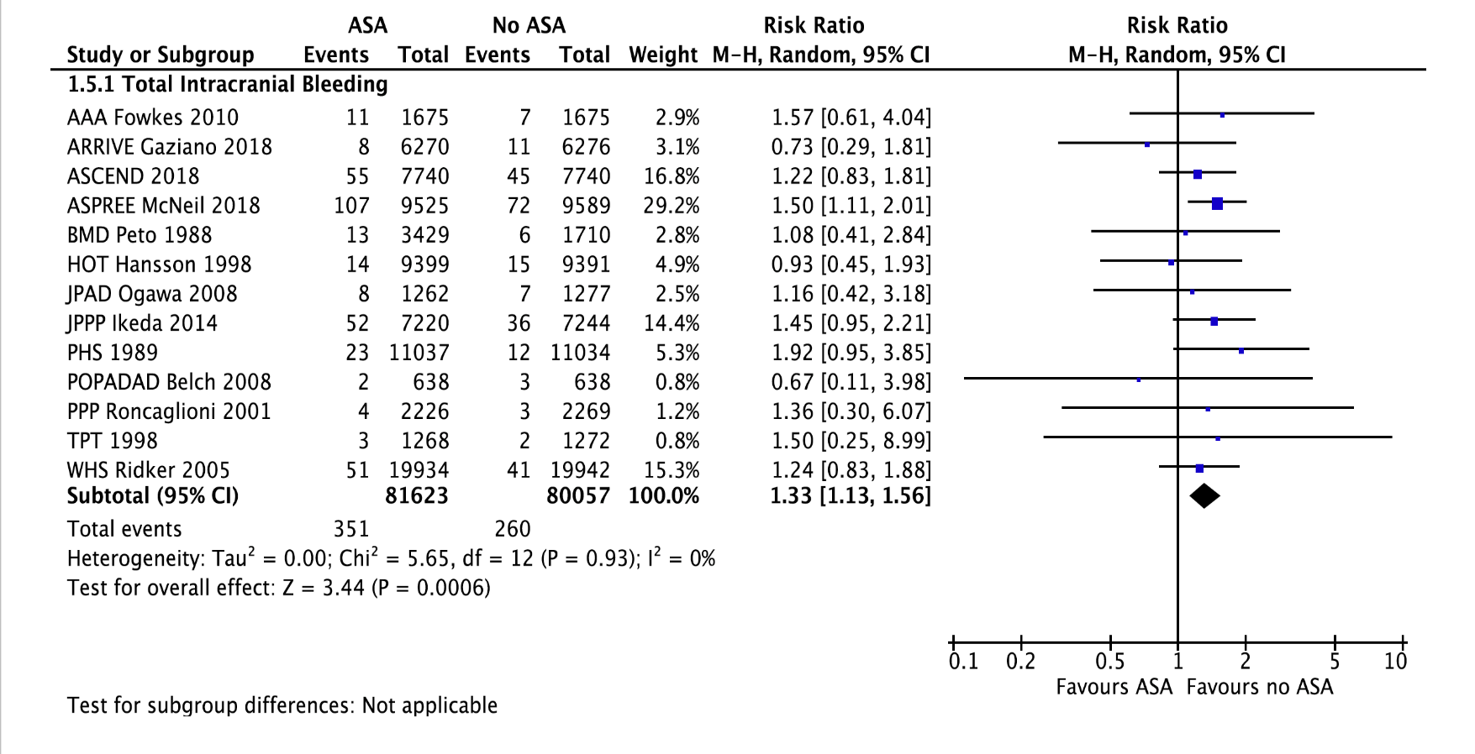
Small risk of intracranial bleeding
Laferrière et al. CJC Open 2023; doi: 10.1016/j.cjco.2023.08.011

Slide 31
Values and preferences
In the absence of a mortality benefit with ASA in primary prevention, we valued nonfatal ischemic and major bleeding events equally.
In such circumstances, consideration of patients’ values and preferences for nonfatal outcomes is essential.

Slide 32
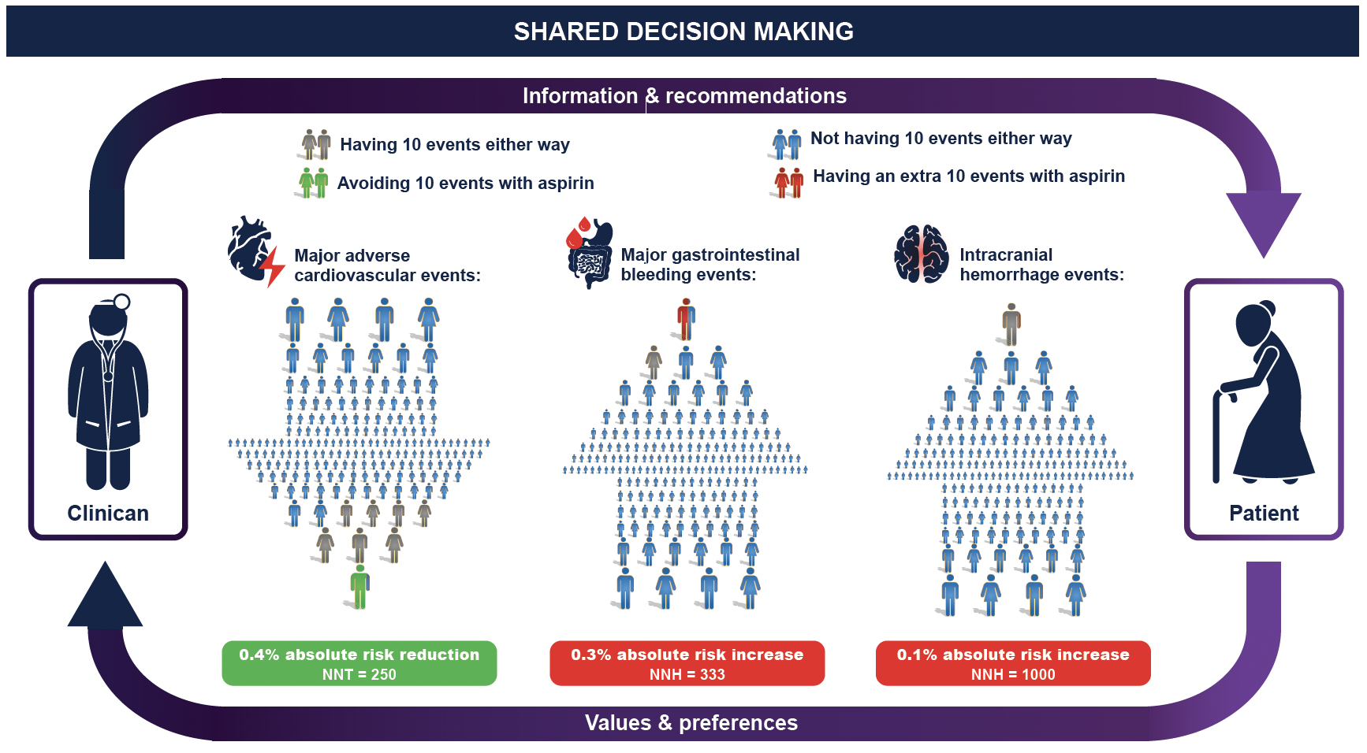
Bainey K, Marquis-Gravel G, et al. CJC 2023 in Press

Slide 33
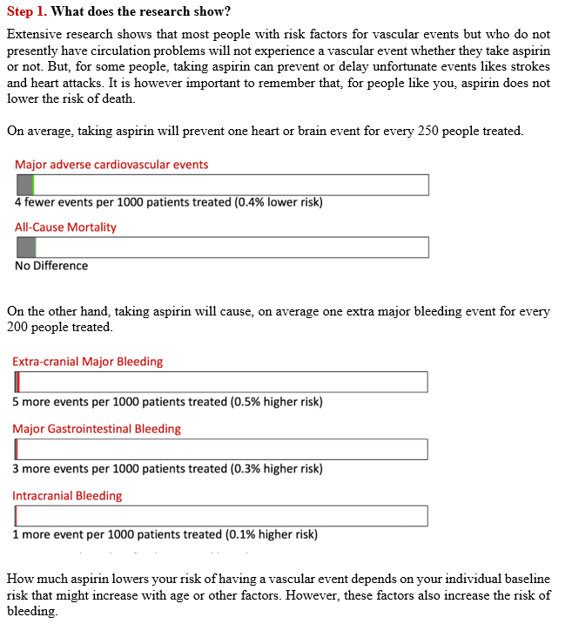
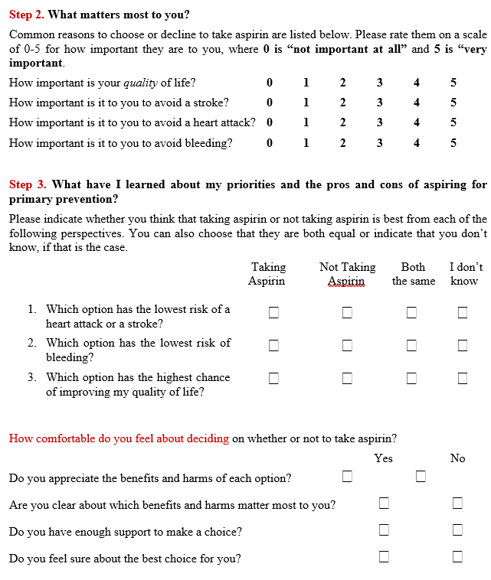
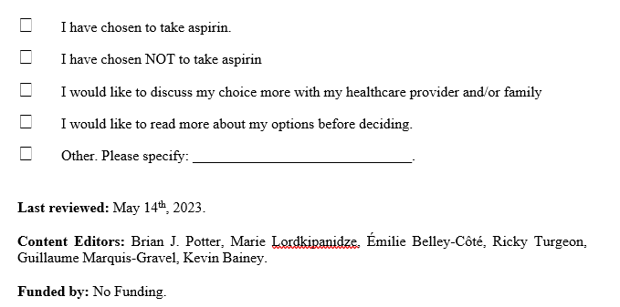
Aspirin for Primary Prevention Decision Aid
Bainey K, Marquis-Gravel G, et al. CJC 2023 in Press

Slide 34
Practical tips
Prescription of ASA based on cardiovascular risk stratification tools has not been prospectively validated in clinical trials, hence the lack of endorsement.
Clinicians should emphasize optimization of cardiovascular risk factors prior to initiation of ASA in primary prevention.
Most of the recent trials were carried out with enteric-coated ASA tablets.
The role of ASA in subclinical ASCVD (e.g. incidental finding on chest CT) remains undefined and we would encourage a patient-centered, informed, shared decision-making process.
Patients who opt for ASA in primary prevention could be offered screening for H. pylori with eradication therapy as appropriate, be co-prescribed a proton pump inhibitor, and prescribers should preferentially consider gastroprotective formulations of ASA.
Notes:
Whether newer formulations of ASA, such as extended-release capsules, pharmaceutical lipid-aspirin complex (PL-ASA) tablets, or plain aspirin, will change the risk/benefit balance of ASA in primary prevention remains to be established through dedicated clinical trials.

Slide 35
DAPT Duration after PCI in patients at High Bleeding Risk (HBR)

Slide 36
Speakers
Co-leads:
-Dr. Andrew Yan
-Dr. David Bewick
David Bewick, FACC, FACP, FRCP
Associate Professor,
New Brunswick Heart Center
Shamir R. Mehta, MD, MSc
Population Health Research Institute, McMaster University, Hamilton Health Sciences

Slide 37
Conflict of Interest
 | Any direct financial payments including receipt of honoraria | Membership on advisory boards or speaker’s bureaus | Funded grants or clinical trials
David Bewick | None | N/A | None
Shamir Mehta | None​ | ​ | Abbott, Amgen, Bristol-Myers Squibb, Janssen

Slide 38
Case presentation
81 y.o. female
Past medical history:
CKD (eGFR 35)
Chronic anemia 90 g/L
Presents with inferior STEMI
Primary PCI of RCA with DES x 1 (complete revascularization)

Slide 39
Survey
Is this patient at high bleeding risk (HBR)?
Yes
No
Maybe
Do not know

Slide 40
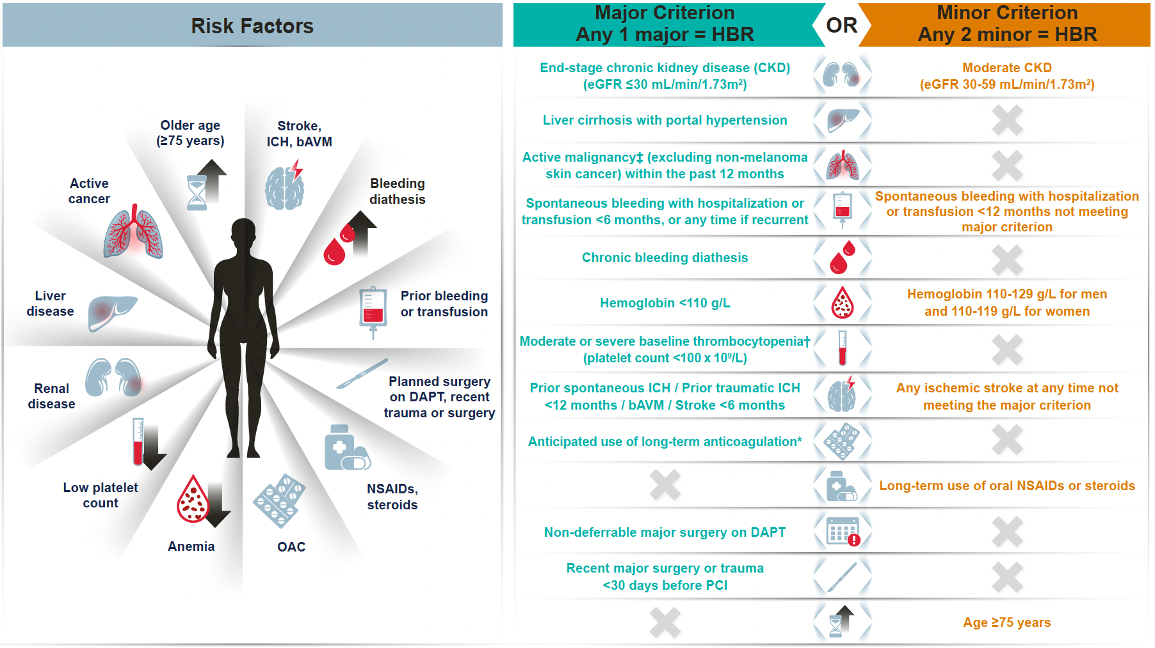
Bainey K, Marquis-Gravel G, et al. CJC 2023 in Press
Notes:
Figure 2: Evaluating the bleeding risk following PCI and the ischemic risk with complex PCI. Figure 2A provides criteria for high-bleeding risk (HBR) as defined by the BARC Academic Research Consortium (1 major or 2 minor criteria) where short DAPT should be considered. Figure 2B provides criteria for complex PCI (1 criterion) where longer DAPT may be considered.
bAVM, brain arteriovenous malformation; CKD, chronic kidney disease; CTO, chronic total occlusion; DAPT, dual antiplatelet therapy; eGFR, estimated glomerular filtration rate; HBR, high bleeding risk; ICH, intracranial hemorrhage; NSAID, nonsteroidal anti-inflammatory drug; PCI, percutaneous coronary intervention
* Excludes vascular protection doses; † Baseline thrombocytopenia is defined before percutaneous coronary intervention; ‡ Active malignancy is defined as a diagnosis within 12 months and/or ongoing treatment

Slide 41
Evidence
High Bleeding Risk(HBR)= 1 major or 2 minor criterion
The patient is a high bleeding risk
2 minor criterion (age>75 yrs., eGFR 30-59)
1 Major criterion (Hb<110 g/L)

Slide 42
Survey
Assuming she experienced no bleeding or ischemic events in the first month with DAPT post-discharge, what APT strategy would you recommend?
De-escalate to SAPT
DAPT for total of 3 months
DAPT for total of 6 months
DAPT for total of 12 months

Slide 43
Recommendations
We suggest using short DAPT for 1-3 months rather than 6-12 months in patients at HBR undergoing PCI for ACS or elective PCI with maintenance single antiplatelet therapy thereafter, in those patients who do not have any ischemic or bleeding events in the first month (weak recommendation; moderate quality of evidence).

Slide 44
Evidence
MACE
Major bleeding
Bainey, Marquis-Gravel, et al. PLoS One. 2023 Sep 1;18(9):e0291061.

Slide 45
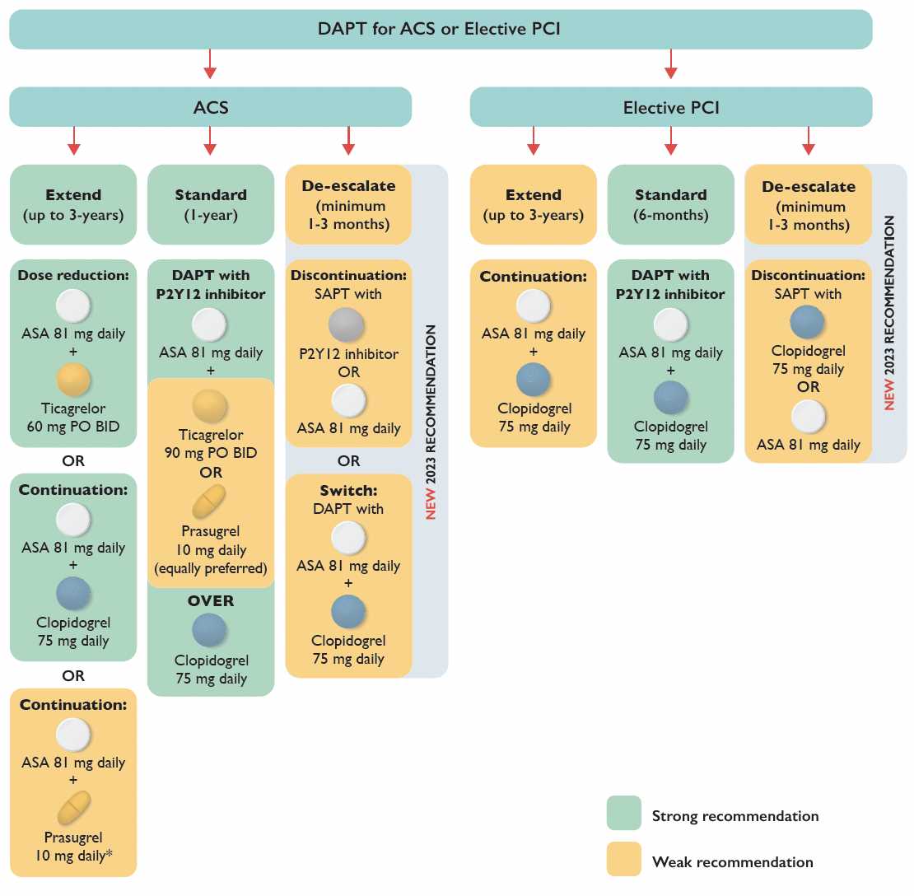
Sept 8 Design
Bainey K, Marquis-Gravel G, et al. CJC 2023 in Press
Notes:
Figure 3: Recommendations for the duration of DAPT in patients with ACS or elective PCI with provisions for escalation or de-escalation of DAPT.
This figure incorporates recommendations from 2018 and 2023 regarding DAPT duration.
ACS, acute coronary syndrome; BID, bis in die (twice daily); DAPT, dual antiplatelet therapy; PCI, percutaneous coronary intervention; PO, per oral; SAPT, single antiplatelet therapy

Slide 46
Practical Tips
In patients at HBR, after 1-3 months of DAPT, current practice emphasizes consideration of SAPT with a P2Y12 inhibitor over ASA monotherapy (ASA-free strategy).
The risk of stent thrombosis must be considered when contemplating short DAPT of 1-3 months. Patients undergoing complex PCI or with a history of stent thrombosis may not be suitable for short DAPT. Complex PCI is defined by the presence of at least 1 criterion as highlighted in Figure 2B.

Slide 47
Bainey K, Marquis-Gravel G, et al. CJC 2023 in Press

Slide 48
Evidence
This was not a complex PCI thus suitable for short DAPT
Complex PCI= 1 criterion

Slide 49
Potent P2Y12 inhibitor choice in patients with acute coronary syndrome, and DAPT de-escalation strategies following PCI

Slide 50
Speakers
Co-leads:
-Dr. Michelle Graham
-Dr. Laurie-Anne Boivin-Proulx
Laurie-Anne Boivin-Proulx MD MSC
Interventional Cardiology Fellow
University of Ottawa Heart Institute
Jean-François Tanguay, MD
Montreal Heart Institute
Université de Montréal

Slide 51
Conflict of Interest
 | Any direct financial payments including receipt of honoraria | Membership on advisory boards or speaker’s bureaus | Funded grants or clinical trials
Laurie-Anne Boivin-Proulx | None | None | None
Jean-François Tanguay | None | JAMP pharma, HLS, Novartis | Abbott Vascular, BioPhase, MicroPort, Novartis
Notes:
Abbott Vascular, BioPhase, MicroPort, Novartis

Slide 52
Case presentation
71 y.o. male
Past medical history: hypertension
Not at high bleeding risk
Presents with Killip 1 NSTEMI
Angiogram revealed a mid-LAD 95% stenosis that was stented with a DES (26 mm x 3.0 mm).
Discharged on day 3.

Slide 53
Survey
What antiplatelet strategy would you recommend after discharge?:
A) ASA + ticagrelor
B) ASA + clopidogrel
C) ASA + prasugrel

Slide 54
Recommendation
We suggest, when potent DAPT is considered in patients with ACS who receive PCI, either ticagrelor or prasugrel can be used, without preference for either agent (Weak recommendation; Low certainty of evidence)

Slide 55
Evidence
All-cause death with ticagrelor versus prasugrel-based DAPT in ACS patients treated with PCI
Bainey K, Marquis-Gravel G, et al. CJC 2023 in Press
Notes:
No difference in major bleeding: RR 0.99 [0.77-1.27]
Limitations of ISAR-REACT 5:
- Open-label trial subject to investigator bias
Delayed loading dose of prasugrel until diagnostic angiography in NST-ACS patients
About 1/3 of patients not an assigned therapy at the end of the clinical trial, and more patients discontinued ticagrelor due to side effects.
11.6% of patients on prasugrel were excluded from the bleeding analysis vs 1.1% (23 patients) of participants on ticagrelor.
And findings could not be replicated in the SWEDEHEART registry.
Limitations of PRAGUE-18:
-Stopped early for futility
-Differed in need to switch to clopidogrel due to financial strain (34% with prasugrel and 44% with ticagrelor), as some centers provided reimbursement for prasugrel only.
Ongoing registry-based, step-wedge, cluster randomized SWITCH-SWEDEHEART trial may provide a more definitive comparison of prasugrel versus ticagrelor.

Slide 56
Recommendation
We suggest that the option of de-escalating potent DAPT by switching to clopidogrel-based DAPT be considered in appropriate patients with ACS who receive PCI and tolerate at least 1 month of potent DAPT without a recurrent thrombotic event. (Weak recommendation; Moderate quality of evidence)
Notes:
In those who de-escalate, to clopidogrel, no loading dose is recommended.

Slide 57
Survey
You see this patient in follow-up at 30 days and he complains about the cost of DAPT. What do you do with DAPT?
De-escalate to clopidogrel + ASA at 30 days
Continue DAPT and ignore his concerns regarding costs

Slide 58
Potent P2Y12 inhibitors de-escalation strategies
Major bleeding
MACE
Bainey K, Marquis-Gravel G, et al. CJC 2023 in Press
Notes:
No difference in MACE.
Unguided potent P2Y12 inhibitor de-escalation strategies have mostly been studied in RCT conducted in East Asia. Whether their results apply to other regions remain unknown.
Given the low certainty evidence from a single trial, no recommendation for dose de-escalation of a potent P2Y12 inhibitor therapy as part of DAPT in patients with ACS treated with PCI is provided

Slide 59
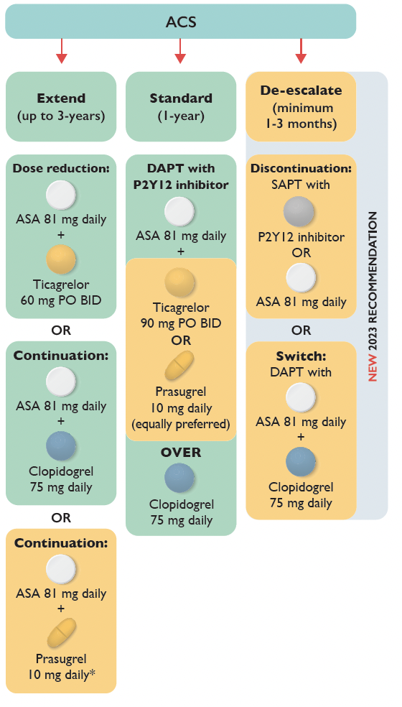
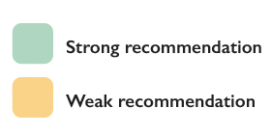
Bainey K, Marquis-Gravel G, et al. CJC 2023 in Press

Slide 60
Choice and duration of DAPT in ACS patients who are medically treated without revascularization

Slide 61
Speakers
Co-leads:
-Dr. Jay Shavadia
-Dr. Hazal Babadagli
Laurie-Anne Boivin-Proulx MD MSC
Interventional Cardiology Fellow
University of Ottawa Heart Institute
Robert C. Welsh MD
Mazankowski Alberta Heart Institute
University of Alberta
Notes:
Place in alpha order

Slide 62
Conflict of Interest
 | Any direct financial payments including receipt of honoraria | Membership on advisory boards or speaker’s bureaus | Funded grants or clinical trials
Laurie-Anne Boivin-Proulx | None | None | None
Robert C. Welsh | None | Bayer, Novartis | Astra Zeneca
Notes:
Abbott Vascular, BioPhase, MicroPort, Novartis

Slide 63
Case presentation
60 y.o. male
Previous medical history: hypertension, dyslipidemia
Presents with NSTEMI
hs-Troponins >500
ECG: new antero-lateral ST depressions
Coronary cath:
Diffuse CAD
No significant stenosis of major epicardial vessel
CTO of small 1st diagonal
Revascularization was not indicated / doable

Slide 64
Survey
What antiplatelet regimen would you recommend during the first year after NSTEMI without revascularization?
ASA + Ticagrelor
ASA + Prasugrel
ASA + Clopidogrel

Slide 65
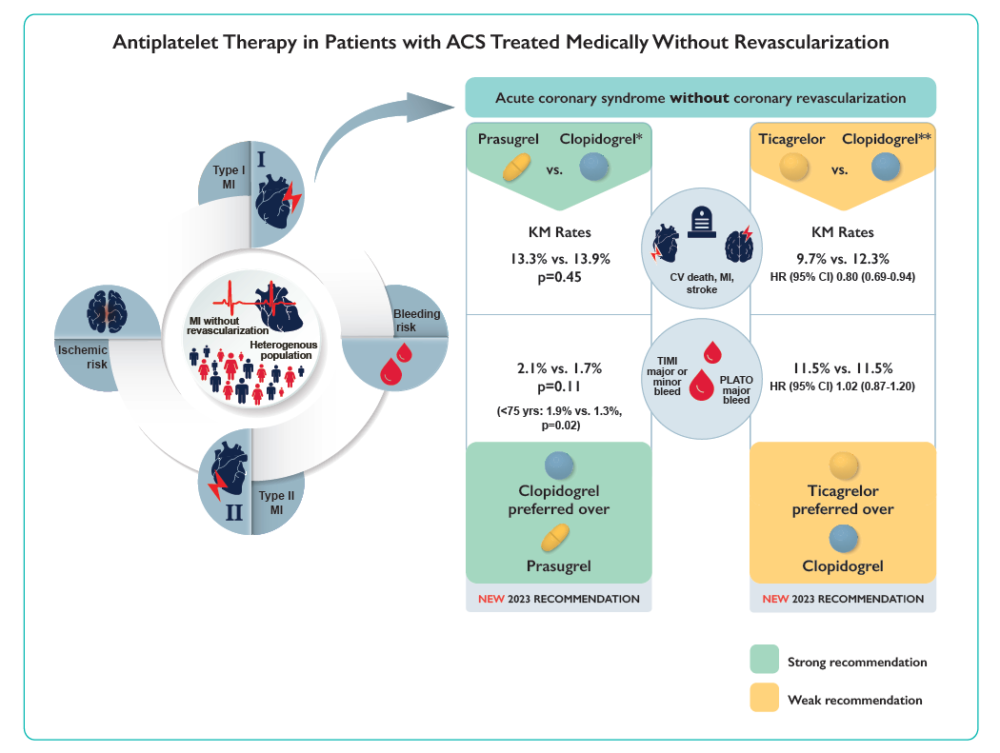
Bainey K, Marquis-Gravel G, et al. CJC 2023 in Press
Notes:
Figure 4: Antiplatelet therapy in patients with ACS treated medically without revascularization
*From the TRILOGY-ACS trial in the overall population. **Subgroup analysis of the PLATO trial evaluating the efficacy and safety between randomized P2Y12 inhibitor (ticagrelor clopidogrel) and management of NSTE-ACS with or without revascularization.
CV, cardiovascular; MI, myocardial infarction. Arrow represents our practical tip of treating those only with Type 1 MI.

Slide 66
Recommendations
We recommend clopidogrel over prasugrel (in addition to ASA) as part of a DAPT regimen for patients with medically managed ACS without coronary revascularization, (strong recommendation; moderate quality of evidence).
2. We suggest ticagrelor over clopidogrel (in addition to ASA) as part of a DAPT regimen for patients with medically managed ACS without coronary revascularization, (weak recommendation; low-certainty of evidence).
Notes:
In those who de-escalate, to clopidogrel, no loading dose is recommended.

Slide 67
Values and Preferences
We value a patient centric shared-decision making approach weighing the risks of bleeding versus ischemic events in deciding on type and duration of P2Y12 inhibitor based dual antiplatelet therapy.
Practical tips
1. These recommendations should apply to medically-managed patients with Type 1 MI, as there is insufficient data to determine the optimal therapy for Type 2 MI patients.
2. There is no direct evidence from RCTs to guide DAPT after a myocardial infarction with non- obstructive coronary artery disease (MINOCA) or spontaneous coronary artery dissection (SCAD).
3. In selected patients with low bleeding risk, high ischemic risk, and prior MI treated without revascularization and demonstrated severe coronary disease, extending ticagrelor-based DAPT to 3 years can be considered in clinical practice (given recurrent ischemic events in this population); however, the panel felt that there was insufficient evidence to make a definitive recommendation on this clinical question.
Notes:
In those who de-escalate, to clopidogrel, no loading dose is recommended.

Slide 68
Pre-treatment with DAPT (P2Y12 inhibitor) before elective or non-elective coronary angiography

Slide 69
Speakers
Co-leads:
-Dr. Mina Madan
-Dr. Robert C. Welsh
Robert C. Welsh MD
Mazankowski Alberta Heart Institute
University of Alberta
Shamir R. Mehta, MD, MSc
Population Health Research Institute, McMaster University, Hamilton Health Sciences

Slide 70
Conflict of Interest
 | Any direct financial payments including receipt of honoraria | Membership on advisory boards or speaker’s bureaus | Funded grants or clinical trials
Robert C. Welsh | None | Bayer, Novartis | Astra Zeneca
Shamir Mehta | None​ | ​ | Abbott, Amgen, Bristol-Myers Squibb, Janssen
Notes:
Abbott Vascular, BioPhase, MicroPort, Novartis

Slide 71
Case presentation
50 y.o. female
Previous medical history: dyslipidemia
Presents with NSTEMI
hs-Troponins >500
ECG: new antero-lateral ST depressions
Chest pain now resolved
Cardiac catheterization booked the day of admission (Friday); the schedule was fully booked with existing patients and the angiogram unlikely to occur until next Monday.

Slide 72
Survey
What antiplatelet regimen would you recommend at admission for this patient with documented NSTEMI?
A) ASA alone (loading + maintenance doses)
B) ASA + Prasugrel (loading and maintenance doses)
C) ASA + Clopidogrel (loading and maintenance doses)
D) ASA + Ticagrelor (loading and maintenance doses)

Slide 73
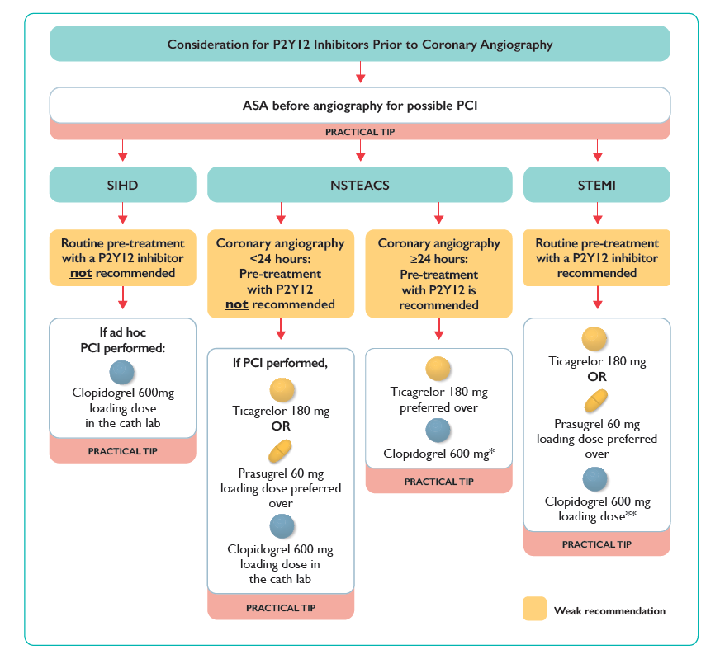
Bainey K, Marquis-Gravel G, et al. CJC 2023 in Press

Slide 74
NSTEACS:
We suggest against routine pre-treatment with a P2Y12 inhibitor before the procedure in patients undergoing coronary angiography for non-ST-elevation acute coronary syndrome, if the procedure is expected to occur ≤ 24 hours following admission (weak recommendation; moderate quality evidence).
We suggest routine pre-treatment with a P2Y12 inhibitor before the procedure in patients undergoing coronary angiography for non-ST-elevation acute coronary syndrome, if the procedure is expected to occur > 24 hours after admission (weak recommendation; low quality of evidence).

Slide 75
STEMI:
We suggest routine pre-treatment with a P2Y12 inhibitor before the procedure in patients undergoing primary percutaneous coronary intervention for ST-elevation myocardial infarction (weak recommendation; low quality of evidence)
Stable Ischemic Heart Disease for Elective PCI:
We suggest against routine pre-treatment with a P2Y12 inhibitor before the procedure in patients undergoing elective coronary angiography for suspected coronary artery disease, (weak recommendation; low quality evidence)

Slide 76
Values and Preferences
We value non-fatal ischemic and major bleeding events equally in this topic. In such circumstances, consideration of patient preferences for non-fatal outcomes is essential, whenever possible.
Practical tips
1. Current practice emphasizes consideration for maintenance of chronic ASA therapy before elective coronary angiography. For elective coronary angiography with possibility of PCI, if a patient is not on chronic ASA therapy, a loading dose of ASA is usually administered orally before the procedure.
2. For planned elective PCI, current practice emphasizes consideration for pre-treatment with DAPT at least 2 hours before PCI.
3. In patients undergoing elective PCI, clopidogrel (with a loading dose of 600 mg) is the preferred P2Y12 inhibitor.
Notes:
In those who de-escalate, to clopidogrel, no loading dose is recommended.

Slide 77
4. In patients undergoing PCI for ACS (regardless of need for pre-treatment), loading doses are required for P2Y12 inhibitors - Ticagrelor 180 mg, Prasugrel 60 mg and Clopidogrel 600 mg (except for STEMI treated with fibrinolysis), with maintenance doses instituted thereafter.
5. Clopidogrel is the P2Y12 inhibitor that has been the most studied in patients undergoing elective PCI.
6. Pre-treatment with P2Y12 inhibitor for NSTEMI depends on local practice and needs to be individualized based on access to catheterization laboratory.
7. If the suspicion of a coronary anatomy requiring CABG is high before coronary angiography in ACS, it is reasonable to not pre-treat with a P2Y12 inhibitor even if the expected delay for the procedure is >24 hours.
8. Routine pre-loading with clopidogrel-based DAPT (300 mg) at the time of fibrinolysis (the only P2Y12 inhibitor of choice) and before coronary angiography is usually performed in patients undergoing reperfusion with a pharmacoinvasive approach for STEMI.
Notes:
In those who de-escalate, to clopidogrel, no loading dose is recommended.

Slide 78
Peri-operative and longer-term APT management in patients requiring coronary artery bypass graft (CABG) surgery

Slide 79
Speakers
Co-leads:
-Dr. Derek F. So
-Dr. Stephen Fremes
Stephen Fremes MD MSc FRCS
Cardiac Surgeon
Sunnybrook HSC, University of Toronto

Slide 80
Conflict of Interest
 | Any direct financial payments including receipt of honoraria | Membership on advisory boards or speaker’s bureaus | Funded grants or clinical trials
Stephen Fremes | None | Polypid | Boston Scientific; Medtronic; CIHR-ODIN
Notes:
Abbott Vascular, BioPhase, MicroPort, Novartis

Slide 81
Patient Awaiting CABG
74 y.o. female
Past medical history: DM on oral meds, hypertension, hyperlipidemia
Presents Killip 1 NSTEMI and is loaded with ticagrelor and aspirin
Cath: 70% left main; 90% proximal RCA (dominant)
Heart Team: urgent surgery recommended

Slide 82
Survey
What would you do with the antiplatelet medications prior to CABG?
A) Stop ticagrelor for a minimum of 5-7 days
B) Stop ticagrelor for 2-3 days
C) Maintain ticagrelor and operate within the next 48 hours because the ischemic risk >> bleeding risk

Slide 83
Recommendation
We suggest holding ticagrelor for 2-3 days rather than 5-7 days prior to coronary artery bypass graft surgery (weak recommendation; low quality of evidence).

Slide 84
Best Practice Statement
Recognizing the limited evidence, the time from clopidogrel discontinuation to CABG surgery should be based on factors such as coronary anatomy, hemodynamic stability, bleeding risk, and surgical team expertise, with ideal timing anywhere between 2-7 days for patients not requiring urgent CABG surgery.

Slide 85
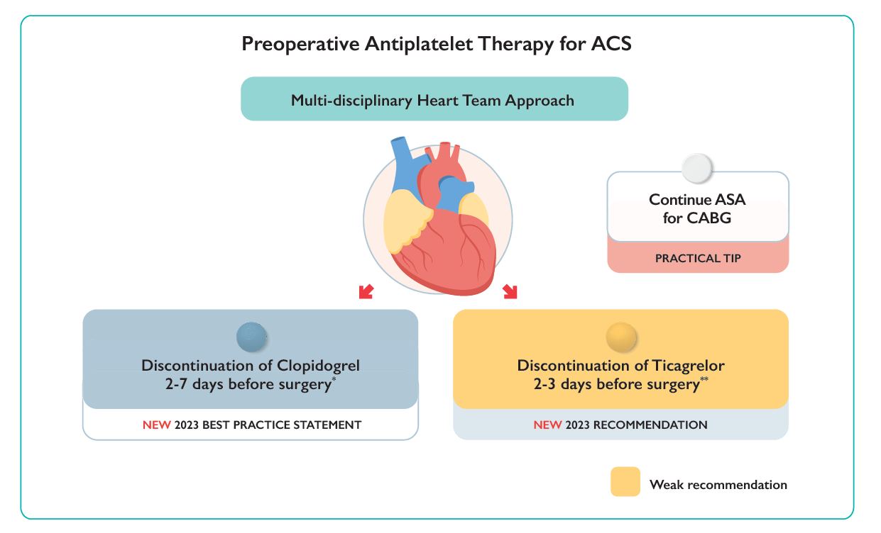
Bainey K, Marquis-Gravel G, et al. CJC 2023 in Press
Notes:
Figure 6: Preoperative antiplatelet strategies in patients undergoing CABG.
*Decision should be based on factors such as coronary anatomy, hemodynamic stability, bleeding risk and surgical team expertise with value placed on a heart team approach.
** Recommendation based solely on the Canadian study RAPID CABG trial.
ACS: acute coronary syndrome; DAPT: dual antiplatelet therapy; HBR: high bleeding risk; MACE: major adverse cardiovascular event; SIHD: stable ischemic heart disease.

Slide 86
Evidence for Preoperative Management
Ticagrelor:
RAPID CABG trial (n=143)
2-3 day cessation vs 5-7 days
Severe or massive peri-operative bleeding: 4.6% vs 5.2%
p =0.03 for non-inferiority
Large European registries support 2-3 day cessation of ticagrelor
Clopidogrel:
1 very small RCT
Mostly observational data

Slide 87
What to do Postop?
Bob: “What should we do about the anti-platelet meds for the patient in bed 6 who had urgent CABG this morning and was on ticagrelor preop?”
Gail: “I have no idea but check out this issue of CJC – I think they have updated the CPGs”

Slide 88
Recommendation
We suggest the use of DAPT over single antiplatelet therapy after coronary artery bypass graft surgery with or without ACS (weak recommendation; moderate quality of evidence)
We suggest using DAPT with ticagrelor/prasugrel rather than clopidogrel-based DAPT in patients with a recent ACS who undergo coronary artery bypass graft surgery (weak recommendation; moderate quality of evidence)

Slide 89
Values and preferences
Values and Preferences: Large mortality benefits with Ticagrelor/Prasugrel vs Clopidogrel based DAPT were observed in CABG subgroups of the PLATO and TRITON-TIMI-38 RCTS, despite the fact that these were mostly PCI trials and in which CABG was a post-randomization variable.

Slide 90
Practical tips
Continue ASA until surgery, resume ASA early postoperatively, and start the second antiplatelet agent when the bleeding risk is acceptable in the post-operative period according to the surgical team.
DAPT may be considered more strongly in patients who had off-pump surgery given the reduction in MACE in that subgroup
In patients at HBR, abbreviated DAPT may be preferred to SAPT after CABG for ACS, and SAPT could be considered for elective CABG

Slide 91
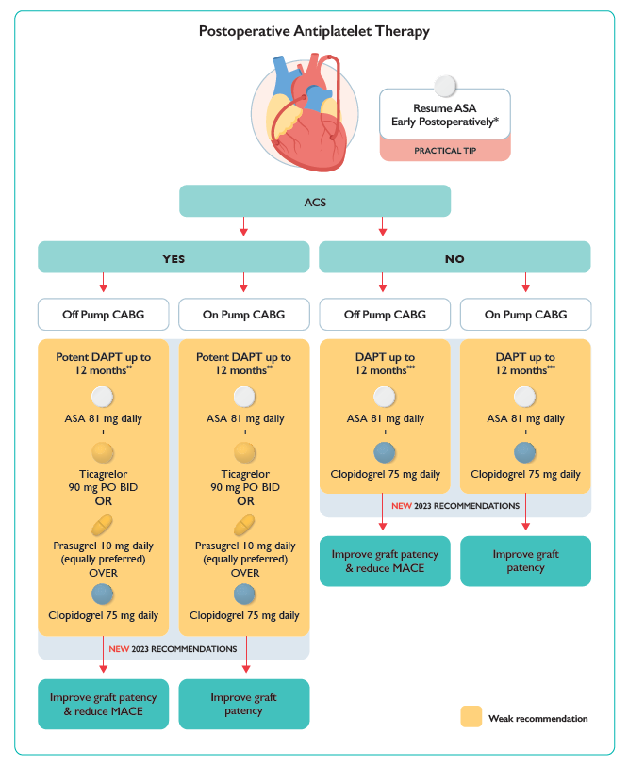
Bainey K, Marquis-Gravel G, et al. CJC 2023 in Press
Notes:
Figure 7: Postoperative antiplatelet strategies in patients undergoing CABG.
*When deemed clinically safe for bleeding risk as per clinician.
** Ticagrelor may be preferred over prasugrel – both preferred over clopidogrel.
*** Predominant evidence for clopidogrel based DAPT.
ACS, acute coronary syndrome; BID, bis in die (twice daily); CABG, coronary artery bypass grafting surgery; DAPT, dual antiplatelet therapy; PO, per oral

Slide 92
Meta-analysis
Graft patency
No difference in MACE, death, and major bleeding
Bainey K, Marquis-Gravel G, et al. CJC 2023 in Press

Slide 93
Use of APT in patients with atrial fibrillation requiring oral anticoagulation after PCI or medically managed ACS

Slide 94
Speakers
Co-leads:
-Dr. Warren Cantor
-Dr. Margaret Ackman
-Dr. Samer Mansour
Samer Mansour MD
Centre Hospitalier de l’Université de Montréal (CHUM), Montreal
Jean-François Tanguay, MD
Montreal Heart Institute
Université de Montréal

Slide 95
Conflict of Interest
 | Any direct financial payments including receipt of honoraria | Membership on advisory boards or speaker’s bureaus | Funded grants or clinical trials
Samer Mansour | None | Pfizer, HLS, Sanofi, Amgen, Boehringer Ingelheim and Novartis | Abbott Vascular, Amgen, AstraZeneca, Bayer, Novartis
Jean-François Tanguay | None | JAMP pharma, HLS, Novartis | Abbott Vascular, BioPhase, MicroPort, Novartis
Notes:
Abbott Vascular, BioPhase, MicroPort, Novartis

Slide 96
Case presentation
79 y.o. female
Past medical history: permanent AF (on DOAC), hypertension
Presents with STEMI
Primary PCI of the mid-LAD with 2 drug-eluting stents
Discharged on day 3

Slide 97
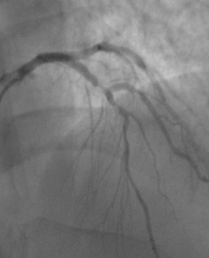
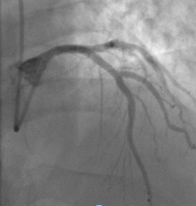
Coronary Angiography and PCI
Critical mid LAD stenosis
LAD PCI with 2 DES

Slide 98
Survey
Which regimen would you choose post discharge?
ASA+ ticagrelor
ASA + clopidogrel + DOAC
Clopidogrel + DOAC
Prasugrel + DOAC

Slide 99
Recommendation: first 12 months
We suggest dual pathway therapy (P2Y12 inhibitor plus OAC and discontinue ASA after 1-30 days) rather than triple therapy (DAPT plus OAC) in the majority of patients with AF with an indication for OAC, and who have undergone PCI or who are medically-managed for an ACS (weak recommendation; moderate quality of evidence)

Slide 100
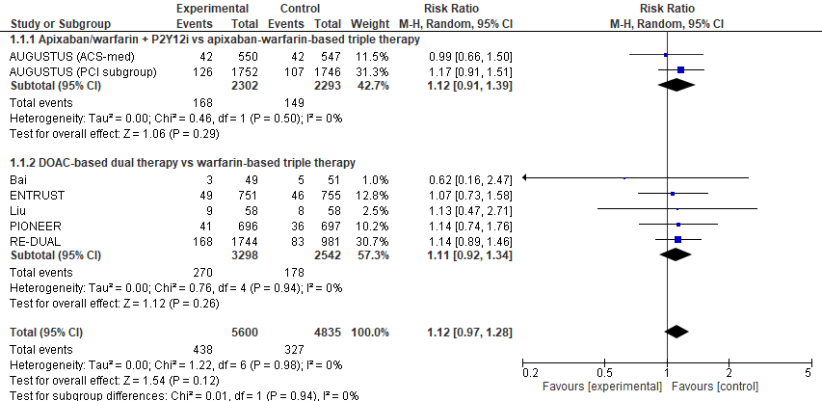
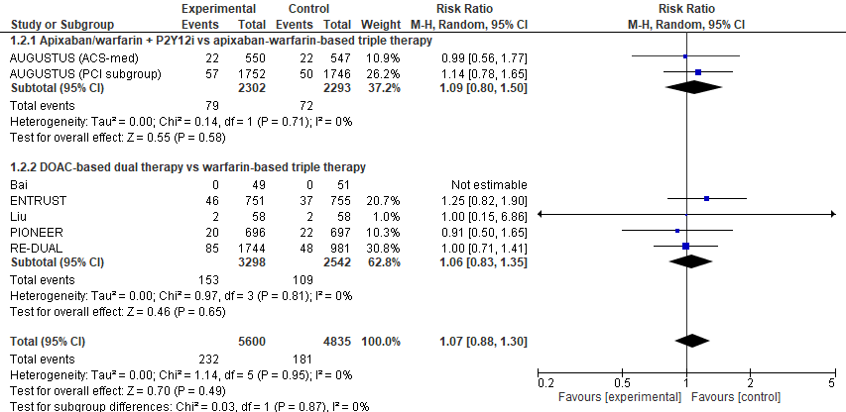
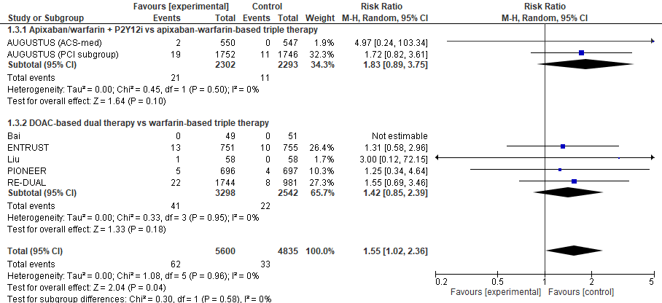
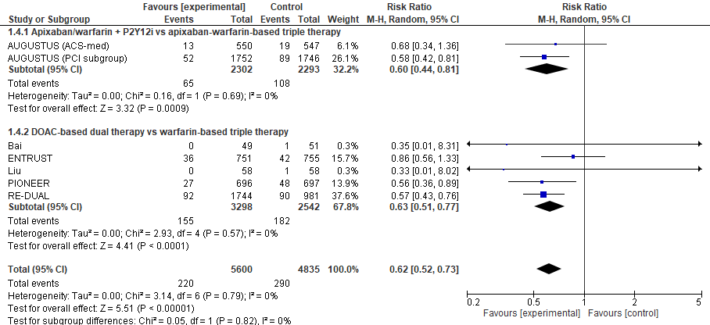
Evidence
Meta-analysis of the risk of MACE(A), death (B), stent thrombosis (C) and major bleeding (D)
A
B
C
D
Bainey K, Marquis-Gravel G, et al. CJC 2023 in Press
Notes:
The differences in MACE (RR 1.12, 95% CI 0.97-1.28, I²=0%; A) and death (RR 1.07, 95% CI 0.88-1.30, I²=0%; B) between DPT and triple antithrombotic therapy were not statistically significant. DPT increased the risk of stent thrombosis compared with triple antithrombotic therapy (RR 1.55, 95% CI 1.02-2.36, I²=0%;), translating to a 0.4% absolute risk increase. Conversely, DPT reduced the risk of major bleeding compared with triple antithrombotic therapy (RR 0.62, 95% CI 0.52-0.73, I²=0%; D), translating to a 2.1% absolute risk reduction.

Slide 101
Recommendation: after 12 months
We suggest OAC monotherapy rather than dual-pathway therapy (OAC plus antiplatelet therapy) in patients with CAD and concomitant AF with an indication for long-term OAC, who have not had a coronary revascularization procedure or ACS in the past 12 months. (weak recommendation; very-low quality of evidence)
Notes:
In those who de-escalate, to clopidogrel, no loading dose is recommended.

Slide 102
Evidence
MACE
Major bleeding
Bainey et al. CJC 2023 (supplemental material) in Press
Notes:
The differences in MACE (RR 0.91, 95% CI 0.58-1.41, I²=75%; A), death (RR 0.85, 0.37-1.92, I²=87%; B), and stent thrombosis (RR 5.03, 95% CI 0.24-104.37; C) between OAC monotherapy and DPT were not statistically significant. OAC monotherapy reduced the risk of major bleeding compared with DPT (RR 0.66, 95% CI 0.49-0.91, I²=0%; D), translating to a 2.2% absolute risk reduction.

Slide 103
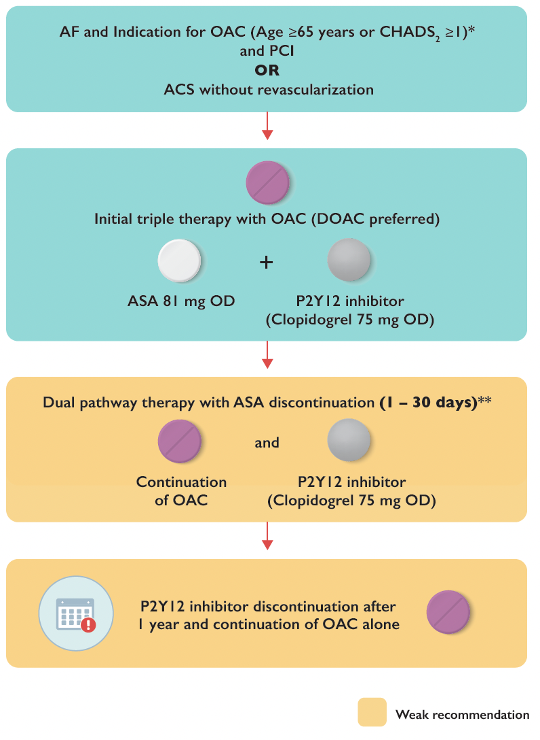
Bainey K, Marquis-Gravel G, et al. CJC 2023 in Press
Notes:
Figure 8: Antiplatelet strategies in patients with concomitant AF and PCI and/or ACS.
* Patients who do not require OAC for their AF as per the Canadian guidelines for the management of AF would receive DAPT as per other sections of these guidelines.
OAC regimens evaluated in this context include apixaban 5mg BID (2.5mg BID if patients met two or more of the following dosage reduction criteria: >80 years of age, <60kg in weight or creatinine >133 micromole/L), dabigatran 110mg or 150mg BID, edoxaban 60mg daily (30mg daily if patients with any of the following characteristics: moderate or severe renal impairment (creatinine clearance 15-50mL/min), <60kg in weight, or concurrent use of specific potent P-glycoprotein inhibitors, rivaroxaban 15mg daily (10mg in patients with renal dysfunction) and warfarin. If warfarin is to be used, recommended INR target is 2.0 to 2.5. All patients should receive a loading dose of ASA 160 mg at the time of PCI (if previously ASA naïve).
** ASA duration before switching to dual pathway was one average of 1.6 to 6.6 days after PCI in the large-scale trials.

Slide 104
Thank you
Carolyn Gall Casey, CCS
Dennis Ko, MD (Guidelines committee liaison)
Brad Sarak, MD, Jasmine Grewal, MD (Guidelines committee liaison)
Jonathan Howlett, MD (Chair, CCS Guidelines committee)
Lisa Soulard (Canadian VIGOUR Center)
All writing panel members, the CCS Guidelines Committee, CCS members and CCS staff involved in the development, publication and dissemination CCS Guidelines

Slide 105
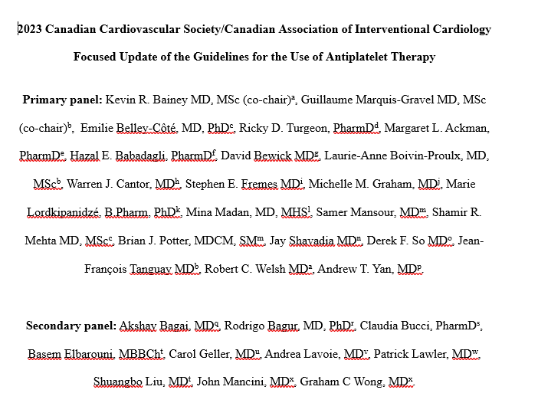
Available CJC Online (today) Article in Press
Visit CCS Guidelines and Clinical Practice Update Library or the CAIC website for more information
Notes:
https://ccs.ca/guidelines-and-clinical-practice-update-library/

Slide 106
Thank you
Find this session On Demand on the Vascular 2023 platform.
On Demand includes almost every Vascular 2023 scientific and educational session. Look for the symbol to find all On Demand content available.

