Slide 1




Peripheral Arterial Disease (PAD)
Webinar 3: Revascularization Procedures in PAD
Date: April 19, 2023
Scan the QR Code to fill out the Pre-survey for this session. All data are anonymous and will be used only for quality improvement.

Slide 2
© Canadian Cardiovascular Society. 2022. All rights reserved.
Distribution, transmission or republication is strictly prohibited without the prior written permission of the Canadian Cardiovascular Society.
For medical institution internal education or training (i.e. grand rounds, medical college/classroom education, etc.), kindly consider and implement the following:
  Include the citation for the Canadian Journal of Cardiology
  Add ‘Reproduced with permission from the Canadian Cardiovascular Society. [insert year].’
  Avoid use of CCS logos or trademarks on slides, tools or publications that are not the property of the CCS
  Do not modify the slide content and, the layout and CCS branding on the Guideline-related slides
  Guideline recommendations must be reproduced exactly as published
For an industry supported or involved program, permissions are required:
  If content is published in the Canadian Journal of Cardiology, permissions must be sought through our publisher Elsevier (www.onlinecjc.com)
  If content is property of the CCS, contact guidelines@ccs.ca

Slide 3
We extend our respect to all First Nations, Inuit and Métis peoples for their valuable past and present contributions to this land we call Canada.
We acknowledge the Indigenous Peoples of all the lands that we are each on today, and reaffirm our commitment and responsibility as individuals, to improving relationships between nations and to collaborating in a spirit of reconciliation.

Slide 4
LEARNING OBJECTIVES
At the end of the session, participants will be able to:
identify key recommendations from the 2022 CCS Peripheral Arterial Disease (PAD) guidelines on revascularization procedures for patients with PAD (Professional)
be informed recommended pre-operative risk assessment in PAD (Expert, Communicator, Scholar)
understand key considerations around revascularization in PAD (Expert, Communicator, Scholar)

Slide 5

MODERATOR
Dr. Thomas Lindsay
MDCM, FRCSC
University Health Network
University of Toronto

Slide 6



PANELIST
Dr. Randolph Guzman
M.D. FRCSC, FACS, RVT, RPVI, ICD.D
Professor of Surgery and Head, Section of Vascular Surgery
University of Manitoba, Max Rady College of Medicine
Regional Lead, Section of Vascular Surgery, WRHA
St. Boniface Hospital, Winnipeg, Manitoba
Dr. Zaina Albalawi
MD, MSc, FRCPC
Clinical Assistant Professor,
Memorial University
Department of Medicine, Division of Endocrinology and Metabolism
Dr. Charles de Mestral
MDCM, PhD, FRCSC
University of Toronto
Division of Vascular Surgery

Slide 7
DISCLOSURES OF CONFLICT OF INTEREST
Dr. Zaina Albalawi
Consulting fees/Honoraria: Canadian Medical & Surgical Knowledge Translation, EOCI, Palliser Primary Care Network,
Funded Grants/Clinical Trials: Allergan, CIHR, NovoNordisk, UofA Hospital Foundation
Advisory Boards/Speakers Bureaus: Canadian Cardiovascular Society
Dr. Randolph Guzman
Consulting fees/Honoraria: NA
Funded Grants/Clinical Trials NA
Advisory Boards/Speakers Bureaus: Canadian Cardiovascular Society
Dr. Charles de Mestral
Consulting fees/Honoraria: NA
Funded Grants/Clinical Trials: NA
Advisory Boards/Speakers Bureaus: Canadian Cardiovascular Society
Dr. Thomas Lindsay
Consulting fees/Honoraria: Bayer, HLS Therapeutics, Cook Canada
Funded Grants/Clinical Trials: Cook Canada
Advisory Boards/Speakers Bureaus: Canadian Cardiovascular Society

Slide 8
INTRODUCTION
Dr. Thomas Lindsay, MDCM, FRCSC

Slide 9
PREOPERATIVE ASSESSMENT AND RISK STRATIFICATION
Zaina Albalawi MD, MSc, FRCPC

Slide 10
LEARNING OBJECTIVES
During this section, participants will:
Review the importance of preoperative assessment for people with PAD
Differentiate PAD preoperative assessment from non-PAD preoperative assessment
Apply key recommendations from the 2022 CCS PAD guidelines for pre-operative risk assessment

Slide 11
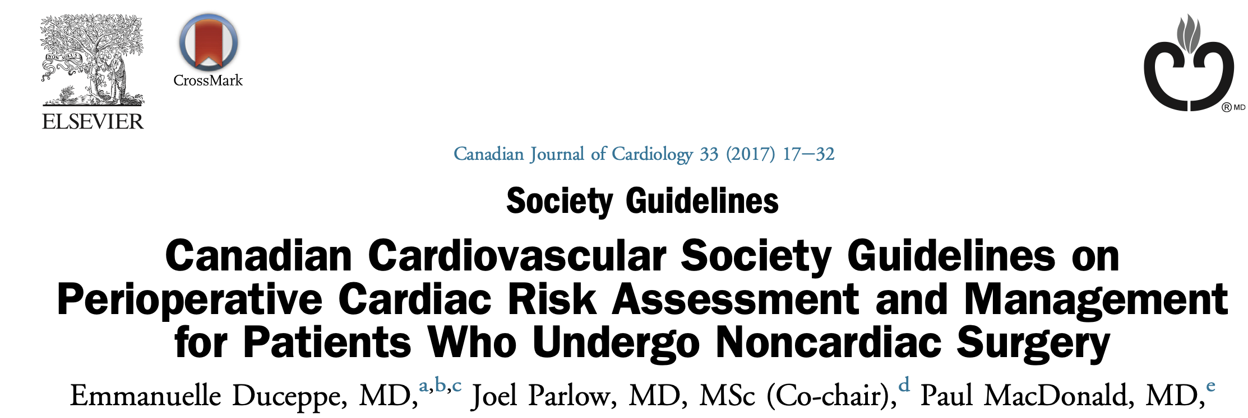
WHAT IS KNOWN ABOUT PERIOPERATIVE ASSESSMENT IN PAD?
Individuals with PAD are at high risk for perioperative complications
Essential for patients and healthcare providers to have reliable tools to guide risk stratification based on outcomes, and inform management decisions
The 2017 CCS guidelines have been broadly applied to the PAD population
Evidence derived from non-cardiac surgery includes a heterogenous population that may not capture the perioperative risk properly

Slide 12
HOW DO CURRENT 2022 CCS PAD GUIDELINES COMPARE TO PRIOR PERIOPERATIVE GUIDELINES?
Prior tools likely underestimate the perioperative risk
GRADE framework applied:
  Evaluating evidence across outcomes
  Analysis of PAD population: tools specifically developed from and assessed in PAD
  GRADE= Grading of Recommendations Assessment, Development, and Evaluation (GRADE) system of evidence assessment for guidelines

Slide 13

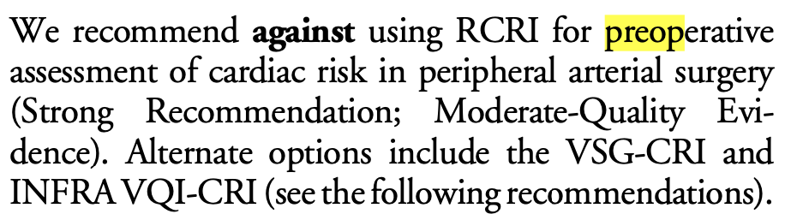
RCRI, Revised Cardiac Risk Index; INTRA VQI-CRI, Infrainguinal Vascular Quality Initiative Cardiac Risk Index; VSG-CRI, Vascular Study Group of New England Cardiac Risk Index
KEY RECOMMENDATIONS FROM 2022 PAD GUIDELINES
Cardiac Risk
1.

Slide 14
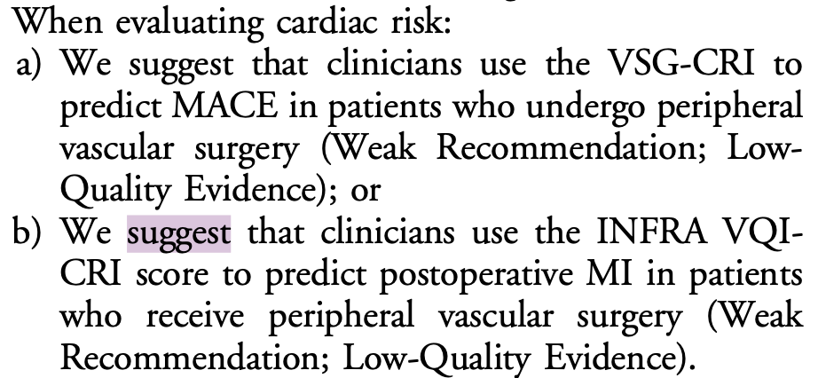
Cardiac Risk
2.
MACE, major adverse cardiac event; MI, myocadiac infraction; RCRI, Revised Cardiac Risk Index; INTRA VQI-CRI, Infrainguinal Vascular Quality Initiative Cardiac Risk Index; VSG-CRI, Vascular Study Group of New England Cardiac Risk Index

Slide 15
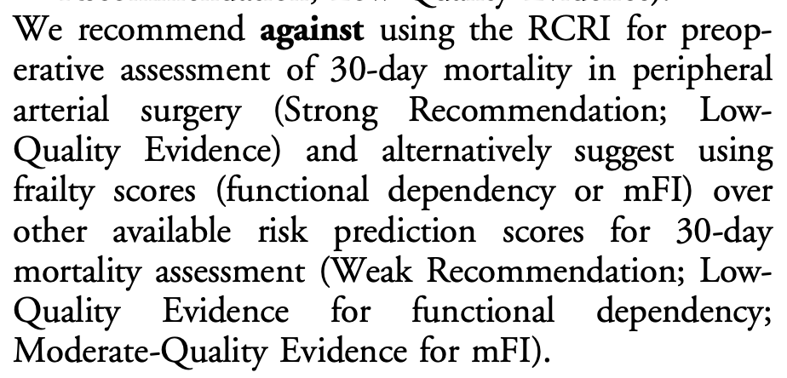
30-day Mortality
3.
mFI, modified Frailty Index; RCRI, Revised Cardiac Risk Index

Slide 16
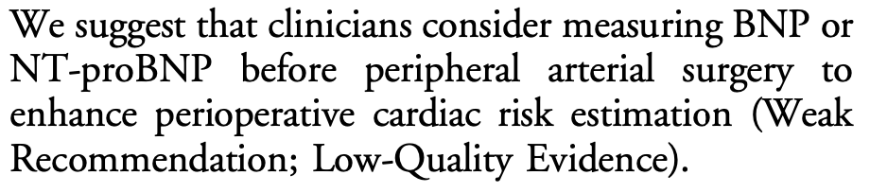
4.
Biomarkers: BNP or NT-proBNP
BNP, brain natriuretic peptide, NT-proBNP, N-terminal fragment pro hormone BNP

Slide 17
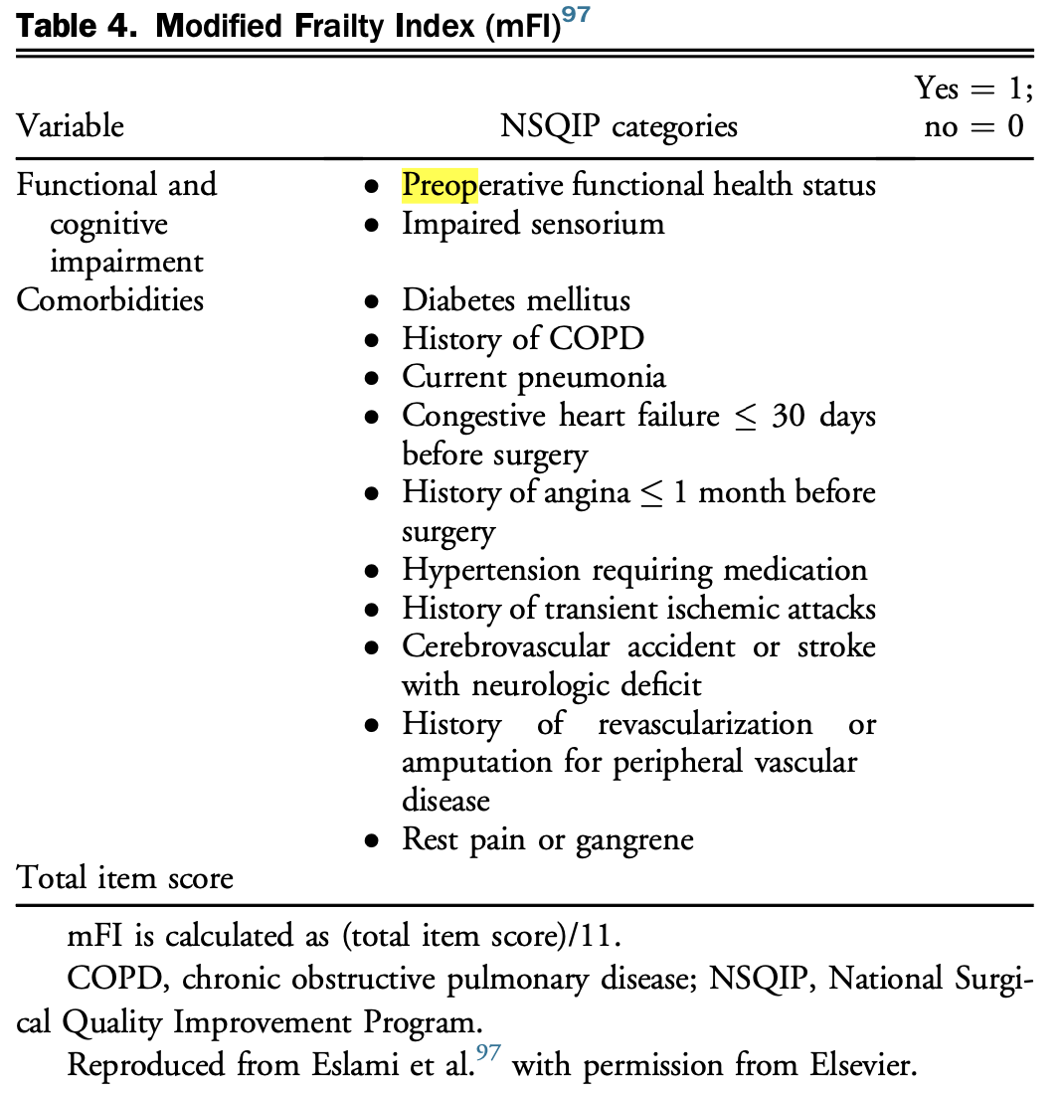
Modified Frailty Index (mFI)

Slide 18
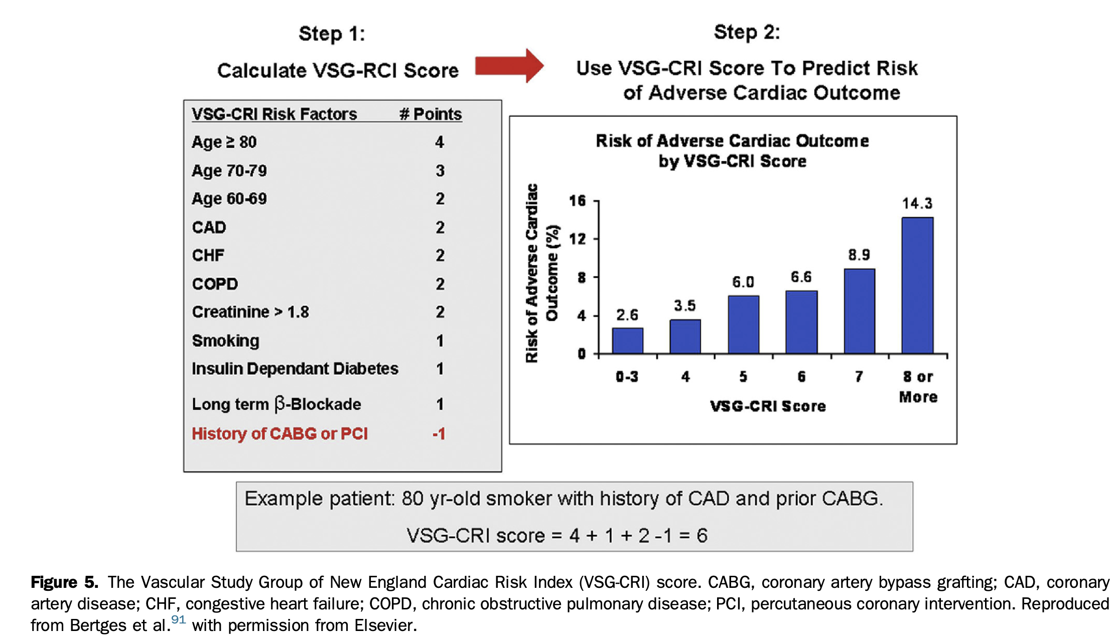
VSG-CRI Score

Slide 19

RCRI, Revised Cardiac Risk Index; VSG-CRI, Vascular Study Group of New England Cardiac Risk Index; INTRA VQI-CRI, Infrainguinal Vascular Quality Initiative Cardiac Risk Index
IN SUMMARY
For cardiac outcomes:
  Tools: VSG-CRI score, INFRA-VQI CRI, Modified Frailty Index (mFI)
  RCRI
For 30-day Mortality:
  Frailty Scores (functional dependency, mFI)
  RCRI

Slide 20
TECHNIQUES FOR REVASCULARIZATION
Randolph Guzman MD, FRCSC, FACS, RVT, RPVI, ICD.D

Slide 21
LEARNING OBJECTIVES
During this section, participants will:
Recognize the 2 main different techniques of revascularization
Appreciate the general approaches and considerations of endovascular revascularization
Appreciate the general approaches and considerations of open revascularization

Slide 22
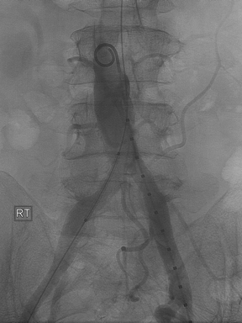
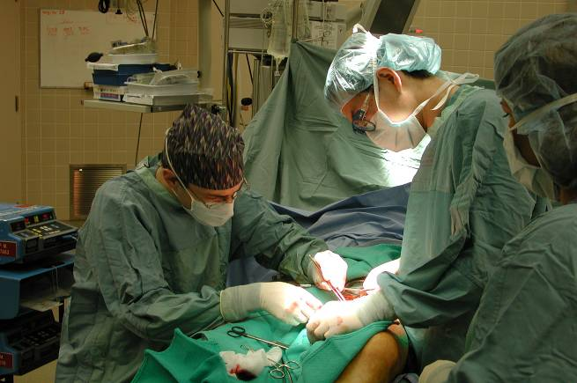
TECHNIQUES OF REVASUCLARIZATION: OBJECTIVE
Target hemodynamically significant lesions ( 75%-100%)
Re-establish inline flow to affected muscle group or ischemic tissue lower extremity
Outcomes are separated into anatomical regions
Endovascular
Open surgery

Slide 23
Endovascular Revascularization
Minimally invasive procedures: variations of balloon dilatation, stent technologies
Primary option
  Severely comorbid patients (PATIENT RISK)
  Open revascularization not feasible anatomy or conduit availability (ANATOMIC RISK)
Favourable anatomical characteristics of lesions (all relative!)
short lesion length
stenosis (vs chronic total occlusions)
proximal lesions (iliac vs femoropopliteal vs tibial)
minimal calcification, good distal runoff
Disease Anatomy
Patient Risk
and Preference
Notes:
Minimally invasive procedures use variations of balloon dilatation and stent technologies
Primary option for severely comorbid patients with CLI or claudication, in whom an open surgical revascularization procedure would not have been tolerated, is not feasible as a result of anatomy or conduit availability, or is undesirable because of concomitant morbidity and recovery time. Although less invasive, these endovascular therapies continue to face challenges with respect to limited durability compared with open surgical repair.^{115,116}
The objective of endovascular therapy is to target lesions that are hemodynamically significant, usually in the range of 75%-100% occlusion, with the goal of creating inline flow to the affected muscle group or ischemic tissue in the lower extremity. In addition to considering patient factors, anatomical characteristics of lesions considered favourable for endovascular therapy include short lesion length, stenosis (vs chronic total occlusions), proximal lesions (iliac vs femoropopliteal vs tibial), those with minimal calcification, and good distal runoff. Common femoral and profunda artery lesions are generally not considered for standard endovascular therapy.117, 118, 119, 120

Slide 24
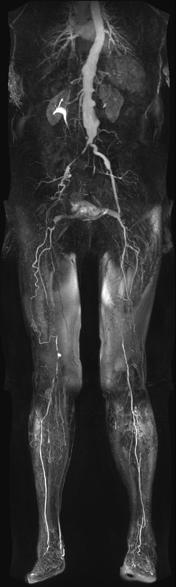
Endovascular Revascularization
Preferred option, excellent patency rates
  Low incidence of morbidity and mortality
Aortoiliac
Multiple techniques available
  Balloon, stent, drug eluting, covered, atherectomy, others
  Recent data for DES patency rates (86%1 yr, 66% 5 yrs)
Infrainguinal
High incidence of restenosis
  1⁰ patency rates1yr (22% - 92%)
  Limb salvage can be obtained and maintained despite relatively poor vessel patency rates
Infrapopliteal

Slide 25
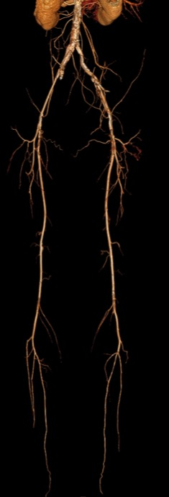
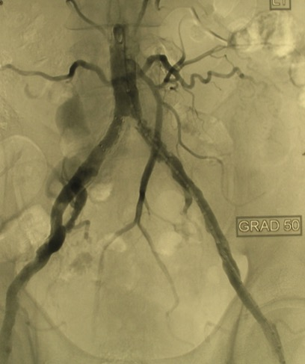
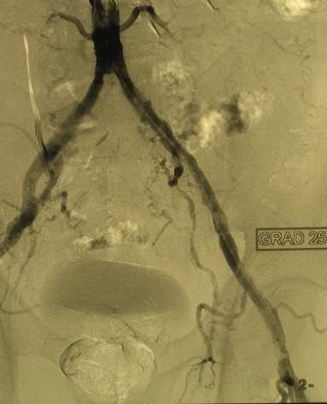
Common iliac stenosis: stent
PRE
POST

Slide 26
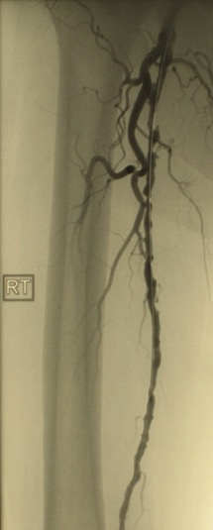
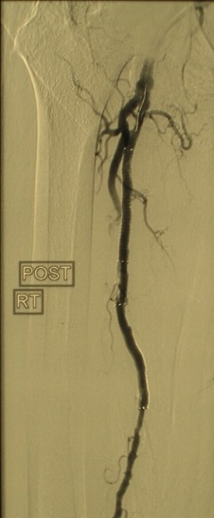
Superficial femoral artery stenosis: Stent
PRE
POST

Slide 27
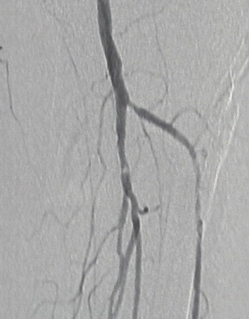
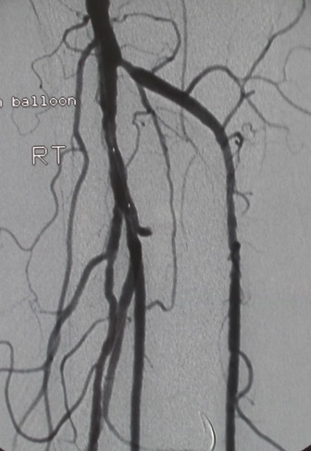
Tibial stenosis: stent
PRE
POST

Slide 28
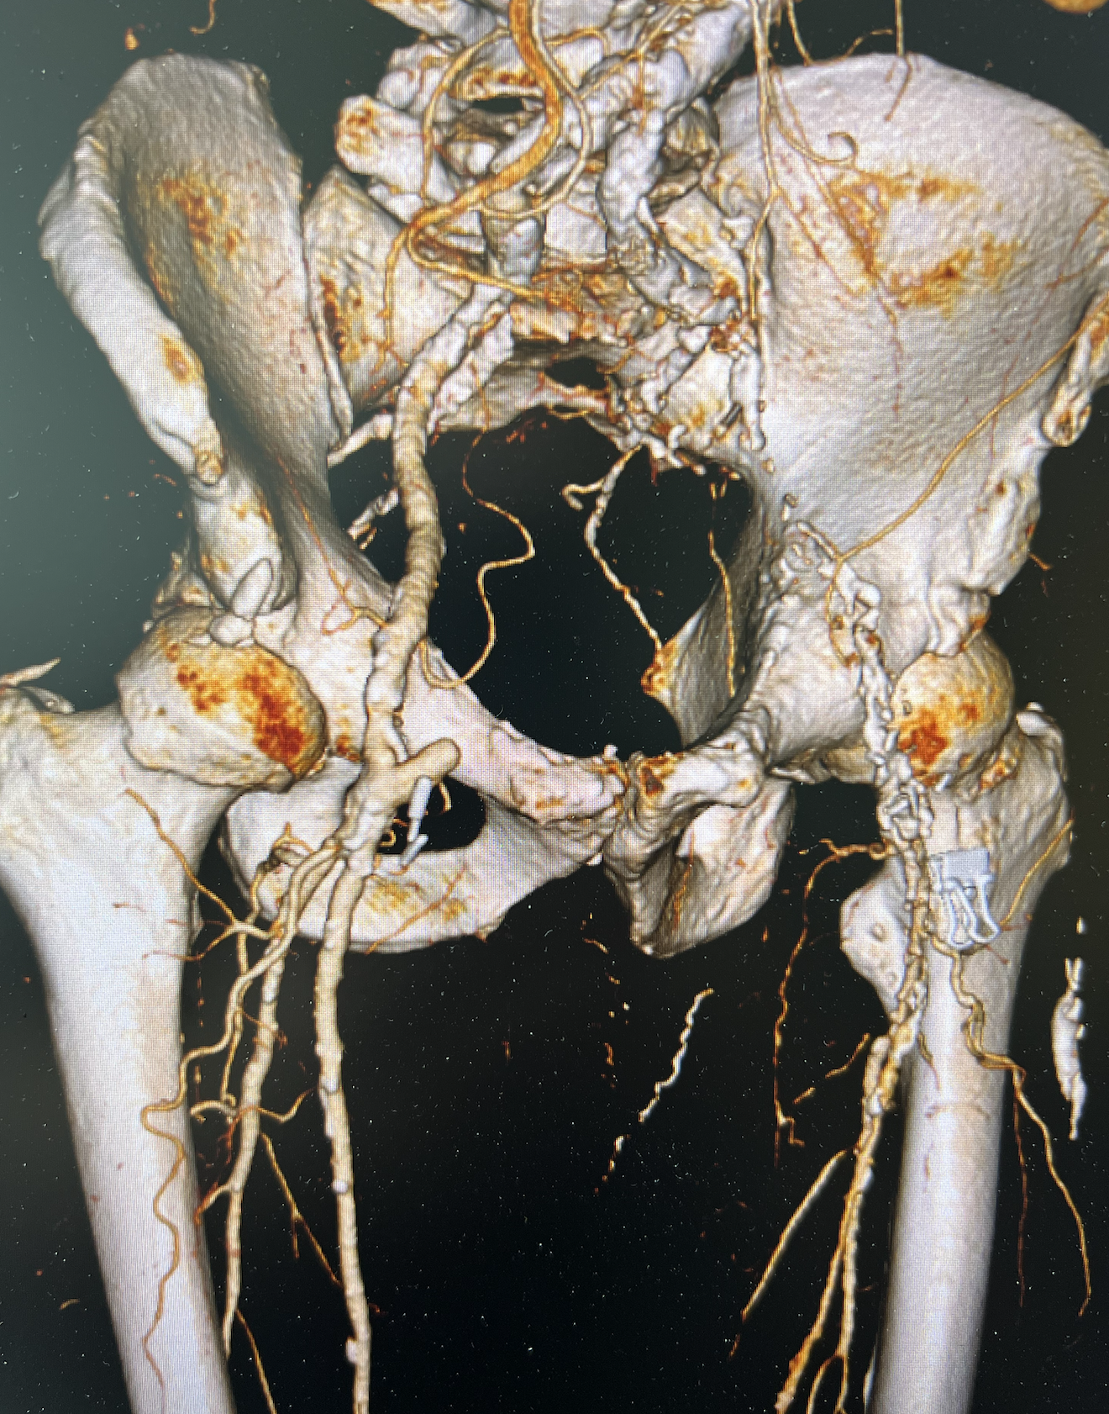
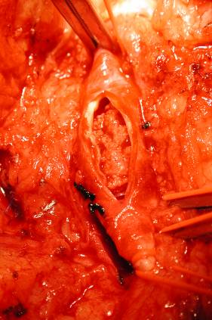
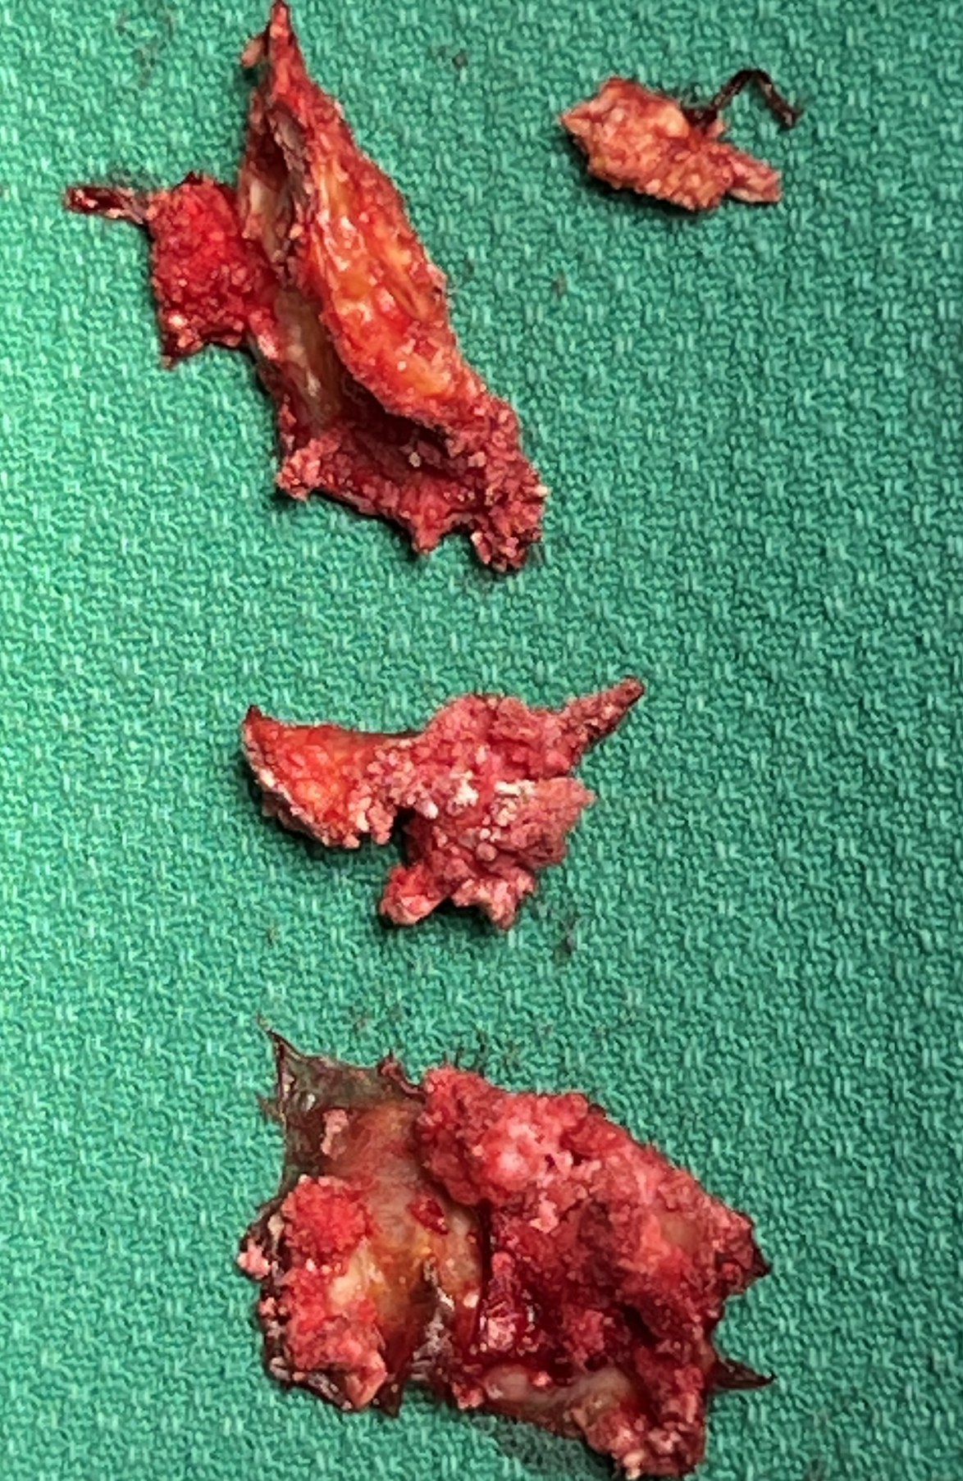
Endovascular Revascularization: Not for CFA
Common femoral and profunda artery lesions are generally not considered for standard endovascular therapy.
Although less invasive, ? limited durability vs. open surgical repair
Femoral Endarterectomies

Slide 29
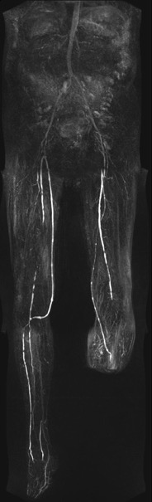
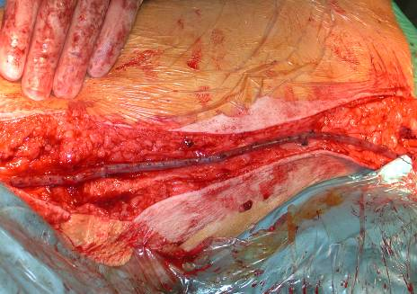
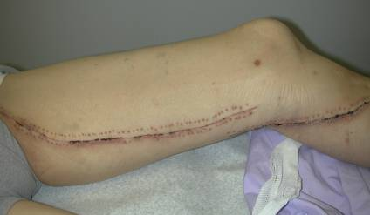
Open surgical revascularization (Proximal to distal)
Aorto-iliac Aortobifemoral; Axillofemoral
Iliac Femoro-femoral, ilio femoral
Common Femoral (CFA) Endarterectomy
Femoral to Popliteal Femoro Popliteal ( Above or Below)
Tibial Femoro- Anterior Tibial/Posterior Tibial/Peroneal,
Pedal DP, PT/Plantar
Conduits
Autogenous
Greater Saphenous Vein • Ipsilateral, contralateral
Reverse or In-situ
Arm veins • Basilic ,Cephalic
Prosthetic (PTFE, Dacron , others)
Vein harvest
Below-knee popliteal

Slide 30
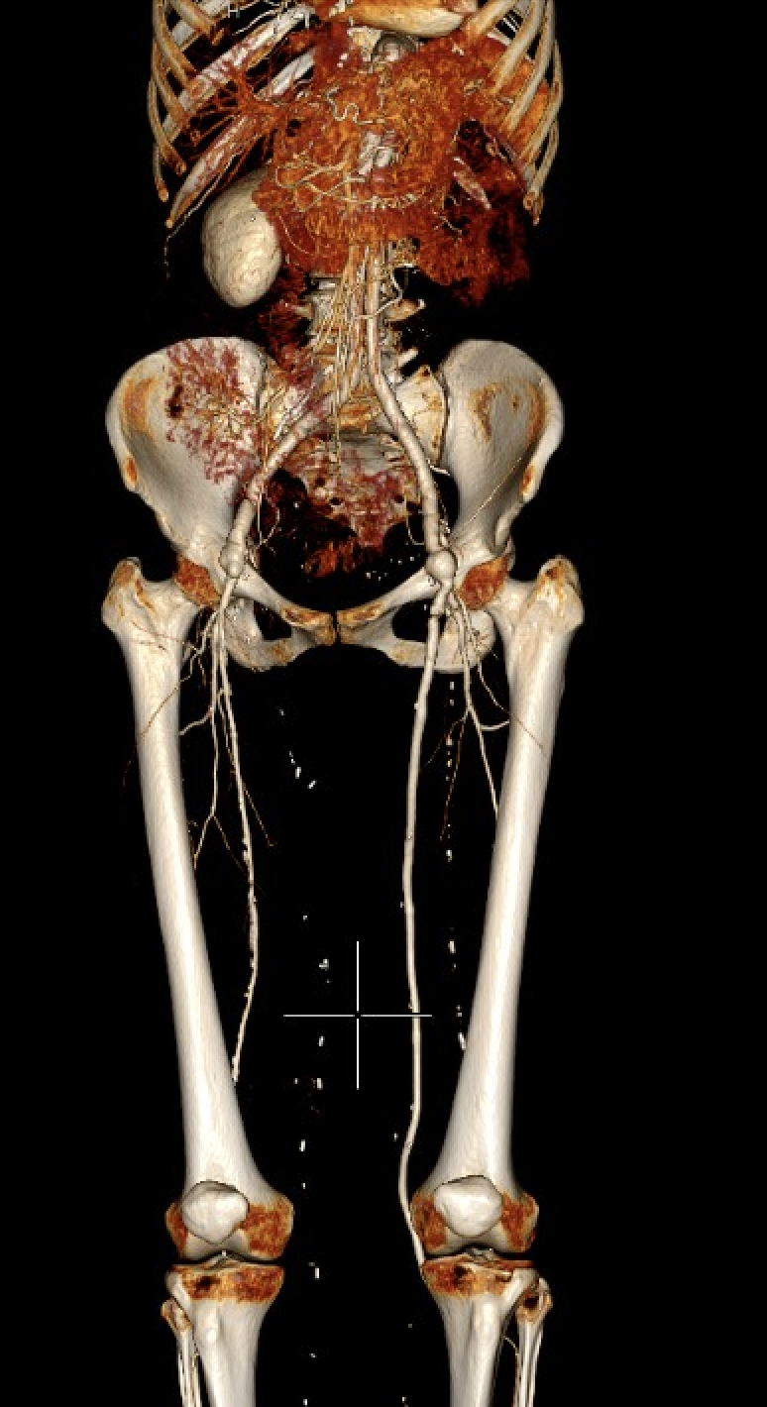
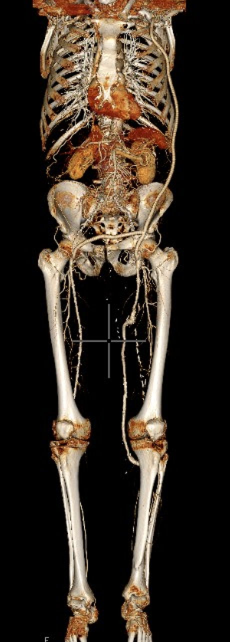
Open surgical revascularization
Lower but acceptable 5-yr patency
femoral-femoral(60%-80%)
axillo-femoral bypasses (80%)
(Aortofemoral 90% at 5 years)
Bypass patency is generally highest with autogenous (saphenous or other) vein grafts. (60%-80%) 5 years

Slide 31
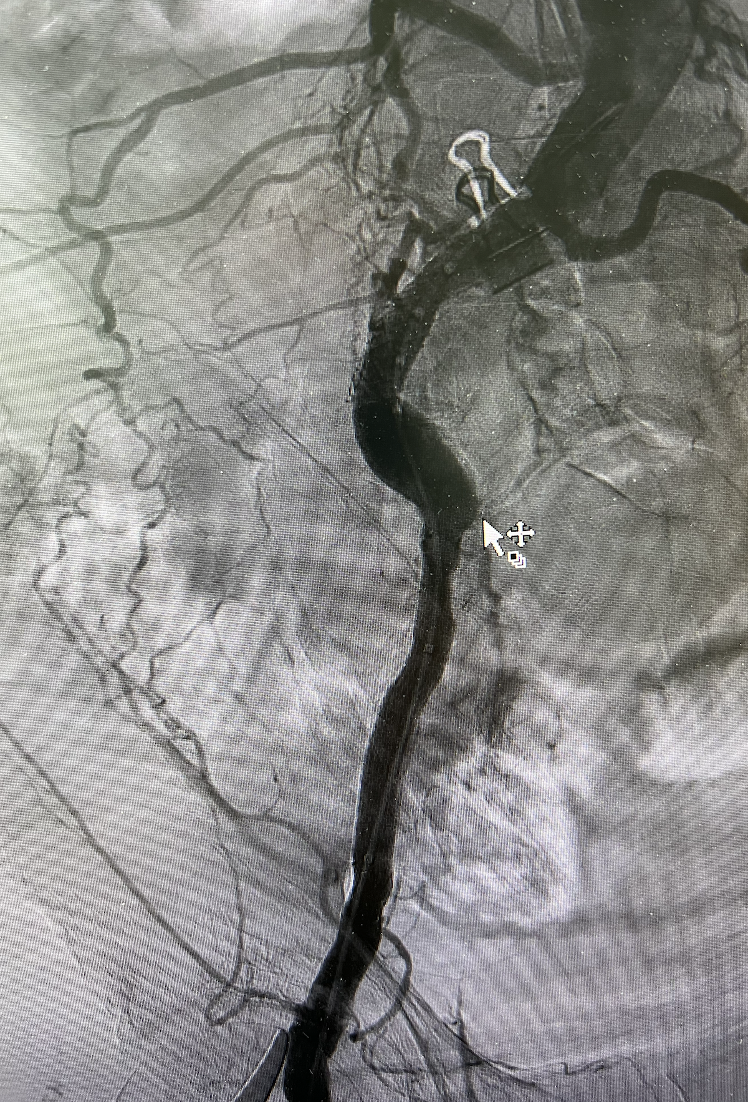
Hybrid procedures:
Concurrent endovascular + open revascularization techniques
Where endovascular treatment alone might be insufficient or is not anatomically feasible
Angioplasty with or without stent is performed proximal or distal to a surgical bypass or endarterectomy to optimize inflow or outflow (limiting surgical exposure and operative time)
Iliac stent
Femoral Endarterectomies

Slide 32
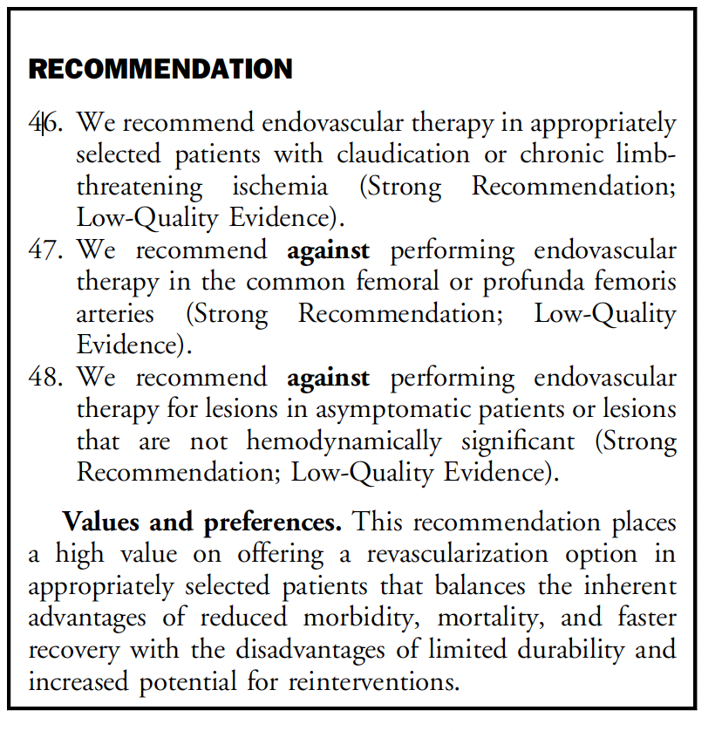

Slide 33
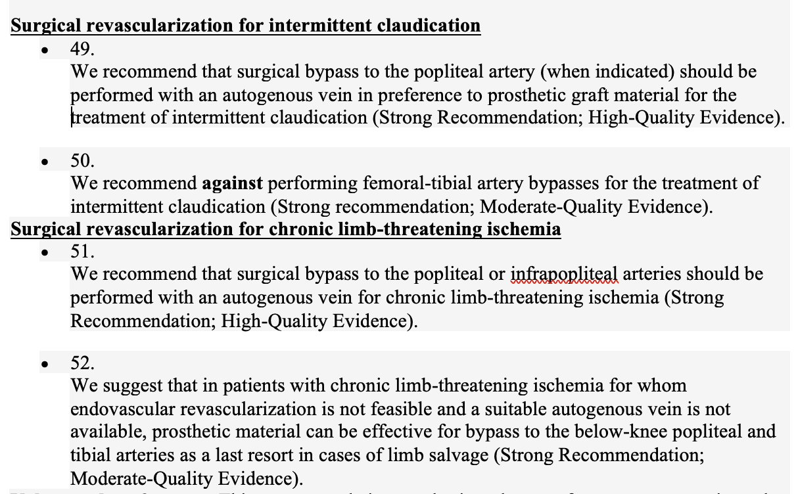

Slide 34
CHOOSING BETWEEN SURGICAL AND ENDOVASCULAR PROCEDURES
Charles de Mestral MD, FRCSC

Slide 35
LEARNING OBJECTIVES
During this sections, participants will:
Understand key considerations around approach to revascularization in PAD

Slide 36
APPROACH TO REVASCULARIZATION IN PAD
Endovascular, open, or hybrid revascularization should be considered on the basis of
Degree of ischemia;
Anatomical pattern of disease;
Expected durability of the procedure;
Perioperative risk;
Patient life expectancy;
Operator expertise;
Resource availability
(Strong Recommendation; Low-Quality Evidence)
Values and preferences: This recommendation places a high value on individualizing revascularization strategies for PAD patients.

Slide 37
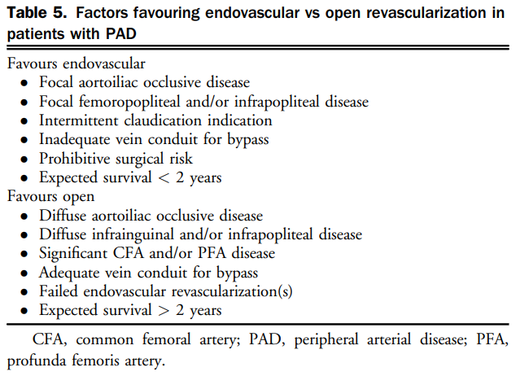
APPROACH TO REVASCULARIZATION IN PAD

Slide 38
APPROACH TO REVASCULARIZATION IN CLAUDICATION
No contemporary trials that have compared surgical with endovascular revascularization
Offering the lowest possible risk intervention when moving forward with revascularization for debilitating claudication

Slide 39
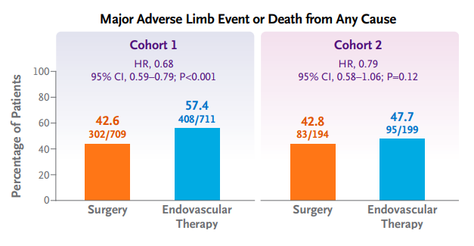
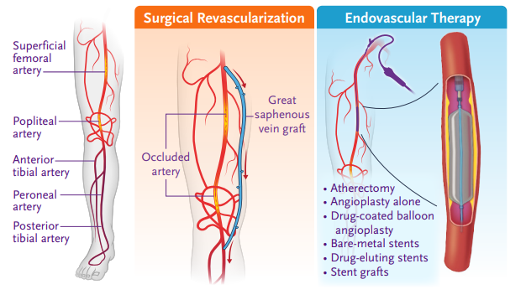
APPROACH TO REVASCULARIZATION IN CLTI
BASIL (Bradbury et al. Lancet 2005)
Infrainguinal PAD with CLI: Open surgical bypass vs. balloon angioplasty
No differences in amputation-free survival at 1 or 5 years but post hoc analysis suggested greater amputation-free survival with bypass surgery starting 2 years after randomization
BEST-CLI (Farber et al. NEJM 2022)
CLI, chronic limb ischemia
Notes:
BASIL supports the superior durability of surgical bypass relative to balloon angioplasty in patients with chronic limb-threatening ischemia.
There are, however, no trials that have compared open surgical vs endovascular revascularization that include: (1) aortoiliac disease; (2) the full spectrum of open (eg, endarterectomy) and hybrid revascularization (eg, iliac stent and femoral patch angioplasty); or (3) the full spectrum of contemporary endovascular revascularization approaches.

Slide 40
INDICATION FOR REVASULARIZATION
Thomas Lindsay MDCM, FRCSC

Slide 41
REVASCULARIZATION IN ASYMPTOMATIC PAD
We recommend not offering revascularization to patients with asymptomatic PAD
(Strong Recommendation; Low-Quality Evidence).
We recommend against performing endovascular therapy for lesions in asymptomatic patients or lesions that are not hemodynamically significant
(Strong Recommendation; Low-Quality Evidence).

Slide 42
INDICATIONS FOR INTERVENTION IN PAD

Slide 43
APPROACH TO REVASCULARIZATION IN CLAUDICATION
Choice of revascularization procedure should:
be individualized;
have the expectation of low perioperative morbidity;
have a reasonable likelihood of providing sustained symptomatic benefit.
(Strong Recommendation; Low-Quality Evidence).

Slide 44
REVASCULARIZATION IN CLAUDICATION
Revascularization may be considered in patients:
with limited vocational, recreational, or daily living activities;
who have an acceptable risk profile;
reasonable expectation for function and life expectancy;
In whom a trial of nonoperative therapy with an exercise program and optimal medical therapy has failed
(Weak Recommendation; Moderate-Quality Evidence).
We recommend against performing femoral-tibial artery bypasses for the treatment of intermittent claudication
(Strong recommendation; Moderate-Quality Evidence).

Slide 45
INDICATIONS FOR INTERVENTION IN PAD
Claudication

Slide 46
REVASCULARIZATION IN CLTI
Patients with CLTI should be urgently referred to a vascular specialist for consideration of revascularization
(Strong Recommendation; Low-Quality Evidence).
Wound debridement and/or minor amputation simultaneously with revascularization or in a staged manner depending on the degree of tissue loss, gangrene, and/or infection
(Strong Recommendation; Low-Quality Evidence).
Primary major amputation in patients with:
non-reconstructible disease/non-salvageable limb
non-ambulatory status
severe sepsis
for palliation for those with a short life expectancy and who are unfit for revascularization
(Strong Recommendation; Low-Quality Evidence).

Slide 47
INDICATIONS FOR INTERVENTION IN PAD
Critical Limb Threatening Ischemia

Slide 48
INDICATIONS FOR INTERVENTION IN PAD

Slide 49
APPROACH TO REVASCULARIZATION IN CLTI
Endovascular, open, or hybrid revascularization should be considered on the basis of
anatomical pattern of disease;
degree of ischemia;
expected durability of the procedure;
perioperative risk;
patient life expectancy;
(Strong Recommendation; Low-Quality Evidence).

Slide 50
INDICATIONS FOR INTERVENTION IN PAD

Slide 51
AUDIENCE QUESTIONS AND DISCUSSION

Slide 52
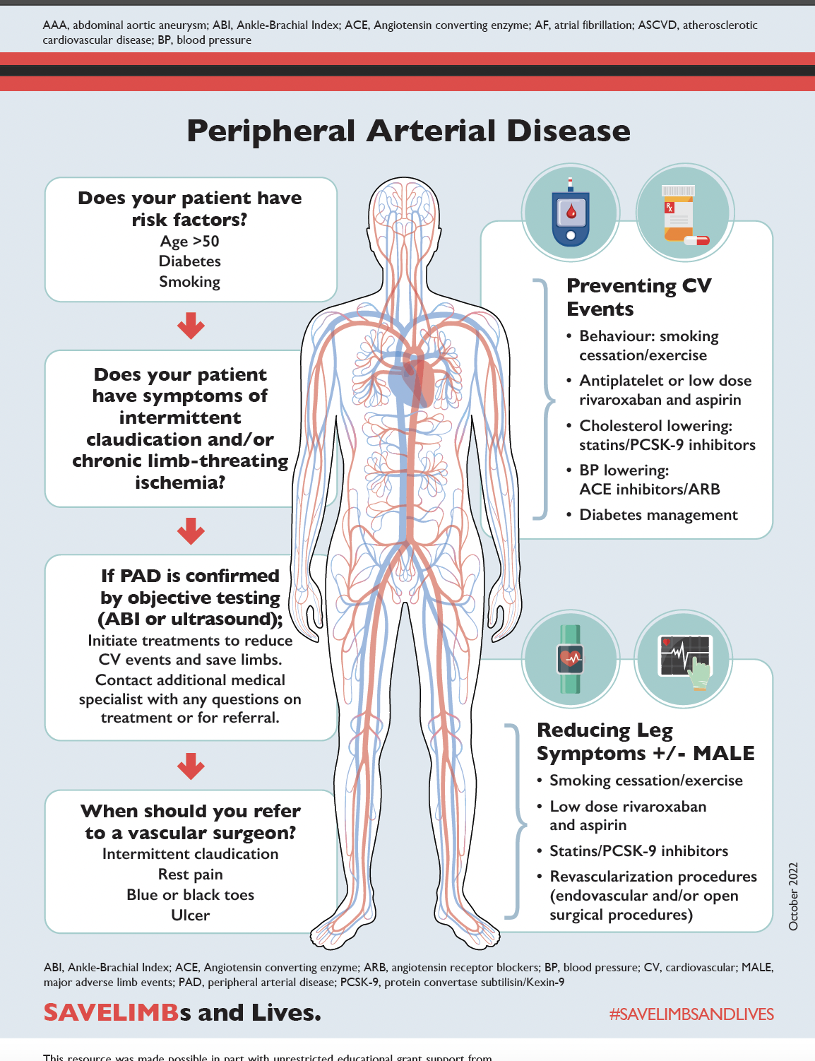
SAVE LIMB
ccs.ca/companion-resources/

Slide 53
THANK YOU!
ACCESS ON-DEMAND
This webinar will be available for On-Demand access.
View this webinar, as well as the Atrial Fibrillation, Heart Failure and Pulmonary Hypertension webinars, On-Demand: CCS.ca/On-Demand-Guideline-Webinars/

Slide 54

Join our new
CCS Affiliate Society!
THANK YOU!
Kick off meeting at Vascular 2023 in Montreal, October 27, 28th!
Hope to see you there!

Slide 55

THANK YOU!

Slide 56

THANK YOU!

Slide 57
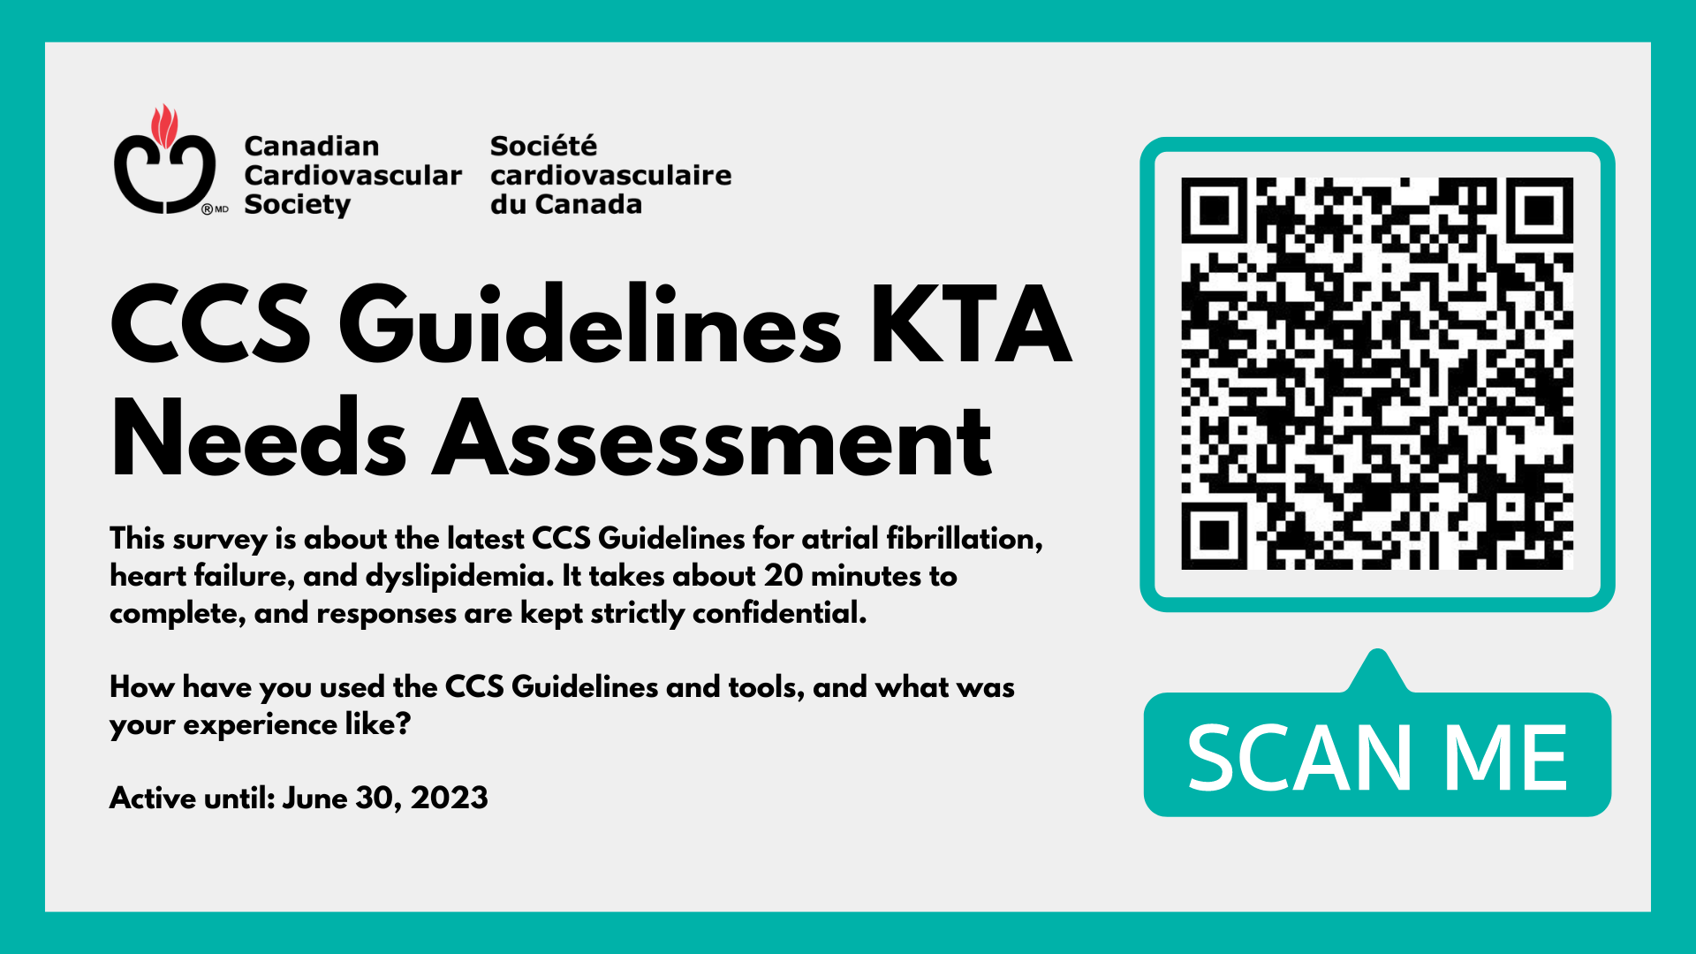
THANK YOU!

Slide 58

THANK YOU!

