Slide 1




Peripheral Arterial Disease
Webinar 2: Management
Date: March 31, 2023
Scan the QR Code to fill out the Pre-survey for this session. All data are anonymous and will be used only for quality improvement.

Slide 2
© Canadian Cardiovascular Society. 2022. All rights reserved.
Distribution, transmission or republication is strictly prohibited without the prior written permission of the Canadian Cardiovascular Society.
For medical institution internal education or training (i.e. grand rounds, medical college/classroom education, etc.), kindly consider and implement the following:
  Include the citation for the Canadian Journal of Cardiology
  Add ‘Reproduced with permission from the Canadian Cardiovascular Society. [insert year].’
  Avoid use of CCS logos or trademarks on slides, tools or publications that are not the property of the CCS
  Do not modify the slide content and, the layout and CCS branding on the Guideline-related slides
  Guideline recommendations must be reproduced exactly as published
For an industry supported or involved program, permissions are required:
  If content is published in the Canadian Journal of Cardiology, permissions must be sought through our publisher Elsevier (www.onlinecjc.com)
  If content is property of the CCS, contact guidelines@ccs.ca

Slide 3
We extend our respect to all First Nations, Inuit and Métis peoples for their valuable past and present contributions to this land we call Canada.
We acknowledge the Indigenous Peoples of all the lands that we are each on today, and reaffirm our commitment and responsibility as individuals, to improving relationships between nations and to collaborating in a spirit of reconciliation.

Slide 4
LEARNING OBJECTIVES
At the end of the session, participants will be able to:
identify key recommendations from the 2022 CCS Peripheral Arterial Disease (PAD) guidelines on management of PAD, that they can apply to their patients with PAD
describe key evidence that supports risk factor modification and drug therapy for patients with PAD
recognize the efficacy and safety of antithrombotic therapy in patients with PAD
advise optimal lifestyle strategies for patients with PAD

Slide 5
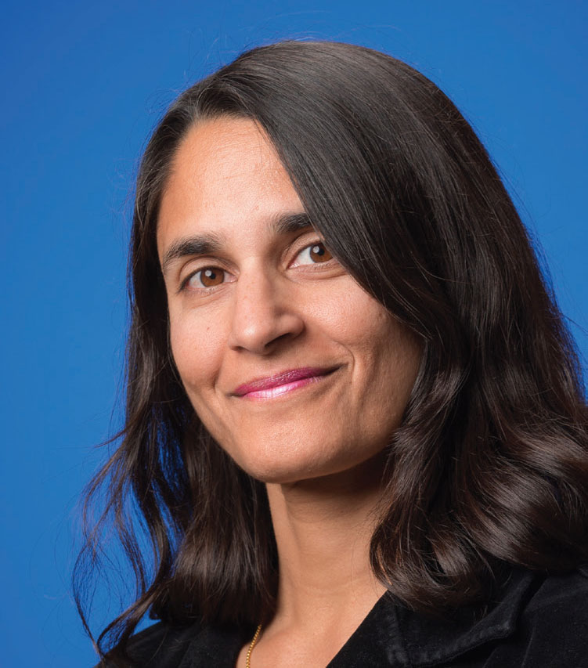
MODERATOR
Dr. Sonia Anand (co-chair)
MD, PhD, FRCPC
Professor of Medicine, McMaster University
Centre for Cardiovascular Innovation

Slide 6
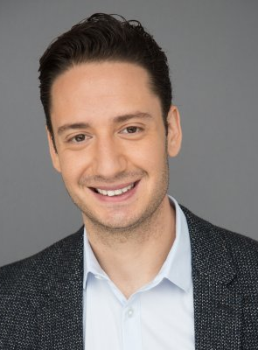

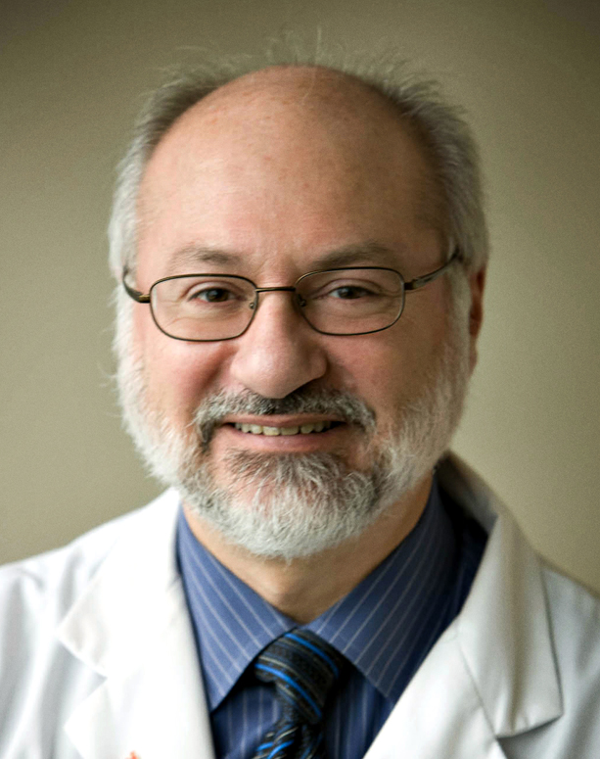
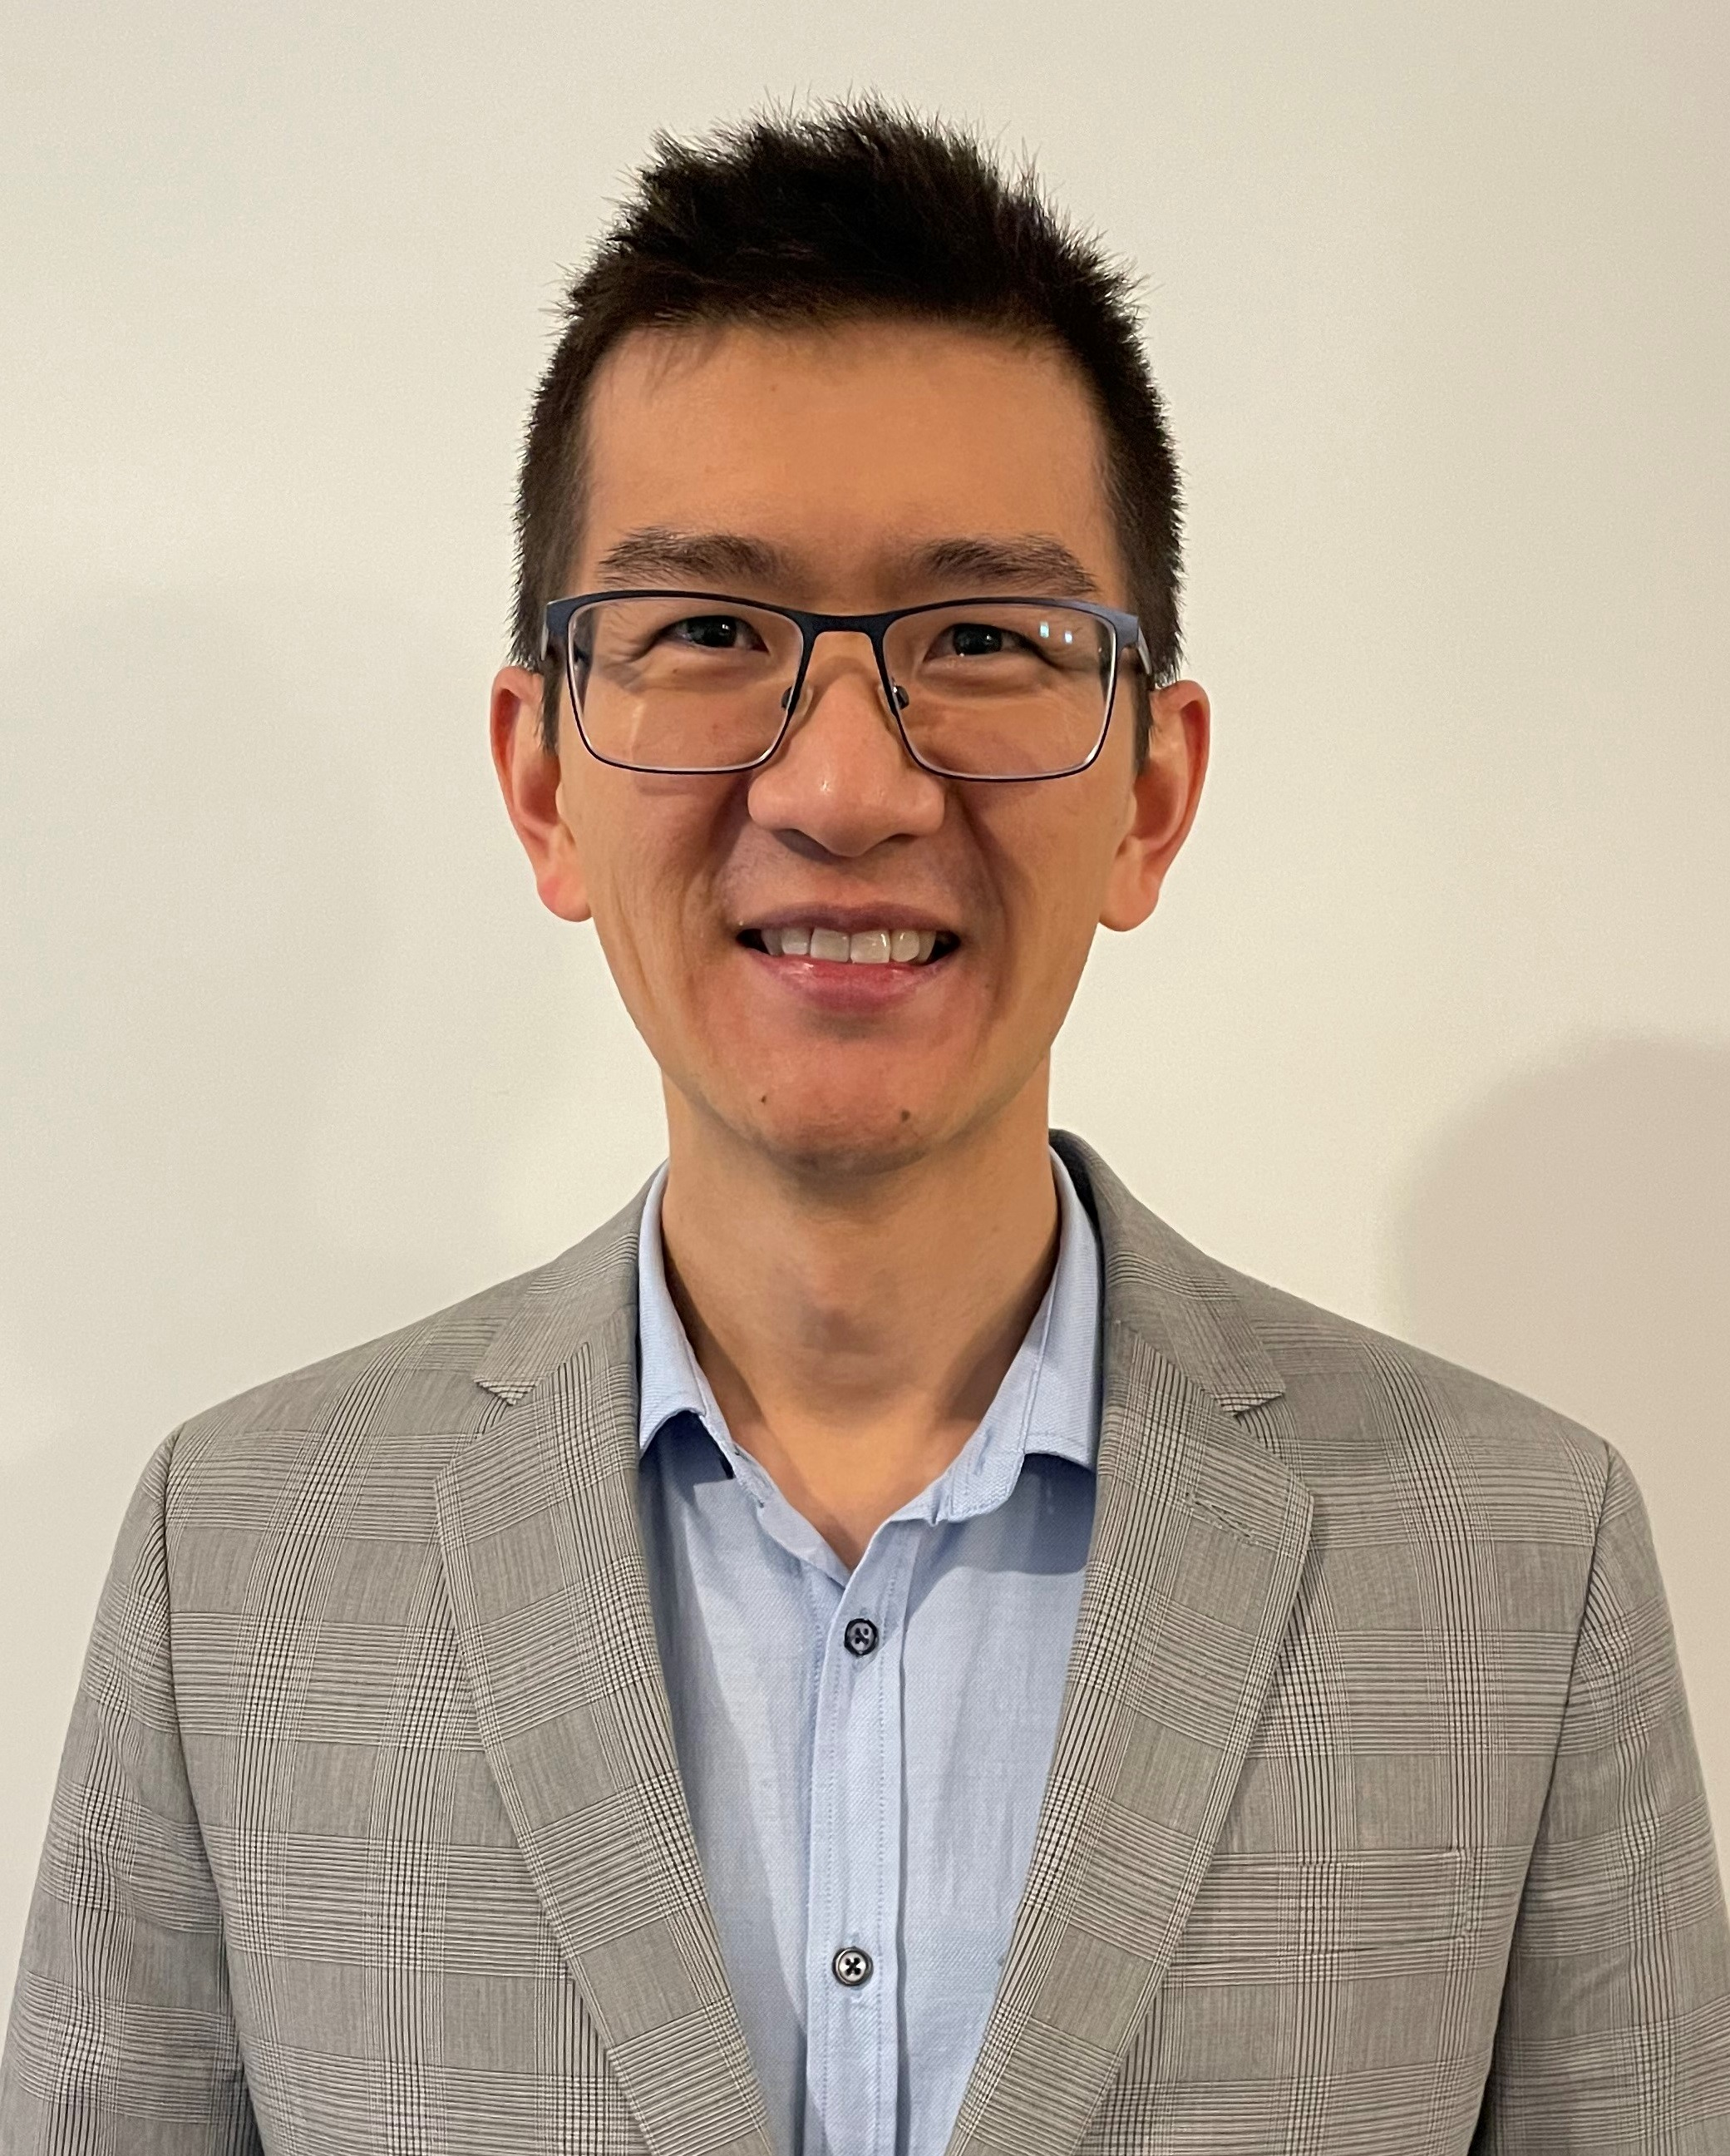
PANELIST
Dr. Hassan Mir
MD, FRCPC
Cardiology and Echocardiography
Division of Cardiology and Division of Cardiac Prevention & Rehabilitation
Assistant Professor, Department of Medicine
University of Ottawa Heart Institute, University of Ottawa
Dr. Eric Kaplovitch
MD, FRCPC
Internal Medicine, Thrombosis and Vascular Medicine
University Health Network / Sinai Health System
University of Toronto
Dr. G B John Mancini
MD, FRCPC
Professor of Medicine
University of British Columbia
Centre for Cardiovascular Innovation
Dr. Darryl Wan
MD, FRCPC
Cardiology and Vascular Medicine
University of British Columbia

Slide 7
DISCLOSURES OF CONFLICT OF INTEREST
Dr. Sonia Anand
Consulting fees/Honoraria: Bayer AG, Daiichi Sankyo Inc, Janssen Pharmaceuticals
Funded Grants/Clinical Trials: NA
Advisory Boards/Speakers Bureaus: Bayer, Canadian Cardiovascular Society, Canadian Vascular Medicine Society,
Janssen, National Heart & Stroke Foundation Advisory Board
Dr. G. B. John Mancini
Consulting fees/Honoraria: Astra Zeneca, Boehringer Ingelheim/Lilly, Janssen, Novo Nordisk
Funded Grants/Clinical Trials: Novo Nordisk
Advisory Boards/Speakers Bureaus: Esperion, Novo Nordisk, Canadian Cardiovascular Society
Dr. Eric Kaplovitch
Consulting fees/Honoraria: NA
Funded Grants/Clinical Trials: NA
Advisory Boards/Speakers Bureaus: Canadian Cardiovascular Society
Dr. Hassan Mir
Consulting fees/Honoraria: NA
Funded Grants/Clinical Trials: NA
Advisory Boards/Speakers Bureaus: Canadian Cancer Society, Canadian Institute of Health Research, University of Ottawa Heart Institute, Hamilton Health Sciences

Slide 8
DISCLOSURES OF CONFLICT OF INTEREST (cont’d)
Dr. Darryl Wan
Consulting fees/Honoraria: Amgen Canada, HLS Therapeutics Inc., Sanofi
Funded Grants/Clinical Trials: NA
Advisory Boards/Speakers Bureaus: Canadian Cardiovascular Society

Slide 9
INTRODUCTION
Dr. Sonia Anand, MD PhD FRCPC

Slide 10
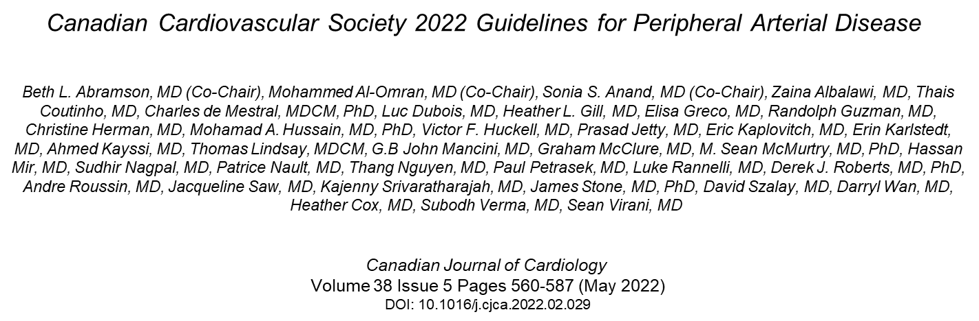
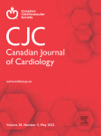
CCS 2022 GUIDELINES FOR PAD

Slide 11
MEDICAL MANAGEMENT OF PAD
Domain | Recommendation | Evidence
Smoking- smoking cessation to prevent MACE and MALE | Strong | Moderate Quality
Smoking – intensive counselling, NRT, bupropion, vernicline | Strong | High Quality
Exercise – Supervised exercise or structured home-based; pref walking | Strong | High-Quality
If can’t walk try alternative forms of exercise or resistance training | Weak | Moderate-quality
Glucose Control – Tight Glycemic control | Weak | Low-Quality
SGLT-2 inhibitor in PAD for MACE | Strong | High-Quality
PAD and diabetes use GLP-1 or DPP-4 | Weak | Low-Quality
Blood Pressure Management – Use ACE or ARB as first choice | Strong | Moderate-Quality
Lipid Lowering – Statin + ezetimibe, +PCSK-9i | Strong | High-Quality
Maximal statin with elevated triglycerides add Highly purified fish oil. | Strong | Moderate-Quality
Dual pathway inhibition: Aspirin and low dose rivaroxaban for symptomatic LEPAD with high risk features (if low bleeding risk) | Strong | High-Quality
Dual pathway inhibition or SAPT for low risk symptomatic PAD (if low bleeding risk) | Strong | High-Quality
OAC and AP for PAD | Strong | High-Quality

Slide 12
SMOKING
Hassan Mir MD, FRCPC

Slide 13
LEARNING OBJECTIVES
During this section, participants will:
Review the importance of smoking cessation for patients with PAD
Discuss an approach to smoking cessation including an evidence review

Slide 14
CV, cardiovascular; MALE, major adverse limb event; MI myocardial infraction;
TOBACCO AND PAD
Smoking is the strongest risk factor for developing PAD
It is strongly associated with MI, stroke, CV death, and MALE
Cessation is an effective tool to prevent the development or progression of PAD
Notes:
Major adverse limb event

Slide 15
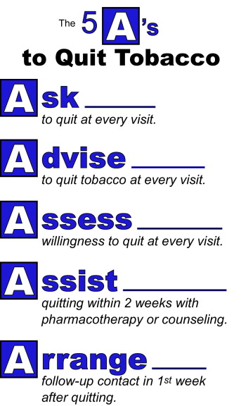
APPROACH TO SMOKING CESSATION
Systematic approach
  Identify
  Advise
  Manage

Slide 16
APPROACH TO SMOKING CESSATION
Counselling and Follow-up
  Relevance
  Risks
  Rewards
  Roadblocks
  Repetition

Slide 17
APPROACH TO SMOKING CESSATION
Counselling and Follow-up
  High‐certainty evidence of benefit for the provision of counselling
  OR 1.44, 95% CI 1.22-1.70
  194 studies, n = 72,273
Hartmann-Boyce et al 2021
Notes:
17%, 25%, 26%,

Slide 18
APPROACH TO SMOKING CESSATION
Pharmacotherapy
  Nicotine Replacement Therapy (NRT)
  Bupropion
  Varenicline
  Nicotine-containing E-cigarettes*

Slide 19
APPROACH TO SMOKING CESSATION
Agent | Dose
NRT – long acting (patch) | <10 cig/d | 10-30 cig/d | 30-40 cig/d | >40 cig/d
 | 14 mg | 21 mg | 28 mg | 42 mg
NRT – short acting | Gum or Lozenge: 2 mg q30min prn
 | Inhaler: 1 cartridge q30min prn
Bupropion | 150 mg daily x 3 days then 150 mg bid x 12 weeks
Varenicline | 0.5 mg daily x 3 days, 0.5 mg bid x 4 days, then 1 mg bid x 11 weeks
NRT = nicotine replacement therapy

Slide 20
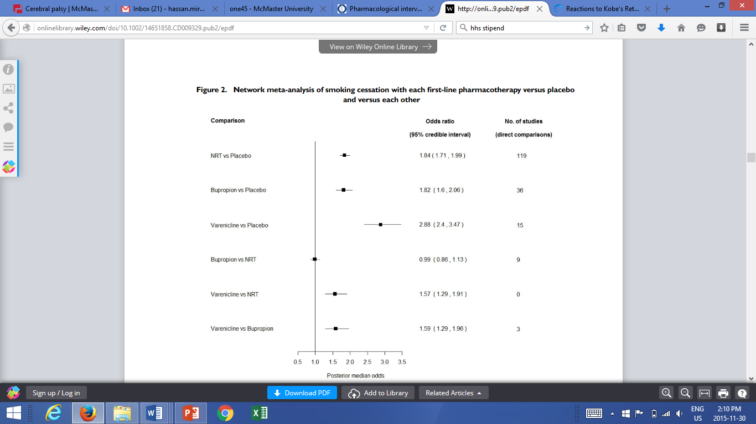
Cahill et al 2013

Slide 21

Cahill et al 2013

Slide 22
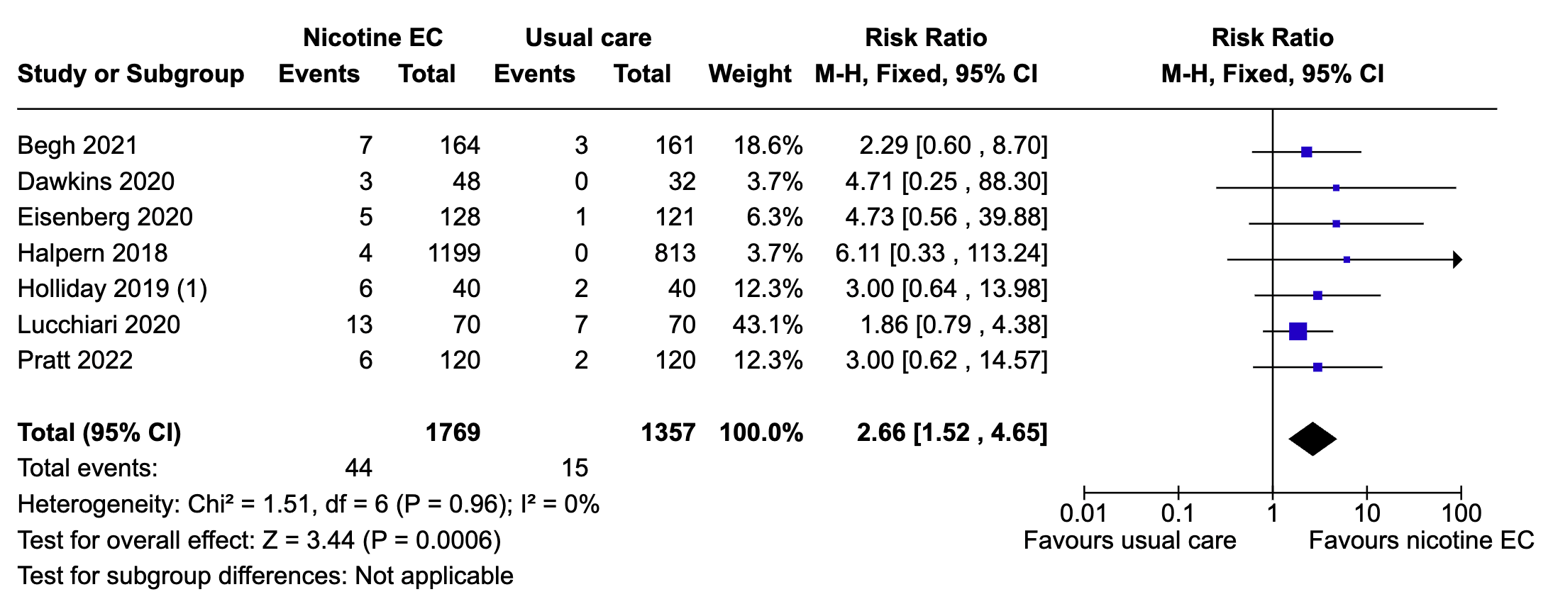
Hartmann-Boyce et al 2022

Slide 23
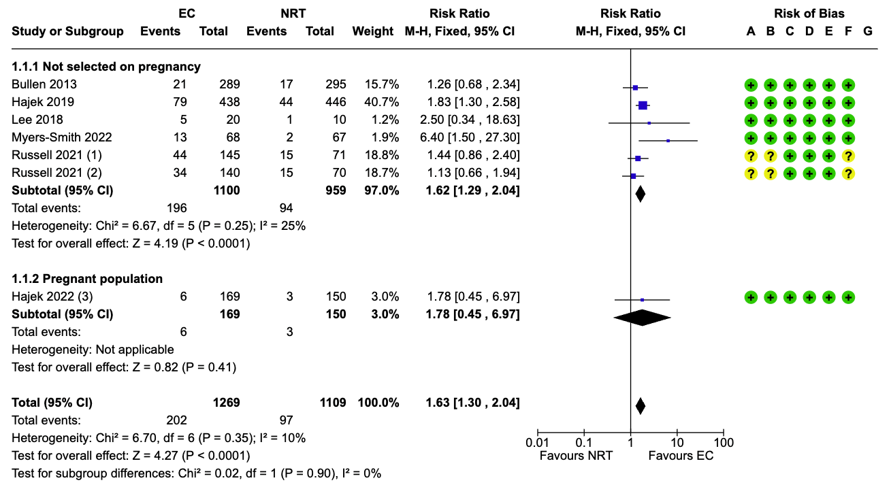
Hartmann-Boyce et al 2022

Slide 24
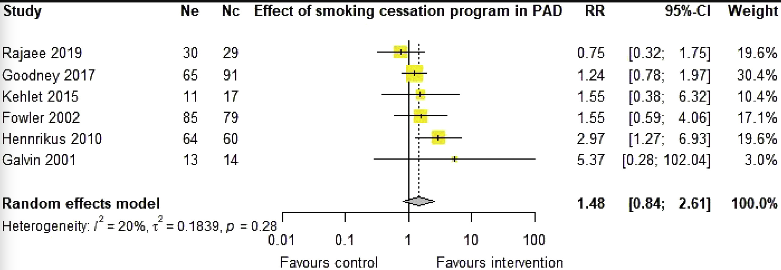
SMOKING CESSATION IN PAD
Few studies (n=6) with small sample size (n=558)
Combined interventions (advice, counselling, NRT, and/or varenicline)
Trend to benefit but not statistically significant
Thanigaimani et al 2022

Slide 25
EC, electric cigarettes; MACE, major adverse cardiovascular event; MALE, major adverse limb event; NRT, nicotine replacement therapy
RECOMMENDATIONS
We recommend smoking cessation to prevent PAD, and to prevent MACE and MALE in patients with PAD (Strong Recommendation; Moderate-Quality Evidence).
We recommend smoking cessation interventions ranging from intensive counselling, NRT, bupropion, varenicline, and sometimes nicotine EC (Strong Recommendation; High-Quality Evidence).

Slide 26
GLUCOSE CONTROL, DIABETES AND PAD
Sonia Anand MD, FRCPC

Slide 27
LEARNING OBJECTIVES
During this sections, participants will:
Review the CCS PAD Guidelines rationale for choice of glucose lowering medications for patients with PAD and diabetes

Slide 28
DPP-4, Dipeptidyl peptidase 4; GLP-1, Glucagon-like peptide-1; MACE, major adverse cardiovascular event; SGLT-2 inhibitors; Sodium-Glucose Transport Protein 2 Inhibitors
GLUCOSE CONTROL, DIABETES AND PAD
Glucose Control –Tight Glycemic control (Weak Recommendation; Low Quality evidence)
SGLT-2 inhibitor in PAD for major adverse cardiovascular event (MACE) (Strong Recommendation; High Quality evidence)
PAD and diabetes use GLP-1 receptor antagonist or DPP-4 inhibitors (Weak Recommendation; Low Quality evidence)

Slide 29
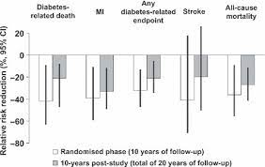
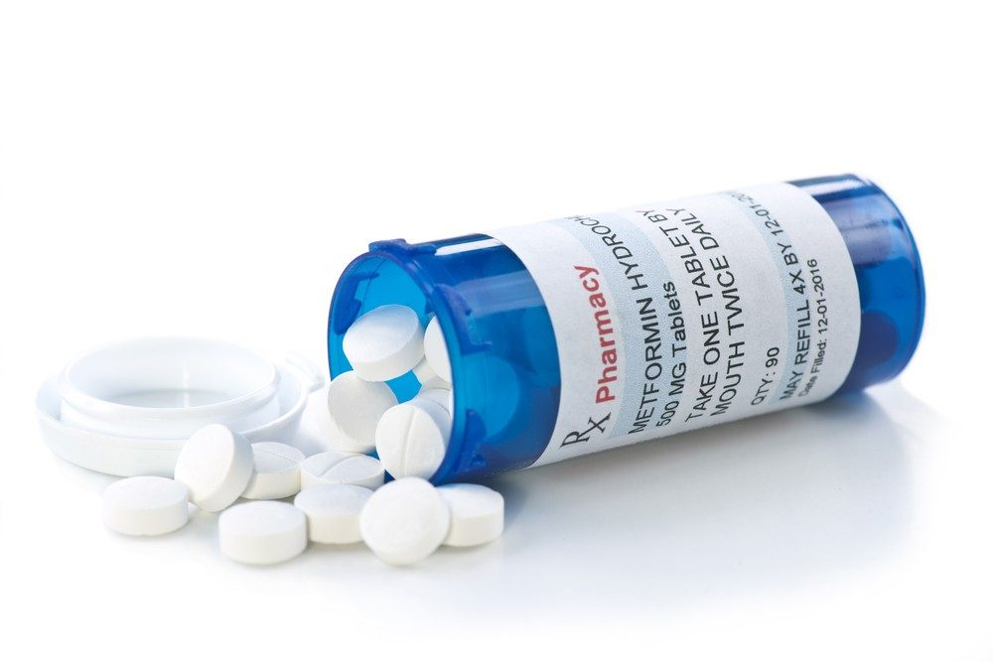
CLTI, chronic limb-threating ischemia; MALE, major adverse limb event; QoE, quality of evidence; UKPDS, UK Prospective Diabetes Study
RECENT DIAGNOSIS OF DIABETES
Many guidelines recommend metformin as the first line medication in patients with type 2 diabetes (UKPDS)
No evidence that metformin reduces MALE
Commonly used first line, and reduces MI, and associated with reduced off-target effects
Use metformin as the primary hypoglycemic agent in patients
with type 2 diabetes and CLTI.
Strength: 1 (Strong); QoE: A (High)

Slide 30
DYSLIPIDEMIA MANAGEMENT AND REDUCTION OF MACE AND MALE
G. B. John Mancini MD, FRCPC, FACC
Darryl Wan MD, FRCPC

Slide 31
LEARNING OBJECTIVES
During this section, participants will:
Identify opportunities to reduce MACE and MALE in patients with PAD and dyslipidemia using:
  Statins
  Ezetimibe
  PCSK9i
  IPE
IPE, icosapent ethyl; MACE, major adverse cardiovascular event; MALE, major adverse limb event; proprotein convertase subtilisin/kexin type 9 inhibitors, PCSK9i

Slide 32
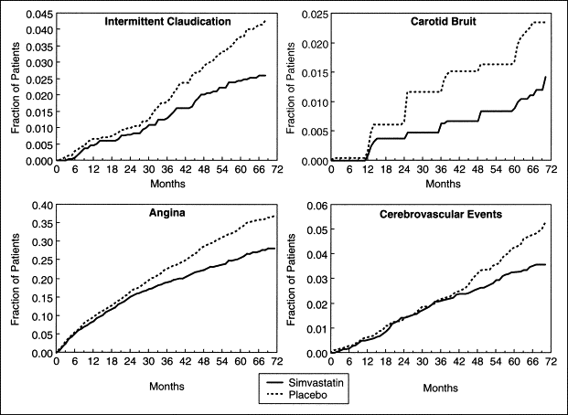
4S TRIAL
-38%
-48%
-30%

Slide 33
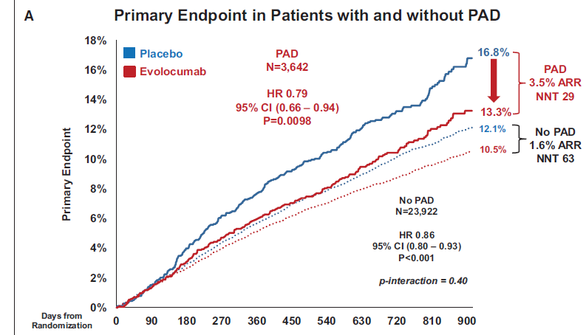
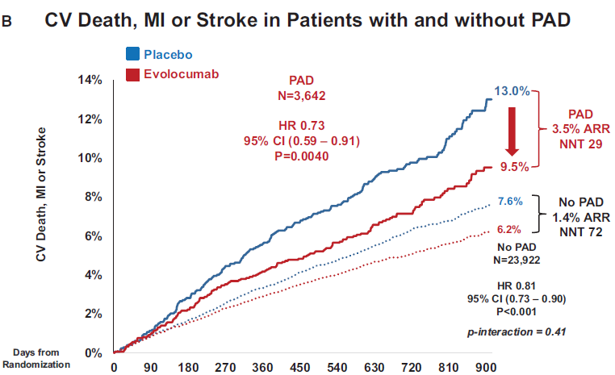
FOURIER: EVOLOCUMAB AND PAD
CV, cardiovascular; myocardial infraction; MI
Bonaca, M et. Al. Circulation 2018.

Slide 34
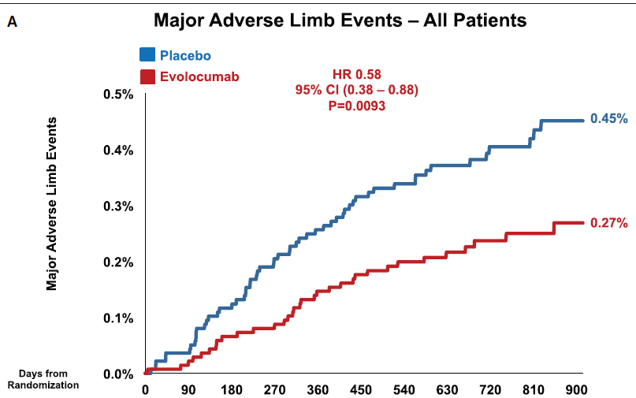

Slide 35
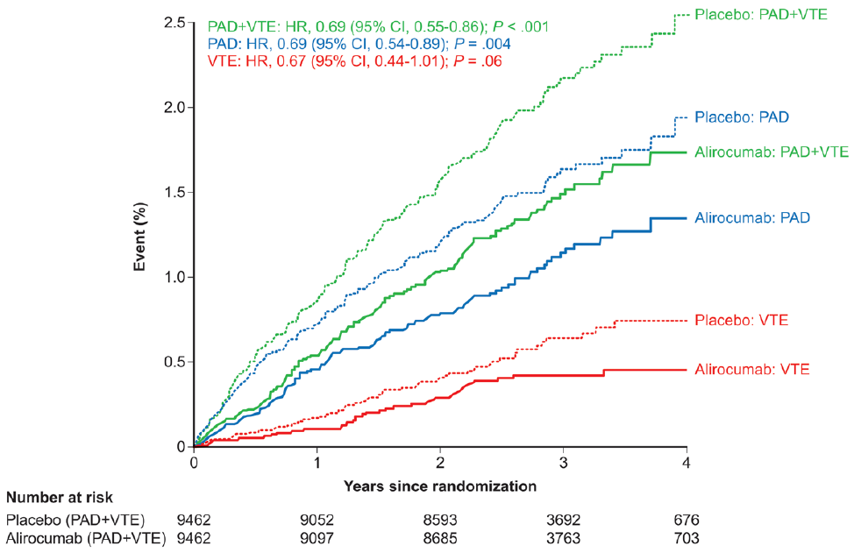
ODYSSEY OUTCOMES: ALIROCUMAB and PAD

Slide 36
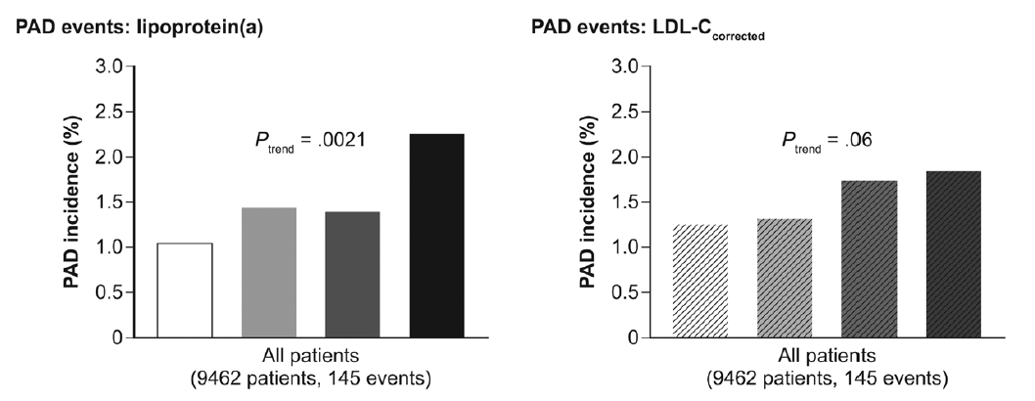
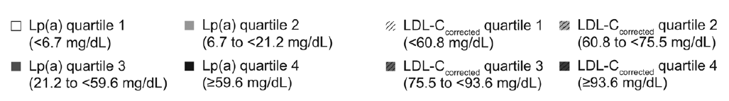
ODYSSEY PAD and VTE

Slide 37
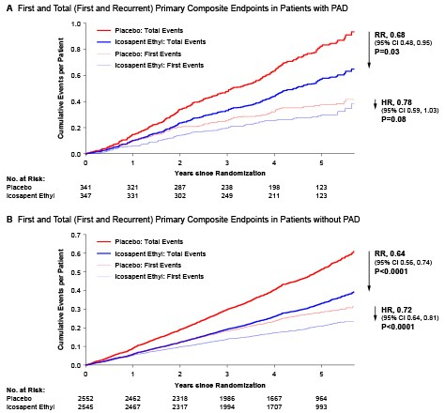
REDUCE-IT: ICOSAPENT ETHYL AND PAD
  PAD patients
    First event rate: 32.8% (with PAD) vs. 24.5% (without)
    Primary composite: 26.2% with IPE vs. 32.8% with placebo
    No (published) data on limb outcomes
IPE, icosapent ethyl

Slide 38
In Patients with PAD:
To reduce MACE and MALE use:
maximally tolerated statins
statin add-ons (ezetimibe and PCSK9i) if LDL-C > 1.8 mmol/L, non-HDL-C > 2.4 mmol/l, apoB > 0.7 mg/dL (i.e. THRESHOLDS for HIGH RISK)
To reduce MACE if TG 1.5 – 5.6 mmol/L on maximally tolerated statins use:
IPE
IPE, icosapent ethyl; MACE, major adverse cardiovascular event; MALE, major adverse limb event; TG, triglycerides

Slide 39
HYPERTENSION
Darryl Wan MD, FRCPC

Slide 40
LEARNING OBJECTIVES
During this sections, participants will:
Review the diagnosis of hypertension in PAD patients
Discuss management considerations of hypertension in PAD

Slide 41
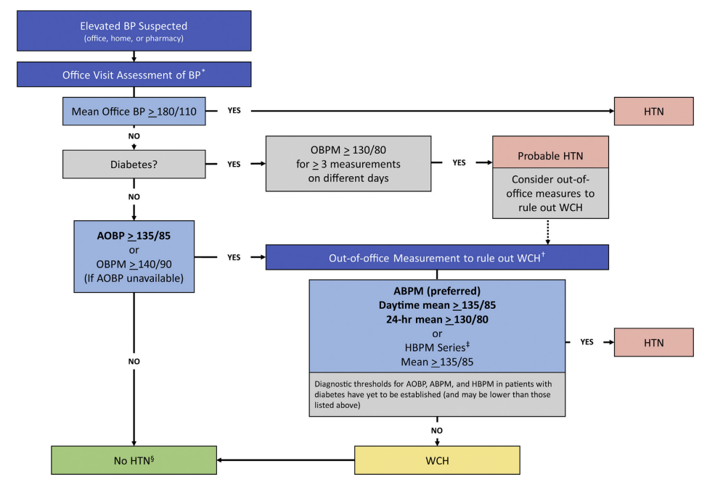

Slide 42
DIAGNOSIS
Additional considerations
Out-of-office recordings are preferred over in-office recordings
24-hour ambulatory BP monitor remains the preferred method
Consider measuring bilateral upper extremity blood pressures (to assess for subclavian stenosis)
BP, blood pressure

Slide 43
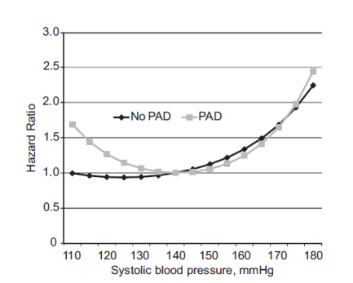
TARGETS
Standard targets
<140/90mmHg is reasonable for most patients without compelling indications for other targets (eg. Diabetes)
Intensive targets
<120mmHg systolic can be considered in select patients, but SBP <110mmHg has been associated with an increased risk of adverse events in patients with PAD
SBP, systolic blood pressure

Slide 44





Diet
Exercise
NON-PHARMACOLOGIC
Weight loss
Salt
Stress reduction

Slide 45
PHARMACOLOGIC THERAPY
ACE inhibitors or ARBs
Remain the first choice for the reduction of MACE
Other agents
Calcium channel blockers, diuretics etc. can be used as per standard approach in Hypertension Canada guidelines
MACE, major adverse cardiovascular event

Slide 46
ANTITHROMBOTIC THERAPY
Eric Kaplovitch MD, FRCPC

Slide 47
LEARNING OBJECTIVES
During this section, participants will:
1dentify the optimal antithrombotic therapy for,
Patients with symptomatic stable PAD
Patients undergoing elective peripheral revascularization
Patients requiring urgent/emergent revascularization

Slide 48
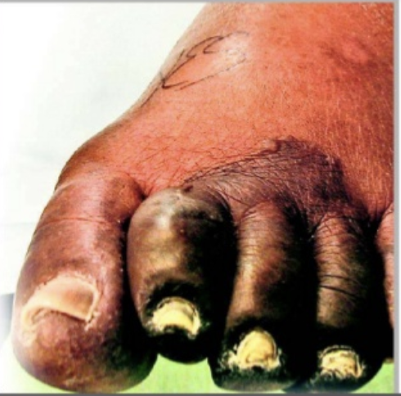
ANTITHROMBOTICS IN PAD – RATIONALE FOR USE
Major Adverse Cardiovascular Events
(MACE)
Major Adverse Limb Events
(MALE)
Notes:
PAD is not only common, its not a benign condition
Global atherosclerotic disease,
Not only is PAD common, patients with PAD are at high risk for cardiovascular events.
Most of us are familiar with the concept of mace – MI stroke, CV death.
But a major outcome and important vernacular in the PAD world is MALE
MALE
Acute limb ischemia
Chronic limb ischemia
Amputation
MALE can be devastating – loimation, pain, gangerene, infectiom amputation.
OBVIOUS PUN NOT INTENDED

Slide 49
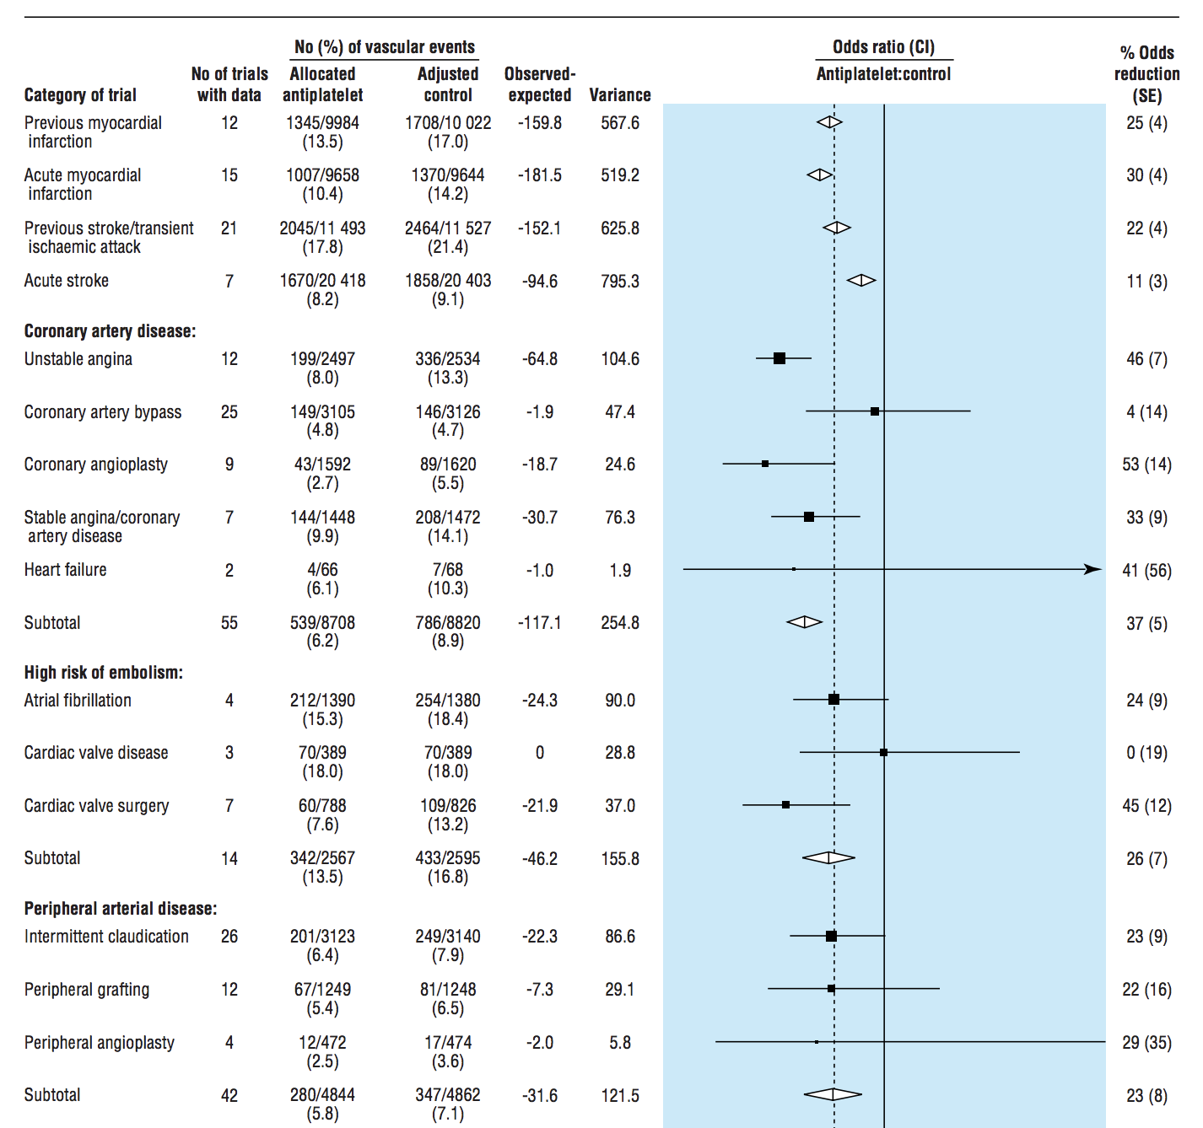
STABLE PAD – SINGLE ANTIPLATELET THERAPY
Antithrombotic Trialists' Collaboration
  23% reduction in ‘serious vascular events’
  Similar across all symptomatic groups
2011 Cochrane Review
  34% decrease in all-cause mortality
1) ATC. BMJ 324.7329 (2002): 71-86 ; 2) Wong et al. Cochrane (2011): 11
Notes:
AHA, ESC, eurapean and american society for vascular surgery all agree that Aspirin therapy is reasonable for anithrombotic treatment for CAD
23% reduction in ‘serious vascular events’: non-fatal myocardial infarction, non-fatal stroke, or vascular death
2011 Cochrane Review
34% decrease in all-cause mortality
Non-significant, but likely real, increase in major bleeding
Again, largely non-aspirin
287 studies included in the AAT. Up to 1997
s Overall, among these high risk patients, allocation to antiplatelet therapy reduced the combined outcome of any serious vascular event by about one quarter; non-fatal myocardial infarction was reduced by one third, non-fatal stroke by one quarter, and vascular mortality by one sixth (with no apparent adverse effect on other deaths)
However,
nearly 60% of the data incorporated into that meta-analysis
was derived from studies of antiplatelet agents other than
aspirin, such as picotamide.
Much of the new evidence came from the atherosclerotic disease evolution by picotamide trial, in which 2304 patients with intermittent claudication were allocated to receive the thromboxane synthase inhibitor picotamide or placebo
Randomised trials of an antiplatelet regimen versus control or of one antiplatelet regimen versus another in high risk patients (with acute or previous vascular disease or some other predisposing condition) from which results were available before September 1997
287 studies involving 135 000 patients in comparisons of antiplatelet therapy versus control and 77 000 in comparisons of different antiplatelet regimens. Main outcome measure “Serious vascular event”: non-fatal myocardial infarction, non-fatal stroke, or vascular death.
Patients with peripheral arterial disease Overall, among 9214 patients with peripheral arterial disease in 42 trials (compared with 4939 such patients in 33 trials previously1 ) there was a proportional reduction of 23% (8%) in serious vascular events (P = 0.004; fig 4), with similar benefits among patients with intermittent claudication, those having peripheral grafting, and those having peripheral angioplasty (heterogeneity test ÷2 = 3.8, df = 3; NS). Much of the new evidence came from the atherosclerotic disease evolution by picotamide trial, in which 2304 patients with intermittent claudication were allocated to receive the thromboxane synthase inhibitor picotamide or placebo.6
JAMA. -Antiplatelet Therapy to Prevent
Cardiovascular Events and Mortality
in Patients With Intermittent Claudication
Picotamide is a platelet aggregation inhibitor. It works as a thromboxane synthase inhibitor and a thromboxane receptor inhibitor,

Slide 50
STABLE PAD – DUAL PATHWAY THERAPY
COMPASS-PAD
Patients with symp. PAD, CAD w/ ↓ABI, or CAS
  1:1:1 Randomization
    Aspirin 100mg + Placebo
    Aspirin 100mg + Riva 2.5 BID
    Riva 5 BID + placebo
28% decrease in MACE (MI, stroke, CV death)
46% decrease in MALE (acute or chronic limb ischemia, or amputation)
61% increase in ISTH major bleeding
NO DIFFERENCE in fatal or critical organ bleeding
ABI, ankle-brachial index; CAD, coronary artery disease, disease; CAS, carotid artery stenting; COMPASS-PAD,
Cardiovascular Outcomes for People Using Anticoagulation Strategies; CV, cardiovascular; ISTH, International Society on
Thrombosis and Haemostasias; MACE, major adverse cardiovascular event; MALE, major adverse limb event; MI, myocardial infraction; Riva, rivaroxaban
Notes:
COMPASS PAD 7,470 patients with symptomatic PAD, CAD with low ABI, or carotid stenosis (previous revasc or >50%)
OVERALL COMPASS
27,395 patients with CAD, PAD or both
1:1:1 Randomization
Aspirin 100mg + Placebo
Aspirin 100mg + Riva 2.5 BID
Riva 5 BID + placebo
Enrolled on average 7.1 years after the acute event
Mean follow up 23 months
Stopped early!
At first interim analysis (50% of planned events)
24% decrease in MACE (MI, stroke, CV death)
18% decrease in death from any cause
Z score for ASA + Riva was greater than 4
Key composite outcomes for peripheral artery
disease were major adverse limb events (defined as the
development of acute or chronic limb ischaemia over the course of the trial follow-up, including any additional
major amputations due to a vascular event that was not
included in acute or chronic limb ischaemia),
Peripheral artery disease outcomes were
prespecified and included: acute limb ischaemia, chronic
limb ischaemia, and amputation (appendix). Acute limb
ischaemia was defined as limb threatening ischaemia with
evidence of acute arterial obstruction by radiological
criteria or a new pulse deficit leading to an intervention
(ie, surgery, thrombolysis, peripheral angioplasty, or
amputation) within 30 days of symptoms onset. All cases
of reported acute limb ischaemia were verified using a
diagnostic algorithm developed for use in COMPASS, and
an adjudicator reviewed the event if the diagnostic
algorithm did not confirm the event. Chronic limb
ischaemia was defined as severe limb ischaemia leading to
a vascular intervention. Major amputation was defined as
amputations due to a vascular event above the forefoot, or
High bleeding risk was excluded
After a run in period

Slide 51
STABLE PAD – DUAL PATHWAY THERAPY
Net Clinical Benefit
Outcome | R + A N=2,492 | A N=2,504 | Riva + aspirin vs. aspirin
 | N (%) | N (%) | HR (95% CI) | P
Net Clinical Benefit | 169 (6.8) | 234 (9.3) | 0.72 (0.59-0.87) | 0.0008
CV death, MI, stroke or MALE, major amputation, or fatal or critical organ bleeding
CV, cardiovascular; MALE, major adverse limb event; MI, myocardial infraction; Riva, rivaroxaban
Anand et al. Lancet (2018): 219-229

Slide 52
STABLE PAD – DUAL PATHWAY THERAPY
High Risk Comorbidities (HRCM)
  Polyvascular Disease
  Diabetes
  Heart Failure
  Renal insufficiency
High Risk Limb Presentations (HRLP)
  Prior Amputation
  Fontaine III/IV
  Previous Revascularization
↑ ↑ ARR!
Notes:
Figure 2: Estimated number of Ischemic Events Prevented and Bleeding Events Caused per 1,000 Patients When Treated With Rivaroxaban and Aspirin in Combination as Compared to Aspirin alone over 30 Months
High Risk Comorbidities (HRCM)
Prognosticates risk of MACE, MALE and Major amputation in PAD patients:
Polyvascular Disease: 12.8%
Diabetes: 13.4%
Heart Failure: 13.5%
Renal insufficiency (gfr <60): 14.1%
High Risk Limb presentations (HRLP)
Prognosticates risk of MACE, MALE and major amputation in PAD patients:
Prior Amputation: 22.6%
Fontaine III/IV: 17.6%
Previous Revascularization: 11.8%

Slide 53
LEARNING OBJECTIVES
During this section, participants will identify the optimal antithrombotic therapy for:
Patients with symptomatic PAD
RECOMMENDATION 19: We recommend treatment with aspirin (80-100mg daily) and rivaroxaban 2.5mg BID in combination for patients at low bleeding risk with either HRCM and/or HRLP
RECOMMENDATION 20: We recommend treatment with either single antiplatelet therapy or aspirin (80-100mg daily) and rivaroxaban 2.5mg BID in combination for patients without HRCM or HRLP
HRCM, high risk comorbidities; HRLP, high risk limb presentations

Slide 54
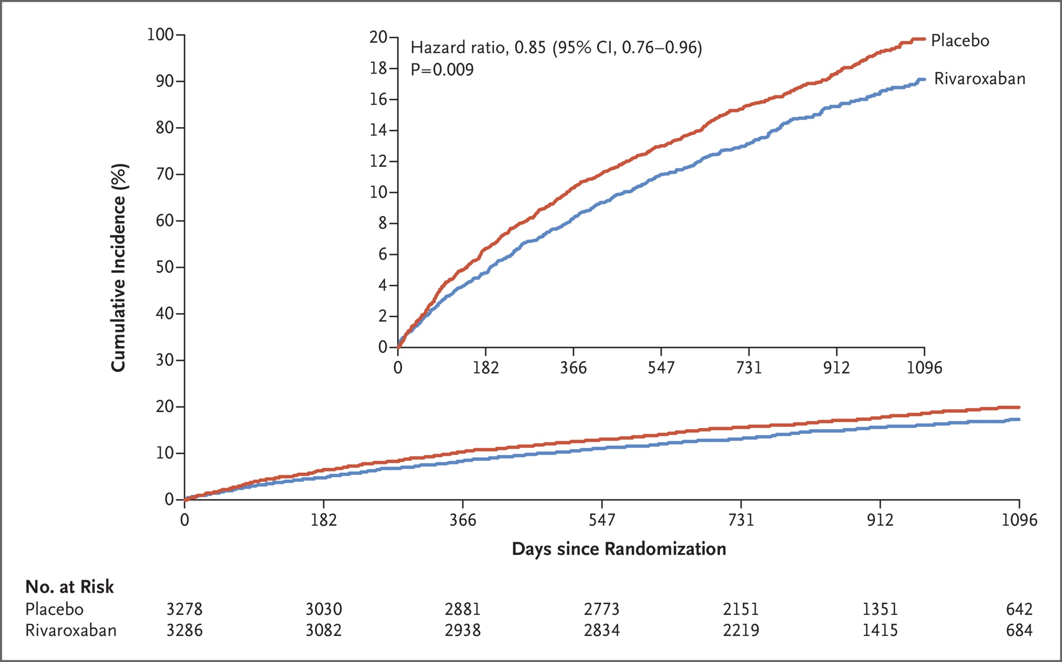
AFTER REVASCULARIZATION – DUAL PATHWAY THERAPY
VOYAGER-PAD
  Patients with symptomatic PAD
  undergoing peripheral revascularization
  Randomization to:
    Aspirin + Rivaroxaban 2.5 BID
    Aspirin + Placebo
  Clopidogrel (Max 6 months) at discretion
  of investigator
Non-emergent patients
  >75% Claudication
  Excluded ALI
Representative revascularization
  65.5% Endovascular vs. 34.5% Surgical
ALI, major amputation for vascular causes, MI, ischemic stroke, or CV death
Significant 33% ↓ in Acute Limb Ischemia
ALI, acute limb ischemia, CV, cardiovascular; MI, myocardial infraction
Bonaca et al. NEJM (2020): 1994-2004
Notes:
In a double-blind trial, patients with peripheral artery disease who had undergone revascularization were randomly assigned to receive rivaroxaban (2.5 mg twice daily) plus aspirin or placebo plus aspirin. The primary efficacy outcome was a composite of acute limb ischemia, major amputation for vascular causes, myocardial infarction, ischemic stroke, or death from cardiovascular causes. The principal safety outcome was major bleeding, defined according to the Thrombolysis in Myocardial Infarction (TIMI) classification; major bleeding as defined by the International Society on Thrombosis and Haemostasis (ISTH) was a secondary safety outcome.
Figure 2: Estimated number of Ischemic Events Prevented and Bleeding Events Caused per 1,000 Patients When Treated With Rivaroxaban and Aspirin in Combination as Compared to Aspirin alone over 30 Months
High Risk Comorbidities (HRCM)
Prognosticates risk of MACE, MALE and Major amputation in PAD patients:
Polyvascular Disease: 12.8%
Diabetes: 13.4%
Heart Failure: 13.5%
Renal insufficiency (gfr <60): 14.1%
High Risk Limb presentations (HRLP)
Prognosticates risk of MACE, MALE and major amputation in PAD patients:
Prior Amputation: 22.6%
Fontaine III/IV: 17.6%
Previous Revascularization: 11.8%

Slide 55
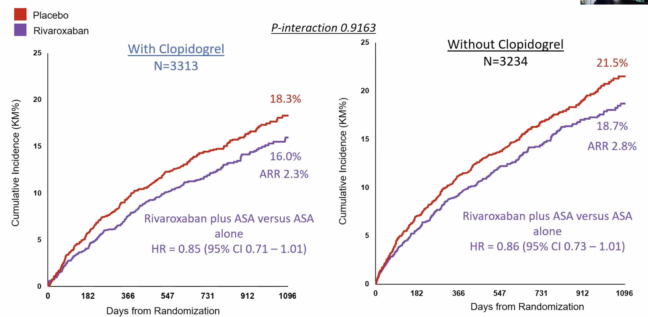
AFTER REVASCULARIZATION – TRIPLE THERAPY?
90% of those on clopidogrel were endovascular
Hiatt et al. Circulation (2020): 2219-2230
Notes:
Figure 2: Estimated number of Ischemic Events Prevented and Bleeding Events Caused per 1,000 Patients When Treated With Rivaroxaban and Aspirin in Combination as Compared to Aspirin alone over 30 Months
High Risk Comorbidities (HRCM)
Prognosticates risk of MACE, MALE and Major amputation in PAD patients:
Polyvascular Disease: 12.8%
Diabetes: 13.4%
Heart Failure: 13.5%
Renal insufficiency (gfr <60): 14.1%
High Risk Limb presentations (HRLP)
Prognosticates risk of MACE, MALE and major amputation in PAD patients:
Prior Amputation: 22.6%
Fontaine III/IV: 17.6%
Previous Revascularization: 11.8%

Slide 56
AFTER REVASCULARIZATION – TRIPLE THERAPY?
ISTH, International Society on Thrombosis and Haemostasias
Hiatt et al. Circulation 2020
Hiatt et al. Circulation (2020): 2219-2230
Notes:
If one does choose to use clopidogrel, which seems not strictly necessary, very recent data also advocates for a short 30 day course or less, AS WE SEE THAT THERE WAS SIGNIFICANTLY

Slide 57
LEARNING OBJECTIVES
During this section, participants will identify the optimal antithrombotic therapy for:
Patients undergoing elective peripheral revascularization
RECOMMENDATION 25: We recommend treatment with aspirin (80-100mg daily) and rivaroxaban 2.5mg BID in combination with or without short-term clopidogrel use after elective endovascular revascularization
RECOMMENDATION 26: We recommend treatment with aspirin (80-100mg daily) and rivaroxaban 2.5mg BID in combination after elective open revascularization

Slide 58
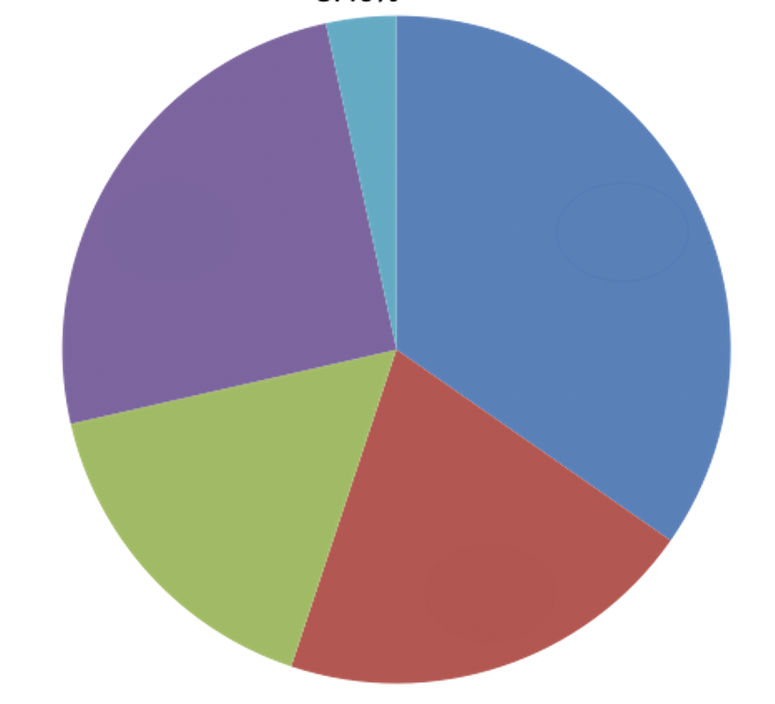
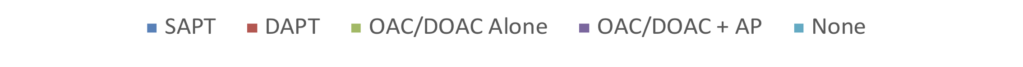
URGENT/EMERGENT REVASC – PAUCITY OF EVIDENCE
CANALISE-1
  Audit of antithrombotics prescribed following urgent/emergent revascularization
CANALISE Survey
  Survey of Canadian Vascular Surgeons
  66% with >10 years of practice
What therapy options are considered when concerned re: risk of re-thrombosis?
    #1: ASA and full dose anticoagulation
    #2: DAPT
Antithrombotics at Discharge Following Urgent/Emergent Revascularization
What about a VOYAGER-PAD Strategy??
1) Kaplovitch et al. CJC open (2021): 1325-1332; 2) McClure et al. CJC (2021): 504-507
Notes:
AHA, ESC, eurapean and american society for vascular surgery all agree that Aspirin therapy is reasonable for anithrombotic treatment for CAD
23% reduction in ‘serious vascular events’: non-fatal myocardial infarction, non-fatal stroke, or vascular death
2011 Cochrane Review
34% decrease in all-cause mortality
Non-significant, but likely real, increase in major bleeding
Again, largely non-aspirin
287 studies included in the AAT. Up to 1997
s Overall, among these high risk patients, allocation to antiplatelet therapy reduced the combined outcome of any serious vascular event by about one quarter; non-fatal myocardial infarction was reduced by one third, non-fatal stroke by one quarter, and vascular mortality by one sixth (with no apparent adverse effect on other deaths)
However,
nearly 60% of the data incorporated into that meta-analysis
was derived from studies of antiplatelet agents other than
aspirin, such as picotamide.
Much of the new evidence came from the atherosclerotic disease evolution by picotamide trial, in which 2304 patients with intermittent claudication were allocated to receive the thromboxane synthase inhibitor picotamide or placebo
Randomised trials of an antiplatelet regimen versus control or of one antiplatelet regimen versus another in high risk patients (with acute or previous vascular disease or some other predisposing condition) from which results were available before September 1997
287 studies involving 135 000 patients in comparisons of antiplatelet therapy versus control and 77 000 in comparisons of different antiplatelet regimens. Main outcome measure “Serious vascular event”: non-fatal myocardial infarction, non-fatal stroke, or vascular death.
Patients with peripheral arterial disease Overall, among 9214 patients with peripheral arterial disease in 42 trials (compared with 4939 such patients in 33 trials previously1 ) there was a proportional reduction of 23% (8%) in serious vascular events (P = 0.004; fig 4), with similar benefits among patients with intermittent claudication, those having peripheral grafting, and those having peripheral angioplasty (heterogeneity test ÷2 = 3.8, df = 3; NS). Much of the new evidence came from the atherosclerotic disease evolution by picotamide trial, in which 2304 patients with intermittent claudication were allocated to receive the thromboxane synthase inhibitor picotamide or placebo.6
JAMA. -Antiplatelet Therapy to Prevent
Cardiovascular Events and Mortality
in Patients With Intermittent Claudication
Picotamide is a platelet aggregation inhibitor. It works as a thromboxane synthase inhibitor and a thromboxane receptor inhibitor,

Slide 59
LEARNING OBJECTIVES
During this section, participants will identify the optimal antithrombotic therapy for:
Patients requiring urgent/emergent revascularization
RECOMMENDATION 29: After urgent/emergent revascularization, we recommend treatment with any of
  Full-dose anticoagulation in combination with single antiplatelet therapy
  Rivaroxaban 2.5 mg twice daily in combination with aspirin, with or without short-term use of clopidogrel
  Dual antiplatelet therapy
MORE EVIDENCE NEEDED

Slide 60
LEARNING OBJECTIVES
During this section, participants will identify the optimal antithrombotic therapy for:
Patients with symptomatic stable PAD
  ASA + rivaroxaban 2.5 BID for patients with HRCM and/or HRLP and at low bleeding risk
  Either SAPT alone or ASA + rivaroxaban 2.5 BID for patients without HRCM or HRLP
Patients undergoing elective peripheral revascularization
  ASA + rivaroxaban 2.5 BID with or without short term clopidogrel after elective endovascular revascularization
  ASA + rivaroxaban 2.5 BID after elective open revascularization
Patients requiring urgent/emergent revascularization
  Any of a) SAPT + Full dose AC; b) ASA + rivaroxaban 2.5 BID; or c) DAPT, informed by bleeding risk and perceived risk of re-thrombosis
  MORE EVIDENCE NEEDED
ASA, aspirin; AC, anticoagulant; DAPT, dual antiplatelet therapy; HRCM, high risk comorbidities; HRLP, high risk limb presentations; SAPT, single antiplatelet therapy;

Slide 61
EXERCISE THERAPY FOR INTERMITTENT CLAUDICATION
Sonia Anand MD, PhD, FRCPC
Thais Coutinho MD, FRCPC
Heather L. Gill MDCM, MPH, FRCPC

Slide 62
LEARNING OBJECTIVES
During this sections, participants will:
Review the CCS PAD Guidelines recommendation for exercise programs to improves outcomes among patients with PAD

Slide 63
RECOMMENDATIONS
Supervised exercise is optimal
Structured home-based or community exercise program when supervised exercise not available
Walking preferred over other forms
If cannot walk, resistance training second to walking for PAD

Slide 64
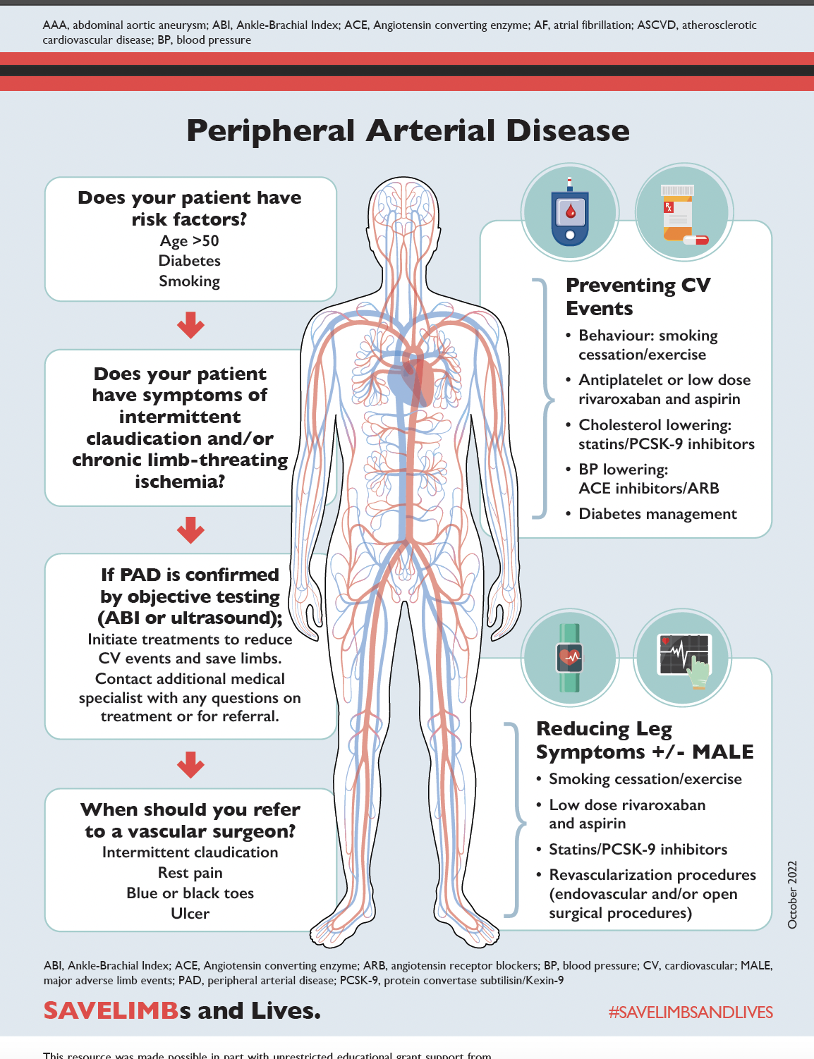
SAVE LIMB
ccs.ca/companion-resources/

Slide 65
AUDIENCE QUESTIONS AND DISCUSSION

Slide 66
THANK YOU!
ACCESS ON-DEMAND
This webinar will be available for On-Demand access.
View this webinar, as well as the Atrial Fibrillation, Heart Failure and Pulmonary Hypertension webinars, On-Demand: CCS.ca/On-Demand-Guideline-Webinars/

Slide 67

Join our new
CCS Affiliate Society!
THANK YOU!
Kick off meeting at Vascular 2023 in Montreal, October 27, 28th!
Hope to see you there!

Slide 68

THANK YOU!

Slide 69

THANK YOU!

Slide 70
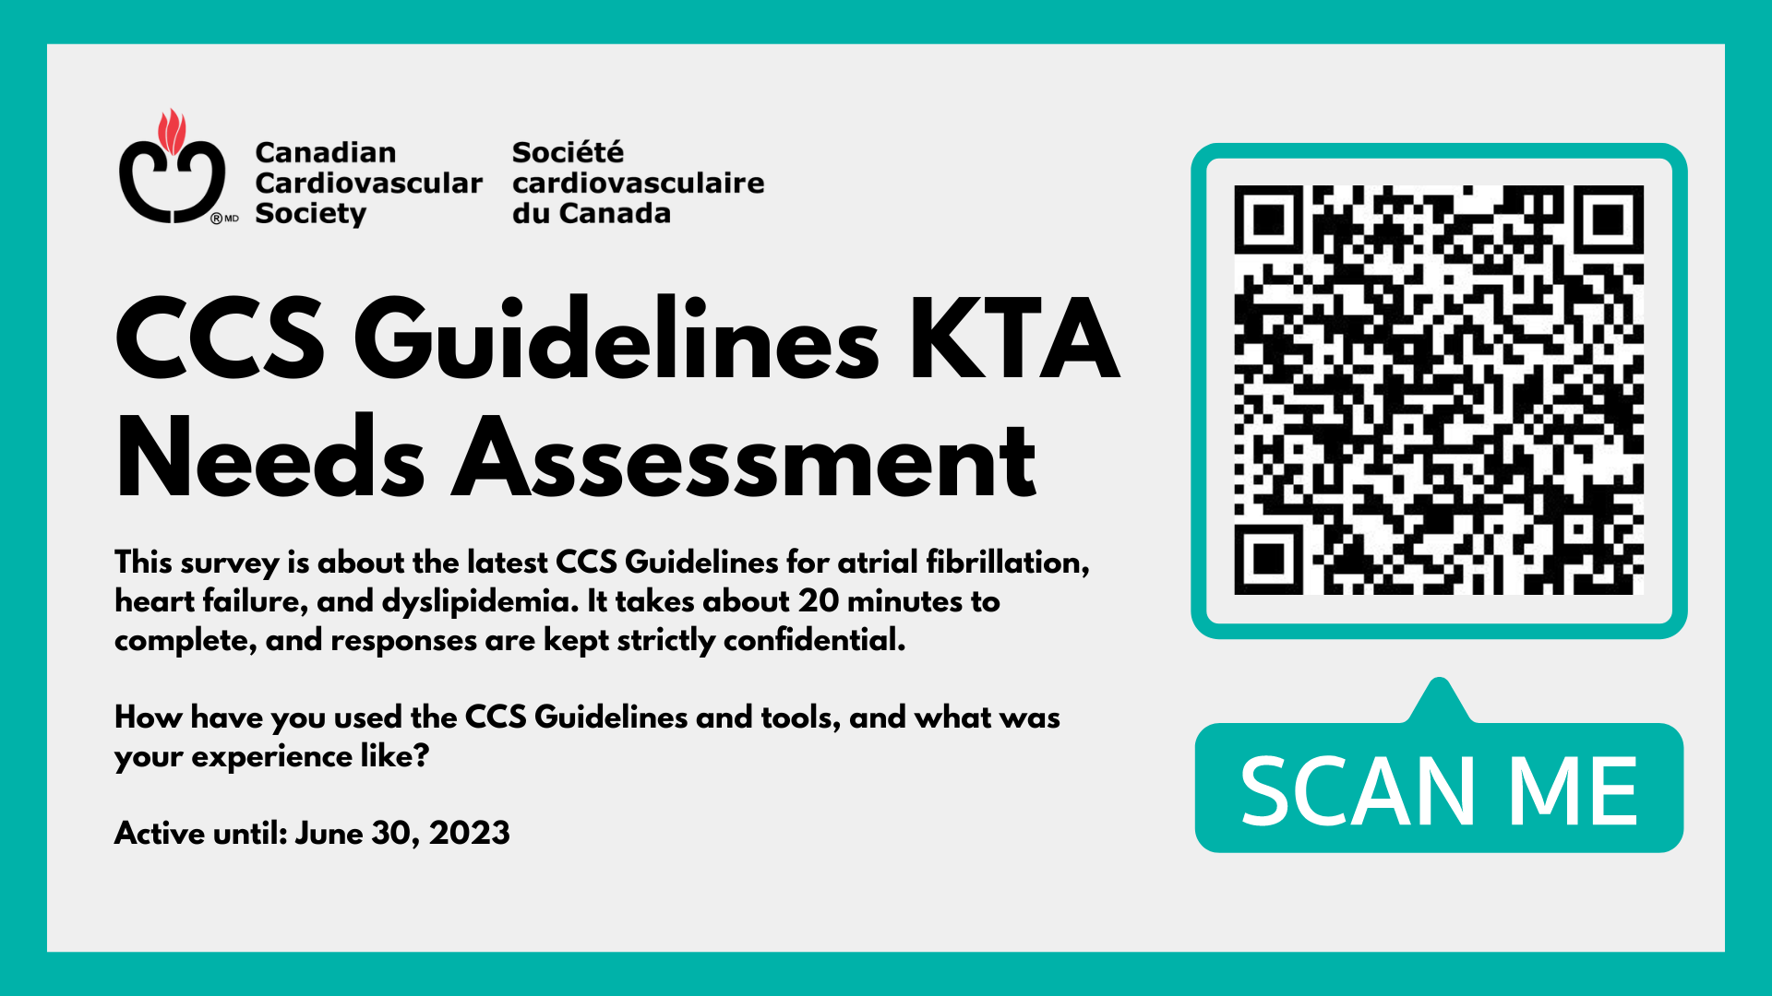
THANK YOU!

Slide 71

THANK YOU!

