Slide 1




CCS 2022 Cardiorenal Guidelines in Action
Webinar
Date: February 10, 2023
Scan the QR Code to fill out the Pre-survey for this session. All data are anonymous and will be used only for quality improvement.

Slide 2
© Canadian Cardiovascular Society. 2022. All rights reserved.
Distribution, transmission or republication is strictly prohibited without the prior written permission of the Canadian Cardiovascular Society.
For medical institution internal education or training (i.e. grand rounds, medical college/classroom education, etc.), kindly consider and implement the following:
  Include the citation for the Canadian Journal of Cardiology
  Add ‘Reproduced with permission from the Canadian Cardiovascular Society. [insert year].’
  Avoid use of CCS logos or trademarks on slides, tools or publications that are not the property of the CCS
  Do not modify the slide content and, the layout and CCS branding on the Guideline-related slides
  Guideline recommendations must be reproduced exactly as published
For an industry supported or involved program, permissions are required:
  If content is published in the Canadian Journal of Cardiology, permissions must be sought through our publisher Elsevier (www.onlinecjc.com)
  If content is property of the CCS, contact guidelines@ccs.ca

Slide 3
We extend our respect to all First Nations, Inuit and Métis peoples for their valuable past and present contributions to this land we call Canada.
We acknowledge the Indigenous Peoples of all the lands that we are each on today, and reaffirm our commitment and responsibility as individuals, to improving relationships between nations and to collaborating in a spirit of reconciliation.

Slide 4
LEARNING OBJECTIVES
Participants will be:
updated on the rapidly evolving evidence base supporting use of SGLT2i and GLP-1 RA for cardiorenal risk reduction
able to identify opportunities for use of SGLT2i and GLP-1 RA in patients with heart failure (HF) or chronic kidney disease (CKD) with or without type 2 diabetes
confident in implementing these new classes through understanding safe strategies for implementation and avoidance of side effects

Slide 5
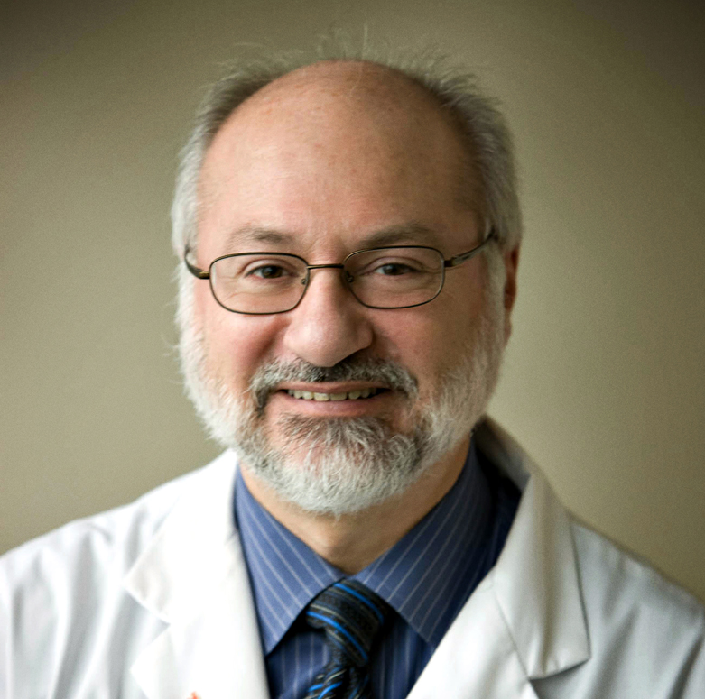
#
MODERATOR
Dr. G. B. John Mancini (co-chair)
MD, FRCPC
Professor of Medicine, University of British Columbia
Centre for Cardiovascular Innovation

Slide 6

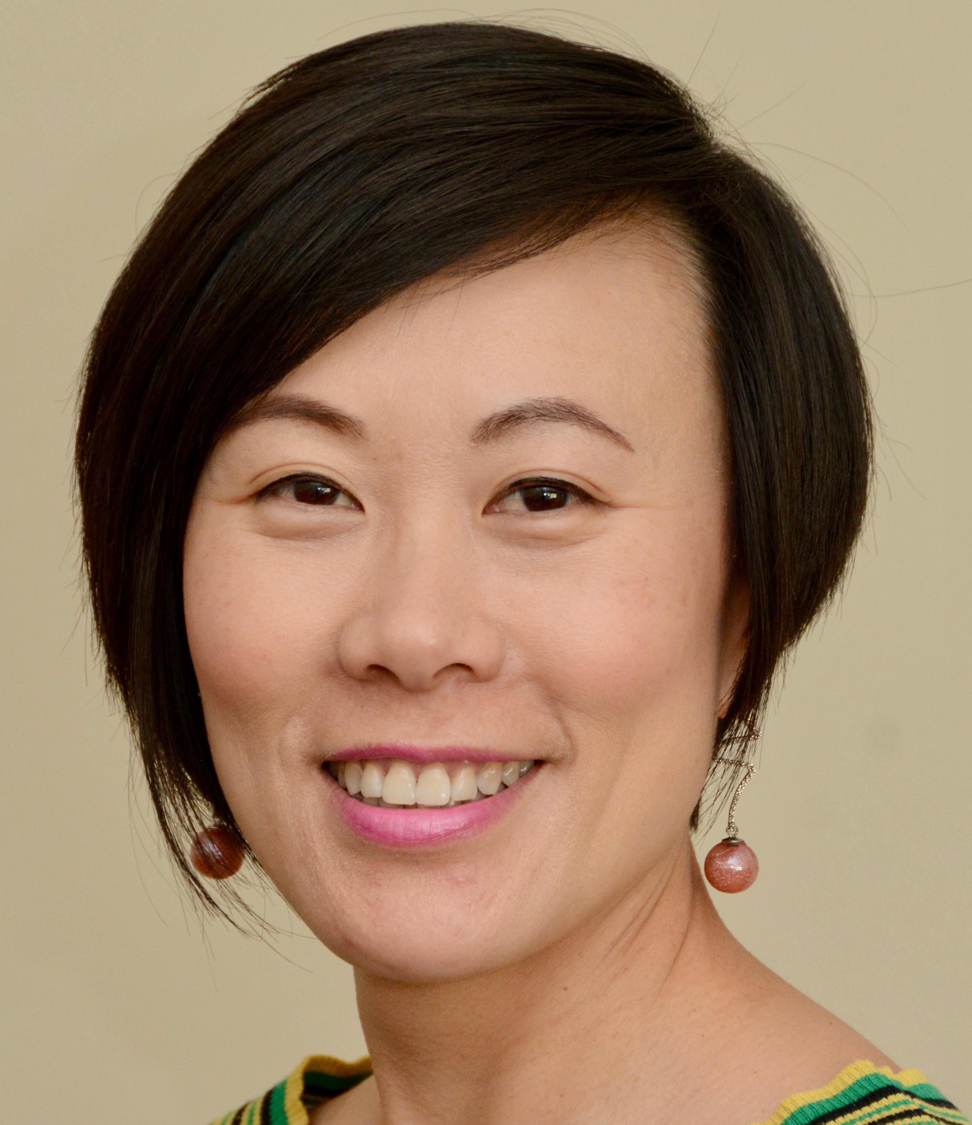
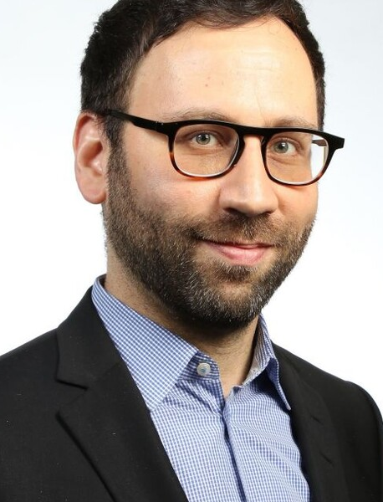

PANELIST
Dr. Eileen O’Meara (co-chair)
MD, FRCPC
Professor of Medicine,
Université de Montréal,
Cardiologist, Montreal Heart Institute
Past co-chair, CCS HF guidelines
Dr. Alice YY Cheng
MD, FRCPC
Endocrinologist,
Associate Professor,
University of Toronto
Dr. David Cherney
MD, CM, PhD, FRCPC
Professor of Medicine, University of Toronto
Clinician Scientist, Division of Nephrology, UHN
Director, Renal Physiology Laboratory, UHN
Senior Scientist, Toronto General Hospital Research Institute
Dr. David Bewick
MD, FRCPC
Associate Professor,
Division of Cardiology, Department of Medicine
New Brunswick Heart Center

Slide 7
DISCLOSURES OF CONFLICT OF INTEREST
Dr. G. B. John Mancini
Consulting fees/Honoraria: Astra Zeneca, Boehringer Ingelheim/Lilly, Janssen, Novo Nordisk
Funded Grants/Clinical Trials: Astra Zeneca, Boehringer Ingelheim/Lilly, Janssen, Novo Nordisk
Advisory Boards/Speakers Bureaus: Novo Nordisk
Dr. David Cherney
Consulting fees/Honoraria: Abbvie, AstraZeneca, Bayer, BMS, Boehringer Ingelheim-Lilly, CSL-Behring, Janssen, Maze, Merck, Mitsubishi-Tanabe, Novo-Nordisk, Prometic
Sanofi
Funded Grants/Clinical Trials: AstraZeneca, Boehringer Ingelheim-Lilly, Janssen, Merck, Novo-Nordisk, Sanofi.
Advisory Boards/Speakers Bureaus:
Dr. Eileen O’Meara
Consulting fees/Honoraria: Astra Zeneca, Boehringer Ingelheim, Bayer, Eli Lilly, Janssen
Funded Grants/Clinical Trials: Astra Zeneca, Boehringer Ingelheim, Bayer, cytokinetics
Advisory Boards/Speakers Bureaus: CIHR Team Grant (SC member for the Canadian Heart Function Alliance) and SC member for DAPA-ACT (TIMI group and Astra Zeneca), NLI for DELIVER (AZ), SC member for HEART-FID (American Regent) and CARDINAL-HF (Cardurion), Canadian Cardiovascular Society

Slide 8
DISCLOSURES OF CONFLICT OF INTEREST (cont’d)
Dr. Alice YY Cheng
Consulting fees/Honoraria: Abbott, Amgen, Astra Zeneca, Bausch, Bayer, Boehringer Ingelheim, Dexcom, Eli Lilly, GSK, HLS Therapeutics, Insulet, Janssen, Medtronic, Merck, Novo Nordisk, Pfizer, Sanofi, Antibody, EOCI, Six Degrees, Liv, CPD Network, Canadian Collaborative Research Network, Master Clinical Alliance, Canadian Medical & Surgical Knowledge Translation Research Group, Sea Courses, Alliance of Best Practices in Health Education, Partners in Progressive Medical Education, Agence Unik, MD Briefcase, LMC Physician Inc., Meducomm, Humber Hospital, Timed Right, The ACADEMY
Funded Grants/Clinical Trials: Abbott, Amgen, Astra Zeneca, Bausch, Bayer, Boehringer Ingelheim, Dexcom, Eli Lilly, GSK, HLS Therapeutics, Insulet, Janssen, Medtronic, Merck, Novo Nordisk, Pfizer, Sanofi, Takeda
Advisory Boards/Speakers Bureaus: Applied Therapeutics, Sanofi
Dr. David Bewick
Consulting fees/Honoraria: Amgen, Sanofi, Servier
Funded Grants/Clinical Trials: None
Advisory Boards/Speakers Bureaus: Amgen, HLS, Novartis, Servier

Slide 9
INTRODUCTION
Dr. G. B. John Mancini MD, FRCPC

Slide 10
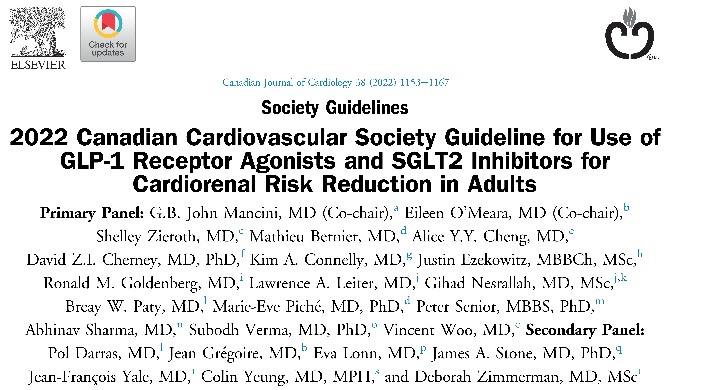

Slide 11
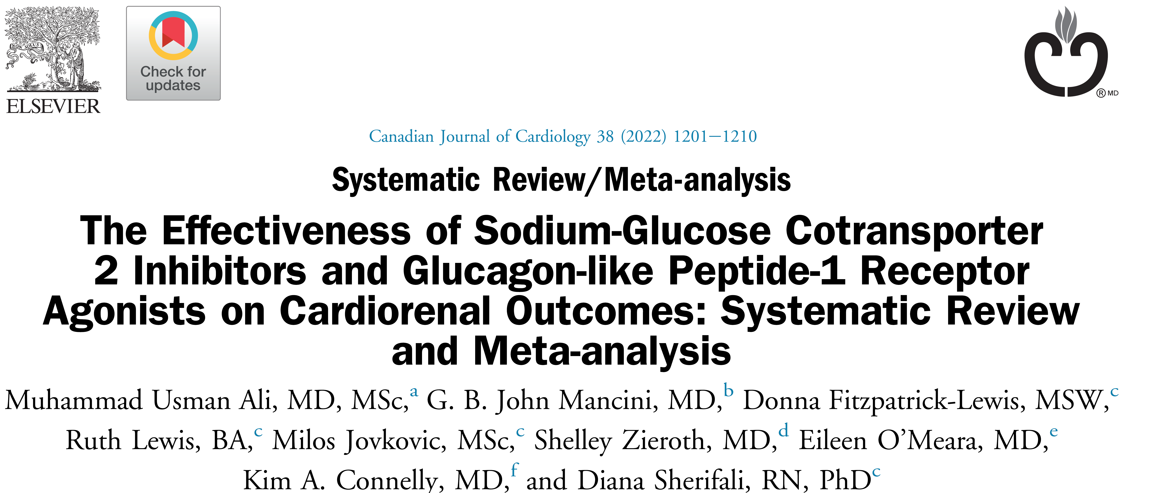

Slide 12
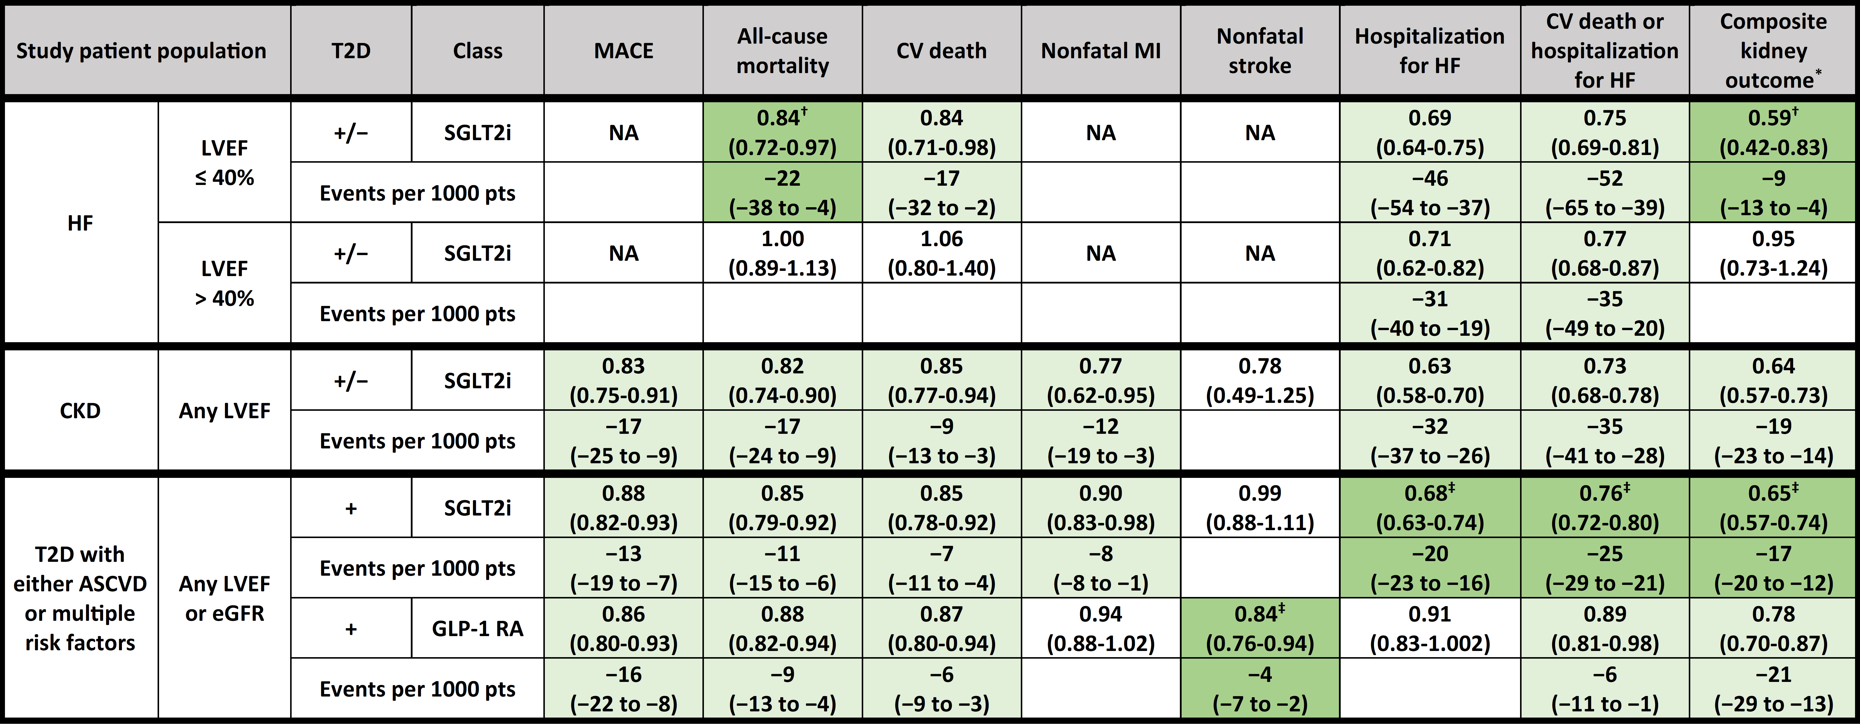
Summary of relative (hazard ratios) and absolute event reductions per 1000 treated patients for cardiorenal outcomes in study populations with heart failure, chronic kidney disease, or type 2 diabetes

Slide 13
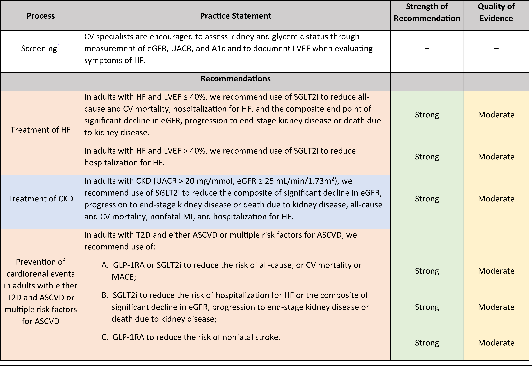

Slide 14
Change CV practice!

Slide 15
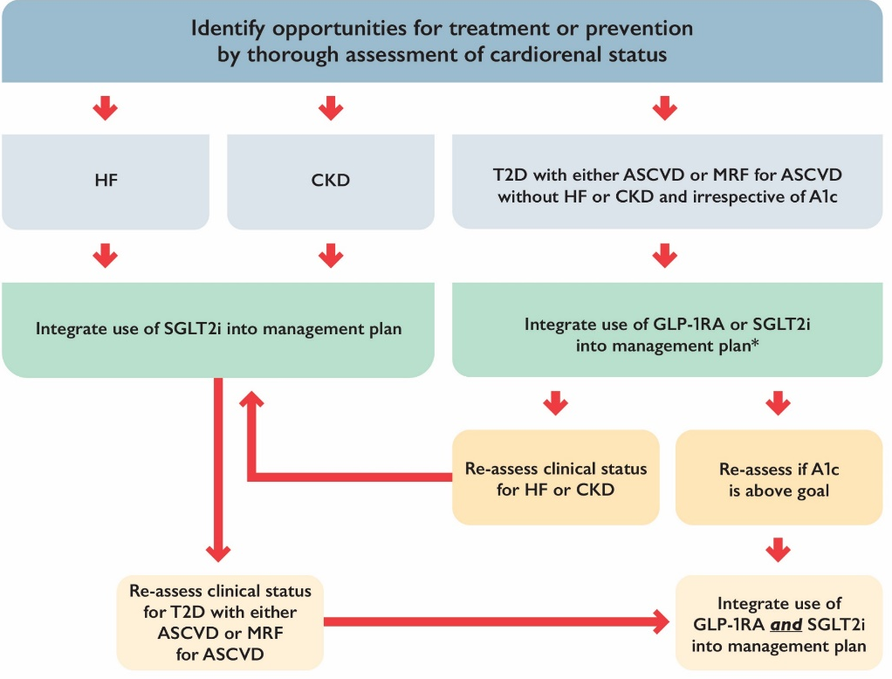
“ONE PAGER”
Available at ccs.ca/companion-resources/

Slide 16
HEART FAILURE
Dr. Eileen O’Meara MD, FRCPC

Slide 17
LEARNING OBJECTIVES
During this section, participants will:
Review the burden of heart failure in 2022
Understand the indications for treatment with a SGLT2 inhibitor in heart failure (HF)
Review the data from recent large clinical trials on the clinical impact of SGLT2 inhibitors in HFrEF and HFpEF
Find out if there are any interactions between the benefits of SGLT2 inhibitors in HF and baseline NT-proBNP levels or baseline LVEF

Slide 18
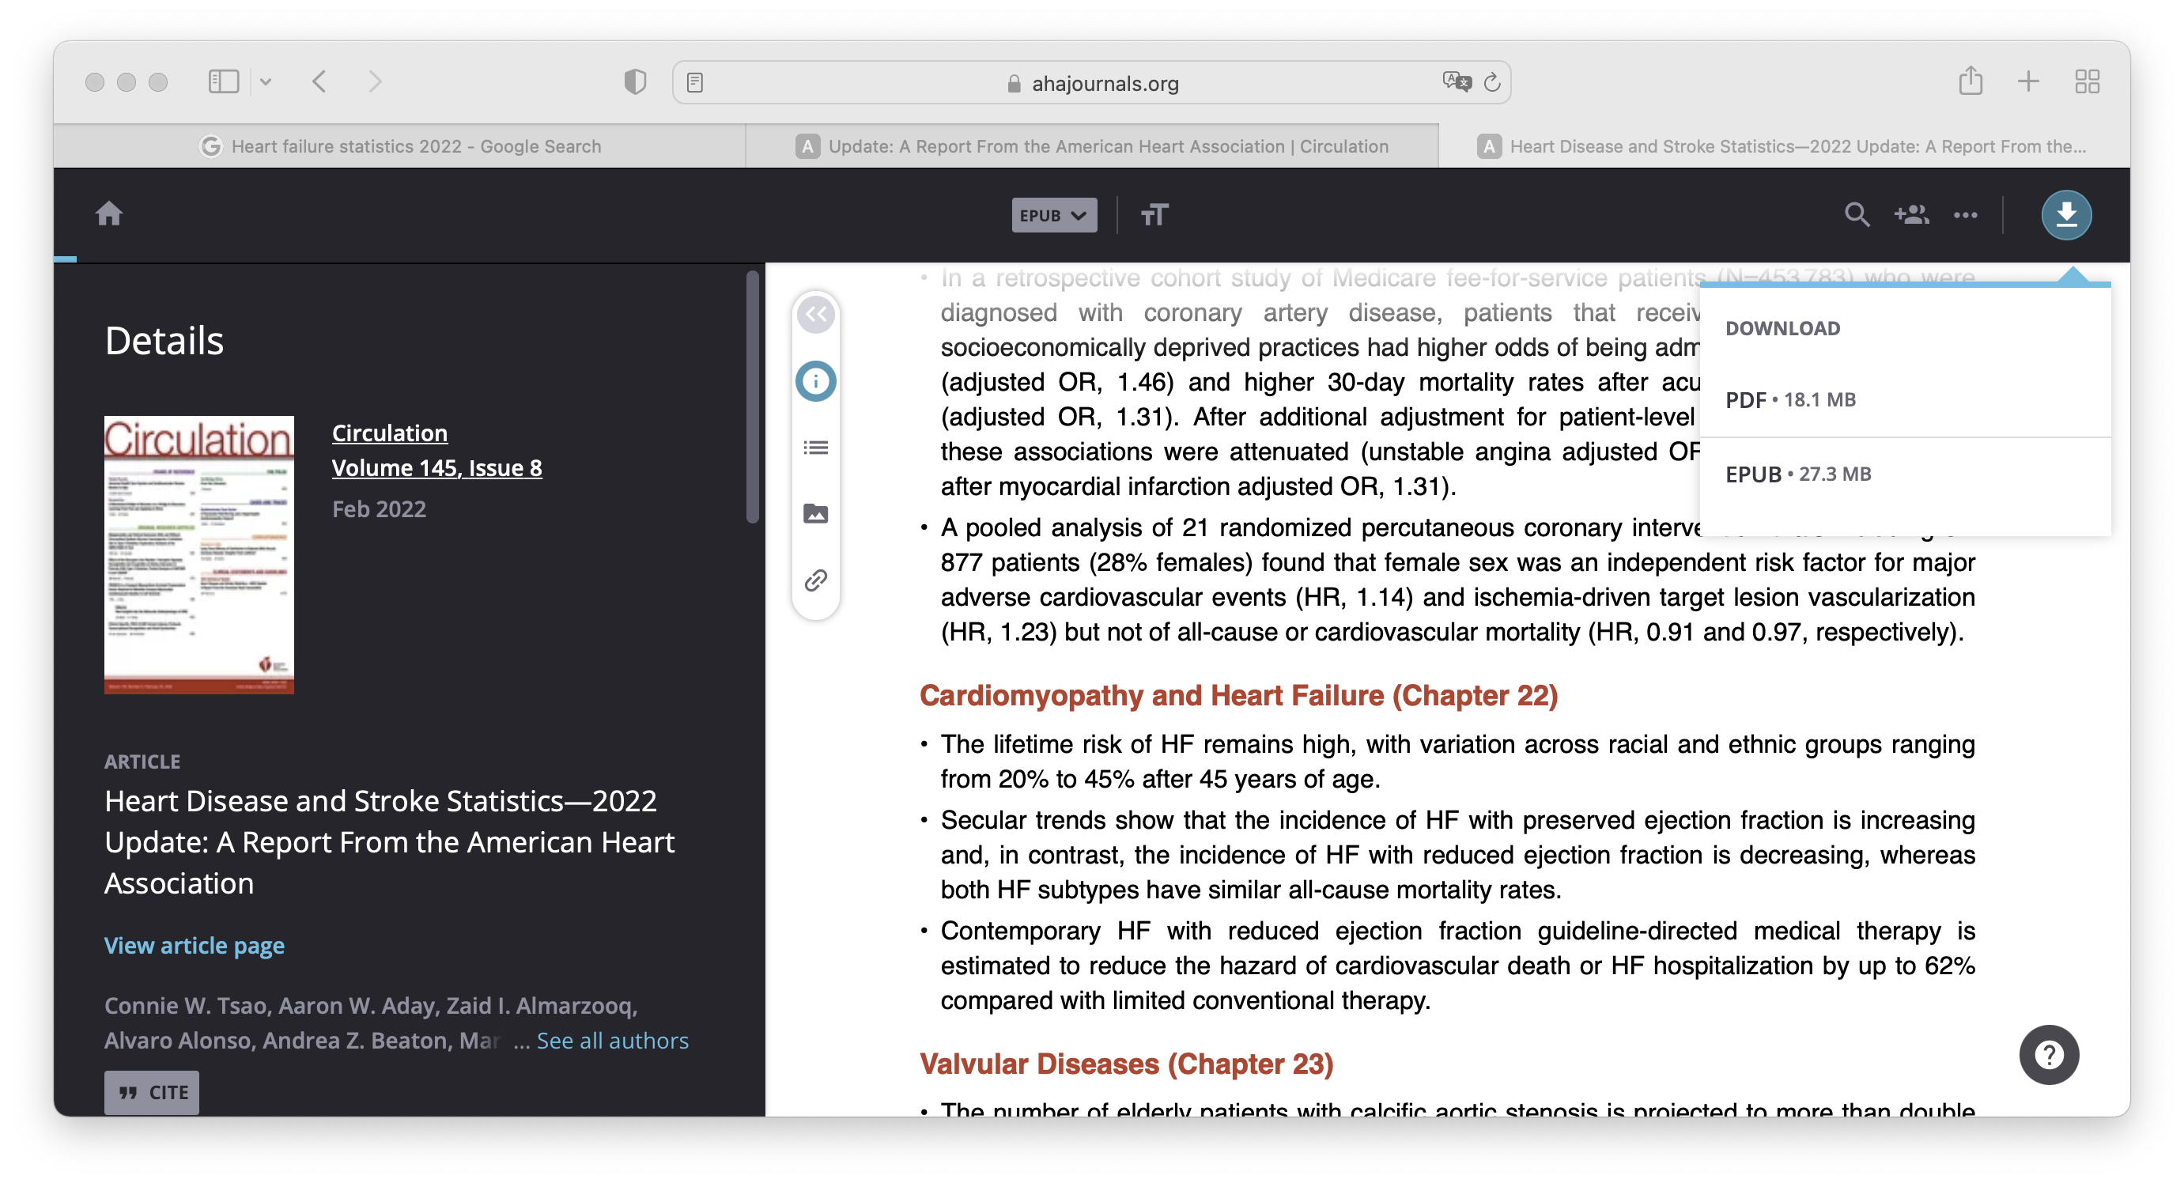
Heart Failure
1
2
3
Prevalence
Burden
750,000
Canadians are living
with HF¹
50%
have EF > 40%²
est. 50%
of HF hospitalizations
are for HFpEF³⁻⁷
up to 75%
5-year mortality rate⁸
Undetected
>50%
are undiagnosed⁹
EF, ejection fraction; est, estimated; HF, heart failure; HFpEF, heart failure with preserved ejection fraction.
1. Heart and Stroke Foundation of Canada. Heart Failure. Online at https://www.heartandstroke.ca/heart-disease/conditions/heart-failure. Accessed April 29, 2022; 2. Borlaug BA. Nat Rev Cardiol. 2020 Sep;17(9):559–73; 3. Lenzen MJ et al. Eur Heart J. 2004;25(14): 1214-20; 4. Mavrea AM et al. Clin Interv Aging. 2015;10: 979-90; 5. Crespo-Leiro MG et al. Eur J Heart Fail. 2016;18(6): 613-25; 6. Oktay AA et al. Curr Heart Fail Rep. 2013;10(4):401–10; 7. Fonarow GC al. J Am Coll Cardiol. 2007;50(8):768–77; 8. Shah KS et al. JACC. 2017;70(20):2476–86; 9. Groenewegen A et al. Eur J Heart Fail. 2020;22(8):1342–56.
Notes:
Andrea
Speak to slide

Slide 19
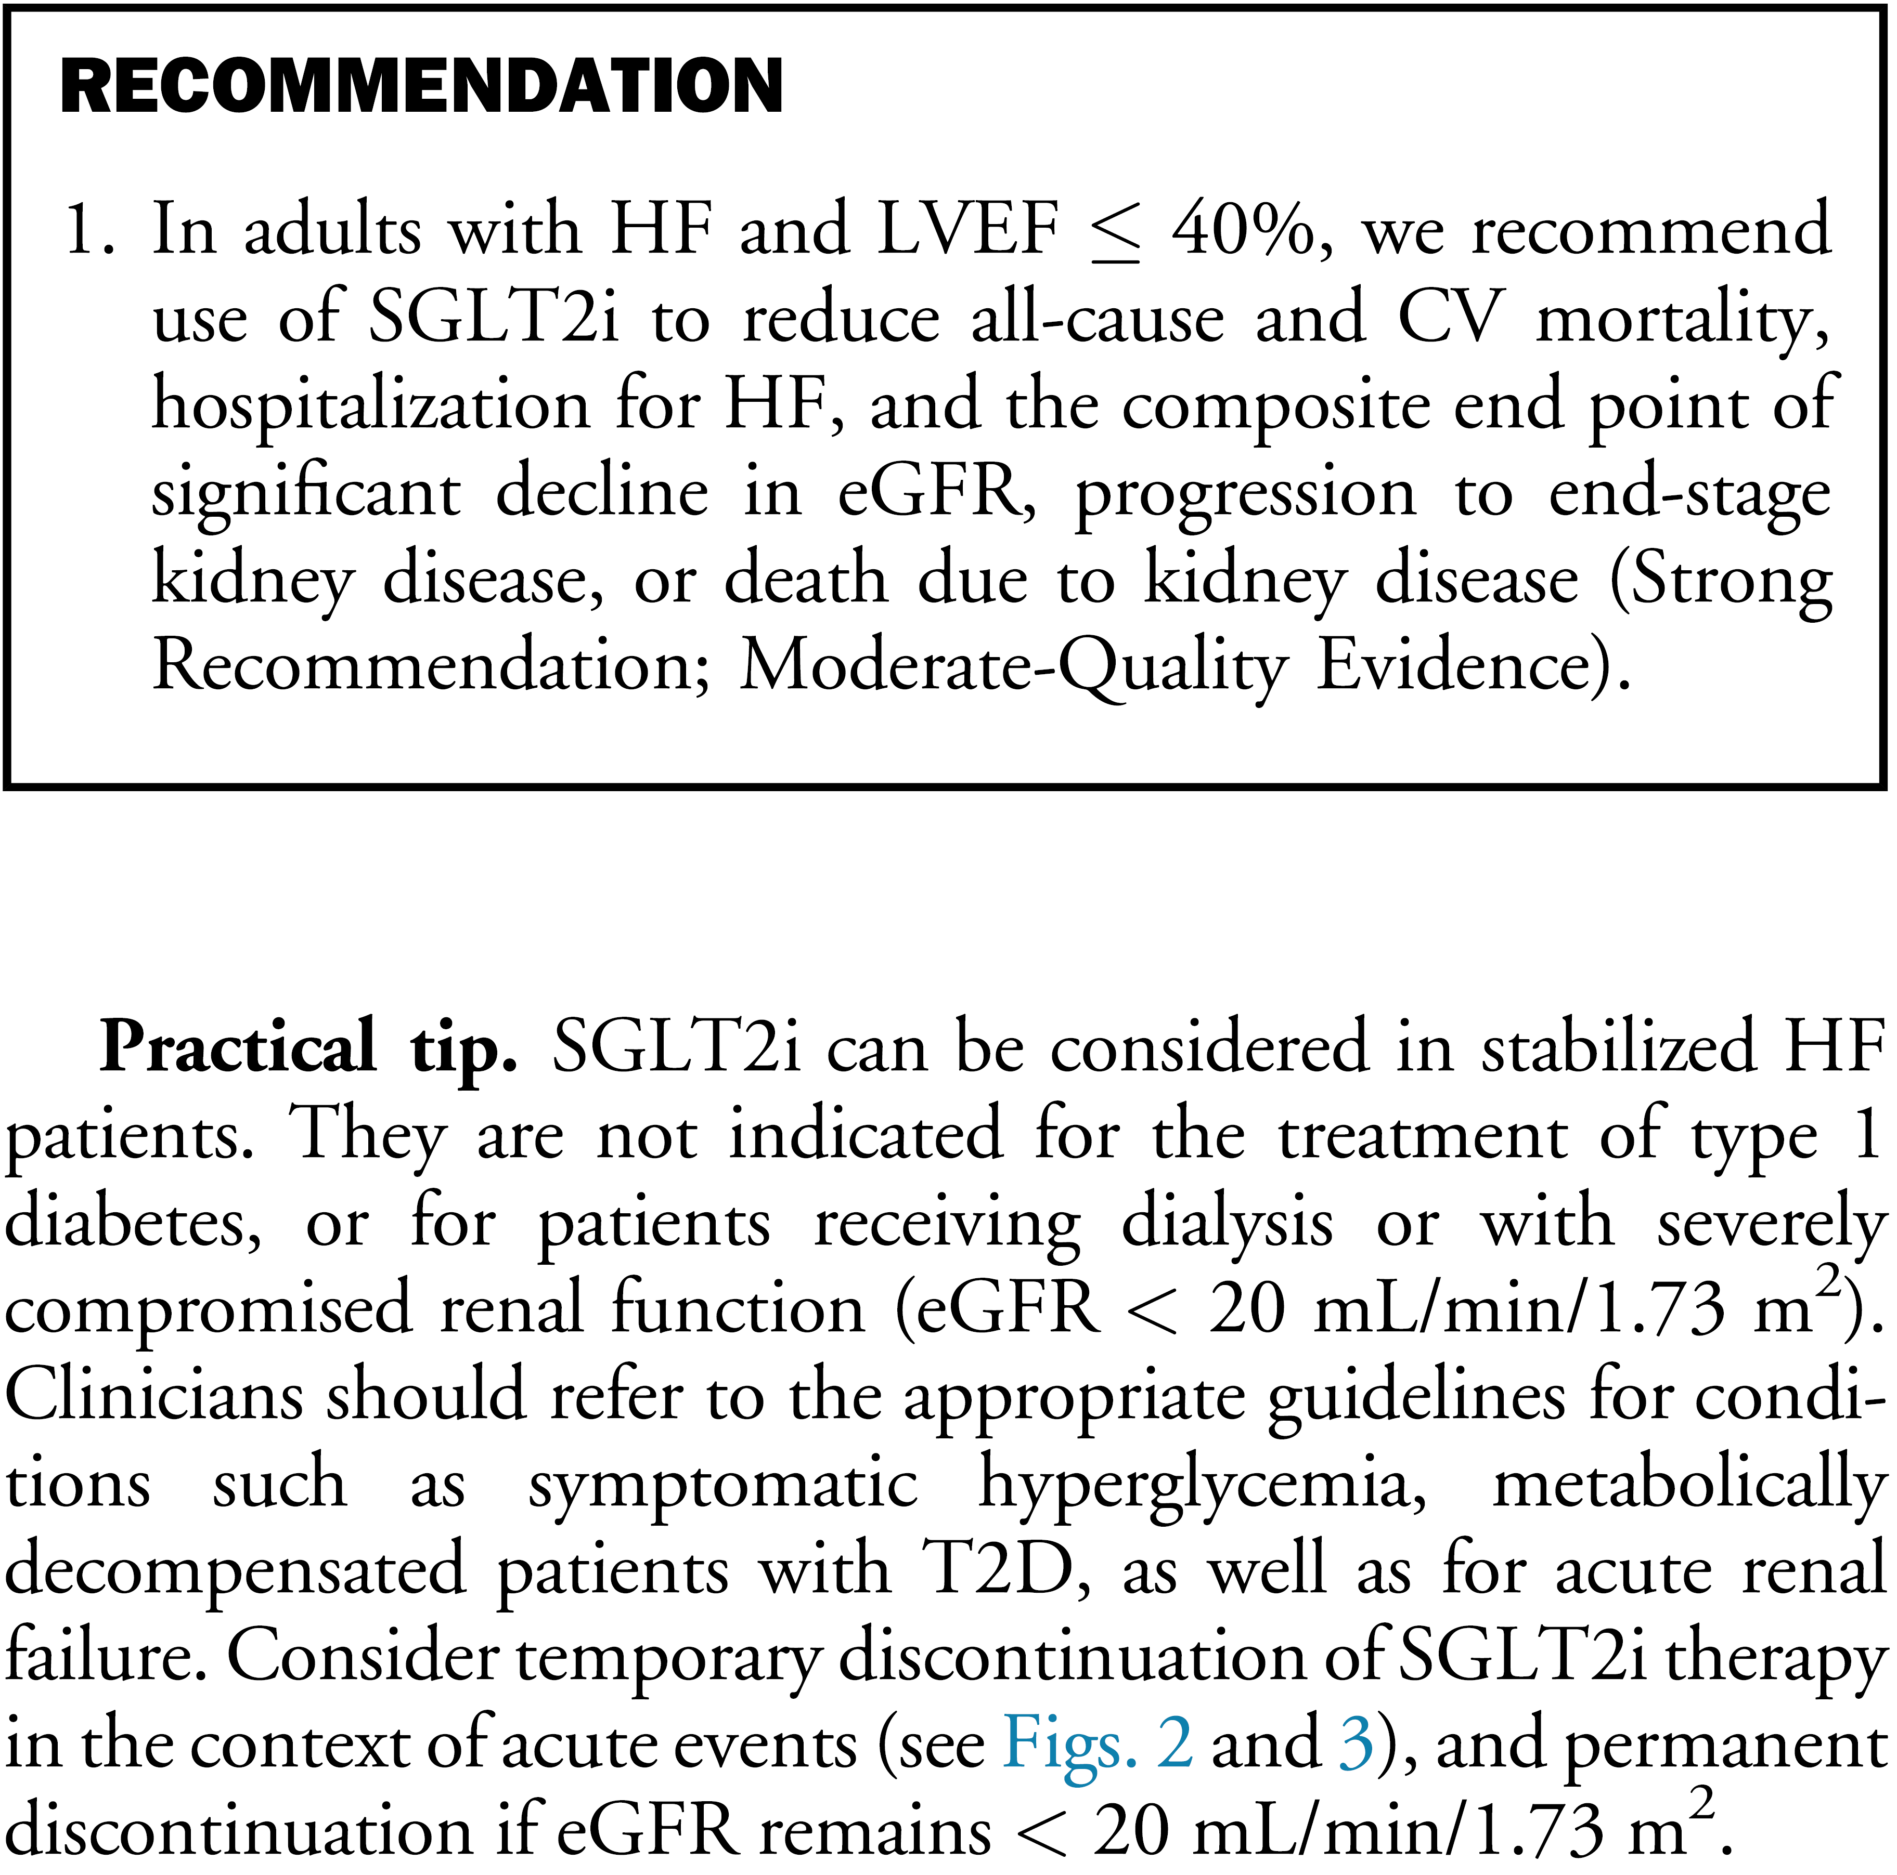
HF and LVEF
≤ 40%
Mancini et al. Can J Cardiol 2022;38:1153-67

Slide 20
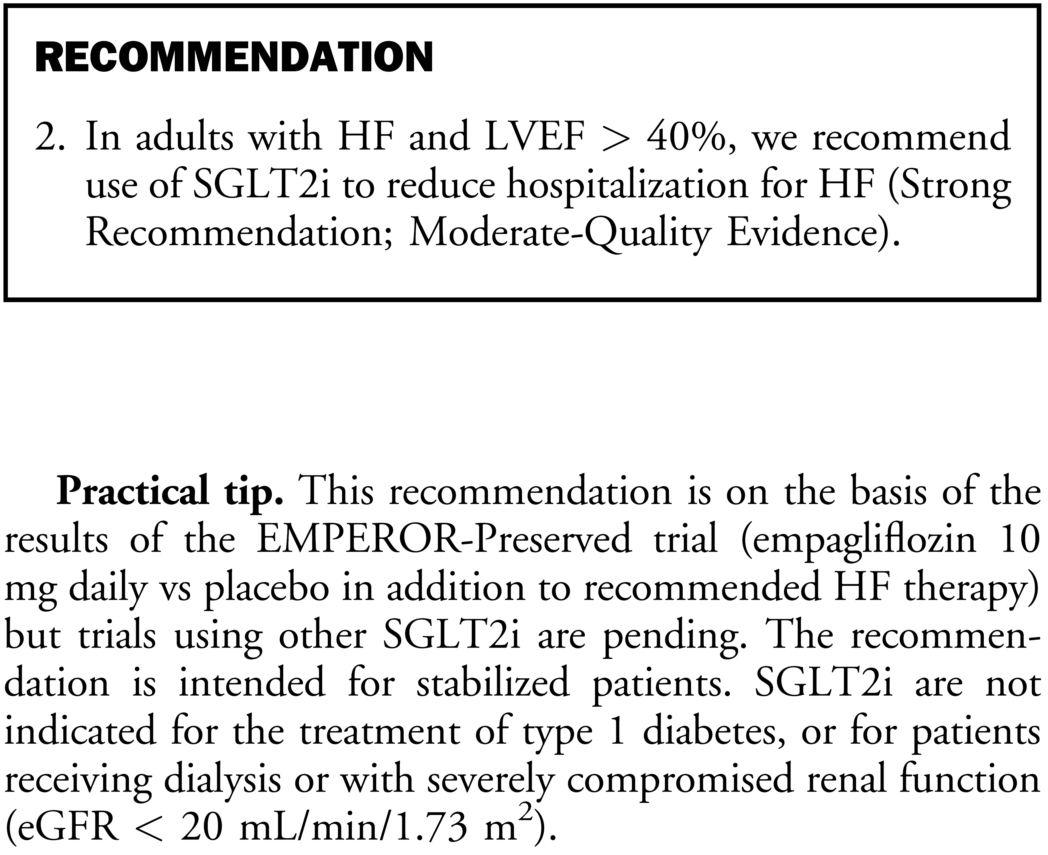
HF and LVEF
> 40%
Mancini et al. Can J Cardiol 2022;38:1153-67

Slide 21


DELIVER Study Design
Eligibility Criteria
Age ≥ 40 years
NYHA class II-IV
LVEF > 40% (including improved EF)
Evidence of structural heart disease (LVH or LA dilatation) Elevatated NP levels (NTproBNP > 300 pg/ml or 600 pg/ml in AFF)
Ambulatory or hospitalized for HF
Double-insu
Période de traitement
Dapagliflozin 10mg die
Event Driven (1117 estimated events)
Placebo
Solomon et al. Eur J Heart Fail 2021
Notes:
THE DELIVER trial was a randomized, double-blind, placebo controlled trial testing the hypothesis that dapagliflozin would reduce cardiovascular death or worsening heart failure in patients with heart failure and mildly reduced or preserved ejection fraction
Patients were eligible of they were 40 years of age or older, had NYHA class 2-4 heart failure, had a left ventricular ejection fraction greater than 40%, even if they had had a previous LVEF of less than 40%, had evidence of structural heart disease, elevation in natriuretic peptides, and were either ambulatory or hospitalized for heart failure
Patients were randomized to dapagliflozin 10mg once daily or placebo, with a median followup time of 2.3 years.

Slide 22
DELIVER and EMPEROR-Preserved meta-analysis
Cardiovascular Death or First Hospitalization for HF
HR (95% CI)
Despite methodological differences, CCS guideline conclusions remain unchanged.
CVD or HHF:
0.77 (0.68 – 0.87)
↓ 20% (13-27%) Relative Risk Reduction of Primary Endpoint with Consistent Reductions in Both Components
Study
DELIVER
0.80 (0.71-0.91)
EMPEROR-Preserved
0.79 (0.69-0.90)
HR 0.80; 95% CI 0.73-0.87 P<0.0001
Overall
0.50
0.75
1.00 1.25
Cardiovascular Death (excluding Unknown Death)
HR (95% CI)
Hospitalization for HF
HR (95% CI)
Study
Study
DELIVER
EMPEROR-Preserved
0.88 (0.74-1.05)
DELIVER
0.77 (0.67-0.89)
0.88 (0.73-1.07)
HR 0.88; 95% CI 0.77-1.00 P=0.052
EMPEROR-Preserved
0.71 (0.60-0.84)
Overall
Overall
HR 0.74; 95% CI 0.67-0.83 P<0.0001
0.74 ( 0.67, 0.83)
0.50
0.75
1.00 1.25
0.50
0.75
1.00 1.25
CVD: 1.06 (0.80 – 1.40)
hHF: 0.71 (0.62 – 0.82)
P_{heterogeneity} >0.40 for all endpoints

Slide 23
DAPA-HF and DELIVER pooled dataset
Dapagliflozin 10mg once daily vs placebo
Median follow-up = 22 (IQR 17-30) months
Pooled dataset n=11,007
n=4,744
n=6,263
DAPA-HF
DELIVER
2
88
16
20
25
30
35
40
44
50
55
60
65
70
74
1st percentile
Mean
99th percentile
LVEF (%)
McMurray JJV et al Eur J Heart Fail. 2019;21:665-675
Solomon SD et al Eur J Heart Fail 2021;23:1217-1225

Slide 24
DAPA-HF & DELIVER: CV death/HF hospitalization
HR 0.78 (95% CI 0.72-0.86) p<0.001
Placebo better
Dapagliflozin better
P for interaction =0.71

Slide 25
↓ 23% (18-28%) Relative Risk Reduction of Primary Endpoint
(CV Death or HF Hospitalization)
Meta-Analysis of 5 Large Placebo-Controlled Trials:
Study
HR (95% CI)
DAPA-HF
0.75 (
0.65,
0.85)
DELIVER
0.80 (
0.71,
0.91)
EMPEROR-Preserved
0.79 (
0.69,
0.90)
EMPEROR-Reduced
0.75 (
0.65,
0.86)
SOLOIST-WHF*
0.71 (
0.56,
0.90)
HR 0.77; 95% CI 0.72-0.82
P<0.001
P_{heterogeneity} = 0.87
Overall
0.50
0.75
1.00
1.25
*SOLOIST-WHF evaluated an SGLT1/2 inhibitor

Slide 26
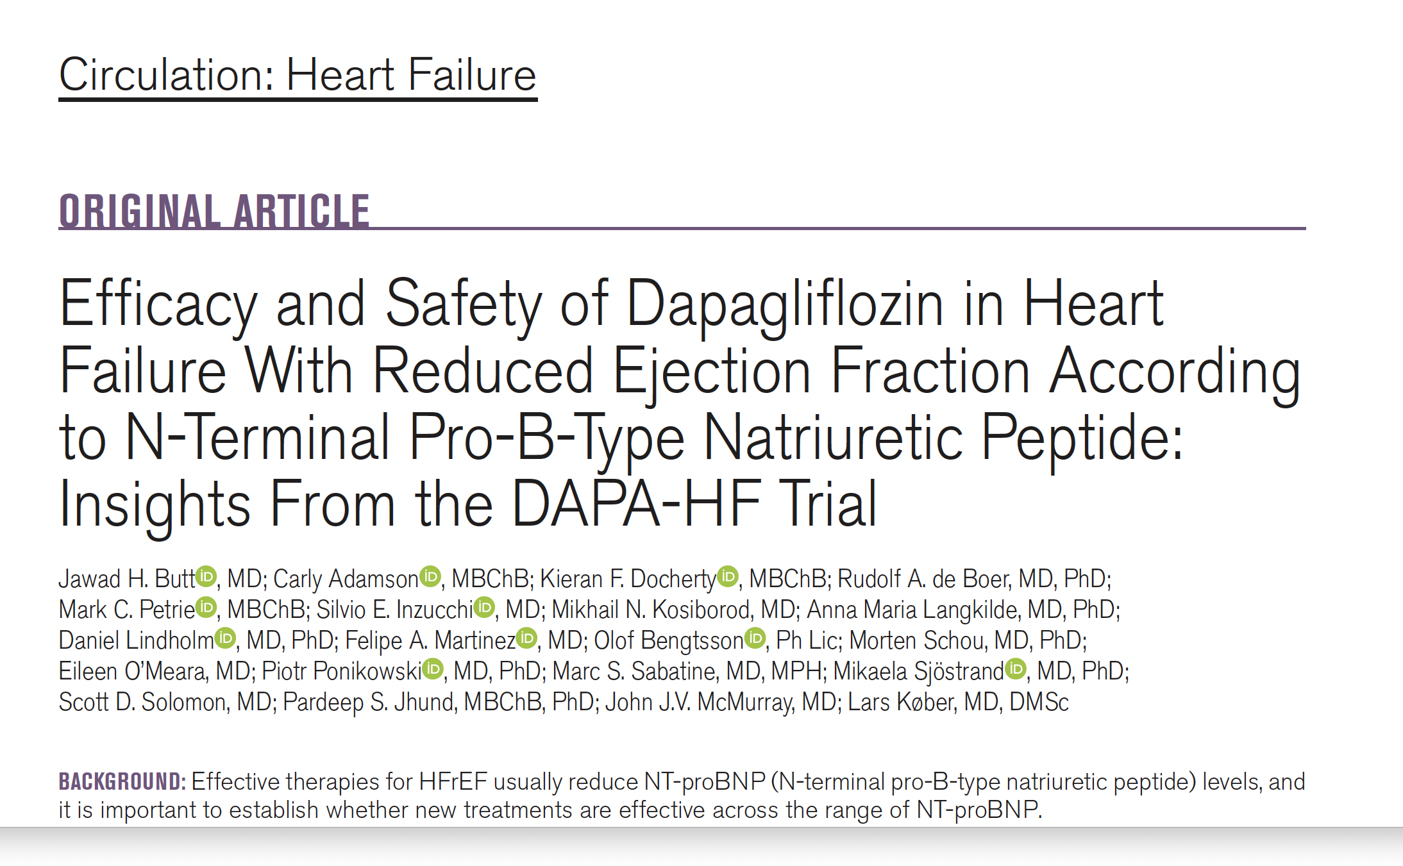
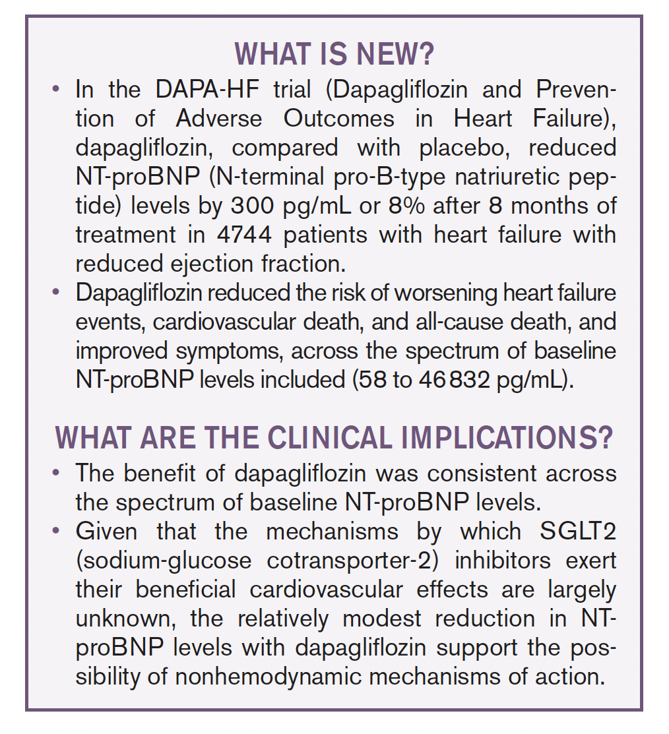
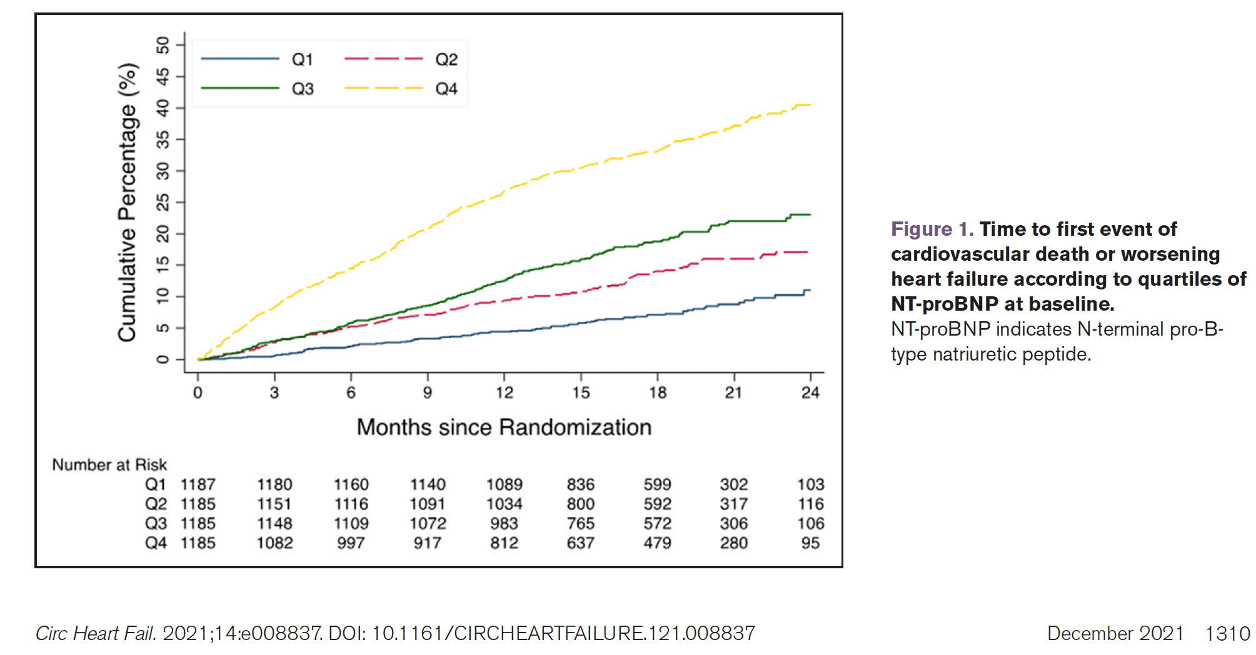

Slide 27
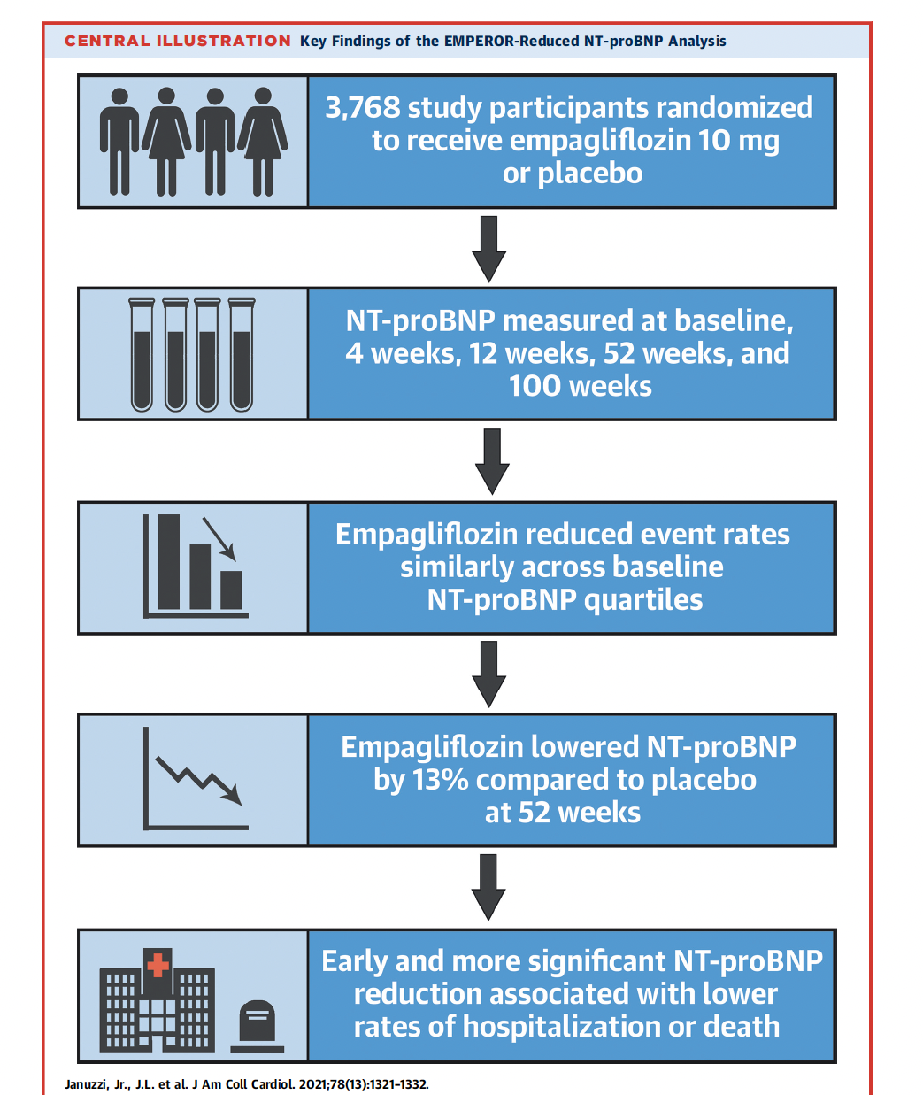
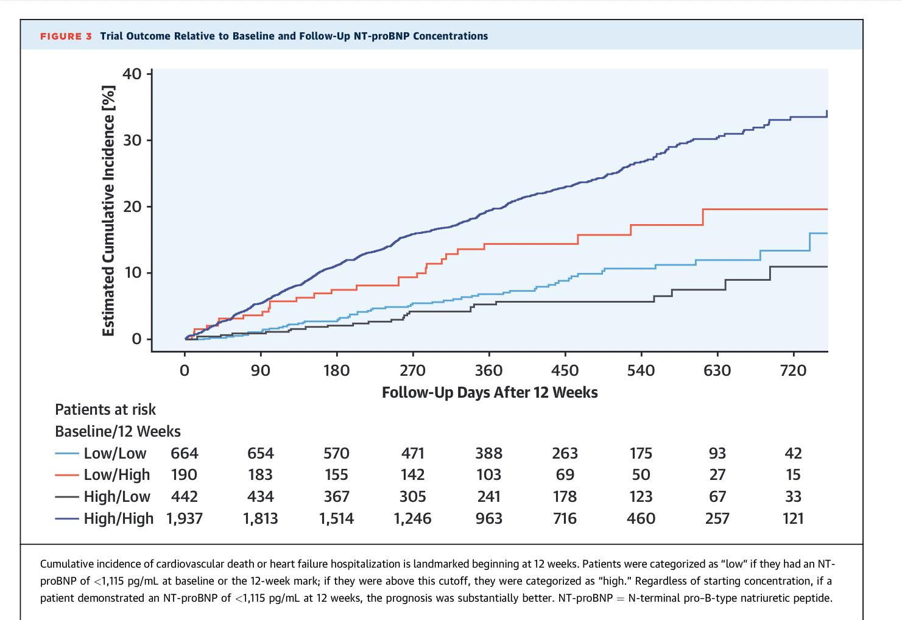
Januzzi JL, et al. J Am Coll Cardiol. 2021;78:1321–1332.

Slide 28
CHRONIC KIDNEY DISEASE
Dr. David Cherney MD, FRCPC

Slide 29
LEARNING OBJECTIVES
During this sections, participants will:
Review the epidemiology and diagnosis of Chronic Kidney Disease (CKD)
Updated on the evidence for clinical approaches to management
Understand the practice recommendation for the treatment of CKD based on the 2022 CCS Cardiorenal Guidelines

Slide 30
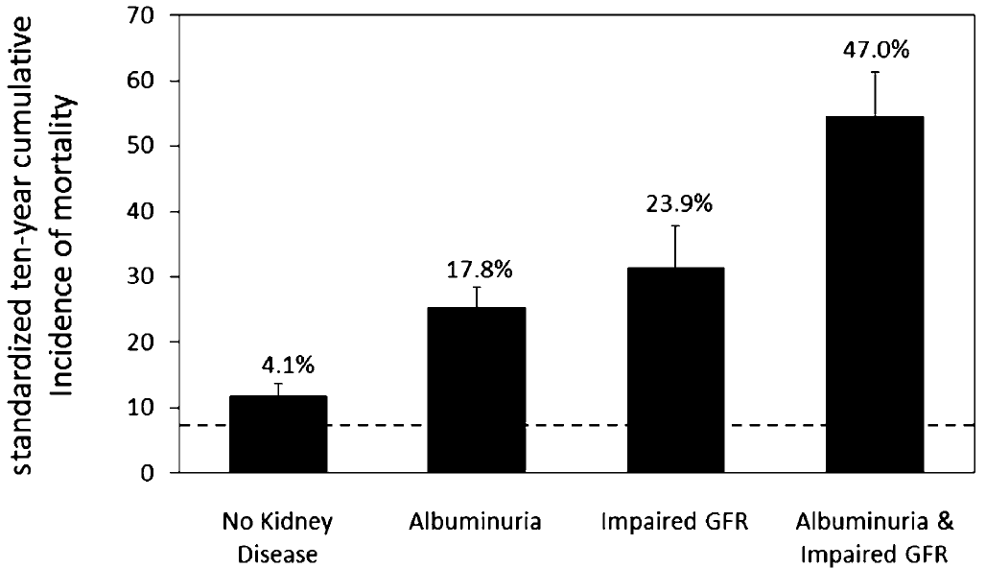
Ten-year mortality in type 2 diabetes by kidney disease manifestation
Absolute differences in mortality risk were estimated using linear regression and were adjusted for age, sex, and race. Standardized 10-year all-cause cumulative incidences were estimated for the mean levels of the covariates in the study population. The dashed line indicates mortality in persons without diabetes or kidney disease (the reference group). Afkarian et al. J Am Soc Nephrol 24: 302–308, 2013

Slide 31


It is recommended that all people with T2D are screened for CKD at least annually with dual assessment of eGFR and albuminuria
ADA 2022 Standards of Medical Care recommendations¹
11.1a At least annually, urinary albumin (e.g. spot urinary albumin-to-creatinine ratio [UACR]) and estimated glomerular filtration rate (eGFR) should be assessed in people with type 1 diabetes with duration of ≥5 years and in all people with type 2 diabetes regardless of treatment. B
11.1b People with diabetes and UACR ≥300 mg/g and/or an eGFR 30–60 ml/min/1.73 m² should be monitored twice annually to guide therapy. B
Dual assessment of eGFR and albuminuria^{2,3}
  Glomerular filtration rate:
  flow rate of filtered fluid throughout the kidney and a measure of kidney function²
  Albuminuria:
  indicates increased glomerular permeability and is a measure of kidney damage³
CKD, chronic kidney disease; eGFR, estimated glomerular filtration rate; UACR, urine albumin-to-creatinine ratio. 1. American Diabetes Association. Diabetes Care 2022;45:S1; 2. Kidney Disease: Improving Global Outcomes (KDIGO) CKD Work Group. Kidney Int Suppl 2013;3:1; 3. Shlipak MG et al. Kidney International 2021;99:34

Slide 32
Kidney outcomes using generally consistent definitions:
Sustained ≥40% decline in eGFR, ESKD or renal death
Kidney composite outcomes
HR (95% CI)
EMPA-REG OUTCOME¹
Sustained ≥40% reduction in eGFR, renal-replacement therapy (dialysis or transplantation), or death from renal causes
0.55
(0.41, 0.73)
CANVAS Program²
Sustained ≥40% reduction in eGFR, renal-replacement therapy (dialysis or transplantation), or death from renal causes
0.60
(0.47, 0.77)
DECLARE-TIMI 58³
Sustained ≥40% decrease in eGFR to
<60 mL/min/1.73 m² and/or end-stage renal disease and/or renal death
0.53
(0.43, 0.66)
VERTIS CV⁴
Sustained ≥40% reduction in eGFR, renal-replacement therapy (dialysis or transplantation), or death from renal causes
0.66
(0.50, 0.88)
Perkovic V et al. Nephrol Dial Transplant (2019) 1–9, Neal B et al. N Engl J Med 2017;377:644-657; ³Wiviott SD et al. N Engl J Med 2019;380:347-357. ⁴Cherney et al. Diabetologia 2021

Slide 33
EMPA-KIDNEY enrolls a broad CKD population
 |  |  | Albuminuria stage, description and range (mg/g)
 |  |  | A1 | A2 | A3
 |  |  | Normal to mildly increased | Moderately increased | Severely increased
 |  |  | <30 | 30–300 | >300
eGFR category, description and range (ml/min/1.73 m²) | G1 | ≥90
 | G2 | 60–89
 | G3a | 45–59
 | G3b | 30–44
 | G4 | 15–29
 | G5 | <15
CREDENCE population¹
eGFR ≥30 to <90 ml/min/1.73 m² and UACR >300 mg/g
CREDENCE population¹
eGFR ≥30 to <90 ml/min/1.73 m² and UACR >300 mg/g
DAPA-CKD population²
eGFR >25 to <75 ml/min/1.73 m²
and UACR >200 mg/g
EMPA-KIDNEY population³
eGFR ≥20 to <45 ml/min/1.73 m²
eGFR ≥45 to <90 ml/min/1.73 m²
and UACR ≥200 mg/g
Low risk*
Moderately increased risk
High risk
Very high risk
EMPA-Kidney

Slide 34
CREDENCE Primary Outcome: ESKD, Doubling of Serum Creatinine, or Renal or CV Death
Hazard ratio, 0.70 (95% CI, 0.59–0.82)
P = 0.00001
340 participants
245 participants
Placebo
Canagliflozin
6
12
18
24
30
36
42
No. at risk
Placebo | 2199 | 2178 | 2132 | 2047 | 1725 | 1129 | 621 | 170
Canagliflozin | 2202 | 2181 | 2145 | 2081 | 1786 | 1211 | 646 | 196
Perkovic et al. NEJM 2019

Slide 35
DAPA-CKD Primary Composite Outcome: Prespecified Subgroup Analyses
 |  |  |  | Number of Events
 | HR (95% CI) |  |  | DAPA 10 mg (N=2152) | Placebo (N=2152) | HR | 95% CI | p-value Interaction
Composite of ≥50% eGFR Decline, ESKD, or Renal or CV Death
All Patients |  |  |  | 197 | 312 | 0.61 | (0.51, 0.72)
T2D at Baseline |  |  |  |  |  |  |  | 0.24
Yes |  |  |  | 152 | 229 | 0.64 | (0.52, 0.79)
No |  |  |  | 45 | 83 | 0.50 | (0.35, 0.72)
UACR (mg/g) at Baseline |  |  |  |  |  |  |  | 0.52
≤1000 |  |  |  | 44 | 84 | 0.54 | (0.37, 0.77)
>1000 |  |  |  | 153 | 228 | 0.62 | (0.50, 0.76)
eGFR (mL/min/1.73m²) at Baseline |  |  |  |  |  |  |  | 0.22
<45 |  |  |  | 152 | 217 | 0.63 | (0.51, 0.78)
≥45 |  |  |  | 45 | 95 | 0.49 | (0.34, 0.69)
0.13
0.50
1.00
1.25
DAPA 10 mg Better
Placebo Better
Heerspink HJL. Presented at: ESC Congress – The Digital Experience; August 29 - September 1, 2020.
Notes:
Speaker Notes:
The effect of dapagliflozin on the primary outcome was generally consistent across prespecified subgroups, including patients with or without T2D, those with eGFR <45 or ≥45 mL/min/1.73m², and those with UACR ≤1000 or >1000 mg/g at baseline.
Reference:
Heerspink HJL. Dapagliflozin in patients with chronic kidney disease [presentation]. Presented at: European Society of Cardiology Congress – The Digital Experience; August 29 - September 1, 2020.

Slide 36
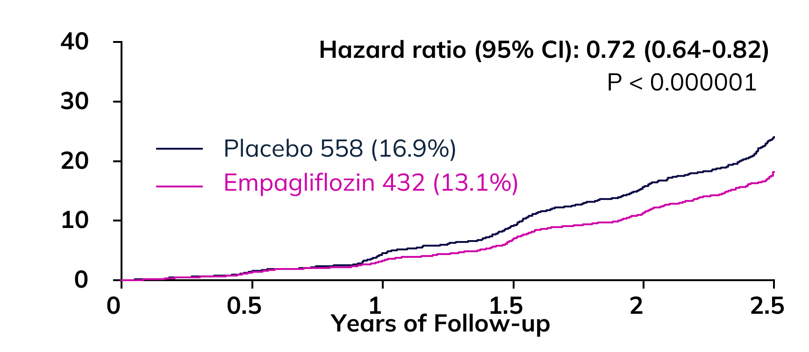
Primary Composite Outcome
Herrington et al NEJM 2023

Slide 37
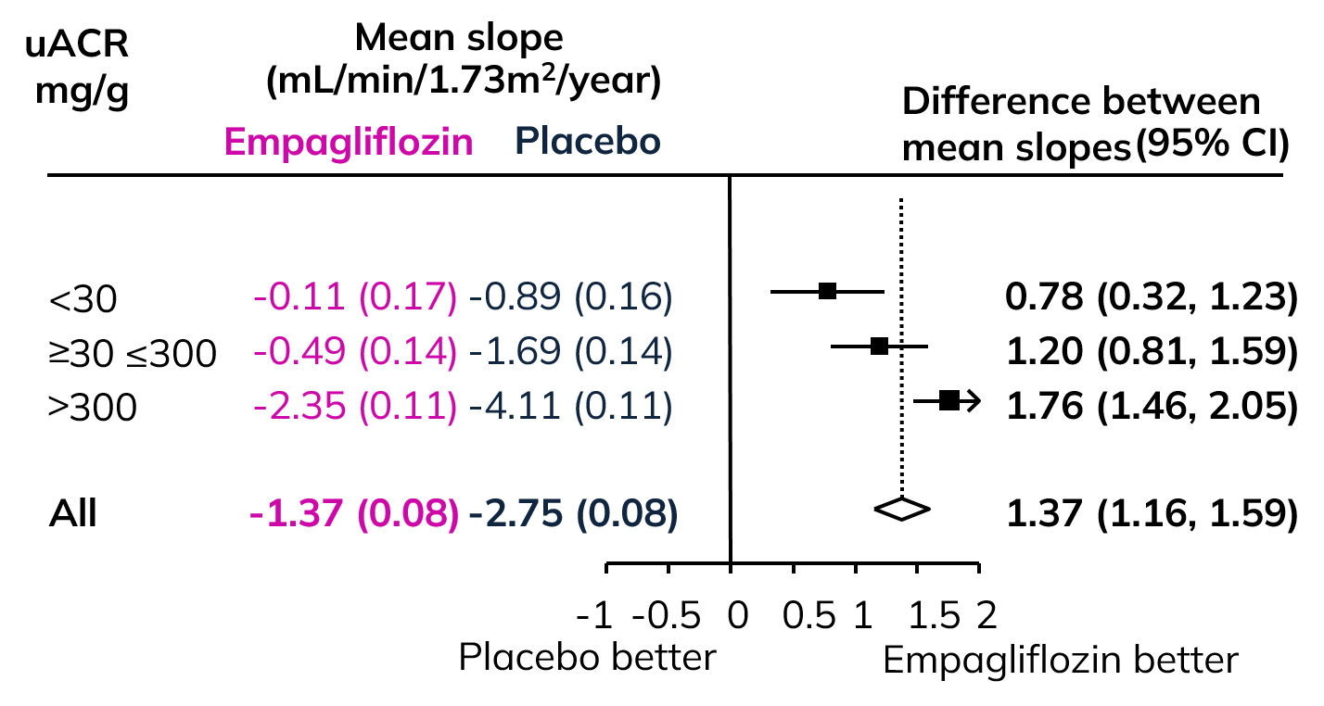
Chronic eGFR slopes by albuminuria
Prespecified exploratory analyses
EMPA-Kidney

Slide 38
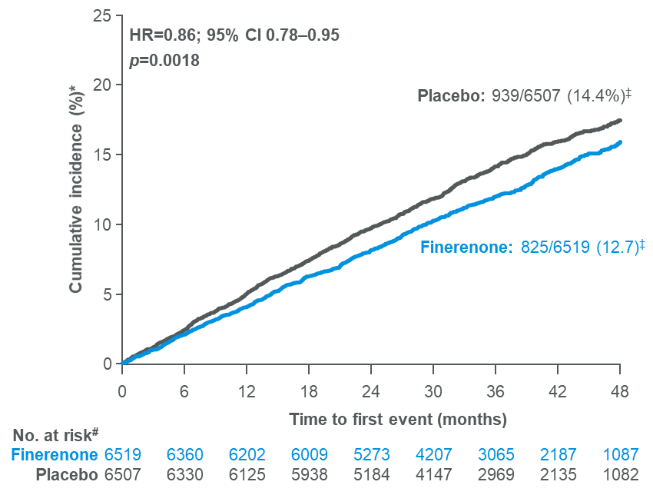
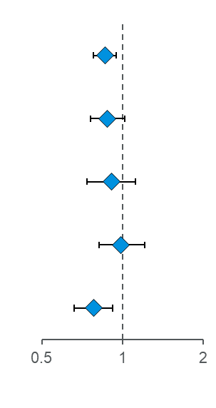
Finerenone significantly reduced the risk of the CV composite outcome by 14% and had consistent effects on CV death, MI and hospitalisation for HF
Time to CV death, non-fatal MI, non‑fatal stroke, or hospitalisation for HF
ARR after 3 years = 2.2%
Outcome | Finerenone (n=6519) | Placebo (n=6507) | Hazard ratio (95% CI) |  | p-value
 | n (%) | n (%)
Composite CV outcome§ | 825 (12.7) | 939 (14.4) |  | 0.86 (0.78–0.95) | 0.0018
CV death | 322 (4.9) | 364 (5.6) |  | 0.88 (0.76–1.02) | 0.0922
Non-fatal MI | 173 (2.7) | 189 (2.8) |  | 0.91 (0.74–1.12) | 0.3601
Non-fatal stroke | 198 (3.0) | 198 (3.0) |  | 0.99 (0.82–1.21) | 0.9460
Hospitalisation for HF | 256 (3.9) | 325 (5.0) |  | 0.78 (0.66–0.92) | 0.0030
NNT after 3 years = 46
(95% CI 29–109)
Favours finerenone
Favours placebo
38
Notes:
Mention: ARR 2.2% at 3yrs
Notes
For effect of finerenone on CV outcomes by subgroups, please refer to back-up slides 27–28.
Statistical analyses will be of explorative and descriptive nature. No confirmatory hypothesis tests will be performed. In the case that statistical tests are performed, p-values will be provided in an exploratory manner only. Therefore, no adjustment for multiplicity is necessary
Abbreviations
ARR, absolute risk reduction; CI, confidence interval; CV, cardiovascular; HF, heart failure; HR, hazard ratio; MI, myocardial infarction; NNT, number needed to treat
Script
References
Filippatos G, et al. ESC 2021; abstract 7161

Slide 39
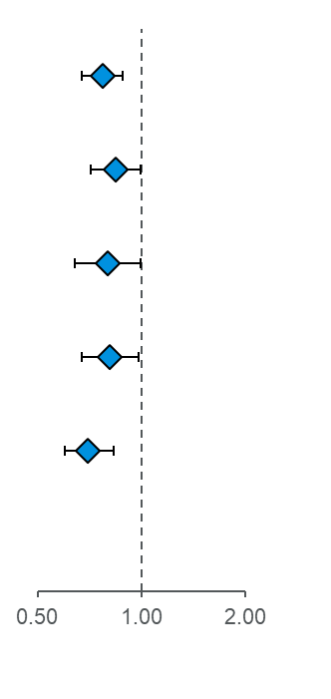
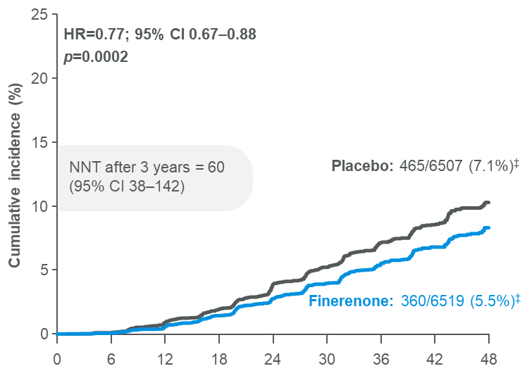

Finerenone significantly reduced the risk of the key kidney composite outcome by 23% and had consistent significant effects on the outcome components
Time to kidney failure,* sustained# ≥57% decrease in eGFR from baseline, or renal death‡
Outcome | Finerenone (n=6519) | Placebo (n=6507) | HR (95% CI) |  | p-value
 | n (%) | n (%)
Kidney composite outcome | 360 (5.5) | 465 (7.1) |  | 0.77 (0.67–0.88) | 0.0002
Kidney failure* | 254 (3.9) | 297 (4.6) |  | 0.84 (0.71–0.99) | 0.039
ESKD | 151 (2.3) | 188 (2.9) |  | 0.80 (0.64–0.99) | 0.040¶
Sustained# decrease in eGFR to <15 ml/min/1.73 m² | 195 (3.0) | 237 (3.6) |  | 0.81 (0.67–0.98) | 0.026¶
Sustained# ≥57% decrease in eGFR from baseline | 257 (3.9) | 361 (5.5) |  | 0.70 (0.60–0.83) | <0.0001
Renal death‡ | 2 (<0.1) | 4 (<0.1) |  | 0.53 (0.10–2.91) | 0.459
ARR after 3 years = 1.7%
No. at risk
Time to first event (months)
Finerenone
6519
6291
6107
5848
5027
3973
2815
2024
959
Placebo
6507
6292
6071
5815
4949
3932
2798
1988
962
Favours finerenone
Favours placebo
Notes:
Mention: ARR 1.7% at 3yrs
Notes
Abbreviations
ARR, absolute risk reduction; CI, confidence interval; CV, cardiovascular; eGFR, estimated glomerular filtration rate; ESKD, end-stage kidney disease; HR, hazard ratio; KRT, kidney replacement therapy; NNT, number needed to treat; PY, patient-years
References
Filippatos G, et al. ESC 2021; abstract 7161

Slide 40
Patients with diabetes and CKD (2022)

Slide 41
TYPE 2 DIABETES
Dr. Alice Cheng MD, FRCPC

Slide 42
LEARNING OBJECTIVES
At the completion of this section, participants should be able to:
Describe the evidence supporting the use of GLP-1 receptor agonists and SGLT2 inhibitors to reduce outcomes in people living with type 2 diabetes and ASCVD or multiple risk factors for ASCVD.
Discuss practical considerations when utilizing these therapies.

Slide 43
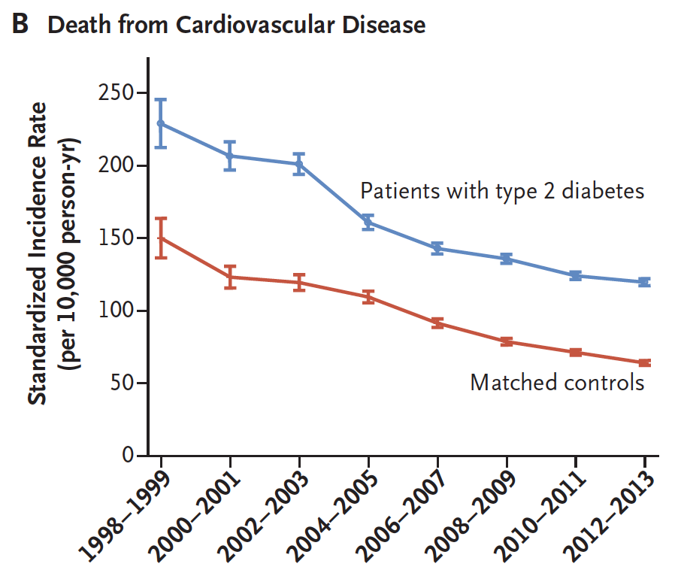
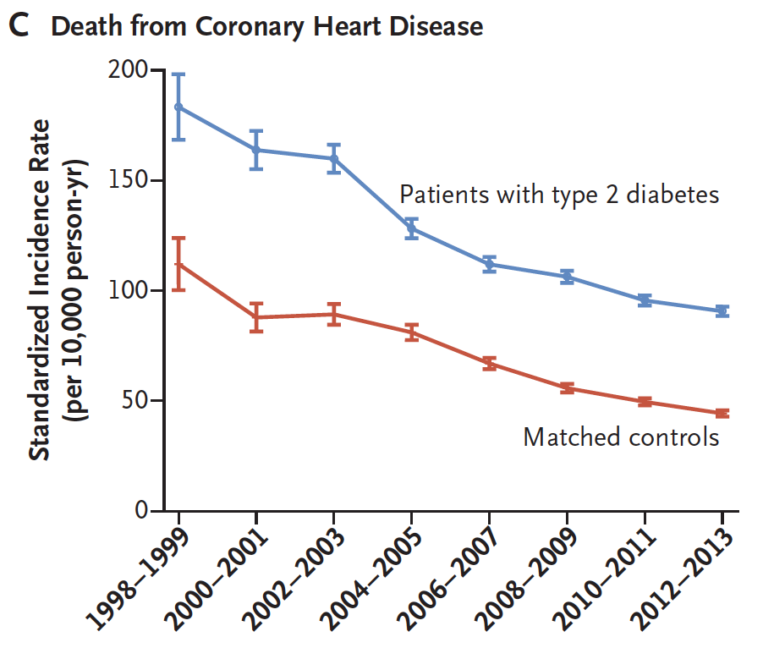
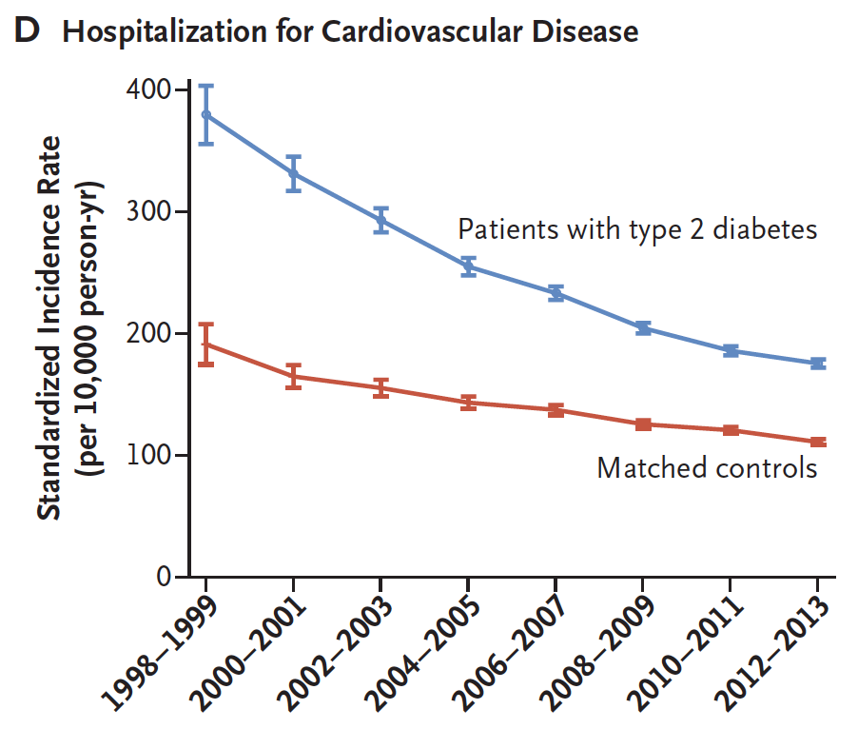
CVD hospitalizations and death in DM reducing over time but still higher than those without DM
Analysis of 457,493 people with Type 2 diabetes in the
Swedish National Diabetes Register
Death from Cardiovascular disease
Death from Coronary heart disease
Hospitalization for CVD
Rawshani A et al. N Engl J Med 2017;376(15):1407-1418.

Slide 44
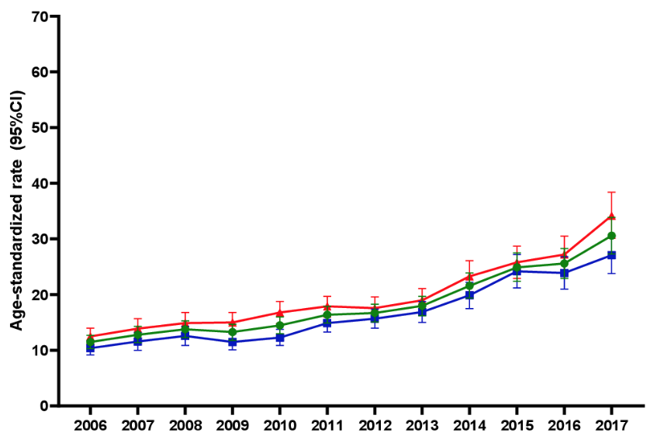
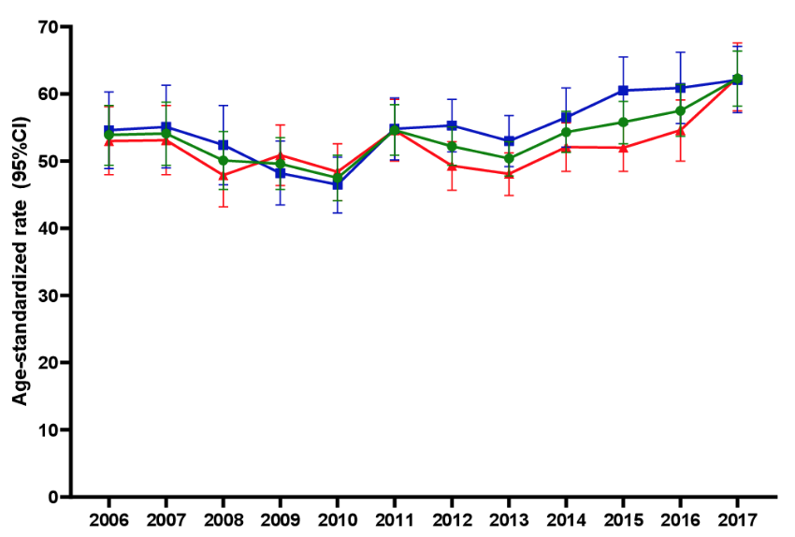
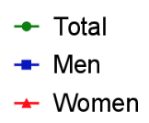
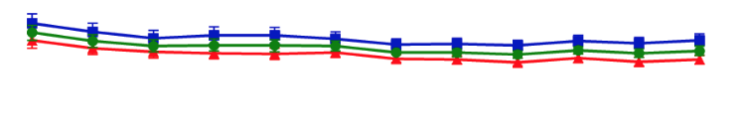
Heart failure ED visits and hospitalizations in diabetes rising (2006-2017) in United States
Emergency Department Visits
Admissions to hospital
Diabetes
Diabetes
No Diabetes
No Diabetes
Harding JL, et al. BMJ Open Diab Res Care 2021;9:e002377. doi:10.1136/bmjdrc-2021-00237

Slide 45

ABCDES³ of Diabetes Care
2018
A • A1C – optimal glycemic control (usually ≤7%)
B • BP – optimal blood pressure control (<130/80)
C • Cholesterol – LDL <2.0 mmol/L or >50% reduction
D • Drugs to protect the heart
    A – ACEi or ARB │ S – Statin │ A – ASA if indicated │SGLT2i/GLP-1 RA with demonstrated CV benefit
E • Exercise / Healthy Eating
S • Screening for complications
S • Smoking cessation
S • Self-management, stress and other barriers
Notes:
The fourth element of the ABCDESSS mnemonic is Drugs to protect the heart, which is a composite of the several evidence-based therapies that have been proven to be cardioprotective among patients with type 2 diabetes. This includes ACE inhibitors / ARBs, statins, ASA if indicated, and two types of antihyperglycemics that have also been shown to reduce cardiovascular risk: SGLT-2 inhibitors and GLP-1 receptor agonists. These latter medications are discussed in detail in the second section of this program and are not summarized on the ensuing slides.
Reference:
Diabetes Canada Clinical Practice Guidelines Expert Committee. Diabetes Canada 2018 Clinical Practice Guidelines for the Prevention and Management of Diabetes in Canada. Can J Diabetes. 2018; 42(Suppl 1):S1-S325.

Slide 46
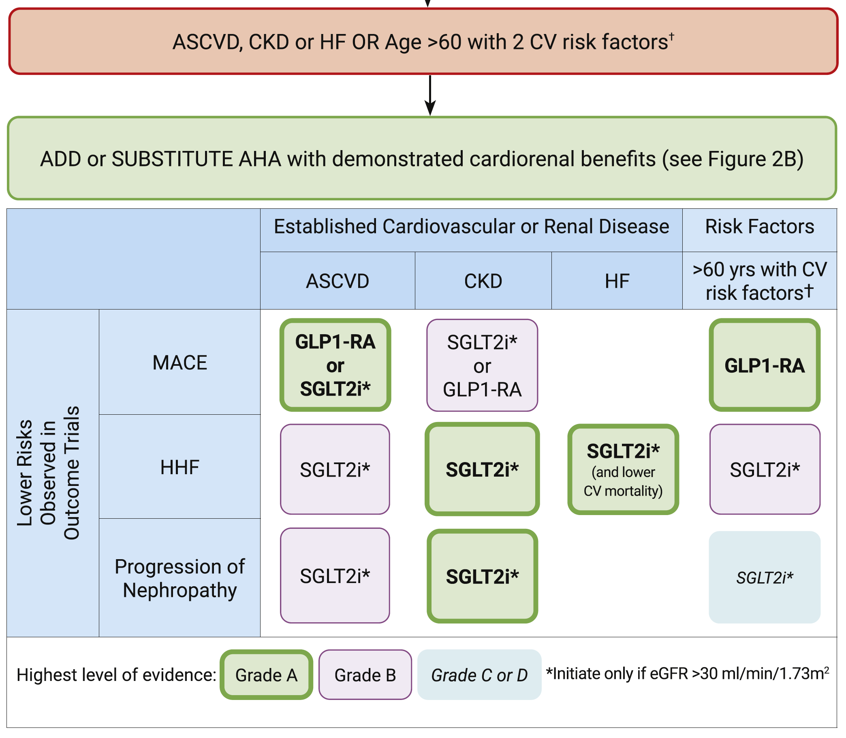
2020
CV Risk Factors
Smoking
HTN (on Rx or not)
Dyslipidemia
  On treatment OR
  LDL >3.4 mmol/L OR
  TG >2.3 mmol/L OR
  HDL <1.3 (F) or <1.0 (M)
Central obesity
Lipscombe L et al. Can J Diabetes 2020;44:575-91.

Slide 47
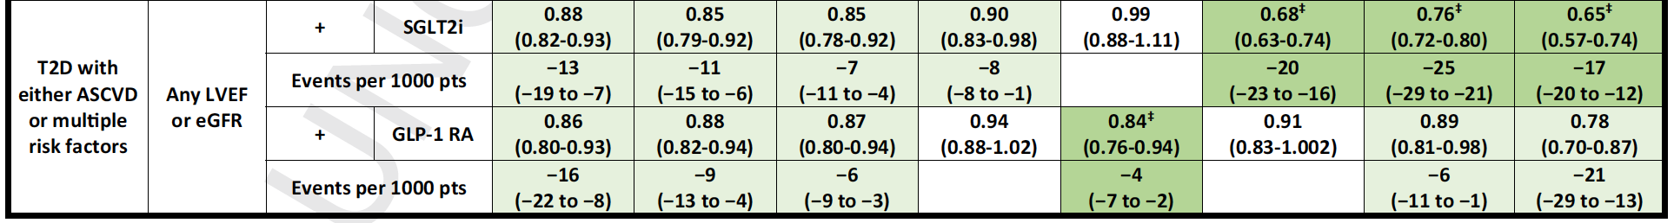
Summary of relative (hazard ratios) and absolute event reductions per 1000 treated patients for cardiorenal outcomes in those with T2D with ASCVD or multiple risk factors
Mancini GB et al. Can J Cardiol 2022;38:1153-67.

Slide 48

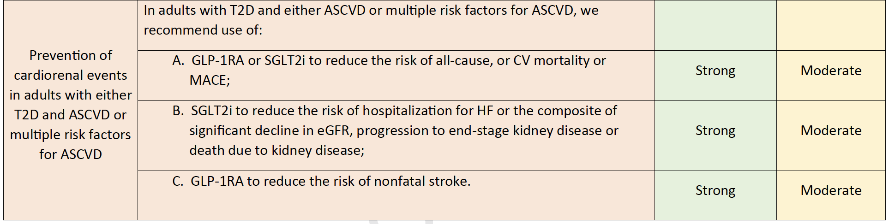
Practice recommendations
Mancini GB et al. Can J Cardiol 2022;38:1153-67.

Slide 49
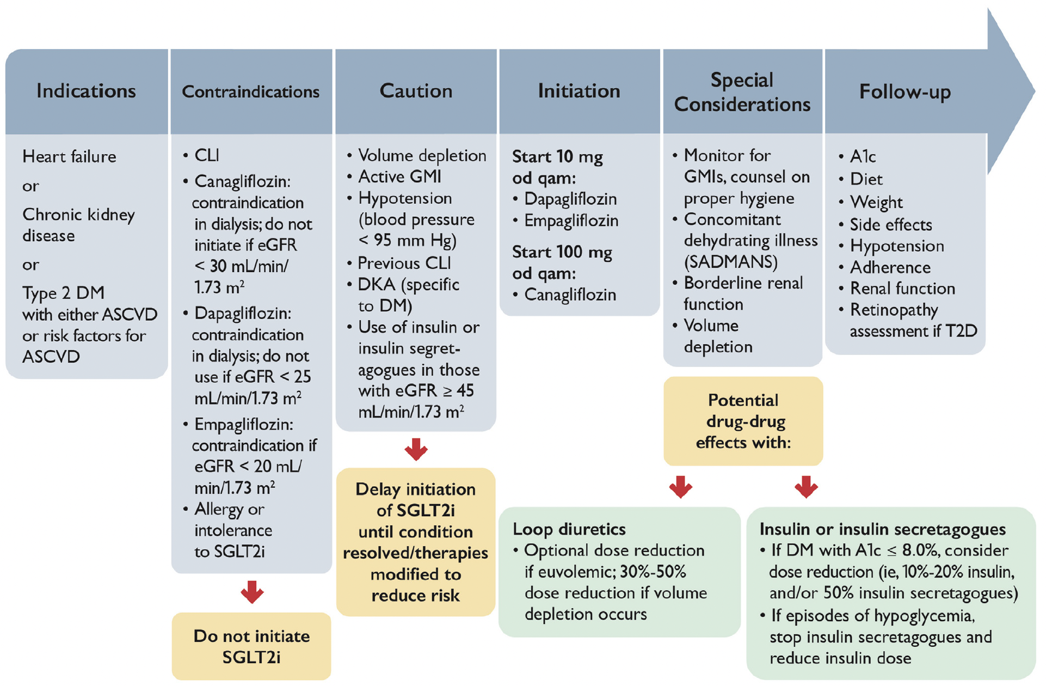
Practical approach to the use of SGLT2i for treatment of CVD
Mancini GB et al. Can J Cardiol 2022;38:1153-67
© Canadian Cardiovascular Society. 2022. All rights reserved.
Notes:
A1c, glycosylated hemoglobin; ASCVD, atherosclerotic cardiovascular disease; CLI, critical limb ischemia; DKA, diabetic ketoacidosis; DM, diabetes mellitus; eGFR, estimated glomerular filtration rate; GMI, genital mycotic infection; od qam, once daily every morning; SADMANS, sulfonylureas, angiotensin-converting enzyme inhibitors, diuretics and direct renin inhibitors, metformin, angiotensin receptor blockers, nonsteroidal anti-inflammatory drugs, sodium-glucose co-transporter 2 inhibitors; T2D, type 2 diabetes.

Slide 50
Side effects and mitigation strategies (SGLT2i)
Side effect | Mitigation Strategies
Genital mycotic infections | Explain mechanism of action Maintain genital hygiene (rinse, wipe; episodes rarely recur after treatment)
Volume depletion | Adequate hydration Hold in acute illness or preoperative
Hypoglycemia | Potential exists if used in combination with insulin secretagogues or insulin and eGFR ≥45 mL/min/1.73m²
Diabetic ketoacidosis | Do not use in type 1 diabetes Do not discontinue insulin without the advice of a diabetes specialist (cautiously reduce insulin by 10-20% at a time) Hold SGLT2i in acute illness Hold SGLT2i for 2-3 days before scheduled surgery or procedures Patients without diabetes are not at risk
Amputations | Uncertain risk with canagliflozin but increased risk not seen with other SGLT2i Emphasis on preventative foot care Risk factors that predispose to need for amputation should be considered Hold during active foot ulcer
Mancini GB et al. Can J Cardiol 2022;38:1153-67.

Slide 51
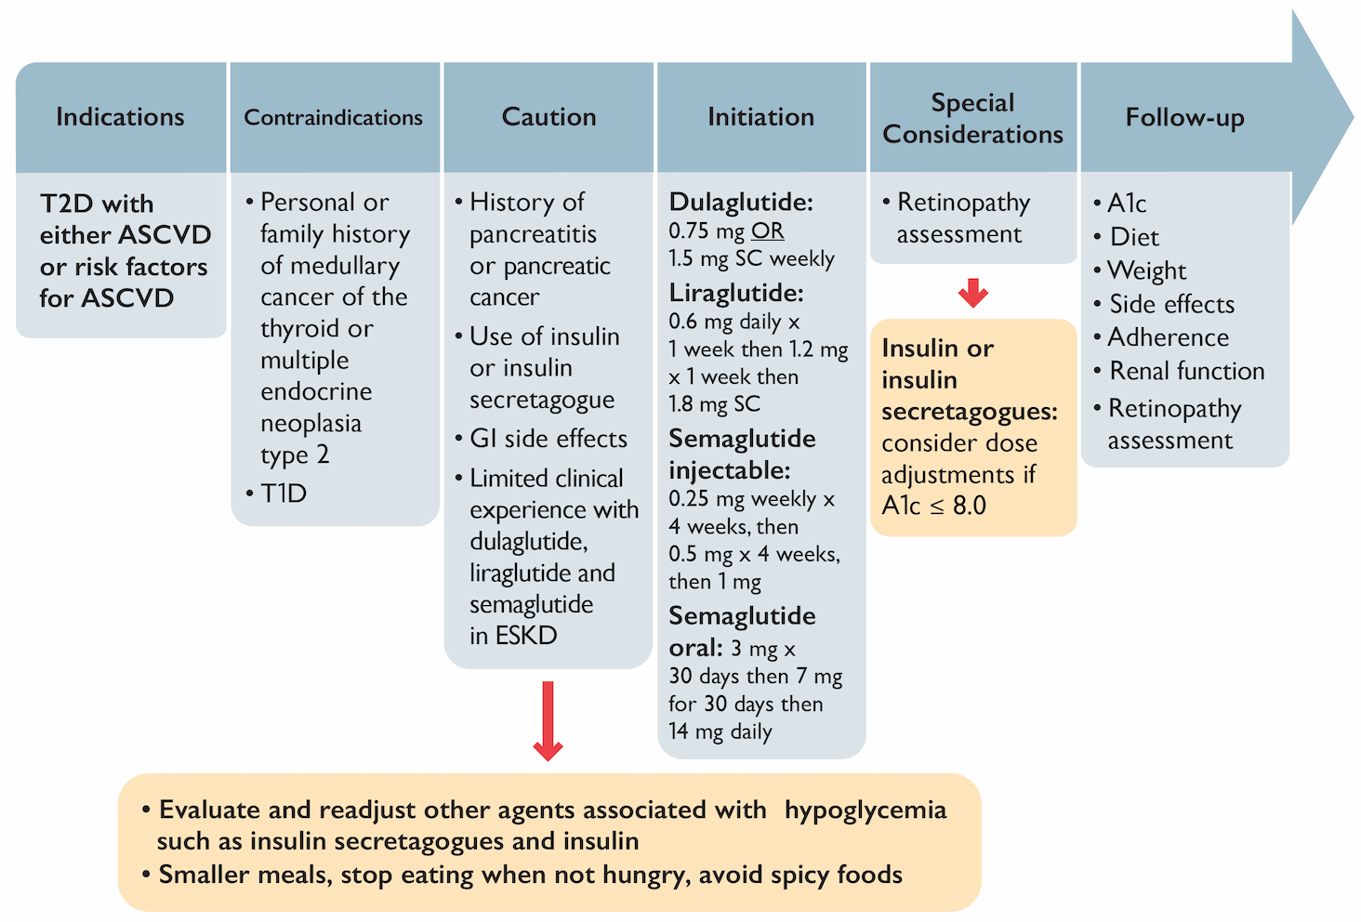
Practical Approach to using GLP-1 receptor agonists
Mancini GB et al. Can J Cardiol 2022;38:1153-67.
© Canadian Cardiovascular Society. 2022. All rights reserved.

Slide 52
Side effects and mitigation strategies (GLP1RAs)
Side effect | Mitigation Strategies
Gastrointestinal (nausea, vomiting, diarrhea) | Usually transient Slow titration of dose Smaller meals; stop eating when no longer hungry Avoid spicy foods Maintain adequate hydration May use antiemetics if required
Hypoglycemia | Potential exists if used in combination with insulin secretagogues or insulin and eGFR ≥45 mL/min/1.73m²
Mancini GB et al. Can J Cardiol 2022;38:1153-67.

Slide 53
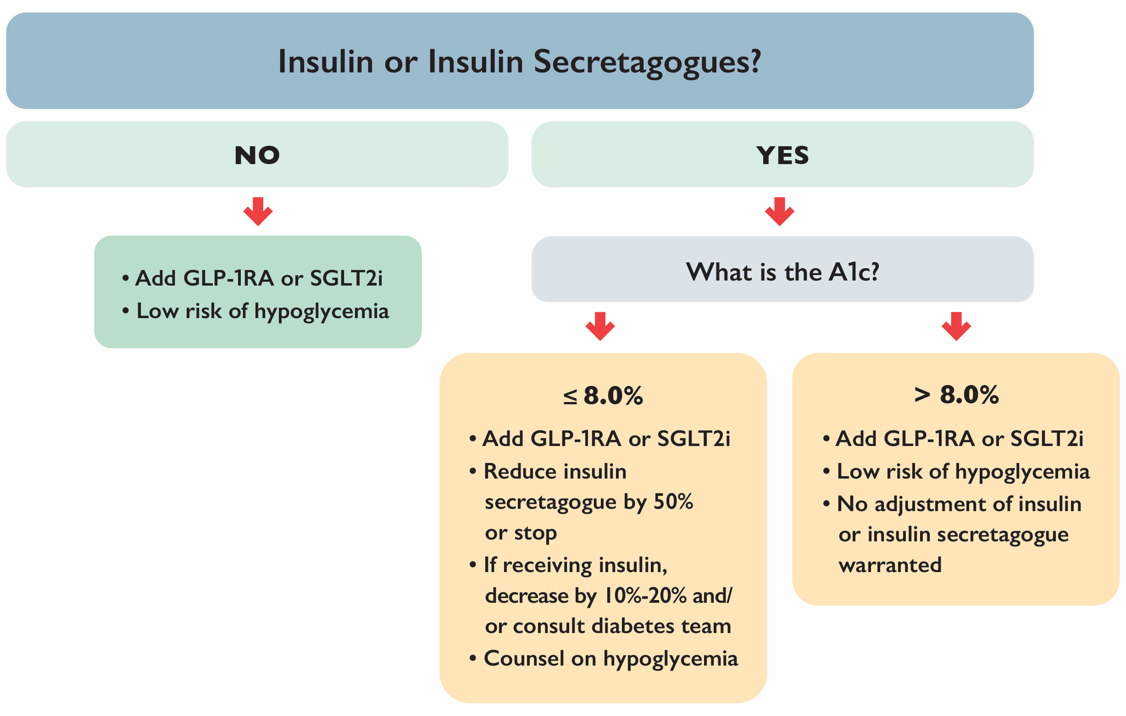
Management of antihyperglycemic therapies when adding SGLT2i (if eGFR ≥45 mL/min/1.73m²) or GLP1RA
Mancini GB et al. Can J Cardiol 2022;38:1153-67.

Slide 54
#
SUMMARY

Slide 55
CARDIOLOGIST IMPLICATIONS
Dr. David Bewick MD, FRCPC

Slide 56
QUESTION 1
A patient with T2D, prior TIA and high CV risk, on 2 lipid lowering drugs, 2 BP meds, ASA and intolerant of metformin has evidence of CKD.
A1c is 7.5
Which medication(s) would you add?

Slide 57
QUESTION 2
What would the panel recommend to our community cardiologists if a patient develops a yeast infection on a SGLT2i?

Slide 58
QUESTION 3
How do you counsel patients about to start GLP-1 RA regarding the potential for worsening
diabetic retinopathy?

Slide 59
QUESTION 4
What lower level of eGFR would you not start an SGLT2i?
If the patient is on a SGLT2i and eGFR drops to this low level, would you stop it?

Slide 60
AUDIENCE QUESTIONS AND DISCUSSION

Slide 61
THANK YOU!
#
ACCESS ON-DEMAND
This webinar will be available for On-Demand access.
View this webinar, as well as the Atrial Fibrillation, Heart Failure and Pulmonary Hypertension webinars, On-Demand: CCS.ca/On-Demand-Guideline-Webinars/

Slide 62

THANK YOU!
#

Slide 63

THANK YOU!
#

Slide 64
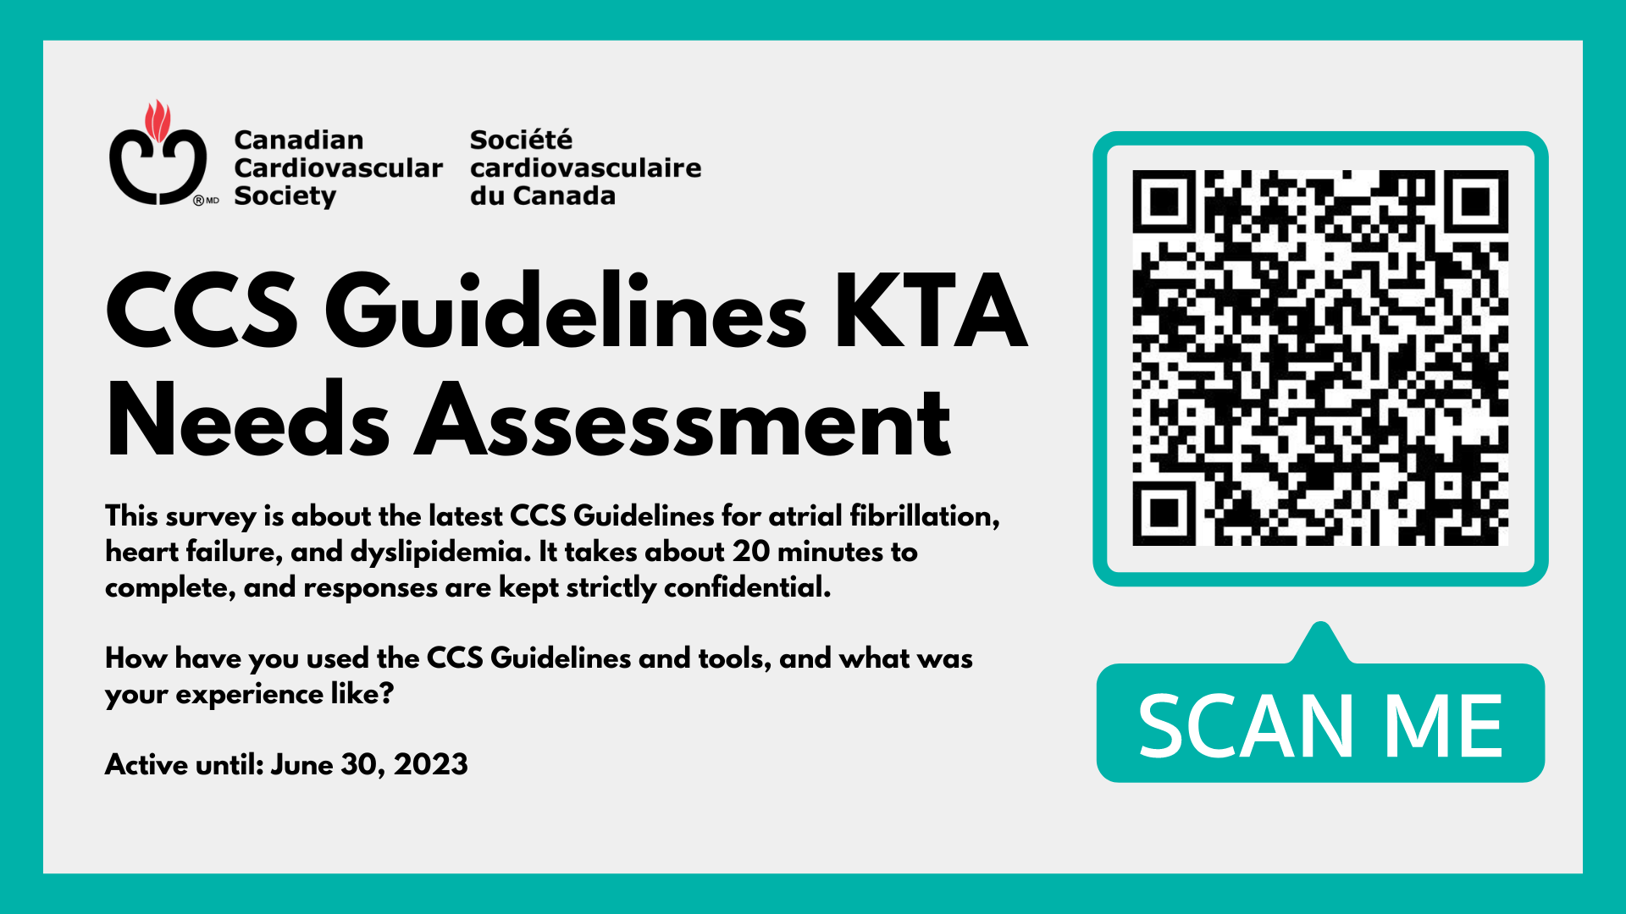
THANK YOU!
#

Slide 65

THANK YOU!
#

