Slide 1
CCS 2022 Guideline
Peripheral Arterial Disease
Webinar 1: Screening and Diagnosis
Guidance from the 2022 PAD Guideline Panel
September 30, 2022

Slide 2
© Canadian Cardiovascular Society. 2022. All rights reserved.
Distribution, transmission or republication is strictly prohibited without the prior written permission of the Canadian Cardiovascular Society.
For medical institution internal education or training (i.e. grand rounds, medical college/classroom education, etc.), kindly consider and implement the following:
Include the citation for the Canadian Journal of Cardiology
Add ‘Reproduced with permission from the Canadian Cardiovascular Society. [insert year].’
Avoid use of CCS logos or trademarks on slides, tools or publications that are not the property of the CCS
Do not modify the slide content and, the layout and CCS branding on the Guideline-related slides
Guideline recommendations must be reproduced exactly as published
For an industry supported or involved program, permissions are required:
If content is published in the Canadian Journal of Cardiology, permissions must be sought through our publisher Elsevier (www.onlinecjc.com)
If content is property of the CCS, contact guidelines@ccs.ca
© Canadian Cardiovascular Society. 2021. All rights reserved.

Slide 3
We extend our respect to all First Nations, Inuit and Métis peoples for their valuable past and present contributions to this land we call Canada.
We acknowledge the Indigenous Peoples of all the lands that we are each on today, and reaffirm our commitment and responsibility as individuals, to improving relationships between nations and to collaborating in a spirit of reconciliation.

Slide 4
Overall Learning Objectives
CCS Guidelines
Peripheral Arterial Disease (PAD)
Webinar 1: Screening and Diagnosis
To review the most accurate signs, symptoms, and tests for detecting PAD in adults
To review the data for asymptomatic PAD Screening in patients at risk
To review the evidence for screening for CAD and carotid disease in PAD patients

Slide 5
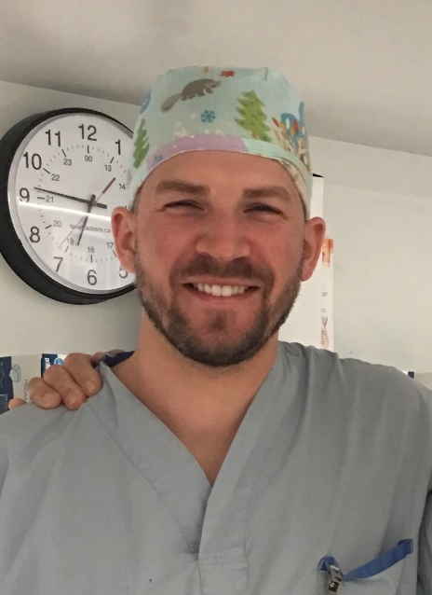
Faculty and Topic Overview
Dr. Beth Abramson
Dr. Derek Roberts
Dr. Kajenny Srivaratharajah
Introduction and Screening CAD, Carotid in PAD
Diagnosis
Screening for PAD

Slide 6
Disclosure of potential conflicts of interest
Beth Abramson
Consulting Fees/Honoraria: Amgen, AstraZeneca, Bayer, BioSyent, BMS-Pfizer, Boehringer Ingelheim, CHRC, HLS Therapeutics, Novartis, Novo Nordisk, Servier, Sanofi
Clinical Trials: None
Grant/Research Support: Janssen has sponsored a prevention fellowship
Advisory boards/speaker bureaus: CCS
Kajenny Srivaratharajah
Consulting Fees/Honoraria: None
Clinical Trials: None
Grant/Research Support: None
Advisory boards/speaker bureaus: CCS
Derek Roberts
Consulting Fees/Honoraria: None
Clinical Trials: CHIR-funded Project Grant for a non-profit RCT of anesthetic type for lower limb revascularization surgery
Grant/Research Support: None
Advisory boards/speaker bureaus: CCS

Slide 7
Access On-Demand
This webinar will be available for On-Demand access
View this webinar, as well as the Atrial Fibrillation, Heart Failure and Pulmonary Hypertension webinars, On-Demand: CCS.ca/On-Demand-Guideline-Webinars/

Slide 8
Accreditation and Interactivity
This webinar is an Accredited Group Learning Activity (Section1) as defined by the Maintenance of Certification Program of the Royal College of Physicians and Surgeons of Canada, and approved by the Canadian Cardiovascular Society. You may claim a maximum of 1 hour.
Immediately following the presentations, we will have our Q&A Session. The Q&A period will be an opportunity for audience members to ask our panelists pressing questions and encourage constructive discussion among the faculty.

Slide 10
PERIPHERAL ARTERIAL DISEASE (PAD) is common, debilitating, and can be deadly. Fortunately, it’s preventable when you think about it!
Patients with widespread atherosclerosis such as peripheral artery disease (PAD) have a high risk of cardiovascular and limb symptoms and complications, which affects their quality of life and longevity
Over the past 2 decades there have been substantial advances in diagnostics, pharmacotherapy, and interventions to aid in the management of PAD patients.
To summarize the evidence regarding approaches to diagnosis, risk stratification, medical and intervention treatments for patients with PAD, guided by the GRADE framework, evidence was synthesized, and assessed for quality, and recommendations provided
Fifty-six recommendations were made
This webinar deals with the diagnosis and screening for PAD, and within PAD patients

Slide 11
Diagnosis
Dr. Derek Roberts
MD, PhD, FRCSC
Ottawa, ON
Assistant Professor - Department of Surgery and School of Epidemiology and Public Health, University of Ottawa
Associate Scientist - Clinical Epidemiology Program, The Ottawa Hospital Research Institute
Attending Surgeon - Division of Vascular and Endovascular Surgery, The Ottawa Hospital
Research Committee Chair - Canadian Society for Vascular Surgery
Member - O'Brien Institute for Public Health, University of Calgary

Slide 12
Disclosure of potential conflicts of interest
Derek Roberts
Consulting Fees/Honoraria: None
Clinical Trials: CIHR-funded Project Grant for a non-profit RCT of anesthetic type for lower limb revascularization surgery
Grant/Research Support: None
Advisory boards/speaker bureaus: CCS

Slide 13
Learning Objectives
Know the typical history and physical exam findings of a patient presenting with peripheral artery disease
Know the Edinburgh claudication questionnaire
Know the differential diagnosis of PAD
Know how to perform and interpret an (ankle-brachial index) ABI

Slide 14
History Taking
Typical patient profile of a patient presenting with PAD:
Age 50 years old and older
Smoker
Has diabetes
Concomitant dyslipidemia, hypertension, coronary artery disease or disease of other vascular beds
Classical symptoms of intermittent claudication include:
Muscle pain often described as cramping, typically calf muscles or muscle group distal to arterial stenosis/occlusion
Pain only when the muscle is exercised (usually after walking a similar distance)
Pain that resolves within 10 minutes of discontinuation of exercise or resting
Patients with PAD DO NOT have ischemic rest pain, gangrene or ulceration on the lower extremities – this is diagnostic of chronic limb-threatening ischemia (CLTI)

Slide 15
Edinburgh Claudication Questionnaire
1. Do you get a pain or discomfort in your leg(s) when you walk?
2. Does this pain ever begin when you are standing still or sitting?
3. Do you get it if you walk uphill or hurry?
4. Do you get it when you walk at an ordinary pace on the level?
5. What happens to it if you stand still?
Usually continues more than 10 minutes
Usually disappears in 10 minutes or less
6. Where do you get this pain or discomfort?
Sensitivity 91.3% (95% CI)
Specificity 99.3% (95% CI)
Answers to the questions in green should be YES
Answers to the questions in red should be NO

Slide 16
Differential Diagnosis for Leg Pain or Claudication
Neurogenic | Spinal stenosis Peripheral neuropathy Peripheral nerve pain (eg. Radiculopathy) Spondylolisthesis | Shock-like quality Pain even at rest, not related to exercise Lower back pain
Musculoskeletal | Arthritis of the hip or knee Symptomatic Baker cyst Chronic exertional compartment syndrome Stress fracture Muscle spasms or cramps | Reproducible on exam by movement or palpation
Vascular | Chronic limb-threatening ischemia Venous insufficiency Deep venous thrombosis Nonatherosclerotic arterial disease (eg, popliteal entrapment syndrome) | Presence of ischemic wounds and/or ulcerations Edema Varices and/or varicose veins
Other | Restless leg syndrome Malignancy | Pain not related to exercise

Slide 17
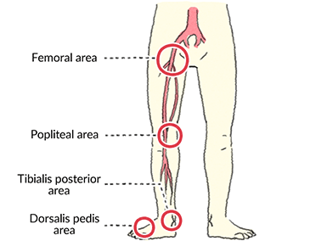
Physical Exam – Focused Peripheral Vascular Exam
Feel for all the pulses
Femoral pulse - halfway between the ASIS and the pubic symphysis below the inguinal ligament
Popliteal pulse – behind the knee, with patient supine and the knee in flexed position
Posterior tibialis – behind the medial malleolus
Dorsalis pedis – lateral to the D1 extensor tendon
Look for gangrene and/or ulcerations to rule out CLTI
Look for other vascular findings such as varices, edema, discoloration
Look for any findings suggestive of another diagnosis such as DVT, MSK problem, cellulitis, etc.
https://www.otsuka.co.jp/en/health-and-illness/peripheral-artery-disease/diagnosis/img/index_im02.gif
Notes:
https://www.otsuka.co.jp/en/health-and-illness/peripheral-artery-disease/diagnosis/img/index_im02.gif

Slide 18
Confirmatory Diagnostic Tests – Ankle Brachial Index

Slide 19
RECOMMENDATION:
We recommend using an ABI and/or a TBI study to confirm the diagnosis of PAD in patients with symptoms of PAD (Strong Recommendation; Moderate Quality Evidence).
To improve patient’s quality and quantity of life in the long-term, it is important to diagnose PAD in symptomatic patients to initiate appropriate best, evidence-based, medical therapy

Slide 20
Screening for PAD
Dr. Kajenny Srivaratharajah
MD, MSc, FRCPC
Hamilton, ON
Assistant Professor
Division of General Internal Medicine,
Department of Medicine, McMaster University

Slide 21
Disclosure of potential conflicts of interest
Kajenny Srivaratharajah
Consulting Fees/Honoraria: None
Clinical Trials: None
Grant/Research Support: None
Advisory boards/speaker bureaus: CCS

Slide 22
Learning Objectives
To review the utility of the ankle-brachial index (ABI) as a screening tool for asymptomatic PAD.
To review evidence for routine PAD screening in asymptomatic patients at high risk for clinically apparent atherosclerotic disease.
To review the role of systematic screening for PAD in asymptomatic patients with documented vascular disease elsewhere.
Notes:
Learning objective(s) for your section

Slide 23
Population based screening strategy
Screening allows early detection of disease or elevated risk of disease
Offers the opportunity to intervene early and reduced disease morbidity and mortality
Ideally need a test with high sensitivity to identify those at risk who would benefit from therapy
https://www.health.gov.on.ca/en/pro/programs/ohip/bulletins/redux/bul211102.aspx​

Slide 24
Principles of screening
Wilson and Jungner’s principles of screening
The condition sought should be an important health problem. The natural history of the condition, including development from latent to declared disease, should be adequately understood. There should be a recognizable latent or early symptomatic stage. There should be a suitable test or examination. The test should be acceptable to the population. There should be an agreed policy on whom to treat as patients. There should be an accepted treatment for patients with recognized disease. Facilities for diagnosis and treatment should be available. The cost of case-finding (including diagnosis and treatment of patients diagnosed) should be economically balanced in relation to possible expenditure on medical care as a whole. Case-finding should be a continuing process and not a “once and for all” project.
Notes:
In 1968, Wilson and Jungner published 10 principles of screening that serve as a starting
point for screening decisions today

Slide 25
Refined set of consolidated screening principles – CMAJ 2018
Notes:
Consolidated principles for screening based
on a systematic review and consensus process

Slide 26
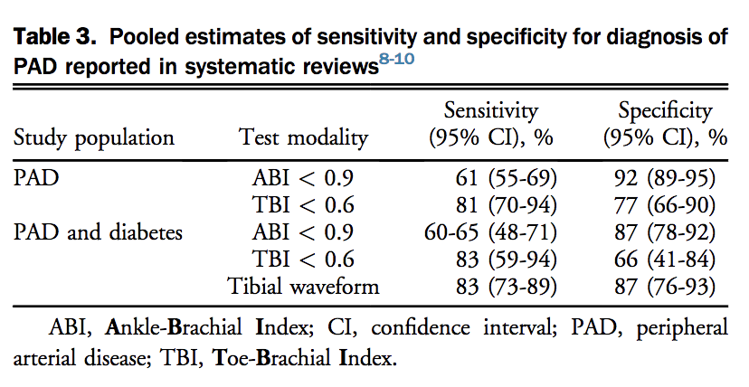
Ankle-brachial index (ABI) as a screening tool for asymptomatic PAD
The most commonly used screening tool for PAD is the ankle-brachial index (ABI)
ABI has high specificity for detecting PAD but low sensitivity (95% CI for sens ~10-30% and for spec ~96-100%; Guirguis-Blake et al, 2018).
US Preventative Services Task Force (USPSTF) [updated evidence report and systematic review, 2018] - no direct evidence and limited indirect evidence on the benefits of PAD screening with the ABI in unselected or asymptomatic populations; available studies suggest low sensitivity and lack of beneficial effect on health outcomes
https://www.health.gov.on.ca/en/pro/programs/ohip/bulletins/redux/bul211102.aspx​

Slide 27
Sensitivity and Specificity of ABI in Screening for asymptomatic PAD

Slide 28
Refined set of consolidated screening principles - CMAJ 2018

Slide 29
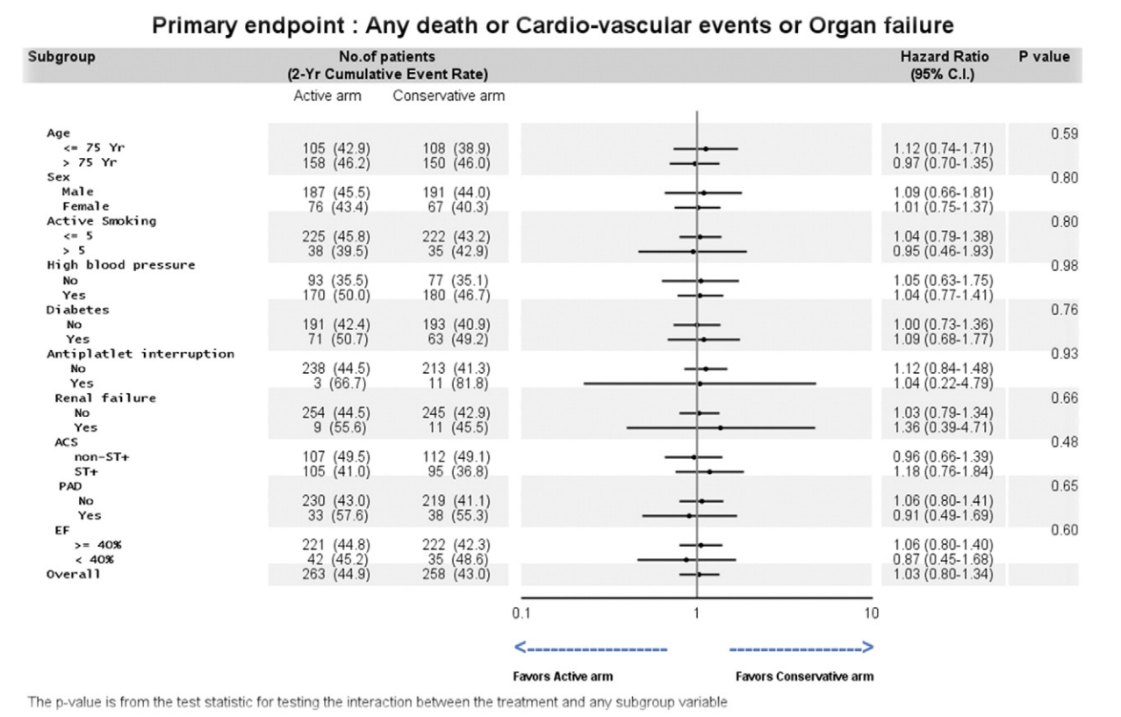
Population based screening for PAD in asymptomatic patients at elevated risk
No current recommendations for intervention on asymptomatic disease due to no demonstrated benefit
The Society for Vascular Surgery and the Canadian Society for Vascular Surgery recommend against invasive treatments for asymptomatic PAD (percutaneous or surgery), regardless of ABI or other test results that indicate PAD
A recent systematic review including studies of asymptomatic patients demonstrated no benefit in major adverse CV events (MACE) or quality of life measures with intervention
A meta-analysis commissioned by the Society for Vascular Surgery did not show evidence of either cost-effectiveness or any clear reduction in morbidity or mortality for ABI screening of asymptomatic patients
Collet JP et al. Systematic detection of polyvascular disease combined with aggressive secondary prevention in patients presenting with severe coronary artery disease: The randomized AMERICA Study. Int J Cardiol. 2018
https://www.health.gov.on.ca/en/pro/programs/ohip/bulletins/redux/bul211102.aspx​

Slide 30
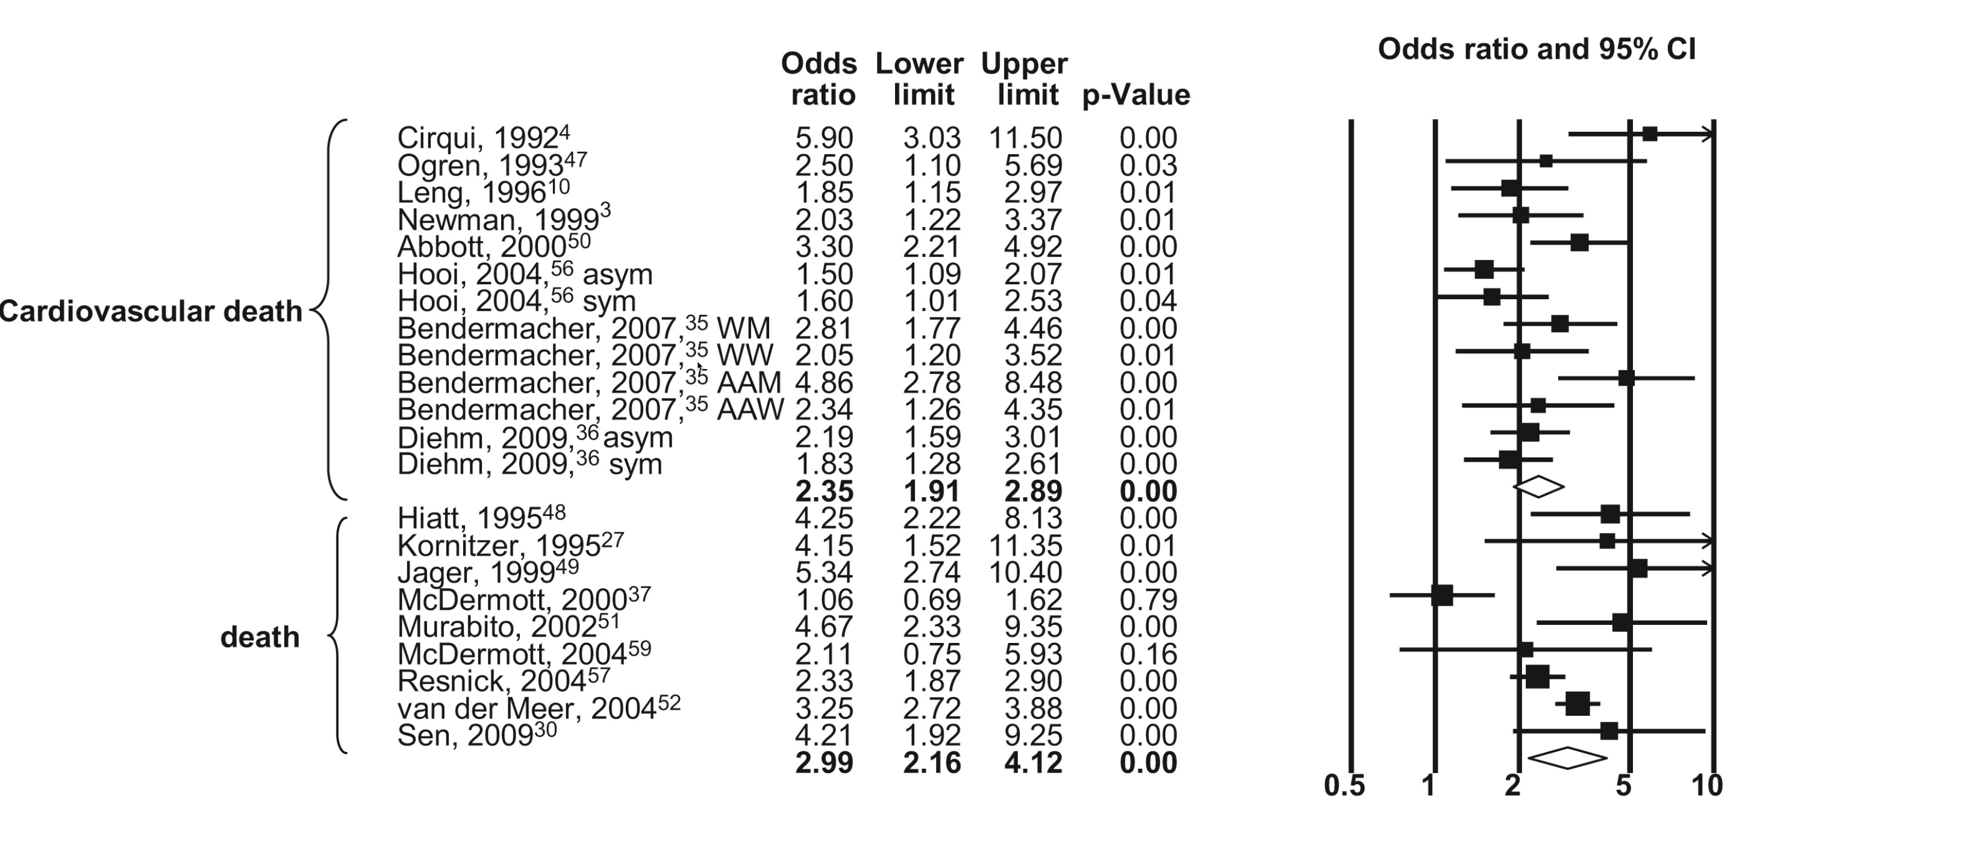
Global CV outcomes in screening asymptomatic PAD patients with Polyvascular Disease
Screening for PAD in asymptomatic patients with polyvasular disease has not been shown to be effective in lowering rates of CV events or major adverse limb events (MALE)
Risk factor management and pharmacotherapy strategies are not vastly different in managing atherosclerotic disease in single versus multiple vascular territories.
An abnormal ABI is prognostic, regardless of symptoms; however, does not detect preclinical disease and therefore, may not assist in global CV risk assessment in a primary prevention setting.
Alahdab et al., “A Systematic Review for the Screening for Peripheral Arterial Disease in Asymptomatic Patients.”
https://www.health.gov.on.ca/en/pro/programs/ohip/bulletins/redux/bul211102.aspx​

Slide 31
RECOMMENDATION:
We recommend against implementing a broad, population-based screening strategy for PAD, in patients without signs or symptoms of claudication (Strong Recommendation; High-Quality Evidence).
Values and preferences:
In contrast to general population screening, individual patients with high-risk features such as smoking and diabetes, might benefit from identification of PAD and more aggressive medical management. However, patients do not benefit from revascularization with asymptomatic PAD. Patients’ interest in their future vascular risk should be considered when determining if ABI testing will be undertaken.
Notes:
Recommendation 4

Slide 32
RECOMMENDATION:
We suggest against routine PAD testing for inferring global CV risk, in patients without symptoms of PAD, who have clinically symptomatic atherosclerosis in another vascular territory (Weak Recommendation; Moderate-Quality Evidence).
Values and preferences:
For patients with polyvascular disease, strong evidence for routine screening of other vascular territories is lacking. There is lack of consensus on how this screening would differentiate treatment. We could not recommend this practice. However, the committee recognizes that in select patients, identifying a second vascular bed might change management and assist in overcoming financial barriers for certain pharmaceuticals.
Notes:
Recommendation 5

Slide 33
Screening CAD, Carotid in PAD
Dr. Beth L. Abramson
MD MSc FRCP FACC
Toronto, ON
Paul Albrechtsen Professor in Cardiac Prevention and Women’s Health
Associate Professor of Medicine, University of Toronto
Division of Cardiology, St. Michael's Hospital

Slide 34
Disclosure of potential conflicts of interest
Beth Abramson
Consulting Fees/Honoraria: Amgen, AstraZeneca, Bayer, BioSyent, Boehringer Ingelheim, BMS-Pfizer, CHRC, HLS Therapeutics, Novartis, Novo Nordisk, Servier, Sanofi
Clinical Trials: None
Grant/Research Support: Janssen has sponsored a prevention fellowship
Advisory boards/speaker bureaus: CCS

Slide 35
Learning Objectives
To review the concept of polyvascular disease
To review evidence for screening patients with PAD for CAD or cerebrovascular disease.
To introduce the rationale for interventions that reduce myocardial infarction (MI), stroke, or CV death
Notes:
Learning objective(s) for your section

Slide 36
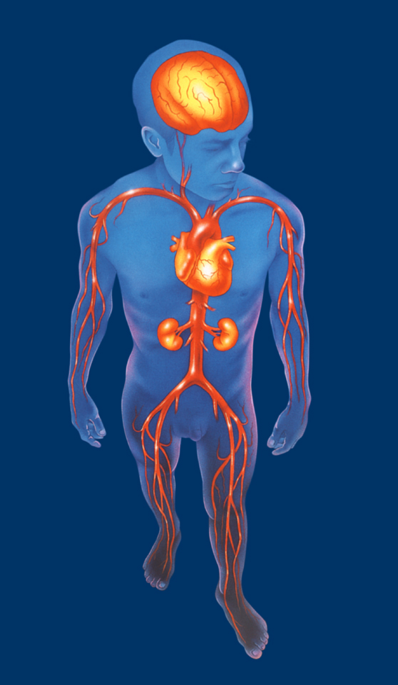
Atherosclerosis is a systemic disease that can affect multiple arterial beds
Cerebrovascular disease
Coronary artery disease
Peripheral arterial disease
Intermittent claudication
Critical limb ischemia

Slide 37
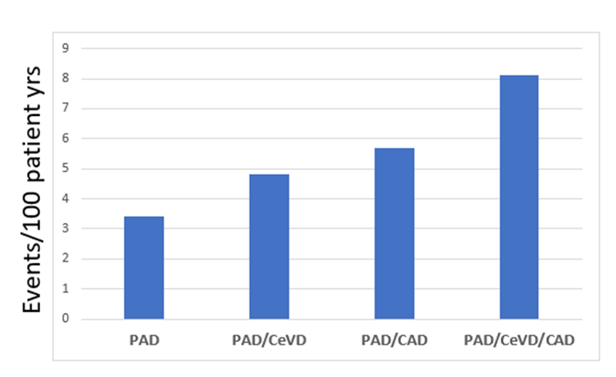
The presence of polyvascular disease is the most potent risk factor for future cardiovascular events.
Risk of cardiovascular event (cardiovascular death/MI/stroke) in patients with disease in multiple vascular beds (Taken from secondary data analysis of EUCLID trial)
PAD = peripheral arterial disease; CeVD = cerebrovascular disease; CAD = coronary artery disease

Slide 38
Screening for CAD and carotid disease in PAD patients
The coexistence of PAD, cerebrovascular disease (CeVD), and coronary artery disease (CAD) is known as polyvascular disease.
The coexistence of significant disease in more than one arterial bed, particularly in patients with peripheral artery disease (PAD), significantly increases the risk of cardiovascular events.
Among patients with PAD, polyvascular disease is common, > 40% of unselected patients with PAD enrolled in a major RCT.
Both the presence and severity of PAD have been associated with concurrent CeVD and CAD.
Up to 1 in 5 patients with PAD will have CeVD, with increasing severity of PAD associated with increased CeVD prevalence and symptomatic cerebral infarction.
In patients with PAD, the addition of concomitant CAD and CeVD have an additive effect with a two-fold increase in major cardiovascular events.

Slide 39
Screening for CAD and carotid disease in PAD patients
Despite these known associations and significantly increased risk for adverse outcomes, studies have consistently shown undertreatment of cardiovascular risk factors in these PAD patients.
There have been no randomized controlled trials evaluating routine screening of patients with peripheral artery disease for asymptomatic CAD or CeVD in order to reduce myocardial infarction and stroke; this could be the focus of future trials.
However, given the frequency of polyvascular disease among PAD patients, and its prognostic significance, patients with PAD should be questioned about concomitant symptoms related to disease in cerebrovascular and cardiac beds during clinical follow-up.

Slide 40
RECOMMENDATION:
We suggest against routine screening for asymptomatic carotid artery stenosis or asymptomatic CAD, among patients with documented PAD (Weak Recommendation; Low-Quality Evidence).
Values and preferences:
Most patients with PAD require aggressive CV risk factor management to improve long-term outcomes. This is on the basis of the strong epidemiological evidence linking PAD with incident MI and stroke

Slide 41
QUESTIONS?

Slide 42
Upcoming Program
Canadian Cardiovascular Congress 2022 October 27-30, 2022
PAD session: Saturday, Oct 29, 2:00-3:00PM EDT
Re-connect in-person with friends and colleagues for the first time in 3 years!
Learn from and connect with key opinion leaders
Be inspired by new ideas, technology and advancements in cardiovascular care
The CCS is proud to host the much-anticipated CCC 2022 and the 75th scientific meeting in-person in Ottawa and online.
SCAN QR CODE TO REGISTER TODAY!

Slide 43
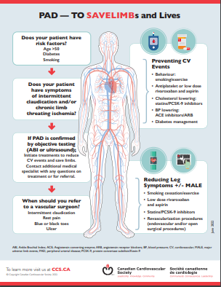
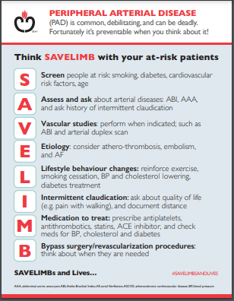
Thank you!
Visit CCS.ca for more Guidelines and Resources
Guideline Library:
https://ccs.ca/guidelines-and-position-statement-library/
Guideline Resources:
https://ccs.ca/guideline-resources/
NEW PAD resources coming soon!

