Slide 1
CCS Guidelines:
The Role of Lipoprotein(a) in Cardiovascular Risk Stratification
Guidance from the 2021 Dyslipidemia Guideline Panel
December 16, 2021
This webinar is an Accredited Group Learning Activity (Section 1) as defined by the Maintenance of Certification Program of the Royal College of Physicians and Surgeons of Canada, and approved by the Canadian Cardiovascular Society. You may claim a maximum of 1 hour.

Slide 2
© Canadian Cardiovascular Society. 2021. All rights reserved.
Distribution, transmission or republication is strictly prohibited without the prior written permission of the Canadian Cardiovascular Society.
For medical institution internal education or training (i.e. grand rounds, medical college/classroom education, etc.), kindly consider and implement the following:
  Include the citation for the Canadian Journal of Cardiology
  Add ‘Reproduced with permission from the Canadian Cardiovascular Society. [insert year].’
  Avoid use of CCS logos or trademarks on slides, tools or publications that are not the property of the CCS
  Do not modify the slide content and, the layout and CCS branding on the Guideline-related slides
  Guideline recommendations must be reproduced exactly as published
For an industry supported or involved program, permissions are required:
  If content is published in the Canadian Journal of Cardiology, permissions must be sought through our publisher Elsevier (www.onlinecjc.com)
  If content is property of the CCS, contact guidelines@ccs.ca
Pearson, Thanassoulis, et.al., Canadian Journal of Cardiology: https://doi.org/10.1016/j.cjca.2021.03.016
© Canadian Cardiovascular Society. 2021. All rights reserved.

Slide 3
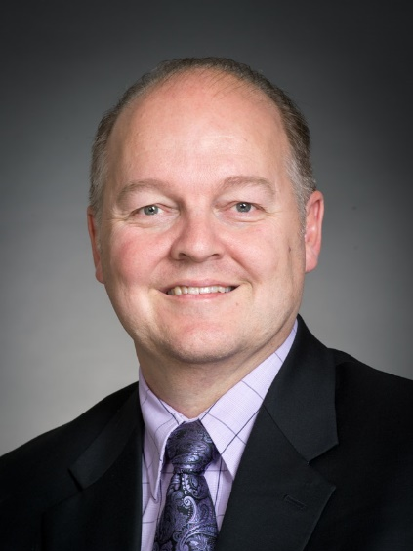
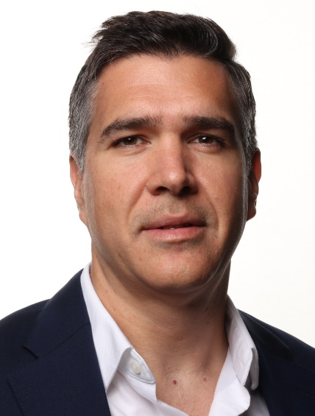
Co-Moderators
Glen Pearson
BSc, BScPhm, PharmD, FCSHP, FCCS
Edmonton, AB
George Thanassoulis
MD MSc FRCPC
Montreal, QC
Professor of Medicine
University of Alberta
Faculty of Medicine & Dentistry
Division of Cardiology
Mazankowki Alberta Heart Institute
Associate Professor, Department of Medicine, Faculty of Medicine and Health Sciences, McGill University
Department of Medicine, Division of Cardiology, MUHC

Slide 4

Disclosure of potential conflicts of interest
Glen Pearson
Consulting Fees/Honoraria: Novartis
Clinical Trials: None
Grant/Research Support: None
George Thanassoulis
Consulting Fees/Honoraria: Amgen, HLS Therapeutics, Novartis, Sanofi, Servier, Silence
Clinical Trials: Amgen, Novartis
Grant/Research Support: Ionis, Servier

Slide 5
We extend our respect to all First Nations, Inuit and Métis peoples for their valuable past and present contributions to this land we call Canada.
We acknowledge the Indigenous Peoples of all the lands that we are each on today, and reaffirm our commitment and responsibility as individuals, to improving relationships between nations and to collaborating in a spirit of reconciliation.

Slide 6

2021 Dyslipidemia Guidelines Committee Members
Co-Chairs:
Glen Pearson (Edmonton)
George Thanassoulis (Montreal)
Todd Anderson (Calgary)
Arden Barry (Vancouver)
Patrick Coutoure (Quebec City)
Natalie Dayan (Montreal)
Gordon Francis (Vancouver)
Jacques Genest (Montreal)
Jean Grégoire (Montreal)
Steven Grover (Montreal)
Milan Gupta (Toronto)
Rob Hegele (London)
David Lau (Calgary)
Lawrence Leiter (Toronto)
Alex Leung (Calgary)
Eva Lonn (Hamilton)
John GB Mancini (Vancouver)
Priya Manjoo (Victoria)
Ruth McPherson (Ottawa)
Daniel Ngui (Vancouver)
Marie-Eve Piche (Quebec City)
Paul Porier (Quebec City)
John Sievenpiper (Toronto)
Jim Stone(Calgary)
Rick Ward (Calgary)
Wendy Wray (Montreal)

Slide 7

Overview of the Guidelines Process
Data informing each PICO question summarized and reviewed using GRADE standards
Recʼds voted on – 2/3 majority required to be accepted
CJC publication (pre-proof on-line March 26; final copy-edited version August 25, 2021)
•Presentations
•KT-Tools
Dissemination
Recommendation Development
Defined approach and topics to be addressed
Defined clinical questions (13 different PICOs rated based on availability and significance of evidence -- 6 included)
Formed small subgroups with leads for each PICO question
Evidence Summary
Working Groups
Priorities & Process
PICO Questions

Slide 8
Can J Cardiol 2021;37:1129-50.

Slide 9

Overall Learning Objectives
CCS Guidelines:
The Role of Lipoprotein(a) in Cardiovascular Risk Stratification
Understand lipoprotein(a) and the evidence demonstrating its association with atherosclerotic cardiovascular disease (ASCVD);
Identify the 2021 CCS guideline recommendations for lipoprotein(a) in risk stratifying patients and its application to clinical treatment decisions;
Recognize how to order lipoprotein(a) for their patients according to the Ontario MoHLTC Access Pilot program.
Evaluate and apply lipoprotein(a) to cases of both primary and secondary cardiovascular risk reduction.

Slide 10
Access On-Demand
This webinar will be available for On-Demand access
View this webinar, as well as the Atrial Fibrillation, Heart Failure and Pulmonary Hypertension webinars, On-Demand: CCS.ca/On-Demand-Guideline-Webinars/

Slide 11
Accreditation and Interactivity
This webinar is an Accredited Group Learning Activity (Section1) as defined by the Maintenance of Certification Program of the Royal College of Physicians and Surgeons of Canada, and approved by the Canadian Cardiovascular Society. You may claim a maximum of 1 hour.
Immediately following the presentations, we will have our Q&A Session. The Q&A period will be an opportunity for audience members to ask our panelists pressing questions and encourage constructive discussion among the faculty.

Slide 12

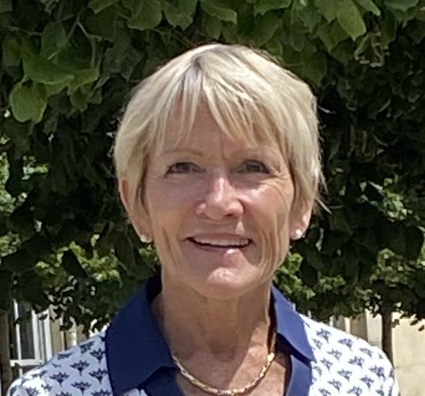

Faculty and Topic Overview
Gordon FRANCIS
Ruth MCPHERSON
Priya MANJOO
Rationale for Recommendation
How to order Lp(a)
Case Studies

Slide 13

Rationale for the recommendation of Lp(a) screening in cardiovascular risk stratification
Gordon Francis
MD, FRCPC, FAHA
Vancouver, BC
Professor of Medicine
Division of Endocrinology and Metabolism
Michael Smith Health Research BC/Providence Research Health Professional Investigator
Centre for Heart Lung Innovation
University of British Columbia

Slide 14
Disclosure of potential conflicts of interest
Gordon Francis
Consulting Fees/Honoraria: None
Clinical Trial: Novartis (pelacarsen)
Grant/Research Support: CIHR, Heart and Stroke Foundation of Canada

Slide 15

Learning Objectives
Understand lipoprotein(a) and the evidence demonstrating its association with atherosclerotic cardiovascular disease (ASCVD).
Identify the 2021 CCS guideline recommendations for lipoprotein(a) in risk stratifying patients and its application to clinical treatment decisions.

Slide 16
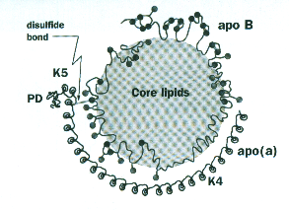
Lipoprotein (a) Lp(a)
Lp(a) level is >90% heritable; mostly controlled by a single gene locus
Levels >500 mg/L found in ≥ 20% of the population
Level not influenced by age, sex, lifestyle factors; not lowered by statins/ezetimibe
Levels stable throughout life; repeat measurements are not required
Notes:
110 bpm for acute rate control changed

Slide 17
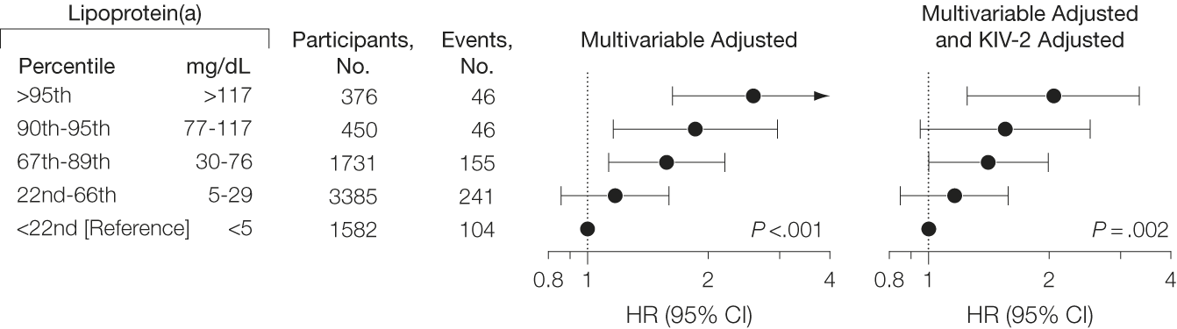
Independent association of elevated Lp(a) and risk for myocardial infarction
Mendelian randomization clearly shows gene variants of Lp(a) that regulate Lp(a) level are robustly and
positively associated with CHD risk, strongly suggesting a causal association of Lp(a) and CVD
Kastrup PR et al., JAMA. 2009;301:2331-2339

Slide 18
Lp(a) level and atherosclerotic cardiovascular disease risk
INTERHEART Study of risk factors for first MI: Lp(a) > 50 mg/dL (>500 mg/L) associated with 1.5-fold increased risk of MI, independent of other CVD risk factors including DM, smoking, high blood pressure
Copenhagen Heart Study: Lp(a) between 30-76 mg/dL (300-760 mg/L) had 1.7-fold higher and with level > 117 mg/dL (1170 mg/L) 2.7-fold higher hazard ratio for myocardial infarction
Higher Lp(a) carries even higher burden of CVD risk in South Asian and Latin American individuals
With very high levels (>1000 mg/L) CVD event rate is similar to individuals with heterozygous FH, a condition for which family screening is recommended

Slide 19
Guidelines Recommendation
Pearson GJ et al., Can J Cardiol 2021;37:1129-1150
Notes:
110 bpm for acute rate control changed

Slide 20
Recommended response to finding elevated Lp(a)
Primary prevention: Careful review of all major CAD risk factors (smoking, diabetes, hypertension, psychosocial stress, abdominal obesity, family history of premature CAD or stroke/TIA); consider additional risk stratification including vascular imaging (carotid ultrasound, coronary calcium score, coronary CT angiogram); consider earlier introduction of long-term statin therapy, pending evidence for benefit of Lp(a)-lowering treatment, which is currently under investigation.
Secondary prevention: Elevated Lp(a) is a very strong predictor of recurrent CVD events and suggests need for further intensification of lipid-lowering therapy. If patient qualifies otherwise for PCSK9 inhibitor, evidence suggests use of these agents lowers recurrent CVD events independent of their LDL-lowering effect.
In both primary and secondary prevention, when the clinical implications of elevated Lp(a) are uncertain, consultation with a lipid specialist may be considered.
Notes:
110 bpm for acute rate control changed

Slide 21
How to Order Lp(a)
Ruth McPherson
MD, PhD, FRCPC, FACP, FRCS
Ottawa, ON
Director Lipid Clinic, Atherogenomics Laboratory & Ruddy Canadian Cardiovascular Genetics Centre
Professor of Medicine, Division of Cardiology
University of Ottawa Heart institute

Slide 22

Disclosure of potential conflicts of interest
Ruth MCPHERSON
Consulting Fees/Honoraria: Amgen, HLS, Novartis, Pendopharm
Clinical Trials: Novartis, Pfizer
Grant/Research Support: CIHR

Slide 23
Learning Objectives
Recognize how to order lipoprotein(a) for their patients according to the Ontario MoHLTC Access Pilot program.

Slide 24
Ontario MoHLTC pilot project to improve access to a number of medically important tests
NT-proBNP, ApoB, Lp(a) and others
The Pilot will run from November 1, 2021, until March 31, 2022, and the data collected from the Pilot will contribute to healthcare system planning efforts.​
The ministry will develop and maintain a Questions & Answers (“Q&A”) document to support the implementation of the Pilot.
The Q&A document will be updated by ministry staff as needed and shared with community laboratories and implementation partners upon request. ​
https://www.health.gov.on.ca/en/pro/programs/ohip/bulletins/redux/bul211102.aspx​

Slide 25
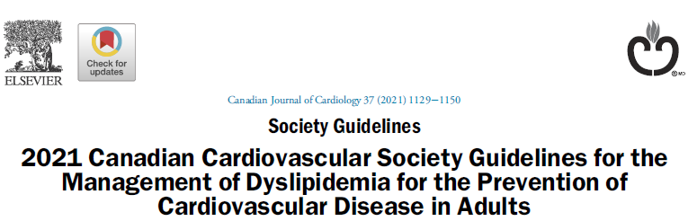
Lp(a) can now be performed by a community laboratory, at no cost to the patient as part of this pilot project.
Criteria for Lp(a) testing are based on the CCS 2021 guidelines.
“Measuring Lp(a) level once in a person’s lifetime as a part of the initial lipid screening is recommended” (Strong Recommendation; High Quality Evidence).
Order as Lp(a) (Not to be confused with apolipoprotein A1)
“The goal of increasing access to these services is to improve patient choice and access to testing services that are appropriate for a laboratory to be providing in the community setting.​”

Slide 26
Participating Laboratories
Alpha Laboratories Inc.
Bio-Test Laboratory Inc.
Dynacare-Gamma Laboratory Partnership
Eglinton Diagnostic Laboratories Ltd.
LifeLabs LP
Med-Health Laboratories Ltd.
Medical Laboratories of Windsor Ltd.

Slide 27
Case Studies
Priya Manjoo
MD, FRCPC Endocrinology
Victoria, BC
American Board of Obesity Medicine
MSc Clinical Epidemiology
Clinical Assistant Professor
Department of Endocrinology
University of British Columbia
VIHA, Department of Medicine

Slide 28
Disclosure of potential conflicts of interest
Priya MANJOO
Consulting Fees/Honoraria: Amgen, HLS therapeutics, Pfizer
Clinical Trials: None
Grant/Research Support: None

Slide 29
Learning Objectives
Evaluate and apply lipoprotein(a) to cases of both primary and secondary cardiovascular risk reduction.

Slide 30
Ms. B
43-year old lady presents for health maintenance visit. No specific complaints
Medical History: Hypertension in pregnancy
Medications: Cipralex 10 mg daily
Social History: 4 glasses of wine per week. No dedicated leisure time physical activity.
Family History: Father had heart failure at age 69. No family history of CAD or stroke that she is aware of.

Slide 31
Examination
Height 157 cm; Weight 78.5 kg; BP (R) 146/88; (L) 144/90; HR 70 and regular; BMI 31.8 kg/m²; Neck Circumference 39 cm; Waist Circumference 98 cm, STOP BANG 4/8, Epsworth Score 8/24
The cardiovascular and respiratory examinations were within normal limits.
There were no carotid, femoral or abdominal bruits heard.
Normal volume and symmetrical posterior tibial pulses.
There were no stigmata of dyslipidemia Mild acanthosis and a few skin tags noted
Notes:
110 bpm for acute rate control changed

Slide 32
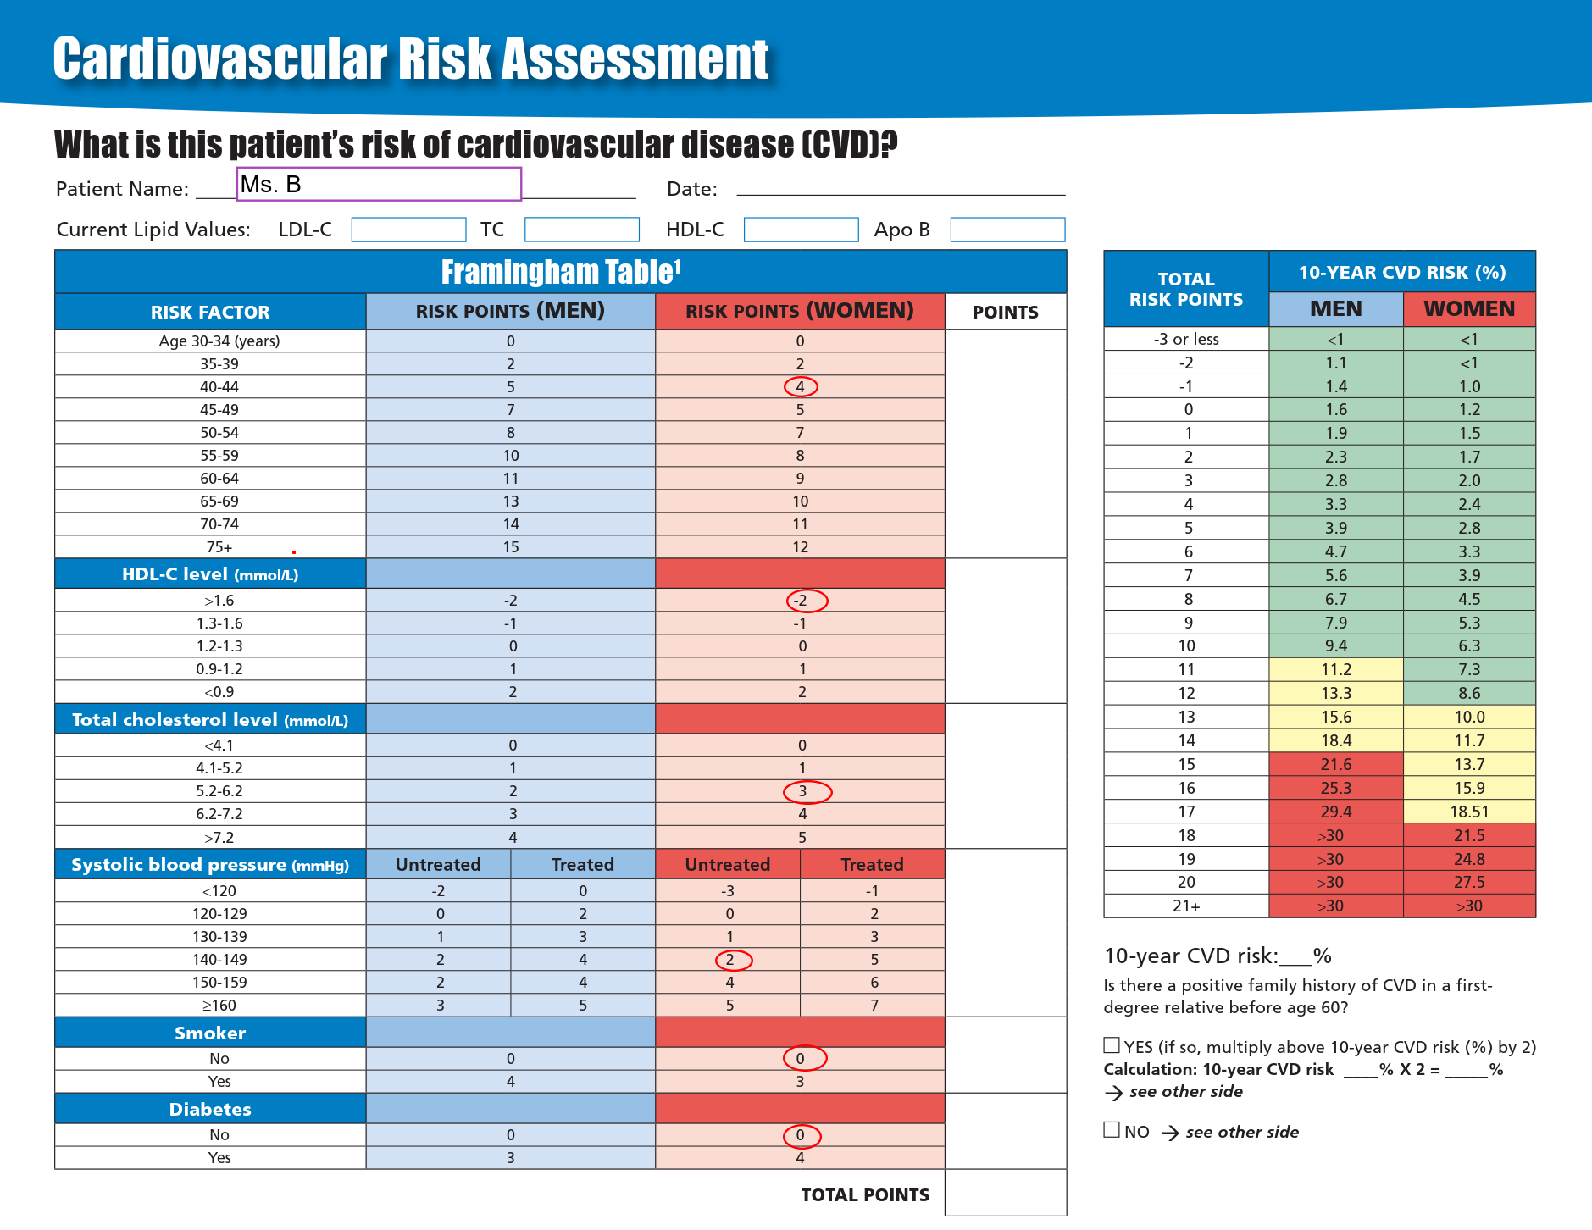
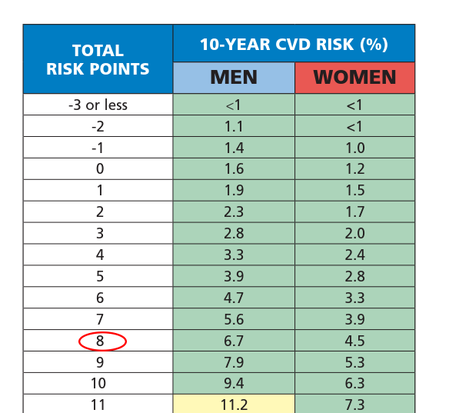
Framingham Risk Score: LOW RISK

Slide 33
Blood Work
 | Apr.15
FBG | 6.2
A1C | 6.1
eGFR | 93
Urine ACR | 1.1
Total cholesterol | 5.44
LDL | 3.08
HDL | 1.91
Triglycerides | 1.00
Non HDL | 3.53
Apo-B100 | 1.02
Hs CRP | 2.6
Lipoprotein (a) | 1417
ALT | 23
CK | 96
TSH | 2.1

Slide 34
CV risk factors
Pre-diabetes
Hypertension in pregancy
Pre hypertension
Metabolic syndrome (BP, FBS, Waist)
Markedly elevated Lipoprotein (a)

Slide 35
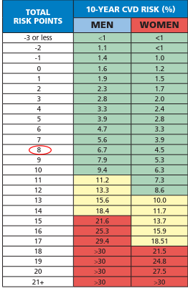
?Pharmacotherapy for lipid lowering therapy
Consider elevating Risk to Moderate Category
Still below the threshold for initiating lipid lowering therapy for someone in the moderate risk category

Slide 36
Recommendations
Optimizing engagement in healthy behaviors
Aiming for a 5-10% weight loss
Referred to dietitian
Information on the BC physical activity line
Discussion about noninvasive risk stratification
Reassessment in 3-6 months

Slide 37
Mr S.
50 year old gentleman referred to the Lipid Clinic for reassessment
RFR: Premature CAD and dyslipidemia in the setting of maximally tolerated statin
PMH: Premature CAD- PCIs 2018, 2021
Type 2 diabetes
Hypertension
Chronic back pain
COPD

Slide 38
History
Family History: Father had an MI at age 40. Mother had an MI (age uncertain)
Social History: >30 pack year history of tobacco use. Quit 3-4 years prior.
Medications:
ASA 162 mg od
Ramipril 10 mg bid
Tiazac XC 240 mg od
Ventolin/Flovent
Rosuvastatin 20 mg daily
Ezetrol 10 mg daily

Slide 39
History
Intolerances: Severe muscle cramping with crestor 40, lipitor, Lipidil EZ. Resultant muscle weakness

Slide 40
Physical Examination
Weight 105kg, BMI 32.5 kg/m2, WC 104 cm, BP 140/90, (no significant difference between the arms).
No stigmata of dyslipidemia.
Marked abdominal adiposity with WC 128 cm.
Normal cardiovascular and respiratory examination
Normal volume and symmetric peripheral pulses.
Normal Neuromuscular examination.

Slide 41
Course in Lipid Clinic
 | Mar.21 | Jul.20 | Sep.19 | Mar.18
A1C | 5.7 | 5.8 | 5.7 | 5.8
Creatinine | 69 | 71 | 77 | 73
eGFR | 83 | 81 | 74 | 79
Urine ACR | <1.0 | <1.0 |  | <1.0
Uric acid | 238
ALT/AST | 20/20 | 30 | 31 | 27/-
T. Chol | 3.08 | 4.01 |  | 4.23
LDL | 1.80 | 2.10 |  | 2.24
HDL | 1.60 | 1.67 |  | 1.71
Non HDL | 1.48 | 2.34 |  | 2.52
TG | 0.69 | 0.52 |  | 0.62
Apo B-100 | 0.78 | 0.86 | 0.83 | 0.95
Lipoprotein(a) |  |  |  | 1179
CK |  |  | 82 | 96
Hs CRP | 0.8 | 0.8 |  | 0.9
TSH | 1.09 |  | 0.48 | 0.85

Slide 42
Course in Lipid Clinic 2019-2021
Very aggressive progression of his cardiovascular disease with blockage of several coronary arteries requiring stents and angioplasties to stents for in stent thrombosis.
The most recent was in July 2021-> Balloon angioplasty to 4 sites.

Slide 43
Cardiovascular Optical Coherence (OCT) Angiography-2021
Catheter-based invasive imaging system. Using light rather than ultrasound.
Produces high-resolution in vivo images of coronary arteries and deployed stents.
Intravascular OCT requires a single fiber-optic wire that both emits light and records the reflection while simultaneously rotating and being pulled back along the artery.

Slide 44
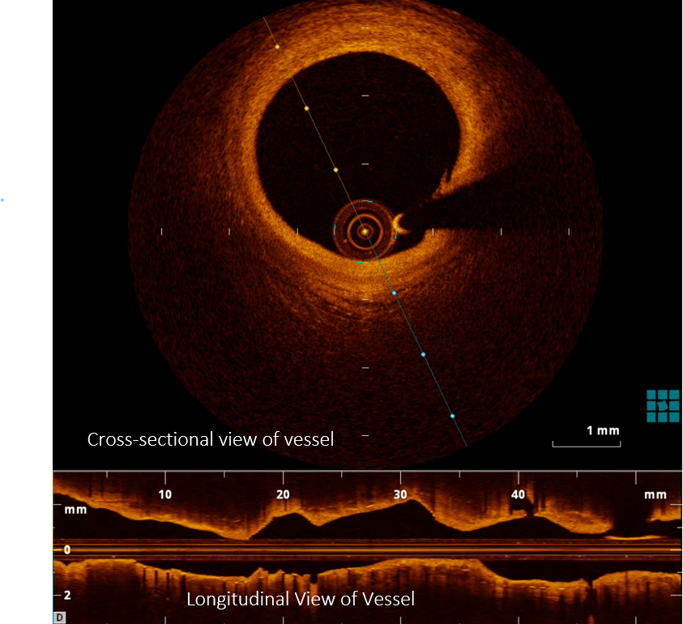
The coronary OCT light source uses a bandwidth in the near-infrared spectrum.
The image is formed by the back-scattering of light from the vessel wall or the time it takes for emitted light to travel between the target tissue and back to the lens.
Multiple axial scans (A-lines) are continuously acquired as the image-wire rotates and a full revolution creates a complete cross section of the vessel.

Slide 45
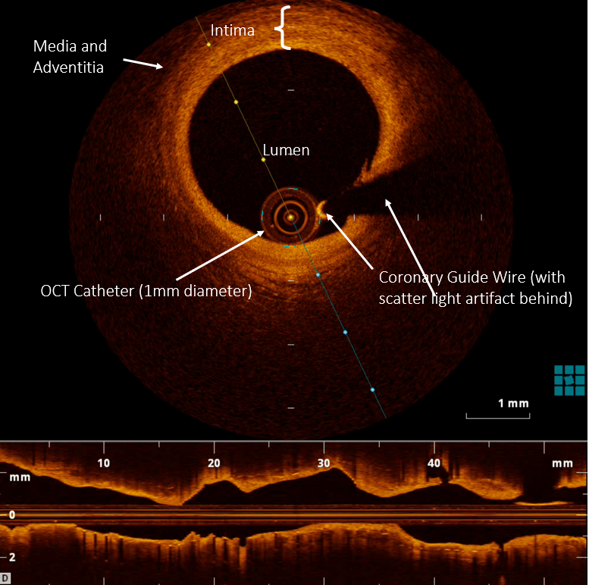

Slide 46
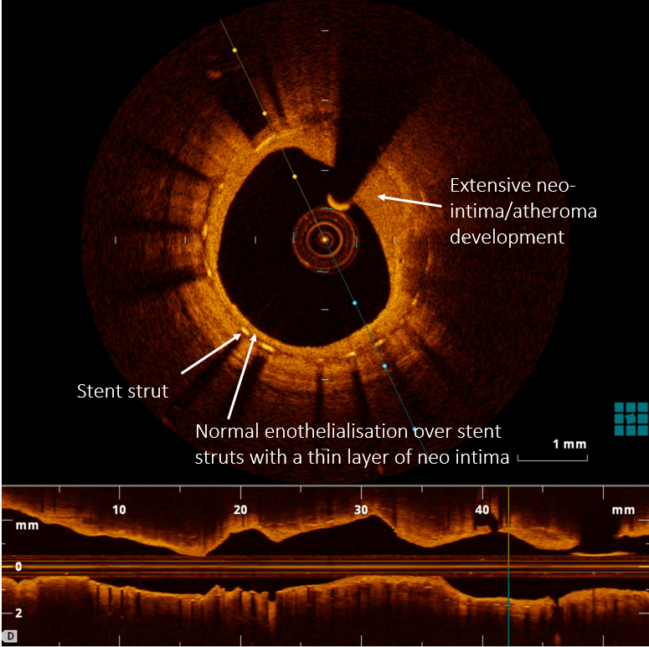

Slide 47
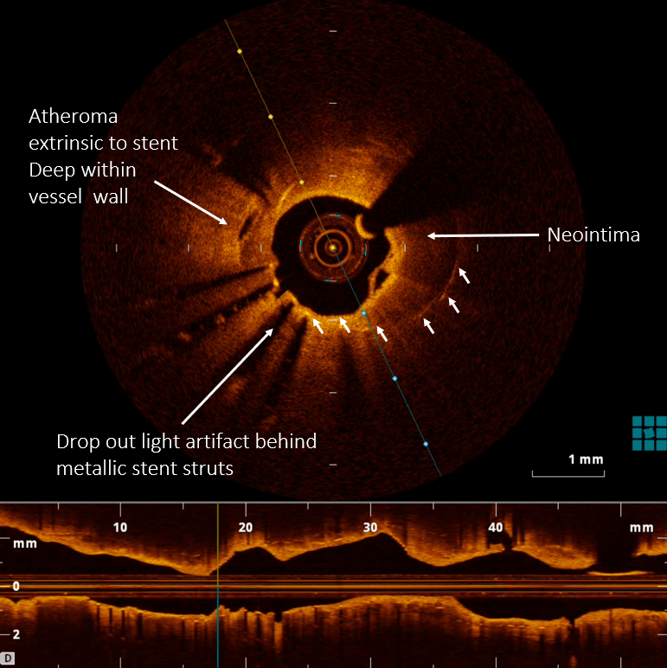
Atheroma extrinsic to stent
Deep within vessel wall

Slide 48
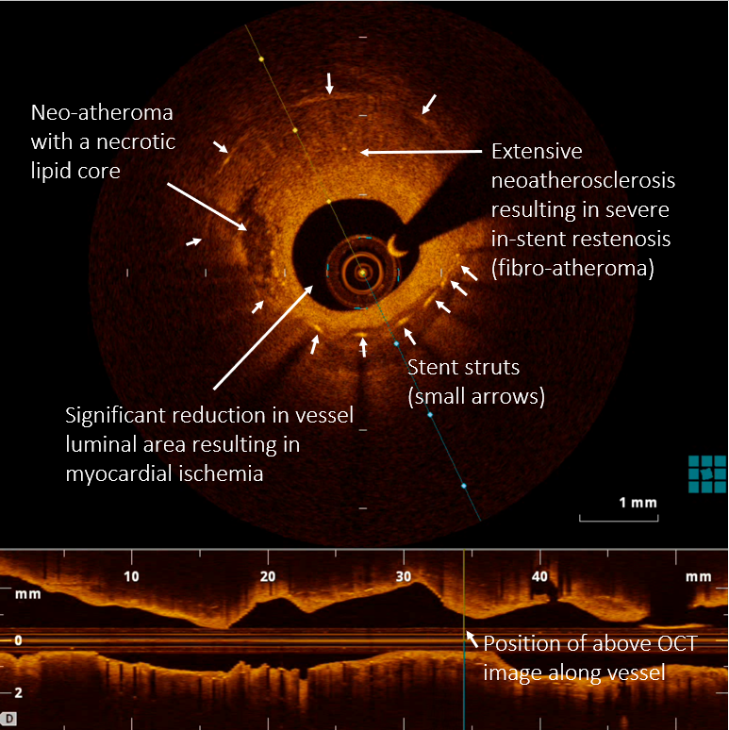

Slide 49
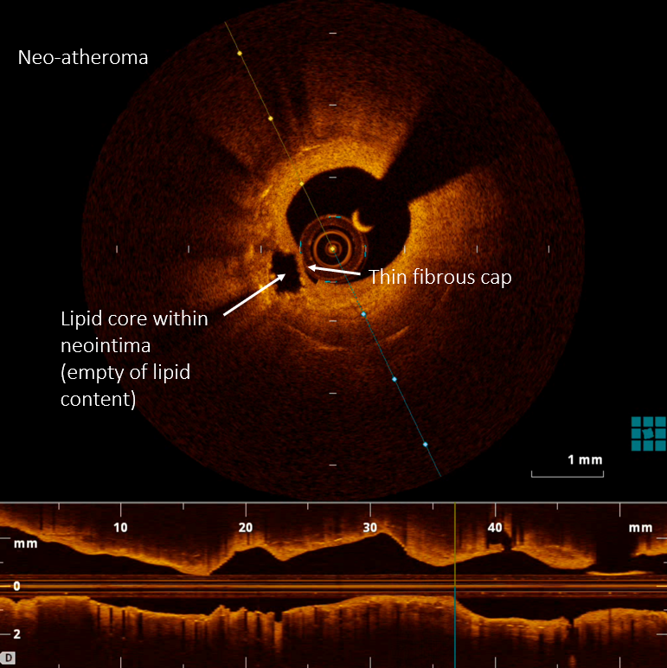

Slide 50
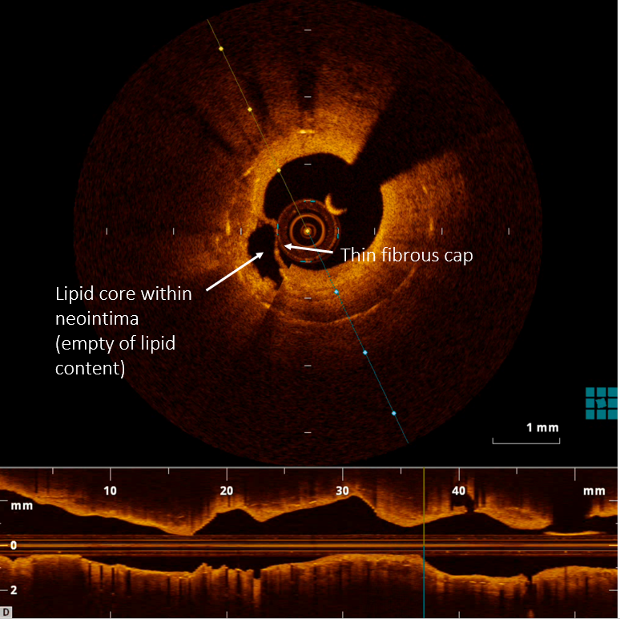

Slide 51
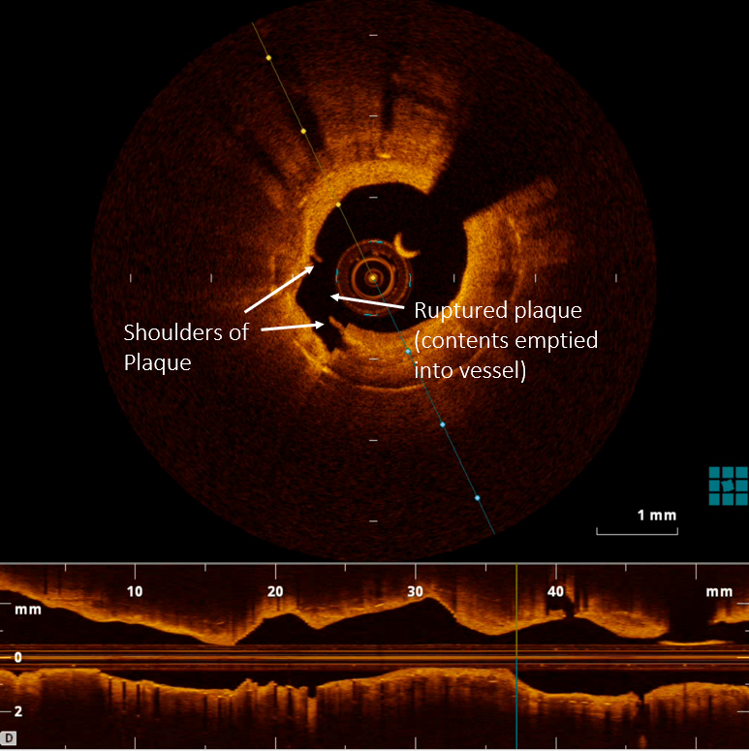

Slide 52
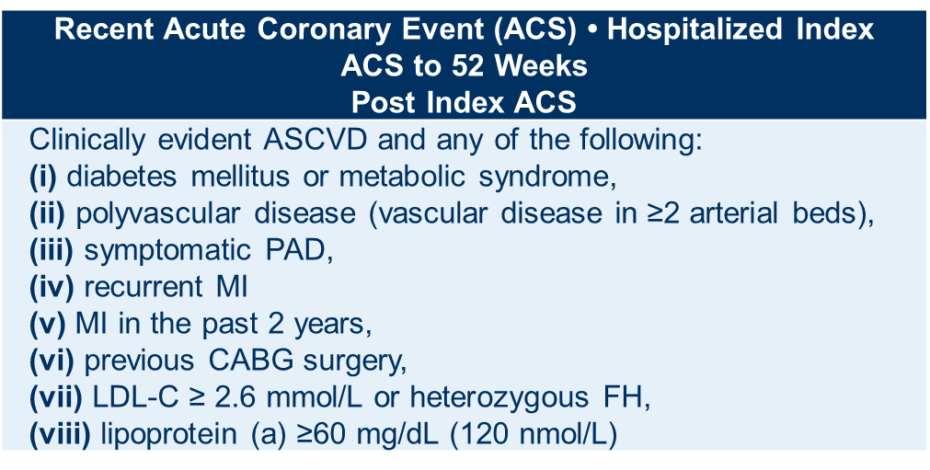
Secondary prevention patients shown to derive the largest benefit from intensification PCSK9 inhibitor
1. Sabatine MS, Giugliano RP, Keech AC, et al. Evolocumab and clinical outcomes in patients with cardiovascular disease. N Engl J Med 2017; 376:1713-22; 2. Schwartz GG, Steg PG, Szarek M, et al. Alirocumab and cardiovascular outcomes after acute coronary syndrome. N Engl J Med 2018; 379:2097-107. ACS, acute coronary syndrome; ASCVD, atherosclerotic cardiovascular disease; CABG, coronary artery bypass graph; CVD, cardiovascular disease; FH, familial hypercholesterolemia; LDL-C, low-density lipoprotein cholesterol; MI, myocardial infarction; PAD, peripheral artery disease; Pearson et al. 2021 Canadian Cardiovascular Society Guidelines for the Management of Dyslipidemia for the Prevention of Cardiovascular Disease in the Adult. From: https://doi.org/10.1016/j.cjca.2021.03.016

Slide 53
Management
There are many contributors to atherosclerosis
Inflammatory component is very robust in this patient
Lipoprotein(a) is a very strong risk factor for CV disease
Started on PCSK-9 inhibitor

Slide 54


QUESTIONS?

Slide 55
Thank you!
Visit CCS.ca for more Guidelines and Resources
Guideline Library:
https://ccs.ca/guidelines-and-position-statement-library/
Guideline Resources:
https://ccs.ca/guideline-resources/

