Slide 1
How to Optimally Manage Dyslipidemia and CV Risk in 2021:
A Review of the Updated CCS Guidelines
October 22, 2021
© Canadian Cardiovascular Society. 2021. All rights reserved.
Distribution, transmission or republication is strictly prohibited without the prior written permission of the Canadian Cardiovascular Society.

Slide 2
© Canadian Cardiovascular Society. 2021. All rights reserved.
Distribution, transmission or republication is strictly prohibited without the prior written permission of the Canadian Cardiovascular Society.
For medical institution internal education or training (i.e. grand rounds, medical college/classroom education, etc.), kindly consider and implement the following:
  Include the citation for the Canadian Journal of Cardiology
  Add ‘Reproduced with permission from the Canadian Cardiovascular Society. [insert year].’
  Avoid use of CCS logos or trademarks on slides, tools or publications that are not the property of the CCS
  Do not modify the slide content and, the layout and CCS branding on the Guideline-related slides
  Guideline recommendations must be reproduced exactly as published
For an industry supported or involved program, permissions are required:
  If content is published in the Canadian Journal of Cardiology, permissions must be sought through our publisher Elsevier (www.onlinecjc.com)
  If content is property of the CCS, contact guidelines@ccs.ca

Slide 3
Session Outline
Topic | Speaker | Time
Introduction | Glen Pearson | 2 min
Review traditional and ancillary approaches to identify individuals for treatment | John Mancini | 10 min
Recognize the potential role of non-statin lipid-modulating drugs | Arden Barry | 10 min
Discuss the evidence for various lipid/lipoprotein thresholds for intensification therapy | Eva Lonn | 10 min
Conclusion + Questions | Glen Pearson, George Thanassoulis and Panelists | 15 min

Slide 4
Disclosures of Potential Conflicts of Interest
Glen Pearson
Consulting Fees/Honoraria: Novartis
Clinical Trials: None
Eva Lonn
Consulting Fees/Honoraria: Amgen, Bayer, Boehringer Ingelheim, Novartis, Sanofi
Clinical Trials: Amgen, AstraZeneca, Bayer, Boehringer Ingelheim, Sanofi
John Mancini
Consulting Fees/Honoraria: Astra Zeneca, Boerhinger-Ingelheim, Janssen, Lilly, Novo Nordisk, Amgen, Sanofi, HLS Therapeutics, Esperion
Clinical Trials: SOUL trial, HORIZON, ZERBINI
George Thanassoulis
Consulting Fees/Honoraria: Amgen, Regeneron/Sanofi, HLS therapeutics, Ionis, Servier, Novartis, Silence
Research Grants: Servier, Ionis
Clinical Trials: Amgen, Novartis
Arden Barry
Consulting Fees/Honoraria: None
Clinical Trials: None

Slide 5

2021 Dyslipidemia Guidelines Committee Members
Co-Chairs:
Glen Pearson (Edmonton)
George Thanassoulis (Montreal)
Todd Anderson (Calgary)
Arden Barry (Vancouver)
Patrick Coutoure (Quebec City)
Natalie Dayan (Montreal)
Gordon Francis (Vancouver)
Jacques Genest (Montreal)
Jean Grégoire (Montreal)
Steven Grover (Montreal)
Milan Gupta (Toronto)
Rob Hegele (London)
David Lau (Calgary)
Lawrence Leiter (Toronto)
Alex Leung (Calgary)
Eva Lonn (Hamilton)
John GB Mancini (Vancouver)
Priya Manjoo (Victoria)
Ruth McPherson (Ottawa)
Daniel Ngui (Vancouver)
Marie-Eve Piche (Quebec City)
Paul Porier (Quebec City)
John Sievenpiper (Toronto)
Jim Stone(Calgary)
Rick Ward (Calgary)
Wendy Wray (Montreal)

Slide 6

Overview of the Guidelines Process
Data informing each PICO question summarized and reviewed using GRADE standards
Recʼds voted on – 2/3 majority required to be accepted
CJC publication (pre-proof on-line March 26; final copy-edited version August 25, 2021)
•Presentations
•KT-Tools
Dissemination
Recommendation Development
Defined approach and topics to be addressed
Defined clinical questions (13 different PICOs rated based on availability and significance of evidence -- 6 included)
Formed small subgroups with leads for each PICO question
Evidence Summary
Working Groups
Priorities & Process
PICO Questions

Slide 8
Review of Traditional and Ancillary Approaches to Identify Individuals for Treatment
G. B. John Mancini, MD, FRCP(C), FACC
Professor of Medicine, Division of Cardiology
University of British Columbia
Director, CardioRisk Clinic

Slide 9
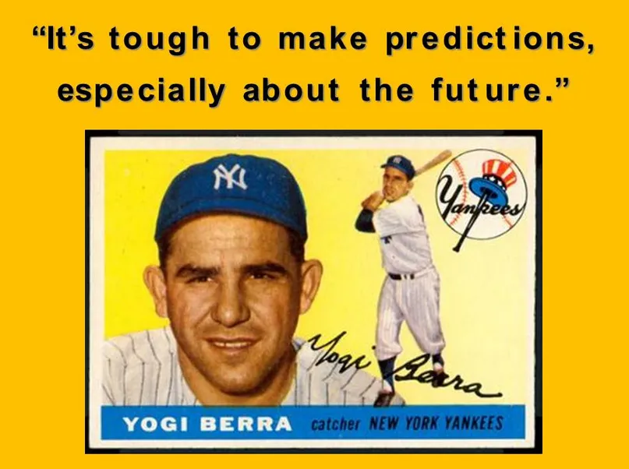

Slide 10
The CCS Dyslipidemia Guideline uses a HYBRID SYSTEM to identify patients for treatment
Statin-indicated conditions
Framingham Risk Score (with modifications)

Slide 11
Statin-indicated conditions
A mixture of primary and secondary prevention clinical syndromes shown to benefit from lipid lowering on the basis of:
  Observational studies wherein RCT’s are unethical to perform: i.e. patients with FH and/or extremely high level of LDL-C (5 mmol/L for adults, 4.5 mmol/L for young adults, 4.0 mmol/L for teens)
  Randomized clinical trials (i.e. mimicking eligibility criteria of milestone trials): myriad of ASCVD trials, SHARP Trial (mainly pre-dialysis CKD), CARDS (most T2D)
  Note: ASCOT - hypertensives with evidence of cardiorenal end-organ damage and MRF’s; previously defined as a statin-indicated condition but was mysteriously dropped
  Note: JUPITER (“low LDL-C” with hs-CRP ≥ 2.0 mg/L) was never adopted because of concerns regarding mandating routine measurement of hs-CRP, the very low risk of this population and the emerging concept that LDL-C < 3.5 mmol/L was not really ideal, irrespective of hs-CRP

Slide 12
Framingham Risk Score (with modifications)
FRS should be calculated (not guessed) for primary prevention patients 40 – 75yo without statin-indicated conditions
Modifications allow for weighing additional information reflecting societal values and preferences as well as emerging data:
  Absolute level of LDL-C (above/below 3.5 mmol/L)
  Lipoprotein (a) (new recommendation to measure once)
  Family History (x 2)
  Other risk enhancers (e.g. South Asians, Indigenous, Hypertensive Disorders of Pregnancy, Inflammatory Diseases etc), and one enhancer/de-enhancer (i.e. CACS); these modify risk but have not been subjected to RCT’s
The FRS has itself not been used in RCT’s to identify patients who may/may not derive cardiovascular risk reduction from LLT so dogmatism is not warranted

Slide 13
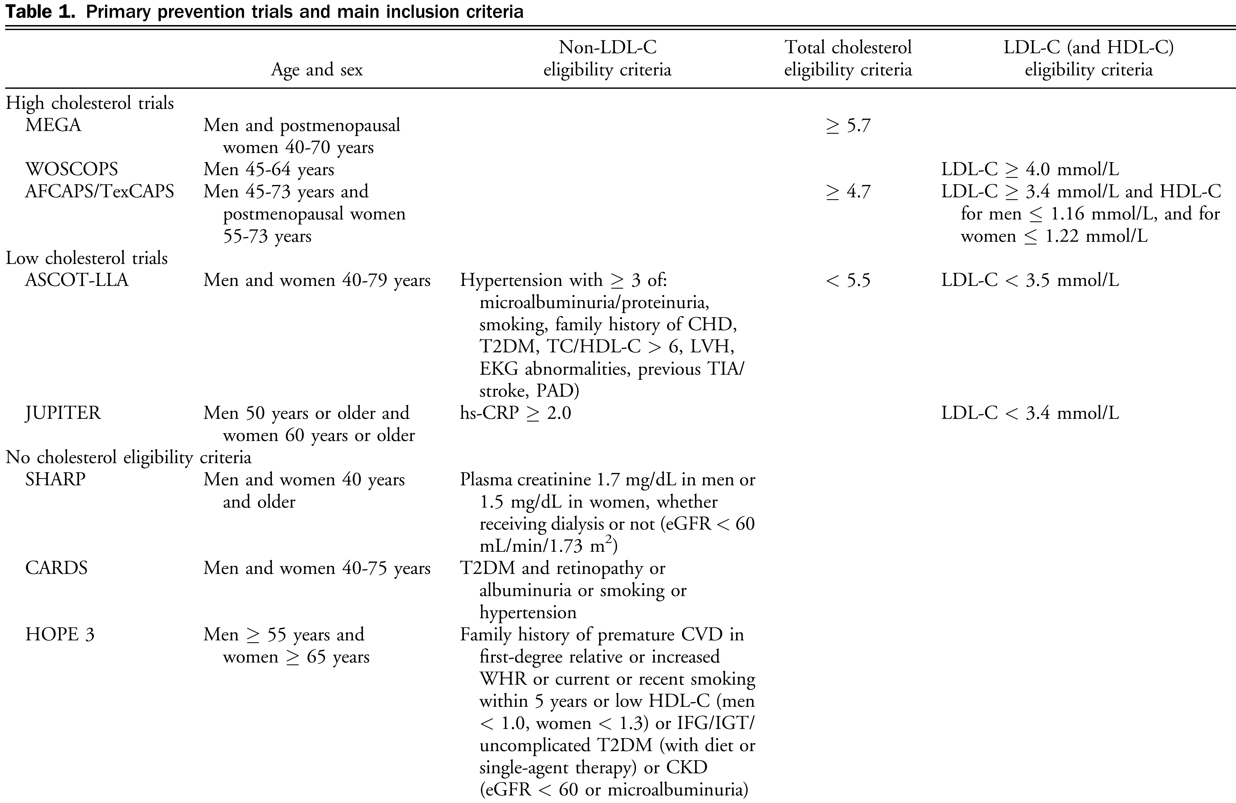
NB: Risk calculators or CACS were not used to identify eligible patients in any trial
Mancini & Hegele CJC 2018; 34: 546

Slide 14
Outcomes that determine the % events/10 years

Slide 15
 | PERCENT 10 YEAR RISK
 | 50 yo MALE |  |  |  |  | 55 yo FEMALE
 | SBP 135, TC 6, HDL-C 1, TG 2, LDL-C 4.09, Non smoker, No ASCVD, T2D or CKD
Framingham | 13 |  |  |  |  | 10
Reynolds | hsCRP (mg/L) |  |  |  |  | hsCRP (mg/L)
 | 1 | 2 | 3 | 10 |  | 1 | 2 | 3 | 10
 | 4.99 | 5.35 | 5.57 | 6.27 |  | 2.73 | 3.09 | 3.32 | 4.11
SCORE (High Risk) | 2.26 |  |  |  |  | 1.13
SCORE (Low Risk) | 1.17 |  |  |  |  | 0.73
SCORE2 | 3.38 |  |  |  |  | 2.73
PCE | 6.11 |  |  |  |  | 3.59
ATP - III | 7.64 |  |  |  |  | 2.65
MESA - CAC | Coronary Artery Calcification (Agatston Units) |  |  |  |  | Coronary Artery Calcification (Agatston Units)
 | 0 | 50 | 100 | 300 |  | 0 | 50 | 100 | 300
 | 2.5 | 7.16 | 8.57 | 11.39 |  | 1.18 | 5.24 | 6.29 | 8.39

Slide 16
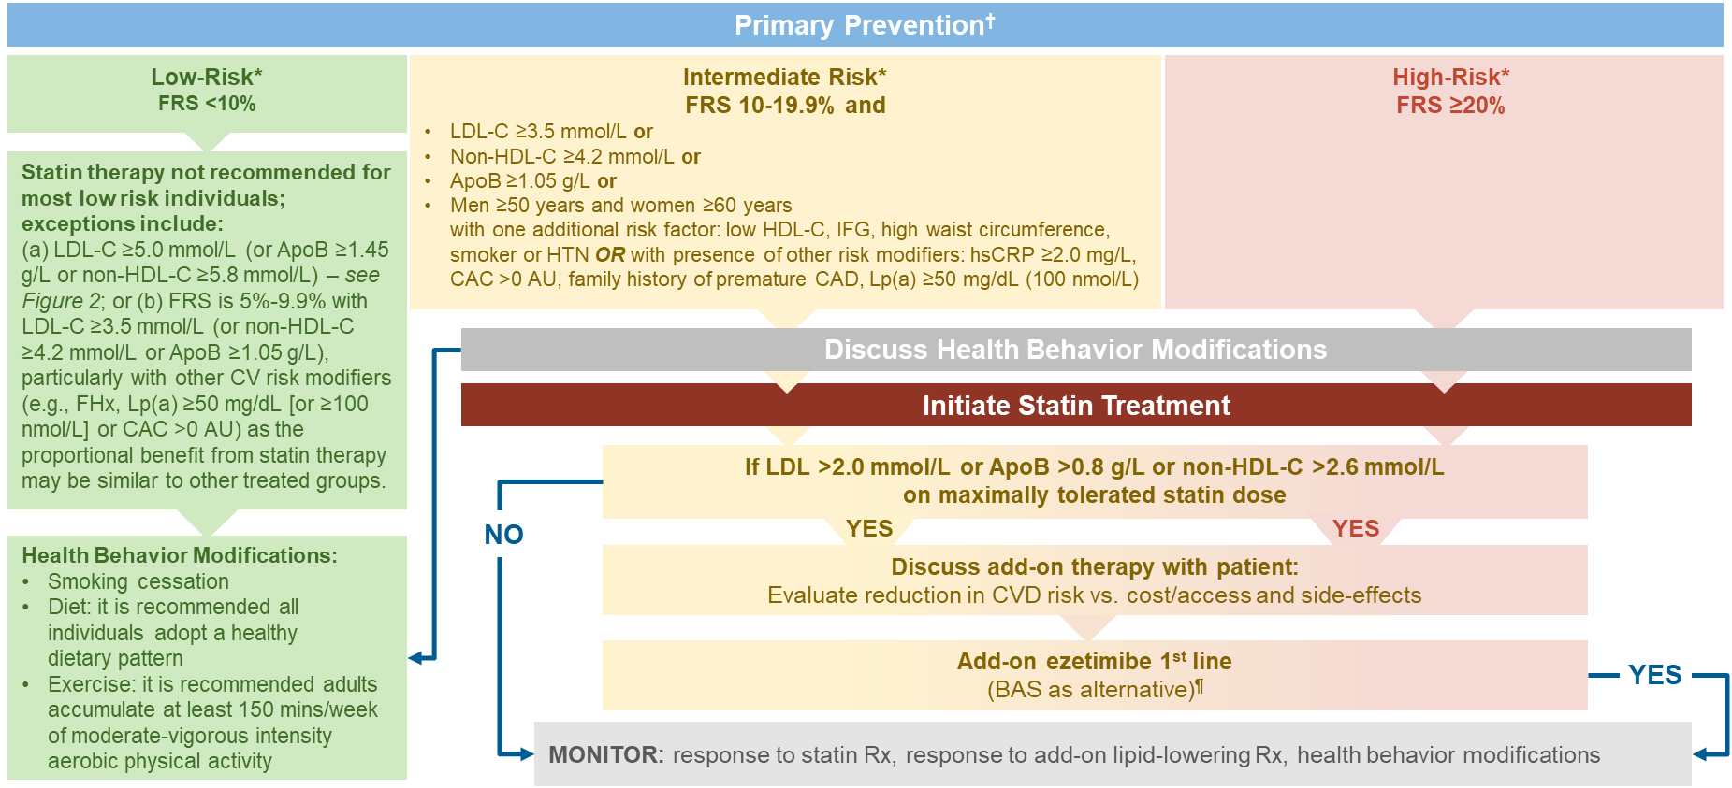

Figure 1: Treatment Approach for Primary Prevention Patients (Without a Statin Indicated Condition)‡
YOU NEED TO CALCULATE FRS

Slide 17
Low Risk < 10% events/10 years

Slide 18
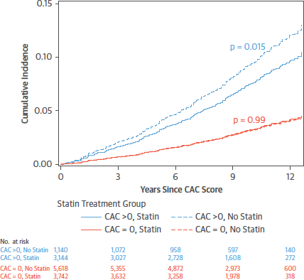
Coronary Artery Calcium Scoring for Shared Decision-making in Moderate Risk Subjects: Risk Enhancer and De-enhancer
In primary prevention, the potential benefit of statins is associated with the presence (and severity) of CAC
Useful to reclassify in patients with Moderate or “Low-moderate” Risk and to aid discussions in statin reluctant patients.
Mitchell et al JACC 2018 72:3233

Slide 19
CACS for Risk Reclassification
Framingham Risk Score | CACS | RESULT/RECLASSIFICATION
 |  | > 300 VERY HIGH RISK
HIGH | NO | > 100 HIGH RISK
MODERATE | CONSIDER | 1 – 99 MODERATE RISK
LOW but CONCERNING# | CONSIDER
LOW with no concerning features | NO | 0 LOW RISK (re-evaluate)*
X
X
* Use routine measures for re-evaluation during follow-up. CACS should not be repeated sooner than 5y or at all if patient-physician discussion leads to lipid risk factor modification.
#Concerning features include: family history, elevated Lp(a), FRS 5 – 9.9% with LDL-c > 3.5 mmol/L

Slide 20
The World Needs More Canada!
(Mortensen et al, Ann Int Med 2018; 168: 85 – 92, Mancini,
Ann Int Med 2018: 168: 145 - 146)
Highest Events Averted

Slide 21
The CCS Dyslipidemia Guideline uses a HYBRID SYSTEM to identify patients for treatment
Statin-indicated conditions and
Framingham Risk Score (with modifications)
The approach is a balance between the RCT’s, observational studies and emerging data that can help support patient-physician decision-making to individualize therapy
Evidence suggests that the approach compares very favorably with other guidelines for averting events and keeping societal treatment burden (NNT) reasonable

Slide 22
Role of Non-statin Lipid-modulating Drugs
Arden Barry BSc BSc(Pharm) PharmD ACPR
Faculty of Pharmaceutical Sciences
The University of British Columbia
Vancouver, BC

Slide 23
PICO 5: In adults already receiving (or intolerant to) statins, what is the role of non-statin drugs to reduce ASCVD risk?
Can J Cardiol 2021;37:1129-50

Slide 24
Ezetimibe
⬇ LDL-C by ~20% in addition to statin
IMPROVE-IT
  Patients with a recent ACS on statin therapy
  Ezetimibe 10 mg PO daily vs placebo
  ⬇ MACE (NNT=50 over 7 yr)
  CV death NS
Can J Cardiol 2021;37:1129-50; N Engl J Med 2015;372:2387-97

Slide 25
PCSK9 Inhibitors
⬇ LDL-C by ~50-70% in addition to statin
ODYSSEY OUTCOMES and FOURIER
  Patients with ASCVD on statin therapy
  Alirocumab or evolocumab vs placebo
  ⬇ MACE (NNT=63-67 over ~2 yr)
  CV death NS
Limited data in patients with FH and statin-intolerant patients
No data in primary CV prevention
Can J Cardiol 2021;37:1129-50; N Engl J Med 2017;376:1713-22; N Engl J Med 2018;379:2097-107

Slide 26
Omega-3 Fatty Acids
REDUCE-IT
  Patients with ASCVD (or DM and ≥1 ASCVD risk factor) on statin therapy with TG 1.5-5.6 mmol/L and LDL-C 1.1-2.6 mmol/L
  Icosapent ethyl 2 g PO BID vs placebo (mineral oil)
  ⬇ MACE (NNT=21 over 5 yr)
  ⬇ CV death (NNT=112 over 5 yr)
  All-cause death NS
Can J Cardiol 2021;37:1129-50; N Engl J Med 2019;380:11-22

Slide 27
Omega-3 Fatty Acids
STRENGTH
  Patients with ASCVD (or DM and ≥1 ASCVD risk factor or high-risk primary CV prevention) on statin therapy with TG 2.0-5.6 mmol/L
  Omega-3 carboxylic acids 4 g PO daily vs placebo (corn oil)
  MACE NS
  CV death NS
Can J Cardiol 2021;37:1129-50; JAMA 2020;324:2268-80

Slide 28
Recommendations
We recommend the use of icosapent ethyl to decrease the risk of CV events in patients with ASCVD, or DM and ≥1 ASCVD risk factor, who have an elevated fasting TG level of 1.5-5.6 mmol/L despite maximally tolerated statin therapy (Strong Recommendation; High-Quality Evidence).
We recommend the use of a PCSK9 inhibitor (alirocumab or evolocumab) to lower LDL-C in patients with heterozygous FH whose LDL-C remains above the threshold (LDL-C ≥2.5 mmol/L or <50% reduction from baseline for patients without ASCVD or LDL-C ≥1.8 mmol/L for patients with ASCVD) despite maximally tolerated statin therapy with or without ezetimibe therapy (Strong Recommendation; High-Quality Evidence).
Can J Cardiol 2021;37:1129-50

Slide 29
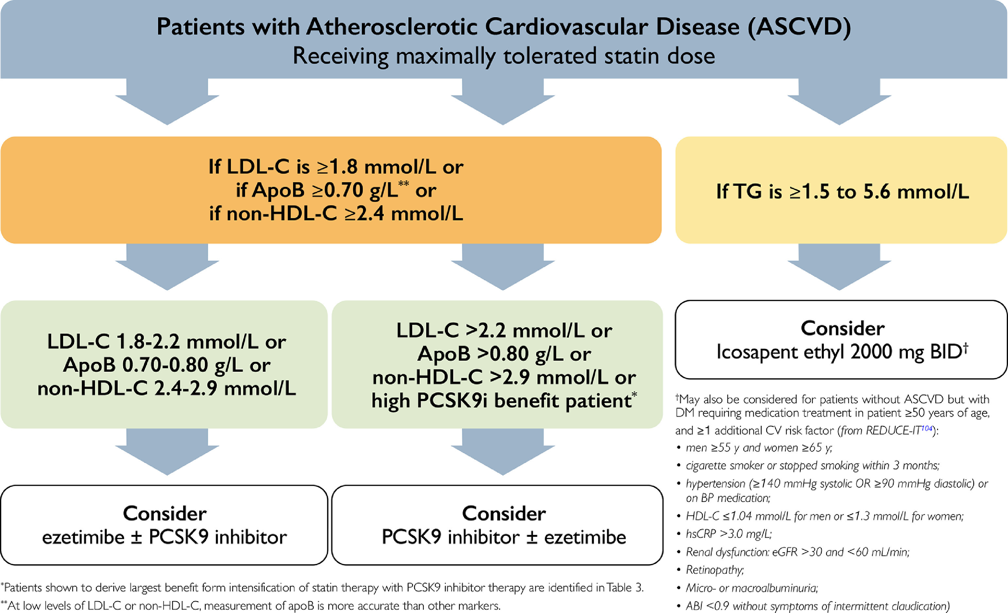
Can J Cardiol 2021;37:1129-50

Slide 30
Omega-3 Fatty Acids
ASCEND and VITAL
  Patients without ASCVD
  Omega-3 fatty acids 1000 mg PO daily vs placebo
  MACE NS
Can J Cardiol 2021;37:1129-50; N Engl J Med 2018;379:1540-50; N Engl J Med 2019;380:23-33

Slide 31
Recommendations
We do not recommend the use of over-the-counter omega-3 polyunsaturated fatty acid supplements (marketed as natural health products in Canada) to reduce ASCVD risk (Strong Recommendation; High-Quality Evidence).
Can J Cardiol 2021;37:1129-50

Slide 32
The Evidence for Various Lipid/Lipoprotein Threshold for Intensified Lipid Lowering Therapy
Eva Lonn, MD, MSc, FRCPC, FACC
Professor of Medicine, McMaster University
Senior Scientist, Population Health Research Institute
Medical Director Heart Failure Services
Medical Director Cardiac Health and Rehabilitation Services

Slide 33
Thresholds vs Targets of Lipid Lowering Therapy
RCTs identify thresholds of initiation of intensified lipid lowering therapy in secondary prevention
No direct evidence from RCTs (or other research) for any specific targets
No evidence for the often-quoted argument that targets rather than thresholds will result in better implementation of intensified lipid lowering therapy in secondary prevention
Potential detrimental effect of targets as it may lead to dose adjustment and higher LDL-C levels
Possible more complicated clinical practice algorithm when chasing targets
Inaccuracy in calculated LDL-C for low LDL-C concentrations

Slide 34
Non-HDL-C
Analysis of CV events in the UK Biobank and metanalysis of 110 prospective cohort studies found overall similar ability of non-HDL and apo-B to predict events, both superior to LDL-C (slightly better for apo-B)
Apo-B available in Canada without charge in all provinces except Ontario
Especially important when TG ≥ 1.5 mmol/L
RECOMMENDATION
We recommend that for any patient with triglycerides ≥ 1.5 mmol/L, non-HDL-C or Apo-B be used instead of LDL-C as the preferred lipid parameter for screening (Strong Recommendation, High-Quality Evidence).

Slide 35
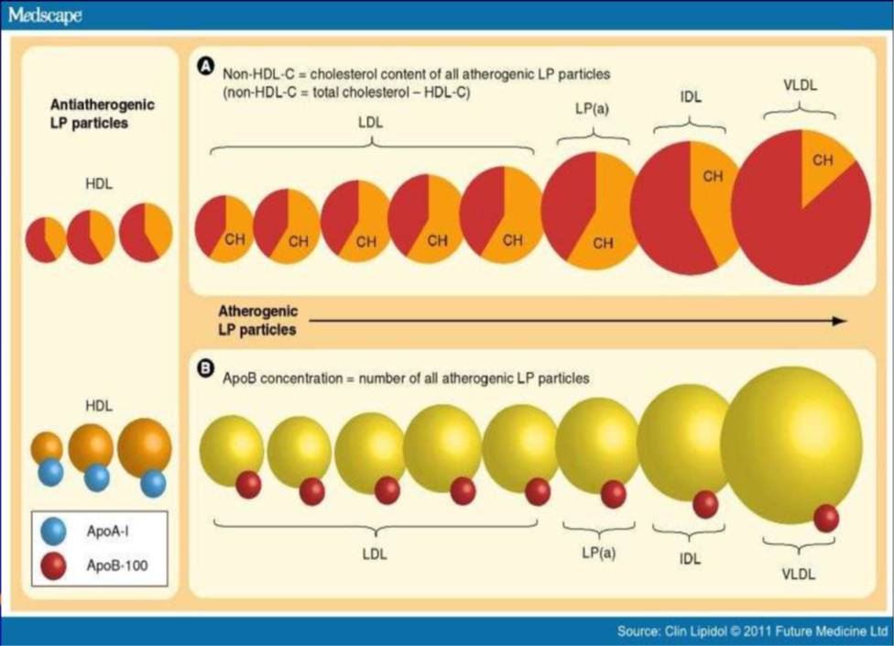
Apolipoprotein B
Each of the atherogenic lipid particles (LDL, Lp_{(a)}, IDL, VLDL) contain 1 molecule of Apo-B
Serum concentration of Apo-B reflects the total number of these particles in the circulation
Measuring apo-B provides information about the number and total atherogenicity of the lipid profile
Discordance between non-HDL-C and Apo-B in 8%-23% of individuals

Slide 36
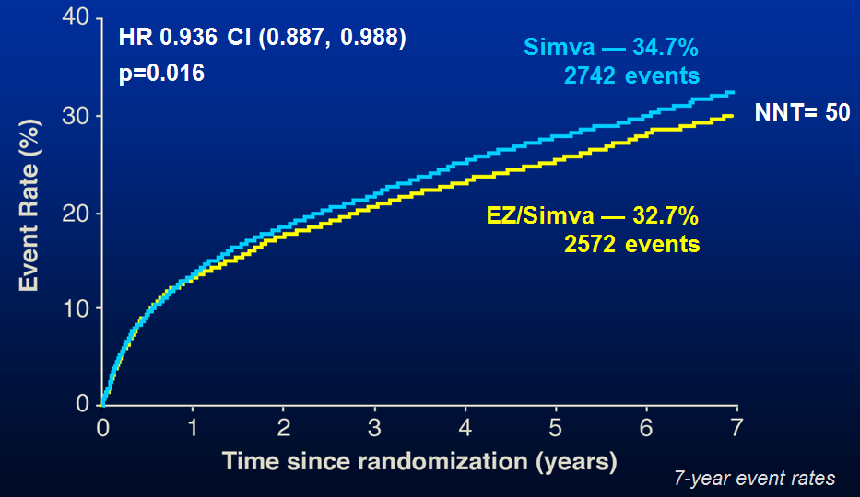
IMPROVE-IT
18,144 patients within 10 days post ACS (N=18144); LDL>1.3 mmol/L; not on LLT < 3.2 mmol/L; on LLT < 2.6 mmol/L
Primary endpoint: CV death, MI, UAP requiring rehospitalization, coronary revascularization (≥30 days), or stroke
Mean LDL-C at 1 year: 1.4 mmol/L for simvastatin/ezetimibe
vs 1.8 mmol/L for simvastatin alone
Cannon C. N Engl J Med 2015;372:2387-97
Notes:
IMPROVE-IT was a double-blind, randomized trial involving 18,144 patients who had been hospitalized for an ACS within the preceding 10 days and had LDL cholesterol levels 1.3 to 2.6 mmol/L if they were receiving LLT or 1.3 to 3.2 mmol/L if not receiving LLT. The combination of simvastatin (40 mg) and ezetimibe (10 mg) (simvastatin–ezetimibe) was compared with simvastatin (40 mg) and placebo (simvastatin monotherapy). The primary end point was a composite of cardiovascular death, nonfatal myocardial infarction, unstable angina requiring rehospitalization, coronary revascularization (≥30 days after randomization), or nonfatal stroke. The median follow-up was 6 years.
RESULTS
The median time-weighted average LDL cholesterol level during the study was 1.4 mmol/L in the simvastatin–ezetimibe group, as compared with 1.8 mmol/L in the simvastatin-monotherapy group (P<0.001). The Kaplan–Meier event rate for the primary end point at 7 years was 32.7% in the simvastatin–ezetimibe group, as compared with 34.7% in the simvastatin-monotherapy group (absolute risk difference, 2.0 percentage points; hazard ratio, 0.936; 95% confidence interval, 0.89 to 0.99; P=0.016). Rates of prespecified muscle, gallbladder, and hepatic adverse effects and cancer were similar in the two groups.
CONCLUSIONS
When added to statin therapy, ezetimibe resulted in incremental lowering of LDL cholesterol levels and improved cardiovascular outcomes. Moreover, lowering LDL cholesterol to levels below previous targets provided additional benefit.

Slide 37
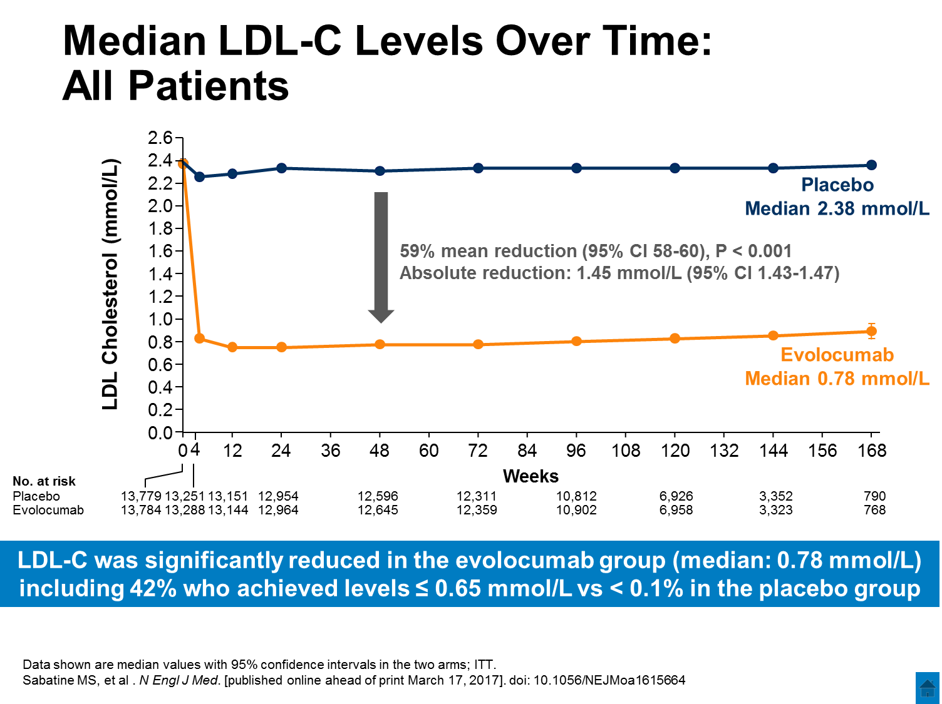
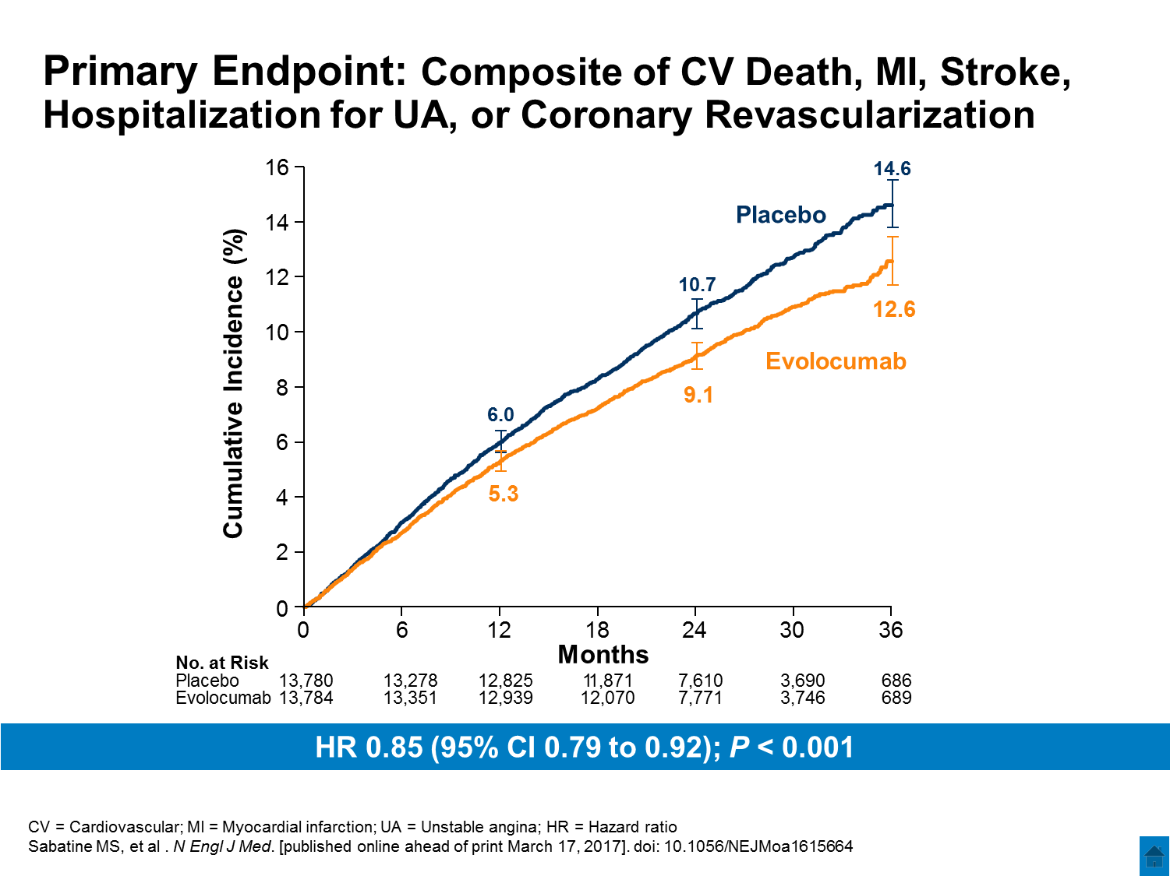
FOURIER
27,564 patients with history of CVD event (chronic stable ASCVD) plus additional RFs;
Fasting LDL-C ≥ 1.8 mmol/L or non-HDL-C ≥2.6 mmol/L
Primary Endpoint: CV death, MI, stroke, hosp. for UA, or coronary revascularization
ARR=1.5%
NNT=67
HR=0.85 (0.79-0.92)
P<0.001
Sabatine M. N Engl J Med 2017 ;376(18):1713-1722
Notes:
FOURIER was a randomized, double-blind, placebo-controlled trial involving 27,564 patients with atherosclerotic cardiovascular disease and LDL cholesterol levels of 1.8 mmol/L or higher who were receiving statin therapy. Patients were randomly assigned to receive evolocumab (either 140 mg every 2 weeks or 420 mg monthly) or matching placebo as subcutaneous injections. The primary efficacy end point was the composite of cardiovascular death, myocardial infarction, stroke, hospitalization for unstable angina, or coronary revascularization. The key secondary efficacy end point was the composite of cardiovascular death, myocardial infarction, or stroke. The median duration of FU was 2.2 years.
RESULTS
At 48 weeks, the least-squares mean percentage reduction in LDL cholesterol levels with evolocumab, as compared with placebo, was 59%, from a median baseline value of 2.4 mmol/L to 0.78 mmol/L (P<0.001). Relative to placebo, evolocumab treatment significantly reduced the risk of the primary end point (1344 patients [9.8%] vs. 1563 patients [11.3%]; hazard ratio, 0.85; 95% confidence interval [CI], 0.79 to 0.92; P<0.001) and the key secondary end point (816 [5.9%] vs. 1013 [7.4%]; hazard ratio, 0.80; 95% CI, 0.73 to 0.88; P<0.001). The results were consistent across key subgroups, including the subgroup of patients in the lowest quartile for baseline LDL cholesterol levels (median, 74 mg per deciliter [1.9 mmol per liter]). There was no significant difference between the study groups with regard to adverse events (including new-onset diabetes and neurocognitive events), with the exception of injection-site reactions, which were more common with evolocumab (2.1% vs. 1.6%).
CONCLUSIONS
In our trial, inhibition of PCSK9 with evolocumab on a background of statin therapy lowered LDL cholesterol levels to a median 0.78 mmol/L and reduced the risk of cardiovascular events. These findings show that patients with atherosclerotic cardiovascular disease benefit from lowering of LDL cholesterol levels below current targets.

Slide 38
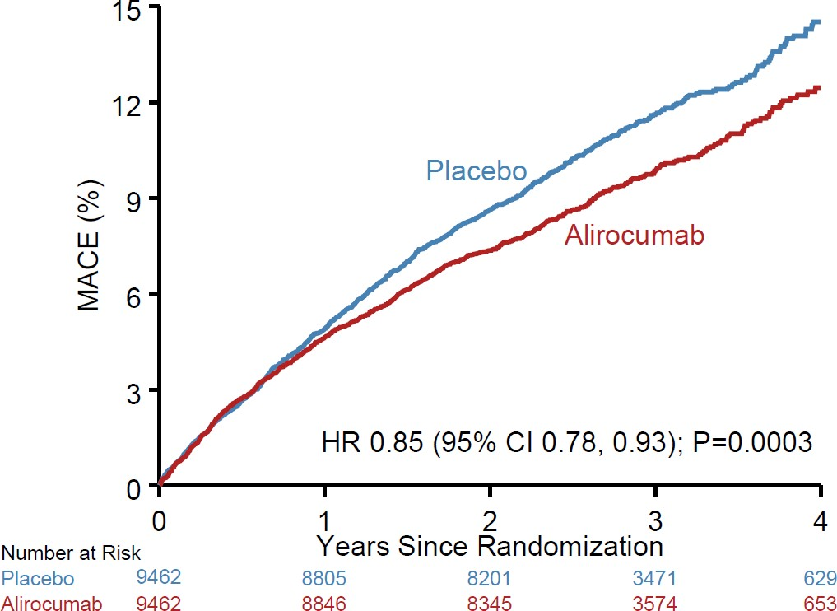
ODYSSEY OUTCOMES
18,924 post ACS patients (1-12 months); LDL-C ≥ 1.8 mmol/L or non-HDL ≥ 2.6 mmol/L or apo B ≥ 80 mg/dL
Primary Outcome: CHD death, non-fatal MI, fatal or non-fatal stroke, UAP requiring hospitalization
Alirocumab ITT
Alirocumab On Treatment
Placebo ITT
Placebo On Treatment
ARR* 1.6%
NNT=63 at 2 yrs
2.67
mmol/L
105
2.4
mmol/L
2.5
mmol/L
2.63
mmol/L
2.5
90
1.7
mmol/L
2.0
75
60
1.2
mmol/L
1.5
HR 0.85
(95% CI 0.78, 0.93) P=0.0003
Mean LDL-C (mg/dL)
Mean LDL-C (mmol/L)
1.0
mmol/L
45
1.3
mmol/L
1.1
mmol/L
1.0
30
0.9
mmol/L
15
0.5
0
0
0
4
8
12
16
20
24
28
32
36
40
44
48
Months since randomization
Schwarz GG. N Engl J Med 2018
Notes:
METHODS: ODYSSEY was a multicenter, randomized, double-blind, placebo-controlled trial involving 18,924 patients who had an acute coronary syndrome 1 to 12 months earlier, had a low-density lipoprotein (LDL) cholesterol level of at least 1.8 mmol/L, a non−high-density lipoprotein cholesterol level of at least 2.6 mmol/L, or an apolipoprotein B level of at least 80 mg/dL, and were receiving statin therapy at a high-intensity dose or at the maximum tolerated dose. Patients were randomly assigned to receive alirocumab subcutaneously at a dose of 75 mg (9462 patients) or matching placebo (9462 patients) every 2 weeks. The dose of alirocumab was adjusted under blinded conditions to target an LDL cholesterol level of 0.6 to 1.3 mmol/L. The primary end point was a composite of death from coronary heart disease, nonfatal myocardial infarction, fatal or nonfatal ischemic stroke, or unstable angina requiring hospitalization.
RESULTS: The median duration of follow-up was 2.8 years. A composite primary end-point event occurred in 903 patients (9.5%) in the alirocumab group and in 1052 patients (11.1%) in the placebo group (hazard ratio, 0.85; 95% confidence interval [CI], 0.78 to 0.93; P<0.001). A total of 334 patients (3.5%) in the alirocumab group and 392 patients (4.1%) in the placebo group died (hazard ratio, 0.85; 95% CI, 0.73 to 0.98). The absolute benefit of alirocumab with respect to the composite primary end point was greater among patients who had a baseline LDL cholesterol level of 2.6 mmol/L than among patients who had a lower baseline level. The incidence of adverse events was similar in the two groups, with the exception of local injection-site reactions (3.8% in the alirocumab group vs. 2.1% in the placebo group). Death from CAD was not significant – 2.16% (Alirocumab) vs. 2.34% (Placebo) (p = 0.38) – low event rate, short follow-up (2.8 yrs), etc.
CONCLUSIONS: Among patients who had a previous acute coronary syndrome and who were receiving high-intensity statin therapy, the risk of recurrent ischemic cardiovascular events was lower among those who received alirocumab than among those who received placebo.

Slide 39
Patients with ASCVD who derived most benefit from Intensification of Statin Therapy with PSCK9i Therapy
Recent acute coronary event (ACS)
Hospitalized index ACS to 52 weeks post index ACS
Clinically evident ASCVD and any of the following:
Diabetes mellitus or metabolic syndrome
Polyvascular disease (vascular disease in ≥ 2 arterial beds)
Symptomatic PAD
Recurrent MI
MI in the past 2 years
Previous CABG surgery
LDL-C ≥ 2.6 mmol/L or heterozygous FH
Lipoprotein (a) ≥ 60 mg/dL (120 nmol/L)
14
Notes:
The dose of alirocumab was adjusted under blinded conditions to target an LDL cholesterol level of 0.6 to 1.3 mmol/L.

Slide 40

ODYSSEY Outcomes: A Target Range for LDL-C
Target range
Undesirably high baseline range
We attempted to maximize the number of patients in the target range and minimize the number below target by blindly titrating alirocumab (75 or 150 mg SC Q2W) or blindly switching to placebo.
Acceptable range
Below target
Alirocumab
0
15 25
50 70
LDL-C (mg/dL)
Schwartz GG, et al. Am Heart J 2014;168:682-689.e1.
Notes:
The dose of alirocumab was adjusted under blinded conditions to target an LDL cholesterol level of 0.6 to 1.3 mmol/L.

Slide 41
REDUCE-IT: Primary and Key Secondary Composite
Endpoints
N=8179 patients; FU 4.9 yrs
Primary Composite Endpoint:
CV Death, MI, Stroke, Coronary Revasc, Unstable Angina
Key Secondary Composite Endpoint:
CV Death, MI, Stroke
30
28.3%
30
Hazard Ratio, 0.75
Hazard Ratio, 0.74
(95% CI, 0.68–0.83)
(95% CI, 0.65–0.83)
RRR = 24.8%
Placebo
RRR = 26.5%
ARR = 4.8%
ARR = 3.6%
20.0%
20
NNT = 21 (95% CI, 15–33)
20
NNT = 28 (95% CI, 20–47)
P=0.00000001
23.0%
P=0.0000006
Placebo
Patients with an Event (%)
Patients with an Event (%)
Icosapent Ethyl
16.2%
10
10
Icosapent Ethyl
0
0
0
1
2
3
4
5
0
1
2
3
4
5
Years since Randomization
Years since Randomization
Bhatt DL, Steg PG, Miller M, et al. N Engl J Med. 2019. Bhatt DL. AHA 2018, Chicago.

Slide 42
Lipids in Large Recent RCTs
Trial | Lipid Eligibility (mmol/L) | Baseline LDL-C (mmol/L) | Target LDL-C (mmol/L) | Achieved LDL-C In Active Rx group
IMPROVE-IT | Statin naïve: 1.3-3.2 On Statin: 1.3-2.6 | LDL-C: 2.45 | NA | LDL-C: 1.39
FOURIER | LDL-C> or non-HDL-C: >2.6 | LDL-C: 2.4 | NA | 0.78 (IQR: 0.49-1.2 mmol/L)
ODYSSEY Outcomes | LDL-C>1.8 or non-HDL-C>2.6 or Apo B: 0.8 mg/dl | LDL-C: 2.4 | LDL-C: 0.65-1.3 | 1.0 - 4 mths 1.2 - 12 mths 1.7 - 48 mths
REVEAL | TC<4.0 | LDL-C: 1.58 | NA | LDL-C: 1.0 *1.37 (beta quantification)
REDUCE-IT | TG: 1.69-5.63 LDL-C: 1.06 to 2.59 | TG:2.43 LDL-C: 1.9 | NA | TG:1.99 LDL-C: 1.95

Slide 43
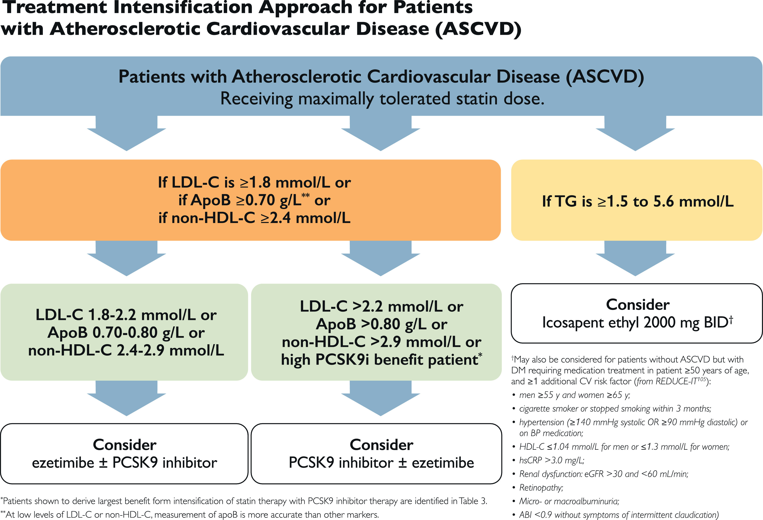
Evidence from several large cohorts were reviewed and percentile equivalents for apoB and non-HDL-C
for each LDL-C threshold referenced are provided

Slide 44
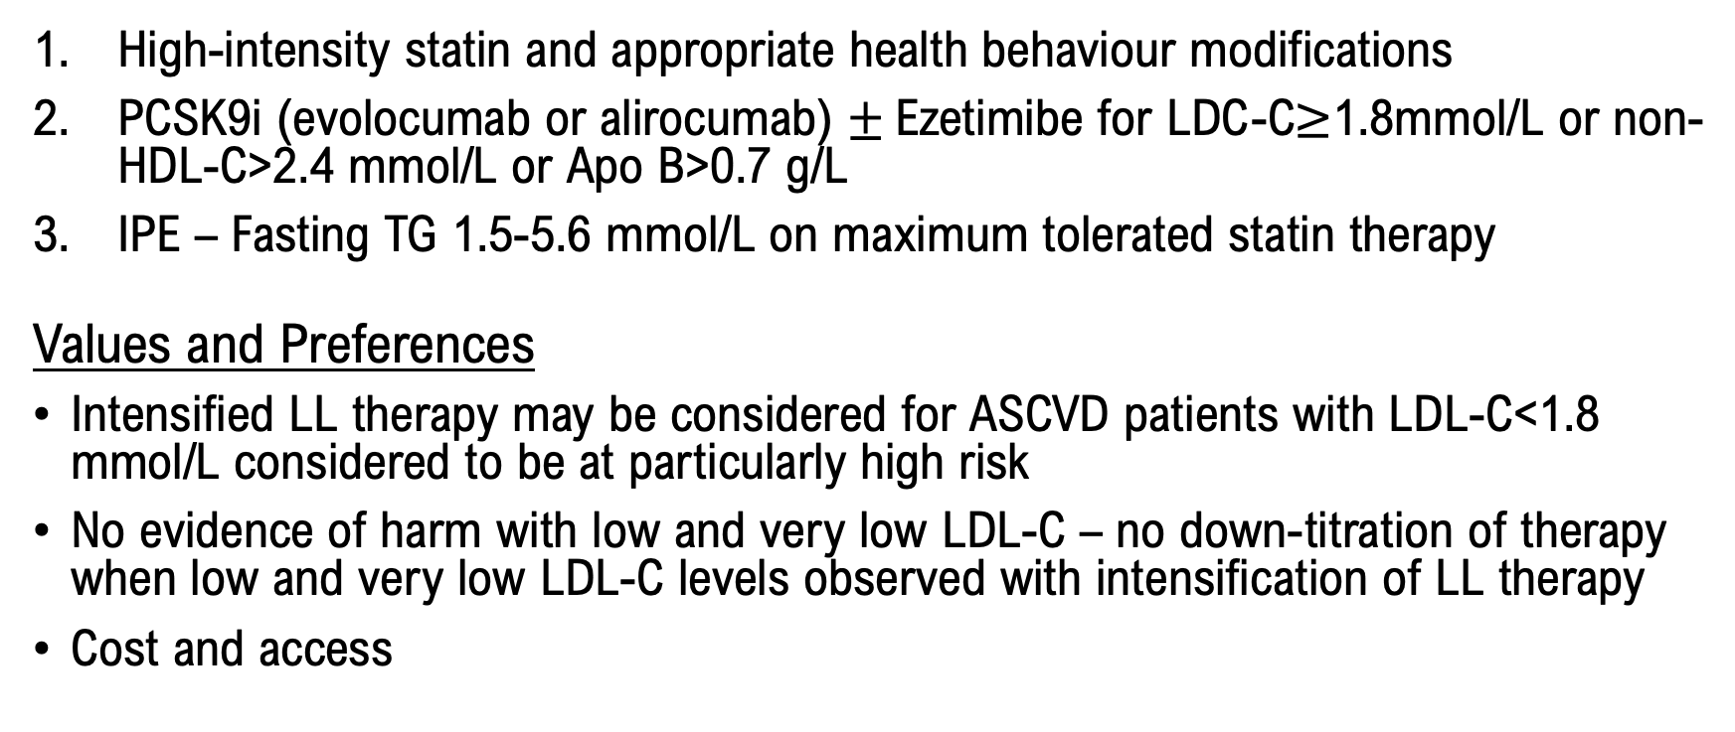
Intensification of Lipid Lowering Therapy in Secondary Prevention
RECOMMENDATIONS:
High-intensity statin and appropriate health behaviour modifications
PCSK9i (evolocumab or alirocumab) $±$Ezetimibe for LDC-C$≥$1.8mmol/L or non-HDL-C>2.4 mmol/L or Apo B>0.7 g/L
IPE – Fasting TG 1.5-5.6 mmol/L on maximum tolerated statin therapy
Values and Preferences
Intensified LL therapy may be considered for ASCVD patients with LDL-C<1.8 mmol/L considered to be at particularly high risk
No evidence of harm with low and very low LDL-C – no down-titration of therapy when low and very low LDL-C levels observed with intensification of LL therapy
Cost and access

Slide 45
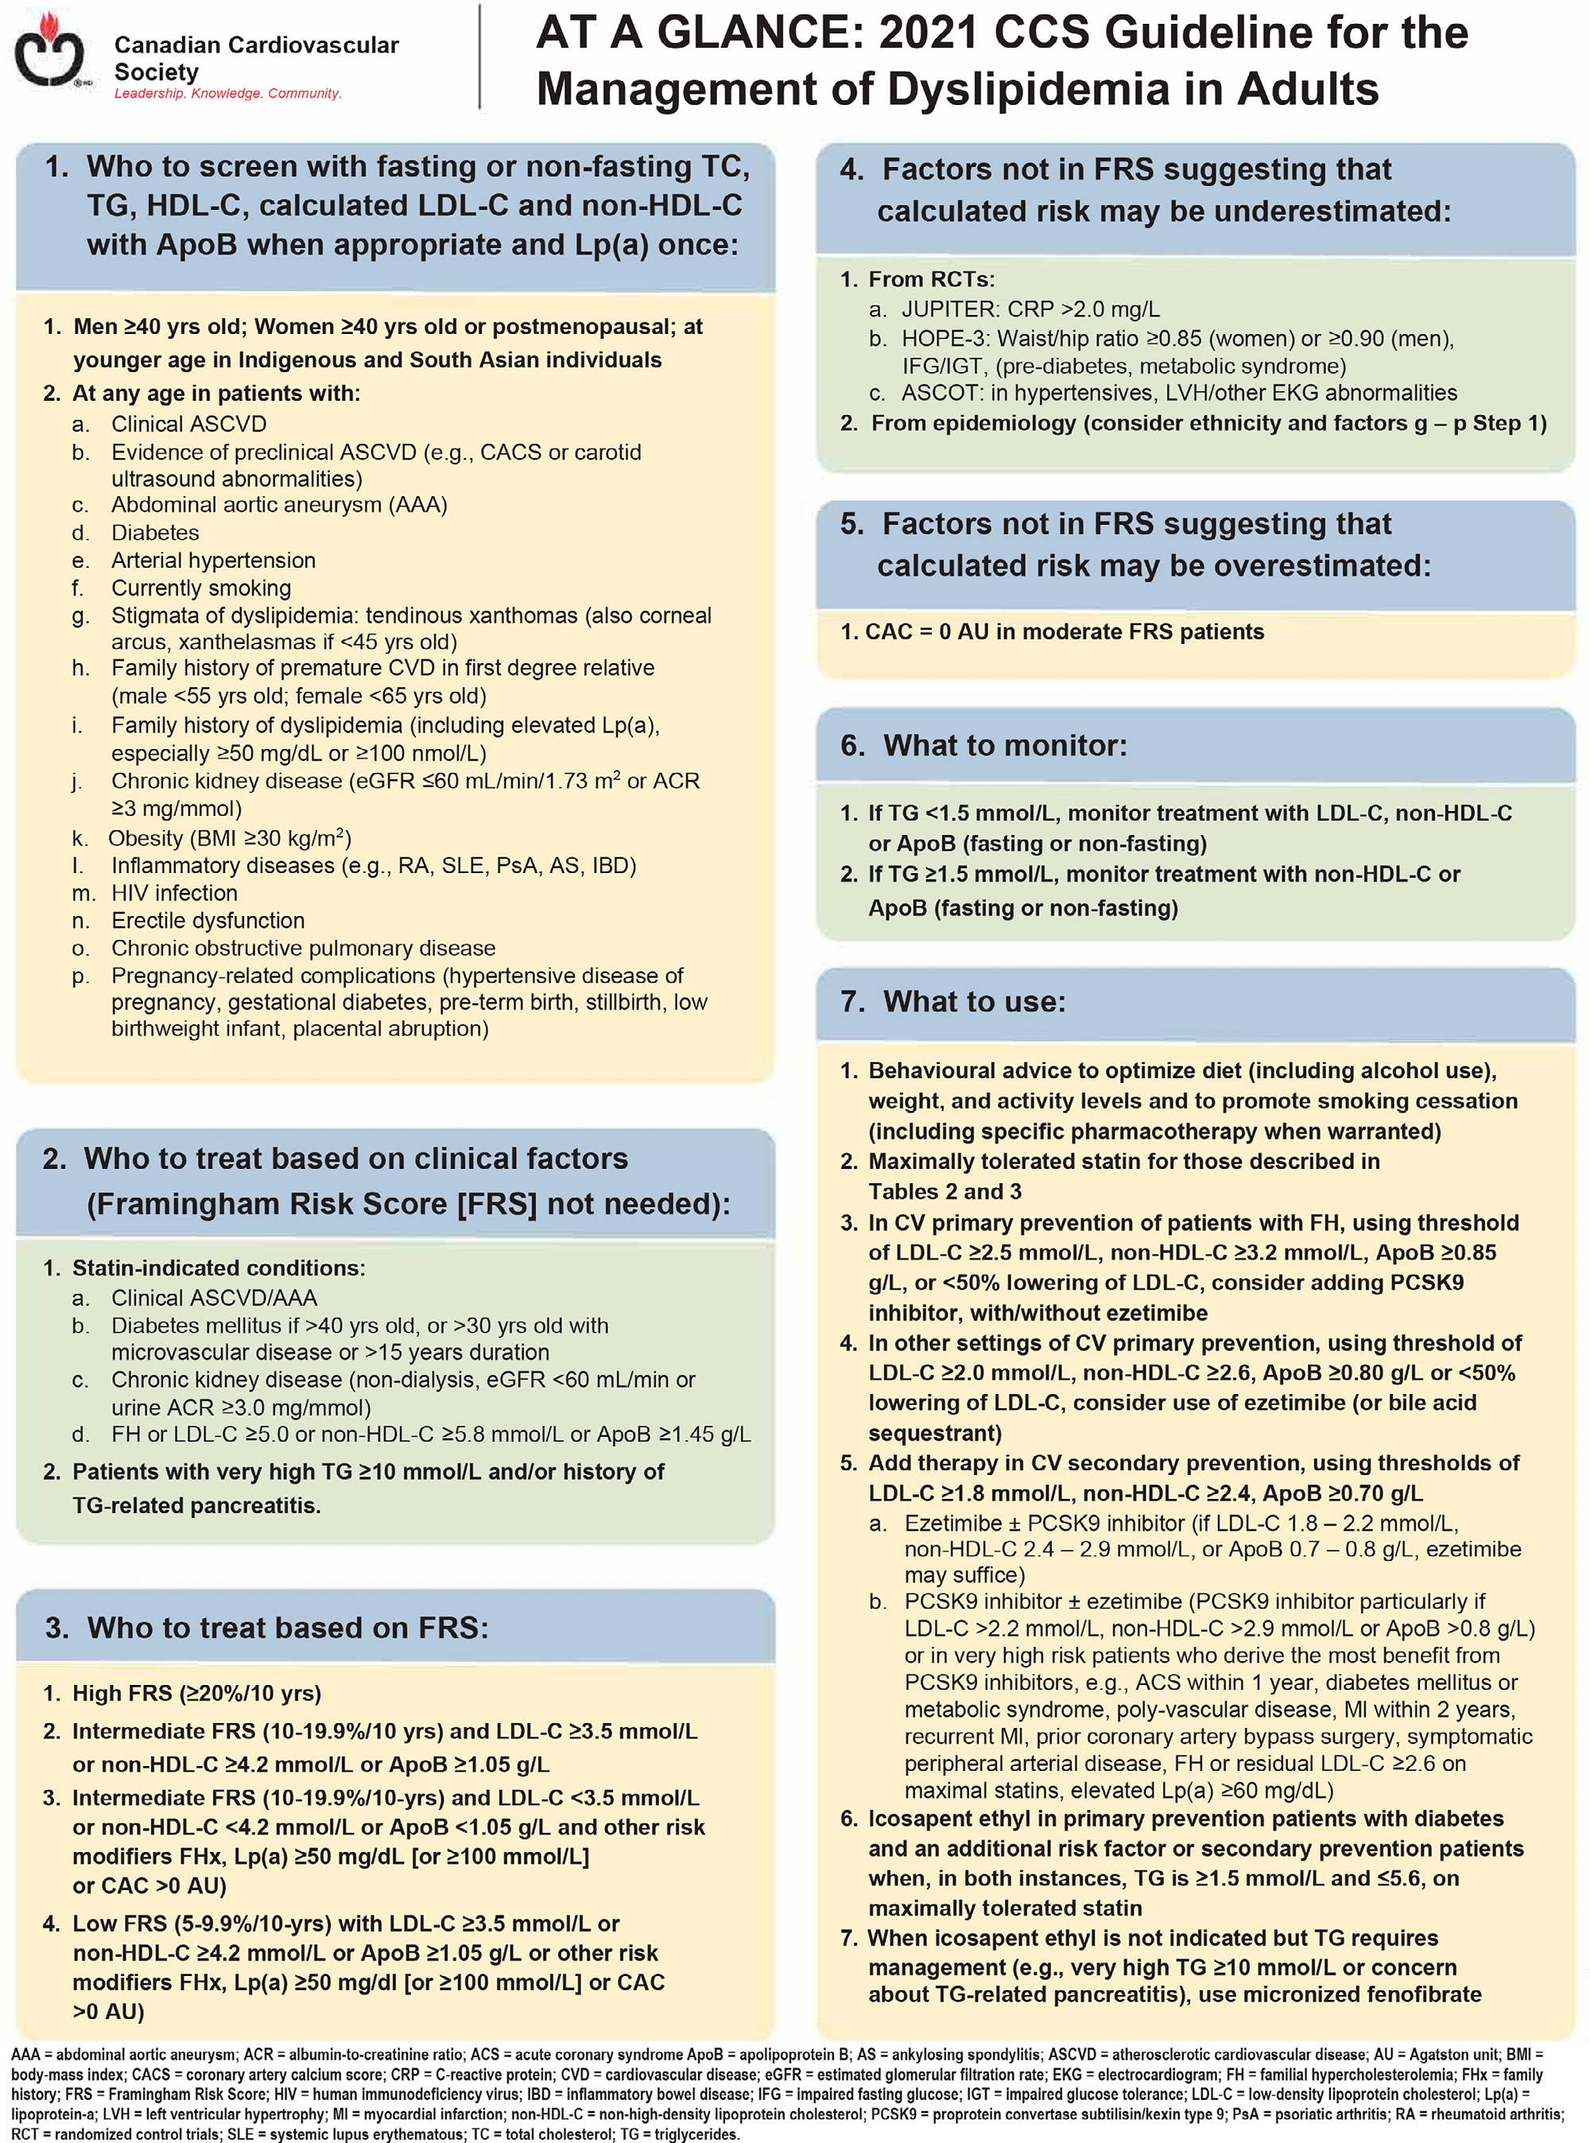
KT Tool
KT strategy currently being developed with the CCS to facilitate uptake of the new guideline recommendations
  pocket cards
  educational videos on key topics
  others
the At A Glance Summary appear as an appendix in the print version of the guidelines -- will be made available in pocket format

Slide 46
Visit CCS.ca for more Guidelines and Resources
Guideline Library:
https://ccs.ca/guidelines-and-position-statement-library/
Guideline Resources:
https://ccs.ca/guideline-resources/

