Slide 1
Atrial Fibrillation:
Focus on screening and prevention
Guidance from the CCS/CHRS 2020 Atrial Fibrillation Guideline Panel
September 23, 2021
This webinar is an Accredited Group Learning Activity (Section 1) as defined by the Maintenance of Certification Program of the Royal College of Physicians and Surgeons of Canada, and approved by the Canadian Cardiovascular Society. You may claim a maximum of 1 hour.

Slide 2
© Canadian Cardiovascular Society. 2021. All rights reserved.
Distribution, transmission or republication is strictly prohibited without the prior written permission of the Canadian Cardiovascular Society.
For medical institution internal education or training (i.e. grand rounds, medical college/classroom education, etc.), kindly consider and implement the following:
  Include the citation for the Canadian Journal of Cardiology
  Add ‘Reproduced with permission from the Canadian Cardiovascular Society. [insert year].’
  Avoid use of CCS logos or trademarks on slides, tools or publications that are not the property of the CCS
  Do not modify the slide content and, the layout and CCS branding on the Guideline-related slides
  Guideline recommendations must be reproduced exactly as published
For an industry supported or involved program, permissions are required:
  If content is published in the Canadian Journal of Cardiology, permissions must be sought through our publisher Elsevier (www.onlinecjc.com)
  If content is property of the CCS, contact guidelines@ccs.ca
Andrade, Macle, et.al., Canadian Journal of Cardiology: https://doi.org/10.1016/j.cjca.2020.09.001
© Canadian Cardiovascular Society. 2021. All rights reserved.

Slide 3
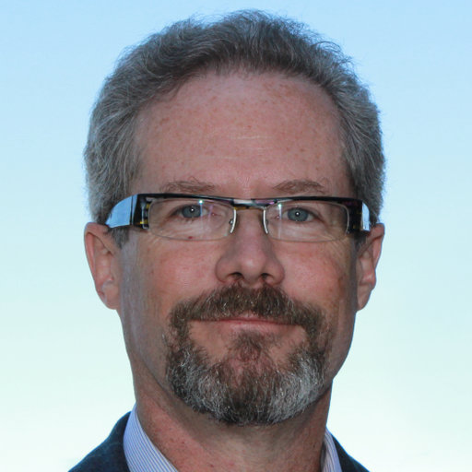
CHRS President,
Co-Moderator
Laurence Sterns
MD, FRCPC
Victoria, BC
Head, Cardiac Electrophysiology Program and Pacemaker/ICD Clinic, Royal Jubilee Hospital

Slide 4
We extend our respect to all First Nations, Inuit and Métis peoples for their valuable past and present contributions to this land we call Canada.
We acknowledge the Indigenous Peoples of all the lands that we are each on today, and reaffirm our commitment and responsibility as individuals, to improving relationships between nations and to collaborating in a spirit of reconciliation.

Slide 5
WELCOME TO THE CCS/CHRS AF WEBINAR SERIES
Webinar 1
Webinar 2
Webinar 3
All about stroke prevention!
When it comes to arrhythmia management…
Focus on screening and prevention
Available On-Demand
Moderators: Laurence Sterns, Laurent Macle
Faculty: Jason Andrade, Alan Bell, Kori Leblanc, L. Brent Mitchell, Teresa Tsang
Available On-Demand
Moderators: Matthew Bennett, Jason Andrade
Faculty: Martin Aguilar, Clare Atzema, Louise Pilote, Atul Verma
Today!
Moderators: Laurence Sterns, Laurent Macle
Faculty: Paul Dorian, Jeff Healey, Ratika Parkash, Roopinder Sandhu
The Canadian Cardiovascular Society is grateful to our partner(s) for their commitment to building knowledge and expertise of the heart team. This program was made possible in part by Bayer, BMS/Pfizer Alliance and Servier. CCS thanks our partners for their dissemination support so that healthcare providers can benefit from this important information.

Slide 6
CCS/CHRS KTA COLLABORATION
Webinar series to encourage dissemination of key topics from the 2020 comprehensive AF guidelines
Works in progress:
  Website updates and online decision support tools
  Collaborative communication efforts
    We are working to establish a communication campaign to announce the pocket guide, webinars and additional companion publications (focused for specific audiences)
  Needs assessments + themes of care
    CCS Guideline Review Working Group is developing a needs assessment to rank AF themes of care, identify barriers and facilitators and assess preferences for practice tools and learning modes

Slide 7
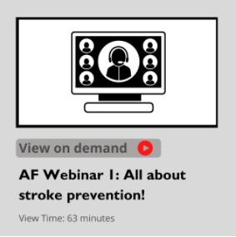
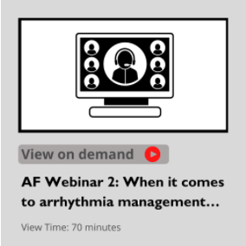
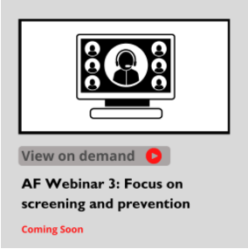
Access On-Demand
The AF Webinar series is available for On-Demand access
View this series, as well as the Heart Failure and Pulmonary Hypertension webinars, On-Demand: CCS.ca/On-Demand-Guideline-Webinars/

Slide 8
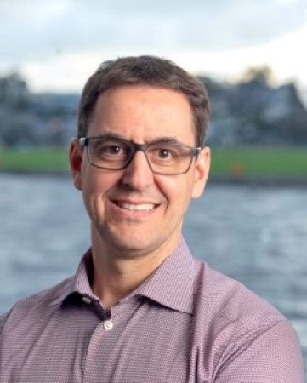
CHRS President-Elect,
Co-Moderator
Laurent Macle
MD, FRCPC, FHRS
Montreal, QC
Cardiac electrophysiologist
Professor of Medicine, Université de Montréal
Chief of electrophysiology service, Montreal Heart Institute

Slide 9
THE CCS/CHRS AF WEBINAR SERIES
Webinar 1
Webinar 2
Webinar 3
All about stroke prevention!
When it comes to arrhythmia management…
Focus on screening and prevention
Available On-Demand
Moderators: Laurence Sterns, Laurent Macle
Faculty: Jason Andrade, Alan Bell, Kori Leblanc, L. Brent Mitchell, Teresa Tsang
Available On-Demand
Moderators: Matthew Bennett, Jason Andrade
Faculty: Martin Aguilar, Clare Atzema, Louise Pilote, Atul Verma
Today!
Moderators: Laurence Sterns, Laurent Macle
Faculty: Paul Dorian, Jeff Healey, Ratika Parkash, Roopinder Sandhu
View On-Demand at CCS.ca/On-Demand-Guideline-Webinars/

Slide 10
Accreditation and Interactivity
This webinar is an Accredited Group Learning Activity (Section1) as defined by the Maintenance of Certification Program of the Royal College of Physicians and Surgeons of Canada, and approved by the Canadian Cardiovascular Society. You may claim a maximum of 1 hour.
Immediately following the presentations, we will have our Q&A Session. The Q&A period will be an opportunity for audience members to ask our panelists pressing questions and encourage constructive discussion among the faculty.

Slide 11
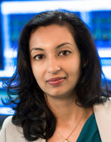

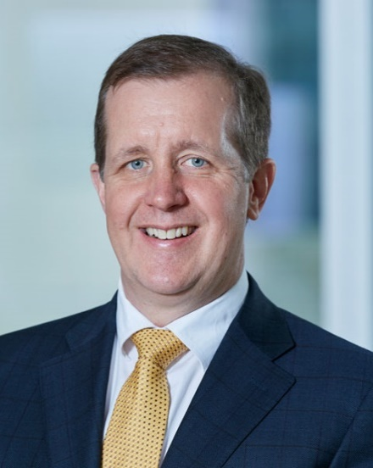
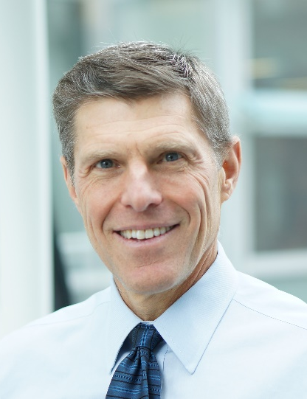
Faculty and Topic Overview
Ratika PARKASH
Roopinder SANDHU
Jeff HEALEY
Paul DORIAN
Detection and management of modifiable risk factors
Screening and opportunistic AF detection
Subclinical AF
AF and exercise

Slide 12

Disclosure of potential conflicts of interest
Laurence Sterns
Consulting Fees/Honoraria: Bayer, Johnson & Johnson
Clinical Trials: Abbott, Boston Scientific, Medtronic
Laurent Macle
Consulting Fees/Honoraria: Abbott, Bayer, BMS Pfizer, Servier, Johnson & Johnson, Medtronic
Clinical Trials: BMS Pfizer, Johnson & Johnson

Slide 13
Disclosure of potential conflicts of interest
Ratika Parkash
Grant/Research Support: Abbott Canada, Bayer, BMS Pfizer, Bristol-Myers Squibb, Medtronic, Pfizer, Servier, St. Jude Medical
Consulting Fees/Honoraria: Abbott Canada, Bayer, Novartis
Roopinder Sandhu
Consulting Fees/Honoraria: None
Clinical Trials: None
Research Grants: BMS/Pfizer and Servier
Jeff Healey
Consulting Fees/Honoraria: Bayer, Boston Scientific
Grant/Research/Speaking Support: Abbott, Bayer, BMS Pfizer, Boston Scientific, Bristol-Myers Squibb, Medtronic, Incarda, Myokardia, Servier
Paul Dorian
Consulting Fees/Honoraria: Bayer, BMS Pfizer, Boehringer Ingelheim, Bristol-Myers Squibb, Servier
Clinical Trials: Bayer, BMS Pfizer, Boehringer Ingelheim, Servier

Slide 14

Overall Learning Objectives
Atrial Fibrillation:
Focus on screening and prevention
Guidance from the CCS/CHRS 2020 Atrial Fibrillation Guideline Panel
Identify and manage risk factors associated with AF
Review recommendations for screening and opportunistic detection of AF
Explore subclinical AF and considerations for AF and exercise

Slide 15
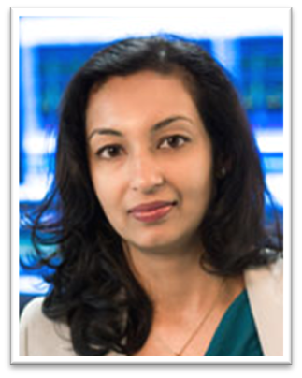
Detection and management of modifiable risk factors
Ratika Parkash
MD, MS, FRCPC, FHRS
Halifax, NS
Director of Cardiology Research & Director of Heart Rhythm, Queen Elizabeth II Health Sciences Center
University Research Professor, Dalhousie University

Slide 16

Learning Objectives
To review and understand current and emerging risk factors related to AF, as well as the effect of modification of these factors on AF.

Slide 17
Risk factors
Notes:
110 bpm for acute rate control changed

Slide 18
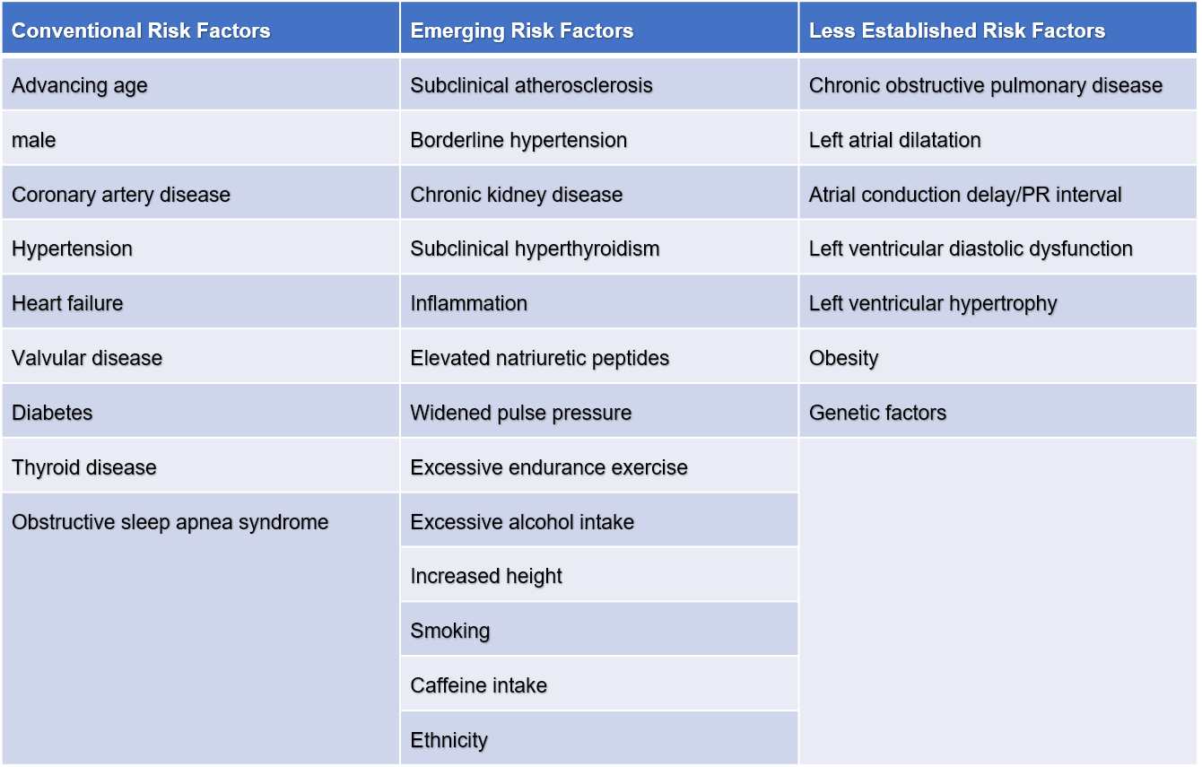
Risk markers and comorbid conditions related to AF

Slide 19
Risk factors

Slide 20
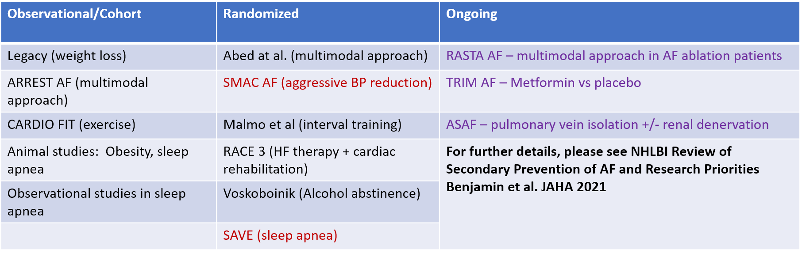
Studies targeting risk factor modification
Pathak et al JACC 2015; 2159-69
Abed et al. JAMA. 2013;310(19):2050-2060
Pathak et al JACC 2015: 985-96
Rienstra et al. 2018 EHJ
Pathak et al. JACC 2014; 64: 2222-31
Voskoboinik A et al. N Engl J Med 2020;382:20-28
Parkash et al Circulation 2017
Malmo et al Circulation. 2016;133:466–473

Slide 21
2020 AF Guidelines Recommendation
In patients with established AF or at high risk of developing AF, we recommend a systematic approach to the identification of traditional modifiable cardiovascular risk factors and/or conditions associated with AF, with strict guideline-adherent management in order to reduce major cardiovascular events (Strong Recommendation; High-Quality Evidence) and to prevent recurrence of the arrhythmia and/or decrease its symptom burden (Strong Recommendation; Low-Quality Evidence).

Slide 22

Screening and opportunistic AF detection
Roopinder Sandhu
MD, MPH, FHRS
Edmonton, AB
Director, Device Clinic, Cedars-Sinai Medical Center
Associate Professor of Medicine, Smidt Heart Institute, Cedars-Sinai Medical Center
Associate Professor in Residence, University of California Los Angeles (UCLA)
Associate Adjunct Professor of Medicine, University of Alberta
Faculty, Canadian VIGOUR Centre

Slide 23
Learning Objectives
Discuss the rationale, population, method, and techniques for AF screening.
Provide an approach for opportunistic AF screening.

Slide 24
Rationale for AF screening

Slide 25
Screening population
NNS = 69 1 new AF case ≥ 65 years
Lowres et al. PLOS Medicine 2019;16:e1002903.

Slide 26
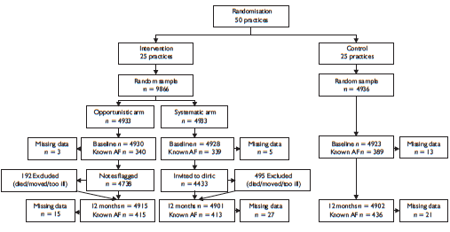
Screening method
Pulse palpation and ECG if irregular
Pulse Palpation and ECG
1.63%
1.04%
1.64%
1.62%
Fitzmaurice et al. BMJ 2007;335:383.

Slide 27
Screening method: Economic evaluation
Base-case cost-effectiveness estimates.
Hobbs et al. Health Technol Assess 2005;9:1-74.

Slide 28
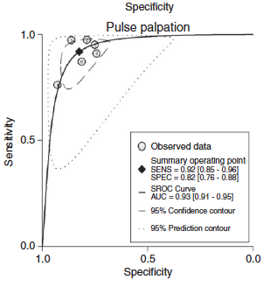
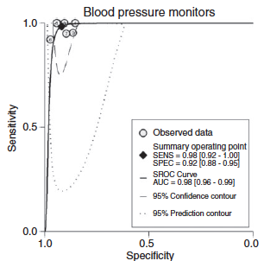
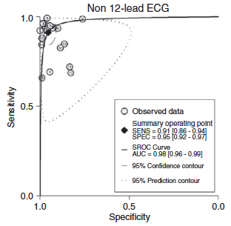
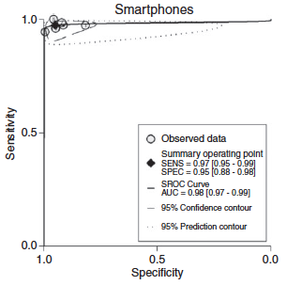
Screening techniques
SENS=0.92; SPEC=0.82
SENS=0.98; SPEC=0.92
SENS=0.91; SPEC=0.95
SENS=0.97; SPEC=0.95
Tagger et al. Eur J Prev Card 2016;23:1330-1338.

Slide 29
Screening approach

Slide 30

AF screening and device-detected AF: Where to start and what to do
Jeff Healey
MD, MSc, FRCPC, FHRS
Hamilton, ON
Cardiology Division Director, and Yusuf Chair in Cardiology
Cardiologist and Electrophysiologist; Hamilton Health Sciences
Senior Scientist, and Stuart Connolly Chair in Cardiology Research, Population Health Research Institute
Professor of Medicine, McMaster University

Slide 31
Learning Objectives
To understand the strengths and weaknesses of devices used to detect AF
To understand the populations for whom AF screening may be desirable.
To discuss available randomized trial evidence in support of AF screening and review national guidelines.

Slide 32
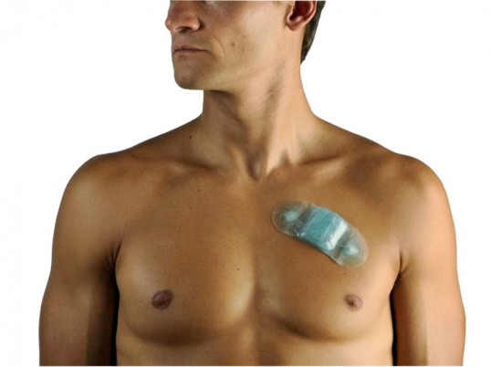
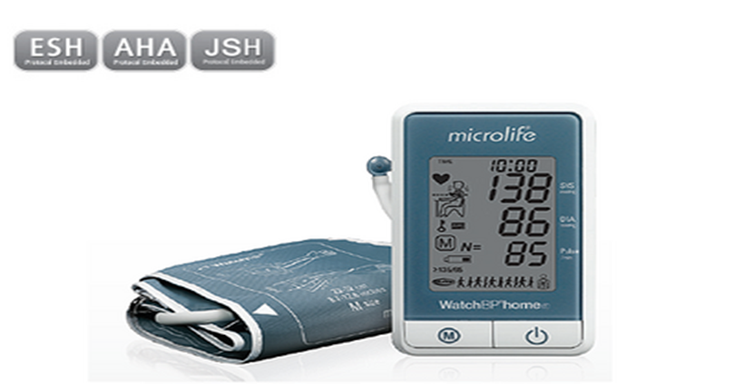
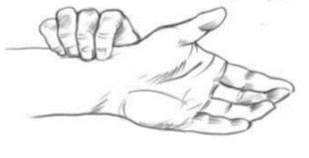
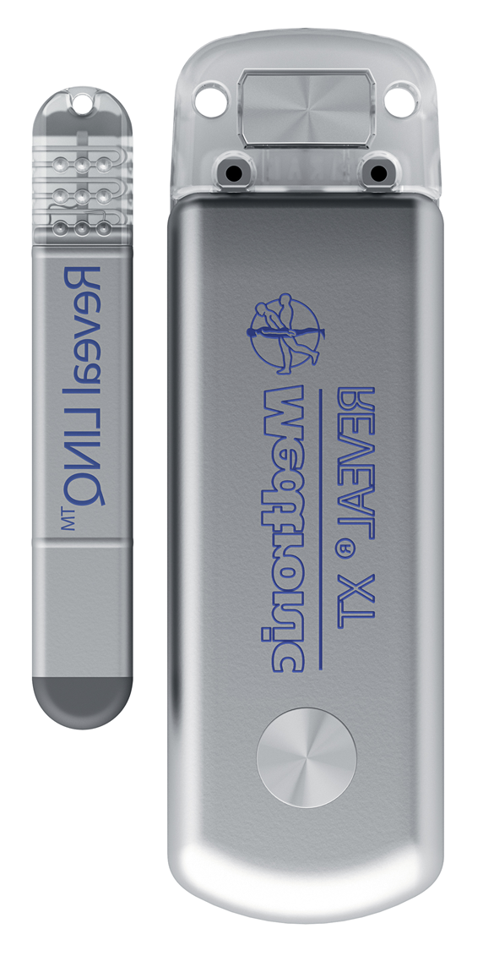
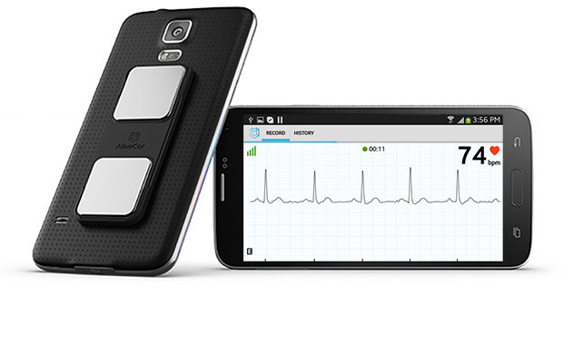
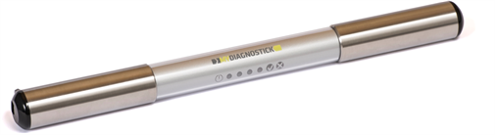

Different screening tools

Slide 33
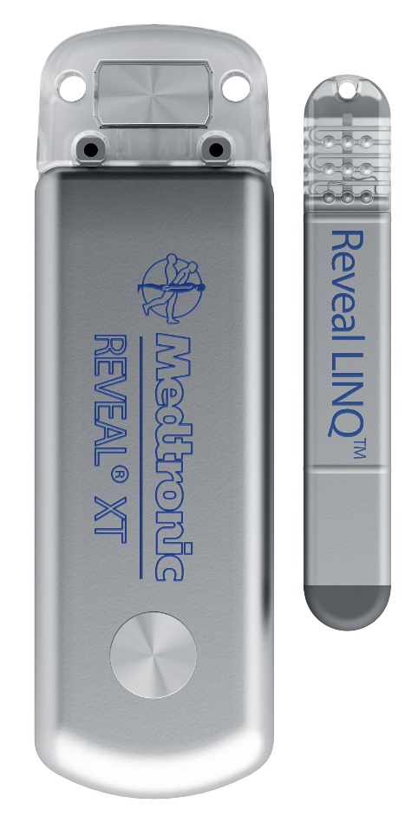
AF screening with continuous monitoring
Study | Size | Device | Inclusion | Rate of AF Detection
ASSERT-II | 250 | SJM Confirm | Age>65, AND CHADS-VASc≥2, or OSA, or BMI> 30; AND LA> 58mL, or NT-ProBNP > 290 pg/mL | ≥ 5 min 34.4% at one year
GRAF | 200 | MDT REVEAL-XT | Age ≥ 18 CHADS-VASc≥4 | Pending
REVEAL-AF | 450 | MDT REVEAL-XT | Age ≥ 18 CHADS≥3, or CKD/COPD/OSA/CAD | 29.3% at 18 months
PREDATE-AF | 245 | REVEAL-LINQ | Age>18, AND CHADS-VASc≥2 | ≥ 6 min 22.4% at 451 days
DANISH LOOP | 6000 | REVEAL-LINQ (1500) | Age > 70 One of HTN, DM, HF or stroke | Pending

Slide 34
Duration of SCAF and stroke risk
0.20
No SCAF
6mins~6hrs
6hrs~24hrs
0.15
>24hrs
Cumulative event rates
0.10
0.05
0.0
0
0.5
1
1.5
2
2.5
3
3.5
Years of Follow-up
No. at Risk
No SCAF
2455
1926
1708
1528
1251
900
624
390
6mins~6hrs
0
226
302
347
322
281
218
155
6hrs~24hrs
0
88
104
103
108
93
80
52
>24hrs
0
91
124
144
140
126
116
85
Van Gelder IC; Eur Heart J.

Slide 35
StrokeStop-1: handheld ECG BID x 14 days
Referral to Cardiologist for OAC
Declaration of health
OAC treatment
n=517
Known AF
n=666
( 9.3%)
Attends screening clinic
n= 7 173
No OAC-treatment
n= 149 (2.1%)
Intermittent ECG-recordings 2 weeks
Silent AF
n=218 (3 %)
No AF
Svennberg et al, Circulation 2015

Slide 36
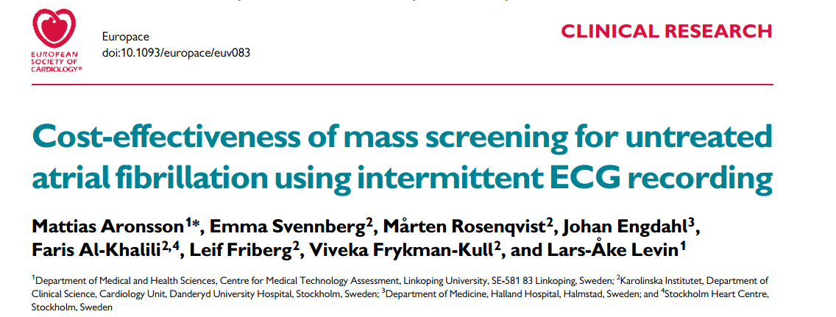
8 fewer strokes/1000 screened
12 QALYs / 1000 screened
€ 4313/QALY

Slide 37

PIAAF Pharmacy
Age Groups (years) | Total N (%) | ‘Actionable’ AF N (%) | No AF N (%)
65-74 | 620 (54.8) | 11 (1.8) | 609 (98.2)
75-85 | 422 (37.3) | 9 (2.1) | 413 (97.9)
>85 | 89 (7.9) | 7 (7.9) | 82 (92.1)
Approximately 50% of patients had a BP > 140/90 at screening
Only 50% of screen-positive patients receiving OAC 3 months later
RK Sandhu, Open Heart 2016

Slide 38
Randomized trial of AF SCREENING
 | Country | Status | N | Screening method
AF-CATCH | China | Follow-up | 7641 | ALIVECOR; ECG 1x/yr vs 4x/yr vs 1x/wk in 1st month
D2AF study | Netherlands | Ongoing | 19200 | MyDiagnostik, Watch BP Single time-point
DANCAVAS | Denmark | Near done | 35K | Single-time, 3-lead ECG
Danish Loop Study | Denmark | Ongoing | 6K | ICM
HKU pharmacy | Hong Kong | Planning | ?? | ??
London Pharmacy | UK | Soon |  | Single time-point
MonDAFIS | Germany | Follow-up | 3,470 | Post-stroke, hospital ECG
MSTOPS | USA | Ongoing | ~6000 | Ziopatch
REHEARSE-AF | UK/Wales | Complete | 1K | Alivecor
SAFER | UK | Planning | 120K | Zenicor
SCREEN-AF | Canada | Complete | 822 | Ziopatch
STROKESTOP | Sweden | Complete | 7,173 | Zenicor, BID for 14 days
STROKESTOP II | Sweden | Soon complete | 8K | Zenicor, BID for 14 days
VITAL-AF | USA | Ongoing | 30K | Single time-point
GUARD-AF | USA | Ongoing | 52 K | ZioXT
Total of over 300,000 individuals

Slide 39
SCREEN-AF: JAMA-Cardiol 2021:Gladstone D.
Age > 75 with HTN
2-week patch, T=0 and 3 months
AF (>5 min) detection: 5.3% vs. 0.5%; p=0.001
Median duration of longest AF was 5.7 hours
OAC used in 75%
OAC use at 6 months: 4.1% vs. 0.9%; p=0.007

Slide 40
VITAL-AF: S. Lubitz
16 clinics randomized to handheld ECG during assessment of vital signs or not
Patients > 65 years; n = 30,715
AF detection: 1.72% vs. 1.59%; p=0.38
  5.6% vs. 3.8% in those > 85 years; p<0.05

Slide 41
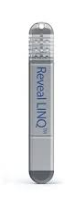
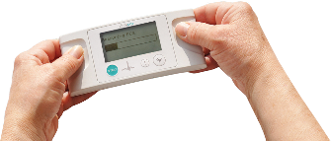

STROKESTOP
LOOP Lancet 2021
SAFER
Population
75/76 yo
≥70 yo + ≥1 of HTN, DM, stroke, HF, w/o AF
≥75 yo
Screening visit
Screening visit
Inclusion
N=28 768
N=6 004
Planned N=126 000
793 Excluded
1
1
1
3
1
2
Analyzed (ITT)
13 979
Intervention
13 996
Control
1 501
Intervention
4 503
Control
Est. 42 000
Intervention
Est. 84 000
Control
Screening visit
ILR 3.3 y
Four x daily 3 w
Intervention
Twice daily 2w
51% received
95% received
All-cause Death, Stroke, Bleeding
Stroke or Systemic Arterial Embolism
Stroke
4 456 events (31.9 %)
4 616 events (33.0 %)
67 events (4.5 %)
251 events (5.6 %)
Primary outcome
HR 0.96 [95% CI 0.92–1.00]
HR 0.80 [95% CI 0.61–1.05]
Aim 12 % RR (5 y)
3.07% vs. 3.5 %
Per-protocol analysis of stroke
372 events
874 events
56 events
251 events
HR 0.76 [95% CI 0·67–0.85]
HR 0.75 [95% CI 0·56–1.00]
Andrade, Macle, et.al., Canadian Journal of Cardiology: https://doi.org/10.1016/j.cjca.2020.09.001
© Canadian Cardiovascular Society. 2021. All rights reserved.

Slide 42
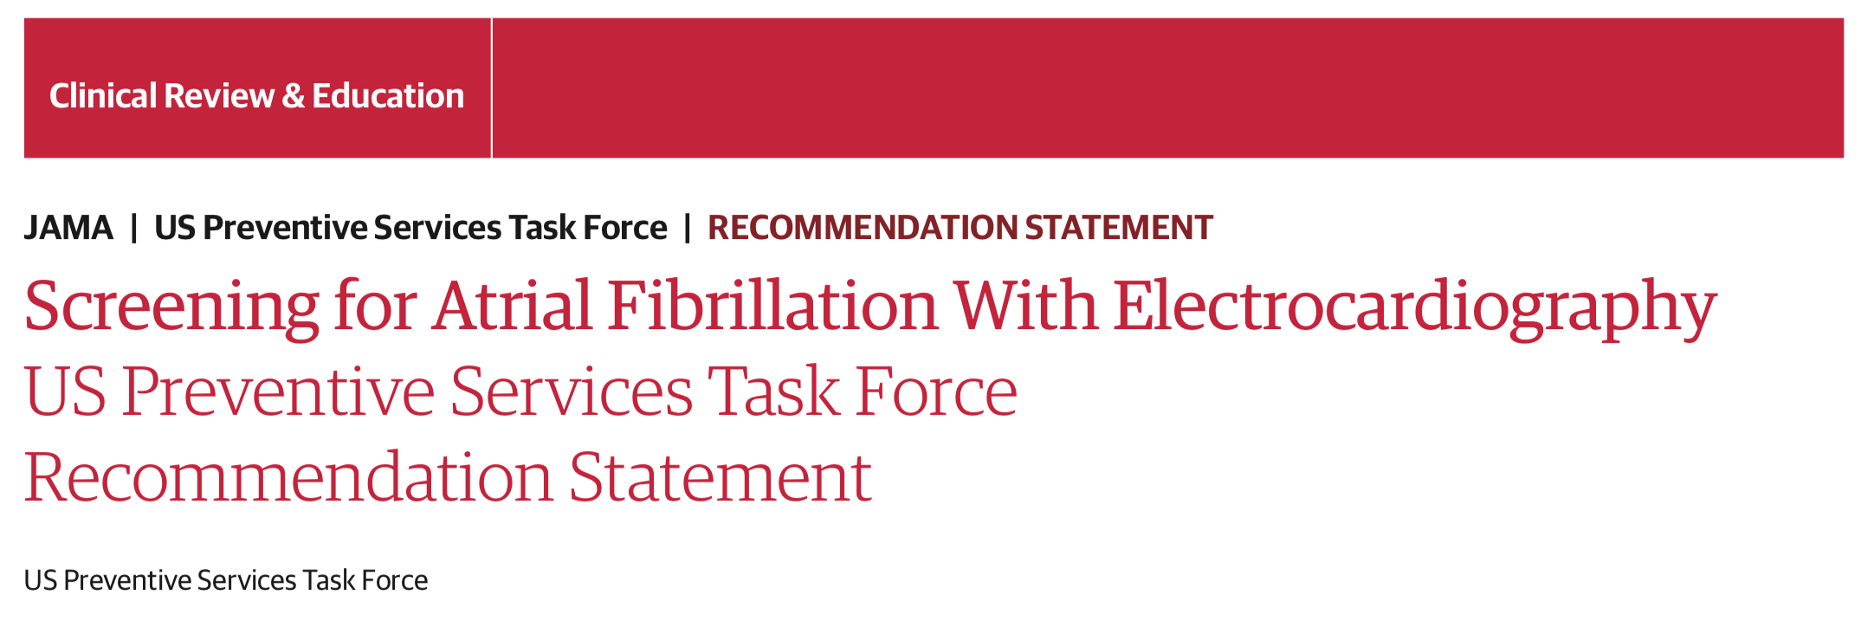
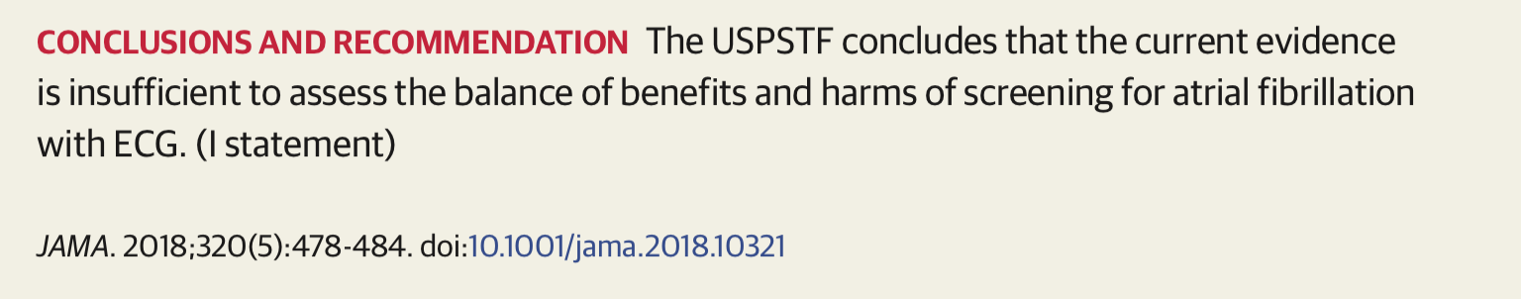
NSC UK National Screening Program 2018
Similarly did NOT recommend AF screening

Slide 43

AF and Exercise
Paul Dorian
MD, MSc, FRCPC
Toronto, ON
Staff Cardiac Electrophysiologist, St. Michael’s Hospital
Professor, Medicine and Cardiology, St. Michael’s Hospital, University of Toronto
Director, Division of Cardiology, University of Toronto

Slide 44
Learning Objectives
To understand the relationship between frequency, intensity and lifetime duration of exercise and risk of incident AF.
To evaluate the effect of exercise on the risk of recurrences of AF and the safety of exercise.

Slide 45
AF incidence and endurance exercise
The Meme: endurance exercise causes AF
The facts: at any exercise level short of daily intensive training for decades, exercise reduces the risk of AF
In the most highly trained competitive athletes, there is a very small absolute increase in AF incidence
The direct effect in increasing AF risk is mostly offset by a much lower incidence of AF risk factors (hypertension, obesity, diabetes, CAD)

Slide 46
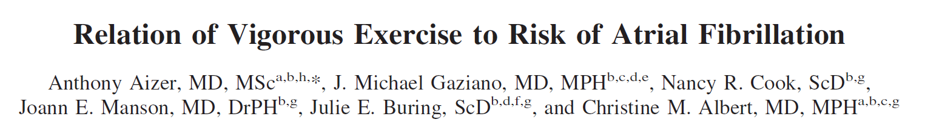
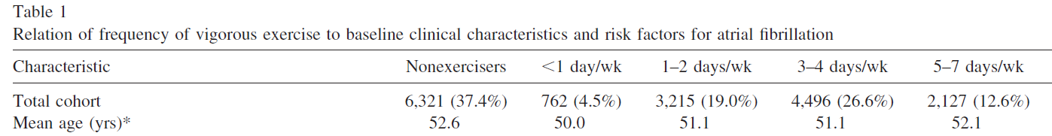
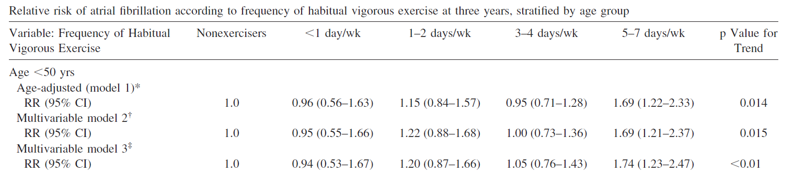
Physicians Health Study
17,000 MDs, “ exercise to break a sweat ” , 15-19 yrs follow-up
Greatest risk (HR 2.0) in Persistent exercisers > 10 yrs, age < 50 at baseline
Absolute incidence not stated
Am J Cardiol 2009;103:1572-1577

Slide 47
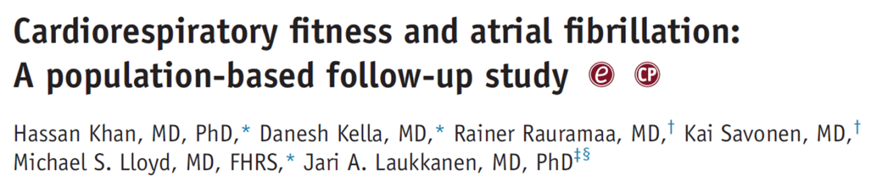
Cumulative hazard for incident AF age at baseline 52 + 5
4 METS
7 METS
8 METS
10 METS
Heart Rhythm, Mar 2015

Slide 48
All Swedish skiers (208 654) completing 1 or more races in the 30 to 90 km cross-country skiing event Vasaloppet (1989–2011) and a matched sample (n=527 448) of nonskiers were followed until first event of atrial fibrillation
Absolute risk: 0.16/100 person years in men
Svedberg N et al. Circulation. 2019;140:910–920

Slide 49
Long-term incidence of AF and stroke among cross-country skiers
Direct effect; adjusted for age, income, education, time of inclusion, diabetes mellitus, hypertension, hyperthyroidism, and ischemic heart disease
Circulation, Volume: 140, Issue: 11, Pages: 910-920, Niclas Svedberg.et al

Slide 50
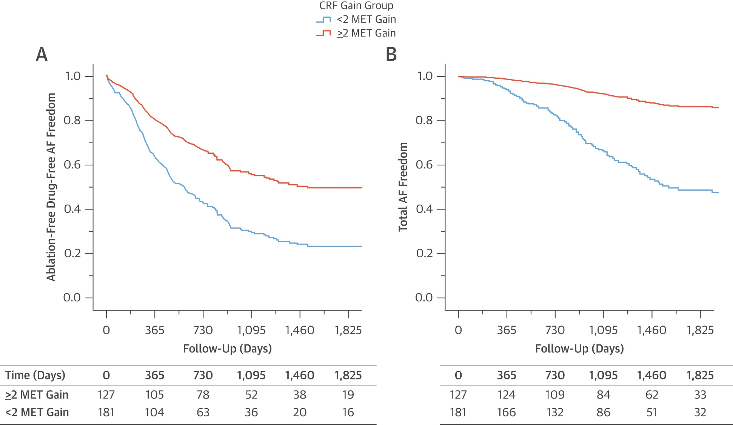
Impact of CARDIOresiratory FITness on arrhythmia recurrence in obese individuals with AF
Moderate intensity exercise, 200 min/week, X 48 mo
Pathak RK et al , JACC 2015; 66(9): 985-996

Slide 51
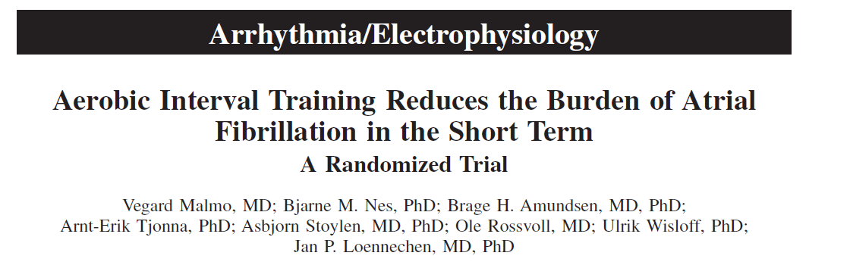
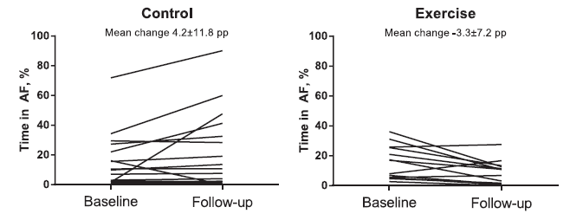
Significant improvement in symptoms scores and QOL in the exercise group
Circulation. 2016; 133:466-473

Slide 52


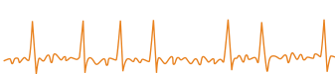
Exercise and AF literature: Current evidence and future directions – courtesy of Dr. J. Reed
Physical and Psychosocial Health Improvements in AF ¹
Comparators: Exercise vs. controls; Duration: 8-24 weeks; Volume: 120 to 225 minutes weekly
  CRF (MD 1.59 mL/kg/min, 95% CI 0.11 to 3.08, p=0.04)
  Functional capacity (6-minute walk test: MD 46.93 m, 95% CI 26.44 to 67.42, p<0.001)
  Left ventricular ejection fraction (MD 4.31%, 95% CI 2.12 to 6.51, p<0.001)
  QoL (MCS: MD 4.00, 95% CI 0.26 to 7.74, p=0.04; PCS: MD 1.82, 95% CI 0.06 to 3.59, p=0.04)
  Resting heart rate (MD −4.61 bpm, 95% CI −7.42 to −1.80, p=0.001)
  Maximal heart rate (MD −2.95 bpm, 95% CI −5.31 to −0.59, p=0.01)
  Time in AF (MD 7.6%, 95% CI 2.0 to 13.0, p=0.001, 1 study following HIIT)
  Symptom burden (1 study, AF Symptoms and Severity Checklist)
  Cardiovascular disease risk factors (conflicting findings)
Sex Differences in Exercise (AF Females vs. Males) ²
Mertens et al: Smaller improvement in CRF (F: +7% vs. M: 18%) after 1-year walking program (100-240 minutes/week)
Wagner et al: Smaller improvement in CRF (F: +1.7 vs. M: +2.9 mL/kg/min) after 12 weeks of CR (180 minutes/week)
Wagner et al: AF-specific QoL improved in females, not males, after 12 weeks of CR (180 minutes/week)
Future Research Directions
Which exercise paradigm(s) is the most effective for improving AF symptoms and QoL?
Does sex and/or gender play a role in the response to exercise?
Can exercise prevent the development/progression of AF?
Can exercise and aggressive risk factor management prevent the need for or improve cardioversion and ablation outcomes?
References: 1. Smart NA et al. Open Heart. 2018;5:e000880. 2. Reed JL et al. Can J Cardiol. 2018;34:S284-S95.
AF, atrial fibrillation; CR, cardiac rehabilitation; CRF, cardiorespiratory fitness; MCS, mental component summary; MD, mean difference; HIIT, high-intensity interval training; PCS, physical component summary; QoL, quality of life.

Slide 53


QUESTIONS?

Slide 54


SAVE THE DATE – CCC 2021!
OCTOBER 20 – 23, 2021
Registration is open for the 2021 Canadian Cardiovascular Congress
Join the largest interactive Canadian cardiovascular event of the year and re-connect with your colleagues!
Register at cardiocongress.org

Slide 55
Visit CCS.ca for more Guidelines and Resources
Guideline Library:
https://ccs.ca/guidelines-and-position-statement-library/
Guideline Resources:
https://ccs.ca/guideline-resources/

