Slide 1
Atrial Fibrillation:
When it comes to arrhythmia management…
Guidance from the CCS/CHRS 2020 Atrial Fibrillation Guideline Panel
July 8, 2021
This webinar is an Accredited Group Learning Activity (Section 1) as defined by the Maintenance of Certification Program of the Royal College of Physicians and Surgeons of Canada, and approved by the Canadian Cardiovascular Society. You may claim a maximum of 1 hour.

Slide 2
© Canadian Cardiovascular Society. 2021. All rights reserved.
Distribution, transmission or republication is strictly prohibited without the prior written permission of the Canadian Cardiovascular Society.
For medical institution internal education or training (i.e. grand rounds, medical college/classroom education, etc.), kindly consider and implement the following:
  Include the citation for the Canadian Journal of Cardiology
  Add ‘Reproduced with permission from the Canadian Cardiovascular Society. [insert year].’
  Avoid use of CCS logos or trademarks on slides, tools or publications that are not the property of the CCS
  Do not modify the slide content and, the layout and CCS branding on the Guideline-related slides
  Guideline recommendations must be reproduced exactly as published
For an industry supported or involved program, permissions are required:
  If content is published in the Canadian Journal of Cardiology, permissions must be sought through our publisher Elsevier (www.onlinecjc.com)
  If content is property of the CCS, contact guidelines@ccs.ca
Andrade, Macle, et.al., Canadian Journal of Cardiology: https://doi.org/10.1016/j.cjca.2020.09.001
© Canadian Cardiovascular Society. 2021. All rights reserved.

Slide 3

CHRS Representative
Matthew Bennett
MD, FRCPC
Vancouver, BC
Clinical Associate Professor at the University of British Columbia
Chair of the CHRS Education Committee

Slide 4
WELCOME TO THE CCS/CHRS AF WEBINAR SERIES
Webinar 1
Webinar 2
Webinar 3
All about stroke prevention!
When it comes to arrhythmia management…
Focus on screening and prevention
Available On-Demand
Moderators: Laurence Sterns, Laurent Macle
Faculty: Jason Andrade, Alan Bell, Kori Leblanc, L. Brent Mitchell, Teresa Tsang
Today!
Moderators: Matthew Bennett, Jason Andrade
Faculty: Martin Aguilar, Clare Atzema, Louise Pilote, Atul Verma
Sept 23 from 8 PM – 9 PM ET
Moderators: Jason Andrade, Laurent Macle
Faculty: Paul Dorian, Jeff Healey, Ratika Parkash, Roopinder Sandhu
The Canadian Cardiovascular Society is grateful to our partner(s) for their commitment to building knowledge and expertise of the heart team. This program was made possible in part by Bayer, BMS/Pfizer Alliance and Servier. CCS thanks our partners for their dissemination support so that healthcare providers can benefit from this important information.
Register at CCS.ca/programs-and-events/

Slide 5
CCS/CHRS KTA COLLABORATION
Webinar series to encourage dissemination of key topics from the 2020 comprehensive AF guidelines
Works in progress:
  Website updates and online decision support tools
  Collaborative communication efforts
    We are working to establish a communication campaign to announce the pocket guide, webinars and additional companion publications (focused for specific audiences)
  Needs assessments + themes of care
    CCS Guideline Review Working Group is developing a needs assessment to rank AF themes of care, identify barriers and facilitators and assess preferences for practice tools and learning modes

Slide 6
SAVE THE DATE!
For our upcoming AF Guideline Webinar
Atrial Fibrillation:
Webinar 3: Focus on screening and prevention
On Thursday, September 23, 2021 from 8 PM – 9 PM ET, join Drs. Andrade, Macle, Dorian, Healey, Parkash and Sandhu for the “AF Guidelines: Focus on screening and prevention” webinar.
Register at CCS.ca/programs-and-events/
View previously recorded events On-Demand CCS.ca/On-Demand-Guideline-Webinars/

Slide 7

Moderator
Jason Andrade
MD, FRCPC, FHRS
Vancouver, BC
Cardiac Electrophysiologist, Vancouver General Hospital, with joint appointment at St. Paul’s Hospital and the Montreal Heart Institute
Associate Professor of Medicine, University of British Columbia
Assistant Professor, Université de Montréal
Director, Electrophysiology Laboratory, Atrial Fibrillation Clinic, Vancouver General Hospital
Medical Chair, Heart Rhythm Disease, Cardiovascular Disease Network, BC
Co-Chair, CCS Atrial Fibrillation Guidelines
Past-Chair, CHRS Education Committee
@DrJasonAndrade

Slide 8
We extend our respect to all First Nations, Inuit and Métis peoples for their valuable past and present contributions to this land we call Canada.
We acknowledge the Indigenous Peoples of all the lands that we are each on today, and reaffirm our commitment and responsibility as individuals, to improving relationships between nations and to collaborating in a spirit of reconciliation.

Slide 9
THE CCS/CHRS AF WEBINAR SERIES
Webinar 1
Webinar 2
Webinar 3
All about stroke prevention!
When it comes to arrhythmia management…
Focus on screening and prevention
Available On-Demand
Moderators: Laurence Sterns, Laurent Macle
Faculty: Jason Andrade, Alan Bell, Kori Leblanc, L. Brent Mitchell, Teresa Tsang
Today!
Moderators: Matthew Bennett, Jason Andrade
Faculty: Martin Aguilar, Clare Atzema, Louise Pilote, Atul Verma
Sept 23 from 8 PM – 9 PM ET
Moderators: Jason Andrade, Laurent Macle
Faculty: Paul Dorian, Jeff Healey, Ratika Parkash, Roopinder Sandhu
Register at CCS.ca/programs-and-events/

Slide 10
Accreditation and Interactivity
This webinar is an Accredited Group Learning Activity (Section1) as defined by the Maintenance of Certification Program of the Royal College of Physicians and Surgeons of Canada, and approved by the Canadian Cardiovascular Society. You may claim a maximum of 1 hour.
Immediately following the presentations, we will have our Q&A Session. The Q&A period will be an opportunity for audience members to ask our panelists pressing questions and encourage constructive discussion among the faculty.

Slide 11

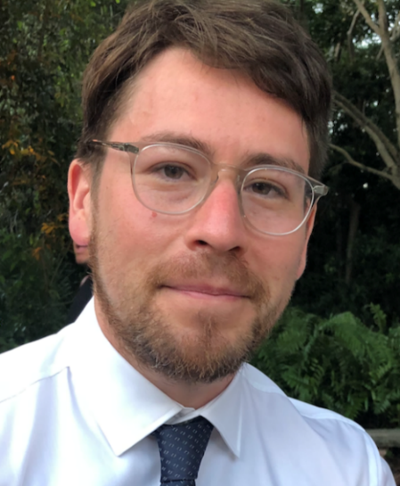

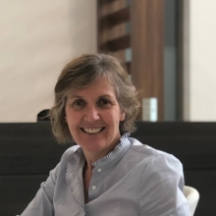
Faculty and Topic Overview
Clare ATZEMA
Martin AGUILAR
Atul VERMA
Louise PILOTE
Acute management of AF
Long-term rate and rhythm control strategies
Catheter ablation for the treatment of AF
Sex difference considerations in AF management

Slide 12

Disclosure of potential conflicts of interest
Jason G. Andrade
Consulting Fees/Honoraria: Bayer HealthCare, BMS/Pfizer Alliance, Medtronic, Servier
Grants/Research Support: Canadian Arrhythmia Network, a Network of Clinical Excellence, Heart and Stroke Foundation of Canada, Michael Smith Foundation for Health Research, Baylis Medical, Medtronic, Inc, Bayer HealthCare, BMS/Pfizer Alliance, Servier
Matthew Bennett
Consulting Fees/Honoraria: None
Research Collaborations: Canadian Arrhythmia Network, a Network of Clinical Excellence, Baylis Medical; Medtronic, Inc; Bayer HealthCare; BMS/Pfizer Alliance; Servier

Slide 13
Disclosure of potential conflicts of interest
Clare Atzema
Grant/Research Support: CIHR, Heart and Stroke Foundation
Consulting Fees/Honoraria: None
Other: None
Martin Aguilar
Consulting Fees/Honoraria: Johnson & Johnson
Clinical Trials: None
Atul Verma
Advisory Board: Acutus, Adagio Medical, Bayer, Biosense Webster, Epix/ACT, Kardium, Medtronic, Medlumics, Thermedical, Vytronus
Clinical Trials: Acutus, Biosense Webster, Epix/ACT, Medtronic, Thermedical, Vytronus
Research Grants: Bayer, Biotronik, Bristol Meyers Squibb, Cardiostat, Medtronic
Louise Pilote
Consulting Fees/Honoraria: None
Clinical Trials: None

Slide 14

Overall Learning Objectives
Atrial Fibrillation:
When it comes to arrhythmia management…
Guidance from the CCS/CHRS 2020 Atrial Fibrillation Guideline Panel
Discuss acute management of AF and explore long-term rate and rhythm control strategies,
Review the role of catheter ablation for the treatment of AF, and
Identify sex specific considerations for management of AF.

Slide 15

Acute management of AF
Clare Atzema
MD, MSc, FRCPC
Toronto, ON
Program Research Director, Integrated Community, Sunnybrook Research Institute
Senior Scientist, Sunnybrook Research Institute
Senior Scientist, ICES
Staff Emergency Physician, Sunnybrook Health Sciences Centre
Associate Professor, University of Toronto
@Atzema

Slide 16

Learning Objectives
Highlight changes in the CCS AF guidelines around the timing of acute cardioversion of AF.
Review changes in the CCS AF guidelines around OAC prescribing following cardioversion of acute AF.
Update rate-control concepts in the acute management of AF.

Slide 17
Cardioversion of acute onset AFF
“Acute AF”: Duration < 7 days
Eligibility for cardioversion if not already on OAC ≥ 3 weeks
  Old:
    AF < 48 hours
    and
    No recent CVA/TIA (< 6 months)
    Not valvular AF
      Mechanical heart valve
      Moderate-severe MS

Slide 18
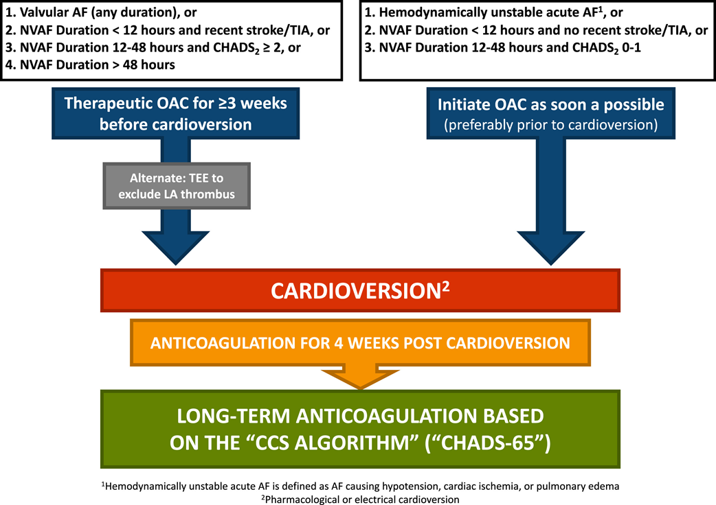
Cardioversion of acute onset AFF
New:
    AF <12 hours
    and
    No recent CVA/TIA (< 6 months)
    Not valvular (i.e. mechanical heart valve or mod-severe MS)
      OR
    AF 12-48h and CHADS2 <2
    No recent CVA/TIA (< 6 months)
    Not valvular (i.e. mechanical heart valve or mod-severe MS)

Slide 19
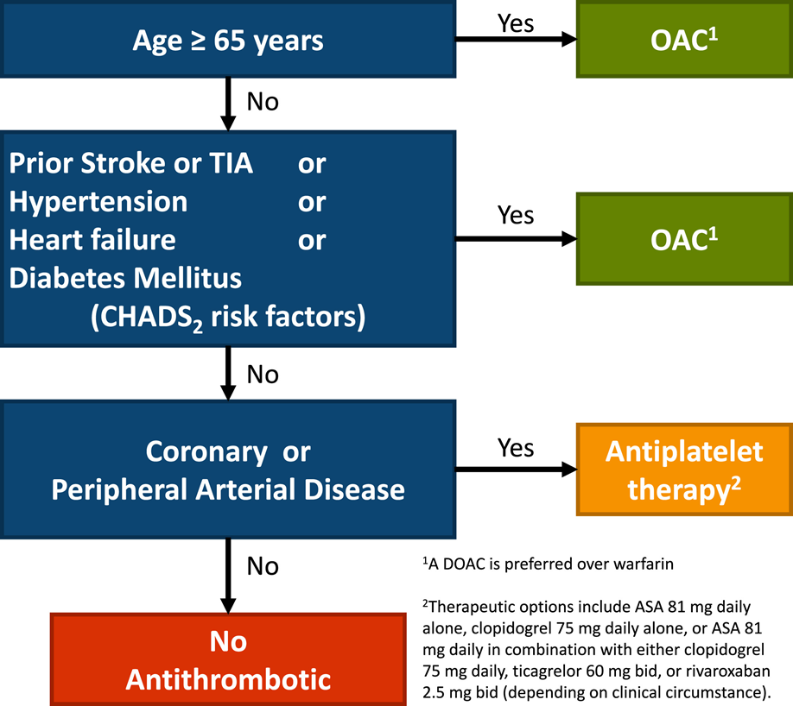
OAC: CHADS-65
Post-cardioversion:
    Everyone: OAC Rx x 4 weeks
      DOAC over warfarin
    Then according to CHADS-65

Slide 20
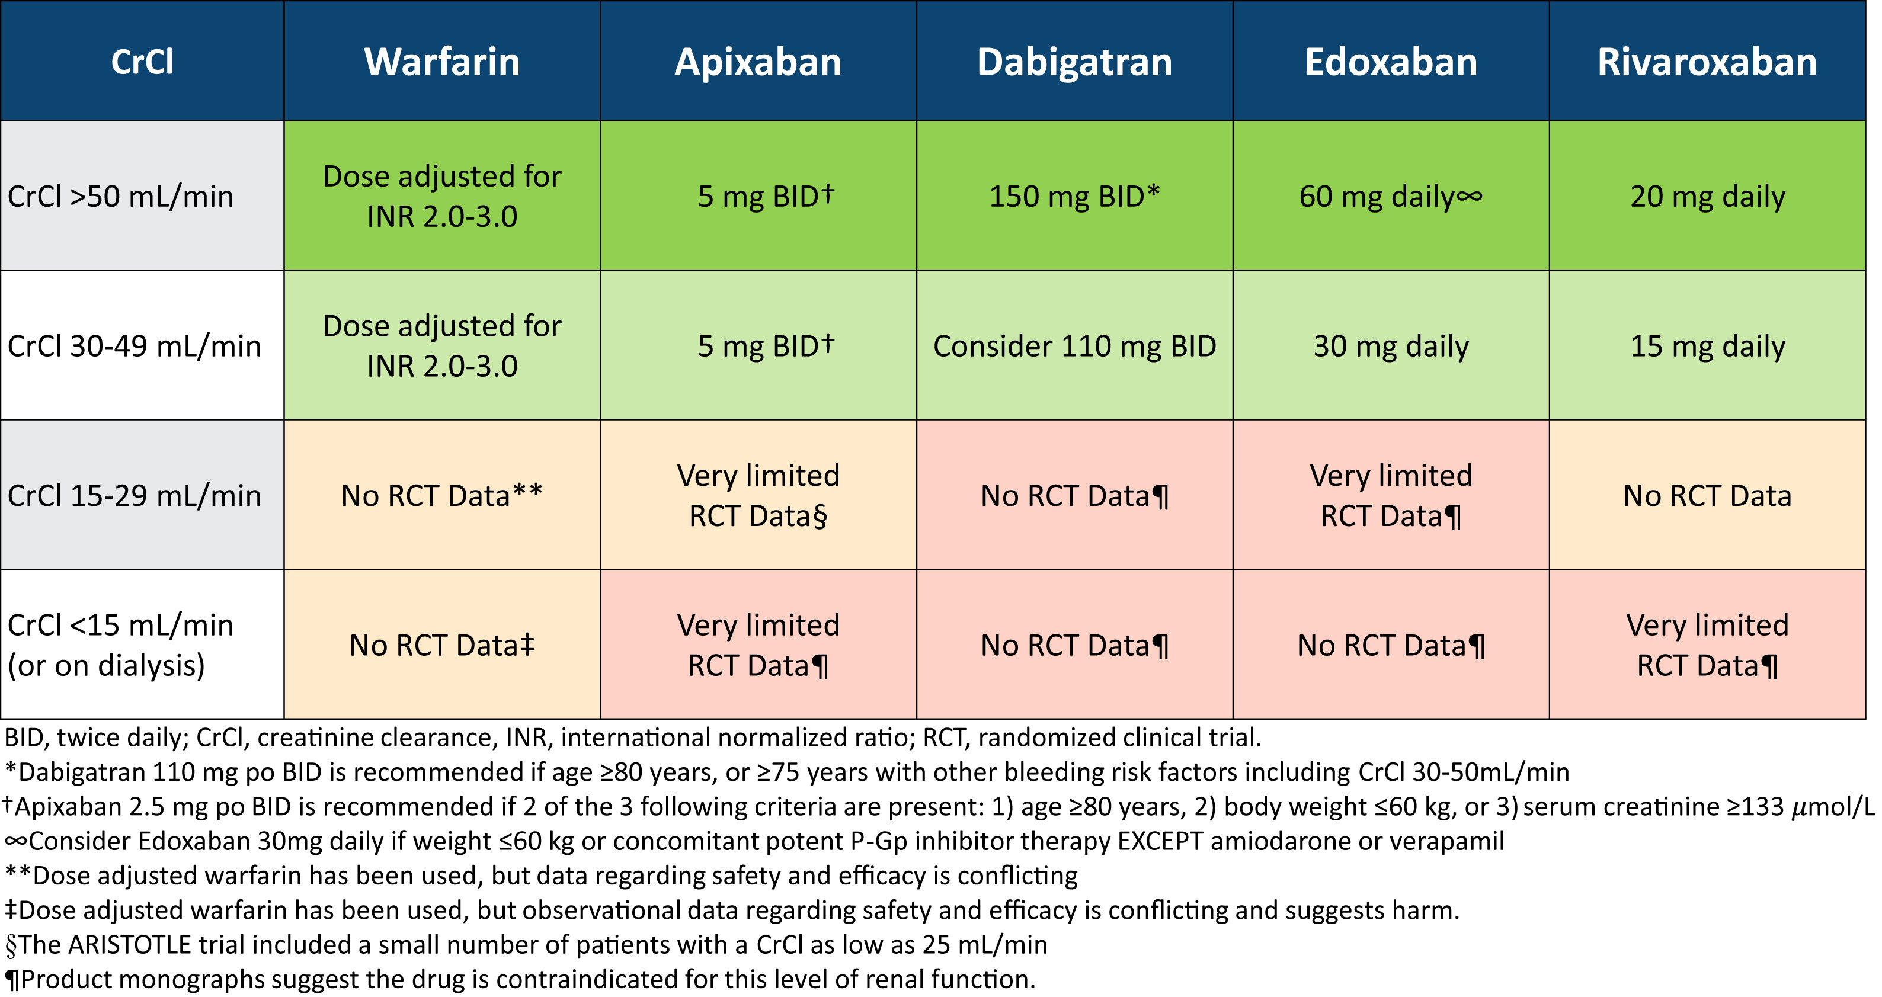
Notes:
If eGFR 30-60 mL/min, monitor renal fxn every 6 mo, every 3 mo if 15-30 mL/min (“stage 4 CKD”) [stage 5 CKD < 15 mL/min]
“it is important to ensure that the prescribed dose is c/w Health Canada labelling and the product monograph”

Slide 21
Rate-control
Goal of ~100 bpm
  Needs follow-up
CCB over BB?
  *ND-CCBs (verapamil & diltiazem) have favourable pharmacological properties for rate control and might be the preferred choice in patients without a compelling indication for β-blocker usage
    “We recommend evidence-based β-blockers (bisoprolol, carvedilol, metoprolol) be first-line agents for rate control of AF in patients with significant LV dysfunction (LVEF ≤ 40%) (Strong Recommendation; Moderate-Quality Evidence).”
Notes:
110 bpm for acute rate control changed

Slide 22
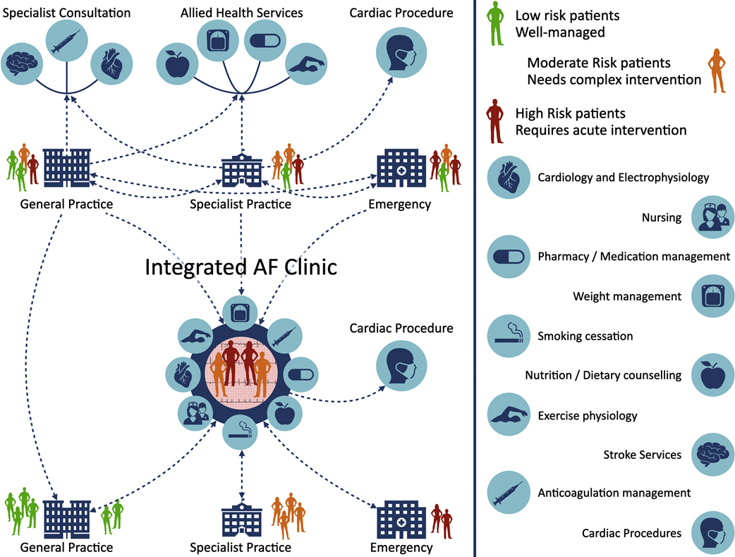
Integrated Care
Fig 7
Notes:
Structured, integrated, multidisciplinary, patient-focused approach to care

Slide 23
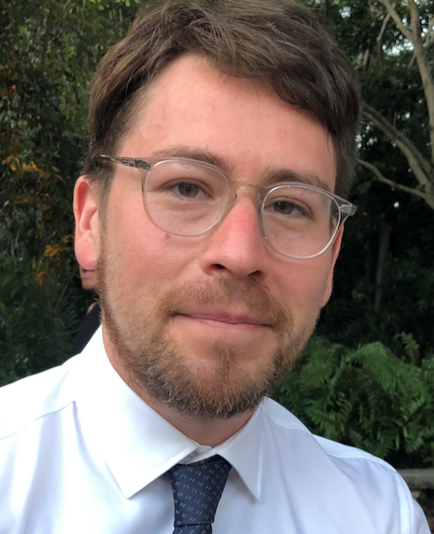
Long-term rate and rhythm control strategies
Martin Aguilar
MD, PhD
Montréal, QC
Cardiologist, with specialty in Clinical cardiac electrophysiology, Montreal Heart Institute
Training in Clinical Cardiac Electrophysiology and Research at Brigham and Women's Hospital, Harvard University.

Slide 24
Learning Objectives
To review the guideline-based strategies for long-term AF rate-control.
To review the guideline-based strategies for long-term AF rhythm-control.

Slide 25
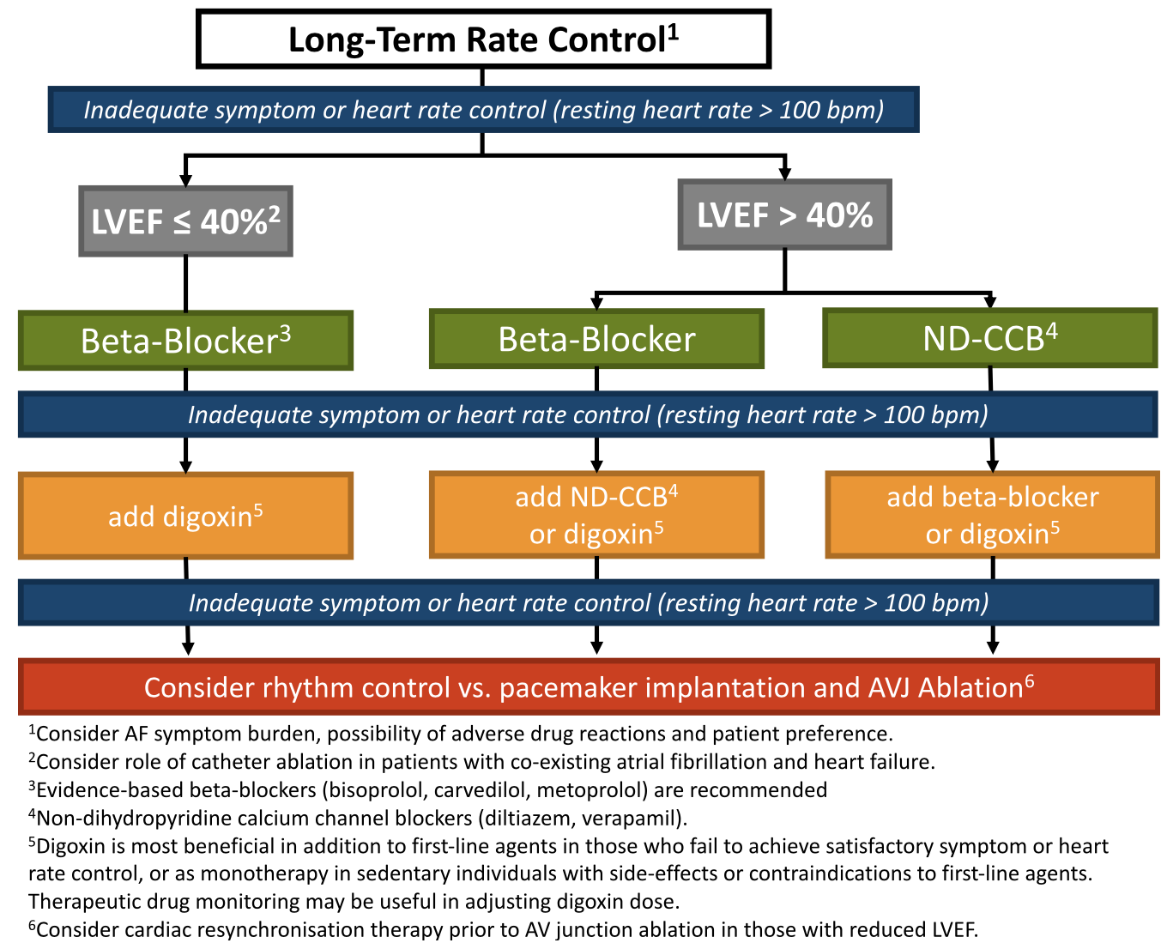

Mean resting HR < 100 bpm during AF
In patients with HFrEF, maximize evidence-based β-blocker + HR < 100 bpm
In patients with CRT, maximize biventricular pacing (as close to 100% as possible)
Insufficient evidence for HR targets during exercise
Consider monitoring if
(i) exercise-related Sx
  (ii) highly active individuals
Specific population may benefit from stricter control
(e.g., HF, tachycardia-mediated CMP, mitral stenosis, stable angina)

Slide 26
Evidence-based β-blocker
(bisoprolol, carvedilol, metoprolol)
Consider drug monitoring, particularly if high risk
Trough levels 0.5-0.9 ng/mL

Slide 28
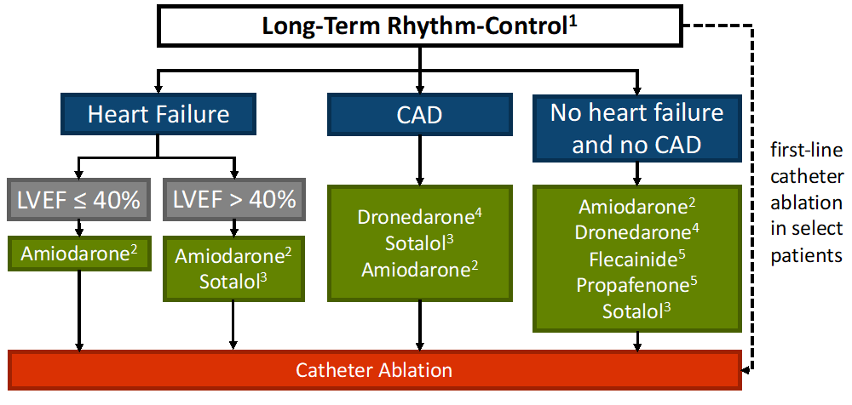
Goal: to improve QoL/outcomes, not necessarily elimination of all AF episodes
||
Careful evaluation of risk vs benefits of antiarrhythmic drugs

Slide 29
Goal: to improve QoL/outcomes, not necessarily elimination of all AF episodes
||
Careful evaluation of risk vs benefits of antiarrhythmic drugs
Consider alternative as first-line
Chronic monitoring for extra-cardiac toxicities
C-I in persistent AF and HF
Caution with digoxin
Combine with AVN blocking agent
Caution with LVH/AV conduction disease
Check QRS duration (>25% increase)
Caution in ≥65 yo/women/renal impairment/LVH
Check QTc 48-72h after initiation

Slide 30
Goal: to improve QoL/outcomes, not necessarily elimination of all AF episodes
||
Careful evaluation of risk vs benefits of antiarrhythmic drugs

Slide 31
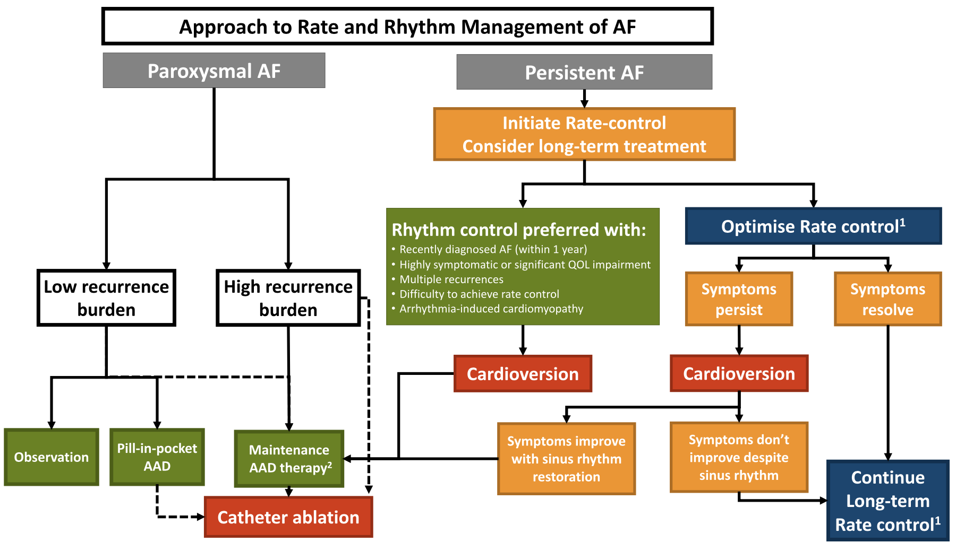

Slide 32
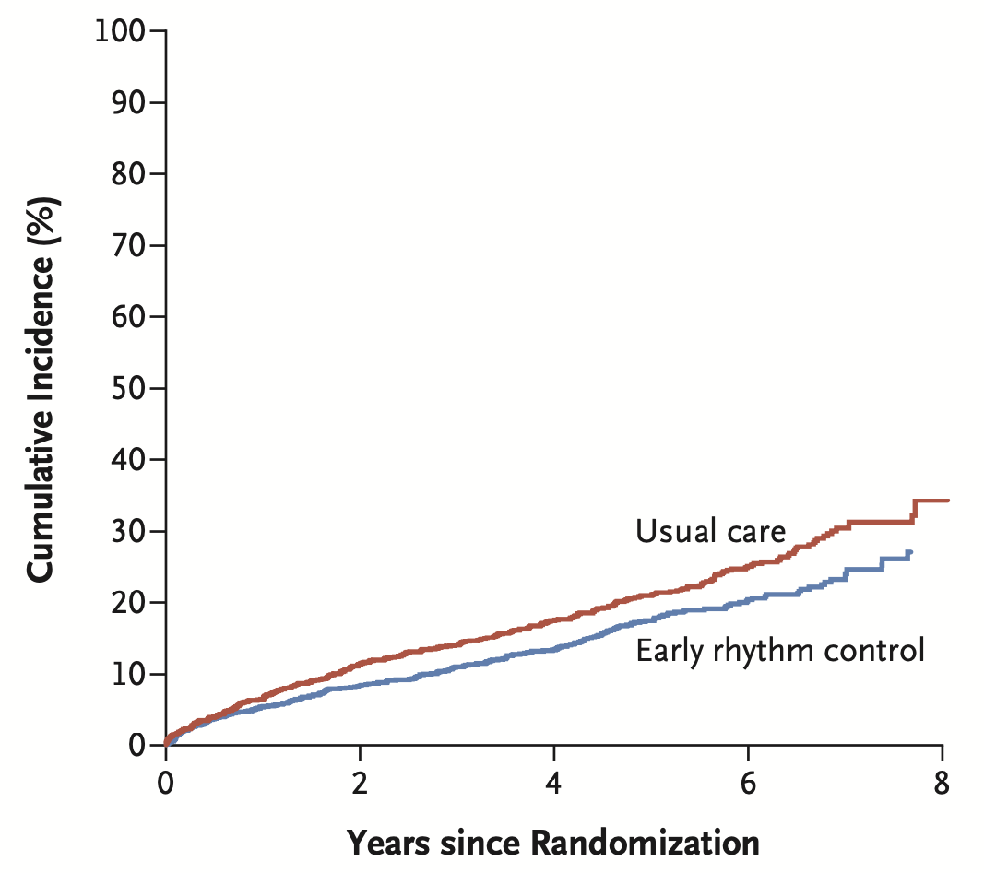
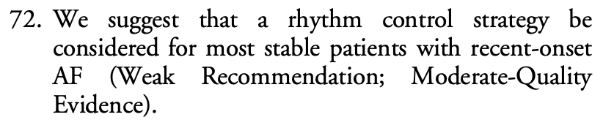
CV death
Stroke
CV hospitalization
EAST AFNET 4

Slide 33

Catheter ablation for the treatment of AF
Atul Verma
MD, FRCPC, FHRS
Newmarket, ON
Director, Heart Rhythm Program, Southlake Regional Health Center
Associate Professor, University of Toronto
Adjunct Professor, McGill University
Associate Scientist, Li Ka Shing Knowledge Institute at University of Toronto
@atulverma_md

Slide 34
Learning Objectives
To provide evidence for catheter ablation for treatment of atrial fibrillation.
To define specific populations who most benefit from catheter ablation of atrial fibrillation.

Slide 35
Catheter ablation recommendations
We recommend catheter ablation of AF in patients who remain symptomatic after an adequate trial of antiarrhythmic therapy and in whom a rhythm control strategy remains desired (Strong Recommendation; High-Quality Evidence).
  Values and preferences. This recommendation recognizes the positive effect of catheter ablation on AF burden, symptoms, QOL, and cardiovascular hospitalizations, as well as the declining risks of the procedure.
We suggest catheter ablation to maintain sinus rhythm as first-line therapy for relief of symptoms in select patients with symptomatic AF (Weak Recommendation; Moderate-Quality Evidence).
  Values and preferences. This recommendation recognizes that patients might have relative or absolute contraindications to pharmacologic rhythm control.

Slide 36
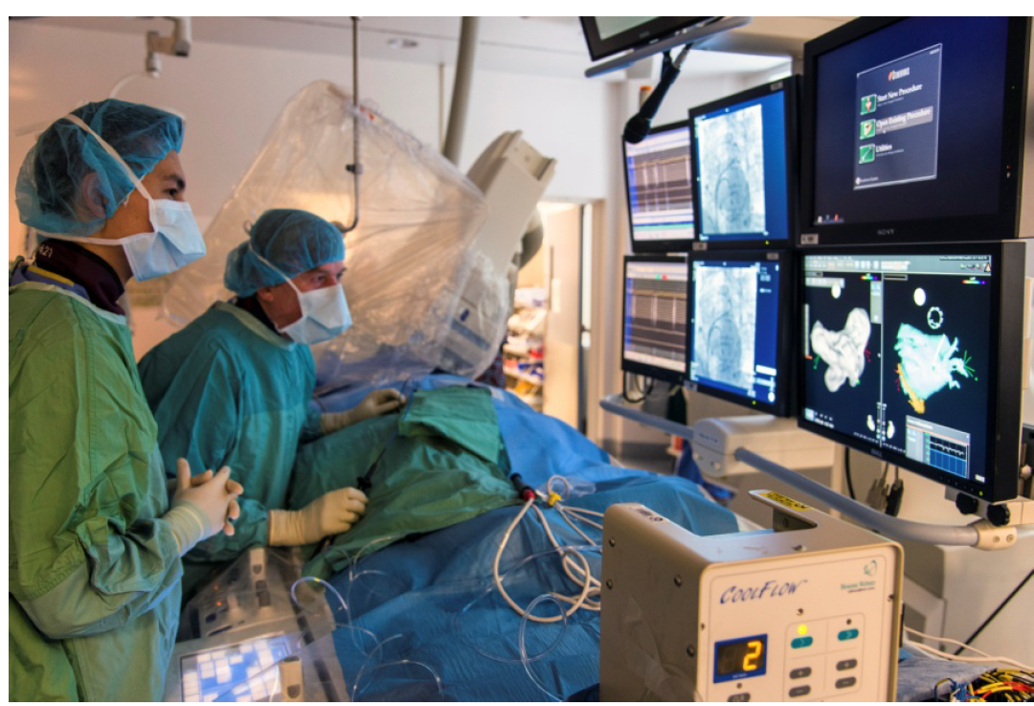
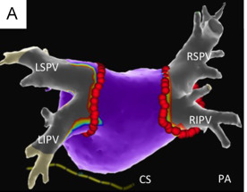
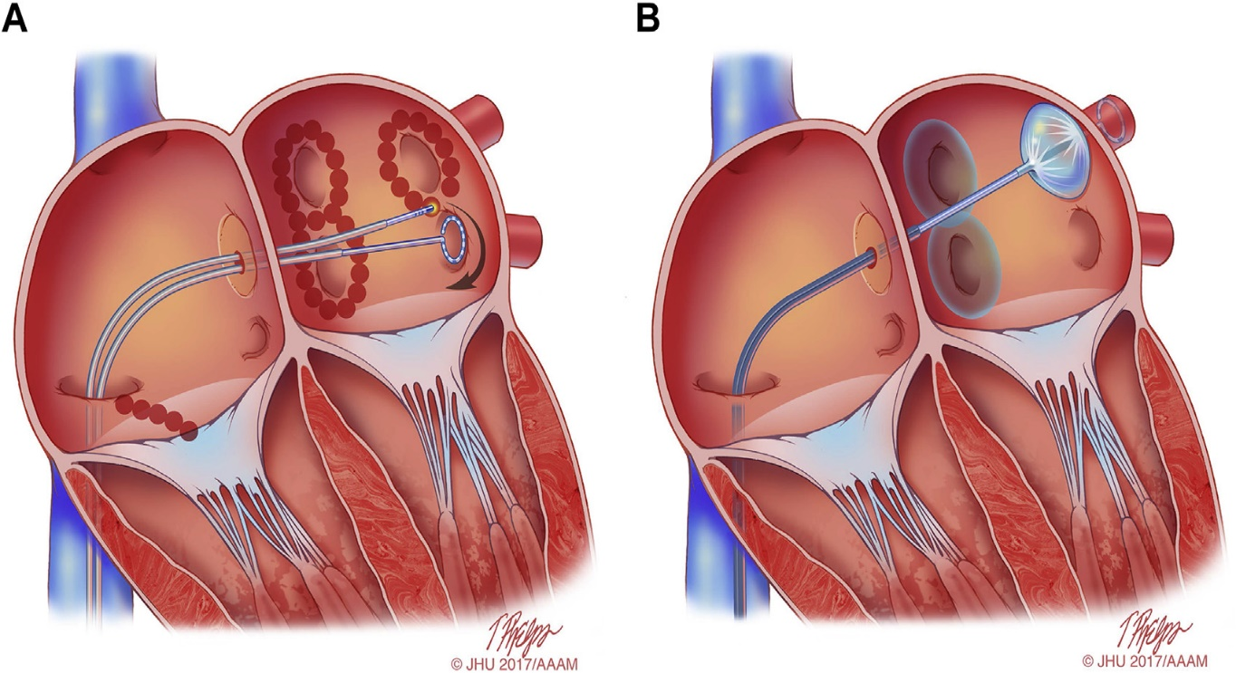
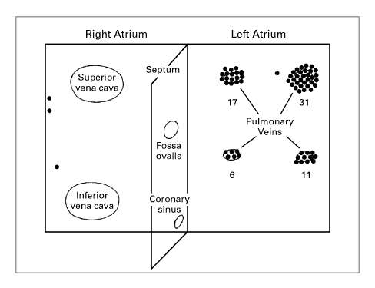
Catheter ablation for atrial fibrillation
Percutaneous procedure using either radiofrequency (heat), cryothermy (freeze), or pulsed field ablation (electric).
Haissaguerre et al. NEJM 1998
https://www.ottawaheart.ca/sites/default/files/uploads/documents/Patients-Visitors/complex-ablation-patient-guide-dec2015.pdf

Slide 37
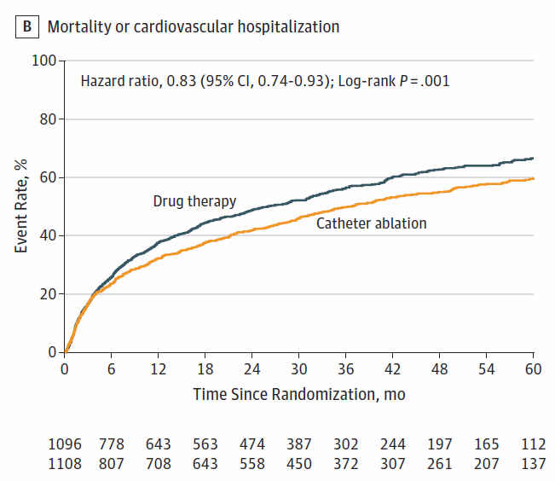
CABANA Trial
Packer et al, JAMA 2019 321(13):1261-74

Slide 38
Primary endpoints – CASTLE AF
Marrouche et al, N Engl J Med 2018

Slide 39
EARLY ablation intervention – EARLY AF
November 16, 2020

Slide 40
Number of all-cause hospitalizations and ER visits before and after complex ablation procedures for atrial fibrillation in Ontario (2016/17 – 2018/19)
P<0.05
Ha, Wijeysundera, Verma JAHA 2020

Slide 41
Candidates for AF ablation
Not every patient who has AF needs an ablation
Currently, we are ablating 1-2% of all patients with AF; target probably needs to be closer to 5-15%
Candidates for AF ablation:
  Symptomatic AF
  AF causing heart failure or LV dysfunction
  Resistant (or patient intolerance) to antiarrhythmic medication
  Left atrial size <55 mm
  Age <80 or non-frail patients
  Younger, paroxysmal patients who are for first-line ablation

Slide 42
Sex difference considerations in AF management
Louise Pilote
MDCM, PhD, FRCPC
Montréal, QC
Professor of Medicine, McGill University
James McGill Chair
@PiloteDr

Slide 43
Learning Objectives
To demonstrate sex differences in the mechanism and risk factors in patients with atrial fibrillation.
To illustrate sex differences in symptom manifestation and risk of stroke amongst patients with atrial fibrillation.

Slide 44
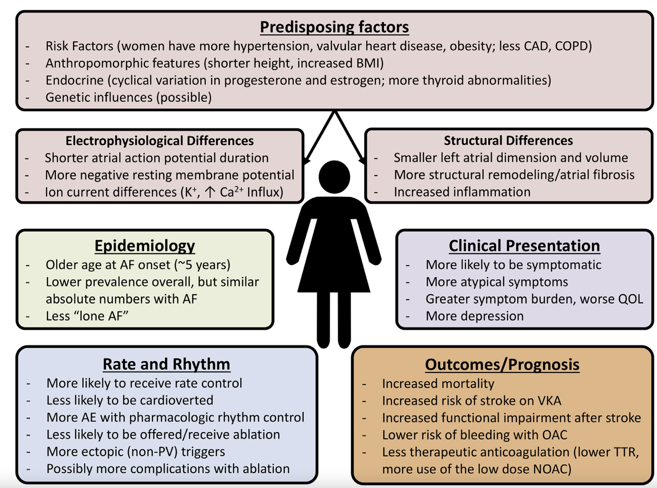
Andrade, et al, 2018

Slide 45
Epidemiological considerations
Risk of atrial fibrillation doubles with each decade of life
Male sex is associated with 1.5-fold increase in risk of AF
AF prevalence is 9.2% in females and 15% in males
AF incidence in:
  Females: 1.6 per 1000 person-years
  Males: 1.8 per 1000 person-years
Absolute number of patients with AF is higher in females than males
Magnani, et al., 2014 / Andrade et al, 2018

Slide 46
Structural and electrophysiological differences
The exact mechanism to explain AF sex differences is poorly understood due to lack of adequate studies.
Some hypotheses include:
  Larger LA size in males
  Higher expression of repolarizing ion channels in males resulting in reentry and hence increased risk of AF onset
  Increased atrial remodeling and fibrosis in females
  Estrogen increases conduction time in females
  Progesterone shortens of action potential in females and resulting re-entry circuit and AF development
Andrade, et al, 2018 / Samuel, et al, 2020

Slide 47
Sex differences in AF clinical risk factors
Sex specific models for adverse clinical outcomes in AF have not been developed yet
Risk Factor | Females (OR) | Males (OR)
Congestive Heart Failure | 5.9 | 4.5
Valvular Disease | 3.4 | 1.8
Hypertension | 1.5 | 1.4
Diabetes Mellitus | 1.6 | 1.4
Obesity | 1.8 | 1.4
Myocardial Ischemia | 1.2 | 1.4
Andrade, et al, 2018 / Samuel, et al, 2020 / Reynold et al, 2006
Notes:
Overall in the literature sex specific risk stratification models have not been thoroughly studied. However, it has been shown that while some comorbidities including hypertension and valvular diseases may be important risk factors in females, CAD and LVD substantially increase the risk of AF development in males. Some other risk factors including advanced age, CHF, and cardiac interventions remain an important predictor of AF for both sexes.
Samuel M, Abrahamowicz M, Joza J, Essebag V, Pilote L. Population-level sex differences and predictors for treatment with catheter ablation in patients with atrial fibrillation and heart failure. CJC Open. 2020.
Reynolds, Matthew R., et al. "Influence of age, sex, and atrial fibrillation recurrence on quality of life outcomes in a population of patients with new-onset atrial fibrillation: the Fibrillation Registry Assessing Costs, Therapies, Adverse events and Lifestyle (FRACTAL) study." American heart journal 152.6 (2006): 1097-1103.

Slide 48
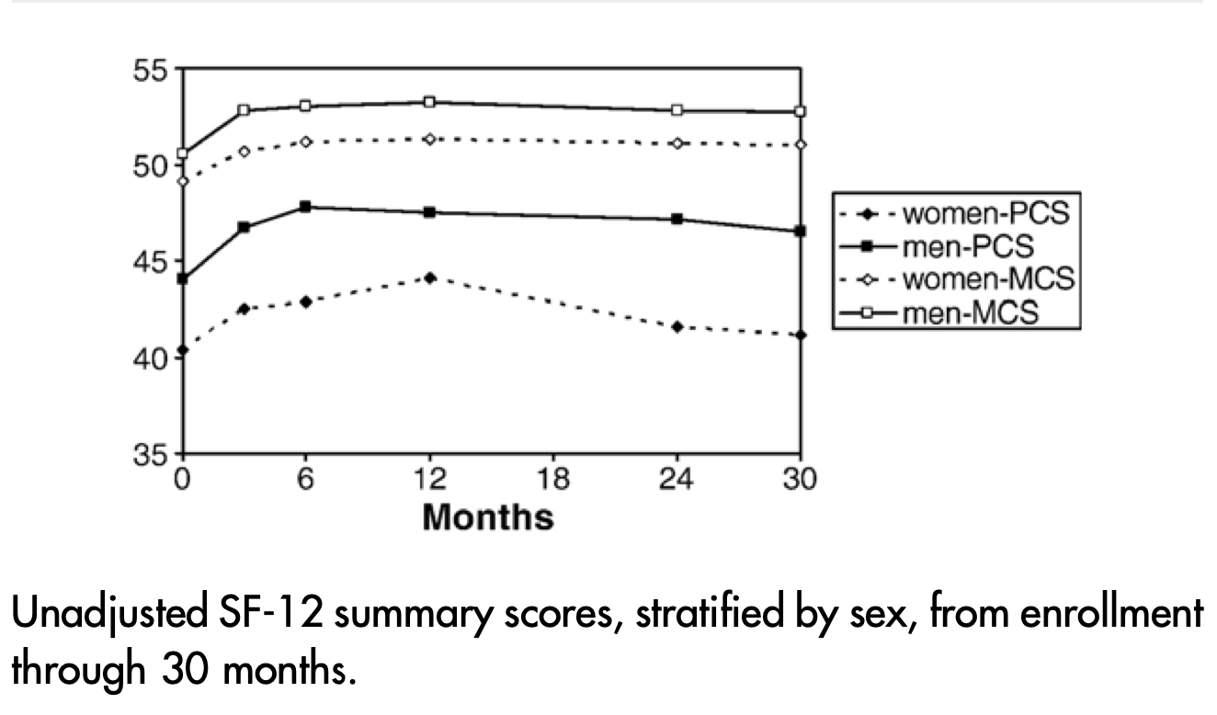
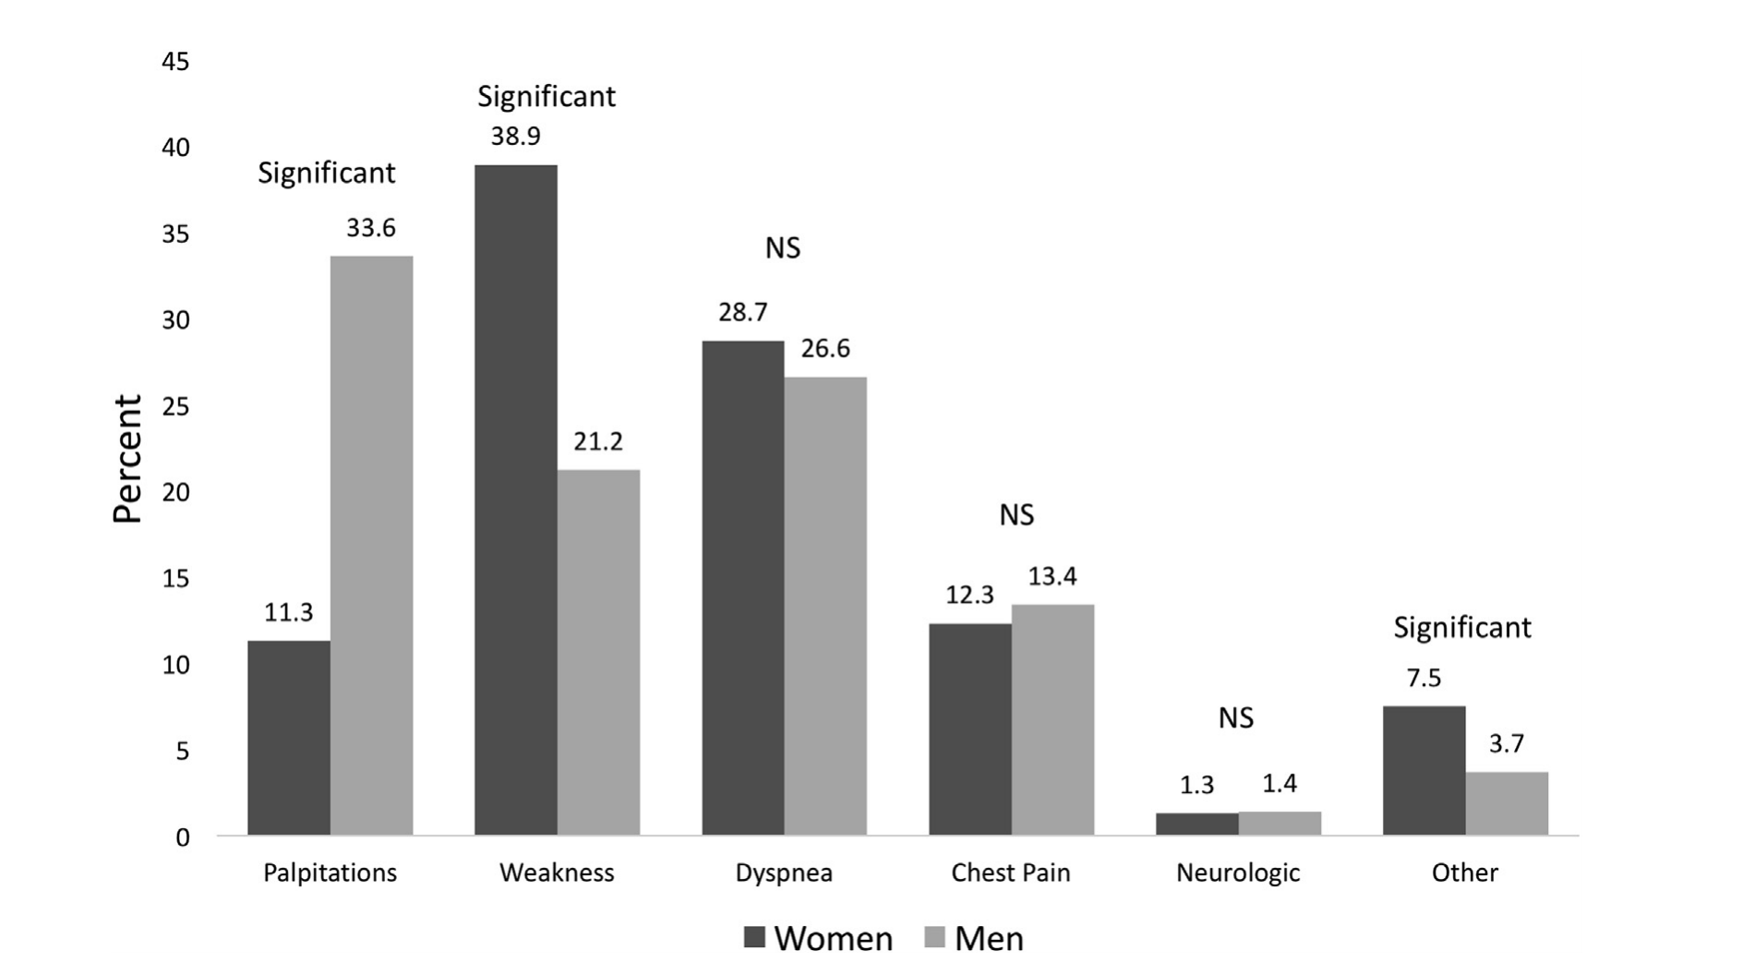
Sex differences in quality of life and symptoms in patients with AF
Females are less likely to present with asymptomatic AF
They present with a higher burden of “atypical” symptoms
Reynolds et al, 2016 / Andrade, et al, 2018

Slide 49
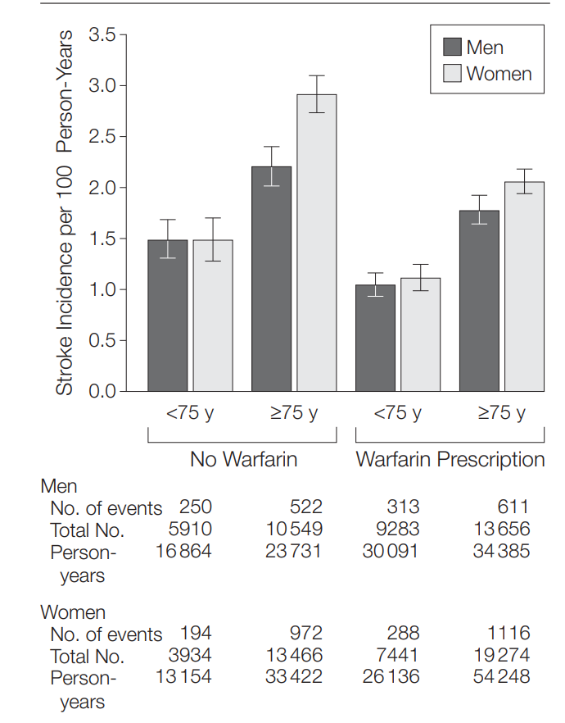
Sex differences in risk of stroke in AF patients
Females are at higher risk of AF-induced stroke
  Likely to be under treated with respect to anticoagulation
  Less likely to be cardioverted back to normal sinus rhythm
  Less likely to undergo catheter ablation
Severity of stroke is greater in females compared to males
  Experiencing more functional disability
  More likely to be institutionalized
12% increase in relative risk of all-cause mortality amongst females compared to males (relative risk, 1.12; 95% CI, 1.07-1.17)
Female patients have greater residual risk of stroke even if anticoagulated properly
Emdin et al, 2016 / Tsadok, Pilote et al, 2012 / Samuel, Pilote et al, 2020 / Reynold et al, 2006
Notes:
Samuel M, Abrahamowicz M, Joza J, Essebag V, Pilote L. Population-level sex differences and predictors for treatment with catheter ablation in patients with atrial fibrillation and heart failure. CJC Open. 2020.
Reynolds, Matthew R., et al. "Influence of age, sex, and atrial fibrillation recurrence on quality of life outcomes in a population of patients with new-onset atrial fibrillation: the Fibrillation Registry Assessing Costs, Therapies, Adverse events and Lifestyle (FRACTAL) study." American heart journal 152.6 (2006): 1097-1103.

Slide 50
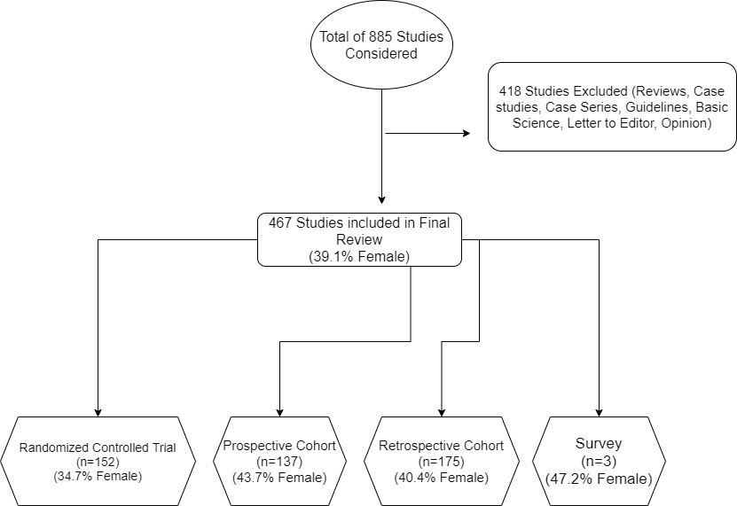
Representation of WOMEN in studies supporting the 2020 CCS Guidelines

Slide 51
Conclusions
Understanding of sex-specific differences provide opportunity for recognition of risk-benefit treatment paradoxes
Appreciating “atypical” symptom presentation of females provides opportunity to alter treatment for increased efficacy
Recognizing that females have more severe consequences of AF, increases clinician awareness and reduces likelihood of under treatment
Targeting of early obesity and hypertension in females may be an effective first step towards AF prevention
Increased representation of women in AF trials will provide better evidence

Slide 52


QUESTIONS?

Slide 53
SAVE THE DATES!
For our upcoming Guideline Webinars
Heart Failure:
Webinar 4: Non-pharmacological management of HF
On Thursday, July 15, 2021 from 8 PM – 9 PM EDT, join Dr. Swiggum, Dr. Virani, Dr. Van Spall and Dr. Zieroth for the final webinar in the HF webinar series highlighting content from the Heart Failure Guidelines
Atrial Fibrillation:
Webinar 3: Focus on screening and prevention
On Thursday, September 23, 2021 from 8 PM – 9 PM ET, join Drs. Andrade, Macle, Dorian, Healey, Parkash and Sandhu for the “AF Guidelines: Focus on screening and prevention” webinar.
Register at CCS.ca/programs-and-events/

Slide 54
Visit CCS.ca for more Guidelines and Resources
Guideline Library:
https://ccs.ca/guidelines-and-position-statement-library/
Guideline Resources:
https://ccs.ca/guideline-resources/

