Slide 1

Non-pharmacological management of HF: nutrition, cardiac rehabilitation and advance care planning
Guidance from the CCS/CHFS 2021 Heart Failure Guideline Panel
July 15, 2021
The Canadian Cardiovascular Society is grateful to our partner(s) for their commitment to building knowledge and expertise of the heart team. This program was made possible in part by Astra Zeneca, Bayer and Novartis Canada. CCS thanks our partners for their dissemination support so that healthcare providers can benefit from this important information.

Slide 2
© Canadian Cardiovascular Society. 2021. All rights reserved.
Distribution, transmission or republication is strictly prohibited without the prior written permission of the Canadian Cardiovascular Society.
For medical institution internal education or training (i.e. grand rounds, medical college/classroom education, etc.), kindly consider and implement the following:
  Include the citation for the Canadian Journal of Cardiology
  Add ‘Reproduced with permission from the Canadian Cardiovascular Society. [insert year].’
  Avoid use of CCS logos or trademarks on slides, tools or publications that are not the property of the CCS
  Do not modify the slide content and, the layout and CCS branding on the Guideline-related slides
  Guideline recommendations must be reproduced exactly as published
For an industry supported or involved program, permissions are required:
  If content is published in the Canadian Journal of Cardiology, permissions must be sought through our publisher Elsevier (www.onlinecjc.com)
  If content is property of the CCS, contact guidelines@ccs.ca

Slide 3

Co-MODERATOR
Dr. Sean A. Virani
MD, MSc, MPH, FRCPC, FCCS
Vancouver, BC
Head, Division of Cardiology, Providence Health Care
Physician Program Director, The HEART Centre, St. Paul’s Hospital
Provincial Medical Director, Cardiac Services BC
Associate Professor, Department of Medicine, University of British Columbia
Past President, Canadian Heart Failure Society
Medical Director, HeartLife Foundation
@DktrV

Slide 4
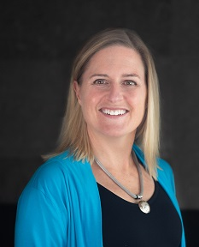
Co-MODERATOR
Dr. Elizabeth Swiggum
MD, FRCPC, FCCS
Victoria, BC
Medical Director, Heart Function Clinic and Cardiac Rehabilitation Program, Royal Jubilee Hospital
Clinical Associate Professor, University of British Columbia
Board member, Canadian Heart Failure Society
Medical Chair, Heart Failure and Chronic Cardiovascular Disease, CSBC
@lizswiggum

Slide 5
Non-pharmacological management of HF: nutrition, cardiac rehabilitation and advance care planning
Guidance from the CCS/CHFS 2021 Heart Failure Guideline Panel
July 15, 2021

Slide 6
We extend our respect to all First Nations, Inuit and Métis peoples for their valuable past and present contributions to this land we call Canada.
We acknowledge the Indigenous Peoples of all the lands that we are each on today, and reaffirm our commitment and responsibility as individuals, to improving relationships between nations and to collaborating in a spirit of reconciliation.

Slide 7
Welcome to the HF WEBINAR SERIES
Webinar 1
Webinar 2
Webinar 3
Webinar 4
What’s new in 2021: HFrEF
Screening + Diagnosis in HFrEF and HFpEF
Device Therapy
Non-pharmacological Management
Available On-Demand
Faculty:
Justin Ezekowitz
Mike McDonald
Sean Virani
Available On-Demand
Faculty:
Sean Virani
Eileen O’Meara Jonathan Howlett
Available On-Demand
Faculty:
Mike McDonald
Sheri Koshman
Anique Ducharme Mustafa Toma
Today!
Faculty:
Sean Virani
Elizabeth Swiggum Harriette Van Spall Shelley Zieroth
Register at CCS.ca/programs-and-events/
On-Demand CCS.ca/On-Demand-Guideline-Webinars/

Slide 8
Accreditation and Interactivity
This webinar is an Accredited Group Learning Activity (Section1) as defined by the Maintenance of Certification Program of the Royal College of Physicians and Surgeons of Canada, and approved by the Canadian Cardiovascular Society. You may claim a maximum of 1 hour.
Immediately following the presentations, we will have our Q&A Session. The Q&A period will be an opportunity for audience members to ask our panelists pressing questions and encourage constructive discussion among the faculty.

Slide 9


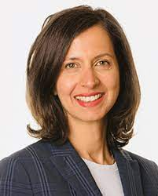
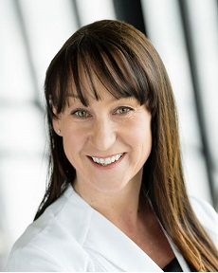
Our Faculty
Elizabeth
SWIGGUM
Shelley
zIEROTH
Sean
ViRANI
Harriette
VAN SPALL
CO-MODERATORS

Slide 10

Disclosure of potential conflicts of interest
Sean Virani
Consulting Fees/Honoraria: Abbott, Amgen, AstraZeneca, Bayer, Boehringer Ingelheim, BMS/Pfizer Alliance, Medtronic, Merck, Novartis, Pfizer, Servier
Clinical Trials: Abbott, AstraZeneca, Boehringer Ingelheim, Medtronic, Novartis, Pfizer
Elizabeth Swiggum
Consulting Fees/Honoraria: AstraZeneca, Bayer, Boehringer Ingelheim, BI Lilly Alliance, Novartis, Pfizer, Servier
Clinical Trials: Abbott, Boehringer Ingelheim, InVentiv Health Clinical, Novartis
Shelley Zieroth
Consulting/Speaker Fees: Abbott, Akcea, Amgen, AstraZeneca, Amgen, Alnylam, Bayer, Boehringer Ingelheim, Eli-Lilly, HLS Therapeutics, Janssen, Merck, Novartis, Novo Nordisk, Otsuka, Pfizer, Servier, Vifor
Clinical Trials: Amgen, AstraZeneca, Bayer, Boehringer Ingelheim, Eidos, Merck, Novartis
Grants/Research Support: Novartis, Servier
Harriette Van Spall
Grants/Research Support: Canadian Institutes of Health Research, Heart and Stroke Foundation, Ontario’s Ministry of Health and Long-Term Care

Slide 11

Overall Learning Objectives
Explore the role of non-pharmacological therapy options for the management of heart failure (HF),
Identify individualized treatment plans including nutrition and cardiac rehabilitation, and
Discuss considerations for advance care planning.

Slide 12

Case #1
53 year old female
prior MI with late PCI to LAD
Type 2 DM, HbA1c 7.0%
Current smoker – pre-contemplative
Hospitalized for new onset HF 4 months ago
            Patent stent, no new CAD
            Uncertain of how to be active
            Hasn’t returned to work
Medications
Carvedilol 25 mg bid
Spironolactone 25mg/d
Sacubitril-Valsartan 49/51 mg bid
Empagliflozin 25 mg/d
Metformin 500 mg bid
ECASA 81 mg/d
Rosuvastatin 40 mg/d
LVEF 30-35%
NYHA II
Referred for consideration of ICD
Narrow complex QRS
What should we offer next?
HR 65 bpm; BP 110/70 mmHg
Euvolemic
Obese

Slide 13
How can we support the patient further?
Increase sacubitril/valsartan
Refer to cardiac rehabilitation
Advise her to walk daily, quit smoking, eat healthy and meditate…

Slide 14
Case #2
83 year old male
Diagnosed with HFrEF 10 years ago
ICD for 1⁰ prevention
Poor appetite, weight loss, fatigue
LVEF 20% (Biventricular)
            Severe functional MR, severe TR
            RVSP 60mmHg
Medications
Sacubitril-valsartan 24/26mg bid
            Did not tolerate higher doses (lightheaded)
Bisoprolol 10 mg/d
Spironolactone 25mg/d
Dapagliflozin 5 mg/d (intolerant of 10mg/d)
Furosemide 20 mg/d
Apixaban 2.5mg bid
Normal coronaries
Atrial fibrillation
Moderate COPD
CKD (eGFR 30-35)
Persistent NYHA III symptoms, recent worsening
What are the next steps?
HR 60-66 bpm, BP 85/60 mmHg sitting, 80/58 standing
Modest volume overload
Thin

Slide 15
Next steps?
Refer to nephrology
Reduce medications
Review goals of care and advance care planning

Slide 16

Nutrition and cardiac rehabilitation in HF
Dr. Harriette Van Spall
MD, MPH, FCCS (Cardiology)
Hamilton, ON
Associate Professor of Medicine, Department of Medicine, Department of Health Research Methods, Evidence and Impact Scientist, Population Health Research Institute
@hvanspall

Slide 17

Learning Objectives
Evaluate nutritional and dietary considerations in the management of HF
Explore key features of a cardiac rehabilitation program for patients with HF

Slide 18
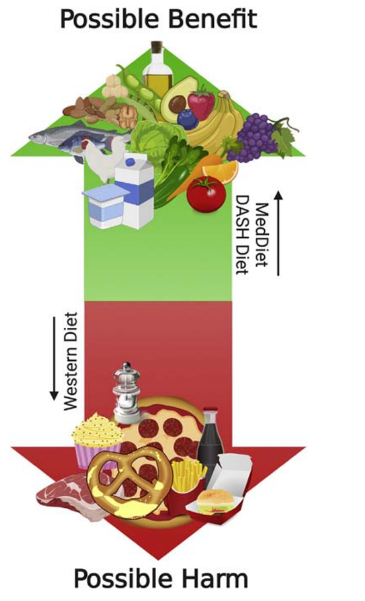
Dietary patterns in HF
Micronutrient deficiencies
  Calcium, folate, magnesium, zinc, and vitamins C, D, E, and K common in HF (US, Canada)
  Diet monotony, ethnicity (BIPOC), ? SES
  High index predicts 1 year hospitalization / death in HF
HF etiology - Selenium, B12 deficiency
Diuretic depletion – Mg, potassium
Mediterranean diet and DASH diet in HF
  Both: fruit, vegetables, whole grains, legumes; limited saturated fats
  DASH: high potassium, limited sodium
  Mediterranean: greater unsaturated fatty acids
Lennie et al. JAHA 2018;7:e007251 / Bilingsley et al. Prog Cardiovasc Dis 2020;63:538-551

Slide 19
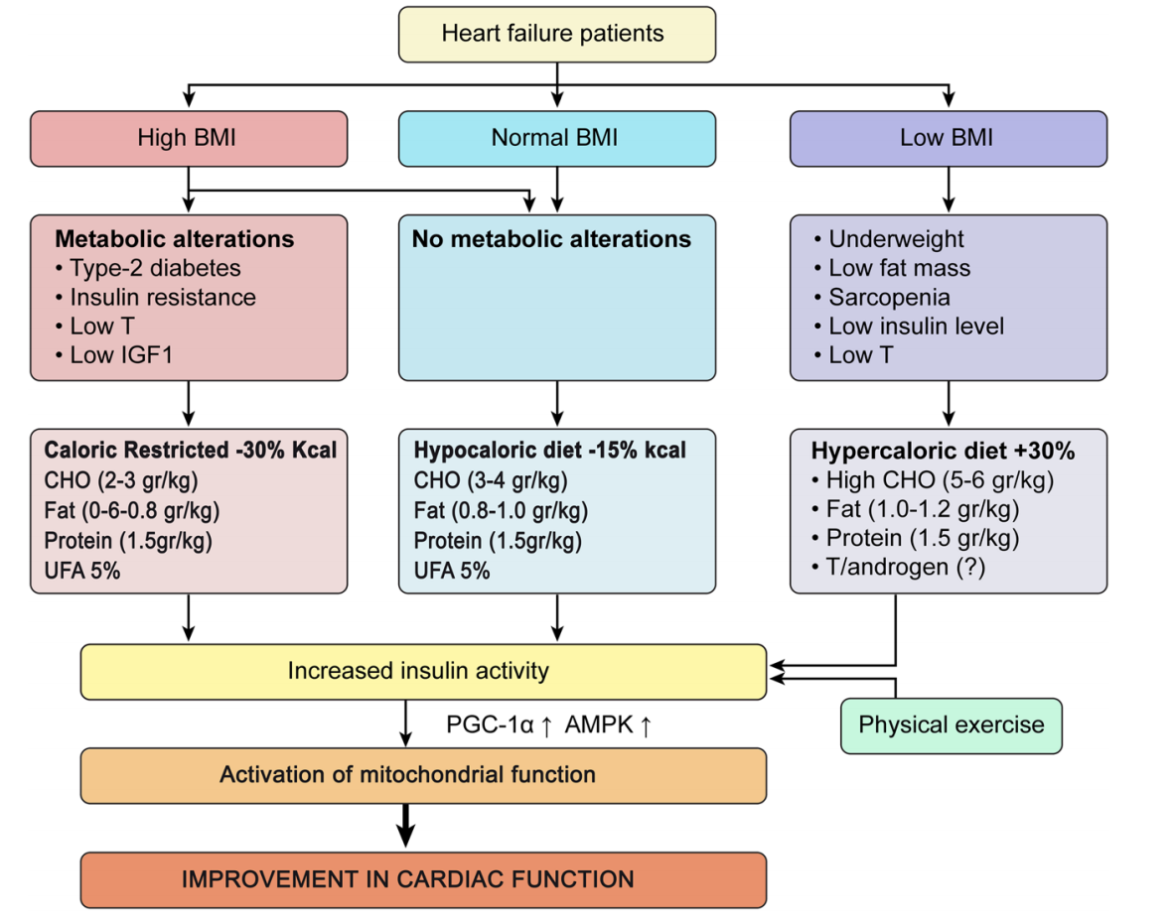
Nutritional approach for patients with HF based on BMI
Bianchi. Heart Fail Rev 2020;25;1017-1026.

Slide 20
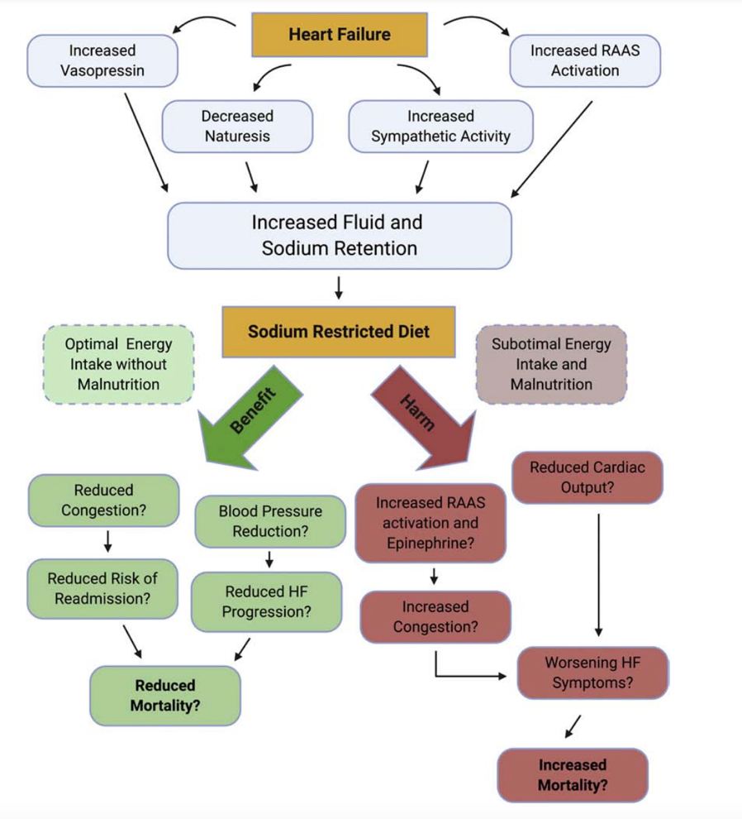
Effect of sodium restriction in HF
Suggested restriction in guidelines varies from <1500 mg to <3000 mg per day
May be associated with micronutrient deficiencies
Systematic review of 9 RCTs (n=479) inpatient + ambulatory
  No evidence to support / refute Na restriction
Bilingsley et al. Prog Cardiovasc Dis 2020;63:538-551. / JAMA Intern Med. 2018;178(12):1693-1700

Slide 21
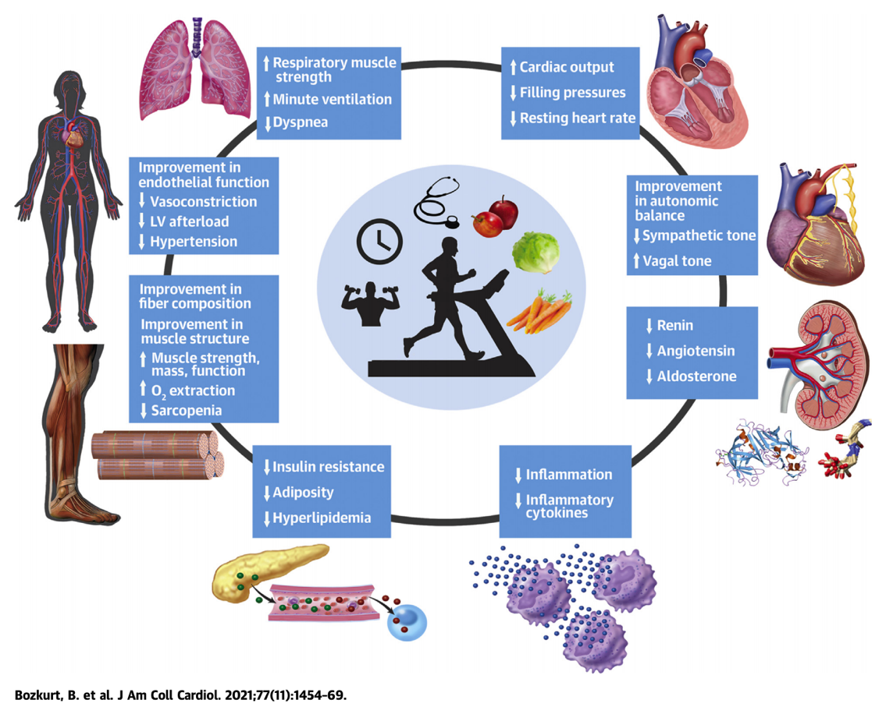
Benefits of exercise training in patients with HF

Slide 22
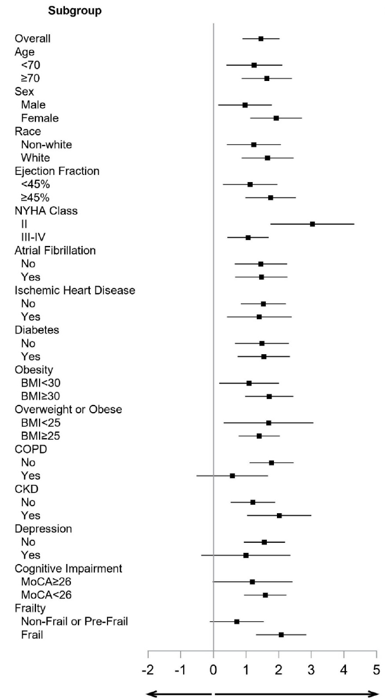
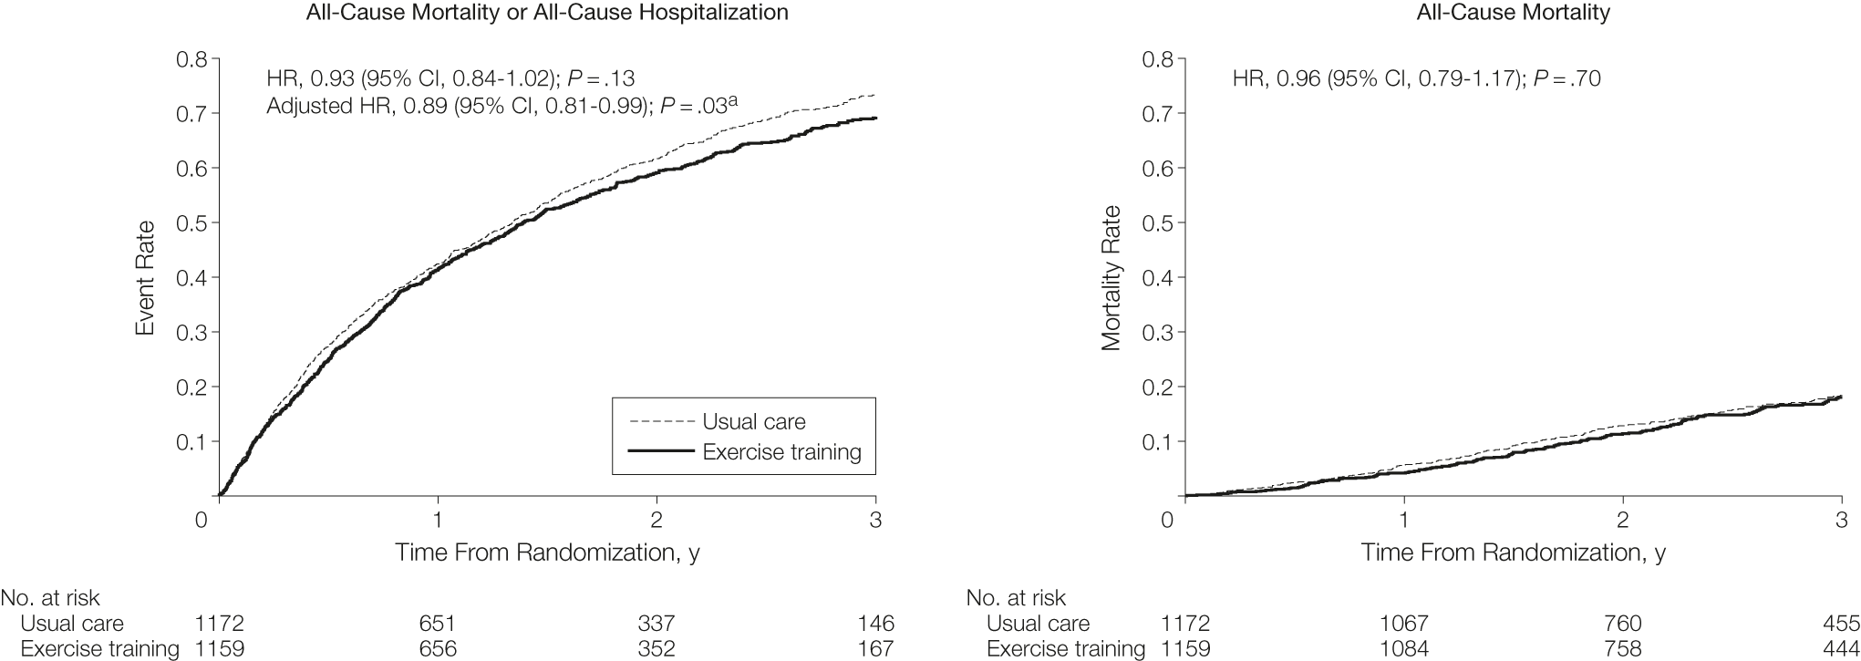
Eligibility criteria HF-action (N=2331):
Inclusion: EF ≤35% and NYHA class II to IV symptoms despite optimal HF therapy for ≥6 weeks
Intervention: group supervised exercise program, with a goal of 3 sessions per week for total of 36 sessions in 3 months
Eligibility criteria REHAB-HF (N=249):
Inclusion: Hospitalization for ADHF, indep in ADLs, able to walk 4m (assistive device OK), > 1 yr life expectancy
Intervention: tailored exercise program, 3 sessions per week X 12 week in facility, home exercise on non-facility days
Primary outcome
Short
Physical
Performance
Battery
Kitzman et al. NEJM 2021
O’Connor et al. JAMA 2009;301:1439-1450.

Slide 23
Key features of a cardiac rehabilitation program for patients with HF
Baseline assessment of functional capacity and physical activity
Individualized risk assessment
Individualized exercise prescription
Monitored exercise (including telemetry)
Education – self-care, risk factor modification
Diet and nutritional counseling
Access to smoking cessation program
Psychosocial assessment
Monitoring progress

Slide 24
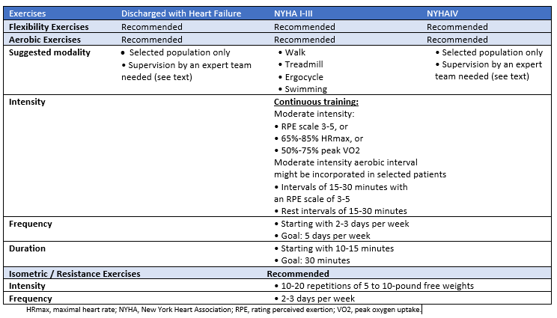
Exercise modalities according to clinical scenario
https://ccs.ca/app/uploads/2021/05/2021-HF-Gui-PG-EN-2.pdf

Slide 25
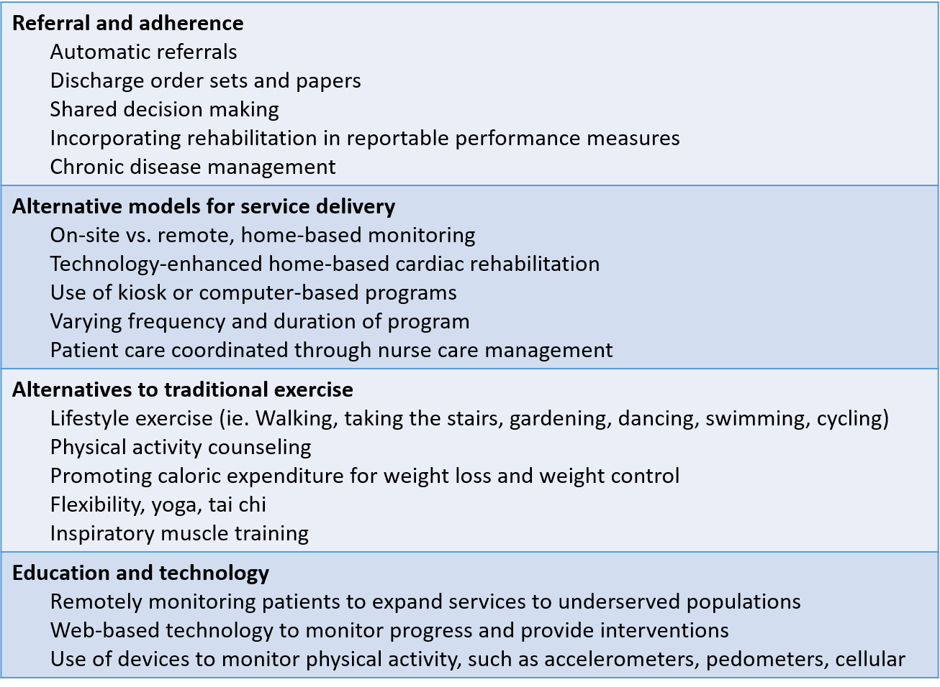
Strategies to enhance referral and adherence of cardiac rehabilitation
Bozkurt et al. J Am Coll Cardiol 2021;77:1454-1469.

Slide 26

Advance care planning
Dr. Shelley Zieroth
MD, FRCPC, FCCS, FHFSA(hon), FESC, FACC, FHFA
Winnipeg, MB
Immediate Past President, Canadian Heart Failure Society
SPC Chair, Canadian Cardiovascular Congress
@DktrV
@ShelleyZieroth

Slide 27
Learning Objectives
Identify the role for advance care planning (ACP) throughout the HF trajectory
Review communication strategies for advance care planning

Slide 28
Advance care planning
Practical Tips
Although the course of HF in individual patients can be unpredictable, high symptom burden and high mortality rates should be anticipated, and advance care planning discussions should be initiated early in the course of illness.
Triggers for discussion:
  After important clinical events such as hospitalization
  When considering invasive therapies
  When requested by the patient/family
Discussions should focus on the values and goals of the individual patient, what they find valuable and important in their lives and what they hope for in the future (e.g. attending an important upcoming family event).
Discussions are dynamic and evolve over time; ongoing and repeated discussions are often necessary.
Visit www.advancecareplanning.ca for tools and resources to help patients and families with advance care planning.
https://ccs.ca/app/uploads/2021/05/2021-HF-Gui-PG-EN-2.pdf

Slide 29
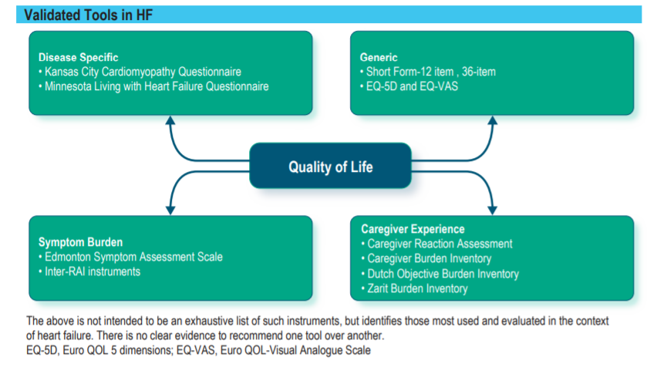
https://ccs.ca/app/uploads/2021/05/2021-HF-Gui-PG-EN-2.pdf

Slide 30
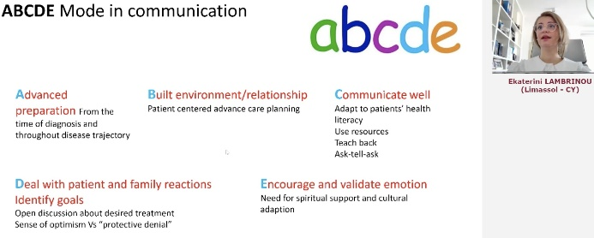
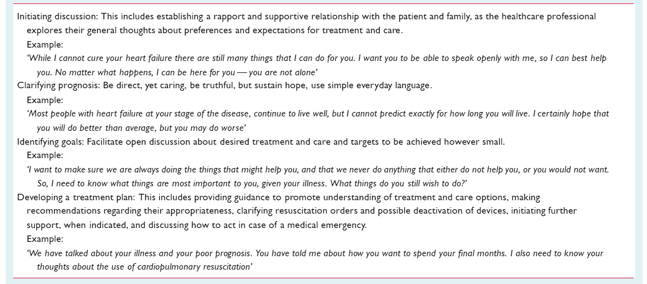
Communication strategies

Slide 31
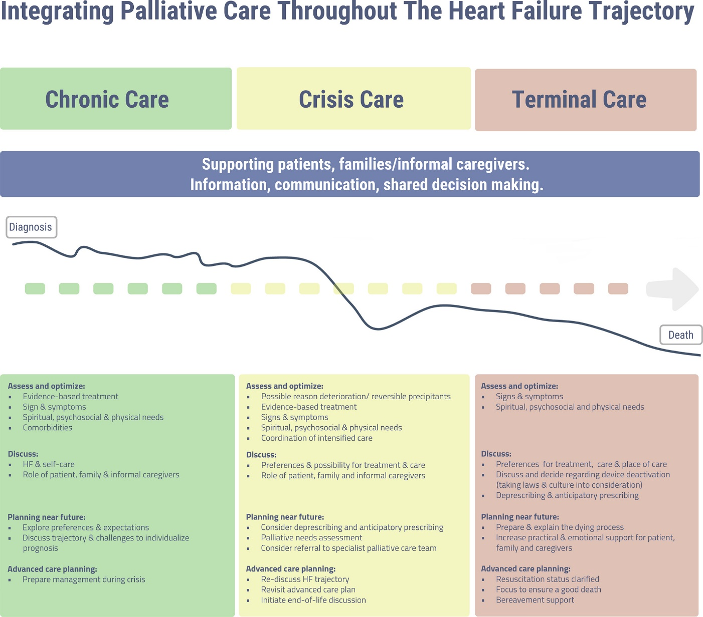
Integrating palliative care throughout the HF trajectory
Hill L et al., European Journal of Heart Failure, Volume: 22, Issue: 12, Pages: 2327-2339, First published: 06 September 2020, DOI: (10.1002/ejhf.1994)

Slide 32
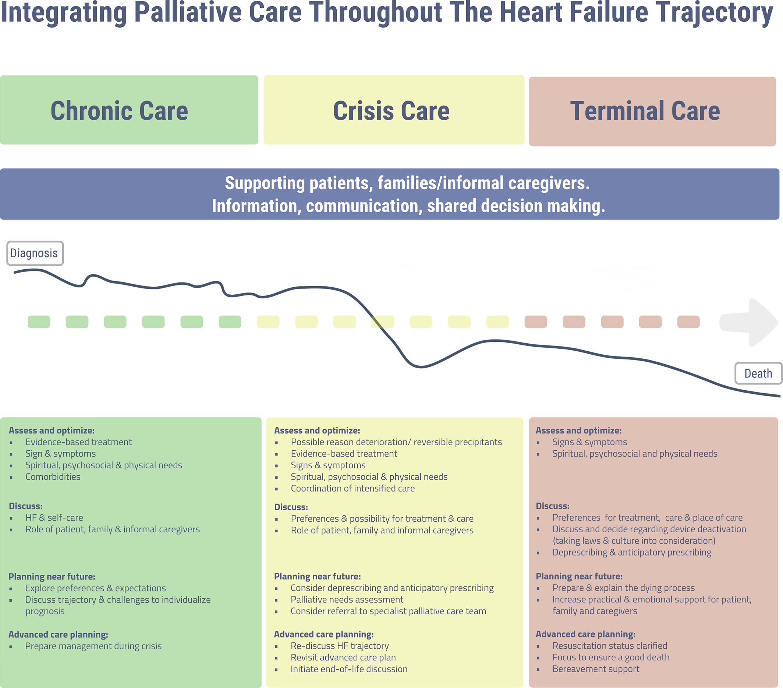
ACP during chronic + crisis HF care

Slide 33
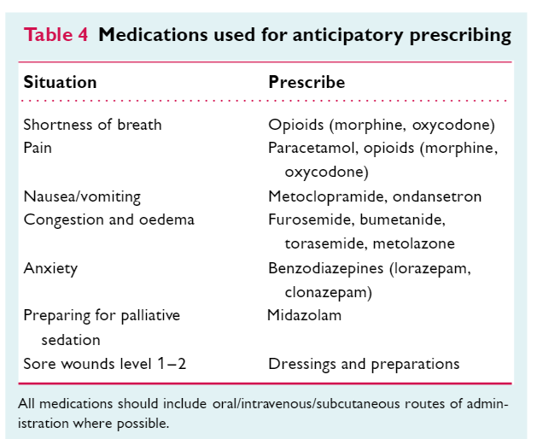
ACP during terminal HF care

Slide 34
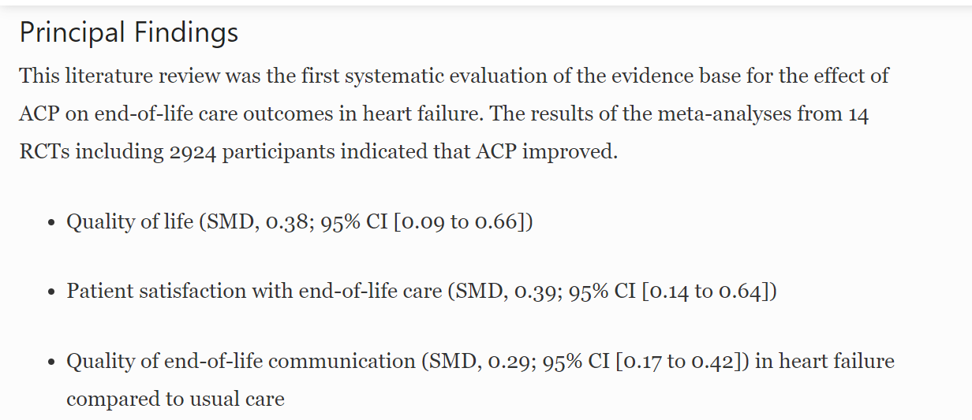
The effect of ACP on HF:
Systematic review and meta-analysis
Schichtel, M., Wee, B., Perera, R. et al. J GEN INTERN MED 35, 874–884 (2020). https://doi.org/10.1007/s11606-019-05482

Slide 35
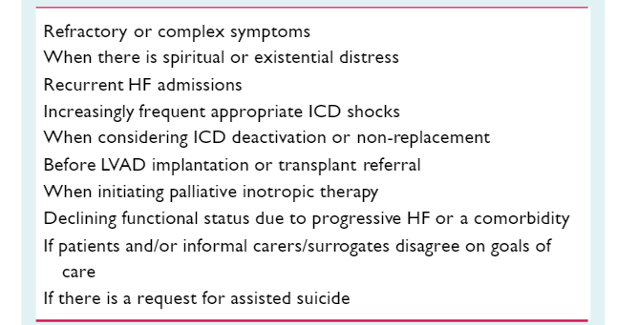
Possible triggers for the involvement of specialist palliative care for those with HF
medical assistance in dying

Slide 36


QUESTIONS?

Slide 37
Case #1
53 year old female
prior MI with late PCI to LAD
Type 2 DM, HbA1c 7.0%
Current smoker – pre-contemplative
Hospitalized for new onset HF 4 months ago
            Patent stent, no new CAD
            Uncertain of how to be active
            Hasn’t returned to work
Medications
Carvedilol 25 mg bid
Spironolactone 25mg/d
Sacubitril-Valsartan 49/51 mg bid
Empagliflozin 25 mg/d
Metformin 500 mg bid
ECASA 81 mg/d
Rosuvastatin 40 mg/d
LVEF 30-35%
NYHA II
Referred for consideration of ICD
Narrow complex QRS
What should we offer next?
Increase sacubitril/valsartan
Refer to cardiac rehabilitation
Advise her to walk daily, quit smoking, eat healthy and meditate….
HR 65 bpm; BP 110/70 mmHg
Euvolemic
Obese

Slide 38
Case #2
83 year old male
Diagnosed with HFrEF 10 years ago
ICD for 1⁰ prevention
Poor appetite, weight loss, fatigue
LVEF 20% (Biventricular)
            Severe functional MR, severe TR
            RVSP 60mmHg
Medications
Sacubitril-valsartan 24/26mg bid
            Did not tolerate higher doses (lightheaded)
Bisoprolol 10 mg/d
Spironolactone 25mg/d
Dapagliflozin 5 mg/d (intolerant of 10mg/d)
Furosemide 20 mg/d
Apixaban 2.5mg bid
Normal coronaries
Atrial fibrillation
Moderate COPD
CKD (eGFR 30-35)
Persistent NYHA III symptoms, recent worsening
What are next steps?
Refer to nephrology
Reduce medications
Review goals of care and advance care planning
HR 60-66 bpm, BP 85/60 mmHg sitting, 80/58 standing
Modest volume overload
Thin

Slide 39
SAVE THE DATE!
For our upcoming Guideline Webinar
Atrial Fibrillation: Webinar 3: Screening and prevention
On Thursday, September 23, 2021 from 8 PM – 9 PM EDT, join Drs. Andrade, Dorian, Healey, Macle, Parkash and Sandhu for the “AF Guidelines: Focus on screening and prevention” webinar. This webinar highlights content from the 2020 CCS/CHRS Comprehensive Atrial Fibrillation Guidelines.
Register at CCS.ca/programs-and-events/
View previously recorded events On-Demand CCS.ca/On-Demand-Guideline-Webinars/

Slide 40
Visit CCS.ca for more Guidelines and Resources
Guideline Library:
https://ccs.ca/guidelines-and-position-statement-library/
Guideline Resources:
https://ccs.ca/guideline-resources/

