Slide 1

When to consider device therapy – Management of complex HF
Guidance from the CCS/CHFS 2021 Heart Failure Guideline Panel
June 17, 2021
The Canadian Cardiovascular Society is grateful to our partner(s) for their commitment to building knowledge and expertise of the heart team. This program was made possible in part by Astra Zeneca, Bayer and Novartis Canada. CCS thanks our partners for their dissemination support so that healthcare providers can benefit from this important information.

Slide 2
© Canadian Cardiovascular Society. 2021. All rights reserved.
Distribution, transmission or republication is strictly prohibited without the prior written permission of the Canadian Cardiovascular Society.
For medical institution internal education or training (i.e. grand rounds, medical college/classroom education, etc.), kindly consider and implement the following:
  Include the citation for the Canadian Journal of Cardiology
  Add ‘Reproduced with permission from the Canadian Cardiovascular Society. [insert year].’
  Avoid use of CCS logos or trademarks on slides, tools or publications that are not the property of the CCS
  Do not modify the slide content and, the layout and CCS branding on the Guideline-related slides
  Guideline recommendations must be reproduced exactly as published
For an industry supported or involved program, permissions are required:
  If content is published in the Canadian Journal of Cardiology, permissions must be sought through our publisher Elsevier (www.onlinecjc.com)
  If content is property of the CCS, contact guidelines@ccs.ca

Slide 3
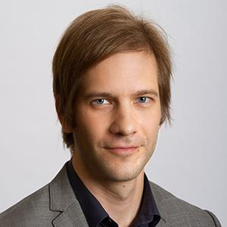
MODERATOR
Dr. Michael McDonald
MD, FRCPC
Toronto, ON
Associate Professor, University of Toronto
Medical Director, Ted Rogers Centre of Excellence in Heart Function
Medical Director, Ajmera Heart Transplant Program, University Health Network
Martha Rogers Chair in Heart Failure Education

Slide 4
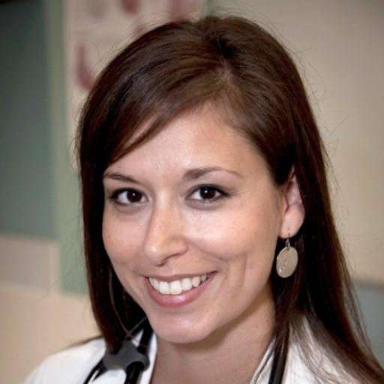
MODERATOR
Dr. Sheri Koshman
PharmD
Edmonton, AB
Associate Professor, Division of Cardiology, Faculty of Medicine and Dentistry, University of Alberta
Advanced Year 2 Pharmacy Residency (Cardiology) Coordinator
Pharmacist, Heart Function Clinic, Mazankowski Alberta Hearth Institute
@iheart_Rx

Slide 5
When to consider device therapy – Management of complex HF
Guidance from the CCS/CHFS 2021 Heart Failure Guideline Panel
June 17, 2021

Slide 6
We extend our respect to all First Nations, Inuit and Métis peoples for their valuable past and present contributions to this land we call Canada.
We acknowledge the Indigenous Peoples of all the lands
that we are each on today, and reaffirm our commitment and responsibility as individuals, to improving
relationships between nations and to collaborating in a spirit of reconciliation.

Slide 7
Welcome to the HF WEBINAR SERIES
Webinar 1
Webinar 2
Webinar 3
Webinar 4
What’s new in 2021: HFrEF
Screening + Diagnosis in HFrEF and HFpEF
Device Therapy
Non-pharmacological Management
Available On-Demand
Faculty:
Justin Ezekowitz
Mike McDonald
Sean Virani
Available On-Demand
Faculty:
Sean Virani
Eileen O’Meara Jonathan Howlett
Today!
Faculty:
Mike McDonald
Sheri Koshman Anique Ducharme Mustafa Toma
July 15 from 8 PM – 9 PM ET
Faculty:
Sean Virani
Elizabeth Swiggum Harriette Van Spall Shelley Zieroth
Register at CCS.ca/programs-and-events/
On-Demand CCS.ca/On-Demand-Guideline-Webinars/

Slide 8
Accreditation and Interactivity
This webinar is an Accredited Group Learning Activity (Section1) as defined by the Maintenance of Certification Program of the Royal College of Physicians and Surgeons of Canada, and approved by the Canadian Cardiovascular Society. You may claim a maximum of 1 hour.
Immediately following the presentations, we will have our Q&A Session. The Q&A period will be an opportunity for audience members to ask our panelists pressing questions and encourage constructive discussion among the faculty.

Slide 9
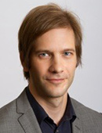
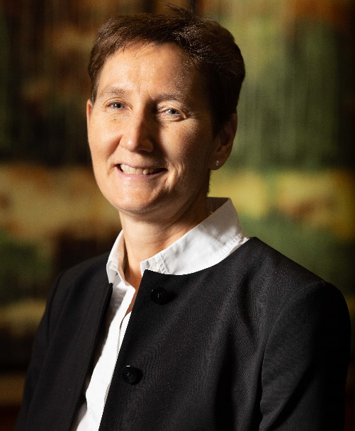
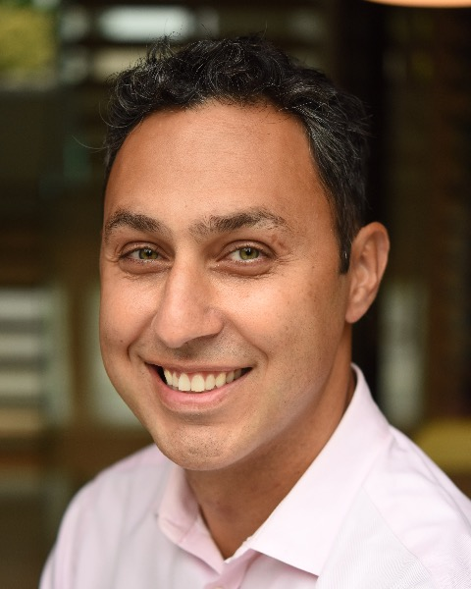
Our Faculty
Dr. Sheri
Koshman
Dr. Mustafa
Toma
Dr. Michael
McDonald
Dr. Anique
ducharme
CO-MODERATORS

Slide 10

Disclosure of potential conflicts of interest
Michael McDonald
Consulting Fees/Honoraria: Abbott, Bayer, Boehringer Ingelheim, Merck, Novartis, Servier
Clinical Trials: Novartis
Sheri Koshman
Consulting Fees/Honoraria: AstraZeneca, Novartis
Clinical Trials: None
Anique Ducharme
Consulting Fees/Honoraria: Abbott, Akcea, Alnylam, AstraZeneca, Boehringer Ingelheim, Novartis, Pfizer, Servier
Clinical Trials: Abbott, Corvia, Eidos, Novartis, Pfizer, Servier
Mustafa Toma
Consulting Fees: AstraZeneca, Bayer, Boehringer Ingelheim, Novartis, Novo Nordisk, Servier
Speakers Bureau/Honoraria: AstraZeneca, Boehringer Ingelheim, Novartis, Servier
Grants/Research Support: AstraZeneca, Novartis, Servier

Slide 11

Overall Learning Objectives
Review the indications for device therapy in heart failure,
Explore the risk of sudden death on contemporary guideline-directed medical therapy for HFrEF, and
Discuss the optimal timing of referral for device therapy in the current era.

Slide 12

Case #1
51 year old female
prior MI with late PCI to LAD
Type 2 DM, HbA1c 6.6%
Hospitalized for new onset HF 4 months ago
            Patent stent, no new CAD
Medications
Bisoprolol 10mg/d
Spironolactone 25mg/d
Sacubitril-Valsartan 49/51 mg bid
Empagliflozin 25 mg/d
Metformin 500 mg bid
LVEF 30-35%
NYHA II
Referred for consideration of ICD
Narrow complex QRS
What should we offer next?
HR 78-82bpm; BP 110/70 mmHg
Euvolemic

Slide 13
What should we offer next?
Primary prevention ICD?
Start ivabradine?
Increase sacubitril-valsartan dose

Slide 14
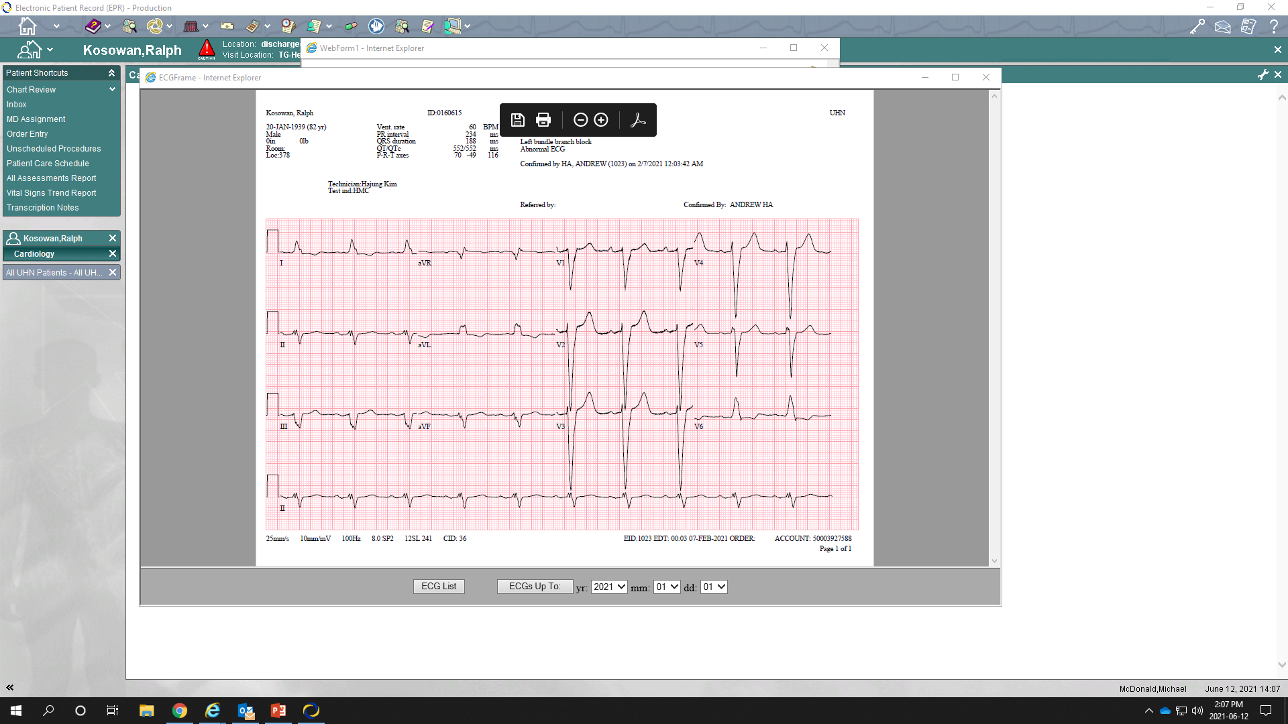
Case #2
83 year old male
Diagnosed with HFrEF 3 months ago as an outpatient
LVEF 30% at diagnosis
            Severe functional MR
            RVSP 60mmHg
Medications
Sacubitril-valsartan 24/26mg bid
            Did not tolerate higher doses (lightheaded)
Carvedilol 12.5 mg bid
Spironolactone 25mg/d
Dapagliflozin 5 mg/d (intolerant of 10mg/d)
Furosemide 20 mg/d
Normal coronaries
Moderate COPD
CKD (baseline creatinine 120)
Previous prostate Ca
Persistent NYHA III symptoms
ECG:
HR 60-66 bpm, BP 95/60 mmHg
Euvolemic
What should we offer next?

Slide 15
What should we offer next?
Digoxin
Mitra-clip
CRT-pacemaker
CRT-defibrillator
Palliative care

Slide 16

Risk of sudden death – controversy surrounding relative benefits of ICD
Dr. Anique Ducharme
MD
Montréal, QC
President, Canadian Heart Failure Society
Director, Heart Failure clinic, Montreal Heart Institute
Professor of medicine, University of Montreal
Chair holder, University of Montreal Fondation Marcelle et Jean Coutu, Cal et Janine Moisan for better practices in advanced heart failure
@AniqueDucharme

Slide 17


Learning Objectives
Evaluate the risk of sudden cardiac death for patients with HFrEF in 2021
Determine if 2% is the new 8%

Slide 18
Striking the balance:
Pragmatism, personalization, and population health
Refer Later
Optimal medical therapy is a moving target
May be able to avoid interventions
Pharmacotherapy is generally under prescribed
Refer Now
Avoid delays in treatment
Avoid under treatment
No good evidence to support a particular ‘care algorithm’

Slide 19
Myth #1
Current HF therapy has not done much to decrease the rate of SCD and therefore we should refer early for ICD

Slide 20
Severity of hearth failure – modes of death
NYHA II
NYHA III
NYHA IV
12%
CHF
CHF
CHF
26%
33%
Other
Other
56%
Other
24%
59%
64%
Sudden
Sudden
Sudden
Death
15%
Death
11%
Death
n = 103
n = 103
n = 27
MERIT-HF Study Group. LANCET 1999;353:2001-07.

Slide 21
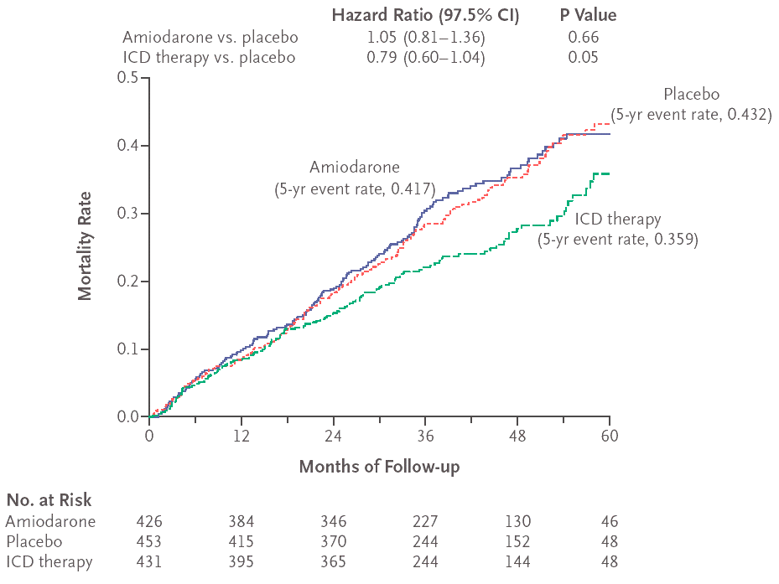
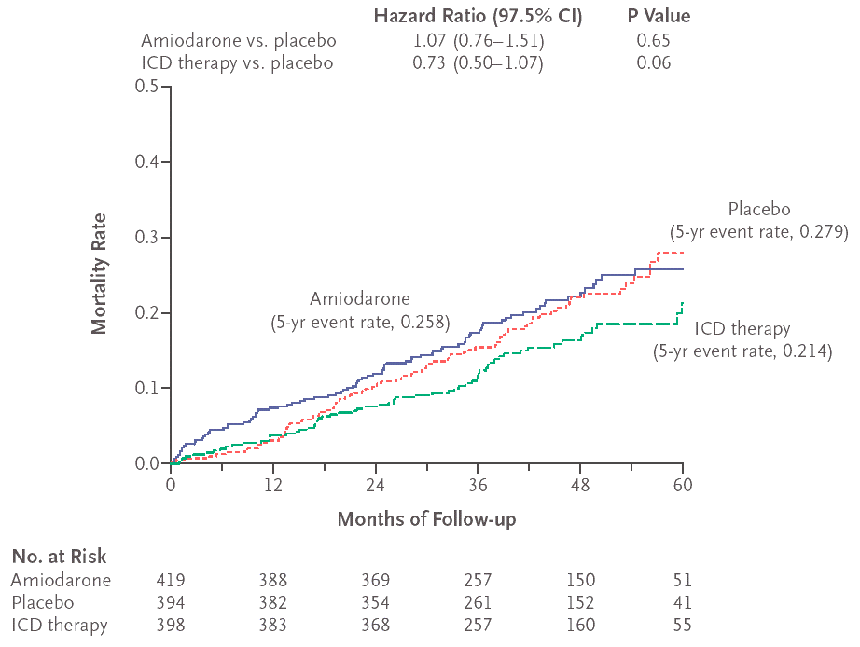
Sudden Cardiac Death-HF Trial (SCD-HeFT)
Sudden Cardiac Death
SCD-HeFT
Heart Failure Trial
Kaplan-Meier Estimates of Death from Any Cause:
NYHA Class II-III and LVEF < 35%
Ischemic CHF
Non-Ischemic CHF
INDICATION: Class 1A Class 1B
Bardy G et al. NEJM 2005; 352:3
Notes:
To determine, by intention-to-treat analysis, if amiodarone or a conservatively programmed shock-only single lead ICD reduces all-cause mortality compared to placebo* in patients with either ischemic or non-ischemic NYHA Class II and III CHF and EF < 35%.
Good background Therapy at the time
ACE or ARB 87%
β-blocker 78%
Multiple randomized controlled trials of primary prevention of sudden cardiac death with the implantable cardioverter defibrillator (ICD) provided robust evidence of incremental mortality benefit over guideline-based medical therapy in patients with ischaemic and non-ischaemic cardiomyopathy with reduced left ventricular ejection fraction (LVEF).1–5 Based on these trials, published between 2002 and 2012, primary prevention ICDs continue to be recommended in current international guidelines.6,7 However, sudden death and total mortality have decreased in heart failure patients with improved medical therapy since these legacy ICD trials.8,9 A recent analysis of drug trials in heart failure patients with impaired LVEF, including >40 000 patients without ICDs enrolled in 12 clinical trials of pharmacological therapy, demonstrated a 44% decline in sudden death across the trials between 1995 and 2014.8 The cumulative incidence of sudden death at 90 days after randomization was 2.4% in the earliest trial and 1.0% in the most recent trial.8 The annual rate of sudden death per 100 patient-years in the treatment limbs decreased from 5.4 to 3.0 in long-term follow-up.8 These trends were attributed to the sequential introduction of angiotensin-converting enzyme inhibitors, beta-blockers, angiotensin receptor blockers, and mineralocorticoid receptor antagonists.8 The decreased risk of sudden death in recent heart failure trials has resulted in reasonable questions regarding continued survival benefit of primary prevention ICDs in this patient population.8 The lack of improved survival among patients with non-ischaemic cardiomyopathy with high rates of guideline-recommended pharmacological treatment and cardiac resynchronization therapy in the DANISH Trial has been represented as supporting lack of benefit.8,9
combining all available randomized controlled trials of patients with non-ischaemic cardiomyopathy including the DANISH trial demonstrates a continued reduction in all-cause mortality.10 Addressing this gap in evidence regarding contemporary benefit of primary prevention ICDs is particularly important given the limited resources of healthcare systems. It is evident that randomizing patients with contemporary drug therapy to primary prevention ICDs would be unethical given the benefit demonstrated in the legacy trials

Slide 22
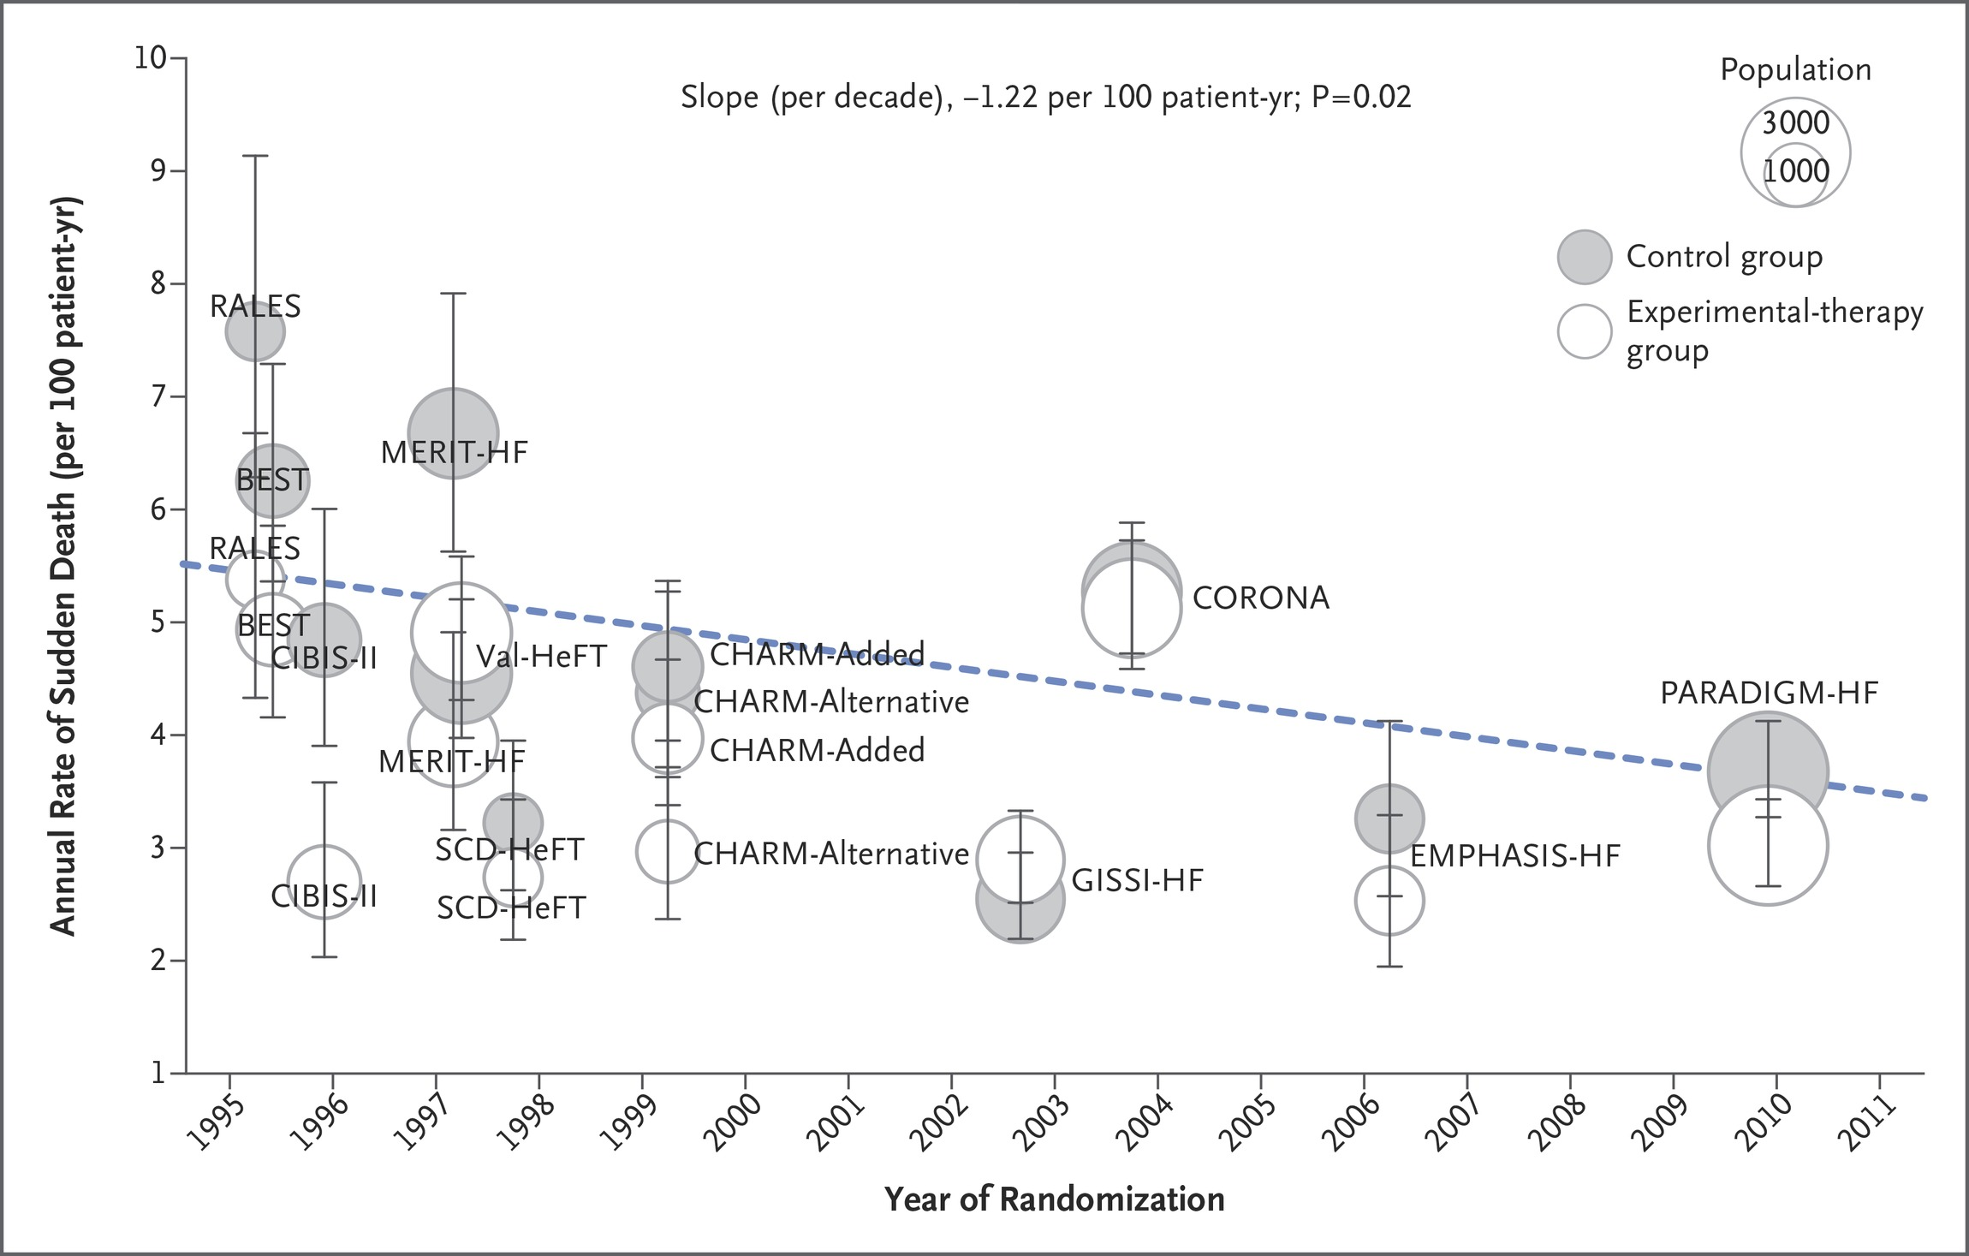
Trends in the rate of sudden death across trial groups over time
40,195 HFrEF patients
12 clinical trials– 1995-2014
Sudden-death rates declined substantially over time,
consistent with a cumulative effect of evidence-based medical therapy on this cause of death.
Implication: Need to consider the relative benefit Of ICD in the current era
Shen L et al. N Engl J Med ;377:41-51

Slide 23
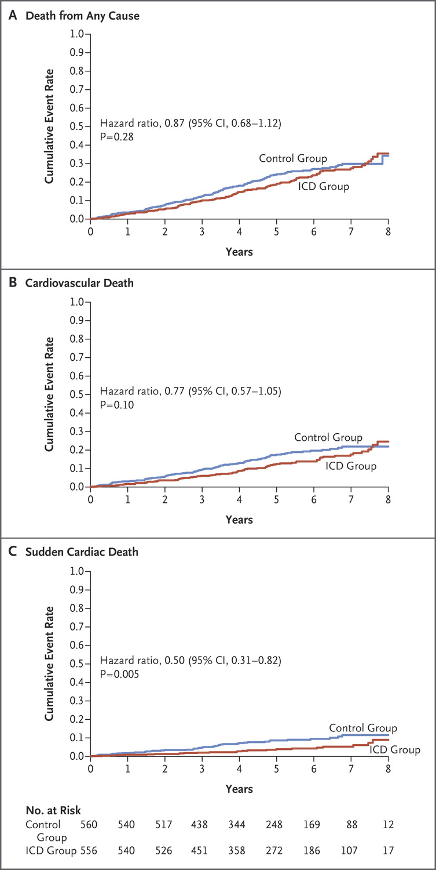
DANISH Study: Time-to-event curves for death from any cause, cardiovascular death, and sudden cardiac death
Køber L et al. N Engl J Med 2016. DOI: 10.1056/NEJMoa1608029

Slide 24
Myth #2
There is very little added benefits of the four pillars for improving LVEF beyond Beta-blockers and ACEi

Slide 25
CCS guideline recommendation rationale: repeat ECHO after titration of medical therapy
~25% of patients with initial LVEF <40% (HFrEF) may increase to >40% over 1 year f/u
60
55
50
HFpEF
45
Estimated EF (%)
40
HFrEF
35
30
25
1
2
3
4
5
Time After HF Diagnosis (years)
Dunlay et al. Circ Heart Fail. 2012

Slide 26
Myth #3
The timing of ICD implant is not very important as patients are optimized on GDMT after anyway…

Slide 27
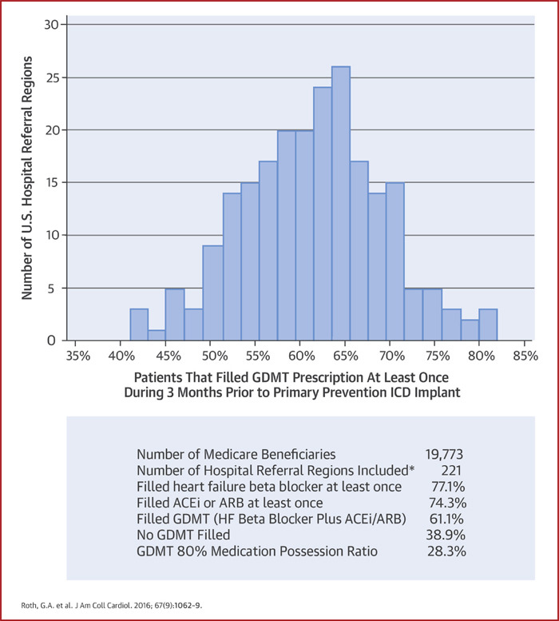
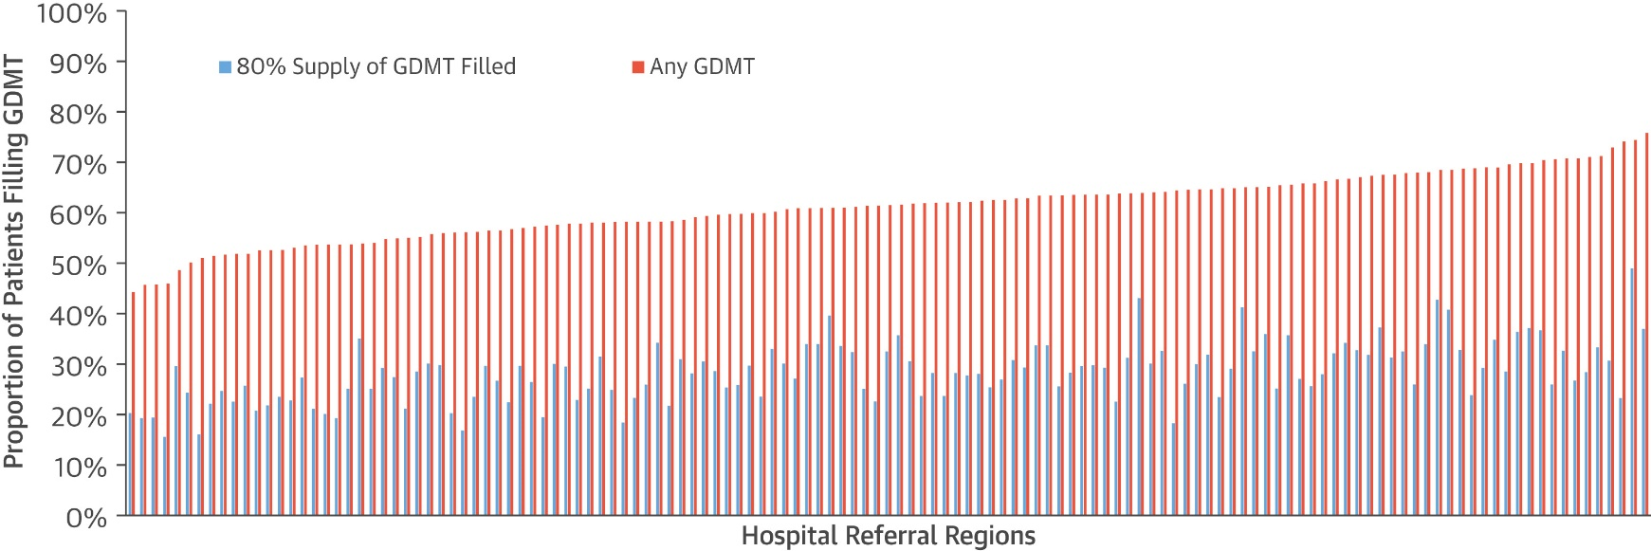
Myth #3 – Patients are optimized after ICD implant

Slide 28
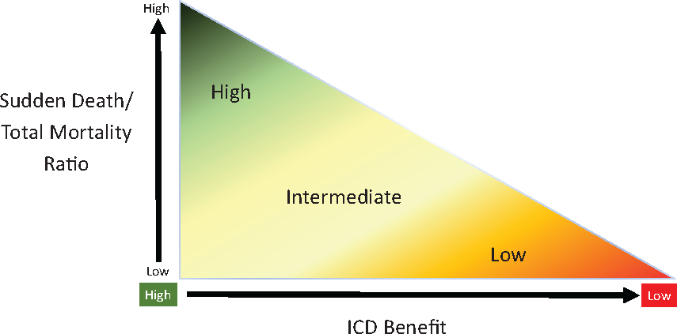
Paradigm for potential benefit of primary prevention ICD based on the ratio of sudden death to total mortality
Who benefits from a defibrillator?
  risk of sudden death and
  competing risk of other, non-sudden causes of death.
The balance of these risks is changing.
Calling into question whether historic evidence for the use of defibrillators remains robust in the modern era.
Eur Heart J, Volume 41, Issue 36, 21 September 2020, Pages 3448–3450, https://doi.org/10.1093/eurheartj/ehaa324
The content of this slide may be subject to copyright: please see the slide notes for details.

Slide 29
Back to Mike’s cases…
ICD for ALL?

Slide 30
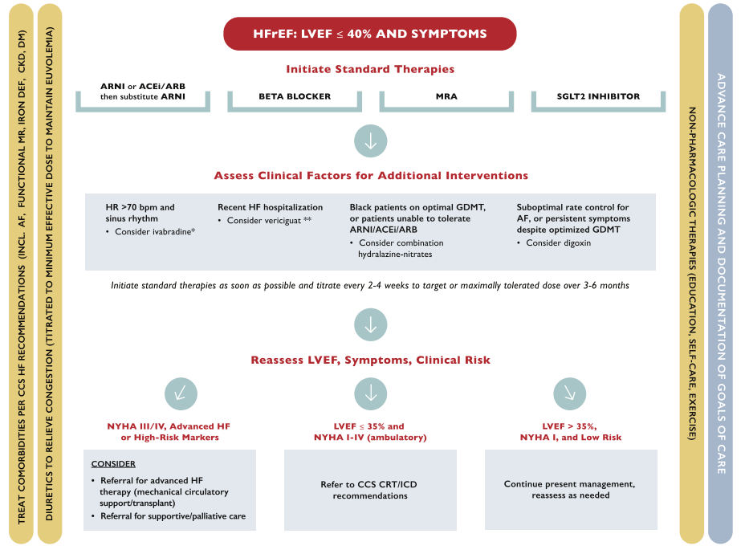
CRT-D should be POST OPTIMIZATION

Slide 31
Referral for ICD / CRT
Dr. Mustafa Toma
MD, FRCPC
Vancouver, BC
Associate Clinical Professor, University of British Columbia
Education Director, UBC Division of Cardiology
Medical Director, Heart Transplant and MCS
Program Director, Advanced Heart Failure/Transplant Training Division of Cardiology, St. Paul's Hospital
@mustoma

Slide 32
Learning Objectives
Review evidence for reverse modelling with the new HF therapies
Discuss the timing of device implantation using the new HF treatment algorithm

Slide 33
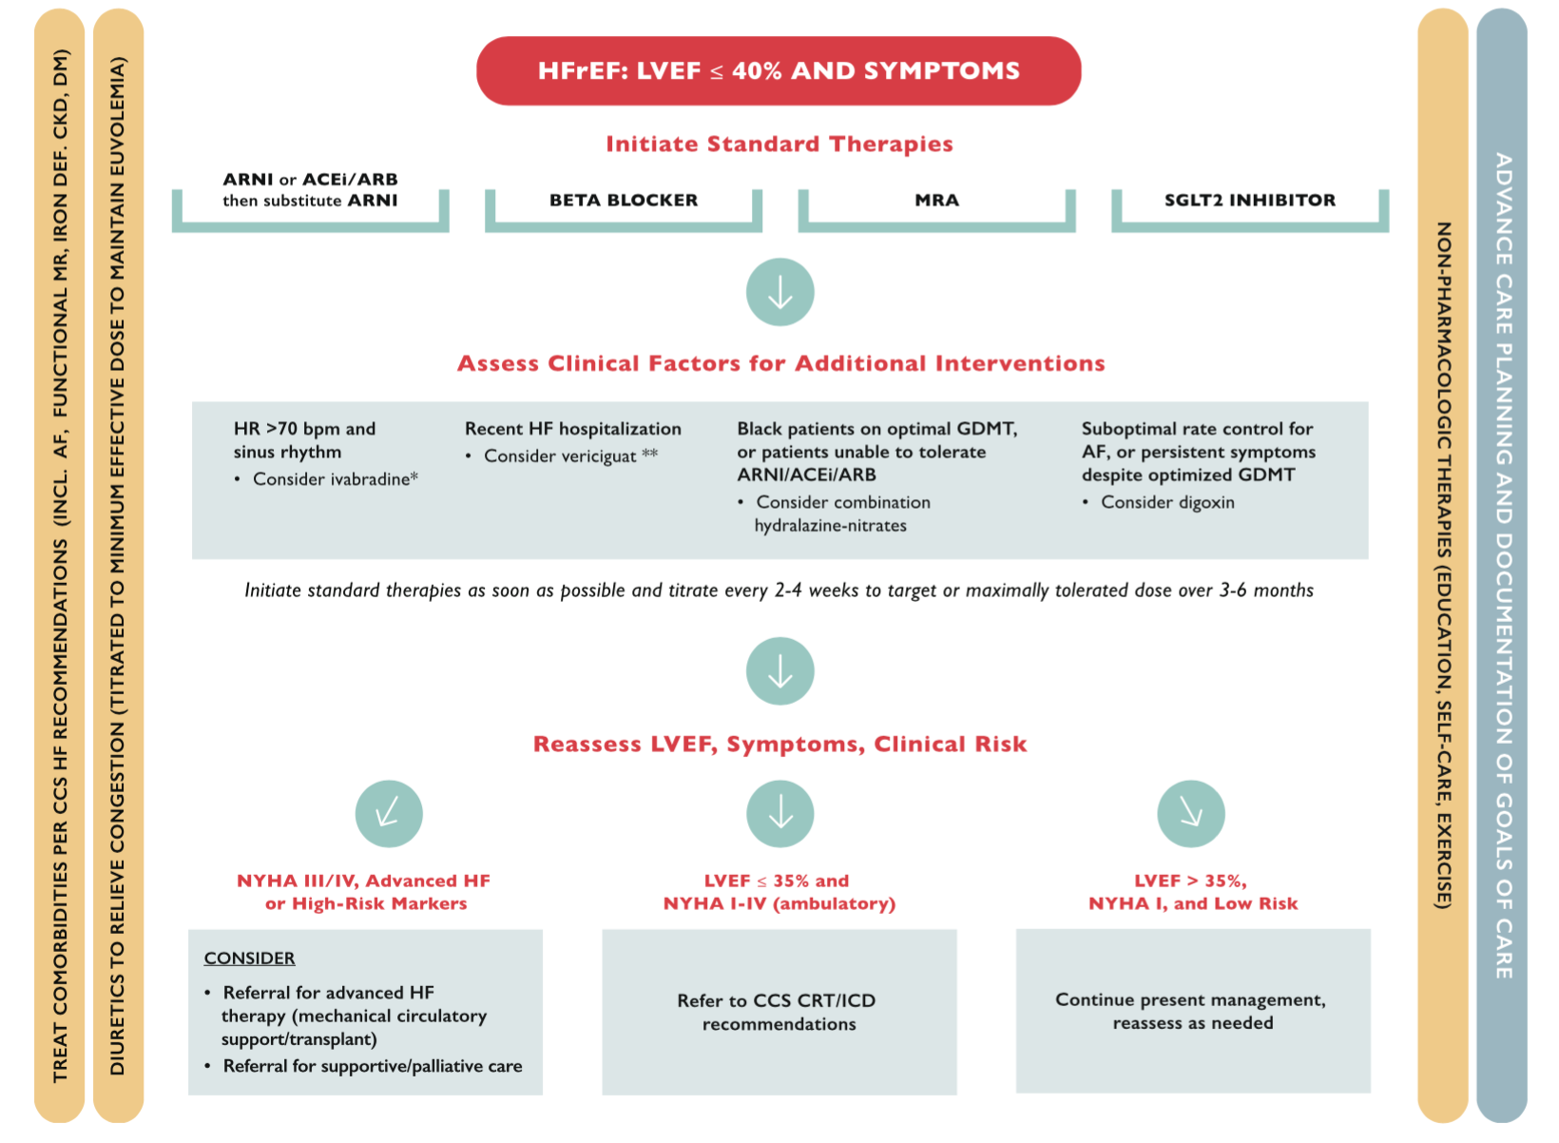
Guideline approach to treatment goals in HFrEF

Slide 34

Timing of referral for device therapy has to strike a balance:
Risk of sudden cardiac death
‘Need time for uptitration of medical therapy’
Risk of device-related complication
Potential intolerance to medical therapy
Patient preference
Patient profile/ ‘personalization’
etc

Slide 35
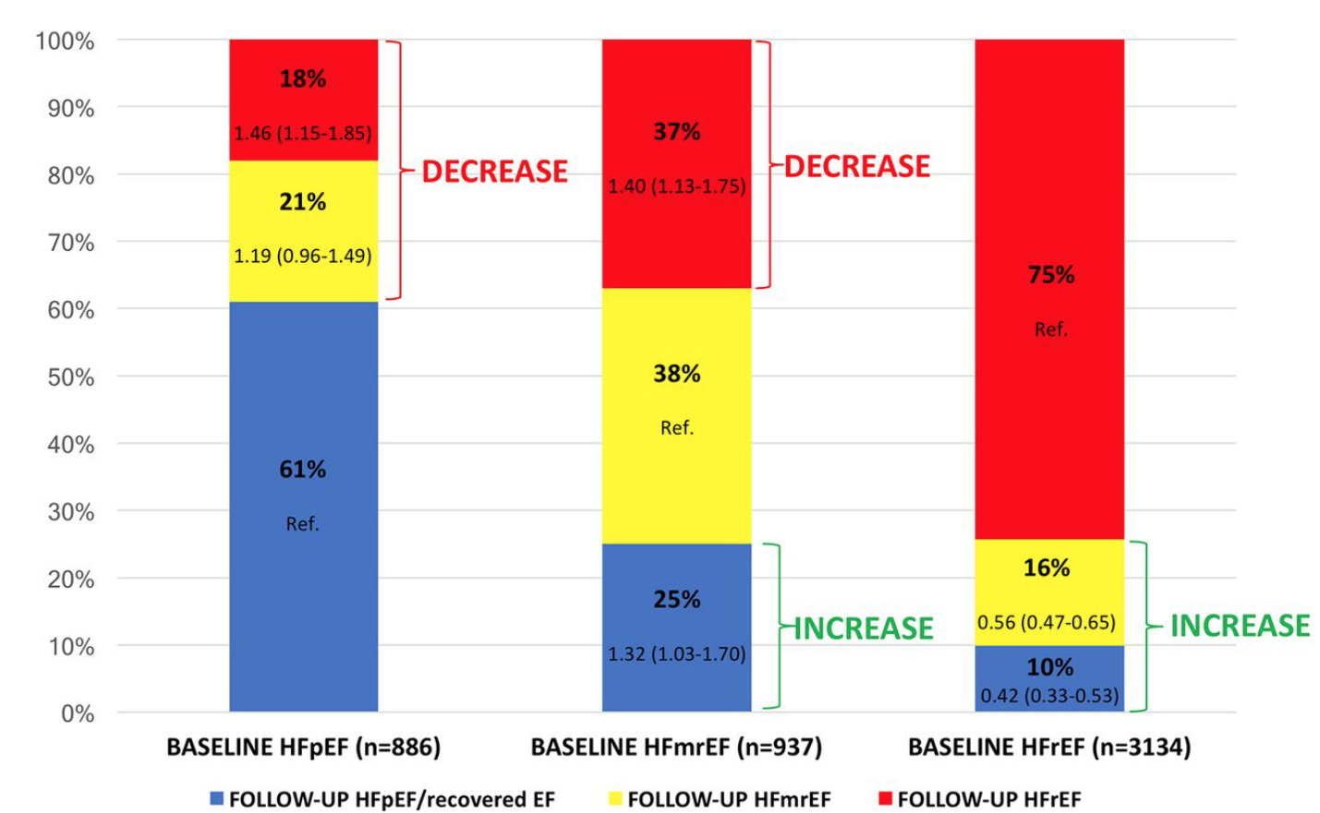
LVEF Trends Following Initial Diagnosis of HF
The majority of device trials were done prior to the era of novel HF therapies
A substantial proportion of HFrEF patients will have an increase in their EF
Novel therapies likely play a role in improving LVEF

Slide 36
PROVE-HF: ARNI
LVEDVi
LVEF
∆ -13.8, P<0.001
∆ +8.8, P<0.001
∆ -6.6, P<0.001
∆ +4.9, P<0.001
Januzzi JL, et al. JAMA 2019; DOI: 10.1001/jama.2019.1282 Januzzi JL, et al. Late Breaker ESC 2019. Paris, France August 31-September 4, 2019
Notes:
794 patients

Slide 37
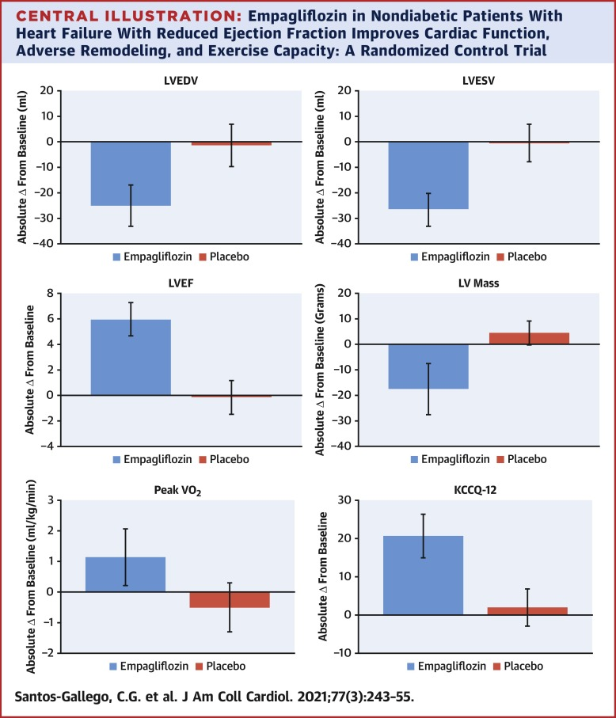
Change in LVEF with Empa in non-diabetics with HFrEF
Notes:
84 patients – empa 10 vs placebo x 6 months
CMR assessment of LV
Randomized study of EMPA: 84 patients with HfREF and NO DM: improvements in LV ejection fraction (6.0 ± 4.2 vs. −0.1 ± 3.9; p < 0.001).

Slide 38
SHiFT: Echo sub-study
LVESVI
∆ -5.8, P=0.0002
∆ + 2.7, P<0.001
75
LVEF
70
40
D 2.4 ± 7.7
D - 7.0 ± 16.3
D - 0.9 ± 17.1
D - 0.1 ± 8.0
65
35
mL/m²
30
65.2
± 29.1
60
%
25
31.6 ±9.3
31.5±10.0
65.2±29.1
58.2±28.3
63.6 ±30.1
62.8 ±28.7
20
32.3±9.1
34.7±10.2
55
15
50
10
5
0
8 months
0
Baseline
8 months
Baseline
8 months
Baseline
Baseline
8 months
Ivabradine (n=204)
Placebo (n=199)
Ivabradine (n=208)
Placebo (n=203)
Tardif JC, O'Meara E, Komajda M, et al. Eur Heart J. 2011;32(20):2507-15
Notes:
LVESVI improves to 58 with ivabradine…and looking at those with LVESVI <59

Slide 39
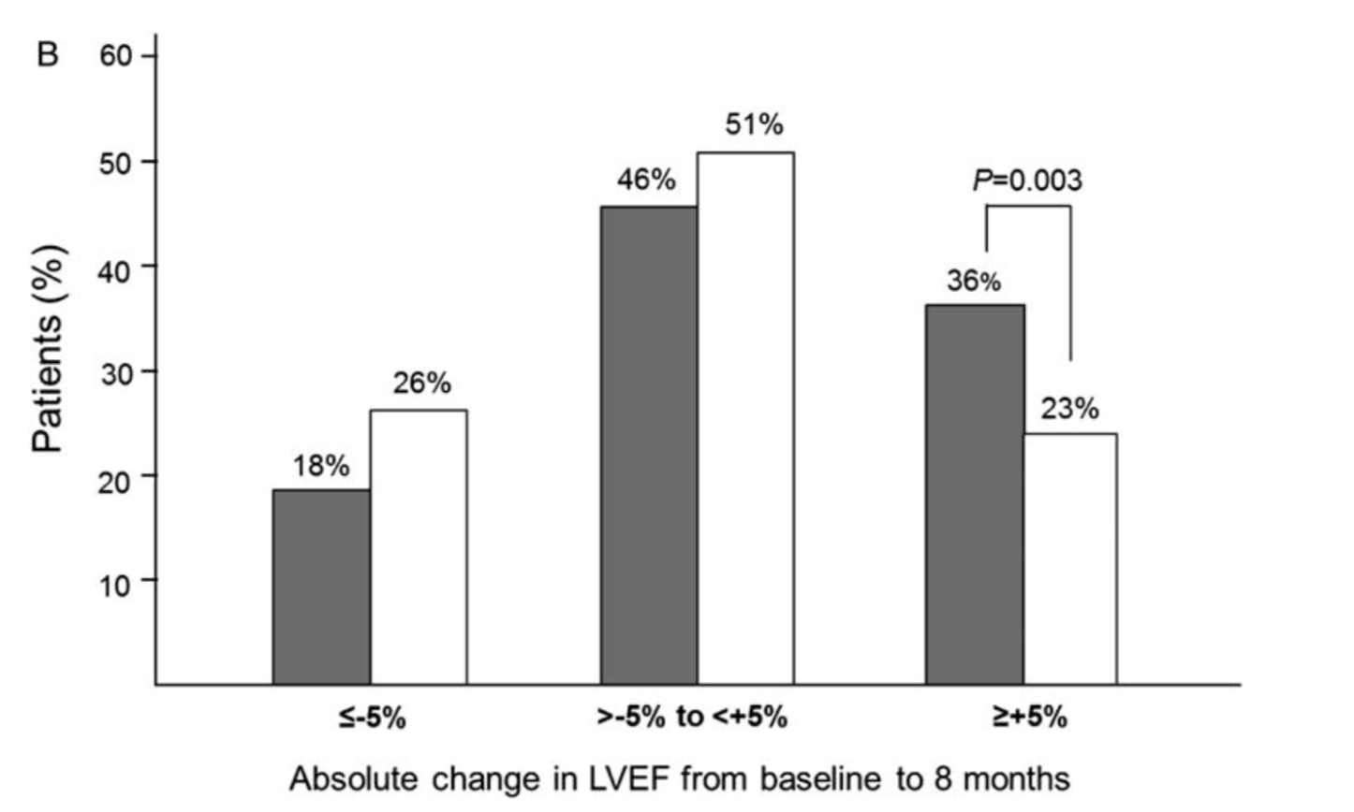
Additional medical therapy and improvements in LVEF
ivabradine
placebo
Echo sub-study of 411 patients in the SHIFT Trial;
Baseline vs 8 month follow up
Tardif et al, Eur Heart J 2011

Slide 40
Missed opportunity to optimize medical therapy = Missed opportunity to improve LVEF
% of Patients on Target Dose at Baseline and 1 Year in CHAMP Registry
30
Baseline
12 months
27
25.4
25
21.6
20.3
20
15
11.1
10
9.8
5
3.4
1.7
0
ACE/ARB
BB
MRA
ARNI
ACE/ARB
BB
MRA
ARNI
target dose among eligible patients (%)
target dose among eligible patients (%)
Bozkurt B. J Am Coll Cardiol 2019.
Notes:
There are clearly opportunities for optimization of GDMT, but in many cases the barriers are not related to therapeutic inertia and there are true physiological limitations to up-titration.
2588 out of 3518 outpatients in USA from primary care and cardiologists offices. In multivariate analysis, across the classes of medications, multiple patient characteristics were associated with a higher likelihood of initiation or dose increase (e.g., previous HF hospitalization, higher blood pressure, lower ejection fraction) and discontinuation or dose decrease (e.g., previous HF hospitalization, impaired quality of life, more severe functional class)

Slide 41
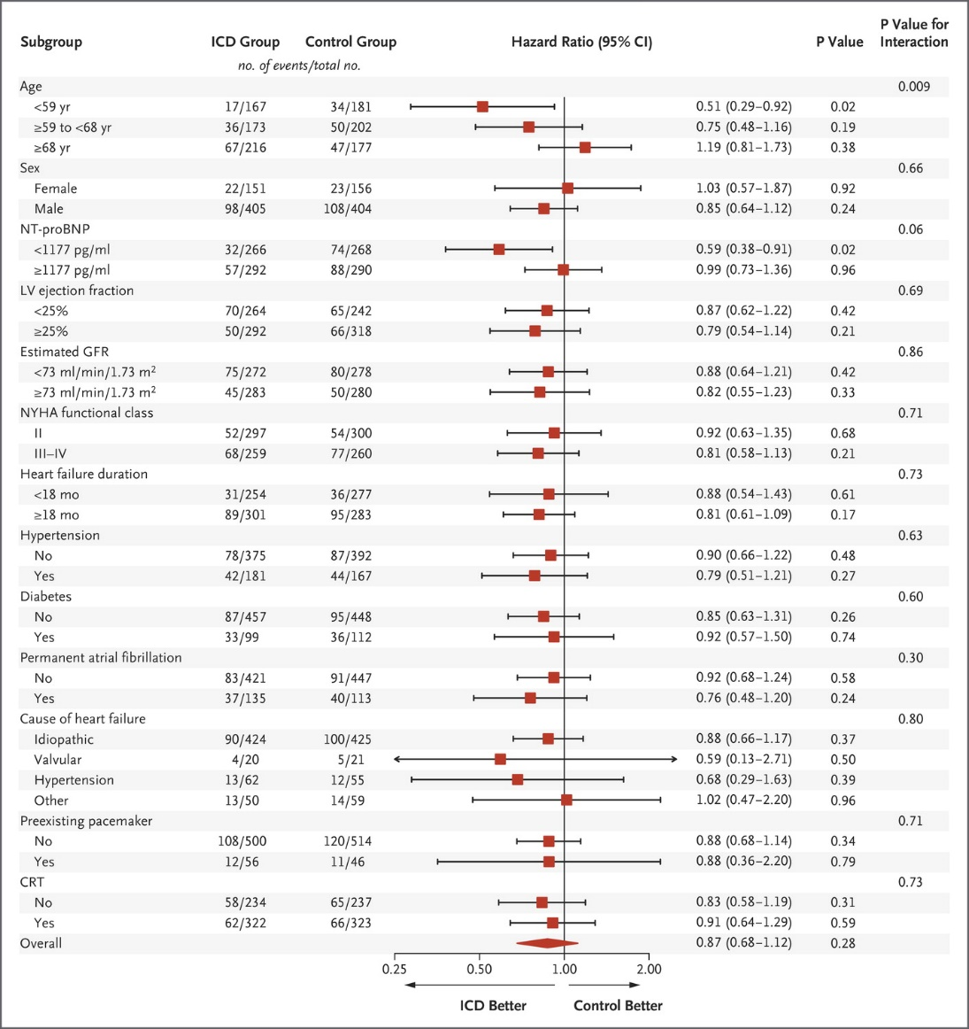
Need for personalization of care
Patient factors:
  Ischemic/non-ischemic
  Age
  Patient preference
Imaging factors
  LVEF modality
  Scar burden
Systems of care
  Ability to uptitrate in reasonable time
  Drug coverage/cost
Køber L et al. N Engl J Med 2016. DOI: 10.1056/NEJMoa1608029
Notes:
Figure 3. Rate of Death from Any Cause (Primary Outcome) in Prespecified Subgroups. GFR denotes glomerular filtration rate, LV left ventricular, NT-proBNP N-terminal pro–brain natriuretic peptide, and NYHA New York Heart Association.

Slide 42
Recommendation
We recommend that after a diagnosis of HFrEF, standard medical therapy should be initiated and titrated to target or maximally tolerated doses with a repeat assessment of LVEF prior to referral for ICD or CRT.
Strong Recommendation; Moderate-Quality Evidence
Practical tips:
  Reassessment of ejection fraction should be performed 3 months after the achievement of target or maximally tolerated doses of GDMT.
  An assessment of arrhythmic and non-arrhythmic SCD risk should be performed to estimate the risk/benefit of an ICD/CRT.
  Specific HF therapies may contribute to improvements in LVEF and should be considered prior to referral for ICD or CRT:
    For eligible patients, switching to ARNI therapy should be considered prior to referral for ICD or CRT.
    Adding ivabradine, where otherwise indicated after beta-blocker optimization, should be considered prior to referral for ICD or CRT.
  Referral for ICD or CRT should not be unduly delayed if timely titration of pharmacologic therapies is infeasible or impractical.
McDonald, Virani, et al, Can J Cardiol 2021

Slide 43
After titration of guideline directed medical therapy

Slide 44


QUESTIONS?

Slide 45
Case #1
51 year old female
prior MI with late PCI to LAD
Type 2 DM, HbA1c 6.6%
Hospitalized for new onset HF 4 months ago
            Patent stent, no new CAD
Medications
Bisoprolol 10mg/d
Spironolactone 25mg/d
Sacubitril-Valsartan 49/51 mg bid
Empagliflozin 25 mg/d
Metformin 500 mg bid
LVEF 30-35%
NYHA II
Referred for consideration of ICD
Narrow complex QRS
What should we offer next?
Primary prevention ICD?
Start ivabradine?
Increase sacubitril-valsartan dose?
HR 78-82bpm; BP 110/70 mmHg
Euvolemic

Slide 46
Case #2
83 year old male
Diagnosed with HFrEF 3 months ago as an outpatient
LVEF 30% at diagnosis
            Severe functional MR
            RVSP 60mmHg
ECG:
Normal coronaries
Moderate COPD
CKD (baseline creatinine 120)
Previous prostate Ca
Persistent NYHA III symptoms
HR 60-66 bpm, BP 95/60 mmHg
Euvolemic
What should we offer next?
Digoxin
Mitra-clip
CRT-pacemaker
CRT-defibrillator
Palliative care
Medications
Sacubitril-valsartan 24/26mg bid
            Did not tolerate higher doses (lightheaded)
Carvedilol 12.5 mg bid
Spironolactone 25mg/d
Dapagliflozin 5 mg/d (intolerant of 10mg/d)
Furosemide 20 mg/d

Slide 47
SAVE THE DATE!
For our upcoming Guideline Webinars
Atrial Fibrillation: Webinar 2: When it comes to arrhythmia management…
On Thursday, July 8, 2021 from 8 PM – 9 PM EDT, join Drs. Bennett, Andrade, Aguilar, Atzema, Pilote, and Verma for the “AF Guidelines: When it comes to arrhythmia management…” webinar. This webinar highlights content from the 2020 CCS/CHRS Comprehensive Atrial Fibrillation Guidelines.
Heart Failure: Webinar 4: Non-pharmacological management of HF
On Thursday, July 15, 2021 from 8 PM – 9 PM EDT, join Dr. Swiggum, Dr. Van Spall, Dr. Virani and Dr. Zieroth for the fourth webinar in the HF webinar series focused on non-pharmacological management, including nutrition, cardiac rehabilitation and advance care planning.
Register at CCS.ca/programs-and-events/

Slide 48
Visit CCS.ca for more Guidelines and Resources
Guideline Library:
https://ccs.ca/guidelines-and-position-statement-library/
Guideline Resources:
https://ccs.ca/guideline-resources/

