Slide 1

Screening + Diagnosis in HFrEF and HFpEF: Recognizing and managing risk factors
Guidance from the CCS/CHFS 2021 Heart Failure Guideline Panel
May 19, 2021
The Canadian Cardiovascular Society is grateful to our partner(s) for their commitment to building knowledge and expertise of the heart team. This program was made possible in part by Astra Zeneca, Bayer and Novartis Canada. CCS thanks our partners for their dissemination support so that healthcare providers can benefit from this important information.

Slide 2
© Canadian Cardiovascular Society. 2021. All rights reserved.
Distribution, transmission or republication is strictly prohibited without the prior written permission of the Canadian Cardiovascular Society.
For medical institution internal education or training (i.e. grand rounds, medical college/classroom education, etc.), kindly consider and implement the following:
  Include the citation for the Canadian Journal of Cardiology
  Add ‘Reproduced with permission from the Canadian Cardiovascular Society. [insert year].’
  Avoid use of CCS logos or trademarks on slides, tools or publications that are not the property of the CCS
  Do not modify the slide content and, the layout and CCS branding on the Guideline-related slides
  Guideline recommendations must be reproduced exactly as published
For an industry supported or involved program, permissions are required:
  If content is published in the Canadian Journal of Cardiology, permissions must be sought through our publisher Elsevier (www.onlinecjc.com)
  If content is property of the CCS, contact guidelines@ccs.ca

Slide 3

MODERATOR
Dr. Sean A. Virani
MD, MSc, MPH, FRCPC, FCCS
Vancouver, BC
Head, Division of Cardiology, Providence Health Care
Physician Program Director, The HEART Centre, St. Paul’s Hospital
Provincial Medical Director, Cardiac Services BC
Associate Professor, Department of Medicine, University of British Columbia
Past President, Canadian Heart Failure Society
Medical Director, HeartLife Foundation
@DktrV

Slide 4
Screening + Diagnosis in HFrEF and HFpEF: Recognizing and managing risk factors
Guidance from the CCS/CHFS 2021 Heart Failure Guideline Panel
May 19, 2021

Slide 5
Welcome to the HF WEBINAR SERIES
Webinar 1
Webinar 2
Webinar 3
Webinar 4
What’s new in 2021: HFrEF
Screening + Diagnosis in HFrEF and HFpEF
Device Therapy
Non-pharmacological Management
Available On-Demand
Faculty:
Justin Ezekowitz
Mike McDonald
Sean Virani
Today!
Faculty:
Sean Virani
Eileen O’Meara Jonathan Howlett
June 17 from 8 PM – 9 PM ET
Faculty:
Mike McDonald
Sheri Koshman Anique Ducharme Mustafa Toma
July 15 from 8 PM – 9 PM ET
Faculty:
Sean Virani
Elizabeth Swiggum Harriette Van Spall Shelley Zieroth
Register at CCS.ca/programs-and-events/
On-Demand CCS.ca/On-Demand-Guideline-Webinars/

Slide 6



Our Faculty
Dr. Eileen
O’Meara
Dr. Sean
Virani
Dr. Jonathan
Howlett
MODERATOR

Slide 7

Disclosure of potential conflicts of interest
Jonathan Howlett
Consulting Fees/Honoraria: AstraZeneca, Bayer, Boehringer Ingelheim, General Electric, Government of Canada & Alberta, Merck, Novartis, Novo Nordisk, Pfizer, Servier, St. Jude Grants/Research Support: AstraZeneca, Bayer, Medtronic, Merck, Novartis, Pfizer, Servier
Medical Advisory Board: Cardiol
Sean Virani
Consulting Fees/Honoraria: Abbott, Amgen, AstraZeneca, Bayer, Boehringer Ingelheim, BMS/Pfizer Alliance, Medtronic, Merck, Novartis, Pfizer, Servier
Clinical Trials: Abbott, AstraZeneca, Boehringer Ingelheim, Medtronic, Novartis, Pfizer
Eileen O’Meara
Consulting Fees/Honoraria: Amgen, AstraZeneca, Bayer, Boehringer Ingelheim, Merck, Novartis, Servier
Clinical Trials: Amgen, Abbott, American Regent, AstraZeneca, Bayer, Boehringer Ingelheim, Cytokinetics, Eidos, Novartis, Merck, Pfizer, Sanofi

Slide 8

Overall Learning Objectives
Identify populations at risk of HF and key questions to consider during screening,
Review when and how to use imaging and biomarkers when heart failure is suspected, and
Discuss a practical approach to the diagnosis of heart failure when LVEF is over 40%.

Slide 9

Case: Mrs. Disnea
72 year old female
CKD 2° to T2DM and HTN
Baseline NYHA I-II
Slowly progressive SOB over last 6 months
Precipitous decline in last 2 weeks
Investigations
eGFR 40 ml/min/m²
A1c 7.6 and ACR 10mg/mmol
ECG: AF with HR 95 bpm and LVH
Echo: mild AS, ↑ LA volume, LVH and LVEF 60%
MPI: no ischemia, normal LVEF
No other cardiac symptoms
GP initiates work-up for ischemia (?angina)
BP consistently above 145mmHg
  Amlodipine initiated and then stopped due to edema
Physical exam otherwise remarkable for new irregularly irregular HR at 90 bpm and murmur of AS
Edema progresses despite stopping amlodipine
Progressive functional decline with dyspnea at rest
Presents to the ER
  CXR shows pulmonary edema
  ECG shows AF with rapid ventricular response
  eGFR now 30 ml/min/m²
Diagnosed with heart failure and new AF
  Admitted to hospital and initiated on iv diuretics
Medications
Metformin 1000 mg bid
Valsartan 160 mg bid
Rosuvastatin 10 mg od
Could this have been avoided?

Slide 10

Looking for heart failure…
Dr. Eileen O’Meara
MD
Montréal, QC
Professor, Université de Montréal, Institut de Cardiologie de Montréal

Slide 11

Learning Objectives
Identify populations at risk of HF and discuss the use of risk scores
Review key questions to screen for heart failure
Understand how to use imaging and biomarkers when heart failure is suspected

Slide 12
Clinical phenotypes and comorbid conditions in HFpEF
Hypertension is a major risk factor for HFpEF¹
% of patients with HFpEF and additional comorbidity
Pulm HTN
50%
Atrial Fibrillation
29-51%
CKD
30-60%
Aging
Hypertension
60-89%
Obesity
Anemia
30-60%
Obstructive
sleep apnea
40-62%
COPD
30%
CAD
35-53%
Frailty
20-74%
Diabetes
45%
Yancy CW et al. Circulation. 2013;128:e240-e327. 2. Samson R. et al. J Am Heart Assoc. 2016;5(1):e002477. doi:10.1161/JAHA.115.002477.
3. Guazzi M. Circ Heart Fail. 2014;7:367-377.

Slide 13

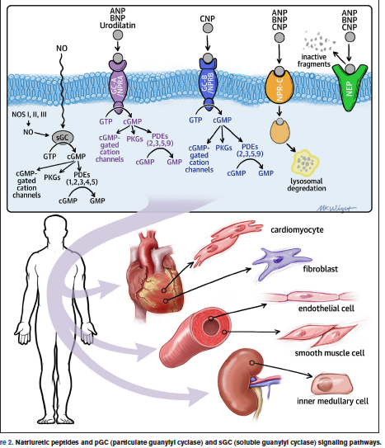
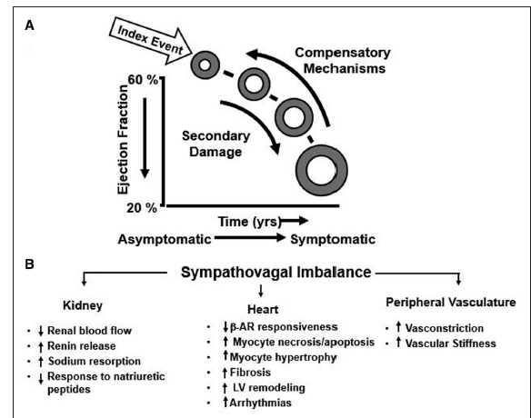
Mechanisms and models in HF
HFrEF 2021
Circulation Research. 2021; 128: 1435-1450. DOI: 10.1161/CIRCRESAHA.121.31858

Slide 14
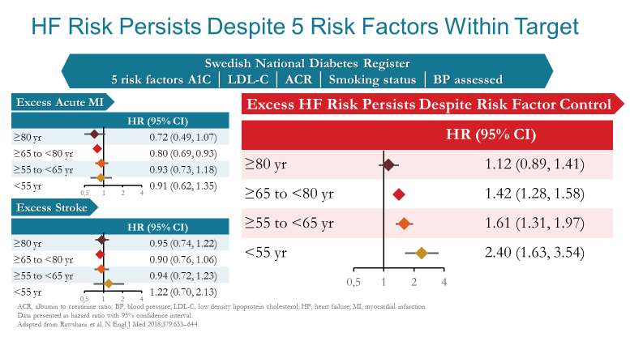
HF risk persists after control of risk factors in T2DM
Rawshani A, et al. N Engl J Med. 2018 Aug 16;379(7):633-644

Slide 15
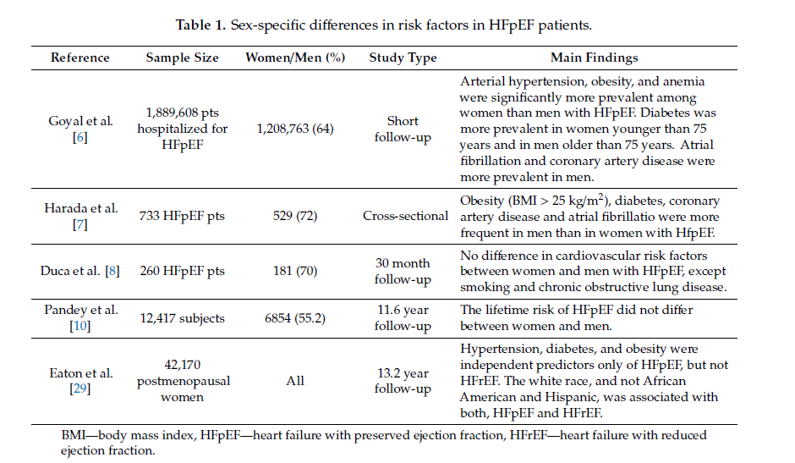
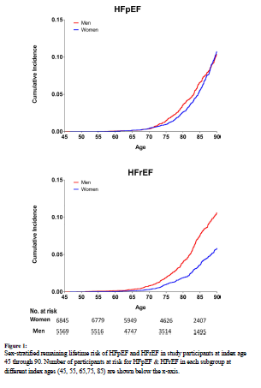
Characteristics of women and men with HFpEF
Tadic M et al. J. Clin. Med. 2019, 8, 792; doi:10.3390/jcm8060792
Circulation. 2018 April 24; 137(17): 1814–1823.
doi:10.1161/CIRCULATIONAHA.117.031622

Slide 16
Canadian Cardiovascular Society
Suspected hearth failure
Echocardiography is recommended in all patients with suspected HF to assess cardiac structure and function, to quantify systolic function for planning and monitoring of treatment, and for prognostic stratification
Elevated NP levels are recommended as an additional diagnostic criterion for HFpEF and are associated with increased risk, although levels may be lower than in HFrEF
Symptoms
Functional limitation
Prior cardiac disease
Risk factors
Exacerbating factors
Comorbidities
Drugs
Vital signs
Weight
Volume status
Heart
Lung
Abdomen
Peripheral vasculation
Clinical history
Physical examination
Chest radiograph
Electrocardiogram
Lab work (CBC, electrolytes, renal function,
urinalysis, glucose, thyroid function)
Initial investigations
Still suspect heart failure?
Yes
NT–proBNP > 125 pg/ml
BNP > 50 pg/ml
(if available)
Echocardiogram¹
Cardiac catheterization
Cardiopulmonary
exercise testing
Others (CMR, MIBI, MUGA, CT scan)
Assess natriuretic
peptides*
Assessment of
ventricular function
Additional diagnostic
investigations
No
Yes
No heart failure;
workup other
diagnosis
Heart failure likely, treat accordingly
Ezekowitz J, O’Meara E, et al. Can J Cardiol 2017;33: 1342-1433

Slide 17
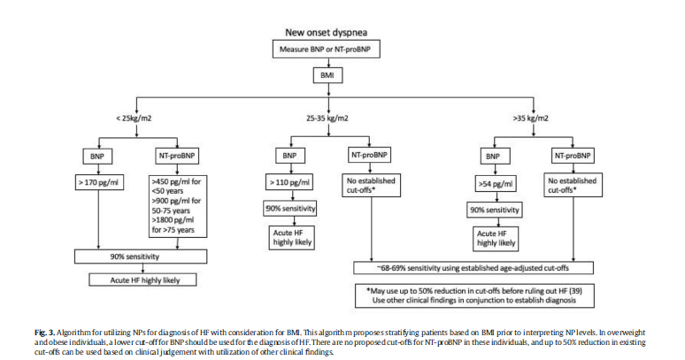
Obesity, NP levels, and diagnosis of HF
Singh S, et al. Progress in Cardiovascular Diseases 63 (2020) 649–655

Slide 18
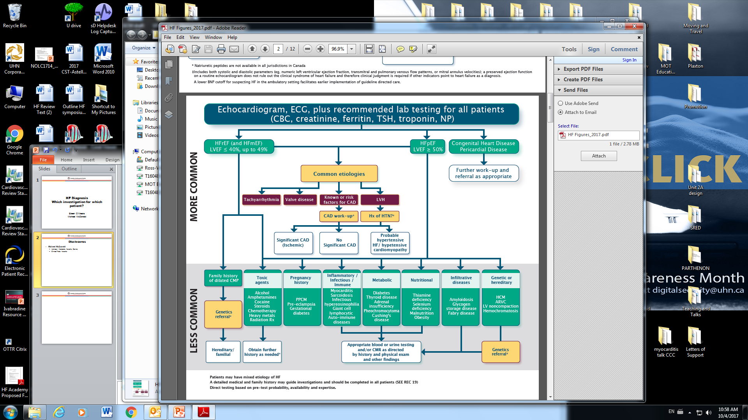
Etiology of HF
Notes:
The PIONEER open label extension (ref) evaluated the clinical course of patients in the PIONEER-HF study who were initiated on sacubitril-valsartan in-hospital as well as those who were switched from enalapril to sacubitril-valsartan at week 8 of the trial protocol and followed up for an additional 4 weeks. For patients continuing sacubitril-valsartan through weeks 8 to 12 of the study protocol, a further 17.2% reduction in NT-proBNP was observed; for patients switching from enalapril to sacubitril-valsartan at 8 weeks, a more significant 37.4% decline in NT-proBNP was seen over the following 4 weeks. An additional key overall finding in this phase of the study was that patients initiated on the ARNI therapy in-hospital had a lower incidence of subsequent HF hospitalization or cardiovascular mortality through the entire 12-week trial period compared to patients converted to ARNI after the first 8 weeks (13.0% vs 18.1%, p=0.03).

Slide 19
Differential diagnosis of HFpEF
Uncorrected primary left-sided valvular heart disease*
Aortic stenosis
Aortic regurgitation
Mitral stenosis
Mitral regurgitation‡
Pericardial disease
Tamponade
Constrictive pericarditis
Isolated right ventricular failure
WHO groups 1,3,4, or 5 pulmonary hypertension§
Genetic
  Arrhythmogenic right ventricular dysplasia
Congenital heart disease
Isolated primary pulmonary or tricuspid valvular disease‡
Right ventricular infarction
Specific cardiomyopathies
Infiltrative (amyloidosis)||
Infectious/inflammatory
  Sarcoidosis
  Viral¶
Genetic Hypertrophic cardiomyopathy
Restrictive cardiomyopathy#

Slide 20
H₂FpEF diagnostic score
Heavy
Hypertensive
BMI > 30 kg/m²
≥2 antihypertensive medications
2 points for BMI; 1 point
for antihypertensive agents
H₂
F
Atrial Fibrillation
Paroxysmal or persistent
1 point
P
Pulmonary Hypertension
Doppler echocardiographic estimated pulmonary artery systolic pressure >35 mm Hg
3 points
E
Elder
Age > 60 years
1 point
F
Filling Pressure
Doppler echocardiographic E/e′ >9
1 point
H₂FPEF score
Sum (0 to 9)
Total Points
0
1
2
3
4
5
6
7
8
9
Probability of HFpEF
0.2
0.3
0.4
0.5
0.6
0.7
0.8
0.9
0.95

Slide 21

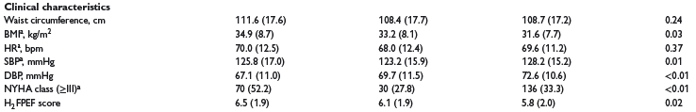
Phenomapping of patients with HFpEF using machine learning-based unsupervised cluster analysis
The TOPCAT study included a total of 3445 patients (aged between 50 and 90 years)
With at least one symptom of HF
LVEF ≥45%, and either a history of HF hospitalization within the previous 12months
Or an elevated natriuretic peptide (NP) level [brain natriuretic peptide (BNP) ≥100 pg/mL, or
N-terminal pro-BNP (NT-proBNP) ≥360 pg/mL] within 60 days prior to randomization.
Segar MW et al. European Journal of Heart Failure (2020) 22, 148–158

Slide 22
PARAGON-HF: Key inclusion & exclusion criteria
Key inclusion criteria | Key exclusion criteria
≥ 50 years of age and LVEF ≥ 45% HF signs/symptoms (NYHA Class II–IV) requiring treatment with diuretic(s) for at least 30 days prior to enrollment Structural heart disease (LAE or LVH by echocardiography) Elevation in natriuretic peptides NT-proBNP 200 pg/ml if hospitalized for HF within 9 months, and 300 pg/ml if not hospitalized; 3-fold increase for patients in AF at enrollment | Any prior measurement of LVEF < 40% Current acute decompensated HF Alternative reason for signs and symptoms SBP < 110 or > 180mm Hg (or > 150mm Hg if patient not taking 3 or more antihypertensive medications)
Solomon SD, et al. JACC-Heart Fail 2017

Slide 23
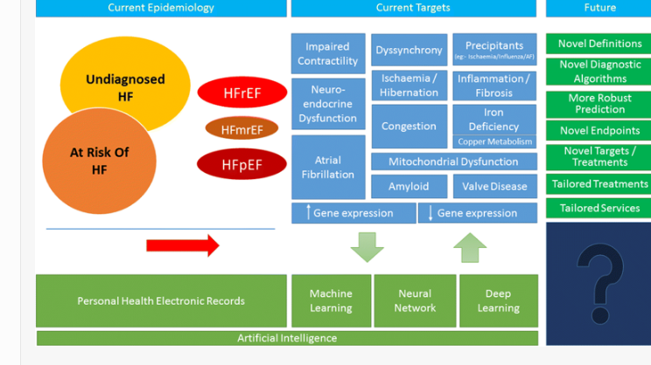
CAN WE DETECT HF EARLIER??
Pellicori P, et al. Heart Fail Reviews, July 2019

Slide 24
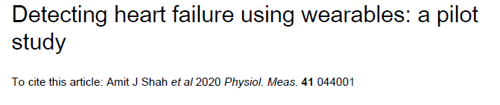
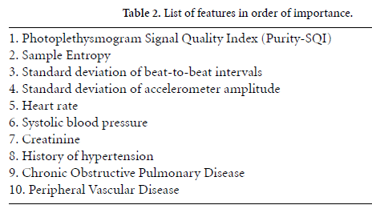
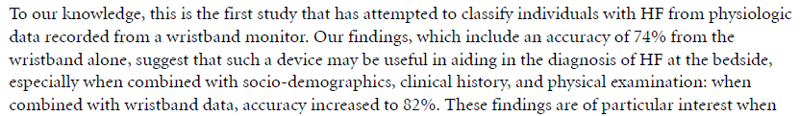
The future of HF screening…
One of the most notable differences between
HF and controls is impaired autonomic function
and increased propensity for arrhythmia.
HF patients have less heart rate variability,
higher overall heart rates, and increased arrhythmia risk.
In this study, we seek to examine the ability of
heart rate variability and entropy (as an indirect arrhythmia measure)
derived from a wristband wearable with PPG sensor to classify HF
in a pilot cohort of inpatient subjects.

Slide 25
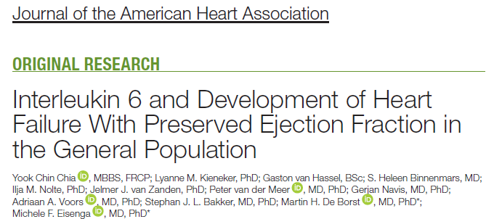
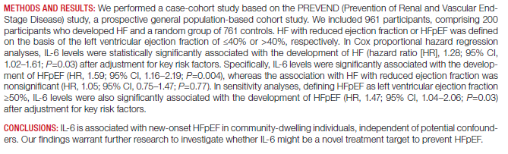
Biomarkers?

Slide 26
Diagnosis of Heart Failure
Dr. Jonathan Howlett
MD, FRCPC, FCCS, FACC, FHFSA (hon)
Calgary, AB
Clinical Professor of Medicine, University of Calgary
Libin Cardiovascular Institute of Alberta, Calgary
Past & Founding President, Canadian Heart Failure Society
@JonathanHowlet6

Slide 27
Learning Objectives
Describe the ‘universal diagnosis’ of heart failure
Describe a practical approach to heart failure when LVEF is over 40%

Slide 28
Case: Mrs. Disnea
72 year old female
CKD 2° to T2DM and HTN
Baseline NYHA I-II
Slowly progressive SOB over last 6 months
Precipitous decline in last 2 weeks
Investigations
eGFR 40 ml/min/m²
A1c 7.6 and ACR 10mg/mmol
ECG: AF with HR 95 bpm and LVH
Echo: mild AS, ↑ LA volume, LVH and LVEF 60%
MPI: no ischemia, normal LVEF
Lets run this back shall we??
No other cardiac symptoms
GP initiates work-up for ischemia (?angina)
BP consistently above 145mmHg
  Amlodipine initiated and then stopped due to edema
Physical exam otherwise remarkable for new irregularly irregular HR at 90 bpm and murmur of AS
Edema progresses despite stopping amlodipine
Progressive functional decline with dyspnea at rest
Presents to the ER
  CXR shows pulmonary edema
  ECG shows AF with rapid ventricular response
  eGFR now 30 ml/min/m²
Diagnosed with heart failure and new AF
  Admitted to hospital and initiated on iv diuretics
Medications
Metformin 1000 mg bid
Valsartan 160 mg bid
Rosuvastatin 10 mg od
Could this have been avoided?

Slide 29
Case: Mrs. Disnea – 5 months EARLIER
72 year old female
CKD 2° to T2DM and HTN
Newly notes mild SOBOE
Investigations
eGFR 50 ml/min/m²
A1c 7.6 and ACR 10mg/mmol
ECG: NSR with HR 75 bpm and LVH
Echo: mild AS (APIG 18), mild LVH and LVEF 60%
  RVSP 39 mmHg
  LA volume 33 mm3/M2
  E/e’= 13
No other cardiac symptoms
BP 150/70 mmHg
Physical exam
  No rales. JVP 3 cm, ? +HJR, mild ankle edema
  ?S4
Now what?
Medications
Metformin 1000 mg bid
Valsartan 160 mg bid
Rosuvastatin 10 mg od

Slide 30
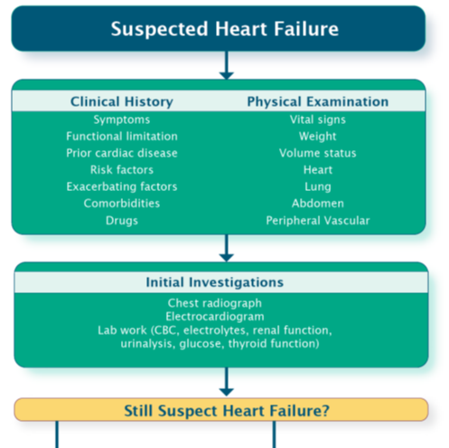
Algorithm for the diagnosis of HF in the ambulatory setting

Slide 32
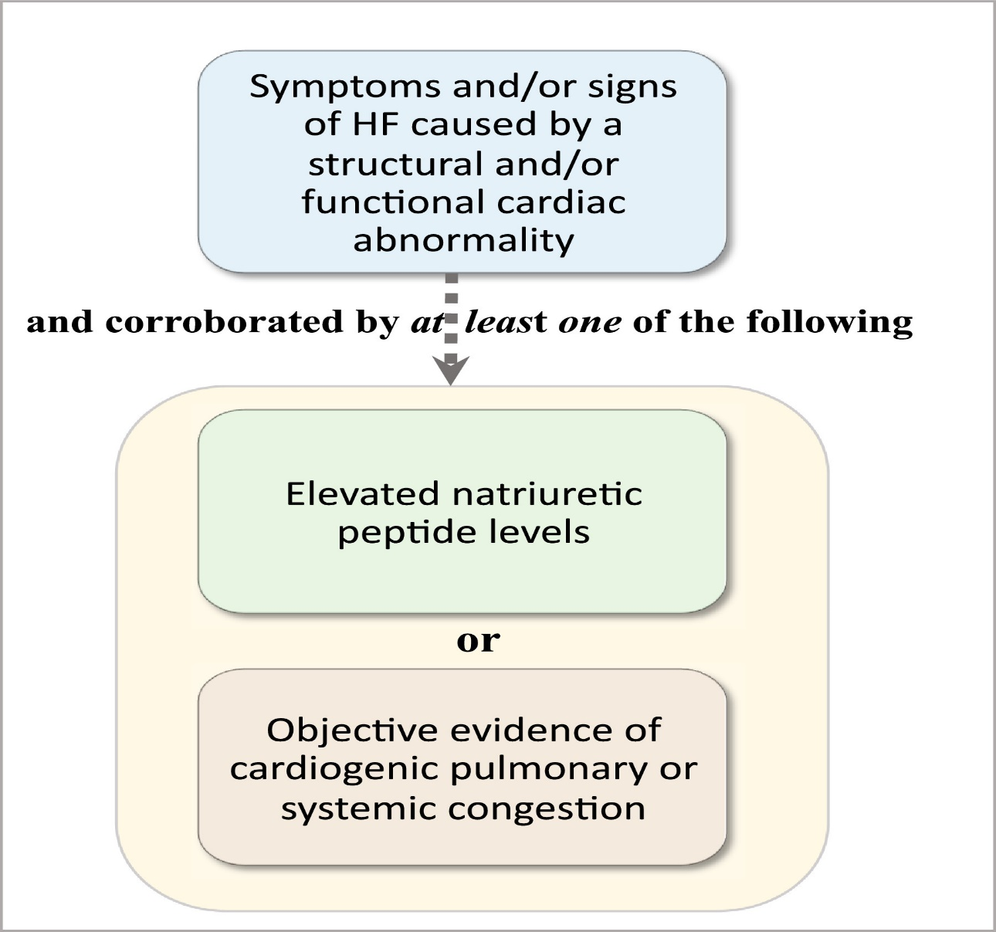
Requirements for a diagnosis of heart failure
Journal of Cardiac Failure DOI: (10.1016/j.cardfail.2021.01.022)

Slide 33
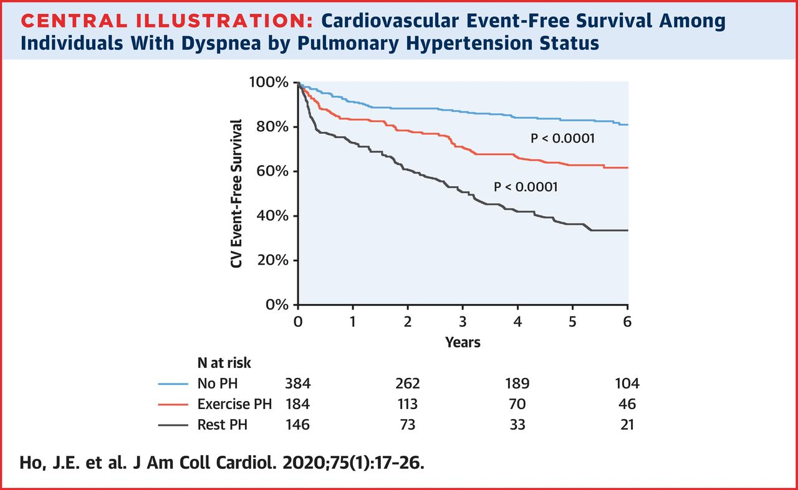
HF diagnosed by any of:
PCWP > 15 mmHg at rest
PCWP > 25 mmHg during stress
ΔPCWP/ ΔCO > 2 during stress

Slide 34
Mrs. Disnea has: 4 points
Intermediate risk (2-6)

Slide 38
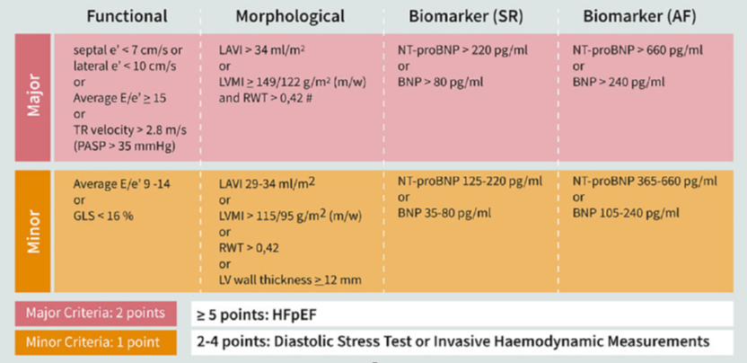
Step E
Mrs Disnea has: 5 points
Looks like a wrap…

Slide 39
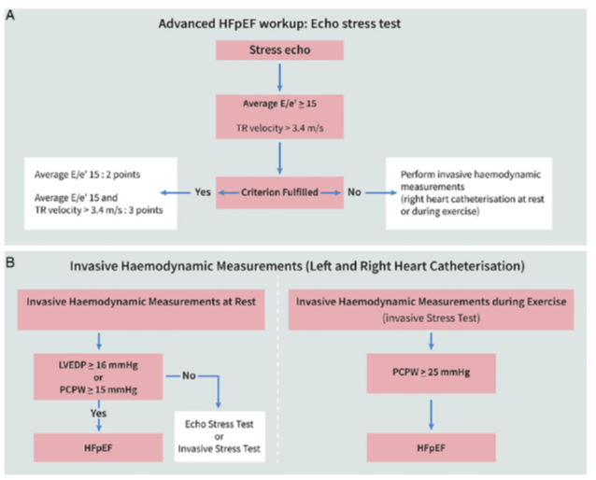
Step F1

Slide 40
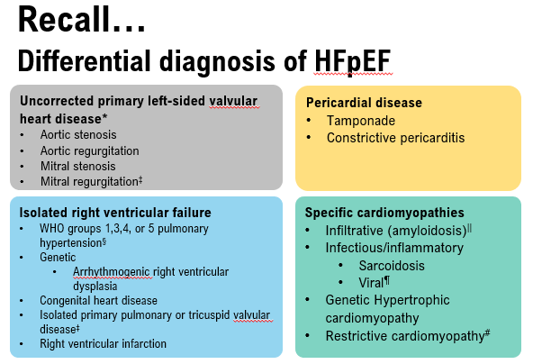
Circulation. 2020; 142:1770-1780. DOI: 10.1161/CIRCULATIONAHA.119.041818

Slide 41
Case: Mrs. Disnea
72 year old female
CKD 2° to T2DM and HTN
Baseline NYHA I-II
Slowly progressive SOB over last 6 months
Precipitous decline in last 2 weeks
Investigations
eGFR 40 ml/min/m²
A1c 7.6 and ACR 10mg/mmol
ECG: AF with HR 95 bpm and LVH
Echo: mild AS, ↑ LA volume, LVH and LVEF 60%
MPI: no ischemia, normal LVEF
Yes – we could have avoided this!!
No other cardiac symptoms
GP initiates work-up for ischemia (?angina)
BP consistently above 145mmHg
  Amlodipine initiated and then stopped due to edema
Physical exam otherwise remarkable for new irregularly irregular HR at 90 bpm and murmur of AS
Edema progresses despite stopping amlodipine
Progressive functional decline with dyspnea at rest
Presents to the ER
  CXR shows pulmonary edema
  ECG shows AF with rapid ventricular response
  eGFR now 30 ml/min/m²
Diagnosed with heart failure and new AF
  Admitted to hospital and initiated on iv diuretics
Medications
Metformin 1000 mg bid
Valsartan 160 mg bid
Rosuvastatin 10 mg od
Could this have been avoided?

Slide 42
Diagnosis of HF: New concepts
Acute HF criteria have not changed
  Early combination of clinical assessment and NP testing recommended
  Much easier to diagnose HF when congestion is present
Outpatient diagnosis much more difficult
  Frequently cannot rely on congestion to get answer
  Stepwise, clinical, NP approach
    ECHO adds important information
    May need invasive assessment
  Diagnosis of HF ≠ Etiology
    You still have to do this, including HF Mimics……

Slide 43


QUESTIONS?

Slide 44
How do I integrate all this information into practice?
Suspected hearth failure
HFpEF
HFA-PEFF
H2FPEF
Symptoms
Functional limitation
Prior cardiac disease
Risk factors
Exacerbating factors
Comorbidities
Drugs
Vital signs
Weight
Volume status
Heart
Lung
Abdomen
Peripheral vasculation
Clinical history
Physical examination
Chest radiograph
Electrocardiogram
Lab work (CBC, electrolytes, renal function,
urinalysis, glucose, thyroid function)
Initial investigations
Still suspect heart failure?
Yes
NT–proBNP > 125 pg/ml
BNP > 50 pg/ml
(if available)
Echocardiogram¹
Cardiac catheterization
Cardiopulmonary
exercise testing
Others (CMR, MIBI, MUGA, CT scan)
Assess natriuretic
peptides*
Assessment of
ventricular function
Additional diagnostic
investigations
No
Yes
No heart failure;
workup other
diagnosis
Heart failure likely, treat accordingly
Ezekowitz J, O’Meara E, et al. Can J Cardiol 2017;33: 1342-1433

Slide 45
SAVE THE DATE!
For our upcoming Guideline Webinars
Heart Failure: Webinar 3: Device therapy: when to consider and how to manage complex HF
On Thursday, June 17, 2021 from 8 PM – 9 PM EDT, join Dr. McDonald, Dr. Koshman, Dr. Ducharme and Dr. Toma for the third webinar in the HF webinar series highlighting content from the Heart Failure Guidelines.
Atrial Fibrillation: Webinar 2: When it comes to arrhythmia management…
On Thursday, July 8, 2021 from 8 PM – 9 PM EDT, join Drs. Bennett, Andrade, Aguilar, Atzema, Pilote, and Verma for the “AF Guidelines: When it comes to arrhythmia management…” webinar. This webinar highlights content from the 2020 CCS/CHRS Comprehensive Atrial Fibrillation Guidelines.
Register at CCS.ca/programs-and-events/

Slide 46
Visit CCS.ca for more Guidelines and Resources
Guideline Library:
https://ccs.ca/guidelines-and-position-statement-library/
Guideline Resources:
https://ccs.ca/guideline-resources/

