Slide 1
Pulmonary Hypertension: What’s New?
Guidance from the CCS/CTS Position Statement on Pulmonary Hypertension Panel
March 31, 2021

Slide 2
© Canadian Cardiovascular Society. 2021. All rights reserved.
Distribution, transmission or republication is strictly prohibited without the prior written permission of the Canadian Cardiovascular Society.
For medical institution internal education or training (i.e. grand rounds, medical college/classroom education, etc.), kindly consider and implement the following:
  Include the citation for the Canadian Journal of Cardiology
  Add ‘Reproduced with permission from the Canadian Cardiovascular Society. [insert year].’
  Avoid use of CCS logos or trademarks on slides, tools or publications that are not the property of the CCS
  Do not modify the slide content and, the layout and CCS branding on the Guideline-related slides
  Guideline recommendations must be reproduced exactly as published
For an industry supported or involved program, permissions are required:
  If content is published in the Canadian Journal of Cardiology, permissions must be sought through our publisher Elsevier (www.onlinecjc.com)
  If content is property of the CCS, contact guidelines@ccs.ca

Slide 3

We are grateful to our partners for their commitment to the CCS.
The Canadian Cardiovascular Society is grateful to our partner(s) for their commitment to building knowledge and expertise of the heart team. This program was made possible in part by Janssen. CCS thanks Janssen for their dissemination support so that healthcare providers can benefit from this important information.

Slide 4




Our Faculty
Dr. Lisa
Mielniczuk
Dr. Sanjay
MEHTA
Dr. Naushad
Hirani
Dr. Ali
KAPASI
MODERATOR

Slide 5

Disclosure of potential conflicts of interest
Lisa Mielniczuk
Consulting Fees/Honoraria: Actelion, Amgen, Bayer, Johnson & Johnson, Novartis, PHA Canada, Servier
Clinical Trials: Actelion, Amgen, Bayer, Johnson & Johnson, Novartis, PHA Canada
Ali Kapasi
Consulting Fees/Honoraria: Actelion, Bayer, Boehringer Ingelheim, GlazoSmithKline, Roche
Clinical Trials: Actelion, Bayer, Boehringer Ingelheim, Sanofi
Naushad Hirani
Consulting Fees/Honoraria: Actelion/Janssen, Bayer
Clinical Trials: Bayer, Bellerophon, Gilead, Gossamer Bio, United Therapeutics
Sanjay Mehta
Consulting Fees/Honoraria: Actelion/Janssen, Bayer, Natco
Clinical Trials: Actelion/Janssen, Bellerophon, Eiger, Gilead, Reata, United Therapeutics

Slide 6

MODERATOR
Dr. Lisa Mielniczuk
MD MSc FRCPC
Ottawa ON
Cardiologist and Clinician Investigator, University of Ottawa Heart Institute
Director, Heart Failure Program
Medical Director, Pulmonary Hypertension Clinic

Slide 7

Overall Learning Objectives
Recognize pulmonary hypertension and identify risk factors,
Examine recommendations regarding new therapeutic targets and treatment strategies available, and
Review an approach to the diagnosis and treatment of pulmonary hypertension in left heart disease.

Slide 8
A clinical case: Mr. CB – A 56-year-old male
Relevant past medical history
  HTN
  Dyslipidemia
  Hypothyroidism
  Non-smoker
  Obesity
Presents with 18 months of gradually worsening SOB
One syncopal episode on year prior
4-5 presyncopal episodes 3 months prior

Slide 9


A clinical case: Mr. CB – A 56-year-old male
Presented to emergency with right HF
Initial testing
CT scan chest – no evidence of PE
PFTs: no evidence of airflow obstruction or abnormal lung volumes
6 minute walk test 100m
NTproBNP 700 ng/mL
Transferred to our hospital for diagnosis and management
NYHA FC III

Slide 10
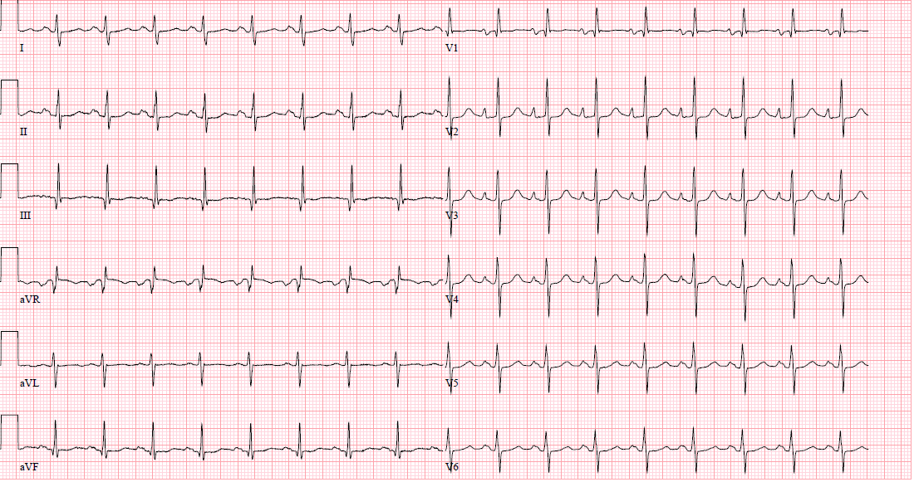
ECG
Notes:
Borderline LAD
LAE
RVH

Slide 11
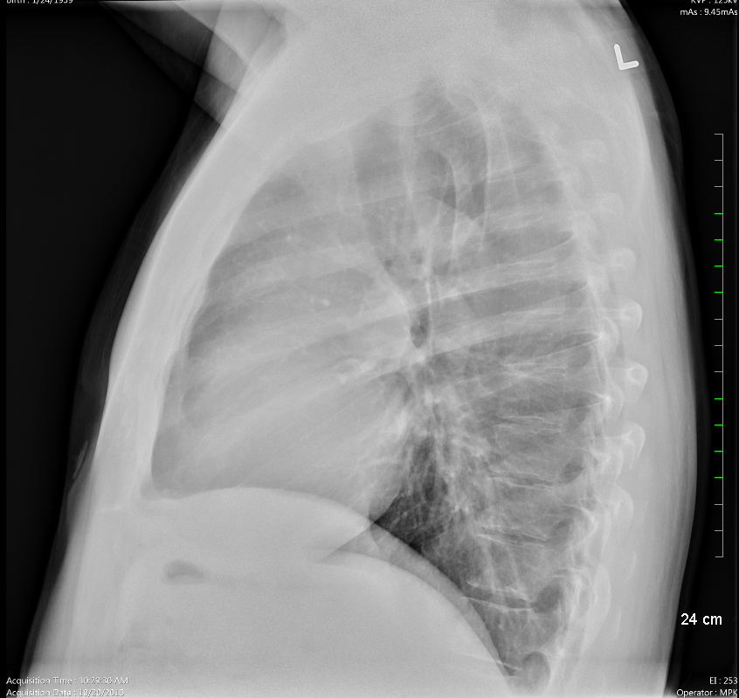
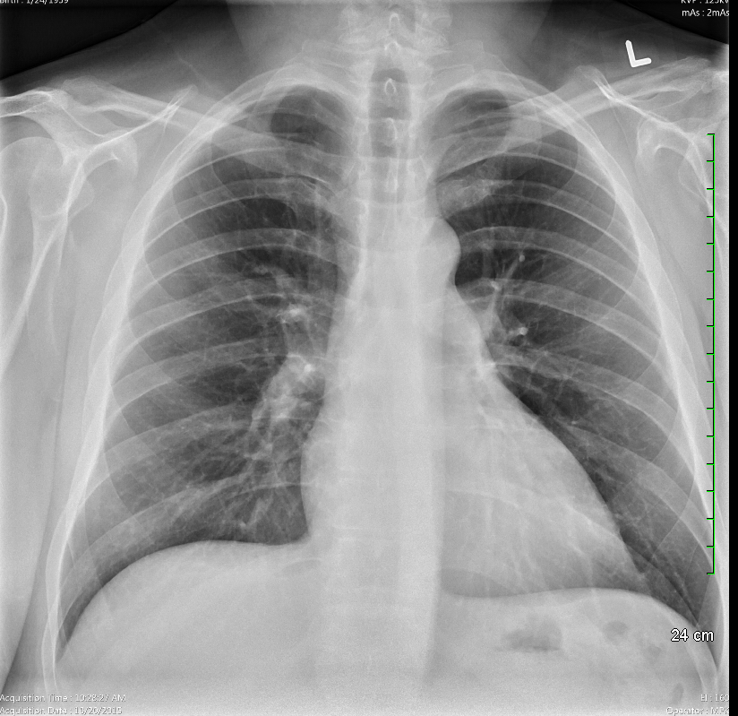
CXR

Slide 12
V/Q scan

Slide 13
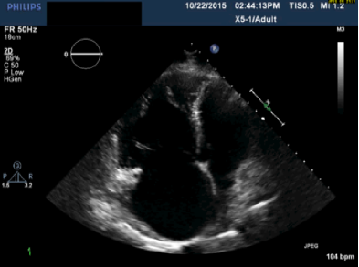
Echocardiogram
Notes:
Severe RV dysfunction with moderate reduction in function
-moderate to severe TR

Slide 14
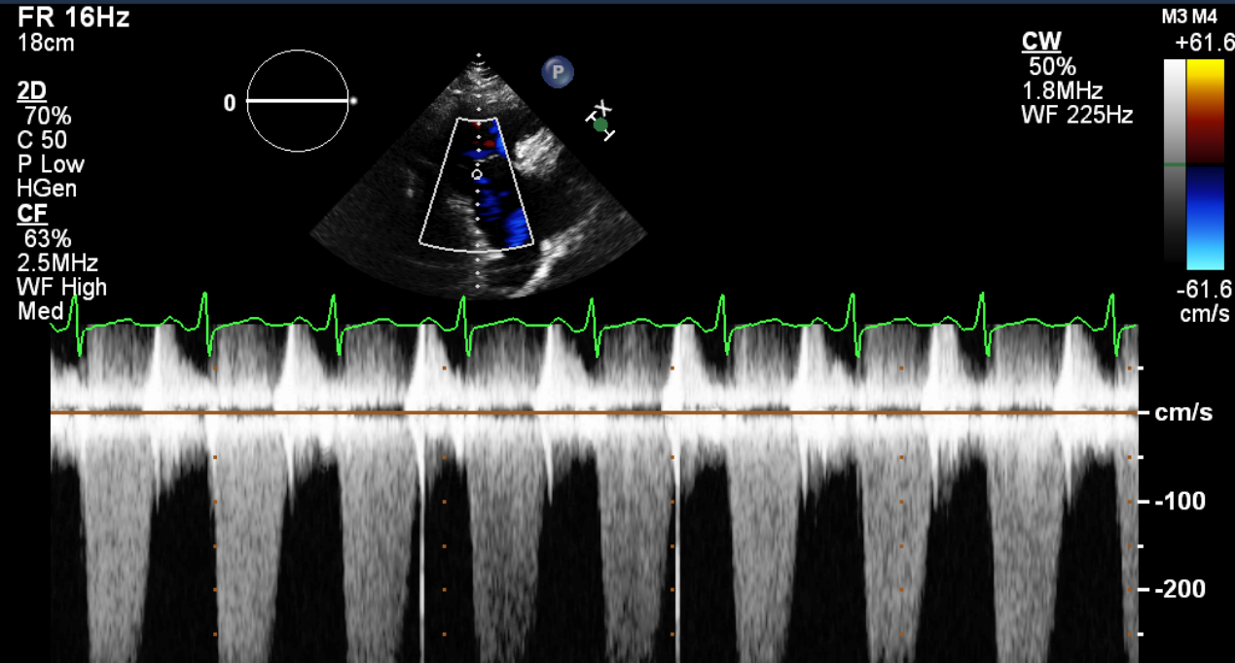
Notes:
Calculated pulmonary pressures RVSP 108 mmhg

Slide 15
Initial considerations
What is the most likely cause of the PH?
What are the next steps in diagnosis?
What is his assessment of risk?
What treatment strategies should be considered?

Slide 16
Right heart catheterization
PAP 82/41/57
PCWP 14/17/10
RAP 15/13
PA 49%
CO 2.75
CI 1.26
PVR 17 (1367 dsc)

Slide 17
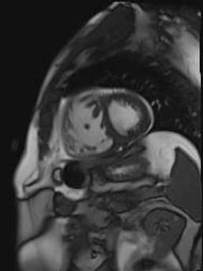
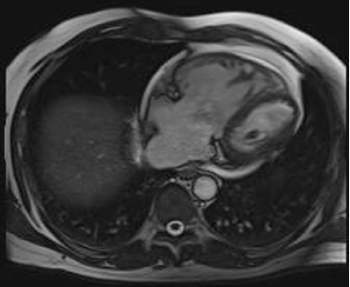
Cardiac MRI
Notes:
-MRI report – severe dilatation with moderate reduction in function EF 40%, severe TR, delayed GE at RV insertion points consistent wieht PAH
-how would folks manage this patient? – single, dual, triple and or prostacyclin therapy??

Slide 18
Diagnostic Approach
Dr. Naushad Hirani
MD FRCPC FCCP
Calgary AB
Clinical Assistant Professor, Division of Respiratory Medicine, University of Calgary
Southern Alberta Pulmonary Hypertension Clinic

Slide 19

Learning Objectives: Diagnostic Approach
Discuss the diagnosis of pulmonary hypertension using echocardiography, MRI and right heart catheterization
Recognize special groups of patients who may need to be screened for pulmonary hypertension

Slide 20
Diagnosis of pulmonary hypertension
Symptoms, signs and history suggestive of PH
Echocardiographic probability of PH
Modified from ESC/ERS PH Guidelines 2015

Slide 21
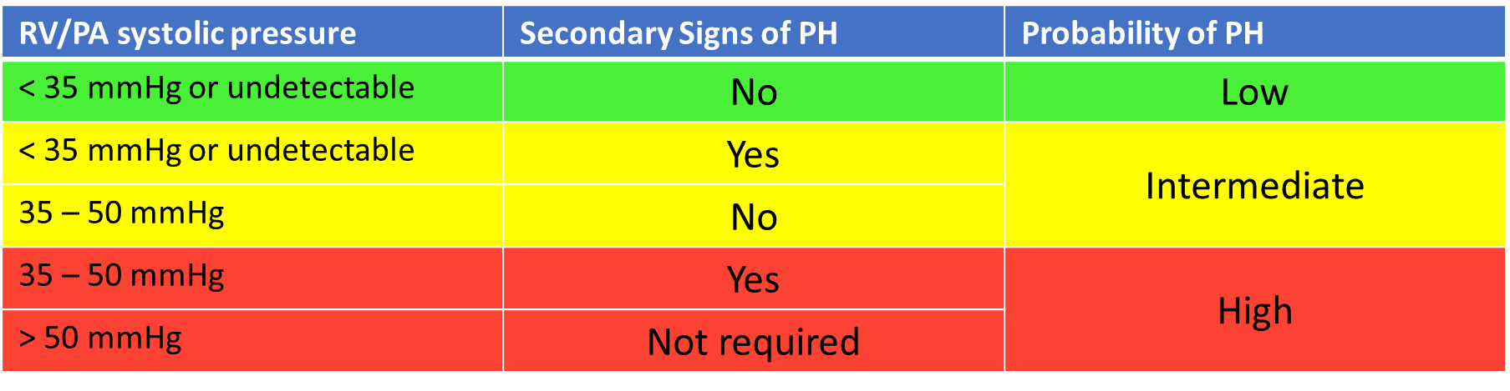
Echocardiographic probability of PH
Modified from ESC/ERS PH Guidelines 2015

Slide 22
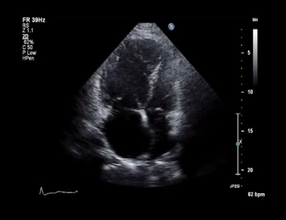
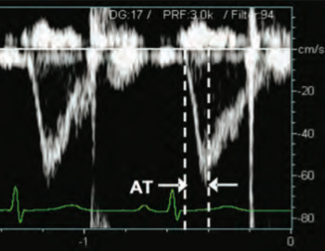
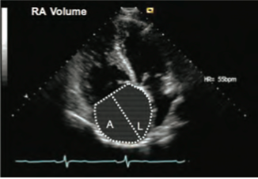
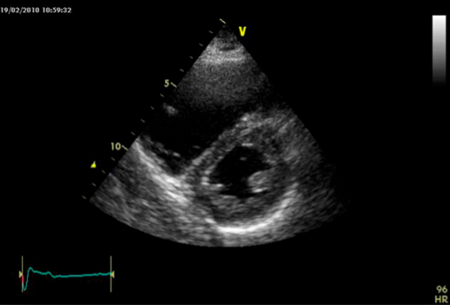
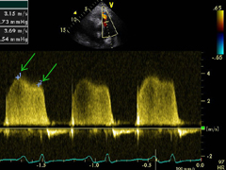
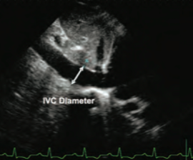
Secondary signs of PH
Ventricles
Pulmonary Artery
RA/IVC
RVd/LVd > 1.0
RVOT AT < 105 ms, midsyst notching
RA area > 18 cm²
Septal flattening, LVEI > 1.1
PI early diastolic vel. > 2.2
IVC > 21 mm/ dec. inspire. collapse
British Society Echo Guidelines 2010. ESC/ERS PH Guidelines 2015

Slide 23
Recommendation: Echo for identification of PH
We recommend transthoracic echocardiography for initial assessment of all patients with clinically suspected PH or unexplained dyspnea
We recommend complete echo assessment when assessing for PH including:
    estimation of sPAP using the TRV jet,
    measurement of IVC size and degree of inspiratory collapse,
    assessment of “secondary” signs of PH, such as right atrial or right ventricular (RV) enlargement, RV hypertrophy, septal flattening, and RV dysfunction
  Strong Recommendation, Moderate-Quality Evidence

Slide 24
Echo: Screening populations at risk for PAH
Connective tissue disease (CTD)
  Scleroderma (SLE, overlap syndromes)
Adults with congenital heart disease
Hepatic Cirrhosis
  Porto-pulmonary hypertension
  Liver transplantation – contraindicated if mPAP >35
HIV Infection

Slide 25
Symptoms, signs and history suggestive of PH
High/Intermediate
Echo probability of PH
Low
Consider left heart disease and lung disease
Consider other diagnoses or ongoing follow up
Modified from ESC/ERS PH Guidelines 2015

Slide 26
Left heart disease: HFpEF
Normal
HFrEF
HFpEF
Melenovsky V, et al. Eur Heart J 2014; 35: 2452-3462
Fayyaz AU, et al. Circulation 2018; 137: 1796-1810

Slide 27

Approach to the classification of PH
Pulmonary Hypertension
WHO Group 1
WHO Group 2
WHO Group 3
WHO Group 4
Pulmonary Arterial
Hypertension
Left-Sided Heart Dysfunction
Lung Disease and/or Hypoxemia
Chronic Thromboembolic Disease
Idiopathic
Connective Tissue Disease
Portal Hypertension
Congenital Heart Disease
Systolic
Diastolic
Valvular
COPD
Interstitial Lung Disease
Sleep Apnea

Slide 28
Multimodality testing for classification of PH
Cardiac | ECG Echo, +/- CMR | RVH, RA enlargement, LVH, etc. Structural change, shunt, diastolic dys.
Respiratory | PFTs Overnight oximetry +/- ABG | Obstruction/Restrictrion , DLCO Nocturnal desaturation Hypoxemia, hypercapnea
Blood | PAH serology +/- Genetics | CTD, HIV, liver disease Known mutations (EIF2AK4 in PVOD)
Exercise | +/- CPET | Physiologic patterns
Imaging | CXR V/Q HRCT CTPA Abdo U/S +/- Pulm. angiography | Cardiomegaly, edema, lung disease, etc. To r/o CTEPH Pulm parenchymal disease, etc. CTEPH, shunts, etc. PoHTN CTEPH, sarcoma, etc.

Slide 29
Symptoms, signs and history suggestive of PH
Echo probability of PH
High/Intermediate
Low
Consider left heart disease and lung disease
Consider other diagnoses or ongoing follow up
V/Q scan to screen for chronic thromboembolic PH (CTEPH)
Refer to expert center for multimodality assessment, diagnosis and Rx
Modified from ESC/ERS PH Guidelines 2015

Slide 30
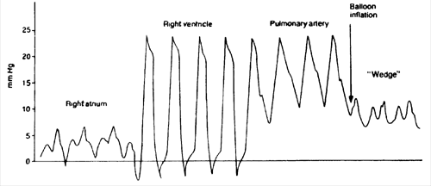
Right heart catheterization
Should be done after noninvasive workup
For diagnosis of PAH
  mPAP >20 mmHg
  PAWP ≤15 mmHg
  PVR ≥3 WU (240 DSC)
Recommend that RHC is performed at PH Centre with technical expertise and experience with diagnosis of PH

Slide 31
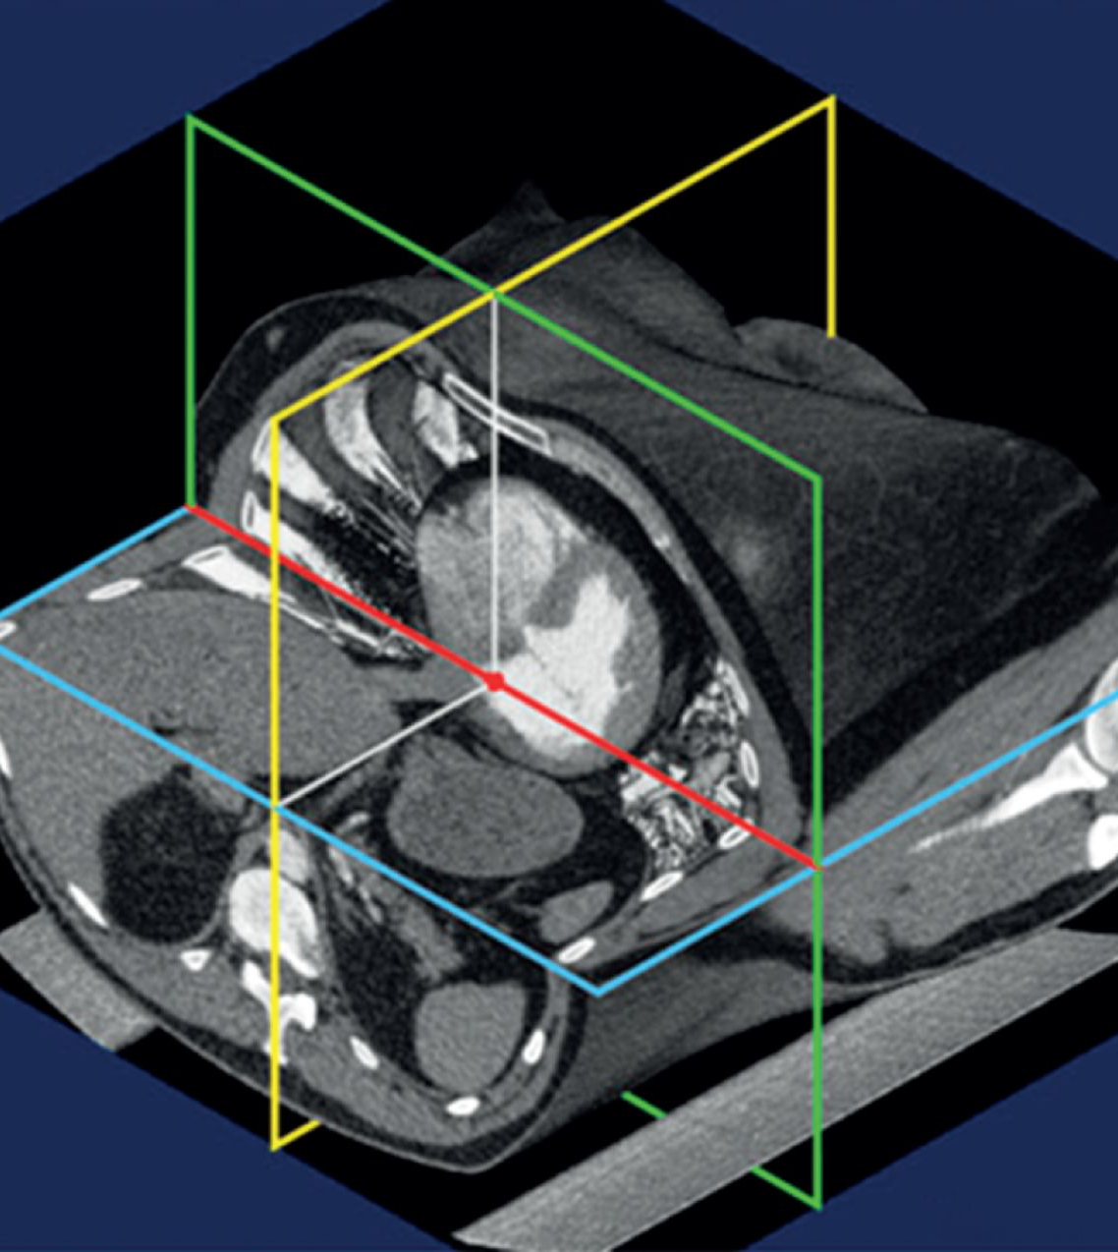
Reference level
Mid thoracic height best approximates position of left atrium
This should be the reference level used at RHC
Kovacs et al. Eur Respir J 2013;42:1586-94

Slide 32
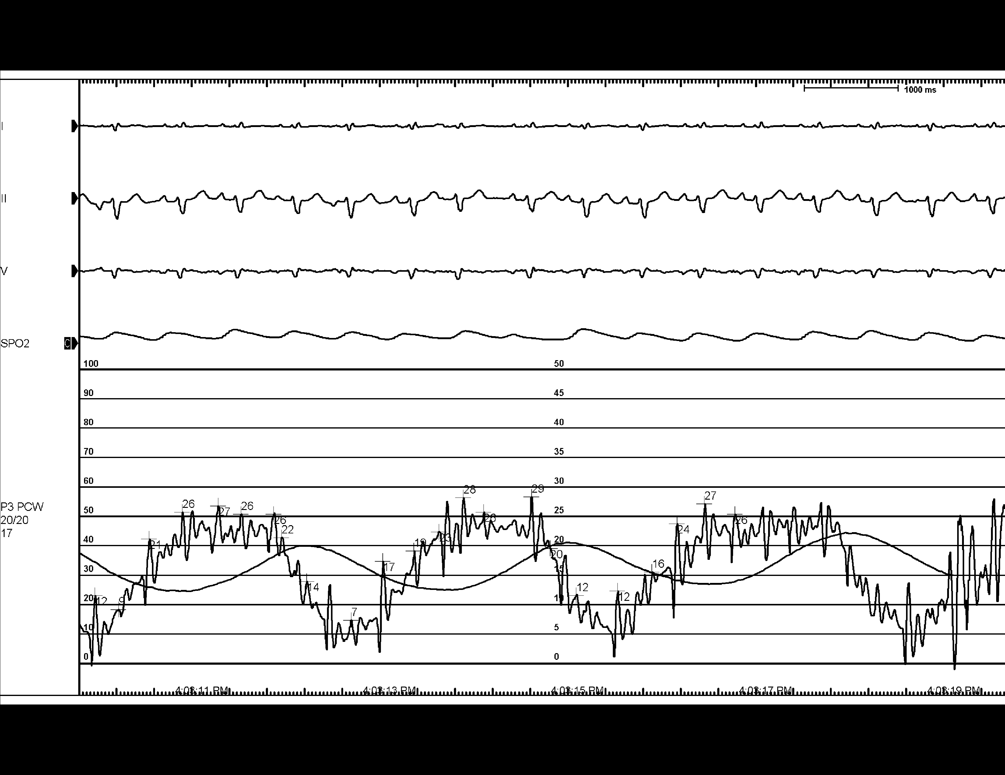
End expiratory measurements
End-expiratory wedge
Computer mean wedge
Using mean vs. End-expiratory changes PH classification in 25-30% of cases
Ryan et al., Am Heart J. 2012;163:589-94
LeVarge et al, Eur Respir J. 2014;44:425-34

Slide 33
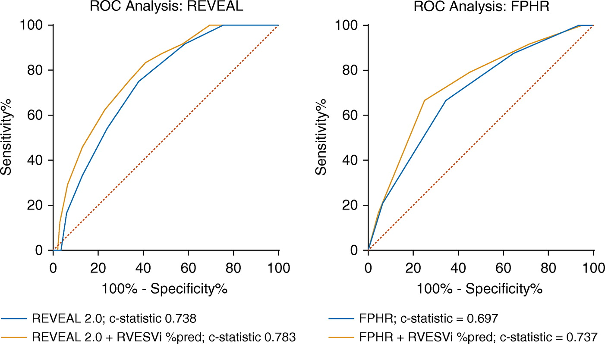
Cardiac MRI
Accurate assessment of chamber size, function, shunts
Cannot replace RHC
RVEDV can enhance risk assessment
Useful when CHD is suspected
Second line imaging for difficult cases
Lewis RA, et al. Am J Resp Crit Care Med Feb 2020

Slide 34
Management of PH
Dr. Ali Kapasi
MD FRCPC
Edmonton AB
Associate Professor, Department of Medicine, Division of Pulmonary Medicine, University of Alberta
Heart & Lung Transplantation
@kapasi_am

Slide 35
Learning Objectives: Management of PH
Describe when PAH targeted therapies are indicated
Develop and appreciation for how PAH targeted therapies are selected and adjusted

Slide 36
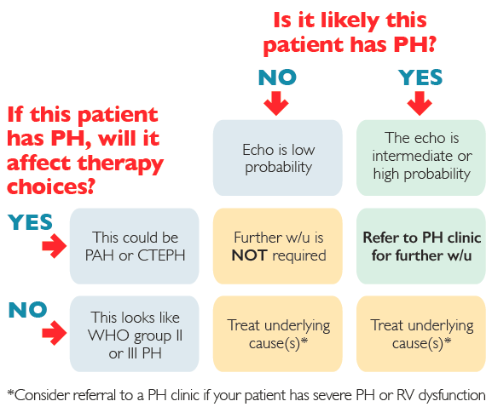
PAH targeted therapies are only indicated in WHO group 1 and 4

Slide 37
General medical therapies for PAH
Avoidance of pregnancy
Immunizations against influenza, pneumococcal infection (COVID-19?)
Psychosocial support/counselling
Supervised exercise training
  Excessive physical activity leading to distressing symptoms in not advised
Supplemental O2 (if resting PaO2 consistently <60 mmHg)
Spinal anesthesia is preferable to GA whenever possible for elective surgery

Slide 38
General medical therapies for PAH
Diuretics are indicated in patients with signs of RV failure and fluid retention
Oral anti-coagulation should be considered in patients with IPAH, HPAH, and DPAH
Correct anemia/Fe deficiency
Avoid ACEi, ARBs, β-blockers, ivabradine where possible
  Tachyarrhythmias are better managed with amiodarone
CCBs are reserved for patients with IPAH, HPAH, and DPAH who respond to acute vasoreactivity testing

Slide 39
PAH targeted therapies
ORAL
Phosphodiesterase type 5 inhibitors
Sildenafil
Tadalafil
Endothelin receptor antagonists
Bosentan
Ambrisentan
Macitentan
Prostanoid analogues
Treprostinil IV/SC
Epoprostenol IV
Soluble guanylate cyclase stimulants
Riociguat
Prostacyclin receptor agonists
Selexipag

Slide 40
How do we deploy these drugs?
We usually start with dual oral combination therapy
Patients presenting in NYHA FC IV/with RHF are usually considered for parenteral prostanoids
A third drug is usually introduced based on inadequate response to two drugs
There are numerous tools for risk assessment in PAH

Slide 41
What about unstable patients?

Slide 42
What about the other (most common) causes of PH?
Dr. Sanjay Mehta
MDCM FRCPC
London ON
Director, Southwest Ontario PH Clinic, London Health Sciences Centre
Professor of Medicine, Western University
Eternal PHriend / Past-Chair / Founding Board Member, PHA Canada

Slide 43
Learning Objectives: Other Causes of PH
Recognize and diagnose chronic thromboembolic pulmonary hypertension (CTEPH)
Appreciate the limitations of current treatment approaches for some types of pulmonary hypertension

Slide 44
N Hirani et al / CCS - CTS, CJC 2020

Slide 45
D Helmersen et al / CTS, CJRCCSM 2019

Slide 46
WHO classification of PH
Pulmonary Hypertension
WHO Group 1
WHO Group 2
WHO Group 3
WHO Group 4
Pulmonary Arterial
Hypertension
Left-Sided Heart Dysfunction
Lung Disease and/or Hypoxemia
Chronic Thromboembolic Disease
Idiopathic
Connective Tissue Disease
Portal Hypertension
Congenital Heart Disease
Systolic
Diastolic
Valvular
COPD
Interstitial Lung Disease
Sleep Apnea

Slide 47
Global estimates of PH
M Hoeper et al, Lancet Resp Med 2016

Slide 48
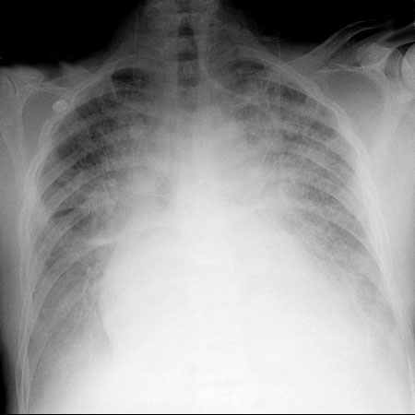
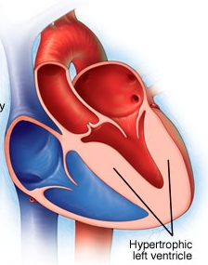
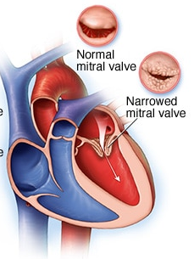
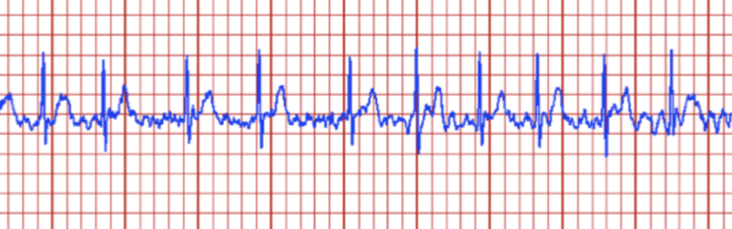
WHO Group 2 PH due to left heart disease
Notes:
Speaker’s Notes:
To complete the first two objectives, this presentation will examine the following illustration.
Expiratory airflow limitation is the pathophysiological hallmark of COPD. Expiratory flow limitations with dynamic collapse of the small airways compromise the ability of patients to expel air during forced and quiet expiration; thus air trapping and lung hyperinflation (overinflation) occurs.¹
Air Trapping and hyperinflation are the principal causes of dyspnea (or breathlessness).² It is the physiological mechanism that provides the link between expiratory airflow limitation and patient-centred outcomes.
Dyspnea: Impairment of lung mechanics appears central in generating dyspnea in COPD.³ COPD patients describe their dyspnea as a sense of increased effort to breathe, heaviness, air hunger or gasping.^{4 a}
Reduced Activity: Dyspnea can severely limit functional activities of COPD patients.⁵ Eventually dyspnea (breathlessness) is present during everyday activities (i.e., dressing, washing) or at rest, leaving the patient confined to the home.^{4a}
Deconditioning: Peripheral muscle dysfunction which contributes to exercise intolerance, results from the combined effects of immobility, altered nutritional status, prolonged hypoxia and, possibly, to sustained systemic inflammation.¹
The cycle of physical consequences of dyspnea include exercise deconditioning^{4b}. Many secondary effects of COPD symptoms are due to their effects on mobility and limitation of activity.⁶ This leads to a worsening of the disease and, ultimately, the patient’s HRQoL (Health Related Quality of Life) suffers.⁶
References:
1. O'Donnell DE, Aaron S, Bourbeau J, et al. Canadian Thoracic Society recommendations for management of chronic obstructive pulmonary disease 2003. Can Respir J. 2003;10(Suppl A):13A.
2. O'Donnell DE, Webb K. The etiology of dyspnea during exercise in COPD. Pulmonary and Critical Care Update 14, Lesson 15. http://www.chestnet.org/downloads/education/online/Vol14_13_18.pdf. Accessed February 24, 2004.
3. Calverley PMA, Chapter 16: Ventilatory control and breathlessness. In: Calverley PMA, MacNee W, Pride NB (eds). Chronic Obstructive Pulmonary Disease, 2nd edition. London: Arnold; pp.479-489.
4. Global Initiative for Chronic Obstructive Lung Disease. Global strategy for the diagnosis, management, and prevention of chronic obstructive pulmonary disease. NHLBI/WHO workshop report. http://www.goldcopd.com/workshop/toc.html. Accessed November 14, 2003. (a) Component 1: Assess and Monitor Disease. pg. 4 of 16. (b) Adapted from Component 3: Management of Stable COPD. pg. 14 of 29.
5. Mahler DA, Harver A. A factor analysis of dyspnea ratings, respiratory muscle strength, and lung function in patients with chronic obstructive pulmonary disease. Am Rev Respir Dis. 1992;145:467-470.
6. Jones PW. Chapter 31: Health Status. In: Calverley PMA, MacNee W, Pride NB (eds). Chronic Obstructive Pulmonary Disease, 2nd edition. London: Arnold; pp.479-489. (a) pg. 480, (b) pg. 479 Fig. 31.1

Slide 49
WHO Group 2 PH due to left heart disease
Diagnosis / Management
  Disproportionate dyspnea, edema
  Echo identification of PH and/or RV failure
  Optimal heart failure management: especially aggressively DIURESE !!!
  Assess / treat possible underlying
    Hypoxemia
    Lung disease (eg. COPD, sleep apnea)
    Pulmonary emboli

Slide 50
Management:
WHO Group 2 (post-capillary) PH due to heart disease
We recommend that management should focus on efforts to optimize LV filling pressures and treat the underlying causes of and contributors to left heart disease
Strong Recommendation, Low-Quality Evidence
We recommend against the routine use of PAH-targeted therapies
  Strong Recommendation, Low-Quality Evidence
N Hirani et al / CCS - CTS, CJC 2020

Slide 51
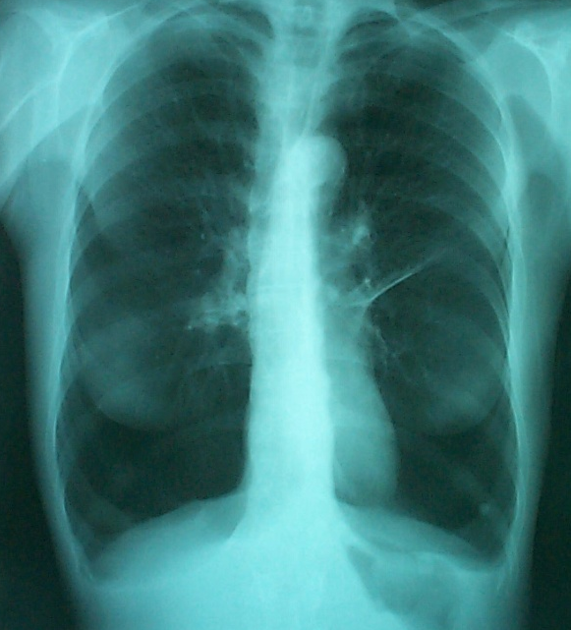
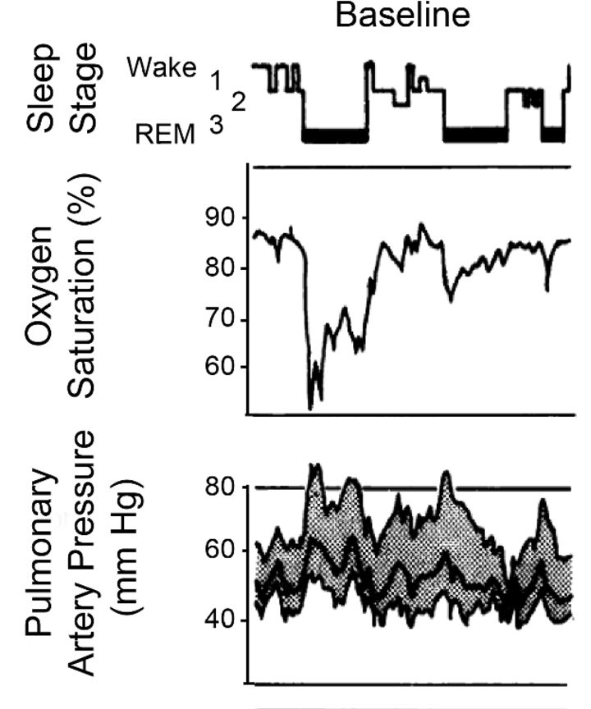
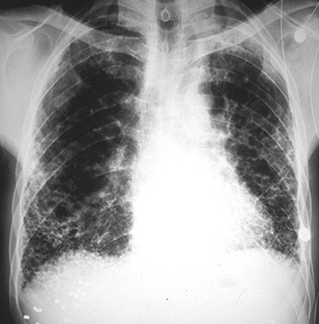
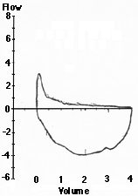
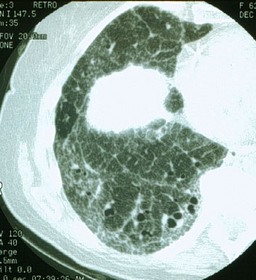
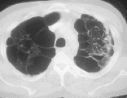
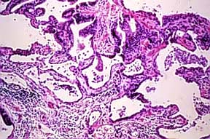
WHO Group 3 PH due to lung disease / hypoxemia

Slide 52
WHO Group 3 PH due to lung disease / hypoxemia
Diagnosis / Management
  Disproportionate dyspnea, edema
  Echo identification of PH and/or RV failure
  Optimal lung disease management
    Hypoxemia (resting, exertional, nocturnal eg. sleep apnea)
  Assess / treat contributing causes
    Identify and Rx pulmonary embolism
    Identify and Rx underlying heart disease / fluid overload
Notes:
Speaker’s Notes:
To complete the first two objectives, this presentation will examine the following illustration.
Expiratory airflow limitation is the pathophysiological hallmark of COPD. Expiratory flow limitations with dynamic collapse of the small airways compromise the ability of patients to expel air during forced and quiet expiration; thus air trapping and lung hyperinflation (overinflation) occurs.¹
Air Trapping and hyperinflation are the principal causes of dyspnea (or breathlessness).² It is the physiological mechanism that provides the link between expiratory airflow limitation and patient-centred outcomes.
Dyspnea: Impairment of lung mechanics appears central in generating dyspnea in COPD.³ COPD patients describe their dyspnea as a sense of increased effort to breathe, heaviness, air hunger or gasping.^{4 a}
Reduced Activity: Dyspnea can severely limit functional activities of COPD patients.⁵ Eventually dyspnea (breathlessness) is present during everyday activities (i.e., dressing, washing) or at rest, leaving the patient confined to the home.^{4a}
Deconditioning: Peripheral muscle dysfunction which contributes to exercise intolerance, results from the combined effects of immobility, altered nutritional status, prolonged hypoxia and, possibly, to sustained systemic inflammation.¹
The cycle of physical consequences of dyspnea include exercise deconditioning^{4b}. Many secondary effects of COPD symptoms are due to their effects on mobility and limitation of activity.⁶ This leads to a worsening of the disease and, ultimately, the patient’s HRQoL (Health Related Quality of Life) suffers.⁶
References:
1. O'Donnell DE, Aaron S, Bourbeau J, et al. Canadian Thoracic Society recommendations for management of chronic obstructive pulmonary disease 2003. Can Respir J. 2003;10(Suppl A):13A.
2. O'Donnell DE, Webb K. The etiology of dyspnea during exercise in COPD. Pulmonary and Critical Care Update 14, Lesson 15. http://www.chestnet.org/downloads/education/online/Vol14_13_18.pdf. Accessed February 24, 2004.
3. Calverley PMA, Chapter 16: Ventilatory control and breathlessness. In: Calverley PMA, MacNee W, Pride NB (eds). Chronic Obstructive Pulmonary Disease, 2nd edition. London: Arnold; pp.479-489.
4. Global Initiative for Chronic Obstructive Lung Disease. Global strategy for the diagnosis, management, and prevention of chronic obstructive pulmonary disease. NHLBI/WHO workshop report. http://www.goldcopd.com/workshop/toc.html. Accessed November 14, 2003. (a) Component 1: Assess and Monitor Disease. pg. 4 of 16. (b) Adapted from Component 3: Management of Stable COPD. pg. 14 of 29.
5. Mahler DA, Harver A. A factor analysis of dyspnea ratings, respiratory muscle strength, and lung function in patients with chronic obstructive pulmonary disease. Am Rev Respir Dis. 1992;145:467-470.
6. Jones PW. Chapter 31: Health Status. In: Calverley PMA, MacNee W, Pride NB (eds). Chronic Obstructive Pulmonary Disease, 2nd edition. London: Arnold; pp.479-489. (a) pg. 480, (b) pg. 479 Fig. 31.1

Slide 53
Management:
WHO Group 3 PH due to lung disease / hypoxemia
Mild-moderate PH / absence of RV failure:
We recommend against routine RHC and against the use of PAH-targeted therapy
Strong Recommendation, Moderate-Quality Evidence
Moderate-severe PH and/or RV failure:
We suggest referral to a PH centre
  Strong Recommendation, Low-Quality Evidence
N Hirani et al / CCS - CTS, CJC 2020

Slide 54
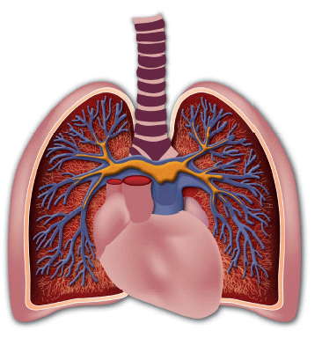
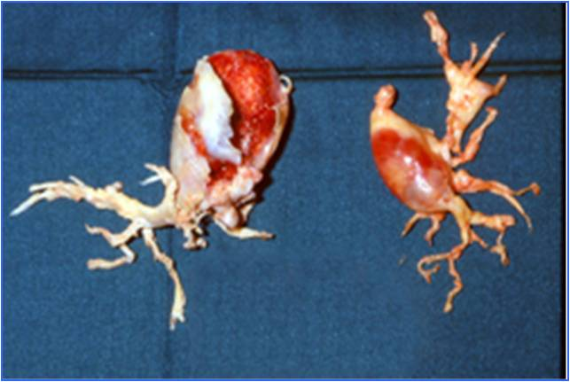
WHO Group 4 chronic thromboembolic PH (CTEPH)
The most important cause of PH
  A common cause of PH which is frequently curable
  Established diagnostic work-up
  Available, effective treatment options
    Anticoagulation
    PEA/Pulmonary endarterectomy surgery
    PH-specific medical therapy
    Balloon pulmonary angioplasty (BPA)

Slide 55
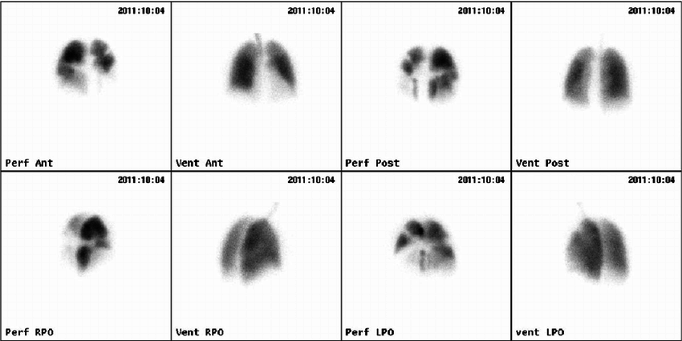
Nuclear V/Q lung scan
CTEPH

Slide 56
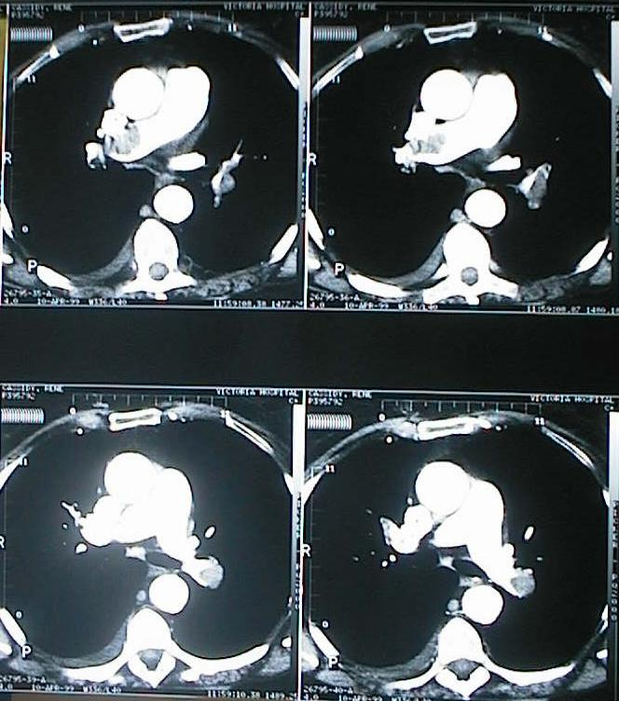

Slide 57
WHO Group 4 CTEPH can be cured by pulmonary endarterectomy
Notes:
Surgical Approach:
Bilateral approach
Median sternotomy
Cardiopulmonary bypass
Deep hypothemia
Circulatory arrest
Removal of all thrombotic material is crucial
Criteria for surgical intervention – from ACCP clinical guidelines:
NYHA FC II or IV
Preoperative PVR > 300
Surgically accessible thrombus in main lobar or segmental PA
No severe comorbidities
Major reasons for rejection of interventions are severe comorbidity and significant distal disease with excessive PH
CTEPH pts are classified into four types – type 1 (fresh thrombus), type 2 (intimal thickening and fibrosis proximal to the segmental arteries), type 3 (disease with distal segmental arteries only), type 4 (distal arteriolar vasculopathy without visible thromboembolic disease) This is intraoperative and does not help select surgical candidates.
Postoperative management and Complications
Most important is postoperative PH. Seen in approx. 10% of pts. Due to inadequat removal of distal thrombotic pathology, or secondary vasculopathy (small-vessel) and can lead to RVF.
Reperfusion edema
Postoperative Outcome:
Mortality rates range from 4 to 24%
Persistent PH is the principal cause
Followed by pulmonary edema and pneumopathy
Survival rate for PEA appears to be superior to that of lung transplantation for CTEPH

Slide 58
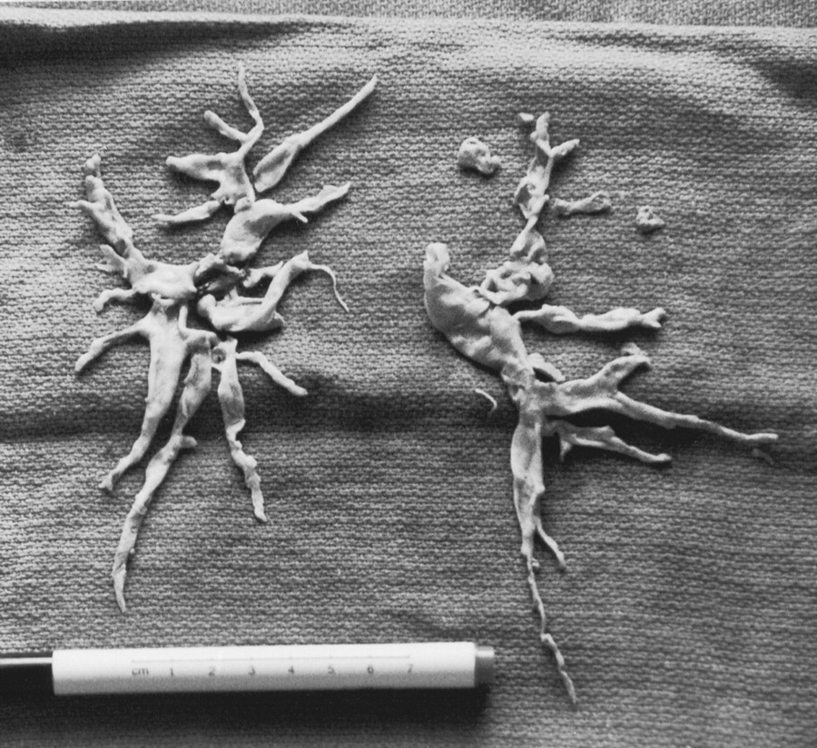

Slide 59
PEA surgery: outcome
X – Untreated Historical
Survival
M Madani et al / UCSD, Ann Thoracic Surg 2012

Slide 60
CTEPH: a role for PH-targeted medical therapy
Rx: Riociguat, BPA,
? others
Distal vascular obstruction - inoperable
Proximal vascular obstruction surgery eligible
Residual
Post-Op PH
‘Cured’

Slide 61
Case wrap-up
What is the most likely cause of the PH?
What are the next steps in diagnosis?
What is his assessment of risk?
What treatment strategies should be considered?

Slide 62


QUESTIONS?

Slide 63



CCS/CHFS HF Guidelines Webinar
What’s new in 2021: An updated standard of care of HFrEF
On Thursday, April 15, 2021 from 8 PM – 9 PM EDT, join us for an interactive case-based webinar highlighting content from the 2021 Canadian Cardiovascular Society/Canadian Heart Failure Society Heart Failure Guidelines Update: Defining a New Pharmacologic Standard of Care for HFrEF
Register at CCS.ca
FACULTY
Dr. Ezekowitz
Dr. McDonald
Dr. Virani
Notes:
https://register.gotowebinar.com/register/5061842984723377419

