Slide 1
Atrial Fibrillation:
All about stroke prevention !
Guidance from the CCS/CHRS 2020 Atrial Fibrillation Guideline Panel
April 22, 2021

Slide 2
© Canadian Cardiovascular Society. 2021. All rights reserved.
Distribution, transmission or republication is strictly prohibited without the prior written permission of the Canadian Cardiovascular Society.
For medical institution internal education or training (i.e. grand rounds, medical college/classroom education, etc.), kindly consider and implement the following:
  Include the citation for the Canadian Journal of Cardiology
  Add ‘Reproduced with permission from the Canadian Cardiovascular Society. [insert year].’
  Avoid use of CCS logos or trademarks on slides, tools or publications that are not the property of the CCS
  Do not modify the slide content and, the layout and CCS branding on the Guideline-related slides
  Guideline recommendations must be reproduced exactly as published
For an industry supported or involved program, permissions are required:
  If content is published in the Canadian Journal of Cardiology, permissions must be sought through our publisher Elsevier (www.onlinecjc.com)
  If content is property of the CCS, contact guidelines@ccs.ca

Slide 3
WELCOME TO THE CCS/CHRS AF WEBINAR SERIES
Webinar 1: All about stroke prevention!
Wednesday, April 22, 2021 from 8 PM – 9 PM ET
Webinar 2: When it comes to arrhythmia management…
Thursday, July 8, 2021 from 8 PM – 9 PM ET
Webinar 3: Focus on screening and prevention
Thursday, September 23, 2021 from 8 PM – 9 PM ET
The Canadian Cardiovascular Society is grateful to our partner(s) for their commitment to building knowledge and expertise of the heart team. This program was made possible in part by Bayer, BMS/Pfizer Alliance and Servier. CCS thanks our partners for their dissemination support so that healthcare providers can benefit from this important information.
Register at CCS.ca/programs-and-events/

Slide 4

CHRS President
Laurence Sterns
MD, FRCPC
Victoria, BC
Head, Cardiac Electrophysiology Program and Pacemaker/ICD Clinic, Royal Jubilee Hospital

Slide 5
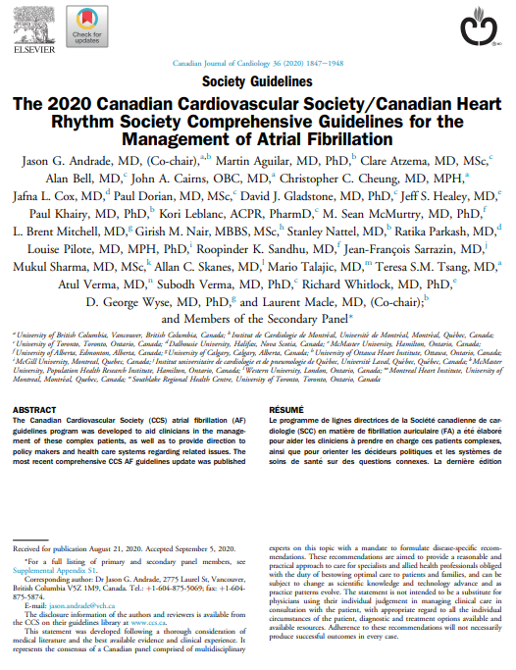
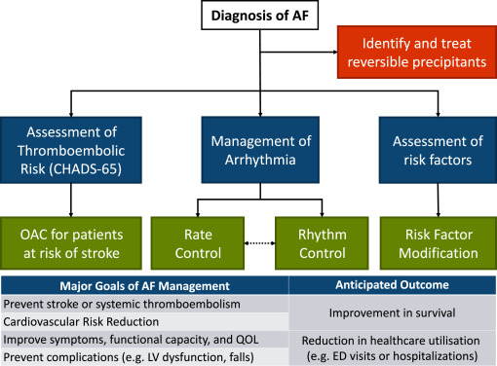
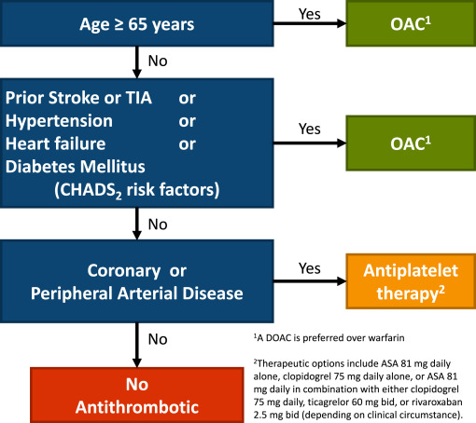
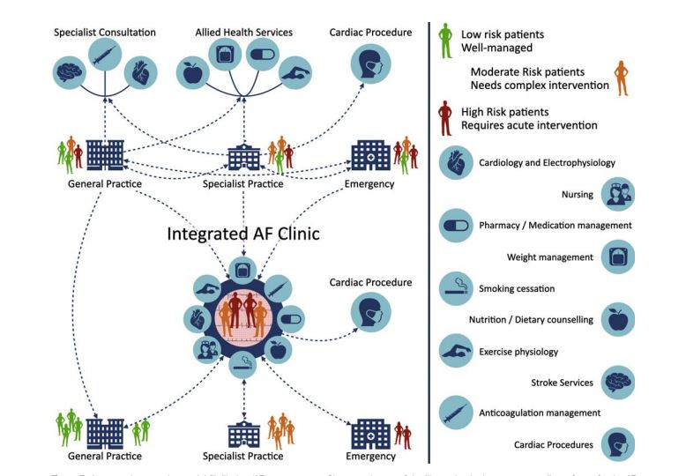
CCS/CHRS 2020 Comprehensive AF Guidelines
CCS/CHRS Atrial Fibrillation Guidelines – DOI: https://doi.org/10.1016/j.cjca.2020.09.001

Slide 6
CCS/CHRS KTA COLLABORATION
Webinar series to encourage dissemination of key topics from the 2020 comprehensive AF guidelines
Works in progress:
  Website updates and online decision support tools
  Collaborative communication efforts
    We are working to establish a communication campaign to announce the pocket guide, webinars and additional companion publications (focused for specific audiences)
  Needs assessments + themes of care
    CCS Guideline Review Working Group is developing a needs assessment to rank AF themes of care, identify barriers and facilitators and assess preferences for practice tools and learning modes

Slide 7
INTRODUCING THE CCS/CHRS AF WEBINAR SERIES
Webinar 1: All about stroke prevention!
Wednesday, April 22, 2021 from 8 PM – 9 PM ET
Moderators: Laurence Sterns, Laurent Macle
Faculty: Jason Andrade, Alan Bell, Kori Leblanc, L. Brent Mitchell, Teresa Tsang
Webinar 2: When it comes to arrhythmia management…
Thursday, July 8, 2021 from 8 PM – 9 PM ET
Moderators: Matthew Bennett, Jason Andrade
Faculty: Martin Aguilar, Clare Atzema, Louise Pilote, Atul Verma
Webinar 3: Focus on screening and prevention
Thursday, September 23, 2021 from 8 PM – 9 PM ET
Moderators: Jason Andrade, Laurent Macle
Faculty: Paul Dorian, Jeff Healey, Ratika Parkash, Roopinder Sandhu
Register at CCS.ca/programs-and-events/

Slide 8
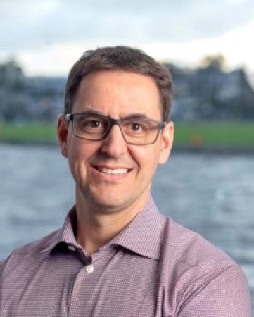
MODERATOR
Laurent Macle
MD, FRCPC
Montreal, QC
Cardiac electrophysiologist
Professor of Medicine, Université de Montréal
Chief of electrophysiology service, Montreal Heart Institute

Slide 9
Atrial Fibrillation:
All about stroke prevention !
Guidance from the CCS/CHRS 2020 Atrial Fibrillation Guideline Panel
April 22, 2021
This webinar is an Accredited Group Learning Activity (Section 1) as defined by the Maintenance of Certification Program of the Royal College of Physicians and Surgeons of Canada, and approved by the Canadian Cardiovascular Society. You may claim a maximum of 1 hour.

Slide 10


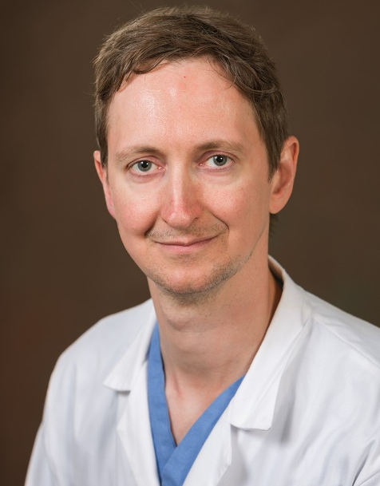
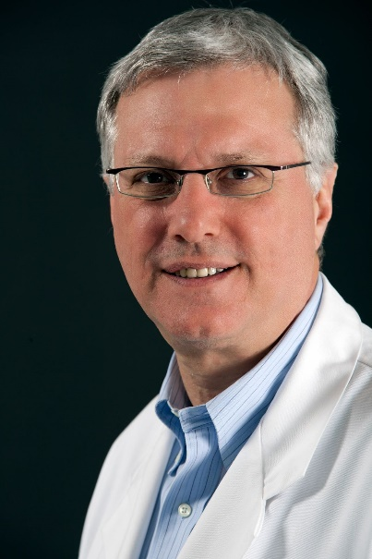
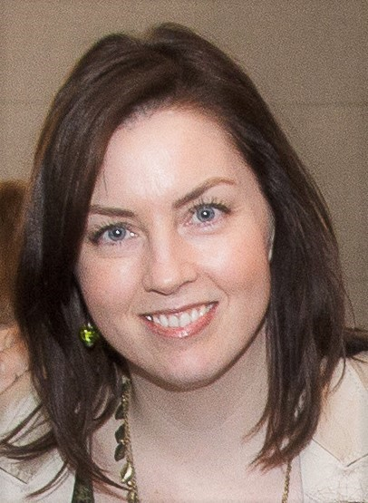

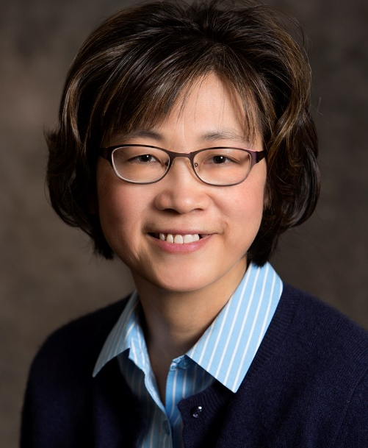
Our Faculty
Laurence
Sterns
Laurent
Macle
CHRS President
MODERATOR
Jason
Andrade
Alan
Bell
Kori
Leblanc
L. Brent
Mitchell
Teresa
Tsang

Slide 11

Disclosure of potential conflicts of interest
Laurent Macle
Consulting Fees/Honoraria: BMS Pfizer, Servier, Johnson & Johnson, Medtronic
Clinical Trials: BMS Pfizer, Johnson & Johnson
Laurence Sterns
Consulting Fees/Honoraria: Bayer, Johnson & Johnson
Clinical Trials: Abbott, Boston Scientific, Medtronic
Jason G. Andrade
Consulting Fees/Honoraria: Bayer HealthCare, BMS/Pfizer Alliance, Medtronic, Servier
Grants/Research Support: Canadian Arrhythmia Network, a Network of Clinical Excellence, Heart and Stroke Foundation of Canada, Michael Smith Foundation for Health Research, Baylis Medical, Medtronic, Inc, Bayer HealthCare, BMS/Pfizer Alliance, Servier

Slide 12
Disclosure of potential conflicts of interest
Alan D. Bell
Consulting Fees/Honoraria: Amgen, AstraZeneca, Bausch Health, Bayer, Boehringer Ingelheim, BMS, Canopy, Janssen, Lilly, Novartis, Sanofi, Servier, Takeda
Clinical Trials: Amgen, AstraZeneca, Bayer, Boehringer Ingelheim, BMS, Canopy, Janssen, Lilly, Novartis, Pfizer, Sanofi, Bausch Health, Servier
L. Brent Mitchell
Consulting Fees/Honoraria: Boehringer Ingelheim, Bristol-Myers Squibb, Pfizer, Medtronic
Clinical Trials: Bristol-Myers Squibb
Teresa Tsang
Consulting Fees/Honoraria: Bayer, Boehringer Ingelheim, Bristol-Myers Squibb, Pfizer, Sanofi, Servier
Grants/Research Support: CIHR, NSERC, UBC VPRI, Bayer, Sanofi, Canada Supercluster, Vancouver Coastal Health Research Institute
Kori Leblanc
Consulting Fees/Honoraria: AstraZeneca, Bayer, Boehringer Ingelheim, BMS, Novartis, Sanofi, Servier
Clinical Trials: Boehringer Ingelheim, Servier

Slide 13
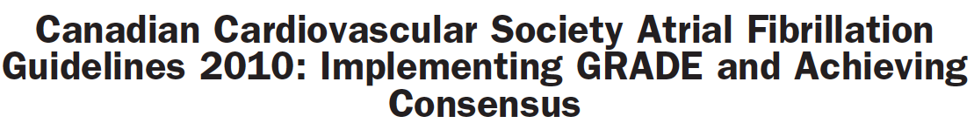
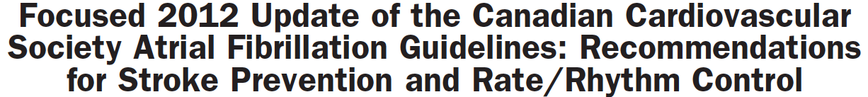

Gillis et al. Canadian Journal of Cardiology 2011;27:27-30
Skanes et al. Canadian Journal of Cardiology 2012;28:125-36
Verma et al. Canadian Journal of Cardiology 2014;30:1114-30
Macle et al. Canadian Journal of Cardiology 2015;31:1207-18
Macle et al. Canadian Journal of Cardiology 2016;32:1170-85
Andrade et al. Canadian Journal of Cardiology 2018;34:1371-92
Notes:
LAURENT
The Canadian Cardiovascular Society (CCS) Atrial Fibrillation (AF) Guidelines committee provides periodic reviews of new data to produce focused updates that address clinically-important advances in AF management.

Slide 14
Authors
2020 CCS/CHRS Comprehensive Guidelines for the Management of Atrial Fibrillation
Primary Panel: Jason G. Andrade (co-chair), Laurent Macle (co-chair), Martin Aguilar, Clare Atzema, Alan Bell, John A. Cairns, Christopher C. Cheung, Jafna L. Cox, Paul Dorian, David J. Gladstone, Jeff S. Healey, Paul Khairy, Kori Leblanc, M. Sean McMurtry, L. Brent Mitchell, Girish M. Nair, Stanley Nattel, Ratika Parkash, Louise Pilote, Roopinder K. Sandhu, Jean-François Sarrazin, Mukul Sharma, Allan C. Skanes, Mario Talajic, Teresa S. M. Tsang, Atul Verma, Subodh Verma, Richard Whitlock, D. George Wyse
Secondary Panel: David Bewick, Vidal Essebag, Peter Guerra, Milan Gupta, Brett Heilbron, George Klein, Simon Kouz, Daniel Ngui, Pierre Pagé, Calum Redpath, Jan Surkes
Notes:
The 2020 iteration of the CCS AF guidelines represents a comprehensive renewal that integrates, updates and replaces the past decade of guidelines, recommendations, and practical tips. It is intended to be used by practising clinicians across all disciplines who care for patients with AF.

Slide 15
Overview of Guideline Topics
Content
  Classification and Definitions
  Epidemiology
  Pathophysiology
  Clinical Evaluation
  Screening and Opportunistic AF Detection
  Detection and Management of Modifiable Risk Factors
  Integrated Approach to AF Management
  Stroke Prevention
  Arrhythmia Management
  Sex Differences
  Atrial Fibrillation and Special Populations
Notes:
Total: 130 recommendations, 20 figures, 9 tables

Slide 16

Overall Learning Objectives
Atrial Fibrillation:
All about stroke prevention!
Guidance from the CCS/CHRS 2020 Atrial Fibrillation Guideline Panel
Discuss stroke prevention considerations in general, and for patients with CKD and special populations (liver disease, obesity, cancer, frailty)
Review optimal management of antithrombotic therapy for patients with CAD
Explore anticoagulation in the context of cardioversion

Slide 17
Atrial Fibrillation:
All about stroke prevention!
Guidance from the CCS/CHRS 2020 Atrial Fibrillation Guideline Panel
Topic | Speakers
Stroke prevention, bleeding and bridging | Teresa Tsang
Stroke prevention in patients with AF and Chronic Kidney Disease | Jason Andrade
Optimal management of antithrombotic therapy in patients with AF and concomitant CAD | Alan Bell
Anticoagulation in the context of cardioversion | Brent Mitchell
Stroke considerations for special populations | Kori Leblanc
Q&A
Notes:
Total: 130 recommendations, 20 figures, 9 tables

Slide 18
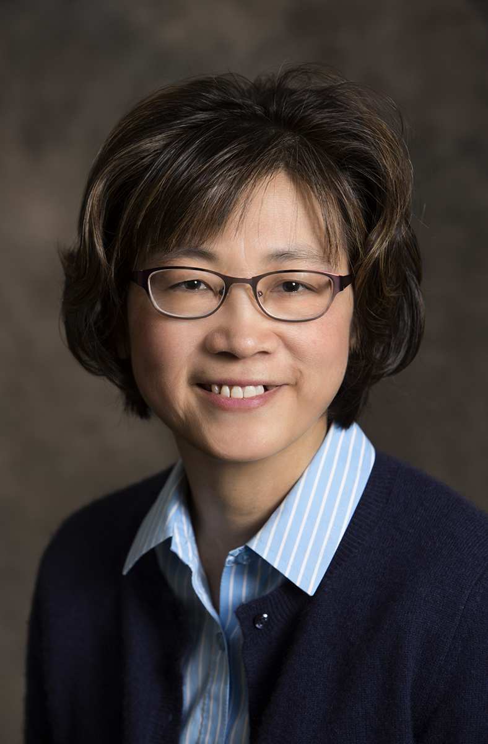
Stroke prevention
Teresa Tsang
MD, FRCPC, FACC, FASE
Vancouver, BC
Director of Echo Lab, VGH and UBC
Professor of Medicine, Division of Cardiology
Associate Head Research, Department of Medicine
University of British Columbia
@TTcardUBC

Slide 19

Learning Objectives
Discuss stroke risk stratification in AF
Discuss use of anticoagulants in AF in general

Slide 20
CHADS-65
Factor | Definition
Congestive heart failure | Signs and symptoms of HF with reduced EF Recent decompensated HF of any EF
Hypertension | SBP>140 and/or DBP>90 mm Hg on at least 2 occasions, or on antihypertensive treatment
Age 65 | Age ≥ 65 years
Diabetes mellitus | Fasting glucose ≥7 mmol/L, or treatment with oral hypoglycemic agents and/or insulin
Stroke or TIA or peripheral embolism | Ischemic stroke: focal neurological deficit >24 h TIA: focal neurological deficit <24 h Peripheral embolism: thromboembolism outside brain, heart, eyes, and lungs; or pulmonary embolism
Vascular disease | Coronary artery disease, peripheral artery disease, or aortic plaque

Slide 21
Special valve considerations in patients with AF
Mechanical Valves: warfarin
  RE-ALIGN (Dabigatran versus warfarin in AF patients with mechanical valves): higher thromboembolic and bleeding events with Dabigratran.
Moderate/severe mitral stenosis (rheumatic, non-rheumatic): warfarin
  No randomized trials; 4- to 15-fold decrease in the incidence of embolic events with warfarin. Severe mitral valve disease was excluded from key DOAC trials; by default, warfarin remains the standard of care in this group.
  INVICTUS: Ongoing trial of rivaroxaban versus warfarin in these patients.
Bioprosthetic Valves: DOAC
  RIVER (bioprosthetic mitral valve): Rivaroxaban was noninferior to warfarin with respect to the mean time until the primary outcome (death, major cardiovascular events, or major bleeding at 12 months).

Slide 22
HAS-BLED bleeding risk score and risk mitigation
HAS-BLED | SCORE
Hypertension (SBP>160 mm Hg) | 1
Abnormal renal function (Cr>200 umol/L) or liver function (cirrhosis, bilirubin >2x upper normal, or AST/ALT/ALP >3 x upper normal | 1 1
Stroke history | 1
Bleeding (major) or tendency (prior GI bleed, PUD, prior cerebral hemorrhage) | 1
Labile INR (unstable INR, time in therapeutic range <60%) | 1
Elderly: Age >65 years | 1
Drugs (antiplatelet, NSAIDS, anti-inflammatory medications, steroids); alcohol or drug abuse | 1
Major bleeding risk
(% per year)
15 %
12.5
8.7
3.7
1.02
1.9
1.1
0 %
0
1
2
3
4
5
HASBLED Score
*Other conditions with increased bleeding risk: Thrombocytopenia, coagulation defects, anemia,
lower body weight, drug interactions
*Correct dosing of DOACs with changing renal function; effective INR monitoring
*PPI to decrease the risk of gastrointestinal adverse effects for patients who require daily antithrombotic therapy that includes ASA (Weak Recommendation; Moderate-Quality Evidence).

Slide 23
DOACs vs warfarin in clinical trials:
Efficacy and safety differences
 | Apixaban (Eliquis) | Dabigatran 110 (Pradaxa) | Dabigatran 150 (Pradaxa) | Edoxaban 60 (Lixiana) | Rivaroxaban (Xarelto)
Stroke/Systemic Embolism
Major Bleed
Intracranial Bleed
GI Bleed
Death
Significant
Increase
Significant
Reduction
Non-Significant Difference
(all-cause
death)
(CV death)
To date there are no head-to-head trials between apixaban, dabigatran, edoxaban and rivaroxaban, therefore comparative efficacy
and safety have not been established
**Bleed management considerations: prevention is key; warfarin (hold warfarin, vit K, FFP, PCC; tranexamic acid & aminocaproic acid); DOAC (delay dose; idarucizumab for dabigatran; PCC; andexanet for Factor Xa inhibitors when available; tranexamic acid and & aminocaproic acid)
All-cause mortality, regardless of the cause; CV death: cardiovascular mortality
Adapted from: Ruff CT, et al. Lancet 2014;383(9921):955-62; Granger CB, et al. N Engl J Med 2011;365(11):981-92; Connolly SJ, et al. N Engl J Med 2009;361:1139-51; Patel MR, et al. N Engl J Med 2011;365:883-91; Giugliano RP, et al. N Engl J Med 2013;369:2093-104.
Notes:
DOAC preferred over Warfarin
Efficacy at least as good
Bleeding less particularly ICH
Convenience
No head to head comparisons between DOAC
“Real World” data plentiful but too subject to bias for decision making

Slide 24

Interrupting anticoagulation for a procedure
Bleeding Risks:
Procedural risks (minimal, low-moderate, moderate-severe)
Recommendations:
Minimal risk – no need to interrupt
Low-moderate, high, or uncertain risks – interruption
Patient bleeding risks (HAS-BLED score)
Thromboembolic Risks
High Risks if:
CHADS2 score 5-6
Mechanical valve
Thromboembolism <3 m
Moderate-severe mitral stenosis
Practical Tip: http://thrombosiscanada.ca

Slide 25
Risk categories of procedures (CCS/CHRS AF Guidelines 2020)
Minimal Bleed Risk No need to interrupt OAC | Low/Moderate Bleed Risk Need to Interrupt | High Bleed Risk Need to Interrupt
Cataract surgery Dermatologic procedures (e.g. biopsy) Gastroscopy or colonoscopy without biopsies Coronary angiography (using radial arterial approach) Permanent pacemaker insertion or internal defibrillator placement (if bridging anticoagulation is not used) Selected procedures with small-bore needles (e.g. thoracentesis, paracentesis, arthrocentesis) Dental extractions (1 or 2 teeth) Endodontic (root canal) procedure Subgingival scaling or other cleaning | Abdominal surgery (e.g. cholecystectomy, hernia repair, colon resection) Other general surgery (e.g. breast) Other intrathoracic surgery Other orthopedic surgery Other vascular surgery Non-cataract ophthalmologic surgery Gastroscopy or colonoscopy with biopsies Coronary angiography* Selected procedures with large-bore needles (e.g. bone marrow biopsy, lymph node biopsy) Complex dental procedure (e.g. multiple tooth extractions) | Any surgery or procedure with neuraxial (spinal or epidural) anesthesia Neurosurgery (intracranial or spinal) Cardiac surgery (e.g. CABG, heart valve replacement) Major vascular surgery (e.g. aortic aneurysm repair, aortofemoral bypass) Major orthopedic surgery (e.g. hip/knee joint replacement surgery) Lung resection surgery Urological surgery (e.g. prostatectomy, bladder tumour resection) Extensive cancer surgery (e.g. pancreas, liver) Intestinal anastomosis surgery Reconstructive plastic surgery Selected procedures involving vascular organs (e.g. kidney biopsy, prostate biopsy) or high bleed risk interventions (e.g., colonic polypectomy, spinal injection, pericardiocentesis)
Andrade et al. 2020 Canadian Cardiovascular Society/Canadian Heart Rhythm Society Comprehensive Guidelines for the Management of Atrial Fibrillation Canadian Journal of Cardiology.
Notes:
This slide shows the risk categorization.
Low-moderate risk

Slide 26
Andrade et al. 2020 Canadian Cardiovascular Society/Canadian Heart Rhythm Society Comprehensive Guidelines
for the Management of Atrial Fibrillation Canadian Journal of Cardiology.

Slide 27
Andrade et al. 2020 Canadian Cardiovascular Society/Canadian Heart Rhythm Society Comprehensive Guidelines
for the Management of Atrial Fibrillation Canadian Journal of Cardiology.

Slide 28

Stroke prevention in patients with CKD
Jason Andrade
MD, FRCPC, FHRS
Vancouver, BC
Cardiac Electrophysiologist, Vancouver General Hospital, with joint appointment at St. Paul’s Hospital and the Montreal Heart Institute
Associate Professor of Medicine, University of British Columbia
Assistant Professor, Université de Montréal
Director, Electrophysiology Laboratory, Atrial Fibrillation Clinic, Vancouver General Hospital
Medical Chair, Heart Rhythm Disease, Cardiovascular Disease Network, BC
Co-Chair, CCS Atrial Fibrillation Guidelines
Past-Chair, CHRS Education Committee
@DrJasonAndrade

Slide 29
Learning Objectives
To recognize appropriate use of OAC across stages of CKD
To understand the means and need for dose adjustment for DOACS

Slide 30
AF and CKD – commonly co-exist
1/3 of AF Patients have CKD
GFR 15-29
2%
GFR <15
1%
GFR 30-44
10%
GFR 45-59
20%
eGFR >60
67%
Can J Cardiol 2013; 29(7 Suppl):S60-S70.

Slide 31
AF and CKD – commonly co-exist
1/3 of AF Patients have CKD
CKD is associated with worse outcomes
GFR 15-29
2%
GFR <15
1%
GFR 30-44
10%
GFR 45-59
20%
eGFR >60
67%
Can J Cardiol 2013; 29(7 Suppl):S60-S70.
N Engl J Med 2012; 367:625-35.

Slide 32
AF and CKD – DOACs work well for CrCl >30
Meta-analysis of Phase III Trials – Moderate Renal Impairment Population
Stroke or Systemic Embolism
Creatinine clearance (mL/min)
< 50 | 249/5,539 | 311/5,503 |  | 0.79 (0.65-0.96)
50-80 | 405/13,055 | 546/13,155 |  | 0.75 (0.66-0.85)
> 80 | 256/10,626 | 255/10,533 |  | 0.98 (0.79-1.22)
Major Bleeding
Creatinine clearance (mL/min)
< 50 | 514/4,376 | 620/4,346 |  | 0.74 (0.52-1.05)
50-80 | 1104/10,139 | 1174/10,228 |  | 0.91 (0.76-1.08)
> 80 | 625/8,681 | 672/8,595 |  | 0.85 (0.66-1.10)
0.5
1
2
Ruff CT, et al. Lancet 2014; 383(9921):955-62.
Favors DOAC
Favors warfarin

Slide 33
AF and CKD – safety and efficacy for CrCl 15-30
Stroke or Systemic Embolism
Major Bleeding
Yao et al. Circ Cardiovasc Qual Outcomes 2020 Oct;13(10):e006515

Slide 34
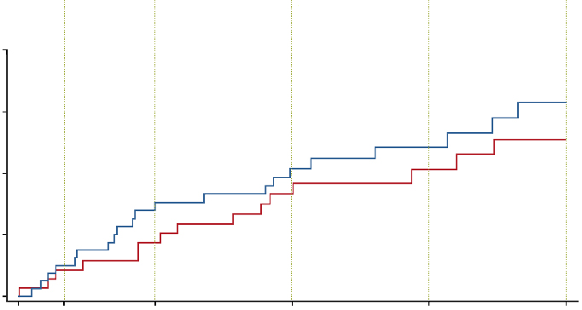


AF and ESRD
 | Apixaban N = 82 | Warfarin N = 72
ISTH major bleed/clinically relevant non-major bleed¹ | 21 (25.6%) | 16 (22.2%)
Intracranial | 1 (1.2%) | 1 (1.4%)
Gastrointestinal | 2 (2.4%) | 6 (8.3%)
Hemodialysis access site | 11 (13.4%) | 6 (8.3%)
Stroke | 2 (2.4%) | 2 (2.8%)
Ischemic | 1 (1.2%) | 2 (2.8%)
Hemorrhagic | 1 (1.2%) | 0 (0.0%)
Systemic embolism | 0 (0.0%) | 0 (0.0%)
Death | 21 (25.6%) | 13 (18.1%)
Cardiovascular | 9 (11.0%) | 4 (5.6%)
Non-cardiovascular | 5 (6.1%) | 8 (11.1%)
Undetermined | 7 (8.5%) | 1 (1.4%)
Event
rates:
5.0%
4.3%
15.3%
8.7%
20.7%
16.6%
24.2%
20.6%
31.5%
25.5%
40
30
Apixaban
Warfarin
ISTH Major Bleed/Clinically Relevant Non-major Bleed (%)
20
10
HR (95% CI):
1.20 (0.63, 2.30)
0
0
1
3
6
9
12
Number of risk
Months from randomization
Apixaban
82
72
64
62
55
48
32
34
24
21
Warfarin

Slide 35
AF and CKD
Severity of CKD | RECOMMENDATION
CrCl >30 mL/min | We recommend patients receive antithrombotic therapy as determined by the “CCS Algorithm” (Strong Recommendation; High-Quality Evidence).
CrCl 15-29 mL/min | We suggest patients receive antithrombotic therapy as determined by the “CCS Algorithm” (Weak Recommendation; Low-Quality Evidence).
CrCl <15 mL/min* (or on dialysis) | We suggest patients not routinely receive anticoagulation therapy or antiplatelet therapy for stroke prevention in AF (Weak Recommendation; Low-Quality Evidence).

Slide 36
AF and CKD – DOACs require dose adjustment
CrCl > 80 mL/min
Mild
CrCl 50-80 mL/min
Moderate
CrCl 30-50 mL/min
Severe
CrCl < 30 mL/min
Pradaxa package insert, Boehringer Ingelheim Pharmaceuticals Inc. Xarelto package insert, Janssen Pharmaceuticals Inc.
Eliquis package insert, BMS/Pfizer. Lixiana package insert, Daiichi Sankyo Inc.
Notes:
It is important to consider that not all NOACs are the same with respect to renal clearance.
For the example, dabigatran has a high reliance for renal clearance meaning that, as renal function declines, there is more exposure to anticoagulant effect of the drug.
This relative effect is lower with rivaroxaban, edoxaban, and apixaban, meaning the impact of chronic kidney disease is less with these other agents.

Slide 37
AF and CKD – CrCl for dose adjustment
831 non-dialysis-dependent
CKD patients with AF (CHA₂DS₂-VASc 3.9)
CrCl > 80 mL/min
Mild
CrCl 50-80 mL/min
 | MDRD
CG | < 30 | 30-50 | > 50 | Total
< 30 | 318 | 60 | 3 | 381 (46%)
30-50 | 110 | 167 | 14 | 291 (35%)
> 50 | 14 | 100 | 45 | 159 (19%)
Total | 442 (53%) | 327 (39%) | 62 (7%) | 831
Moderate
CrCl 30-50 mL/min
Severe
CrCl < 30 mL/min
Agreement = 63.8% (95% CI 59.6-67.7)
Under-treated = 26.9% (95% CI 23.3-30.9)
Over-treated = 9.3% (95% CI 7.1-12.0)
Pradaxa package insert, Boehringer Ingelheim Pharmaceuticals Inc. Xarelto package insert, Janssen Pharmaceuticals Inc.
Eliquis package insert, BMS/Pfizer. Lixiana package insert, Daiichi Sankyo Inc.
Andrade J, et al. Can J Cardiol 2018; 34(8);1010-8.
Notes:
It is important to consider that not all NOACs are the same with respect to renal clearance.
For the example, dabigatran has a high reliance for renal clearance meaning that, as renal function declines, there is more exposure to anticoagulant effect of the drug.
This relative effect is lower with rivaroxaban, edoxaban, and apixaban, meaning the impact of chronic kidney disease is less with these other agents.

Slide 38
AF and CKD

Slide 39

Optimal management of antithrombotic therapy in patients with AF and concomitant CAD
Alan Bell
MD, CCFP, FCPC
Toronto, ON
Assistant Professor, Department of Family and Community Medicine, University of Toronto
Vice President, Thrombosis Canada
Board of Directors, Hypertension Canada
@AlanBellmd

Slide 40
Learning Objectives
In patients with AF and concomitant CAD:
Provide an evidence based approach to the antithrombotic management
Define thrombotic and bleeding risk that determines choice and duration of antithrombotic therapy

Slide 41
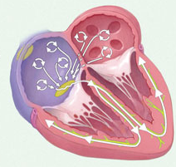
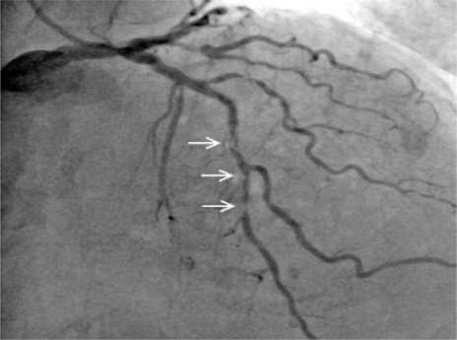
Concomitant AF and CAD
Approximately 30% of patients with AF also have CAD
Coronary Artery Disease
Atrial Fibrillation
Singer DE, et al. Ann Intern Med 2009;151:297-305

Slide 42
Management of CAD + AF
STROKE RISK
CORONARY RISK
1. Stable CAD
2. Recent ACS or PCI
Low Risk
High Risk

Slide 43
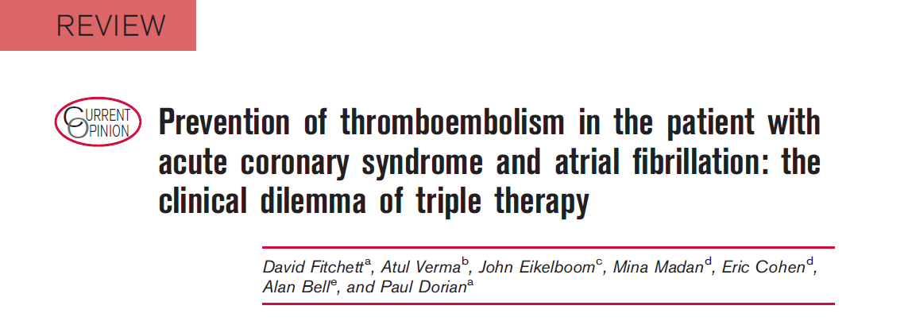
Where we were 7 years ago
Additional research studies are required to further optimize treatment strategies in this high-risk population
Curr Opin Cardiol. 2014 Jan;29(1) 1-9

Slide 44
Where are we now compared to the dreaded triple therapy?
RANDOMIZED CONTROLLED TRIALS
AF + PCI / ACS
WOEST – WARFARIN
PIONEER AF PCI – RIVAROXABAN
RE-DUAL PCI – DABIGATRAN
AUGUSTUS – APIXABAN
ENTRUST AF – EDOXABAN
AF + STABLE CAD
AFIRE - RIVAROXABAN

Slide 45
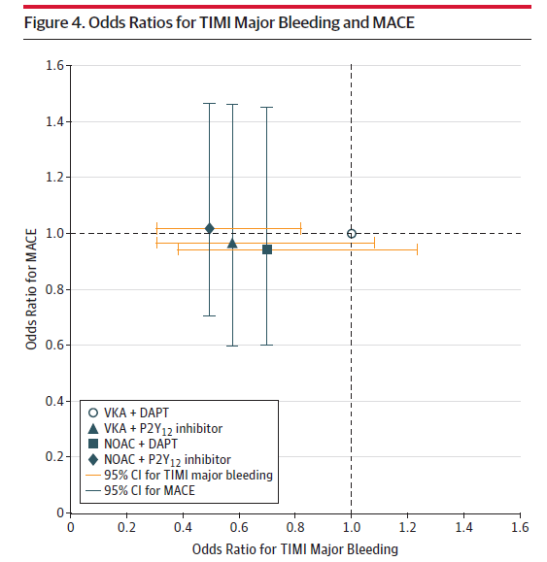
Dual pathway vs triple Rx Metaanalysis
Lopes RD, Hong H, Harskamp RE, et al.
JAMA Cardiol. 2019;4(8):747–755
Notes:
IMPORTANCE The antithrombotic treatment of patients with atrial fibrillation (AF) and coronary

Slide 46
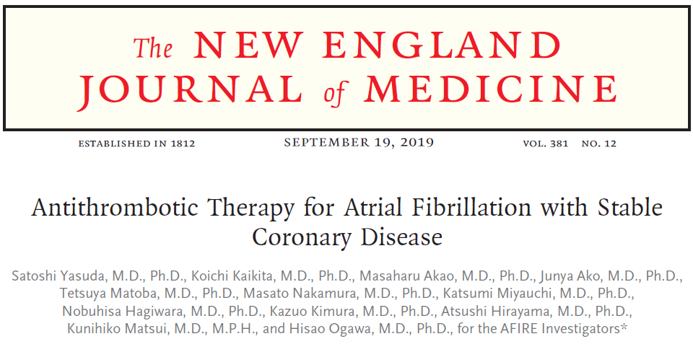
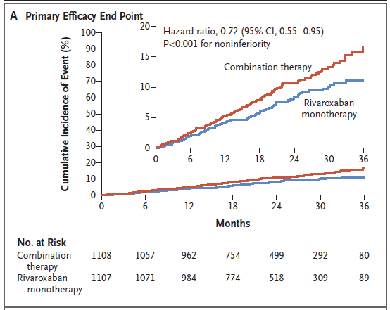
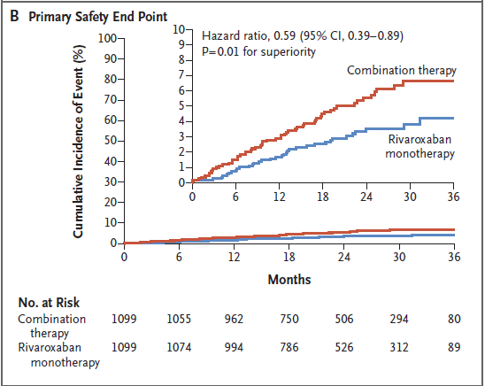
AF + stable CAD

Slide 47
Tested OAC regimens include:
Rivaroxaban 2.5 mg BID
Apixaban 5/2.5 BID
NOAC Preferred over warfarin
  If warfarin used target INR 2 – 2.5
Tested OAC regimens include:
Rivaroxaban 15 mg OD
Dabigatran 110/150 BID
Apixaban 5/2.5 mg BID
Edoxaban 60/30 mg OD
Warfarin (DOAC preferred)
1 YEAR
Tested OAC regimens include
Apixaban 5/2.5 BID
Tested OAC regimens include
Rivaroxaban 15/10 mg OD
Single antiplatelet may be added only in highly-selected patients with high-risk for ischemia and low risk of bleeding

Slide 49

Anticoagulation in the context of cardioversion
L. Brent Mitchell
MD, FRCPC, CAHS
Calgary, AB
Professor of Medicine, Department of Cardiac Sciences, Libin Cardiovascular Institute, Alberta Health Services and University of Calgary

Slide 50
Learning Objectives
Review the CCS AF Guidelines for the selection of patients presenting to acute care with AF who may undergo immediate cardioversion in the absence of three weeks of prior therapeutic anticoagulation.
Explore the rationale for the CCS AF Guidelines recommendation that all patients receive at least one month of anticoagulation after undergoing cardioversion of atrial fibrillation.

Slide 51
Stroke prevention for CV of AF: Questions
Is CV a risk factor for stroke / STE in AF without OAC? ............YES (RR ≈ 2.6)
If CV is a risk factor, does OAC decrease this risk?..............YES (RRR ≈ 0.80)
Is CV in acute AF (<48 hours) without AC safe? NOT ALWAYS (≈ 0.8% in 30d)
When is CV of acute AF without 3 weeks of prior OAC appropriate?
Should all patients receive OAC for at least 1 month after CV of AF?
Are the DOACs acceptable alternatives to warfarin in this setting?

Slide 52
Parsing the risk of TE after CV of acute AF
AF <48 H no OAC: ≤12 H Versus >12 H
AF <48 h with CV On AC Versus Off AC by CHA₂DS₂-VASc
>12 H: RR 3.42 (1.57-7.44), P<0.001
CHAD₂DS₂-Vasc ≥2: 0.2% vs. 1.1%; RRR 0.84 (0.47-0.95). P<0.001
0-1
2
3-4
≥5
2.20
1.50
monthly event rate (%)
1.10
monthly event rate (%)
0.30
0.30
0.20
0.20
0.00
0.00
0.15
Nuotio I et al. JAMA 312:647-8, 2014
Grönberg T et al. Am J Cardiol 117:1294-8, 2016

Slide 53
Anticoagulation for CV of acute AF
PT UNSTABLE 2º AF/AFL
(↓BP, ACS, PUL EDEMA)
YES
CARDIOVERSION
NO
ON THERAPEUTIC
OAC FOR ≥3 WEEKS
YES
CARDIOVERSION
NO
AF/AFL < 12 HRS
No stroke or TIA (6 mo)
YES
CARDIOVERSION
NO
CARDIOVERSION
YES
AF/AFL 12-48 HRS
YES
CHADS₂ < 2
NO
3 WEEKS THERAPEUTIC OAC
(or TEE) THEN CARDIOVERSION
NO
AF/AFL >48 HRS
YES
3 WEEKS THERAPEUTIC OAC
(or TEE) THEN CARDIOVERSION

Slide 54
Stroke prevention for CV of AF: Questions
Is CV a risk factor for stroke / STE in AF without OAC? ............YES (RR ≈ 2.6)
If CV is a risk factor, does OAC decrease this risk?..............YES (RRR ≈ 0.80)
Is CV in acute AF (<48 hours) without AC safe? NOT ALWAYS (≈ 0.8% in 30d)
When is CV of acute AF without 3 weeks of prior OAC appropriate?....CHART
Should all patients receive OAC for at least 1 month after CV of AF?
Are the DOACs acceptable alternatives to warfarin in this setting?

Slide 55
Post-CV anticoagulation of low-risk acute AF
FinCV: 5116 successful CV: on OAC vs
off OAC in CHA₂DS₂-VASc = 0-1 patients
Recommendation:
We suggest that, in the absence of a strong contraindication, all patients who undergo cardioversion of AF receive at least 4 weeks of therapeutic anticoagulation (adjusted-dose VKA or a DOAC) after cardioversion (Weak Recommendation; Low-Quality Evidence).
Thereafter, we recommend that the need for ongoing antithrombotic therapy should be on the basis of the risk of stroke as determined by the CCS Algorithm (CHADS-65) (Strong Recommendation; Moderate-Quality Evidence).
0.9
30-day event rate (%)
0.4
0.2
0.0
0.0
0.0
<12 H
12-24 H
24-48 H
Nuoto I et al. JAMA 312:647-9, 2014

Slide 56
Stroke prevention for CV of AF: Questions
Is CV a risk factor for stroke / STE in AF without OAC? ............YES (RR ≈ 2.6)
If CV is a risk factor, does OAC decrease this risk?..............YES (RRR ≈ 0.80)
Is CV in acute AF (<48 hours) without AC safe? NOT ALWAYS (≈ 0.8% in 30d)
When is CV of acute AF without 3 weeks of prior OAC appropriate?....CHART
Should all patients receive OAC for at least 1 month after CV of AF?........YES
Are the DOACs acceptable alternatives to warfarin in this setting?....……YES

Slide 57
Stroke considerations for special populations
Kori Leblanc
RPh, ACPR, PharmD
Toronto, ON
Pharmacotherapy Specialist, Department of Pharmacy, University Health Network
Assistant Professor of Pharmacy, Leslie Dan Faculty of Pharmacy, University of Toronto
Clinician Investigator, Toronto General Research Institute, University Health Network
@kori_leblanc_Rx

Slide 58
Learning Objectives
Evaluate key considerations regarding antithrombotic therapy for stroke prevention in AF patients with concomitant cancer, liver disease or obesity
Select an optimal stroke prevention strategy for elderly patients in their practice

Slide 59
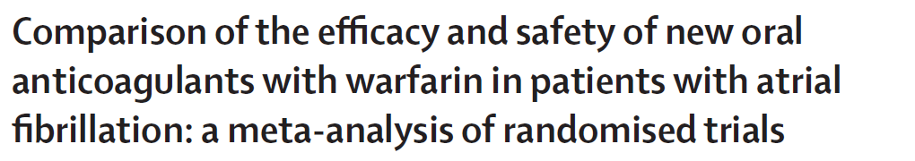
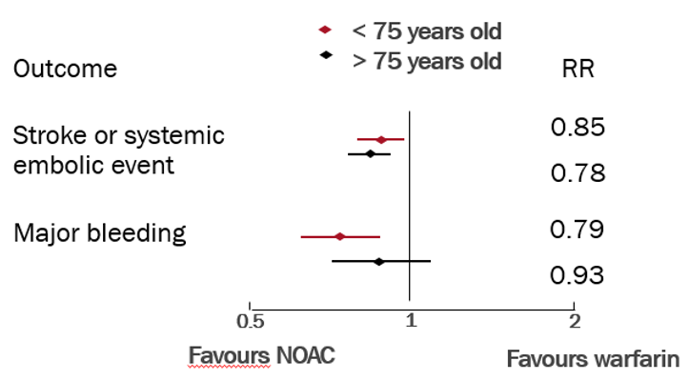
Stroke prevention in the frail elderly
We recommend that OAC be prescribed for most frail elderly patients with AF
Strong Recommendation; Moderate-Quality Evidence
  Values and Preferences
    This recommendation places relatively greater value on the observation that elderly AF patients are at higher risk of stroke and, therefore, are more likely to benefit from OAC than younger patients, and places less value on the perceived increased risk of adverse treatment-related events (e.g. the risk of bleeding if the patient falls).
    In general, the net clinical benefit is in favour of anticoagulant therapy in older patients given the high risk of ischemic stroke.
  Practical Tip
    Treatment decisions regarding specific OAC agents profile, should carefully consider the patients co-morbidity the risk for drug-drug interactions, and the risk of drug-disease interactions.
P_{int}=0.38
P_{int}=0.28
 | Age | DOAC events | Warfarin events
SSE | < 75y | 496/18073 (2.7%) | 578/18004 (3.2%)
 | 75y+ | 578/18004 (3.2%) | 532/11095 (4.8%)
MB | <75y | 1317/18460 (7.1%) | 1543/18396 (8.4%)
 | 75y+ | 1328/10771 (12.3%) | 1346/10686 (12.6%)

Slide 60
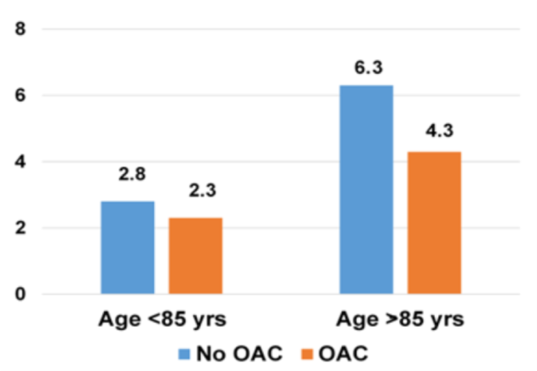
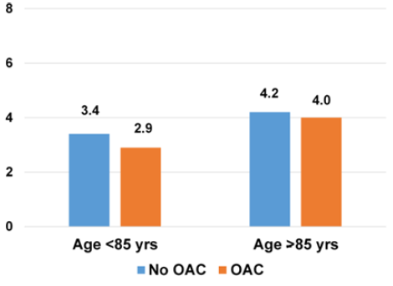
Stroke prevention in the frail elderly
We recommend that OAC be prescribed for most frail elderly patients with AF
Strong Recommendation; Moderate-Quality Evidence
  Values and Preferences
    This recommendation places relatively greater value on the observation that elderly AF patients are at higher risk of stroke and, therefore, are more likely to benefit from OAC than younger patients, and places less value on the perceived increased risk of adverse treatment-related events (e.g. the risk of bleeding if the patient falls).
    In general, the net clinical benefit is in favour of anticoagulant therapy in older patients given the high risk of ischemic stroke.
  Practical Tip
    Treatment decisions regarding specific OAC agents profile, should carefully consider the patients co-morbidity the risk for drug-drug interactions, and the risk of drug-disease interactions.
Thromboembolic Events
(n per 100 patients/year)
N=505
Major Bleeding Events
(n per 100 patients/year)
J Am Heart Assoc. 2017;6:e005657. DOI:10.1161/JAHA.117.005657.

Slide 61
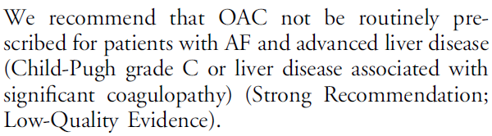
Stroke prevention in patients with hepatic dysfunction
RECOMMENDATION
Practical Tips:
OAC may be appropriate in select patients
Decisions should be made in consultation (hepatologist, hematologist)
If baseline INR is < 1.7, VKA may be considered with careful monitoring
No evidence for safety and efficacy of DOACS in advance liver disease

Slide 62
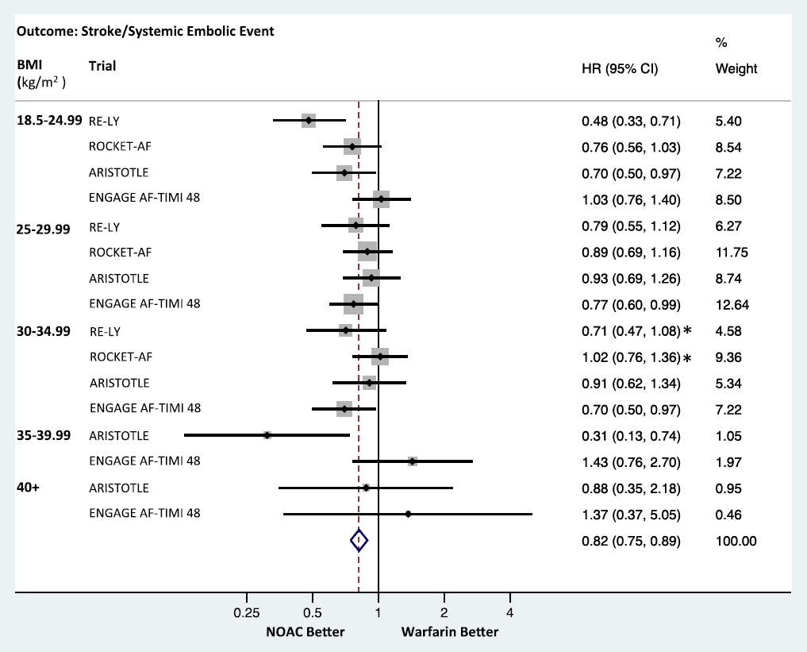
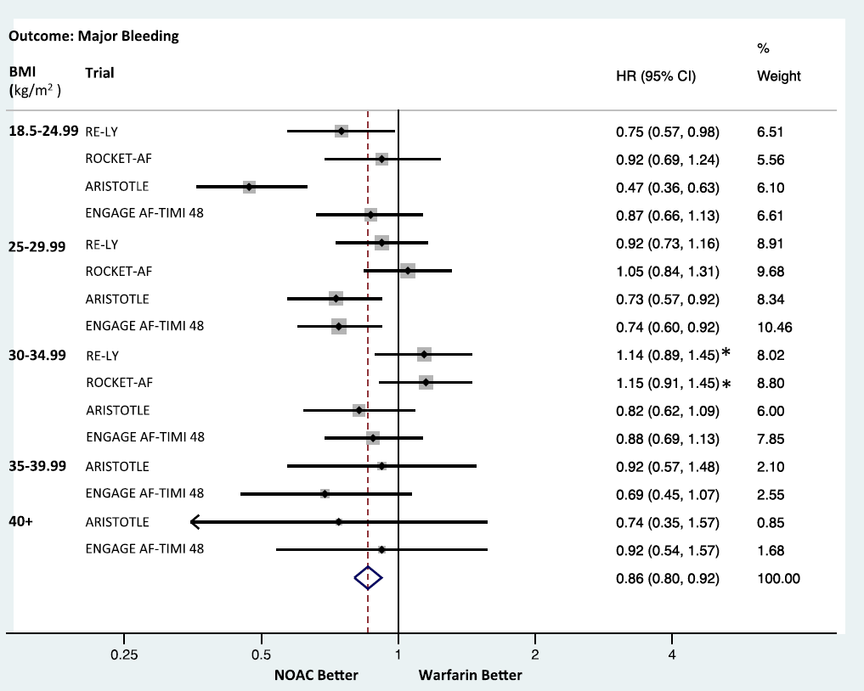
Stroke prevention in obese patients
Obesity is an established risk factor for developing AF
Patients with high BMI appear to have a lower stroke risk
Data supports DOAC over warfarin for most patients with BMI 40kg/m² or less
Stroke/Systemic Embolus
Major Bleeding

Slide 63
Stroke prevention in patients with cancer
RECOMMENDATION
We suggest that OAC treatment decisions be individualized for patients with AF and active malignancy, in consideration of the goals of care, the risk of stroke/systemic embolism, the risk of bleeding, and the concomitant antineoplastic therapy(ies)
(Weak Recommendation; Low-Quality Evidence).
When an OAC is indicated in the presence of active malignancy, we suggest a DOAC in preference to a VKA
(Weak Recommendation; Low-Quality Evidence).
Values and Preferences:
This recommendation places relatively greater value on the difficulties in ensuring stable INRs and the extensive drug-drug interactions between VKAs and active cancer therapeutic agents.
Although there are no randomized data on the use of DOACs in patients with active cancer and NVAF, this recommendation places a relatively high value on the recognition that DOACs cause no more or less major bleeding compared with VKAs; that they are associated with less ICH compared with VKAs; and on the greater ease of use of DOACs compared with dose-adjusted VKAs.
Practical Tip:
The specific choice of OAC should be tailored according to potential drug-drug interactions

Slide 64


QUESTIONS?

Slide 65
SAVE THE DATES!
For our upcoming Guideline Webinars
Heart Failure: Webinar 2: Screening + Diagnosis in HFrEF and HFpEF
On Wednesday, May 19, 2021 from 8 PM – 9 PM EDT, join Dr. Virani, Dr. O’Meara and Dr. Howlett for the second webinar in the HF webinar series highlighting content from the Heart Failure Guidelines
Atrial Fibrillation:
Webinar 2: When it comes to arrhythmia management…
On Thursday, July 8, 2021 from 8 PM – 9 PM EDT, join Drs. Bennett, Andrade, Aguilar, Atzema, Pilote, and Verma for the “AF Guidelines: When it comes to arrhythmia management…” webinar.
Webinar 3: Focus on screening and prevention
On Thursday, September 23, 2021 from 8 PM – 9 PM ET, join Drs. Andrade, Macle, Dorian, Healey, Parkash and Sandhu for the “AF Guidelines: Focus on screening and prevention” webinar.
Register at CCS.ca/programs-and-events/

Slide 66
Visit CCS.ca for more Guidelines and Resources
Guideline Library:
https://ccs.ca/guidelines-and-position-statement-library/
Guideline Resources:
https://ccs.ca/guideline-resources/

