Slide 1
Canadian Cardiovascular Society Guidelines for the Diagnosis and Management of Stable Ischemic Heart Disease

Slide 2
Disclaimer
The Canadian Cardiovascular Society (CCS) welcomes reuse of our educational slide deck for medical institution internal education or training (i.e. grand rounds, medical college/classroom education, etc.). However, if the material is being used in an industry sponsored CME program, permission must be sought through our publisher Elsevier (www.onlinecjc.com).
If your reuse qualifies as medical institution internal education, you may reuse the material under the following conditions:
You must cite the Canadian Journal of Cardiology and the Canadian Cardiovascular Society as references.
You may not use any Canadian Cardiovascular Society logos or trademarks on any slides or anywhere in your presentation or publications.
Do not modify the slide content.
If repeating recommendations from the published guideline, do not modify the recommendation wording.

Slide 3
Primary Panel
G.B. John Mancini MD, Co-chair; University of British Columbia
Gilbert Gosselin MD, Co-chair; Montreal Heart Institute, University of Montreal
Benjamin Chow MD; Ottawa Heart Institute
William Kostuk MD; University of Western Ontario
James Stone MD; University of Calgary
Kenneth J. Yvorchuk MD; Vancouver Island Health Authority, Victoria, British Columbia
Beth L. Abramson MD; St. Michael’s Hospital, University of Toronto
Raymond Cartier MD; Montreal Heart Institute, University of Montreal
Victor Huckell MD; University of British Columbia
Jean-Claude Tardif MD; Montreal Heart Institute, University of Montreal
Secondary Panel
Kim Connelly MD; St. Michael’s Hospital, University of Toronto
John Ducas MD; University of Manitoba
Michael E. Farkouh MD; University Health Network Hospitals, University of Toronto
Milan Gupta MD; McMaster University
Martin Juneau MD; Montreal Heart Institute, University of Montreal
Blair O’Neill MD; University of Alberta
Paolo Raggi MD; University of Alberta
Koon Teo MD; McMaster University
Subodh Verma MD; St. Michael’s Hospital, University of Toronto
Rodney Zimmermann MD; Regina Qu’Appelle Health Region, University of Saskatchewan

Slide 4
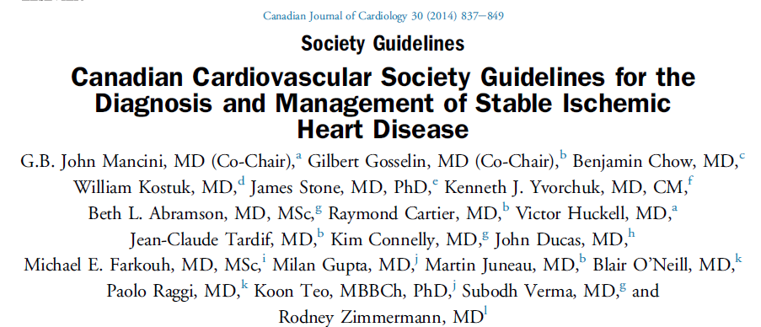
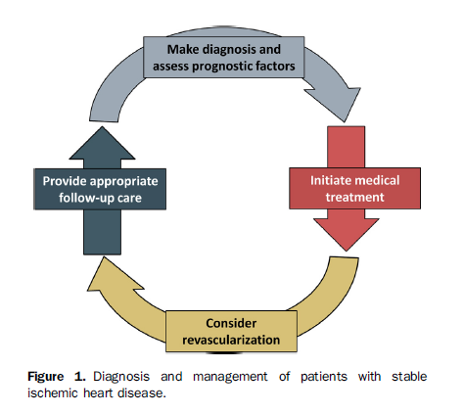

Slide 5
Diagnosis and management of patients with stable ischemic heart disease
Make diagnosis and assess prognostic factors
Provide appropriate
follow-up care
Initiate medical treatment
Consider revascularization

Slide 6
Canadian Cardiovascular Society Guidelines 2014 Diagnosis and Management of Stable Ischemic Heart Disease
Establishing Diagnosis and Prognosis

Slide 7
Making the Diagnosis
Recommendation | Strength of recommendation | Level of evidence
We recommend that a focused history and physical examination be obtained to elucidate symptoms, cardiac risk factors, past medical history and signs of cardiovascular disease or other etiologies of symptoms | Strong | High quality
We recommend that cardiovascular co-morbidities of heart failure, valvular heart disease, cerebrovascular and peripheral vascular disease and renal disease should be fully documented | Strong | High quality
We suggest that initial assessment be supplemented by routine testing that includes hemoglobin, full cholesterol panel, fasting glucose, Hemoglobin A1c, renal function tests, liver function tests, thyroid function tests, and a 12 lead ECG | Conditional | Moderate quality

Slide 8
Using Non-invasive Diagnostic and Prognostic Testing
Recommendation | Strength of recommendation | Level of evidence
We suggest that adults > 30 years of age with 2 or 3 anginal criteria should undergo testing for diagnostic (and prognostic) purposes | Conditional | Moderate quality
We suggest that men > 40 and women > 60 years of age with 1 of 3 anginal features should undergo non-invasive testing for diagnostic (and prognostic) purposes | Conditional | Moderate quality
We suggest that men < 40 and women < 60 years of age with 1 of 3 anginal features have a low pre-test likelihood of CAD but should undergo non-invasive diagnostic testing if other features indicative of CV risk are present | Conditional | Low quality

Slide 9
Using Non-invasive Diagnostic and Prognostic Testing (con’d)
Recommendation | Strength of recommendation | Level of evidence
We suggest that exercise testing, if possible, is preferred as it is more strongly perceived by patients as relevant to their activities than pharmacologic testing and provides assessment of functional capacity | Conditional | Low quality
We suggest that patients with an interpretable rest ECG who are able to exercise should have an exercise ECG test (ideally free of anti-ischemic drugs) | Conditional | Low quality
We suggest that the initial test in patients able to exercise, with a rest ECG that precludes ST segment interpretation should be exercise myocardial perfusion imaging or exercise echocardiography | Conditional | Moderate quality
We suggest that the initial test in patients without LBBB or paced rhythm who cannot exercise be vasodilator stress myocardial perfusion imaging or dobutamine echocardiography | Conditional | Moderate quality
We recommend that the initial test in patients with LBBB or ventricular paced rhythm should be either vasodilator stress myocardial perfusion imaging or CCTA | Strong | High quality

Slide 10
Using Non-invasive Diagnostic and Prognostic Testing (con’d)
Recommendation | Strength of recommendation | Level of evidence
We recommend that a non-invasive assessment of rest left ventricular function be obtained in all patients with suspected SIHD | Strong | High quality
We suggest that patients with initially equivocal or non-diagnostic test results or a strong discrepancy between clinical impression and test results be considered for further testing using a complementary, non-invasive modality ) | Conditional | Low quality
We suggest that CCTA not be used in patients felt likely to warrant invasive angiography on the basis of high risk symptom pattern, high pre-test probability of coronary artery disease, severe risk factors or important reasons to minimize exposure to radiation or contrast material | Conditional | Low quality
We suggest that invasive coronary angiography be obtained in patients with SIHD who have high pre-test likelihood of CAD, high risk features on prior non-invasive testing, survived sudden cardiac arrest or who have life threatening arrhythmias | Conditional | Moderate quality

Slide 11
Fundamental prognostic factors for assessing stable ischemic heart disease.

Slide 12
Pretest likelihood of CAD as detected by invasive angiography in symptomatic patients according to age and sex (Combined Diamond Forrester and CASS Data).
A low pretest risk of CAD is considered < 10% (green) and a high pretest risk is considered > 90% (red). All others are at intermediate risk (yellow).
Age | Chest Pain Criteria: Sub-sternal chest discomfort with characteristic quality and duration Provoked by exertion or emotional stress Relieved promptly by rest or nitroglycerin
 | Non-anginal Chest Pain 1 of 3 Criteria |  | Atypical Angina 2 of 3 Criteria |  | Typical Angina 3 of 3 Criteria
 | Male | Female | Male | Female | Male | Female
30 – 39 | 4% | 2% | 34% | 12% | 76% | 26%
40 - 49 | 13% | 3% | 51% | 22% | 87% | 55%
50 - 59 | 20% | 7% | 65% | 33% | 93% | 73%
60 – 69 | 27% | 14% | 72% | 51% | 94% | 86%
Adapted from Diamond et al NEJM 1979;300:1350-58 and Weiner et al NEJM 1979;301:230-5

Slide 13
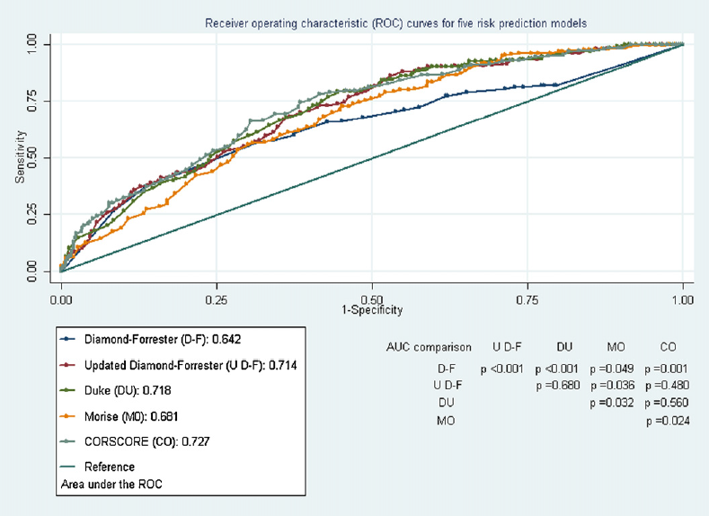
Receiver operating characteristic (ROC) curves for five risk prediction models.
The AUC for the updated Diamond–Forrester, Duke, and CORSCORE risk models were significantly larger than the AUC for the Diamond–Forrester (p < 0.001, p < 0.001, and p = 0.001, respectively) and Morise (p = 0.036, p = 0.032, and p = 0.024, respectively) risk models. The AUC for the Morise model was significantly larger than the AUC for the Diamond–Forrester risk model (p = 0.049).
Jensen et al. Atherosclerosis 2012; 220:557-62
Notes:
Diamond-Forrester - age, sex and symptoms of angina pectoris in order to calculate the likelihood of a significant coronary artery stenosis >50%.
Updated Diamond-Forrester – similar to Diamond-Forrester, but extended to include patients older than 69 years old.
Duke – based on sex, age, tobacco use, diabetes, history of myocardial infarction, symptoms of angina pectoris, hypercholesterolemia, and ECG changes, and calculates the pre-test probability of at least one coronary artery stenosis≥75% lumen diameter reduction at coronary angiography.
Morise - based on sex, age, tobacco use, diabetes, symptoms of angina pectoris, hypercholesterolemia, hypertension, family history of CAD, BMI, obesity (defined as BMI >27), and oestrogen status. The Morise risk score calculates the pre-test probability of stenosis at coronary angiography >50% in one or more coronary arteries.
CORSCORE - age, sex, tobacco use, history of myocardial infarction, CCS angina class, medically treated hypercholesterolemia, and medically treated hypertension. The model calculates the probability of at least one coronary artery stenosis >50% at coronary angiography.

Slide 14
Use of non-invasive testing for diagnostic and prognostic purposes in patients with classical anginal chest pain symptoms suggestive of SIHD.
Stable Chest Pain Syndrome (1 – 3/3 anginal symptoms)
Cardiovascular history, physical, laboratory tests, 12 lead EKG
2 or 3/3 Chest pain criteria
1/3 Chest pain criteria
Significant non-CV co-morbidities and quality of life issues are present
Male ≥ 40 yo
Female ≥ 60 yo
or single severe or multiple risk factors
Male < 40 yo
Female < 60 yo
No risk factors
Non-invasive testing for diagnostic and/or prognostic purposes (tailored to patient characteristics, access and local expertise)
Assess for other causes as appropriate
Conservative diagnostic and treatment strategy

Slide 15
Summary Estimates of Pooled Sensitivity and Specificity (with 95% confidence intervals) for Non-Invasive Cardiac Tests for the Diagnosis of Coronary Artery Disease
Technology | Sensitivity | Specificity
Exercise Treadmill | 0.68 (0.23-1.0) | 0.77 (0.17-1.0)
Attenuation Corrected SPECT | 0.86 (0.81-0.91) | 0.82 (0.75-0.89)
Gated SPECT | 0.84 (0.79-0.88) | 0.78 (0.71-0.85)
Traditional SPECT | 0.86 (0.84-0.88) | 0.71 (0.67-0.76)
Contrast Stress Echocardiography (wall motion) | 0.84 (0.79-0.90) | 0.80 (0.73-0.87)
Exercise or Pharmacologic Stress Echocardiography | 0.79 (0.77-0.82) | 0.84 (0-.82-0.86)
Cardiac Computed Tomographic Angiography | 0.96 (0.94-0.98) | 0.82 (0.73-0.90)
Positron Emission Tomography | 0.90 (0.88-0.92) | 0.88 (0.85-0.91)
Cardiac MRI (perfusion) | 0.91 (0.88-0.94) | 0.81 (0.75-0.87)
Adapted from Gianrossi et al Circulation 1989; 80:87-98, Medical Advisory Secretariat 2010; 10:1-40,
and McArdle et al J Am Coll Cardiol 2012;60:1828-37

Slide 16
Guidance for selection of an initial non-invasive test for diagnosing suspected CAD in routine practice settings.
Able to exercise adequately and no contraindications (see legend)
YES
NO
ECG normal
ECG abnormal
(eg. ST depression ≥ 1 mm, LVH, digoxin, ventricular pre-excitation
ECG normal or abnormal
No LBBB or ventricular paced rhythm
LBBB or ventricular paced rhythm
No LBBB or ventricular paced rhythm
LBBB or ventricular paced rhythm
Exercise stress test
Exercise echocardiography
Exercise myocardial perfusion imaging
Vasodilator myocardial perfusion imaging
Dobutamine or vasodilator echocardiography
Vasodilator myocardial perfusion imaging
Cardiac computed tomographic angiography

Slide 17
High Risk Features of Noninvasive Test Results Associated with > 3% Annual Rate of Death or MI
Exercise Treadmill ≥ 2mm of ST-segment depression at low (< 5 metabolic equivalents, METS) workload or persisting into recovery Exercise-induced ST-segment elevation Exercise-induced VT/VF Failure to increase systolic blood pressure to > 120 mm
Myocardial Perfusion Imaging Severe resting LV dysfunction (LVEF < 35%) not readily explained by non-coronary causes Resting perfusion abnormalities ≥10% of the myocardium in patients without prior history or evidence of MI Severe stress-induced LV dysfunction (peak exercise LVEF <45% or drop in LVEF with stress ≥10%) Stress-induced perfusion abnormalities encumbering ≥10% myocardium or stress segmental scores indicating multiple vascular territories with abnormalities Stress-induced LV dilation Increased lung uptake
Stress Echocardiography Inducible wall motion abnormality involving >2 segments or 2 coronary beds Wall motion abnormality developing at low dose of dobutamine (< 10 micrograms/kg/min) or at a low heart rate (<120 beats/min)
Coronary Computed Tomographic Angiography Multivessel obstructive CAD or left main stenosis on CCTA
Adapted from Fihn et al Circ 2012;126:e354-e471

Slide 18
Canadian Cardiovascular Society Guidelines 2014 Diagnosis and Management of Stable Ischemic Heart Disease
Initiation of Medical Treatment in Patient
With Established CAD

Slide 19
Chronic Management for the Patient with SIHD to Improve Prognosis
Recommendation | Strength of recommendation | Level of evidence
We recommend that all patients receive 81 mg of acetylsalicylic acid daily indefinitely, unless contraindicated | Strong | High quality
We recommend that clopidogrel 75 mg daily be used in acetylsalicylic acid intolerant individuals | Strong | High quality
We suggest that dual antiplatelet therapy should not be used in routine management of SIHD or beyond the time period required as a result of stenting | Conditional | Moderate quality
We recommend that all patients receive a statin in accordance with CCS 2012 Dyslipidemia Guidelines | Strong | High quality
We recommend that all patients with SIHD who also have hypertension, diabetes, a left ventricular ejection fraction of < 40%, or chronic kidney disease, should receive an angiotensin-converting enzyme (ACE) inhibitor, unless contraindicated | Strong | High quality
We recommend that it is also reasonable to consider treatment with an ACE inhibitor in all patients with SIHD | Strong | High quality
We recommend that ARBs should be used for patients who are intolerant of ACE inhibitors | Strong | High quality
We recommend that beta-blocker therapy be used in all patients with SIHD and left ventricular systolic dysfunction (ejection fraction < 40%) with or without heart failure, unless contraindicated, and continued indefinitely | Strong | High quality

Slide 20
Chronic Management of Anginal Symptoms
Recommendation | Strength of recommendation | Level of evidence
We suggest that beta-blockers be used as first-line therapy for symptom relief, with the dose titrated to reach a target resting heart rate of 55 to 60 bpm | Conditional | Moderate quality
We suggest that beta-blockers or long-acting calcium channel blockers be used for chronic stable angina in uncomplicated patients | Conditional | Moderate quality
We suggest the addition of a long-acting nitrate when initial treatment with a beta-blocker and/or long acting calcium channel blocker is not tolerated or contraindicated or does not lead to adequate symptom control | Conditional | Moderate quality
We recommend avoiding non-dihydropyridine calcium channel blockers in conjunction with beta-blockers if there is risk of AV block or excessive bradycardia | Strong | High quality
We suggest that chelation therapy, allopurinol, magnesium supplementation, coenzyme Q10, suxiao jiuxin wan or shenshao tablets and testosterone should not be used to attempt to improve angina or exercise tolerance | Conditional | Moderate quality
We recommend that implementation and optimization of medical therapy should be achieved within 12 to 16 weeks of an initial evaluation suggesting presence of SIHD without high risk features during which adequacy of symptom control and quality of life can be assessed prior to consideration of revascularization therapy | Strong | High quality

Slide 21
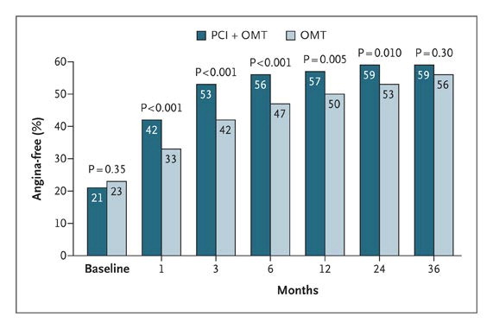
Freedom from Angina over Time as Assessed with the Angina-Frequency Scale of the Seattle Angina Questionnaire, According to Treatment Group.
Weintraub WS et al. N Engl J Med 2008;359:677-687.

Slide 22
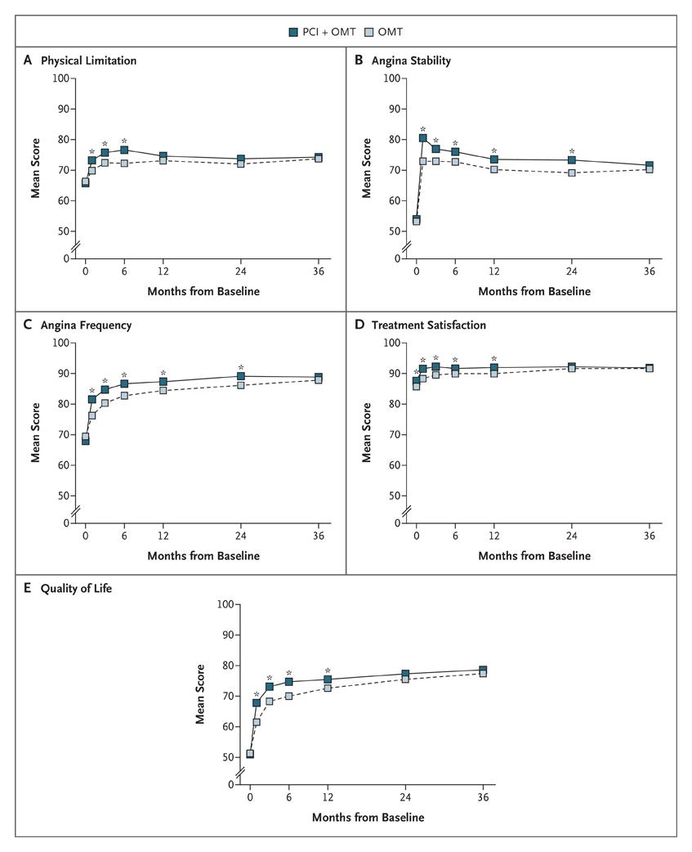
Mean Scores over Time in Five Domains of the Seattle Angina Questionnaire.
An asterisk indicates P<0.01 for the difference between treatment groups
Weintraub WS et al. N Engl J Med 2008;359:677-687.

Slide 23
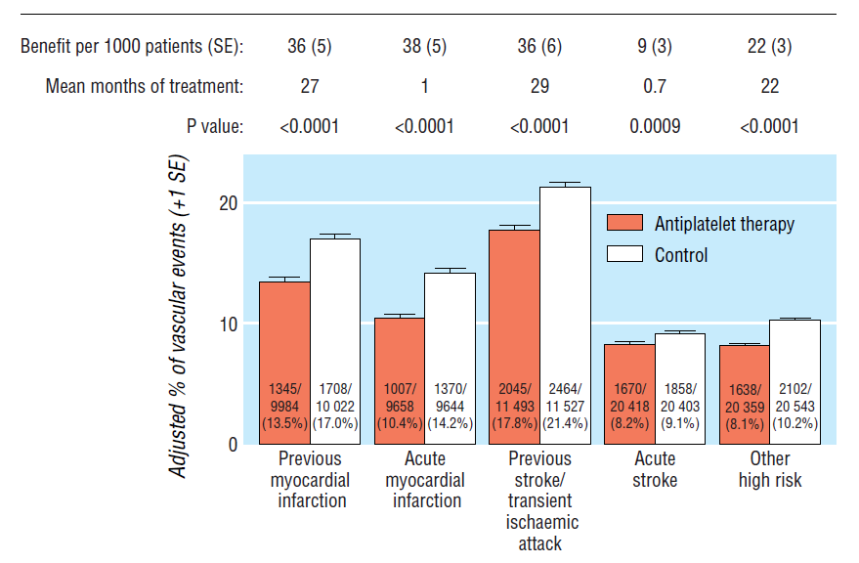
Absolute effects of antiplatelet therapy on vascular events (myocardial infarction, stroke, or vascular death) in five main high risk categories.
Adjusted control totals have been calculated after converting any unevenly randomised trials to even ones by counting control groups more than once
Antithrombotic Trialists' Collaboration. BMJ. 2002;324:71-86

Slide 24
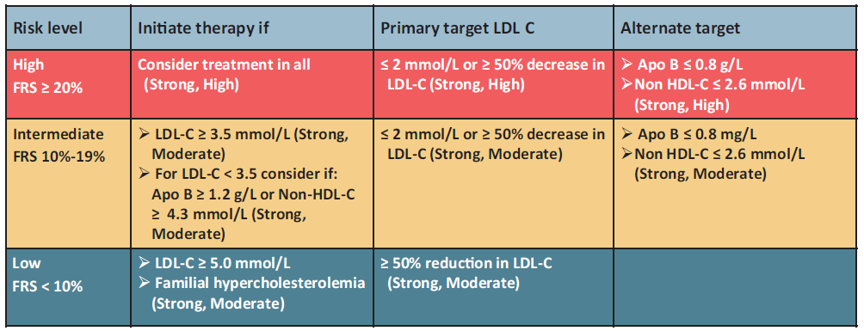
Summary of treatment thresholds and targets based on Framingham Risk Score (FRS), modified by family history. HDL-C, high-density lipoprotein C; LDL-C, low-density lipoprotein cholesterol
Anderson et al. Can J Cardiol 2013; 29:151-67

Slide 25
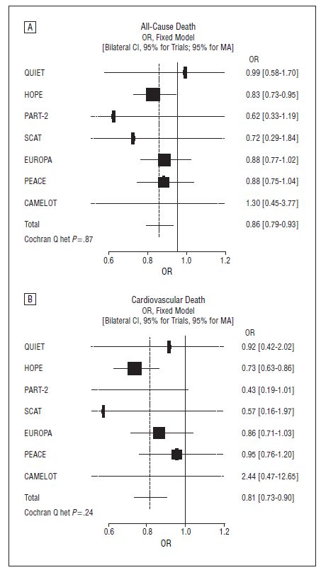
All-cause mortality (A) and cardiovascular mortality (B) in patients with coronary artery disease and no left ventricular systolic dysfunction randomized to long-term angiotensin-converting enzyme inhibitor therapy or placebo
Danchin et al. Arch Intern Med 2006; 166:787-96

Slide 26
Meta-analysis of Main Clinical End Points in Trials in patients with coronary artery disease and no left ventricular systolic dysfunction randomized to receive angiotensin-converting enzyme inhibitors
Danchin et al. Arch Intern Med 2006; 166:787-96

Slide 27
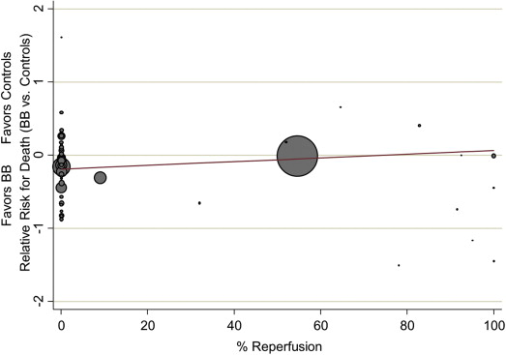
Meta regression analysis of the relationship of percentage of patients with reperfusion therapy on the risk ratio of mortality with β-blockers.
β-blockers reduced mortality in pre-reperfusion[IRR=0.86, 95% CI=0.79-0.94] but not in the reperfusion era(IRR=0.98, 95% CI=0.92-1.05) where there was reduction (short-term) in myocardial infarction(IRR=0.72, 95% CI=0.62-0.83) and angina(IRR=0.80, 95%CI=0.65-0.98) but increase in heart failure(IRR=1.10, 95% CI=1.05-1.16), cardiogenic shock(IRR=1.29, 95% CI=1.18-1.41) and drug discontinuation.
In contemporary treatment of MI, β-blockers have no mortality benefit but reduce myocardial infarction and angina (short-term) with increase in heart failure, cardiogenic shock and drug discontinuation
Bangalore S, et al. The American Journal of Medicine, 2014 http://dx.doi.org/10.1016/j.amjmed.2014.05.032

Slide 28
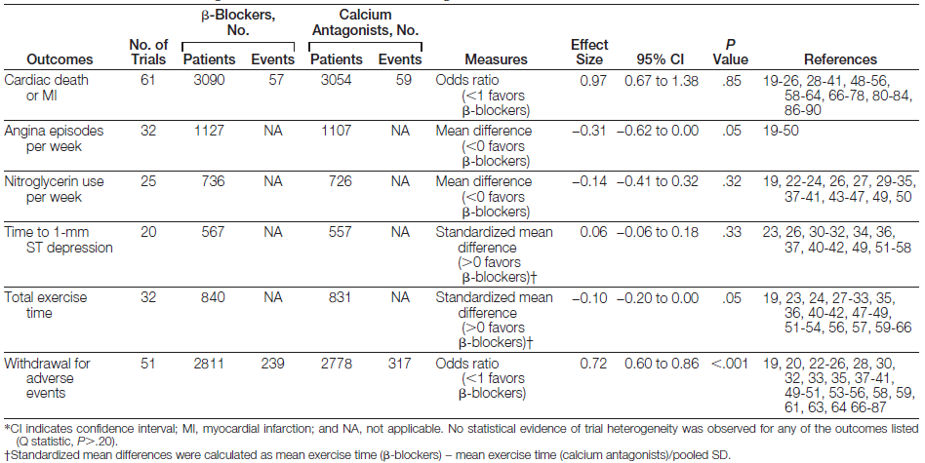
Outcomes in Stable Angina for β-Blockers vs Calcium Antagonists
Heidenreich et al. JAMA 1999; 281-1927-36

Slide 29
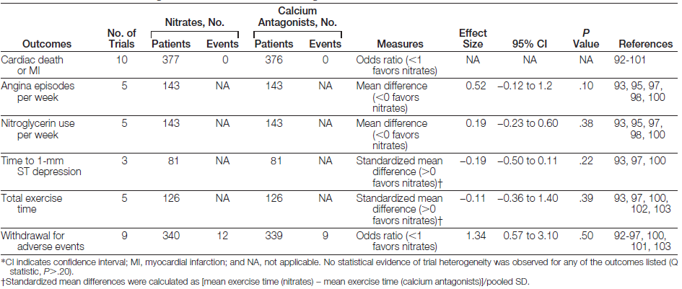
Outcomes in Stable Angina for Nitrates vs Calcium Antagonists
Heidenreich et al. JAMA 1999; 281-1927-36

Slide 30
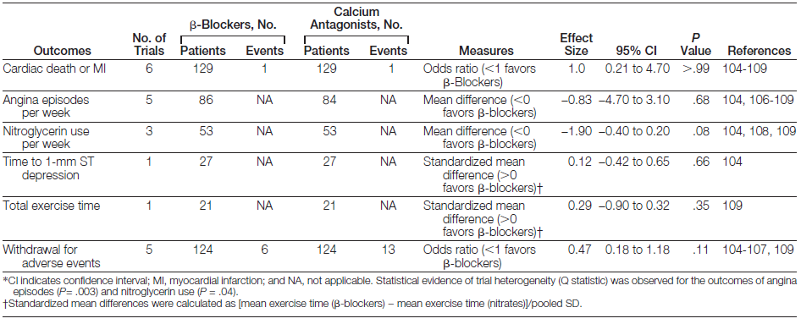
Outcomes in Stable Angina for β-Blockers vs Nitrates
Heidenreich et al. JAMA 1999; 281-1927-36

Slide 31
Canadian Cardiovascular Society Guidelines 2014 Diagnosis and Management of Stable Ischemic Heart Disease
Consideration of Revascularization Therapy

Slide 32
Consideration of Revascularization Therapy
Recommendation | Strength of recommendation | Level of evidence
We recommend that coronary angiography be considered early in patients who are identified to have high risk non-invasive test features | Strong | High quality
We recommend that patients who develop medically refractory symptoms or inadequate CV quality of life on medical therapy should undergo elective coronary angiography in anticipation of possible revascularization procedures | Strong | High quality

Slide 33
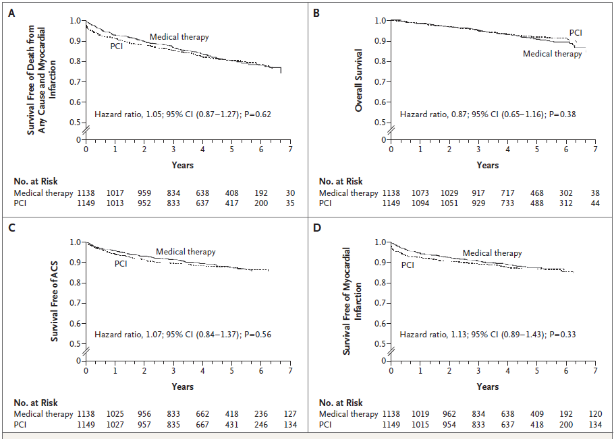
Kaplan–Meier Survival Curves - COURAGE.
In Panel A, the estimated 4.6-year rate of the composite primary outcome of death from any cause and nonfatal myocardial infarction
was 19.0% in the PCI group and 18.5% in the medical-therapy group. In Panel B, the estimated 4.6-year rate of death from any cause
was 7.6% in the PCI group and 8.3% in the medical-therapy group. In Panel C, the estimated 4.6-year rate of hospitalization for acute
coronary syndrome (ACS) was 12.4% in the PCI group and 11.8% in the medical-therapy group. In Panel D, the estimated 4.6-year rate
of acute myocardial infarction was 13.2% in the PCI group and 12.3% in the medical-therapy group.
Boden et al. N Engl J Med 2007; 356:1503-16

Slide 34
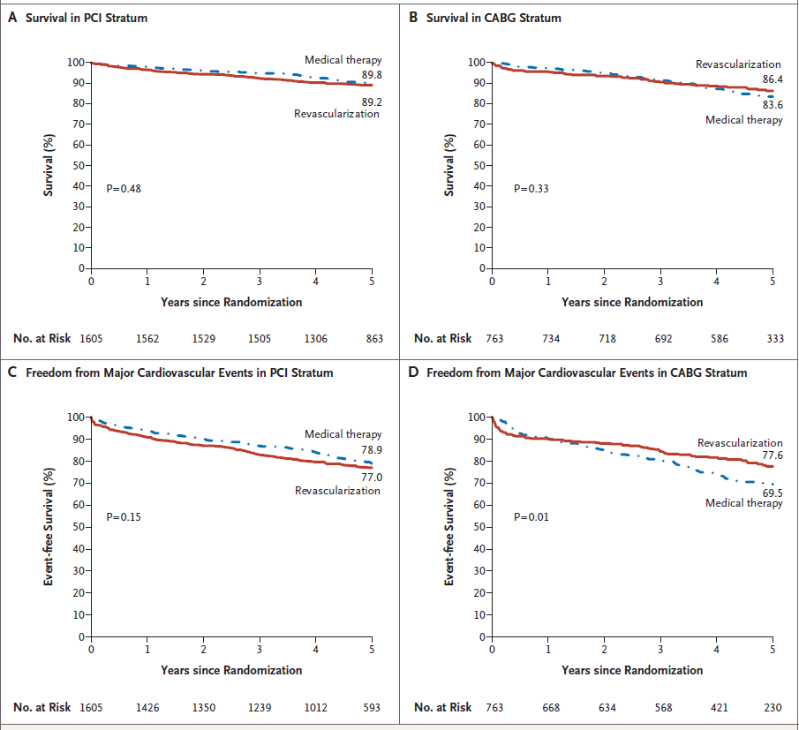
Rates of Survival and Freedom from Major Cardiovascular Events, According to PCI and CABG Strata – BARI 2D
There was no significant difference in rates of survival between the revascularization group and the medical-therapy group among patients who were selected for the percutaneous coronary intervention (PCI) stratum (Panel A) or among those who were selected for the coronary artery bypass grafting (CABG) stratum (Panel B). The rates of freedom from major cardiovascular events (death, myocardial infarction, or stroke) also did not differ significantly between the revascularization group and the medical-therapy group among patients in the PCI stratum (Panel C), but the rates were significantly better among patients in the revascularization group than in the medical-therapy group within the CABG stratum (Panel D).
BARI 2D study group N Engl J Med 2009; 360(4):2503-15

Slide 35
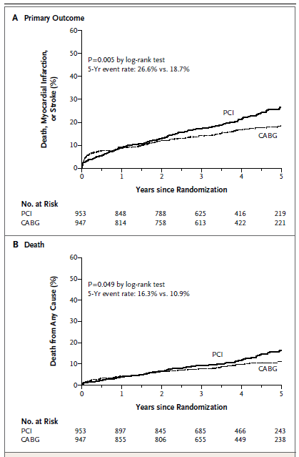
Kaplan–Meier Estimates of the Composite Primary Outcome and Death
Farkouh ME, et al. FREEDOM, N Engl J Med 2012; 367:2375-84
Notes:
Shown are rates of the composite primary outcome of death, myocardial infarction, or stroke (Panel A) and death from any cause (Panel B) truncated at 5 years after randomization. The P value was calculated by means of the log-rank test on the basis of all available follow-up data.

Slide 36
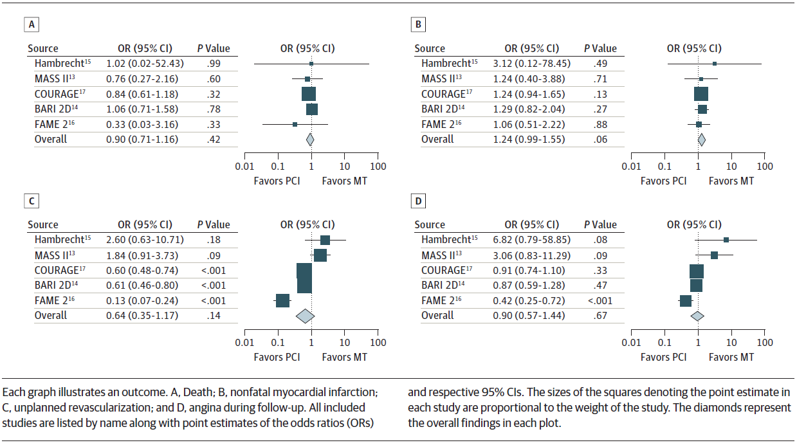
Comparison of Percutaneous Coronary Intervention (PCI) and Medical Therapy (MT) vs Medical Therapy Alone in Patients With Documented Myocardial Ischemia
Stergiopoulos et al. JAMA Intern Med 2014; 174(2):232-40

Slide 37
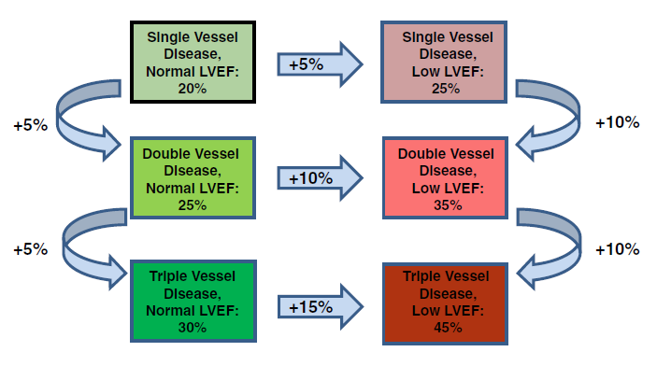
COURAGE “Rule of Thumb” for estimating residual risk on OMT and
either elective or symptom-driven PCI.
Mancini et al. Am Heart J 2013; 166(3):481-7

Slide 38
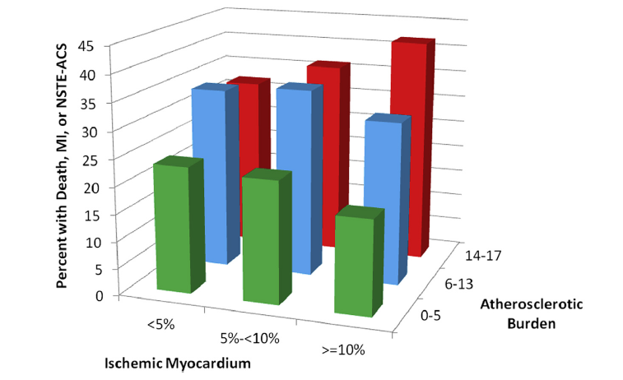
Proportion of Patients With Death, Myocardial Infarction or Non–ST-Segment Elevation Acute Coronary Syndrome by Ischemic Myocardium and Atherosclerotic Burden of Disease
Mancini et al. J Am Coll Cardiol 2014; 7:195-201

Slide 39
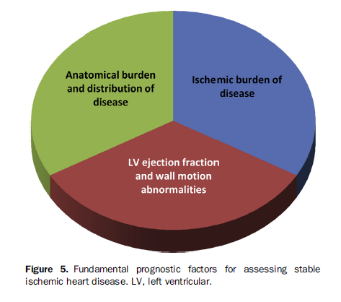
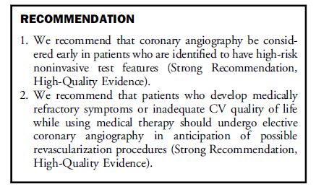
When to intervene beyond medication…

Slide 40
Canadian Cardiovascular Society Guidelines 2014 Diagnosis and Management of Stable Ischemic Heart Disease
Provision of Appropriate Clinical Follow-up

Slide 41
Provision of Appropriate Clinical Follow-up
Recommendation | Strength of recommendation | Level of evidence
We suggest that a resting ECG be acquired with a change in symptom status or in the setting of annual routine clinical follow-up. | Conditional | Low quality
We suggest that patients with SIHD who have not previously participated be referred to a comprehensive cardiac rehabilitation program | Conditional | Moderatequality
We suggest that asymptomatic patients with SIHD, with the approval of their physician, should accumulate 150 minutes of moderate to vigorous physical activity per week, preferably in bouts of 10 minutes or more, with additional exercise providing additional benefits. | Conditional | Moderate quality
We suggest that patients whose symptoms are not controlled on optimal medical therapy should be re-evaluated as per the sections on diagnosis and revascularization above | Conditional | Low quality
We suggest that routine use of exercise stress testing (excluding formal cardiac rehabilitation programs) or exercise/pharmacological stress cardiac imaging in asymptomatic patients with SIHD should be avoided. | Conditional | Moderate quality

Slide 42
Provision of Appropriate Clinical Follow-Up Overview
Most Appropriate Clinical Follow-up:
Difficult to Define
Need for Regular Communication
Focused History and Physical
Cardiometabolic Fitness

Slide 43
Provision of Appropriate Clinical Follow-Up Recommendation 1
Resting EKG be acquired with:
Change in Symptom Status
Routine Clinical Follow-Up

Slide 44
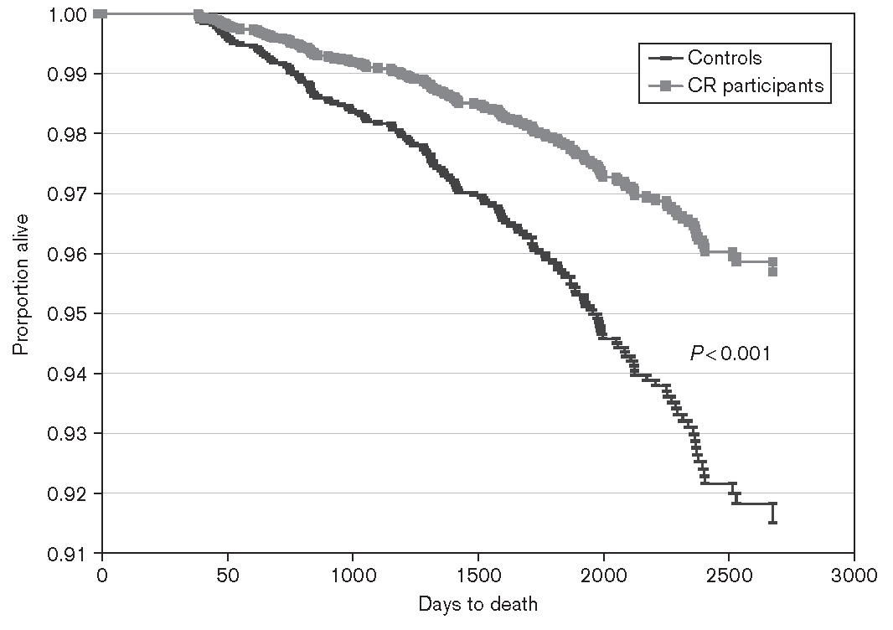
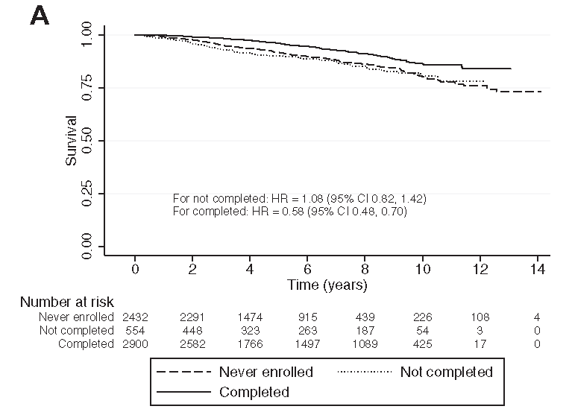
Provision of Appropriate Clinical Follow-Up Recommendation 2
Patients with Stable Ischemic Heart Disease
Cardiac Rehabilitation Referral

Slide 45
Provision of Appropriate Clinical Follow-Up Recommendation 3
Patients with Stable Ischemic Heart Disease
Moderate-Vigorous Physical Activity

Slide 46
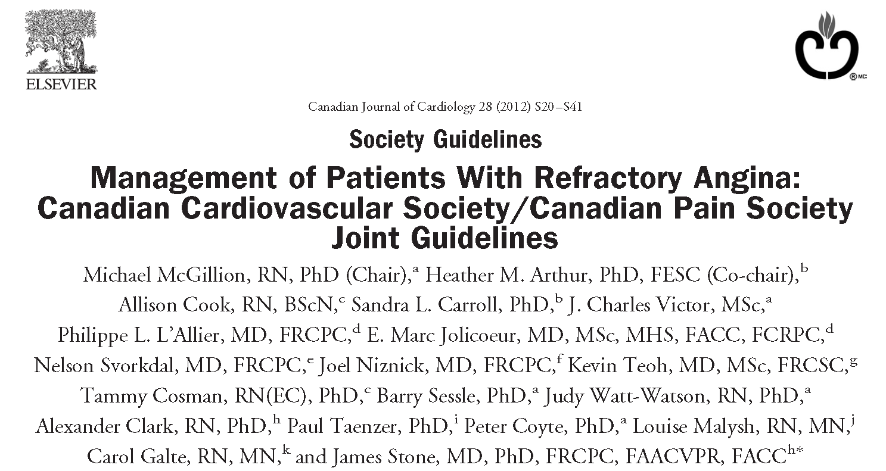
Provision of Appropriate Clinical Follow-Up Recommendation 4
Refractory Angina
CCS Refractory Angina CPGs
Despite Optimal Medical Therapy
Revascularization Re-evaluation
Spinal Cord Stimulator

Slide 47
Provision of Appropriate Clinical Follow-Up Recommendation 5
In Asymptomatic SIHD Patients:
Choose Wisely and Avoid Routine:
Exercise Stress Testing
Exercise Stress Cardiac Imaging
Pharmacological Stress Cardiac Imaging
Invasive Assessment

Slide 48
Canadian Cardiovascular Society Guidelines 2014 Diagnosis and Management of Stable Ischemic Heart Disease
Applying the Guidelines Using
Sample Case Scenarios.
Victor Huckell
Supported by Beth Abramson and
Kenneth Yvorchuk

Slide 49
PATIENT 1
52-year-old male patient with no previous cardiac history Mild hypertension, only on hydrochlorothiazide 25mg once daily – not sure of BP numbers Presents with 6 month history of vague right sided chest pain most commonly occurring while 10-pin bowling Can continue bowling but has to slow down Works as a truck driver Not certain of family history but believes that father had a stroke at age 88 and mother died of old age. No siblings. Tends to avoid the medical profession No laboratory work available.

Slide 50
Based only on symptoms what is this patient’s pre-test likelihood of coronary artery disease that’s detected by invasive angiography
20%
65%
93%

Slide 51
Which would be an appropriate first non-invasive investigation?
Exercise testing
Exercise myocardial perfusion imaging
Exercise echocardiography
Vasodilator stress myocardial perfusion imaging

Slide 52
Which of the following is not a high RISK feature for a non-invasive stress test?
Greater than 2mm ST segment depression at low workload
Rapid resolution of ST segment depression and recovery
Exercise induced ST segment elevation
Exercise induced VT/VF
Failure to increase systolic blood pressure to greater than 120 mmHg

Slide 53
PATIENT 1 - continued
The patient undergoes exercise treadmill testing which is positive with 2mm horizontal ST segment depression at 7 minutes of exercise.
There are no exercise provocable dysrhythmias. Blood pressure response is appropriate.
The patient subsequently undergoes coronary arteriography. This confirms the presence of atherosclerotic coronary artery disease with at least one lesion exceeding 60% narrowing.
Left ventricular function is normal on echocardiography and angiography.
Diastolic pressures are normal.

Slide 54
Which of the following medications improve prognosis in chronic management for the patient with SIHD?
Acetylsalicylic acid
Clopidogrel
Statins
ACE inhibitors
Beta blockers

Slide 55
Which of the following tests or conditions would not impact on decisions to treat with a statin?
Rheumatoid arthritis
Elevated hsCRP
Elevated LP(a)
Hyperuricemia
Metabolic syndrome

Slide 56
Medical therapy used to help with ischemic heart disease should include:
Statins and anti-platelet agents
Chelation therapy
Co-enzyme Q10
Magnesium supplements and Vitamin E

Slide 57
PATIENT 2
A 64-year-old female with classic angina and a positive treadmill test has undergone angiography for verification of the diagnosis. She has CCS Class II angina. She tends to be a therapeutic nihilist and is reluctant to take medications. She notes, however, that her ongoing symptoms are interfering with activities of daily living and quality of life. She is a retired cardiology medical office assistant with some understanding of biostatistics. She asks which forms of therapy would improve quality of life for the longest period of time. She also asks which form of therapy would offer a mortality benefit ­ possibly without symptomatic relief. Following discussions she agrees to take optimum medical therapy (OMT).

Slide 58
Residual risk on optimum medical therapy for single vessel disease and normal left ventricular ejection fraction is:
20%
25%
30%

Slide 59
Residual risk on optimum medical therapy for triple vessel disease with low left ventricular ejection fraction:
25%
35%
45%

Slide 60
At 12 months following therapy which has a greater freedom from angina?
Optimum medical therapy
PCI plus optimum medical therapy

Slide 61
PATIENT 2 - continued
The patient has a significant reduction in symptomatology on optimum medical therapy for risk factor management plus a beta-blocker.
She decides to postpone revascularization by either mechanical or surgical means.
The patient is interested in an exercise rehabilitation program but, unfortunately, lives at a distance.

Slide 62
We should recommend a minimum of _______ minutes of moderate to vigorous physical activity per week.
60
90
120
150
180

Slide 63
Routine exercise stress testing should be carried out on a yearly basis
Yes
No

Slide 64
Which of the following is NOT a primary goal of therapy for patients with chronic stable angina?
Reduce coronary perfusion pressure.
Increase quality of life by reducing ischemia and preventing symptoms.
Increase quantity of life by disease modification and prevention of myocardial infarction and death.

Slide 65
CardioRisk Calculator is available at: http://www.circl.ubc.ca/cardiorisk-calculator.html

