Slide 1
Disclaimer
The Canadian Cardiovascular Society (CCS) welcomes reuse of our educational slide deck for medical institution internal education or training (i.e. grand rounds, medical college/classroom education, etc.). However, if the material is being used in an industry sponsored CME program, permission must be sought through our publisher Elsevier (www.onlinecjc.com).
If your reuse request qualifies as medical institution internal education, you may reuse the material under the following conditions:
  You must cite the Canadian Journal of Cardiology and the Canadian Cardiovascular Society as references.
  You may not use any Canadian Cardiovascular Society logos or trademarks on any slides or anywhere in your presentation or publications.
  Do not modify the slide content.
  If repeating recommendations from the published guideline, do not modify the recommendation wording.

Slide 2
CCS Guidelines for the Management of Heart Failure:
2017 Comprehensive Update
October 2017

Slide 3
Session Outline
Introduction
Etiology – Which investigation for which patient
Prognostic Risk Scores
Acute HF – What if they don’t get better?
Prevention vs Treatment of HF
Medical Therapies – Order + Timing of Titration
Conclusions

Slide 4
HF Etiology:
Which investigation for which patient?

Slide 5
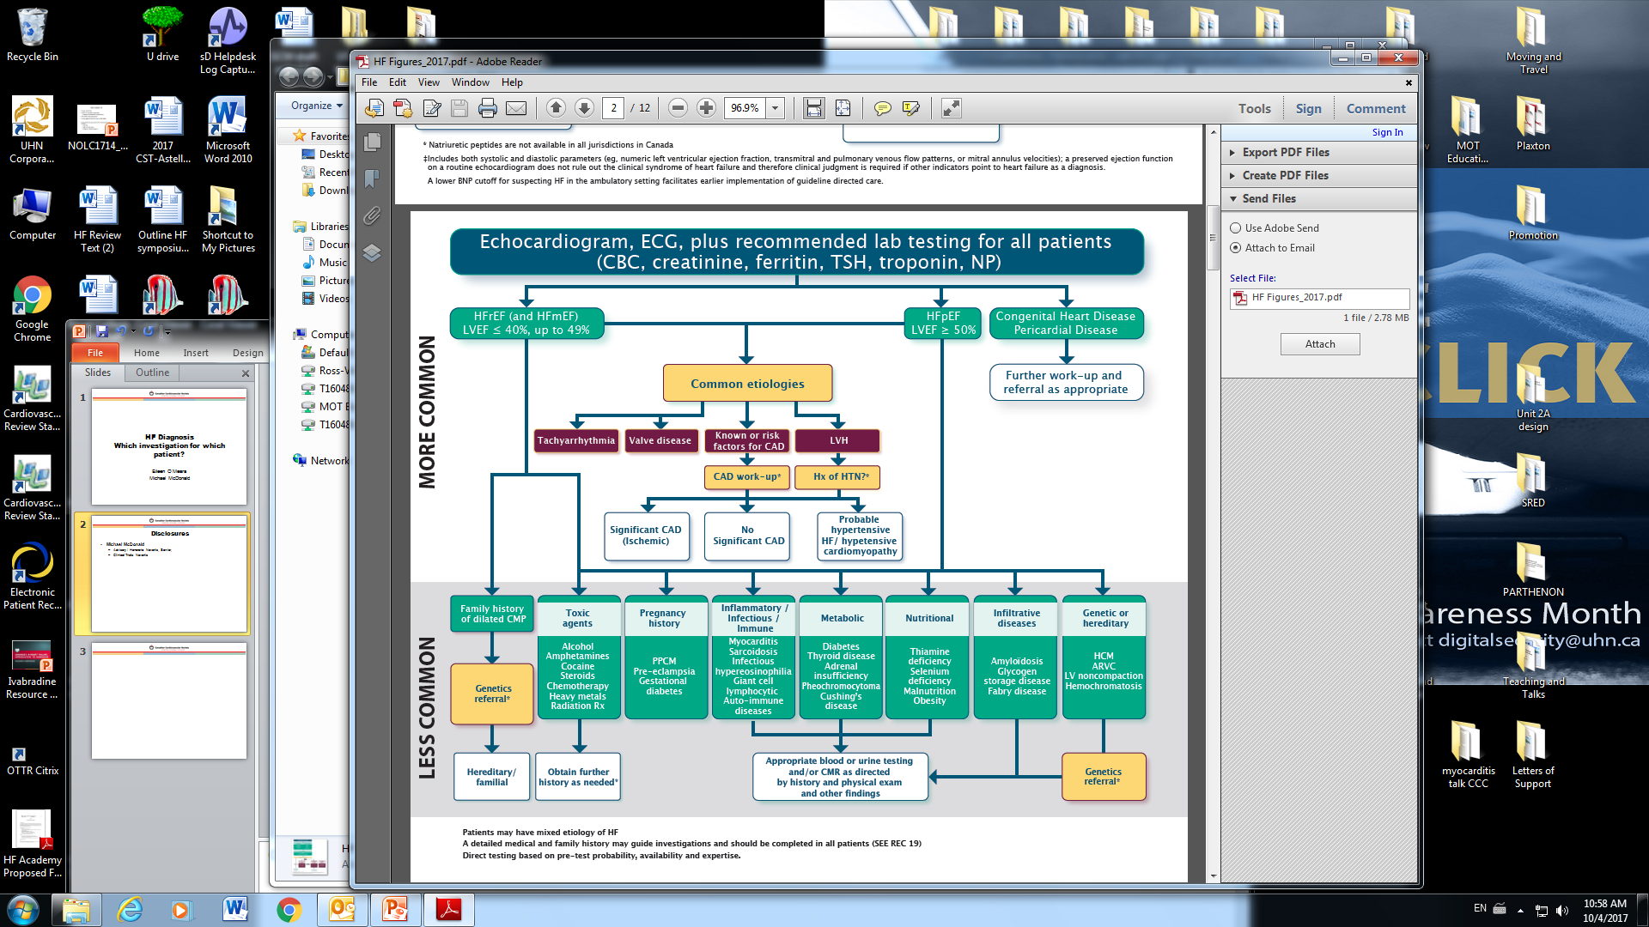
Etiology of HF

Slide 6
54 M, referred for HF management
LVEF <20%, LVIDd 60mm – unchanged over 2 years
PMHx: dyslipidemia (treated)
On appropriate HF therapy (ACEi, beta blocker, MRA)
Recent ICD implantation
  Now dependent on RV pacing

Slide 7
54 M
Review of systems
  Complains of weakness in legs, fatigue
  No history of MI or angina
  No ICD shocks
  No symptoms of systemic illness or endocrinopathy
  No toxin/drug exposures
  No family hx of cardiomyopathy, SCD
Investigations
  BNP: 230pg/mL
  TSH, HIV, iron indices all normal
  ECG: A sensed, V paced rhythm
  MIBI scan: fixed LAD territory infarct, no ischemia

Slide 8
Differential Diagnosis?
More likely
  Coronary disease/ischemic cardiomyopathy
Less likely
  Infectious/post infectious cardiomyopathy
  Myocarditis
  Systemic illness related
  Infiltrative/storage disease
  Endocrinopathy
  Familial/genetic

Slide 9
Etiology of HF

Slide 10
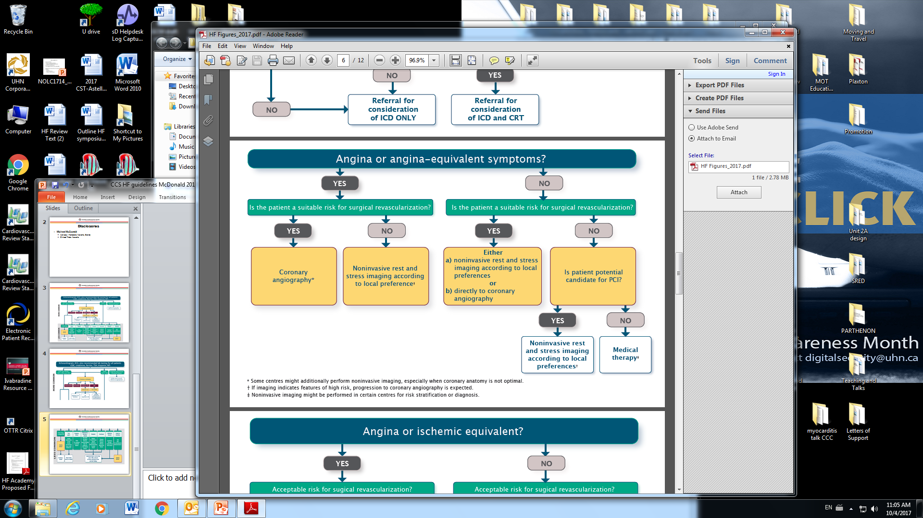
Evaluating for Coronary Disease

Slide 11
Evaluating for Coronary Disease
Recommendation
We recommend that coronary angiography be:
i. Performed in patients with HF with ischemic symptoms and who are likely to be good candidates for revascularization (Strong Recommendation, Moderate Quality Evidence);
ii. Considered in patients with systolic HF, LVEF < 35%, at risk of CAD, irrespective of angina, who might be good candidates for revascularization (Strong Recommendation, Low Quality Evidence);
iii. Considered in patients with systolic HF and in whom noninvasive coronary perfusion testing yields features consistent with high risk (Strong Recommendation, Moderate Quality Evidence).

Slide 12

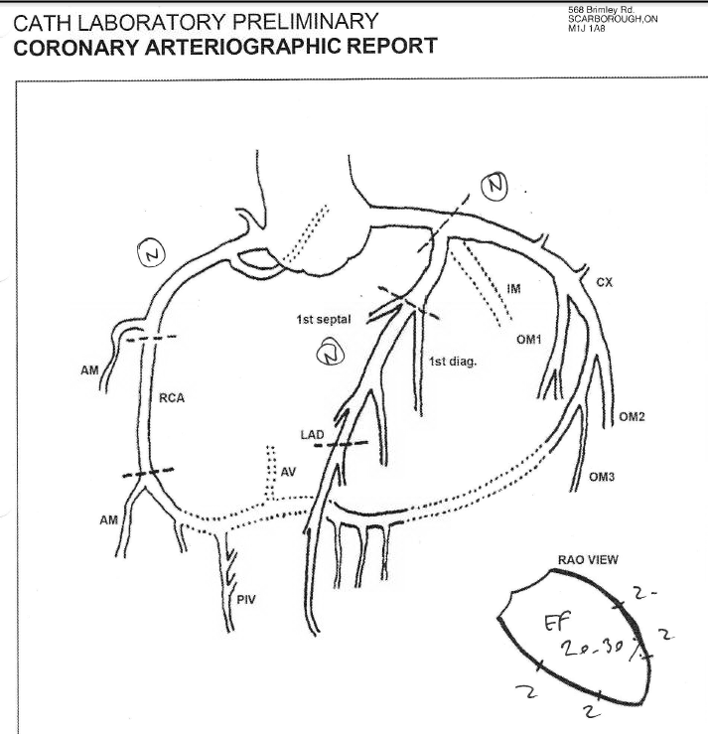
Investigation
Question:
  What might be the next appropriate investigation?
  A) PET scan
  B) Genetics referral
  C) Selenium and thiamine levels
  D) No further diagnostic test
Normal coronaries

Slide 13
Investigation
Recommendation
We recommend the choice of investigations should first be guided by careful history and physical examination and when clinical evidence suggests a possible cause and the planned test(s) result would be reasonably expected to lead to a change in clinical care (Strong Recommendation, Low Quality Evidence).
We recommend that in a patient suspected of a cardiomyopathy, an inquiry should be made regarding family history, concomitant illnesses, prior malignancy requiring radiation or chemotherapy, symptoms of hypo- or hyperthyroidism, pheochromocytoma, acromegaly, previous travel, occupational exposure to chemicals or heavy metals, nutritional status, alternative medicine or naturopathic agents, illicit drug use and exposure to HIV (Strong Recommendation, Low Quality Evidence).

Slide 14
Other etiology considerations

Slide 15
Case – clues?
Main complaint remains leg weakness
  CK levels consistently 500-800 (off statin)
  Troponin levels fluctuate – hsTn 50 - 10,000 ng/L
Densely dependent on RV pacing

Slide 16
Further work-up
Rheumatology and neurology evaluation
  Skeletal muscle biopsy, nerve conduction studies – all normal
  Connective tissue disease work up – normal
PET scan – no evidence for active inflammation
  Unlikely to be sarcoid or giant cell myocarditis
Etiology remains obscure
  Other tests unlikely to yield specific diagnosis that impacts management

Slide 17
47 yo with new onset HF
47 M, admitted on 9/4, transferred from community center for HF and rapid atrial flutter with intraLV thrombus and LVEF 15%
No past cardiac history or risk fx other than smoking 1 pq/week.
Had respiratory infection 3 weeks before adm and progressive SOB up to NYHA III 1 week before adm
Scan in ref hospital showed broncho-pneumonia (no PE) ➔ Ceftriaxone-azithromycin started.
Remains in flutter ≈ 150/no CVersion because of fear of reducing CO by reducing HR and given the 3 large thrombi at apex.

Slide 18
47 yo with new onset HF
Tachypneic on arrival, mild cyanosis, cold and wet
CPAP, IV lasix, central line, art line, milrinone and digoxin!
NT proBNP 13000, hsTnT 36
TTE on arrival (stable after lasix): non dil LV, no LVH, EF 10-15%, thrombus x 3 at apex ad 27mm long.
CI 1.6 L/min/m² pre-milrinone. RV: moderate hypokinesis, MR 1, TR1
CXR: RLL infiltrate
What is the diagnosis and what else would you do?

Slide 19
Etiology of HF

Slide 20
Other etiology considerations

Slide 21
47 yo with new onset HF
Coronary angiogram and RHC: mPAP 19, W 11, RA 7, Angio N, Biopsies RV (later negative).
CI on milrinone (0.375mcg/kg/min) = 2.4 L/min/m²
Progressively started HF thx w ramipril 2.5 bid, bisoprolol 2.5 bid, digoxin 0.125mg qd…
Milrinone weaned on 10-11/9 with succes!
HR ≈ 120, 0₂ 2L/min, eager to walk!
CMR when HR permits but discussion with EP re possible ablation…

Slide 22
Recommendation
Recommendation
We recommend that myocarditis should be suspected in the following clinical scenarios:
  Cardiogenic shock due to LV systolic dysfunction (global or regional), where etiology is not apparent.
  Acute or subacute development of LV systolic dysfunction (global or regional), where etiology is not apparent.
  Evidence of myocardial damage not attributable to epicardial CAD or another cause (Strong Recommendation, Low Quality Evidence).

Slide 23
Last but not least…
M 53 T from community hospital 9/9 PM for cardiogenic shock
Progressive SOB x 6 months➔ severe since 8/17 with OTP, NYHA 3-4/4➔ admitted to other hospital
hsTnT> 1000. Dx NI CMP (angio RCA prox 40%: ASA)
LVEF then 28%, med thx started, bisoprolol ad 7.5mg qd, spironolactone 12.5mg qd, lisinopril 2.5 qd and furosemide 40 qd
Consults again on 9/6 for NYHA, OTP, NSVT, meds withdrawn/low BP, amio started then in shock on 9/9 with noradrenaline and dobutamine started

Slide 24
Last but not least…
H 53 in cardiogenic shock with NSVT
Low dose Dobu changed to milrinone 0.375mcg/Kg/min.
Fragile, cachectic but albumine 31
Creatinine 110umol/L but solitary kidney
Has lost some 15 pounds
TTE 9/9 on arrival : LVEF 15%, non dilated LV. CI on low dose dobu (+noradrenaline) = 1.4L/min/m2, at 100 bpm, RV OK on dobu, MR ¾ IIIb, TR 2, PAPs 56-60
Possible myocarditis, no drugs
ETOH in the past but stopped many years ago
CXR shows pulmonary oedema, lactate levels around 2

Slide 25
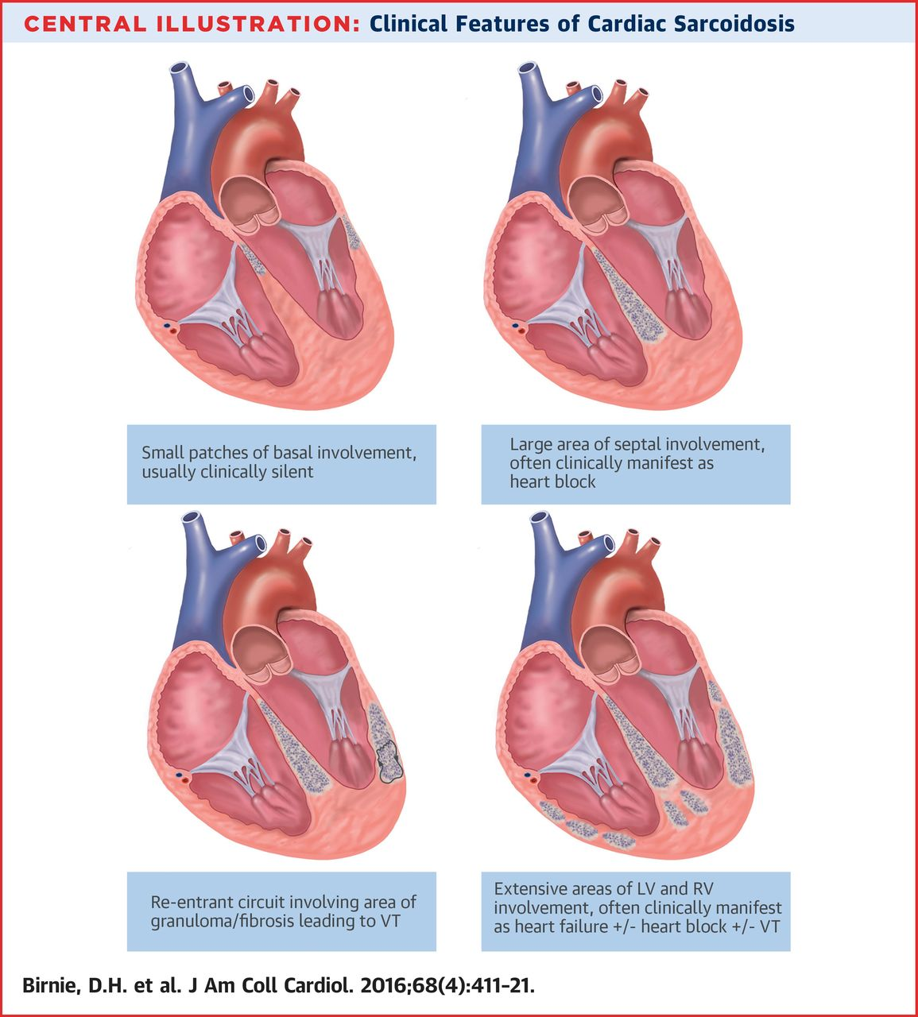
Last but not least…
2 days later, patient goes in refractory VT ➔ ECMO decided but in the mean time treating physician gives … which stops the arrhythmia rapidly (still had to go on ECMO)
Right heart catheter and biopsies done
What is this??
STEROIDS

Slide 26
Prognostic Risk Scores

Slide 27
Case
76 yo man
Known ischemic heart disease with prior MI in 2010
CRT-D
Echo 6 months ago: Enlarged LV with EF 25%, mild MR, mod TR, diffuse RV hypokinesis, PAP 30
Remote smoker, mild COPD, non-diabetic, No HF hospitalization in last year
c/o fatigue, SOB, low effort tolerance NYHA III-type symptoms
2 pillow orthopnea, no pnd, mild persistent edema, abdomen fullness
Exam: BP 88/60, HR 62, RR 20, weight 60kg(stable)/height 1.68m
Inc JVP, displaced apex, S3, hs murmur, chest: clear, 2+ edema, no ascites

Slide 28
Case
ECG: AV paced CRT
Labs: Hemoglobin 100g/L, creat 188 micromol/L, Na 132mEq/L, K+ 5.0mEq/L
Meds:
  Sacubitril/valsartan 24/26 mg bid (dizzy with higher dose)
  Bisoprolol 5mg OD (max dose tolerated, weakness with higher dose)
  Spironolactone 25mg OD
  Lasix 40mg in am, 20mg in pm
  Atorvastatin 40mg OD
  ASA 80mg OD

Slide 29
Question:
Based on this clinical presentation, your estimate of 1 year mortality would be?
1-10%
10-20%
20-40%
>60%

Slide 30
Discussion with patient
What are the patient’s expectations?
What are the goals of therapy for a particular patient?
  Decrease hospitalizations?
  Prolong life?
  Improve quality of life?
  Provide supportive care?

Slide 31
Prognostic Risk Scores
Facilitate discussion about expectations and reasonable goals of therapy by incorporating objective measures into discussion
Avoid relying on single, opinion-based prognostic factors
Help plan approach to patient care moving forward

Slide 32
2017 Guidelines:
Prognostic risk scores
A table with examples of HF prognostic scores
  Score name and reference
  Population studied
  Endpoints measured
  Strengths and limitations of the studies used to develop these scores
  How to access
  Variables measured
Scores included are easy to access and calculate
Emphasis on methodologically sound, externally-valid risk scores to provide more accurate risk stratification
Many others risk scores available and can be used

Slide 33
2017 Guidelines:
Prognostic risk scores
Risk Scores
Score Name | Population | Endpoint | Other Considerations | Access | Variables
Seattle Heart Failure Model⁶⁴⁵ | HFrEF | Mortality risk at 1, 2 and 5 years with or without intervention. Mean life expectancy. | Restricted to clinical trial patients with ‘severe’ HF; Lab data entry non-SI units; More than 20 variables to enter. | https://depts.washington.edu/shfm/ | Age, gender, NYHA class, weight, EF, SBP, ischemic etiology, diuretic dose, Na, lymphocyte count, Hgb, cholesterol, uric acid, use of ACEi/ARB/BB/aldosterone blocker/allopurinol/statins, QRS>120msec, use of device therapy
MAGGIC Risk Score⁶⁴⁶ | HFrEF and HFpEF | Mortality risk at 1 and 3 years | Cohorts from many sites; missing data in the overall analysis. | www.heartfailurerisk.org | Age, gender, NYHA class, diabetes, COPD, timing of diagnosis, EF, smoking, SBP, creatinine, BMI, use of beta-blocker/ACEi/ARB
3C-HF⁶⁴⁷ | HFrEF and HFpEF | Mortality risk at 1 year | Patients from centres with experience with HF management; mostly Caucasian patients; Lab data entry in non-SI units. | http://www.3chf.org/site/home.php | Age, NYHA class, AF, valvular heart disease, EF, anemia, diabetes, hypertension, creatinine, use of ACEi/ARB or beta-blockers.
BCN- Bio-HF⁶⁴⁸ | HFrEF and HFpEF | Mortality risk at 1,2 and 3 years | Limited to patients with chronic HF treated in HF unit in a tertiary hospital. Lab data entry in US units. Use of biomarkers improves accuracy but is optional. | www.BCNBioHFcalculator.cat | Age, gender, NYHA class, Na, eGFR, Hgb, EF, diuretic dose, use of statins, beta-blockers or ACEi/ARB. Optional: hs-cTnT, ST2, Nt-pro-BNP
EFFECT⁶⁴⁹ | Hospitalized HFrEF and HFpEF | 30-day and 1-year mortality | Limited to hospitalized patients; missing current clinically important variables | http://www.ccort.ca/Research/CHFRiskModel.aspx | Age, respiratory rate, SBP, BUN, Na, CVD, dementia, COPD, cirrhosis, cancer, Hgb
EHMRG⁶⁵⁰ | HFrEF and HFpEF patients presenting to the ED | 7 day mortality | Limited to patients presenting to the ER and only short-term mortality; missing current clinically important variables | https://ehmrg.ices.on.ca | Age, arrival by ambulance, triage SBP, triage HR, triage O2 sat, potassium, creatinine, active cancer, metolazone, troponin. Optional: BNP
ELAN⁶⁵¹ | Hospitalized HFrEF and HFpEF | 180-day mortality | Limited to hospitalized patients |  | Age, edema, SBP, serum sodium, serum urea, NYHA class at discharge, NT-proBNP at discharge and change in NT-proBNP
ADHERE⁶⁵² | HFrEF and HFpEF | In-hospital mortality | Limited to hospitalized patients |  | BUN, creatinine, SBP
LACE⁶⁵³ | Hospitalized patients | 30-day mortality or readmission | Limited to hospitalized patients |  | Length of stay, acute admission, comorbidity index, # of ED visits in last 6 months

Slide 34
2017 Guidelines:
Prognostic risk scores
Reliance on clinical judgement remains critically important to place these risk scores in context
Where possible, risk scores should be incorporated into practice and used to convey risk to patients
Scores also useful in discussions between clinicians to adequately characterize the overall risk of a patient and determine a consistent treatment plan

Slide 35
Case
76 yo man
Known ischemic heart disease with prior large MI in 2010
EF 25%, mild MR, mod TR, diffuse RV hypokinesis, PAP 30
mild COPD, non-diabetic
Paced CRT-D
NYHA III-type symptoms
Exam: BP 90/70, weight 60kg(stable)/height 1.68m
Inc JVP, displaced apex, S3, holosystolic murmur, 2+ edema, no ascites
Labs: Hgb 100g/L, creat 188 mmol/L, Na 132mEq/L, K+ 5.0mEq/L, NT-pro-BNP 6900 ng/L
On max tolerated doses of S/V, bisoprolol and MRA
What discussion will you have with this patient?
What is his prognosis?

Slide 36
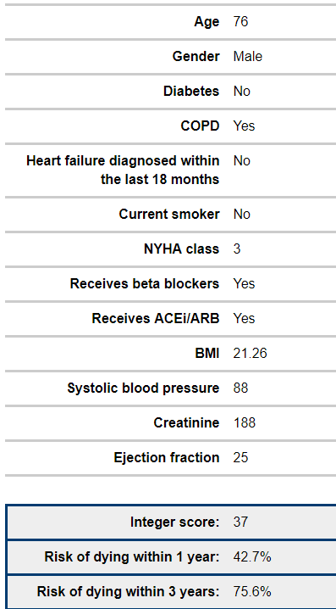
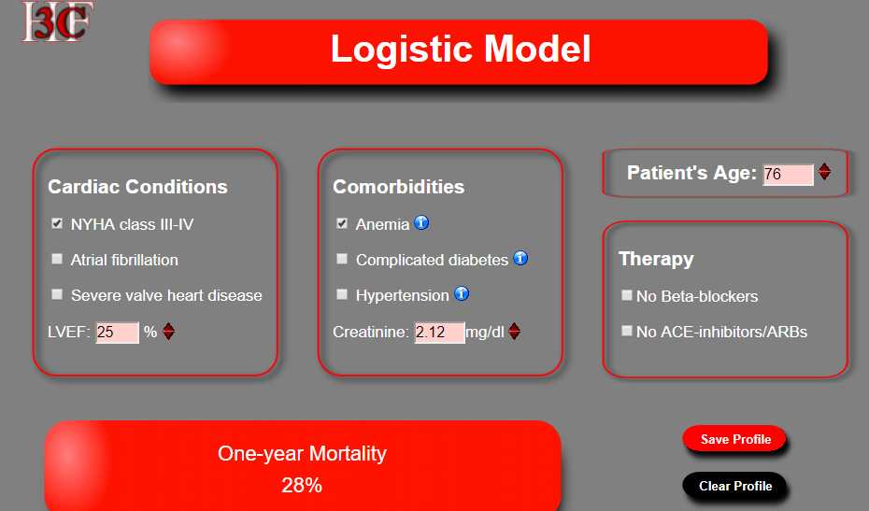
Examples of risk scores for this case
MAGGIC score (www.heartfailurerisk.org)
3chf score: http://www.3chf.org

Slide 37
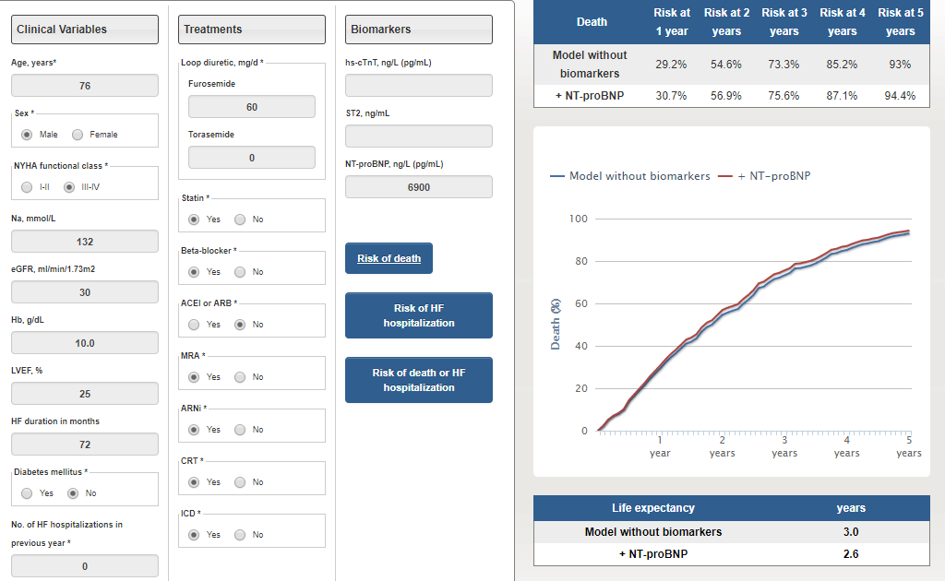
Examples of risk scores for this case
BCN- Bio-HF
http://ww2.bcnbiohfcalculator.org/web/calculations

Slide 38
Discussion with this patient
Overall poor prognosis
  1 year mortality estimated at between 28-40%
What are goals of therapy moving forward?
  Quality of life, supportive care, help for care-giver, home care….

Slide 39
Conclusion
Prognostic risk scores have a role in patient care to better define expectations, goals of therapy and a care plan
Easily accessible, validated risk scores for different HF populations and with different end-points are described in the 2017 CCS Heart Failure guidelines

Slide 40
Acute Heart Failure

Slide 41
New data; new failures; data gaps
TRUE-AHF: no additional benefit of ularatide
RELAX-AHF2: no additional benefit of serelaxin
Still no HQ data on nitroglycerin
No additional benefit of oxygen in normoxic patients with AHF / ACS
No additional benefit of morphine in AHF
No additional benefit of fluid restriction in AHF

Slide 43
What to do if I am unsure?
Use a scoring system of course!

Slide 44
Can I go home from the ER now?

Slide 46
Diuretic Dosing

Slide 47
Precipitants of AHF

Slide 48
Daily follow-up

Slide 49
Can I leave the hospital now?

Slide 50
Prevention vs Treatment of HF: sglt2 inhibitors

Slide 51
Which scenario would apply to people with Type II DM in your practice?
Prescribe SGLTi to prevent the occurrence of HF
Prescribe SGLTi to TREAT HF of all types
Prescribe SGLTi to TREAT HFrEF only
Recommend SGLTi to prevent the occurrence of HF
Recommend SGLTi to TREAT HF of all types
Recommend SGLTi to TREAT HFrEF only

Slide 52
Framingham Heart Study: high rate of heart failure in Patients with Diabetes over 30 years of follow-up
Risk of CVD events by age and sex
Ages 35-64
10
Men
Women
8
PRO
6
Risk Ratio
4
2
0
Total CVD
CHD
Cardiac Failure
Intermittent Claudication
Stroke
p < 0.001 for all values.
Wilson PWF, Kannel WB. In: Ruderman N et al, eds. Hyperglycemia, Diabetes and Vascular Disease. 1992.
Notes:
Message: HF is the dominant outcome for people with diabetes

Slide 53
HF is a more common OUTCOME than MI, Stroke and Death in DM trials
Look AHEAD
LIFE
RENAAL
IDNT
PROACTIVE
ALTITUDE
Various large US registries

Slide 54
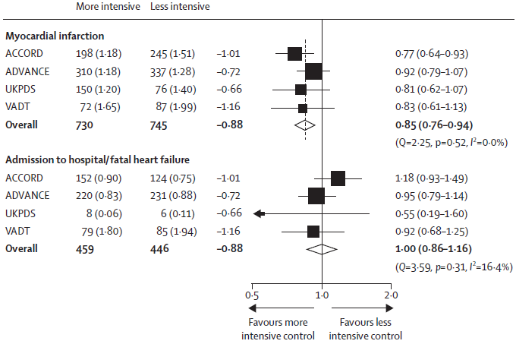
Effect of More vs Less Intensive Glycemic Control on MI and HF resulting in Hospital Admission or Death
No. of events
(yearly event rate, %)
ΔA1C
(%)
HR (95% CI)

Slide 55
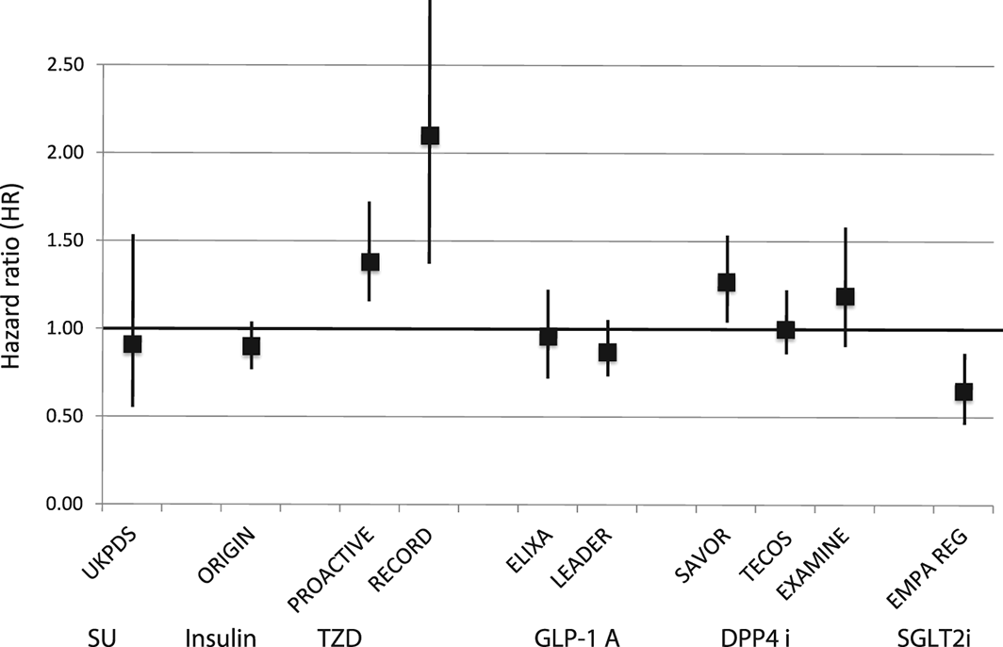
Heart failure outcomes in clinical trials of glucose‐lowering agents in patients with diabetes
European Journal of Heart Failure
Volume 19, Issue 1, pages 43-53, 21 SEP 2016 DOI: 10.1002/ejhf.633
http://onlinelibrary.wiley.com/doi/10.1002/ejhf.633/full#ejhf633-fig-0004

Slide 56
Evidence for benefit of sglt2i’s on HF risk in patients with diabetes:
EMPA-REG OUTCOME Trial
Placebo
(n = 2333)
Screening
(n = 11 531)
Randomized and treated
(n = 7020)
Empagliflozin 10 mg
(n = 2345)
Empagliflozin 25 mg
(n = 2342)
PRO
Key inclusion criteria:
  Adults with type 2 diabetes and established CVD (10.1% had HF at baseline)
  BMI ≤45 kg/m²; HbA1c 7–10%; eGFR ≥30 mL/min/1.73m² (MDRD)
Study medication was given in addition to standard of care.
The trial was to continue until ≥691 patients experienced an adjudicated primary outcome event.
CVD, cardiovascular disease; BMI, body mass index; eGFR, estimated glomerular filtration rate; HF, heart failure; MDRD, Modification of Diet in Renal Disease; SGLT2i, Sodium-glucose co-transporter-2 inhibitor
Zinman B et al. N Engl J Med 2015; 373:2117–2128.
Notes:
Study medication was given in addition
to standard of care.
The trial was to continue until ≥691 patients
experienced an adjudicated primary outcome event.

Slide 57
EMPA-REG Outcome: significant reduction in 3-point mace and cv death
Patients with
event/analysed
Empagliflozin
Placebo
HR
(95% CI)
p-value
Primary outcome:
3-point MACE
CV death
Non-fatal MI
Non-fatal stroke
490/4687
172/4687
213/4687
150/4687
282/2333
137/2333
121/2333
60/2333
0.86 (0.74–0.99)*
0.62 (0.49–0.77)
0.87 (0.70–1.09)
1.24 (0.92–1.67)
0.0382
<0.0001
0.2189
0.1638
PRO
0.25
0.50
1.00
2.00
Favours empagliflozin
Favours placebo
*Primary outcome.
CI, confidence interval; CV, cardiovascular; HR, hazard ratio; MACE, major adverse cardiac event; MI, myocardial infarction
Zinman B et al. N Engl J Med 2015; 373:2117–2128.

Slide 58
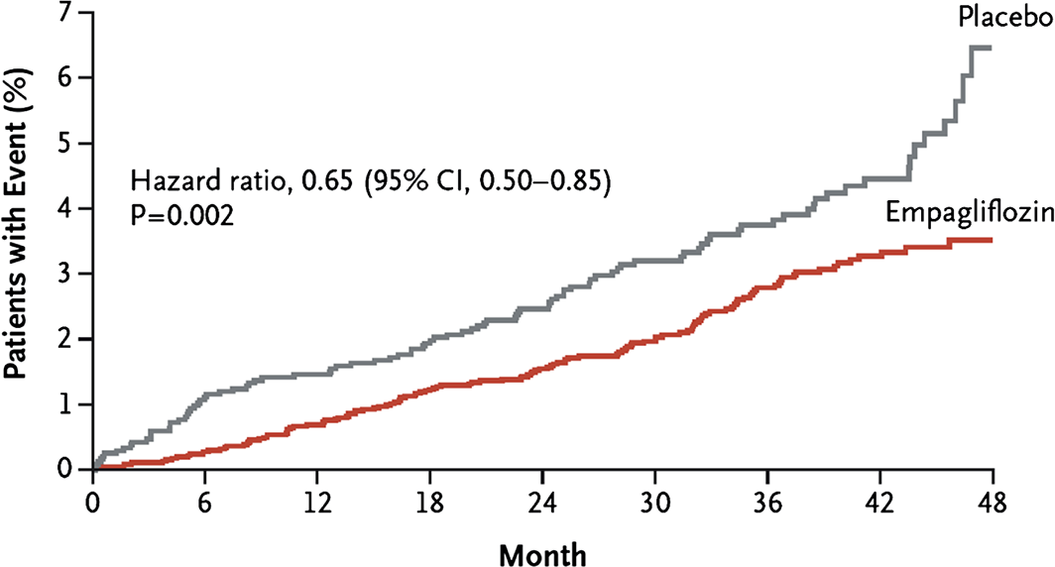
Heart failure outcomes in clinical trials of glucose‐lowering agents in patients with diabetes
European Journal of Heart Failure
Volume 19, Issue 1, pages 43-53, 21 SEP 2016 DOI: 10.1002/ejhf.633
http://onlinelibrary.wiley.com/doi/10.1002/ejhf.633/full#ejhf633-fig-0003
Notes:
Time to first hospitalization for heart failure or cardiovascular death in patients receiving empagliflozin or placebo in the EMPA‐REG OUTCOME trial. Reprinted with permission from Fitchett et al. CI, confidence interval; HR, hazard ratio.
IF THIS IMAGE HAS BEEN PROVIDED BY OR IS OWNED BY A THIRD PARTY, AS INDICATED IN THE CAPTION LINE, THEN FURTHER PERMISSION MAY BE NEEDED BEFORE ANY FURTHER USE. PLEASE CONTACT WILEY'S PERMISSIONS DEPARTMENT ON PERMISSIONS@WILEY.COM OR USE THE RIGHTSLINK SERVICE BY CLICKING ON THE 'REQUEST PERMISSIONS' LINK ACCOMPANYING THIS ARTICLE. WILEY OR AUTHOR OWNED IMAGES MAY BE USED FOR NON-COMMERCIAL PURPOSES, SUBJECT TO PROPER CITATION OF THE ARTICLE, AUTHOR, AND PUBLISHER.

Slide 59
Heart Failure Related Outcomes in
EMPA-REG
Fitchett, EJHF 2017

Slide 60
EMPA -REG: Empagliflozin outcomes and HF risk at baseline
Fitchett, J 2017

Slide 61
CANagliflozin cardioVascular Assessment Study (CANVAS) in patients with diabetes:
TRIAL DESIGN
Canagliflozin 300 mg
2-week
placebo run-in
R
Canagliflozin 100 mg
Placebo
PRO
Key inclusion criteria:
  A1c ≥7.0% to ≤10.5%
  eGFR ≥30 mL/min/1.73 m²
  Age ≥30 years and history of prior CV event OR age ≥50 years with ≥2 CV risk factors (DM duration
  ≥10 yrs, SBP >140 on ≥1 medication, current smoker, micro- or macroalbuminuria, or HDL <1 mmol/L)
  ~14% of patients had HF at baseline
A1c, glycated hemoglobin; CV, cardiovascular; DM, diabetes mellitus; eGFR, estimated glomerular filtration rate; HDL, high-density lipoprotein; R, randomization; SBP, systolic blood pressure
Neal B et al. N Engl J Med 2017;377:644-657.

Slide 62
CANVAS: significant reduction in composite cardiovascular outcomes
Hazard ratio
(95% CI)
Primary cardiovascular outcome
0.86 (0.75–0.97)
CV death
Nonfatal myocardial infarction
Nonfatal stroke
0.87 (0.72–1.06)
0.85 (0.69–1.05)
0.90 (0.71–1.15)
PRO
Hospitalization for heart failure
CV death or hospitalization for heart failure
All-cause mortality
0.67 (0.52–0.87)
0.78 (0.67–0.91)
0.87 (0.74–1.01)
0.5
1.0
2.0
Favours canagliflozin
Favours placebo
CV, cardiovascular
Neal B et al. N Engl J Med 2017;377:644-657.

Slide 63
CANVAS: significant reduction in hf hospitalization but not cv death
Hospitalization for Heart Failure
CV Death Component of
Primary Outcome
20
HR 0.67 (95% CI, 0.52–0.87)
20
HR 0.87 (95% CI, 0.72–1.06)
18
18
16
Placebo
16
Placebo
14
Canagliflozin
14
Canagliflozin
12
12
PRO
10
10
Patients with an event (%)
Patients with an event (%)
8
8
6
6
4
4
2
2
0
0
1
2
3
4
5
6
0
0
1
2
3
4
5
6
Years since randomization
Years since randomization
Placebo
4347
4198
3011
1274
1236
1180
829
4347
4279
3119
1356
1328
1292
924
Canagliflozin
5795
5653
4437
2643
2572
2498
1782
5795
5723
4576
2761
2710
2651
1904
Intent-to-treat analysis.
CI, confidence interval; CV, cardiovascular; HF, heart failure
Neal B et al. N Engl J Med 2017;377:644-657.

Slide 65

A multinational, retrospective, observational study
in patients with type 2 diabetes mellitus who are initiating treatment with SGLT2 inhibitor or another glucose-lowering drug
Primary outcomes:
Risk of hospitalization for HF
All-cause mortality
PRO
SGLT2, sodium/glucose cotransporter 2

Slide 66

Significant reduction in Hospitalization for HF with sglt2 inhibitors: Primary Analysis
Database
n
# of events
HR (95% CI)
US
Norway
Denmark
Sweden
UK
Germany
Total
233,798
25,050
18,468
18,378
10,462
2900
309,056
298
278
167
191
16
11
961
0.55 (0.44–0.69)
0.62 (0.49–0.79)
0.77 (0.59–1.01)
0.61 (0.45–0.82)
0.36 (0.12–1.13)
0.14 (0.03–0.68)
0.61 (0.51–0.73)
p-value for
SGLT2i vs oGLD: <0.001
PRO
Heterogeneity
p-value: 0.17
0.05
0.10
0.25
0.50
1.00
2.00
Favours SGLT2i
Favours oGLD
Data are on treatment, unadjusted.
oGLD, other glucose-lowering drug; HR, hazard ratio; SGLT2, sodium-glucose co-transporter
Kosiborod M et al. Circulation 2017;136 :249-259.

Slide 67
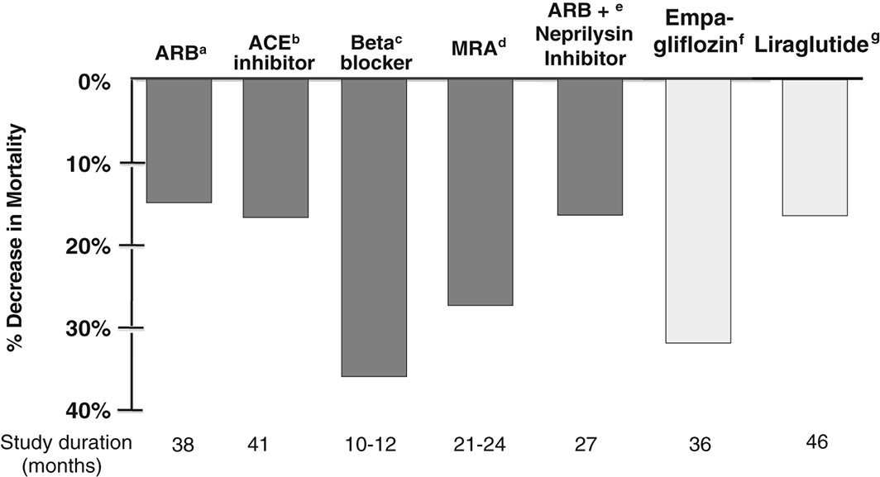
Heart failure outcomes in clinical trials of glucose‐lowering agents in patients with diabetes
European Journal of Heart Failure
Volume 19, Issue 1, pages 43-53, 21 SEP 2016 DOI: 10.1002/ejhf.633
http://onlinelibrary.wiley.com/doi/10.1002/ejhf.633/full#ejhf633-fig-0005
Notes:
Comparison of all‐cause mortality reduction observed in heart failure trials with the EMPA‐REG OUTCOME and LEADER cardiovascular outcome trials in patients with diabetes. ªSOLVD Treatment, ^{b}CHARM Alternative, ^{c}COPERNICUS and MERIT‐HF, ^{d}RALES and EMPHASIS‐HF, ^{e}PARADIGM, ^{f}EMPA‐REG OUTCOME, ^{g}LEADER.
IF THIS IMAGE HAS BEEN PROVIDED BY OR IS OWNED BY A THIRD PARTY, AS INDICATED IN THE CAPTION LINE, THEN FURTHER PERMISSION MAY BE NEEDED BEFORE ANY FURTHER USE. PLEASE CONTACT WILEY'S PERMISSIONS DEPARTMENT ON PERMISSIONS@WILEY.COM OR USE THE RIGHTSLINK SERVICE BY CLICKING ON THE 'REQUEST PERMISSIONS' LINK ACCOMPANYING THIS ARTICLE. WILEY OR AUTHOR OWNED IMAGES MAY BE USED FOR NON-COMMERCIAL PURPOSES, SUBJECT TO PROPER CITATION OF THE ARTICLE, AUTHOR, AND PUBLISHER.

Slide 68
Defronzo, Nature Reviews Neph VOLUME 13 | JANUARY 2017 | 23

Slide 69
But……

Slide 70
Patients with history of hf in empa-reg not the same as in traditional studies: cannot extrapolate to hf populations
HR 0.59
(95% CI 0.43–0.82)
HR 0.75
(95% CI 0.48–1.19)
Patients
hospitalized
for HF (%)
CON
Placebo
Empagliflozin
Less than half rate of EMPHASIS, despite lower level triple therapy
Cox regression analysis.
HR, hazard ratio; CI, confidence interval.
Zinman B et al. N Engl J Med 2015;373: 2117–2128.

Slide 71
Therapies for prevention of hf are not always effective once hf is present
Ex: rosuvasatin
Primary Outcome
35
30
Placebo
25
20
Rosuvastatin
Patients (%)
15
10
p = 0.12
5
0
0
6
12
18
24
30
36
No. at Risk
Months
Placebo
2497
2315
2156
2003
1851
1431
811
Rosuvastatin
2514
2345
2207
2068
1932
1484
855
HF, heart failure
Kjekshus J et al. N Engl J Med 2007; 357:2248-2261.

Slide 72
Differential Results for Downstream vs. Upstream Strategy
HR 0.96 (95% CI, 0.88–1.06) p = 0.43
Placebo
Trandolapril
Number of Patients
Placebo
4132
3992
3722
3491
3034
1941
906
Tran
4158
4019
3758
3515
3093
1981
985
CV, cardiovascular, CABG, coronary artery bypass surgery; HR, hazard ratio; MI, mycardial infarction; PCI, percutaneous coronary intervention
Braunwald E et al. N Engl J Med 2004; 351:2058-2068..

Slide 73
Anecdotal evidence for harm associated with sglt2i’s in hf patients
Currently we see AKI about once every
3-4 weeks when SGLT2 started in HF
clinic patients¹
  Exaggeration of the normal 10% reduction in eGFR with SGLT2 initiation²
CON
AKI, acute kidney injury; eGFR, estimated glomerular filtration rate; EF, ejection fraction; HF,heart failure; HFrEF, heart failure with preserved ejection fraction; SGLT2, sodium-glucose co-transporter 2
J. Howlett, personal communication;
Heerspink HJ et al. Circulation 2016; 134: 752-72;

Slide 74
To use or not to use in all HF patients?
For Rx: Against Rx:
Consistency of data
Multiple studies/design
Consistent across risk levels
Total mortality reduced
Mechanism of action unknown
Surprise finding in safety trial- question was not asked
Low event rate- unlikely a true HF population
Poorly characterized HF population

Slide 75
Prevention vs. Treatment of HF
Therapies that
ONLY prevent HF:
Therapies that ONLY treat established HF:
Therapies that BOTH treat and prevent HF:
Statins BP control, eg CCBs, thiazides SGLT2 inhibitors Antiplatelets? Weight loss? Primary prevention?
ARNi Ivabradine CRT/ICD MRA
ACEi/ARB Beta blockers Exercise
CON
ACE, angiotensin converting enzyme; ARB, angiotensin receptor blocker; ARNi, angiotensin receptor-neprilysin inhibitor; CCB, Calcium channel blockers; CRT, cardiac resynchronization therapy; HF, heart failure; ICD, implantable cardioverter defibrillator; SGLT2, sodium-glucose co-transporter 2
Adapted from Howlett JG et al. Can J Cardiol 2016; 32:296-310

Slide 76
2017 CCS Recommendations
HF Prevention in DM

Slide 77
Canadian Diabetes association guidelines: existing knowledge
At diagnosis of type 2 diabetes Start lifestyle intervention (nutrition therapy and physical activity) +/- Metformin
A1C <8.5% | A1C ≥8.5% | Symptomatic hyperglycemia with metabolic decompensation
If not at glycemic target
(2-3 mos)
Start metformin immediately.
Consider initial combination with another antihyperglycemic agent.
Initiate
insulin +/- metformin
CON
Start/Increase metformin
If not at glycemic targets
Add another agent best suited to the individual by prioritizing patient characteristics:
PATIENT CHARACTERISTIC | CHOICE OF AGENT
Priority: Clinical cardiovascular disease | Antihyperglycemic agent with demonstrated CV outcome benefit (empagliflozin, liraglutide)
Degree of hyperglycemia Risk of hypoglycemia Overweight or obesity Cardiovascular disease or multiple risk factors Comorbidities (renal, CHF, hepatic) Preferences & access to treatment | Consider relative A1C lowering Rare hypoglycemia Weight loss or weight neutral Effects on cardiovascular outcome See therapeutic considerations, consider eGFR See cost column; consider access
A1C, blood glucose control; CHF, congestive heart failure; CV, cardiovascular; eGFR, estimated glomerular filtration rate
Cheng AYY et al. Can J Diabetes 2013;37(Suppl 1):S1-S212.

Slide 78
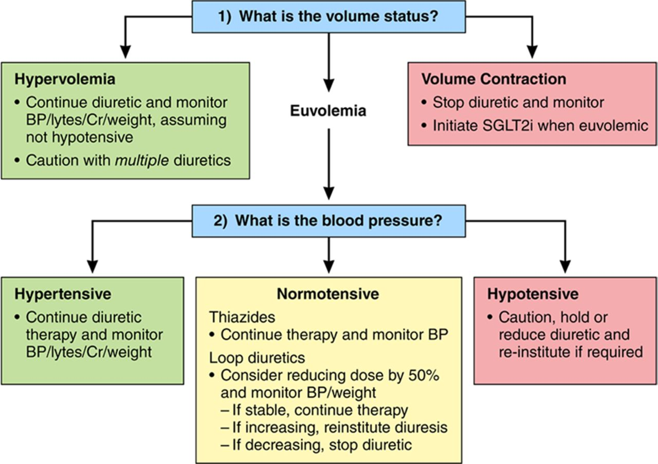

Proposed management of concomitant diuretics when initiating a sodium glucose cotransport-2 inhibitor (SGLT2i) in high-risk patients with type 2 diabetes mellitus (T2DM).
David Z.I. Cherney, and Jacob A. Udell Circulation. 2016;134:1915-1917
Copyright © American Heart Association, Inc. All rights reserved.
Notes:
Proposed management of concomitant diuretics when initiating a sodium glucose cotransport-2 inhibitor (SGLT2i) in high-risk patients with type 2 diabetes mellitus (T2DM). Green boxes represent scenarios in which the practitioner can typically proceed with initiation of SGLT2i therapy among stable outpatients with T2DM. Red boxes represent scenarios in which the practitioner should not initiate SGLT2i therapy given the potential for deleterious natriuresis/hemodynamic effects in these settings. Yellow boxes represent scenarios in which the practitioner may proceed with caution with initiation of SGLT2i therapy and monitor for natriuresis/hemodynamic effect. Clinical monitoring includes consideration of checking blood pressure (BP), renal function, electrolytes, and weight response to therapy within the first 2 weeks. Similar recommendations may be applicable in patients taking angiotensin II receptor-neprilysin inhibition (ARNI) therapy, and additional data on SGLT2i-ARNI combinations are required. Cr indicates creatinine.

Slide 79
Medical Therapy for HFrEF
When…What Order…and How Much?

Slide 80
Mrs. “rEF”
50 yr old F
Referred to you for optimization of medication for HFrEF “is she appropriate for one of those new fancy drugs”?
PMHx
  HTN, dyslipidemia
Meds prior to HF diagnosis
  amlodipine 5 mg od, rosuvastatin 10 mg od
Presentation
  2 presentations to ER with “respiratory tract infection”
  3 pillow orthopnea and moderate HF symptoms
  Review of systems: unremarkable
  BP 120/80, HR 90, volume overloaded (JVP, crackles, peripheral edema)

Slide 81
Mrs. “rEF”
Investigations
  ECG: sinus rhythm, QRS 116 ms, no Q waves
  CXR: cardiomegaly
  Echo: LVEF 25-30%, LVIDd 62 mm, moderate functional MR
  MIBI scan: normal perfusion
  Na 136, K 4.1, Creat 100, CBC normal
Initial Rx by Primary Care
  furosemide 40 mg/d,
  ramipril 2.5 mg bid
  amlodipine and rosuvastatin continued
Improved – fluctuates NYHA class II-III symptoms, no orthopnea
Now what?

Slide 82
Question 1
What is an appropriate next step in her medical therapy?
Carvedilol 3.125 mg bid; stop amlodipine
Digoxin .125 mg od
Spironolactone 12.5 mg po od
Add ivabradine 5 mg bid
Substitute ramipril for sacubitril-valsartan 50 mg bid

Slide 83
Question 1
What is an appropriate next step in her medical therapy?
Carvedilol 3.125 mg bid; stop amlodipine
Digoxin .125 mg od
Spironolactone 12.5 mg po od
Add ivabradine 5 mg po bid
Substitute ramipril for sacubitril-valsartan 50 mg bid

Slide 84
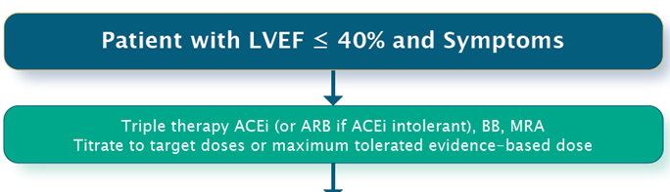
Step 1
Triple Therapy for HFrEF
STEP 1

Slide 85
Step 1
Triple Therapy for HFrEF
ACE INHIBITOR
+
B-BLOCKER
(max tolerated dose)
STEP 1
MRA
(max tolerated dose)

Slide 86
Mrs. “rEF” 4 months later after
Triple Therapy Uptitration
Feels generally well
  No hospitalizations
  More stamina, but still fatigues with ordinary activities; NYHA II
  Describes satisfactory quality of life
  Meds:
    ramipril 5 mg bid
    carvedilol 12.5mg bid
    spironolactone 12.5 bid
  BP 114/72, HR 72, euvolemic
  CBC normal, creat 104, K 4.3
Triple Therapy

Slide 87
Question 2
What is your next move?
Add ivabradine 5 mg bid
Substitute ramipril for sacubitril-valsartan 50 mg bid
Nothing; this patient feels well, is tolerating meds

Slide 88

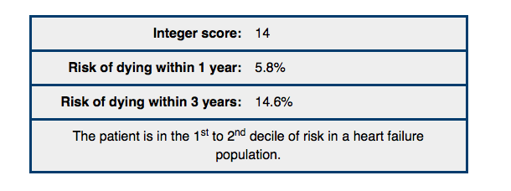
Lower risk….but not low risk
Mortality with NYHA II Symptoms
www.heartfailurerisk.org
Pocock et al, Eur Heart J 2012
Notes:
The MAGGIC meta-analysis includes individual data on 39 372 patients with HF, both reduced and preserved left-ventricular ejection fraction (EF), from 30 cohort studies, six of which were clinical trials. 40.2% of patients died during a median follow-up of 2.5 years. Using multivariable piecewise Poisson regression methods with stepwise variable selection, a final model included 13 highly significant independent predictors of mortality in the following order of predictive strength: age, lower EF, NYHA class, serum creatinine, diabetes, not prescribed beta-blocker, lower systolic BP, lower body mass, time since diagnosis, current smoker, chronic obstructive pulmonary disease, male gender, and not prescribed ACE-inhibitor or angiotensin-receptor blockers. In preserved EF, age was more predictive and systolic BP was less predictive of mortality than in reduced EF. Conversion into an easy-to-use integer risk score identified a very marked gradient in risk, with 3-year mortality rates of 10 and 70% in the bottom quintile and top decile of risk, respectively.
CONCLUSION:
In patients with HF of both reduced and preserved EF, the influences of readily available predictors of mortality can be quantified in an integer score accessible by an easy-to-use website www.heartfailurerisk.org. The score has the potential for widespread implementation in a clinical setting.

Slide 89
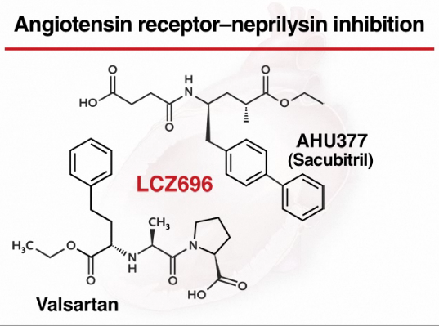
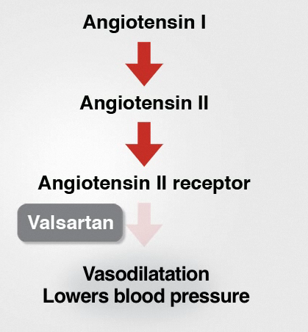
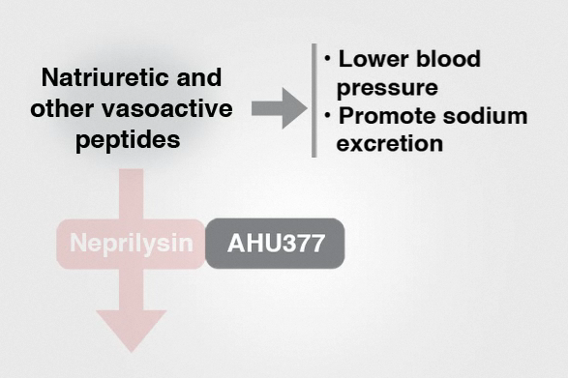
PARADIGM-HF: LCZ696/Sac-Val/ARNI
Prospective Comparison of ARNI [Angiotensin Receptor–Neprilysin Inhibitor] with ACEI to Determine Impact on Global Mortality
New Therapies for HFrEF:
Sacubitril-Valsartan
McMurray et al. N Engl J Med 2014;371(11):993-1004
Notes:
The paradigm study PARADIGM-HF (Prospective Comparison of ARNI [Angiotensin Receptor–Neprilysin Inhibitor] with ACEI [Angiotensin-Converting–Enzyme Inhibitor] to Determine Impact on Global Mortality
and Morbidity in Heart Failure Trial), was deliberately designed to provide evidence to support the replacement of Ace I or ARB’s with LCZ696 in the management of HF. It was undertaken in 2009 and is the largest clinical trial in HF ever undertaken in over 1000 sites thoughout the world

Slide 90
PARADIGM-HF: Primary endpoint
(CV death or HF hospitalization)
40
Enalapril
(n=4212)
1117
32
914
24
Sac-Val
(n=4187)
Kaplan-Meier Estimate of
Cumulative Rates (%)
16
8
HR = 0.80 (0.73-0.87)
P = 0.0000002
Number needed to treat = 21
0
0
180
360
540
720
900
1080
1260
Patients at Risk
Days After Randomization
LCZ696
Enalapril
4187
4212
3922
3883
3663
3579
3018
2922
2257
2123
1544
1488
896
853
249
236
McMurray et al. N Engl J Med 2014;371(11):993-1004
Notes:
The paradigm study PARADIGM-HF (Prospective Comparison of ARNI [Angiotensin Receptor–Neprilysin Inhibitor] with ACEI [Angiotensin-Converting–Enzyme Inhibitor] to Determine Impact on Global Mortality
and Morbidity in Heart Failure Trial), ), was deliberately designed to provide evidence to support the replacement of Ace I or ARB’s with LCZ696 in the management of HF. It was undertaken in 2009 and is the largest clinical trial in HF ever undertaken in over 1000 sites thoughout the world

Slide 91
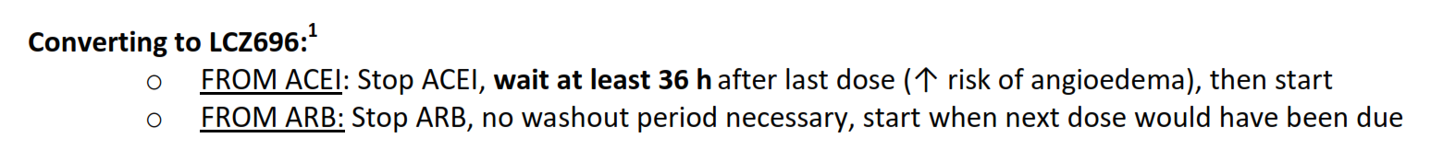
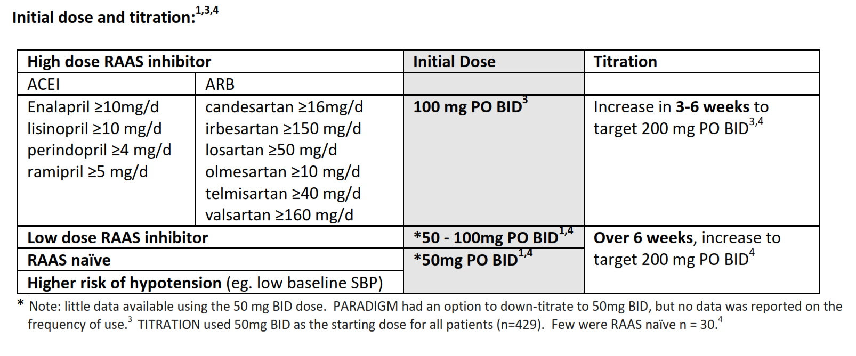
How to Switch High Dose + Low Dose RAAS to Sacubitril-Valsartan in
“Real Life”
Koshman, Ezekowitz Nov 2015

Slide 92
2017 Recommendation: ARNI
Recommendation
We recommend that an ARNI be used in place of an ACEi or ARB, in patients with HFrEF, that remain symptomatic despite treatment with appropriate doses of GDMT in order to decrease cardiovascular death, HF hospitalization and symptoms (Strong Recommendation, High Quality Evidence).
Practical tips:
Drug tolerability, side effects and laboratory monitoring with use of ARNIs is similar to that of ACEi or ARB
PARADIGM-HF excluded patients with a serum K > 5.2 and eGFR < 30 and SBP < 100mmHg
ACEi (not ARB) require a washout period of 36 hours to decrease the risk of angioedema

Slide 93
Mrs. “rEF” Next Follow Up: 3 Months
Feels ‘ok;’ but fatigues easily, persistent NYHA 2 symptoms
Meds:
  carvedilol 12.5 mg bid
  spironolactone 12.5 mg bid
  sacubitril-valsartan 100 mg bid
BP 100/70, HR 84, euvolemic
BNP 185, CBC normal, creat 104, K 4.3

Slide 94
Question 3
What is your next move?
Add ivabradine 5 mg bid
Reassess LVEF
Refer for ICD

Slide 95
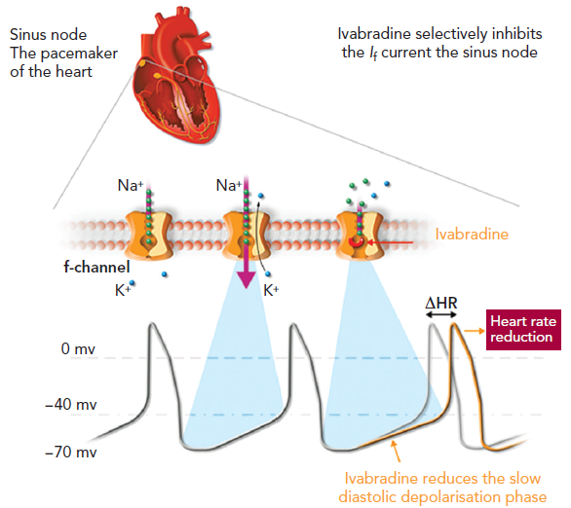


New Therapies for HFrEF:
Ivabradine
90% B blockers
91% Ace or ARB
60% Aldactone
70
ivabradine
placebo
Cardiac Fail Review Vol 3(1) Apr 27, 2017
Swedberg K, et al. Eur j Heart Fail 2010;12:75-81
Notes:
Systolic Heart Failure treatment with the If inhibitor ivabradine Trial

Slide 96
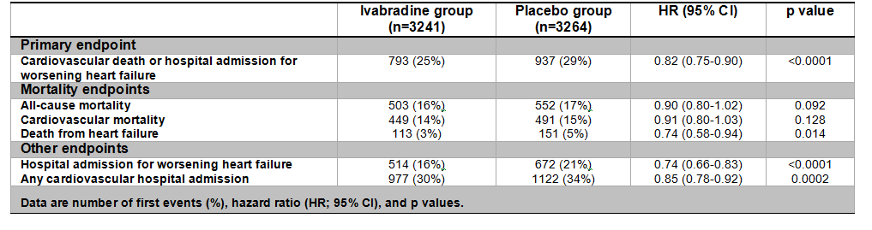
Effects of Ivabradine on Primary and Secondary Endpoints in the SHIFT Study
Ivabradine resulted in 18% reduction in the primary end point
Effect mainly driven by reduction in hospital admissions for worsening HF (26%) and deaths due to HF (26%)
Swedberg K, et al. Eur j Heart Fail 2010;12:75-81

Slide 97
2017 Recommendation: Ivabradine
Recommendation
We recommend that ivabradine be considered in patients with HFrEF, who remain symptomatic despite treatment with appropriate doses of GDMT with a resting HR > 70 BPM, in sinus rhythm and a prior HF hospitalization within 12 months, for the prevention of cardiovascular death and HF hospitalization (Strong Recommendation, Moderate Quality Evidence).
Practical tips:
Every effort should be made to achieve target or maximally tolerated doses of beta-blockers prior to initiation of ivabradine
Ivabradine has no effect on BP or myocardial contractility

Slide 98
Comparison: Ivabradine vs
Sacubitril-Valsartan
Ivabradine
Add on therapy
  Little evidence for de novo HF
    Need BB titrated first
  Indicated for those in NSR and HR >70 bpm
  Limited by bradycardia, fatigue
  Not affected by BP, creatinine
  Other side effects less common
  One titration (5, 7.5 bid) at 2 week interval
Sacubitril-Valsartan
Replacement for ACE/ARB
  Little evidence for de novo HF
    Needs ACE/ARB first (for now)
  Indicated for those on ACE/ARB
  Limited by hypotension, creatinine, potassium
  Not affected by HR
  Other side effects not common
  Two titrations (50, 100, 200 bid) for 6-12 weeks

Slide 99
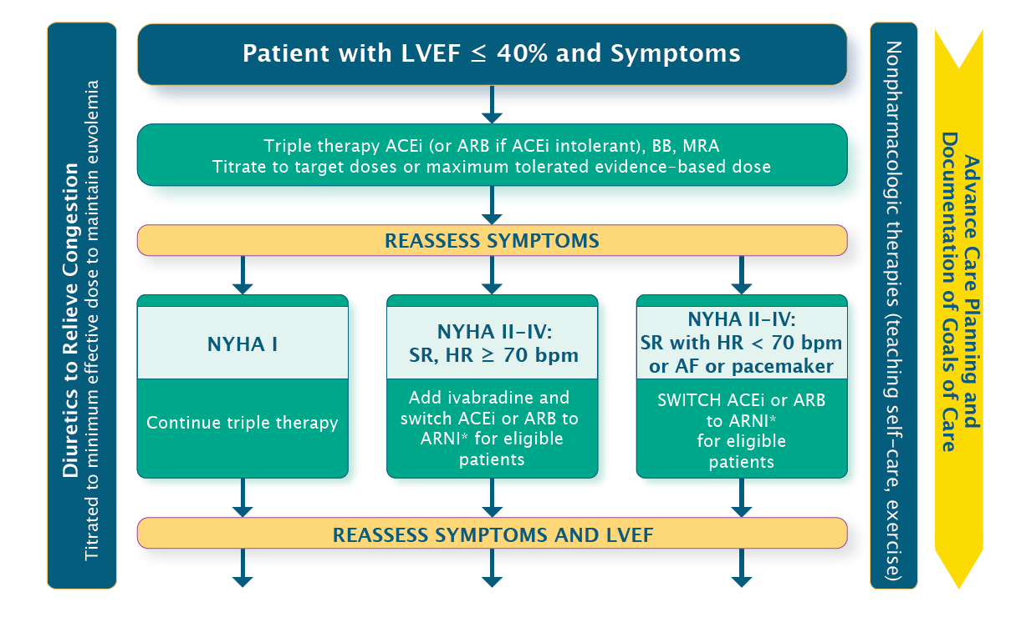
Therapeutic Approach to Patients With HFrEF

Slide 100

Questions?

