Slide 1
2019 Canadian Cardiovascular Society/Canadian Association of Interventional Cardiology Guidelines on the Acute Management of ST Elevation Myocardial Infarction: Focused Update on Regionalization and Reperfusion

Slide 2
Endorsed by the Canadian Association of Emergency Physicians (CAEP)

Slide 3
2019 STEMI Guideline Authors
Graham C. Wong MD MPH (Co-Chair), Michelle Welsford MD, Craig Ainsworth MD, Wael Abuzeid MD MSc, Christopher Fordyce MDCM MHS MSc, Jennifer Greene BSc ACP, Thao Huynh MD MSc PhD, Laurie Lambert PhD, Michel Le May MD, Sohrab Lutchmedial MDCM, Shamir Mehta MD MSc, Madhu Natarajan MD MSc, Colleen Norris RN, MN, PhD, Christopher Overgaard MD MSc, Michele Perry Arnesen MHA, BSN, RN, Ata Quraishi MBBS, Jean François Tanguay MD, Mouheiddin Traboulsi MD, Sean van Diepen MD MSc, Robert Welsh MD, David Wood MD, Warren J Cantor MD (Co-Chair)

Slide 4
The primary panel consisted of cardiologists, intensivists, emergency medicine physicians, nurses, health care researchers and emergency health services personnel

Slide 5
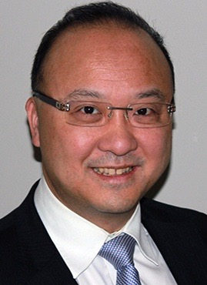
Committee Co-Chairs
Warren Cantor
MD, FRCPC, FSCAI
University of Toronto
Southlake Regional Health Centre
Graham Wong
MD, MPH, FRCPC, FACC, FCCS, FAHA
University of British Columbia
Vancouver General Hospital

Slide 6
Primary Panelists
Ata Quraishi
MBBS, FCPS, FACC
Dalhousie University
Chris Overgaard
MD, MSc, FRCPC
University Health Network
Michelle Welsford
MD, FACEP, CCPE, FRCPC
McMaster University
Shamir R. Mehta
MD, MSc, FRCPC, FACC, FESC
McMaster University
Jean-François Tanguay
MD, FRCPC, FACC, FAHA
Montreal Heart Institute
Université de Montréal

Slide 7
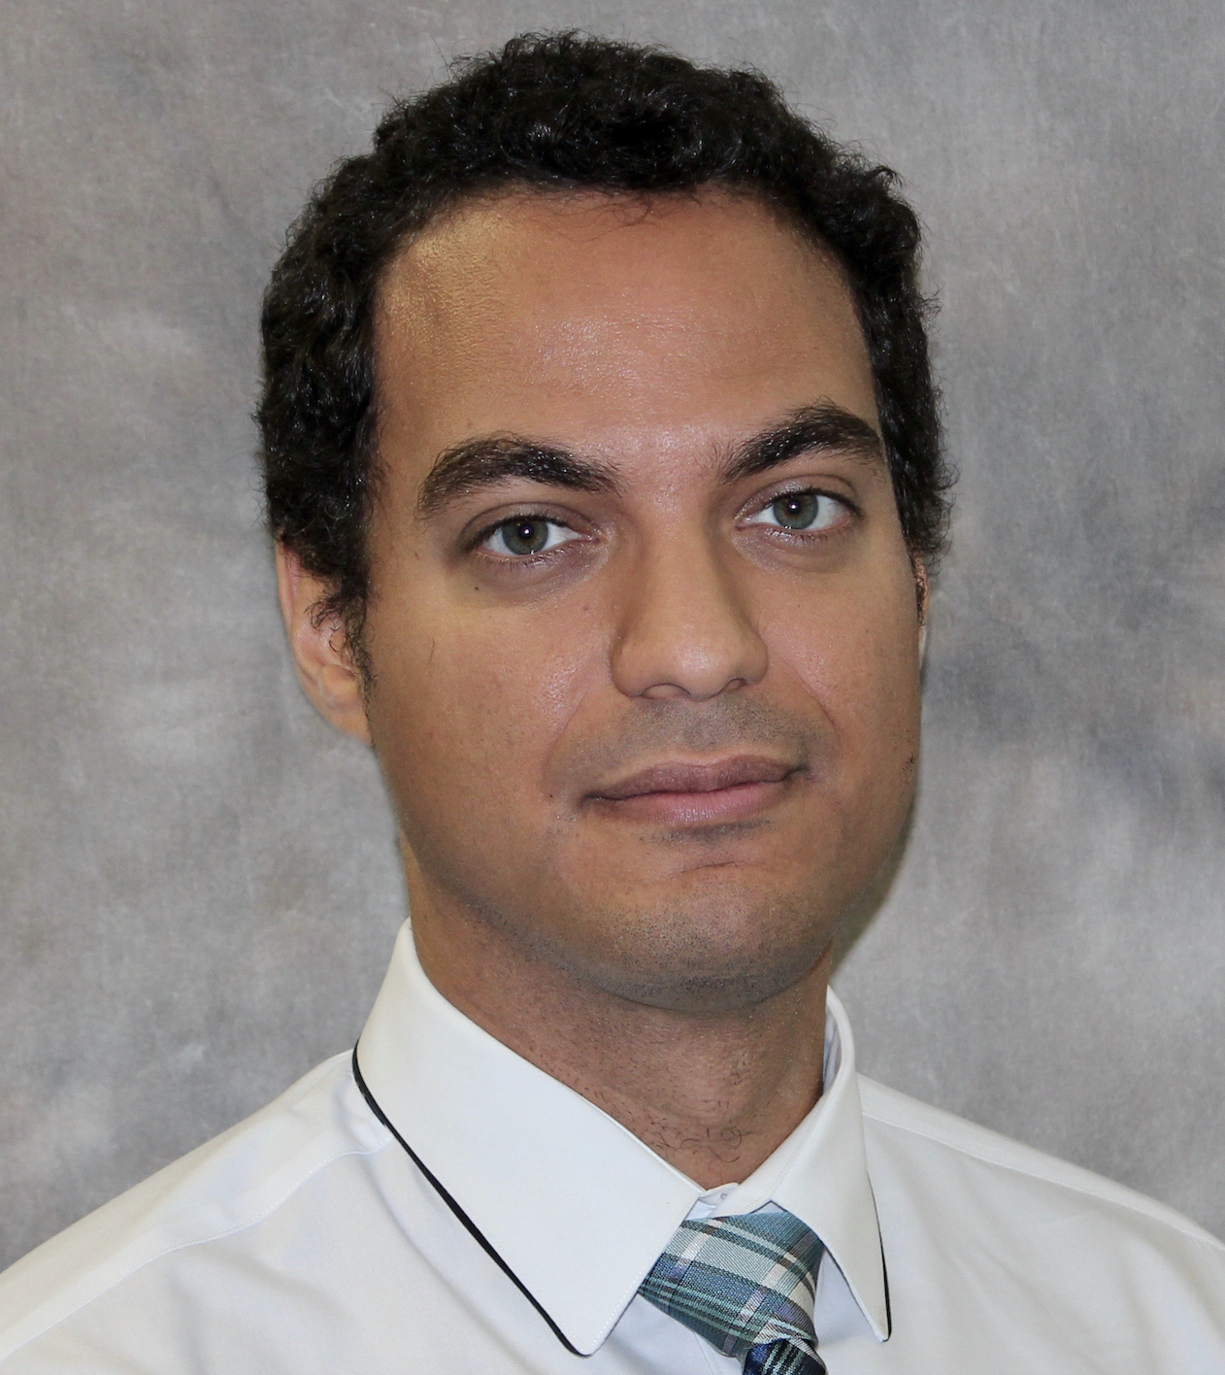
Primary Panelists
Wael Abuzeid
MD, MSc, FRCPC
Queen’s University
Sean Van Diepen
MD, MSc, FRCPC, FAHA
University of Alberta Hospital
Robert Welsh
MD, FRCPC, FESC, FACC, FAHA
University of Alberta
Thao Huynh
MD, MSc, PhD, FRCPC
McGill University Health Centre
Collen Norris
PhD, MSc, BScN, RN, FAHA
University of Alberta

Slide 8
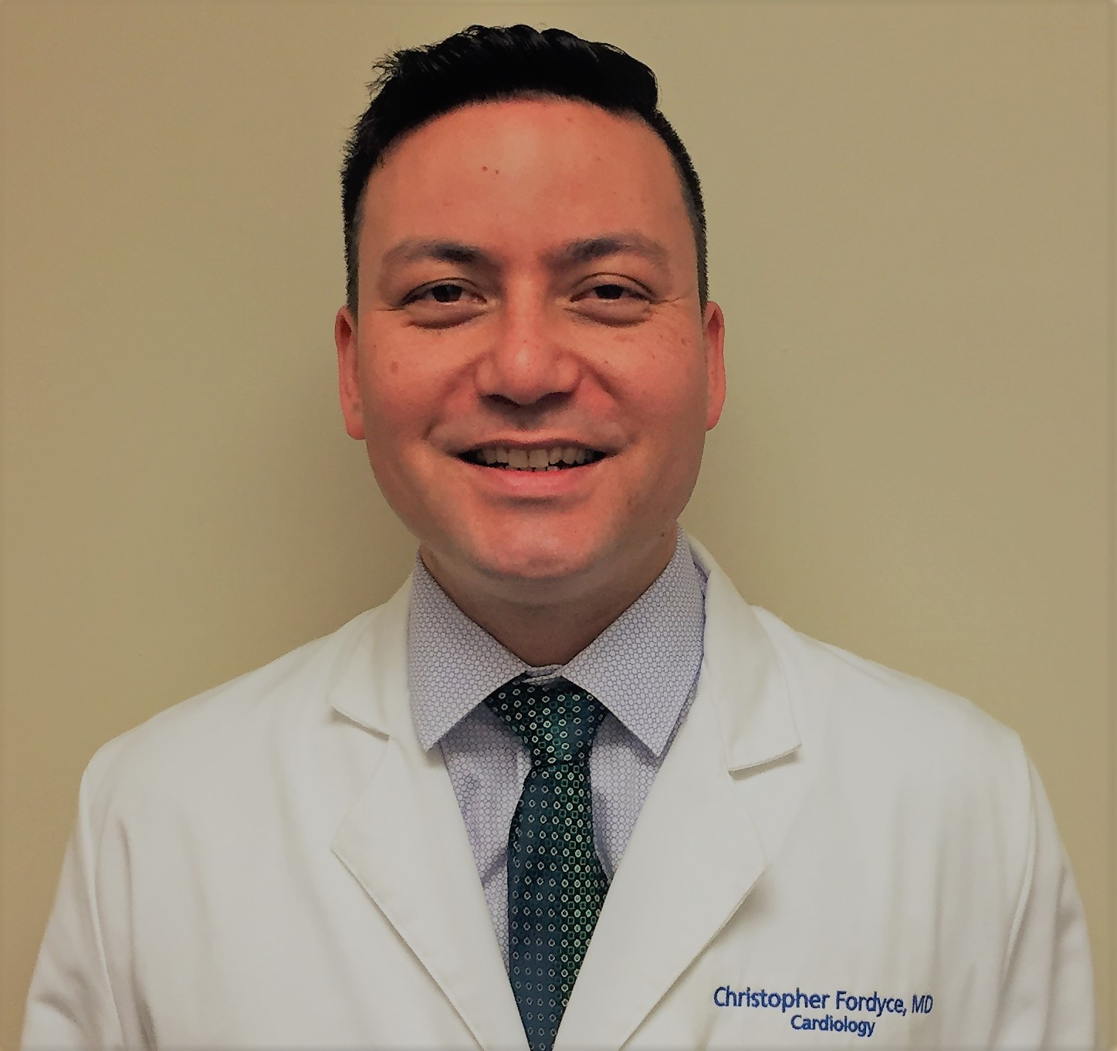
Primary Panelists
Chris Fordyce
MDCM, MHS, MSc, FRCPC
University of British Columbia
Vancouver General Hospital
Madhu Natarajan
MD, MSc, FRCPC
McMaster University
Sohrab Lutchmedial
MDCM, FRCPC
Dalhousie University
Michel Le May
MD, FRCPC
University of Ottawa
Heart Institute
Laurie Lambert
PhD
Institut national d’excellence
en santé et en services sociaux

Slide 9
Primary Panelists
Jennifer Greene
BSc, ACP
Dalhousie University
Craig Ainsworth
MD, FRCPC, FACC
McMaster University
David Wood
MD, FRCPC, FACC, FSCAI, FESC
University of British Columbia
Michele Perry Arnesen
MHA, BSN, RN
Fraser Health Authority
Mouhieddin Traboulsi
MD, FRCPC, FACC
University of Calgary

Slide 10
Secondary Panelists
Paul Armstrong MD
Akshay Bagai MD
Kevin Bainey MD
John Cairns MD
Sheldon Cheskes MD
John Ducas MD
Vlad Dzavik MD
Sanjit Jolly MD
Jennifer McVey MD
Erick Schampaert MD
Gregory Schnell MD
Derek So MD

Slide 11
2019 STEMI Recommendations - Overview
21 PICO questions resulting in 34 Recommendations
Focus on practical aspects of regional systems of STEMI care with particular emphasis on:
Organization of STEMI care networks and patient identification
Safe patient transportation including adjunctive prehospital interventions
Reperfusion decision making in the prehospital and hospital setting
Practical aspects of pharmacological and percutaneous revascularization specific to the 3 clinical settings where STEMI patients could be initially diagnosed:
In field
Non-PCI capable hospital
PCI-capable hospital
First CCS Guideline to incorporate sex and gender considerations in the development of Guideline Recommendations

Slide 12
REGIONALIZATION OF STEMI CARE
Development of Regional STEMI Centres (“Hub and Spoke”) and regional reperfusion strategies
Reperfusion decision making within a regional STEMI network
Prehospital and interfacility EMS transportation within regional networks

Slide 13
MANAGEMENT OF THE STEMI PATIENT DIAGNOSED IN THE PREHOSPITAL SETTING
Use of prehospital electrocardiograms
Reperfusion therapy for suspected STEMI patients identified in the prehospital setting
Adjunctive interventions administered in the prehospital setting:
Oxygen
Opioids
P2Y12 inhibitors

Slide 14
MANAGEMENT OF THE STEMI PATIENT DIAGNOSED IN A NON-PCI CAPABLE CENTRE
Primary PCI
Fibrinolysis
Fibrinolysis for cardiogenic shock
Pharmacoinvasive PCI
Facilitated PCI

Slide 15
MANAGEMENT OF THE STEMI PATIENT DIAGNOSED IN A PCI CAPABLE CENTRE
Performance of primary PCI
Multivessel vs culprit only PCI in STEMI patients with and without cardiogenic shock
Thrombectomy
Radial vs femoral access
Adjunctive medications used with primary PCI
Antithrombotic agents
Glycoprotein IIb/IIIa inhibitors
Intracoronary fibrinolysis
Intracoronary adenosine

Slide 16
CCS Pilot Project Incorporating Sex and Gender into Guidelines
There is no conventional approach for systematically including sex or gender-specific information in guidelines
Sex:
Biological construct assigned at birth (man/woman)
Encompasses hormones, genes, anatomy, physiology etc.
Gender:
A social construct (female/male) linked to power and status
Is culturally specific and temporal
We sought to determine the feasibility and outcomes of a structured process for considering sex and gender in the STEMI Guideline update

Slide 17
CCS Pilot Project Incorporating Sex and Gender into Guidelines
RESULTS
21 PICO questions
180 studies, of which 175 studies were included
The mean percentage of women:
24.5% (SD 6.6 %, min 0%, max 51%)
The mean participation to prevalence ratio (PPR):
0.62 (SD-0.16, min 0.00, max 1.19)
A PPR of 1 indicates that the sex composition of the study is that of the population
By convention, a PPR of less than 0.8, or greater than 1.2 indicates that one sex was underrepresented or overrepresented
Notes:
The 21 PICO questions yielded a total of 180 studies, of which 175 studies were included in the sex-based analyses (1 node network analysis, 2 reviews and 2 editorials were excluded).
22 meta-analyses, 7 multicentre RCTs, 73 RCTs, 1 pragmatic trial RCT, 28 prospective cohort studies, 38 retrospective cohort studies, and 6 retrospective studies using registry data.
The PPR is a metric used to identify the representation of a specific population included in a study relative to their representation in the disease population. The representation of female patients in each study was calculated by dividing the number of women in the trial by the total study enrolment.
The proportion of female patients who were hospitalized with an acute myocardial infarction in Canada in 2015 was 39.5% based on CIHI data (20,399 females/51,635 total patients).

Slide 18
CCS Pilot Project Incorporating Sex and Gender into Guidelines
RESULTS
16/175 studies reported main outcomes stratified by sex
No studies included gender as a variable
Based on PPR and the analyses presented:
only one study provided sufficient evidence to confirm the applicability of recommendations for the management of STEMI for female as well as male patients.

Slide 19
CCS Pilot Project Incorporating Sex and Gender into Guidelines
CONCLUSIONS
systematic appraisal of sex and gender considerations into guideline development was feasible
Barriers include:
inadequate enrollment of women in randomized trials (PPR < 0.8)
lack of publication of main outcomes stratified by sex
lack of inclusion of gender as a study variable
“While we make the agnostic assumption that the recommendations in this guideline hold equally for both men and for women, we acknowledge that the published literature are inadequate to confirm this clearly and objectively”.

Slide 20
2018 Recommendations

Slide 21
DEFINITIONS – REPERFUSION INTERVALS
TERM | DEFINITION
First medical contact (FMC) | Time of EMS arrival at scene (prehospital) or hospital registration (walk-in)
Time of STEMI diagnosis | Time of performance and interpretation of first ECG diagnostic of STEMI
First device deployment | Deployment of first PCI device (balloon or first stent)
Door in Door out (DIDO) | Time between registration of patient at non PCI capable hospital and patient leaving non-PCI capable hospital via EMS
Interfacility transport time | Time on the road between leaving non-PCI capable hospital and arrival at PCI capable hospital

Slide 22
DEFINITIONS – REPERFUSION STRATEGIES
STRATEGY | DEFINITION
Primary percutaneous coronary intervention (PPCI) | Mechanical reperfusion techniques aimed at restoring flow to the culprit vessel in acute STEMI. May include balloon angioplasty, coronary stenting or thrombectomy
Pharmacoinvasive strategy | A reperfusion strategy utilizing adjunctive PCI following initial pharmacological reperfusion with fibrinolysis. Consists of 1. routine rapid transfer to PCI centres after fibrinolysis, 2. immediate PCI for patients with failed fibrinolysis, and 3. routine angiography +/- PCI within 24 hours after successful fibrinolysis
Facilitated PCI | A reperfusion strategy where adjuvant therapies such as fibrinolysis or glycoprotein IIb/IIIa inhibitors are administered while in transit to immediate diagnostic angiography with the intent to perform immediate PPCI

Slide 23
REGIONALIZATION OF STEMI CARE
Development of Regional STEMI Centres (”hub and spoke”) and regional reperfusion strategies
Reperfusion decision making within a regional STEMI network
Prehospital and interfacility EMS transportation within regional networks

Slide 24
ELEMENTS OF A REGIONAL STEMI NETWORK
A pre-planned default initial reperfusion strategy (PPCI or fibrinolysis) for each hospital within the network based on geographic and transport considerations.
The ability to deliver appropriate adjunctive PCI following fibrinolysis.
The capability of emergency medical service (EMS) and emergency department teams to rapidly diagnose and treat STEMI.
For PPCI, the ability for EMS and emergency departments to activate the STEMI team for reperfusion therapy through a ‘single call’ mechanism immediately from the point of first medical contact (FMC) with the patient.
The implementation of a “no-refusal” policy at PCI centres for STEMI patients who are deemed appropriate for PPCI.
The ability for EMS teams that diagnose STEMI patients in the field to bypass non-PCI centres and transport patients directly to a PCI centre.
The ability for appropriately selected patients to bypass the emergency department (ED) of a PCI centre and proceed directly to the cardiac catheterization laboratory.

Slide 25
We recommend the development and implementation of regional STEMI networks using a hub-and-spoke model to define optimal reperfusion strategies, reduce reperfusion delay, improve reperfusion rates and apply protocols for comprehensive ongoing STEMI care.
(Strong Recommendation, Moderate Quality Evidence)

Slide 26
We recommend a first medical contact (FMC) to STEMI diagnosis (ECG acquisition and interpretation) time of ≤10 minutes.
(Strong Recommendation, Low Quality Evidence)

Slide 27
We recommend development of a STEMI network of care that incorporates the use of prehospital catheterization laboratory activation, single call patient transfer protocols, and in-field bypass of non-PCI centres to minimize FMC to device times for patients who are treated with PPCI.
(Strong Recommendation, Moderate Quality Evidence)
We recommend the use of protocols to minimize time to fibrinolysis, and the development of a formal relationship with a PCI centre to enable adjunctive PCI for those patients who are treated with fibrinolysis within a STEMI network.
(Strong Recommendation, Moderate Quality Evidence)

Slide 28
REPERFUSION TREATMENT GOALS
METRIC | GOAL (Regional goal: >75% of cases to achieve each metric)
First Medical Contact (FMC) to Diagnosis (ECG acquisition & interpretation) | <10 Minutes
Diagnosis to Catheterization Lab Activation | <10 Minutes
Door-in to Door-out Time for Emergency Departments | <30 Minutes
Transport Times for Inter-Hospital Transfers or STEMI patients diagnosed in the field | <60 Minutes
Time from arrival at catheterization lab to first balloon activation | <30 Minutes
Total time from FMC to first device activation (for primary PCI)- for non-PCI centres or patients diagnosed in the field | <120 Minutes
Total time from FMC to first device activation (for primary PCI) - for patients presenting to PCI centres | <90 Minutes

Slide 29
We recommend that hospitals and EMS services within STEMI networks maintain written, updated STEMI management protocols, and audit treatment delays, reperfusion rates, and false activation rates to monitor quality metrics.
(Strong Recommendation, Low Quality Evidence)

Slide 30
Practical tip:
All hospitals within a STEMI network should define their default STEMI reperfusion strategy based on local geography and local resource availability.

Slide 31
We suggest that Primary Care Paramedics (PCPs) may transport clinically stable STEMI patients from the field to a PPCI centre when an Advanced Care Paramedic (ACP) crew is not readily available. If patients under the care of a PCP crew clinically deteriorate en route to a primary PCI centre, the ambulance should redirect to the closest emergency department and/or rendezvous with an ACP crew depending on resource availability in the particular region.
(Weak Recommendation, Low Quality Evidence).

Slide 32
We suggest that Primary Care Paramedics (PCPs) may transport clinically stable STEMI patients from a non-PCI centre to a PCI centre when an Advanced Care Paramedic (ACP) crew is not readily available. For patients who have hemodynamic instability, early cardiogenic shock, respiratory failure, life-threatening arrhythmias or are comatose post-arrest, transport should be facilitated by a critical care crew and/or medical personnel from the sending facility.
(Weak Recommendation, Low Quality Evidence).

Slide 33
Values and Preferences:
The majority of paramedics in ground ambulances in Canada are PCPs. Given the low rates of clinically important events that require ACP training, our recommendation enables regions that have few or no ACPs to transport stable STEMI patients with no anticipated complications for PPCI without compromising patient safety. Additional medical personnel or ACPs may be required for transfer if the patient requires intravenous medications that are beyond the scope of PCP care.

Slide 34
“…STEMI regional networks should develop EMS transport protocols and define which complications are beyond the scope of practice for various transporting crews.”
“Patients who are too unstable for PCP transport to a PPCI centre should be taken to the nearest emergency department and can then be transferred for PPCI using paramedic crews with more advanced training and/or medical personnel…”

Slide 35
MANAGEMENT OF THE STEMI PATIENT DIAGNOSED IN THE PREHOSPITAL SETTING
Use of prehospital electrocardiograms
Reperfusion therapy for suspected STEMI patients identified in the prehospital setting
Adjunctive interventions administered in the prehospital setting:
Oxygen
Opioids
P2Y12 inhibitors

Slide 36
We recommend that EMS personnel acquire an ECG in the field to identify STEMI and alert STEMI care teams of an imminent patient arrival.
(Strong Recommendation, Low Quality Evidence)

Slide 37
If primary PCI is used as a default reperfusion strategy for suspected STEMI patients in the field, we recommend that patients should bypass non-PCI capable centres and instead be transported to the nearest PPCI centre with the goal of achieving a maximum FMC-to-device time of ≤ 120 minutes (ideal FMC-to-device time ≤ 90 minutes in urban settings). Fibrinolytic therapy should be considered if this timeline cannot be achieved.
(Strong Recommendation, Low Quality Evidence)

Slide 38
Values and Preferences:
The goal of ≤ 120 minutes was selected to maintain consistency with treatment of STEMI identified at non-PCI capable centres, and to maximize access to PPCI in rural and remote regions.
Practical Tip:
Despite the goal of ≤ 120 minutes, PPCI should be performed as rapidly as possible, ideally ≤ 90 minutes in urban settings.

Slide 39
We suggest it is reasonable to routinely transport STEMI patients identified in the prehospital setting by EMS directly to the catheterization laboratory by bypassing the PCI centre emergency department.
(Weak Recommendation, Very Low Quality evidence)

Slide 40
Values and Preferences:
This recommendation is based on the importance of minimizing reperfusion delays, but this strategy may not be feasible at all centres.
Practical Tips:
1.This recommendation should only be considered in centres where a receiving team is available to safely attend to the patient upon arrival to the catheterization centre, regardless of time of day. Contingency plans should be in place to respond to emergencies that may occur prior to initiation of PPCI, and for patients who become unstable prior to arrival at hospital or shortly after arrival. Such plans include transferring the patient to the cardiac intensive care unit (CICU) or emergency department.
2. Protocols should be developed to manage suspected STEMI patients who are subsequently found to have an alternate diagnosis.

Slide 41
We suggest avoiding routine prehospital administration of supplemental oxygen to STEMI patients with oxygen saturation ≥ 90%.
(Weak Recommendation, Low Quality Evidence)

Slide 42
Values and Preferences:
This recommendation is based on the concern of potential harm from hyperoxemia. Furthermore, supplemental oxygen may cause anxiety or impair communication and does not appear to have any benefit in the absence of hypoxia.
Practical Tips:
If SaO2 monitoring is not available or not reliable (poor waveform), prehospital providers may provide oxygen supplementation during initial care to those patients exhibiting signs of respiratory distress.

Slide 43
We suggest avoidance of routine intravenous opioid analgesic (e.g., morphine or fentanyl) administration for STEMI-related discomfort. However, selective use of opioid analgesic medications may be considered for severe pain with the goal of relieving pain and reducing anxiety.
(Weak Recommendation, Low Quality Evidence)

Slide 44
Values and Preferences:
The writing group recognizes the importance of managing the significant discomfort that can be associated with STEMI. Although there may be a potential for harm as measured by surrogate outcomes, this recommendation permits for selective use of opioid analgesic by providers in patients experiencing severe STEMI-related pain.

Slide 45
We suggest that prehospital (in-ambulance) P2Y12 receptor antagonist medications not routinely be added to ASA in patients with STEMI transported for PPCI. The P2Y12 receptor antagonist should be administered in the emergency department or cardiac catheterization laboratory as early as possible prior to coronary angiography.
(Weak Recommendation, Low Quality Evidence)

Slide 46
Values and Preferences:
Administration of any medication to a critically ill patient may add complexity in the prehospital environment. Based on the currently available evidence, the writing group concluded that routine prehospital administration of a P2Y12 receptor antagonist could not be recommended for transport times less than 60 minutes.
Practical Tip:
Prehospital administration of P2Y12 receptor antagonist medications may be considered in systems or subsets of patients that have prolonged transport times (those greater than 60 minutes) for PPCI. Similarly, administration may be considered for those systems that administer prehospital fibrinolysis.

Slide 47
MANAGEMENT OF THE STEMI PATIENT DIAGNOSED IN A NON-PCI CAPABLE CENTRE
Primary PCI
Fibrinolysis
Fibrinolysis for cardiogenic shock
Pharmacoinvasive PCI
Facilitated PCI

Slide 48
If Primary PCI is used as the default reperfusion strategy:
We recommend that STEMI networks target a total FMC-to-device time (including interfacility transfer) of ≤120 minutes. Fibrinolytic therapy should be considered if this timeline cannot be achieved.
(Strong Recommendation, Low Quality Evidence)
We recommend a target Door-in-Door-Out (DIDO) time at the transferring hospital of ≤30 min.
(Strong Recommendation, Low Quality Evidence)

Slide 49
If fibrinolysis is used as the default reperfusion strategy:
We recommend that STEMI networks target a total FMC-to-needle time of ≤30 minutes.
(Strong Recommendation, Low Quality Evidence)
We suggest that a pharmacoinvasive strategy could be considered as an alternative to primary PCI for patients who are early presenters (symptom onset <3 hours), who are at low risk of bleeding and who cannot undergo rapid primary PCI.
(Weak recommendation, Moderate quality evidence)

Slide 50
Practical Tip #1:
For patients with a contraindication to fibrinolysis, transfer for PPCI should be initiated even if the FMC-to-device time is expected to be greater than 120 minutes.
Practical Tip #2:
Prehospital fibrinolysis may be applied within STEMI systems of care with appropriate EMS training and physician oversight in appropriate patients.
Practical Tip #3:
A half dose of fibrinolytic may be considered for patients >75 years of age undergoing a pharmacoinvasive strategy.

Slide 51
If fibrinolysis is used as the default reperfusion strategy:
We suggest that fibrinolysis prior to transfer to a PCI centre may be considered in patients with STEMI complicated by cardiogenic shock when excessive delays to cardiac catheterization are anticipated.
(Weak Recommendation, Very Low Quality Evidence)

Slide 52
Values and Preferences:
The writing group recognizes that Canada’s unique geography and climate may contribute to very long transport times to PCI capable hospitals for patients presenting to non-urban hospitals or remote nursing stations. We valued the potential benefits of fibrinolysis reperfusion in such a setting for the treatment of this time sensitive condition that is associated with a high mortality rate.

Slide 53
Practical Tips:
The decision to administer fibrinolysis should be individualized based on the perceived likelihood of reperfusion as a function of symptom duration, risk of bleeding, and estimated time to angiography.
Adequate coronary perfusion pressure may be necessary for effective fibrinolysis. It is reasonable to aim to keep mean arterial pressure > 60-65mmHg with vasopressors after fibrinolysis.

Slide 54
Pharmacoinvasive Strategy: Definition
A reperfusion strategy utilizing adjunctive PCI following initial pharmacological reperfusion with fibrinolysis.
Consists of:
1. Routine rapid transfer to PCI centres after fibrinolysis
2. Immediate PCI for patients with failed fibrinolysis
3. Routine angiography +/- PCI within 24 hours after successful fibrinolysis

Slide 55
We recommend routine rapid transfer to PCI centres after fibrinolysis, immediate PCI for patients with failed reperfusion, and routine angiography +/- PCI within 24 hours after successful fibrinolysis.
(Strong recommendation, Moderate Quality Evidence)

Slide 56
Values and Preferences:
This recommendation is based on the established benefits such as reduced short-term re-infarction, recurrent ischemia and heart failure and the absence of any increase in major bleeding. However, some regions may not have the resources required to transfer all STEMI patients early after fibrinolysis and may need to transfer only high-risk patients.

Slide 57
We recommend against a strategy of pharmacologic facilitation with full dose fibrinolysis or combination fibrinolysis and GP IIb/IIIa inhibitor or GP IIb/IIIa inhibitor when access to cardiac catheterization is available within 120 minutes of FMC.
(Strong Recommendation, High Quality Evidence)

Slide 58
MANAGEMENT OF THE STEMI PATIENT DIAGNOSED IN A PCI CAPABLE CENTRE
Performance of primary PCI
Multivessel vs culprit only PCI in STEMI patients with and without cardiogenic shock
Thrombectomy
Radial vs femoral access
Adjunctive medications used with primary PCI
Antithrombotic agents
Glycoprotein IIb/IIIa inhibitors
Intracoronary fibrinolysis
Intracoronary adenosine

Slide 59
Large, retrospective observational studies have demonstrated improved, risk-adjusted outcomes among patients presenting directly to a PCI-centre with the shortest reperfusion times, including door-to-balloon times of ≤ 90 minutes compared to patients with longer delays
Contemporary cohort studies have demonstrated that prospectively targeting an FMC-to-device of ≤ 90 minutes is feasible and is associated with improved outcomes

Slide 60
For patients with STEMI identified at a primary PCI centre:
We recommend that STEMI networks target a FMC-to-device time of ≤ 90 minutes. (Strong Recommendation, Low Quality Evidence)

Slide 61
Practical Tip:
Fibrinolytic therapy should be considered as a viable reperfusion strategy at a PPCI centre if it is anticipated that PCI will be significantly delayed due to extenuating circumstances (eg multiple STEMI patients arriving concurrently).

Slide 62
In hemodynamically stable patients with STEMI and multivessel disease, we suggest that complete revascularization can be considered.
(Weak Recommendation, Moderate Quality Evidence)

Slide 63
Values and Preferences:
This recommendation places a greater emphasis on safety than efficacy as currently only small studies with composite endpoints have been published.

Slide 64
Practical Tip#1:
Until further randomized evidence is available, the decision whether to treat or not to treat obstructive non-culprit lesions and the optimal timing of such a procedure should be thoughtfully considered and individualized. In hemodynamically stable patients, several factors should be considered in decision-making including success of the culprit vessel PCI, patient comorbidities (e.g. renal dysfunction), left ventricular function, non-culprit lesion severity and complexity as well as the logistics of care delivery.
Practical Tip#2:
PCI of non-culprit lesions that are chronic total occlusions is not recommended during the initial PPCI procedure.

Slide 65
Practical Tip #3:
Staged multivessel revascularization can be accomplished with either percutaneous or surgical revascularization depending on both anatomical and clinical characteristics. Until further randomized evidence is available, either invasive FFR-guided revascularization or non-invasive testing may be utilized to determine the appropriateness of non-culprit vessel revascularization.

Slide 66
In STEMI patients with cardiogenic shock and multivessel disease, we recommend against non-culprit lesion PCI during the initial primary PCI procedure.
(Strong Recommendation, Moderate Quality Evidence)

Slide 67
We recommend that upfront thrombectomy not be performed routinely in patients with STEMI undergoing primary PCI.
(Strong recommendation, High Quality evidence)

Slide 68
Values & Preferences:
This recommendation is based on the absence of any clear benefit in clinical endpoints in the two largest randomized trials, and the possibility of increased stroke with thrombectomy observed in the largest trial.
Values & Preferences:
Bailout thrombectomy may still be useful when there is a high residual thrombus burden following balloon angioplasty and/or stenting.

Slide 69
We recommend transradial over transfemoral access as the preferred access site in STEMI patients undergoing PCI when it can be performed by an experienced radial operator.
(Strong recommendation, Moderate quality evidence)

Slide 70
Values & Preferences:
Procedural volume and expertise are important in considering the access mode. High-volume radial centers and high-volume radial operators are needed to achieve the best clinical results. This recommendation places emphasis on the observed reduction of bleeding complications and possible reduction in mortality.
Values & Preferences:
High-volume operators and centres should maintain expertise in both access sites to avoid any paradoxical increase in vascular complications when femoral access is needed.

Slide 71
We recommend the use of UFH for procedural anticoagulation in patients with STEMI undergoing primary PCI.
(Strong Recommendation, Low Quality Evidence)
We suggest bivalirudin can be used as an alternative option for procedural anticoagulation in patients with STEMI undergoing primary PCI.
(Weak Recommendation, Moderate Quality Evidence)

Slide 72
We recommend the preferential use of bivalirudin over UFH or LMWH for procedural anticoagulation in patients with STEMI undergoing primary PCI who have a history of heparin-induced thrombocytopenia or a very high risk of bleeding.
(Strong Recommendation, Low Quality Evidence)
We suggest enoxaparin can be used as an alternative option for procedural anticoagulation in patients with STEMI undergoing primary PCI.
(Weak Recommendation, Moderate Quality Evidence)
We recommend against using fondaparinux for procedural anticoagulation in patients with STEMI undergoing primary PCI.
(Strong Recommendation, Moderate Quality Evidence)

Slide 73
Values & Preferences:
The higher cost of bivalirudin compared to UFH was a key consideration for determining the strength of the recommendation for routine bivalirudin use.
Practical Tips
If bivalirudin is used for procedural anticoagulation, pre-procedural UFH and/or a post procedural bivalirudin infusion may reduce the risk of acute stent thrombosis.
Patients who receive subcutaneous fondaparinux prior to their arrival in the catheterization laboratory should receive UFH during the PCI procedure.

Slide 74
We recommend against the routine use of intravenous GPIs for primary PCI. (Strong recommendation, High Quality Evidence) (Weak Recommendation, Moderate Quality Evidence)
We recommend against the routine use of intracoronary GPIs for primary PCI.
(Strong recommendation, High Quality Evidence)

Slide 75
Practical Tips
1. GPIs may be useful for patients who have not received oral antiplatelet therapy or experience vomiting before PPCI.
2. GPIs use may be considered when there are residual thrombotic complications post PPCI such as large residual thrombus burden, residual dissection or no-reflow.

Slide 76
We suggest that intracoronary fibrinolysis should not be routinely administered during primary PCI.
(Weak Recommendation; Low Quality Evidence).

Slide 77
Values & Preferences:
Although available studies suggest a potential benefit on angiographic outcomes, routine treatment with IC fibrinolysis at this time is not indicated until larger studies addressing clinical outcomes have been performed.
Practical Tip:
Low dose intracoronary fibrinolysis may be considered in selected cases to treat large burden residual thrombus during PPCI.

Slide 78
We suggest that intracoronary adenosine should not be routinely administered during primary PCI.
(Weak recommendation, Low Quality Evidence)

Slide 79
Values & Preferences:
This recommendation is based on the absence of any improvement in clinical outcomes with intracoronary adenosine, despite the improvement in ST resolution and myocardial perfusion seen in some studies.
Practical Tip:
Intracoronary adenosine may be considered for the selective treatment of no reflow during PPCI.

Slide 80
Summary
These guidelines provide advice regarding the optimal prehospital and initial in-hospital management of STEMI patients irrespective of where they are initially identified:
In the field
Non-PCI capable centre
PCI capable centre
Guidance is provided regarding the elements of a regional STEMI network of care, practical aspects of patient transport, reperfusion decision making, adjunctive pre-hospital interventions and practical aspects of mechanical reperfusion
It is hoped that these guidelines may serve as a practical template to develop care systems capable of providing optimal care to a wide range of STEMI patients

Slide 81
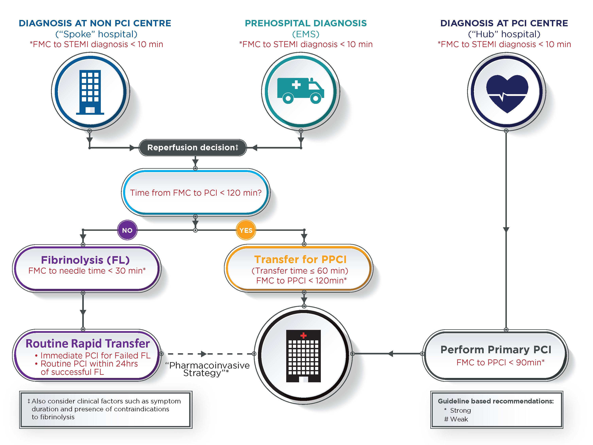
Figure 1
STEMI Reperfusion Strategies

Slide 82
Figure 2

Slide 83
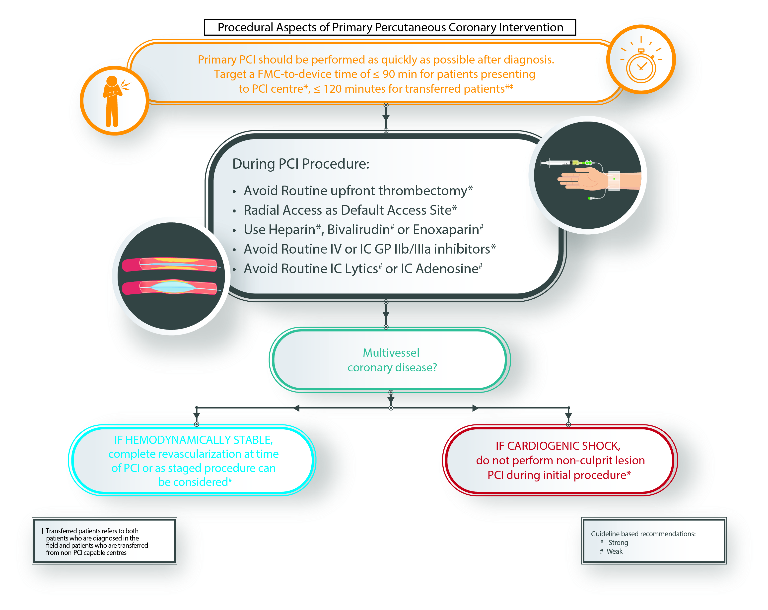
Figure 3

Slide 84
Acknowledgements and Thanks
Ms. Mary Doug Wright – Apex Information
Dr. M. Sean McMurtry MD – CCS
Ms. Susan Oliver – CCS
Ms. Brittany Forrest – CCS

Slide 85
Disclaimer
The Canadian Cardiovascular Society (CCS) welcomes reuse of our educational slide deck for medical institution internal education or training (i.e. grand rounds, medical college/classroom education, etc.). However, if the material is being used in an industry sponsored CME program, permission must be sought through our publisher Elsevier (www.onlinecjc.com).
If your reuse request qualifies as medical institution internal education, you may reuse the material under the following conditions:
You must cite the Canadian Journal of Cardiology and the Canadian Cardiovascular Society as references.
You may not use any Canadian Cardiovascular Society logos or trademarks on any slides or anywhere in your presentation or publications.
Do not modify the slide content.
If repeating recommendations from the published guideline, do not modify the recommendation wording.
Copyright © 2018 Canadian Cardiovascular Society ™ All Rights Reserved

