Slide 1
Canadian Cardiovascular Society Antiplatelet Guidelines
COMBINATION WARFARIN + ASA THERAPY
WHEN: TO USE, TO CONSIDER, TO AVOID
Working Group: James D. Douketis MD, FRCP(C); A. Graham Turpie MD, FRCP (C)

Slide 2
Objectives
Interpret the Canadian Cardiovascular Society Guideline recommendations regarding the use of warfarin in combination with antiplatelet agents.
Analyze the risk and benefits of combining warfarin with antiplatelet agents.
Evaluate the evidence supporting the recommendations regarding the combination of warfarin and antiplatelet agents.

Slide 3
Case study no. 1
71-year old woman with stable CAD is receiving long-term ASA, 81 mg daily, is found to have atrial fibrillation on a routine examination and, over time, is classified as having chronic AF.
Comorbidities: hypertension, compensated heart failure, moderate renal insufficiency (CrCl = 48 mL/min)
CHADS₂ score = 2 (CHA₂DS₂VASc score = 3)
What to do now?

Slide 4
Management question
Add warfarin, target INR = 2.5
Add dabigatran, 150 mg twice-daily
Add clopidogrel, 75 mg once-daily
Warfarin alone, target INR = 2.5
Dabigatran alone, 150 mg twice-daily

Slide 5
Evidence: Thrombotic/ischemic events
Warfarin-ASA vs. Warfarin | Study Type Comparing Warfarin-ASA vs. Warfarin
 | Meta-analysis¹ | Linked database² | RCT sub-study³ | Community-based study⁴
Absolute risk difference (per yr) | 8.8% vs. 6.3% | n/a | 1.5% vs. 1.7% | 0.3% vs. 0.4%
Odds ratio (95% CI) | 0.66 (0.52-084) 0.99 (0.47-2.07)† 0.69 (0.35-1.36)‡ | 1.27 (1.14-1.40)¶ | n/a | 1.48 (0.43-5.1)
†Studies of patients with atrial fibrillation
‡Studies of patients with coronary artery disease
¶Ischemic stroke risk

Slide 6
Evidence: Major bleeding events
Warfarin-ASA vs. Warfarin | Study Type Comparing Warfarin-ASA vs. Warfarin
 | Meta-analysis¹ | Linked database² | RCT sub-study³ | Community-based study⁴
Absolute risk difference (NNH) | 3.8% vs. 2.8% (100) | 6.9% vs. 3.9% (33) | 3.9% vs. 2.3% (63) | 2.0% vs. 0.9% (91)
Odds ratio (95% CI) | 1.43 (1.00-2.02) | 1.83 (1.72-1.96) | 1.96 (1.49-2.58) | 2.06 (1.01-4.36)

Slide 7
Evidence for therapeutic benefit with combination warfarin-ASA therapy
Strong evidence for benefit
mechanical mitral valve
mechanical aortic valve + risk factors for thromboembolism
Weak evidence for benefit
chronic AF alone
chronic stable CAD
chronic AF + chronic stable CAD

Slide 8
What if?
Patient develops acute MI after laparoscopic colon resection?
Coronary angiography is followed by 4-vessel CABG surgery.

Slide 9
Management question
Continue warfarin + ASA indefinitely.
Continue warfarin + ASA for 12 months, afterwards stop ASA.
Stop warfarin, start ASA + clopidogrel.

Slide 10
Evidence for therapeutic benefit with combination warfarin-ASA therapy
Insufficient evidence for therapeutic benefit but
reasonable to consider warfarin + ASA:
Chronic AF (or prior VTE) + recent coronary artery stent
Chronic AF (or prior VTE) + recent CABG
Chronic AF (or prior VTE) + new stroke despite therapeutic INR

Slide 11
Recommendations
In patients with a mechanical heart valve, warfarin (INR: 2-3) + ASA (75-162 mg daily) should be considered, especially for: - any mechanical mitral valve - older (caged-ball, monoleaflet) mechanical aortic valve (Class IIa, Level A).
In patients with an indication for long-term warfarin who develop an ACS that is treated with medical therapy alone, warfarin (INR: 2-3) + ASA (75‑162 mg daily) is reasonable for up to 12 weeks, at which time ASA may be withdrawn if there are no further cardiac events (Class IIb, Level C).

Slide 12
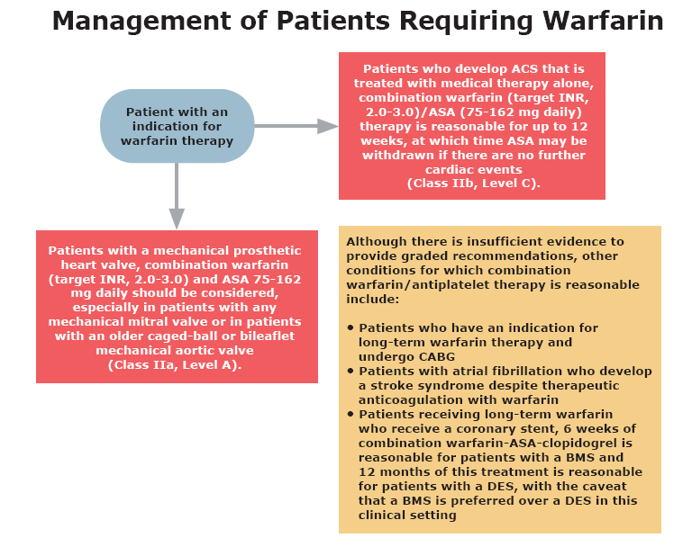
Antiplatelet therapy in patients requiring warfarin

Slide 13
Notes:
13

