Slide 1
Canadian Cardiovascular Society
Antiplatelet Guidelines
USE OF ANTIPLATELET THERAPY IN WOMEN WHO ARE PREGNANT OR BREASTFEEDING
Working Group: Wee Shian Chan MD, FRCP(C); James D. Douketis MD, FRCP(C)

Slide 2
Objectives
Evaluate the Canadian Cardiovascular Society Guideline recommendations regarding the use antiplatelet therapy in pregnant and lactating patients.
Evaluate the risks and benefits of antiplatelet therapy in pregnant and lactating patients.

Slide 3
Case study
36 year old woman with a history of pre-eclampsia during her last pregnancy, 2 years ago, that resulted in a miscarriage is now 9 weeks pregnant.
Other medical problems:
  Central obesity (BMI = 38 kg/m²)
  Mild hypertension (systolic BP = 135-145 mmHg)
  Type-2 diabetes (diet + oral hypoglycemic drugs)
She has been reading about the risks of ASA during pregnancy and is concerned about the potential for congenital malformations.

Slide 4
Management question
  Start ASA, 325 mg daily, but wait until 2nd trimester.
  Start ASA, 325 mg daily, now.
  Start ASA, 81 mg daily, but wait until 2nd trimester.
  Start ASA, 81 mg daily, now.
  Monitor BP carefully but no ASA needed.

Slide 5
Evidence: ASA and pre-eclampsia
Associated with modest (15-20%) reductions in relative risk for pre-eclampsia:
  OR = 0.86 (95% CI: 0.76-0.96)
  RR = 0.81 (95% CI: 0.75-0.81)

Slide 6
Evidence: ASA and congenital malformations
Meta-analysis investigating 1st trimester ASA use
  No increased risk for congenital malformations:
  OR = 1.33 (95% CI: 0.94-1.89) increased risk for gastroschisis (herniation of abdominal contents through abdominal wall defect):
  OR = 2.37 (95% CI: 1.44-3.88)
Absolute risk increase
  0.8-5.8/10,000 births to 23/10,000 births
Limitations of meta-analysis
  Possibility of recall bias
  Uncertainty about ASA dose in affected pregnancies

Slide 7
Recommendation
Low-dose ASA (75-162 mg daily) is likely safe for use during the first trimester of pregnancy (Class IIa, Level A).
Low-dose ASA can be used safely during the second and third trimesters of pregnancy (Class I, Level A).

Slide 8
What if?
She receives ASA 81 mg daily for the duration of an uneventful pregnancy. She remains at increased risk for pre-eclampsia-related complications in the post-partum period.
She asks whether it is safe to continue ASA during breastfeeding?

Slide 9
Management question: During breastfeeding
  Do not continue ASA post-partum.
  Continue ASA post-partum for 1 week.
  Continue ASA post-partum for 4 weeks.

Slide 10
Evidence: ASA and breastfeeding
Maternal ingestion of ASA associated with excretion of salicylate and salicylate metabolites into breast milk.
Few case reports of adverse side effects (e.g., metabolic acidosis, thrombocytopenia) in infants with use of high-dose ASA (several grams/day).
Theoretic risk for Reye's syndrome in infants due to salicylate in breast milk unknown.
Use of low-dose ASA (75-162 mg daily) during breastfeeding has not been reported to result in adverse infant outcomes and is mostly considered safe.

Slide 11
Recommendation
Low-dose ASA (75-162 mg daily) may be considered for use in breastfeeding women (Class I, Level C).
Use of agents other than low-dose ASA by breastfeeding mothers should only be considered after weighing maternal benefits with potential risks for the newborn (Class IIb, Level C).

Slide 12
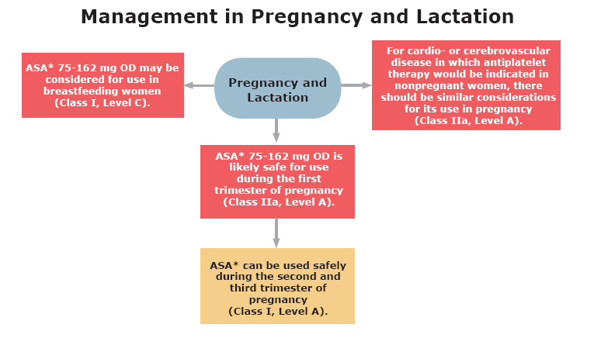
Antiplatelet therapy in patients pregnant or lactating

Slide 13

Notes:
13

