Slide 1
Canadian Cardiovascular Society
Antiplatelet Guidelines
PERIOPERATIVE MANAGEMENT OF ANTIPLATELET THERAPY
Working Group: James D. Douketis MD, FRCP(C); A. Graham Turpie MD, FRCP(C)

Slide 2
Objectives
Interpret the Canadian Cardiovascular Society Guideline recommendations regarding the perioperative management of antiplatelet therapy.
Recognize when antiplatelet agents should and should not be interrupted in the setting of surgery or invasive procedures.
Evaluate the evidence supporting the use of antiplatelet agents in the perioperative setting.
Distinguish the bleeding risk associated with operative procedures.

Slide 3
Case study no. 1
68 year old man with a sirolimus-eluting coronary stent inserted 4 months ago following NSTEMI
  Now requires surgery for removal of a parotid neoplasm (adenocarcinoma)
Receiving ASA, 81 mg + clopidogrel, 75 mg daily
Other cardiovascular risk factors
  CABG 8 years ago
  Hypertension
  Type 2 diabetes
  N.B.: No ACS-related symptoms since stent placement

Slide 4

Acute coronary stent thrombosis

Slide 5
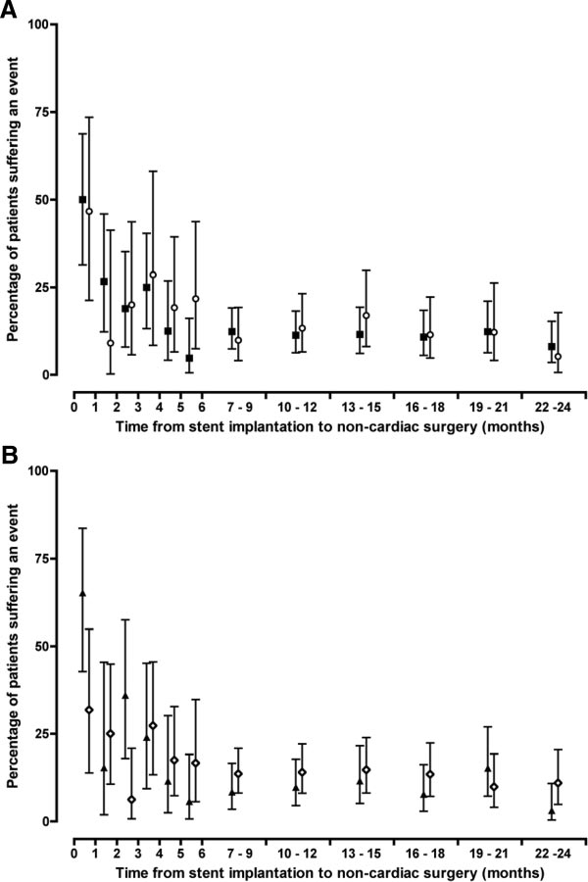
CV events after non-cardiac surgery
Linked database (UK)
Cruden LM, et al. Circ Cardiovasc Interv 2010;3:236
- 17,797 stented patients (71% BMS)
1,953 (11%) had non-cardiac surgery within <2 yr of PCI (4% within 1 yr)
Post-op CV events:
  42% if surgery <6 wks
  13% if surgery >6 wks
No difference, BMS vs. DES
Stent thrombosis: 2%

Slide 6
Management question
  Stop ASA and clopidogrel 7-10 days pre-op and resume both drugs 1-2 days post-op.
  Stop ASA and clopidogrel 7-10 days pre-op and administer bridging with SC low-molecular-weight heparin or IV heparin.
  Continue ASA pre-/post-op and stop clopidogrel 7-10 days pre-op.
  Continue ASA + clopidogrel pre-/post-op.
  Stop ASA and clopidogrel 7-10 days pre-op and administer GP IIa/IIIb inhibitor around the time of surgery.

Slide 7
Evidence
Prospective cohort study: 1,911 DES patients
  Received AP therapy (ASA + clopidogrel) for ≥3 months
  Median follow-up = 19.4 months
Incidence of stent thrombosis
  3.3% with AP interruption vs. 0.6% without AP interruption
Risk factors for stent thrombosis
  Co-morbidity (LV dysfunction, prior stroke, DM, renal disease)
  Artery-specific (calcified lesion, length stented)
  Premature interruption of AP therapy: RR, 19.2 (95% CI: 5.6-65.5)
Park DW, et al. Am J Cardiol 2006; 98:352

Slide 8
Non-cardiac surgery in stented patients
Study | Design | Patients | Time Elapsed: PCI to surgery | Stent Thrombosis number | Case-fatality
Schouten O, et al. JACC 2007;49:122 | retrospective cohort | 192 | < 2 yrs | 5 (2.6%) | 100%
Nuttall GA, et al. Anesthes 2008;109:588 | retrospective cohort | 899 | < 2 yrs | 47 (5.2%) | 66%
Rabbits JA, et al. Anesthes 2008;109:596 | retrospective cohort | 520 | < 2yrs | 28 (5.4%) | 50%
Brotman DJ, et al. J Hosp Med 2007;2 | retrospective cohort | 114 | 2 yrs | 0 | 0%
Compton PA, et al. Am J Cardiol 2006;98:1212 | retrospective cohort | 38 | N/A | 0 | 0
Anwaruddin S, et al. JACC CV Int 2009;2:542 | retrospective cohort | 481 | 1.1 yrs | 11 (2.0%) | N/A

Slide 9
Recommendations
Whenever possible, elective surgery in patients receiving ASA and clopidogrel secondary to coronary stent implantation should be deferred for at least - 6 weeks after BMS placement
- 12 months after DES placement (Class I, Level B).
For patients who are receiving ASA and clopidogrel for a BMS and require urgent surgery <6 weeks of placement, ASA and clopidogrel should be continued in the perioperative period (Class I, Level B).
For patients who are receiving ASA and clopidogrel for a DES and require urgent surgery <12 months of placement, ASA and clopidogrel should be continued in the perioperative period (Class I, Level B).

Slide 10
What if?
Patient requires surgery in which there is a high risk for bleeding?

Slide 11
Timing of stent thrombosis after stopping AP drugs
ASA + clopidogrel stopped
clopidogrel only stopped
Eisenberg MJ, et al. Circulation 2009;119:1634

Slide 12
Case study no. 2
78 year old obese woman with CAD and NSTEMI 1.5 years ago
  Treated medically, no angiography
  Now requires bilateral inguinal hernia surgery
Receiving ASA, 81 mg
Other cardiovascular risk factors
  Hypertension
  Type 2 diabetes
  N.B. no ACS-related symptoms since NSTEMI

Slide 13
Management question
  Stop ASA 7-10 days pre-op and resume 1-2 days post-op.
  Stop ASA 4-5 days pre-op and resume 1-2 days post-op.
  Continue ASA pre-/post-op.

Slide 14
Evidence
Meta-analysis of >49,000 patients having non-cardiac surgery
  Perioperative continuation of ASA conferred increased bleeding risk (RR, 1.5; inter-quartile range: 1.0-2.5) but NO increased risk for bleeding that required medical or other interventions
  N.B. ASA + intracranial surgery/TURP → increased major bleeds
  Burger W, et al. J Intern Med 2005;257:399
Systematic review
  Perioperative interruption of ASA conferred a 3-fold increased risk for adverse CV events (OR, 3.1; 95% CI:1.8-5.6).
  Biondi-Zoccai GG, et al. Eur Heart J 2006;27:2667

Slide 15
Evidence
220-patient RCT in at-risk patients having non-cardiac surgery:
ASA (75 mg) 7 days pre-op, vs. no pre-op ASA
ASA conferred 7.2% ARR (95% CI: 1.3-13) in post-op MACE
POISE-2 Trial
10,000 patients having non-cardiac surgery
2 × 2 factorial design: ASA vs. no ASA or clonidine vs. placebo
Oscarsson A, et al. Br J Anesth 2010;104:305

Slide 16
Recommendation
Patients who are receiving ASA and require elective non-cardiac surgery should discontinue ASA 7-10 days prior to surgery if the risk for cardiovascular events is low but continue therapy if cardiovascular risk is high (Class IIa, Level B).

Slide 17
What if?
ASA is stopped 7-10 days pre-op and post-op develops dyspnea and NSTEMI?
Treatment includes: ASA, 81 mg and clopidogrel, 75 mg and fondaparinux, 2.5 mg.
Angiography shows severe 3-vessel disease, scheduled for CABG.

Slide 18
Recommendation
Patients who are receiving ASA and require CABG should: Continue ASA up to the time of surgery (Class I, Level B).
Patients who are receiving ASA and clopidogrel should: Continue ASA until the time of surgery but
Discontinue clopidogrel at least 5 days before surgery (Class I, Level B).

Slide 19
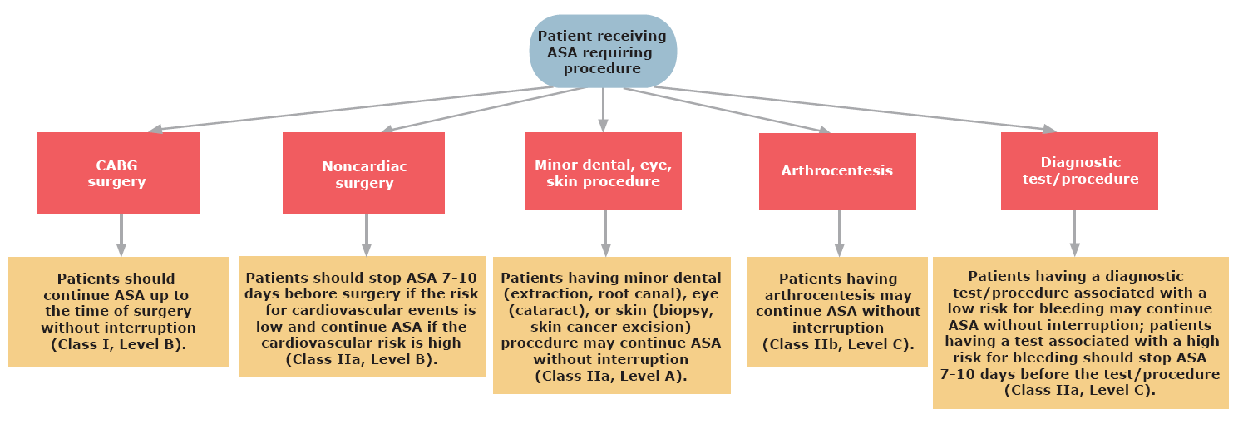
Antiplatelet therapy in patients taking ASA and requiring surgery or procedure

Slide 20
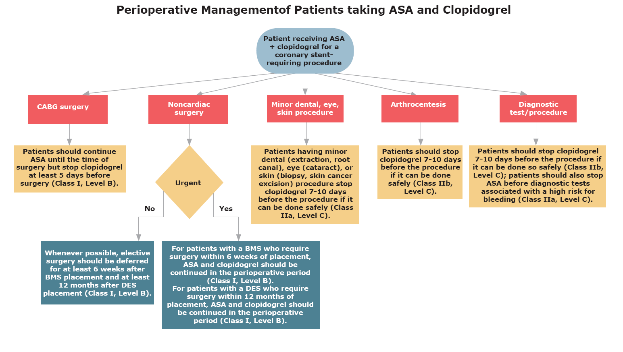
Antiplatelet therapy in patients taking ASA + clopidogrel and requiring surgery or procedure

Slide 21
Relative risk of bleeding associated with common surgical and nonsurgical procedures
Intermediate Risk
Other intraabdominal surgery
Other intrathoracic surgery
Other orthopaedic surgery
Other vascular surgery
Selected procedures (prostate or cervical biopsy)
Low Risk
Laproscopic cholecystectomy
Laproscopic inguinal hernia repair
Dental procedures
Dermatologic procedures
Ophthalmologic procedures
Coronary angiography
Gastroscopy or colonoscopy
Selected procedures (bone marrow or lymph node biopsy, thoracentesis, paracentesis, arthrocentesis)
Very Low Risk
Single tooth extraction or teeth cleaning
Skin biopsy or selected skin cancer removal
Cataract removal
Very High Risk
Neurosurgery (intracranial or spinal surgery)
Cardiac surgery (coronary artery bypass or heart valve replacement)
High Risk
Major vascular surgery (abdominal aortic aneurysm repair, aortofemoral bypass)
Major urologic surgery (prostatectomy, bladder tumour resection)
Major lower limb orthopaedic surgery (hip/knee joint replacement)
Lung resection surgery
Intestinal anastomosis surgery
Permanent pacemaker insertion or internal defibrillator placement
Selected procedures (kidney biopsy, pericardiocentesis, colonic polypectomy)

Slide 22


