Slide 1
Canadian Cardiovascular Society
Antiplatelet Guidelines
INTERACTION BETWEEN CLOPIDROGEL AND PROTON PUMP INHIBITORS
Working Group: Wee Shian Chan, MD, FRCP; Alan D. Bell, MD, CCFP

Slide 2
Objectives
Interpret the Canadian Cardiovascular Society Guideline recommendations regarding the use of proton pump inhibitors in patients on antiplatelet therapy.
Recognize the role of the cytochrome enzymes in the metabolism of clopidogrel and proton pump inhibitors.
Evaluate the evidence of the clinical impact of the interaction between clopidogrel and proton pump inhibitors.

Slide 3
Case
A diabetic patient with recently implanted medicated stents is back to your office because of gastric upset.
He has suffered from non-HP gastritis in the past.
He is presently taking a statin, a B Blocker, an ACEI, ASA 81 mg and clopidogrel 75 mg.
The physical examination is unremarkable.

Slide 4
Question
What medication would you add ?
Lansoprazole
Omeprazole
Pantoprazole
Ranitidine
Any of the above

Slide 5
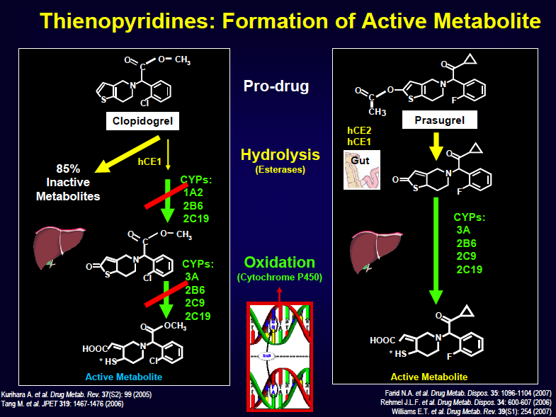
Notes:
5

Slide 6
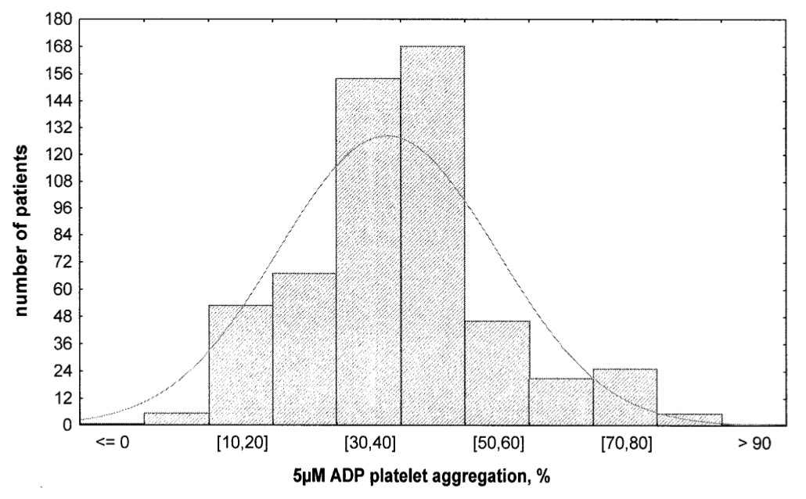
Variability in platelet responsiveness to clopidogrel among 544 individuals
Serebruany et al. J Am Coll Cardiol 2005; 45: 246-51
Notes:
6
6
OBJECTIVES BACKGROUND
METHODS RESULTS
CONCLUSIONS
We sought to describe the responses of patients to clopidogrel using ex vivo measures of platelet aggregation and activation in a large, heterogeneous population. Recently, a number of reports, using various definitions, have dichotomized patients who are treated with clopidogrel into a minority of “non-responders” and a majority of “responders.” Such classifications imply that treatment leads to an all-or-none response, with potentially important clinical implications.
We conducted secondary post-hoc analyses of a dataset consisting of volunteers (n 􏰀 94) and patients after coronary stenting (n 􏰀 405), with heart failure (n 􏰀 25), and after stroke (n 􏰀 20). The response of subjects to clopidogrel followed a normal, bell-shaped distribution, with a mean and standard deviation of 41.9 􏰁 20.8% when aggregation was induced by 5 􏰆mol/l of adenosine diphosphate. When hyporesponsiveness and hyper-responsiveness to clopidogrel were considered to be two standard deviations less than and greater than the mean, respectively, the prevalence of hyporesponsiveness and hyper-responsiveness in these patients was 4.2% and 4.8%, respectively. Pretreatment platelet activity and clinical characteristics were not associated with responsiveness to clopidogrel.
Individuals receiving clopidogrel exhibit a wide variability in response that follows a normal distribution. The clinical implications of this variability are unknown but potentially are important. Clinical trials are needed to define whether hyporesponders to clopidogrel are at increased risk for thrombotic events and whether hyper-responders are at increased risk for bleeding. If so, the individualization of antiplatelet therapy, including clopidogrel dosing, may be possible in the future but will require the ability to easily and reproducibly measure responsiveness by a method that has been proven to be predictive of clinical events. (J Am Coll Cardiol 2005;45:246–51)

Slide 7
CYP2C19 Alleles
3 allele classes
  - “Wild type” (*1): 63%
  - Loss-of-function (*2, *3): 13%
  - Gain-of-function (*17): 24%
5 metabolizer phenotypes
  - Poor: 2 loss-of-function alleles (2%)
  - Intermediate: 1 loss-of-function and 1wild type alleles (16%)
  - Extensive: 2 wild types alleles (39%)
  - Ultra: 1 or 2 gain-of-function alleles (37%)
  - Unknown: 1 gain-of-function and 1 loss-of-function alleles (6%)
2 carrier status
- Loss-of-function carriers (1 or more *2, *3): 24%
- Gain-of-function carriers (1 or more *17): 41%

Slide 8
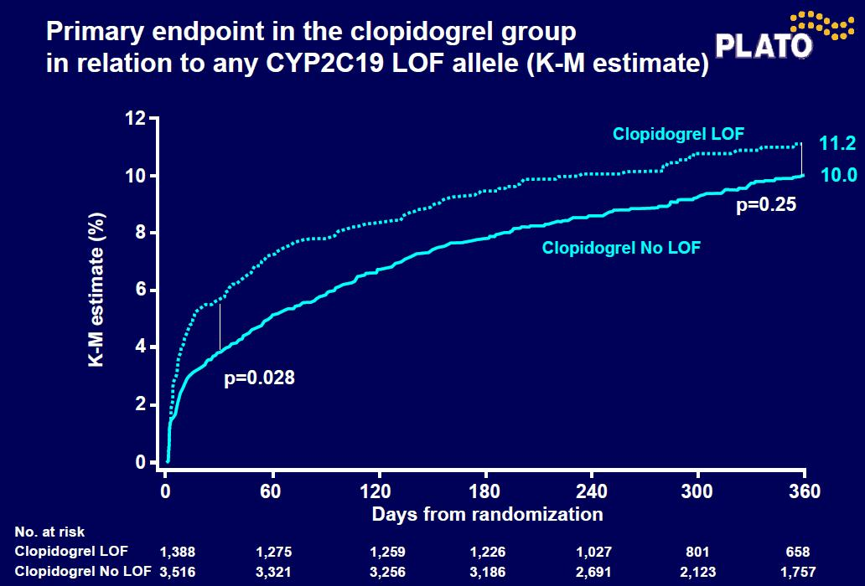

Slide 9
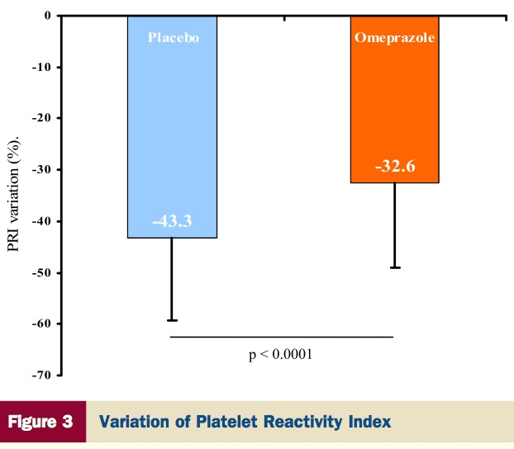
Influence of Omeprazole on the antiplatelet action of Clopidogrel associated with aspirin: The randomized, double-blind OCLA (Omeprazole CLopidogrel Aspirin) study
Gilard M et al. J Am Coll Cardiol, 2008; 51: 256-60
Notes:
Objectives Background
Methods
Results
Results
This trial sought to assess the influence of omeprazole on clopidogrel efficacy.
Clopidogrel has proved its benefit in the treatment of atherothrombotic diseases. In a previous observational study, we found clopidogrel activity on platelets, tested by vasodilator-stimulated phosphoprotein (VASP) phos- phorylation, to be diminished in patients receiving proton pump inhibitor (PPI) treatment.
In this double-blind placebo-controlled trial, all consecutive patients undergoing coronary artery stent implanta- tion received aspirin (75 mg/day) and clopidogrel (loading dose, followed by 75 mg/day) and were randomized to receive either associated omeprazole (20 mg/day) or placebo for 7 days. Clopidogrel effect was tested on days 1 and 7 in both groups by measuring platelet phosphorylated-VASP expressed as a platelet reactivity index (PRI). Our main end point compared PRI value at the 7-day treatment period in the 2 groups.
Data for 124 patients were analyzed. On day 1, mean PRI was 83.2% (standard deviation [SD] 5.6) and 83.9% (SD 4.6), respectively, in the placebo and omeprazole groups (p 􏰀 NS), and on day 7, 39.8% (SD 15.4) and 51.4% (SD 16.4), respectively (p 􏰂 0.0001).
Omeprazole significantly decreased clopidogrel inhibitory effect on platelet P2Y12 as assessed by VASP phos- phorylation test. Aspirin-clopidogrel antiplatelet dual therapy is widely prescribed worldwide, with PPIs frequently associated to prevent gastrointestinal bleeding. The clinical impact of these results remains uncertain but merits further investigation. (OCLA: Influence of Omeprazole on the Antiplatelet Action of Clopidogrel Associated to As- pirin; http://www.clinicaltrials.gov/ct2/show/NCT00349661; NCT00349661) (J Am Coll Cardiol 2008;51: 256–60)
9

Slide 10
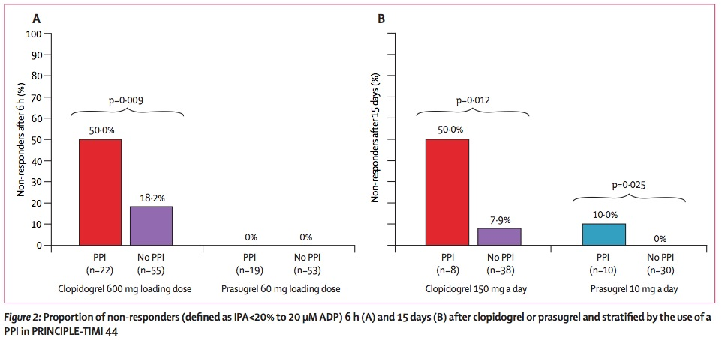
PRINCIPLE-TIMI 44: prasugel/clopidogrel
Proportion of non-responders at 6 hours and fifteen days
6 hours
15 days
Wiviott SD et al. Circulation 2007; 116; 2923-32
Notes:
Background—The increasing use of higher-than-approved doses of clopidogrel in clinical practice is based in part on the desire for greater levels of inhibition of platelet aggregation (IPA). Prasugrel is a new thienopyridine that is more potent than standard-dose clopidogrel in healthy subjects and patients with stable coronary artery disease. The relative antiplatelet effects of prasugrel versus high-dose clopidogrel in percutaneous coronary intervention patients are unknown.
Methods and Results—Prasugrel in Comparison to Clopidogrel for Inhibition of Platelet Activation and Aggregation– Thrombolysis in Myocardial Infarction 44 (PRINCIPLE-TIMI 44) was a randomized, double-blind, 2-phase crossover study of prasugrel compared with high-dose clopidogrel in patients undergoing cardiac catheterization for planned percutaneous coronary intervention. The primary end point of the loading-dose phase (prasugrel 60 mg versus clopidogrel 600 mg) was IPA with 20 􏰊mol/L ADP at 6 hours. Patients with percutaneous coronary intervention entered the maintenance-dose phase, a 28-day crossover comparison of prasugrel 10 mg/d versus clopidogrel 150 mg/d with a primary end point of IPA after 14 days of either drug. In this study, 201 subjects were randomized. IPA at 6 hours was significantly higher in subjects receiving prasugrel (mean􏰇SD, 74.8􏰇13.0%) compared with clopidogrel (31.8􏰇21.1%; P􏰀0.0001). During the maintenance-dose phase, IPA with 20 􏰊mol/L ADP was higher in subjects receiving prasugrel (61.3􏰇17.8%) compared with clopidogrel (46.1􏰇21.3%; P􏰀0.0001). Results were consistent across all key secondary end points; significant differences emerged by 30 minutes and persisted across all time points.
Conclusions—Among patients undergoing cardiac catheterization with planned percutaneous coronary intervention, loading with 60 mg prasugrel resulted in greater platelet inhibition than a 600-mg clopidogrel loading dose. Maintenance therapy with prasugrel 10 mg/d resulted in a greater antiplatelet effect than 150 mg/d clopidogrel. (Circulation. 2007;116:2923-2932.)
10

Slide 11
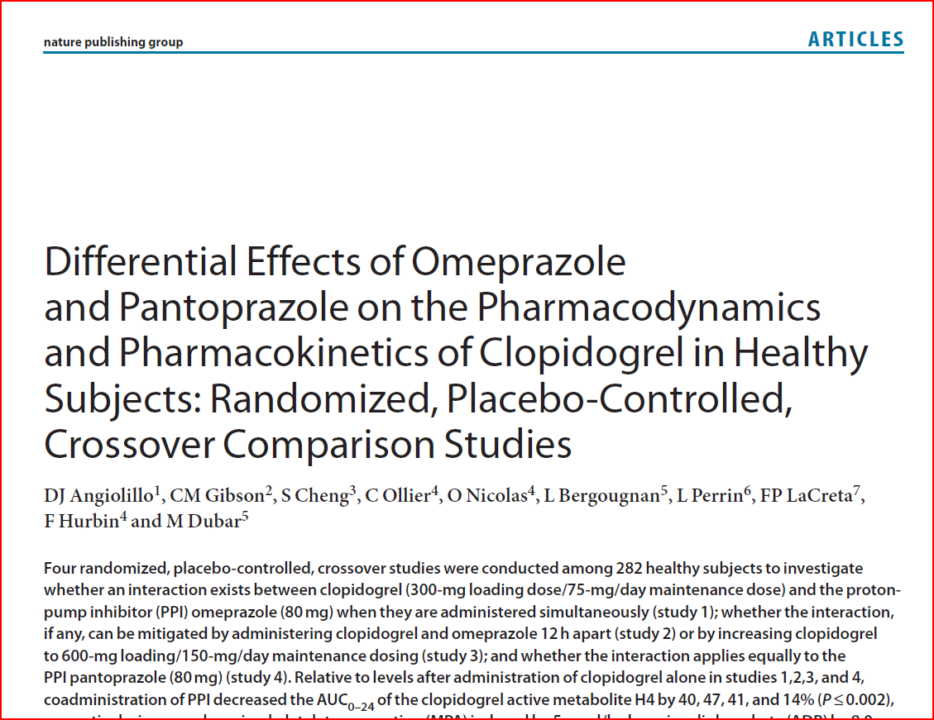
FDA-studies Mandated Studies
Angiolillo DJ et al. Clin Pharmacol Ther. 2011 Jan;89(1):65-74.
Presenter | Nycomed | February 2010
Slide 11
Notes:
These studies were demanded by the FDA.
Four randomized, placebo-controlled, crossover studies were conducted among 282 healthy subjects to investigate whether an interaction exists between clopidogrel (300-mg loading dose/75-mg/day maintenance dose) and the protonpump inhibitor (PPI) omeprazole (80 mg) when they are administered simultaneously (study 1); whether the interaction, if any, can be mitigated by administering clopidogrel and omeprazole 12 h apart (study 2) or by increasing clopidogrel to 600-mg loading/150-mg/day maintenance dosing (study 3); and whether the interaction applies equally to the PPI pantoprazole (80 mg) (study 4). Relative to levels after administration of clopidogrel alone in studies 1,2,3, and 4, coadministration of PPI decreased the AU C0–24 of the clopidogrel active metabolite H4 by 40, 47, 41, and 14% (P ≤ 0.002),
respectively; increased maximal platelet aggregation (MPA ) induced by 5 μmol/l adenosine diphosphate (ADP) by 8.0, 5.6, 8.1, and 4.3% (P ≤ 0.014), respectively; and increased the vasodilator-stimulated phosphoprotein phosphorylationplatelet reactivity index (VASP-PRI) by 20.7, 27.1, 19.0 (P < 0.0001), and 3.9% (P = 0.3319), respectively. The results suggest
that a metabolic drug–drug interaction exists between clopidogrel and omeprazole but not between clopidogrel and pantoprazole.
11

Slide 12
FDA-studies Mandated Studies
The results suggest:
that a metabolic drug–drug interaction exists between clopidogrel and omeprazole but not between clopidogrel and pantoprazole.
Angiolillo DJ et al. Clin Pharmacol Ther. 2011 Jan;89(1):65-74.
Notes:
These studies were demanded by the FDA.
Four randomized, placebo-controlled, crossover studies were conducted among 282 healthy subjects to investigate whether an interaction exists between clopidogrel (300-mg loading dose/75-mg/day maintenance dose) and the protonpump inhibitor (PPI) omeprazole (80 mg) when they are administered simultaneously (study 1); whether the interaction, if any, can be mitigated by administering clopidogrel and omeprazole 12 h apart (study 2) or by increasing clopidogrel to 600-mg loading/150-mg/day maintenance dosing (study 3); and whether the interaction applies equally to the PPI pantoprazole (80 mg) (study 4). Relative to levels after administration of clopidogrel alone in studies 1,2,3, and 4, coadministration of PPI decreased the AU C0–24 of the clopidogrel active metabolite H4 by 40, 47, 41, and 14% (P ≤ 0.002),
respectively; increased maximal platelet aggregation (MPA ) induced by 5 μmol/l adenosine diphosphate (ADP) by 8.0, 5.6, 8.1, and 4.3% (P ≤ 0.014), respectively; and increased the vasodilator-stimulated phosphoprotein phosphorylationplatelet reactivity index (VASP-PRI) by 20.7, 27.1, 19.0 (P < 0.0001), and 3.9% (P = 0.3319), respectively. The results suggest
that a metabolic drug–drug interaction exists between clopidogrel and omeprazole but not between clopidogrel and pantoprazole.

Slide 13
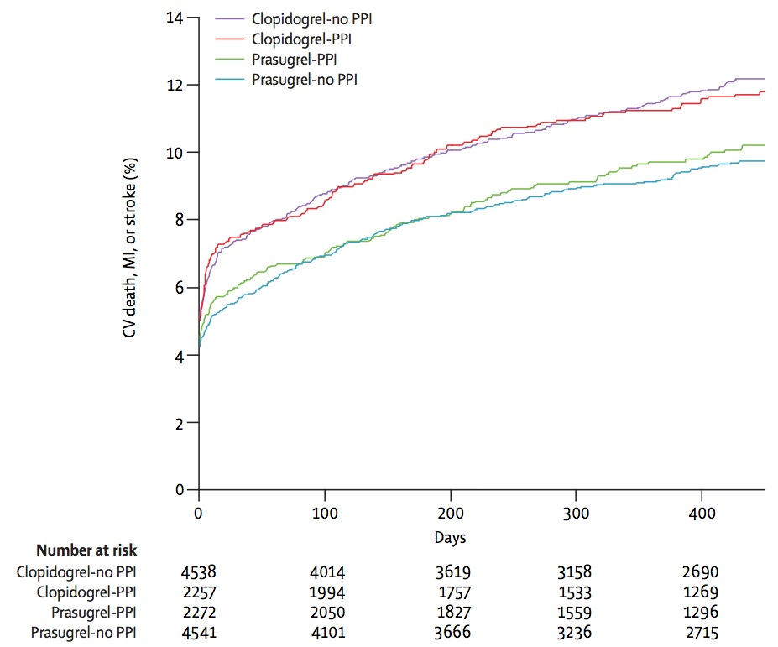
TRITON-TIMI 38: ACS with planned PCI
Clopidogrel/prasugrel with/without PPI
Clopidogrel
Prasugrel
Wiviott SD et al.; NEJM 2007; 357; 2001-15
Notes:
Background
Dual-antiplatelet therapy with aspirin and a thienopyridine is a cornerstone of treat- ment to prevent thrombotic complications of acute coronary syndromes and percu- taneous coronary intervention.
Methods
To compare prasugrel, a new thienopyridine, with clopidogrel, we randomly assigned 13,608 patients with moderate-to-high-risk acute coronary syndromes with sched- uled percutaneous coronary intervention to receive prasugrel (a 60-mg loading dose and a 10-mg daily maintenance dose) or clopidogrel (a 300-mg loading dose and a 75-mg daily maintenance dose), for 6 to 15 months. The primary efficacy end point was death from cardiovascular causes, nonfatal myocardial infarction, or nonfatal stroke. The key safety end point was major bleeding.
Results
The primary efficacy end point occurred in 12.1% of patients receiving clopidogrel and 9.9% of patients receiving prasugrel (hazard ratio for prasugrel vs. clopidogrel, 0.81; 95% confidence interval [CI], 0.73 to 0.90; P<0.001). We also found significant reductions in the prasugrel group in the rates of myocardial infarction (9.7% for clopidogrel vs. 7.4% for prasugrel; P<0.001), urgent target-vessel revascularization (3.7% vs. 2.5%; P<0.001), and stent thrombosis (2.4% vs. 1.1%; P<0.001). Major bleed- ing was observed in 2.4% of patients receiving prasugrel and in 1.8% of patients receiving clopidogrel (hazard ratio, 1.32; 95% CI, 1.03 to 1.68; P=0.03). Also great- er in the prasugrel group was the rate of life-threatening bleeding (1.4% vs. 0.9%; P = 0.01), including nonfatal bleeding (1.1% vs. 0.9%; hazard ratio, 1.25; P = 0.23) and fatal bleeding (0.4% vs. 0.1%; P=0.002).
Conclusions
In patients with acute coronary syndromes with scheduled percutaneous coronary intervention, prasugrel therapy was associated with significantly reduced rates of ischemic events, including stent thrombosis, but with an increased risk of major bleeding, including fatal bleeding. Overall mortality did not differ significantly between treatment groups. (ClinicalTrials.gov number, NCT00097591.)
13

Slide 14
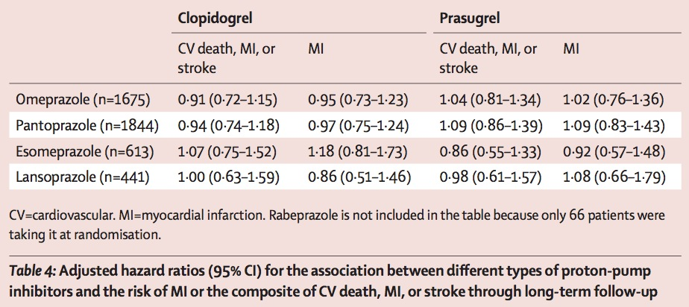
TRITON-TIMI 38: ACS with planned PCI
Clopidogrel/prasugrel according to PPI molecule
Wiviott SD et al. NEJM 2007; 357; 2001-15
Notes:
Background
Dual-antiplatelet therapy with aspirin and a thienopyridine is a cornerstone of treat- ment to prevent thrombotic complications of acute coronary syndromes and percu- taneous coronary intervention.
Methods
To compare prasugrel, a new thienopyridine, with clopidogrel, we randomly assigned 13,608 patients with moderate-to-high-risk acute coronary syndromes with sched- uled percutaneous coronary intervention to receive prasugrel (a 60-mg loading dose and a 10-mg daily maintenance dose) or clopidogrel (a 300-mg loading dose and a 75-mg daily maintenance dose), for 6 to 15 months. The primary efficacy end point was death from cardiovascular causes, nonfatal myocardial infarction, or nonfatal stroke. The key safety end point was major bleeding.
Results
The primary efficacy end point occurred in 12.1% of patients receiving clopidogrel and 9.9% of patients receiving prasugrel (hazard ratio for prasugrel vs. clopidogrel, 0.81; 95% confidence interval [CI], 0.73 to 0.90; P<0.001). We also found significant reductions in the prasugrel group in the rates of myocardial infarction (9.7% for clopidogrel vs. 7.4% for prasugrel; P<0.001), urgent target-vessel revascularization (3.7% vs. 2.5%; P<0.001), and stent thrombosis (2.4% vs. 1.1%; P<0.001). Major bleed- ing was observed in 2.4% of patients receiving prasugrel and in 1.8% of patients receiving clopidogrel (hazard ratio, 1.32; 95% CI, 1.03 to 1.68; P=0.03). Also great- er in the prasugrel group was the rate of life-threatening bleeding (1.4% vs. 0.9%; P = 0.01), including nonfatal bleeding (1.1% vs. 0.9%; hazard ratio, 1.25; P = 0.23) and fatal bleeding (0.4% vs. 0.1%; P=0.002).
Conclusions
In patients with acute coronary syndromes with scheduled percutaneous coronary intervention, prasugrel therapy was associated with significantly reduced rates of ischemic events, including stent thrombosis, but with an increased risk of major bleeding, including fatal bleeding. Overall mortality did not differ significantly between treatment groups. (ClinicalTrials.gov number, NCT00097591.)
14

Slide 15
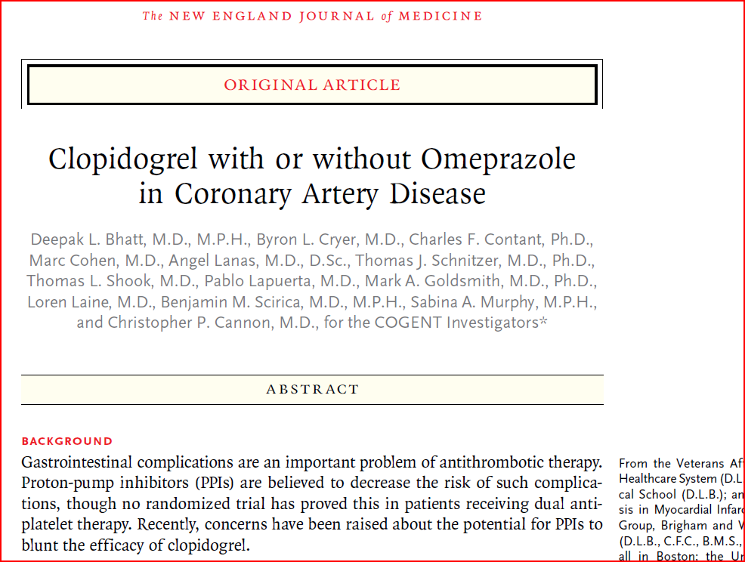
COGENT
BHATT DL et al. N Engl J Med. 2010 Nov 11;363(20):1909-17
Presenter | Nycomed | February 2010
Slide 15
Notes:
BHATT et al, COGENT-trial n=3700, prematurely stopped, NEJM
Published online on October 6, 2010, at NEJM
Background
Gastrointestinal complications are an important problem of antithrombotic therapy.
Proton-pump inhibitors (PPIs) are believed to decrease the risk of such complications,
though no randomized trial has proved this in patients receiving dual antiplatelet
therapy. Recently, concerns have been raised about the potential for PPIs to
blunt the efficacy of clopidogrel.
Methods
We randomly assigned patients with an indication for dual antiplatelet therapy to
receive clopidogrel in combination with either omeprazole or placebo, in addition
to aspirin. The primary gastrointestinal end point was a composite of overt or occult
bleeding, symptomatic gastroduodenal ulcers or erosions, obstruction, or perforation.
The primary cardiovascular end point was a composite of death from
cardiovascular causes, nonfatal myocardial infarction, revascularization, or stroke.
The trial was terminated prematurely when the sponsor lost financing.
Results
We planned to enroll about 5000 patients; a total of 3873 were randomly assigned
and 3761 were included in analyses. In all, 51 patients had a gastrointestinal event;
the event rate was 1.1% with omeprazole and 2.9% with placebo at 180 days (hazard
ratio with omeprazole, 0.34, 95% confidence interval [CI], 0.18 to 0.63; P<0.001).
The rate of overt upper gastrointestinal bleeding was also reduced with omeprazole
as compared with placebo (hazard ratio, 0.13; 95% CI, 0.03 to 0.56; P = 0.001). A total
of 109 patients had a cardiovascular event, with event rates of 4.9% with omeprazole
and 5.7% with placebo (hazard ratio with omeprazole, 0.99; 95% CI, 0.68 to
1.44; P = 0.96); high-risk subgroups did not show significant heterogeneity. The two
groups did not differ significantly in the rate of serious adverse events, though the
risk of diarrhea was increased with omeprazole.
Conclusions
Among patients receiving aspirin and clopidogrel, prophylactic use of a PPI reduced
the rate of upper gastrointestinal bleeding. There was no apparent cardiovascular
interaction between clopidogrel and omeprazole, but our results do not rule out a
clinically meaningful difference in cardiovascular events due to use of a PPI. (Funded
by Cogentus Pharmaceuticals; ClinicalTrials.gov number, NCT00557921.)
15

Slide 16
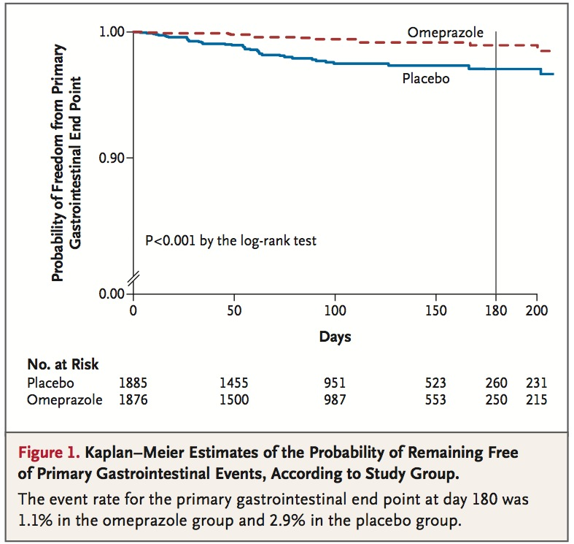
COGENT: GI events
Bhatt DL et al. NEJM 2010; 363: 1909-17
Notes:
Background
Gastrointestinal complications are an important problem of antithrombotic therapy. Proton-pump inhibitors (PPIs) are believed to decrease the risk of such complica- tions, though no randomized trial has proved this in patients receiving dual anti- platelet therapy. Recently, concerns have been raised about the potential for PPIs to blunt the efficacy of clopidogrel.
Methods
We randomly assigned patients with an indication for dual antiplatelet therapy to receive clopidogrel in combination with either omeprazole or placebo, in addition to aspirin. The primary gastrointestinal end point was a composite of overt or oc- cult bleeding, symptomatic gastroduodenal ulcers or erosions, obstruction, or per- foration. The primary cardiovascular end point was a composite of death from cardiovascular causes, nonfatal myocardial infarction, revascularization, or stroke. The trial was terminated prematurely when the sponsor lost financing.
Results
We planned to enroll about 5000 patients; a total of 3873 were randomly assigned and 3761 were included in analyses. In all, 51 patients had a gastrointestinal event; the event rate was 1.1% with omeprazole and 2.9% with placebo at 180 days (hazard ratio with omeprazole, 0.34, 95% confidence interval [CI], 0.18 to 0.63; P<0.001). The rate of overt upper gastrointestinal bleeding was also reduced with omeprazole as compared with placebo (hazard ratio, 0.13; 95% CI, 0.03 to 0.56; P=0.001). A total of 109 patients had a cardiovascular event, with event rates of 4.9% with omepra- zole and 5.7% with placebo (hazard ratio with omeprazole, 0.99; 95% CI, 0.68 to 1.44; P=0.96); high-risk subgroups did not show significant heterogeneity. The two groups did not differ significantly in the rate of serious adverse events, though the risk of diarrhea was increased with omeprazole.
Conclusions
Among patients receiving aspirin and clopidogrel, prophylactic use of a PPI reduced the rate of upper gastrointestinal bleeding. There was no apparent cardiovascular interaction between clopidogrel and omeprazole, but our results do not rule out a clinically meaningful difference in cardiovascular events due to use of a PPI. (Fund- ed by Cogentus Pharmaceuticals; ClinicalTrials.gov number, NCT00557921.)
16

Slide 17
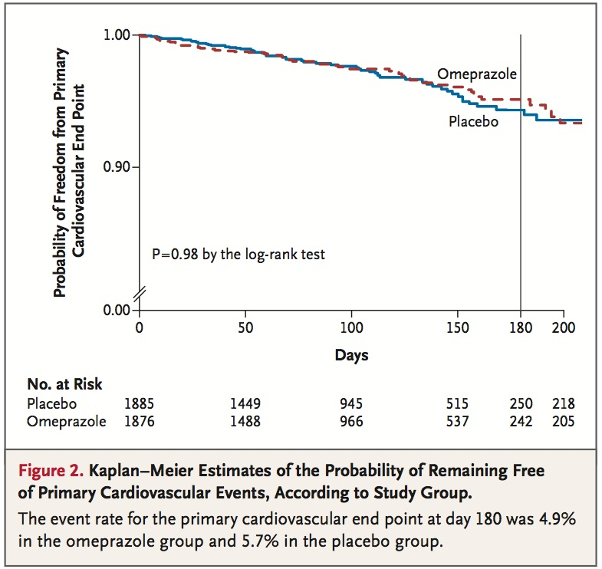
COGENT: CV events
Bhatt DL et al. NEJM 2010; 363: 1909-17
Notes:
Background
Gastrointestinal complications are an important problem of antithrombotic therapy. Proton-pump inhibitors (PPIs) are believed to decrease the risk of such complica- tions, though no randomized trial has proved this in patients receiving dual anti- platelet therapy. Recently, concerns have been raised about the potential for PPIs to blunt the efficacy of clopidogrel.
Methods
We randomly assigned patients with an indication for dual antiplatelet therapy to receive clopidogrel in combination with either omeprazole or placebo, in addition to aspirin. The primary gastrointestinal end point was a composite of overt or oc- cult bleeding, symptomatic gastroduodenal ulcers or erosions, obstruction, or per- foration. The primary cardiovascular end point was a composite of death from cardiovascular causes, nonfatal myocardial infarction, revascularization, or stroke. The trial was terminated prematurely when the sponsor lost financing.
Results
We planned to enroll about 5000 patients; a total of 3873 were randomly assigned and 3761 were included in analyses. In all, 51 patients had a gastrointestinal event; the event rate was 1.1% with omeprazole and 2.9% with placebo at 180 days (hazard ratio with omeprazole, 0.34, 95% confidence interval [CI], 0.18 to 0.63; P<0.001). The rate of overt upper gastrointestinal bleeding was also reduced with omeprazole as compared with placebo (hazard ratio, 0.13; 95% CI, 0.03 to 0.56; P=0.001). A total of 109 patients had a cardiovascular event, with event rates of 4.9% with omepra- zole and 5.7% with placebo (hazard ratio with omeprazole, 0.99; 95% CI, 0.68 to 1.44; P=0.96); high-risk subgroups did not show significant heterogeneity. The two groups did not differ significantly in the rate of serious adverse events, though the risk of diarrhea was increased with omeprazole.
Conclusions
Among patients receiving aspirin and clopidogrel, prophylactic use of a PPI reduced the rate of upper gastrointestinal bleeding. There was no apparent cardiovascular interaction between clopidogrel and omeprazole, but our results do not rule out a clinically meaningful difference in cardiovascular events due to use of a PPI. (Fund- ed by Cogentus Pharmaceuticals; ClinicalTrials.gov number, NCT00557921.)
17

Slide 18
Clopidogrel with or without Omeprazole in coronary artery disease: COGENT study
Cogent Criticisms
Lower risk population – only 42% were taking clopidogrel for ACS
Fixed dose formulation used quite distinct from individual dosing
Study stopped early as sponsor lost funding – only 77% of planned subjects were enrolled
“There was no apparent cardiovascular interaction between clopidogrel and omeprazole, but our results do not rule out a clinically meaningful difference in cardiovascular events due to use of a PPI. “
Bhatt DL et al. NEJM 2010; 363: 1909-17
Notes:
Background
Gastrointestinal complications are an important problem of antithrombotic therapy. Proton-pump inhibitors (PPIs) are believed to decrease the risk of such complica- tions, though no randomized trial has proved this in patients receiving dual anti- platelet therapy. Recently, concerns have been raised about the potential for PPIs to blunt the efficacy of clopidogrel.
Methods
We randomly assigned patients with an indication for dual antiplatelet therapy to receive clopidogrel in combination with either omeprazole or placebo, in addition to aspirin. The primary gastrointestinal end point was a composite of overt or oc- cult bleeding, symptomatic gastroduodenal ulcers or erosions, obstruction, or per- foration. The primary cardiovascular end point was a composite of death from cardiovascular causes, nonfatal myocardial infarction, revascularization, or stroke. The trial was terminated prematurely when the sponsor lost financing.
Results
We planned to enroll about 5000 patients; a total of 3873 were randomly assigned and 3761 were included in analyses. In all, 51 patients had a gastrointestinal event; the event rate was 1.1% with omeprazole and 2.9% with placebo at 180 days (hazard ratio with omeprazole, 0.34, 95% confidence interval [CI], 0.18 to 0.63; P<0.001). The rate of overt upper gastrointestinal bleeding was also reduced with omeprazole as compared with placebo (hazard ratio, 0.13; 95% CI, 0.03 to 0.56; P=0.001). A total of 109 patients had a cardiovascular event, with event rates of 4.9% with omepra- zole and 5.7% with placebo (hazard ratio with omeprazole, 0.99; 95% CI, 0.68 to 1.44; P=0.96); high-risk subgroups did not show significant heterogeneity. The two groups did not differ significantly in the rate of serious adverse events, though the risk of diarrhea was increased with omeprazole.
Conclusions
Among patients receiving aspirin and clopidogrel, prophylactic use of a PPI reduced the rate of upper gastrointestinal bleeding. There was no apparent cardiovascular interaction between clopidogrel and omeprazole, but our results do not rule out a clinically meaningful difference in cardiovascular events due to use of a PPI. (Fund- ed by Cogentus Pharmaceuticals; ClinicalTrials.gov number, NCT00557921.)
18

Slide 19
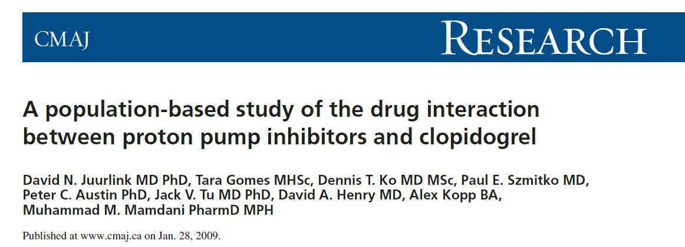
CV event rates post ACS in clopidogrel patients with or without PPI
Juurlink DN, et al. CMAJ. 2009 Mar 31;180(7):713-8

Slide 20
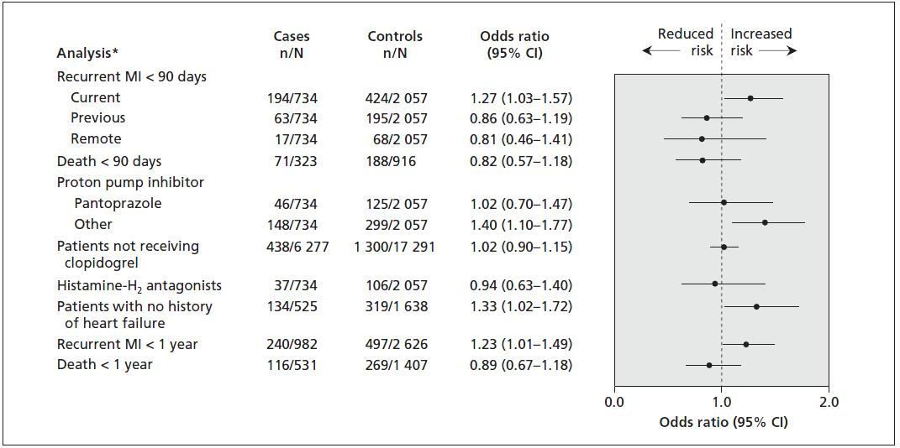
CV event rates post ACS in clopidogrel patients with or without PPI

Slide 21



Regulatory Authority Statements
16
Notes:
21

Slide 22
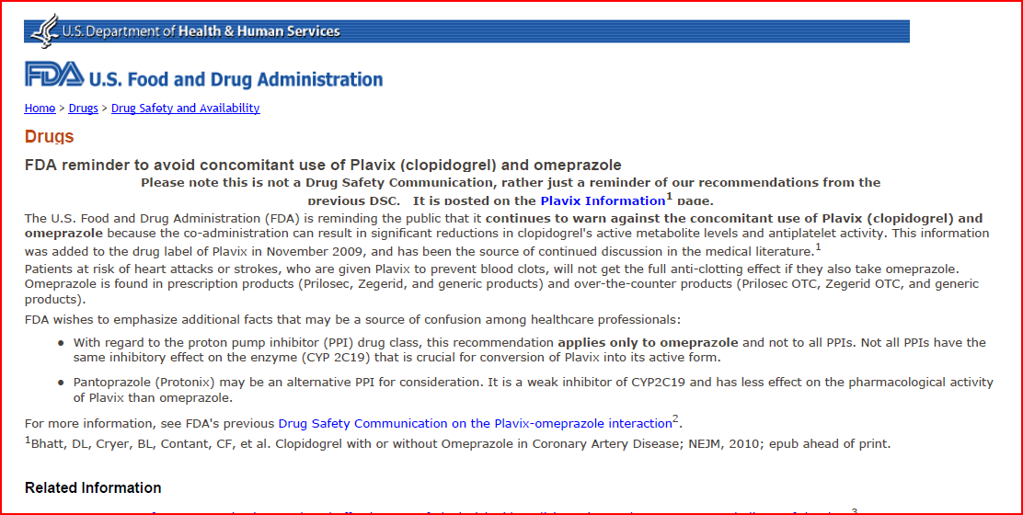
FDA 10. Oct 2010
…to warn against the concomitant use of Plavix and omeprazole because the co-adinistration can result in significant reductions in clopidogrel’s active metabolite…
Presenter | Nycomed | February 2010
Slide 22
Notes:
After publication of COGENT (Bhatt, 2010), FDA reemphasized its statement about interactions of PPIs and Clopidogrel.
22

Slide 23
FDA 10. Oct 2010
With regard to the proton pump inhibitor (PPI) drug class, this recommendation applies only to omeprazole and not to all PPIs. Not all PPIs have the same inhibitory effect on the enzyme (CYP 2C19) that is crucial for conversion of Plavix into its active form.
Pantoprazole (Protonix) may be an alternative PPI for consideration. It is a weak inhibitor of CYP2C19 and has less effect on the pharmacological activity of Plavix than omeprazole.
Presenter | Nycomed | February 2010
Slide 23
Notes:
After publication of COGENT (Bhatt, 2010), FDA reemphasized its statement about interactions of PPIs and Clopidogrel.
23

Slide 24
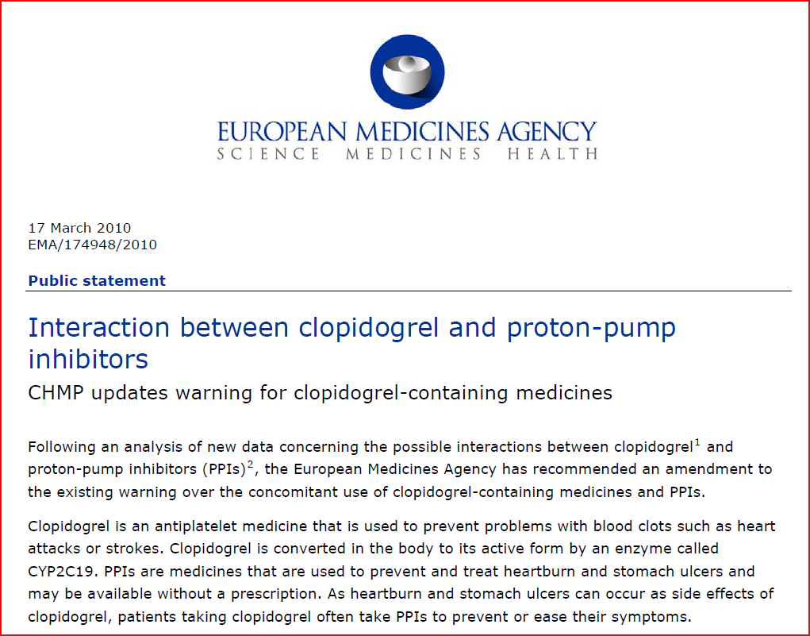
EMA March 17, 2010:
Presenter | Nycomed | February 2010
Slide 24
...there are no solid grounds to extend the warning to other PPIs. The class warning for all PPIs has been replaced with a warning stating that only the concomitant use of clopidogrel and omeprazole or esomeprazole should be discouraged.
Notes:
24

Slide 25
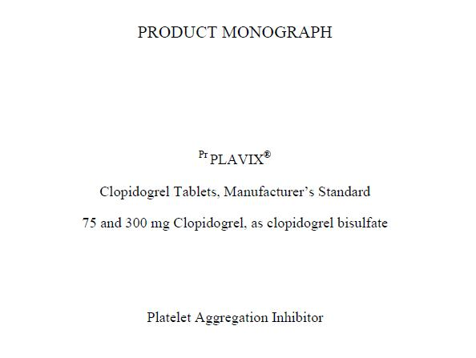
Health Canada
Use with Proton Pump Inhibitors (PPI):
Omeprazole, a moderate CYP2C19 inhibitor, reduces the pharmacological activity of PLAVIX. Avoid use of strong or moderate CYP2C19 inhibitors with PLAVIX. Consider using another acid-reducing agent with less CYP2C19 inhibitory activity, or alternative treatment strategies. Pantoprazole, a weak CYP2C19 inhibitor, had less effect on the pharmacological activity of PLAVIX than omeprazole

Slide 26
Summary
PPIs offer significant benfit to patients on antiplatelet therapy to reduce the risk of UGI bleeding
However, PPIs may interfere with the formation of the active metabolite of clopidogrel through inhibition of CYP2C19.
PPIs differ largely in their pharmaco- kinetics: Omeprazole exhibits the highest potential for drug– drug interactions among PPIs, and pantoprazole the lowest
Notes:
Summary. To investigate whether proton pump inhibitors (PPIs) negatively affect clinical outcome in patients treated with clopidogrel. Systematic review and meta-analysis. Outcomes evaluated were combined major adverse cardiac events (MACE), myocardial infarction (MI), stent thrombosis, death and gastrointestinal bleeding. Studies included were random- ized trials or post-hoc analyzes of randomized trials and observational studies reporting adjusted effect estimates. Twenty five studies met the selection criteria and included 159 138 patients. Administration of PPIs together with clopi- dogrel corresponded to a 29% increased risk of combined major cardiovascular events [risk ratio (RR) = 1.29, 95% confidence intervals (CI) = 1.15–1.45] and a 31% increased risk of MI (RR = 1.31, 95%CI = 1.12–1.53). In contrast, PPI use did not negatively influence the mortality (RR = 1.04, 95%CI = 0.93–1.16), whereas the risk of developing a gastro- intestinal bleed under PPI treatment decreased by 50% (RR = 0.50, 95% CI = 0.37–0.69). The presence of signifi- cant heterogeneity might indicate that the evidence is biased, confounded or inconsistent. The sensitivity analysis, however, yielded that the direction of the effect remained unchanged irrespective of the publication type, study quality, study size or risk of developing an event. Two studies indicate that PPIs have a negative effect irrespective of clopidogrel exposure. In conclusion, concomitant PPI use might be associated with an increased risk of cardiovascular events but does not influence the risk of death. Prospective randomized trials are required to investigate whether a cause-and-effect relationship truly exists and to explore whether different PPIs worsen clinical outcome in clopidogrel treated patients as the PPI-clopidogrel drug–drug interaction does not seem to be a class effect.
26

Slide 27
Canadian Cardiovascular Society Guidelines
The pharmacodynamic interaction between clopidogrel and PPIs and the initial findings from observational studies suggested an increased risk of cardiovascular events in concomitant users of clopidogrel and PPIs. Recently published data from a randomized clinical trial suggest that this risk is likely clinically insignificant. Nevertheless, because of potential limitations with study design and patients recruited, PPIs that minimally inhibit CYP2C19 are preferred for patients taking clopidogrel who are considered to be at increased risk of upper gastrointestinal bleeding (Class IIb, Level of Evidence B).
Bell AD et al. Can J Cardiol. 2011 Mar-Apr;27(2):
Notes:
27

Slide 28
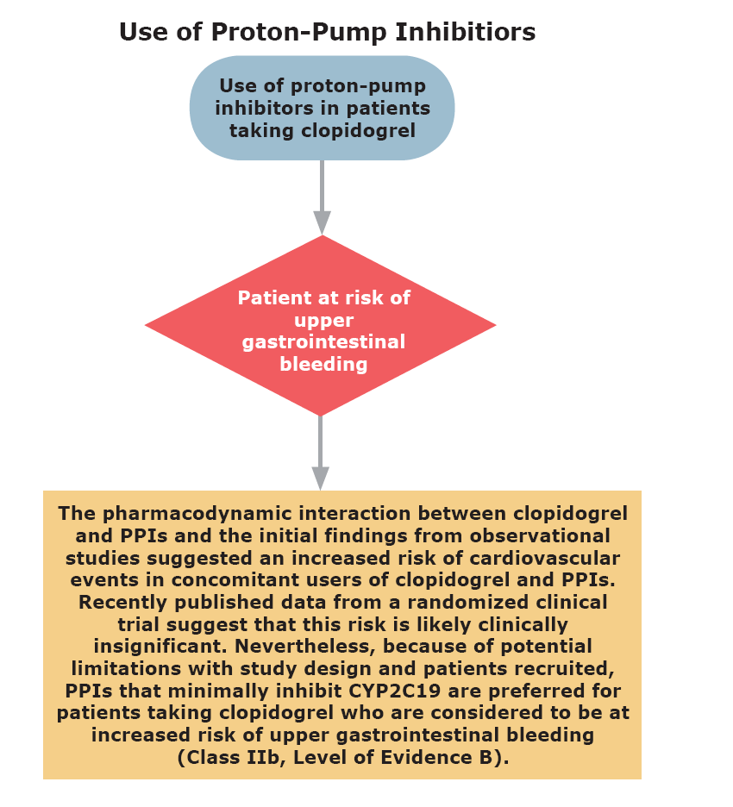
Interaction between clopidogrel and proton pump inhibitors: CCS 2010
Bell AD et al. Can J Cardiol. 2011 Mar-Apr;27(2):

