Slide 1
Canadian Cardiovascular Society Antiplatelet Guidelines
ASA – NSAID Drug/Drug Interaction
Working Group: Alan D. Bell, MD, CCFP; Wee Shian Chan, MD, FRCP
Notes:
1

Slide 2
Objectives
Interpret the Canadian Cardiovascular Society Guideline recommendations regarding the use of antiplatelet therapy in patients taking Non-Steroidal Anti-Inflammatory Drugs.
Recognize how traditional NSAID and Coxibs affect platelet function.
Identify the drug interaction between NSAID and ASA.
Evaluate the evidence regarding the clinical effect of the concomitant use of NSAID and ASA.
Notes:
Although surgery and other methods may be raised by participants, the purpose of the poll is to gauge the comfort of using NSAID and coxibs in patients with CAD on ASA
2

Slide 3
George
George, a 64 year old male is in your office complaining of L knee pain of 8 months duration.
History, physical exam and X-rays of the knee indicate a diagnosis of osteoarthritis.
He notes some improvement with the use of OTC ibuprofen.
He has a past history of:
  Coronary artery disease, with NSTEMI 3 years prior
  Hypertension
  Hyperlipidemia
  GERD
Current medications include:
  ASA 81 mg OD
  Atenolol 50 mg OD
  Ramipril 10 mg OD
  Hydrochlorothiazide 12.5 mg OD
  Atorvastatin 40 mg OD
  Omeprazole 20 mg OD

Slide 4
Polling question
Other than physical measures and intra-articular steroid, how would you manage George’s knee OA pain?
Analgesics followed by traditional NSAID if required
Analgesics followed by Coxib if required
Analgesics only. I would avoid the use of traditional NSAID and Coxibs.
Notes:
Although surgery and other methods may be raised by participants, the purpose of the poll is to gauge the comfort of using NSAID and coxibs in patients with CAD on ASA
4

Slide 5
Prostaglandin biosynthesis
Laminar Shear Stress
(+)
Arachidonic Acid
Inflammatory cytokines
(+)
COX-1
(constitutive)
COX-2
(inducible)
COX-2 specific inhibitors
(–)
(–)
Homeostatic PG
NSAIDs
Inflammatory PG
Stomach
Intestine
Kidney
Platelet
Prostacyclin
Arthritis
Anti-thrombosis
Notes:
5

Slide 6
Arachidonic Acid
Although it has a short serum half life, ASA forms permanent covalent bond to platelet COX-1 halting thromboxane synthesis.
ASA
X
Platelet COX-1
X
X
Thromboxane
Traditional NSAID
Forms weak temporary bond to platelet COX-1 blocking ASA binding
Notes:
6

Slide 7
Arachidonic Acid
Platelet COX-1
Platelet activation
Thromboxane
When serum levels of traditional NSAID fall, platelet becomes active again.
Notes:
7

Slide 8
ASA NSAID platelet interaction
Inhibition of Platelet COX-1 by ASA Measured 24 Hours Post ASA
Pre-treatment
with diclofenac
or rofecoxib
ASA
Alone
Pre-treatment
with ibuprofen
0
Thromboxane B₂
% inhibition
Platelet
aggregation
100
Catella-Lawson F et al. N Engl J Med 2001;345:1809-17.
Notes:
8
Key Discussion Points:
In this study, the following combinations of drugs were administered for six days: ASA (81 mg every morning) two hours before ibuprofen (400 mg every morning) and the same medications in the reverse order; ASA two hours before acetaminophen (1,000 mg every morning) and the same medications in the reverse order; ASA two hours before rofecoxib (25 mg every morning) and the same medications in the reverse order; enteric-coated ASA two hours before ibuprofen (400 mg three times a day); and enteric-coated ASA two hours before delayed-release diclofenac (75 mg twice daily).
Serum thromboxane B₂ levels (an index of COX-1 activity in platelets) and platelet aggregation were maximally inhibited 24 hours after the administration of ASA on day 6 in the subjects who took ASA before a single daily dose of any other drug, as well as in those who took rofecoxib or acetaminophen before taking ASA. In contrast, inhibition of serum thromboxane B₂ formation and platelet aggregation by ASA was blocked when a single daily dose of ibuprofen was given before ASA, as well as when multiple daily doses of ibuprofen were given.
The concomitant administration of rofecoxib, acetaminophen or diclofenac did not affect the pharmacodynamics of ASA.
References:
Catella-Lawson F et al. Cyclooxygenase inhibitors and the antiplatelet effects of aspirin. N Engl J Med. 2001; 345(25):1809-1817.

Slide 9
ASA NSAID Interaction
Observational study
n=7,107 post CV event discharge
Ibuprofen users had
a significantly increased
risk of CV and all-cause
mortality compared
to ASA alone
100
90
80
70
60
50
Proportion surviving (%)
40
30
ASA alone
ASA + diclofenac
ASA + other NSAIDs
ASA + ibuprofen
20
10
p=0.03 vs. ASA
0
0
1
2
3
4
5
6
7
8
9
Follow-up (year)
MacDonald TM, Wei L. Lancet 2003;361:573-4.
Notes:
Key Discussion Points:
The results of an observational study confirm the clinical relevance
of this interaction.
When 7,107 patients prescribed ASA after first hospital admission for CVD were compared with patients using ASA alone, patients taking ASA plus ibuprofen had:
⬆ risk of all-cause mortality (adjusted HR, 1.93; 95% CI, 1.30 to 2.87)
⬆ risk of CV mortality (adjusted HR, 1.73; 95% CI, 1.05 to 2.84)
These observations are in full agreement with the experimental data from
Catella-Lawson et al’s study. One message from this observation is that patients requiring ASA for cardioprevention should not use ibuprofen. This is of critical importance given the fact that ibuprofen is easily available over the counter.
Note that this is a retrospective analysis and has all the weaknesses of
a retrospective cohort analysis.
Reference:
MacDonald TM, Wei L. Effect of ibuprofen on cardioprotective effect of aspirin. Lancet 2003;
361(9357):573-574.

Slide 10
Aspirin, NSAIDs and risk of myocardial infarction
USPHS, n=22,071
Follow up 60 months
Placebo vs ASA 325mg q2d (44% MI reduction)
NSAID use:
  None
  1-59 days per year
  > 60 days per year
Circulation. 2003;108:1191-1195
Notes:
Background—There is clear evidence from numerous randomized trials and their meta-analyses that aspirin reduces risks
of first myocardial infarction (MI). Recent data also suggest that other nonsteroidal anti-inflammatory drugs (NSAIDs)
may interfere with this benefit of aspirin.
Methods and Results—We performed subgroup analysis from a 5-year randomized, double-blind, placebo-controlled trial
of 325 mg aspirin on alternate days among 22 071 apparently healthy US male physicians with prospective observational
data on use of NSAIDs. A total of 378 MIs were confirmed, 139 in the aspirin group and 239 in the placebo group.
Aspirin conferred a statistical extreme (P0.00001) 44% reduction in risk of first MI. Among participants randomized
to aspirin, use of NSAIDs on 1 to 59 d/y was not associated with MI (multivariable adjusted relative risk [RR], 1.21;
95% confidence interval [CI], 0.78 to 1.87), whereas the use of NSAIDs on 60 d/y was associated with MI (RR, 2.86;
95% CI, 1.25 to 6.56) compared with no use of NSAIDs. In the placebo group, the RRs for MI across the same
categories of NSAID use were 1.14 (95% CI, 0.81 to 1.60) and 0.21 (95% CI, 0.03 to 1.48).
Conclusions—These data suggest that regular but not intermittent use of NSAIDs inhibits the clinical benefits of aspirin.
Chance, bias, and confounding remain plausible alternative explanations, despite the prospective design and adjustment
for covariates. Nonetheless, we believe the most plausible interpretation of the data to be that regular but not intermittent
use of NSAIDs inhibits the clinical benefit of aspirin on first MI. (Circulation. 2003;108:1191-1195.)
10

Slide 11
MI and NSAID use in ASA users from USPHS
GROUP NSAID USE | ASA | PLACEBO
None | 1 | 1
< 59 days | 1.18 NS | 1.17 NS
> 60 days | 2.81 P<0.05 | 0.21 NS
Circulation. 2003;108:1191-1195
Notes:
Background—There is clear evidence from numerous randomized trials and their meta-analyses that aspirin reduces risks
of first myocardial infarction (MI). Recent data also suggest that other nonsteroidal anti-inflammatory drugs (NSAIDs)
may interfere with this benefit of aspirin.
Methods and Results—We performed subgroup analysis from a 5-year randomized, double-blind, placebo-controlled trial
of 325 mg aspirin on alternate days among 22 071 apparently healthy US male physicians with prospective observational
data on use of NSAIDs. A total of 378 MIs were confirmed, 139 in the aspirin group and 239 in the placebo group.
Aspirin conferred a statistical extreme (P0.00001) 44% reduction in risk of first MI. Among participants randomized
to aspirin, use of NSAIDs on 1 to 59 d/y was not associated with MI (multivariable adjusted relative risk [RR], 1.21;
95% confidence interval [CI], 0.78 to 1.87), whereas the use of NSAIDs on 60 d/y was associated with MI (RR, 2.86;
95% CI, 1.25 to 6.56) compared with no use of NSAIDs. In the placebo group, the RRs for MI across the same
categories of NSAID use were 1.14 (95% CI, 0.81 to 1.60) and 0.21 (95% CI, 0.03 to 1.48).
Conclusions—These data suggest that regular but not intermittent use of NSAIDs inhibits the clinical benefits of aspirin.
Chance, bias, and confounding remain plausible alternative explanations, despite the prospective design and adjustment
for covariates. Nonetheless, we believe the most plausible interpretation of the data to be that regular but not intermittent
use of NSAIDs inhibits the clinical benefit of aspirin on first MI. (Circulation. 2003;108:1191-1195.)
11

Slide 12
TARGET
Composite cardiovascular outcomes in the ibuprofen sub-study of high-risk patients
Composite cardiovascular outcomes* | Lumiracoxib (%) | Ibuprofen (%) | p
No aspirin | 0.92 | 0.80 | NS
Low-dose aspirin | 0.25 | 2.14 | 0.03
Overall | 0.56 | 1.61 | 0.05
*Composite end point includes nonfatal and silent MI, stroke, and cardiovascular death .
Total TARGET population n=18,325
High C/V Risk population n=3042
Ibuprofen substudy n=1343
Naproxen substudy n=1699
Ann Rheum Dis. 2007 Jun;66(6):764-70
Notes:
12
Abstract
Background
Evidence suggests that both selective cyclooxygenase (COX)‐2 inhibitors and non‐selective non‐steroidal anti‐inflammatory drugs (NSAIDs) increase the risk of cardiovascular events. However, evidence from prospective studies of currently available COX‐2 inhibitors and non‐selective NSAIDs is lacking in patients at high cardiovascular risk who are taking aspirin.
Objective
To determine the cardiovascular outcomes in high risk patients with osteoarthritis treated with ibuprofen, naproxen or lumiracoxib.
Methods
The Therapeutic Arthritis Research and Gastrointestinal Event Trial (TARGET) of 18325 patients with osteoarthritis comprised two parallel substudies, comparing lumiracoxib (COX‐2 inhibitor) with either ibuprofen or naproxen. A post hoc analysis by baseline cardiovascular risk, treatment assignment, and low‐dose aspirin use was performed. The primary composite end point was cardiovascular mortality, non‐fatal myocardial infarction, and stroke at 1 year; a secondary end point was the development of congestive heart failure (CHF).
Results
In high risk patients among aspirin users, patients in the ibuprofen substudy had more primary events with ibuprofen than lumiracoxib (2.14% vs 0.25%, p=0.038), whereas in the naproxen substudy rates were similar for naproxen and lumiracoxib (1.58% vs 1.48%, p=0.899). High risk patients not taking aspirin had fewer primary events with naproxen than with lumiracoxib (0% vs 1.57%, p=0.027), but not for ibuprofen versus lumiracoxib (0.92% vs 0.80%, p=0.920). Overall, CHF developed more often with ibuprofen than lumiracoxib (1.28% vs 0.14%; p=0.031), whereas no difference existed between naproxen and lumiracoxib.
Conclusions
These data suggest that ibuprofen may confer an increased risk of thrombotic and CHF events relative to lumiracoxib among aspirin users at high cardiovascular risk. The study indicates that naproxen may be associated with lower risk relative to lumiracoxib among non‐aspirin users. This study is subject to inherent limitations, and therefore should be interpreted as a hypothesis‐generating study.

Slide 13
TARGET
Composite cardiovascular outcomes in the naproxen sub-study of high-risk patients
Composite cardiovascular outcomes* | Lumiracoxib (%) | Naproxen (%) | p
No aspirin | 1.57 | 0 | 0.02
Low-dose aspirin | 1.48 | 1.58 | NS
Overall | 1.51 | 0.95 | NS
*Composite end point includes nonfatal and silent MI, stroke, and cardiovascular death .
Total TARGET population n=18,325
High C/V Risk population n=3042
Ibuprofen substudy n=1343
Naproxen substudy n=1699
Ann Rheum Dis. 2007 Jun;66(6):764-70
Notes:
13
Abstract
Background
Evidence suggests that both selective cyclooxygenase (COX)‐2 inhibitors and non‐selective non‐steroidal anti‐inflammatory drugs (NSAIDs) increase the risk of cardiovascular events. However, evidence from prospective studies of currently available COX‐2 inhibitors and non‐selective NSAIDs is lacking in patients at high cardiovascular risk who are taking aspirin.
Objective
To determine the cardiovascular outcomes in high risk patients with osteoarthritis treated with ibuprofen, naproxen or lumiracoxib.
Methods
The Therapeutic Arthritis Research and Gastrointestinal Event Trial (TARGET) of 18325 patients with osteoarthritis comprised two parallel substudies, comparing lumiracoxib (COX‐2 inhibitor) with either ibuprofen or naproxen. A post hoc analysis by baseline cardiovascular risk, treatment assignment, and low‐dose aspirin use was performed. The primary composite end point was cardiovascular mortality, non‐fatal myocardial infarction, and stroke at 1 year; a secondary end point was the development of congestive heart failure (CHF).
Results
In high risk patients among aspirin users, patients in the ibuprofen substudy had more primary events with ibuprofen than lumiracoxib (2.14% vs 0.25%, p=0.038), whereas in the naproxen substudy rates were similar for naproxen and lumiracoxib (1.58% vs 1.48%, p=0.899). High risk patients not taking aspirin had fewer primary events with naproxen than with lumiracoxib (0% vs 1.57%, p=0.027), but not for ibuprofen versus lumiracoxib (0.92% vs 0.80%, p=0.920). Overall, CHF developed more often with ibuprofen than lumiracoxib (1.28% vs 0.14%; p=0.031), whereas no difference existed between naproxen and lumiracoxib.
Conclusions
These data suggest that ibuprofen may confer an increased risk of thrombotic and CHF events relative to lumiracoxib among aspirin users at high cardiovascular risk. The study indicates that naproxen may be associated with lower risk relative to lumiracoxib among non‐aspirin users. This study is subject to inherent limitations, and therefore should be interpreted as a hypothesis‐generating study.

Slide 14
Naproxen effect
Like other traditional NSAIDs, naproxen competes with ASA to bind COX-1.
Although it has a stronger antiplatelet effect than other NSAID it remains a reversible inhibitor.
Clinical benefit of naproxen in prevention of CV events is not established.
May be the best choice if a traditional NSAID is absolutely needed.
Notes:
OBJECTIVES We investigated the occurrence of pharmacodynamic interaction between low-dose aspirin
and naproxen.
BACKGROUND The uncertainty of cardioprotection by naproxen has encouraged its combination with aspirin
in patients with arthritis and cardiovascular disease.
METHODS The incubation of washed platelets with naproxen for 5 min before the addition of aspirin
reduced the irreversible inhibition of thromboxane (TX)B2 production by aspirin. The
pharmacodynamic interaction between the two drugs was then investigated in four healthy
volunteers who received aspirin (100 mg daily) for 6 days and then the combination of aspirin
and naproxen for further 6 days: aspirin 2 h before naproxen (500 mg, twice-daily dosing).
After 14 days of washout, naproxen was given 2 h before aspirin for further 6 days.
RESULTS The inhibition of serum TXB2 production (index of platelet cyclooxygenase [COX]-1
activity) and platelet aggregation ex vivo and urinary 11-dehydro-TXB2 levels (index of TXB2
biosynthesis in vivo) by aspirin alone (99 0.2%, 95 0.6%, and 81 4%, respectively) was
not significantly altered by the co-administration of naproxen, given either 2 h after aspirin
or in reverse order. In a second study, the concurrent administration of a single dose of aspirin
and naproxen did not affect platelet TXB2 production and aggregation at 1 h after dosing,
when aspirin alone causes maximal inhibitory effect. Moreover, the rapid recovery of platelet
COX-1 activity and function supports the occurrence of a pharmacodynamic interaction
between naproxen and aspirin.
CONCLUSIONS Naproxen interfered with the inhibitory effect of aspirin on platelet COX-1 activity and
function. This pharmacodynamic interaction might undermine the sustained inhibition of
platelet COX-1 that is necessary for aspirin’s cardioprotective effects. (J Am Coll Cardiol
2005;45:1295–301) © 2005 by the American College of Cardiology Foundation
14

Slide 15
Do Coxibs interfere with ASA cardioprotection?
A new cyclooxygenase-2 inhibitor, rofecoxib (VIOXX), did not alter the antiplatelet effects of low-dose aspirin in healthy volunteers. [J Clin Pharmacol. 2000] PMID: 11185674
Celecoxib, ibuprofen, and the antiplatelet effect of aspirin in patients with osteoarthritis and ischemic heart disease. [Clin Pharmacol Ther. 2006] PMID: 16952493
The COX-2 selective inhibitor, valdecoxib, does not impair platelet function in the elderly: results of a randomized, controlled trial. [J Clin Pharmacol. 2003] PMID: 12751271
Lumiracoxib does not affect the ex vivo antiplatelet aggregation activity of low-dose aspirin in healthy subjects. [J Clin Pharmacol. 2005] PMID: 16172182
Celecoxib does not affect the antiplatelet activity of aspirin in healthy volunteers. [J Clin Pharmacol. 2002]

Slide 16
Risk estimate for hospitalization for MI for NSAID Users compared with non-users
Case control study of 10,280 MI events
Drug | Adjusted Relative Risk | 95% CI
Rofecoxib | 1.80 | 1.47-2.21
Celecoxib | 1.25 | 0.97-1.62
COX-2 “selective” agents* | 1.45 | 1.09-1.93
Naproxen | 1.50 | 0.99-2.29
Other NSAIDs | 1.68 | 1.52-1.85
High-dose ASA | 1.34 | 1.18-1.52
*Etodolac, meloxicam, nabumatone
Arch Intern Med. 2005;165:978-984.

Slide 17
Risk of AMI and SCD with current use of COX-2 celective and NS-NSAIDs
Case-control observational study (1.4 m from Kaiser data)
P<0.01
3.5
3.15
(1.14-8.75)
3.0
2.5
P=0.06
2.0
P=0.01
P<0.01
P=0.005
1.69
(0.97-2.93)
Adjusted† Odds Ratio (95% CI)
1.18
(1.04-1.35)
1.29
(0.93-1.79)
1.16
(1.04-1.30)
1.33
(1.09-1.63)
1.5
1.09
(0.99-1.21)
1.00
(reference)
0.86
(0.69-1.07)
1.0
0.5
0.0
Control
(remote use)
Celecoxib
Ibuprofen
Naproxen
Rofecoxib
≤25 mg
Rofecoxib
>25 mg
Other
NSAIDs
Indomethacin
Diclofenac
†Adjusted for age, gender, health plan region, medical history, smoking, and medication use.
Lancet. 2005;365:475-81.
Notes:
17

Slide 18
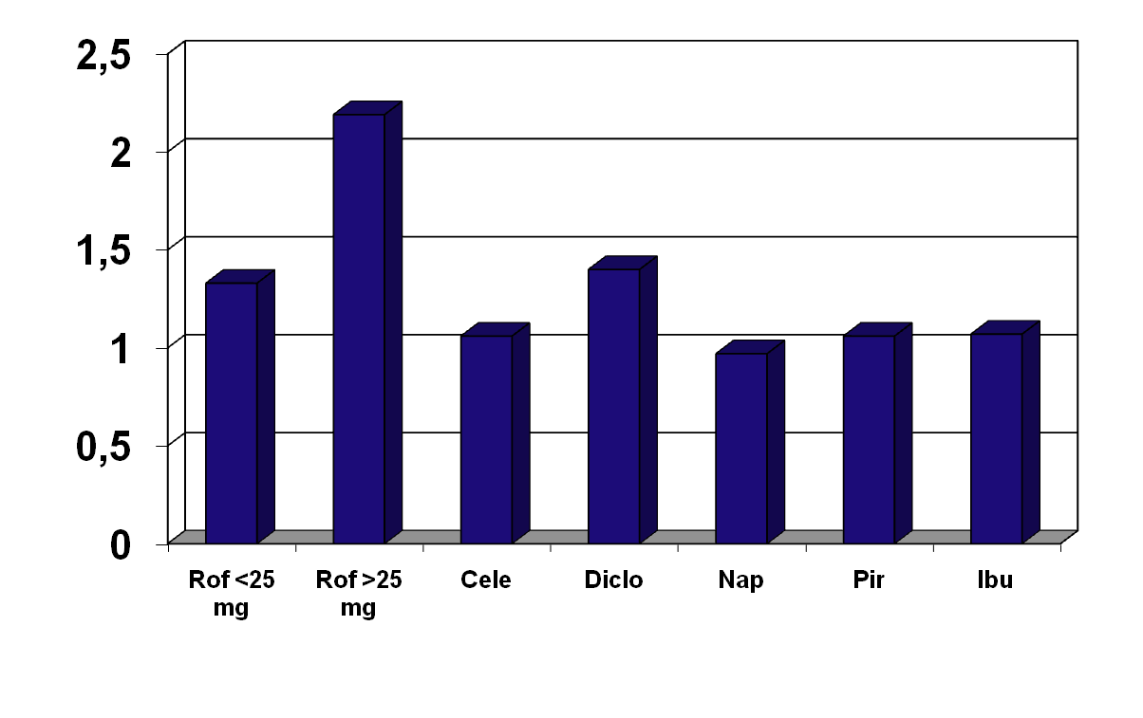
Systematic review of observational studies
*
*
*
RR of CV event
* p < 0.05
JAMA. 2006 Oct 4;296(13):1633-44
Notes:
Abstract
CONTEXT: Evidence that rofecoxib increases the risk of myocardial infarction has led to scrutiny of other nonsteroidal anti-inflammatory drugs (NSAIDs). Regulatory agencies have provided variable advice regarding the cardiovascular risks with older nonselective NSAIDs.
OBJECTIVE: To undertake a systematic review and meta-analysis of controlled observational studies to compare the risks of serious cardiovascular events with individual NSAIDs and cyclooxygenase 2 inhibitors.
DATA SOURCES: Searches were conducted of electronic databases (1985-2006), scientific meeting proceedings, epidemiological research Web sites, and bibliographies of eligible studies.
STUDY SELECTION: Eligible studies were of case-control or cohort design, reported on cardiovascular events (predominantly myocardial infarction) with cyclooxygenase 2 inhibitor, NSAID use, or both with nonuse/remote use of the drugs as the reference exposure. Of 7086 potentially eligible titles, 17 case-control and 6 cohort studies were included. Thirteen studies reported on cyclooxygenase 2 inhibitors, 23 on NSAIDs, and 13 on both groups of drugs.
DATA EXTRACTION: Two people independently extracted data and assessed study quality with disagreements resolved by consensus.
DATA SYNTHESIS: Data were combined using a random-effects model. A dose-related risk was evident with rofecoxib, summary relative risk with 25 mg/d or less, 1.33 (95% confidence interval [CI], 1.00-1.79) and 2.19 (95% CI, 1.64-2.91) with more than 25 mg/d. The risk was elevated during the first month of treatment. Celecoxib was not associated with an elevated risk of vascular occlusion, summary relative risk 1.06 (95% CI, 0.91-1.23). Among older nonselective drugs, diclofenac had the highest risk with a summary relative risk of 1.40 (95% CI, 1.16-1.70). The other drugs had summary relative risks close to 1: naproxen, 0.97 (95% CI, 0.87-1.07); piroxicam, 1.06 (95% CI, 0.70-1.59); and ibuprofen, 1.07 (95% CI, 0.97-1.18).
CONCLUSIONS: This review confirms the findings from randomized trials regarding the risk of cardiovascular events with rofecoxib and suggests that celecoxib in commonly used doses may not increase the risk, contradicts claims of a protective effect of naproxen, and raises serious questions about the safety of diclofenac, an older drug.
18

Slide 19
Meta analysis of randomized controlled trials of CV events in NSAID users
RR of CV event
BMJ. 2006 Jun 3;332(7553):1302-8.
Notes:
Abstract
OBJECTIVE: To assess the effects of selective cyclo-oxygenase-2 (COX 2) inhibitors and traditional non-steroidal anti-inflammatory drugs (NSAIDs) on the risk of vascular events.
DESIGN: Meta-analysis of published and unpublished tabular data from randomised trials, with indirect estimation of the effects of traditional NSAIDs.
DATA SOURCES: Medline and Embase (January 1966 to April 2005); Food and Drug Administration records; and data on file from Novartis, Pfizer, and Merck.
REVIEW METHODS: Eligible studies were randomised trials that included a comparison of a selective COX 2 inhibitor versus placebo or a selective COX 2 inhibitor versus a traditional NSAID, of at least four weeks' duration, with information on serious vascular events (defined as myocardial infarction, stroke, or vascular death). Individual investigators and manufacturers provided information on the number of patients randomised, numbers of vascular events, and the person time of follow-up for each randomised group.
RESULTS: In placebo comparisons, allocation to a selective COX 2 inhibitor was associated with a 42% relative increase in the incidence of serious vascular events (1.2%/year v 0.9%/year; rate ratio 1.42, 95% confidence interval 1.13 to 1.78; P = 0.003), with no significant heterogeneity among the different selective COX 2 inhibitors. This was chiefly attributable to an increased risk of myocardial infarction (0.6%/year v 0.3%/year; 1.86, 1.33 to 2.59; P = 0.0003), with little apparent difference in other vascular outcomes. Among trials of at least one year's duration (mean 2.7 years), the rate ratio for vascular events was 1.45 (1.12 to 1.89; P = 0.005). Overall, the incidence of serious vascular events was similar between a selective COX 2 inhibitor and any traditional NSAID (1.0%/year v 0.9%/year; 1.16, 0.97 to 1.38; P = 0.1). However, statistical heterogeneity (P = 0.001) was found between trials of a selective COX 2 inhibitor versus naproxen (1.57, 1.21 to 2.03) and of a selective COX 2 inhibitor versus non-naproxen NSAIDs (0.88, 0.69 to 1.12). The summary rate ratio for vascular events, compared with placebo, was 0.92 (0.67 to 1.26) for naproxen, 1.51 (0.96 to 2.37) for ibuprofen, and 1.63 (1.12 to 2.37) for diclofenac.
CONCLUSIONS: Selective COX 2 inhibitors are associated with a moderate increase in the risk of vascular events, as are high dose regimens of ibuprofen and diclofenac, but high dose naproxen is not associated with such an excess.
19

Slide 20
George
The patient is advised to avoid the use of OTC ibuprofen due to the well established adverse drug interaction with ASA.
He is advised to use acetaminophen in doses up to 2 – 4 grams/day.
If acetaminophen fails other interventions should be attempted including:
  Physiotherapy
  Intra-articular steroid
  Surgery
  Higher potency analgesics
If these fail or are inappropriate, a coxib may be tried with monitoring of BP, renal function and hemoglobin.

Slide 21
Interaction between Acetylsalicylic Acid and Nonsteroidal Anti-inflammatory Drugs
RECOMMENDATIONS
Working Group: Alan D. Bell, MD, CCFP
Wee Shian Chan, MD, FRCP
Notes:
21

Slide 22
Interaction between acetylsalicylic acid and nonsteroidal anti-inflammatory drugs
Individuals taking low-dose ASA (75-162 mg daily) for vascular protection should avoid the concomitant use of traditional (non-coxib) NSAIDs (Class III, Level C).
If a patient taking low-dose ASA (75-162 mg daily) for vascular protection requires an anti-inflammatory drug, specific cyclooxygenase-2 inhibitors (coxibs) should be chosen over traditional NSAIDS (Class IIb, Level C).
Both coxib and traditional NSAIDs increase cardiovascular risk and if possible, should be avoided in patients at risk of ischemic vascular events (Class III, Level A).
Notes:
22

Slide 23
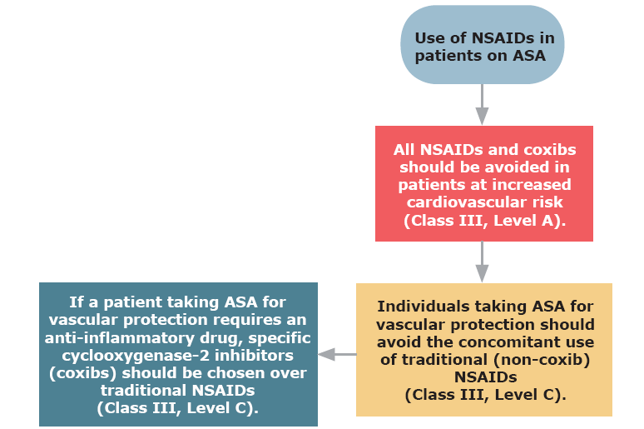
Interaction between acetylsalicylic acid and nonsteroidal anti-inflammatory drugs
Notes:
23

Slide 24
What if…
GEORGE HAS A CONTRAINDICATION FOR COXIBS, BUT NEEDS AN NSAID?

Slide 25
“What if”
If a traditional NSAID is required, some evidence suggests that naproxen may be the best choice due to it’s more potent antiplatelet effect.
It should be used in combination with gastroprotection either a PPI or misoprostol.
Blood pressure, hemoglobin and renal function should be monitored.

Slide 26

Notes:
26

