Slide 1
Introduction
Canadian Cardiovascular Society Antiplatelet Guidelines
Notes:
1

Slide 2
Objectives
Interpret the Canadian Cardiovascular Society Guideline for the Use of Antiplatelet Therapy in the Outpatient Setting recommendations regarding the use antiplatelet therapy for the prevention of vascular events.
Recognize the scope of the Guideline.
Interpret the Class of Recommendation and Level of Evidence used in the Guideline.
Evaluate the rationale, mandate and target audience for the development of the guidelines.
Acknowledge the contribution of the Canadian Cardiovascular Society, The Thrombosis Interest Group of Canada and the Authors to the development of the Guidelines

Slide 3
Thrombosis Interest
Group of Canada
Le Groupe de Travail
sur la Thrombose du Canada
www.tigc.org
B

Slide 4
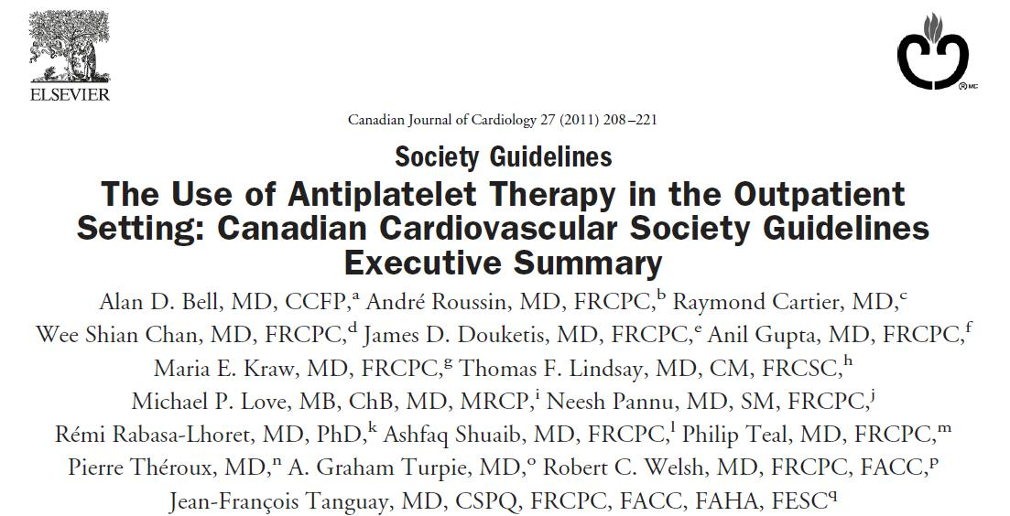
Notes:
The CCS antiplatelet committee was composed of national physicians, with specialties in interventional cardiology, general cardiology, thrombosis, internal medicine, primary care, CV surgery, peripheral vascular surgery, neurology, endocrinology, vascular medicine and nephrology. The Committee was chaired by Alan Bell and Jean-Francois Tanguay.

Slide 5
Rationale
Clinicians need clear guidance on the use of all risk prevention strategies to reduce the burden of ischemic vascular disease.
Lipids
Hypertension
Diabetes
Disease states
Coronary, Cerbrovascular, Peripheral Arterial




Notes:
One Canadian suffers a myocardial infarction every 7 minutes and a stroke every 10
Put another way ~ 20 individuals will suffer one of these life changing or life ending events during the 90 minutes we have to chat so nicely
Guidance in lipid management has been well provided by the CCS
Similarly risk reduction in hypertension has been lead by the Canadian Hypertension Education Program and diabetes management by the CDA
A number of disease based guidelines exist for coronary, cerebrovascular and peripheral arterial disease

Slide 6
Mandate/Target
Mandate
To provide an evidence based, treatment focused guideline for the use of antiplatelet drugs in the outpatient setting.
Target audience
All health care professionals who manage patients at risk of vascular ischemic events.
Notes:
A single comprehensive, authoritative place to find best practice in the use of antiplatelet agents

Slide 7
CCS Antiplatelet Guideline committee
Acute Coronary Syndrome/
Percutaneous Coronary Intervention
Jean FrancoisTanguay
Robert Welsh
Michael Love
Diabetes
Maria Kraw
Rémi Rabasa-Lhoret
Primary Prevention
Alan D Bell
James Douketis
Stable CAD
Anil Gupta
Pierre Theroux
Special Topics
Heart Failure
Alan D Bell, James Douketis
Chronic Kidney Disease
Neesh Pannu, Alan D Bell
Pregnancy and Lactation
Wee Shian Chan
Surgical /BleedingManagement
James Douketis, Graham Turpie
Antiplatelet agents + Warfarin
James Douketis, Graham Turpie
Antiplatelet Drug Interactions
Alan D Bell, Wee Shian Chan
Cerebrovascular disease
Ashfaq Shuaib
Phil Teal
Peripheral Arterial Disease
Andre Roussin
Thomas Lindsay
Surgical Vascular Disease
Raymond Cartier
Thomas Lindsay

Slide 8
Class of recommendation | Level of evidence
I: Evidence and/or general agreement that a given diagnostic procedure/treatment is beneficial, useful and effective | A: Data derived from multiple randomized clinical trials or meta-analyses
IIa: Conflicting evidence and/or a divergence of opinion about the usefulness/efficacy of the treatment with the weight of evidence in favour | B: Data derived from a single randomized clinical trial or large nonrandomized studies
IIb: Conflicting evidence and/or a divergence of opinion about the usefulness/efficacy of the treatment with the usefulness/efficacy less well established | C: Consensus of opinion by experts and/or small studies, retrospective studies, and registries
III: Evidence that the treatment is not useful and in some cases may be harmful

Slide 9
Educational modules
Use of antiplatelet agents in:
ACS and PCI
Stable CAD
Cerebrovascular Disease
Peripheral Arterial Disease
Primary Prevention
Diabetes
Heart Failure
Chronic Kidney Disease
Concomitant PPI
Concomitant NSAID
Concomitant Warfarin
Minor Bleeding
Pregnancy and Lactation
Perioperative Management
Guideline Pearls

