Slide 1
Canadian Cardiovascular Society
Antiplatelet Guidelines
HEART FAILURE
Working Group: Alan D. Bell, MD, CCFP; James D. Douketis, MD, FRCP
Notes:
1

Slide 2
Objectives
Interpret the Canadian Cardiovascular Society Guideline recommendations regarding the use of antiplatelet therapy in patients with heart failure.
Distinguish the difference in the use of antiplatelet agents in patients with ischemic versus non-ischemic heart failure.
Evaluate the clinical effects of the drug interaction between ASA and ACE inhibitors.
Evaluate the evidence supporting the use of antiplatelet agents in patients with heart failure.

Slide 3
Betty
Betty, a previously well 50 year old female, is in your office one week after discharge from a 10-day hospital admission. Her presentation at that time was worsening dyspnea, pedal edema and ascites.
Investigations revealed:
  EKG – Normal sinus rhythm, no ischemic changes
  Transthoracic/esophageal echocardiogram – Dilatation of all 4 chambers with global LV dysfunction, EF 26%, no evidence of intracardiac thrombus
  Cardiac catheterization – No evidence of coronary artery disease
  Hematology and biochemistry – Essentially normal, other than mild elevation of hepatic transaminases
Diagnosis : idiopathic dilated cardiomyopathy.
She was discharged on: Furosemide 40 mg bid, Ramipril 5 mg bid, Metoprolol 12.5 mg bid

Slide 4
Polling question
Do you feel Betty requires antiplatelet therapy?
Yes
No
I just don’t know and I admit it.

Slide 5
Potential benefits of antithrombotic therapy
Heart failure is associated with:
  Increased cardiac, arterial and venous stasis
  Abnormal ventricular wall motion
  CAD
  Increased serum fibrinogen and viscosity
  Reduced mobility
Resulting in pro-thrombotic state with rates of thromboembolic events of 2 – 3.5/100 pt yrs^{1,2}
1. Circulation 1993;87:VI94-101. 2. Am J Cardiol 1981;47:525-31.

Slide 6
Anticoagulation in heart failure
Early studies of anticoagulation in HF demonstrated benefit however these were confounded by subjects with atrial fibrillation and valvular disease.
This presentation will focus on antiplatelet therapy in the absence of these associated conditions.
Notes:
Cochrane Review
Last updated Dec 2005
Anticoagulation for heart failure in sinus rhythm
Lip GYH, Chung I
Background
Patients with chronic heart failure (heart failure) are at risk of thromboembolic events, including stroke, pulmonary embolism and peripheral arterial embolism, whilst coronary ischaemic events also contribute to the progression of heart failure. Long-term oral anticoagulation is established in certain groups, including patients with heart failure and atrial fibrillation but there is wide variation in the indications and use of oral anticoagulation in the broader heart failure population.
Objectives
To determine whether long-term oral anticoagulation reduces total deaths and/or major thromboembolic events in patients with heart failure.
Search strategy
We searched CENTRAL on The Cochrane Library (Issue 2 2005), MEDLINE (2000 to June 2005) and EMBASE (1998 to June 2005). Reference lists of papers and abstracts from national and international cardiovascular meetings were studied to identify unpublished studies. Relevant authors were contacted to obtain further data. No language restrictions were applied.
Selection criteria
Randomised controlled trials (RCTs) comparing oral anticoagulants with control or placebo in adults with heart failure, and with treatment duration at least one month. Non-randomised studies were also included for assessing side-effects. Inclusion decisions were duplicated, disagreement resolved by discussion or a third party.
Data collection and analysis
Data were collected by two reviewers independently and where appropriate data from RCTs were meta-analysed.
Main results
Cochrane Review last updated Dec 2005
Anticoagulation for heart failure in sinus rhythm
Lip GYH, Chung I
Background
Patients with chronic heart failure (heart failure) are at risk of thromboembolic events, including stroke, pulmonary embolism and peripheral arterial embolism, whilst coronary ischaemic events also contribute to the progression of heart failure. Long-term oral anticoagulation is established in certain groups, including patients with heart failure and atrial fibrillation but there is wide variation in the indications and use of oral anticoagulation in the broader heart failure population.
Objectives
To determine whether long-term oral anticoagulation reduces total deaths and/or major thromboembolic events in patients with heart failure.
Search strategy
We searched CENTRAL on The Cochrane Library (Issue 2 2005), MEDLINE (2000 to June 2005) and EMBASE (1998 to June 2005). Reference lists of papers and abstracts from national and international cardiovascular meetings were studied to identify unpublished studies. Relevant authors were contacted to obtain further data. No language restrictions were applied.
Selection criteria
Randomised controlled trials (RCTs) comparing oral anticoagulants with control or placebo in adults with heart failure, and with treatment duration at least one month. Non-randomised studies were also included for assessing side-effects. Inclusion decisions were duplicated, disagreement resolved by discussion or a third party.
Data collection and analysis
Data were collected by two reviewers independently and where appropriate data from RCTs were meta-analysed.
Main results
One recent pilot RCT comparing warfarin, aspirin and no antithrombotic therapy was identified, and one large RCT comparing warfarin and antiplatelet therapy (aspirin, clopidogrel) is awaiting evaluation. Three small prospective controlled studies of warfarin in heart failure were also identified, but were over 50 years old with methods not considered reliable by modern standards. Anticoagulation was more efficacious than control for the reduction of all cause death (odds ratio 0.64 95% CI 0.45 to 0.90) and the reduction of cardiovascular events (0.26 95% CI 0.16 to 0.43). Four retrospective non-randomised cohort analyses and four observational studies of oral anticoagulation in heart failure included differing populations of heart failure patients and reported contradictory results.
Authors' conclusions
Evidence from the RCTs and observational studies found a reduction in mortality and cardiovascular events with anticoagulants compared to control. This evidence needs to be interpreted with caution. Although oral anticoagulation is indicated in certain groups of patients with heart failure (e.g. atrial fibrillation), the data available does not support its routine use in heart failure patients who remain in sinus rhythm. Large randomised trials of warfarin in heart failure patients in sinus rhythm are completed or currently in progress and data from these will be useful addition to this topic.
6

Slide 7
WASH
Warfarin/Aspirin™ study in heart failure
Pilot study of 279 subjects with HF in sinus rhythm
Randomized to open label / blinded end point
  ASA 300 mg OD
  Warfarin (target INR 2.5)
  Placebo
Mean follow up 27 months

Slide 8
WASH
Primary composite end point of death, nonfatal MI or nonfatal stroke
No benefit demonstrated with ASA or Warfarin over placebo
Am Heart J 2004;148:157-64

Slide 9
WATCH
Warfarin and antiplatelet therapy in chronic heart failure
1587 subjects with HF (EF < 35%) in sinus rhythm
Most with ischemic heart disease
Randomized to open label Warfarin or double blinded ASA 162 mg OD or Clopidogrel 75 mg OD
Mean follow up 1.9 yrs
Notes:
9
Background—Chronic heart failure remains a major cause of mortality and morbidity. The role of antithrombotic therapy
in patients with chronic heart failure has long been debated. The objective of this study was to determine the optimal
antithrombotic agent for heart failure patients with reduced ejection fractions who are in sinus rhythm.
Methods and Results—This prospective, randomized clinical trial of open-label warfarin (target international normalized
ratio of 2.5 to 3.0) and double-blind treatment with either aspirin (162 mg once daily) or clopidogrel (75 mg once daily)
had a 30-month enrollment period and a minimum of 12 months of treatment. We enrolled 1587 men and women 18
years of age with symptomatic heart failure for at least 3 months who were in sinus rhythm and had left ventricular
ejection fraction of 35%. The primary outcome was the time to first occurrence of death, nonfatal myocardial
infarction, or nonfatal stroke. For the primary composite end point, the hazard ratios were as follows: for warfarin
versus aspirin, 0.98 (95% CI, 0.86 to 1.12; P0.77); for clopidogrel versus aspirin, 1.08 (95% CI, 0.83 to 1.40;
P0.57); and for warfarin versus clopidogrel, 0.89 (95% CI, 0.68 to 1.16; P0.39). Warfarin was associated with
fewer nonfatal strokes than aspirin or clopidogrel. Hospitalization for worsening heart failure occurred in 116
(22.2%), 97 (18.5%), and 89 (16.5%) patients treated with aspirin, clopidogrel, and warfarin, respectively (P0.02
for warfarin versus aspirin).
Conclusion—The primary outcome measure and the mortality data do not support the primary hypotheses that warfarin
is superior to aspirin and that clopidogrel is superior to aspirin. (Circulation. 2009;119:1616-1624.)

Slide 10
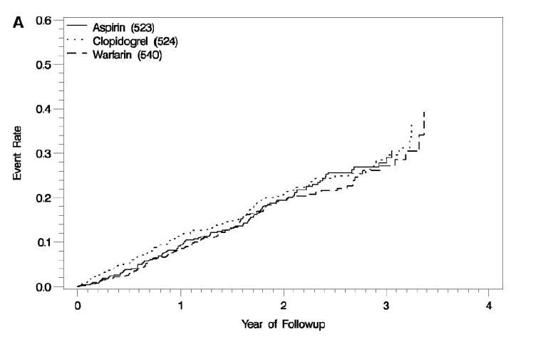
WATCH
Primary composite end point of death, nonfatal MI or nonfatal stroke
No differential benefit demonstrated with any of the antithrombotic therapies
Circulation 2009;119:1616-24

Slide 11
Adverse effects of ASA on heart failure
Prostaglandins, including prostacyclin and prostaglandin E1, are upregulated in HF and offer several benefits, including:
  Vasodilatory, natriuretic,and antiplatelet effects
Effect is further enhanced by ACE inhibition, which reduces bradykinin breakdown.
  Bradykinin, a potent vasodilator, acts by stimulating formation of vasodilatory prostaglandins such as prostacyclin.
ASA, like other nonsteroidal anti-inflammatory agents, inhibits the enzyme cyclooxygenase, which in turn decreases the production of prostaglandins.
J Am Geriatr Soc 2002;50:1293-6.

Slide 12
Adverse effects of ASA on HF
WASH¹ and WATCH² trials
  ASA was associated with increased hospitalization for HF in both trials.
SOLVD³
  Patients who received ASA had reduced survival benefits of from ACE inhibition.
McAlister et al⁴
  Cohort study of 7352 patients after discharge from 1st HF admission
  Users of ACE inhibitors were less likely to die or require readmission for heart failure (HR, 0.87; 95% CI, 0.79-0.96), even if they were using ASA (HR, 0.86; 95% CI, 0.77-0.95).
Teo et al⁵
  Systematic review of 22,060 ACEI HF trials
  Overall, ACE inhibitor therapy significantly reduced the relative risk of the composite outcome by 22% (P<0.0001), with clear risk reductions observed among both those receiving ASA at baseline (OR, 0.80; 99% CI, 0.73-0.88) and those who were not (OR, 0.71; 99% CI, 0.62-0.81; interaction P=0.07).
¹Am Heart J 2004;148:157-64 ²Circulation 2009;119:1616-24 ³N Engl J Med 1991;325:293‑302 ⁴Circulation 2006;113:2572-8
⁵Lancet 2002;360:1037-43.

Slide 13
Adverse effects of ASA on HF
PRO
McAlister et al⁴
  Cohort study of 7352 patients after discharge from 1st HF admission
  Users of ACE inhibitors were less likely to die or require readmission for heart failure regardless of ASA use
Teo et al⁵
  Systematic review of 22,060 ACEI HF trials
  Overall, ACE inhibitor therapy significantly reduced the relative risk of major clinical outcomes regardless of ASA use
CON
WASH¹ and WATCH² trials
  ASA was associated with increased hospitalization for HF in both trials
SOLVD³
  Patients who received ASA had reduced survival benefits from ACE inhibition
¹Am Heart J 2004;148:157-64 ²Circulation 2009;119:1616-24 ³N Engl J Med 1991;325:293‑302 ⁴Circulation 2006;113:2572-8
⁵Lancet 2002;360:1037-43.
Notes:
In both WASH¹⁷⁷ and the WATCH trial,¹⁷⁸ ASA was associated with increased hospitalization for HF, and the aforementioned meta-analysis¹⁷⁹ is consistent with a substantial increase in the rate of heart failure-related hospitalization for ASA versus warfarin (RR, 0.64; 95% CI, 0.48 to 0.85). In a post-hoc analysis of SOLVD (Studies Of Left Ventricular Dysfunction),¹⁸² patients who received ASA or dipyridamole at baseline did not receive the survival benefits of the ACE inhibitor enalapril.¹⁸⁵ A retrospective subgroup analysis of data from CONSENSUS II (COoperative New Scandinavian Enalapril Survival Study II)¹⁸⁶ demonstrated that the 6-month mortality rate of patients with acute MI who received enalapril and ASA was higher than the combined mortality rates of patients receiving enalapril or ASA alone.¹⁸⁵
Contrary to these results are those of McAlister and colleagues, who conducted a cohort study of patients discharged after a first hospitalization for heart failure.¹⁸⁷ In follow-up of 7,352 patients hospitalized for heart failure, ASA use in the absence of ACE inhibitor use did not increase the risk of death or readmission for heart failure (HR, 1.02; 95% CI, 0.91-1.16), even among patients without CAD (HR, 0.98; 95% CI, 0.78-1.22) or patients with renal dysfunction (HR, 1.13; 95% CI, 0.94 to 1.36). Users of ACE inhibitors were less likely to die or require readmission for heart failure (HR, 0.87; 95% CI, 0.79-0.96), even if they were using ASA (HR, 0.86; 95% CI, 0.77-0.95). There were no dose-dependent interactions between ASA and ACE inhibitors. Teo and colleagues undertook a systematic overview of data from 22,060 patients enrolled in 6 long-term randomised trials of ACE inhibitors to assess whether ASA altered the effects of ACE inhibitor therapy on the composite outcome of death, MI, stroke, hospital admission for HF, or revascularisation.¹⁸⁸ Overall, ACE inhibitor therapy significantly reduced the relative risk of the composite outcome by 22% (P<0.0001), with clear risk reductions observed among both those receiving ASA at baseline (OR, 0.80; 99% CI, 0.73-0.88) and those who were not (OR, 0.71; 99% CI, 0.62-0.81; interaction P=0.07).
NOTE: Referrences refer to bibliography of 2010 CCS Antiplatelet Guideline, full text version
13

Slide 14
Betty
Betty, has noted significant improvement in her non-ischemic heart failure on the current regimen of:
  ACE
  Diuretic
  Beta blocker
There is no evidence to support the addition of an antiplatelet agent to improve her overall prognosis.
She is advised to continue her current regimen in addition to a low salt diet.
In view of her low ejection fraction she is referred for consideration of ICD implantation.

Slide 15
Antiplatelet Therapy in Patients with
Heart Failure
RECOMMENDATIONS
Working Group: Alan D. Bell, MD, CCPF and James D. Douketis, MD, FRCP
Notes:
15

Slide 16
Antiplatelet therapy in patients with heart failure
For individuals with HF of ischemic etiology, antiplatelet therapy should be dictated by the underlying CAD (Class IIa, Level A).
For individuals with HF of nonischemic etiology, routine use of antiplatelet agents is not recommended (Class III, Level C).
Low-dose ASA (75-162 mg daily) and an ACE inhibitor in combination may be considered for patients with HF where an indication for both drugs exists (Class IIa, Level B).
Notes:
16

Slide 17
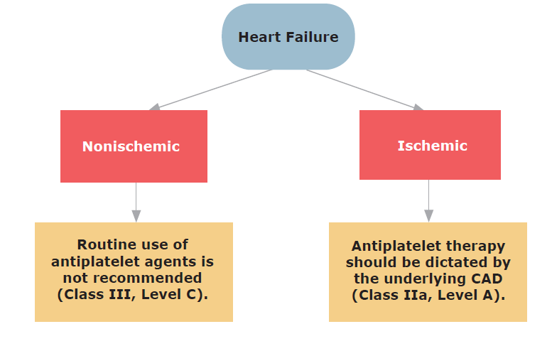
Antiplatelet therapy in patients with heart failure

Slide 18
“What if”
Betty has:
Heart failure on the basis of chronic coronary insufficiency?

Slide 19
“What if”
The benefit of antiplatelet therapy in ischemic coronary disease applies regardless of the presence of or absence of heart failure.
Any potential interaction between ACE inhibition and ASA is outweighed by the benefit of both treatments.

Slide 20
Antiplatelet therapy in patients with heart failure

Slide 21

Notes:
21

