Slide 1
Canadian Cardiovascular Society Antiplatelet Guidelines
USE OF ANTIPLATELET THERAPY IN PATIENTS WITH DIABETES
Working Group: Maria E. Wolfs, MD, FRCP; Rémi Rabasa-Lhoret, MD, PhD

Slide 2
Objectives
Interpret the Canadian Cardiovascular Society Guideline recommendations regarding the use of antiplatelet therapy in patients with diabetes.
Appropriately use antiplatelet agents for primary and secondary vascular prevention.
Recognize the difference in the effect of antiplatelet agents in patients with and without diabetes.
Evaluate the evidence regarding the use of antiplatelet agents in patients with diabetes.

Slide 3
Case
A 65 year old man suffering from type 2 diabetes for 15 years
Currently taking ramipril 10 mg OD, rosuvastatin 20 mg OD and metformin 500 mg TID
He has no history of CAD, CVD or PAD.
The physical examination is unremarkable.
He is concerned about not taking any ASA.

Slide 4
Antiplatelet management
What antiplatelet therapy, if any, would you suggest ?
No antiplatelet therapy
ASA 80 mg
Clopidogrel 75 mg
ASA 80 mg + Clopidogrel 75 mg

Slide 5
Mechanisms contributing to platelet dysfunction In patients with diabetes mellitus
HYPERGLYCAEMIA
DEFICIENT INSULIN
ACTION
ASSOCIATED
METABOLIC
CONDITIONS
OTHER CELLULAR
ABNORMALITIES
Increased P-selectin
expression
Impaired response to
NO and PGI₂
PLATELET
ENDOTHELIAL
DYSFUNCTION
Osmotic effect
Obesity
Activation of PKC
IRS-dependent factors:
Increased intracellular Ca⁺⁺ degranulation
Dyslipidemia
Decreased membrane fluidity by glycation of surface proteins
Inflammation
Increased platelet turnover
Increased intracellular Ca⁺⁺
Upregulation of P2Y₁₂ signalling
Oxydative stress
PKC
IRS-1
Ca⁺⁺
Increased P-selectin and
GP expression
H₂O
P2Y₁₂
ADP
ROS/NOS
Increased production of TF
Decreased NO and PGI₂ production
TF
NO
PGI₂
Endothelial cells
Ferreiro JL, Angiolllo DJ. Circulation 2011; 123: 798-813
Notes:
5
Figure 1. Mechanisms involved in platelet dysfunction in patients with DM. Several mechanisms contribute to platelet dysfunction in diabetes mellitus (DM) patients, including hyperglycemia, insulin deficiency, associated metabolic conditions, and other cellular abnor- malities. Hyperglycemia may increase platelet reactivity by inducing P-selectin (a surface adhesion protein) expression, glycating plate- let surface proteins (decreasing membrane fluidity and, thus, increasing platelet adhesion), and activating protein kinase C (PKC; a mediator of platelet activation) and as a result of the osmotic effect of glucose. Insulin deficiency also contributes to platelet dysfunc- tion by different mechanisms. Some have been suggested to be IRS dependent such as the increase in intracellular calcium concentra- tion, which leads to enhanced platelet degranulation and aggregation. Other factors associated with insulin resistance are not depen- dent on IRS, eg, the impaired response to NO and PGI2, which enhances platelet reactivity. Some metabolic conditions frequently associated with DM may play a role in platelet hyperreactivity, including obesity, dyslipidemia, and enhanced systemic inflammation. In addition to being associated with insulin resistance, obesity contributes to platelet dysfunction, mainly in terms of adhesion and activa- tion, with factors like augmented cytosolic calcium concentration and increased oxidative stress. Abnormalities of the lipid profile, especially hypertriglyceridemia, also affect platelet reactivity by different mechanisms, which include inducing endothelial dysfunction. The presence of endothelial dysfunction is another characteristic feature associated with DM, which enhances platelet reactivity by decreasing the production of NO and PGI2 and contributes to a prothrombotic state through increased production of tissue factor (TF). Other platelet abnormalities present in DM patients can enhance platelet adhesion and activation, including increased expression of surface proteins (P-selectin and GP IIb/IIIa), augmented cytosolic calcium concentration, upregulation of certain pathways like P2Y12 signaling, increased platelet turnover, and oxidative stress, which causes an impairment in platelet function as a result of overproduc- tion of reactive oxygen (ROS) and nitrogen species (NOS).

Slide 6
Diabetes in “primary prevention” Antiplatelet agents
The proportion of diabetic patients in primary prevention studies is SMALL.
PPP: 17%
HOT: 8%
PHS: 2%
BMD: 2%
TPT: 2%
< 20 %
Hayden M et al. U.S. Preventive Services Task Force. Ann Intern Med. 2002;136:161-172
Hayden M et al. U.S. Preventive Services Task Force. Ann Intern Med. 2002;136:161-172

Slide 7
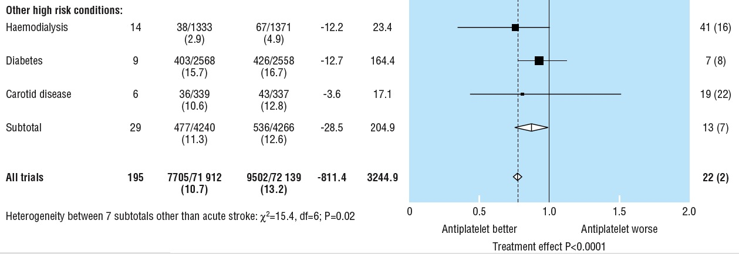
Diabetes in“primary prevention”: Antiplatelet agents “Antithrombotic Trialists Collaboration” 2002
% odds reduction
7%
Much of the new information comes from the early treatment diabetic retinopathy study, in which 3711 people with diabetes (and, generally, no history of myocardial infarction or stroke) were allocated to receive 650 mg aspirin dailyor placebo.
BMJ 2002, vol 24: 71-86

Slide 8
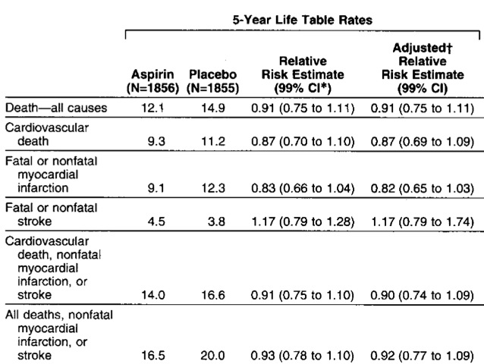
Early treatment diabetic retinopathy Study report 14
CAD baseline: 8%
ETDRS Investigators. JAMA 1992; 268: 1292-1300

Slide 9
ASA and diabetes: 2008 JPAD
Ogawa H et al. JAMA 2008 (300) 18; 2134-2141

Slide 10
ASA and diabetes: 2008 JPAD: Baseline clinical characteristics
Ogawa H et al. JAMA 2008 (300) 18; 2134-2141

Slide 11
ASA and diabetes: 2008 JPAD: Primary end point
Ogawa H et al. JAMA 2008 (300) 18; 2134-2141

Slide 12
ASA and diabetes: 2008 JPAD: Secondary end point
Ogawa H et al. JAMA 2008 (300) 18; 2134-2141

Slide 13
ASA and diabetes: 2008 JPAD: Primary end point if 65 years or older
Ogawa H et al. JAMA 2008 (300) 18; 2134-2141

Slide 14
ASA and diabetes: 2008 JPAD: Subgroup analysis
Ogawa H et al. JAMA 2008 (300) 18; 2134-2141

Slide 15
ASA and diabetes: 2008 POPADAD (with PAD)
Belch J et al. BMJ 2008

Slide 16
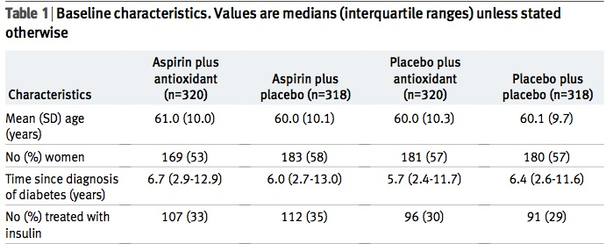
ASA and diabetes: 2008 POPADAD (with PAD)
Belch J et al. BMJ 2008

Slide 17
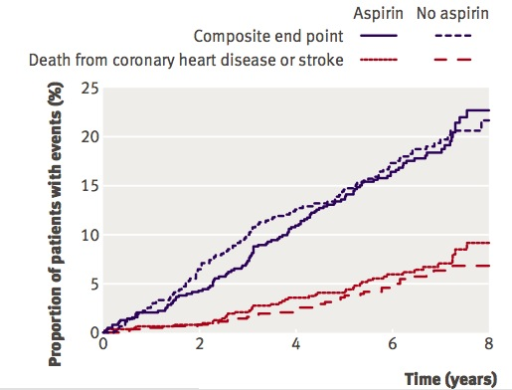
Asymptomatic “PAD” and diabetes ASA ineffective (but ABI 0.9…)
POPADAD Belch J et al. BMJ 2008

Slide 18
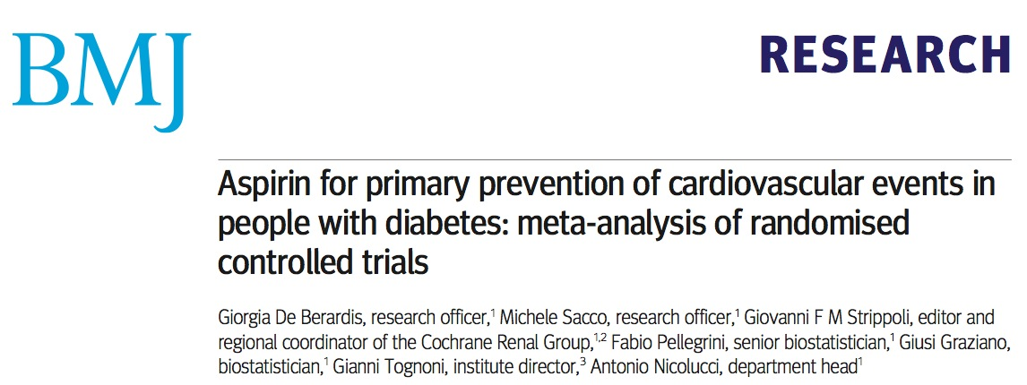
Meta-analysis in primary prevention 2009 ASA and diabetes
De Berardis G et al. BMJ 2009; 399

Slide 19
Meta-analysis in primary prevention 2009 ASA and diabetes: Studies, dose and Tx duration
De Berardis G et al. BMJ 2009; 399

Slide 20
Meta-analysis in primary prevention 2009 ASA and diabetes: Major CV events
De Berardis G et al. BMJ 2009; 399
De Berardis G et al. BMJ 2009; 399

Slide 21
Meta-analysis in primary prevention 2009 ASA and diabetes: MI
De Berardis G et al. BMJ 2009; 399

Slide 22
Meta-analysis in primary prevention 2009 ASA and diabetes: Stroke
De Berardis G et al. BMJ 2009; 399

Slide 23
Meta-analysis in primary prevention 2009 ASA and diabetes: CV death
De Berardis G et al. BMJ 2009; 399

Slide 24
Meta-analysis in primary prevention 2009 ASA and diabetes: Total mortality
De Berardis G et al. BMJ 2009; 399

Slide 25
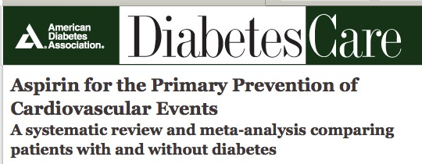
ASA and primary prevention Comparison diabetics and non-diabetics
Calvin AD et al. Diabetes Care 2009; 32: 2300-6

Slide 26
Antiplatelet therapy in patients with diabetes Primary prevention
There is currently no evidence to recommend routine use of ASA at any dose for the primary prevention of vascular ischemic events in patients with diabetes (Class III, Level A).
For patients with diabetes aged more than 40 years and at low risk for major bleeding, low-dose ASA (75-162 mg daily) may be considered for primary prevention in patients with other cardiovascular risk factors for which its benefits are established (Class IIb, Level B).

Slide 27
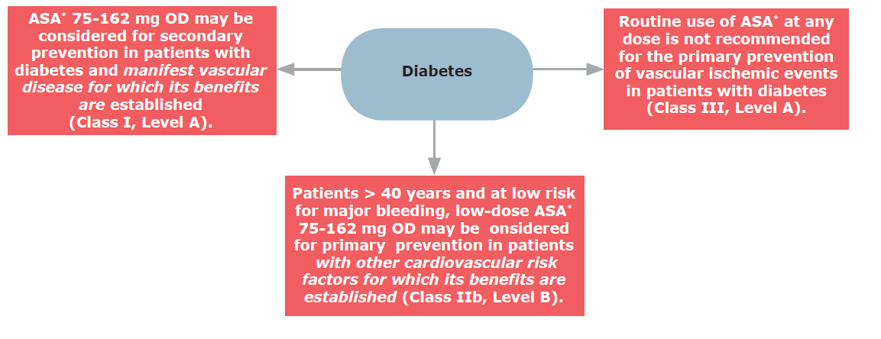
Antiplatelet therapy in patients with diabetes Primary prevention

Slide 28
Case
A 65 year old man suffering from type 2 diabetes for 15 years is currently taking ramipril 10 mg OD, rosuvastatin 20 mg OD and metformin 500 mg TID.
He has no history of CAD, CVD or PAD.
The physical examination is unremarkable.
He is concerned about not taking any ASA.

Slide 29
Antiplatelet management
What antiplatelet therapy, if any, would you suggest ?
No antiplatelet therapy
ASA 80 mg
Clopidogrel 75 mg
ASA 80 mg + Clopidogrel 75 mg

Slide 30
Diabetes and Secondary Prevention: CAPRIE 1996 Clopidogrel and ASA to reduce MI, IS and VD/ yr
High-risk Population | ASA | Clopidogrel
 | Event rate % | RRR (%) | ARR (%) | NNT
Total CAPRIE population | 5.83 | 8.7 | 0.51 | 196
Patients with PAD | 4.86 | 23.8 | 1.15 | 87
Patients with multivascular territory involvement | 10.74 | 22.7 | 2.39 | 42
Patients with a history of more than one ischemic event | NA | NA | NA | NA
Patients with diabetes | NA | NA | NA | NA
Patients with previous CABG | 9.1 | 36 | 3.3 | 30
Patients taking lipid-lowering agents | NA | NA | NA | NA

Slide 31
Diabetes and secondary prevention: CAPRIE 1996 Reduction MI, IS, VD and Hosp for isch or bleeding events/yr
High-risk Population | ASA | Clopidogrel
 | Event rate % | RRR (%) | ARR (%) | NNT
Total CAPRIE population | 13.67 | 8.1 | 1.1 | 90
Patients with PAD | NA | NA | NA | NA
Patients with multivascular territory involvement | NA | NA | NA | NA
Patients with a history of more than one ischemic event | 36.5 / 3yr | 10.7 | 3.9 | 26
Patients with diabetes | 17.7 | 11.8 | 2.1 | 48
Patients with previous CABG | 22.3 | 28.7 | 6.4 | 16
Patients taking lipid-lowering agents | 14.6 | 18.5 | 2.7 | 37

Slide 32
Clopidogrel vs ASA in secondary prevention CAPRIE: Diabetic patient subgroup
ASA
Clopidogrel
Events prevented / 1000 pts/yr
over aspirin
p = 0.032
25
38
20
21
21,5 %
9
17,7 %
15
17,7 %
Annual event rate (%)
15,6 %
10
12,7 %
11,8 %
5
0
non-diabetic
All diabetics
With insulin
Events : MI, IS, VD, hospitalization for ischemic event / bleeding
Bhatt et al. AJC 2002 Sep 15;90(6):625-8
Notes:
Diapositive 19
L’étude CAPRIE comptait 3 866 patients atteints de diabète sucré. En prenant soin de pas compter deux fois les mêmes événements, Bhatt et al. ont compilé les taux d’événements chez les patients diabétiques appartenant aux deux branches de traitement. Chez les 1 952 patients diabétiques qui avaient été assignés de façon aléatoire au groupe recevant l’AAS, le taux d’événements annuel s’élevait à 17,7 %, contre 15,6 % chez les 1 914 patients assignés au groupe recevant le clopidogrel (p = 0,042).
Les chercheurs ont trouvé que la réduction du risque absolu obtenue avec le clopidogrel était supérieure chez les patients diabétiques recevant de l’insuline : le taux d’événements a été de 21,5 % avec l’AAS, contre 17,7 % avec le clopidogrel (p = 0,106).
Dans un modèle multifactoriel incorporant les caractéristiques cliniques de départ, le traitement avec le clopidogrel a été associé de façon indépendante à une réduction du nombre de cas de mort vasculaire, d’IM, d’AVC et de réhospitalisation (pour saignements ou ischémie) chez des patients diabétiques (p = 0,032). Ceci équivaut à la prévention de quelque 38 accidents ischémiques importants de plus par 1 000 années-patients si le clopidogrel est utilisé au lieu de l’AAS.
Référence
Bhatt et al. J Am Coll Cardiol, 2000, 35(Suppl. A), p. 409.
Bhatt DL, Marso SP, Hirsch AT, et al.
Amplified benefit of clopidogrel versus aspirin in patients with diabetes mellitus.
Am J Cardiol (United States), Sep 15 2002, 90(6) p625-8
Following an ischemic event, diabetic patients have a higher rate of recurrence than patients without diabetes mellitus. 1–6 Patients with diabetes but without prior myocardial infarction (MI) have a risk of MI during follow-up that is similar to that of nondiabetic patients who have already had a prior MI. 7 The mechanisms for the heightened risk are multifactorial. 8 However, a greater thrombotic predisposition exists with diabetes, which is largely mediated by platelets. 9–13 Aspirin has been shown to have a modest benefit over placebo in reducing vascular events in patients with diabetes mellitus. 14 The intravenous antiplatelet agent abciximab has been found to be particularly efficacious in patients with diabetes who are undergoing percutaneous revascularization. 15,16 Platelet glycoprotein IIb/IIIa inhibitors, when used for acute coronary syndromes, appear to have their greatest benefit in diabetic patients. 17 The Clopidogrel versus Aspirin in Patients at Risk of Ischemic Events (CAPRIE) study randomized 19,185 patients with recent ischemic stroke, recent MI, or established peripheral arterial disease to the adenosine diphosphate (ADP) receptor antagonist clopidogrel or to aspirin. 18 An 8.7% relative risk reduction was seen in vascular death, MI, or ischemic stroke with use of clopidogrel. A subsequent analysis of CAPRIE found an additional 8.7% reduction in rehospitalization for ischemia or bleeding. 19
Le traitement des patients à haut risque

Slide 33
CHARISMA 2006: Clopidogrel + ASA vs ASA only
Primary endpoint (MI, IS and VD) by subgroups
Characteristic Hazard Ratio and 95% CI
Diabetes Yes
No
Hypertension Yes
No
Hypercholesterolemia Yes
No
History of CABG Yes
No
History of PCI Yes
No
History of MI Yes
No
History of Stroke Yes
No
RF Only (Asymptomatic)
Documented AT (Symptomatic)
RF= Risk Factors
AT= Atherothrombosis
0.5
1
1.5
Clopidogrel Better
Placebo Better
Adapted from Bhatt DL, Fox KA, Hacke W, et al. 2006, in press.
Notes:
There were several pre-specified subgroup analyses:
There were no significant interactions for the primary endpoint in patients with diabetes, hypertension, hypercholesterolemia, history of CABG, history of PCI, history of MI, or history of stroke.
The was a significant interaction (p=0.045) found when examining the differential treatment response in patients with risk factors only (asymptomatic) and patients with documented atherothrombosis (symptomatic)
Reference
Bhatt DL, Fox KA, Hacke W, et al. 2006, in press..

Slide 34
Antiplatelet therapy in patients with diabetes Secondary prevention
Low-dose ASA therapy (75-162 mg daily) may be considered for secondary prevention in patients with diabetes and manifest vascular disease for which its benefits are established (Class I, Level A).
Clopidogrel 75 mg daily may be considered for secondary prevention in patients with diabetes who are unable to tolerate ASA (Class IIa, Level B).

Slide 35
Antiplatelet therapy in patients with diabetes Secondary prevention

Slide 36
“What if” ACS
The same 65 year old man comes back to your office after a hospitalization for ACS with two coated stents implanted.
He is mixed up about his antiplatelet regimen and understands that ASA is important.
How would that change your choice of antiplatelet therapy?

Slide 37
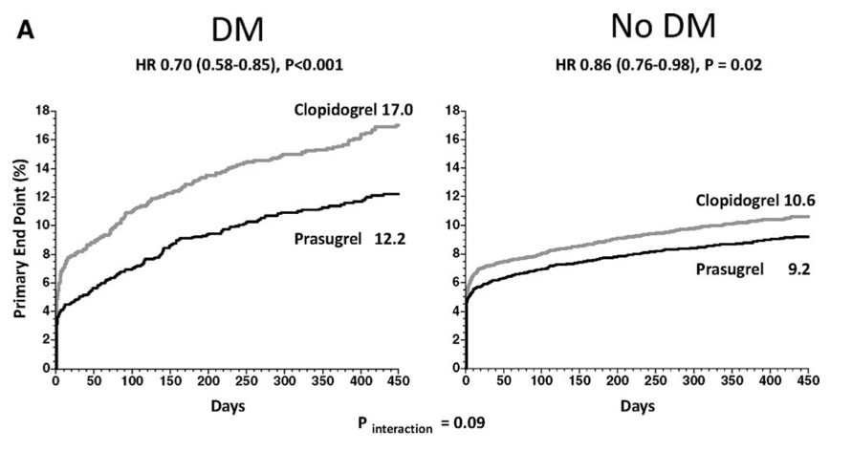
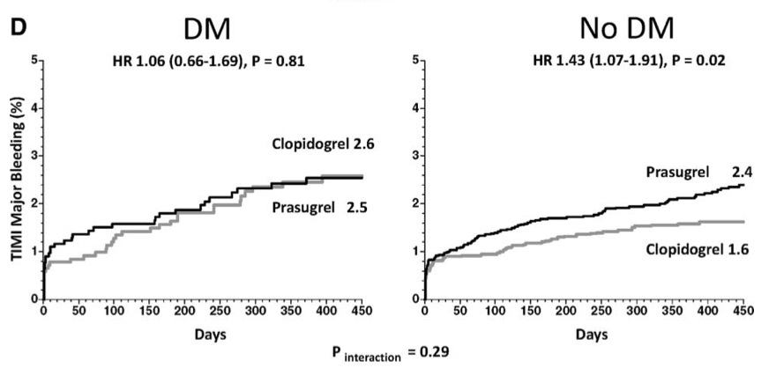
Kaplan–Meier curves for prasugrel versus clopidogrel Patients with DM vs no DM from the TRITON-TIMI 38 trial
DM
No DM
Primary End Point
DM
No DM
TIMI Major Bleeding

Slide 38
Kaplan–Meier curves for prasugrel versus clopidogrel Patients with diabetes mellitus from the TRITON-TIMI 38 trial
18
n=3,146
Clopidogrel
17.0
16
Primary Efficacy
End Point
14
HR 0.70; p<0.001
End Point (%)
12
12.2
10
Prasugrel
8
6
4
Timi Major
Non-CABG Bleeds
Clopidogrel
2.6
2
Prasugrel
2.5
0
0
30
60
90
180
270
360
450
Days
Wiviott SD et al. Circulation 2008;118(16):1626–36

Slide 39
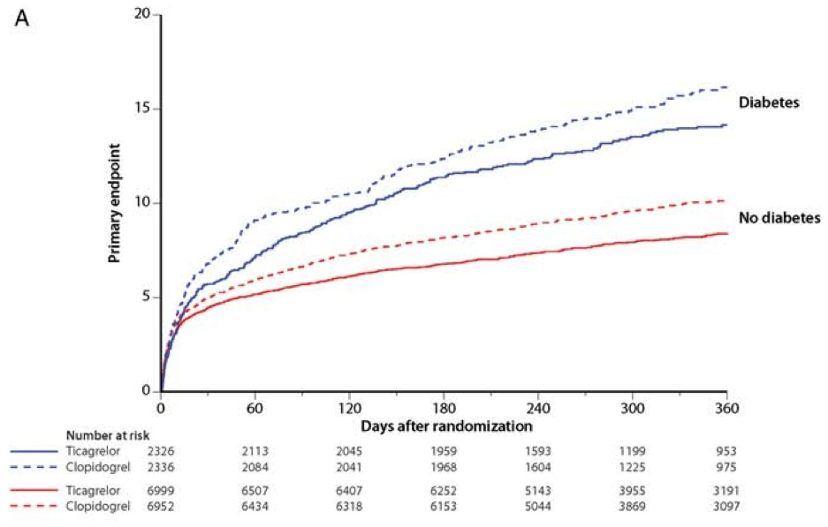
PLATO (ticagrelor vs. clopidogrel) Diabetes substudy primary end point
James S et al. European Heart Journal 2010
Notes:
Aims Patients with diabetes mellitus (DM) have high platelet reactivity and are at increased risk of ischaemic events and bleeding post-acute coronary syndromes (ACS). In the PLATelet inhibition and patient Outcomes (PLATO) trial, tica- grelor reduced the primary composite endpoint of cardiovascular death, myocardial infarction, or stroke, but with similar rates of major bleeding compared with clopidogrel. We aimed to investigate the outcome with ticagrelor
vs. clopidogrel in patients with DM or poor glycaemic control.
.....................................................................................................................................................................................
Methods and results
We analysed patients with pre-existing DM (n 1⁄4 4662), including 1036 patients on insulin, those without DM
(n 1⁄4 13 951), and subgroups based on admission levels of haemoglobin A1c (HbA1c; n 1⁄4 15 150). In patients with
DM, the reduction in the primary composite endpoint (HR: 0.88, 95% CI: 0.76–1.03), all-cause mortality (HR:
0.82, 95% CI: 0.66–1.01), and stent thrombosis (HR: 0.65, 95% CI: 0.36–1.17) with no increase in major bleeding
(HR: 0.95, 95% CI: 0.81–1.12) with ticagrelor was consistent with the overall cohort and without significant diabetes
status-by-treatment interactions. There was no heterogeneity between patients with or without ongoing insulin treat-
ment. Ticagrelor reduced the primary endpoint, all-cause mortality, and stent thrombosis in patients with HbA1c
above the median (HR: 0.80, 95% CI: 0.70–0.91; HR: 0.78, 95% CI: 0.65–0.93; and HR: 0.62, 95% CI: 0.39–1.00,
respectively) with similar bleeding rates (HR: 0.98, 95% CI: 0.86–1.12).
.....................................................................................................................................................................................
Conclusion Ticagrelor, when compared with clopidogrel, reduced ischaemic events in ACS patients irrespective of diabetic status and glycaemic control, without an increase in major bleeding events.

Slide 40
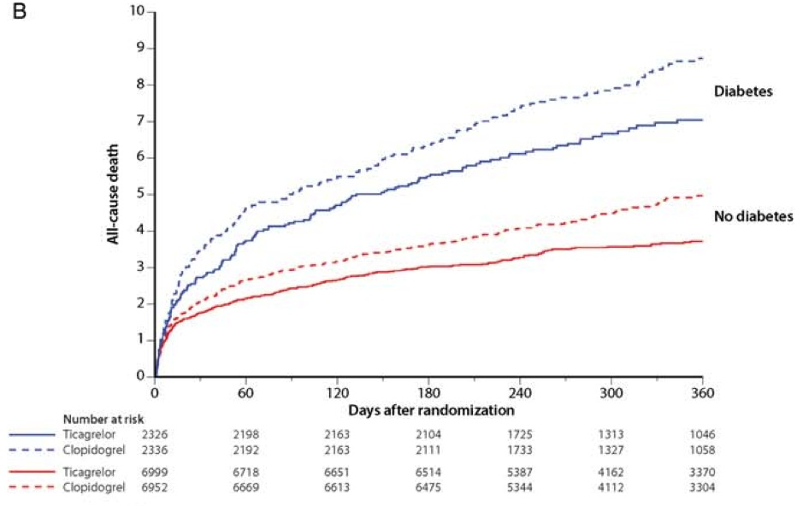
PLATO (ticagrelor vs. clopidogrel) Diabetes substudy Total mortality
James S et al. European Heart Journal 2010

Slide 41
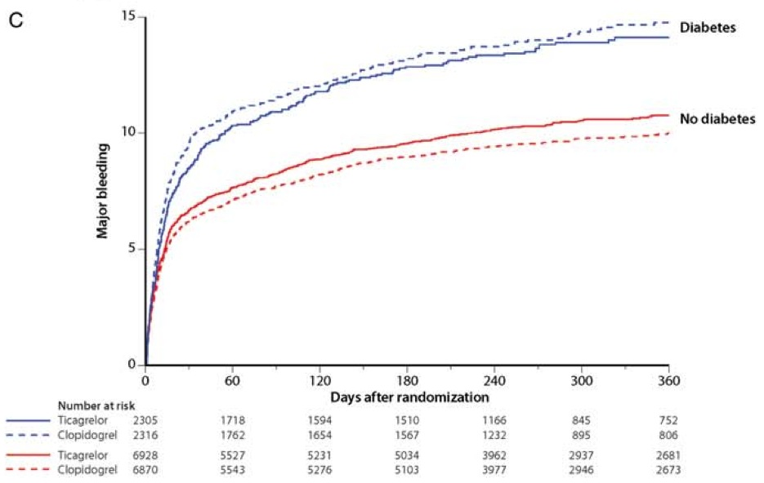
PLATO (ticagrelor vs. clopidogrel) Diabetes substudy Major bleeding
James S et al. European Heart Journal 2010

Slide 42
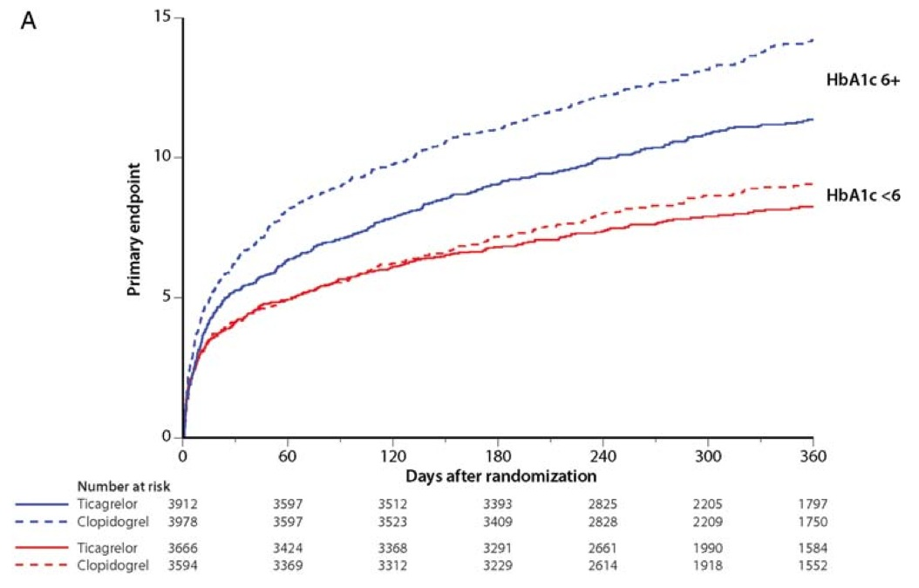
PLATO (ticagrelor vs. clopidogrel) Diabetes substudy Primary end point according to baseline HbA1c
James S et al. European Heart Journal 2010

Slide 43
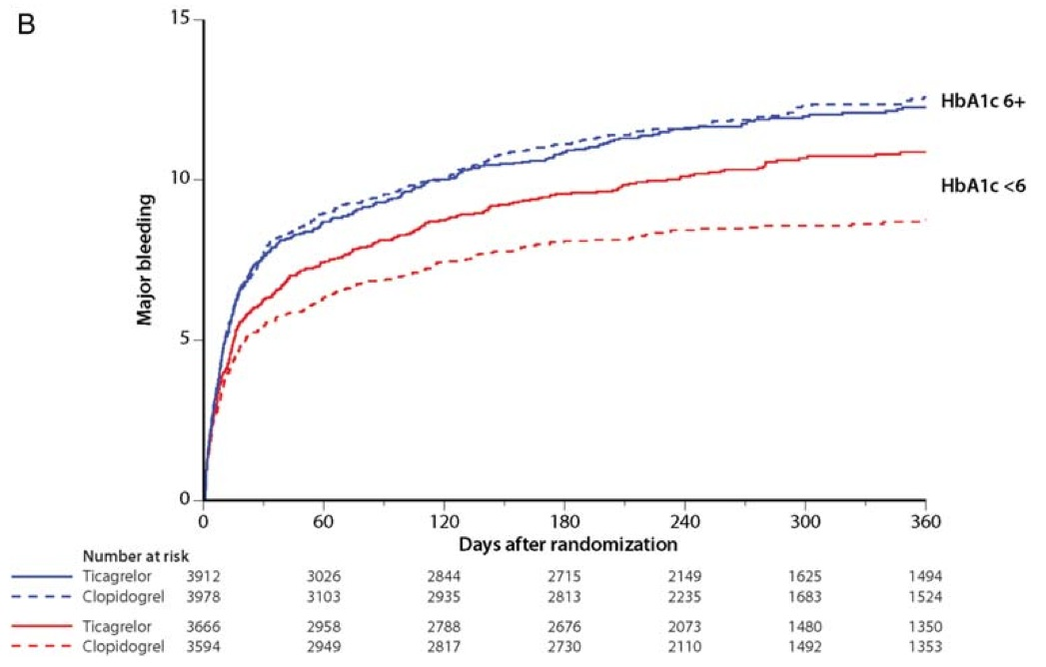
PLATO (ticagrelor vs. clopidogrel) Diabetes substudy Major bleeding according to baseline HbA1c
James S et al. European Heart Journal 2010

Slide 44
Efficacy of Antiplatelet Therapies in ACS Results in the Diabetes Mellitus Subgroups (Adapted from Ferreiro JL et al. Circulation 2011; 123: 798-813)
Study | # pts | Regimen | Primary end-point | Results overall | # pts DM | Results in DM
Cure | 12 562 | ASA+CL VS ASA | CV death, non fatal MI, stroke at 1 yr | 9.3 vs 11.4% RR= 0.80 | 2 840 | 14.2 vs 16.7% RR=0.84 ns
PCI-CURE | 2 658 | ASA+CL VS ASA | Cv death, MI or urgent TVR at 30 days | 4.5 vs 6.4% RR= 0.70 | 504 | 12.9 vs 16.5% RR=0.77 ns
CREDO | 2 116 | ASA+CL VS ASA | Death, MI or stroke at 1 yr | 8.5 vs 11.5% RRR=26.9% | 560 | % NA RRR=11.2% ns
COMMIT | 45 852 | ASA+CL VS ASA | Death, reinfarct or stroke at discharge or 28 days | 9.2 vs 10.1% OR=0.91 | NA | NA
CLARITY | 3 491 | ASA+CL VS ASA | Occluded infarct-related artery on angiography or death or recurrent MI before angiography | 15 vs 21.7% OR=0.64 | 575 | NA
PCI-CLARITY | 1 863 | ASA+CL VS ASA | CV death, recurrent MI or stroke at 30 days | 3.6 vs 6.2% OR=0.54 | 282 | 6 vs 10.1% OR=0.61 ns
TRITON-TIMI 38 | 13 608 | ASA+PRA VS ASA+CL | CV death, non-fatal MI or non-fatal stroke at 15 mo. | 9.9 vs 12.1% HR=0.81 | 3 146 | 12.2 vs 17% HR=0.70
PLATO | 18 624 | ASA+TICA VS ASA+CL | Death from vascular causes, MI or stroke at 12 mo. | 9.8 vs 11.7% HR=0.84 | 4 662 | 14.1 vs 16.2% HR=0.88 ns
Notes:
44
ASA: aspirin; CL: clopidogrel; PRA: Prasugrel; Tica: ticagrelor

Slide 45
Ongoing Studies ASCEND and ACCEPT - D
ASCEND
UK
ASA 100 mg and Omega-3
Randomized double blind for 5 years
10,000+ patients > 40 yrs
ACCEPT – D
Italy
ASA 100 mg + simvastatine 20-40 mg
Randomized open for 5 years
5170 patients > 50 yrs

Slide 46
Notes:
46

