Slide 1
Antiplatelet Therapy for the Secondary Prevention of Cerebrovascular Disease
Canadian Cardiovascular Society Antiplatelet Guidelines
Working Group: Ashfaq Shuaib, MD, FRCP; Philip Teal, MD, FRCP

Slide 2
Objectives
Interpret the Canadian Cardiovascular Society Guideline recommendations regarding the use of antiplatelet therapy in cerebrovascular disease.
Distinguish the differences in antiplatelet therapy in the first month following cerebrovascular events versus the long term therapy.
Evaluate the key evidence supporting the use of antiplatelet agents in the secondary prevention of cerebrovascular events.

Slide 3
Harvey
Harvey, a 77 year old male presents to your office 1 day after being discharged from the emergency room of the local hospital. He states that he went to the ER with an episode of right sided weakness and disturbed speech lasting about 60 minutes. His symptoms are now fully resolved.
He was diagnosed with TIA at the ER and 81 mg of ECASA was added to his treatment.
Past history is significant for hypertension, type 2 diabetes and hyperlipidemia for which he is receiving an ACEI, diuretic, metformin and a statin.
CT scan is normal. Carotid Doppler reveals bilateral minor plaque.

Slide 4
Harvey
ABCD2 score 6; 30-day stroke risk of 15%.
Neurologic examination is normal.
BP is 128/78, pulse is 86 and regular.
Glycemia and lipids are well controlled.
EKG is normal.

Slide 5
Polling question
How would you manage Harvey’s antiplatelet therapy?
Continue ASA 81 mg.
Discontinue ASA 81 mg and start clopidogrel 75 mg.
Continue ASA 81 mg and add clopidogrel 75 mg.
Discontinue ASA 81 mg and start combination extended release dipyridimole + ASA 25 mg BID.
Any of the above are appropriate.

Slide 6
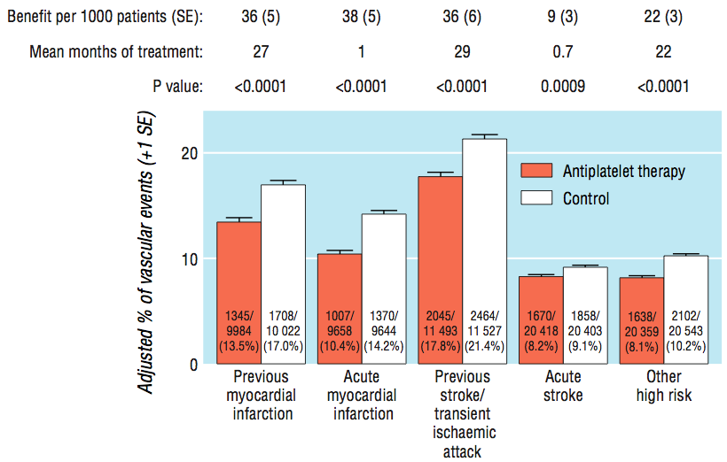
Evidence for Antiplatelet Rx Antithrombotic trialists collaboration
BMJ 2002; 324: 71-86.

Slide 7
EXPRESS – Rapid aggressive treatment vs routine care
Methods
Phase 1 (2002-2004)
Patients with TIA or non-disabling stroke to the study clinic, appointment as quickly as possible.
Report faxed with treatment recommendations
Phase 2 (2004-2007)
Patients sent directly to the study clinic immediately after they presented for medical attention
No need to prearrange referral, and treatment was initiated immediately in the clinic
Primary outcome the 90-day risk of recurrent stroke

Slide 8
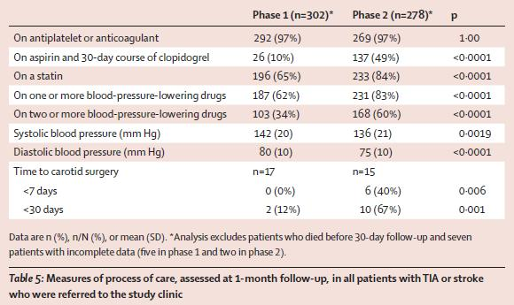
EXPRESS – Rapid aggressive treatment vs routine care
Lancet 2007; 370:1432-1442

Slide 9
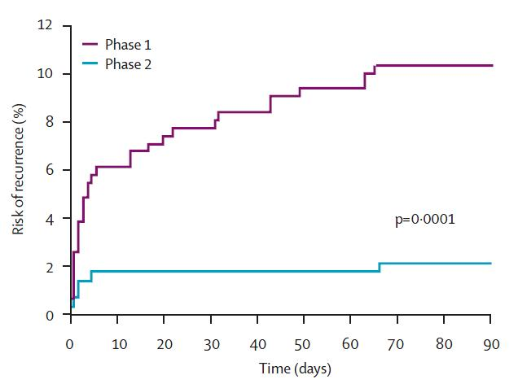
EXPRESS – Rapid aggressive treatment vs routine care
80% RRR

Slide 10
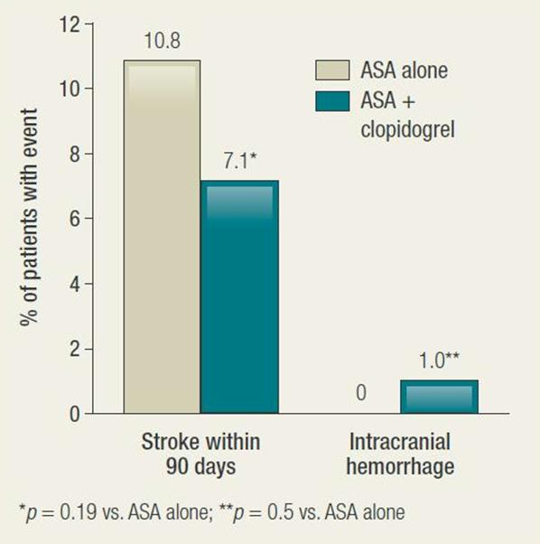
ASA + Clopidogrel vs ASA monotherapy in acute minor stroke or TIA
FASTER Pilot RCT
(N=392)
Subjects enrolled within the first 24 hours after a TIA
or minor stroke and randomized to receive either ASA or ASA + clopidogrel.
Kennedy J, et al. Lancet Neurol 2007; 6: 961–69

Slide 11
What about long term secondary stroke prevention?

Slide 12
MATCH – Clopidogrel + ASA vs Clopidogrel
Cumulative event rate
(Ischemic Stroke, MI, vascular death,
rehospitalization due to ischemic event)
Placebo
18
6.4% RRR
1.03% ARR
P=0.244
ASA
12
Cumulative event rate (%)
* All patients received clopidogrel background therapy
6
On-Treatment Analysis: 9.6% RRR, 1.6% ARR, p=0.10
0
0
1
3
6
12
18
Months of follow-up
Diener HC, et al. Lancet. 2004; 364:331-337.
Notes:
12
The Management of Atherothrombosis with Clopidogrel in High-Risk Patients with Recent Transient Ischemic Attack or Ischemic Stroke (MATCH) trial was a randomized, double-blind, parallel-group study.
The primary objective was to evaluate the efficacy of clopidogrel (75 mg/day) plus ASA (75 mg/day) compared with clopidogrel alone (75 mg/day) in reducing the risk of ischemic events in patients with recent TIA or ischemic stroke and who were at high risk for recurrent ischemic events.
Addition of ASA to clopidogrel resulted in a statistically non-significant 6.4% overall relative risk reduction in the combined primary efficacy end-point of MI, stroke, vascular death, or rehospitalization for an acute ischemic event (P=0.244). Thus, it appears that the addition of aspirin to clopidogrel in high-risk stroke and TIA patients does not provide additional efficacy when compared with clopidogrel monotherapy.
Reference:
Diener HC, Bougousslavsky J, Brass LM, et al; MATCH Investigators. Aspirin and clopidogrel compared with clopidogrel alone after recent ischaemic stroke or transient ischaemic attack in high-risk patients (MATCH): randomised, double-blind, placebo-controlled trial. Lancet. 2004;364(9431):331-337.

Slide 13
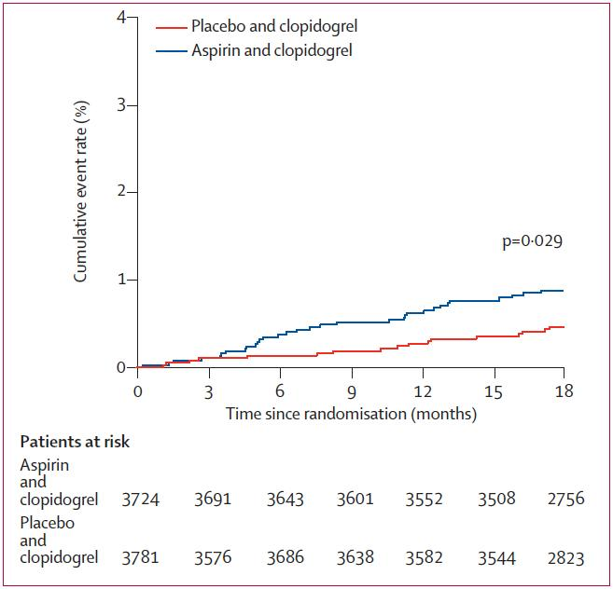
MATCH – Clopidogrel + ASA vs Clopidogrel Intracranial hemorrhage
Diener HC, et al. Lancet. 2004; 364:331-337.

Slide 14
CAPRIE – Clopidogrel vs ASA
Relative Risk Reduction* by qualifying entry criteria
7.3
IS (n=6431)
-3.7
MI (n=6302)
23.8
PAD (n=6452)
8.7
Total (n=1918)
20
10
0
10
20
30
40
ASA better
Clopidogrel better
*Cluster of IS, MI, or vascular death.
Lancet 1996;348:1329-1339.
Notes:
The next two slides show the relative risk reductions of clopidogrel versus aspirin in the subgroups defined by CAPRIE entry criteria are shown in the left panel of this slide.
These findings may suggest a disparity of effect between the entry criteria subgroups. However, CAPRIE was not powered to detect treatment differences between subgroups.
References
1. CAPRIE Steering Committee. Lancet 1996;348:1329-1339.

Slide 15
ESPS 2 ASA/ER dipyridimole vs ASA Risk reduction for stroke or death
n = 6602 within 3 months of stroke or TIA
2 years of follow-up
P<0.001
P=0.006
Stroke relative risk reduction (%)
P<0.05
P<0.05
ER DP = extended release dipyridamole
Diener HC, et al. J Neurol Sci. 1996;143:1-13.
Notes:
15
The European Stroke Prevention Study 2 (ESPS 2) examined the safety and efficacy of low-dose ASA, modified-release dipyridamole, and the two agents in combination for the secondary prevention of ischemic stroke (n = 6,602). Patients with prior stroke or TIA were randomized to treatment with ASA alone (50 mg daily), modified-release dipyridamole alone (400 mg daily), the two agents in a combined formulation, or placebo. Patients were followed on treatment for 2 years.
Relative risk reductions and significance levels are presented in this slide. Factorial analysis demonstrated a highly significant effect for ASA and for dipyridamole in reducing the risk of stroke and stroke or death combined. Compared to placebo, stroke risk was reduced by 18% with ASA alone (p = 0.013), 16% with dipyridamole alone (p = 0.039), and 37% with combination therapy (p < 0.001).
The investigators concluded that ASA and dipyridamole are equally effective for the secondary prevention of ischemic stroke and TIA. However, when used in combination, the protective effects are additive, with the combination being significantly more effective than either agent used alone.
NOTE: Click on the RETURN button to go back to the core case study slides.
Reference:
Diener HC, Cunha L, Forbes C, et al. European stroke prevention study. 2: Dipyridamole and acetylsalicylic acid in the secondary prevention of stroke. J Neurol Sci. 1996;143:1-13.

Slide 16
PRoFESS – Clopidogrel vs ER Dipyridimole + ASA
The rate of first recurrent stroke was similar between the combination therapy and the single antiplatelet agent treatment groups.
HR 1.01
95% CI 0.92-1.11
Stroke recurrence (%)
N Engl J Med 2008; 359:1238-1251
Notes:
16
Background
Recurrent stroke is a frequent, disabling event after ischemic stroke. This study compared
the efficacy and safety of two antiplatelet regimens — aspirin plus extendedrelease
dipyridamole (ASA–ERDP) versus clopidogrel.
Eligibility
The inclusion criteria were a recent ischemic stroke
(within <90 days before randomization), defined
by symptoms persisting for more than 24 hours or
symptoms of a shorter duration but with evidence
of a recent brain infarction on a computed tomographic
scan or magnetic resonance imaging;
clinical and neurologic stability before randomization;
and an age of 55 years or older.
Methods
In this double-blind, 2-by-2 factorial trial, we randomly assigned patients to receive
25 mg of aspirin plus 200 mg of extended-release dipyridamole twice daily or to receive
75 mg of clopidogrel daily. The primary outcome was first recurrence of stroke.
The secondary outcome was a composite of stroke, myocardial infarction, or death
from vascular causes. Sequential statistical testing of noninferiority (margin of 1.075),
followed by superiority testing, was planned.
Results
A total of 20,332 patients were followed for a mean of 2.5 years. Recurrent stroke
occurred in 916 patients (9.0%) receiving ASA–ERDP and in 898 patients (8.8%) receiving
clopidogrel (hazard ratio, 1.01; 95% confidence interval [CI], 0.92 to 1.11). The
secondary outcome occurred in 1333 patients (13.1%) in each group (hazard ratio for
ASA–ERDP, 0.99; 95% CI, 0.92 to 1.07). There were more major hemorrhagic events
among ASA–ERDP recipients (419 [4.1%]) than among clopidogrel recipients (365
[3.6%]) (hazard ratio, 1.15; 95% CI, 1.00 to 1.32), including intracranial hemorrhage
(hazard ratio, 1.42; 95% CI, 1.11 to 1.83). The net risk of recurrent stroke or major
hemorrhagic event was similar in the two groups (1194 ASA–ERDP recipients [11.7%],
vs. 1156 clopidogrel recipients [11.4%]; hazard ratio, 1.03; 95% CI, 0.95 to 1.11).
Conclusions
The trial did not meet the predefined criteria for noninferiority but showed similar rates
of recurrent stroke with ASA–ERDP and with clopidogrel. There is no evidence that either
of the two treatments was superior to the other in the prevention of recurrent
stroke. (ClinicalTrials.gov number, NCT00153062.)

Slide 17
Antiplatelet Therapy for the Secondary Prevention of Cerebrovascular Disease
RECOMMENDATIONS
Working Group: Ashfaq Shuaib, MD, FRCP and Philip Teal, MD, FRCP

Slide 18
Antiplatelet Therapy for the Secondary Prevention of Cerebrovascular Disease
Patients who suffer a TIA or ischemic stroke of noncardiac origin should be treated with an antiplatelet agent (Class I, Level A). Initial therapy should be ASA 75-162 mg once daily, clopidogrel 75 mg once daily, or ER-dipyridamole 200 mg plus ASA 25 mg twice daily (Class I, Level A). The choice of antiplatelet therapy regimen is determined by consideration of cost, tolerance, and other associated vascular conditions. Available data does not allow for differentiation of antiplatelet regimen by specific stroke subtype (Class IIb, Level C).
The combination of ASA 75-162 mg daily plus clopidogrel 75 mg daily in the first month after TIA or minor ischemic stroke may be superior to aspirin alone in patients not at a high risk of bleeding (Class IIb, Level C).
The combination of ASA 75-162 mg daily plus clopidogrel 75 mg daily should not be used for secondary stroke prevention beyond 1 month unless otherwise indicated and the risk of bleeding is low (Class III, Level B).

Slide 19
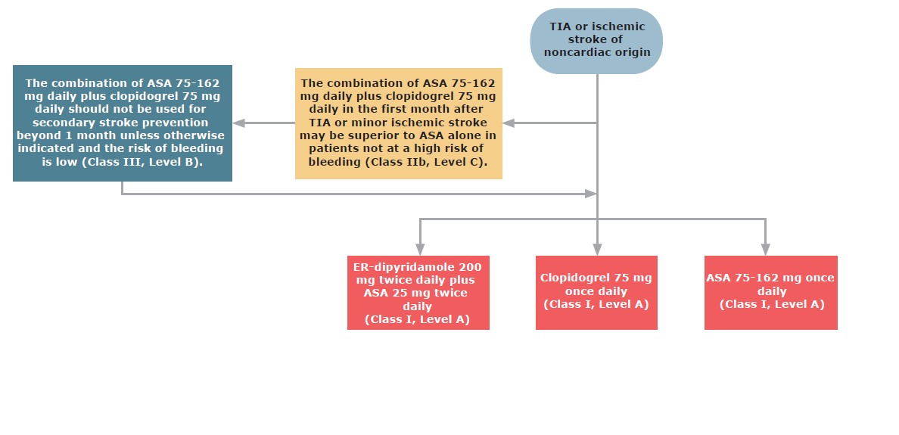
Antiplatelet therapy for the secondary prevention of cerebrovascular disease

Slide 20
Harvey
The patient has had a high risk ischemic TIA (ABCD2 score 6; 30 day stroke risk of 15%) and requires urgent aggressive management.
ASA, Clopidogrel, ER Dipyridamole + ASA are all equally recommended for long term secondary stroke prevention.
In view of his acute presentation and high stroke risk clopidogrel 75 mg is added to his current regimen for a planned duration of 30 days.
His other risk factors including lipids, BP and glycaemia require tight control and monitoring.
He is referred to a stroke prevention clinic for further assessment.

Slide 21
“What if”
Harvey has:
A recent history of gastrointestinal bleeding?
A lower risk TIA – ABCD2 score 3?

Slide 22
“What if”
Dual antiplatelet therapy with ASA + clopidogrel should only be used for 30 days if the risk of recurrent stroke is high AND the bleeding risk is low.
DAPT is not advised with increased bleeding risk.
DAPT is not advised for low risk events.
Mono therapy with any of the first line agents should be used in those circumstances.

Slide 23
Antiplatelet therapy for the secondary prevention of cerebrovascular disease

