Slide 1
Antiplatelet Therapy for Secondary Prevention Beyond One Year Following ACS or PCI
Canadian Cardiovascular Society Antiplatelet Guidelines
Working Group: Anil Gupta MD, FRCPC, Pierre Theroux MD, FRCPC
Notes:
1

Slide 2
Objectives
Interpret the Canadian Cardiovascular Society Guideline recommendations regarding the use of antiplatelet therapy for patients with stable coronary artery disease.
Distinguish when it is appropriate to continue or discontinue dual antiplatelet therapy 1 year post event.
Evaluate the evidence supporting the use of antiplatelet agents in patients with stable coronary artery disease.

Slide 3
Mary
Mary is a 72 year-old retired teacher who suffered a NSTEMI three years ago.
She was managed medically and made an uneventful recovery.
Since her event she remains asymptomatic and has no significant comorbidity.

Slide 4
Mary
Which of the following are appropriate antiplatelet regimens for Mary?
ASA 81 mg OD
Clopidogrel 75 mg daily
ASA 81 mg + Clopidogrel 75 mg daily
Any of the above

Slide 5
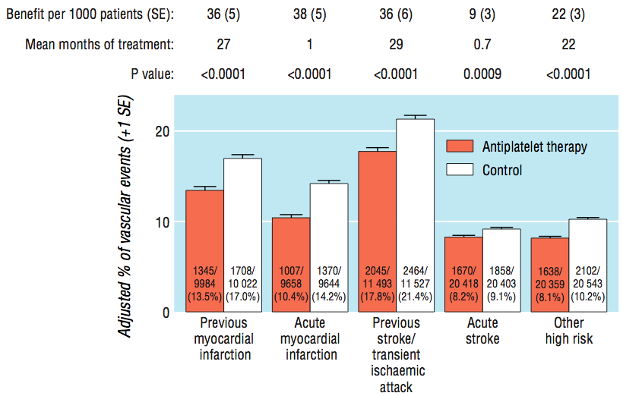
Benefit of antiplatelet therapy
Antithrombotic trialists collaboration
ARR 3.5 % 13.5% vs 17.0%
NNT 29
Antithrombotic Trialists, BMJ 2002; 324: 71-86.
Notes:
Data were available on 19 288 patients with suspected acute myocardial infarction in 15 trials (compared with 18 773 such patients in nine trials previously, nearly all of whom were in the ISIS-2 trial. Allocation to a mean duration of one month of antiplatelet therapy resulted in 38 (5) fewer serious vascular events per 1000 treated patients. This reflects large and highly significant reductions in non-fatal reinfarction (13 (2) fewer/1000; P < 0.0001) and in vascular death (23 (4) fewer/1000; P < 0.0001), together with a small but significant reduction in non-fatal stroke (2 (1) fewer/1000; P = 0.02). The net benefit is substantially larger than the excess risk of major extracranial bleeding (for example from arterial lines), which was estimated to be about 1-2 additional major extracranial bleeds per 1000 patients allocated antiplatelet therapy.
In 12 unstable angina trials involving about 5000 patients, ASA led to a 46% odds reduction in the risk of a vascular event (13.3% to 8%)

Slide 6
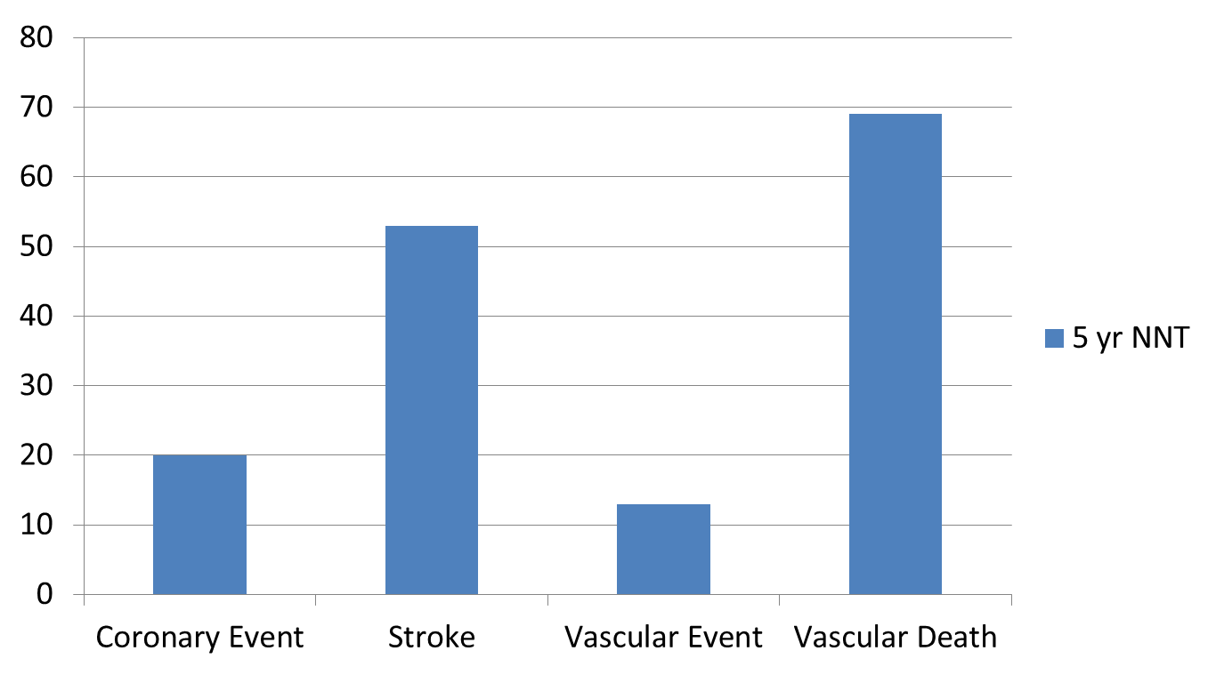
Absolute benefit of ASA in secondary prevention
Baigent C, Blackwell L, Collins R, et al. Lancet 2009;373:1849-60.

Slide 7
ASA VS CLOPIDOGREL
Stable CAD

Slide 8
CAPRIE
Study design | Multicentre, prospective, blinded
Study population | 19,185 patients with atherosclerotic vascular disease
Qualifying conditions | Ischemic stroke (>1 week and <6 months) Myocardial infarction (MI) (<35 days) Peripheral Vascular disease
Study drugs | Clopidogrel 75 mg once daily Aspirin 325 mg once daily
Primary endpoint | MI, ischemic stroke, or vascular death
Treatment duration | Up to 3 years (mean 1.6 year)
Investigational sites | 384 in 16 countries
CAPRIE Steering Committee. Lancet 1996;348:1329-1339.
Notes:
8
CAPRIE was a clinical trial comparing clopidogrel against ASA in patients at risk of ischemic events:
The trial was a multicenter, prospective, randomized, double-blinded clinical trial of clopidogrel in more than 19,000 patients with myocardial infarction (MI), ischemic stroke, or peripheral arterial disease (PAD).
In the trial, clopidogrel 75 mg was compared with aspirin 325 mg.
The trial was led by several independent committees, one of which was in charge of the independent validation of the outcome events.
Patients were recruited by 384 sites in 16 countries and followed for 1-3 years.
The primary end point was the composite outcome cluster of ischemic stroke, MI, or vascular death.
The primary analysis of the effect of the two agents on the first occurrence of MI, ischemic stroke, and vascular death was performed on an intent-to-treat basis.
References
1. CAPRIE Steering Committee. Lancet 1996;348:1329-1339.

Slide 9
CAPRIE results
Relative Risk Reduction* by qualifying entry criteria
7.3
IS (n=6431)
-3.7
MI (n=6302)
23.8
PAD (n=6452)
8.7
Total (n=1918)
20
10
0
10
20
30
40
ASA better
Clopidogrel better
*Cluster of IS, MI, or vascular death.
CAPRIE Steering Committee. Lancet 1996;348:1329-1339.
Notes:
9
The next two slides show the relative risk reductions of clopidogrel versus aspirin in the subgroups defined by CAPRIE entry criteria are shown in the left panel of this slide.
These findings may suggest a disparity of effect between the entry criteria subgroups. However, CAPRIE was not powered to detect treatment differences between subgroups.
References
1. CAPRIE Steering Committee. Lancet 1996;348:1329-1339.

Slide 10
CAPRIE bleeding
% of patients with events
 | Aspirin (325 mg/d) | Clopidogrel (75 mg/d)
Intracranial hemorrhage | 0.49 | 0.35
Gastrointestinal bleeding | 2.66 * | 1.99
Severe bleeding | 1.55 | 1.38
Any bleeding | 9.28 | 9.27
*p<0.05
CAPRIE Steering Committee. Lancet 1996;348:1329-1339.
Notes:
10
The adverse event rates from the CAPRIE study show that clopidogrel has a lower rate of side effects than aspirin, except for diarrhea and rash.
For severe diarrhea and rash, the incidences were low and not felt to be clinically significant. These rates were also lower than reported for ticlopidine.
Patients with aspirin intolerance were excluded from the CAPRIE study, as were patients with a history of bleeding and peptic ulcer. Nevertheless, in the CAPRIE population, the incidence of ulcers as well as gastrointestinal (GI) bleeding complications (i.e., bleeding requiring hospitalization) was more frequent in the aspirin group, demonstrating the favorable safety profile of clopidogrel. The risk of clinically relevant GI bleeding with clopidogrel is lower than with aspirin. Furthermore, this difference in favor of clopidogrel is likely to be underestimated in CAPRIE due to study exclusion criteria.
The effect of clopidogrel on neutrophil count was also analyzed in CAPRIE. The results showed a similar rate of neutropenia (<1.2 x 10⁹ neutrophils per liter) as well as severe neutropenia (<0.45 x 10⁹ neutrophils per liter) between the clopidogrel and aspirin groups.¹
References
1. CAPRIE Steering Committee. Lancet 1996;348:1329-1339.

Slide 11
DUAL ANTIPLATELET THERAPY
VS
ASA MONOTHERAPY
Stable CAD

Slide 12
CHARISMA
Study design
Clopidogrel
75 mg/day
(n=7802)
Patients age ≥ 45 years at high risk of atherothrombotic events
Low dose ASA 75−162 mg/day
R
Double-blind treatment up to 1040 primary efficacy events*
(n=15603)
Low dose ASA 75−162 mg/day
Placebo
1 tablet/day
(n=7801)
1-month
visit
3-month
visit
Visits every 6 months
Final visit
(Fixed study
end date)
* MI (fatal or non-fatal), stroke (fatal or non-fatal), or cardiovascular death;
event-driven trial
Bhatt DL, Topol EJ, et al. Am Heart J 2004; 148: 263–268.
Notes:
12
CHARISMA was a multicenter, multinational, randomized, two-parallel group, double-blind trial of clopidogrel versus placebo
A total of 15603 patients with documented atherothrombotic disease (symptomatic) or multiple risk factors (asymptomatic patients) were randomized to clopidogrel (75 mg per day) or placebo in a double-blind manner, both in addition to background therapy including low-does ASA (75-162 mg/day, the exact dose left to the discretion of the individual treating physician), and followed for a median of 28 months. ²
The randomization was centralized using an IVRS¹
CHARISMA was an event-driven trial, meaning that it was planned to end after at least 1,040 blinded, primary events had accrued ¹
Since 1040 primary efficacy events had been reached, the fixed study end date was 29 August 2005
Final visits occurred within the month following the fixed study end date¹
During the trial each patient had follow-up visits scheduled at 1 month, 3 months, 6 months, 12 months and every 6 months thereafter until a common study end date ¹
All patients were followed from randomization until study end date, with the last patient followed for at least 3 months¹
Reference
Bhatt DL, Topol, EJ, et al. Am Heart J 2004; 148: 263–268.

Slide 13
CHARISMA
Inclusion criteria
Patients aged ≥45 years
with
at least one of the following:
  1) Documented coronary disease
  and/or
  2) Documented cerebrovascular disease
  and/or
  3) Documented symptomatic PAD
  and/or
  4) Two major or one major and two minor or three minor risk factors
Bhatt DL, Topol EJ, et al. Am Heart J 2004; 148: 263–268.
Notes:
13
Patients aged ≥45 years with at least one of the following four categories of criteria (one or more may apply) could be randomized:¹
Documented coronary disease
Documented cerebrovascular disease
Documented symptomatic PAD
Combination of two major or three minor or one major and two minor atherothrombotic risk factors
Reference
1. Bhatt DL, Topol EJ, et al. Am Heart J 2004; 148: 263–268.

Slide 14
Primary efficacy results (MI/troke/CV death) by pre-specified entry category
Population RR (95% CI) p value
Prior CV event 0.88 (0.77, 0.998) 0.046
(n=12153)
Risk Factors Only 1.20 (0.91, 1.59) 0.20 (n=3284)
Overall Population* 0.93 (0.83, 1.05) 0.22 (n=15603)
0.4
0.6
0.8
1.2
1.4
1.6
Clopidogrel + ASA
Better
Placebo + ASA
Better
* A statistical test for interaction showed marginally significant heterogeneity (p=0.045) in treatment response for the pre-specified subgroups of symptomatic and asymptomatic patients
AT=Atherothrombosis
Adapted from Bhatt DL, Fox KA, Hacke W, et al. 2006, in press.
Notes:
14
The primary efficacy endpoint in CHARISMA was a cluster of the first occurrence of MI (fatal or nonfatal), stroke (fatal or nonfatal), or cardiovascular death
Median follow up was 28 months
Among 3284 patients with risk factors only, there was a 20% increase in the primary endpoint events with clopidogrel plus ASA (RR 1.20 [0.91, 1.59], p=0.20), while among the 12,153 patients with documented atherothrombotic disease, there was a significant reduction in the primary end point with clopidogrel plus ASA versus ASA alone (6.9% versus 7.9% in the placebo group, RR 0.88, [95% CI: 0.77, 0.998], p=0.046).
The interaction term for this analysis, examining the differential treatment response in asymptomatic and symptomatic patients, was marginally significant (p=0.045).
There were 166 patients originally randomized which were found later to have not met any of the inclusion criteria. These patients are included in the overall analysis (intention to treat), but are not included in the documented atherothrombosis or risk factor only subgroups. Therefore, the numbers of patients in these subgroups do not add up to 15603.
Reference
Bhatt DL, Fox KA, Hacke W, et al. 2006, in press..

Slide 15
LONG TERM ANTIPLATELET THERAPY IN PATIENTS WITH PCI
Stable CAD

Slide 16
Stent thrombosis
Stent thrombosis occurs following 0.5%-2% of stent placements.
Major safety concern with rates of mortality as high as 45%
Occurs most frequently in the first month after stent implantation (subacute).
Cases of late (30 days to 1 year) and very late (> 1 year) stent thrombosis occur particularly in DES recipients.

Slide 17
Stent thrombosis
Predictors of late stent thrombosis
  Drug Eluting Stent
  Stenting of small vessels
  Presence of multiple lesions
  Long segments implanted with overlapping stents
  Stenting of ostial bifurcation lesions
  Suboptimal stent deployment
  Decreased left ventricular function
  Advanced age
  Diabetes
  Renal failure
  ACS

Slide 18
Stent thrombosis
Drug Eluting vs Bare Metal
Median time to stent thrombosis
20
p = 0.0003
p = 0.0052
p = 0.04
16
12
Months
8
4
0
DES BMS
SES BMS
PES BMS
Bavry AA, et al. Am J Med. 2006;119:1056-61.
Notes:
The median time of late SES thrombosis was 15.5 months with a range of 173 to 773 days, whereas the median time of late BMS thrombosis was 4 months with a range of 40 to 181 days. The median time of late PES thrombosis was 18 months with a range of 40 to 548 days, whereas the median time of late BMS thrombosis was 3.5 months with a range of 105 to 109 days.
Although current guidelines recommend that clopidogrel be continued for 1 year post DES, the figure illustrates that approximately one-third of patients will experience stent thrombosis after the 12-month period, suggesting that perhaps longer-term therapy with clopidogrel may be warranted in DES patients.
Reference:
Bavry AA, Kumbhani DJ, Helton TJ, et al. Late thrombosis of drug-eluting stents: a meta-analysis of randomized clinical trials. Am J Med. 2006;119(12):1056-61.

Slide 19
Incidence of very late stent thrombosis > 1 Year
Per 1,000 pts
7
RR = 5.7
p = 0.049
RR = 5.0
p = 0.02
6
5
4
p = 0.22
3
2
1
0
DES BMS
SES BMS
PES BMS
Bavry AA, et al. Am J Med. 2006;119:1056-61.
Notes:
Bavry and colleagues performed a meta-analysis on 14 contemporary clinical trials that randomized 6675 patients to DES (paclitaxel-eluting stents [PES] or sirolimus-eluting stents [SES]) compared with BMS. Eight of these trials have reported more than a year of clinical follow-up.
The incidence of very late thrombosis (>1 year after the index procedure) was 5.0 events per 1000 DES patients, with no events in BMS patients (risk ratio [RR]=5.02, 95% CI, 1.29 to 19.52, P=0.02). Among SES trials, the incidence of very late thrombosis was 3.6 events per 1000 SES, with no events in BMS patients (RR=3.99, 95% CI, 0.45 to 35.62, P=.22).
The investigators concluded that although the incidence of very late stent thrombosis (more than 1 year after coronary revascularization) is low, DES appear to increase the risk for late thrombosis. Although more of this risk was seen with PES, it remains possible that SES similarly increase the risk for late thrombosis compared with BMS.
Reference:
Bavry AA, Kumbhani DJ, Helton TJ, et al. Late thrombosis of drug-eluting stents: a meta-analysis of randomized clinical trials. Am J Med. 2006;119(12):1056-61.

Slide 20
Discontinuation of Thienopyridine therapy after DES implantation
MI patients who stopped thienopyridine therapy by 30 days post-DES were more likely to die during the next 11 months
15
Continued
Discontinued
Adjusted hazard ratio
9.0; 95% CI = 1.3 to 60.6
10
Mortality (%)
5
P<0.001
0
0
1
2
3
4
5
6
7
8
9
10
11
12
Months
Spertus JA, et al. Circulation. 2006;113:2803–2809.
Notes:
Data were used from a prospective 19-centre study of MI patients to examine the prevalence and predictors of thienopyridine discontinuation 30 days after DES treatment. Mortality and cardiac hospitalization rates for the next 11 months were compared between those who stopped and those who continued thienopyridine therapy. Among 500 DES-treated MI patients who were discharged on thienopyridine therapy, 68 (13.6%) stopped therapy within 30 days. Those who stopped were older, less likely to have completed high school or be married, more likely to avoid health care because of cost, and more likely to have had pre-existing cardiovascular disease or anemia at presentation. They were also less likely to have received discharge instructions about their medications or a cardiac rehabilitation referral. Patients who stopped thienopyridine therapy by 30 days were more likely to die during the next 11 months (7.5% versus 0.7%, P<0.0001; adjusted hazard ratio=9.0; 95% CI=1.3 to 60.6) and to be re-hospitalized (23% versus 14%, P=0.08; adjusted hazard ratio=1.5; 95% CI=0.78 to 3.0).
Reference:
Spertus JA, Kettelkamp R, Vance C, et al. Prevalence, predictors, and outcomes of premature discontinuation of thienopyridine therapy after drug-eluting stent placement: results from the PREMIER registry. Circulation. 2006;113:2803–2809.

Slide 21
BASKET LATE
Late thrombotic events following Thienopyridine discontinuation
Cardiac death or MI
P=0.01
MI
P=0.04
Percentage (%)
Percentage (%)
Drug-eluting stents
Bare metal stents
Pfisterer ME, et al. J Am Coll Cardiol. 2006;48(12)
Notes:
In the original BAsel Stent Kosten-Effekivitäts Trial (BASKET), a rather complex patient population was enrolled and randomized to receive one of the following: a BMS, PES, or SES and the cost effectiveness of DES vs BMS was evaluated.
In the BASKET LATE (BAsel Stent Kosten-Effekivitäts Trial-LAte Thrombotic Events) trial, the 743 patients from the BASKET trial who were MACE (major adverse cardiac event) free at 6 months were followed for an additional 12 months after the cessation of clopidogrel treatment. The BASKET LATE trial pooled the PES and SES groups into one DES group for analysis. The goal of BASKET LATE was to evaluate late thrombotic events among patients treated with DES vs BMS after clopidogrel discontinuation. The primary endpoint was a composite of cardiac death or non-fatal MI.
In the year following clopidogrel discontinuation, the primary composite endpoint of cardiac death or MI occurred significantly more frequently in the DES group than in the BMS group (4.9% vs 1.3%, P=0.01). non-fatal MI was also higher in the DES group compared with the BMS group (4.1% vs 1.3%, P=0.04).
Reference:
Pfisterer M, Brunner-La Rocca HP, Buser PT, et al. Late clinical events after clopidogrel discontinuation may limit the benefit of drug-eluting stents: an observational study of drug-eluting versus bare-metal stents. J Am Coll Cardiol. 2006;48(12):2584-2591.

Slide 22
Clopidogrel use and long-term outcomes after BMS or DES stenting
Adjusted cumulative rates of composite of death or MI using the 6-month landmark analysis
Composite of Death or MI
8
DES
With Clopidogrel
6
Without Clopidogrel
4
Cumulative Incidence (%)
BMS
With Clopidogrel
2
Without Clopidogrel
0
6
12
18
24
Months
Eisenstein EL, et al. JAMA. 2007;297(2):159-68.
Notes:
Eisenstein and colleagues assessed the association between clopidogrel use and long-term clinical outcomes of patients receiving drug-eluting stents (DES) and bare-metal stents (BMS) for treatment of coronary artery disease. This was an observational study examining consecutive patients receiving intracoronary stents at Duke Heart Center, a tertiary care medical center in Durham, NC, between January 1, 2000, and July 31, 2005, with follow-up contact at 6, 12, and 24 months through September 7, 2006. The study population included 4666 patients undergoing initial PCI with BMS (n=3165) or DES (n=1501). Landmark analyses were performed among patients who were event-free (no death, MI, or revascularization) at 6- and 12-month follow-up. At these points, patients were divided into 4 groups based on stent type and self-reported clopidogrel use: DES with clopidogrel, DES without clopidogrel, BMS with clopidogrel, and BMS without clopidogrel.
Among patients with DES who were event-free at 12 months (252 with and 276 without clopidogrel), clopidogrel use continued to predict lower rates of death (0% vs 3.5%; difference, -3.5%; 95% CI, -5.9% to -1.1%; P=0.004) and death or MI (0% vs 4.5%; difference, -4.5%; 95% CI, -7.1% to -1.9%; P<.001) at 24 months. However, among patients with BMS (346 with and 1644 without clopidogrel), there continued to be no differences in death (3.3% vs 2.7%; difference, 0.6%; 95% CI, -1.5% to 2.8%; P=0.57) and death or MI (4.7% vs 3.6%; difference, 1.0%; 95% CI, -1.6% to 3.6%; P=0.44).
The extended use of clopidogrel in patients with DES may be associated with a reduced risk for death and death or MI. However, the appropriate duration for clopidogrel administration can only be determined within the context of a large-scale randomized clinical trial.
Reference:
Eisenstein EL, Anstrom KJ, Kong DF, et al. Clopidogrel use and long-term clinical outcomes after drug-eluting stent implantation. JAMA. 2007;297(2):159-68.

Slide 23
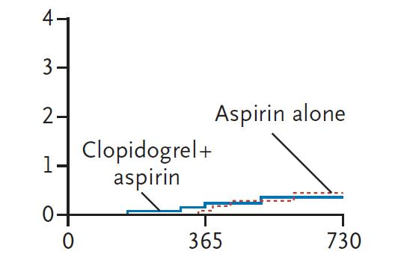
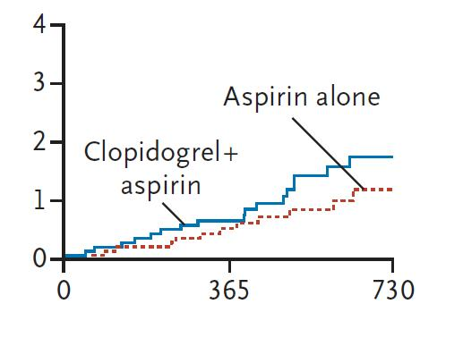
REAL-LATE/ZEST-LATE
2701 patients who had received drug eluting stents
Free of major adverse cardiac or cerebrovascular events and major bleeding for a period of at least 12 months
Randomized open label to receive clopidogrel plus aspirin or aspirin alone
Definite Stent Thrombosis
Cumulative Incidence (%)
Cumulative Incidence (%)
Days from Randomization
Days from Randomization
Park SJ, Park DW, et al. N Engl J Med 2010;362
Notes:
Background
The potential benefits and risks of the use of dual antiplatelet therapy beyond a
12-month period in patients receiving drug-eluting stents have not been clearly established.
Methods
In two trials, we randomly assigned a total of 2701 patients who had received drug eluting
stents and had been free of major adverse cardiac or cerebrovascular events
and major bleeding for a period of at least 12 months to receive clopidogrel plus aspirin
or aspirin alone. The primary end point was a composite of myocardial infarction or
death from cardiac causes. Data from the two trials were merged for analysis.
Results
The median duration of follow-up was 19.2 months. The cumulative risk of the primary
outcome at 2 years was 1.8% with dual antiplatelet therapy, as compared with
1.2% with aspirin monotherapy (hazard ratio, 1.65; 95% confidence interval [CI],
0.80 to 3.36; P = 0.17). The individual risks of myocardial infarction, stroke, stent
thrombosis, need for repeat revascularization, major bleeding, and death from any
cause did not differ significantly between the two groups. However, in the dual-therapy
group as compared with the aspirin-alone group, there was a nonsignificant increase
in the composite risk of myocardial infarction, stroke, or death from any cause (hazard
ratio, 1.73; 95% CI, 0.99 to 3.00; P = 0.051) and in the composite risk of myocardial
infarction, stroke, or death from cardiac causes (hazard ratio, 1.84; 95% CI, 0.99
to 3.45; P = 0.06).
CONCLUSIONS
The use of dual antiplatelet therapy for a period longer than 12 months in patients
who had received drug-eluting stents was not significantly more effective than aspirin
monotherapy in reducing the rate of myocardial infarction or death from
cardiac causes. These findings should be confirmed or refuted through larger,
randomized clinical trials with longer-term follow-up. (ClinicalTrials.gov numbers,
NCT00484926 and NCT00590174.)
23

Slide 24
Antiplatelet therapy for secondary prevention beyond 1 year following acute coronary syndrome or percutaneous coronary intervention
For all patients with ACS who survive to hospital discharge, indefinite therapy with low-dose ASA (75-162 mg daily) is recommended (Class I, Level A).
For patients allergic to or intolerant of ASA, indefinite therapy with clopidogrel 75 mg daily is recommended (Class IIa, Level B).
Dual antiplatelet therapy with ASA 75-162 mg daily and clopidogrel 75 mg daily may be considered beyond 1 year in patients with ACS (see post-ACS recommendations) who are medically managed provided the risk of bleeding is low (Class IIb, Level C).
For all post-PCI patients, indefinite therapy with ASA 75-162 mg daily is recommended, regardless of type of stent (Class I, Level A).
Dual antiplatelet therapy with ASA 75-162 mg daily and clopidogrel 75 mg daily may be considered beyond 1 year in patients with ACS who receive a BMS or DES provided their risk of bleeding is low (Class IIb, Level C).
Notes:
24

Slide 25
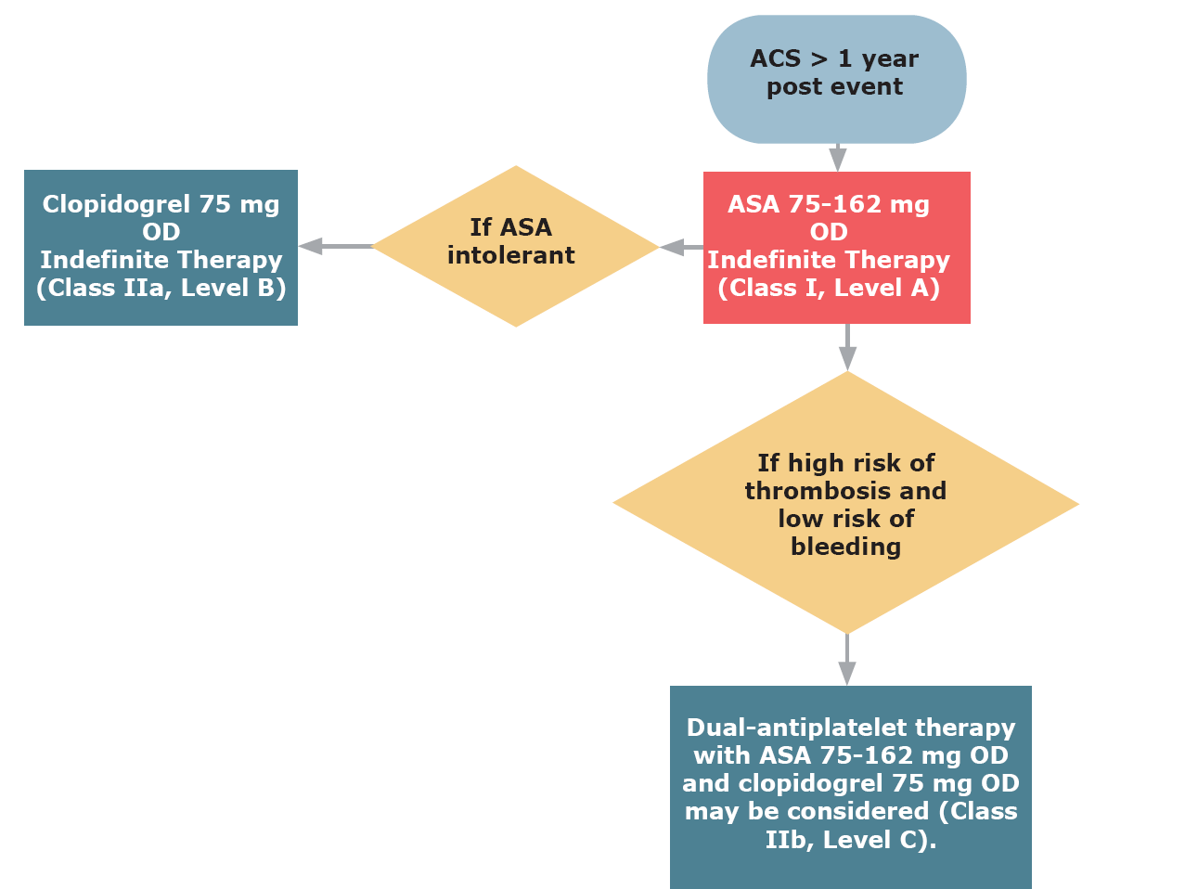
Antiplatelet therapy for secondary prevention beyond 1 year
following ACS or PCI

Slide 26
High-risk Mary
What if Mary has additional risk factors for recurrent thrombosis including:
Drug eluting stent implantation
Diabetes
Other prior vascular events including TIA?

Slide 27
CAPRIE
Clopidogrel vs ASA in multi-bed disease
15
10.74%
10
8.35%
Annual event rate (%)
5
0
Clopidogrel
ASA
Events = ischemic stroke, MI or vascular death
Lancet 1996; 348(9038):1329-39.
Notes:
27
The CAPRIE study demonstrated that clopidogrel is more effective than ASA for the prevention of ischemic stroke, MI or vascular death.
The CAPRIE data have demonstrated that clopidogrel may provide added benefit versus ASA in high-risk patients.
Among the CAPRIE cohort, there were 2,144 patients enrolled in the trial’s ischemic stroke or peripheral arterial disease groups who had a previous history of myocardial infarction.
Patients with disease in these multiple vascular beds fared much better in the clopidogrel group (8.35% annual event rate) as compared to the ASA group (10.74% annual event rate).
This 2.4% absolute risk reduction translates into 24 events prevented per 1000 patients treated with clopidogrel vs. ASA, a relative risk reduction of 22.7% (4.9 to 37.2 95% CI)
References
CAPRIE Steering Committee. Lancet 1996; 348(9038):1329-39.

Slide 28
CAPRIE
Risk reduction in patients with diabetes
25
Clopidogrel
20
21.5%
ASA
17.7%
17.7%
15
15.6%
Annual event rate (%)
12.7%
10
11.8%
5
0
Non diabetic
All diabetic patients
With insulin
Events = ischemic stroke, MI , vascular death, hospitalization for ischemic events/bleeding
Overall benefit p=0.032; multivariate analysis
Bhatt DL et al. J Am Coll Cardiol 2000;35 (Suppl A):409
Notes:
28
The CAPRIE trial population included 3866 patients with diabetes mellitus.
Without double-counting of events, Bhatt et al examined the event rates among diabetics in the two treatment arms. In the 1952 diabetic patients randomized to ASA, the event rate per year was 17.7%, compared with 15.6% in the 1914 patients randomized to clopidogrel (p=0.042).
They found that the absolute risk reduction achieved with clopidogrel was greater in the diabetic patients receiving insulin: event rate of 21.5% with ASA compared with that of 17.7% for clopidogrel (p=0.106).
In a multivariate model incorporating baseline clinical characteristics, clopidogrel therapy was independently associated with a decrease in vascular death, MI, stroke and rehospitalization (for bleeding or ischemia) in diabetic patients (p=0.032). This is equivalent to up to 38 additional major ischemic events prevented per 1000 patients treated per year, if clopidogrel is used instead of ASA.
References
Bhatt DL et al. J Am Coll Cardiol 2000;35 (Suppl A):409.

Slide 29
CHARISMA
Primary Endpoint (MI/Stroke/CV Death) in patients with previous MI, IS or PAD*
“CAPRIE-like Cohort”
N=9,478
8.8%
10
Placebo + ASA
7.3%
8
Clopidogrel + ASA
6
Primary Outcome Event Rate (%)
4
RRR: 17.1 % (95% CI: 4.4%, 28.1%)
P=0.01
2
0
0
6
12
18
24
30
* Post hoc analysis.
Months Since Randomization
Bhatt DL, Flather MD, Hacke W, et al. J Am Coll Cardiol. 2007;49:1982-1988.
Notes:
29
A post-hoc analysis of patients (n=9478) with a previous MI, stroke, or PAD (similar to the entry criteria for the CAPRIE trial) showed a significant 17.1% RRR in favor of clopidogrel plus ASA over ASA alone

Slide 30
High-risk Mary
Mary’s additional risk factors suggest more aggressive antiplatelet therapy should be considered.
As long as her bleeding risk is low, she may be advised to continue dual antiplatelet therapy with ASA 81 mg + clopidogrel 75 mg.

Slide 31
Antiplatelet therapy for secondary prevention beyond 1 year following
ACS or PCI

Slide 32
Prasugrel or Ticagrelor?
No long term secondary prevention studies are available for these agents.
Prasugrel should be avoided in patients with:
  Age > 75
  Weight < 60 kg
  Prior cerebrovascular disease

Slide 33


