Slide 1
Canadian Cardiovascular Society
Antiplatelet Guidelines
MANAGEMENT OF ANTIPLATELET THERAPY IN ASSOCIATION WITH MINOR BLEEDING
Working Group: James D. Douketis MD, FRCP(C); A. Graham Turpie MD, FRCP(C)

Slide 2
Objectives
Interpret the Canadian Cardiovascular Society Guideline recommendations regarding the use of antiplatelet therapy in patients presenting with minor bleeding events.
Appropriately investigate patients on antiplatelet therapy with minor bleeding events.

Slide 3
Case study no. 1
68 year old woman with cerebrovascular disease and new polymyalgia rheumatica presents with ecchymoses over arms and legs.
Receiving ASA, 325 mg daily; other drugs include:
  Prednisone, 5 mg daily
  Periodic over-the-counter NSAID
Other cardiovascular risk factors:
  Prior stroke
  Hypertension
  Type 2 diabetes

Slide 4
Management question
  Stop ASA.
  Continue ASA at 325 mg daily.
  Continue ASA but decrease dose to 81 mg daily.
  Taper and stop prednisone.
  Taper and stop prednisone and reduce ASA to 81 mg daily.

Slide 5
Evidence
Minor bleeding during antiplatelet therapy
Studies assessing incidence, consequence and management of antiplatelet drug-associated minor bleeding are lacking.
Minor bleeding is usually self-limiting.
Ecchymoses and petechiae
Petechiae (pinpoint capillary-based hemorrhage) typically occur in ASA- or clopidogrel-treated patients who have thrombocytopenia (platelet count usually <50 × 10⁹/L).
Ecchymosis (subcutaneous venous bleeding) can occur in ASA-and clopidogrel-treated patients who are receiving warfarin or corticosteroids or with a superimposed coagulopathy.

Slide 6
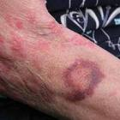
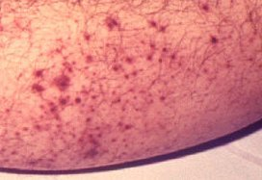
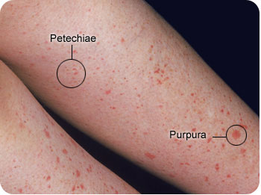
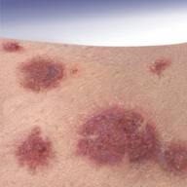
Petechiae and Purpura

Slide 7
Recommendations
Patients who are receiving ASA (or ASA + clopidogrel) and develop ecchymosis and/or petechiae should undergo testing with a CBC, INR and aPTT to investigate for thrombocytopenia or a coagulopathy (Class IIa, Level C).
In the absence of superimposed abnormalities in hemostatic function, antiplatelet drugs can be continued with clinical observation, whereas in patients with thrombocytopenia or a coagulopathy, ASA (or clopidogrel) should be stopped pending further investigations (Class IIa, Level C).

Slide 8
What if?
The prednisone is stopped but painful hip girdle symptoms recur from PMR.
Patient is put back on prednisone.
What to do with ASA?

Slide 9
Case study no. 2
65 year old man with CAD and prior NSTEMI/PCI 2 years ago
  Presents with ‘red eye’
  Recent cold symptoms
  No eye discharge or pain, no recent head injury
Receiving ASA, 81 mg and clopidogrel, 75 mg
  No treatment with NSAIDs
Blood tests
  Platelets = 250 × 10⁹/L, INR = 1.2, aPTT = 36 sec

Slide 10
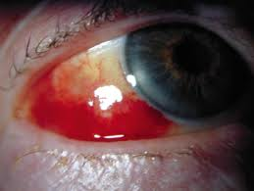
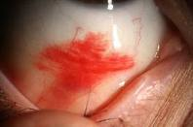
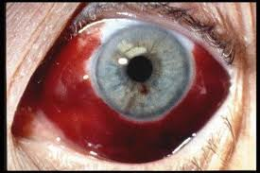
Subconjunctival hemorrhage

Slide 11
Management question
  Stop ASA and clopidogrel until bleeding clears.
  Stop clopidogrel only until bleeding clears.
  Continue both ASA and clopidogrel.
  Stop clopidogrel for 7-10 days until bleed clears.
  Stop ASA and clopidogrel for 7-10 days until bleeding clears.

Slide 12
Evidence
Clinical trials and observational studies as to clinical course and prognosis are lacking.
Subconjunctival bleeding is more common in anticoagulant-treated than antiplatelet-treated patients.
Precipitated by coughing or straining during a bowel movement.
Self‑limiting, resolves within 1-2 weeks, and does not affect visual acuity.

Slide 13
Recommendation
Patients who are receiving ASA (or ASA + clopidogrel) in whom subconjunctival bleeding develops should continue treatment and be monitored for bleeding (Class IIa, Level C).

Slide 14
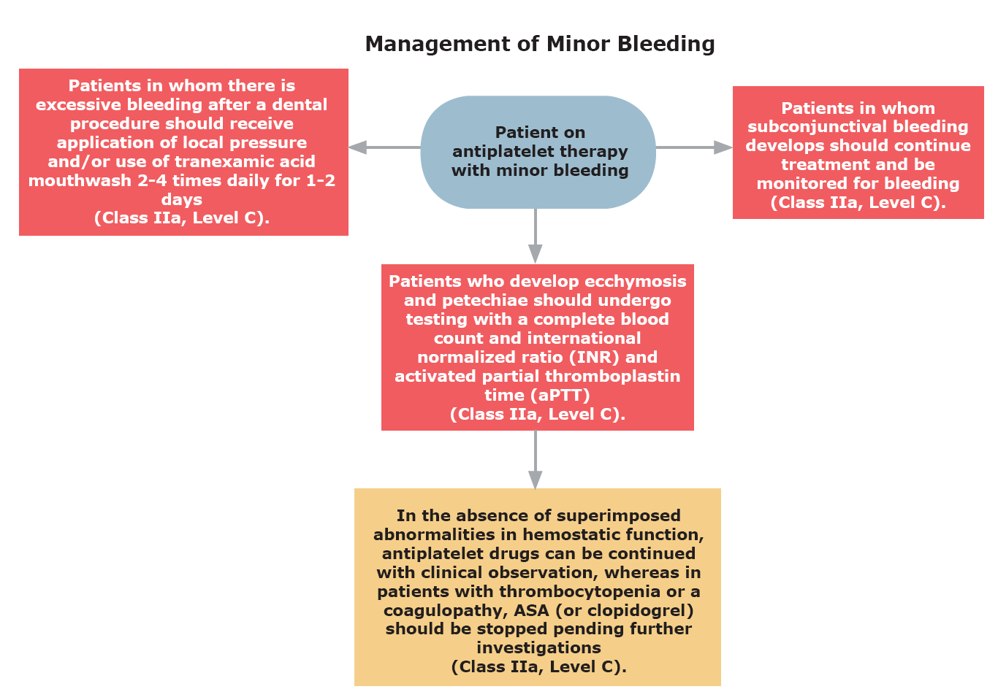
Antiplatelet therapy in patients with minor bleeding

Slide 15


