Slide 1
Antiplatelet Therapy for Secondary Prevention in the First Year Following an Acute Coronary Syndrome
Canadian Cardiovascular Society
Antiplatelet Guidelines
Working Group: Jean-François Tanguay, MD, CSPQ, FRCP(C), FACC, FAHA, FESC; Michael P. Love, MB, ChB, MD, MRCP; and Robert C. Welsh, MD, FRCP, FACC
Notes:
1

Slide 2
Objectives
Interpret the Canadian Cardiovascular Society Guideline recommendations regarding the use antiplatelet therapy in patients with acute coronary syndrome.
Recognize when antiplatelet therapy may be interrupted and when it should be continued.
Examine the role of antiplatelet therapy in clinical scenarios including:
Medically managed ACS
PCI managed ACS with bare metal and drug eluting stents
High risk ACS

Slide 3
Arthur
69 year-old male, hypertensive, diabetic, smoker
Only current Rx: hydrochlorothiazide 25 mg OD
Presented to ED with prolonged typical ischemic chest pain and 2mm ST depression in leads II, III, aVF, V5 and V6
Pain, EKG changes resolved quickly after ASA, oxygen and sublingual nitroglycerin

Slide 4
Arthur
Troponin T mildly positive with a peak of 0.85
Receives oral ASA, clopidogrel, beta blocker and iv heparin; statin and ACE inhibitor added subsequently
Cardiac cath recommended, but refused by patient
Discharged home after ambulating without recurrent symptoms (unable to perform stress test due to osteoarthritis)

Slide 5
Medically-managed Arthur
What antiplatelet therapy would you recommend on discharge expect him to be receiving?
  ASA 81 mg od indefinitely
  ASA 81 mg od indefinitely + a platelet P2Y12 inhibitor for 1 month
  ASA 81 mg od indefinitely + a platelet P2Y12 inhibitor for 12 months

Slide 6
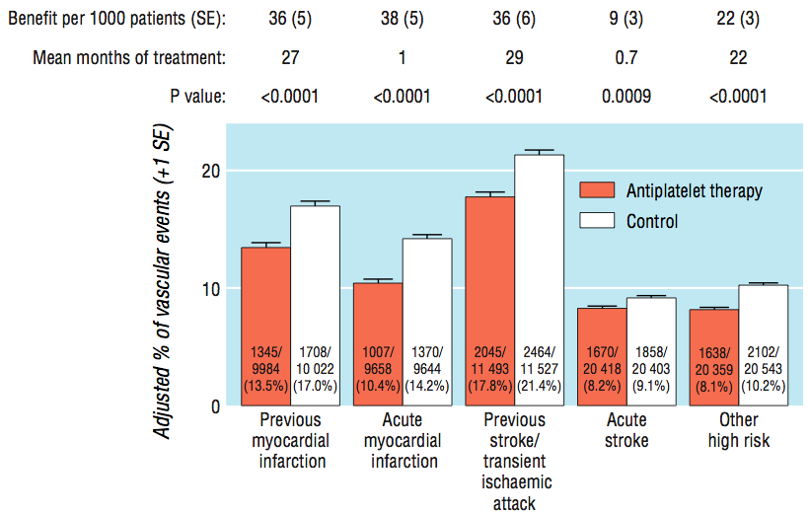
Benefit of antiplatelet therapy
Antithrombotic trialists collaboration
ARR 3.5 % (13.5% vs 17.0%)
NNT 29
ARR 3.8 (10.4% vs 14.2%)
NNT 26
BMJ 2002; 324: 71-86.
Notes:
Data were available on 19 288 patients with suspected acute myocardial infarction in 15 trials (compared with 18 773 such patients in nine trials previously, nearly all of whom were in the ISIS-2 trial. Allocation to a mean duration of one month of antiplatelet therapy resulted in 38 (5) fewer serious vascular events per 1000 treated patients. This reflects large and highly significant reductions in non-fatal reinfarction (13 (2) fewer/1000; P < 0.0001) and in vascular death (23 (4) fewer/1000; P < 0.0001), together with a small but significant reduction in non-fatal stroke (2 (1) fewer/1000; P = 0.02). The net benefit is substantially larger than the excess risk of major extracranial bleeding (for example from arterial lines), which was estimated to be about 1-2 additional major extracranial bleeds per 1000 patients allocated antiplatelet therapy.
In 12 unstable angina trials involving about 5000 patients, ASA led to a 46% odds reduction in the risk of a vascular event (13.3% to 8%)

Slide 7
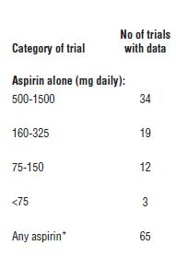
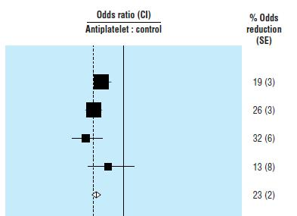

What is the benefit of ASA?
ATTC, BMJ 2002;324:71–86
Notes:
Indirect comparisons of proportional effects of different antiplatelet regimens on vascular events in high risk patients
7

Slide 8
ASA + Clopidogrel
CURE Study design
CURE
Clopidogrel 75 mg o.d.
+ standard therapy†
(n=6259)
Clopidogrel 300 mg
loading dose
Day 1
12 months
Patients with ACS
R
Day 0
(unstable angina or
NQMI without ST elevation)
Day 1
12 months
Placebo
loading dose
Placebo 1 tab o.d.
+ standard therapy†
(n=6303)
R=Randomization, occurred within 24 hours of symptom onset
†Standard therapy always included ASA, and could also include heparin, LMWH, GP IIb/IIIa inhibitors post-randomization, beta-blockers,
ACE-inhibitors, lipid-lowering agents, and/or other therapies or interventions (e.g. PTCA, CABG) at physician’s discretion.
LMWH, low-molecular-weight heparin; GP, glycoprotein; PTCA, percutaneous transluminal coronary angioplasty; CABG, coronary artery bypass graft
CURE Study Investigators. Eur Heart J 2000; 21:2033–2041. The CURE Investigators. N Eng J Med 2001;345:494-502.
Notes:
Patients were eligible for CURE if they were admitted to hospital within 24 hours of an episode of chest pain suggestive of unstable angina or non-Q-wave MI.
Patients were randomized to one of the treatments and received a loading dose of clopidogrel 300 mg or matching placebo on Day 1.
Treatment continued with either clopidogrel 75 mg or matching placebo once daily for up to 1 year.
Follow-up assessments took place at 1 and 3 months for all patients and at 6, 9 and 12 months for patients, depending on time of randomization in the study.
References
CURE Study Investigators. Eur Heart J 2000; 21:2033–2041.
The CURE Investigators. N Eng J Med 2001;345:494-502.

Slide 9
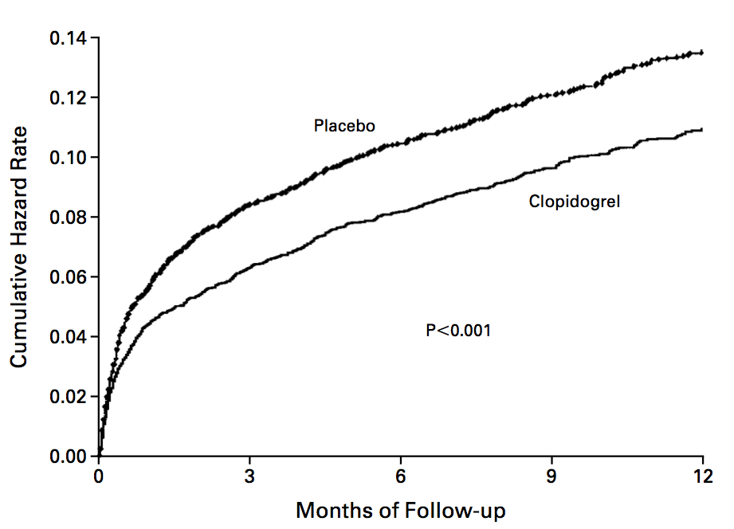
Evidence for ASA and clopidogrel
CURE trial
<30 d
RR 0.79
95% CI 0.67-0.92
11.4%
NNT 48
9.3%
>30d – End of Study
RR 0.82
95% CI 0.70-0.95
End of Study
RR 0.82
95%CI 0.67-0.92
ARR 2.1
NEJM 2001; 345: 494-502.

Slide 10

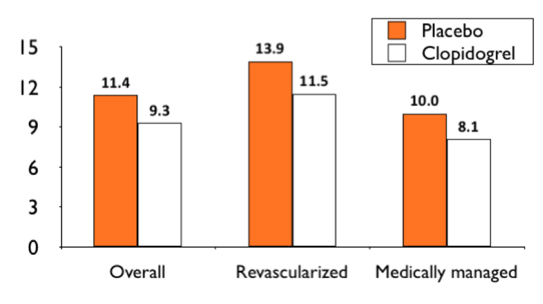
Evidence for ASA and clopidogrel
CURE trial
NEJM 2001; 345: 494-502.

Slide 11
CURE
Major bleeding by ASA dose
6.0
5.0
4.9
Placebo*
4.0
Clopidogrel*
4.0
Bleeding rate (%)
3.5
3.0
2.6
2.0
2.3
2.0
1.0
0.0
<100 mg
100-200 mg
> 200 mg
ASA dose 75-325 mg
*In addition to standard therapy (including ASA).
CURE Trial Investigators. N Engl J Med 2001;345(7):494-502.
Notes:
Notes:
The CURE trial found that more potent antiplatelet administration increased patients’ bleeding risk.
Major bleeding occurred less frequently in patients who received low-dose ASA, than in those who received a higher dose of ASA, irrespective of the use of clopidogrel.
Definition of major bleeding:
Life-threatening bleeding, which was defined as fatal or leading to one of the following: intracranial hemorrhage, drop in hemoglobin of ≥5 g/dL, substantial hypotension requiring inotropic therapy, surgical intervention, or transfusion of four or more units of blood.
Other major bleeding was defined as substantially disabling bleeding, intraocular bleeding leading to the loss of vision, or bleeding necessitating the transfusion of two to three units of blood.
Major bleeding episodes were primarily gastrointestinal hemorrhages or bleeding at the site of arterial puncture.
NOTE: SLIDE CONTAINS ANIMATION.
Reference:
CURE Trial Investigators. Effects of clopidogrel in addition to ASA in patients with acute coronary syndromes without ST-segment elevation. N Engl J Med 2001;345(7):494-502.

Slide 12
PLATO study design
NSTE-ACS (moderate-to-high risk) STEMI (if primary PCI)
Clopidogrel-treated or -naive;
randomised within 24 hours of index event
(N=18,624)
Clopidogrel
If pre-treated, no additional loading dose;
if naive, standard 300 mg loading dose,
then 75 mg qd maintenance;
(additional 300 mg allowed pre PCI)
Ticagrelor
180 mg loading dose, then
90 mg bid maintenance;
(additional 90 mg pre-PCI)
6–12-month exposure
Primary end point: CV death + MI + Stroke
Primary safety end point: Total major bleeding
Notes:
12

Slide 13
K-M estimate of time to first primary efficacy event (composite of CV death, MI or stroke)
13
12
Clopidogrel
11.7
11
10
9.8
9
8
Ticagrelor
7
Cumulative incidence (%)
6
5
4
3
2
1
HR 0.84 (95% CI 0.77–0.92), p=0.0003
0
0
60
120
180
240
300
360
No. at risk
Days after randomisation
Ticagrelor
9,333
8,628
8,460
8,219
6,743
5,161
4,147
Clopidogrel
9,291
8,521
8,362
8,124
6,743
5,096
4,047
K-M = Kaplan-Meier; HR = hazard ratio;
CI = confidence interval

Slide 14
Primary efficacy end point over time
(composite of CV death, MI or stroke)
8
8
Clopidogrel
6.60
6
6
Clopidogrel
5.43
5.28
4.77
4
Cumulative incidence (%)
Cumulative incidence (%)
4
Ticagrelor
Ticagrelor
2
2
0
HR 0.88 (95% CI 0.77–1.00), p=0.045
0
HR 0.80 (95% CI 0.70–0.91), p<0.001
0
10
20
30
31
90
150
210
270
330
Days after randomisation
Days after randomisation*
No. at risk
Ticagrelor
9,333
8,942
8,827
8,763
8,543
7,028
4,822
8,673
8,397
6,480
Clopidogrel
9,291
8,875
8,763
8,688
8,437
6,945
4,751
8,688
8,286
6,379
*Excludes patients with any primary event during the first 30 days

Slide 15
Time to major bleeding
Primary safety event
15
Ticagrelor
11.58
11.20
10
Clopidogrel
K-M estimated rate (% per year)
5
HR 1.04 (95% CI 0.95–1.13), p=0.434
0
0
60
120
180
240
300
360
Days from first IP dose
No. at risk
Ticagrelor
9,235
7,246
6,826
6,545
5,129
3,783
3,433
Clopidogrel
9,186
7,305
6,930
6,670
5,209
3,841
3,479

Slide 16
Time to non-procedure-related
Major bleeding
4
Completeness of follow-up 99.97% = five patients lost to follow-up
3
Ticagrelor
3.06%
2.31%
2
K-M estimated rate (% per year)
Clopidogrel
1
HR 1.31 (95% CI 1.08–1.60), p=0.006
0
0
60
120
180
240
300
360
Days from first IP dose
No. at risk
Ticagrelor | 9,235 | 7,641 | 7,247 | 6,979 | 5,496 | 4,067 | 3,698
Clopidogrel | 9,186 | 7,718 | 7,371 | 7,134 | 5,597 | 4,147 | 3,764
Wallentin L et al. NEJM . 2009;
361:1045-57 (Supplementary Appendix).

Slide 17
Prasugrel?
  Efficacy benefit over clopidogrel in patients undergoing PCI in TRITON TIMI-38 but with increased bleeding risk
  Medically-managed ACS not studied

Slide 18
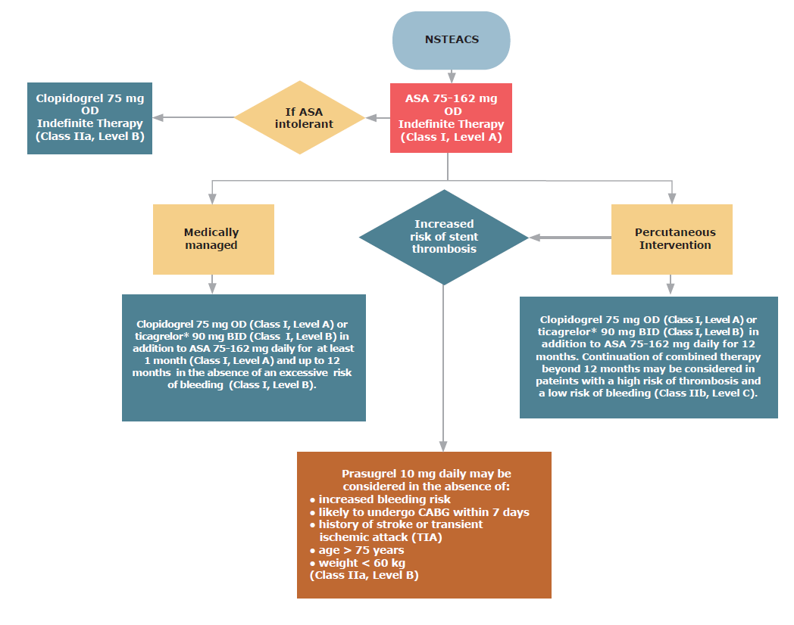

Slide 19
Antiplatelet therapy for secondary prevention in the first year following an acute coronary syndrome
For all patients with ACS who survive to hospital discharge, indefinite therapy with low-dose ASA (75-162 mg daily) is recommended (Class I, Level A). For patients allergic to or intolerant of ASA, indefinite therapy with clopidogrel 75 mg daily is recommended (Class IIa, Level B).
For patients presenting with NSTEACS who are medically managed, clopidogrel 75 mg daily is recommended in addition to ASA 75-162 mg daily for at least 1 month (Class I, Level A) and up to 12 months in the absence of an excessive risk of bleeding (Class I, Level B).
For patients presenting with STEMI who are medically managed, clopidogrel 75 mg daily is recommended in addition to ASA 75-162 mg daily for at least 14 days (Class I, Level B) and up to 12 months in the absence of an excessive risk of bleeding (Class IIb, Level C).
For patients with ACS, ticagrelor 90 mg twice daily may be added to ASA 75-162 mg daily for 12 months (Class I, Level B).

Slide 20
Arthur
Our patient experienced an uncomplicated NSTEACS (NSTEMI) medically managed.
He is discharged from hospital on the usual cocktail of Statin, ACEI and Beta blocker.
His discharge antiplatelet regimen is:
  ASA 81 mg OD with a view to lifetime use
  Clopidogrel 75 mg OD with a view to 1 year of use but:
    This may be discontinued after a minimum of 1 month if there is a high risk of bleeding.
    This may be continued beyond 1 year if there is a high risk of thrombosis and low risk of bleeding.

Slide 21
ARTHUR UNDERWENT PCI?
WITH A BARE METAL STENT (BMS)
WITH A DRUG ELUTING STENT (DES)
What if…
Notes:
21

Slide 22
PCI Arthur
What antiplatelet therapy would you recommend on discharge expect him to be receiving?
  ASA 81 mg od indefinitely
  ASA 81 mg od indefinitely + a platelet P2Y12 inhibitor for 1 month
  ASA 81 mg od indefinitely + a platelet P2Y12 inhibitor for 12 months

Slide 23

PCI-CURE: Overall long-term† results
Composite of cardiovascular death or MI from randomization to end of follow-up†
0.15
12.6%
31% RRR
p=0.002
8.8%
0.10
Cumulative hazard rates (%)
Standard therapy‡
Clopidogrel
+ standard therapy‡
0.05
NNT = 26
0.0
0
10
40
100
200
300
400
Days of follow-up
a
b
†up to 12 months
‡including ASA
The CURE Investigators. Lancet August 2001
a = median time from randomization to PCI (10 days)
b = 30 days after median time of PCI
Notes:
Slide 9 PCI-CURE – Overall Long-term† Results
Composite of cardiovascular death or MI from randomization to end of follow-up
For the endpoint of cardiovascular death or MI from time of randomization to end of follow-up treatment with clopidogrel on top of standard therapy (including ASA) resulted in a 31% RRR (8.8% clopidogrel vs.. 12.6% placebo, p=0.002).
The curves diverged within hours and continued to separate over the course of 12 months.
This endpoint included events that were prevented prior to PCI,
in addition to those following the procedure.
There were consistent reductions in cardiovascular death or MI in almost every subgroup examined.
†up to 12 months
Reference
The CURE Trial Investigators. Effect of clopidogrel and aspirin pre-treatment followed by long term therapy in patients undergoing percutaneous coronary intervention: The PCI-CURE Study. Lancet August 2001.

Slide 24
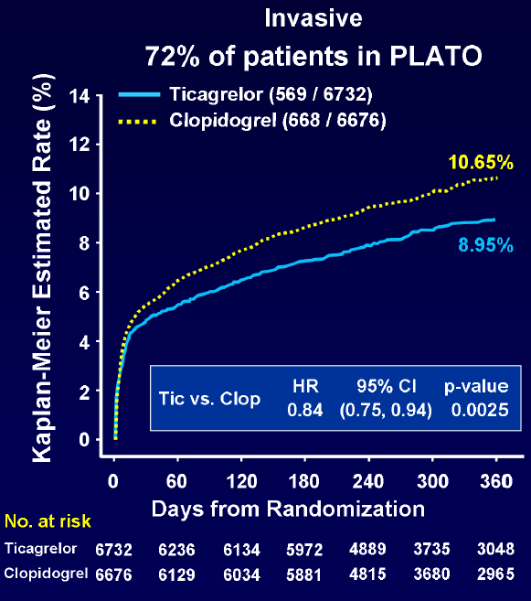
Ticagrelor in patients managed with PCI
NNT = 59
Adapted from http://www.fda.gov/downloads/AdvisoryCommittees/CommitteesMeetingMaterials/Drugs/CardiovascularandRenalDrugsAdvisoryCommittee/UCM221384.pdf

Slide 25
TRITON TIMI 38: Study Design
ACS (STEMI or UA/NSTEMI) & Planned PCI
ASA
N= 13,600
Double-blind
CLOPIDOGREL
300 mg LD/ 75 mg MD
PRASUGREL
60 mg LD/ 10 mg MD
Median duration of therapy - 12 months
1º endpoint: CV death, MI, Stroke
2º endpoints: CV death, MI, Stroke, Rehosp-Rec Isch, CV death, MI, UTVR
Stent Thrombosis (ARC definite/prob.)
Safety endpoints: TIMI major bleeds, Life-threatening bleeds
Wiviott, et al. N Engl J Med 2007;357
Notes:
25

Slide 26
Primary endpoint
CV death, MI, stroke
TRITON TIMI 38
15
Clopidogrel
12.1
(781)
10
9.9 (643)
Primary Endpoint (%)
Prasugrel
HR 0.81
(0.73-0.90)
P=0.0004
HR 0.80
P=0.0003
5
HR 0.77
P=0.0001
NNT= 46
ITT= 13,608
LTFU = 14 (0.1%)
0
0
30
60
90
180
270
360
450
Wiviott, et al. N Engl J Med 2007;357
Days
Notes:
26

Slide 27
Bleeding events
Safety cohort (N=13,457)
TRITON TIMI 38: Study design
Clopidogrel
ICH in Pts w
Prior Stroke/TIA
(N=518)
Prasugrel
Clop 0 (0) %
Pras 6 (2.3)%
(P=0.02)
% Events
ARD 0.6%
HR 1.32
P=0.03
NNH=167
ARD 0.5%
HR 1.52
P=0.01
ARD 0.2%
P=0.23
ARD 0.3%
P=0.002
ARD 0%
P=0.74
Wiviott, et al. N Engl J Med 2007;357
Notes:
27
27

Slide 28
BARE METAL VS DRUG ELUTING STENT

Slide 29
Stent thrombosis
Stent thrombosis occurs following 0.5%-2% of stent placements.
Major safety concern with rates of mortality as high as 45%
Occurs most frequently in the first month after stent implantation (subacute).
Cases of late (30 days to 1 year) and very late (> 1 year) stent thrombosis occur particularly in DES recipients.

Slide 30
Stent thrombosis
Predictors of late stent thrombosis
  Drug Eluting Stent
  Stenting of small vessels
  Presence of multiple lesions
  Long segments implanted with overlapping stents
  Stenting of ostial bifurcation lesions
  Suboptimal stent deployment
  Decreased left ventricular function
  Advanced age
  Diabetes
  Renal failure
  ACS

Slide 31
Stent thrombosis
Drug Eluting vs Bare Metal
Median time to stent thrombosis
20
p = 0.0003
p = 0.0052
p = 0.04
16
12
Months
8
4
0
DES BMS
SES BMS
PES BMS
Bavry AA, et al. Am J Med. 2006;119:1056-61.
Notes:
The median time of late SES thrombosis was 15.5 months with a range of 173 to 773 days, whereas the median time of late BMS thrombosis was 4 months with a range of 40 to 181 days. The median time of late PES thrombosis was 18 months with a range of 40 to 548 days, whereas the median time of late BMS thrombosis was 3.5 months with a range of 105 to 109 days.
Although current guidelines recommend that clopidogrel be continued for 1 year post DES, the figure illustrates that approximately one-third of patients will experience stent thrombosis after the 12-month period, suggesting that perhaps longer-term therapy with clopidogrel may be warranted in DES patients.
Reference:
Bavry AA, Kumbhani DJ, Helton TJ, et al. Late thrombosis of drug-eluting stents: a meta-analysis of randomized clinical trials. Am J Med. 2006;119(12):1056-61.

Slide 32
Incidence of very late stent thrombosis > 1 Year
Per 1,000 pts
7
RR = 5.7
p = 0.049
RR = 5.0
p = 0.02
6
5
4
p = 0.22
3
2
1
0
DES BMS
SES BMS
PES BMS
Bavry AA, et al. Am J Med. 2006;119:1056-61.
Notes:
Bavry and colleagues performed a meta-analysis on 14 contemporary clinical trials that randomized 6675 patients to DES (paclitaxel-eluting stents [PES] or sirolimus-eluting stents [SES]) compared with BMS. Eight of these trials have reported more than a year of clinical follow-up.
The incidence of very late thrombosis (>1 year after the index procedure) was 5.0 events per 1000 DES patients, with no events in BMS patients (risk ratio [RR]=5.02, 95% CI, 1.29 to 19.52, P=0.02). Among SES trials, the incidence of very late thrombosis was 3.6 events per 1000 SES, with no events in BMS patients (RR=3.99, 95% CI, 0.45 to 35.62, P=.22).
The investigators concluded that although the incidence of very late stent thrombosis (more than 1 year after coronary revascularization) is low, DES appear to increase the risk for late thrombosis. Although more of this risk was seen with PES, it remains possible that SES similarly increase the risk for late thrombosis compared with BMS.
Reference:
Bavry AA, Kumbhani DJ, Helton TJ, et al. Late thrombosis of drug-eluting stents: a meta-analysis of randomized clinical trials. Am J Med. 2006;119(12):1056-61.

Slide 33
Discontinuation of Thienopyridine therapy after DES implantation
MI patients who stopped thienopyridine therapy by 30 days post-DES were more likely to die during the next 11 months
15
Continued
Discontinued
Adjusted hazard ratio
9.0; 95% CI = 1.3 to 60.6
10
Mortality (%)
5
P<0.001
0
0
1
2
3
4
5
6
7
8
9
10
11
12
Months
Spertus JA, et al. Circulation. 2006;113:2803–2809.
Notes:
Data were used from a prospective 19-centre study of MI patients to examine the prevalence and predictors of thienopyridine discontinuation 30 days after DES treatment. Mortality and cardiac hospitalization rates for the next 11 months were compared between those who stopped and those who continued thienopyridine therapy. Among 500 DES-treated MI patients who were discharged on thienopyridine therapy, 68 (13.6%) stopped therapy within 30 days. Those who stopped were older, less likely to have completed high school or be married, more likely to avoid health care because of cost, and more likely to have had pre-existing cardiovascular disease or anemia at presentation. They were also less likely to have received discharge instructions about their medications or a cardiac rehabilitation referral. Patients who stopped thienopyridine therapy by 30 days were more likely to die during the next 11 months (7.5% versus 0.7%, P<0.0001; adjusted hazard ratio=9.0; 95% CI=1.3 to 60.6) and to be re-hospitalized (23% versus 14%, P=0.08; adjusted hazard ratio=1.5; 95% CI=0.78 to 3.0).
Reference:
Spertus JA, Kettelkamp R, Vance C, et al. Prevalence, predictors, and outcomes of premature discontinuation of thienopyridine therapy after drug-eluting stent placement: results from the PREMIER registry. Circulation. 2006;113:2803–2809.

Slide 34
BASKET LATE
Late thrombotic events following Thienopyridine discontinuation
Cardiac death or MI
P=0.01
MI
P=0.04
Percentage (%)
Percentage (%)
Drug-eluting stents
Bare-metal stents
Pfisterer ME, et al. J Am Coll Cardiol. 2006;48(12)
Notes:
In the original BAsel Stent Kosten-Effekivitäts Trial (BASKET), a rather complex patient population was enrolled and randomized to receive one of the following: a BMS, PES, or SES and the cost effectiveness of DES vs BMS was evaluated.
In the BASKET LATE (BAsel Stent Kosten-Effekivitäts Trial-LAte Thrombotic Events) trial, the 743 patients from the BASKET trial who were MACE (major adverse cardiac event) free at 6 months were followed for an additional 12 months after the cessation of clopidogrel treatment. The BASKET LATE trial pooled the PES and SES groups into one DES group for analysis. The goal of BASKET LATE was to evaluate late thrombotic events among patients treated with DES vs BMS after clopidogrel discontinuation. The primary endpoint was a composite of cardiac death or non-fatal MI.
In the year following clopidogrel discontinuation, the primary composite endpoint of cardiac death or MI occurred significantly more frequently in the DES group than in the BMS group (4.9% vs 1.3%, P=0.01). non-fatal MI was also higher in the DES group compared with the BMS group (4.1% vs 1.3%, P=0.04).
Reference:
Pfisterer M, Brunner-La Rocca HP, Buser PT, et al. Late clinical events after clopidogrel discontinuation may limit the benefit of drug-eluting stents: an observational study of drug-eluting versus bare-metal stents. J Am Coll Cardiol. 2006;48(12):2584-2591.

Slide 35
Clopidogrel use and long-term outcomes after BMS or DES stenting
Adjusted cumulative rates of composite of death or MI using the 6-month landmark analysis
Composite of Death or MI
8
DES
With Clopidogrel
6
Without Clopidogrel
4
Cumulative Incidence (%)
BMS
With Clopidogrel
2
Without Clopidogrel
0
6
12
18
24
Months
Eisenstein EL, et al. JAMA. 2007;297(2):159-68.
Notes:
Eisenstein and colleagues assessed the association between clopidogrel use and long-term clinical outcomes of patients receiving drug-eluting stents (DES) and bare-metal stents (BMS) for treatment of coronary artery disease. This was an observational study examining consecutive patients receiving intracoronary stents at Duke Heart Center, a tertiary care medical center in Durham, NC, between January 1, 2000, and July 31, 2005, with follow-up contact at 6, 12, and 24 months through September 7, 2006. The study population included 4666 patients undergoing initial PCI with BMS (n=3165) or DES (n=1501). Landmark analyses were performed among patients who were event-free (no death, MI, or revascularization) at 6- and 12-month follow-up. At these points, patients were divided into 4 groups based on stent type and self-reported clopidogrel use: DES with clopidogrel, DES without clopidogrel, BMS with clopidogrel, and BMS without clopidogrel.
Among patients with DES who were event-free at 12 months (252 with and 276 without clopidogrel), clopidogrel use continued to predict lower rates of death (0% vs 3.5%; difference, -3.5%; 95% CI, -5.9% to -1.1%; P=0.004) and death or MI (0% vs 4.5%; difference, -4.5%; 95% CI, -7.1% to -1.9%; P<.001) at 24 months. However, among patients with BMS (346 with and 1644 without clopidogrel), there continued to be no differences in death (3.3% vs 2.7%; difference, 0.6%; 95% CI, -1.5% to 2.8%; P=0.57) and death or MI (4.7% vs 3.6%; difference, 1.0%; 95% CI, -1.6% to 3.6%; P=0.44).
The extended use of clopidogrel in patients with DES may be associated with a reduced risk for death and death or MI. However, the appropriate duration for clopidogrel administration can only be determined within the context of a large-scale randomized clinical trial.
Reference:
Eisenstein EL, Anstrom KJ, Kong DF, et al. Clopidogrel use and long-term clinical outcomes after drug-eluting stent implantation. JAMA. 2007;297(2):159-68.

Slide 36
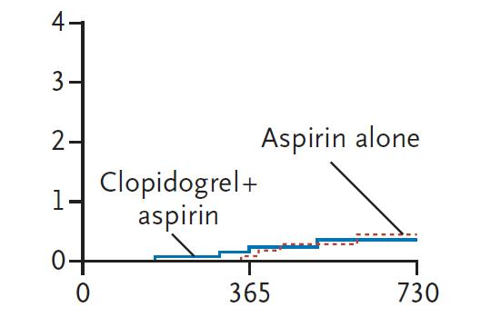
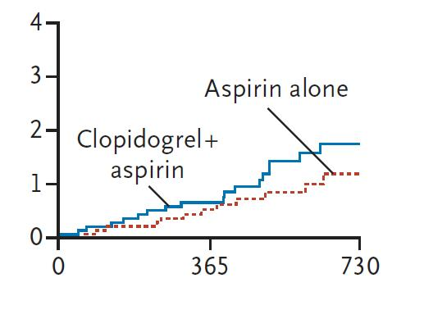
REAL-LATE/ZEST-LATE
2701 patients who had received drug eluting stents
Free of major adverse cardiac or cerebrovascular events and major bleeding for a period of at least 12 months
Randomized open label to receive clopidogrel plus aspirin or aspirin alone
Definite Stent Thrombosis
Cumulative Incidence (%)
Cumulative Incidence (%)
Days from Randomization
Days from Randomization
Park SJ, Park DW, et al. N Engl J Med 2010;362
Notes:
Background
The potential benefits and risks of the use of dual antiplatelet therapy beyond a
12-month period in patients receiving drug-eluting stents have not been clearly established.
Methods
In two trials, we randomly assigned a total of 2701 patients who had received drug eluting
stents and had been free of major adverse cardiac or cerebrovascular events
and major bleeding for a period of at least 12 months to receive clopidogrel plus aspirin
or aspirin alone. The primary end point was a composite of myocardial infarction or
death from cardiac causes. Data from the two trials were merged for analysis.
Results
The median duration of follow-up was 19.2 months. The cumulative risk of the primary
outcome at 2 years was 1.8% with dual antiplatelet therapy, as compared with
1.2% with aspirin monotherapy (hazard ratio, 1.65; 95% confidence interval [CI],
0.80 to 3.36; P = 0.17). The individual risks of myocardial infarction, stroke, stent
thrombosis, need for repeat revascularization, major bleeding, and death from any
cause did not differ significantly between the two groups. However, in the dual-therapy
group as compared with the aspirin-alone group, there was a nonsignificant increase
in the composite risk of myocardial infarction, stroke, or death from any cause (hazard
ratio, 1.73; 95% CI, 0.99 to 3.00; P = 0.051) and in the composite risk of myocardial
infarction, stroke, or death from cardiac causes (hazard ratio, 1.84; 95% CI, 0.99
to 3.45; P = 0.06).
CONCLUSIONS
The use of dual antiplatelet therapy for a period longer than 12 months in patients
who had received drug-eluting stents was not significantly more effective than aspirin
monotherapy in reducing the rate of myocardial infarction or death from
cardiac causes. These findings should be confirmed or refuted through larger,
randomized clinical trials with longer-term follow-up. (ClinicalTrials.gov numbers,
NCT00484926 and NCT00590174.)
36

Slide 37
Antiplatelet therapy for secondary prevention in the first year following percutaneous coronary intervention
Indefinite therapy with ASA 75-162 mg daily should be used in all patients with acute or chronic ischemic heart disease without contraindications to its therapy (Class I, Level A). This includes patients who have undergone PCI.
All patients who have undergone PCI with bare-metal stent (BMS) implantation should be given clopidogrel 75 mg daily in addition to ASA 75-162 mg daily for at least 1 month (Class I, Level B) and up to 12 months in the absence of an excessive risk of bleeding (Class I, Level B) after stent implantation.
For patients with recent bleeding or at increased risk for bleeding, a BMS should be implanted and clopidogrel 75 mg daily should be added to ASA 75-162 mg daily for a minimum of 2 weeks (Class I, Level B).
All patients who have undergone PCI with DES implantation should be given clopidogrel 75 mg daily in addition to ASA 75-162 mg daily for 12 months (Class I, Level A).

Slide 38
Antiplatelet therapy for secondary prevention in the first year following percutaneous coronary intervention
Continuation of dual antiplatelet therapy with ASA 75-162 mg daily and clopidogrel 75 mg daily beyond 1 year may be considered in patients wit an increased risk of stent thrombosis as long as the perceived risk of bleeding is deemed acceptable (Class IIb, Level C).
For patients with ACS who undergo stent implantation and have an increased risk of stent thrombosis (eg, STEMI, history of diabetes mellitus, or prior documented stent thrombosis), prasugrel 10 mg daily may be considered in addition to ASA 75-162 mg daily for 12 months (Class IIa, Level B). Prasugrel should be avoided in patients with an increased bleeding risk, likely to undergo CABG within 7 days, with a history of stroke or TIA, aged ≥75 years, or weight <60 kg (Class III, Level B).
For patients with ACS who undergo stent implantation, ticagrelor 90 mg twice daily may be added to ASA 75-162 mg daily for 12 months (Class I, Level B).

Slide 39
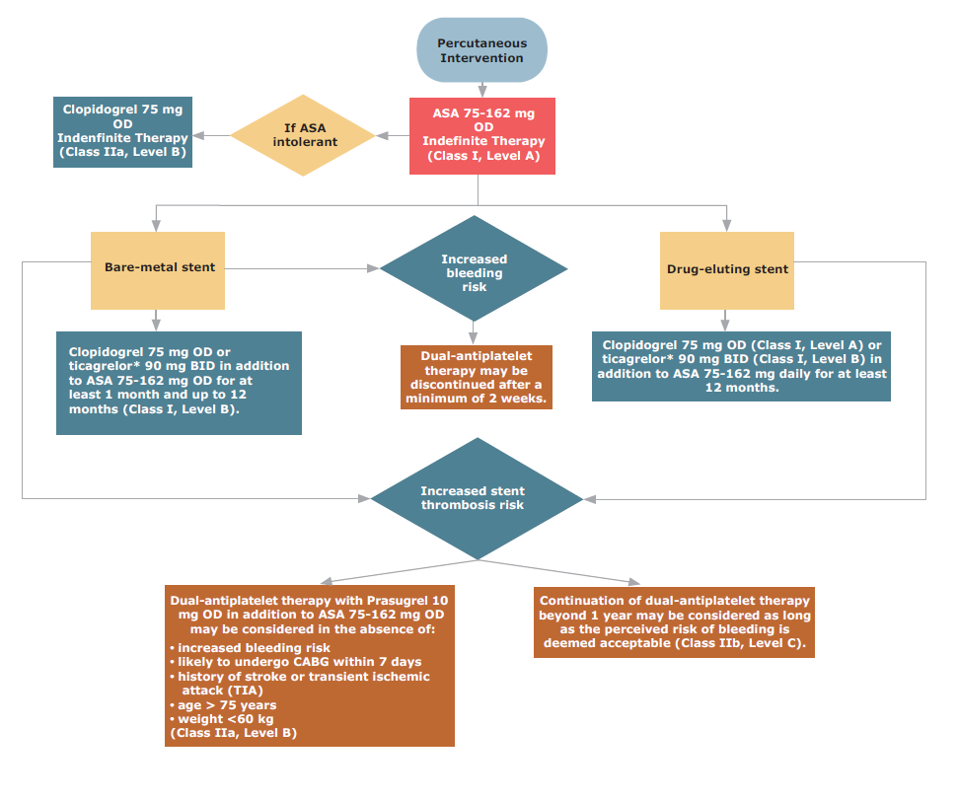

Slide 40
PCI Arthur
Arthur is discharged following the same uncomplicated NSTEMI, but managed with a single, short, wide lumen DES in the mid-LAD.
In addition to the usual meds, his discharge antiplatelet regimen is:
  ASA 81 mg OD with a view to lifetime use
  Clopidogrel 75 mg OD with a view to 1 year of use but:
    This may be continued beyond 1 year if there is a high risk of thrombosis and low risk of bleeding.
    Due to the risk of stent thrombosis with a DES, dual antiplatelet therapy should NOT be discontinued prior to 1 year.

Slide 41
ARTHUR WAS AT INCREASED THROMBOTIC RISK?
What if…

Slide 42
High-risk Arthur
If Arthur is an obese diabetic and suffered a STEMI, treated with multiple complex DES, how would that influence your antiplatelet management?
  I would treat him the same.
  I would consider a longer course of dual antiplatelet therapy.
  I would consider a shorter course of dual antiplatelet therapy.
  I would consider the use of prasugrel or ticagrelor over clopidogrel.

Slide 43
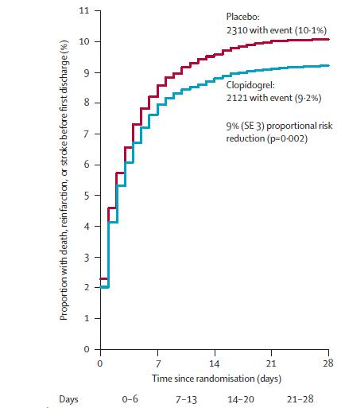
COMMIT
45,852 patients
Randomized within 24 h of MI
93% STEMI
Clopidogrel 75 mg daily or matching placebo in addition to aspirin 162 mg daily
Followed for 4 weeks or discharge
Mean follow up 15 days
  COMMIT Collaborative Group. Lancet 2005; 366:
Notes:
Lancet. 2005 Nov 5;366(9497):1607-21.
Addition of clopidogrel to aspirin in 45,852 patients with acute myocardial infarction: randomised placebo-controlled trial.
Chen ZM, Jiang LX, Chen YP, Xie JX, Pan HC, Peto R, Collins R, Liu LS; COMMIT (ClOpidogrel and Metoprolol in Myocardial Infarction Trial) collaborative group.
Source
Clinical Trial Service Unit and Epidemiological Studies Unit (CTSU), Richard Doll Building, Old Road Campus, Oxford OX3 7LF, UK. zhengming.chen@ctsu.ox.ac.uk
Abstract
BACKGROUND:
Despite improvements in the emergency treatment of myocardial infarction (MI), early mortality and morbidity remain high. The antiplatelet agent clopidogrel adds to the benefit of aspirin in acute coronary syndromes without ST-segment elevation, but its effects in patients with ST-elevation MI were unclear.
METHODS:
45,852 patients admitted to 1250 hospitals within 24 h of suspected acute MI onset were randomly allocated clopidogrel 75 mg daily (n=22,961) or matching placebo (n=22,891) in addition to aspirin 162 mg daily. 93% had ST-segment elevation or bundle branch block, and 7% had ST-segment depression. Treatment was to continue until discharge or up to 4 weeks in hospital (mean 15 days in survivors) and 93% of patients completed it. The two prespecified co-primary outcomes were: (1) the composite of death, reinfarction, or stroke; and (2) death from any cause during the scheduled treatment period. Comparisons were by intention to treat, and used the log-rank method. This trial is registered with ClinicalTrials.gov, number NCT00222573.
FINDINGS:
Allocation to clopidogrel produced a highly significant 9% (95% CI 3-14) proportional reduction in death, reinfarction, or stroke (2121 [9.2%] clopidogrel vs 2310 [10.1%] placebo; p=0.002), corresponding to nine (SE 3) fewer events per 1000 patients treated for about 2 weeks. There was also a significant 7% (1-13) proportional reduction in any death (1726 [7.5%] vs 1845 [8.1%]; p=0.03). These effects on death, reinfarction, and stroke seemed consistent across a wide range of patients and independent of other treatments being used. Considering all fatal, transfused, or cerebral bleeds together, no significant excess risk was noted with clopidogrel, either overall (134 [0.58%] vs 125 [0.55%]; p=0.59), or in patients aged older than 70 years or in those given fibrinolytic therapy.
INTERPRETATION:
In a wide range of patients with acute MI, adding clopidogrel 75 mg daily to aspirin and other standard treatments (such as fibrinolytic therapy) safely reduces mortality and major vascular events in hospital, and should be considered routinely.
43

Slide 44
Patient disposition
18,758 patients enrolled in PLATO
STEMI
134 patients not randomized
18,624 patients randomized
NSTEMI/UA/other: 10,194 patients
STEMI: 8,430 patients
Randomized to ticagrelor*: efficacy population N= 4,201
Randomized to clopidogrel: efficacy population N= 4,229
No intake of study medication: 36 patients
No intake of study medication: 48 patients
Safety population N=4,165
∗ Currently under review by Health Canada. All recommendations concerning ticagrelor are conditional on approval by Health Canada.
Safety population N=4,181
Notes:
44

Slide 45
Primary end point: CV death, MI or stroke
STEMI
12
11
10
9
8
7
6
5
4
3
2
1
0
Clopidogrel
11.0
9.3
Ticagrelor*
K-M estimated rate (% per year)
∗Currently under review by Health Canada. All recommendations concerning ticagrelor are conditional on approval by Health Canada.
HR: 0.85 (95% CI = 0.74–0.97), p=0.02
0 1 2 3 4 5 6 7 8 9 10 11 12
No. at risk
Months
Ticagrelor
4,201
3,887
3,834
3,732
3,011
2,297
1,891
Clopidogrel
4,229
3,892
3,823
3,730
3,022
2,333
1,868
Notes:
45

Slide 46
CV death, MI, stroke
Major subgroups
TRITON TIMI 38
Reduction in risk (%)
UA/NSTEMI
18
26% of enrolled population
STEMI
B
21
Male
21
Female
12
<65
25
Age
65-74
14
>75
6
No DM
14
DM
30
BMS
20
DES
18
GPI
21
No GPI
16
CrCl < 60
14
CrCl > 60
20
OVERALL
19
P_{inter} = NS
0.5
Prasugrel Better
1
Clopidogrel Better
2
Wiviott, et al. N Engl J Med 2007;357
HR
Notes:
46

Slide 47
High-risk Arthur
Discharged following STEMI, managed by primary PCI with multiple, long DES, one of which is at an ostial bifurcation
In addition to statin, ACEI and beta blocker his antiplatelet regimen is:
  ASA 81 mg OD with a view to lifetime use
  Prasugrel 10 mg OD with a view to 1 year of use but:
    This may be continued beyond 1 year if there is a high risk of thrombosis and low risk of bleeding.
    Due to the risk of stent thrombosis with a DES, dual antiplatelet therapy should NOT be discontinued prior to 1 year.

Slide 48
High-risk Arthur
Prasugrel is considered in view of multiple high risk features including:
  STEMI
  Diabetes
  Ostial bifurcation lesion
  Long, DES stent implantation
Absence of:
  Advanced age (>75 yrs)
  History of cerebrovascular disease
  Body weight < 60 kg

