Slide 1
Disclaimer
The Canadian Cardiovascular Society (CCS) welcomes reuse of our Guideline educational slide decks.
For medical institution internal education or training (i.e. grand rounds, medical college/classroom education, etc.), kindly consider and implement the following:
  Include the citation for the Canadian Journal of Cardiology
  Add ‘Reproduced with permission from the Canadian Cardiovascular Society. [insert year].’
  Avoid use of CCS logos or trademarks on slides, tools or publications that are not the property of the CCS
  Do not modify the slide content and, the layout and CCS branding on the Guideline-related slides
  Guideline recommendations must be reproduced exactly as published
For an industry supported or involved program, permissions are required:
  If content is published in the Canadian Journal of Cardiology, permissions must be sought through our publisher Elsevier (www.onlinecjc.com)
  If content is property of the CCS, contact guidelines@ccs.ca

Slide 2


CCS ǀ CHRS
Comprehensive Atrial Fibrillation Guidelines:
A fresh look for 2020
October 2020

Slide 3
© Canadian Cardiovascular Society. 2020. All rights reserved.
Distribution, transmission or republication is strictly prohibited without the prior written permission of the Canadian Cardiovascular Society.

Slide 4
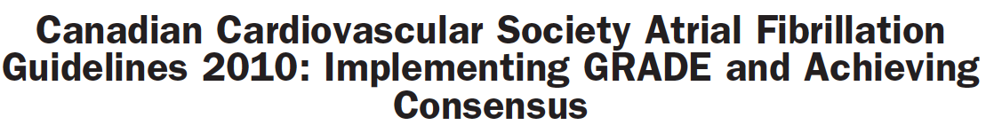


Gillis et al. Canadian Journal of Cardiology 2011;27:27-30
Skanes et al. Canadian Journal of Cardiology 2012;28:125-36
Verma et al. Canadian Journal of Cardiology 2014;30:1114-30
Macle et al. Canadian Journal of Cardiology 2015;31:1207-18
Macle et al. Canadian Journal of Cardiology 2016;32:1170-85
Andrade et al. Canadian Journal of Cardiology 2018;34:1371-92
Notes:
LAURENT
The Canadian Cardiovascular Society (CCS) Atrial Fibrillation (AF) Guidelines committee provides periodic reviews of new data to produce focused updates that address clinically-important advances in AF management.
The 2020 iteration of the CCS AF guidelines represents a comprehensive renewal that integrates, updates and replaces the past decade of guidelines, recommendations, and practical tips. It is intended to be used by practising clinicians across all disciplines who care for patients with AF.

Slide 5
Authors
2020 CCS/CHRS Comprehensive Guidelines for the Management of Atrial Fibrillation
Primary Panel: Jason G. Andrade (co-chair), Laurent Macle (co-chair), Martin Aguilar, Clare Atzema, Alan Bell, John A. Cairns, Christopher C. Cheung, Jafna L. Cox, Paul Dorian, David J. Gladstone, Jeff S. Healey, Paul Khairy, Kori Leblanc, M. Sean McMurtry, L. Brent Mitchell, Girish M. Nair, Stanley Nattel, Ratika Parkash, Louise Pilote, Roopinder K. Sandhu, Jean-François Sarrazin, Mukul Sharma, Allan C. Skanes, Mario Talajic, Teresa S. M. Tsang, Atul Verma, Subodh Verma, Richard Whitlock, D. George Wyse
Secondary Panel: David Bewick, Vidal Essebag, Peter Guerra, Milan Gupta, Brett Heilbron, George Klein, Simon Kouz, Daniel Ngui, Pierre Pagé, Calum Redpath, Jan Surkes

Slide 6
2020 CCS/CHRS Comprehensive Guidelines for the Management of Atrial Fibrillation
Methodology: Grading of Recommendations Assessment, Development and Evaluation (GRADE)
  Quality of Evidence:
  High: Further research is very unlikely to change our confidence in the estimate of effect
  Moderate: Further research is likely to have an important impact on our confidence in the estimate of effect and may change the estimate
  Low: Further research is very likely to have an important impact on our confidence in the estimate of effect and is likely to change the estimate
  Very Low: Any estimate of effect is very uncertain
For more information on the GRADE process and development of recommendations visit www.ccs.ca.
Notes:
LAURENT
This document was developed in accordance with CCS best practices and the Grading of Recommendations, Assessment, Development, and Evaluation (GRADE) approach.⁹ The primary panelists developed the scope of the document, identified topics for review, performed the literature review, evaluated the quality of evidence, and drafted the recommendations. A systematic search was performed to identify relevant studies within each topic, including systematic reviews and meta-analyses. Draft recommendations were presented, reviewed, and refined by the primary panel. Final review was performed by the primary and secondary panels, with each recommendation achieving more than 90% agreement.
Peer review of the guideline document was provided by external content experts, patient partners, and the CCS Guidelines Committee. The final draft was presented and approved by the CCS Executive Committee.
Quality of evidence was evaluated according to the GRADE approach. Evidence derived from randomised clinical trials (RCTs) was initially estimated as high quality evidence, with observational evidence initially deemed low quality evidence. These estimates were further refined through detailed appraisal into four categorical grades (“high,” “moderate,” “low,” and “very low”) based on a consideration of the risk of bias, confounding, consistency of results, directness of evidence, precision, publication bias, magnitude of effect, and dose-response gradient.

Slide 7
2020 CCS/CHRS Comprehensive Guidelines for the Management of Atrial Fibrillation
Methodology: Grading of Recommendations Assessment, Development and Evaluation (GRADE)
Strength of a Recommendation:
  Quality of evidence: The higher the quality of evidence, the greater the probability that a strong recommendation is indicated
  Difference between desirable and undesirable effects: The greater the difference between desirable and undesirable effects, the greater the probability that a strong recommendation is indicated
  Values and preferences: The greater the variation or uncertainty in values and preferences, the higher the probability that a conditional recommendation is indicated
  Cost: The higher the cost, the lower the likelihood that a strong recommendation is indicated
For more information on the GRADE process and development of recommendations visit www.ccs.ca.
Notes:
LAURENT
This document was developed in accordance with CCS best practices and the Grading of Recommendations, Assessment, Development, and Evaluation (GRADE) approach.⁹ The primary panelists developed the scope of the document, identified topics for review, performed the literature review, evaluated the quality of evidence, and drafted the recommendations. A systematic search was performed to identify relevant studies within each topic, including systematic reviews and meta-analyses. Draft recommendations were presented, reviewed, and refined by the primary panel. Final review was performed by the primary and secondary panels, with each recommendation achieving more than 90% agreement.
Peer review of the guideline document was provided by external content experts, patient partners, and the CCS Guidelines Committee. The final draft was presented and approved by the CCS Executive Committee.
Quality of evidence was evaluated according to the GRADE approach. Evidence derived from randomised clinical trials (RCTs) was initially estimated as high quality evidence, with observational evidence initially deemed low quality evidence. These estimates were further refined through detailed appraisal into four categorical grades (“high,” “moderate,” “low,” and “very low”) based on a consideration of the risk of bias, confounding, consistency of results, directness of evidence, precision, publication bias, magnitude of effect, and dose-response gradient.
Following this evaluation, the strength of recommendation was determined by considering the balance between desirable and undesirable effects (i.e. risk-benefit), confidence in the magnitude of effect (quality of evidence), patient values and preferences, as well as resource considerations.
The strength of recommendation was graded as “strong” (the desirable effects outweigh the undesirable effects, and therefore, most individuals will be best served by the recommended course of action) or “weak” (the desirable effects probably outweigh the undesirable effects, indicating that there is a need to consider the individual patient’s clinical details, circumstances, values, and preferences).

Slide 8
Overview of Topics
Content
  Classification and Definitions
  Epidemiology
  Pathophysiology
  Clinical Evaluation
  Screening and Opportunistic AF Detection
  Detection and Management of Modifiable Risk Factors
  Integrated Approach to AF Management
  Stroke Prevention
  Arrhythmia Management
  Sex Differences
  Atrial Fibrillation and Special Populations
Notes:
2020 iteration of the CCS AF guidelines represents a comprehensive renewal that integrates, updates and replaces the past decade of guidelines, recommendations, and practical tips. It is intended to be used by practising clinicians across all disciplines who care for patients with AF.
Total: 130 recommendations

Slide 9
Key Considerations for Stroke Prevention in AF

Slide 10
CCS Stroke Risk Assessment and Antithrombotic Rx
2010 – CHADS₂
2012 – based on CHA₂DS₂-VASc
2014 – Present – CHADS-65
Decision based on:
  A cut off for OAC at annual risk of stroke > 1.5% / year
    OAC increases the risk of bleeding 0.5 – 1% / year
    OAC reduces the risk of stroke by 66+%
    Risk of major bleeding increases < risk of stroke as risk factors accumulate
    Impact of stroke > Impact of major bleeding
  No role for ASA in SPAF

Slide 11
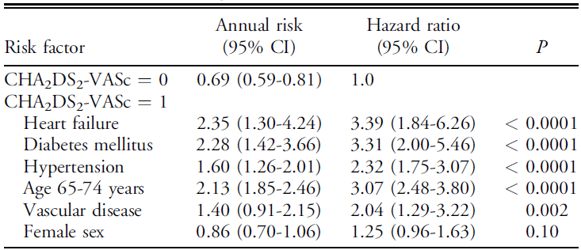
Annual Stroke Rate by Risk Factor
Olesen JB, Lip GY, Hansen ML, et al. BMJ 2011;342:d124

Slide 12
CHADS-65

Slide 13
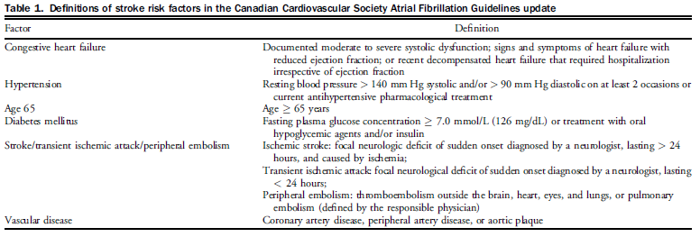
Definition of Risk Factors

Slide 14
Choice of Anticoagulant
DOAC preferred over Warfarin
  Efficacy at least as good
  Bleeding less particularly ICH
  Convenience
No head to head comparisons between DOAC
“Real World” data plentiful but too subject to bias for decision making

Slide 15
Valvular AF
We recommend that warfarin be used for those patients with a mechanical prosthetic valve and those with AF and moderate-to-severe mitral stenosis (Strong Recommendation; Moderate-Quality Evidence).
RE-ALIGN -> ↑ TE and bleeding events in patients with mechanical valves
No current RCT of DOAC in mitral stenosis
  RIVER (bioprosthetic mitral valve)
  INVICTUS (rheumatic heart disease)

Slide 16
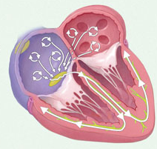
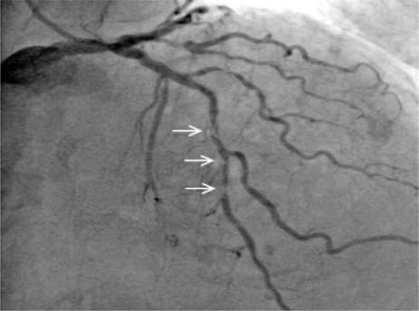
Concomitant AF and CAD
Up to 30% of patients with AF also have CAD
Atrial Fibrillation
Coronary Artery Disease
Singer DE, et al. Ann Intern Med 2009;151:297-305

Slide 17
Management of CAD + AF
STROKE RISK
CORONARY RISK
1. Stable CAD
2. Recent ACS or PCI
Low Risk
High Risk

Slide 18
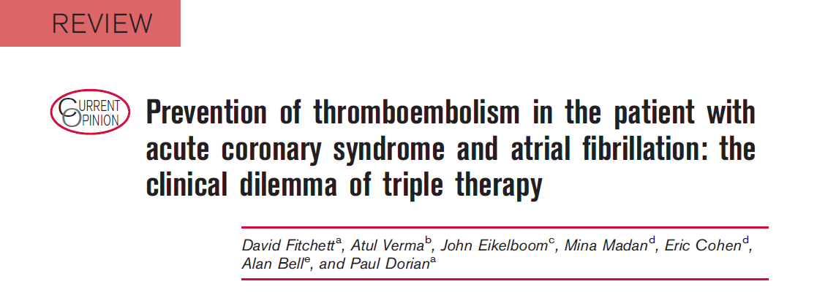
Where we were 6 years ago
Additional research studies are required to further optimize treatment strategies in this high-risk population

Slide 19
Where we are now
RANDOMIZED CONTROLLED TRIALS
AF + PCI / ACS
WOEST – WARFARIN
PIONEER AF PCI – RIVAROXABAN
RE-DUAL PCI – DABIGATRAN
AUGUSTUS – APIXABAN
ENTRUST AF – EDOXABAN
AF + STABLE CAD
AFIRE - RIVAROXABAN

Slide 20
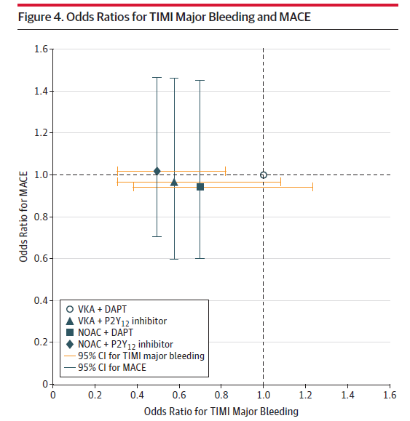
Dual Pathway vs Triple RX Metanalysis
Lopes RD, Hong H, Harskamp RE, et al. JAMA Cardiol. 2019;4(8):747–755
Notes:
IMPORTANCE The antithrombotic treatment of patients with atrial fibrillation (AF) and coronary
artery disease, in particular with acute coronary syndrome (ACS) and/or percutaneous coronary
intervention (PCI), poses a significant treatment dilemma in clinical practice.
OBJECTIVE To study the safety and efficacy of different antithrombotic regimens using a
network meta-analysis of randomized controlled trials in this population.
DATA SOURCES PubMed, EMBASE, EBSCO, and Cochrane databases were searched to
identify randomized controlled trials comparing antithrombotic regimens.
STUDY SELECTION Four randomized studies were included (n = 10 026;WOEST, PIONEER
AF-PCI, RE-DUAL PCI, and AUGUSTUS).
DATA EXTRACTION AND SYNTHESIS The Preferred Reporting Items for Systematic Reviews
and Meta-Analyses guidelines were used in this systematic review and network meta-analysis
between 4 regimens using a Bayesian random-effects model. A pre hoc statistical analysis
plan was written, and the review protocol was registered at PROSPERO. Data were analyzed
between November 2018 and February 2019.
MAIN OUTCOMES AND MEASURES The primary safety outcomewas Thrombolysis inMyocardial
Infarction (TIMI) major bleeding; secondary safety outcomeswere combined TIMI major and
minor bleeding, trial-defined primary bleeding events, intracranial hemorrhage, and
hospitalization. The primary efficacy outcomewas trial-defined major adverse cardiovascular
events (MACE); secondary efficacy outcomeswere individual components ofMACE.
RESULTS The overall prevalence of ACS varied from 28%to 61%. The mean age ranged from
70 to 72 years; 20%to 29% of the trial population were women; and most patients were at
high risk for thromboembolic and bleeding events. Compared with a regimen of vitamin K
antagonist (VKA) plus dual antiplatelet therapy (DAPT; P2Y12 inhibitor plus aspirin), the odds
ratios (ORs) for TIMI major bleeding were 0.58 (95%CI, 0.31-1.08) for VKA plus P2Y12
inhibitor, 0.49 (95%CI, 0.30-0.82) for non-VKA oral anticoagulant (NOAC) plus P2Y12
inhibitor, and 0.70 (95%CI, 0.38-1.23) for NOAC plus DAPT. Compared with VKA plus DAPT,
the ORs forMACE were 0.96 (95%CI, 0.60-1.46) for VKA plus P2Y12 inhibitor, 1.02 (95%CI,
0.71-1.47) for NOAC plus P2Y12 inhibitor, and 0.94 (95%CI, 0.60-1.45) for NOAC plus DAPT.
CONCLUSIONS AND RELEVANCE A regimen of NOACs plus P2Y12 inhibitor was associated with
less bleeding compared with VKAs plus DAPT. Strategies omitting aspirin caused less
bleeding, including intracranial bleeding, without significant difference in MACE, compared
with strategies including aspirin. Our results support the use of NOAC plus P2Y12 inhibitor as
the preferred regimen post–percutaneous coronary intervention for these high-risk patients
with AF. A regimen of VKA plus DAPT should generally be avoided.

Slide 21
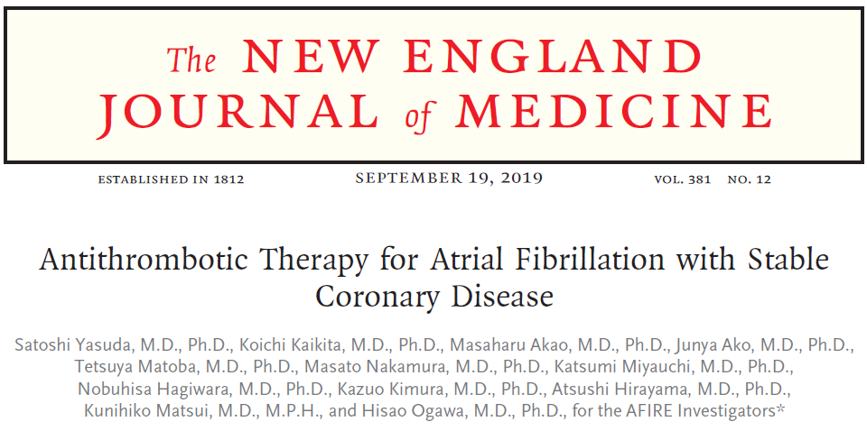
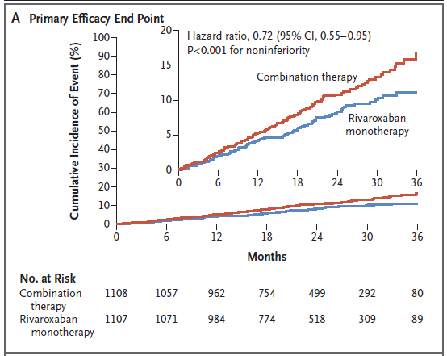
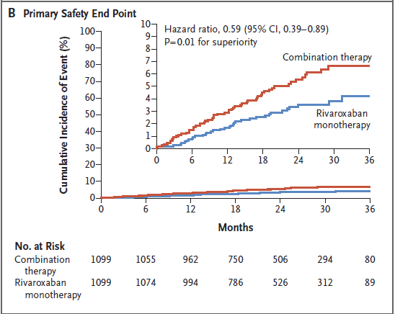
AF + Stable CAD

Slide 22
Tested OAC regimens include:
Rivaroxaban 2.5 mg BID
Apixaban 5/2.5 BID
NOAC Preferred over warfarin
  If warfarin used target INR 2 – 2.5
Tested OAC regimens include
Apixaban 5/2.5 BID
Tested OAC regimens include:
Rivaroxaban 15 mg OD
Dabigatran 110/150 BID
Apixaban 5/2.5 mg BID
Edoxaban 60/30 mg OD
Warfarin (DOAC preferred)
Tested OAC regimens include
Rivaroxaban 15/10 mg OD
Single antiplatelet may be added only in highly-selected patients with high-risk for ischemia and low risk of bleeding

Slide 24
Bleeding and Bridging

Slide 25
Outline
Bleeding
Bleeding risks of antithrombotic therapy
Mitigation of bleeding risks
Management when bleeding occurs including use of antidotes
Periprocedural management: OAC Interruption and Bridging
Decision regarding OAC interruption
Management of OAC for emergency, urgent, non-urgent procedures
Bridging needs for OAC interruption: who, how, and when?

Slide 26
Incidence Rate of Major Bleeding: Single, Dual and Triple Therapy: Nationwide Danish Cohort (N=272,315)
Incidence of Major Bleeding per 100 person-years
Bleed
MI
IHD
Ischemic CVA
Female
Male
DOAC triple therapy
Dual antiplatelet
VKA triple therapy
VKA + antiplatelet
VKA monotherapy
DOAC + antiplatelet
DOAC monotherapy
Aspirin monotherapy
No antithrombotic therapy
Platelet inhibitor monotherapy
Van Rein et al. Circulation 2019: 139

Slide 27
HASBLED Bleeding Risk Score and Risk Mitigation
Major bleeding risk
(% per year)
HAS-BLED | SCORE
Hypertension (SBP>160 mm Hg) | 1
Abnormal renal function (Cr>200 umol/L) or liver function (cirrhosis, bilirubin >2x upper normal, or AST/ALT/ALP >3 x upper normal | 1 1
Stroke history | 1
Bleeding (major) or tendency (prior GI bleed, PUD, prior cerebral hemorrhage) | 1
Labile INR (unstable INR, time in therapeutic range <60%) | 1
Elderly: Age >65 years | 1
Drugs (antiplatelet, NSAIDS, anti-inflammatory medications, steroids); alcohol or drug abuse | 1
15 %
12.5
8.7
3.7
1.02
1.9
1.1
0 %
0
1
2
3
4
5
HASBLED Score
*Other conditions with increased bleeding risk: Thrombocytopenia, coagulation defects, anemia, Lower body weight, drug interactions
*Correct dosing of DOACs with changing renal function; effective INR monitoring
*PPI to decrease the risk of gastrointestinal adverse effects, for patients who require daily antithrombotic therapy that includes acetylsalicylic acid (ASA) (Weak Recommendation; Moderate-Quality Evidence).
Pisters R, et al. Chest. 2010;138:1093-100

Slide 28
General Principles for Treatment of Bleeding and Anticoagulation Management
Best strategy: proactively reduce risk of bleeding
Most bleeding not severe and can be treated with supportive measures: compression at bleeding sites, fluid and blood products where necessary.
Bleeding difficult to stop, hematuria, GI bleed, hemoptysis need urgent assessment and treatment.
Warfarin: hold off, let INR comes down; reversal with vitamin K, 2-10 mg IV; prothrombin complex concentrates (PCC) 30-50 IU/kg; FFP. If life-threatening, consider also tranexamic acid and aminocaproic acid.
DOACs: Delay next dose; Idarucizumab specific for Dabigatran; PCC 50 IU/kg (non- specific reversal). If life-threatening, consider also tranexamic acid and aminocaproic acid.
OAC should be reintroduced as soon as medically appropriate.

Slide 29
Andrade et al. 2020 Canadian Cardiovascular Society/Canadian Heart Rhythm Society Comprehensive Guidelines
for the Management of Atrial Fibrillation Canadian Journal of Cardiology.

Slide 30
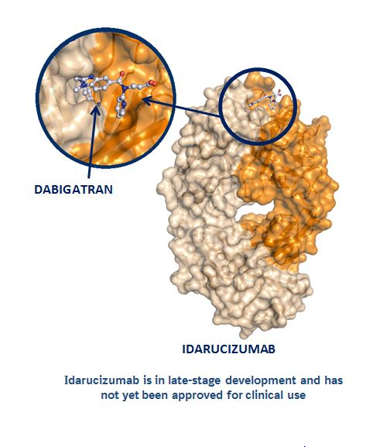
DOAC Antidotes
Idarucizumab (Praxbind®)-Dabigatran-specific reversal
  RE-VERSE AD Trial*: No serious adverse safety signals
  Two IV doses, each 2.5 g, within 15 minutes
  Binds specifically to dabigatran
  Primarily renal excretion
  Short half-life (half-life: initial 45 min; terminal:10.3 hours)
  No interaction with other drugs
  No intrinsic pro-coagulant or anticoagulant activity
  Acts immediately with complete and sustained reversal
  Recommendation: Administer idarucizimab for emergency reversal of dabigatran's anticoagulant effect in patients with uncontrollable or potentially life-threatening bleeding and/or requiring urgent surgery.
  *Pollack C et al.NEJM 2017; 377: 431-441

Slide 31
Other DOAC Antidotes (PIPELINE)
Andexanet Alpha: Factor Xa reversal agent.
Recommendation: Administer andexanet alfa for emergency reversal of Factor Xa inhibitors: apixaban, edoxaban, and rivaroxaban in patients presenting with uncontrollable or potentially life-threatening bleeding who have received any of these agents within the preceding 18 hours. Patients who are anticipated to require unfractionated or low-molecular-weight heparin within 12-24 hours should NOT receive andexanet alfa.
Dosage of Andexanet based on the specific FXa inhibitor, the dose of DOAC patient is taking, and the timing of the last DOAC dose prior to the bleed.
OAC should be reintroduced as soon as medically appropriate.
Ciraparantag (PER-977, aripazine): “universal” reversal agent.

Slide 32
Periprocedural Management of Anticoagulation OAC Interruption and Bridging Considerations
OAC
Interruption
Yes
When to Stop
Bridge or Not
No
When to Restart
Notes:
you need to decide of you need to bridge or not

Slide 33

Interrupting Anticoagulation for a Procedure
  Bleeding Risks:
  1. Procedural risks
  (High, low-moderate, minimal)
  2. Patient bleeding risks
  (HASBLED Score)
Thromboembolic Risks:
1. CHADS2 score 5-6
2. Mechanical valve
3. Thromboembolism <3 m
4. Moderate-severe mitral stenosis

Slide 34
Anticoagulation Interruption
Decision to interrupt antithrombotic therapy for an invasive procedure must balance the risks of a thromboembolic event with those of a peri-procedural bleeding event.
Recommendations:
Minimal risk procedures: No need to interrupt
Low-moderate, high, uncertain risks: Recommend interruption
Practical Tip: Thrombosis Canada (http://thrombosiscanada.ca) Perioperative Anticoagulant Management Algorithm.
Andrade et al. 2020 Canadian Cardiovascular Society/Canadian Heart Rhythm Society Comprehensive Guidelines
for the Management of Atrial Fibrillation Canadian Journal of Cardiology.

Slide 35
Risk Categories of Procedures
Minimal Bleed Risk | Low/Moderate Bleed Risk | High Bleed Risk
Cataract surgery Dermatologic procedures (e.g. biopsy) Gastroscopy or colonoscopy without biopsies Coronary angiography (using radial arterial approach) Permanent pacemaker insertion or internal defibrillator placement (if bridging anticoagulation is not used) Selected procedures with small-bore needles (e.g. thoracentesis, paracentesis, arthrocentesis) Dental extractions (1 or 2 teeth) Endodontic (root canal) procedure Subgingival scaling or other cleaning | Abdominal surgery (e.g. cholecystectomy, hernia repair, colon resection) Other general surgery (e.g. breast) Other intrathoracic surgery Other orthopedic surgery Other vascular surgery Non-cataract ophthalmologic surgery Gastroscopy or colonoscopy with biopsies Coronary angiography* Selected procedures with large-bore needles (e.g. bone marrow biopsy, lymph node biopsy) Complex dental procedure (e.g. multiple tooth extractions) | Any surgery or procedure with neuraxial (spinal or epidural) anesthesia Neurosurgery (intracranial or spinal) Cardiac surgery (e.g. CABG, heart valve replacement) Major vascular surgery (e.g. aortic aneurysm repair, aortofemoral bypass) Major orthopedic surgery (e.g. hip/knee joint replacement surgery) Lung resection surgery Urological surgery (e.g. prostatectomy, bladder tumour resection) Extensive cancer surgery (e.g. pancreas, liver) Intestinal anastomosis surgery Reconstructive plastic surgery Selected procedures involving vascular organs (e.g. kidney biopsy, prostate biopsy) or high bleed risk interventions (e.g., colonic polypectomy, spinal injection, pericardiocentesis)

Slide 36
Andrade et al. 2020 Canadian Cardiovascular Society/Canadian Heart Rhythm Society Comprehensive Guidelines
for the Management of Atrial Fibrillation Canadian Journal of Cardiology.

Slide 37
Andrade et al. 2020 Canadian Cardiovascular Society/Canadian Heart Rhythm Society Comprehensive Guidelines
for the Management of Atrial Fibrillation Canadian Journal of Cardiology.

Slide 38
Bridging in Patients on Warfarin
No Bridging for Interrupted VKA in Patients with Low Thromboembolic risks
When a decision to interrupt VKA therapy for an invasive procedure has been made, we suggest interruption to begin 5 days prior to the procedure, and that a procedure with a low bleeding risk may proceed when the INR is ≤1.5, and a procedure with an intermediate or high bleeding risk may proceed when the INR is ≤1.2.
Bridging for Interrupted VKA in Patients on VKA with High Thromboembolic Risks
When a decision to interrupt VKA-therapy for an invasive procedure has been made, we suggest that bridging therapy with LMWH or UFH be started when INR is below therapeutic level only in patients at high risk of thromboembolic events (mechanical heart valves, moderate-severe mitral valve stenosis, nonvalvular AF with a CHADS2 score of 5-6, and those with a recent stroke or TIA).
Andrade et al. 2020 Canadian Cardiovascular Society/Canadian Heart Rhythm Society Comprehensive Guidelines
for the Management of Atrial Fibrillation Canadian Journal of Cardiology.

Slide 39
No Bridging for Patients Needing DOAC Interruption
When a decision to interrupt a DOAC for an invasive procedure has been made for a patient with AF, we suggest that the duration of interruption be based on the risk of bleeding associated with the procedure and the patient’s renal function. No bridging is necessary.
Resumption of OAC after Interruption
When OAC has been interrupted for an invasive procedure, we suggest that such therapy be restarted when hemostasis is established (within 24 hours for a procedure with a low risk of bleeding and 48-72 hours for a procedure with an intermediate or high risk of bleeding).
Andrade et al. 2020 Canadian Cardiovascular Society/Canadian Heart Rhythm Society Comprehensive Guidelines
for the Management of Atrial Fibrillation Canadian Journal of Cardiology.

Slide 40
Screening for AF /
Device-detected AF /
Embolic Stroke of Unknown Source (ESUS)
Notes:
This section will review screening in the general population, those with implantable cardiac devices and for patients with ESUS.

Slide 41
Opportunistic AF Detection in General Population
Lowres et al. PLOS Medicine 2019;16:e1002903.
Notes:
Screening initiatives that identify asymptomatic AF provide an opportunity for early initiation of treatment including stroke prevention therapy to reduce the risk of AF-related complications.
This is a figure from a recent, large systematic review of 19 studies from multiple countries including the 2 screening studies we conducted in Canada, the detection rate for cases of new AF was 1.44% for those > 65 years compared to 0.41% for those < 65 years when using single time point screen in a general ambulant population.

Slide 42
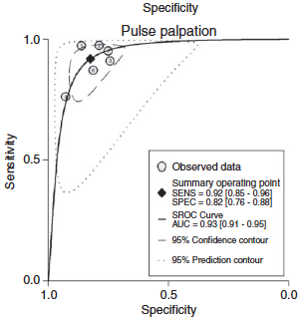
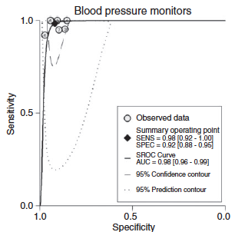
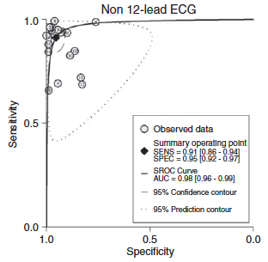
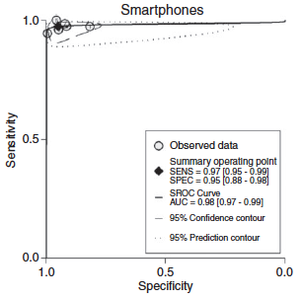
ROC plots of AF screening tools
SENS=0.92; SPEC=0.82
SENS=0.98; SPEC=0.92
SENS=0.91; SPEC=0.95
SENS=0.97; SPEC=0.95
Tagger et al. Eur J Prev Card 2016;23:1330-1338.
Notes:
Multiple screening tools exist. In a pooled analysis, the sensitivity of pulse palpation, BP monitors, non-12-lead ECG, and smart phone-based applications were similar when compared to the gold standard 12-lead ECG, but specificity was lower with pulse palpation. Given the simplicity, ease of use and cost-effectiveness, pulse palpation remains the cornerstone for AF detection.

Slide 43
Notes:
We recommend opportunistic screening for individuals > 65 years occur at the time of a medical encounter. When screening is pursued pulse-based screening, e.g. manual palpitation, is a reasonable first step. Consideration can also be made to use rhythm-based devices.
We recommend downstream confirmatory testing when AF is suspected but not documented i.e. pulse-based screening methods, or when ECG rhythm acquisition does not clearly demonstrate AF.

Slide 44
Opportunistic AF Detection in Patients with Cardiac Implantable Devices
Notes:
title

Slide 45
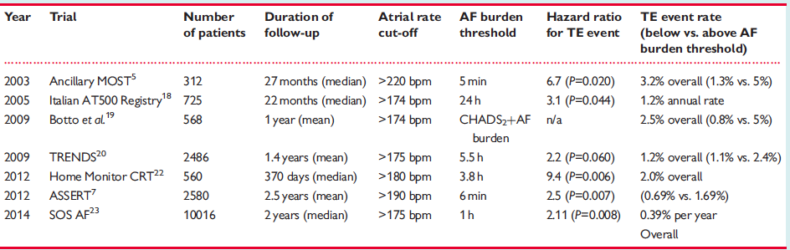
Link Between AHRE and TE
Notes:
Observational and registry data have demonstrated at least a doubling of thromboembolic risk when AHRE are present compared to their absence.

Slide 46
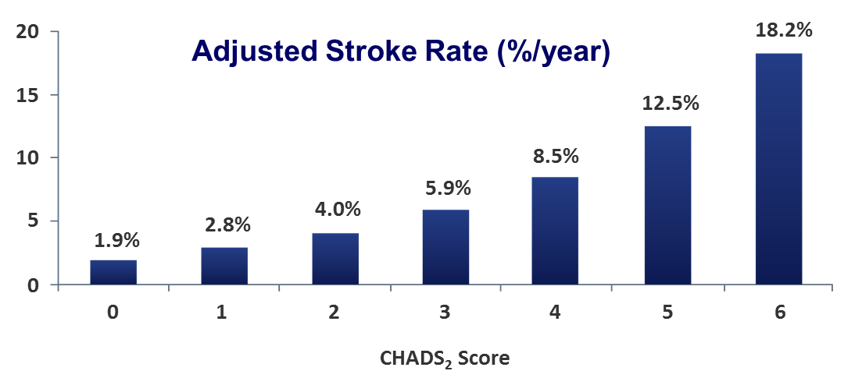
Stroke Risk for AHRE and AF
TRENDS Study:
Overall mean CHADS₂=2.2+1.2; Stroke rate AHRE ≥ 5.5 h=2.4%/year
Notes:
Adjusted stroke rates observed with AHREs appear to be lower than reported among patients with similar risk profiles and clinically apparent AF. For example, in the TRENDS study a mean CHADS2 score =2.2 had a stroke rate=2.4%/yr. For an individual with clinical AF, the adjusted stroke rate would be 4%/yr.

Slide 47
SOR | QOE | Recommendation
Strong | Low Quality | Atrial high-rate episodes (AHREs) be assessed at the time of cardiac implantable electronic device (loop recorder, pacemaker, or cardioverter-defibrillator) interrogation.
Notes:
We recommend

Slide 48
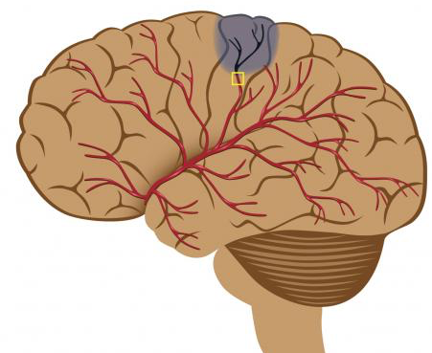
AF Detection After ESUS
Notes:
Screening is important in order to identify patients who would benefit from OAC for the secondary prevention of AF-associated thromboembolism in place of antiplatelet therapy which is standard of care in those without history of AF

Slide 49
Yield of Monitoring Tools for AF
%
Notes:
In the ESUS population, detection of AF is related to burden and improves with increasing intensity of monitoring.

Slide 50

EMBRACE (N=572)
AF detection (30s) at 3 months was 16.1% 30-d event recorder versus 3.2% control group
CRYSTAL AF (N=441)
AF detection (30s) at 6 months was 8.9% ICM versus 1.4% control group.
Gladstone DJ LA et al. NEJM 2014;370:2467-2477.
Sanna t et al. NEJM 2014;370:2478-2486.
Notes:
Two large RCT evaluated prolonged post-discharge cardiac monitoring strategies for the purpose of AF detection following stroke. The EMBRACE trial showed a 30-day monitor detected AF in 16% of patients compared to 3.2% undergoing a 24-hour Holter within 90 days. The CRYSTAL AF trial found a 6-fold higher rate of AF detection at 6 months using an implantable cardiac monitor compared to usual care. Sub-study analyses from both trials found that prolonged rhythm monitoring was cost-effective for the prevention of recurrent stroke.

Slide 51
SOR | QOE | Recommendation
Strong | Low Quality | At least 24 hours of ambulatory ECG monitoring to identify AF in patients with non-lacunar ESUS.
SOR | QOE | Recommendation
Weak | Moderate Quality | Additional monitoring for AF detection be performed for selected older patients with non-lacunar ESUS in whom AF is suspected but not proven.
Notes:
We recommend
We suggest

Slide 52
Secondary Stroke Prevention

Slide 53
Stroke on OAC – Potential Causes
Inadequate intensity of anticoagulation
  INR (warfarin), dose (DOAC)
Suboptimal adherence or persistence
Alternate Stroke Etiology
  Eg. Carotid stenosis, ICAD, dissection, vasculitis, hemodynamic
Suboptimal Risk Factor management

Slide 54
Stroke on OAC – Recommendation
We recommend that patients with AF who experience an ischemic stroke while receiving OAC be managed acutely according to the secondary stroke prevention practice guidelines (e.g. Canadian Stroke Best Practice Recommendations), with emphasis on addressing OAC medication adherence, ensuring correct OAC dosing and avoidance of drug interactions, identifying and treating other potential causes for the stroke other than AF, and promoting general vascular risk factor modification and healthy lifestyle choices (Strong Recommendation; Moderate-Quality Evidence).

Slide 55
Stroke on OAC – Practical Approach
Confirm diagnosis
  CT/MRI, clinical evaluation to exclude mimics
  TIA over diagnosed
Etiologic investigation
  Vascular imaging critical
Medication adherence
  Dosing/intensity, medication interaction
Risk factor optimization
Determine if change required to OAC
  Interruption, change on reinitiation

Slide 56
Timing of OAC initiation after ischemic stroke in patients with AF
We recommend that the timing of initiation of anticoagulant therapy following an ischaemic stroke should be individualised and take into account the competing risks of recurrent stroke against the risk of haemorrhagic transformation of infarction (Strong Recommendation; Moderate-Quality Evidence).

Slide 57
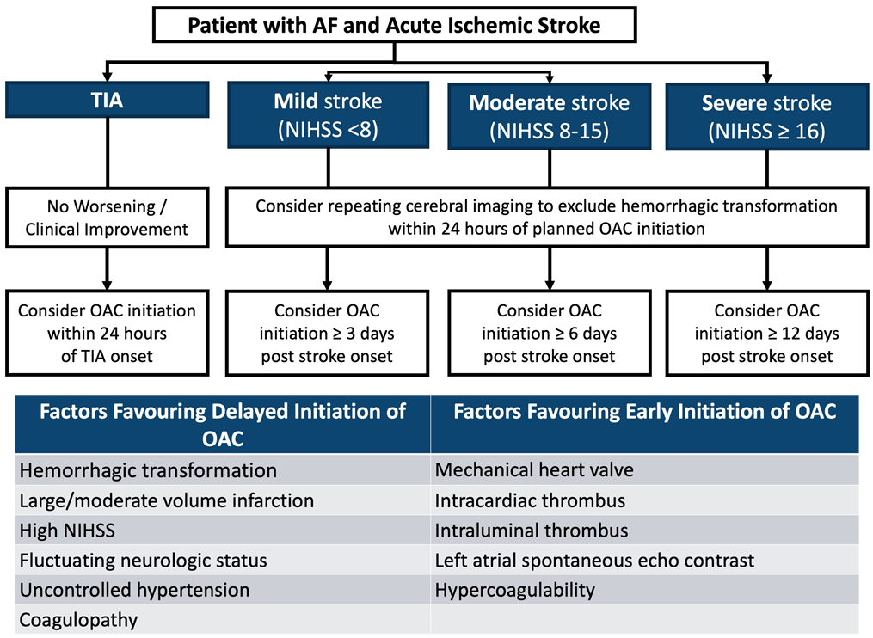
Timing of initiation of OAC – Practical approach

Slide 58
Rate and Rhythm
Acute and Non-Acute

Slide 59
Approach to Rate and Rhythm for AF
Andrade JG et al. Can J Cardiol (in press)

Slide 60
Long-Term Rate Control
Andrade JG et al. Can J Cardiol (in press)

Slide 61
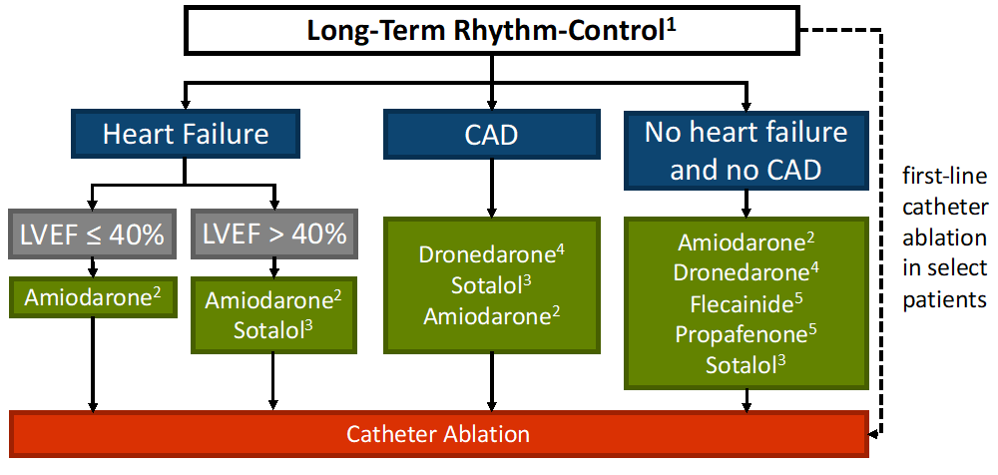
Long-Term Rhythm Control
Andrade JG et al. Can J Cardiol (in press)

Slide 62
Approach to Acute AF/AFL
Andrade JG et al. Can J Cardiol (in press)

Slide 63
Anticoagulation Considerations for CV
Andrade JG et al. Can J Cardiol (in press)

Slide 64
Risk Factors and Other Considerations

Slide 65
Risk Factors

Slide 66
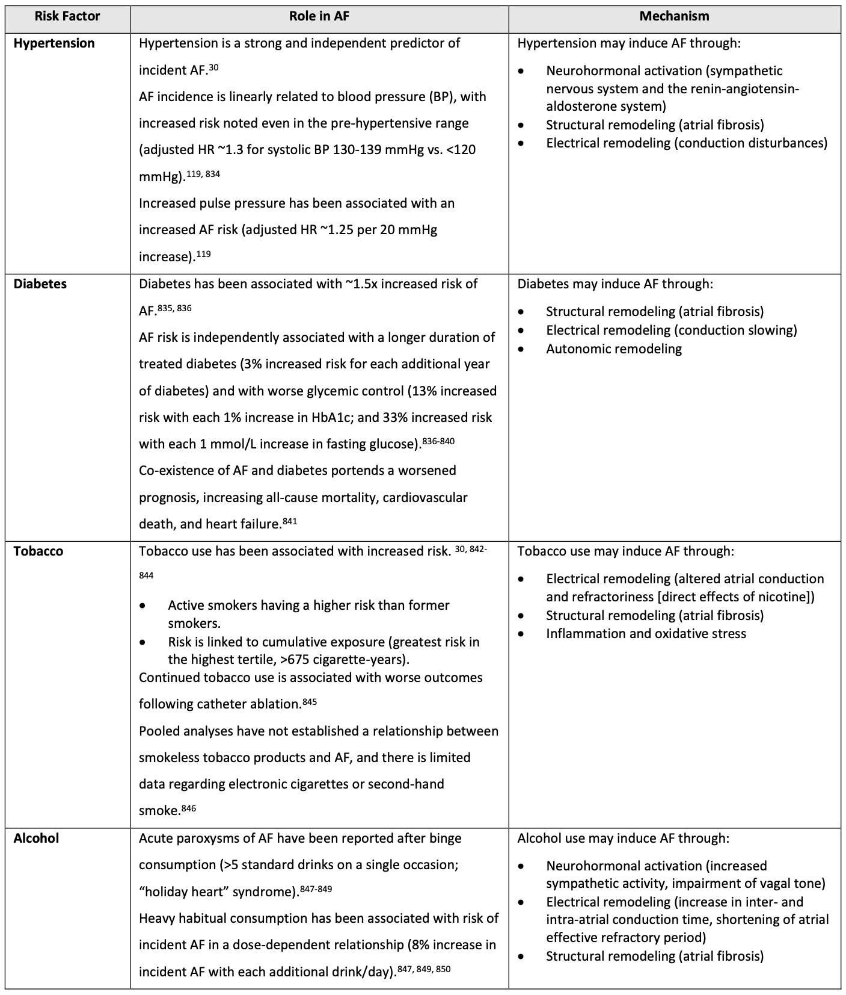
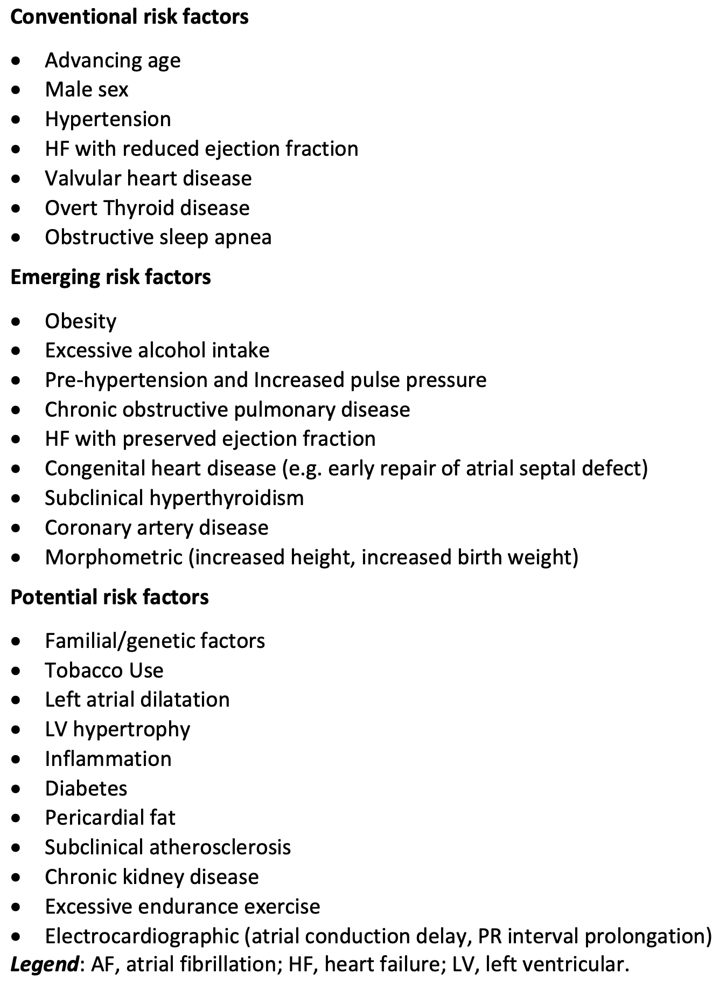
Risk Factors

Slide 67
2020 AF Guidelines Recommendation
In patients with established AF or at high risk of developing AF, we recommend a systematic approach to the identification of traditional modifiable cardiovascular risk factors and/or conditions associated with AF, with strict guideline-adherent management in order to reduce major cardiovascular events (Strong Recommendation; High-Quality Evidence) and to prevent recurrence of the arrhythmia and/or decrease its symptom burden (Strong Recommendation; Low-Quality Evidence).

Slide 68
Risk Factors

Slide 69
Secondary AF

Slide 70
Secondary AF

Slide 71
Secondary AF

Slide 72
2020 AF Guidelines Recommendations
We recommend that the management of patients presenting with recent-onset AF due to a reversible or secondary cause should be directed at the primary illness (Strong Recommendation; Low-Quality Evidence).
We suggest that most patients with secondary AF due to thyrotoxicosis be anticoagulated until a euthyroid state is restored (Weak Recommendation; Low-Quality Evidence).
We suggest that patients with secondary AF, which has resolved, not be routinely anticoagulated in the absence of recurrence (Weak Recommendation; Low-Quality Evidence).
We recommend that patients who have experienced secondary AF be followed indefinitely for the possible emergence of recurrent clinical AF, with opportunistic screening for AF conducted at the time of medical encounters (Strong Recommendation; Moderate-Quality Evidence).

Slide 73
AF Clinics and Multidisciplinary AF Care

Slide 74
AF Clinics and Multidisciplinary AF Care

Slide 75
2020 AF Guidelines Recommendation
We suggest a structured, integrated, multidisciplinary, patient-focused approach to care should be implemented for patients with AF (Weak Recommendation; Moderate-Quality Evidence).
  Values and Preferences – This recommendation recognises that AF is a multi-factorial disease that requires long-term treatment. An integrated patient-focused team-based approach to care has been shown to improve guideline adherence, reduce adverse clinical outcomes such as hospitalization and mortality, and improve quality-of-life

Slide 76
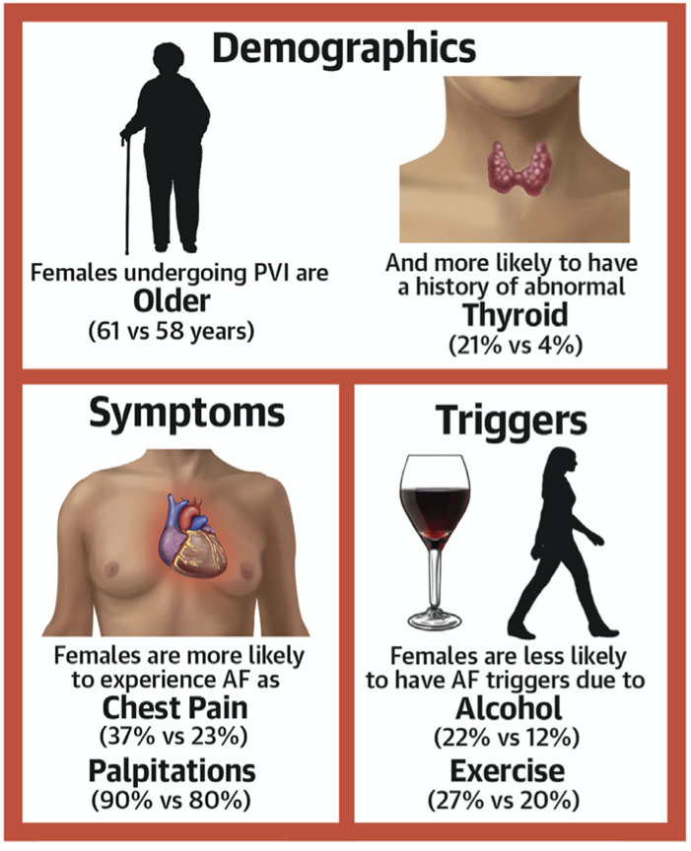
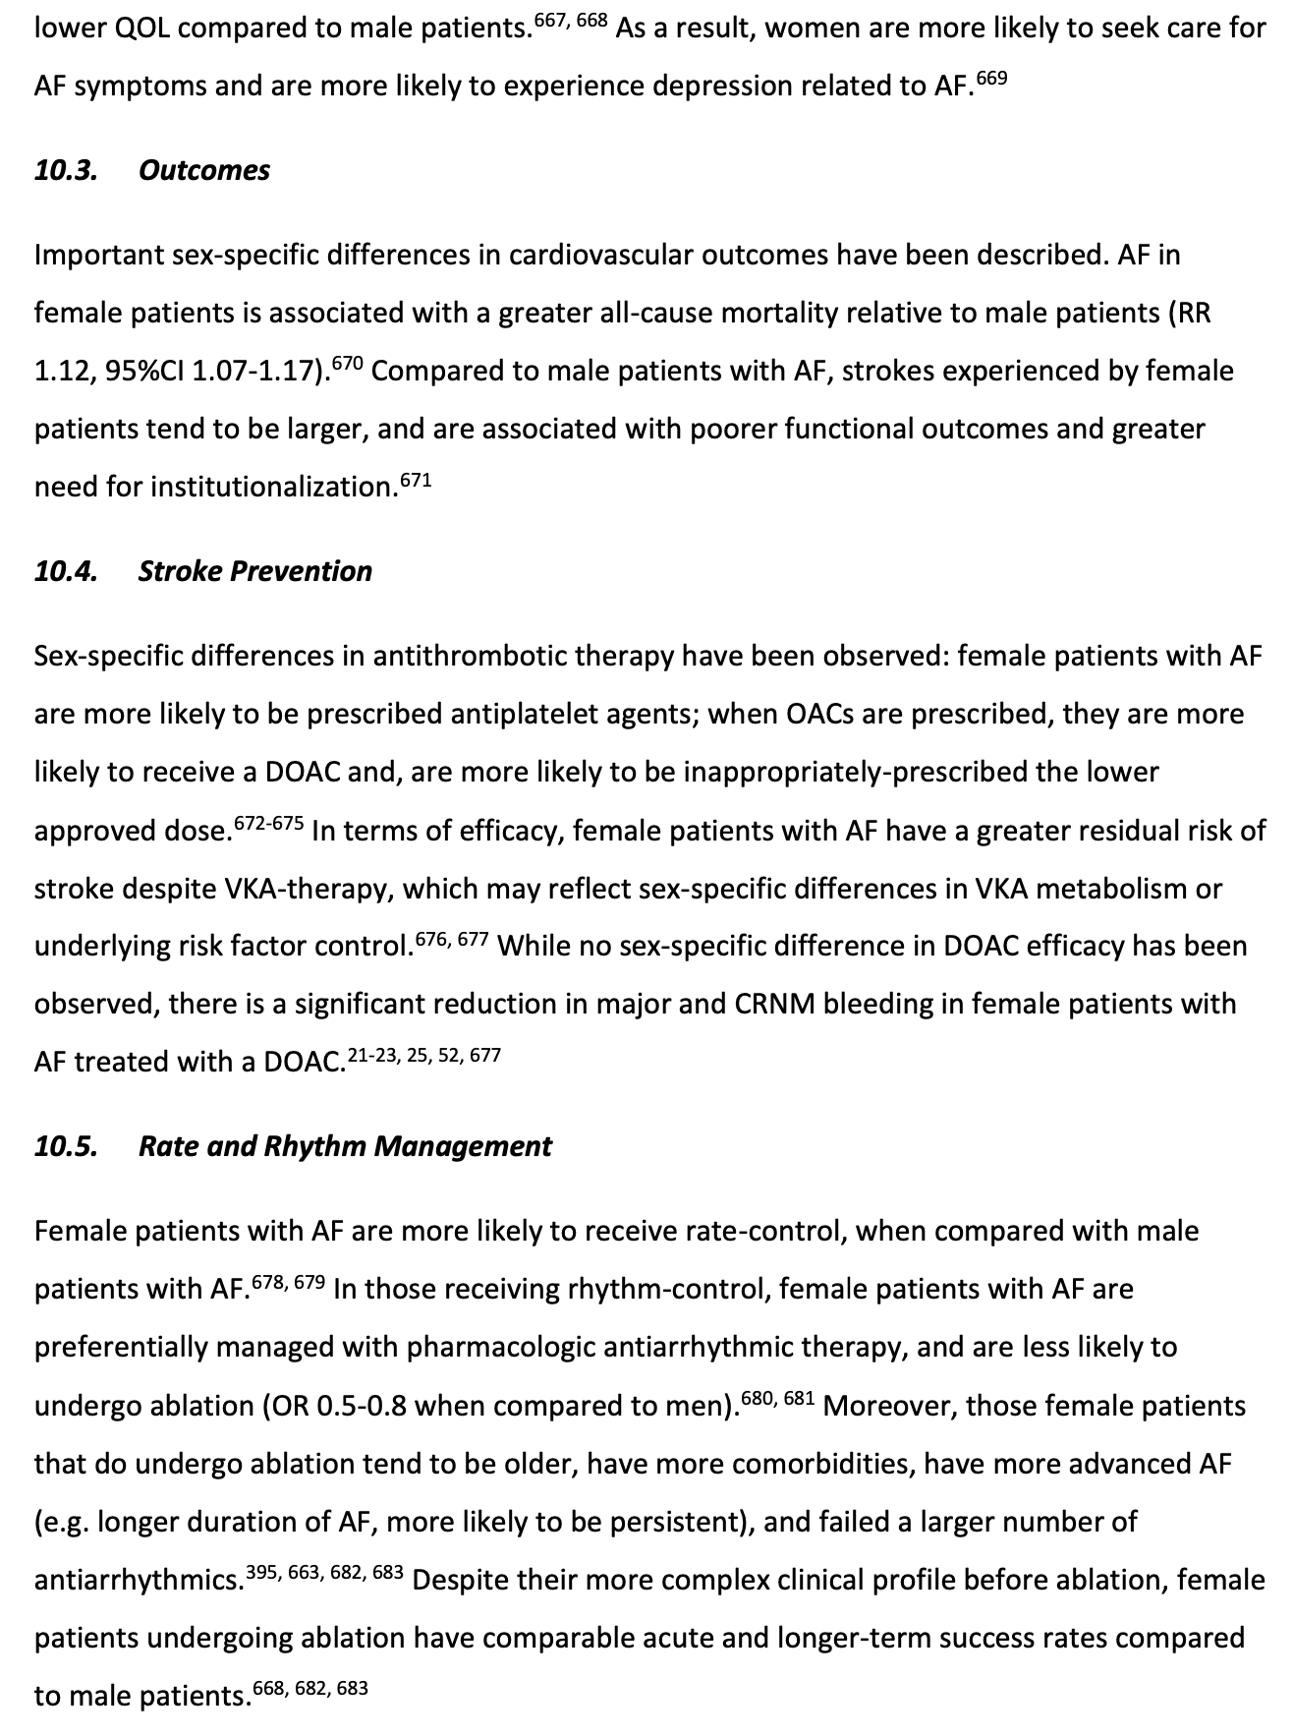
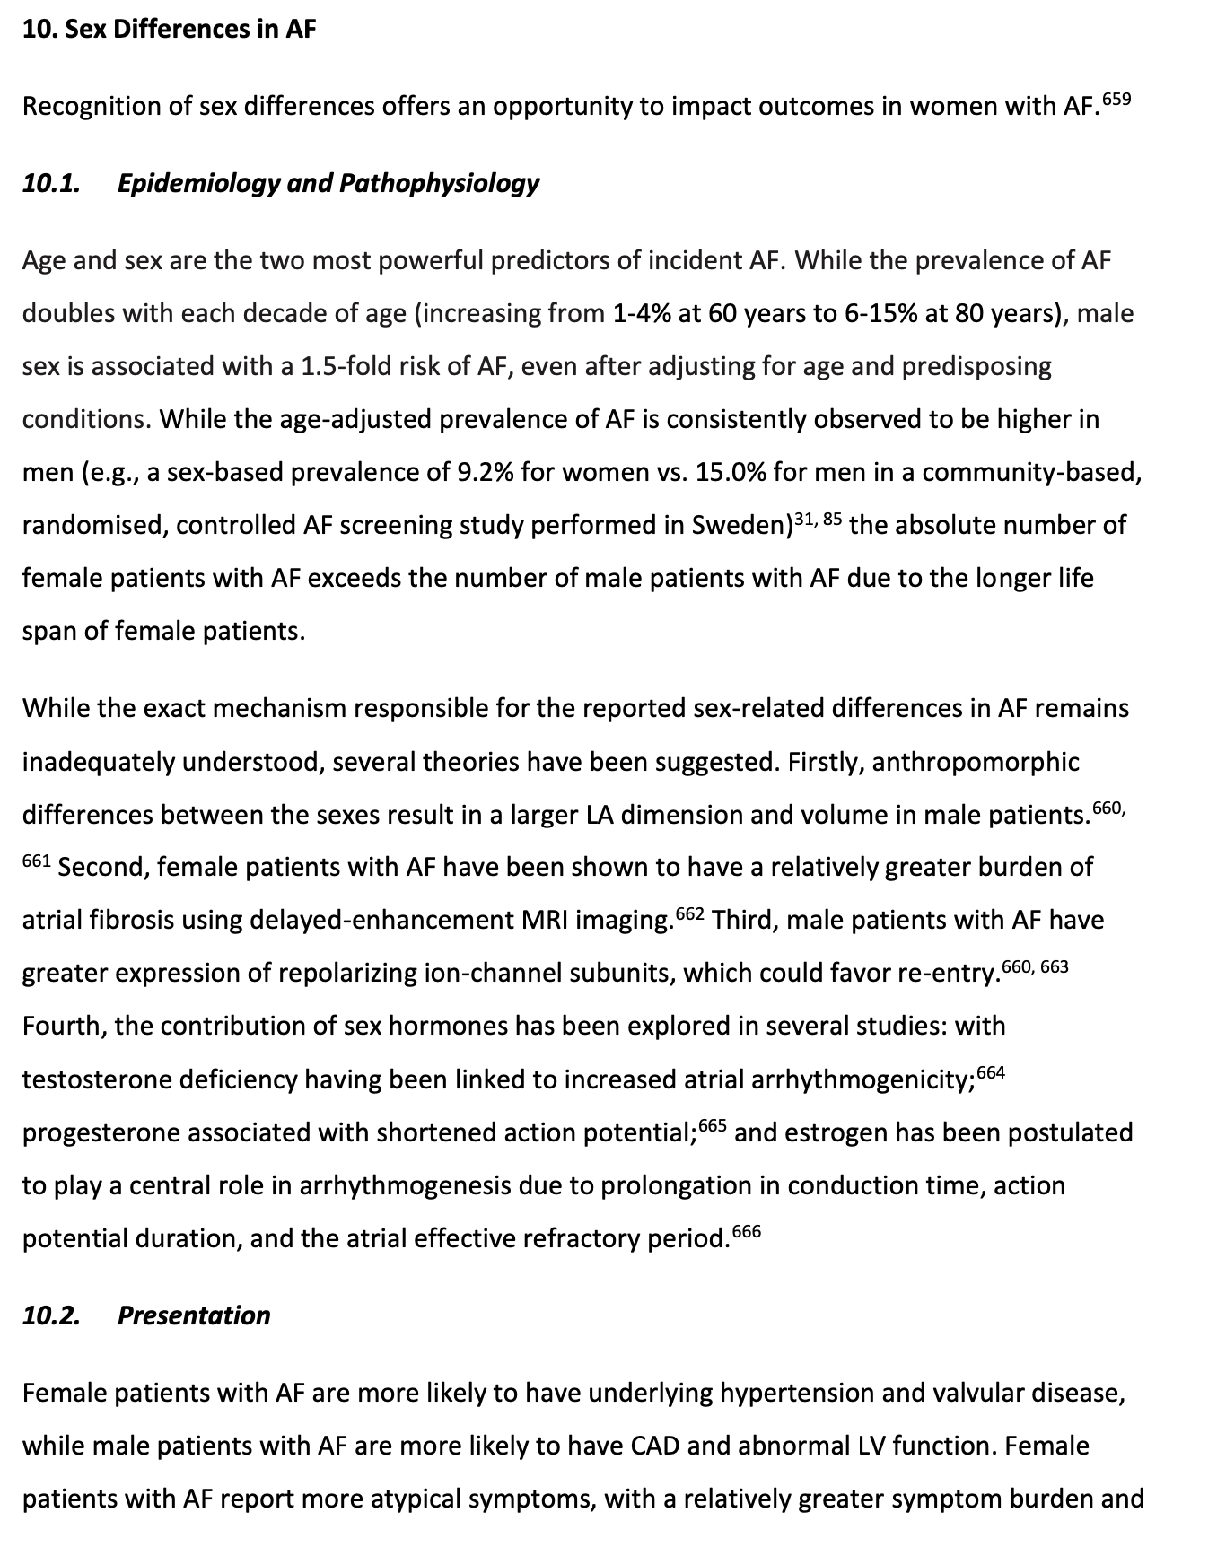
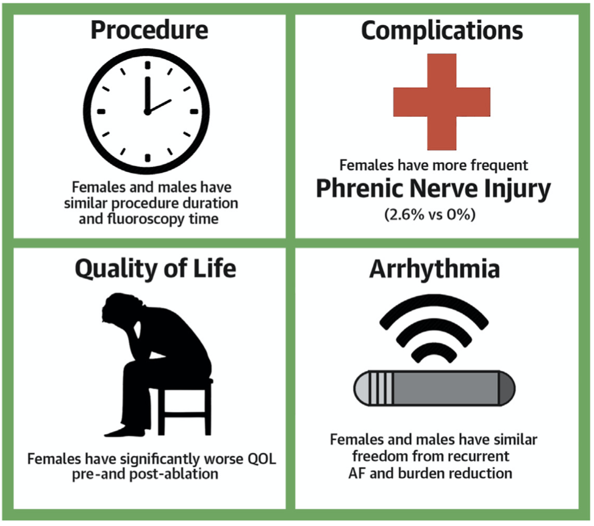
Sex Differences
J Am Coll Cardiol EP 2020;6:945

Slide 77
Special Populations
AF management in populations with:
Device Detected AF
Hypertrophic Cardiomyopathy
Athletes
Adult Congenital Heart Disease
Secondary AF
Post-Operative AF
AF in patients with SVT and WPW
OAC management in populations with:
Chronic Kidney Disease
Coronary Artery Disease
Liver Disease
Cancer
Amyloidosis
Frail Elderly
Obesity

Slide 78
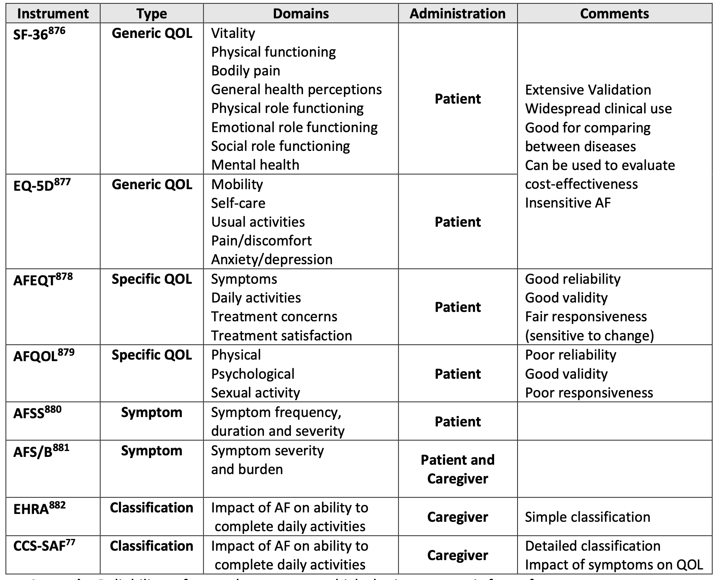
Other Aspects of AF Care
Quality of Life
We recommend that patient-reported AF-related symptoms and quality-of-life be assessed with validated instruments as part of the longitudinal management of patients with AF (Strong Recommendation Low-Quality Evidence).
  Values and Preferences - This recommendation places a high value on the recognition that symptom control has a powerful influence on disability and healthcare resource utilization. The assessment of patient-reported outcomes with validated multi-dimensional instruments offers a relevant and complementary means to evaluate the impact of therapeutic interventions.

Slide 79
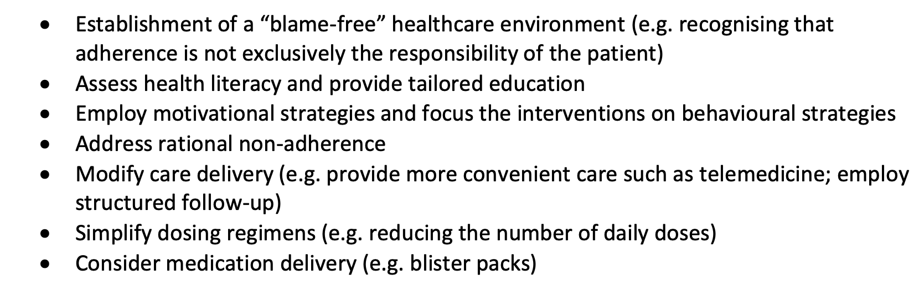
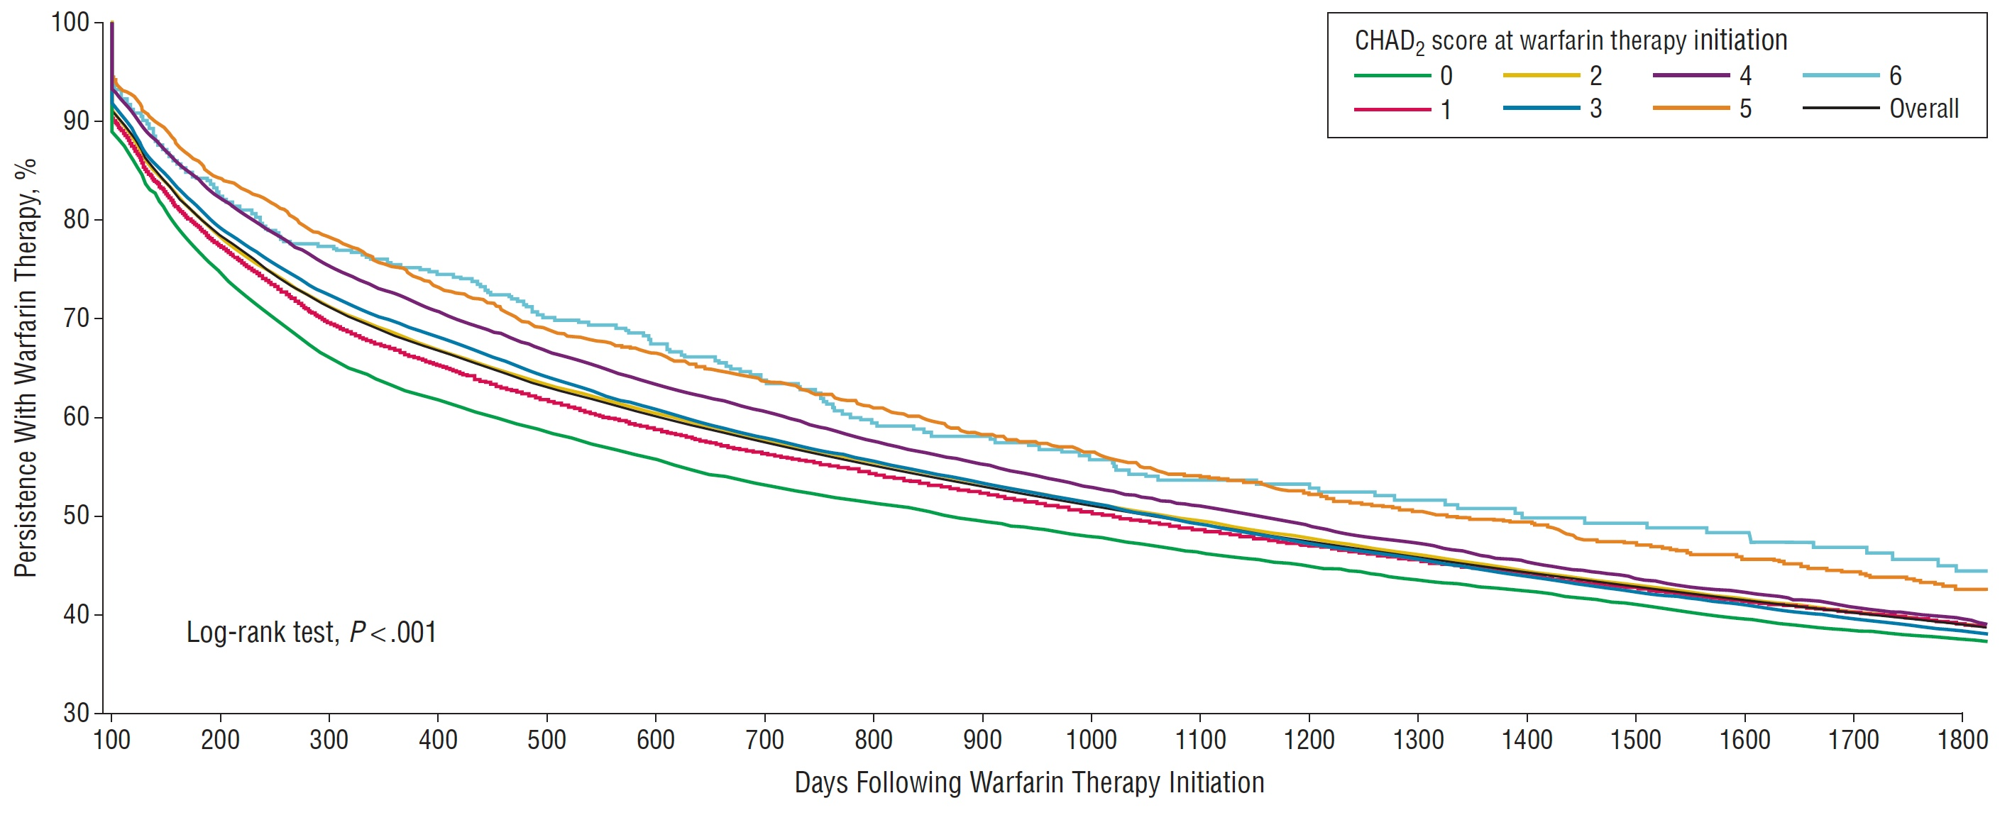
Other Aspects of AF Care
We recommend that adherence and persistence to pharmacotherapy be regularly assessed at each clinical encounter and supported using patient-centered strategies. (Strong Recommendation; Low-Quality Evidence).
  Values and Preferences – This recommendation puts high value on the evidence indicating poor long-term persistence and adherence with OAC, as well as the recognition that strategies to improve persistence and adherence can substantially reduce the risk of stroke/systemic embolism.
Medication Adherence & Persistence
125,195 new users of warfarin in Ontario >65 years with AF
8.9% did not fill a second warfarin prescription
31.8% discontinued therapy within 1 year
43.2% discontinued therapy within 2 years
61.3% discontinued therapy within 5 years
Arch Intern Med. 2012 Nov 26;172(21):1687-9.

Slide 80

Thank you!

