Slide 2
Disclaimer
The Canadian Cardiovascular Society (CCS) welcomes reuse of our educational slide deck for medical institution internal education or training (i.e. grand rounds, medical college/classroom education, etc.). However, if the material is being used in an industry sponsored CME program, permission must be sought through our publisher Elsevier (www.onlinecjc.com).
If your reuse request qualifies as medical institution internal education, you may reuse the material under the following conditions:
You must cite the Canadian Journal of Cardiology and the Canadian Cardiovascular Society as references.
You may not use any Canadian Cardiovascular Society logos or trademarks on any slides or anywhere in your presentation or publications.
Do not modify the slide content.
If repeating recommendations from the published guideline, do not modify the recommendation wording.

Slide 3
Disclosures
Amer Johri
None
Paul Poirier
None
François Philippon
None
Paul Dorian
Grant support related to sudden death (sudden death epidemiology Program Grant) from the CaNET NCE
Andrew Pipe
None
Jimmy McKinney
None
Anne Fournier
None
Nate Moulson
None
Jack Goodman
None

Slide 4
Introduction to Building a Cardiovascular Screening and
Care of the Athlete Program (CSCAP)
Dr. Amer M Johri

Slide 5
Learning Objectives
Recommendations for Cardiovascular Screening and Care of Athletes Program
Discuss the controversy and evidence related to cardiovascular screening
Introduce Shared Decision Making Process Towards Participation

Slide 6
Background
~1 SCD event per 100,000 athlete years
Are these screened or unscreened?
Devastating impact on parents, communities, team mates
Why is more screening not done to prevent SCD?
VS
Should we be doing less screening as the evidence is weak?

Slide 7
Current Guidelines
AHA (2014):
Screening should be performed for student-athletes/competitive athletes
When screening performed the 14-point standardized history and physical exam or other society standardized form be used
12-lead ECG or Echo in association with comprehensive History and Physical Exam may be considered in relatively small cohorts of healthy populations provided close physician involvement and quality control achieved
Maron BJ, Friedman RA, Kligfield P, et al. Assessment of the 12-Lead ECG as a Screening Test for Detection of Cardiovascular Disease in Healthy General Populations of Young People (12-25 years of age): A Scientific Statement From the American Heart Association and the American College of Cardiolog. Circulation. 2014;130(14):1303-1334. doi:10.1016/j.jacc.2014.05.006
Notes:
Updated 2014 statement on the use of 12-lead ECG screening in healthy populations of young people 12-25 years of age. Updated from 2007.
Much of their cited concern regarding the use of a 12-lead ECG stems from concern regarding high false positive rates, and cost and feasibility of implementing a universal program

Slide 8
Current Guidelines
ESC (2005):
Recommends systematic pre-participation CV screening of young competitive athletes for detection of abnormalities predisposing to SCD
Standardized history and physical PLUS 12-Lead Electrocardiogram
Where does this leave Canada?
Incidence of SCD reduced after mandatory ECG screening in athletes- Veneto region
Corrado D. Cardiovascular pre-participation screening of young competitive athletes for prevention of sudden death: proposal for a common European protocol: Consensus Statement of the Study Group of Sport Cardiology of the Working Group of Cardiac Rehabilitation and. Eur Heart J. 2005;26(5):516-524. doi:10.1093/eurheartj/ehi108.
Notes:
The difference from the Europeans is that they suggest an ECG, but they also don’t mandate this –stating that the decision should be regional.

Slide 9
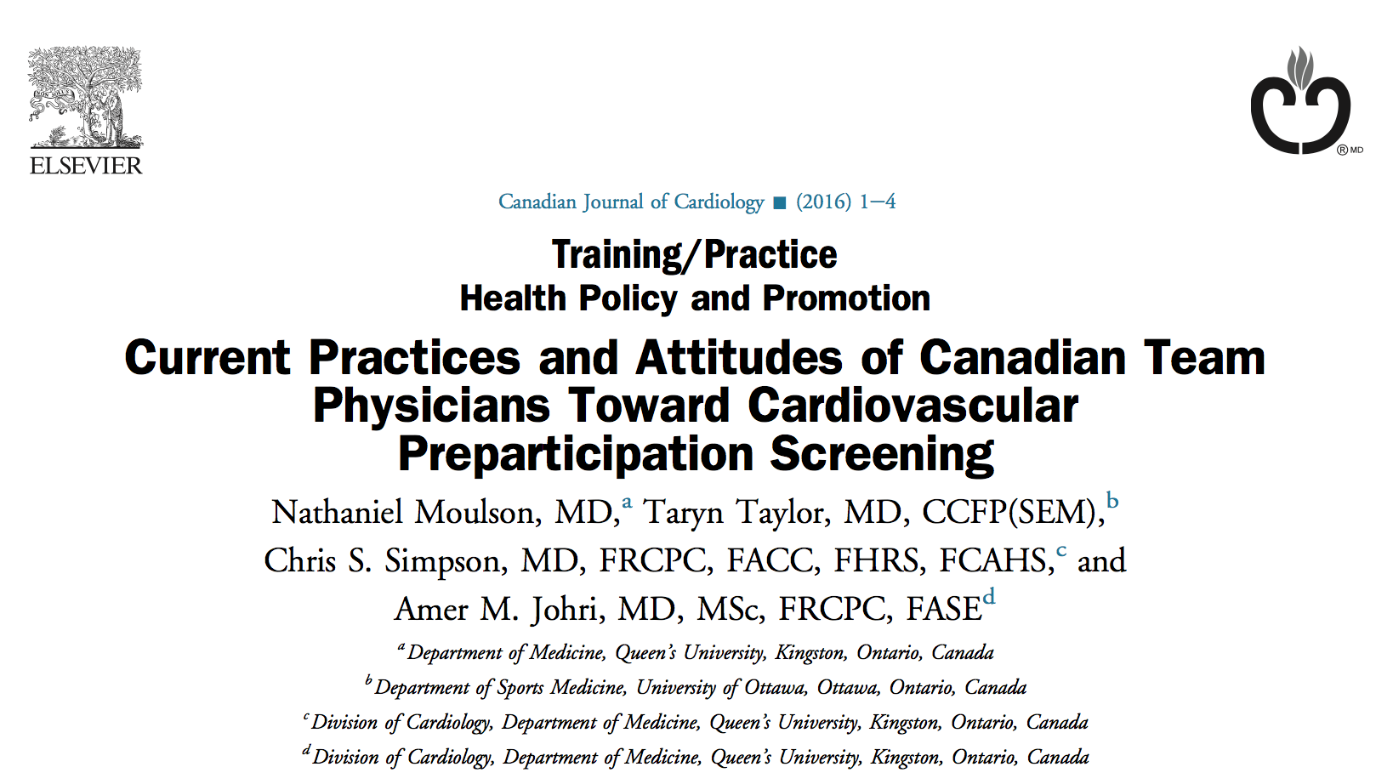
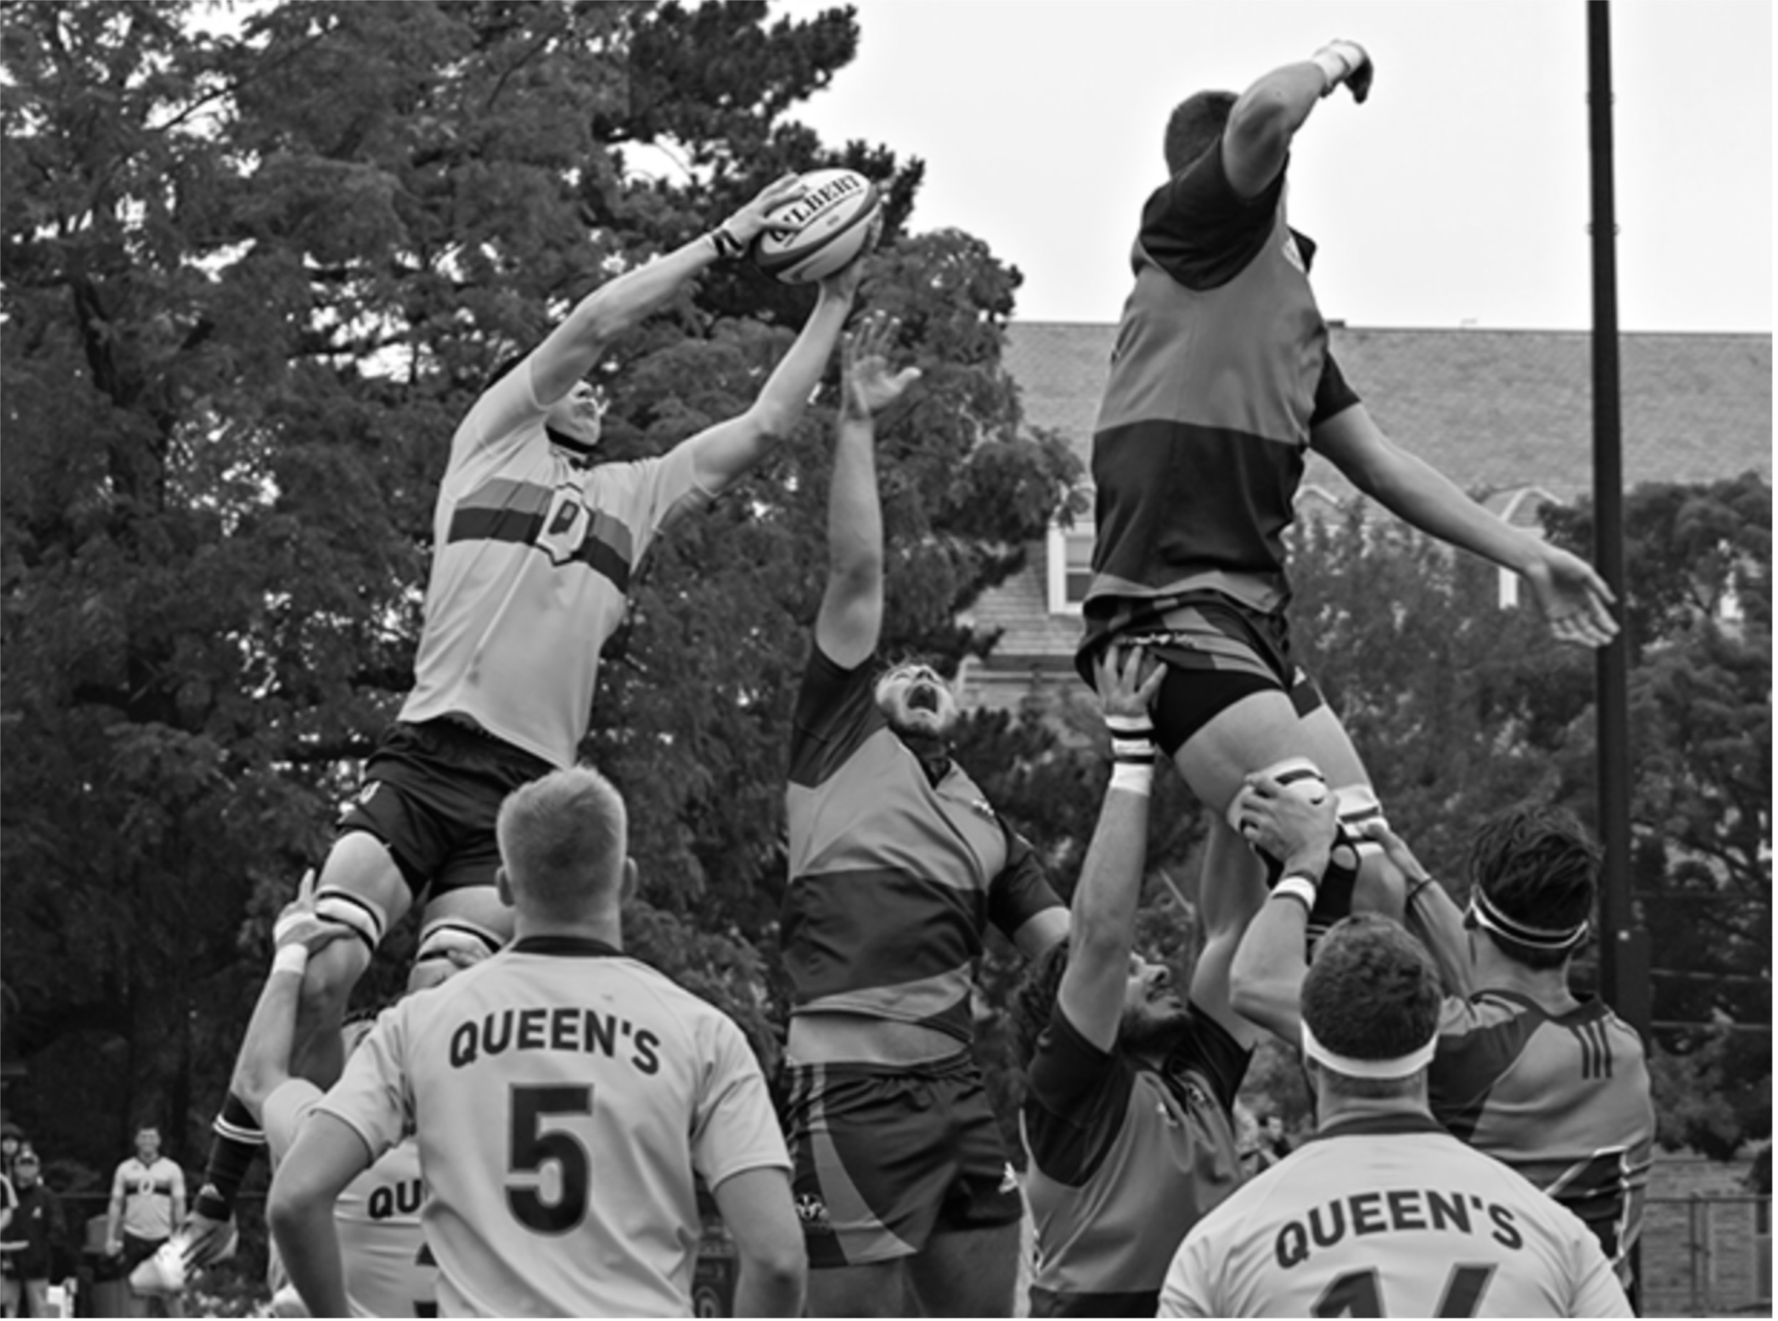
Notes:
We were fortunate to have the right timing to be able to contribute to this area of research with the first study on the current state of Preparticipation screening in Canada

Slide 10
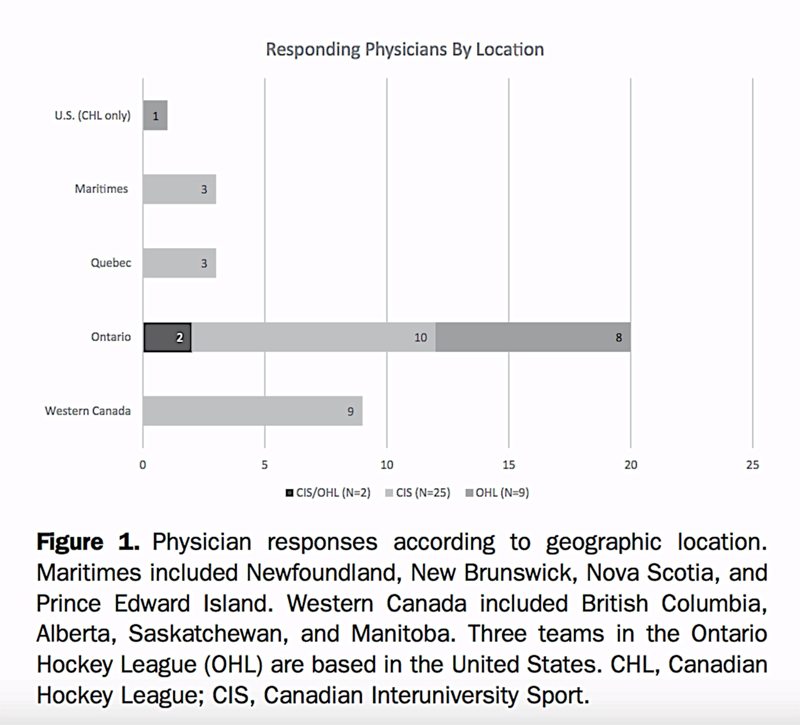
56 Canadian Interuniversity Sport and 20 OHL teams invited
27 and 11 responded respectively
5500 athletes
92% team physicians performed some kind of screening
22% used ECG, rest History and Physical

Slide 11
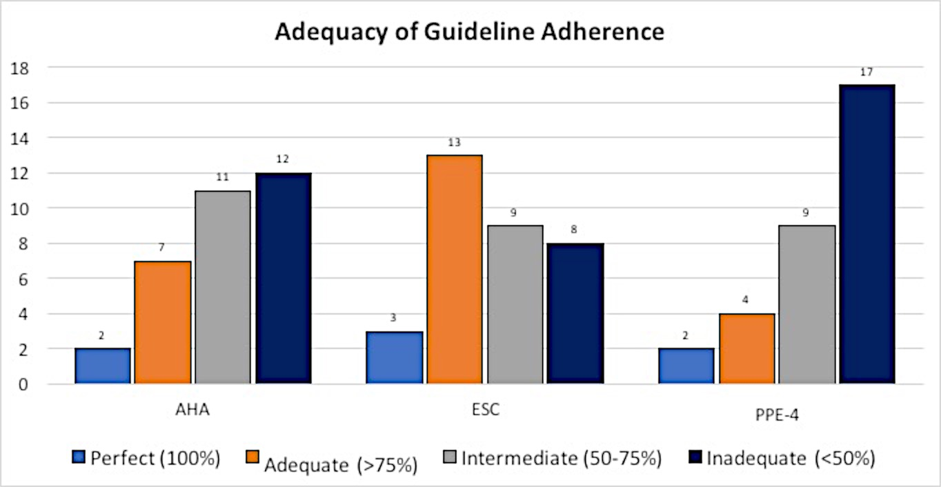
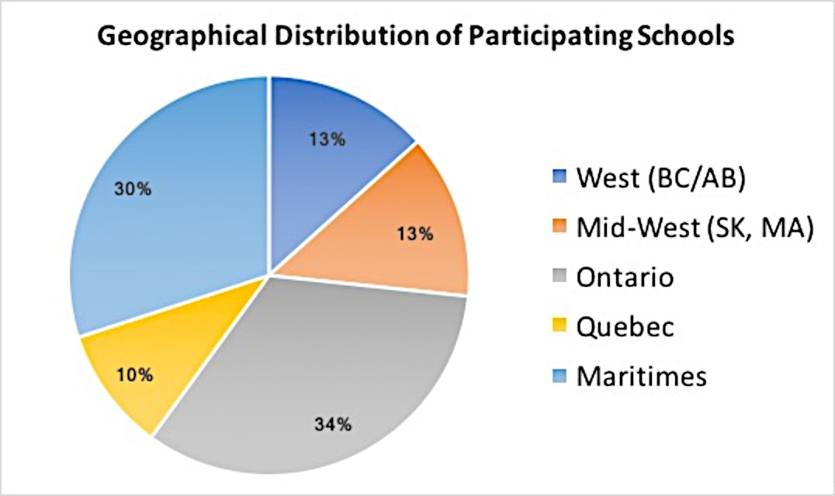
Varsity Screening may be widespread though variable in consistency

Slide 12
Problems to Consider with Screening
Benefits of testing versus the potential problems:
Capacity and resources – varies across institutions
Cascade of follow-up can, result in unnecessary testing?
Could false positives lead to unnecessary restriction?

Slide 13
Considerations for Canada and CCS Approach
Canadian Healthcare system
ECG: need for accurate performance and interpretation
10 National experts from across Canada
Grade Approach, Values & Preferences
Limited Scope: Varsity/college athletes

Slide 14
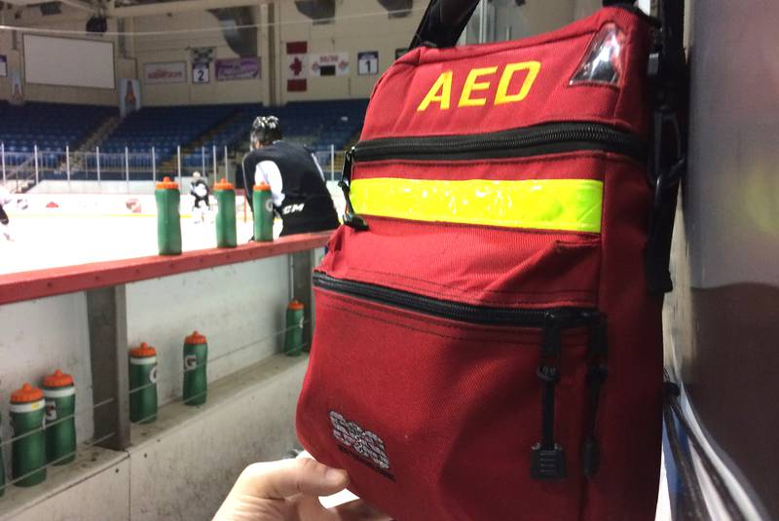
Solution: An Institution-Centered Approach Cardiovascular Screening and Care of the Athlete Program
Recognizes that a foundation of emergency procedures and protocols is critical, upon which a screening program could be built
Offers a ‘menu’ of options, but suggests where to start, and prioritizes steps in a TIERED approach
Recognizes that some institutions may wish to incorporate more advanced screening approaches

Slide 16
Recommendation #1
We recommend an incremental (tiered) approach to cardiovascular screening of competitive athletes as part of a broad, organization/athlete-centred Cardiovascular Screening and Care of Athletes Program (CSCAP). Such screening should occur in the context of a consistent, systematic approach to cardiovascular screening and care that provides: assessment, appropriate investigations, interpretation, management, counselling and follow-up.
Strong recommendation, low quality of evidence.

Slide 17
What does the Tiered Approach Mean?
Such screening should occur in the context of a consistent, systematic approach to cardiovascular screening and care that provides:
Assessment, appropriate investigations, interpretation, management, counselling and follow-up.
ECG is not part of blanket screening, nor are we prohibiting
CCS Sport
Group

Slide 18
Critical Review- American Perspective:
Paraphrasing: “You are downplaying the value of Screening - For some athletes this may be the only health care they get”
Response: Canadian system, primary care network, system of well checks

Slide 19
Critical Review- European Perspective:
Paraphrasing: “You are down playing the value of ECG. History and physical should not be above ECG”
Response: Tiered approach does not mean Hx and Px have greater evidence
We consider principles of good clinical practice and clinical practicality

Slide 21
Recommendations Regarding History, Physical, 12 Lead ECG
Dr. Paul Dorian

Slide 22
Recommendation #2
We recommend that a history/questionnaire should constitute the initial cardiovascular screening (Tier 1), provided it is:
Standardized according to at least one of the AHA, ESC, PPE-4, SCBC tools or equivalent;
Accurately interpreted by an appropriately qualified professional experienced in the care of athletes; and.
Is followed with appropriate investigations as clinically warranted*.
*Clinically warranted findings are those deemed by the interpreter as requiring further assessment, for example by: physical examination; investigations such as ECG testing, imaging or stress testing; and/or consultation with a specialist.
Strong recommendation, low quality of evidence.

Slide 23
Recommendation #3
We recommend that a physical examination should be considered as an adjunct component of cardiovascular screening of competitive athletes (Tier 2) provided it is:
Performed by an appropriately qualified professional involved in the care of athletes and
Followed up as clinically warranted.
Strong recommendation, low quality of evidence.

Slide 24
Recommendation #4a
We recommend against the *routine performance of a 12-lead ECG for the initial cardiovascular screening of competitive athletes.
*Routine in this context is defined as ‘first-line’ or blanket mass performance of ECG not occurring in context of an integrated program as described in #4b.
Strong recommendation, low quality of evidence.

Slide 25
Recommendation #4b
We recommend that a 12-lead ECG should be performed for screening of competitive athletes only when indicated by history/questionnaire and/or physical examination (Targeted Screening, Tier 3) and provided it is:
Of adequate* quality;
Interpreted by those with appropriate expertise† and with consideration of sport history, gender, ethnicity, age, family history, relevant clinical findings, regional§ occurrence of disease; and,
Accompanied by appropriate investigations and expert referral if clinically warranted.
*In this context “adequate” is defined as technically sufficient and of the highest possible quality.
†Appropriate expertise is defined as training and skills in ECG interpretation specific to athletes and persons with disorders associated with arrhythmias.
§Regional refers to geographic areas with a relatively high incidence of certain relevant cardiac conditions.
Strong recommendation, low quality of evidence

Slide 26
Values and Preferences
“… the primary panel clarified our position that these recommendations do not prohibit organizations from performing ECG screening, but suggest a tiered approach that can be tailored to regional needs, resources, and values.
The benefit of mass ECG screening to prevent SCD in asymptomatic athletes is challenging to assess.
As further detailed, our current position is that any ECG performance, whether it is targeted or not, occur in context of an expert led, integrated program to ensure accuracy, minimization of false positives, prioritization of safety protocols in the case of sudden cardiac arrest and follow up of abnormal findings. “

Slide 27
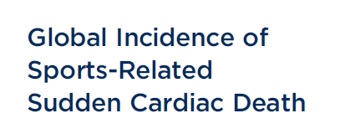
In conclusion, in a meta-analysis of observational
studies incorporating 1,994 SrSCD over >430 million PY,
the incidence of SrSCD is low at 0.72 per 100,000 PY
(1 death per 138,889 PY).
Mohananey D et al

Slide 28
Screening to detect at risk athletes for heart disease?
The presumption is that effective screening will lead to reduced death/event rates.
BUT :
Screening has to be sensitive
Has to have few false positives
Has to be practical
Screening results have to lead to action, and this action has to lead to reduced events

Slide 29
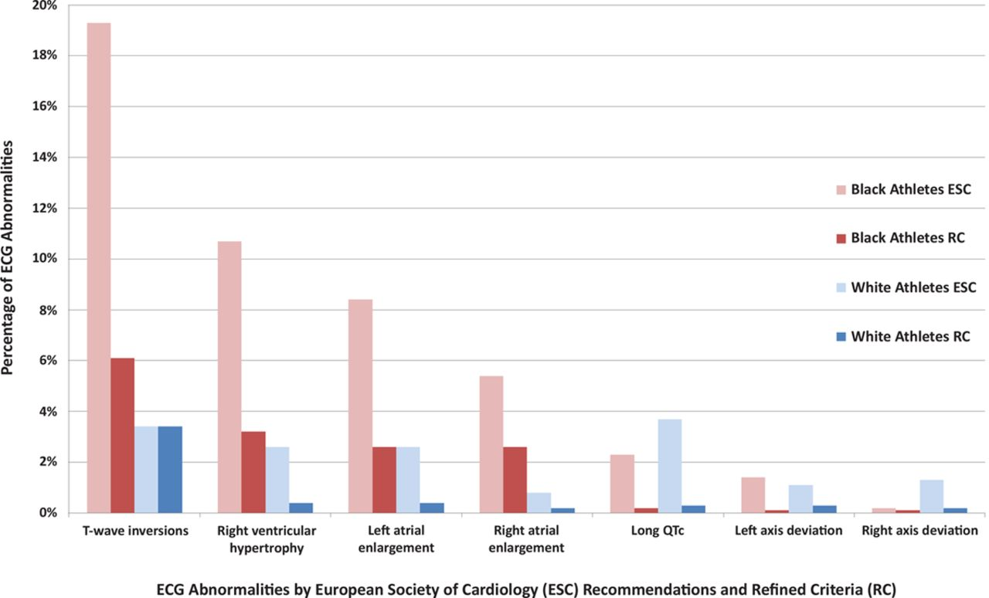
Prevalence of the 7 commonest abnormal ECG patterns in athletes, defined by the European Society of Cardiology recommendations and refined criteria.
Sheikh N et al. Circulation. 2014;129:1637-1649
Copyright © American Heart Association, Inc. All rights reserved.
Notes:
Prevalence of the 7 commonest abnormal ECG patterns in athletes, defined by the European Society of Cardiology recommendations and refined criteria.

Slide 30
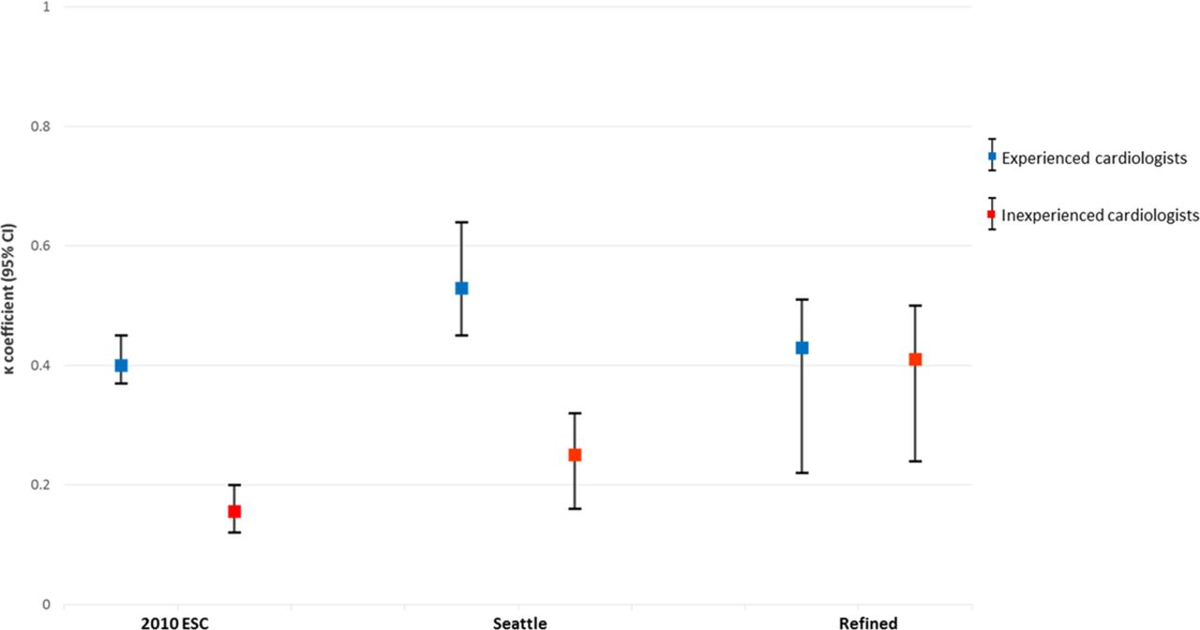
The estimated interobserver reliability among cardiologists for categorizing an ECG as abnormal:
400 screened athletes, 7% abnormal
Seattle criteria recommended in guidelines
Poor interobserver agreement in inexperienced Cards
Fair agreement in experienced sports cardiologists
Harshil Dhutia et al. Circ Cardiovasc Qual Outcomes. 2017;10:e003306
Notes:
The estimated interobserver reliability among cardiologists for categorizing an ECG as abnormal. Interobserver reliability for an abnormal ECG among experienced cardiologists was moderate for all 3 criteria. Among inexperienced cardiologists, modification of ECG criteria improved interobserver reliability from poor to moderate. CI indicates confidence interval; and ESC, European Society of Cardiology.

Slide 31
2.1 million athlete years in Greater Toronto 2009-2014 - no screening programs
Nov 16, 2017; 377:20

Slide 32
Sudden cardiac arrest during competitive sports :Toronto area
Primary arrhythmic:
4/6 had N ECG, MRI, Echo, cath
2/4 had N autopsy
Structural:
2/5 had HCM ; 1 prior screened
3/5 had anomalous coronaries
At most,
1-3 /16 could have been
identified via screening
Landry et al NEJM 2017 ; 377:20

Slide 33
Outcomes of Cardiac Screening in Adolescent Soccer Players – Hx, ECG, Echo
42 with abnormality detected
11,168 screened ; ave. age 16
8 CM restricted: 2 died
6/8 deaths :
No abnormality detected
6.8/100,000 athletes/yr
Malhotra et al N Engl J Med 2018; 379:524-534

Slide 34
Efficiency of Screening
In Landry et al:
Would have had to screen 400,000 athletes (all sports) with ECG to identify 1-2 who were destined to die during sport
In Malhotra et al:
11,000 elite soccer players screened
8 asymptomatic and cardiomyopathy or long QT identified with ECG
2 restricted and died; 6 restricted and did not die

Slide 35
Recommendations on Shared Decision Making, Secondary Prevention of SCD and Cardiovascular Emergencies
Dr. Andrew Pipe

Slide 36
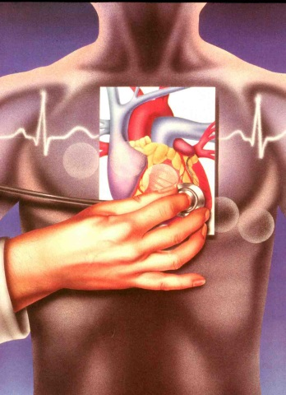
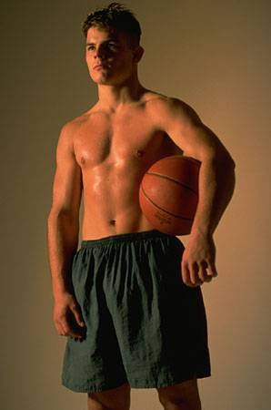
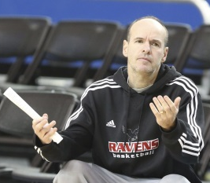
Shared Decision Making - Choice Awareness - Options Dialogue
“Red Flags” or abnormalities during the screening process necessitate a shared decision-making (SDM) approach towards further management.”
“SDM is highly appropriate for the CV care of athletes as it acknowledges the uncertainties surrounding screening, diagnosis, and the risk of CV events during sport.”

Slide 37
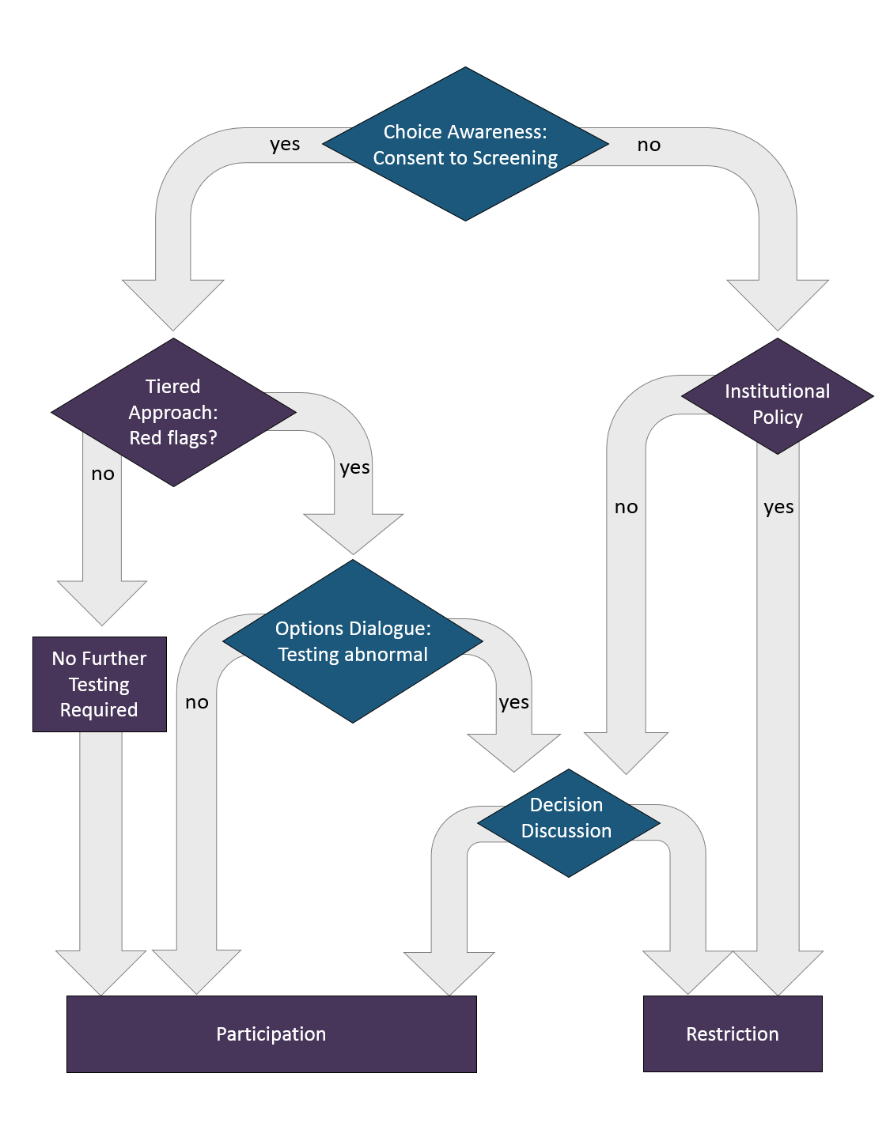
Shared Decision Making (SDM)
SDM should include 3 steps:
Choice Awareness
An Options Dialogue
A Decision Discussion
SDM involves ensuring that all involved become fully informed of:
Degree of uncertainty surrounding a diagnosis and actual risk of SCD
Harms and benefits of the diagnostic cascade and intervention (restriction of competition)
Alternative approaches to management

Slide 38
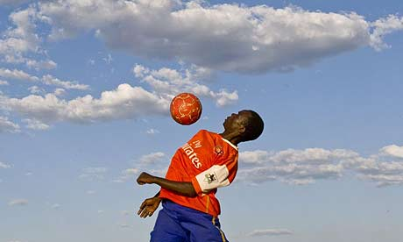
Recommendation #5
We recommend that following the identification and confirmation of any predisposing condition by screening, the probability of SCD* be estimated to facilitate a shared decision-making process regarding sport participation involving the athlete (and parent/guardian if appropriate), caregiver, and sport organization.
*SCD in this context includes the probability of SCA. It is recognized that for some conditions it may be very difficult to define such probability.
Strong Recommendation, Low-Quality Evidence.
“Offsetting a possible benefit of reducing SCD by restricting an athlete is the potential harm of denying a young person the benefits of physical activity…”

Slide 39
Recommendation #6
We recommend that sport restriction be considered and discussed in the following conditions:
ARVC
Significant Ventricular Arrhythmias
Catecholaminergic PVT
Exercise Induced Heart Block
HCM with sustained tachycardias or multiple RFs
Dilated Cardiomyopathy
LV non-compaction with LV Dysfunction or V. arrhythmia
Marfan’s Syndrome with aortic dilatation
Significant aortic dilatation
Coronary artery aneurysm with ischemia
Oral anticoagulation & risk of trauma
Pulmonary hypertension
Cyanotic congenital heart disease
Strong Recommendation, Low Quality Evidence.

Slide 40
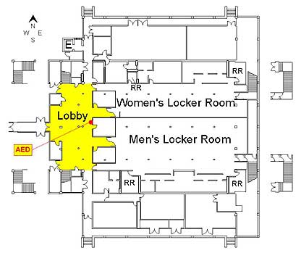
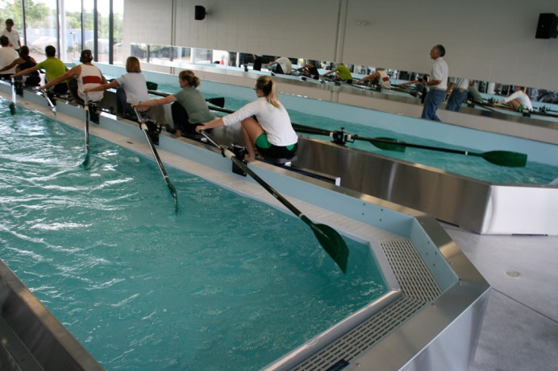
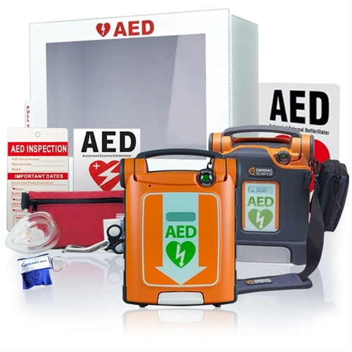
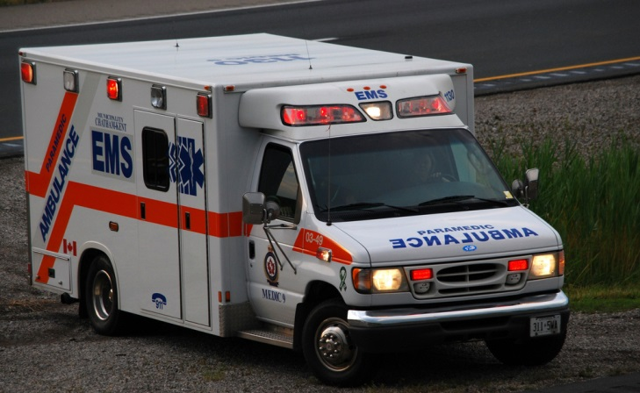
Some Fundamental Considerations
The need for a planned approach to the management of CV Emergencies by Sport Organizations and Institutions
“These are the bedrock of a CV screening and care of athletes programme (CSCAP)”

Slide 41
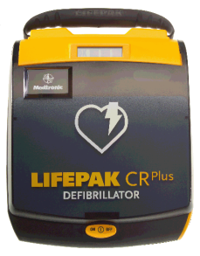
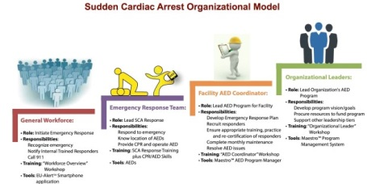
Basic Requirements – AEDs – Education of Personnel & MAPs
“Training in cardiopulmonary resuscitation (CPR), the availability of automated external defibrillators (AEDs) in key activity (competition and training) spaces, and the creation of emergency management protocols should be standard.”

Slide 42
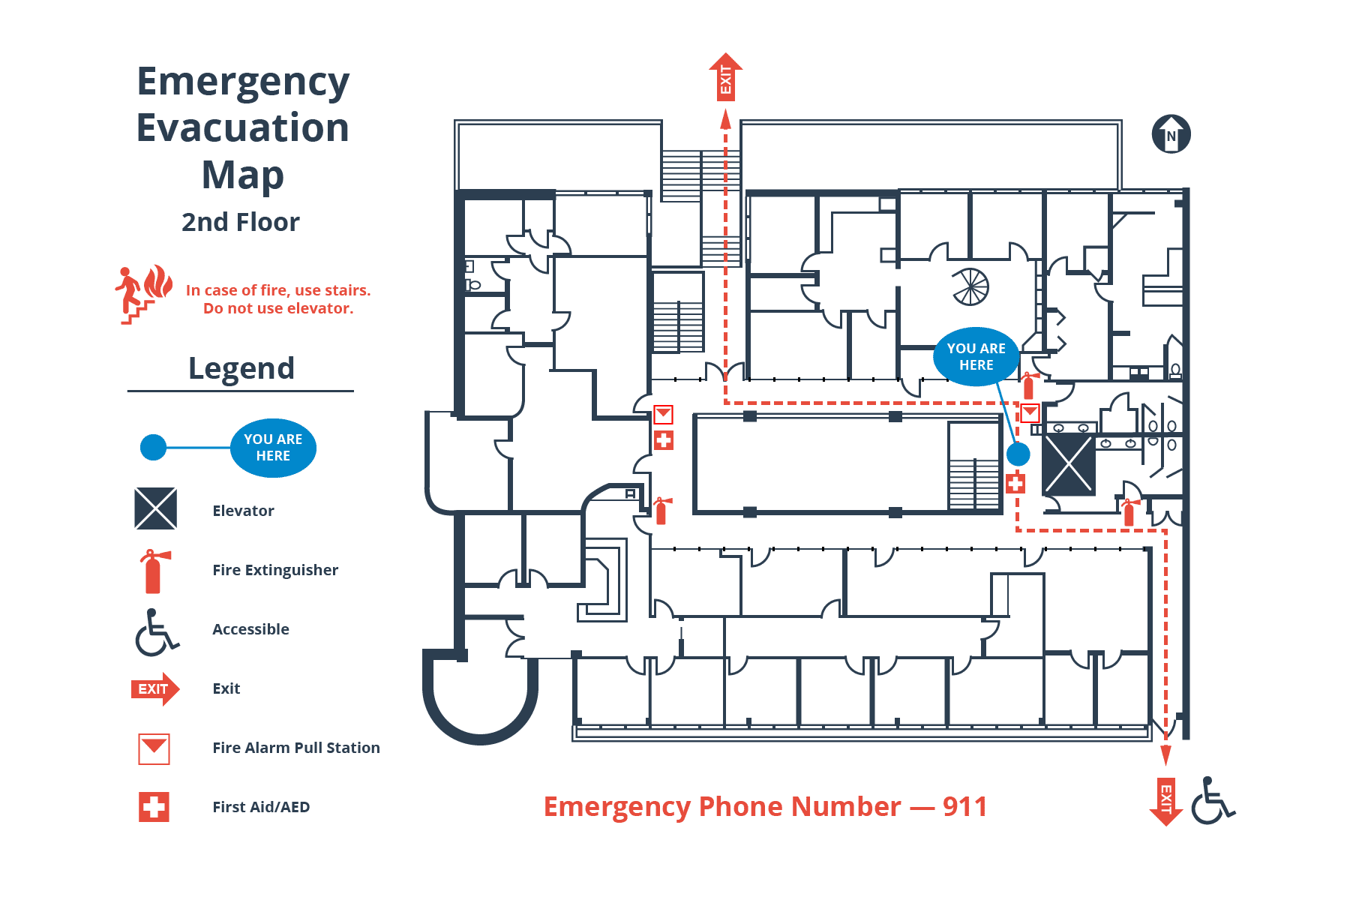
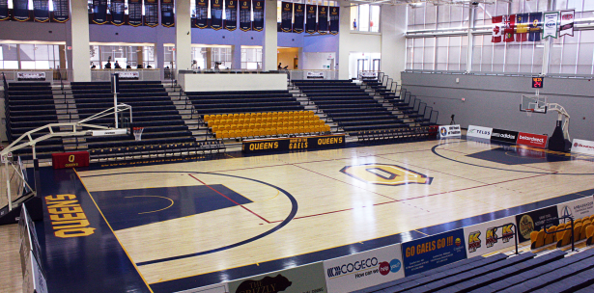
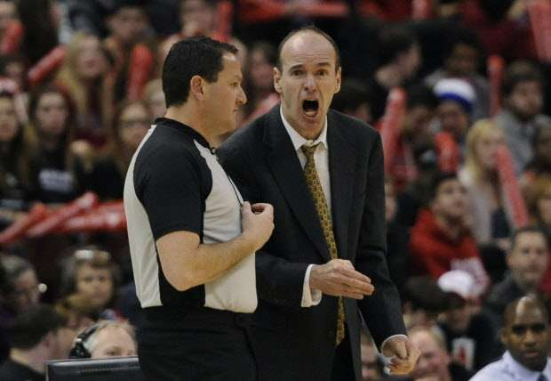
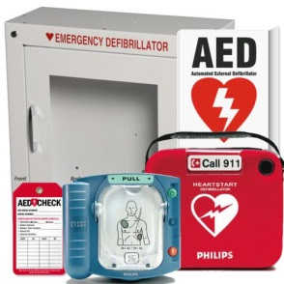
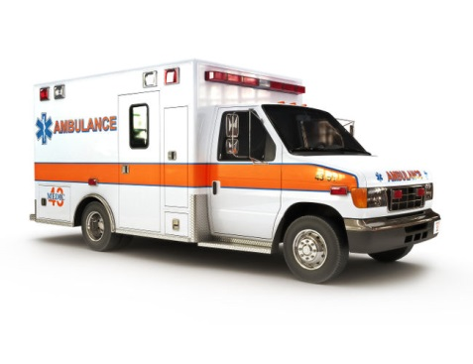
Recommendation #7
We recommend the creation of specific policies and protocols for the delivery of medical action plans specific to cardiac emergencies in all competitive sport settings and as the foundation of a Cardiovascular Screening and Care of Athletes Program (CSCAP).
Strong Recommendation, High-Quality Evidence

Slide 43
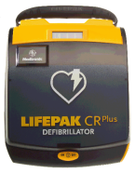
Kinoshi T, et al. N Engl J Med 2018:379:5;
28 SCA - all had return of spontaneous circulation and all had a favourable neurological outcome
Compelling evidence of the benefit of an organized approach to the delivery of CPR and use of AEDs
Aschieri D, et al. Heart 2018;104:1344-1349
“Neurologically intact survival rates were 93% in centres with on site AED and 9% in centres without.”

Slide 44
Kinoshi T, et al. N Engl J Med 2018:379:5;

Slide 45
Recommendation #8
We recommend that all educational and recreational facilities with athletic or sports programs must have AEDs located to ensure rapid access and initiation of defibrillation in less than 3 minutes. They should be placed within close proximity to, if not within, all physical activity spaces used by athletes.
Strong recommendation, moderate level of evidence.

Slide 46
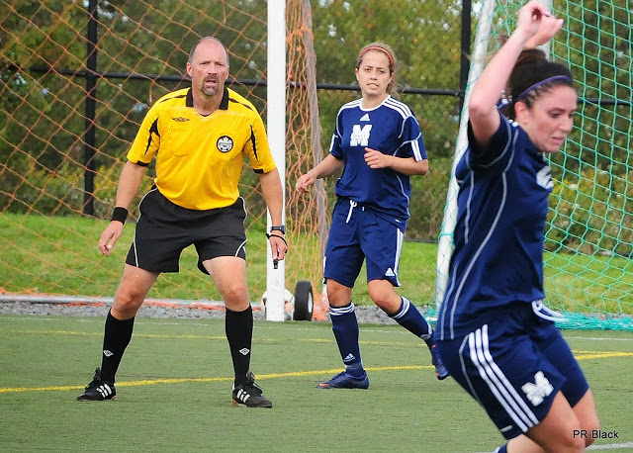
More Fundamental Considerations
The need for a planned approach to the management of CV Emergencies by Sport Organizations and Institutions
Education of Personnel and Medical Action Plans (MAPs)

Slide 47
Recommendation #9
We recommend that because athletes, team staff and referees are most likely to initially witness and attend a collapsed athlete, that at a minimum, team staff and referees be trained in CPR and be familiar with the use of AEDs, rehearse the MAP at their own facility, and be familiar with MAPs at other sporting facilities. Despite the low incidence of SCD in athletes, it is recommended that SCA be considered as the likely cause of an athlete’s non-traumatic collapse during sport.
Strong Recommendation, Moderate Quality Evidence

Slide 48
Summary
A sequential, tiered approach to the identification of cardiac risk
An appreciation of the limits of screening
The importance of shared decision making (SDM)
The creation of emergency management policies in sport settings
The recommendations compose a tiered framework that allows institutions choice as to program creation.
The creation of a network of centres of excellence with the goal of further implementation, research and standardization.

