Slide 1
Disclaimer
The Canadian Cardiovascular Society (CCS) welcomes reuse of our educational slide deck for medical institution internal education or training (i.e. grand rounds, medical college/classroom education, etc.). However, if the material is being used in an industry sponsored CME program, permission must be sought through our publisher Elsevier (www.onlinecjc.com).
If your reuse request qualifies as medical institution internal education, you may reuse the material under the following conditions:
  You must cite the Canadian Journal of Cardiology and the Canadian Cardiovascular Society as references.
  You may not use any Canadian Cardiovascular Society logos or trademarks on any slides or anywhere in your presentation or publications.
  Do not modify the slide content.
  If repeating recommendations from the published guideline, do not modify the recommendation wording.

Slide 2
CCS 2018 GUIDELINES FOR THE MANAGEMENT OF ATRIAL FIBRILLATION
2018 UPDATE
October 2018

Slide 3
Disclosures
Laurent Macle
  Honoraria: Bayer, Boehringer Ingelheim, Bristol-Myers Squibb, Pfizer, Johnson & Johnson, Medtronic, St. Jude Medical
  Clinical Trials: Bayer, Medtronic, Bristol-Myers Squibb, Pfizer, Johnson & Johnson, St. Jude Medical
Jason Andrade
  Honoraria: Bayer, Medtronic, Pfizer
  Clinical Trials: Medtronic
Brent Mitchell
  Honoraria: None
  Clinical Trials: None
Ratika Parkash
  Honoraria: Bayer, Boehringer Ingelheim, Medtronic, Pfizer, St. Jude Medical
  Clinical Trials: None

Slide 4
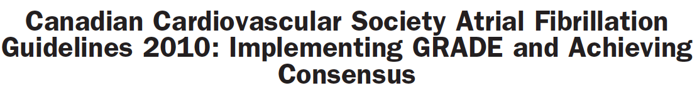
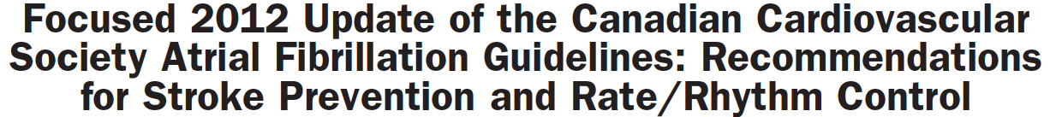
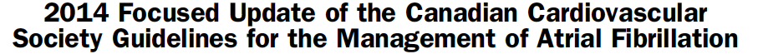
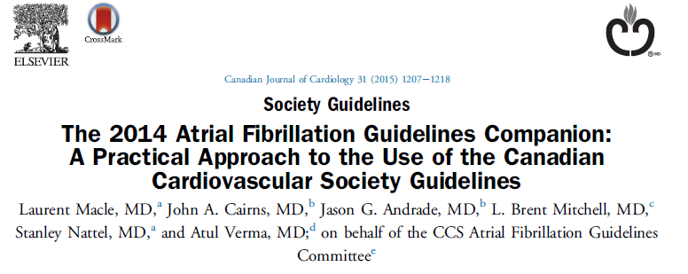
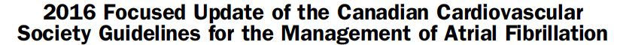
Gillis et al. Canadian Journal of Cardiology 2011;27:27-30
Skanes et al. Canadian Journal of Cardiology 2012;28:125-36
Verma et al. Canadian Journal of Cardiology 2014;30:1114-30
Macle et al. Canadian Journal of Cardiology 2015;31:1207-18
Macle et al. Canadian Journal of Cardiology 2016;32:1170-85

Slide 6
Secondary Panel Members
David Bewick MD, Vidal Essebag MD, Peter Guerra MD, Milan Gupta MD, Brett Heilbron MD, Paul Khairy MD, Bob Kiaii MD, George Klein MD, Simon Kouz MD, Daniel Ngui MD, Pierre Pagé MD, Calum Redpath MD, Jan Surkes MD, Richard Whitlock MD

Slide 7
2018 Focused Update Content
Anticoagulation in the context of cardioversion
Management of antithrombotic therapy for patients with AF and CAD
Investigation and management of subclinical AF
Antidotes for NOACs/NOAC reversal agents
Acute pharmacological rhythm control
Catheter ablation of AF
Integrated approach to AF and modifiable cardiovascular risk factors

Slide 8
Methodology
Grading of Recommendations Assessment, Development and Evaluation (GRADE)
The committee reviewed data published since the 2016 update.
Recommendations were developed using the Grading of Recommendations, Assessment, Development, and Evaluation (GRADE) standards with strength of recommendations now classified as “Strong” or “Weak.”
The literature review process and evidence tables are included as a Supplement, along with an updated summary of all CCS AF Guidelines recommendations in force.
Strength of a Recommendation:
  Quality of evidence: The higher the quality of evidence, the greater the probability that a strong recommendation is indicated
  Difference between desirable and undesirable effects: The greater the difference between desirable and undesirable effects, the greater the probability that a strong recommendation is indicated
  Values and preferences: The greater the variation or uncertainty in values and preferences, the higher the probability that a conditional recommendation is indicated
  Cost: The higher the cost, the lower the likelihood that a strong recommendation is indicated
  Quality of Evidence:
  High: Further research is very unlikely to change our confidence in the estimate of effect
  Moderate: Further research is likely to have an important impact on our confidence in the estimate of effect and may change the estimate
  Low: Further research is very likely to have an important impact on our confidence in the estimate of effect and is likely to change the estimate
  Very Low: Any estimate of effect is very uncertain
For more information on the GRADE process and development of recommendations visit www.ccs.ca.

Slide 9
Session Outline
Topic | Speakers | Time
Atrial Fibrillation and Coronary Artery Disease | Jason Andrade | 15 min + 5 Q&A
Anticoagulation in the context of cardioversion | Brent Mitchell | 20 min + 5 Q&A
Risk Factor Modification in Atrial Fibrillation | Ratika Parkash | 10 min + 5 Q&A
Overview of Topics/Recommendations from other sections | Laurent Macle | 5 min
Conclusions and Questions | All | 20 min

Slide 10
The management of antithrombotic therapy for patients with AF in the context of coronary artery disease
Dr. Jason Andrade

Slide 11
Management of Antithrombotic Therapy in Patients With Concomitant AF and CAD
STROKE RISK
THROMBOTIC CORONARY RISK
1. Stable CAD
2. Low Risk PCI
3. High Risk PCI

Slide 12
Case One
60F
  CAD with remote MI
  Previous stent to LAD and LCX
Medications
  Metoprolol 50 mg bid
  ASA 81
  Atorvastatin 80 mg
New diagnosis of paroxysmal AF
  Non-valvular
What do you recommend?
Nothing
Antiplatelet alone
Dual Antiplatelet Therapy
Dual Pathway Therapy
OAC – Warfarin (INR 2-3)
OAC – NOAC

Slide 13
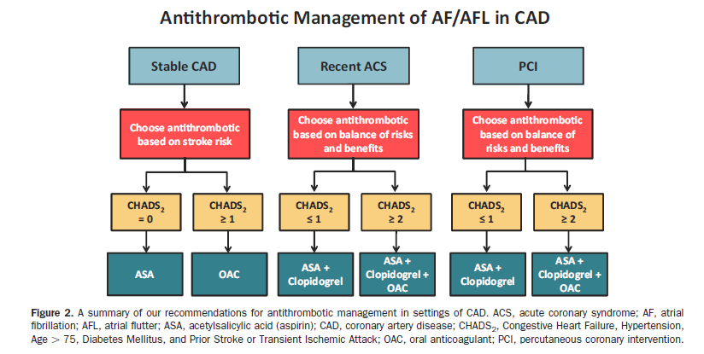
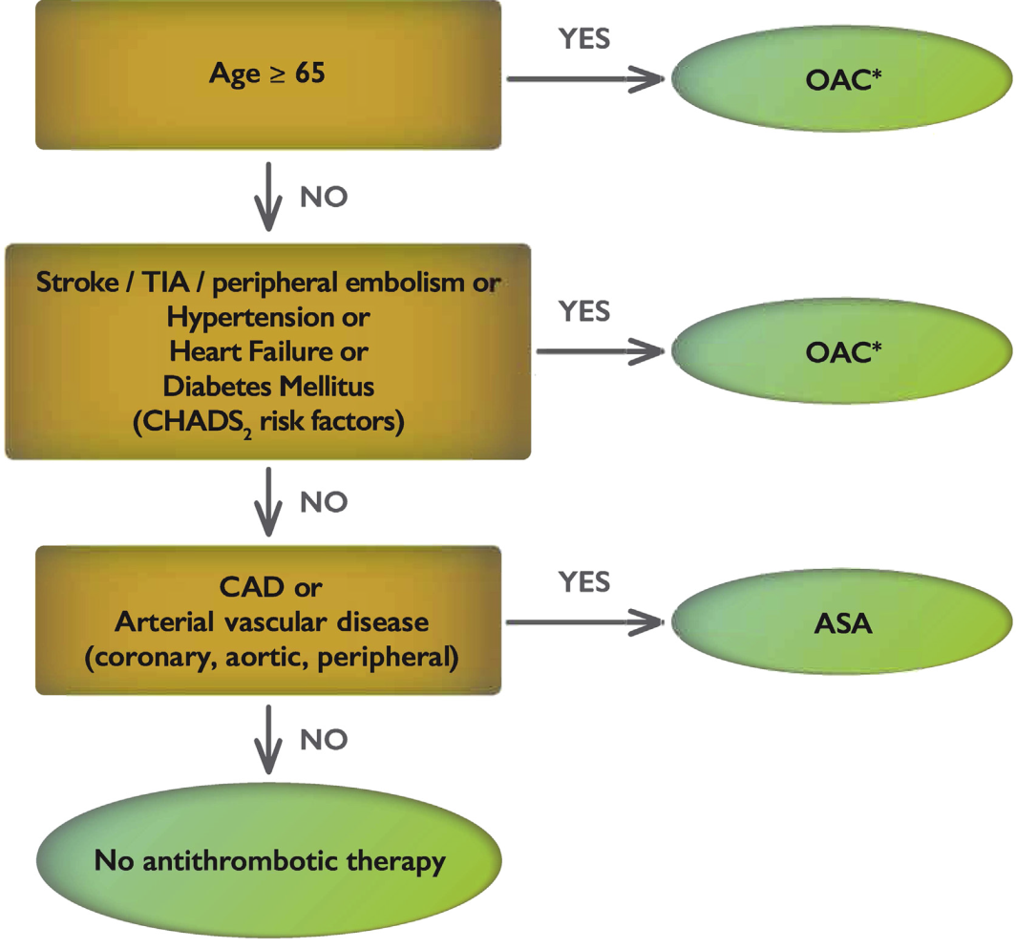
CCS AF Guidelines – CAD/PAD + CHADS-65 = 0
2012
2016
2018

Slide 14
Recommendation based on:
CAD/PAD increases the risk of stroke in patients with AF
Stroke Risk
7,920 NVAF patients off anticoagulation in Taiwan national health insurance database (1997-2008)

Slide 15
Recommendation based on:
CAD/PAD increases the risk of stroke in patients with AF
Antiplatelet therapy
  Less stroke risk reduction vs. OAC
  Less bleeding than OAC
Stroke
Bleeding
Stroke Risk
% change in Risk vs. Placebo
7,920 NVAF patients off anticoagulation in Taiwan national health insurance database (1997-2008)

Slide 16
Recommendation based on:
CAD/PAD therapies benefit CAD/PAD outcomes, as well as reduce stroke
Myocardial Infarction
Mortality
Stroke
*
*
*
*
*
*non-significant; ¹Lancet 2009; 373:1849–60; ²PLOS One 2012; 7; e31642; ³NEJM 2015; 372:1791-1800; ⁴NEJM 2017;377:1319-1330

Slide 17
Case One
60F
  CAD with remote MI
  Previous stents to LAD and LCX
Medications
  Metoprolol 50 mg bid
  ASA 81
  Atorvastatin 80 mg
New diagnosis of paroxysmal AF
  Non-valvular
What do you recommend?
Nothing
Antiplatelet alone
Dual Antiplatelet Therapy
Dual Pathway Therapy
OAC – Warfarin (INR 2-3)
OAC – NOAC

Slide 18
Case Two
65F
  CAD with remote MI
  Previous stents to LAD and LCX
Medications
  Metoprolol 50 mg bid
  ASA 81
  Atorvastatin 80 mg
New diagnosis of paroxysmal AF
  Non-valvular

Slide 19
Case Two
65F
  CAD with remote MI
  Previous stents to LAD and LCX
Medications
  Metoprolol 50 mg bid
  ASA 81
  Atorvastatin 80 mg
New diagnosis of paroxysmal AF
  Non-valvular

Slide 20
Case Two
65F
  CAD with remote MI
  Previous stents to LAD and LCX
Medications
  Metoprolol 50 mg bid
  ASA 81
  Atorvastatin 80 mg
New diagnosis of paroxysmal AF
  Non-valvular

Slide 21
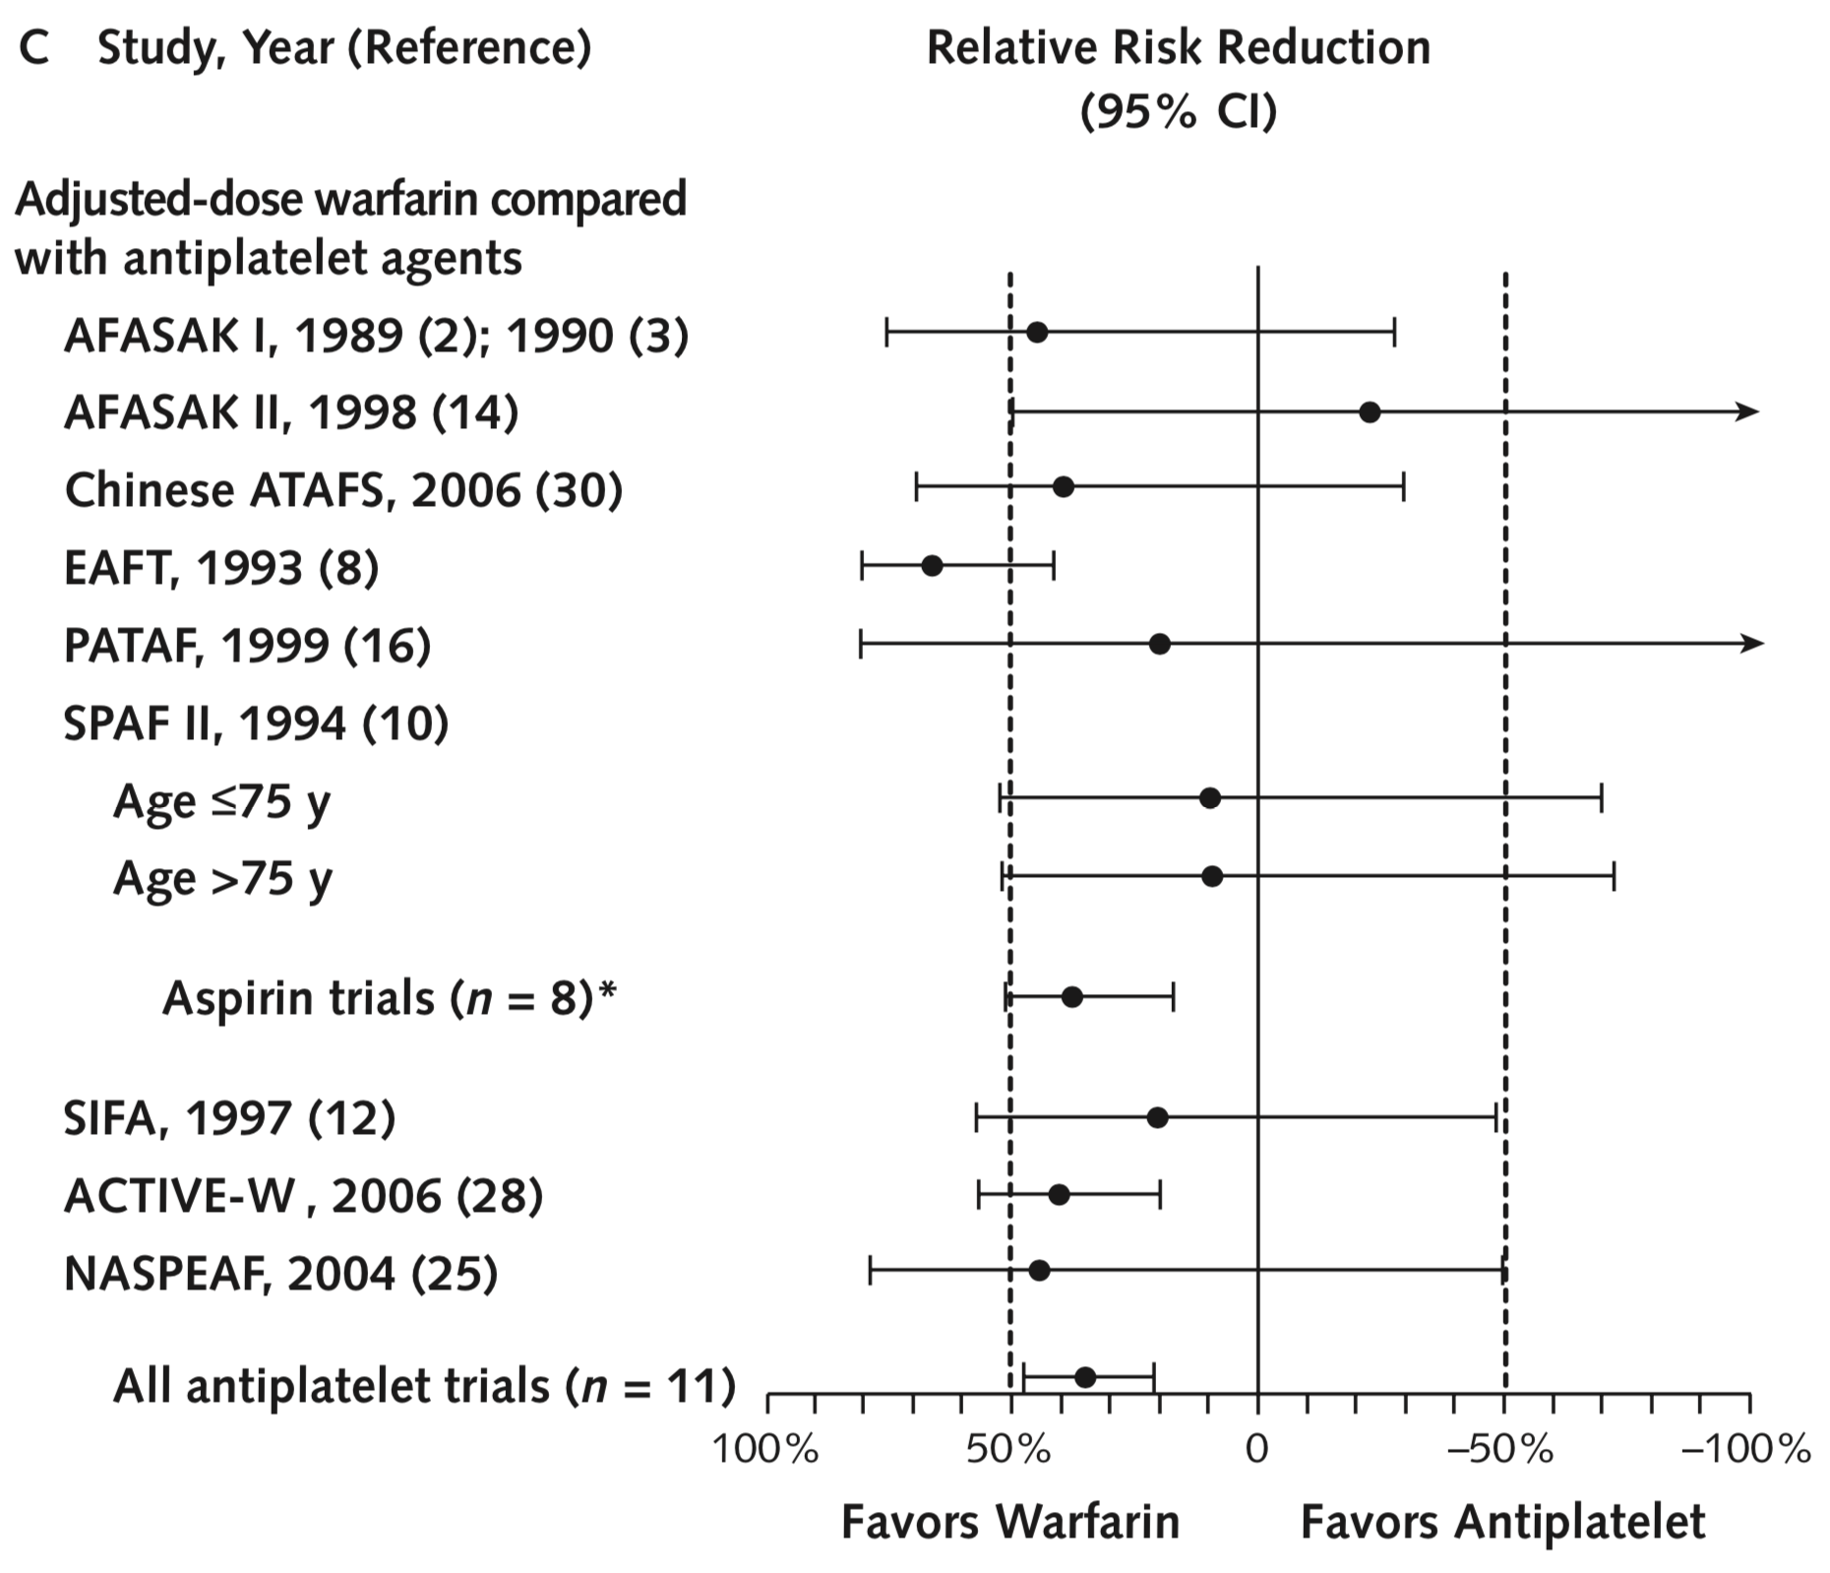
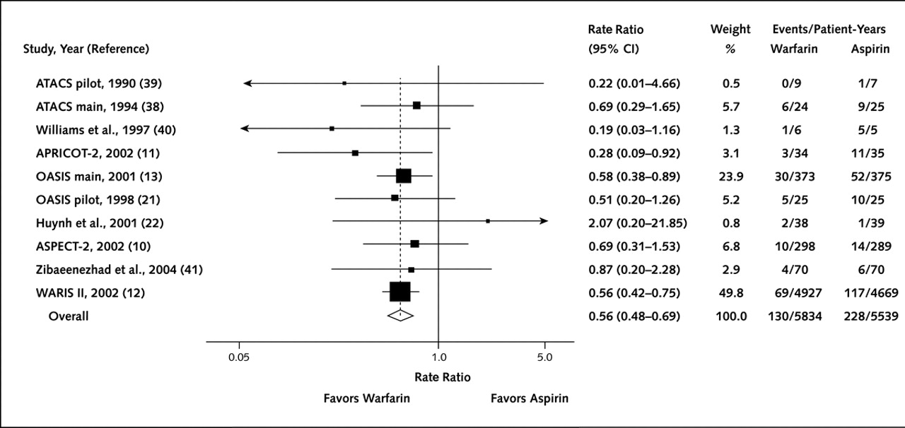
OAC Alone because:
OAC is more effective than APT for:
A. CAD outcomes in CAD patients & B. stroke outcomes in AF patients

Slide 22
OAC Alone because:
Combining APT + OAC
Increases the bleeding risk without improving thrombotic outcomes
Major bleed
WARIS II
HR 1.87
HR 2.14
HR 2.05
P=0.001 A vs. W+A
P=0.18 W vs. W+A
P=0.03 A vs. W
Minor bleed
ASPECT-2
HR 1.47
HR 1.33
HR 1.44
P=0.05 A vs. W+A
P=0.03 A vs. W, A vs. W+A

Slide 23
Case Three
70F with established AF
  HTN
  Remote MI with previous stents to LAD and LCX
Medications
  Metoprolol 100 mg bid
  OAC alone
  Atorvastatin 80 mg
Worsening angina with severe anterior ischemia on MIBI
  New Lesion requiring PCI
Choice of anti-thrombotic regimen?
  ASA + Antiplatelet
  OAC + Single Antiplatelet
  OAC + Dual Antiplatelet
Duration of Combination therapy?
  1 month
  3 months
  6 months
  12 months
Which OAC?
Which P2Y12 inhibitor?

Slide 24
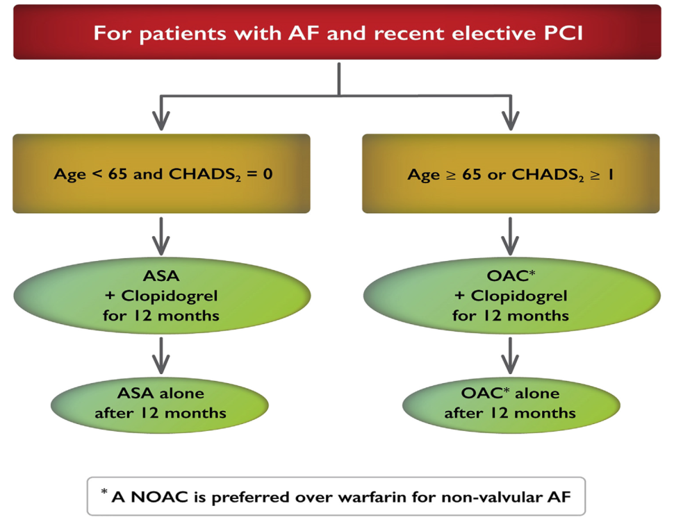
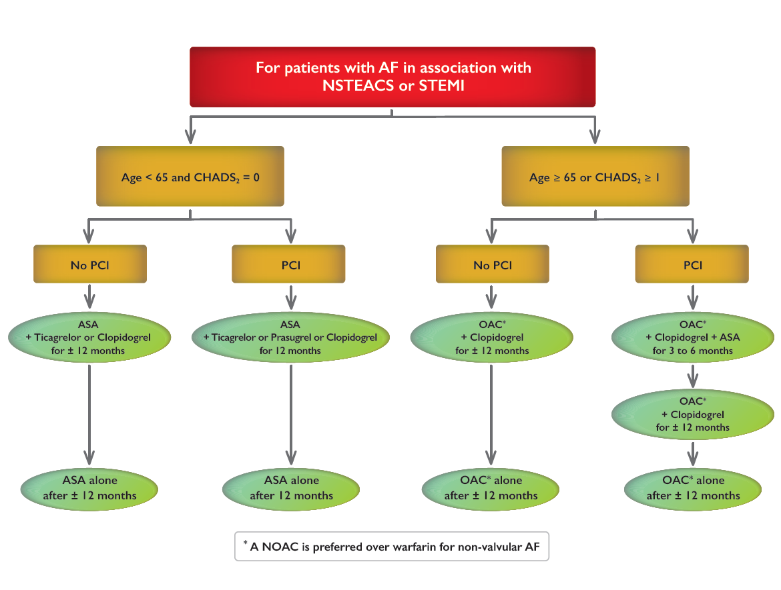
CCS AF Guidelines – PCI + CHADS-65 ≥ 1
2012
2016
2018

Slide 25
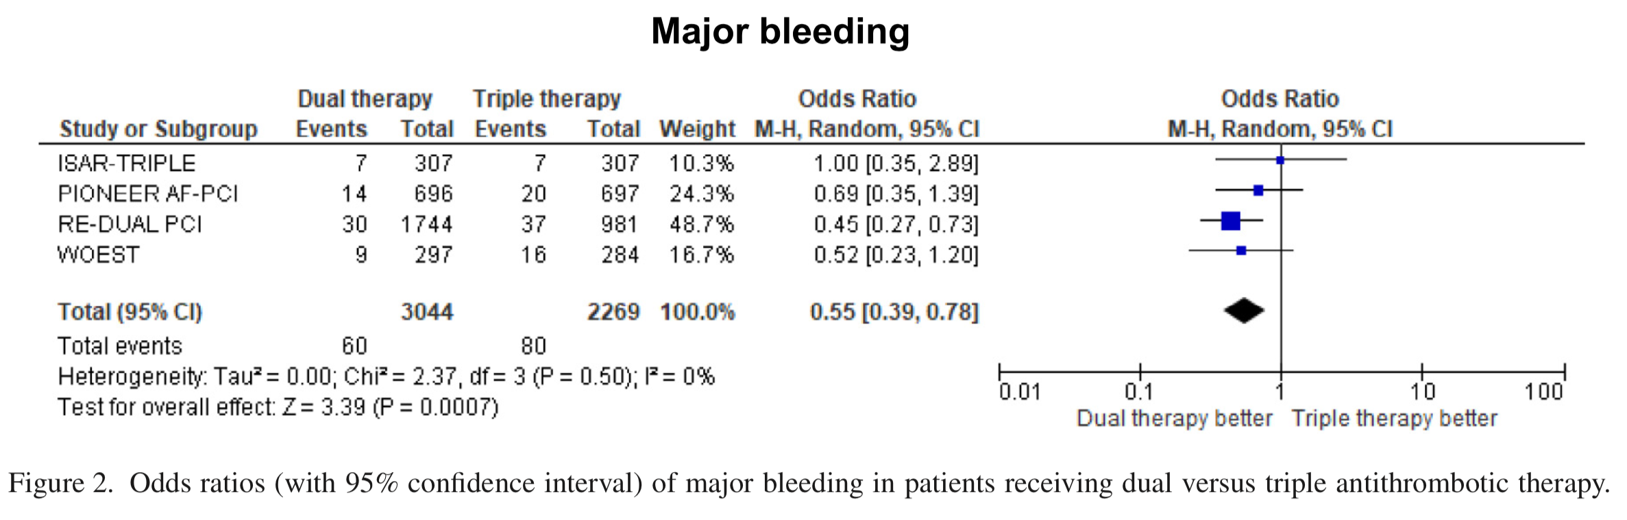
Dual Pathway vs. Triple Antithrombotic Therapy
Am J Cardiol 2018;121:718–724

Slide 26
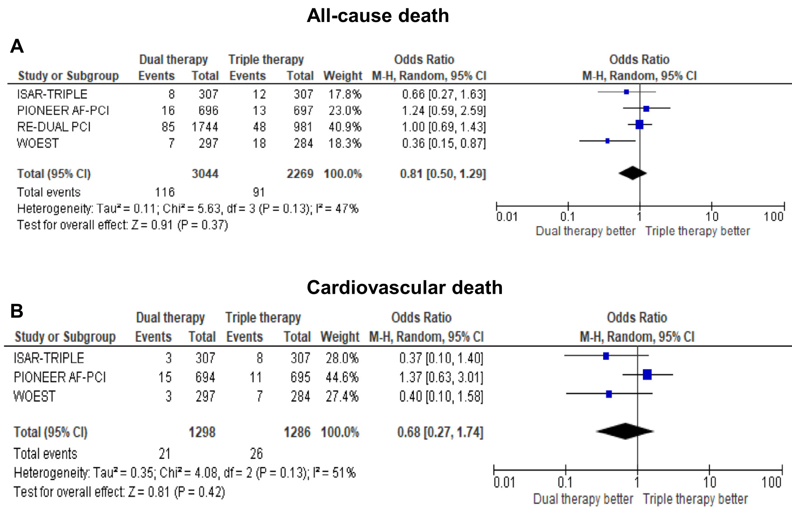
Dual Pathway vs. Triple Antithrombotic Therapy
Am J Cardiol 2018;121:718–724

Slide 27
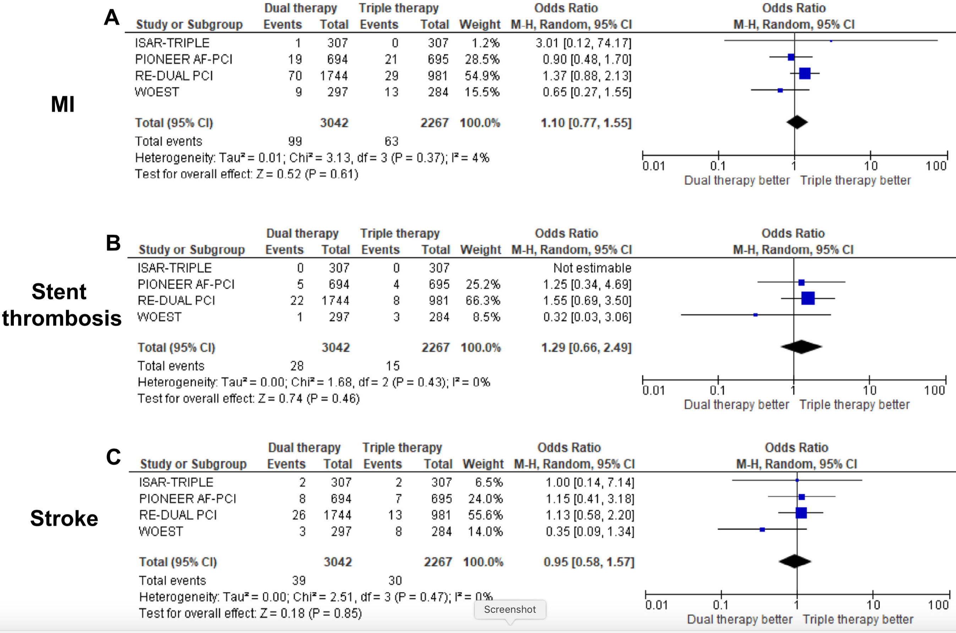
Dual Pathway vs. Triple Antithrombotic Therapy
Am J Cardiol 2018;121:718–724

Slide 29
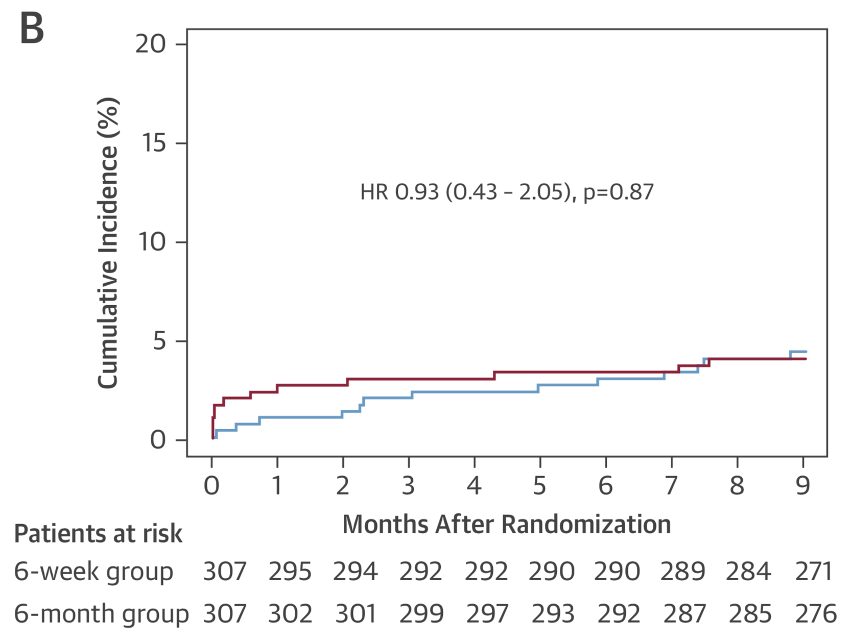
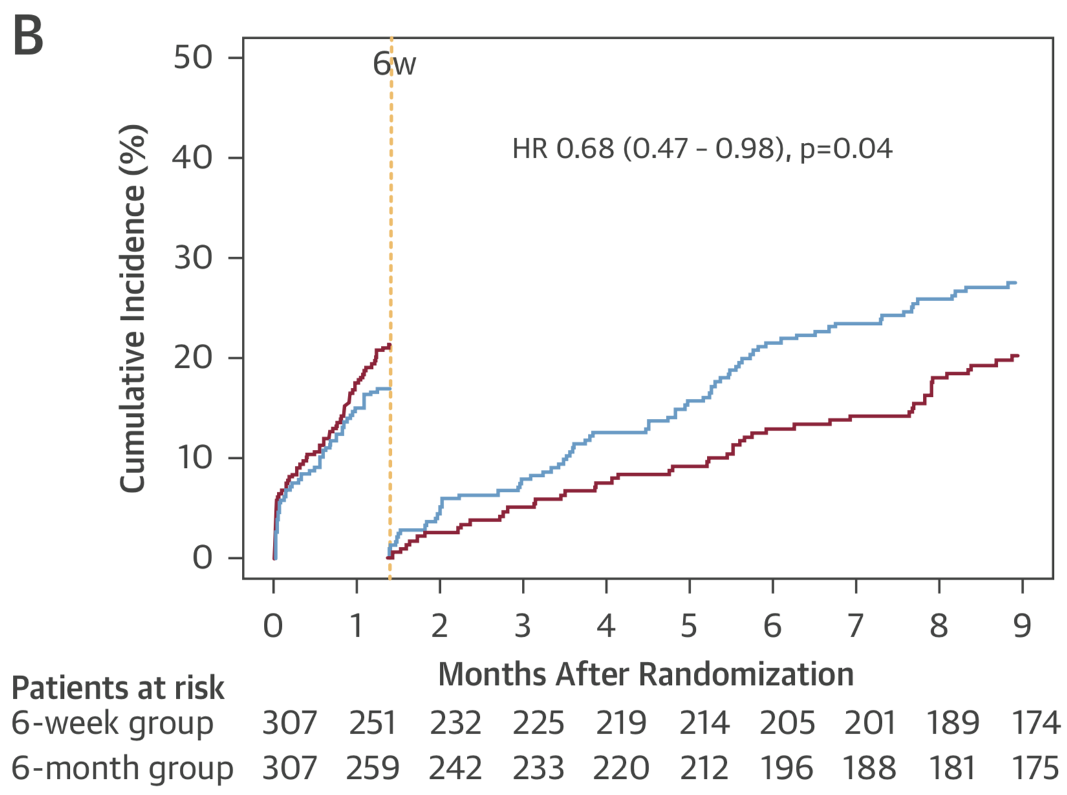
Duration of Combination Therapy
Death, MI, Definite Stent Thrombosis, Stroke
BARC types 1 to 5 bleeding
J Am Coll Cardiol 2015; 65:1619-29

Slide 30
Which P2Y₁₂ as part of Combination therapy?
TRIAL | DUAL PATHWAY | TRIPLE THERAPY | P2Y₁₂ Inhibitor | BLEEDING OUTCOME | EFFICACY OUTCOME
WOEST (n = 573) | Warfarin + clopidogrel | Warfarin + ASA + clopidogrel | Clopidogrel 100% | Less bleeding with Dual pathway | Non-inferior
ISAR-TRIPLE (n = 614) | VKA + ASA | VKA + ASA + clopidogrel | Clopidogrel 100% | Less bleeding with Abbreviated TT | No difference in primary or composite ischemic endpoints
PIONEER AF-PCI (n = 2124) | Rivaroxaban 15 mg + clopidogrel | Rivaroxaban 2.5 mg BID + ASA + clopidogrel VKA + ASA + clopidogrel | Clopidogrel 93-96% Prasugrel 0.7-1.7% Ticagrelor 3-5% | Less bleeding with Dual pathway and NOAC TT | Non-inferior
RE-DUAL PCI (n = 2725) | Dabigatran 110 BID + P2Y₁₂ inhibitor Dabigatran 150 BID + P2Y₁₂ inhibitor | Warfarin + ASA + P2Y₁₂ inhibitor | Clopidogrel 87-92% Ticagrelor 8-13% | Less bleeding with Dual pathway | Noninferior
Lancet 2013; 381:1107-15; JACC 2015; 65:1619-29; NEJM 2016; 375:2423-34; NEJM2017; 377:1513-24.

Slide 31
Wrap-Up

Slide 32
Periprocedural Anticoagulation for Cardioversion of Atrial Fibrillation or Atrial Flutter
Dr. Brent Mitchell

Slide 33
PERIPROCEDURAL ANTICOAGULATION FOR CARDIOVERSION OF ATRIAL FIBRILLATION
Case for Consideration:
  62 year-old female
  presents to the ER at 7:00 PM with palpitations / effort intolerance 2º to dyspnea
  symptoms began suddenly after shower yesterday morning (7:00 AM) (36 hours)
  no such previous history, no known structural heart disease or symptoms thereof
  on no medications
  heart rate is 120 bpm (irreg-irreg); BP is 135/82 mm Hg
  cardiovascular examination is otherwise unremarkable
  ECG shows atrial fibrillation with an irregular ventricular response rate of 120 bpm
  ECG is otherwise unremarkable

Slide 34
PERIPROCEDURAL ANTICOAGULATION FOR CARDIOVERSION OF ATRIAL FIBRILLATION
Cardioversion is contemplated. If so, relative to anticoagulation, I would recommend:
rate-control and delay CV until after 3 weeks of therapeutic OAC
CV with no anticoagulation
CV preceded by low molecular weight heparin of choice
CV followed by immediate institution of OAC therapy
trans-esophageal echocardiogram to decide

Slide 35
PERIPROCEDURAL ANTICOAGULATION FOR CARDIOVERSION OF ATRIAL FIBRILLATION
Cardioversion has been performed. Relative to ongoing anticoagulation, I would recommend:
no ongoing anticoagulation or anti-platelet therapy is required
ongoing antithrombotic therapy with ASA indefinitely
ongoing antithrombotic therapy with oral anticoagulant for 4 weeks
ongoing antithrombotic therapy with oral anticoagulant indefinitely
trans-esophageal echocardiogram to decide

Slide 36
WHAT WERE THE HISTORICAL RATES OF THROMBOEMBOLISM AFTER CV OF AF?
IRRESPECTIVE OF CV
AFTER CV
6 trials
186 events
2900 pts
12 trials
55 events
5597 pts
↑ 380%
↓ 80%
1.90
monthly event rate (%)
monthly event rate (%)
↓ 64%
↑ 200%
0.50
0.36
0.18
>48h
no AC
>48h
ADW
>48h CV
no AC
>48h CV
ADW
Hart R et al. Ann Intern Med 146:857-867, 2007
from 12 early observational trials
Notes:
Note that these data are relative to AF > 48 hours

Slide 37
WHAT ARE THE CONTEMPORARY RATES OF THROMBOEMBOLISM AFTER CV OF AF?
IRRESPECTIVE OF CV
AFTER CV
4 trials
1088 events
71,381 pts
6 trials
30 events
7,653 pts
↑ 329%
↓ 33%
monthly event rate (%)
monthly event rate (%)
↓ 14%
↑ 258%
0.46
0.31
0.14
0.12
>48h
ADW
>48h
NOAC
>48h CV
ADW
>48h CV
NOAC
from 4 NOAC pivotal trials
from 3 NOAC pivotal trials and 3 NOAC CV RTCs
Notes:
Note that these data are relative to AF > 48 hours

Slide 38
WHAT ARE THE CONTEMPORARY RATES OF MAJOR BLEEDING AFTER CV OF AF?
IRRESPECTIVE OF CV
AFTER CV
4 trials
3860 events
71,515 pts
6 trials
53 events
8518 pts
↑ 239%
↓ 13%
monthly event rate (%)
↓ 12%
↑ 252%
monthly event rate (%)
0.67
0.58
0.28
0.23
>48h
ADW
>48h
NOAC
>48h CV
ADW
>48h CV
NOAC
from 4 NOAC pivotal trials
from 3 NOAC pivotal trials and 3 NOAC CV RTCs
Notes:
Note that these data are relative to AF > 48 hours

Slide 39
IS AF CV WITHIN 48 HOURS A MUCH LOWER RISK FACTOR THAN IS CV AFTER 48 HOURS?
AFTER CV >48 H
AFTER CV < 48 H
1 country
86 events
16274 pts
3 hospitals
41 events
7660 pts
9.5 % / year
8.5 % / year
↓ 58%
↓ 82%
monthly event rate (%)
monthly event rate (%)
0.79
0.71
0.33
0.13
>48h CV
no AC
>48h CV
AC
<48h CV
no AC
<48h CV
AC
Danes 2000-2008: Hansen ML et al. Europace 17:18-23, 2015
Finns 2003-2010: Grönberg T et al. Am J Cardiol 117:1294-8, 2016

Slide 40
PARSING THE RISK OF THROMBOEMBOLISM AFTER CV OF ATRIAL FIBRILLATION
<48 Hr AF with CV On AC Versus Off AC by CHA₂DS₂-VASc
0-1
2
3-4
≥5
2.20
significant decrease in TE for CHA₂DS₂-VASc ≥2 if on OAC
0.2% anticoagulated vs. 1.1% not anticoagulated, p=0.001
1.50
monthly event rate (%)
0.30
0.20
0.15
0.20
0.00
0.00
1.5% / yr
Grönberg T et al. Am J Cardiol 117:1294-8, 2016

Slide 41
PARSING THE RISK OF THROMBOEMBOLISM AFTER CV OF ATRIAL FIBRILLATION
<48 Hr AF CV Males Versus Females by Age Group
CV <12 Hr
CV >12 Hr
3.50
strongest predictor of thromboembolism was time to CV
OR 3.70 (95%CI 1.69-8.20) p=0.001
2.70
monthly event rate (%)
1.90
1.40
1.20
1.40
0.90
0.30
0.30
0.40
0.50
1.5% / yr
0.00
<65
65-75
>75
<65
65-75
>75
Bah A et al. Ann Med 49:254-9, 2017

Slide 42
NEW CCS GUIDELINES: ANTICOAGULATION
FOR CARDIOVERSION IN ACUTE AF
INFERENCES
  the risk of thromboembolism in the month after CV of non-acute AF/AFL (0.79%) exceeds the 0.125% monthly risk used by the CCS to recommend OAC .
  the risk of thromboembolism in the month after CV of acute AF/AFL (0.71%) also exceeds the 0.125% monthly risk used by the CCS to recommend OAC.
  The trade-offs to one month OAC after CV in acute AF/AFL are similar to those of long-term OAC for patients with non-acute AF/AFL recommended to OAC.
  The advantages of CV for symptomatic AF/AFL in acute AF suggest that CV proceed without three weeks of pre-CV OAC therapy in lower risk patients.

Slide 43
STANDING CCS AF RECOMMENDTATION
PART 6, RECOMMENDATION 9
We recommend that hemodynamically stable patients with AF or AFL for whom electrical or pharmacological cardioversion is planned should receive therapeutic anticoagulation and rate-control for 3 weeks before cardioversion and at least 4 weeks post cardioversion (Strong Recommendation, Moderate Quality Evidence).
Macle L et al. https://www.cc.ca/images/Guidelines_POS_Library/2016%20AF%20Update_Supplement_Final_PDF.pdf

Slide 44
NEW CCS GUIDELINES: ANTICOAGULATION
FOR CARDIOVERSION IN ACUTE AF
We suggest that, in the absence of a strong contraindication, all patients undergoing cardioversion of AF/AFL receive at least four weeks of therapeutic anticoagulation (adjusted-dose warfarin or a NOAC) after cardioversion. (Weak recommendation, Low Quality Evidence). Thereafter, we recommend that the need for ongoing antithrombotic therapy should be based upon the risk of stroke as determined by the CCS algorithm (“CHADS-65”) (Strong Recommendation, Moderate Quality Evidence).
Andrade JG et al. Can J Cardiol 2018 (in press)

Slide 45
CCS ATRIAL FIBRILLATION GUIDELINES 2018
ANTICOAGULATION AFTER CV IN NVAF
CARDIOVERSION PERFORMED
OAC FOR FOUR WEEKS
YES
OAC INDEFINITELY
AGE ≥65 YEARS
YES
NO
OAC INDEFINITELY
CHF, HT, DIABETES, CVA
YES
NO
ANTIPLATELET THERAPY
VASCULAR DISEASE
YES
NO
NO TE PREVENTION THERAPY
NO TE RISK FACTORS
YES

Slide 46
PERIPROCEDURAL ANTICOAGULATION FOR CARDIOVERSION OF ATRIAL FIBRILLATION
Cardioversion has been performed. Relative to ongoing anticoagulation, I would recommend:
no ongoing anticoagulation or anti-platelet therapy is required
ongoing antithrombotic therapy with ASA indefinitely
ongoing antithrombotic therapy with oral anticoagulant for 4 weeks
ongoing antithrombotic therapy with oral anticoagulant indefinitely
trans-esophageal echocardiogram to decide

Slide 47
NEW CCS GUIDELINES: ANTICOAGULATION
FOR CARDIOVERSION IN ACUTE AF
We suggest that pharmacological or electrical cardioversion of symptomatic AF or AFL without at least 3 weeks of therapeutic anticoagulation be reserved for patients with the following characteristics (Weak Recommendation, Low Quality Evidence):
  patients with non-valvular AF presenting with a clear AF-onset within 12 hours in the absence of recent stroke or TIA (within 6 months); or,
  patients with non-valvular AF and a CHADS₂ score < 2 presenting after 12 hours but within 48 hours of AF onset

Slide 48
CCS ATRIAL FIBRILLATION GUIDELINES 2018
ANTICOAGULATION PRIOR TO CV IN NVAF
PT UNSTABLE 2º AF/AFL
(↓BP, ACS, PUL EDEMA)
CARDIOVERSION
YES
NO
ON THERAPEUTIC
OAC FOR ≥3 WEEKS
YES
CARDIOVERSION
NO
AF/AFL < 12 HRS
No stroke or TIA (6 mo)
YES
CARDIOVERSION
NO
CARDIOVERSION
AF/AFL 12-48 HRS
YES
YES
CHADS₂ < 2
NO
3 WEEKS THERAPEUTIC OAC
THEN CARDIOVERSION
NO
AF/AFL >48 HRS
3 WEEKS THERAPEUTIC OAC
THEN CARDIOVERSION
YES
Notes:
Magenta – or low risk TEE

Slide 49
NEW CCS GUIDELINES: ANTICOAGULATION
FOR CARDIOVERSION IN ACUTE AF
We suggest that, in the absence of a strong contraindication, all patients undergoing cardioversion of AF/AFL receive at least four weeks of therapeutic anticoagulation (adjusted-dose warfarin or a NOAC) after cardioversion. (Weak recommendation, Low Quality Evidence).
When a decision has been reached that a patient will be undergoing unplanned cardioversion of AF/AFL, we suggest that anticoagulation therapy be initiated immediately (preferably before cardioversion) (Weak recommendation, Low Quality Evidence).

Slide 50
PERIPROCEDURAL ANTICOAGULATION FOR CARDIOVERSION OF ATRIAL FIBRILLATION
Cardioversion is contemplated. If so, relative to anticoagulation, I would recommend:
rate-control and delay CV until after 3 weeks of therapeutic OAC
CV with no anticoagulation
CV preceded by low molecular weight heparin of choice
CV with immediate institution of OAC therapy
trans-esophageal echocardiogram to decide

Slide 51
STROKE/SE WITHIN 30 DAYS POST CV
AD-WARFARIN VERSUS NOAC THERAPY
STUDY (agent) HR (95% CI)
RE-LY (dabi) 0.88 (0.26-3.00)
ROCKET-AF (riva) 1.91 (0.18-20.85)
ARISTOTLE (apixa) not estimable
ENGAGE-AF (edox) 2.28 (0.11-47.15)
sample size for non-inferiority trial would be 40 – 60 K
these trials in aggregate involved 7,653 patients
X-VeRT (riva) 0.33 (0.06-1.99)
ENSURE-AF (edox) 0.76 (0.17-3.37)
meta-analysis (all) 0.82 (0.38-1.75)
EMANATE (apixa) 0.08 (0.01-1.34)
combine X-E-E 0.60 (0.26-1.22)
0.1
1.0
10
NOAC Better
Warfarin Better
Renda G et al. Am J Med 130:457-61, 2017
Ezekewitz MD et al. Poster ESC Barcelona 2017
Notes:
X-E-E = XVeRT + ENSURE-AF + EMANATE

Slide 52
NEW CCS GUIDELINES: ANTICOAGULATION
FOR CARDIOVERSION IN ACUTE AF
Practical tip: When oral anticoagulation is to be used for only a short period (less than two months) current evidence does not substantiate either an efficacy or safety advantage for use of a NOAC over adjusted dose warfarin. Nevertheless, the convenience of use of a NOAC over adjusted-dose warfarin in the peri-cardioversion period is substantial and the onset of therapeutic anticoagulation is nearly immediate with a NOAC while being delayed in the case of adjusted-dose warfarin. Accordingly, it is reasonable to use NOAC therapy in the peri-cardioversion period.
Andrade JG et al. Can J Cardiol 2018 (in press)

Slide 53
ANTICOAGULATION PATHWAY: CARDIOVERSION FOR AF OR FLUTTER
Andrade JG et al. Can J Cardiol 2018 (in press)

Slide 54
Integrated approach to the patient with AF and modifiable cardiovascular risk factors.
Dr. Ratika Parkash

Slide 55
Case – Mr RF
40 year old gentleman referred with a new diagnosis of atrial fibrillation
  Chest pain, dizziness, tunnel vision, weakness
Treated with rate control medication and discharged home
Ongoing episodes of palpitations and symptoms lasting 12-24 hours, 2-3 times/month
History of hypertension for last 5 years
Ongoing smoker, binge drinking
Review of systems: snores at night, does not sleep well
Physical Examination: BP 120/80 HR 90 bpm 144 kg (317 lbs) BMI 44.4
Waist circumference > 90 cm
Cardiovascular examination normal
TSH normal; echo unremarkable, left atrial size 4.0 cm

Slide 56
What would you advise this gentleman?

Slide 57
What would you advise this gentleman?
Rate control, oral anticoagulation
Rhythm control, oral anticoagulation
Catheter ablation, oral anticoagulation
Quit drinking, quit smoking, lose weight, exercise, investigate for sleep apnea, rate control and oral anticoagulation (OAC)
Something else

Slide 58
Risk Factor Modification in Atrial Fibrillation: Recommendation
We recommend systematic and strict guideline adherent management of traditional modifiable cardiovascular risk factors and/or conditions associated with AF, to reduce cardiovascular events (e.g. stroke, MI etc.) (Strong Recommendation, High Quality Evidence).
Values and preferences: This recommendation places a high value on a systematic approach to providing guideline-directed therapy for any cardiovascular risk factors and/or conditions associated with AF.
Practical tip: The detection and optimal management of risk factors and concomitant disorders together with appropriate rate/rhythm control and stroke prevention may contribute to a reduction in cardiovascular-related emergency department visits and hospitalizations. Addressing such risk factors might be most comprehensively and efficiently accomplished through a specialized clinic or other multidisciplinary management approach, and through use of a standardized, systematic protocol-based approach.

Slide 59
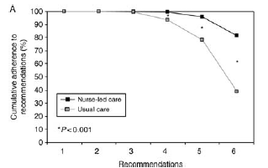
Single-center randomized clinical trial: AF clinic vs usual care
End Point | Nurse-led care | Usual Care | HR 95% CI
Cardiovascular death(%) | 4 (1.1) | 14 (3.9) | 0.28 (0.09, 0.85)
Cardiovascular hospitalization(%) | 48 (13.5) | 68 (19.1) | 0.66 (0.46,0.96)
Stroke (%) | 3 (0.8) | 5 (1.4)
99% cost-effective
Hendriks et al. EHJ 2012;33:2692-99
Hendriks et al. Europace 2013 15:1128-1135

Slide 60
An Integrated Management Approach to Atrial Fibrillation
Outcome | AF Clinic (n = 185) | Usual Care (n = 228) | Odds Ratio (95% CI) | P value
Death, CV hospitalization, AF-related ED visit | 18.4% | 28.5% | 0.57 (0.35, 0.9) | 0.017
Death from any cause | 0% | 1.8% | n/a | 0.13*
CV hospitalization | 6% | 8.8% | 0.66 (0.31, 1.41) | 0.28
AF-related ED visit | 13.5% | 23.7% | 0.5 (0.3, 0.85) | 0.01
Stroke | 2.2% | 3.5% | 0.61 (0.18, 2.05) | 0.42
Major bleeding | 0% | 1.3% | n/a | 0.26
Minor bleeding | 2.2% | 1.8% | 1.24 0.31, 5.02) | 0.77
Carter et al. JAHA 2016;5:e002950

Slide 61
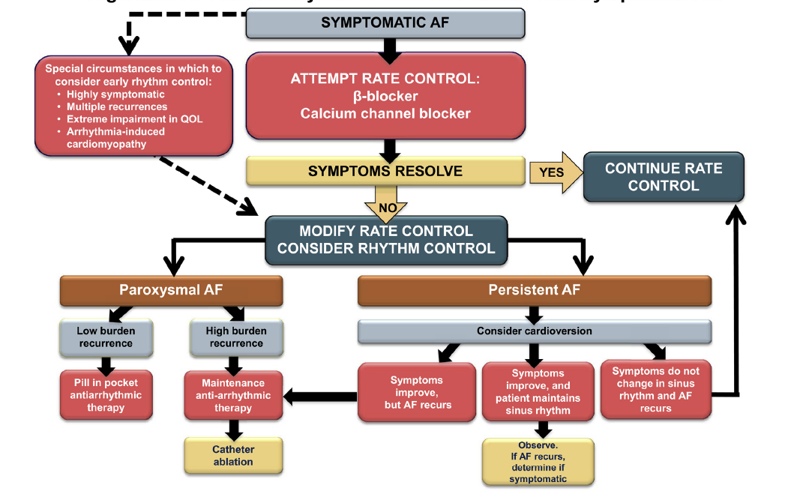
Treatment of AF
Is this enough?
Verma et al CJC 2014

Slide 62
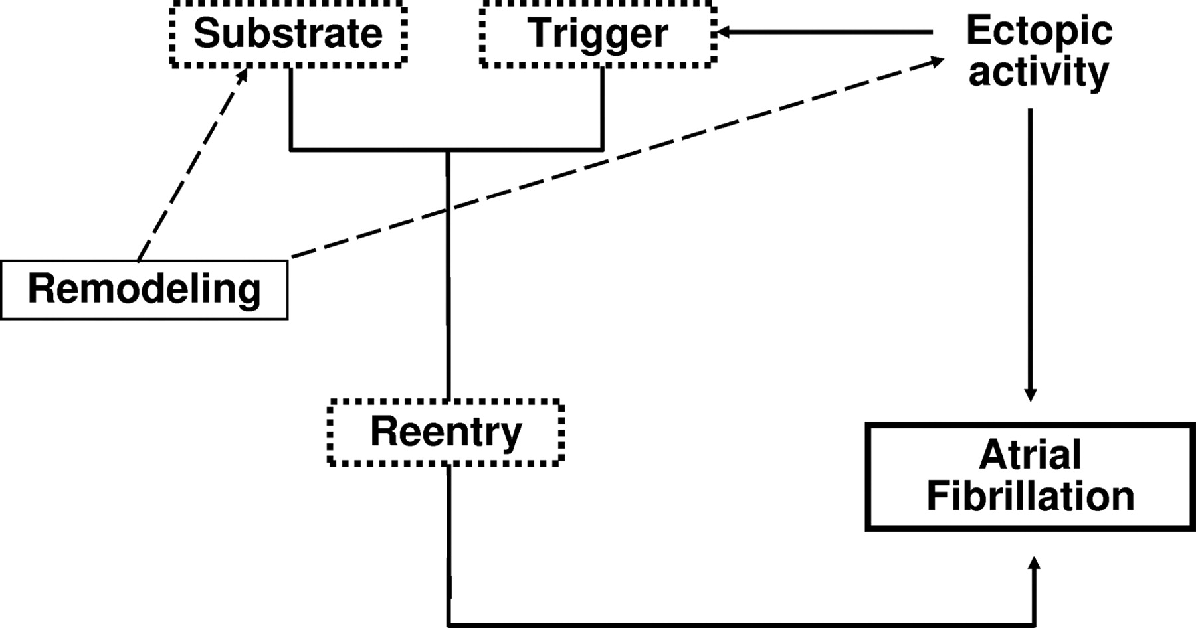

General Schema Representing AF Mechanisms and the Role of Remodeling
Copyright © American Heart Association, Inc. All rights reserved.
Stanley Nattel et al. Circ Arrhythm Electrophysiol. 2008;1:62-73
Notes:
Figure 1. General schema representing AF mechanisms and the role of remodeling.

Slide 63
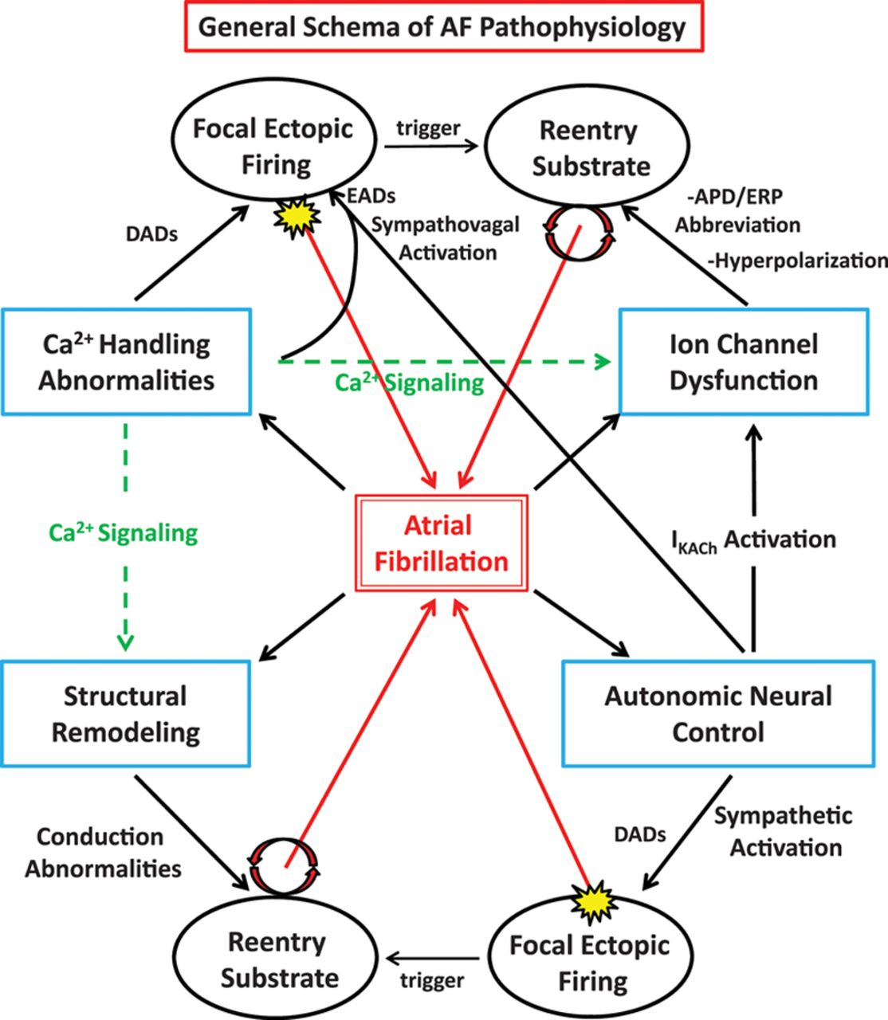
Mechanisms Leading to AF
Jason Andrade et al. Circulation Research. 2014;114:1453-1468
Notes:
A general schema representing the various mechanisms that can lead to the perturbations underlyingatrial fibrillation (AF), including focal ectopic firing and vulnerable substrates that can maintain re-entry. APD indicates action potential duration; DAD, delayed afterdepolarization; EAD, early afterdepolarization; and ERP, effective refractory period.

Slide 64
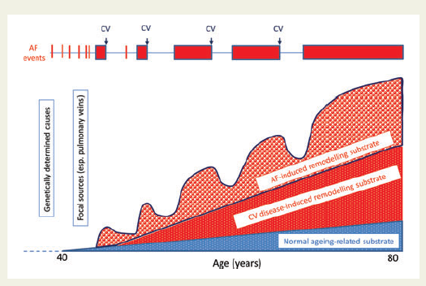
Progression of AF

Slide 65

AF is a symptom, not a disease

Slide 66
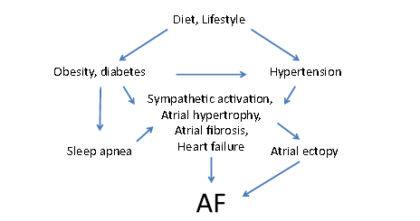
Substrate Modification to Prevent AF
Van Wagoner et al. Heart Rhythm 2015; 12:e6-e22

Slide 67
Blood Pressure and AF
Systolic BP (mm Hg) | <120 | 120-129 | 130-139 | 140-159 | ≥160
Risk of AF | Ref | 1.18 (0.9,1.52) | 1.43 (1.09,1.87) | 1.78 (1.34,2.38) | 2.29 (1.45,3.63)
Conen et al. Circulation 2009;119:2146-52

Slide 68
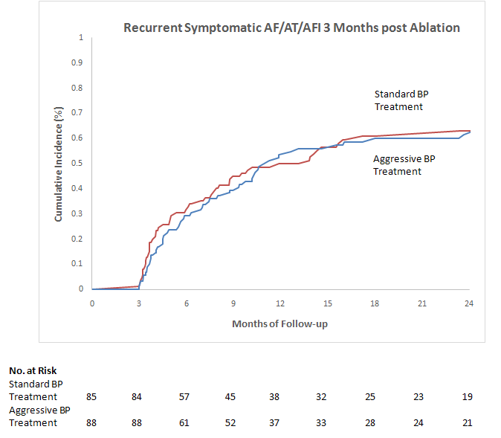
Primary Outcome: Time to Recurrent Symptomatic
AF/AT/AFL 3 Months Post Ablation
Hazard Ratio 0.94
95% CI (0.65,1.38) 0.763
Standard BP Treatment
Aggressive BP Treatment
Months of Follow-up
Parkash et al. Circulation; 2017; 135:1788-98

Slide 69

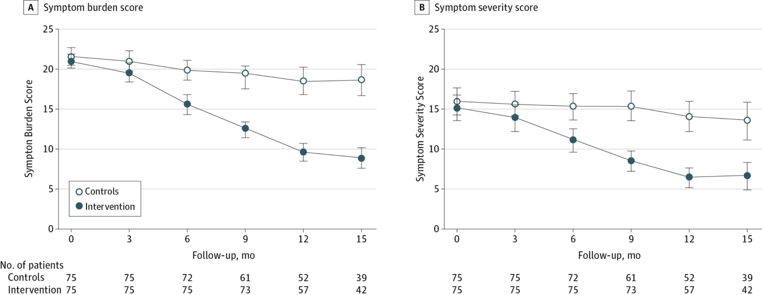
From: Effect of Weight Reduction and Cardiometabolic Risk Factor Management on Symptom Burden and Severity in Patients With Atrial Fibrillation: A Randomized Clinical Trial
JAMA. 2013;310(19):2050-2060. doi:10.1001/jama.2013.280521
Significant reduction in AF symptom burden score and symptom severity score
Figure Legend:
Changes in Atrial Fibrillation Symptom Scale (AFSS) Scores Over Study Follow-upError bars indicate 95% confidence intervals. A, Between-group level of significance: P = .41 at time 0, P = .12 at 3 months, P < .001 at 6, 9, 12, and 15 months. B, Between-group level of significance: P = .49 at time 0, P = .17 at 3 months, P < .001 at 6, 9, 12, and 15 months.
Copyright © 2014 American Medical Association. All rights reserved.
Date of download: 9/13/2014

Slide 70
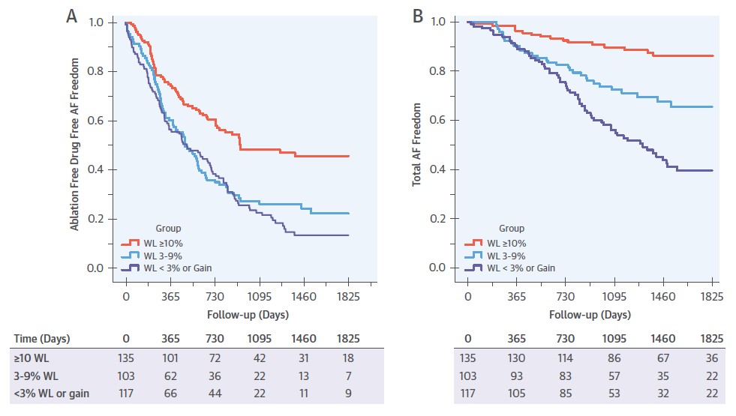
LEGACY: Cohort Study
Pathak et al JACC 2015; 2159-69

Slide 71
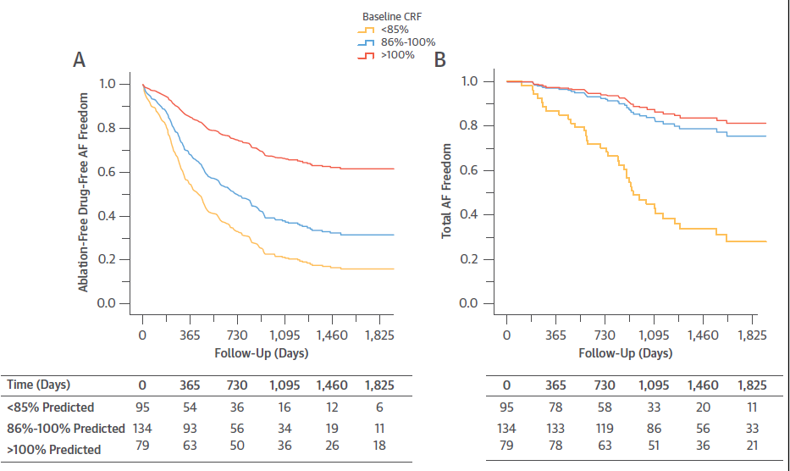
CARDIO FIT
Pathak et al JACC 2015;985-96

Slide 72
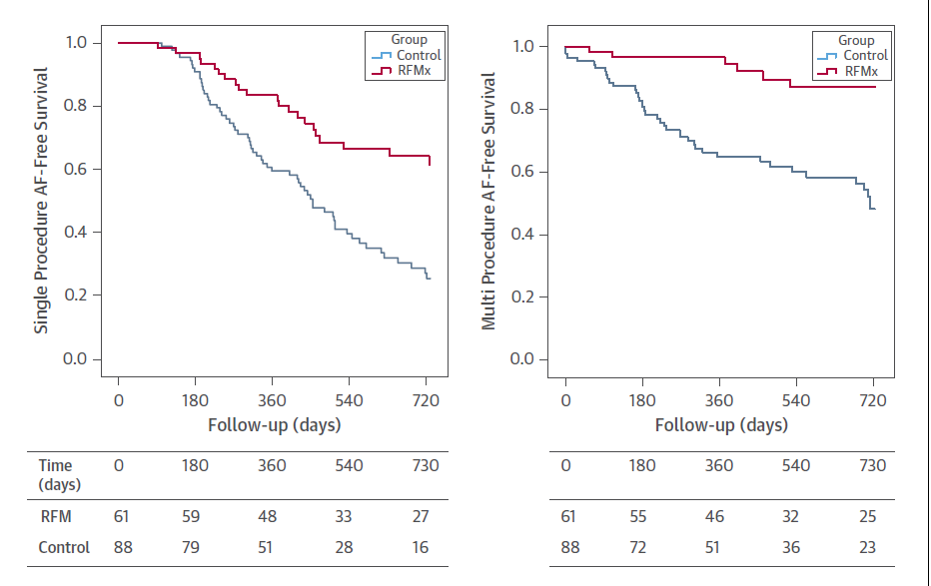
ARREST-AF Cohort Study
Pathak et al. JACC 2014; 64: 2222-31

Slide 73
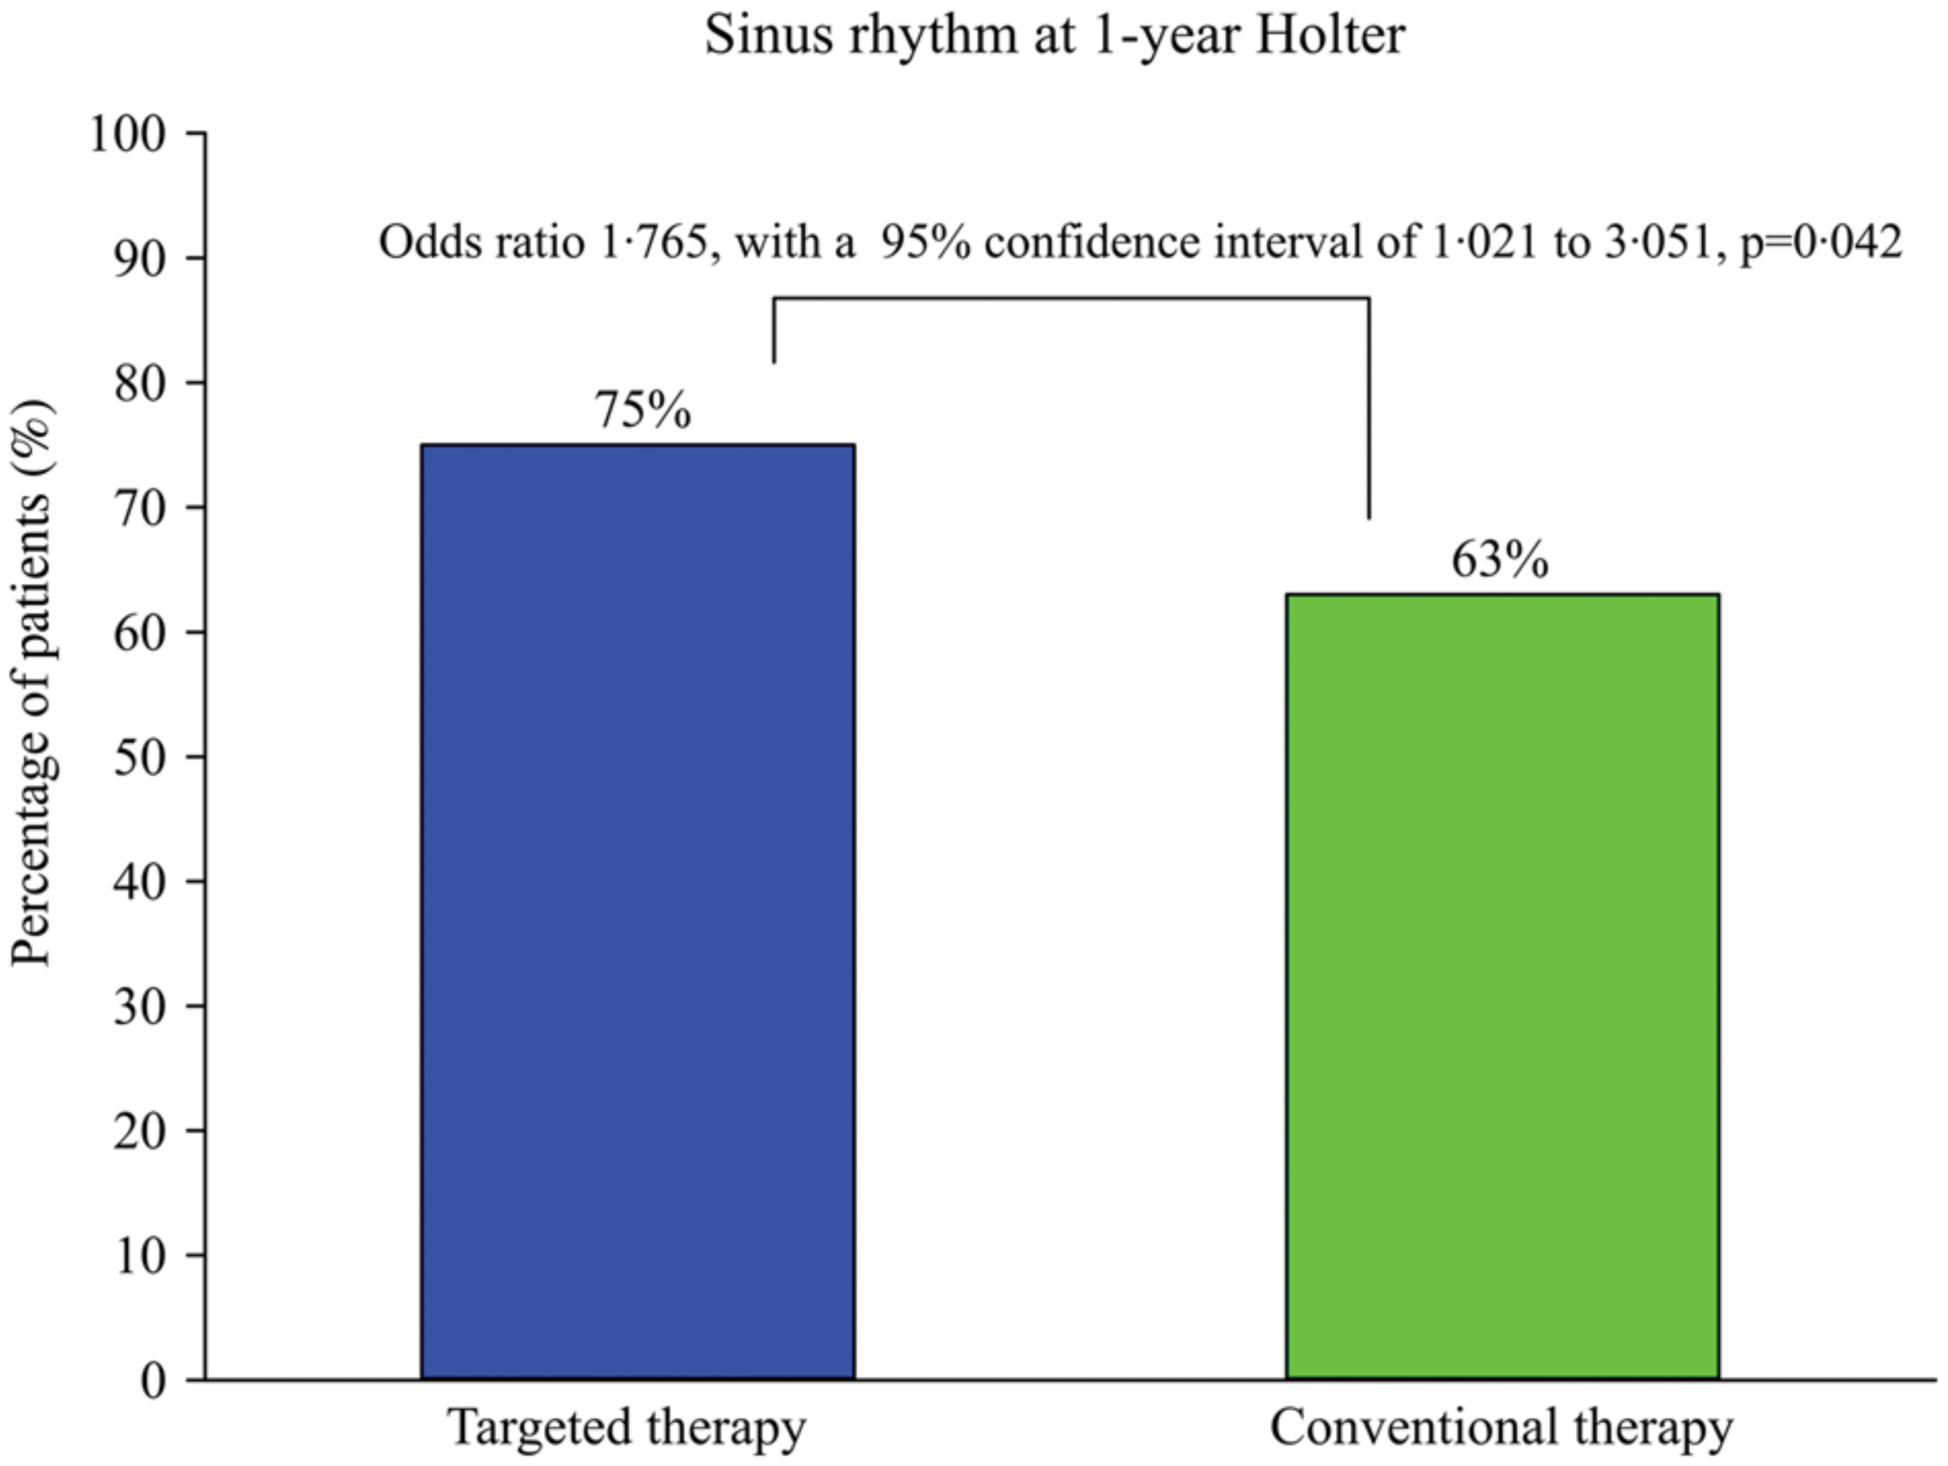
RACE III
Rienstra et al. 2018 EHJ

Slide 74
Risk Factor Modification in Atrial Fibrillation: Recommendation
We suggest that, in addition to implementing appropriate rate or rhythm control measures, an approach targeting modifiable risk markers and conditions associated with AF should be applied to prevent recurrence of the arrhythmia and/or decrease its symptom burden (Weak Recommendation, Low Quality Evidence).
Values and preferences: The aggressive treatment of obesity and cardiometabolic risk markers/conditions (including hypertension, heart failure, diabetes, and sleep apnea) has been shown to reduce AF burden and improve quality of life. This recommendation places a high value on the recognized association between these potential risk markers and conditions that are known to aggravate AF and the possibility that treatment of these may result in prevention and/or regression of the substrate that causes AF as well as improving patient symptoms.

Slide 75
Case of Mr RF
Rate control, oral anticoagulation
Rhythm control, oral anticoagulation
Catheter ablation, oral anticoagulation
Quit drinking, quit smoking, lose weight, exercise, investigate for sleep apnea, rate control and oral anticoagulation
Something else

Slide 76
Overview of Topics/Recommendations from Other Sections
Dr. Laurent Macle

Slide 77
2018 Focused Update Content
Anticoagulation in the context of cardioversion
Management of antithrombotic therapy for patients with AF and CAD
Investigation and management of subclinical AF
Antidotes for NOACs/NOAC reversal agents
Acute pharmacological rhythm control
Catheter ablation of AF
Integrated approach to AF and modifiable cardiovascular risk factors

Slide 78
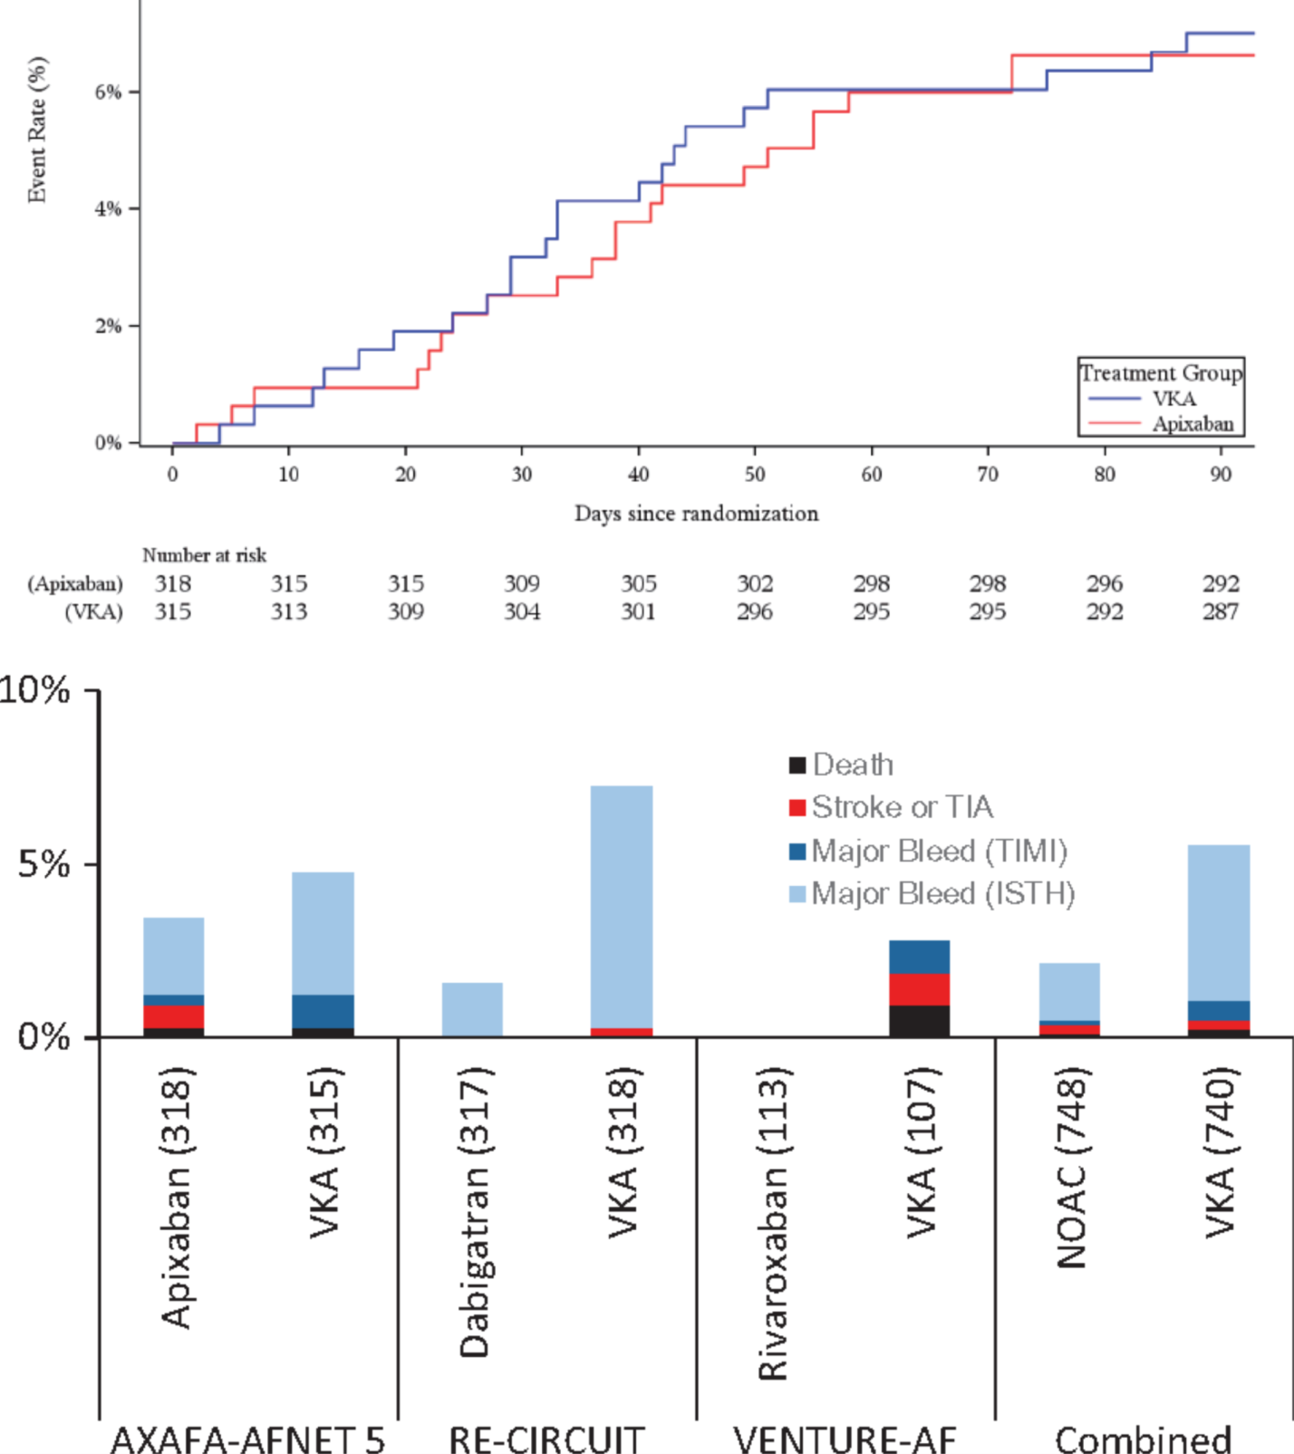
Uninterrupted NOAC vs uninterrupted warfarin: Summary of Trials
Catheter ablation of AF
Kirchhof et al, Eur Heart J 2018

Slide 79
Catheter ablation of AF
Recommendation:
We suggest that catheter ablation may be performed using uninterrupted therapeutic oral anticoagulation with either a NOAC or adjusted-dose warfarin
(Weak Recommendation, Moderate Quality Evidence)

Slide 80
Catheter ablation of AF
AF and HF
Lower HF hospitalization rates
Reduced all-cause mortality
Improved LV function
Increased 6-min walk test
Improved peak VO2
No difference in adverse events
« The consideration of patients with structural heart disease as an appropriate ablation candidate does represent a philosophical shift in practice because these patients were previously discouraged from ablation because of concerns regarding potential inefficacy and harm. »

Slide 81
Acute pharmacological rhythm control

Slide 82
Acute pharmacological rhythm control

Slide 83
Investigation and management of subclinical AF
Recommendation:
We suggest that it is reasonable to prescribe OAC therapy for patients who are aged 65 or older or with a CHADS2 score of ≥ 1 (“CHADS-65”) who have episodes of subclinical AF lasting > 24 continuous hours in duration.
Additionally, high-risk patients (such as those with a recent embolic stroke of unknown source) with shorter-lasting episodes might also be considered for OAC therapy
(Weak Recommendation, Low Quality Evidence)

Slide 84
Antidotes for NOACs/NOAC reversal agents
Recommendation: We recommend administering idarucizumab for emergency reversal of dabigatran’s anticoagulant effect in patients with uncontrollable or potentially life-threatening bleeding and/or in patients who require urgent surgery for which normal hemostasis is necessary
(Strong Recommendation, Moderate Quality Evidence)
Values and preferences: This recommendation places relatively greater value on the ability of idarucizumab to reverse coagulation parameters indicative of dabigatran’s effect, its potential to decrease bleeding-related outcomes and risks of urgent surgery, and its safety and tolerability profile, and less value on the absence of a control group in the REVERSE-AD trial and on the cost of the drug.

Slide 85
2018 Focused Update Content
Anticoagulation in the context of cardioversion
Management of antithrombotic therapy for patients with AF and CAD
Investigation and management of subclinical AF
Antidotes for NOACs/NOAC reversal agents
Acute pharmacological rhythm control
Catheter ablation of AF
Integrated approach to AF and modifiable cardiovascular risk factors

Slide 87
Thank you!

