Slide 1
Disclaimer
The Canadian Cardiovascular Society (CCS) welcomes reuse of our educational slide deck for medical institution internal education or training (i.e. grand rounds, medical college/classroom education, etc.). However, if the material is being used in an industry sponsored CME program, permission must be sought through our publisher Elsevier (www.onlinecjc.com).
If your reuse request qualifies as medical institution internal education, you may reuse the material under the following conditions:
You must cite the Canadian Journal of Cardiology and the Canadian Cardiovascular Society as references.
You may not use any Canadian Cardiovascular Society logos or trademarks on any slides or anywhere in your presentation or publications.
Do not modify the slide content.
If repeating recommendations from the published guideline, do not modify the recommendation wording.

Slide 2
CPCA/CCS 2016 Position Statement - Pulse Oximetry Screening in Newborns to Enhance Detection of Critical Congenital Heart Disease
Notes:
Good morning and thank you for attending the release of the CPCA/CCS Position statement on pulse oximetry screening in newborns to enhance detection of critical congenital heart disease. I am Kenny Wong, a pediatric cardiologist from Halifax and I am joined by the statement co-chair, my colleague and friend Anne Fournier, pediatric cardiologist from Montreal. We have no disclosures.

Slide 3
Why does this matter?
Congenital heart disease is common
Critical congenital heart disease is life threatening
Critical Congenital Heart Disease Lesions
Most consistently cyanotic May be cyanotic
Hypoplastic left heart syndrome Coarctation of the aorta
Pulmonary atresia with intact septum Interrupted aortic arch
Total anomalous pulmonary veins septum Double outlet right ventricle
Tetralogy of Fallot Ebstein anomaly
Transposition of the great arteries Other single ventricles
Tricuspid atresia
Truncus arteriosus
Notes:
But seriously, the reason why this matters is that congenital heart disease is common and occurs in 12/1000 births in Canada. A subgroup with CCHD are the severest of the congenital heart lesions that require intervention early in life to optimize health outcomes and accounts for 25% of CHD cases. These are commonly the duct dependent and cyanotic lesions as listed in this table, some presenting more consistently cyanotic than others based on severity within each type of CHD, allowing the opportunity for pulse oximetry screening to aid in detection of these lesions.
There is data to show that 30% of CHD cases are diagnosed after birth in the US and CCHD accounted for 4-5 deaths /100000 live births in Sweden. So timely diagnosis is important as delays can increase morbidity, mortality and disability for newborns with CCHD.

Slide 4
Why focus on pulse oximetry?
Safe, non-invasive, easy to perform and widely available
Cyanosis is common to most critical CHD lesions
Can be difficult to clinically detect cyanosis
Subject of publications since 1990s
2009 AHA and AAP stated there was a role but not ready for universal screening
2012 publications combining 100000 patients screened brought it into primetime, endorsed by the AHA and AAP
Notes:
We focus on pulse oximetry because it is safe, non invasive, easy to perform and widely available. We’ve seen that cyanosis is common in CCHD lesions and that cyanosis can be difficult to detect clinically.
Pulse oximetry screening for CHD has been the subject of study for the last 25 years, but it wasn’t until 2012 that a threshold level of evidence brought it into prime time.
* CLINICAL EXAM ALONE detected 3/8 CCHD in series from UK looking at 9600 births, published J Maternal Fetal Neonatal Med 2014
OTHER DISEASES: Meberg 50000 patients, 55 penumonia/sepsis, 54 TTN, 6 PPHN, 6 pneumothorax, amniotic aspiration 5, 8 misc hypoglycemia, atelectasis, polycythemia, infantile pulmonary fibromatosis, RDS, cardioyopathy.
Fatal lesions without intervention
Many are duct dependent lesions
<95% is 2SD from the mean
Critical congenital heart defects are cyanotic
Infants dying or needing surgery in first 28d
HLHS, PA/IVS, TGA, IAA, COA, critical AS/PS, TOF, PA/VSD, TAPVC…mostly duct dependent
Cyanosis may be the earliest (only) sign
Physical exam is subjective
Many have no murmurs
It is very difficult to detect mild cyanosis
Can also detect important respiratory disease
Many have no significant murmurs
REMINDER of what causes cyanosis
Can also detect significant respiratory disease
Pneumonia, pulmonary hypertension

Slide 5
Recommendation #1
Pulse oximetry screening should be routinely performed in all healthy newborns to enhance the detection of critical congenital heart disease in Canada.
(Strong Recommendation, Moderate Quality of Evidence)
http://www.sunflowerinfoline.ca/How-We-Can-Help
Notes:
The focus of our statement recommends that pulse oximetry screening should be routinely performed in all healthy newborns to enhance the detection of critical congenital heart disease in Canada. We will go over why we recommend this next.
http://www.sunflowerinfoline.ca/How-We-Can-Help

Slide 6
Isn’t what we are doing enough?
Modified from Reide et al, Eur J Pediatrics 2010; 975
Notes:
One of the primary reasons for screening is that the current strategies for detecting CCHD are not good enough. The prenatal ultrasound offered to all women between 18-22 week gestation, is quite good but unfortunately has very wide variations in detection rates between centres. Colleagues in Alberta reported in 2010, that only 50% of newborns with CHD requiring surgery by 1 year of age were diagnosed prenatally, which is comparable to a study reported by the Society of Thoracic Surgeons Congenital Heart Surgery Database that noted an average prenatal detection rate in 2012 of only 42% for infants operated on by 6 months of age.
While we expect that prenatal ultrasound detection has improved since these earlier reports and there is an abstract from the Edmonton group [resented at this meeting to support this, there appears to be a ceiling in prenatal detection when applied to a larger population because the necessary knowledge, expertise and experience remains a challenge to regionalize.
Physical examination is very helpful and does help to reduce the diagnostic gap, but is dependent on the experience and confidence of the physicians involved. In one study only 77% of CCHD were detected clinically prior to discharge, leaving room for pulse oximetry to further decrease the diagnostic gap.
UK study from 3 centres, Major CHD 47 to 77%, looking at TGAs, 50-78%
In the maritimes, 50% failed antenatal detection, 15 of these actually went home. (27%) were discharged prior to diagnosis.
COMMENT on currently, sats aren’t done, even whem someone has a murmur, et etera…
NS antenatal detection rate for CHD 69%, 33 in NB, of those diagnosed postnatally, 76% were born outside of Halifax.
***********Unpublished data,
5 years, 115 surgeries for critical CHD, only 50% diagnosed prenatally
For NB this number falls to 33%,
Last 5 years, we’ve had 6 HLHS, 14 TGA diagnosed postnatally….

Slide 7
Recommendation #2
The optimal screening for critical congenital heart disease includes prenatal ultrasound, physical examination and pulse oximetry screening.
(Strong Recommendation, Moderate Quality of Evidence)
Notes:
For these reason, we recommend that the optimal screening for CCHD includes prenatal ultrasound, physical examination and pulse oximetry screening.

Slide 8
Assessing pulse oximetry as a tool
Systematic review including 13 studies, 229421 newborns
High specificity (99.9%, 95% CI 99.7%-99.9%)
Moderately high sensitivity (76.5%, 95% CI 67%-83.5%)
Given an abnormal saturation the likelihood of CCHD is 5.5 times higher than a normal saturation
Positive predictive value of pulse oximetry is 7 times higher than physical examination for detecting CCHD
Estimated that screening could detect 136 additional cases earlier, per year in Canada
Thangaratinam et al, Lancet 2012: 2049
de Wahl Granelli et al. BMJ 2009; a3037
Notes:
A systematic review published by Thangaratinam and colleagues in 2012 which included 13 studies and over 220 thousand newborns, which is a huge number of patients studied in the pediatric cardiology literature, helped to confirm pulse oximetry as a good screening test. The test is highly specific with a moderately high sensitivity. Given an abnormal saturation, the likelihood of having CCHD is 5.5times higher than with a normal result. In another study, the PPV of pulse oximetry was shown to be 7 times higher than physical examination for detecting CCHD.
With screening, it is estimated that and addition 35 cases of CCHD could be detected earlier per 100000 births, so in Canada. this would equate to 136 additional cases of earlier detection per year.
-----------
There is a low false positive rate of 0.5% and this is an important number because it is this group that will need assessment. These are the abnormal patients whom need testing to figure out why they are desaturated, which may include an echocardiogram, which may mean transport for many centres. It was identified in the meta analysis that we can lower this false positive number if we screen after 24H, too allow the normally high pulmonary vascular resistance at birth some time to fall. DIAGRAM A high PVR at birth with a normal patent ducutus arteriosus can cause R-L PDA shunting in a structurally normal heart, but as the PVR falls, there is L-R shunting, so no more cyanosis. In the end, we are talking about 1-2 /1000 births whom may need transport for an echo…. A very manageable use of of resources.
Abnormal (<95%) identified critical CHD in 76.5% (moderate sensitivity)
No diference in sensitivty whether test done at or after 24 BUT big difference in false positives so that’s why we test at 24H
Testing <24H is fine if normal.
Low false positive (FP) rate (5/10000 births)
Range 2-12/10000
Even lower if done >24h of age
Low false negative rate 0.01-0.02%, 1-2/10000 patients
Highly specific 98.5% and moderately to high sensitivity….
Sensitivity (also called the true positive rate, or the recall rate in some fields) measures the proportion of actual positives which are correctly identified as such (e.g. the percentage of sick people who are correctly identified as having the condition). Specificity (sometimes called the true negative rate) measures the proportion of negatives which are correctly identified as such (e.g. the percentage of healthy people who are correctly identified as not having the condition)

Slide 9
Recommendation #3
Pulse oximetry screening should be performed between 24 to 36 hours of age.
(Strong Recommendation, Moderate Quality of Evidence)
Screening after 24 hours lowers false positive rate 10 fold compared to screening before 24 hours (0.05% vs 0.50%)
Important implications due to regionalization of echo and cardiology consulting services in Canada
Early discharges need additional consideration
Follow current practices for other screening tests
Thangaratinam et al, Lancet 2012: 2049
Notes:
So we are proposing screening, so when should we screen?
We recommend that pulse oximetry should be performed between 24 to 36 hours of age.
False positives are most commonly due to the transitional circulation resulting in persistently elevated pulmonary vascular resistance which can cause desaturation in a structurally normal heart. Based on the metanalysis, the false positive rate is 0.5% for screening before 24H but can be lowered further if we screen after 24hours to 0.05% (with a range of 0.02 to 0.12%. This would equate to 2-12 false positive screenings per 10000 newborns which is not a signifcant volume, and for the smaller regional and likely remote centres in Canada, they may encounter a false positive results every couple of years which is important when we consider the implications of needing transport to access cardiology services.
Early discharges or births from free standing birthing centres and births occuring at home require additional consideration. Screening early with a higher false positive rate is preferred to not screening at all, but in fact, processes already exist to manage early discharge of newborns for metabolic testing, so pulse oximetry screening can occur at the same time.

Slide 10
What about false negative results?
33 of 229421 patients screened from the meta-analysis were false negative
Majority of these were left heart obstructive lesions
Screening CANNOT rule out ALL forms of CCHD. Do not ignore signs of CHD in newborns with a normal saturation screen.
Thangaratinam et al, Lancet 2012: 2049
Notes:
Thankfully, it is uncommon for a newborn to have a normal saturation and later to be found to have critical CHD. The left heart obstructive lesions, namely some cases of COA are the most likely to be missed by all current detection strategies.
An important message for those caring for newborns is that screening cannot rule out all forms of CCHD and that they should not ignore signs of CHD in a newborn who has had a normal saturation screening test.

Slide 11
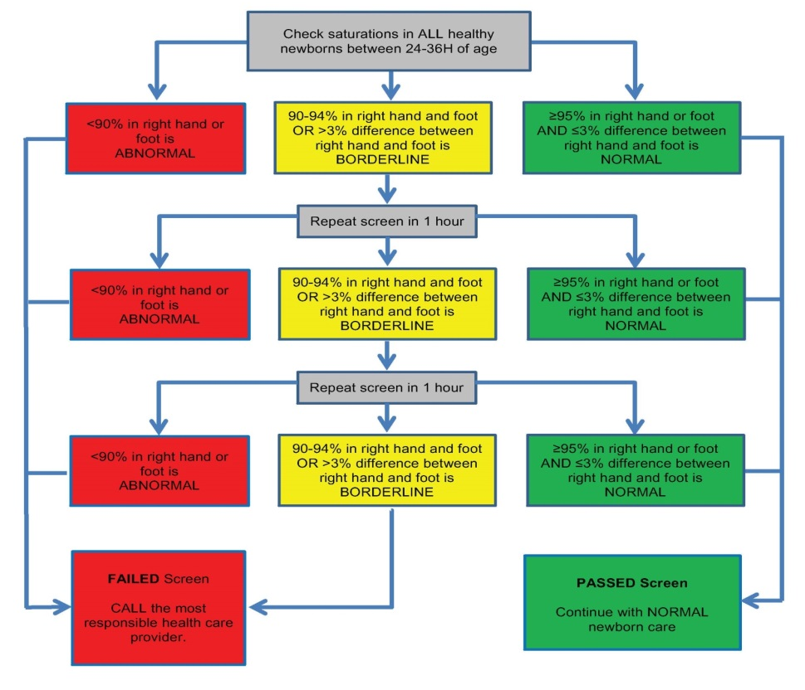
Recommendation #4
Pulse oximetry should be performed using the right hand and either foot.
(Strong Recommendation, Moderate Quality of Evidence)
Modified from Kemper et al, Pediatrics 2011; 2011
Notes:
So we're going to screen, and screen at 24-36H, so how do we screen...what's the protocol…
We recommend that pulse oximetry should be performed using the right hand and either foot. Studies have been performed testing the foot alone, and while the number of additional cases picked up by checking both limbs is small for any series, it may be significant when applied across a population.
A saturation of <90% is the right hand or foot is abnormal and requires further evaluation by the most responsible health care provider, which we will talk about next. A saturation of >95% or <=3% difference between the right hand and foot is normal and you can resume normal newborn care. Saturations between 90-94% or >3% difference between the right hand and foot is considered borderline, which may just reflect the transitional circulation and become normal, so these individuals get retested in hopes to reduce the false positive rate. If after 3 tests, a borderline results persists, you are considered to have failed and require further review.

Slide 13
Comparing two limbs can be confusing
Notes:
A systematic review published by Thangaratinam and colleagues in 2012 which included 13 studies and over 220 thousand newborns, which is a huge number of patients studied in the pediatric cardiology literature, helped to confirm pulse oximetry as a good screening test. The test is highly specific with a moderately high sensitivity. Given an abnormal saturation, the likelihood of having CCHD is 5.5times higher than with a normal result. In another study, the PPV of pulse oximetry was shown to be 7 times higher than physical examination for detecting CCHD.
With screening, it is estimated that and addition 35 cases of CCHD could be detected earlier per 100000 births, so in Canada. this would equate to 136 additional cases of earlier detection per year.
-----------
There is a low false positive rate of 0.5% and this is an important number because it is this group that will need assessment. These are the abnormal patients whom need testing to figure out why they are desaturated, which may include an echocardiogram, which may mean transport for many centres. It was identified in the meta analysis that we can lower this false positive number if we screen after 24H, too allow the normally high pulmonary vascular resistance at birth some time to fall. DIAGRAM A high PVR at birth with a normal patent ducutus arteriosus can cause R-L PDA shunting in a structurally normal heart, but as the PVR falls, there is L-R shunting, so no more cyanosis. In the end, we are talking about 1-2 /1000 births whom may need transport for an echo…. A very manageable use of of resources.
Abnormal (<95%) identified critical CHD in 76.5% (moderate sensitivity)
No diference in sensitivty whether test done at or after 24 BUT big difference in false positives so that’s why we test at 24H
Testing <24H is fine if normal.
Low false positive (FP) rate (5/10000 births)
Range 2-12/10000
Even lower if done >24h of age
Low false negative rate 0.01-0.02%, 1-2/10000 patients
Highly specific 98.5% and moderately to high sensitivity….
Sensitivity (also called the true positive rate, or the recall rate in some fields) measures the proportion of actual positives which are correctly identified as such (e.g. the percentage of sick people who are correctly identified as having the condition). Specificity (sometimes called the true negative rate) measures the proportion of negatives which are correctly identified as such (e.g. the percentage of healthy people who are correctly identified as not having the condition)

Slide 14
Recommendation #5
Newborns with an abnormal screening result should undergo a comprehensive evaluation by the most responsible health care provider. If a cardiac diagnosis cannot be confidently excluded, referral to a pediatric cardiologist for consultation and echocardiogram is advised.
(Strong Recommendation, Moderate Quality of Evidence)
Notes:
So how do we manage abnormal results, those who fail screening.
It is important to realize that there is no change in practice once a newborn has been found to be cyanotic…it’s just that we may see a few more false positives because we are screening.
Newborns with an abnormal screening result should undergo a comprehensive evaluation by the most responsible health care provider. If a cardiac diagnosis cannot be confidently excluded, referral to a pediatric cardiologist for consultation and echocardiogram is advised.
We recognized that the most responsible health care provider in some regions may be a nurse, nurse practitioner, midwife, family physician, pediatrician… so the local practices will have to dictate how to deal with abnormal results. For some regions with in house cardiac services, it may be most efficient to contact cardiology directly to arrange assessment and echo, in others particularly when transport is required to assess cardiology services, further consultation with a more experienced local health care provider (pediatrics, neonatology, colleguae) may be helpful. If after discussion with cardiology, it may be reasonbe to keep a newborn in hospital for observation and further testing rather than trasnport to further reduce the false positive results.

Slide 15
What are the critics saying?
Prenatal detection is better and they all present clinically
Improved prenatal detection should be the ultimate goal
Regions with very high prenatal detection rates may benefit less
Limitations to physical exam; pulse oximetry can still help
It is going to be too much work, too many false positives
False positive rate of 0.5% overall from meta-analysis
Toronto example: 31291 births annually, 156 FP/year, 13/month
For rural centres, false positive may be seen every couple of years
It costs too much
Cost effective to cost neutral based on studies from US and UK
Explore the Maritime model of transmission of echos
Notes:
So what are the criticques of pulse oximetry screening saying?
Prenatal detection is getting better and we don’t need to screen further. While this should be the ultimate goal, we aren’t there yet. Regions with very high prenatal detection rates may benefit less from screening.
Some worry that it’s going to be too much work, generating too many false positives and transports from remote centres. Screening adds a median 5 minutes to the daily work load and remember the false positive rate from the meta analysis was only 5/1000 births, down to 5/10000 births if we test after 24Hrs. So for even the big centres, it’s not a big volume and the smaller centres, they may see a false positive every couple of years.
Some are concerned it is going to cost too much, but there are studies from the US and UK that indicate screening is cost effective to cost neutral. To minimize costs, consider the maritime model of transmitted echos whereby we can see echos being performed in Northern NB for instance, live in Halifax and communicate with the sonographer and physicians by telephone.
I think the same can be said, why aren’t we screening?

Slide 16
Implementation priorities
Get involved because you will be affected
Advocate adding it to provincial newborn screening programs
Figure out the best referral practice for your region
Help with knowledge translation/implementation
Canadian Pediatric Society (CPS) practice points being published
On track for CPS endorsement
Quality improvement
Further study to assess the impact and costs of screening in Canada
Notes:
So, the next job is getting this implemented and we need your help. Get involved, and many of us already are, because you will be affected by this. The provincial newborn screening programs are likely best positioned to help with providing the structure and tracking of newborn pulse oximetry screening. Help to think about the different scenarios of how to deal with a positive result.
Help us to get the message out through CME for those who care for newborns (nursing, midwifery, pediatrician groups). Thorughout this process, we have worked with CPS and a practice points is going to be published that endorses this statement.
Furthermore, we should continue to assess the benefits of screening over time; perhaps a day will come when prenatal ultrasound will be perfect, negating the need for pulse oximetry screening.

Slide 17
In summary…
It is just another vital sign
Removes the subjective assessment for cyanosis
If abnormal, no change to current practices
Few false positives 2-12/10000 births
Very few false negatives, beware of coarctation
ADDING Pulse Ox screening allows us to decrease the diagnostic gap in detecting critical CHD
Be part of the message to help implement screening

Slide 18
Summary of Recommendations
We recommend that pulse oximetry screening should be routinely performed in all healthy newborns to enhance the detection of critical congenital heart disease in Canada.
We recommend that the optimal screening for critical congenital heart disease should include prenatal ultrasound, physical examination and pulse oximetry screening.
We recommend that pulse oximetry screening should be performed between 24-36 hours of age.
We recommend that pulse oximetry screening should be performed in the right hand and either foot.
We recommend that newborns with an abnormal screening result should undergo a comprehensive evaluation by the most responsible health care provider. If a cardiac diagnosis cannot be confidently excluded, referral to a pediatric cardiologist for consultation and echocardiogram is advised.
Notes:
This could stay – leave for now and we’ll decide later

