Slide 1
Disclaimer
The Canadian Cardiovascular Society (CCS) welcomes reuse of our educational slide deck for medical institution internal education or training (i.e. grand rounds, medical college/classroom education, etc.). However, if the material is being used in an industry sponsored CME program, permission must be sought through our publisher Elsevier (www.onlinecjc.com).
If your reuse request qualifies as medical institution internal education, you may reuse the material under the following conditions:
  You must cite the Canadian Journal of Cardiology and the Canadian Cardiovascular Society as references.
  You may not use any Canadian Cardiovascular Society logos or trademarks on any slides or anywhere in your presentation or publications.
  Do not modify the slide content.
  If repeating recommendations from the published guideline, do not modify the recommendation wording.

Slide 2
CCS/CHRS 2016 Implantable Cardioverter-Defibrillator (ICD) Guidelines

Slide 3
Overview
Primary Prevention
Risk stratification tools (risk/benefit of ICD)
Secondary Prevention
Device Selection
Defibrillator Threshold Testing
Infection Prevention strategies
Anti-coagulation
Subcutaneous ICD
Device Programming
VT management in patients with ICDs

Slide 4
Primary Prevention
CCS/CHRS 2016 Implantable Cardioverter-Defibrillator (ICD) Guidelines

Slide 5
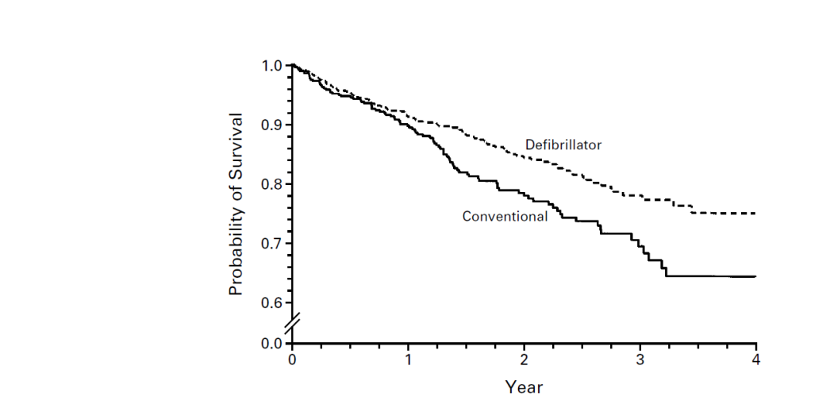
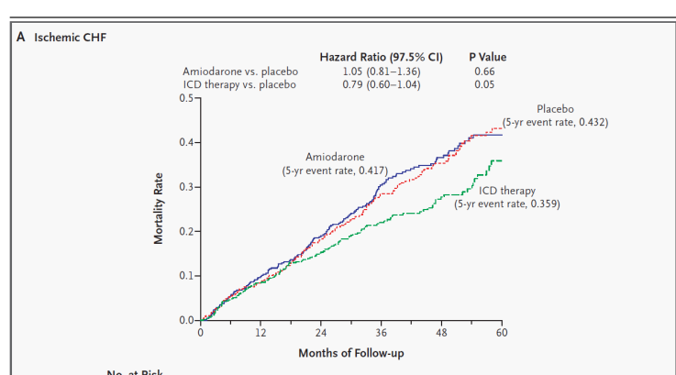
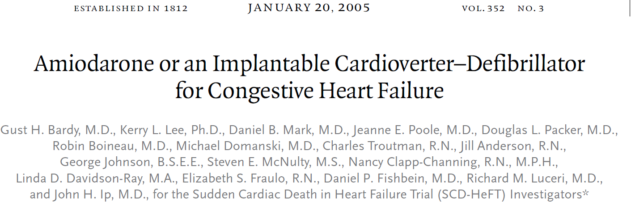
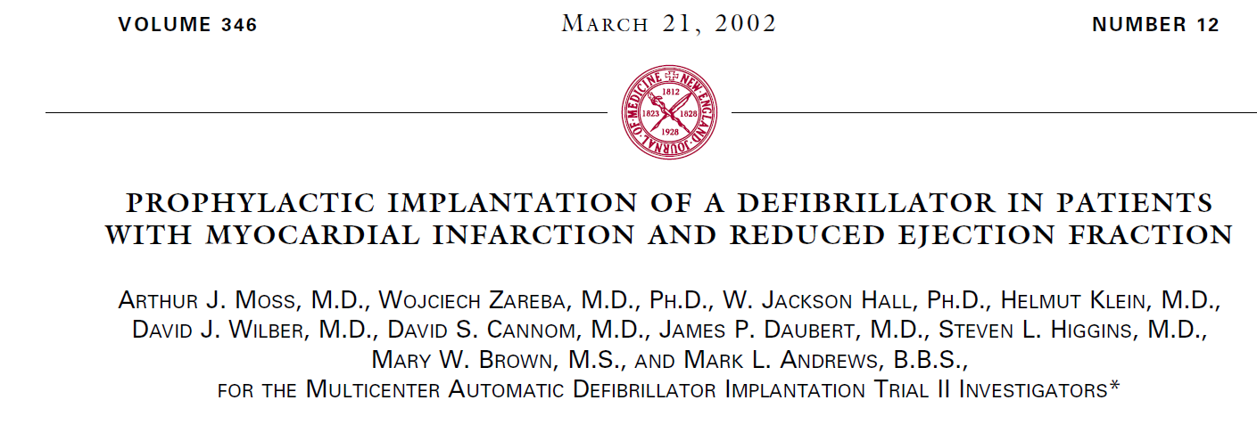
Primary Prevention Trials – Ischemic Cardiomyopathy
31%
21%

Slide 6
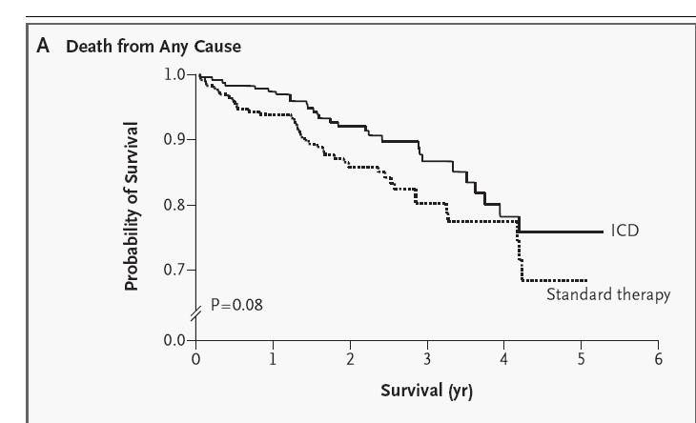
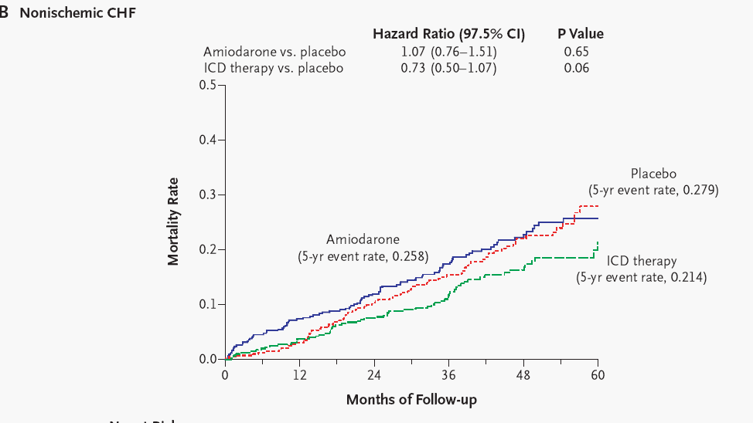
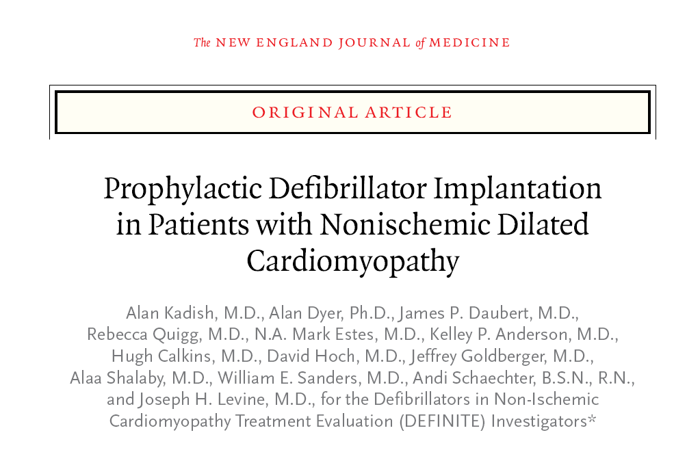
Primary Prevention Trials – Non-ischemic Cardiomyopathy
27%
35%

Slide 7
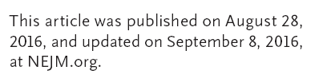
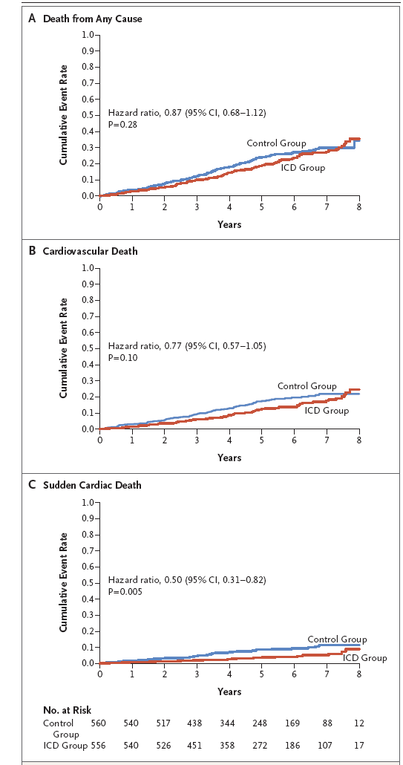
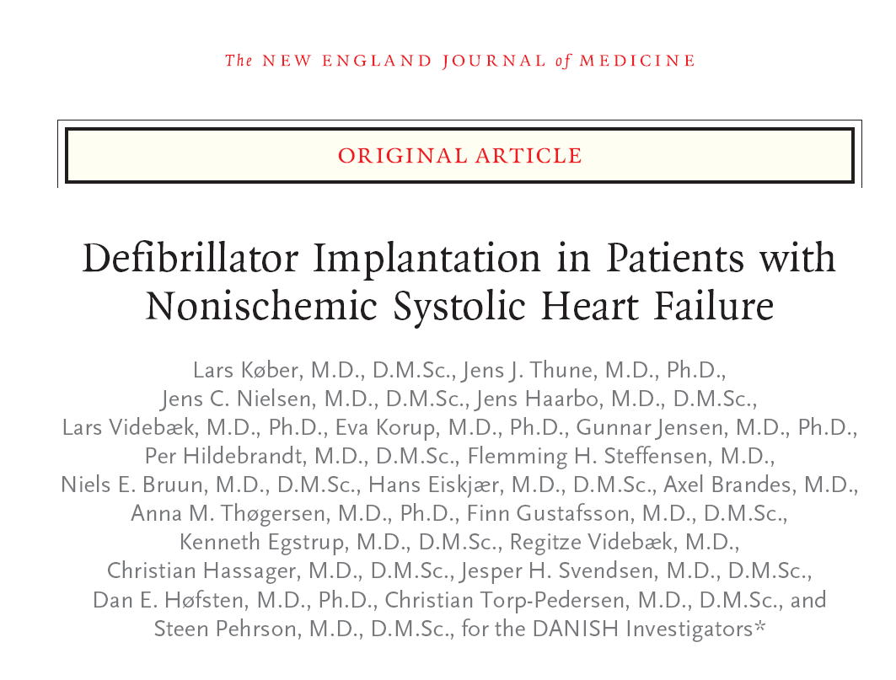
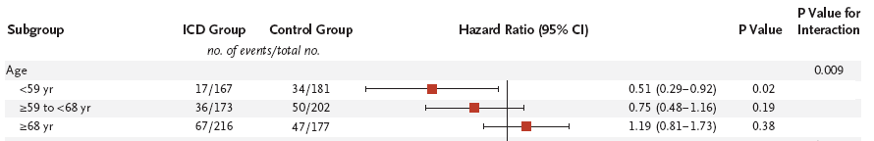

Slide 8
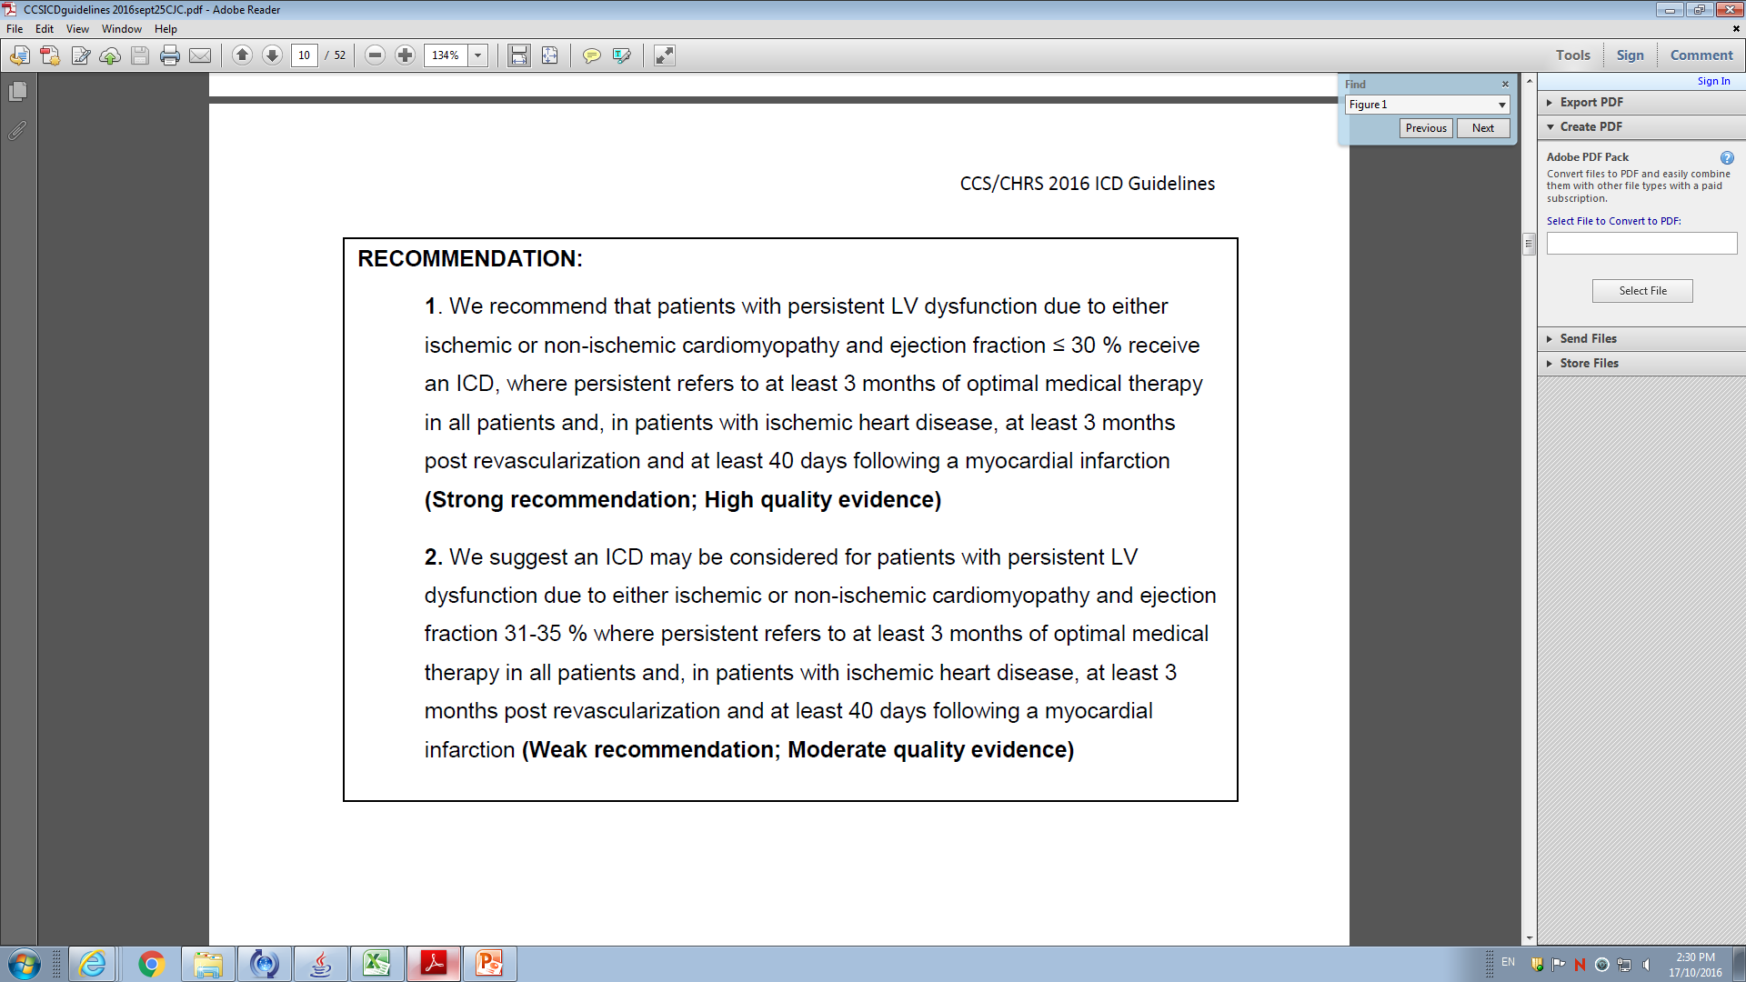
Recommendation 1

Slide 9
Recommendation 2

Slide 10
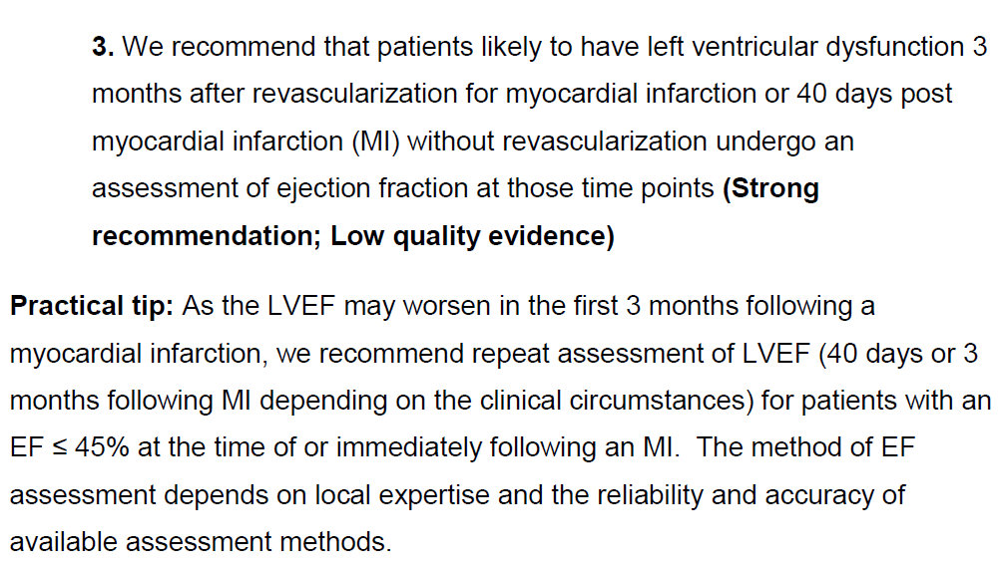
Recommendation 3

Slide 11
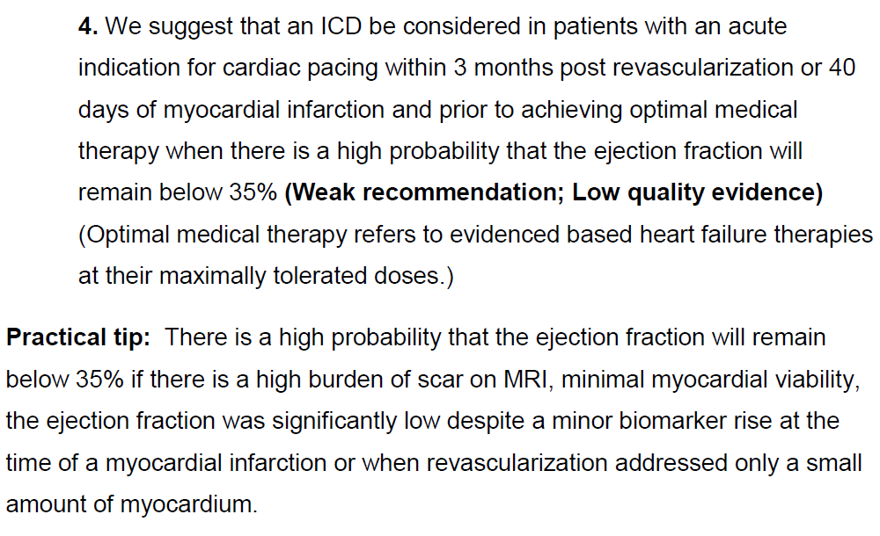
Recommendation 4

Slide 12
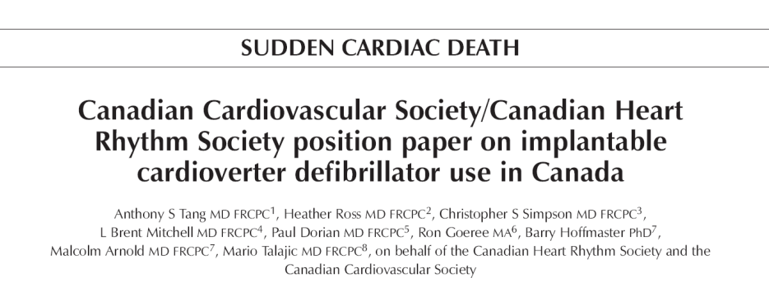
Summary - What is new since 2005 ?
Recommendation 1 and 2: Waiting period for NICM now 3 months (previously 9 months)
Recommendation 3 and 4: entirely new

Slide 13
What is Next?
Committee will reconvene and discuss whether urgent Guideline Update is required
based on publication of DANISH TRIAL

Slide 14
Stratification, Risk Scores, Withholding, Downgrade of ICDs
CCS/CHRS 2016 Implantable Cardioverter-Defibrillator (ICD) Guidelines

Slide 15
Prediction of degree of benefit from ICD implantation
Balance of Risk vs benefit
Sudden Death from
Ventricular Arrhythmia
Non-Sudden Death
Procedural Risk
Inappropriate shocks
Device infection

Slide 16
Recommendation 5
We recommend an ICD not be offered to patients where comorbidities make it unlikely that an ICD will substantially increase a patient‘s life expectancy.
Strong recommendation; moderate quality evidence

Slide 17
Practical Tip
Validated risk calculators/risk assessment tools such as the Charlson Comorbidity Index, the Seattle Heart Failure Model, SHOCKED or MADIT risk scores can be of aid in the estimation of each patient’s benefit/risk of an ICD.

Slide 19
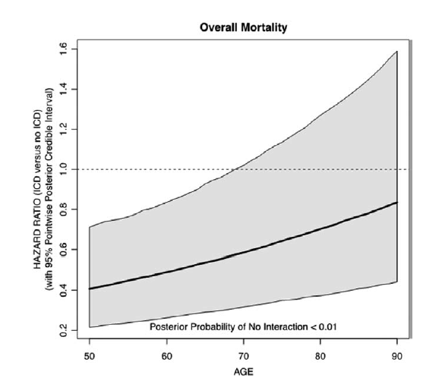
Pooled Analysis from Five RCTs: effect of age on ICD versus no ICD
Benefit of ICD remains with older age, but is attenuated
Age alone is not a reason to withhold ICD therapy
Hess et al Circ Cardiovasc Qual Outcomes 2015;8:179-186

Slide 20
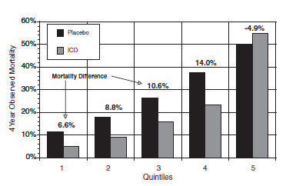
Risk Score | Factors | Score | Outcome
Seattle Heart Failure Model¹ (SCD-HeFT) | Age, gender, ischemic, BP, EF, NYHA, medications, sodium |  | Years need to treat with ICD in first 4 quintiles were 3.5-4.6
MADIT² | NYHA > II Age >70 BUN >26 mg/dl QRS>120 ms | 0 1-2 | 75% vs 58% 47% vs 31%
SHOCKED³ (Medicare)* | age≥75, NYHA III, AF, COPD, CRF, EF≤ 20%, DM | Highest quintile | one year mortality 24% 3 year mortality 58%
Parkash et al⁴ (early mortality after ICD)* | Age >80, AF, CRF, NYHA III/IV | ≥2 <2 | one year mortality: 21% 4%
*mortality after ICD
Levy et al. Circulation 2009; 120:835-42
Barsheshet et al. JACC 2012; 59: 20175-9
Bilchick et al. JACC 2012; 60:1647-55
Parkash et al. AHJ 2006;151:397-403

Slide 21
Seattle Heart Failure Model: applied to SCD-HeFT
Observed Kaplan-Meier mortality at 4 years for placebo and ICD groups in SCD-HeFT: absolute reduction in mortality shown above, no benefit in quintile 5
Levy et al Circulation 2009; 120:835-42

Slide 22
Use of Risk Scores
Clinical impression
  Heart failure clinic
  Primary care physician
  Geriatric evaluation
Used at time of implant and at time of replacement
Additive, not replacement to clinical impression
Assist in improved measurement of risk versus benefit

Slide 23
Frailty Scale
Value | Description | Details
1 | Very fit | Robust, active energetic, well-motivated and fit. Commonly exercises regularly
2 | Well | Without active disease but less fit than category 1
3 | Well with treated comorbid disease | Disease symptoms are well controlled compared with those in category 4
4 | Apparently vulnerable | Although not frankly dependent, commonly complain of being slowed up or have disease symptoms
5 | Mildly frail | Limited dependence on others for instrumental activities of daily living
6 | Moderately frail | Help is needed with activities and instrumental activities of daily living
7 | Severely frail | Completely dependent, or terminally ill
Rockwood et al. CMAJ 2005;173:489-95

Slide 24
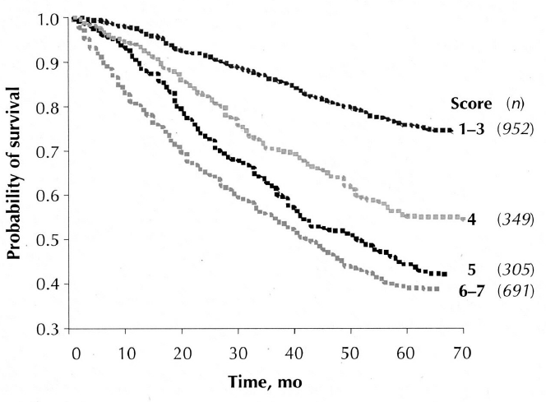
Mortality according to Frailty Scale in Octagenarians
Important to consider biologic age vs chronologic age
Rockwood et al. CMAJ 2005;173:489-95

Slide 25
Patient goals of therapy
Do the patient’s goals of therapy align with receiving a device to prevent arrhythmic death?
  If patient has received appropriate therapy or falls into the secondary prevention category, it is difficult to withhold ICD therapy unless the patient has a very limited life expectancy or has little quality of life and is a ‘DNR’
Primary prevention – does the patient want to receive a shock to prevent arrhythmic death?

Slide 26
At time of initial implant or device replacement…
Consider number of leads
Cardiac resynchronization therapy vs physiologic pacing vs single chamber
Upgrade from pacemaker
Subcutaneous implant
At time of elective replacement or end-of-life:
  Downgrade to pacing system
  No operation
  Replacement with same type of device
  Upgrade to dual chamber or resynchronization system

Slide 27
Recommendation 6
We recommend that an ICD be replaced by a pacing system, removed or abandoned at the time of ICD generator end of life/service in patients with life threatening comorbidities, at the request of the patient or when an ICD is unlikely to increase life expectancy.
Strong Recommendation, Low Quality of Evidence

Slide 28
Summary
Evaluation requires careful history, physical examination, ECG, echo, sometimes ischemic work up, discussion of goals of therapy, assessment of frailty, careful review of device indication and existing hardware
Requirement of upgrade/downgrade
Balance risks and benefits
Timing of assessment should be well prior to planned procedure

Slide 29
Secondary Prevention
CCS/CHRS 2016 Implantable Cardioverter-Defibrillator (ICD) Guidelines

Slide 30
Annual Mortality: 10.2% vs 8.3%, RRR=19.7%, p=0.142
Annual Arrhythmic Mortality: 4.5% vs 3.0%, RRR=32.8%, p=0.094
659 patients with (in the absence of recent AMI or lyte imbalance): VF, out-of-hospital cardiac arrest requiring defib or CV, sustained VT causing syncope, VT (>150 bpm) causing presynope or angina in pt with EF<=35% or unmonitored syncope with subsequent spontaneous VT (>10 sec) or sustained (>30 sec) monomorph VT at EPS
CIDS. Connolly et al., Circulation 2000: 101: 1297-1302

Slide 31
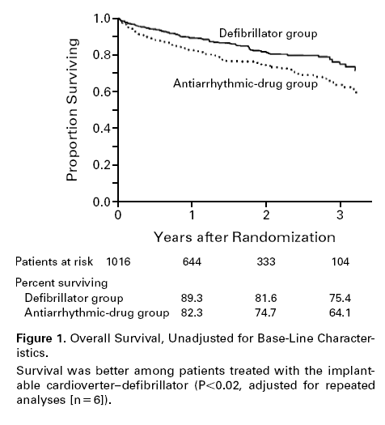
AVID
Survival at 3 years
75.4% vs 64.1% P<0.02
1016 patients with resuscitated VF, sustained VT with syncope, or sustained VT with an EF ≤40% and symptoms suggesting severe hemodynamic compromise due to the arrhythmia
Randomized to ICD vs AAD
AVID: NEJM, 1997; 337: 1576-83

Slide 32
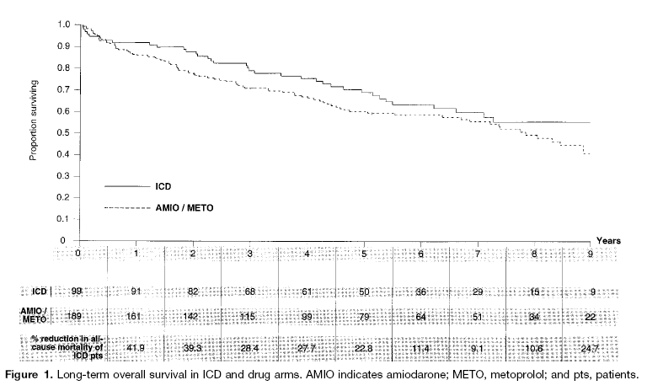
Mortality: ICD=36.4% and Rx 44.4% (p=0.081)
CASH
1897 patients resuscitated from cardiac arrest secondary to documented sustained ventricular arrhythmias (not within 72 hrs of AMI, cardiac surgery, electrolyte abnormalities or proarrhythmic drugs)
Randomized to ICD vs anti-arrhythmic drugs (1:3)
(Amiodarone, Metoprolol, Propafenone)
Sudden Death: ICD=13.0% and Rx 33.0% (p=0.005)
CASH, Circulation, 2000

Slide 35
Device Selection
CCS/CHRS 2016 Implantable Cardioverter-Defibrillator (ICD) Guidelines

Slide 36
ICDs in End Stage Heart Failure
We recommend an ICD not be offered to patients where comorbidities make it unlikely that an ICD will substantially increase a patient’s life expectancy
Patients listed for heart transplant are highly selected & have a 10 year survival of >50% after transplant.
Survival to transplantation is more likely with an ICD.
An ICD may be considered in patients with an LVAD
(Weak recommendation; Low quality evidence).

Slide 37
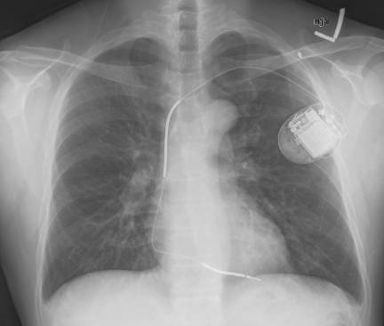
Nomenclature of ICD Systems
RV lead only
→ single chamber
RV & RA lead
→ dual chamber
One RV coil
→ single coil
Two RV coils
→ dual coil
Shock between coil(s) & can
→ active can
Can
Coil
Coil

Slide 38
Single Vs. Dual Chamber ICD
Dual-chamber devices have a role for patients who fulfill guideline recommendation for pacing (e.g., sinus node dysfunction or AV block) & are not CRT candidates.
There is limited data to support the use of dual-chamber device to improve arrhythmia discrimination.
Clear evidence of more major complications with dual vs single-chamber devices (adj. HR 1.8, 95% CI 1.2 to 2.8, p < 0.01).

Slide 39
Single Vs. Dual Chamber ICD
A single-chamber, instead of a dual-chamber ICD, in patients with no indication for atrial pacing & where the indication for an ICD is for the primary prevention of sudden cardiac death.
(Weak recommendation; Moderate quality evidence)

Slide 40
High Voltage ICD Lead Choice
The RV lead is the Achilles Heal of an ICD system.
Single & dual-coil ICD leads have similar efficacy (mean DFT & first shock efficacy).
Dual-coil leads are associated with more complications & are more difficult to remove.
A single coil high voltage (HV) ICD lead is preferred over dual coil lead at time of implantation
(Weak recommendation; Moderate quality evidence)

Slide 41
ICD Generator Location
Likelihood of a successful defibrillation is influenced by the location of ICD generator (active can configuration).
Era of routine non-testing of ICD systems at implant
Contraindications to implantation on a specific side (chronic IV indwelling catheter, mastectomy with LND, prior infection & ipsilateral venous thrombosis).
Transvenous ICDs be implanted on the left side as the first option for endovascular systems
(Strong recommendation; Moderate quality evidence)

Slide 42
Summary
While device prescription should be individualized, key common factors should be considered.
Goal: extend survival, minimizing complications
  Consider an ICD in LVAD recipients
  “Simpler” device
    single chamber
    single coil
  Anatomic position to maximize efficacy (obviate defibrillation / sensing testing).

Slide 43
Infection Prevention Strategy
Defibrillation Threshold Testing
CCS/CHRS 2016 Implantable Cardioverter-Defibrillator (ICD) Guidelines

Slide 47
NORDIC TRIAL
1077 patients randomized 1:1
Follow-up: 22.8 months
No DFT testing non inferior
  17.6% (DFT) vs 13.9% (NO DFT) composite endpoint
  At 22 months
    8.6% appropriate shocks (DFT)
    8.8% appropriate shocks (NO DFT)

Slide 48
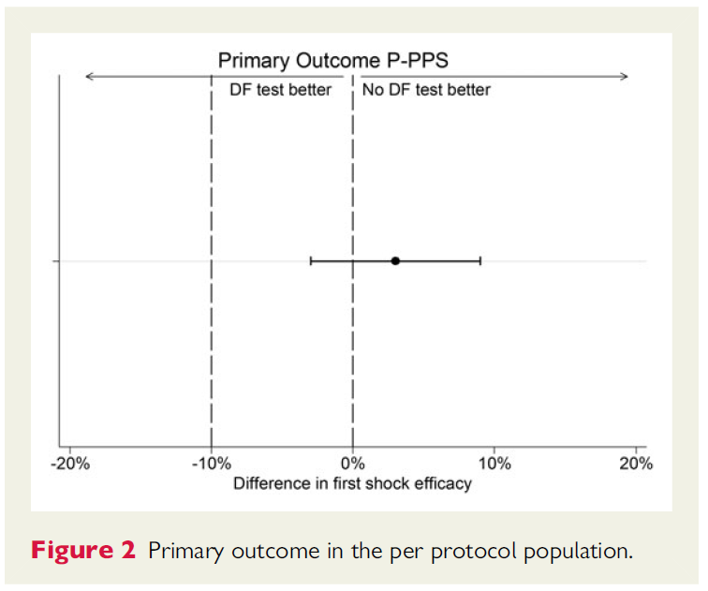
NORDIC TRIAL

Slide 49
SIMPLE TRIAL
2500 patients randomized 1:1
Follow-up: 3.1 Y
NO DFT non inferior
Arrhythmic death or failed appropriate shocks
  7%/year (NO DFT)
  8%/year (DFT), p_{non-inf}< 0.001
Safety composite 5.6% (NO DFT) vs 6.5% (DFT)

Slide 50
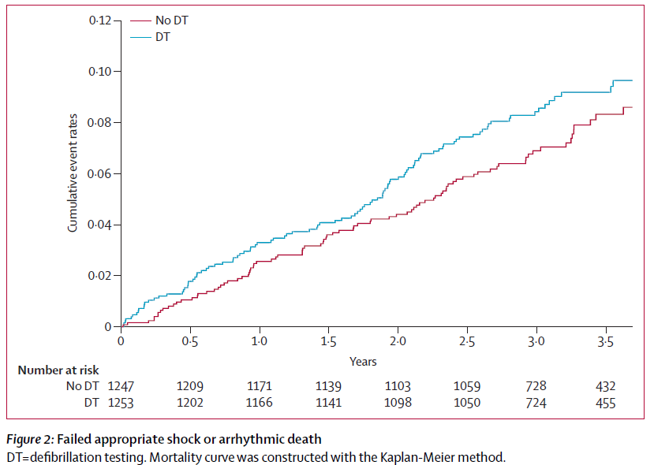
SIMPLE TRIAL

Slide 51
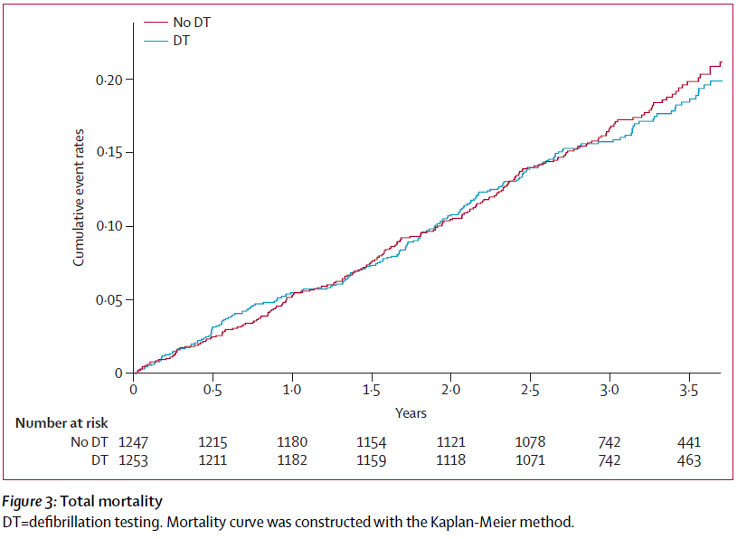
SIMPLE TRIAL

Slide 53
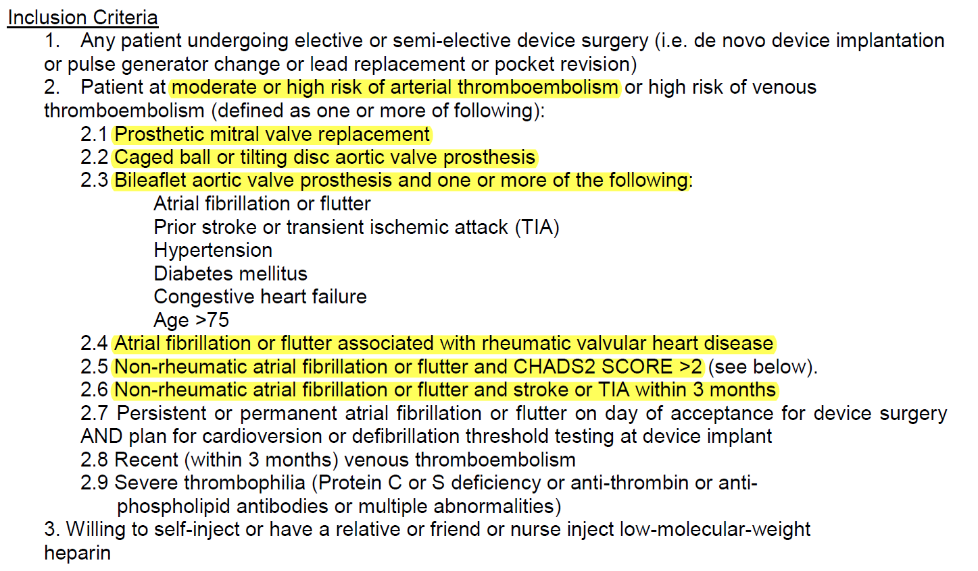
BRUISE
N Engl J Med 2013;368:2084-93.

Slide 54
Subcutaneous ICD
CCS/CHRS 2016 Implantable Cardioverter-Defibrillator (ICD) Guidelines

Slide 55
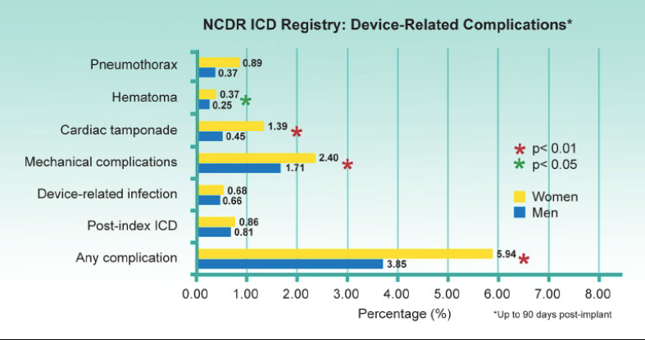
TV-ICD:
ACUTE PROCEDURAL COMPLICATIONS
4-6%
2005-2012
Russo et al. Am J of Cardiol 2015

Slide 56
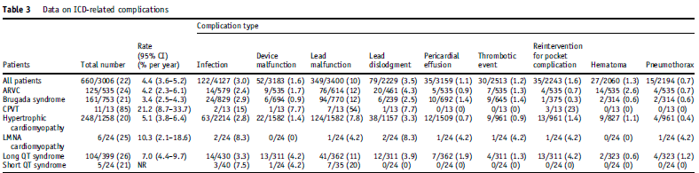
TV-ICD:
LONG-TERM COMPLICATIONS
Nordkamp O, Heart Rhythm 2016

Slide 57
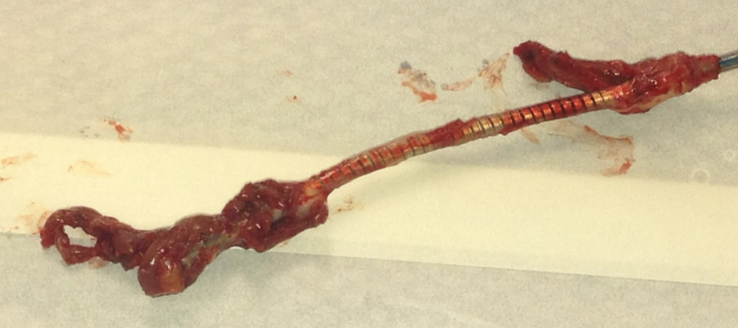
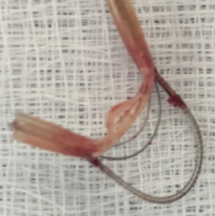
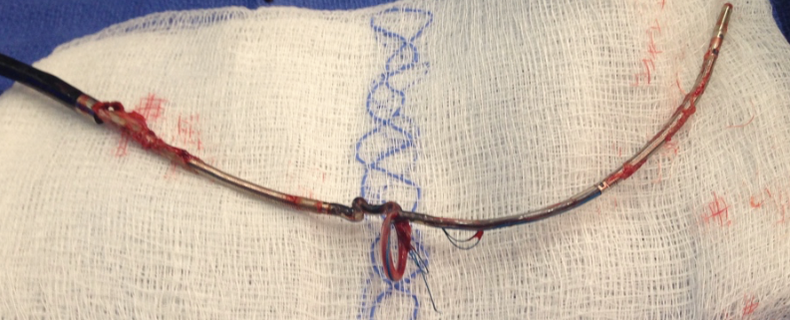
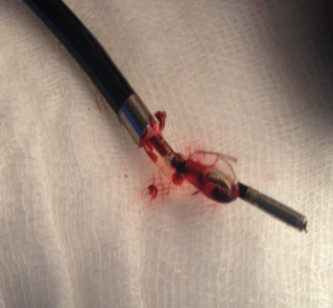
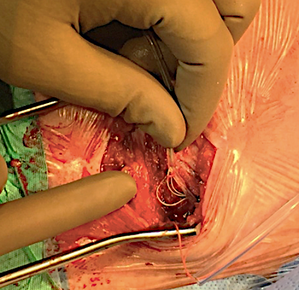
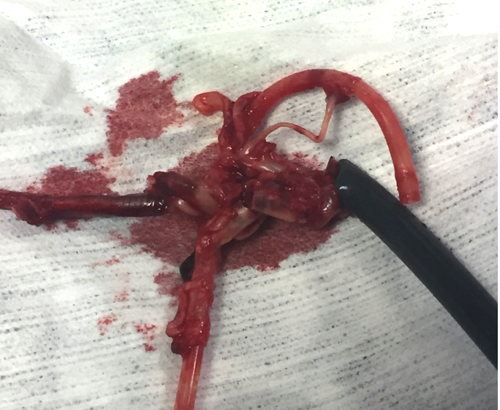
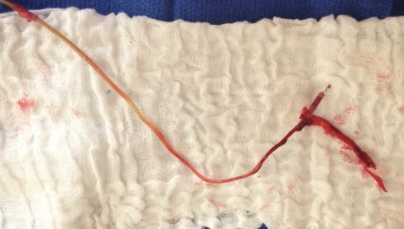
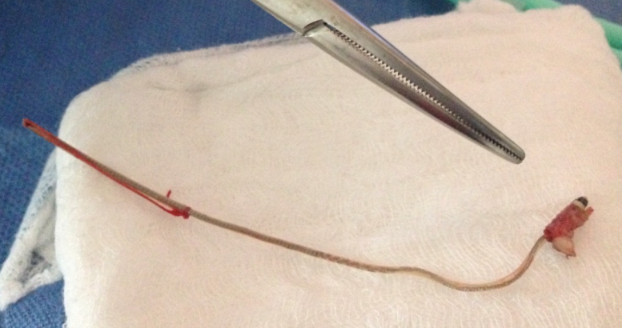
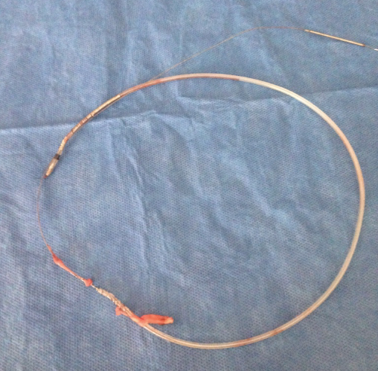
Lead: weakest part of ICD

Slide 58
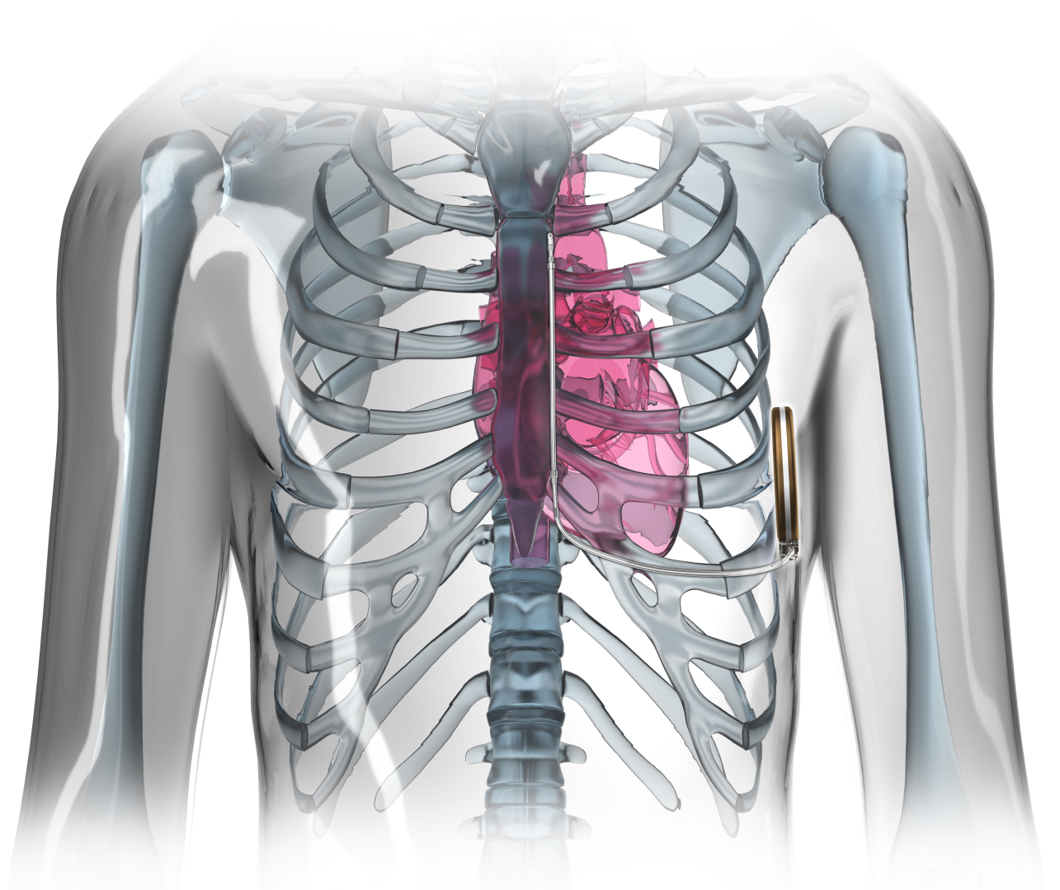
S-ICD

Slide 59
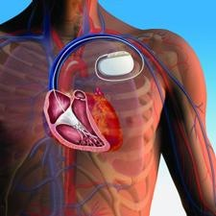
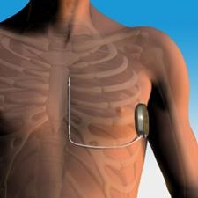
ADVANTAGES
  Effective defibrillation for VT/VF
Notes:
Extarvascular: no risk of vascular injury, allows implantation in patients without vascular access

Slide 60
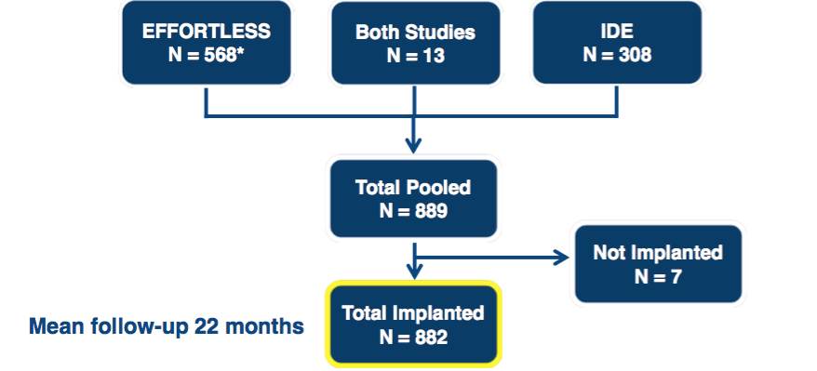
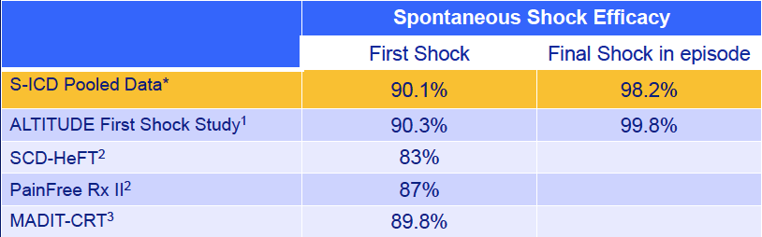
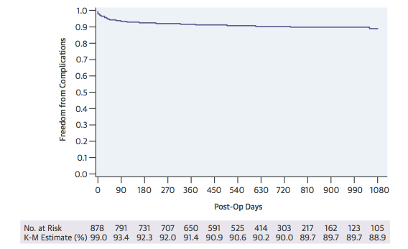
STUDIES: SAFETY AND EFFICACY
Burke MC et al. JACC 2015; 16:1605-15
Cha YM et al. Heart Rhythm 2013;10:702–708
Swerdlow CD et al. PACE 2007; 30:675–700
Kutyifa V, et al. J Cardiovasc Electrophysiol 2013;24:1246-52
Effortless registry, Lambiase P, Eur Heart J. 2014 Jul 1;35(25):1657-65
IDE study, Weiss R, Circulation. 2013;128:944-953

Slide 61
ADVANTAGES
  Effective defibrillation for VT/VF
Anti-bradycardia pacing
ATP
Atrial and ventricular diagnostics
Familiar implant technique
Extravascular
Low risk of systemic infection
Preserves venous access
Avoids risks associated with endovascular lead extraction
Less fluoroscopy
Esthetic considerations
Notes:
Extarvascular: no risk of vascular injury, allows implantation in patients without vascular access

Slide 62

GUIDELINES
Congenital Heart Disease patients with no access to the ventricles
Congenital Heart Disease patients with shunt resulting in increased risk of thromboembolic events with TV-ICD
Absence of a pocket site due to either prior device-related infection and/or chronic indwelling catheters

Slide 63
DISADVANTAGES
Risk of systemic infection
Vein thrombosis / stenosis
Lead fracture
Risks of endovascular extraction
No pacing, no ATP
No advanced diagnostics
80J
Big generator

Slide 64
PATIENTS WHO NEED AN ICD SHOULD NOT RECEIVE A S-ICD IF:
  Need for pacing
  Need for a CRT device
  Need for ATP

Slide 65
DISADVANTAGES
Pocket infections
Pulse generator complications
Inappropriate shocks

Slide 66
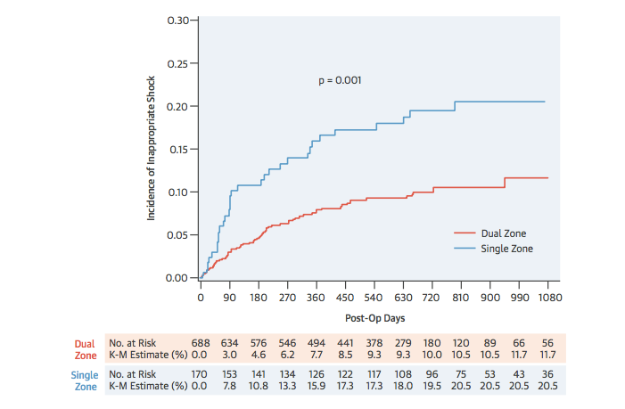
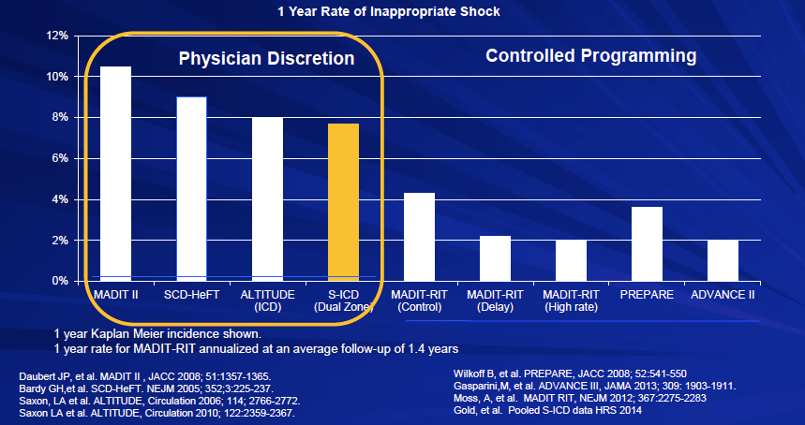
STUDIES: INAPPROPRIATE THERAPIES
* Burke MC et al. JACC 2015; 16:1605-15

Slide 67
DISADVANTAGES
Device longevity?
Long-term safety profile?

Slide 68
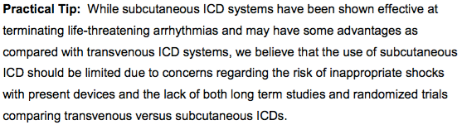
GUIDELINES

Slide 69
ONGOING STUDIES:
PREATORIAN
  Netherlands
  700 patients
  VVI TV-ICD vs S-ICD (1:1)
  Combined endpoint (inappropriate shocks and ICD complications) (non-inferiority)
  Shock efficacy
  Patient mortality
ATLAS:
  Pan Canadian
  500 patients
  VVI TV-ICD vs S-ICD (1:1)
  Sub studies on specific population
  Peri-operative complications and long-term complications (superiority)
  Appropriate therapies failed and arrhythmic death (non-inferiority)
NordKamp O, Am Heart J 2012;163:753-760.e2

Slide 70
ICD Programming
CCS/CHRS 2016 Implantable Cardioverter-Defibrillator (ICD) Guidelines

Slide 71
ICD Programming
Bradycardia programming
Tachycardia detection
  Duration
  Rate
  Discriminators
Tachycardia therapy
  ATP
  Shock output

Slide 72
ICD Bradycardia programming
In patients with NO NEED for rate support
  Backup low rate pacing only
  VVI or DDI 40/min.
In patients with NEED for rate support
  Single chamber
    Consider lower rate to minimize pacing
    Consider upgrade to CRT if high burden (BLOCK-HF)
  Dual chamber:
    RV pacing reduction programming recommended
    MVP mode, AV search programming

Slide 73
ICD Bradycardia programming
In patients with CRT devices
  Program to maximize ventricular pacing per CRT pacing guidelines

Slide 74
ICD Tachycardia programming:
Detection duration
Delayed detection recommended for VT and VF
  Allows self terminating events to stop without therapy
  Has NOT been associated with a significant increase in risk of syncope
  Has been associated with a marked decrease in treated events
    Decreased appropriate therapies
    Decreased inappropriate therapies
  Has been associated with a decrease in mortality vs short detection

Slide 75
ICD Tachycardia programming:
Detection rate
Higher rates recommended for primary prevention devices
  Rates between 181-200 used in studies
  Rate of 170/min used in MADIT-RIT with markedly prolonged detection at this rate (170-200/min detection 60 seconds)
Safety margin needed for secondary prevention devices
  Recommend rate 20/min slower than slowest clinical VT, or no slower than primary prevention settings
  For very slow clinical VT, rate 10/min below
  Some labs use 40 ms longer than slowest VT
    Gives similar results across many rates

Slide 76
ICD Tachycardia programming:
SVT Discriminators
SVT discriminators shown to decrease inappropriate ATP and inappropriate shocks
SVT may occur at rapid rates (up to 220-230/min), thus discriminators should be applied to these rates
Single chamber discriminators:
  Interval stability
  Sudden onset
  ECG morphology
Dual chamber discriminators:
  Add A-V relationships to the above

Slide 77
Table of shock reduction study programming – detection programming
Company | Slowest detection (zone) | VT detection | Fast VT detection | VF detection | SVT upper limit | ATP limit | Outcomes
Medtronic (1,2,3) | 182-188 (VF) | n/a | n/a | 182-188 /min, 30/40 beats | 200 – 230/min | 300/min | Lower shocks, trend lower mortality
St. Jude Medical (4) | 181 (VT) | 181-214 /min, 25 beats | 214-249 /min, 18 beats | 250+/min, 18 beats | 214/min | 250/min | Lower shocks, lower mortality
Boston Scientific (5A) | 200 (VF) | n/a | n/a | 2.5 sec | none | 250/min | Lower shocks, lower mortality
(5B) | 170 (VT) | 170-199 /min, 60 sec | 200-249 /min, 12 sec | 250+/min, 2.5 sec | 250/min | 250/min | Lower shocks, trend lower mortality
PREPARE, 2008
RELEVANT, 2009
ADVANCE III, 2013
4) PROVIDE, 2014
5A) MADIT-RIT, 2012 high rate
5B) MADIT-RIT, 2012 prolonged detect

Slide 78
Table of shock reduction study programming – detection delay
Company | Slowest detection (zone) | VT detection | Fast VT detection | VF detection | SVT upper limit | ATP limit | Outcomes
Medtronic (1,2,3) | 182-188 (VF) | n/a | n/a | 182-188 /min, 9.9 sec | 200 – 230/min | 300/min | Lower shocks, trend lower mortality
St. Jude Medical (4) | 181 (VT) | 181-214 /min, 8.4 sec | 214-249 /min, 5.5 sec | 250+/min, 5 sec. | 214/min | 250/min | Lower shocks, lower mortality
Boston Scientific (5A) | 200 (VF) | n/a | n/a | 4.5 sec | none | 250/min | Lower shocks, lower mortality
(5B) | 170 (VT) | 170-199 /min, 63 sec | 200-249 /min, 12 sec | 250+/min, 4.4 sec | 250/min | 250/min | Lower shocks, trend lower mortality
PREPARE, 2008
RELEVANT, 2009
ADVANCE III, 2013
4) PROVIDE, 2014
5A) MADIT-RIT, 2012 high rate
5B) MADIT-RIT, 2012 prolonged detect

Slide 79
Table of shock reduction study programming – detection delay
(Primary prevention patients)
HR range | 170-181 | 181-200 | 200-250 | 250+
Delay | 63 sec | 8.5–10 sec | 4.5-12 sec | 4.4-7.0 sec
PREPARE, 2008
RELEVANT, 2009
ADVANCE III, 2013
4) PROVIDE, 2014
5A) MADIT-RIT, 2012 high rate
5B) MADIT-RIT, 2012 prolonged detect

Slide 80
ICD Tachycardia programming:
ATP therapies
ATP can terminate regular VT rates to near 300/min
  75% efficacy with single ATP train
  94% efficacy with up to 3 ATP trains
ATP should be programmed for rates at least 250/min
  Below this rate may be separate zone (eg “fast VT zone”)
  Above this rate should be ATP during shock charging
  For slower rates (<200-220), 2-3 trains of ATP can be programmed
This is not necessary if substrate for monomorphic VT not present
  eg) long QT syndrome patients

Slide 81
ICD Tachycardia programming:
Shock therapies
Monomorphic VT
  Less than full output shocks effective
  Must be at least at or above DFT
Polymorphic VT/VF
  Full output shocks have a higher first shock efficacy
As no formal DFT testing routinely done with implants:
  Full output shocks recommended for all shocks to minimize the number of shocks delivered

Slide 82
ICD Tachycardia programming:
Conclusions
Prolonged detection intervals are associated with better outcomes
  Decreased shock and total therapies
  Decreased mortality
  No significant increase in syncope
Detection enhancements (SVT discriminators) are an important part of shock reduction
  Should be used to rates of at least 220/min due to fast SVTs
ATP as separate zones or during charge should be programmed for rates >250/min
Shock therapy should be programmed at full output

Slide 83
Recurrent Ventricular Arrhythmias, VT Storm and Appropriate ICD Shocks
CCS/CHRS 2016 Implantable Cardioverter-Defibrillator (ICD) Guidelines

Slide 84
Causes of ICD Shocks
Appropriate Shocks
Ventricular fibrillation
Monomorphic ventricular tachycardia
Polymorphic ventricular tachycardia
Torsades de pointes
Inappropriate Shocks
Atrial flutter
Atrial fibrillation
Supraventricular tachycardia / Atrial tachycardia / Sinus tachycardia
Consecutive episodes of non-sustained ventricular tachycardia
T-wave oversensing
Double counting of QRS complexes
Oversensing due to lead failure (conductor fracture or insulation breach)
Oversensing of diaphragmatic myopotentials
Electromagnetic interference
Modified from Gehi et al. JAMA 2006

Slide 85
VT/VF Predicts Mortality in Patients with
Heart failure – MADIT II
Moss et al. Circulation 2004;110:3760-65
Notes:
ICDs changes the mode of death in some patients - from sudden to pump failure

Slide 86
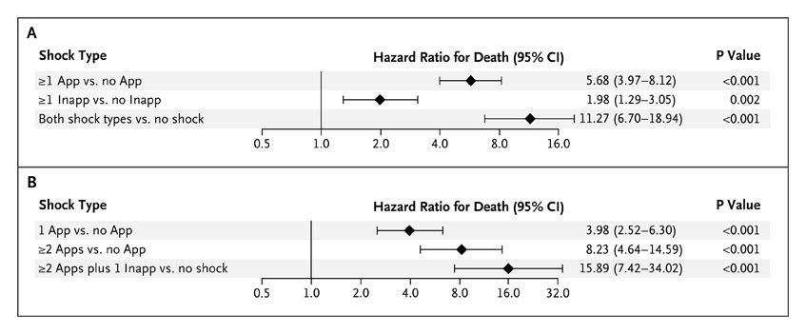
Prognostic Importance of ICD shocks
Hazard Ratios for the Association of ICD Shock with the Risk of Death
Poole JE et al. N Engl J Med 2008;359:1009-1017
Notes:
May remove this one

Slide 87
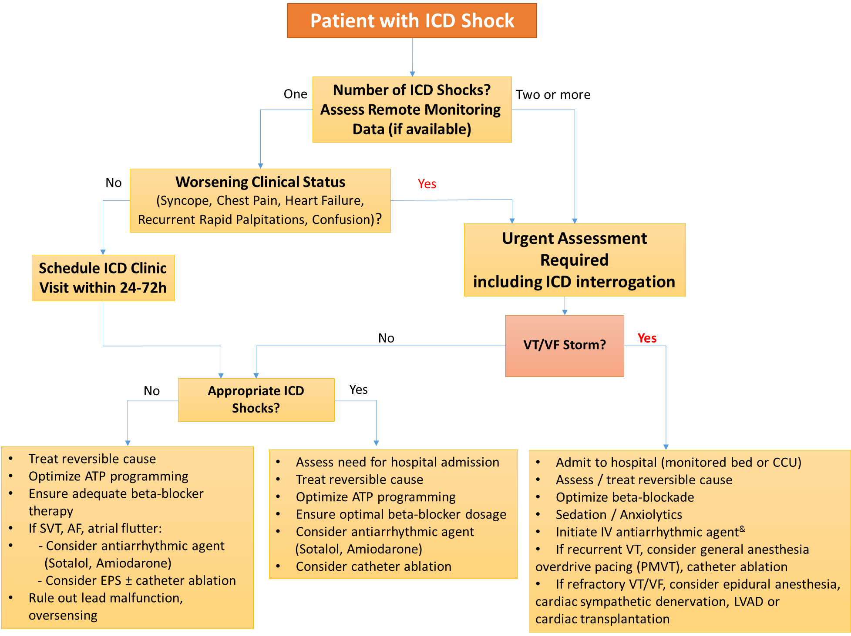

Slide 88
Early ICD Interrogation
Confirm appropriate device function (appropriate shocks?)
Program the ICD to avoid treatment of self-terminating VT episodes
Ensure that ATP therapies are optimized to treat sustained MMVT and reduce the need for shocks
Temporarily turn off ICD shock therapy to avoid repeated defibrillation and sympathetic hyperactivity.

Slide 89
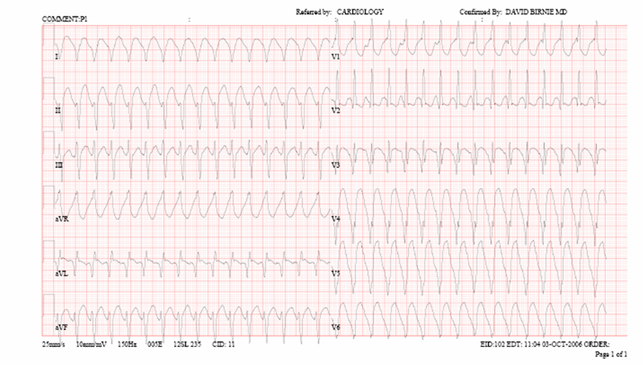
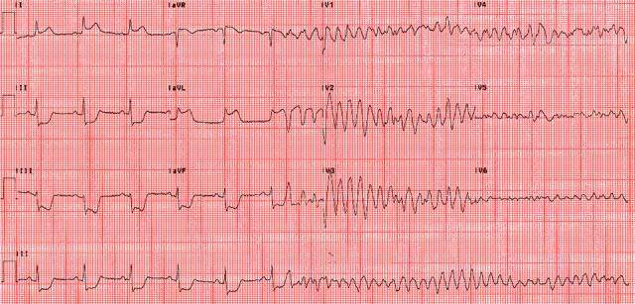
VT Morphology Matters
Monomorphic VT
Scar-related re-entry
Polymorphic VT/
Ventricular Fibrillation
- Consider myocardial Ischemia
- Check QTc

Slide 90
Ventricular Tachycardia (Electrical) Storm
Defined as the occurrence of 3 or more distinct episodes of VT and/or VF within a 24-h period.
VT storm is associated with high mortality risk.
A reduction in sympathetic tone by b-blockers and sedation are essential as increased sympathetic activity plays a key role in the genesis of ES.
Once patient is in CCU (monitored, external defibrillator pads on)
    → Disable ICD shocks
1.Braunschweig F, et al. Europace 2010;12:1673-1690.
2.Nademanee K, et al. Circulation 2000; 102:742-747.

Slide 91
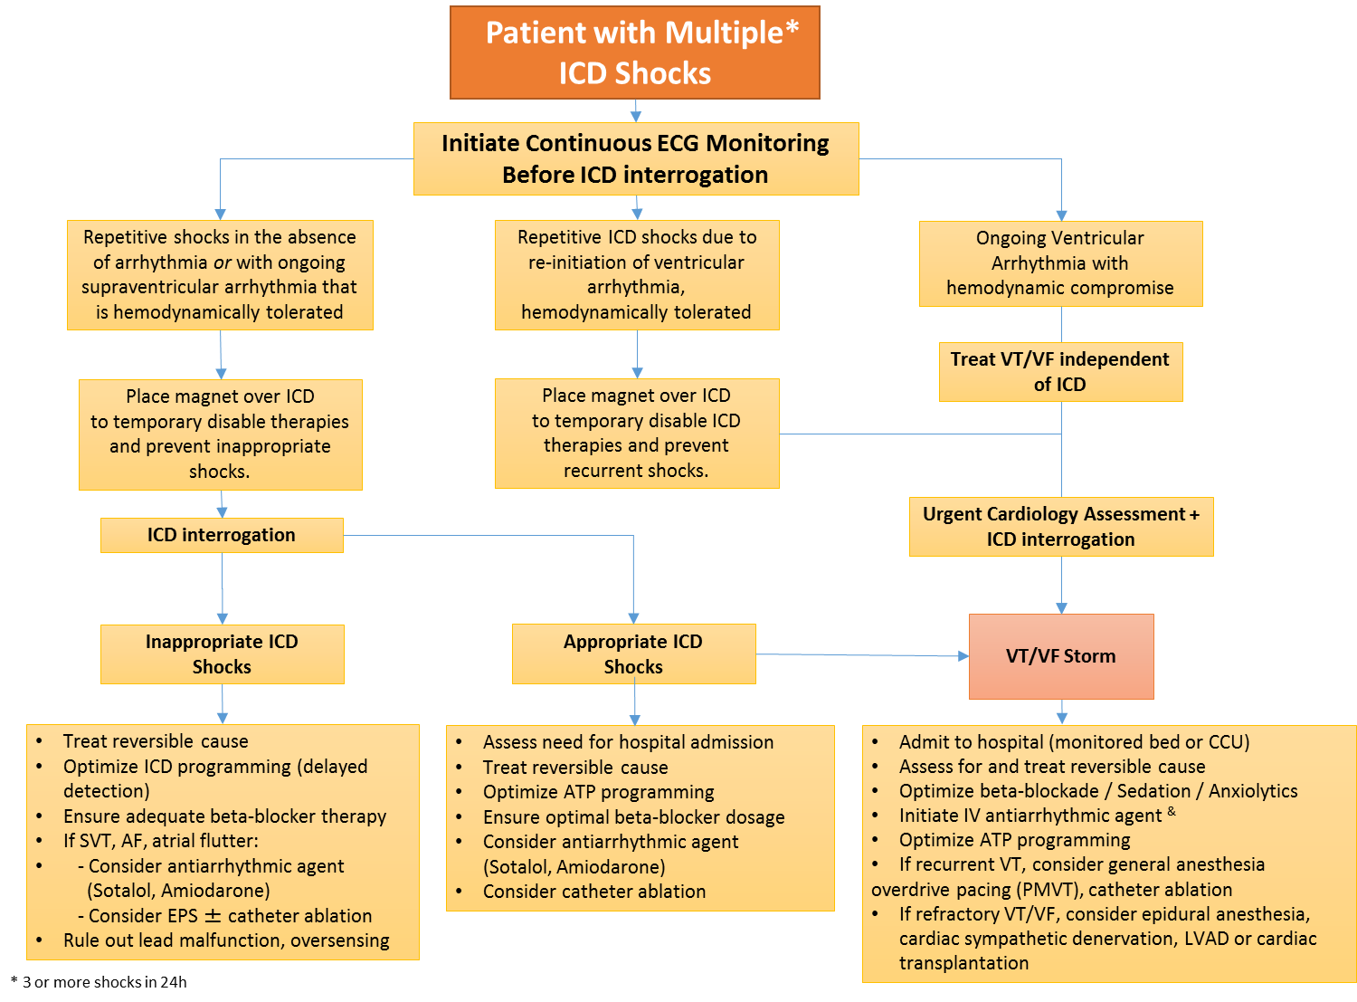

Slide 92
Management of Appropriate ICD Shocks
VT/VF STORM
Appropriate ICD
Shocks
Admit to hospital (monitored bed or CCU)
Assess / treat reversible cause
Optimize beta-blockade
Deep Sedation / Anxiolytics
Initiate IV antiarrhythmic agent &
Optimize ATP programming
If recurrent VT, consider general anesthesia
overdrive pacing (PMVT), catheter ablation
If refractory VT/VF, consider epidural anesthesia, cardiac sympathetic denervation, LVAD or cardiac transplantation
Assess need for hospital admission
Treat reversible cause
Optimize ATP programming
Ensure optimal beta-blocker dosage
Consider antiarrhythmic agent
(Sotalol, Amiodarone)
Consider catheter ablation

Slide 93

Antiarrhythmic Drug Therapy – OPTIC Trial
P=0.055
P=0.02
HR 0.27
P<0.001
Connolly et al. JAMA 2006

Slide 94
VANISH Trial
Primary Outcome: Death, VT Storm, Appropriate Shock
No. at Risk
Ablation | 132 | 80 | 40 | 20 | 8
AAD | 127 | 61 | 25 | 17 | 6
Sapp et al. NEJM 2016

Slide 95

VANISH Trial
Death, VT Storm, Appropriate Shock
Sapp et al. NEJM 2016

Slide 96
Subgoup
Analysis
Only significant interaction was the baseline antiarrhythmic drug (amiodarone vs. non-amiodarone)

Slide 97
Final Remarks
Beta-blockers are particularly important in the treatment of patients with a long QT interval syndrome and catecholaminergic polymorphic VT (CPVT).
The addition of flecainide may be useful in patients with CPVT or long QT syndrome type 3 who experience recurrence despite beta-blocker therapy.
Quinidine has been shown to reduce the likelihood of ventricular arrhythmias recurrence in idiopathic VF, Brugada syndrome, and short QT syndrome.

Slide 98
Inappropriate ICD Shocks
Telemetry (crash cart available/defib pads on)
Apply magnet over ICD:
  - Recurrent ICD shocks due to AFib/SVT/VT on telemetry that is hemodynamically tolerated
  - Recurrent ICD shocks correlating with SR on telemetry
Prior to ICD interrogation!

