Slide 1
What’s new in 2021:
An updated standard of care for HFrEF
Guidance from the CCS/CHFS 2021 Heart Failure Guideline Panel
April 15, 2021

Slide 2
© Canadian Cardiovascular Society. 2021. All rights reserved.
Distribution, transmission or republication is strictly prohibited without the prior written permission of the Canadian Cardiovascular Society.
For medical institution internal education or training (i.e. grand rounds, medical college/classroom education, etc.), kindly consider and implement the following:
  Include the citation for the Canadian Journal of Cardiology
  Add ‘Reproduced with permission from the Canadian Cardiovascular Society. [insert year].’
  Avoid use of CCS logos or trademarks on slides, tools or publications that are not the property of the CCS
  Do not modify the slide content and, the layout and CCS branding on the Guideline-related slides
  Guideline recommendations must be reproduced exactly as published
For an industry supported or involved program, permissions are required:
  If content is published in the Canadian Journal of Cardiology, permissions must be sought through our publisher Elsevier (www.onlinecjc.com)
  If content is property of the CCS, contact guidelines@ccs.ca

Slide 3
We are grateful to our partners for their commitment to the CCS.
The Canadian Cardiovascular Society is grateful to our partner(s) for their commitment to building knowledge and expertise of the heart team. This program was made possible in part by Astra Zeneca and Novartis Canada. CCS thanks our partners for their dissemination support so that healthcare providers can benefit from this important information.

Slide 4
INTRODUCING THE HF WEBINAR SERIES
Webinar 1: What’s new in 2021: An updated standard of care for HFrEF
Today!
Faculty: Justin Ezekowitz, Mike McDonald, Sean Virani
Webinar 2: Screening + diagnosis in HFrEF and HFpEF: recognizing and managing risk factors
Wednesday, April 22, 2021 from 8 PM – 9 PM EDT
Faculty: Sean Virani, Eileen O’Meara, Jonathan Howlett
Webinar 3: Device therapy: when to consider and how to manage complex HF
Thursday, June 17, 2021 from 8 PM – 9 PM EDT
Faculty: Mike McDonald, Sheri Koshman, Anique Ducharme, Mustafa Toma
Webinar 4: Non-pharmacological management: nutrition, cardiac rehabilitation and advance care planning
Thursday, July 15, 2021 from 8 PM – 9 PM EDT
Faculty: Sean Virani, Elizabeth Swiggum, Harriette Van Spall, Shelley Zieroth

Slide 5



Our Faculty
Dr. Justin
Ezekowitz
Dr. Michael
McDonald
Dr. Sean
Virani
MODERATOR

Slide 6

Disclosure of potential conflicts of interest
Justin Ezekowitz
Consulting Fees/Honoraria: Amgen, AstraZeneca, Bayer, Boehringer Ingelheim, BMS/Pfizer Alliance, Merck, Novartis, Servier Clinical Trials: Amgen, Bayer, Boehringer Ingelheim, Merck, Novartis, Pfizer, Sanofi
Sean Virani
Consulting Fees/Honoraria: Abbott, Amgen, AstraZeneca, Bayer, Boehringer Ingelheim, BMS/Pfizer Alliance, Medtronic, Merck, Novartis, Pfizer, Servier
Clinical Trials: Abbott, AstraZeneca, Boehringer Ingelheim, Medtronic, Novartis, Pfizer
Michael McDonald
Consulting Fees/Honoraria: Abbott, Boehringer Ingelheim, Merck, Novartis, Servier
Clinical Trials: Novartis

Slide 7

MODERATOR
Dr. Justin Ezekowitz
MBBCh, MSc
Edmonton, AB
Director, Canadian Vigour Center
Professor, Cardiology, University of Alberta
Director, Cardiovascular Research, University of Alberta
@JustinEzekowitz

Slide 8

Overall Learning Objectives
Discuss new evidence for pharmacological therapies for patients with HFrEF,
Review timing and clinical context for initiating novel pharmacologic therapies for the management of HFrEF, and
Apply practical strategies to integrate the CCS/CHFS heart failure guidelines into daily clinical practice.

Slide 9

Case #1: outpatient, “routine” follow-up
65 year old male
NYHA II for past year
No hospitalizations
LVEF 40%
Non-ischemic etiology
Active, still working
Occ SOBOE, weight up/down 1-2kg
Takes oral Lasix when needed
Medications:
Sacubitril-valsartan 49/51mg bid
Bisoprolol 7.5 mg/d
Metformin for diabetes
Hyperkalemia to 5.2 with spironolactone
His questions today:
Do I need to take all these meds?
My daughter says I may need a pacemaker – do I?
HR 74 bpm, BP 112/80
Euvolemic
Baseline SCr 140 µmol/L, K+ 5.2
ECG shows NSR with QRS of 136ms
How should we answer these questions?

Slide 10
Case #2: ED presentation and Admission
72 year old female
NYHA III
No prior HF diagnosis
LVEF 32%
Admitted for IV Lasix
ACEi uptitrated: ramipril 10 mg daily
Beta-blocker added: bisoprolol 1.25 mg daily
MRA added: spiro 12.5 mg daily
Medications on admission:
Ramipril 5 mg daily (HTN
Hydrochlorothiazide 25 mg daily (HTN)
ASA 81 mg daily
Amlodipine 10 mg daily (HTN)
Discharged after 7 days
Ramipril 10 mg daily
Furosemide 80mg daily
Bisoprolol 1.25 mg daily
Spironolactone 12.5 mg daily
SCr 130 µmol/L at discharge, K+ 4.9
Now NYHA II
HR 101 bpm, BP 102/74
JVP elevated, moderate edema to shins
BNP 799 pg/mL
SCr 186 µmol/L, K+ 4.5
ECG shows AFib with QRS of 112ms
Did we miss an opportunity?

Slide 11
Standard therapies for HFrEF in 2021
Dr. Michael McDonald
MD, FRCPC
Toronto, ON
Associate Professor, University of Toronto
Medical Director, Ted Rogers Centre of Excellence in Heart Function
Medical Director, Ajmera Heart Transplant Program, University Health Network

Slide 12

Learning Objectives
Define the current standard of pharmacologic care for the general HFrEF patient population
Discuss different clinical settings in which HFrEF therapies can be initiated

Slide 13
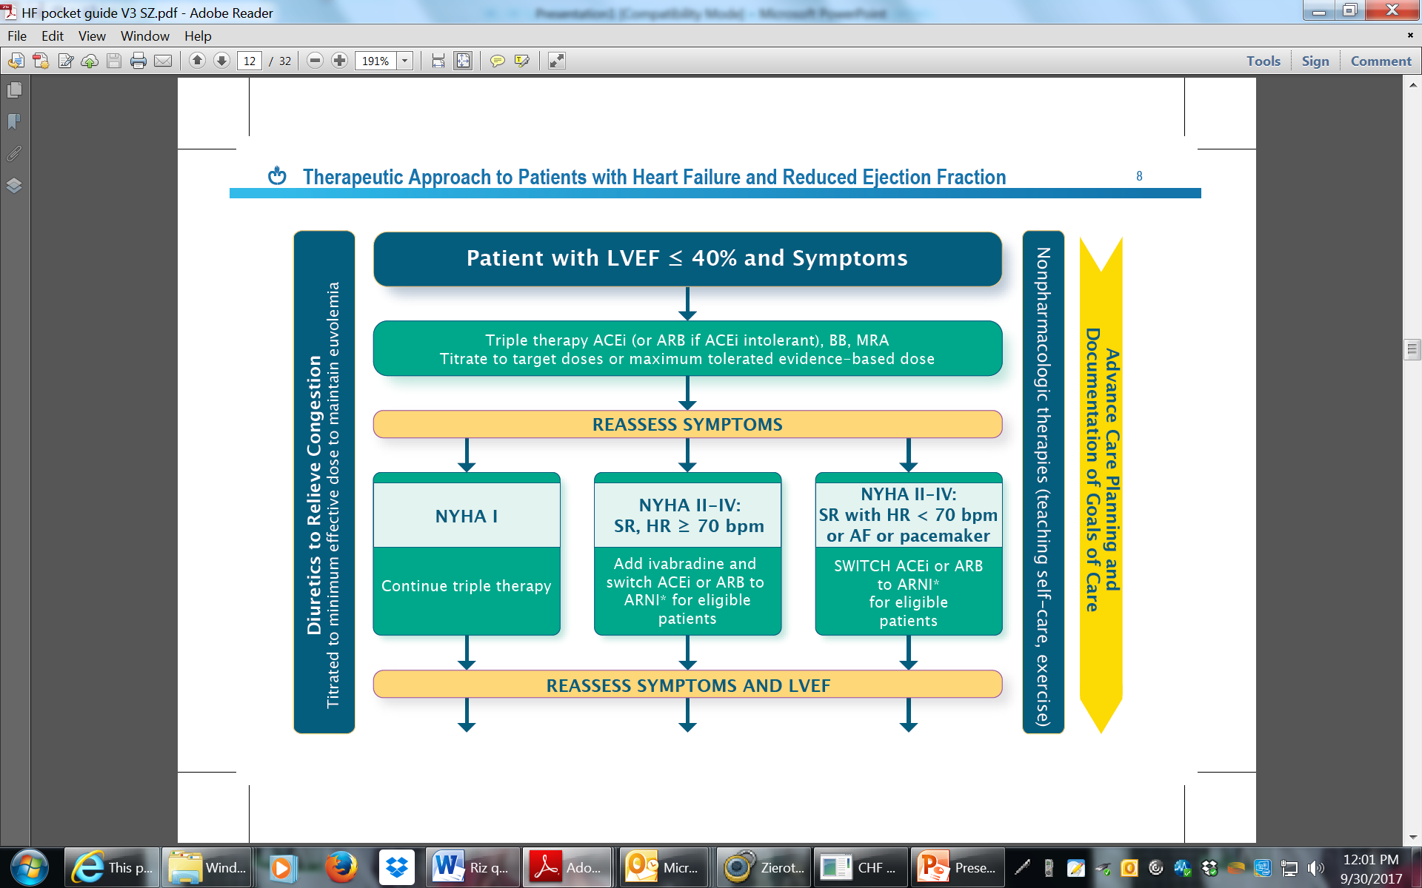
Therapeutic approach to patients with HFrEF (circa 2017)
“Triple therapy”
Substitute for ARNI, add ivabradine
Ezekowitz et al, Can J Cardiol 2017

Slide 14
New evidence for decision making in HFrEF
Study | Drug | Patients | Primary Outcome | Study Implications
PIONEER-HF (and extension study) | Sac-val vs Enalapril | Stabilized after admission with with worsening HF; 35% with de novo HF | Change in NT-proBNP values at 8 weeks | Broader use of ARNI in hospitalized and de novo HF patients
DAPA HF | Dapagliflozin vs placebo | NYHA II-IV, chronic HF, with or without DM2 | CV death or worsening HF | Addition of SGLT2 inhibitors improves outcomes in broad spectrum of HFrEF patients with or without DM2
EMPEROR Reduced | Empagliflozin vs placebo | High risk NYHA II-IV, chronic HF, with or without DM2 | CV death or worsening HF
VICTORIA | Vericiguat vs placebo | NYHA II-IV, recent worsening HF requiring admission or IV diuretic | CV death or worsening HF | Addition of vericiguat in stabilized high risk patients further improves outcomes

Slide 15
Opportunities, with some challenges
Where do we now put ARNI… and SGLT2 inhibitors?
Where do we put sGC stimulators?
What about older HF therapies like digoxin and vasodilators?
When should we refer for ICD and CRT?

Slide 16
PIONEER-HF Study: Open label extension
Velazquez et al, N Engl J Med 2019
Devore et al, JAMA Cardiol 2020
Open label extension:
  Further reduction in NTproBNP (both groups)
  In-hospital sac-val group experienced lower incidence of death or re-hospitalization over 12 weeks follow-up
Notes:
The PIONEER open label extension (ref) evaluated the clinical course of patients in the PIONEER-HF study who were initiated on sacubitril-valsartan in-hospital as well as those who were switched from enalapril to sacubitril-valsartan at week 8 of the trial protocol and followed up for an additional 4 weeks. For patients continuing sacubitril-valsartan through weeks 8 to 12 of the study protocol, a further 17.2% reduction in NT-proBNP was observed; for patients switching from enalapril to sacubitril-valsartan at 8 weeks, a more significant 37.4% decline in NT-proBNP was seen over the following 4 weeks. An additional key overall finding in this phase of the study was that patients initiated on the ARNI therapy in-hospital had a lower incidence of subsequent HF hospitalization or cardiovascular mortality through the entire 12-week trial period compared to patients converted to ARNI after the first 8 weeks (13.0% vs 18.1%, p=0.03).

Slide 17
Updated recommendations
We recommend that an ARNI be used in place of an ACEI or ARB, in patients with HFrEF, who remain symptomatic despite treatment with appropriate doses of GDMT to decrease CV death, HF hospitalizations, and symptoms
Strong Recommendation; High-Quality Evidence
We recommend that patients admitted to hospital for acute decompensated HF with HFrEF should be switched to an ARNI, from an ACEI or ARB, when stabilized and before hospital discharge
  Strong Recommendation; Moderate-Quality Evidence
We suggest that patients admitted to hospital with a new diagnosis of HFrEF should be treated with ARNI as first-line therapy, as an alternative to either an ACEI or ARB
  Weak Recommendation; Moderate-Quality Evidence
McDonald, Virani, et al, Can J Cardiol 2021

Slide 18
DAPA-HF and EMPEROR-Reduced
DAPA-HF
EMPEROR-Reduced
Outcome | Dapagliflozin | Placebo
 | Events/100 patient-yr | Events/100 patient-yr | HR (95%CI)
Primary outcome | 11.6 | 15.6 | 0.74 (0.65-0.85)
HHF | 6.9 | 9.8 | 0.70 (0.59-0.83)
CV death | 6.5 | 7.9 | 0.82 (0.69-0.98)
Outcome | Empagliflozin | Placebo
 | Events/100 patient-yr | Events/100 patient-yr | HR (95%CI)
Primary outcome | 15.8 | 21.0 | 0.75 (0.65-0.86)
HHF | 10.7 | 15.5 | 0.69 (0.59-0.81)
CV death | 7.6 | 8.1 | 0.92 (0.75-1.12)
McMurray JJV, et al. N Engl J Med. 2019
Packer M, et al. N Engl J Med. 2020
In these trials, dapagliflozin and empagliflozin, respectively, significantly reduced combined endpoint of CV death or HF hospitalization compared to placebo, with very few adverse events
Differences in trials relate to baseline characteristics; EMPEROR Reduced patients with both higher risk and more aggressively treated with HF therapies
Magnitude of benefit observed in both trials similar in patient WITH and WITHOUT diabetes

Slide 19
Updated recommendation
We recommend an SGLT2 inhibitor, such as dapagliflozin or empagliflozin, be used in patients with HFrEF, with or without concomitant type 2 diabetes, to improve symptoms and quality of life and to reduce the risk of HF hospitalization and/or CV mortality
Strong Recommendation; High-Quality Evidence
McDonald, Virani, et al, Can J Cardiol 2021

Slide 20
Why guideline therapy matters:
Comprehensive treatment improves survival in HFrEF
A
B
16
20
In HFrEF, treatment effects of comprehensive therapy (ARNI, beta- blocker, MRA, SGLT2i) was compared to conventional therapy (ACEI/ARB, beta-blocker) in cross trial analyses
Significant improvement with comprehensive therapy observed in both overall survival and event-free survival across all age groups
In a 55-year-old man, comprehensive therapy would improve event-free survival by 8.3 years and overall survival by 6.3 years
14
18
12
16
10
14
12
8
Event-free survival (yrs)
10
Overall survival (yrs)
6
8
4
6
2
Comprehensive therapy
4
Comprehensive therapy
Conventional therapy
2
Conventional therapy
0
0
55
60
65
70
75
80
D
55
60
65
70
75
80
C
Age (yrs)
Age (yrs)
10
10
8
8
6
Difference in
event-free survival (yrs)
Difference in
overall survival (yrs)
6
4
4
2
Vaduganathan M et al. Lancet 2020
2
0
55
60
65
70
75
80
55
60
65
70
75
80
CCS/CHFS Heart Failure Guidelines
Age (yrs)
Age (yrs)

Slide 21
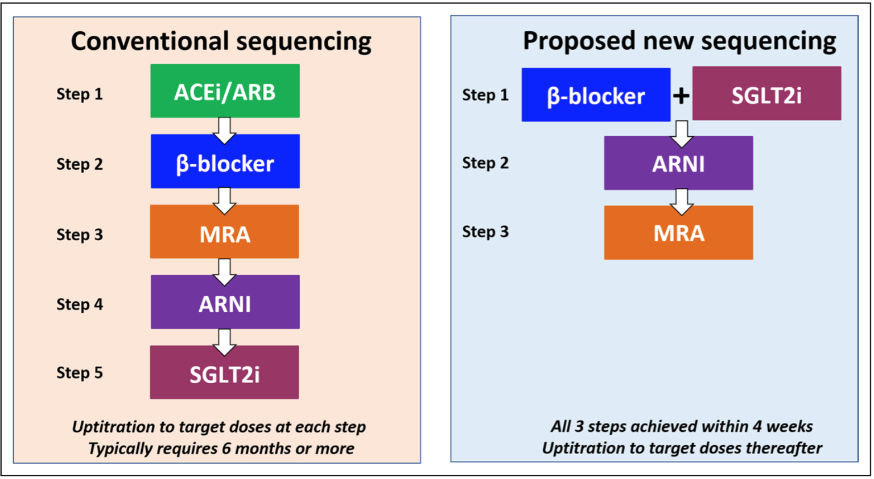
What people are talking about: how best to prescribe?
McMurray and Packer, Circulation 2021

Slide 22
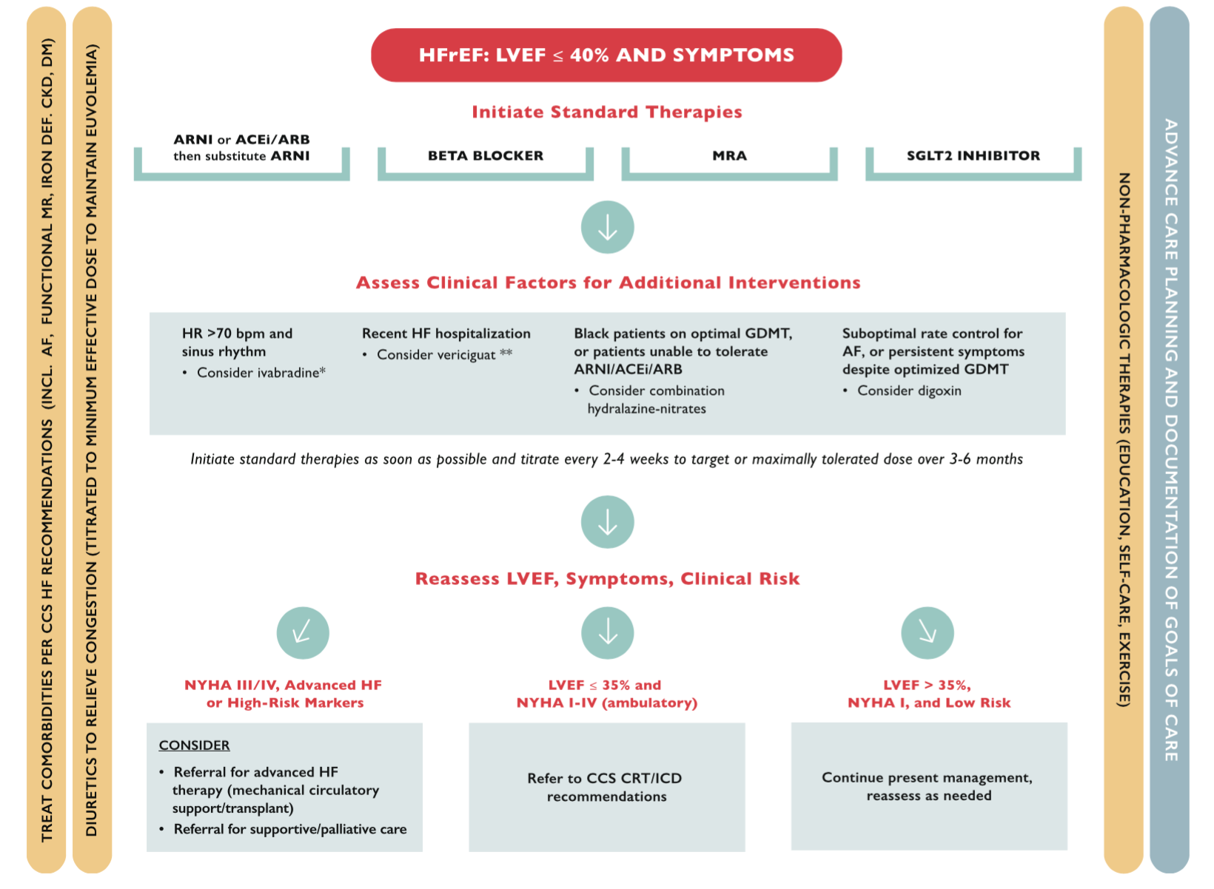

How best to prescribe?
Step 1
Step 2
Step 3

Slide 23
New recommendation
We recommend that in the absence of contraindications, patients with HFrEF be treated with combination therapy including 1 evidence-based medication from each of the following categories:
  ARNI (or ACEI/ARB);
  Beta-blocker;
  MRA;
  SGLT2 inhibitor.
Strong Recommendation, Moderate-Quality Evidence

Slide 24

Additional therapies to consider
Dr. Sean A. Virani
MD, MSc, MPH, FRCPC, FCCS
Vancouver, BC
Head, Division of Cardiology, Providence Health Care
Physician Program Director, The HEART Centre, St. Paul’s Hospital
Provincial Medical Director, Cardiac Services BC
Associate Professor, Department of Medicine, University of British Columbia
Past President, Canadian Heart Failure Society
Medical Director, HeartLife Foundation
@DktrV

Slide 25
Learning Objectives
Discuss the evidence for additional pharmacologic therapies in high risk HFrEF patients
Discuss an approach to personalizing pharmacologic care in HFrEF

Slide 26
Optimizing treatment beyond ‘foundational’ therapies
Quadruple Therapy is an important first step in achieving GDMT, but where applicable additional therapies must be considered:
  (1) There is a significant residual risk of adverse events even when quadruple therapy is utilized
  (2) Not all patients will be able to achieve (or tolerate) all four therapies at target doses
We must consider additional approaches and treatments to mitigate risk

Slide 27
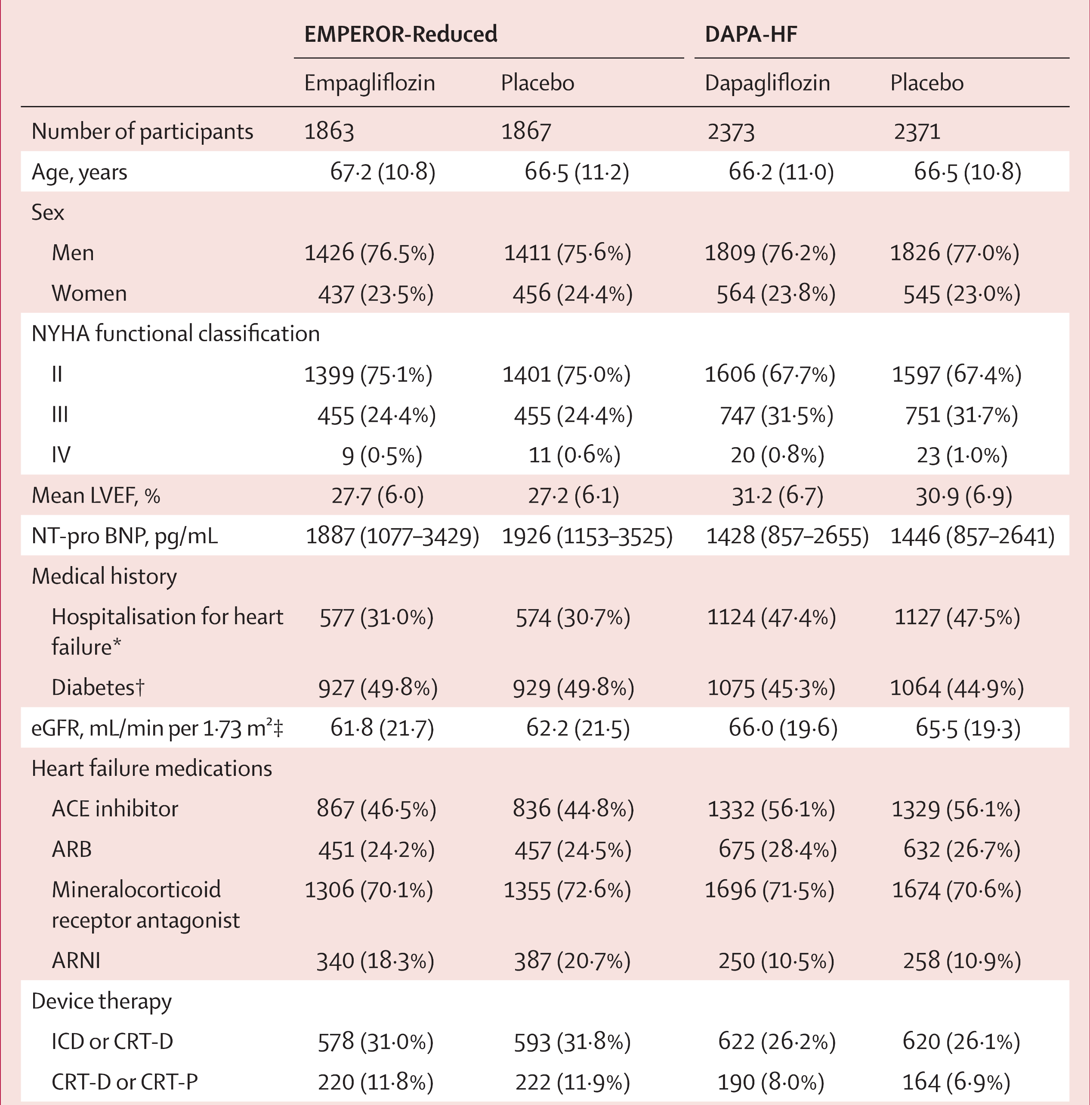
Baseline medical and device therapies
SGLT2i heart failure trials
Zannad F et al: Lancet Aug 30
Notes:
BB use was approximately 95%

Slide 28
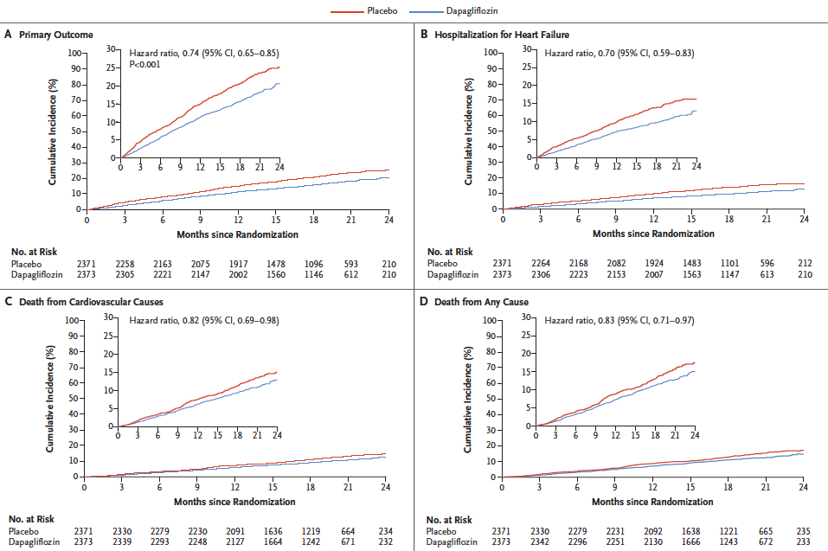
Notes:
Even with excellent utilization of these agents, we see rates of the primary outcome of interest approaching 20% in the DAPA-HF Trial with death from cardiovascular causes greater than 10%

Slide 29
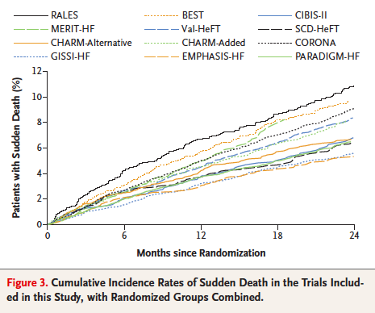
Sudden cardiac death in HF trials
The annual rate of SCD in the treatment arm of PARADIGM-HF was 3.0%

Slide 30
Therapeutic inertia: missed opportunity to optimize medical therapy
% of Patients on Target Dose at Baseline and 1 Year in CHAMP Registry
30
Baseline
12 months
27
25.4
25
21.6
20.3
20
15
11.1
10
9.8
5
3.4
1.7
0
ACE/ARB
BB
MRA
ARNI
ACE/ARB
BB
MRA
ARNI
target dose among eligible patients (%)
target dose among eligible patients (%)
Bozkurt B. J Am Coll Cardiol 2019
Notes:
There are clearly opportunities for optimization of GDMT, but in many cases the barriers are not related to therapeutic inertia and there are true physiological limitations to up-titration.

Slide 31
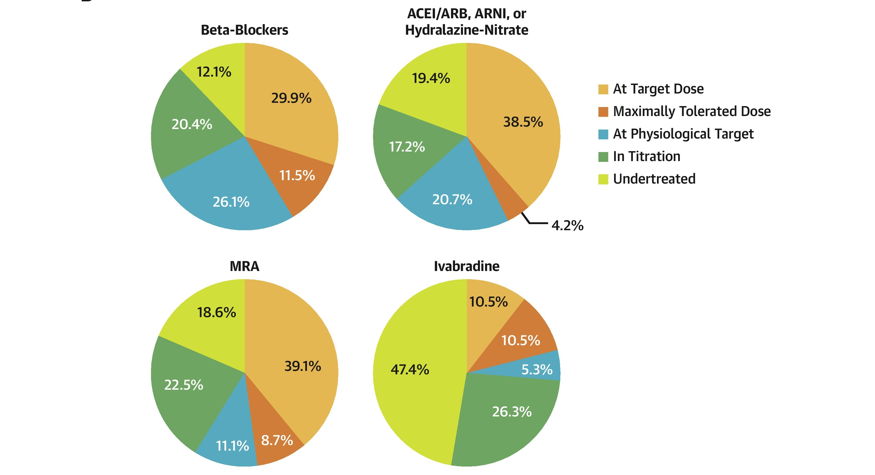
Achieving GDMT in Canadian ambulatory HF patients
Jarjour et al. JACC HF 2020 Sep 8 (9) 725-38
Notes:
Gross prescription rates were high for beta-blockers (98.6%), mineralocorticoid receptor antagonist (MRA) (93.4%), vasodilators (90.3%), ICDs (75.1%), and CRT (82.1%) among those eligible, except for ivabradine (46.3%, n = 41)
Medical records of all patients with HFrEF followed for at least 6 months at the authors’ HF clinic (n = 511) allowed for drug optimization and were reviewed regarding the prescription rates of recommended pharmacological agents and devices (implantable cardioverter-defibrillator [ICD] or cardiac resynchronization therapy [CRT]). Then, an algorithm integrating clinical (New York Heart Association [NYHA] functional class, heart rate, blood pressure and biologic parameters (creatinine, serum potassium) based on the inclusion/exclusion criteria of landmark trials guiding these recommendations) was applied for each agent and device to identify potential explanations for treatment gaps.
Gaps in adherence to guidelines exist in specialized HF setting and are mostly explained by limiting physiological factors rather than inertia.

Slide 32
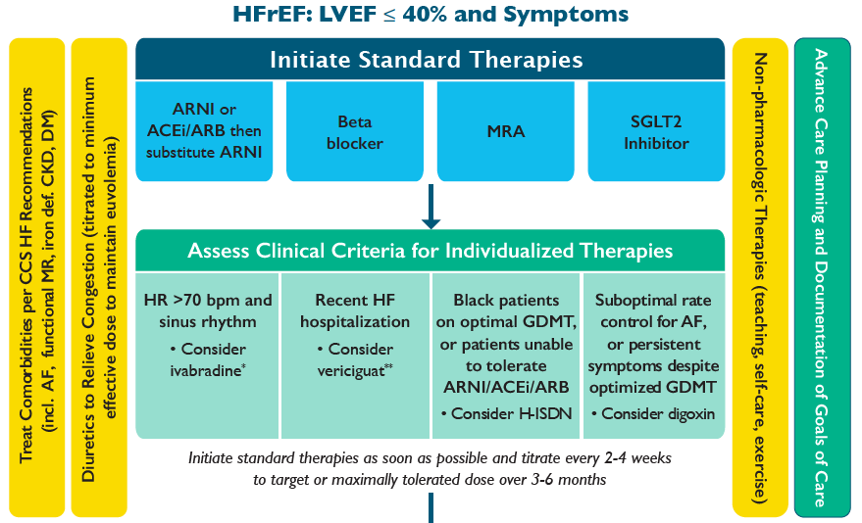

Slide 33
Is this patient a candidate for individualized therapies?
72 year old female
NYHA II since discharge
One hospitalization this year
LVEF 32%
SCr 130 µmol/L
BNP 799 pg/mL
K+ 5.3
ECG shows NSR, HR 80 bpm and QRS of 112ms
Medications:
Ramipril 10 mg daily
Furosemide 80 mg daily
Bisoprolol 1.25 mg daily
Spironolactone 12.5 mg daily
Events since discharge:
Sac-val attempted at low dose and then D/C as patient developed hyperkalemia requiring ER visit
  Currently awaiting review with dietician
No public coverage for SGLT2i
Patient and family concerned about risk of falls as the patient lives independently
  ? Decrease furosemide to 40 mg daily
Now being seen in primary cardiologist’s office:
SOB stable
Light headed with postural changes
HR 81 bpm, BP 102/80 (no postural drop)
Euvolemic on exam with stable weights
How can we further optimize in this setting?

Slide 35
Clinical factors for consideration with individualized therapies
Drug | Main Indication | Heart Rate and Blood Pressure | Renal Function | Notes
Ivabradine | Sinus rhythm HR ≥70 bpm despite beta-blocker optimization | Minimum effect on blood pressure Contraindicated in bradycardia | Use in patients with severe renal dysfunction not well studied No safety data for patients on dialysis or eGFR <15mL/min/1.73m2 | Subgroup with HR ≥ 77bpm most likely to benefit Can be initiated in hospital prior to discharge once clinical stability has been achieved Potential side effects include visual disturbances (phosphenes) and bradycardia
Vericiguat | Worsening HF symptoms and/or HF hospitalization in prior 6 months | Avoid in patients with SBP <100mmHg or symptomatic hypotension Minimal effect on HR | No contraindication No safety data for patient on dialysis or eGFR <15mL/min/1.73 m2 | Should not be combined with nitrate therapy Patients with very high NT-proBNP levels (>8000pg/mL) unlikely to benefit Potential side effects include symptomatic hypotension and anemia

Slide 36
VICTORIA trial
To assess whether vericiguat reduces the primary composite outcome of cardiovascular (CV) death or first HF hospitalization
Secondary outcomes were:
  Components of the primary composite endpoint
  Total HF hospitalizations; first and recurrent
  Composite of all-cause mortality or first HF hospitalization
  All-cause mortality
To evaluate the safety and tolerability of vericiguat in this high-risk population with HF with reduced EF (HFrEF)
Armstrong et al. NEJM 2020, doi: 10.1056/NEJMoa1915928
Notes:
Event driven study that randomized 5050 patients to vericiguat (stepped dose titration) or placebo

Slide 37
Hospitalization remains a major risk factor for adverse events
“Chronic HF”
“Worsening event”
after
NYHA class II–IV
LVEF < 45%
Guideline based HF therapies
Recent HFH or IV diuretic use
With very elevated natriuretic peptides (BNP or NT-proBNP)
BNP ≥ 300 & pro-BNP ≥ 1000 pg/ml NSR
BNP ≥ 500 & pro-BNP ≥ 1600pg/ml AF
Armstrong et al. JACC Heart Fail. 2018 Feb;6(2):96-104. doi: 10.1016/j.jchf.2017.08.013.
Notes:
A very sick population:
About 85% had a hospitalization in last 6 months (rather than entering the trial on the basis of IV diuretics)
40% NYHA III-IV
High NP levels
EF <30%
Only 60% on triple therapy GDMT but approximately 1/3 had devices

Slide 38
VICTORIA: Outcomes
 | Vericiguat (N=2526) |  | Placebo (N=2524) |  | Treatment Comparison
 | % | Events/ 100 Pt-Yrs | % | Events/ 100 Pt-Yrs | HR (95%)* | P-value†
PRIMARY COMPOSITE OUTCOME | 35.5 | 33.6 | 38.5 | 37.8 | 0.90 (0.82–0.98) | 0.019
HF hospitalization | 27.4 |  | 29.6
Cardiovascular death‡ | 8.2 |  | 8.9
SECONDARY OUTCOMES
Cardiovascular death | 16.4 | 12.9 | 17.5 | 13.9 | 0.93 (0.81–1.06) | 0.269
HF hospitalization | 27.4 | 25.9 | 29.6 | 29.1 | 0.90 (0.81–1.00) | 0.048
Total HF hospitalizations |  | 38.3 |  | 42.4 | 0.91 (0.84–0.99) | 0.023
Secondary composite outcome | 37.9 | 35.9 | 40.9 | 40.1 | 0.90 (0.83–0.98) | 0.021
HF hospitalization | 27.4 |  | 29.6
All-cause mortality‡ | 10.5 |  | 11.3
All-cause mortality | 20.3 | 16.0 | 21.2 | 16.9 | 0.95 (0.84–1.07) | 0.377
Armstrong et al. NEJM 2020, doi: 10.1056/NEJMoa1915928

Slide 39
New recommendation
We recommend that vericiguat, an oral soluble guanylate cyclase stimulator, be considered in addition to optimal heart failure therapies for HFrEF patients with worsening symptoms and hospitalization for HF in the past 6 months, to reduce the risk of subsequent heart failure hospitalization
Conditional Recommendation; Moderate-Quality Evidence
Practical tip:
  Subgroup analysis from the VICTORIA Trial suggests that clinical response to vericiguat may be attenuated in patients with very elevated natriuretic peptide levels.
McDonald, Virani, et al, Can J Cardiol 2021

Slide 40
Is this patient a candidate for advanced HF therapies or a device?
72 year old female
NYHA II since discharge
One hospitalization this year
LVEF 32% at baseline
SCr 135 µmol/L
BNP 900 pg/mL
K+ 4.4
ECG shows NSR, HR 60 bpm and QRS of 112ms
Echo: LVEF unchanged at 32%
Medications:
Ramipril 10 mg daily
Furosemide 40 mg daily
Bisoprolol 1.25 mg daily
Spironolactone 12.5 mg daily
Ivabradine 2.5 mg bid
Events since discharge:
Reviewed by dietician
  Decrease in K+ containing foods
Still no public coverage for SGLT2i
Patient and family don’t want to ‘rock the boat’ since she’s feeling well and no further hospitalizations
3 month follow-up in primary cardiologist’s office:
Symptoms stable with no hospitalizations
HR 61 bpm, BP 102/80 (no postural drop)
Clinically euvolemic
How can we further optimize in this setting?

Slide 41
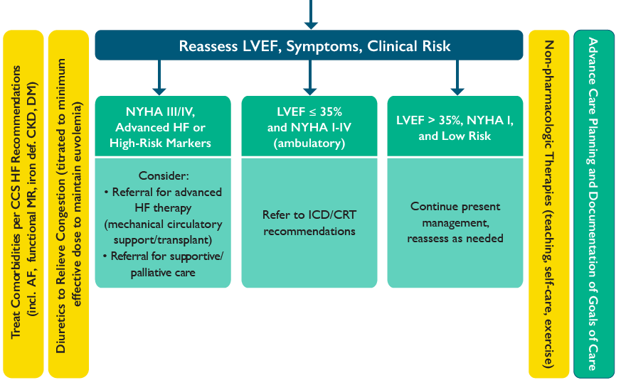

Slide 42
Recommendation
We recommend that after a diagnosis of HFrEF, standard medical therapy should be initiated and titrated to target or maximally tolerated doses with a repeat assessment of LVEF prior to referral for ICD or CRT
Strong Recommendation; Moderate-Quality Evidence
Practical tips:
  Reassessment of ejection fraction should be performed 3 months after the achievement of target or maximally tolerated doses of GDMT.
  An assessment of arrhythmic and non-arrhythmic SCD risk should be performed to estimate the risk/benefit of an ICD/CRT.
  Specific HF therapies may contribute to improvements in LVEF and should be considered prior to referral for ICD or CRT:
    For eligible patients, switching to ARNI therapy should be considered prior to referral for ICD or CRT.
    Adding ivabradine, where otherwise indicated after beta-blocker optimization, should be considered prior to referral for ICD or CRT.
  Referral for ICD or CRT should not be unduly delayed if timely titration of pharmacologic therapies is infeasible or impractical.
McDonald, Virani, et al, Can J Cardiol 2021

Slide 43
Visit CCS.ca for more Guidelines and Resources
Guideline Library:
https://ccs.ca/guidelines-and-position-statement-library/
Guideline Resources:
https://ccs.ca/guideline-resources/

Slide 44
SAVE THE DATE!
For our upcoming Guideline Webinars
Atrial Fibrillation: Webinar 1: All about stroke prevention!
On Thursday, April 22, 2021 from 8 PM – 9 PM EDT, join Drs. Macle, Andrade, Sterns, Tsang, Bell, Mitchell, and Leblanc for the “AF Guidelines: All about stroke prevention!” webinar. This webinar highlights content from the 2020 CCS/CHRS Comprehensive Atrial Fibrillation Guidelines.
Heart Failure: Webinar 2: Screening + Diagnosis in HFrEF and HFpEF
On Wednesday, May 19, 2021 from 8 PM – 9 PM EDT, join Dr. Virani, Dr. O’Meara and Dr. Howlett for the second webinar in the HF webinar series highlighting content from the Heart Failure Guidelines.
Register at CCS.ca
And download a copy of the updated HF Pocket Guide!

