Slide 1
Antiplatelet Therapy for the Primary Prevention of Vascular Events
Canadian Cardiovascular Society Antiplatelet Guidelines
Working Group: Alan D. Bell, MD, CCFP and James D. Douketis, MD, FRCP

Slide 2
Objectives
Interpret the Canadian Cardiovascular Society Guideline recommendations regarding the use of antiplatelet therapy for primary prevention of vascular events.
Distinguish the clinical impact of absolute versus relative risk reduction in primary prevention.
Distinguish the effect of risk factors on the clinical impact of antiplatelet therapy for primary prevention.
Evaluate the evidence supporting the recommendations regarding the use of antiplatelet therapy in primary prevention.

Slide 3
Alex
Alex is accompanying his wife who is seeing you in follow up for her coronary disease. Alex wants to know if he should be taking ASA to prevent a heart attack.
Alex is 65 and has never had any manifestation of vascular disease.

Slide 4
Polling question
Do you offer low dose ASA to Alex?
Yes
No

Slide 5
Primary prevention
What else do you want to know?
Risk factors
  Hypertension
  Diabetes
  Lipids
  Risk score
  BMI
  Age
  Sex
  Family history
  Smoking
  Bleeding Risk

Slide 6
Primary prevention
Antithrombotic trialists’ collaboration
Aspirin in the primary and secondary prevention of vascular disease: collaborative meta-analysis of individual participant data from randomised trials.
Lancet 2009; 373: 1849–60
Notes:
Antithrombotic Trialists’ (ATT) Collaboration*
Summary
Background Low-dose aspirin is of definite and substantial net benefi t for many people who already have occlusive
vascular disease. We have assessed the benefits and risks in primary prevention.
Methods We undertook meta-analyses of serious vascular events (myocardial infarction, stroke, or vascular death)
and major bleeds in six primary prevention trials (95 000 individuals at low average risk, 660 000 person- years,
3554 serious vascular events) and 16 secondary prevention trials (17 000 individuals at high average risk,
43 000 person-years, 3306 serious vascular events) that compared long-term aspirin versus control. We report
intention-to-treat analyses of first events during the scheduled treatment period.
Findings In the primary prevention trials, aspirin allocation yielded a 12% proportional reduction in serious vascular
events (0·51% aspirin vs 0·57% control per year, p=0·0001), due mainly to a reduction of about a fifth in non-fatal
myocardial infarction (0·18% vs 0·23% per year, p<0·0001). The net effect on stroke was not significant (0·20% vs
0·21% per year, p=0·4: haemorrhagic stroke 0·04% vs 0·03%, p=0·05; other stroke 0·16% vs 0·18% per year, p=0·08).
Vascular mortality did not differ significantly (0·19% vs 0·19% per year, p=0·7). Aspirin allocation increased major
gastrointestinal and extracranial bleeds (0·10% vs 0·07% per year, p<0·0001), and the main risk factors for coronary
disease were also risk factors for bleeding. In the secondary prevention trials, aspirin allocation yielded a greater
absolute reduction in serious vascular events (6·7% vs 8·2% per year, p<0.0001), with a nonsignificant increase in
haemorrhagic stroke but reductions of about a fifth in total stroke (2·08% vs 2·54% per year, p=0·002) and in
coronary events (4·3% vs 5·3% per year, p<0·0001). In both primary and secondary prevention trials, the proportional
reductions in the aggregate of all serious vascular events seemed similar for men and women.
Interpretation In primary prevention without previous disease, aspirin is of uncertain net value as the reduction in
occlusive events needs to be weighed against any increase in major bleeds. Further trials are in progress.
Funding UK Medical Research Council, British Heart Foundation, Cancer Research UK, and the European Community
Biomed Programme.

Slide 7
Primary prevention
Antithrombotic trialists’ collaboration
6 primary prevention trials
  ASA vs Placebo
  95 000 individuals
  660 000 person- years
  3554 serious vascular events
16 secondary prevention trials
  17 000 individuals
  43 000 person-years
  3306 serious vascular events

Slide 8
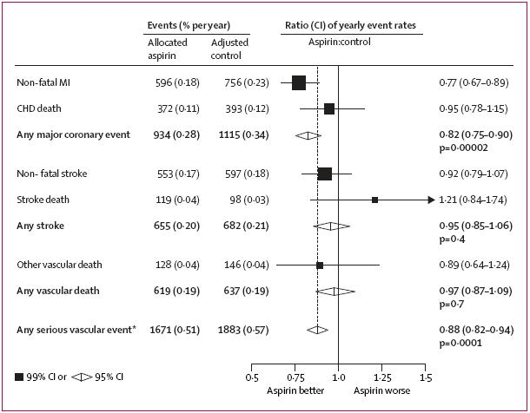
Serious vascular events in ATTC primary prevention trials
Lancet 2009;373:1849-60.
Notes:
8

Slide 9

Primary prevention
Serious vascular events in ATTC primary
Relative risk reduction
RR
Baigent C, Blackwell L, Collins R, et al. Lancet 2009;373:1849-60.

Slide 10
Polling question
Do you offer low dose ASA to Alex?
  Yes
  No

Slide 11
Primary Prevention
Serious vascular events in ATTC primary
Absolute risk reduction
1428
NNT
67
Baigent C, Blackwell L, Collins R, et al. Lancet 2009;373:1849-60.

Slide 12
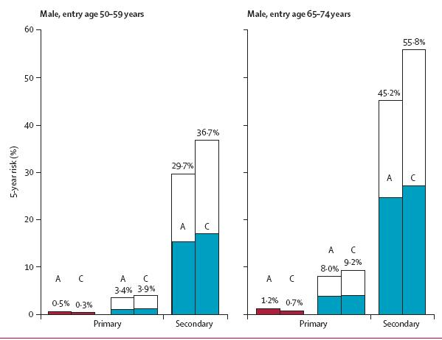

Primary Prevention What about bleeding?
Net Clinical Benefit
NCBNNT 49.5
NNT 47.2
NCBNNT73.5
NNT 70
NCBNNT 1666
NCBNNT 714
NNH 2500
NNT 1000
NNH 1000
NNT 415
NNT – Number needed to treat for 1 year to prevent a single event
Lancet 2009;373:1849-60.
Notes:
Moreover, these trials of aspirin were mainly in people who were not taking statin therapy, which would have reduced both myocardial infarction and ischaemic stroke with little hazard.
If the risk of occlusive vascular disease is already approximately halved by statins or other measures, then the further absolute benefit of adding aspirin could well be only about half as large as was suggested by these primary prevention trials, but the main bleeding hazards could well remain. In that case, the benefits and hazards of adding long-term aspirin in people without pre-existing disease might be of approximately similar magnitude.

Slide 13
Primary prevention
Demographic subgroups
RRR ASA vs Placebo
RR ASA vs Placebo
NNT | 2000 | 625 |  | 769 | 2500
Baigent C, Blackwell L, Collins R, et al. Lancet 2009;373:1849-60.

Slide 14
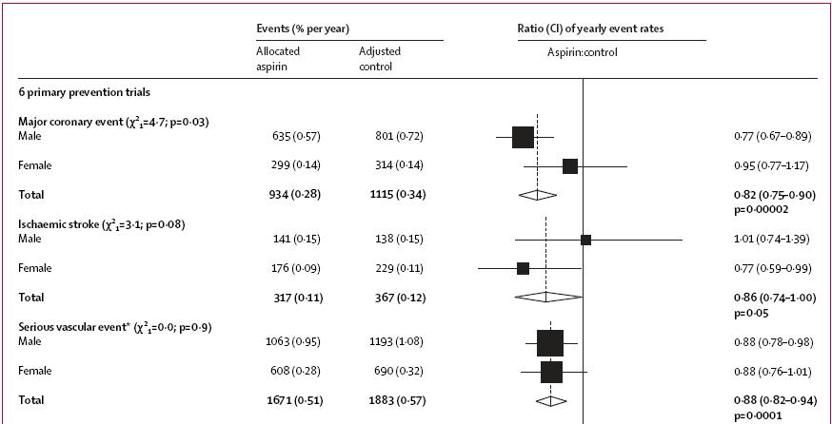

Is it Alex or Alexis?
Primary prevention
Baigent C, Blackwell L, Collins R, et al. Lancet 2009;373:1849-60.
Notes:
These results are largely driven by the Women’s Health Study
A randomized trial of low-dose aspirin in the primary prevention of cardiovascular disease in women.
Ridker PM, Cook NR, Lee IM, Gordon D, Gaziano JM, Manson JE, Hennekens CH, Buring JE.
BACKGROUND: Randomized trials have shown that low-dose aspirin decreases the risk of a first myocardial infarction in men, with little effect on the risk of ischemic stroke. There are few similar data in women. METHODS: We randomly assigned 39,876 initially healthy women 45 years of age or older to receive 100 mg of aspirin on alternate days or placebo and then monitored them for 10 years for a first major cardiovascular event (i.e., nonfatal myocardial infarction, nonfatal stroke, or death from cardiovascular causes). RESULTS: During follow-up, 477 major cardiovascular events were confirmed in the aspirin group, as compared with 522 in the placebo group, for a nonsignificant reduction in risk with aspirin of 9 percent (relative risk, 0.91; 95 percent confidence interval, 0.80 to 1.03; P=0.13). With regard to individual end points, there was a 17 percent reduction in the risk of stroke in the aspirin group, as compared with the placebo group (relative risk, 0.83; 95 percent confidence interval, 0.69 to 0.99; P=0.04), owing to a 24 percent reduction in the risk of ischemic stroke (relative risk, 0.76; 95 percent confidence interval, 0.63 to 0.93; P=0.009) and a nonsignificant increase in the risk of hemorrhagic stroke (relative risk, 1.24; 95 percent confidence interval, 0.82 to 1.87; P=0.31). As compared with placebo, aspirin had no significant effect on the risk of fatal or nonfatal myocardial infarction (relative risk, 1.02; 95 percent confidence interval, 0.84 to 1.25; P=0.83) or death from cardiovascular causes (relative risk, 0.95; 95 percent confidence interval, 0.74 to 1.22; P=0.68). Gastrointestinal bleeding requiring transfusion was more frequent in the aspirin group than in the placebo group (relative risk, 1.40; 95 percent confidence interval, 1.07 to 1.83; P=0.02). Subgroup analyses showed that aspirin significantly reduced the risk of major cardiovascular events, ischemic stroke, and myocardial infarction among women 65 years of age or older. CONCLUSIONS: In this large, primary-prevention trial among women, aspirin lowered the risk of stroke without affecting the risk of myocardial infarction or death from cardiovascular causes, leading to a nonsignificant finding with respect to the primary end point.
14

Slide 15
Primary prevention risk reduction of serious vascular events
Risk factor sub-groups
RR ASA vs Placebo
NNT | 909 | 2500 |  | 9999 | 1250
Baigent C, Blackwell L, Collins R, et al. Lancet 2009;373:1849-60.
Notes:
When stratified by level of BP, Cholesterol or BMI similar risk reductions are noted. Benefit is not correlated with existence of or degree of risk factor
15

Slide 16
Primary prevention risk reduction of serious vascular events
Risk factor sub-groups
RR ASA vs Placebo
NNT | 667 | 714 | 625 | 1000
Baigent C, Blackwell L, Collins R, et al. Lancet 2009;373:1849-60.

Slide 17
Primary prevention risk reduction of serious vascular events
10-year risk sub-groups
RR ASA vs Placebo
NNT | 2500 | 476 | 416 | -666
Baigent C, Blackwell L, Collins R, et al. Lancet 2009;373:1849-60.

Slide 18
Risk Factors and the Benefit of ASA in Primary Prevention
“It did not depend significantly on age, sex, smoking history, blood pressure, total cholesterol, body-mass index, history of diabetes, or predicted risk of coronary heart disease.”
Lancet 2009;373:1849-60.

Slide 19
PRIMARY PREVENTION IN HIGH-RISK PATIENTS

Slide 20
Ongoing trials
ARRIVE (Aspirin to Reduce Risk of Initial Vascular Events)
  12,000 patients
  20-30% 10-year risk of an event associated with CVD or 10-20% 10-year risk of an event associated with Coronary Heart Disease (CHD).
ASPREE
  19,000 patients
  Age > 70 years
Notes:
ASPREE is a randomised, double-blind placebo controlled study
It involves both males and females, 70 years and older
Participants are randomly assigned (or randomised) to take either a low-dose aspirin tablet (100mg) or a placebo tablet (dummy pill) for a period of 5 years
The study will recruit 19,000 healthy participants through regional centres (both in urban and rural locations throughout Australia and the United States)
ARRIVE
Study Design and Primary Endpoint
Randomized, multicenter, double-blind, placebo-controlled, parallel group study.
Will continue until an adequate number of events associated with CVD are observed for analysis. It is estimated that this will take approximately five years of follow up.
Primary endpoint of ARRIVE will be an evaluation of the time to first occurrence of non-fatal myocardial infarction (MI), non-fatal stroke, and CVD death (including both fatal MI and fatal stroke) as a composite endpoint. The use of a composite endpoint comprising cardio- or cerebrovascular death combined with other non-fatal outcomes has become a standard assessment technique in cardiovascular research studies and was recently utilized in the meta-analysis of the six key studies evaluating Aspirin in primary prevention.
Eligibility Criteria
There are many patients, such as those in the ARRIVE trial, who do not have a history of events associated with CVD or symptomatic disease, but instead have CVD risk profiles sufficiently high enough that they may benefit from treatment with Aspirin. These moderate risk patients may be appropriate candidates for consideration of Aspirin therapy.
Key inclusion criteria
Men aged 55 years or older with two to four CVD risk factors
Women aged 60 or older with three or more CVD risk factors
CVD risk factors include elevated total and/or LDL cholesterol, low HDL cholesterol, cigarette smoking, elevated blood pressure, current use of medication to treat high blood pressure, and a family history of early CHD.
Key exclusion criteria
Previous history of MI, stroke, or other significant cardiovasular or cerebrovascular condition are not eligible to participate
Currently on antiplatelet or anticoagulant therapy
Treated Type I or II diabetes
Additional risk factors that place patients at greater than moderate CVD risk
20

Slide 21
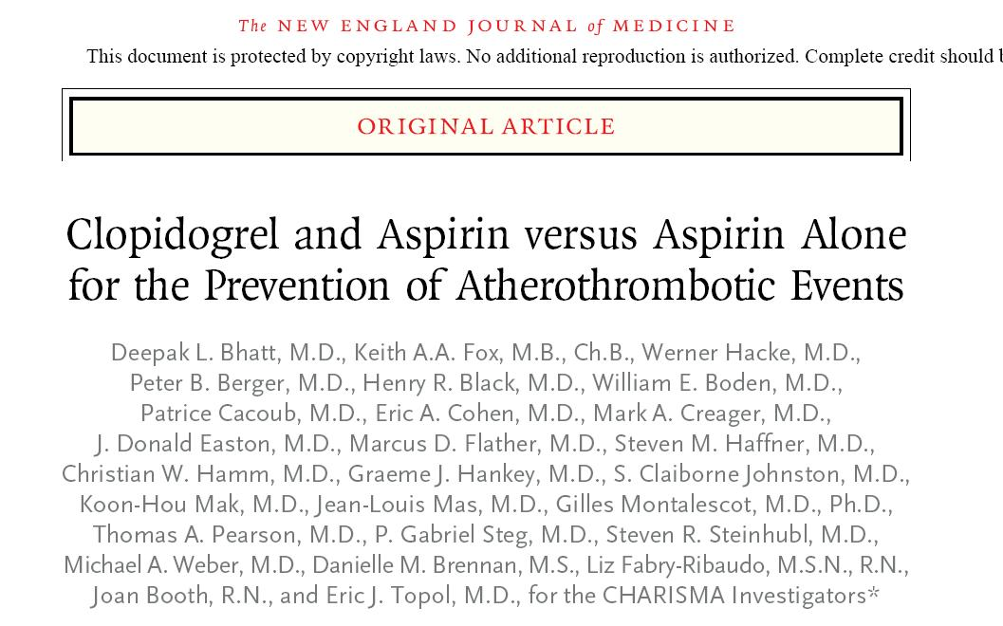
Dual antiplatelet therapy in primary prevention

Slide 22
CHARISMA
Treatment effect by inclusion criteria
Combined end point: MI, stroke, CV death
Hazard ratio
RR (95% CI)
Risk Factor Only
n=3284
1.20 (0.91–1.59)
p=0.20
Manifest
n=12,153
0.88 (0.77–0.998)
p=0.046
All patients
n=15,603
0.93 (0.83–1.05)
p=0.22
0.5
1.0
1.5
Clopidogrel
Placebo
better
better
Bhatt DL, et al. N Engl J Med 2006;354(16):1706-1717.
Notes:
22
Notes:
The CHARISMA (Clopidogrel for High Atherothrombotic Risk and Ischemic Stabilization, Management, and Avoidance) study randomized patients very similar to those in the REACH registry to receive ASA or ASA + clopidogrel. Subjects were followed for a mean duration of 28 months for vascular outcomes.
Although the overall population and the multiple risk factor patients did not demonstrate benefit on dual antiplatelet therapy, those with a history of symptomatic coronary disease, cerebral disease or PAD demonstrated a statistically significant benefit with a relative risk reduction of 0.88 (P=0.046) for the combined endpoint of MI, stroke or cardiovascular death.
Reference:
Bhatt DL, Fox KA, Hacke W, et al. Clopidogrel and aspirin versus aspirin alone for the prevention of atherothrombotic events. N Engl J Med 2006;354(16):1706-1717.

Slide 23
Antiplatelet Therapy for the Primary Prevention of Vascular Events
RECOMMENDATIONS
Working Group: Alan D. Bell, MD, CCFP and James D. Douketis, MD, FRCP

Slide 24
Antiplatelet Therapy for the Primary Prevention of Vascular Events
For men and women without evidence of manifest vascular disease, the use of ASA at any dose is not recommend for routine use to prevent ischemic vascular events (Class III, Level A).
For men and women without evidence of manifest vascular disease, the use of clopidogrel 75 mg daily plus ASA at any dose is not recommended to prevent ischemic vascular events (Class III, Level B).
In special circumstances in men and women without evidence of manifest vascular disease in whom vascular risk is considered high and bleeding risk low, ASA 75-162 mg daily may be considered (Class IIb, Level C).

Slide 25
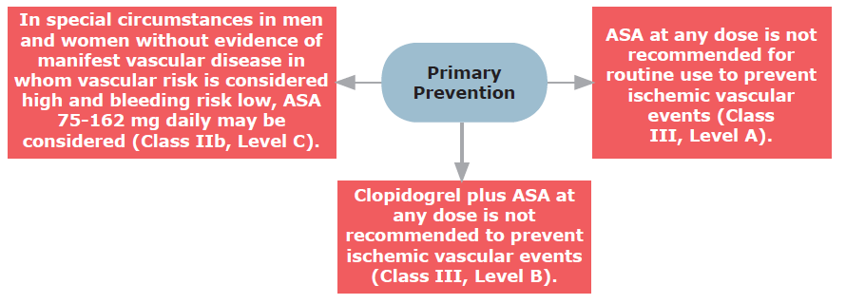
Primary prevention of vascular events

Slide 26
Alex
Alex is accompanying his wife who is seeing you in follow up for her coronary disease. Alex wants to know if he should be taking ASA to prevent a heart attack.
Alex is 65 and has never had any manifestation of vascular disease.

Slide 27
Alex
Lifestyle interventions are recommended to reduce his CV risk including:
  Regular exercise
  Low-fat, low-salt diet
  Smoking cessation (if appropriate)
  BP and lipid monitoring
  Low dose ASA is not recommended

Slide 28
“What if”
Alex has:
Bilateral carotid bruits?
Reduced Ankle Brachial Index?
Severe chronic kidney disease?

Slide 29
“What if”
Although evidence is limited, ASA may be considered for primary prevention in individuals with evidence of significant asymptomatic atherosclerosis or end stage kidney disease.

Slide 30
Primary Prevention of Vascular Events

Slide 31

Notes:
31

