Slide 1
Canadian Cardiovascular Society
Antiplatelet Guidelines
ANTIPLATELET THERAPY IN PATIENTS WITH CHRONIC KIDNEY DISEASE
Working Group: Neesh Pannu, MD, SM, FRCP; Alan D. Bell, MD, CCFP

Slide 2
Objectives
Interpret the Canadian Cardiovascular Society Guideline recommendations regarding the use antiplatelet therapy in patients with chronic kidney disease.
Appropriately use antiplatelet therapy for primary and secondary prevention in patients with CKD.
Evaluate the evidence supporting the use of antiplatelet therapy in patients with CKD.

Slide 3
Case
A 60 year hypertensive lady with long standing T2 diabetes is now on insulin.
Her medications include glucophage, insulin, ramipril, amlodipine, HCT and pravastatin.
She reports no vascular history but the physical exam reveals a carotid bruit.
Her lab work has recently deteriorated, resulting in a Creat clear of 25 ml/min.
The ECG is compatible with an old inferior infarctus.

Slide 4
Antiplatelet management
What antiplatelet therapy, if any, would you suggest?
  No antiplatelet therapy
  ASA 80 mg
  Clopidogrel 75 mg
  ASA 80 mg + Clopidogrel 75 mg

Slide 5
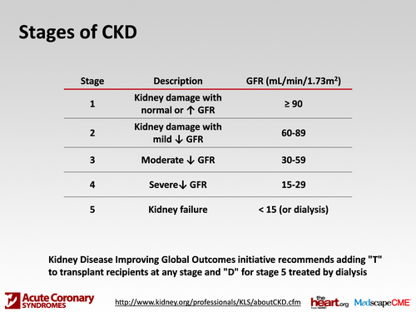
Chronic kidney disease
National Kidney Foundation practice guidelines
Levey AS et al. Ann Intern Med 2003; 139: 137-47

Slide 6
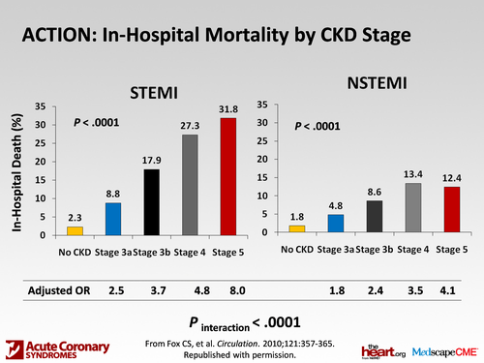
Mortality according to CKD Stage
STEMI and NSTEMI
Fox CS et al. Circulation 2010; 121: 357-65
Notes:
Background—Chronic kidney disease (CKD) is a risk factor for myocardial infarction (MI) and death. Our goal was to characterize the association between CKD severity and short-term outcomes and the use of in-hospital evidence-based therapies among patients with ST-segment elevation MI (STEMI) and non–ST-segment elevation MI (NSTEMI).
Methods and Results—The study sample was drawn from the Acute Coronary Treatment and Intervention Outcomes Network registry, a nationwide sample of STEMI (n􏰇19 029) and NSTEMI (n􏰇30 462) patients. Estimated glomerular filtration rate was calculated with the Modification of Diet in Renal Disease equation in relation to use of immediate (first 24 hours) therapies and early (first 48 hours) cardiac catheterization as well as in-hospital major bleeding events and death. Overall, 30.5% and 42.9% of patients with STEMI and NSTEMI, respectively, had CKD. Regardless of MI type, patients with progressively more severe CKD had higher rates of death. For STEMI, the odds ratio for stage 3a, 3b, 4, and 5 CKD compared with patients with no CKD was 2.49, 3.72, 4.82, and 7.97, respectively (Ptrend􏰃0.0001). For NSTEMI, the analogous odds ratios were 1.81, 2.41, 3.50, and 4.09 (P for trend 􏰃0.0001). In addition, patients with progressively more severe CKD were less likely to receive immediate evidence-based therapies including aspirin, 􏰎-blockers, or clopidogrel, were less likely to undergo any reperfusion (STEMI) or revascularization (NSTEMI), and had higher rates of bleeding.
Conclusions—Reports over the past decade have highlighted the importance of CKD among patients with MI. Data from this contemporary cohort suggest that patients with CKD still receive fewer evidence-based therapies and have substantially higher mortality rates. (Circulation. 2010;121:357-365.)
6

Slide 7
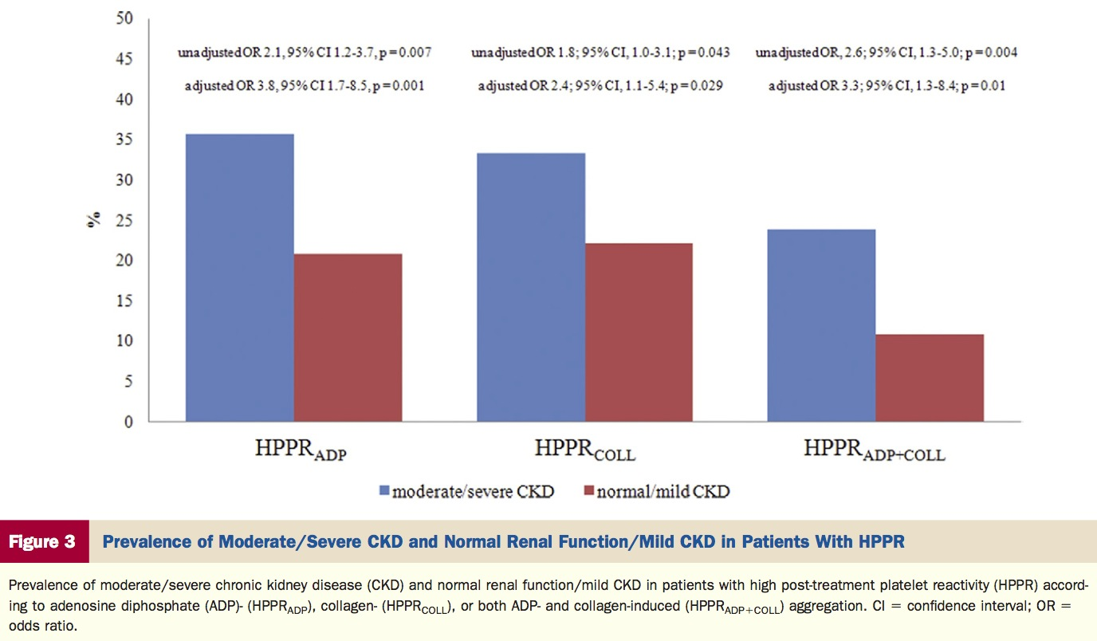
Platelet response to ASA + Clopidogrel according to CKD (306 diabetic patients with CAD)
Angiolillo DJ et al. JACC 2010; 55: 1139-46
Notes:
Objectives Background
Methods
Results
Conclusions
We sought to assess the impact of renal function on platelet reactivity in patients with diabetes mellitus (DM) and coronary artery disease on aspirin and clopidogrel therapy.
Diabetes mellitus is a key risk factor for chronic kidney disease (CKD). In aspirin-treated DM patients the presence of moderate/severe CKD is associated with reduced clinical efficacy of adjunctive clopidogrel ther- apy. Whether these findings may be attributed to differences in clopidogrel-induced effects is unknown.
This was a cross-sectional observational study in which DM patients taking maintenance aspirin and clopidogrel therapy were studied. Patients were categorized into 2 groups according to the presence or absence of moder- ate/severe CKD. Platelet aggregation after adenosine diphosphate (ADP) and collagen stimuli were assessed with light transmittance aggregometry and defined patients with high post-treatment platelet reactivity (HPPR). Markers of platelet activation, including glycoprotein IIb/IIIa activation and P-selectin expression, were also de- termined using flow cytometry.
A total of 306 DM patients were analyzed. Patients with moderate/severe CKD (n 􏰇 84) had significantly higher ADP-induced (60 􏰈 13% vs. 52 􏰈 15%, p 􏰇 0.001) and collagen-induced (49 􏰈 20% vs. 41 􏰈 20%, p 􏰇 0.004) platelet aggregation compared with those without (n 􏰇 222). After adjustment for potential confounders, pa- tients with moderate/severe CKD were more likely to have HPPR after ADP (adjusted odds ratio: 3.8, 95% confi- dence interval: 1.7 to 8.5, p 􏰇 0.001) and collagen (adjusted odds ratio: 2.4; 95% confidence interval: 1.1 to 5.4; p 􏰇 0.029) stimuli. Markers of platelet activation were significantly increased in patients with HPPR.
In DM patients with coronary artery disease taking maintenance aspirin and clopidogrel therapy, impaired renal function is associated with reduced clopidogrel-induced antiplatelet effects and a greater prevalence of HPPR. (J Am Coll Cardiol 2010;55:1139–46) © 2010 by the American College of Cardiology Foundation
7

Slide 8
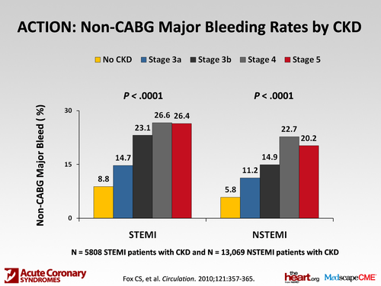
Bleeding according to CKD stage
STEMI and NSTEMI
Fox CS et al. Circulation 2010; 121: 357-65
Notes:
Background—Chronic kidney disease (CKD) is a risk factor for myocardial infarction (MI) and death. Our goal was to characterize the association between CKD severity and short-term outcomes and the use of in-hospital evidence-based therapies among patients with ST-segment elevation MI (STEMI) and non–ST-segment elevation MI (NSTEMI).
Methods and Results—The study sample was drawn from the Acute Coronary Treatment and Intervention Outcomes Network registry, a nationwide sample of STEMI (n􏰇19 029) and NSTEMI (n􏰇30 462) patients. Estimated glomerular filtration rate was calculated with the Modification of Diet in Renal Disease equation in relation to use of immediate (first 24 hours) therapies and early (first 48 hours) cardiac catheterization as well as in-hospital major bleeding events and death. Overall, 30.5% and 42.9% of patients with STEMI and NSTEMI, respectively, had CKD. Regardless of MI type, patients with progressively more severe CKD had higher rates of death. For STEMI, the odds ratio for stage 3a, 3b, 4, and 5 CKD compared with patients with no CKD was 2.49, 3.72, 4.82, and 7.97, respectively (Ptrend􏰃0.0001). For NSTEMI, the analogous odds ratios were 1.81, 2.41, 3.50, and 4.09 (P for trend 􏰃0.0001). In addition, patients with progressively more severe CKD were less likely to receive immediate evidence-based therapies including aspirin, 􏰎-blockers, or clopidogrel, were less likely to undergo any reperfusion (STEMI) or revascularization (NSTEMI), and had higher rates of bleeding.
Conclusions—Reports over the past decade have highlighted the importance of CKD among patients with MI. Data from this contemporary cohort suggest that patients with CKD still receive fewer evidence-based therapies and have substantially higher mortality rates. (Circulation. 2010;121:357-365.)
8

Slide 9
Primary prevention
Antiplatelet therapy in haemodialysis
OR 41%
ATC. BMJ 2002; 324: 71-86
Notes:
Other groups of patients at high risk of occlusive arterial disease that have been studied include haemodialysis patients having shunt or fistula replacement, patients with diabetes, patients having carotid endarterectomy, and patients with asymptomatic carotid stenosis. Studies of antiplatelet therapy among haemodialysis patients after placement of a dialysis shunt or fistula included in the previous meta-analysis1 had typically lasted only a few weeks, but several of the more recent trials assessed the effects of 12-18 months of treatment. Overall, among 2632 patients in 14 trials (compared with only 525 patients in 10 trials previously1), antiplatelet therapy produced a 41% (16%) proportional reduction in serious vascular events. Even though this result is based on only 99 vascular events among such patients, it is consistent with the benefits seen in other circumstances. Chronic renal failure is associated with impaired haemostasis, but only 46 major extracranial bleeds (27/1333 (2.0%) antiplatelet v 31/1371 (2.3%) adjusted con- trol; NS) were recorded in these trials, so the size of any bleeding hazards cannot be reliably estimated
9

Slide 10
Antiplatelet therapy
Patients with chronic kidney disease
ASA 75-162 mg daily may be considered for primary prevention of ischemic vascular events in patients with ESRD and a low risk of bleeding (Class IIb, Level C).
Notes:
10

Slide 11
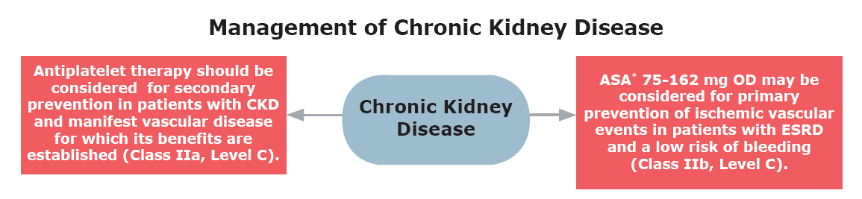

Slide 12
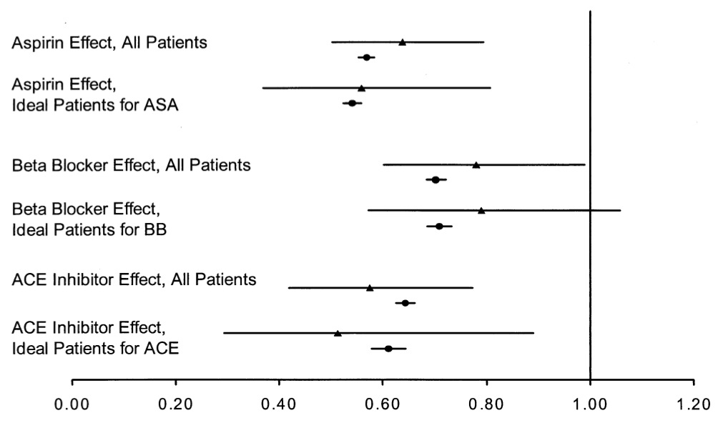
Secondary prevention: ESRD after an acute MI
ESDR
ESDR
Berger AK et al. JACC 2003; 42: 201-8
Notes:
OBJECTIVES BACKGROUND METHODS
RESULTS
CONCLUSIONS
We sought to examine the use and impact of standard medical therapies in patients with end-stage renal disease (ESRD) faced with an acute myocardial infarction (AMI). The poor prognosis of patients in this high-risk population has become increasingly well recognized.
Using the ESRD database and the Cooperative Cardiovascular Project (CCP) database, we identified AMI patients who were receiving either peritoneal dialysis or hemodialysis before admission. The early administration of aspirin and beta-blockers was compared between ESRD and non-ESRD patients and the effect of these therapies on 30-day mortality was evaluated with logistic regression models.
The cohort consisted of 145,740 patients without ESRD and 1,025 patients with ESRD. Aspirin (67.0% vs. 82.4%, p 􏰊 0.001), beta-blockers (43.2% vs. 50.8%, p 􏰊 0.001), and angiotensin-converting enzyme (ACE) inhibitors (38.5% vs. 60.3%, p 􏰊 0.001) were less likely to be administered to ESRD patients than to non-ESRD patients. The benefit of these therapies on 30-day mortality was similar among ESRD patients (aspirin: relative risk [RR] 0.64; 95% confidence interval [CI] 0.50 to 0.80; beta-blocker: RR 0.78; 95% CI 0.60 to 0.99; ACE inhibitor: RR 0.58; 95% CI 0.42 to 0.77) and non-ESRD patients (aspirin: RR 0.57; 95% CI 0.55 to 0.58; beta-blocker: RR 0.70; 95% CI 0.68 to 0.72; ACE inhibitor: RR 0.64; 95% CI 0.63 to 0.66).
End-stage renal disease patients are far less likely than non-ESRD patients to be treated with aspirin, beta-blockers, and ACE inhibitors during an admission for AMI. The lower rates of usage for these medications, particularly aspirin, may contribute to the increased 30-day mortality. These findings demonstrate a marked opportunity to improve care in this population. (J Am Coll Cardiol 2003;42:201–8) © 2003 by the American College of Cardiology Foundation
12

Slide 13
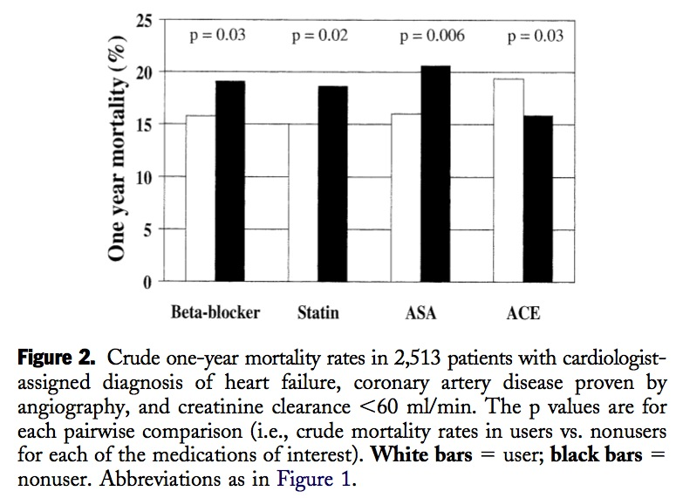
Secondary prevention: Renal insufficiency, heart failure and CAD
nonuser
user
nonuser
Ezekowitz J et al. JACC 2004; 44: 1587-92
Notes:
OBJECTIVES BACKGROUND
METHODS RESULTS
CONCLUSIONS
This study was designed to examine the use of cardiovascular medications and outcomes in patients with heart failure (HF) and renal dysfunction. Renal insufficiency is associated with poorer outcomes in patients with HF, but the mechanisms are uncertain. In particular, the degree of therapeutic nihilism in these patients, and whether it is appropriate, is unclear.
This was a prospective cohort study with a one-year follow-up. In 6,427 patients with cardiologist-diagnosed HF and angiographically proven coronary artery disease (mean age 69 years; 65% men; one-year mortality, 10%), 39% had creatinine clearances 􏰊60 ml/min. Patients with renal insufficiency were less likely to be prescribed angiotensin-converting enzyme (ACE) inhibitors, beta-blockers, statins, or aspirin (all p 􏰊 0.001). However, users of aspirin (odds ratio [OR] 0.69, 95% confidence interval [CI] 0.57 to 0.85), statins (OR 0.79, 95% CI 0.64 to 0.97), and beta-blockers (OR 0.75, 95% CI 0.62 to 0.90) were less likely to die in the subsequent 12 months than nonusers, irrespective of renal function (all OR adjusted for covariates including atherosclerotic burden and ejection fraction). Although ACE inhibitor users with creatinine clearances 􏰉60 ml/min had lower 12-month mortality (OR 0.72, 95% CI 0.48 to 0.99), ACE inhibitor users with clearances 􏰊60 ml/min did not (OR 1.21, 95% CI 0.97 to 1.51). Renal insufficiency is common in patients with HF and coronary artery disease, and these patients have more advanced coronary atherosclerosis. Patients with renal insufficiency are less likely to be prescribed efficacious therapies, but have better outcomes if they receive these medications. (J Am Coll Cardiol 2004;44:1587–92) © 2004 by the American College of Cardiology Foundation
13

Slide 14
Antiplatelet therapy
Patients with chronic kidney disease
Antiplatelet therapy should be considered for secondary prevention in patients with CKD and manifest vascular disease for which its benefits are established (Class IIa, Level C).
Notes:
14

Slide 16
Back to our case
A 60 year hypertensive lady with long standing T2 diabetes is now on insulin.
Her medications include glucophage, insulin, ramipril, amlodipine, HCT and pravastatin.
She reports no vascular history but the physical exam reveals a carotid bruit.
Her lab work has recently deteriorated, resulting in a Creat clear of 25 ml/min.
The ECG is compatible with an old inferior infarctus.

Slide 17
Antiplatelet management
What antiplatelet therapy, if any, would you suggest ?
  No antiplatelet therapy
  ASA 80 mg
  Clopidogrel 75 mg
  ASA 80 mg + Clopidogrel 75 mg

Slide 18
“What if”
ACS
Same patient comes back.
She was recently hospitalized for a ACS and underwent a coronary angioplasty along with two stents deployed.
How would that change your choice of antiplatelet therapy?

Slide 19
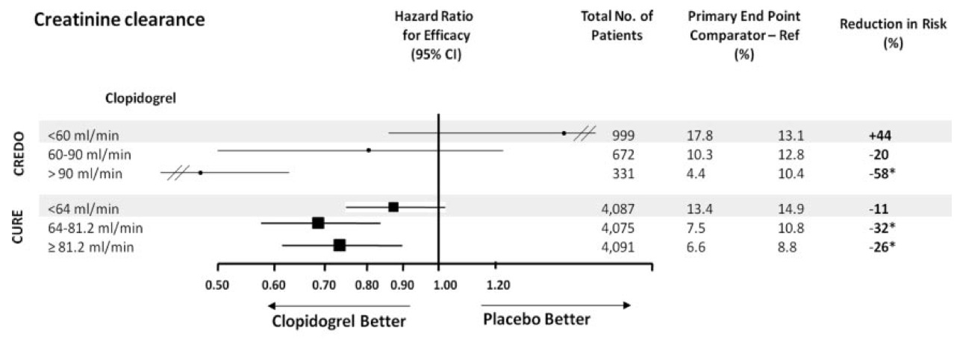
Clopidogrel in CURE and CREDO
Less effective if clearance below 60 ml/min ?
Montalescot G et al. Circulation 2010; 122: 1049-52
Notes:
Figure. Hazard ratio for efficacy (95% confidence interval) evaluated as the composite end point of cardiovascular death, myocardial infarction, or stroke, in the Clopidogrel in Unstable Angina to Prevent Recurrent Events (CURE), Clopidogrel for Reduction of Events During Observation (CREDO), TRial to assess Improvement in Therapeutic Outcomes by optimizing platelet inhibitioN with prasugre (TRITON) and PLATO trials according to renal function calculated with the Cockroft-Gault equation when not specified or the Modifica- tion of Diet in Renal Disease equation when indicated so. * indicates a significant relative risk reduction with the study criteria or a sig- nificant probability value for interaction between subgroups. NA indicates not available
The strong benefit of ticagrelor over clopidogrel in patients with CKD contrasts with the lack of effect observed with clopidogrel against placebo in similar CKD subgroups. In the Clopidogrel in Unstable Angina to Prevent Recurrent Events (CURE) study,15 and the Clopidogrel for Reduction of Events During Observation (CREDO) trial,16 clopidogrel compared with placebo reduced the composite of death, myocardial infarction, and stroke in patients with normal or subnormal renal function, but the benefit of clopidogrel was not apparent in patients with mild or moderate renal dysfunction. In the TRial to assess Improvement in Therapeutic Outcomes by optimizing platelet inhibitioN with prasugrel–Thrombolysis In Myocardial Infarction (TRITON-TIMI) 38 trial, prasugrel superiority over clopidogrel was consistent in patients with or without CKD (see Figure).
19

Slide 20
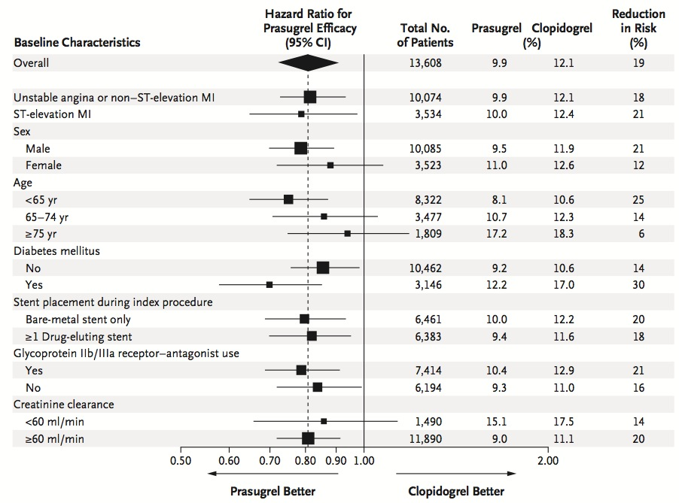
Prasugrel in TRITON- TIMI 38: Primary end point
Notes:
NEJM 2007
Background
Dual-antiplatelet therapy with aspirin and a thienopyridine is a cornerstone of treat- ment to prevent thrombotic complications of acute coronary syndromes and percu- taneous coronary intervention.
Methods
To compare prasugrel, a new thienopyridine, with clopidogrel, we randomly assigned 13,608 patients with moderate-to-high-risk acute coronary syndromes with sched- uled percutaneous coronary intervention to receive prasugrel (a 60-mg loading dose and a 10-mg daily maintenance dose) or clopidogrel (a 300-mg loading dose and a 75-mg daily maintenance dose), for 6 to 15 months. The primary efficacy end point was death from cardiovascular causes, nonfatal myocardial infarction, or nonfatal stroke. The key safety end point was major bleeding.
Results
The primary efficacy end point occurred in 12.1% of patients receiving clopidogrel and 9.9% of patients receiving prasugrel (hazard ratio for prasugrel vs. clopidogrel, 0.81; 95% confidence interval [CI], 0.73 to 0.90; P<0.001). We also found significant reductions in the prasugrel group in the rates of myocardial infarction (9.7% for clopidogrel vs. 7.4% for prasugrel; P<0.001), urgent target-vessel revascularization (3.7% vs. 2.5%; P<0.001), and stent thrombosis (2.4% vs. 1.1%; P<0.001). Major bleed- ing was observed in 2.4% of patients receiving prasugrel and in 1.8% of patients receiving clopidogrel (hazard ratio, 1.32; 95% CI, 1.03 to 1.68; P=0.03). Also great- er in the prasugrel group was the rate of life-threatening bleeding (1.4% vs. 0.9%; P = 0.01), including nonfatal bleeding (1.1% vs. 0.9%; hazard ratio, 1.25; P = 0.23) and fatal bleeding (0.4% vs. 0.1%; P=0.002).
Conclusions
In patients with acute coronary syndromes with scheduled percutaneous coronary intervention, prasugrel therapy was associated with significantly reduced rates of ischemic events, including stent thrombosis, but with an increased risk of major bleeding, including fatal bleeding. Overall mortality did not differ significantly between treatment groups.
20

Slide 21
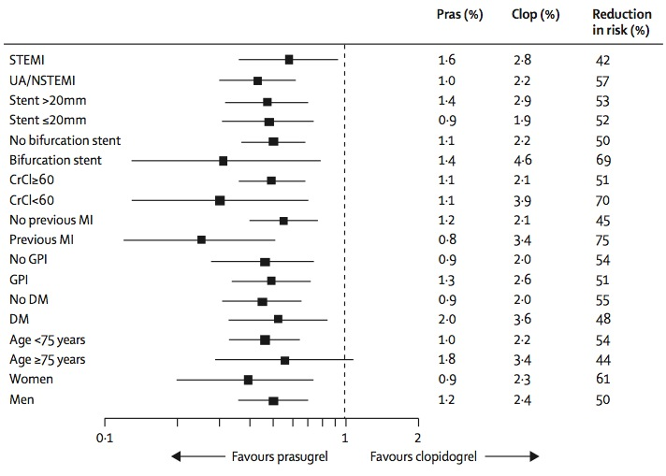
Prasugrel versus clopidogrel in TRITON- TIMI 38
Definite or probable stent thrombosis
Notes:
LANCET 2008
Summary Background Intracoronary stenting can improve procedural success and reduce restenosis compared with balloon angioplasty in patients with acute coronary syndromes, but can also increase the rate of thrombotic complications including stent thrombosis. The TRITON–TIMI 38 trial has shown that prasugrel—a novel, potent thienopyridine— can reduce ischaemic events compared with standard clopidogrel therapy. We assessed the rate, outcomes, and prevention of ischaemic events in patients treated with prasugrel or clopidogrel with stents in the TRITON–TIMI 38 study.
Methods Patients with moderate-risk to high-risk acute coronary syndromes were included in our analysis if they had received at least one coronary stent at the time of the index procedure following randomisation in TRITON-TIMI 38, and were further subdivided by type of stent received. Patients were randomly assigned in a 1 to 1 fashion to receive a loading dose of study drug (prasugrel 60 mg or clopidogrel 300 mg) as soon as possible after randomisation, followed by daily maintenance therapy (prasugrel 10 mg or clopidogrel 75 mg). All patients were to receive aspirin therapy. Treatment was to be continued for a minimum of 6 months and a maximum of 15 months. Randomisation was not stratified by stents used or stent type. The primary endpoint was the composite of cardiovascular death, non-fatal myocardial infarction, or non-fatal stroke. Stent thrombosis was assessed using Academic Research Consortium definitions, and analysis was by intention to treat. TRITON-TIMI 38 is registered with ClinicalTrials.gov, number NCT00097591.
Findings 12 844 patients received at least one coronary stent; 5743 received only drug-eluting stents, and 6461 received only bare-metal stents. Prasugrel compared with clopidogrel reduced the primary endpoint (9·7 vs 11·9%, HR 0·81, p=0·0001) in the stented cohort, in patients with only drug-eluting stents (9·0 vs 11·1%, HR 0·82, p=0·019), and in patients with only bare-metal stents (10·0 vs 12·2%, HR 0·80, p=0·003). Stent thrombosis was associated with death or myocardial infarction in 89% (186/210) of patients. Stent thrombosis was reduced with prasugrel overall (1·13 vs 2·35%, HR 0·48, p<0·0001), in patients with drug-eluting stents only (0·84 vs 2·31%, HR 0·36, p<0·0001), and in those with bare-metal stents only (1·27 vs 2·41%, HR 0·52, p=0·0009).
Interpretation Intensive antiplatelet therapy with prasugrel resulted in fewer ischaemic outcomes including stent thrombosis than with standard clopidogrel. These findings were statistically robust irrespective of stent type, and the data affirm the importance of intensive platelet inhibition in patients with intracoronary stent
21

Slide 22
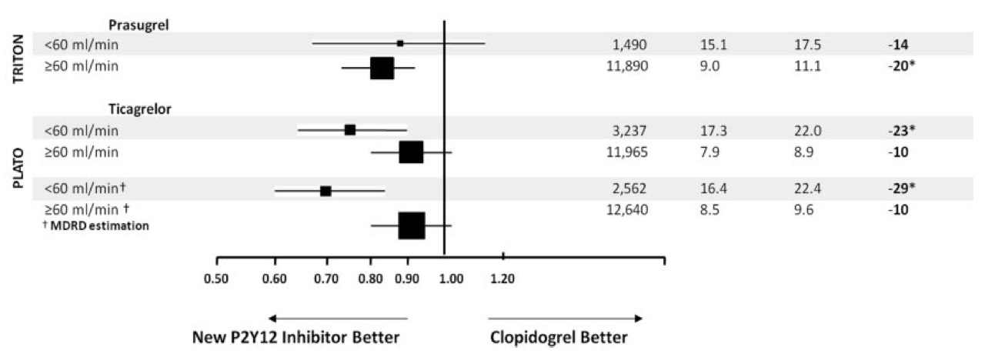
Prasugrel (TRITON-TIMI 38) et Ticagrelor (PLATO)
Primary outcome according to Creatinine clearance
Montalescot G et al. Circulation 2010; 122: 1049-52
Notes:
Figure. Hazard ratio for efficacy (95% confidence interval) evaluated as the composite end point of cardiovascular death, myocardial infarction, or stroke, in the Clopidogrel in Unstable Angina to Prevent Recurrent Events (CURE), Clopidogrel for Reduction of Events During Observation (CREDO), TRial to assess Improvement in Therapeutic Outcomes by optimizing platelet inhibitioN with prasugre (TRITON) and PLATO trials according to renal function calculated with the Cockroft-Gault equation when not specified or the Modifica- tion of Diet in Renal Disease equation when indicated so. * indicates a significant relative risk reduction with the study criteria or a sig- nificant probability value for interaction between subgroups. NA indicates not available
How should we use these results, as they are almost paradox- ical to our daily practice? CKD is usually a factor triggering more conservative approaches with less revascularization, less drugs, and utilization of lower doses. The inherent risk of bleeding in patients with CKD leads physicians to use more standard doses of clopidogrel than in patients with normal renal function. The present analysis suggests the opposite and favors the use of stronger antiplatelet therapy with ticagrelor in patients with CKD in order to reduce mortality and ischemic events at the price of a slight excess of bleeding, especially when considering spontaneous non-CABG bleed- ing. Interestingly, the excess of non-CABG bleeding appears to be more important with the maintenance dose than with the loading dose, as the Kaplan-Meier curves seem to diverge 3 weeks after randomization.
22

Slide 23
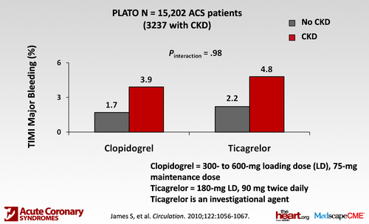
Ticagrelor (PLATO) and non-CABG TIMI major bleeding according to CKD status
James S et al. Circulation 2010; 122: 1056-67
Notes:
Background—Reduced renal function is associated with a poorer prognosis and increased bleeding risk in patients with acute coronary syndromes and may therefore alter the risk-benefit ratio with antiplatelet therapies. In the Platelet Inhibition and Patient Outcomes (PLATO) trial, ticagrelor compared with clopidogrel reduced the primary composite end point of cardiovascular death, myocardial infarction, and stroke at 12 months but with similar major bleeding rates.
Methods and Results—Central laboratory serum creatinine levels were available in 15 202 (81.9%) acute coronary syndrome patients at baseline, and creatinine clearance, estimated by the Cockcroft Gault equation, was calculated. In patients with chronic kidney disease (creatinine clearance 􏰃60 mL/min; n􏰇3237), ticagrelor versus clopidogrel significantly reduced the primary end point to 17.3% from 22.0% (hazard ratio [HR], 0.77; 95% confidence interval [CI], 0.65 to 0.90) with an absolute risk reduction greater than that of patients with normal renal function (n􏰇11 965): 7.9% versus 8.9% (HR, 0.90; 95% CI, 0.79 to 1.02). In patients with chronic kidney disease, ticagrelor reduced total mortality (10.0% versus 14.0%; HR, 0.72; 95% CI, 0.58 to 0.89). Major bleeding rates, fatal bleedings, and non– coronary bypass–related major bleedings were not significantly different between the 2 randomized groups (15.1% versus 14.3%; HR, 1.07; 95% CI, 0.88 to 1.30; 0.34% versus 0.77%; HR, 0.48; 95% CI, 0.15 to 1.54; and 8.5% versus 7.3%; HR, 1.28; 95% CI, 0.97 to 1.68). The interactions between creatinine clearance and randomized treatment on any of the outcome variables were nonsignificant.
Conclusions—In acute coronary syndrome patients with chronic kidney disease, ticagrelor compared with clopidogrel significantly reduces ischemic end points and mortality without a significant increase in major bleeding but with numerically more non–procedure-related bleeding.
Conclusions
Among patients with ACS, any degree of impairment of renal function is associated with a worse prognosis and an increased bleeding risk. The present results provide clini- cal evidence that ticagrelor is a more effective antiplatelet agent than clopidogrel in patients with ACS, regardless of renal function, and that the benefits are larger at poor renal function and without any need for dose reduction to prevent major bleeding. The advantage of ticagrelor over clopidogrel in reducing major adverse cardiac events is accentuated in cohorts with successively increasing renal
dysfunction. Given the high prevalence of renal dysfunc- tion among patients with atherosclerotic disease and the associated elevated risk of ischemic and bleeding compli- cations, ticagrelor provides an important opportunity to substantially improve outcome in patients with ACS and impaired renal function.
23

Slide 24
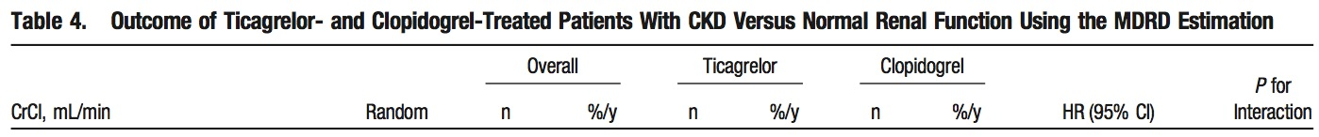
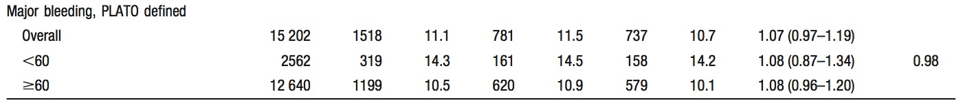
Ticagrelor (PLATO) and PLATO defined major bleeding according to CKD status
James S et al. Circulation 2010; 122: 1056-67
Notes:
Background—Reduced renal function is associated with a poorer prognosis and increased bleeding risk in patients with acute coronary syndromes and may therefore alter the risk-benefit ratio with antiplatelet therapies. In the Platelet Inhibition and Patient Outcomes (PLATO) trial, ticagrelor compared with clopidogrel reduced the primary composite end point of cardiovascular death, myocardial infarction, and stroke at 12 months but with similar major bleeding rates.
Methods and Results—Central laboratory serum creatinine levels were available in 15 202 (81.9%) acute coronary syndrome patients at baseline, and creatinine clearance, estimated by the Cockcroft Gault equation, was calculated. In patients with chronic kidney disease (creatinine clearance 􏰃60 mL/min; n􏰇3237), ticagrelor versus clopidogrel significantly reduced the primary end point to 17.3% from 22.0% (hazard ratio [HR], 0.77; 95% confidence interval [CI], 0.65 to 0.90) with an absolute risk reduction greater than that of patients with normal renal function (n􏰇11 965): 7.9% versus 8.9% (HR, 0.90; 95% CI, 0.79 to 1.02). In patients with chronic kidney disease, ticagrelor reduced total mortality (10.0% versus 14.0%; HR, 0.72; 95% CI, 0.58 to 0.89). Major bleeding rates, fatal bleedings, and non– coronary bypass–related major bleedings were not significantly different between the 2 randomized groups (15.1% versus 14.3%; HR, 1.07; 95% CI, 0.88 to 1.30; 0.34% versus 0.77%; HR, 0.48; 95% CI, 0.15 to 1.54; and 8.5% versus 7.3%; HR, 1.28; 95% CI, 0.97 to 1.68). The interactions between creatinine clearance and randomized treatment on any of the outcome variables were nonsignificant.
Conclusions—In acute coronary syndrome patients with chronic kidney disease, ticagrelor compared with clopidogrel significantly reduces ischemic end points and mortality without a significant increase in major bleeding but with numerically more non–procedure-related bleeding.
Conclusions
Among patients with ACS, any degree of impairment of renal function is associated with a worse prognosis and an increased bleeding risk. The present results provide clini- cal evidence that ticagrelor is a more effective antiplatelet agent than clopidogrel in patients with ACS, regardless of renal function, and that the benefits are larger at poor renal function and without any need for dose reduction to prevent major bleeding. The advantage of ticagrelor over clopidogrel in reducing major adverse cardiac events is accentuated in cohorts with successively increasing renal
dysfunction. Given the high prevalence of renal dysfunc- tion among patients with atherosclerotic disease and the associated elevated risk of ischemic and bleeding compli- cations, ticagrelor provides an important opportunity to substantially improve outcome in patients with ACS and impaired renal function.
24

Slide 25
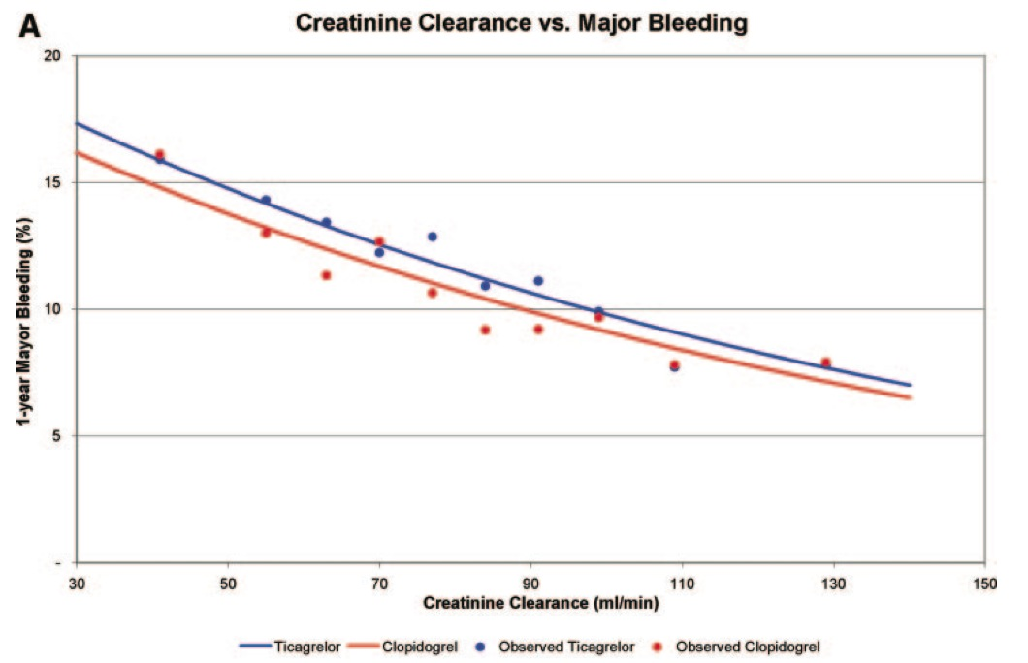
Ticagrelor (PLATO) and PLATO defined major bleeding according to creatinine clearance
James S et al. Circulation 2010; 122: 1056-67
Notes:
Background—Reduced renal function is associated with a poorer prognosis and increased bleeding risk in patients with acute coronary syndromes and may therefore alter the risk-benefit ratio with antiplatelet therapies. In the Platelet Inhibition and Patient Outcomes (PLATO) trial, ticagrelor compared with clopidogrel reduced the primary composite end point of cardiovascular death, myocardial infarction, and stroke at 12 months but with similar major bleeding rates.
Methods and Results—Central laboratory serum creatinine levels were available in 15 202 (81.9%) acute coronary syndrome patients at baseline, and creatinine clearance, estimated by the Cockcroft Gault equation, was calculated. In patients with chronic kidney disease (creatinine clearance 􏰃60 mL/min; n􏰇3237), ticagrelor versus clopidogrel significantly reduced the primary end point to 17.3% from 22.0% (hazard ratio [HR], 0.77; 95% confidence interval [CI], 0.65 to 0.90) with an absolute risk reduction greater than that of patients with normal renal function (n􏰇11 965): 7.9% versus 8.9% (HR, 0.90; 95% CI, 0.79 to 1.02). In patients with chronic kidney disease, ticagrelor reduced total mortality (10.0% versus 14.0%; HR, 0.72; 95% CI, 0.58 to 0.89). Major bleeding rates, fatal bleedings, and non– coronary bypass–related major bleedings were not significantly different between the 2 randomized groups (15.1% versus 14.3%; HR, 1.07; 95% CI, 0.88 to 1.30; 0.34% versus 0.77%; HR, 0.48; 95% CI, 0.15 to 1.54; and 8.5% versus 7.3%; HR, 1.28; 95% CI, 0.97 to 1.68). The interactions between creatinine clearance and randomized treatment on any of the outcome variables were nonsignificant.
Conclusions—In acute coronary syndrome patients with chronic kidney disease, ticagrelor compared with clopidogrel significantly reduces ischemic end points and mortality without a significant increase in major bleeding but with numerically more non–procedure-related bleeding.
Conclusions
Among patients with ACS, any degree of impairment of renal function is associated with a worse prognosis and an increased bleeding risk. The present results provide clini- cal evidence that ticagrelor is a more effective antiplatelet agent than clopidogrel in patients with ACS, regardless of renal function, and that the benefits are larger at poor renal function and without any need for dose reduction to prevent major bleeding. The advantage of ticagrelor over clopidogrel in reducing major adverse cardiac events is accentuated in cohorts with successively increasing renal
dysfunction. Given the high prevalence of renal dysfunc- tion among patients with atherosclerotic disease and the associated elevated risk of ischemic and bleeding compli- cations, ticagrelor provides an important opportunity to substantially improve outcome in patients with ACS and impaired renal function.
25

Slide 26
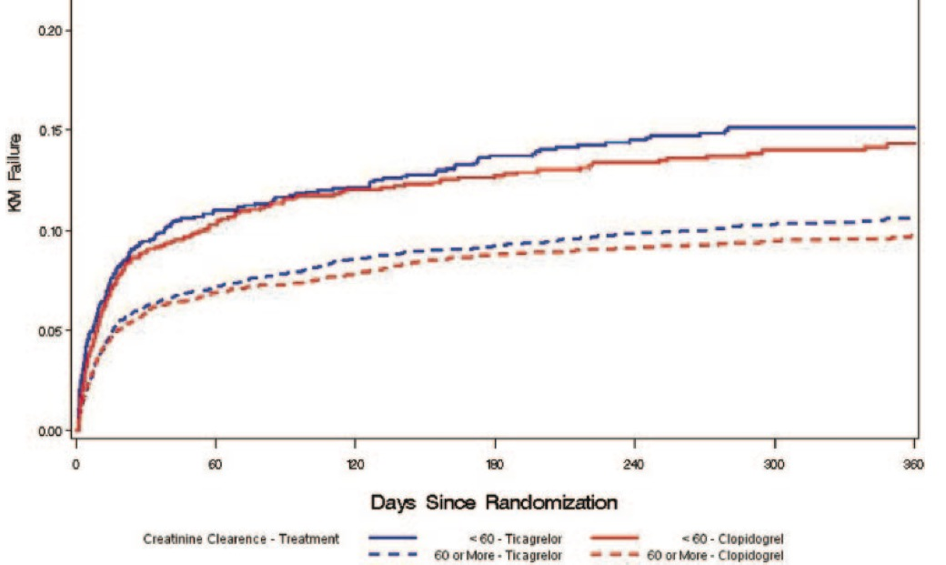
Ticagrelor (PLATO) and Non-CABG-related TIMI major bleeding
According to creatinine clearance over or under 60 ml/min
James S et al. Circulation 2010; 122: 1056-67
Notes:
Background—Reduced renal function is associated with a poorer prognosis and increased bleeding risk in patients with acute coronary syndromes and may therefore alter the risk-benefit ratio with antiplatelet therapies. In the Platelet Inhibition and Patient Outcomes (PLATO) trial, ticagrelor compared with clopidogrel reduced the primary composite end point of cardiovascular death, myocardial infarction, and stroke at 12 months but with similar major bleeding rates.
Methods and Results—Central laboratory serum creatinine levels were available in 15 202 (81.9%) acute coronary syndrome patients at baseline, and creatinine clearance, estimated by the Cockcroft Gault equation, was calculated. In patients with chronic kidney disease (creatinine clearance 􏰃60 mL/min; n􏰇3237), ticagrelor versus clopidogrel significantly reduced the primary end point to 17.3% from 22.0% (hazard ratio [HR], 0.77; 95% confidence interval [CI], 0.65 to 0.90) with an absolute risk reduction greater than that of patients with normal renal function (n􏰇11 965): 7.9% versus 8.9% (HR, 0.90; 95% CI, 0.79 to 1.02). In patients with chronic kidney disease, ticagrelor reduced total mortality (10.0% versus 14.0%; HR, 0.72; 95% CI, 0.58 to 0.89). Major bleeding rates, fatal bleedings, and non– coronary bypass–related major bleedings were not significantly different between the 2 randomized groups (15.1% versus 14.3%; HR, 1.07; 95% CI, 0.88 to 1.30; 0.34% versus 0.77%; HR, 0.48; 95% CI, 0.15 to 1.54; and 8.5% versus 7.3%; HR, 1.28; 95% CI, 0.97 to 1.68). The interactions between creatinine clearance and randomized treatment on any of the outcome variables were nonsignificant.
Conclusions—In acute coronary syndrome patients with chronic kidney disease, ticagrelor compared with clopidogrel significantly reduces ischemic end points and mortality without a significant increase in major bleeding but with numerically more non–procedure-related bleeding.
Conclusions
Among patients with ACS, any degree of impairment of renal function is associated with a worse prognosis and an increased bleeding risk. The present results provide clini- cal evidence that ticagrelor is a more effective antiplatelet agent than clopidogrel in patients with ACS, regardless of renal function, and that the benefits are larger at poor renal function and without any need for dose reduction to prevent major bleeding. The advantage of ticagrelor over clopidogrel in reducing major adverse cardiac events is accentuated in cohorts with successively increasing renal
dysfunction. Given the high prevalence of renal dysfunc- tion among patients with atherosclerotic disease and the associated elevated risk of ischemic and bleeding compli- cations, ticagrelor provides an important opportunity to substantially improve outcome in patients with ACS and impaired renal function.
26

Slide 27
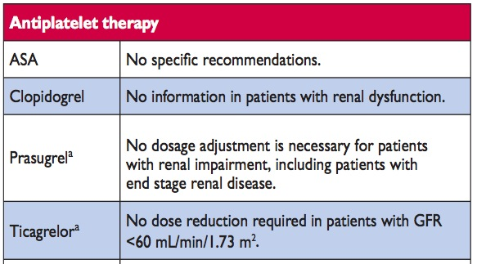
Guidelines on myocardial revascularization
European Society of Cardiology (ESC)
Antiplatelet therapy in CKD
Wijns W et al. EHJ 2010; 31: 2501-55

Slide 28
Antiplatelet therapy
Patients with chronic kidney disease
Antiplatelet therapy should be considered for secondary prevention in patients with CKD and manifest vascular disease for which its benefits are established (Class IIa, Level C).
Notes:
28

Slide 29

Notes:
29

