Slide 1
Disclaimer
The Canadian Cardiovascular Society (CCS) welcomes reuse of our educational slide deck for medical institution internal education or training (i.e. grand rounds, medical college/classroom education, etc.). However, if the material is being used in an industry sponsored CME program, permission must be sought through our publisher Elsevier (www.onlinecjc.com).
If your reuse request qualifies as medical institution internal education, you may reuse the material under the following conditions:
  You must cite the Canadian Journal of Cardiology and the Canadian Cardiovascular Society as references.
  You may not use any Canadian Cardiovascular Society logos or trademarks on any slides or anywhere in your presentation or publications.
  Do not modify the slide content.
  If repeating recommendations from the published guideline, do not modify the recommendation wording.

Slide 2
CCS 2016 Guideline Update:
Atrial Fibrillation

Slide 3
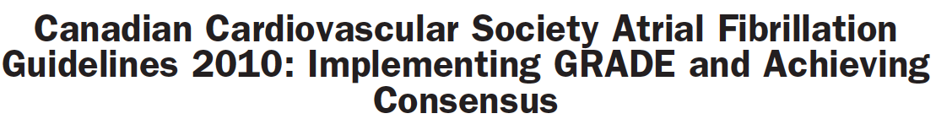
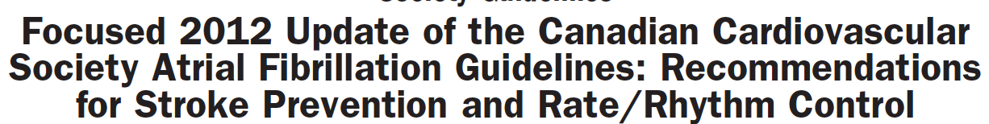
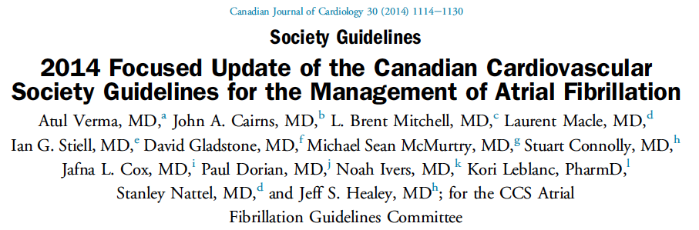
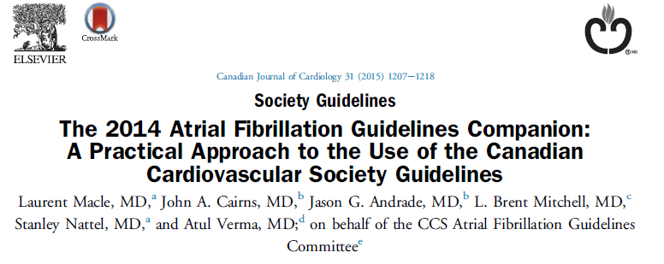
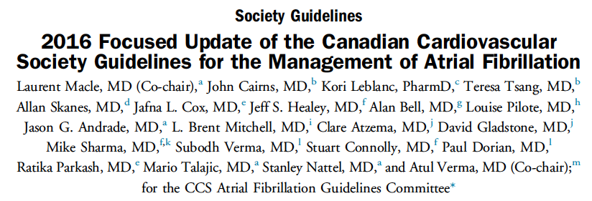
Gillis et al. Canadian Journal of Cardiology 2011;27:27-30
Skanes et al. Canadian Journal of Cardiology 2012;28:125-36
Verma et al. Canadian Journal of Cardiology 2014;30:1114-30
Macle et al. Canadian Journal of Cardiology 2015;31:1207-18
Macle et al. Canadian Journal of Cardiology 2016;32:1170-85
Notes:
The Canadian Cardiovascular Society (CCS) Atrial Fibrillation (AF) Guidelines committee provides periodic reviews of new data to produce focused updates that address clinically-important advances in AF management.

Slide 4
Content
I. Management of Antithrombotic Therapy in Patients with Concomitant AF and CAD
II. Real Life Data with NOACs
III. Reversal Agents for NOACs
IV. Periprocedural Anticoagulation Management
V. Digoxin and Mortality
VI. Surgical Therapy for AF
VII. Prevention and Treatment of AF after Cardiac Surgery
Notes:
This 2016 Focused Update deals with: 1) the management of antithrombotic therapy for AF patients in the context of the various clinical presentations of coronary artery disease (CAD); 2) real-life data with non-vitamin K antagonist oral anticoagulants (NOACs); 3) the use of antidotes for the reversal of NOACs; 4) digoxin as a rate-control agent; 5) perioperative anticoagulation management; and, 6) AF surgical therapy including the prevention and treatment of AF following cardiac surgery.
The section on concomitant AF and CAD was developed in collaboration with the CCS antiplatelet (APT) guidelines committee (a member of the 2010 and 2012 consensus panels and the actual co-chairs of the committee, both of them interventional cardiologists),

Slide 5
Methodology:
Grading of Recommendations Assessment, Development and Evaluation (GRADE)
Strength of a Recommendation:
  Quality of evidence: The higher the quality of evidence, the greater the probability that a strong recommendation is indicated
  Difference between desirable and undesirable effects: The greater the difference between desirable and undesirable effects, the greater the probability that a strong recommendation is indicated
  Values and preferences: The greater the variation or uncertainty in values and preferences, the higher the probability that a conditional recommendation is indicated
  Cost: The higher the cost, the lower the likelihood that a strong recommendation is indicated
  Quality of Evidence:
  High: Further research is very unlikely to change our confidence in the estimate of effect
  Moderate: Further research is likely to have an important impact on our confidence in the estimate of effect and may change the estimate
  Low: Further research is very likely to have an important impact on our confidence in the estimate of effect and is likely to change the estimate
  Very Low: Any estimate of effect is very uncertain
For more information on the GRADE process and development of recommendations visit www.ccs.ca.
Notes:
The recommendations were developed with the same methodology used for the initial 2010 guidelines and the 2012 and 2014 Focused Updates.
Using the (GRADE) standards, individual studies and literature were reviewed for quality and bias; the literature review process and evidence tables are included as a Supplement, and on the CCS website.

Slide 6
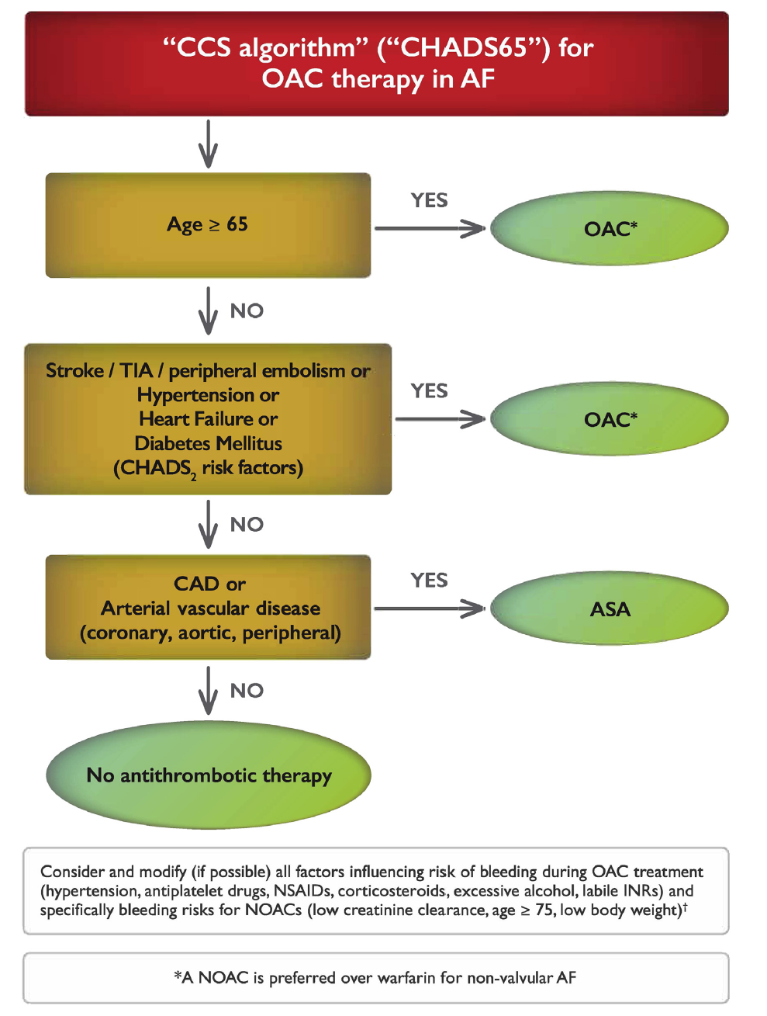
A NOAC is preferred over warfarin for non-valvular AF.
Notes:
Current CCS AF guidelines recommend that AF patients be stratified using the “CCS algorithm” (“CHADS-65”)
The definitions of the CCS algorithm stroke risk factors are provided in Online Supplement, Part 6, Table S5.⁵
In general, oral anticoagulation therapy (OAC) is recommended for all patients with AF except those <65 years old with CHADS₂ score=0. In the latter group, ASA is recommended in patients with CAD/vascular disease, and there is no indication for antithrombotic treatment in the absence of CAD/vascular disease.
When OAC is indicated, a NOAC is recommended in preference to a Vitamin K antagonist (VKA) for non-valvular AF (NVAF).
The use of NOACs is contraindicated in the presence of mechanical heart valves, rheumatic mitral stenosis or moderate and severe non-rheumatic mitral stenosis (Online Supplement, Part 6, Table S6).

Slide 7
Agenda for the Workshop
I. Management of Antithrombotic Therapy in Patients with Concomitant AF and CAD
II. Real Life Data with NOACs
III. Reversal Agents for NOACs
IV. Periprocedural Anticoagulation Management
V. Digoxin and Mortality
VI. Surgical Therapy for AF
VII. Prevention and Treatment of AF after Cardiac Surgery
Notes:
This 2016 Focused Update deals with: 1) the management of antithrombotic therapy for AF patients in the context of the various clinical presentations of coronary artery disease (CAD); 2) real-life data with non-vitamin K antagonist oral anticoagulants (NOACs); 3) the use of antidotes for the reversal of NOACs; 4) digoxin as a rate-control agent; 5) perioperative anticoagulation management; and, 6) AF surgical therapy including the prevention and treatment of AF following cardiac surgery.

Slide 8
Concomitant AF and CAD

Slide 9

Dr HR – Age 54
Stable angina CCS II
DM controlled on diet, hypertension
(metoprolol 100 mg bid mg and HCT 25
mg qam). ASA 81 mg/da

Slide 10
Dr HR – Age 54
Stable angina CCS II
DM controlled on diet, hypertension
(metoprolol 100 mg bid mg and HCT 25
mg qam). ASA 81 mg/da
She develops NVAF, resting HR 80, rising to 90 with brisk walking
Risk of stroke about 4%/yr (CHADS₂ = 2)

Slide 11
Question: Dr HR – Management
What antithrombotic regimen would you prescribe?
ASA 81 mg/da (no change)
ASA 81 mg/da + Warfarin INR 2-3
Warfarin INR 2-3
(ASA 81 mg + Clop 75 mg)/da
Apixaban 5 mg bid
Apixaban 5mg bid + ASA 81 mg/da

Slide 12
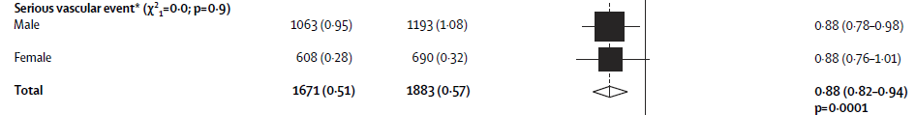
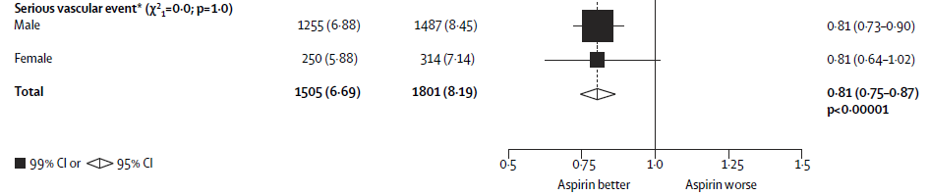
ASA Control RR: ASA/control
6 Primary Prevention Trials 660,000 patient years
Prevention of Serious vascular Events (MI, stroke, vascular death) in
Primary and Secondary Prevention Trials of ASA vs Control
ATT Collaboration. Lancet 2009;373:1849

Slide 13
ASA Control RR: ASA/control
6 Primary Prevention Trials 660,000 patient years
ARR 0.06%/yr 6 events/10,000/yr
16 Secondary Prevention Trials 43,000 patient years
ARR 1.5%/yr 150 events/10,000/yr
Prevention of Serious vascular Events (MI, stroke, vascular death) in
Primary and Secondary Prevention Trials of ASA vs Control

Slide 15
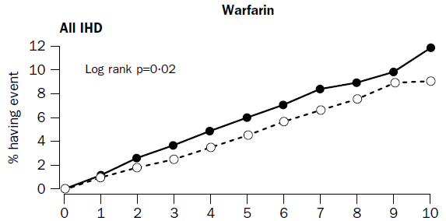

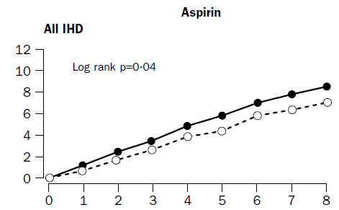

Primary Prevention: Warfarin vs ASA
MRC Thrombosis Prevention Trial (Low intensity Warf, ASA, both or neither)
For Primary Prevention in High Risk Males
MRC TPT. Lancet 1998;351:233

Slide 16
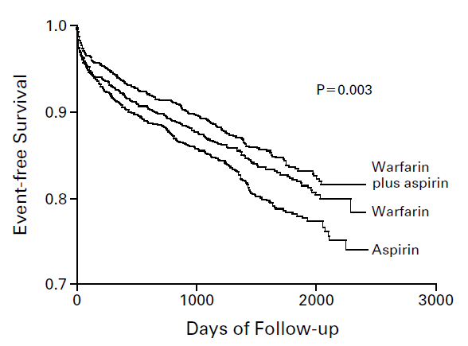
WARIS 2 Trial
3630 Post MI Patients
Warf vs ASA
Vascular events
RR = 0.71, P < 0.001
Non-fatal major bleed
RR = 4, P < 0.05
INR 2.8-4.2
150 mg/da
WARIS-2. Hurlen M. NEJM 2002;347:969

Slide 17
NOAC preferred over Warfarin because of:
Convenience and ease of use for patients and physicians
B. All NOACs are at least as effective and as safe as Warfarin
-some have greater efficacy for stroke/systemic embolus and mortality
-some have greater safety for major bleeding
Warfarin indicated over NOAC for patients with:
Mechanical prosthetic valves
Rheumatic MS
Severe renal dysfunction

Slide 18
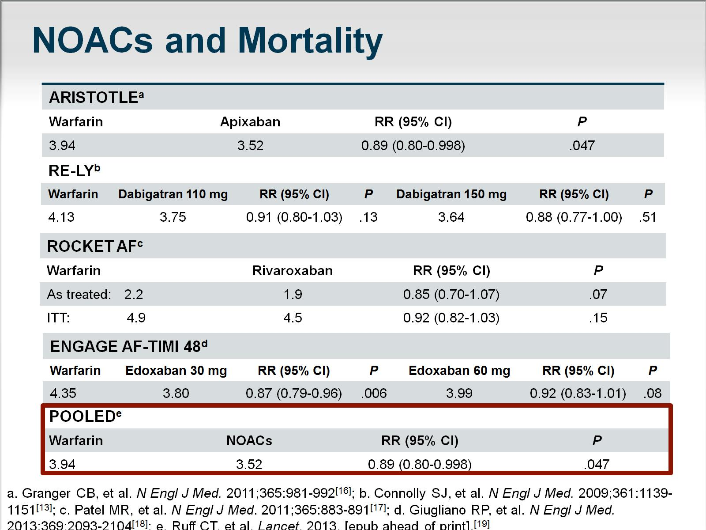

Slide 19
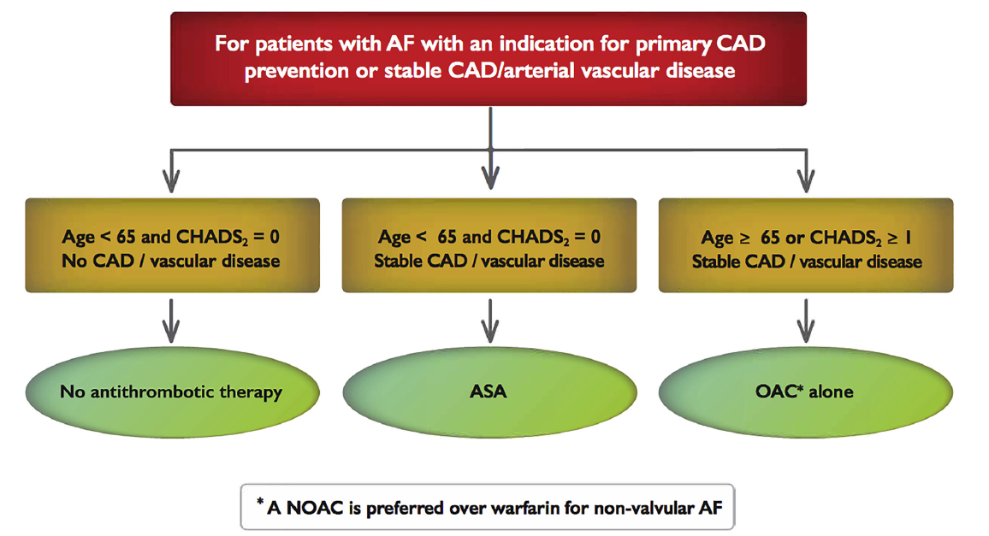
†
† Primary CAD prevention with ASA may be considered in
selected high-risk patients

Slide 20
Dr HR
†
† Primary CAD prevention with ASA may be considered in
selected high-risk patients

Slide 21
Dr HR – Management
What antithrombotic regimen would you prescribe?
ASA 81 mg/da (no change)
ASA 81 mg/da + Warfarin INR 2-3
Warfarin INR 2-3
(ASA 81 mg + Clop 75 mg)/da
Apixaban 5 mg bid
Apixaban 5mg bid + ASA 81 mg/da

Slide 22
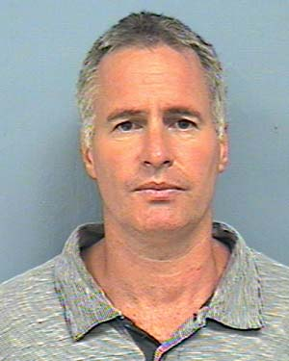
Mr ME – Age 48
AF onset 2 yr ago. He has DM controlled on diet and hypertension managed with metoprolol 100 mg bid mg and HCT 25 mg qam. CHADS₂ = 2, Annual stroke risk 4%. On warfarin, INR well-controlled 2-3.
6 mo ago he began to have exertional angina. Despite adding diltiazem 360 mg he continues to have CCS class 2-3 angina and is very dissatisfied.
Angio shows 85% proximal LAD stenosis, no additional stenoses.
Together you decide to place a stent for relief of angina.

Slide 23
Question: Mr ME – Management
What would be your post PCI antithrombotic regimen?
Warfarin INR 2-3 + ASA 81 mg
Warfarin INR 2-3 + Clop 75 mg
Warfarin INR 2-3 + ASA 81 mg + Clop 75 mg
ASA 81 mg + Clop 75 mg

Slide 24
Mr ME – Management For the prevention of CAD events post PCI (elective):
1. DAPT (ASA + clopidogrel) is superior
to ASA (HR ~ 0.75)
CREDO Steinhubl SR. JAMA 2002;288:2411
2. DAPT (ASA + ticlopidine) is superior
to ASA + VKA (HR ~ 0.25)
ISAR Schomig A. NEJM 1996;334:1084
STARS Leon MB. NEJM 1998;339:1665

Slide 25
Clopidogrel + Aspirin vs. Oral Anticoagulant (OAC)
All Stroke
RR=1.72(1.24-2.37), P=0.001
2.39%/yr
42% RRR by OAC
1.40%/yr
Clopidogrel+aspirin
OAC
ACTIVE-W
Lancet 2006;367:1903

Slide 26
1. DAPT required for prevention of CAD events
CREDO – DAPT superior to ASA
STARS and ISAR – DAPT superior to VKA + ASA
2. DAPT much less effective than OAC for stroke prevention (ACTIVE-W , RR = 1.72)
3. Hence a rationale for DAPT + OAC (triple therapy)
For the prevention of both Stroke in NVAF and CAD events post elective PCI:

Slide 27
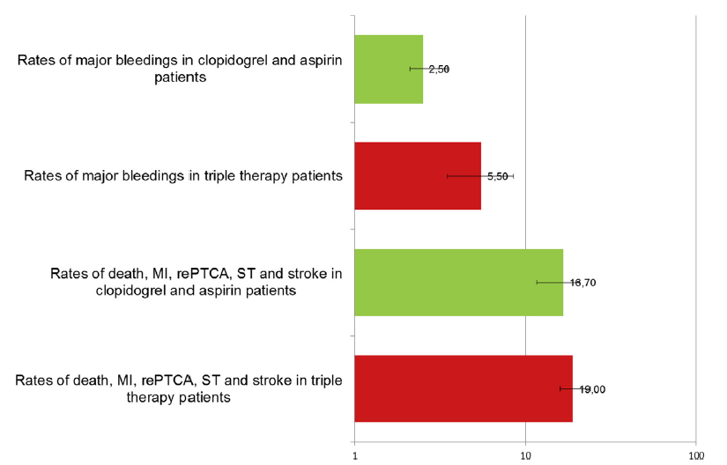
Rates of Major Bleeding
DAPT
DAPT
Triple Therapy
OR 0.51, P < 0.00001
%/yr
Semi-log
DAPT vs Triple Therapy (TT)
Meta-analysis (8 Observational and 1 small RCT)
D’Ascenzo F. Am J Cardiol 2015;115:1185

Slide 28
Rates of Major Bleeding
DAPT
DAPT
Triple Therapy
OR 0.51, P < 0.00001
Rates of Death, MI, rePTCA, ST, Stroke
DAPT
DAPT
Triple Therapy
OR 0.71, P = 0.11
%/yr
Semi-log
DAPT vs TT Meta-analysis (8 Observational and 1 small RCT)
D’Ascenzo F. Am J Cardiol 2015;115:1185

Slide 29
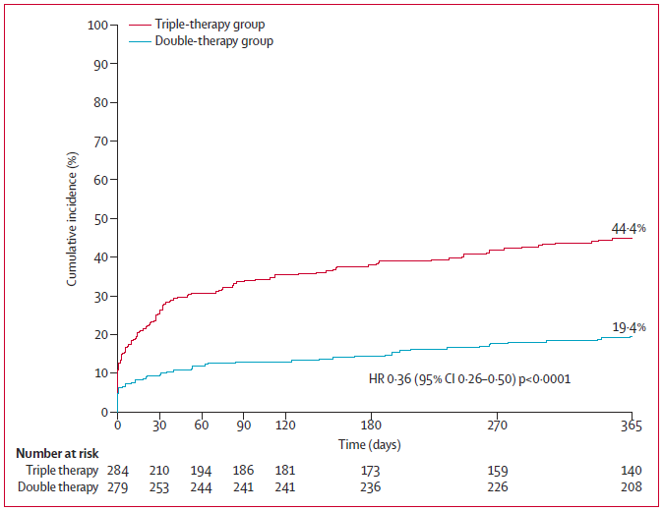
WOEST Trial
573 Long-term Warfarin patients (69 % with AF)
RCT: TT vs Warf/clopidogrel for 1 year post elective PCI (65% DES)
Any Bleeding
HR 0.36, P < 0.0001
Dewilde WJM. Lancet 2013

Slide 30
WOEST Trial
573 Long-term Warfarin patients (69 % with AF)
RCT: TT vs Warf/clopidogrel for 1 year post elective PCI (65% DES)
Any Bleeding
BARC 2 or 3 HR 0.40, P < 0.0001
Transfusion OR 0.39, P = 0.011
Dewilde WJM. Lancet 2013

Slide 31
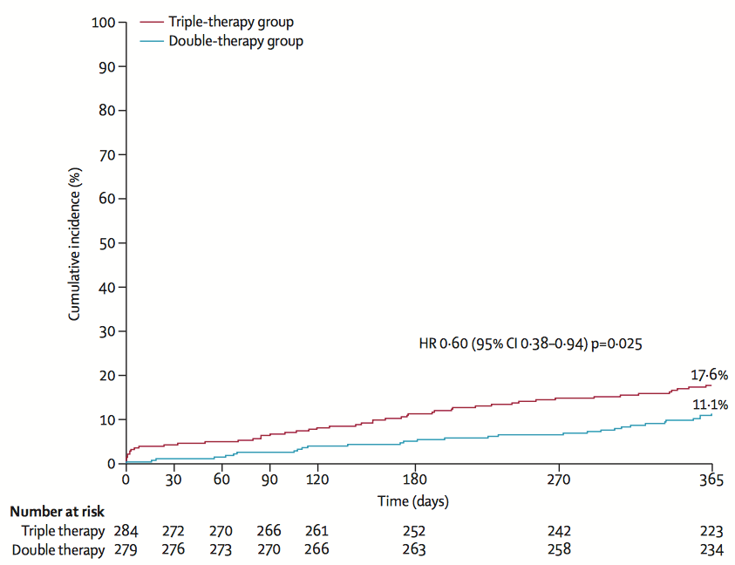
WOEST Trial
573 Long-term Warfarin patients (69 % with AF)
RCT: TT vs Warf/clopidogrel for 1 year post elective PCI (65% DES)
Death, MI, Stroke, TVR, ST
HR 0.60, P = 0.025
Dewilde WJM. Lancet 2013
Notes:
I changed the image -

Slide 32
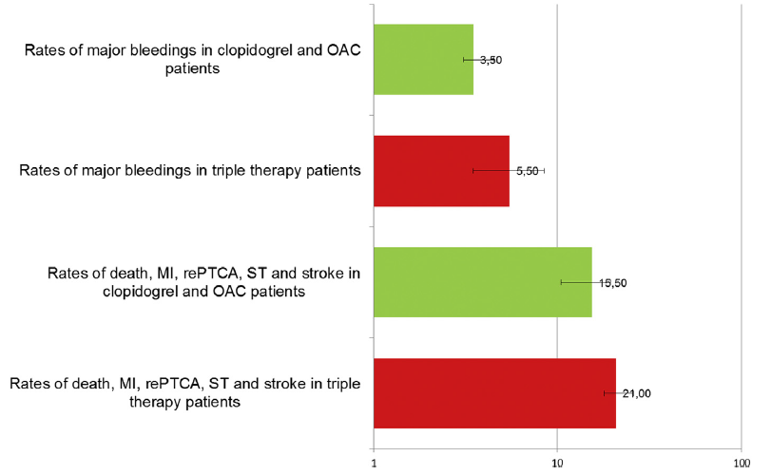
Rates of Major Bleeding
Clopidogrel
+ OAC
Triple Therapy
OR 0.77, P = 0.04
Rates of Death, MI, rePTCA, ST, Stroke
Clopidogrel
+ OAC
Triple Therapy
OR 0.90, P = 0.43
%/yr
Semi-log
Clopidogrel + OAC vs TT Meta-analysis
(1 RCT (WOEST) + 5 Observational)
D’Ascenzo F. Am J Cardiol 2015;115:1185

Slide 33
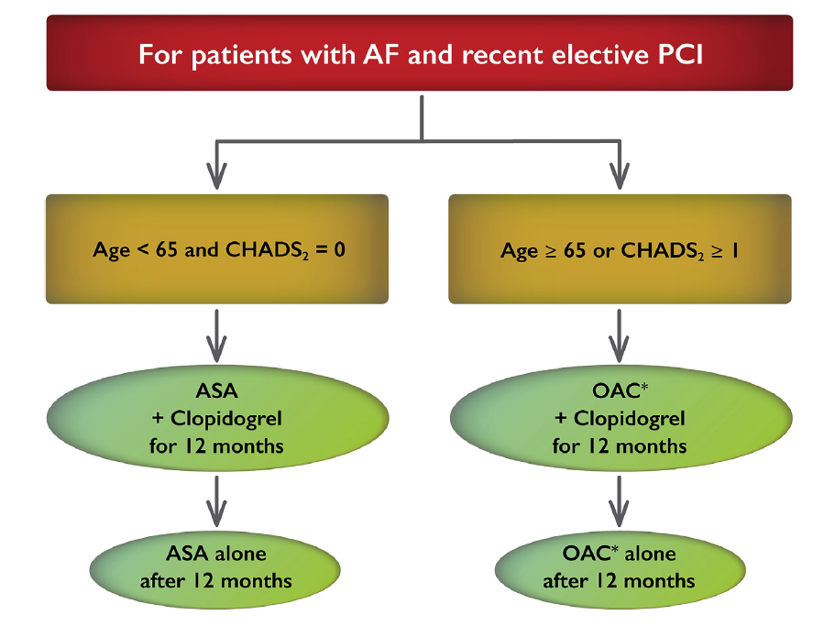

Slide 34
Mr ME

Slide 35
Shorter vs Longer duration DAPT
ASA + Clopidogrel
DAPT. Mauri L. NEJM 2014;371:2155–66.
DAPT 12-30 mo: less MI and ST, but more bleeding and death
Overviews of shorter vs longer
Naverese EP. BMJ 2015;350:h1618
Palmerinini. Lancet 2015;385:2371
Longer: less MI and ST, but more major bleeding
and possibly more death
Therefore individualize and try to balance risk of
thrombotic events and risk of bleeding

Slide 36
BMS vs DES and 1st vs 2nd generation DES
DAPT. Mauri L. NEJM 2014;371:2155–66.
ST and MI by 33 mo much less with DES than BMS
2. Recent trials of 2nd generation DES
Meta-analysis of everolimus eluting stents vs BMS
Valmigli M. BMJ 2014;349:g6427.
Duration of DAPT < 1 yr in most and as short as 3 mo.
All coronary events, including MI and ST were less frequent with DES

Slide 37
Mr ME
Practical tip: High risk of stent thrombosis and acceptable major bleeding risk may continue
(Clopidogrel + ASA) or (Clopidogrel + OAC) for more than 12 months.
Particularly high risk of major bleed may have (Clopidogrel + ASA) or (Clopidgrel + OAC )
converted to ASA alone or OAC alone after < 12 months.

Slide 38
Mr ME – Management
The PCI was undertaken without stopping warfarin (INR 2.3)
2 hr pre PCI: clopidogrel 600 mg
Radial access
UFH iv during procedure (ACT)
DES - Zotarolimus (Endeavor ZES)
DC on Warfarin INR 2-3 + clopidogrel 75 mg
At 6 months switch to Warfarin only, INR 2-3
Pantoprazole 40 mg daily

Slide 39
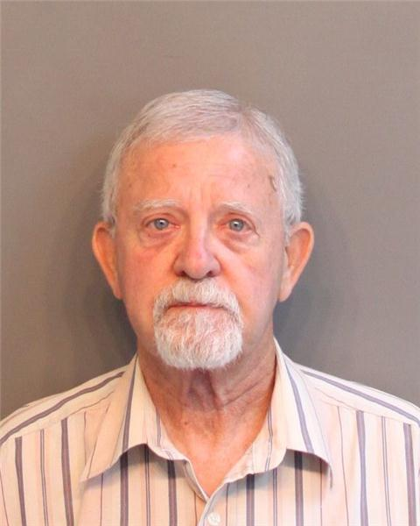
Mr DB – Age 70
T2DM, mild Hypertension, no stroke/TIA or CAD
3 mo ago experienced STEMI and had PPCI of occluded RCA and 48 hr later, PCI of 70% prox LAD stenosis with zoterolimus stents.
Home on metoprolol, ramipril, simvastatin, ASA 81 mg and Ticagrelor 90 mg bid

Slide 40
Mr DB – Age 70
T2DM, mild Hypertension, no stroke/TIA or CAD
3 mo ago experienced STEMI and had PPCI of occluded RCA and 48 hr later, PCI of 70% prox LAD stenosis with zoterolimus stents.
Home on metoprolol, ramipril, simvastatin, ASA 81 mg and Ticagrelor 90 mg bid
6 wk later, sent to you with new AF, HR 80 at rest, no CHF (3 mo post MI). CHADS₂ = 2

Slide 41
Question: Mr DB – Management
What would be your antithrombotic regimen to prevent stroke?
Continue ASA 81 mg + Ticagrelor 90 mg bid
Warfarin INR 2.0 – 3.0 + ASA + Ticagrelor
Warfarin INR 2.0 – 3.0 + ASA + clopidogrel
Warfarin INR 2.0 – 3.0 + ticagrelor 60 mg bid
Rivaroxaban 15 mg + ASA + Ticagrelor
Rivaroxaban 15 mg + ASA + clopidogrel 75 mg
Rivaroxaban 15 mg + ticagrelor 60 mg bid

Slide 42
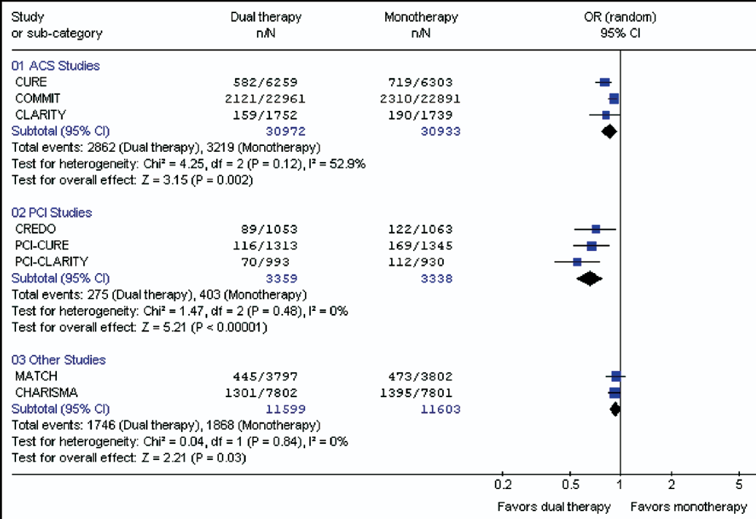
(UA/STEMI)
(STEMI)
(STEMI)
0.85 (0.77, 0.94)
Clopidogrel + ASA vs ASA alone
(death, MI, stroke)
Bowry ADK. Am J Cardiol 2008;101:960

Slide 43
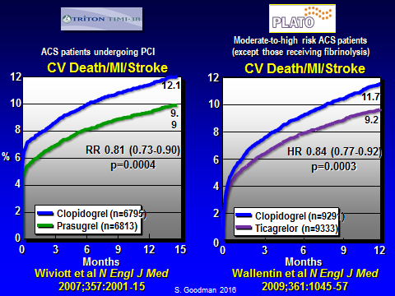

Slide 44
Clopidogrel + Aspirin vs. Oral Anticoagulant (OAC)
All Stroke
RR=1.72(1.24-2.37), P=0.001
2.39%/yr
42% RRR by OAC
1.40%/yr
Clopidogrel+aspirin
OAC
ACTIVE-W
Lancet 2006;367:1903

Slide 45
Rates of Major Bleeding
DAPT
DAPT
Triple Therapy
OR 0.51, P < 0.00001
Rates of Death, MI, rePTCA, ST, Stroke
DAPT
DAPT
Triple Therapy
OR 0.71, P = 0.11
%/yr
Semi-log
DAPT vs TT Meta-analysis (8 Observational and 1 small RCT)
D’Ascenzo F. Am J Cardiol 2015;115:1185

Slide 46
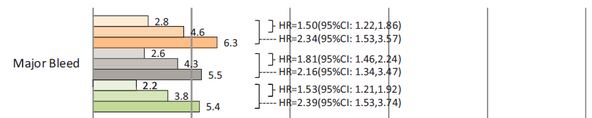
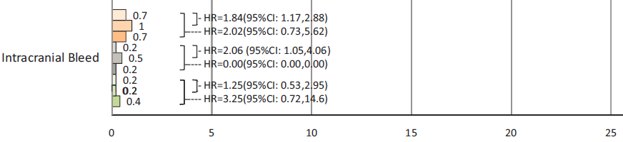
Major Warf
Bleed
D 150
D 110
I.C. Bleed
TT
TT
TT
RE-LY Study
Major and IC Bleeding with single or dual antiplatelet therapy
added to Warfarin or Dabigatran
Dans AL. Circulation 2013;127:634

Slide 47
Rates of Major Bleeding
Clopidogrel
+ OAC
Triple Therapy
OR 0.77, P = 0.04
Rates of Death, MI, rePTCA, ST, Stroke
Clopidogrel
+ OAC
Triple Therapy
OR 0.90, P = 0.43
%/yr
Semi-log
Clopidogrel + OAC vs TT Meta-analysis
(1 RCT (WOEST) + 5 Observational)
D’Ascenzo F. Am J Cardiol 2015;115:1185

Slide 48
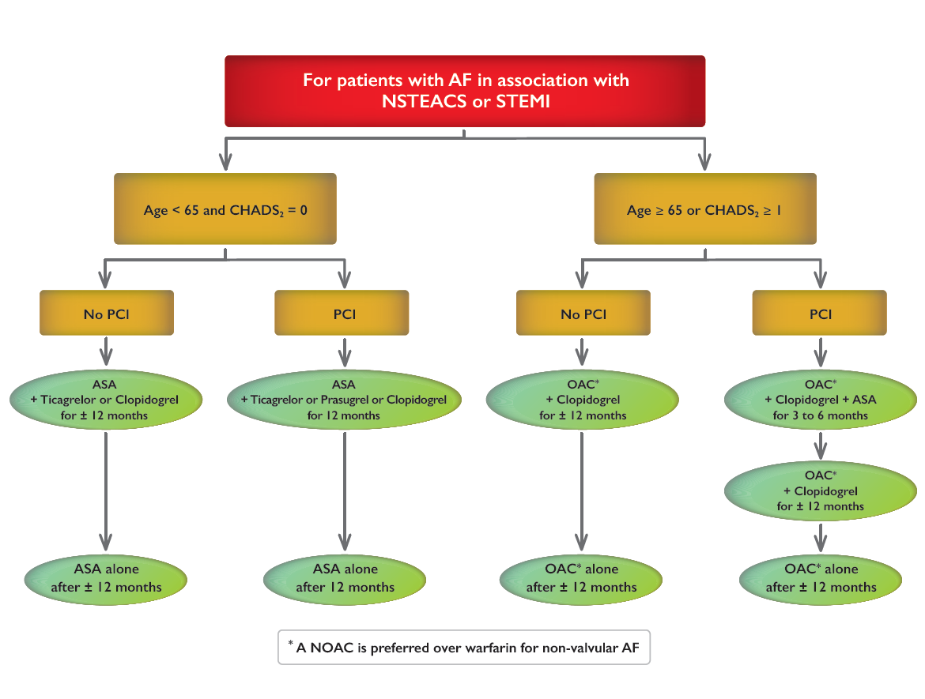

Slide 49
Mr DB

Slide 50
Employ measures to reduce bleeding
Avoid prasugrel and ticagrelor in conjunction with OAC
Target the lower end of the INR range (warfarin)
Consider the use of lower effective NOAC dose
Delay non-urgent catheterization until there is clarity about coagulation and renal status
Measures during invasive procedures
  radial access, small-diameter sheaths, early removal from femoral site and minimized use of acute procedural anti-thrombotic therapies
Consider routine proton pump inhibitor (PPI)

Slide 51
Mr DB
Practical tips: High risk of stent thrombosis and acceptable major bleeding risk may continue
(Clopidogrel + ASA) or (Clopidogrel + OAC) for more than 12 months.
Particularly high risk of major bleed may have (Clopidogrel + ASA) or (Clopidgrel + OAC )
converted to OAC alone after < 12 months.
Some clinicians may prefer clopidogrel + OAC over TT, or among patients at low end of
spectrum of CHADS₂ = 1, they may prefer ASA + ticagrelor, ASA + prasugrel, or ASA + clopidogrel over TT

Slide 52
Mr DB – Management
What would be your antithrombotic regimen to prevent stroke?
Continue ASA 81 mg + Ticagrelor 90 mg bid
Warfarin INR 2.0 – 3.0 + ASA + Ticagrelor
Warfarin INR 2.0 – 3.0 + ASA + clopidogrel
Warfarin INR 2.0 – 3.0 + ticagrelor 60 mg bid
Rivaroxaban 15 mg + ASA + Ticagrelor
Rivaroxaban 15 mg + ASA + clopidogrel
Rivaroxaban 15 mg + ticagrelor 60 mg bid

Slide 53
No RCT data available as yet to evaluate any NOAC dual or triple therapy regimen for AF plus PCI-S
Three studies are in progress:
  PIONEER AF-PCI - open-label, randomized study assessing safety of rivaroxaban triple therapy vs. rivaroxaban + P2Y12 inhibitor vs. VKA triple therapy in patients with AF who have undergone PCI-S
  REDUAL-PCI – open-label, randomized study assessing safety of Dabigatran 110 + P2Y12 inhibitor vs Dabi 150 + P2Y12 vs VKA triple therapy in patients with AF who have undergone PCI-S (elective or for ACS)
  AUGUSTUS - open-label, randomized study assessing safety of apixaban + P2Y12 inhibitor vs VKA + P2Y12 inhibitor, factorial with ASA or placebo in patients who have undergone PCI-S (elective or ACS)

Slide 54
NOAC Antidotes

Slide 55
NOAC Antidotes
Currently available for clinical use
  Idarucizumab (Praxbind®)
    Dabigatran-specific reversal agent
Not available yet for clinical use
  Andexanet Alpha
    Factor Xa reversal agent (e.g apixaban, rivaroxaban, edoxaban)
  Ciraparantag (PER-977, aripazine)
    “universal” reversal agent

Slide 56
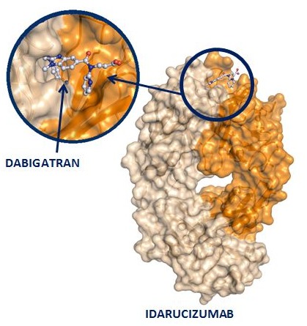
Idarucizumab: A specific reversal agent for anticoagulant activity of dabigatran
Humanized Fab fragment
  High-affinity binding specific to
  dabigatran
Primarily renal excretion
Short half-life
No interaction with other drugs
No intrinsic pro-coagulant or
anticoagulant activity
IV dosing by bolus or rapid infusion
Reduces dabigatran-induced bleeding in
animal models
Immediate, complete, and sustained reversal
of dabigatran anticoagulation in volunteers
Dabigatran
Schiele et al. Blood (2013): Glund et al. Thrombosis & Haemostasis (2015)
Idarucizumab
Notes:
-350-fold greater affinity than that of dabi for thrombin

Slide 57
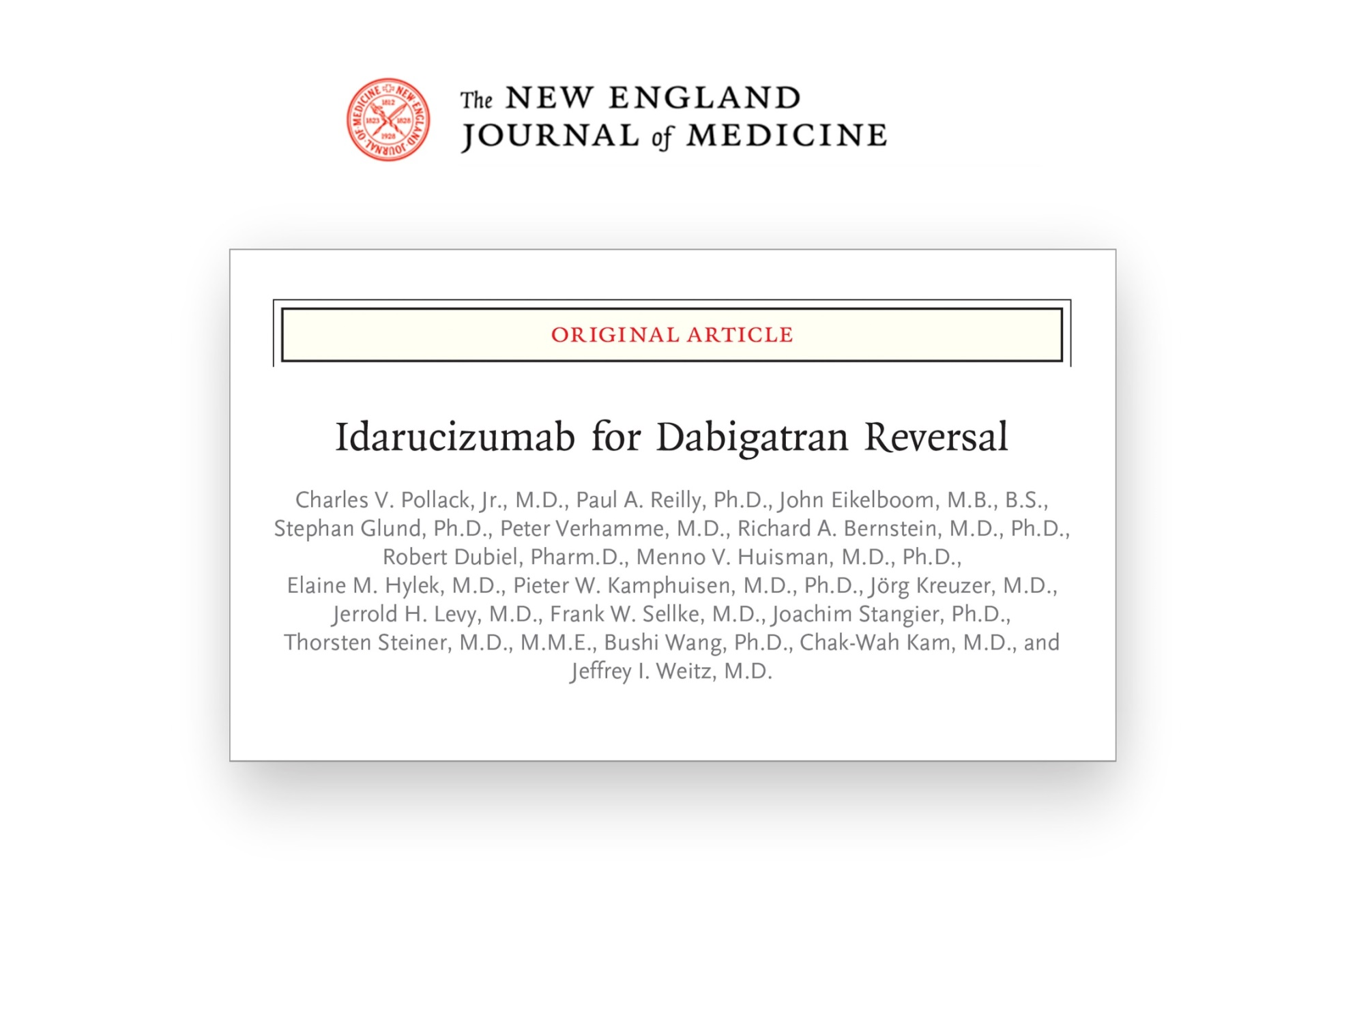

Slide 58
RE-VERSE ADTM: Multicenter, ongoing, open-label, single-arm phase III study
Group A: Uncontrolled bleeding + dabigatran-treated
N=51
5 g idarucizumab (two separate infusions of 2.5 g)
N=90
Group B: Emergency surgery or procedure + dabigatran-treated
N=39
0–15 minutes
90 days follow-up
0–24 hours
Blood
samples
Hospital
arrival
Pre-1st vial
Pre-2nd vial
1 h
2 h
4 h
12 h
24 h
30 d
90 d
~20 min
Primary Endpoint: Maximum percent reversal based on dTT or ECT
Secondary Endpoint: Proportion with complete normalization of dTT or ECT within 4h
Pollack C et al. Thromb Haemost. 2015 May 28;114 [Epub ahead of print]
Notes:
-red triangles are blood sampling for central lab and unavailable to clinicians; local pTT was done in parallel but not at 1,2,4 and 12h
-dTT and ECT were chosen since they correlate highly with unbound dabi concentrations (i.e. whether bound to plasma OR idarucizumab)

Slide 59
RESULTS: Primary endpoint in Group A
130
Diluted thrombin time
325
Ecarin clotting time
120
300
110
275
100
250
90
Idarucizumab
2x 2.5 g
225
Idarucizumab
2x 2.5 g
80
200
dTT (s)
ECT (s)
175
70
150
60
125
50
100
40
Assay upper limit of normal
75
30
50
20
25
Baseline
Between
vials
10–30
min
1h
2h
4h
12h
24h
Baseline
Between
vials
10–30
min
1h
2h
4h
12h
24h
Time post idarucizumab
Time post idarucizumab
Maximum percent reversal 100% dTT (N=40), 100% ECT (N=47)
Complete normalization: dTT: 98%, ECT: 89%
Notes:
Interim analysis – after 90 patients were enrolled
(subsequent abstract at ACC with update on 123 patients)
Group A patients: over 90% on for AFIB, median age 76, CrCl 58, 16 were hemodynamically unstable with ongoing bloodloss at study entry; ICH in 18, GI bleed in 20

Slide 60
RESULTS: Primary endpoint in Group B
130
Diluted thrombin time
325
Ecarin clotting time
120
300
110
275
100
250
90
Idarucizumab
2x 2.5 g
225
Idarucizumab
2x 2.5 g
80
200
dTT (s)
ECT (s)
175
70
150
60
125
50
100
40
Assay upper limit of normal
75
30
50
20
25
Baseline
Between
vials
10–30
min
1h
2h
4h
12h
24h
Baseline
Between
vials
10–30
min
1h
2h
4h
12h
24h
Time post idarucizumab
Time post idarucizumab
Maximum percent reversal 100% dTT (N=28), 100% ECT (N=34)
Complete normalization: dTT: 93%, ECT: 88%
Notes:
Group B patients: all afib, median age: 76, ~50% male, mostly caucasian, median CrCl 65, almost 2/3 on 110bid

Slide 61
Safety
No hypersensitivity observed
Five thrombotic events occurred
  1 early event (DVT + PE) within 72 hours
  4 patients had events after 72 hours (DVT, DVT+PE+LA thrombus, MI, ischemic stroke)
  None of these 5 patients was receiving any antithrombotic therapy when the events occurred
18 deaths occurred (9 in each Group)
  Related to presenting index event and comorbidities

Slide 62
Recommendation
We recommend administering idarucizimab for emergency reversal of dabigatran's anticoagulant effect in patients with uncontrollable or potentially life-threatening bleeding and/or requiring urgent surgery for which normal hemostasis is necessary
  (Strong Recommendation, Moderate Quality Evidence).

Slide 63
Values and Preferences
This recommendation places relatively greater value on:
  the ability of idarucizimab to reverse coagulation parameters indicative of dabigatran’s effect
  its potential to decrease bleeding-related outcomes and risks of urgent surgery
  safety and tolerability profile
This recommendation places less value on:
  the lack of control group in the RE-VERSE AD trial
  cost

Slide 64
Practical Tips - 1
In the acute, life threatening bleed situation, where standard resuscitation is not anticipated to be sufficient or where it has not stabilized the patient
Need to be able to identify a patient with dabigatran on board
  Renal function and time of last dose are key if available
Thrombin time (TT) and activated partial thromboplastin time (aPTT) can generally identify the presence of dabigatran
  Dilute TT and ecarin clotting time (ECT) were used in REVERSE-AD
Obtaining these tests should not delay the administration of idarucizumab

Slide 65
Practical Tips - 2
Coagulation parameters may become re-elevated between 12-24h after administration
  Likely reflects redistribution of drug
  Minimal effects in RE-VERSE AD
Need to reevaluate the need for anticoagulation as soon as medically appropriate

Slide 66
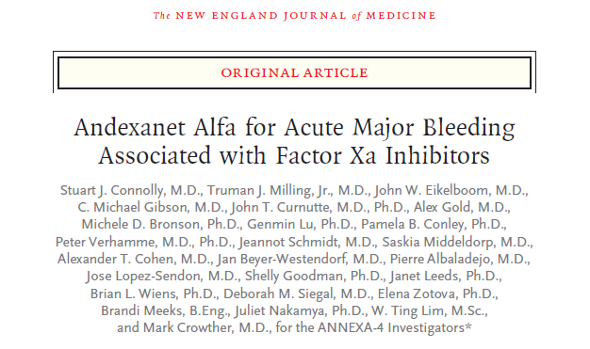

Slide 67
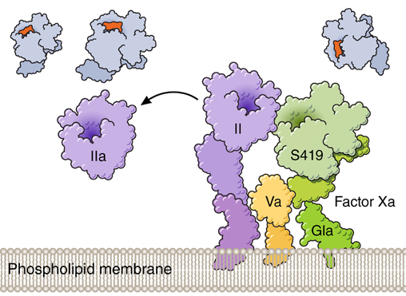
Andexanet Alfa: Reversal of Factor Xa Inhibition
Recombinant, modified human factor Xa “decoy” protein
Competitive binding
Affinity similar to that of native factor Xa
No intrinsic catalytic activity → Xa inhibitors sequestered within the vascular space allowing restoration of endogenous Xa activity, thrombin generation
IV bolus followed by infusion; immediate onset of action with terminal half-life ~6 hrs
Lu et al Nat Med 2013;19:446-51; Ghadimi et al Expert Rev Hematol 2016;9:115-22;
Connolly et al N Engl J Med 2016;in press Aug 30 2016

Slide 68
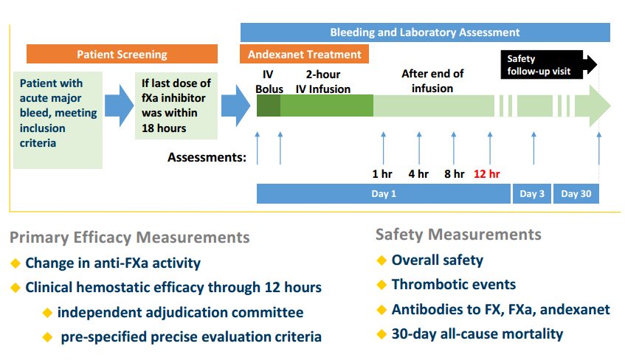
ANNEXA-4 Study Design

Slide 69
Andexanet Alfa:
Reversal of Factor Xa Inhibition
ANNEXA-4: 67 pts with acute major, potentially life-threatening bleeding (mainly GI or intracranial) on rivaroxaban or apixaban
EFFICACY population (n=47)
  Reduction of anti-Xa activity after bolus (~89-93%) and 4 hrs post-infusion (~30-39%)
  12 hrs post-infusion clinical hemostasis good/excellent in 37/47 pts
SAFETY population (n=67)
  thrombotic events in 12/67 (18%) pts during 30-day follow-up (4 ≤72 hrs); therapeutic anticoagulation resumed in only 1 pt
Notes:
20 patients excluded from efficacy analysis: majority due to having anti Xa levels below threshold, 3 didn’t meet the definition of acute major bleed
-of the 47 patients – 26 riva, 20 apixa, 1 enox
-overall restarting of OAC: 18 pts (27%) within 30d

Slide 70
Periprocedural Management of Anticoagulation in AF Patients

Slide 71
Periprocedural Management of Anticoagulation
OAC
Interruption
Yes
When to Stop
Bridge or Not
No
When to Restart

Slide 72

Decision to Interrupt Anticoagulation
for a Procedure
  Bleeding risks of:
  1. Procedure
  (High, intermediate, low)
  2. Patient
  (HASBLED Score)
Thromboembolic Risks:
1. CHADS2
2. Mechanical valve
3. Thromboembolism <3 m
4. Rheumatic valve disease
Notes:
Any decision to interrupt anticoagulation for an invasive procedure must balance the risks of thromboembolic events (as indicated by a higher CHADS2 score, thromboembolic events <3 m, mechanical heart valve, or rheumatic heart disease) with those of bleeding events (as indicated by a higher HASBLED score and procedures with higher bleeding risks) (Strong Recommendation, Low Quality Evidence).
THESE FEATURES ON THE RIGHT SIDES REPRESENT HIGH THROMBOEMBOLIC RISKS: HIGH CHADS2 SCOrE (3 or greater), PRESENCE OF A MECHANICAL VALVE, THROMBOEMEBOLIC EVENTS WITHIN PAST 3 MONTHS, AND RHEUMATIC VALVE DISEASE

Slide 73
Peri-Procedural Anticoagulation Interruption
Recommendation
We recommend that in a patient with AF/AFL, a decision to interrupt antithrombotic therapy for an invasive procedure must balance the risks of a thromboembolic event (as indicated by a higher CHADS2 score, mechanical
heart valve, thromboembolic events <3 months, or rheumatic heart disease) with those of a bleeding event (as indicated by a higher HASBLED score
and procedures with higher bleeding risks)
(Strong Recommendation, Low-Quality Evidence).

Slide 74
HASBLED: Assess Bleeding Risk
HAS-BLED | SCORE
Hypertension (SBP>160 mm Hg) | 1
Abnormal renal function (Cr>200 umol/L) or liver function (cirrhosis, bilirubin >2x upper normal, or AST/ALT/ALP >3 x upper normal | 1 1
Stroke history | 1
Bleeding (major) or tendency | 1
Labile INR (unstable INR, time in therapeutic range <60%) | 1
Elderly: Age >65 years | 1
Drugs (aspirin, NSAIDS, anti-inflammatory medications); alcohol or drug abuse | 1
Major bleeding risk
(% per year)
15 %
12.5
8.7
3.7
1.9
1.1
1.02
0 %
0
1
2
3
4
5
HASBLED Score
Pisters R, et al. Chest. 2010;138:1093-100

Slide 75
Risk of Bleeding
Very low
Low risk
Intermediate risk
High risk
Low risk
↑
No need to interrupt
anticoagulation
Notes:
Risk of bleeding of any procedure was classified as very low, low risk, intermediate or high risks. For the updated guidelines, given that there was no difference in the way we approach low risk versus very low risk, we have now grouped the very low and low risk as simply low risk. As long as INR is not supratherapeutic, there is no need to interrupt anticoagulation

Slide 76
Low Risk of Bleeding
Interruption Not Necessary
Dental extractions (1 or 2 teeth), endodontic (root canal) procedure, subgingival scaling or other cleaning
Cataract surgery
Dermatologic procedures (e.g. biopsy)
Gastroscopy or colonoscopy without biopsies
Coronary angiography
Permanent pacemaker insertion or internal defibrillator placement (if bridging anticoagulation is not used)
Selected procedures (e.g. thoracentesis, paracentesis, arthrocentesis)
The procedural/ surgical risk categorization list may be updated based on new information, and can be found at Thrombosis Canada (http://thrombosiscanada.ca)
Practical Tip: http://thrombosiscanada.ca/?page_id=502&calc=perioperativeAnticoagulantAlgorithm
Notes:
These procedures are of low risk of bleeding

Slide 77
Intermediate Risk of Bleeding
Interruption Necessary
Other intra-abdominal surgery (e.g. laparoscopic cholecystectomy, hernia repair)
Other general surgery (e.g. breast)
Other intrathoracic surgery
Other orthopedic surgery
Other vascular surgery
Non-cataract ophthalmologic surgery
Gastroscopy or colonoscopy with biopsies
Selected procedures (e.g. bone marrow biopsy, lymph node biopsy)
Complex dental procedure (e.g. multiple tooth extractions)
The procedural/ surgical risk categorization list may be updated based on new information, and can be found at Thrombosis Canada (http://thrombosiscanada.ca)
Notes:
These procedures are considered of intermediate risk in terms of bleeding

Slide 78
High Risk of Bleeding
Interruption Necessary
Any surgery or procedure with neuraxial (spinal or epidural) anesthesia
Neurosurgery (intracranial or spinal)
Cardiac surgery (e.g. CABG, heart valve replacement)
Major intra-abdominal surgery
Major vascular surgery (e.g. aortic aneurysm repair, aortofemoral bypass)
Major orthopedic surgery (e.g. hip or knee replacement)
Lung resection surgery
Urological surgery (e.g. prostatectomy, bladder tumour resection)
Extensive cancer surgery (e.g. pancreas, liver)
Intestinal anastomosis surgery
Reconstructive plastic surgery
Selected procedures (e.g. kidney biopsy, prostate biopsy, cervical cone biopsy, pericardiocentesis, colonic polypectomy)
The procedural/ surgical risk categorization list may be updated based on new information, and can be found at Thrombosis Canada (http://thrombosiscanada.ca)
Notes:
These procedures are considered high risk for bleeding

Slide 79
Peri-Procedural Anticoagulation Interruption
Recommendation
We suggest that interruption of anticoagulant therapy, particularly for VKAs, in a patient with AF/AFL is not necessary for most procedures with a low risk of bleeding, such as cardiac device implantation (pacemaker or implantable defibrillator), and most dental procedures (Conditional Recommendation, Moderate-Quality Evidence).
Recommendation
We recommend that the interruption of anticoagulant therapy in a patient with AF/AFL will be necessary for most procedures with an intermediate or high risk of major bleeding
(Strong Recommendation, Low-Quality Evidence)

Slide 80
Timing of Antithrombotic Interruption
Interruption
Aspirin, Clopidogrel, Prasugrel, Ticagrelor
Stop 5-7 days before
Very high bleed risk : stop 7-10 days before
Dabigatran
CrCl≥80mL/min: stop 1-2 days before for low bleed risk and 2-3 days for intermediate/high bleed risk
CrCl 50-80 mL/min: upper end of ranges above
CrCL 30-50 mL/min: add 1 day
CrCL<30 mL/min, add 2 days
Apixaban, Rivaroxaban
Low bleed risk: stop 1-2 days before
Intermediate/high bleed risk: 2-3 days before
Warfarin
Stop 5 days before
INR<1.5 for low bleed risk
INR<1.2 for intermediate/high bleed risk

Slide 81
Question: Case 1
History: Mrs. Smith is 80 years old with well controlled hypertension and permanent NVAF. Her GFR is 72 mL/min. She has been on rivaroxaban 20 mg daily and candesartan 8 mg daily. Blood counts, renal and liver function tests all normal.
Her CHADS2 is 2, and HASBLED is 1.
Procedure: Dental extraction of 2 teeth 2 days from now.
Your recommendation about anticoagulation:
1. Stop rivaroxaban now.
2. Stop rivaroxaban 24 hours before the procedure.
3. No need to stop rivaroxaban.

Slide 82
Case 1 Analysis
Bleeding Risk: Low procedural bleeding risk (list below) and low patient bleeding risk (HASBLED 1)
Thromboembolic Risk: CHADS2 of 2
Recommendation regarding rivaroxaban:
1. Stop rivaroxaban now.
2. Stop rivaroxaban 24 hours before the procedure. [Not wrong]
3. No need to stop rivaroxaban.
Low Bleeding Risk
Dental extractions (1 or 2 teeth), cleaning, and most dental procedures (including root canal)
Skin biopsy or skin cancer removal
Cataract surgery
Dermatologic procedures (e.g. biopsy)
Gastroscopy or colonoscopy without biopsy
Selective invasive procedures: paracentesis, thoracentesis, arthrocentesis
Coronary angiography
Cardiac device implantation (pacemaker, ICD)

Slide 83
Question: Case 2
History: Mrs. Brown is 75 years old and has well-controlled hypertension, diabetes, and paroxysmal AF. Her GFR is 29 mL/minute. She has symptomatic sick sinus syndrome, and is scheduled for pacemaker implant. She is on warfarin, and her INR today is 2.5. Her INR has been stable over the past year.
[CHADS2 of 3; HASBLED of 2].
Procedure: Pacemaker implant in 7 days.
Recommendation regarding anticoagulation:
Continue with warfarin, and proceed as planned.
Stop warfarin 5 days before PPM, check INR to assure <1.2.
Stop warfarin for 3 days before PPM, check INR, and she can proceed if INR is <1.5.
Stop warfarin for 3 days, IV heparin bridging when INR <2.

Slide 84
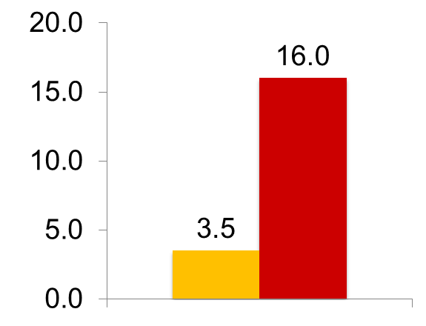
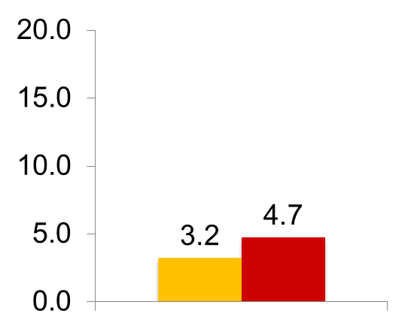
Bruise Trial
RCT comparing continued warfarin (n=343) vs discontinued warfarin with heparin bridging (n=338) in patients undergoing PPM/ICD surgery.
Primary outcomes: Clinically significant device pocket hematoma prolonging hospitalization, requiring anticoagulation interruption, or requiring re-operation.
Secondary outcomes: Each component of the primary outcomes, major bleeding events, thromboembolic events, death from any cause, quality of life, pain, and patient satisfaction.
Primary Outcomes:
Significant Hematoma
Secondary Outcomes:
Other Adverse Events
warfarin interruption
with bridging
no interruption
p<0.001
p=NS
%
%
Birnie DH et al. N Engl J Med 368:2084-93, 2013
Notes:
The Bruise trial is a randomize controlled trial of patients at high risk of thromboembolic events requiring pacemaker or ICD implant. The 2 strategies being tested were continued warfarin with no interruption versus warfarin interruption with heparin bridging. All components of the primary endpoint which reflected different kinds of pocket hematoma were significantly reduced in the continued warfarin group. For the bridging group, 16% had pocket hematoma, as compared to 3.5% for the continued warfarin without interruption. This of course was highly significant. There were no significant differences in terms of other complications between the 2 groups.
Primary endpoint: Hematoma prolonging hospitalization. Hematoma requiring 24 hr anticoagulation interruption, or hematoma requiring re-operation

Slide 85
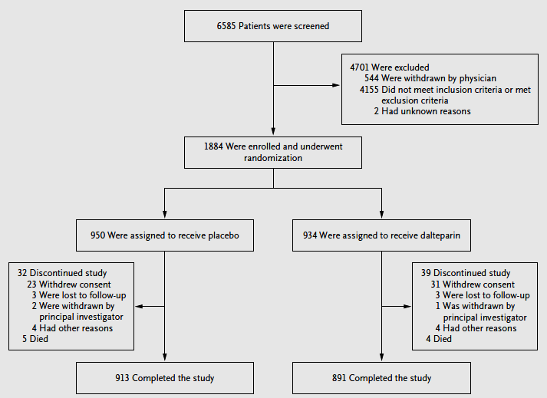
The Bridge Trial: Is Bridging Anticoagulation
Necessary for AF Patients?
Inclusion:
Age ≥18 yrs
Chronic AF or flutter
CHADS2≥1
Exclusion:
Mechanical heart valve
TIA, stroke, systemic embolism <12 weeks
Major bleeding within the prior 6 weeks
GFR < 30 ml/min, platelet <100 x 10⁹/L
Planned cardiac, intracranial, or intraspinal surgery
Douketis et al. NEJM 2015; 373: 823-33

Slide 86
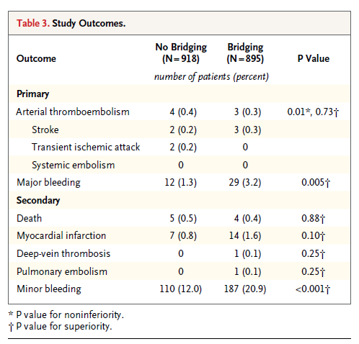
The Bridge Trial: Outcomes and Conclusions
Findings:
Arterial thromboembolism
(No bridge 0.4%, bridge 0.3%;
no bridge was non-inferior)
Major bleed
(No bridge 1.3%, bridge 3.2%;
p=0.005 in favor of no bridge)
Other events
(Death, MI, DVT, PE not significant;
Minor bleeding: no bridge 12%, bridge
20.9%; p<0.001 in favor of no bridge)
Conclusions:
In patients with AF requiring temporary
interruption of warfarin treatment for an
elective operation or invasive procedure,
a strategy of forgoing bridging was non
inferior to perioperative bridging for
prevention of arterial thromboembolism
and is associated with lower
risk of major and minor bleeding.
Douketis et al. NEJM 2015; 373: 823-33

Slide 87
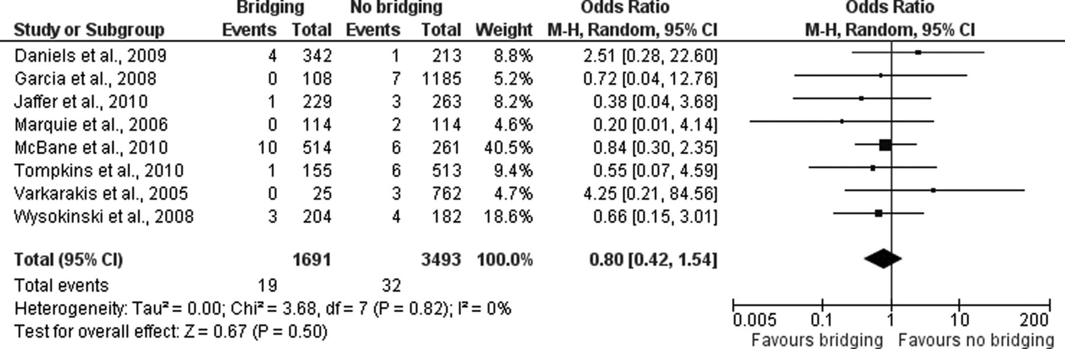
Meta-Analysis of Periprocedural Bridging in
Patients Receiving Vitamin K Antagonists
Studies 2001-2010 from MEDLINE, EMBASE, COCHRANE databases evaluating heparin bridging during interruption of VKA for procedures: 34 studies with 1 RCT
Thromboembolic events: 73 of 7118 bridged patients (pooled incidence, 0.9%; 95% CI, 0.0.0–3.4) and 32 of 5160 nonbridged patients (pooled incidence, 0.6%; 95% CI, 0.0–1.2).
No difference in the risk of thromboembolic events comparing bridged and nonbridged groups in 8 studies (odds ratio, 0.80; 95% CI, 0.42–1.54).
Deborah Siegal et al. Circulation. 2012;126:1630-1639

Slide 88
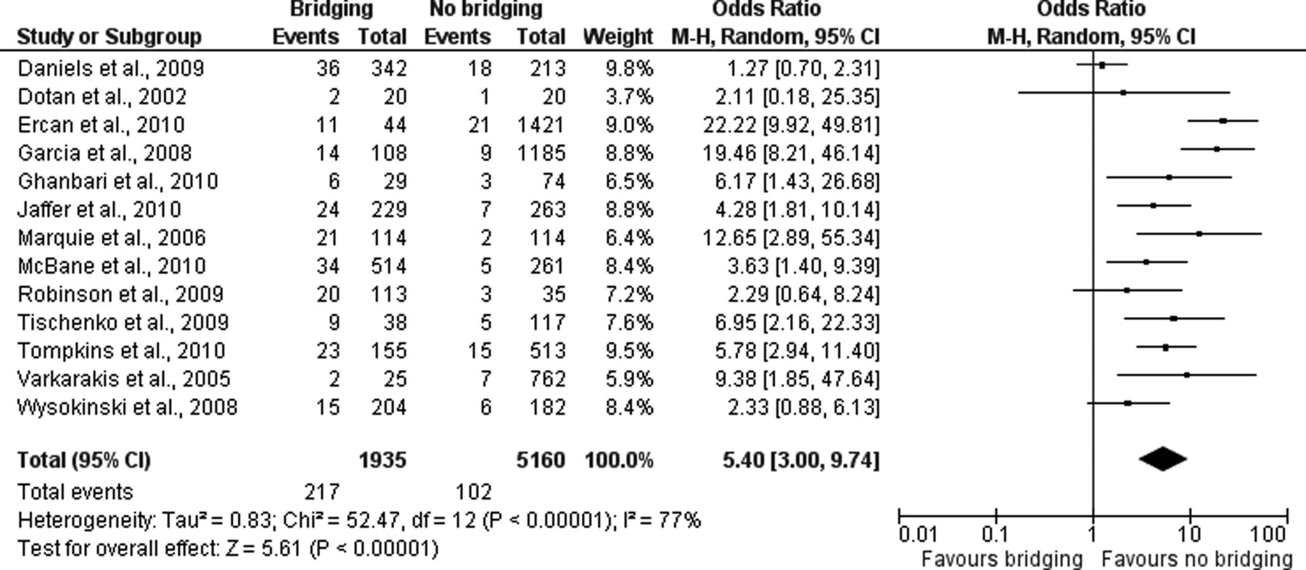
Meta-Analysis of Periprocedural Bridging in
Patients Receiving Vitamin K Antagonists
Bridging was associated with an increased risk of bleeding in bridged patients:
1. Overall bleeding in 13 studies (odds ratio, 5.40; 95% CI, 3.00 –9.74).
2. Major bleeding in 5 studies (odds ratio, 3.60; 95% CI, 1.52– 8.50).
Deborah Siegal et al. Circulation. 2012;126:1630-1639

Slide 89
Case 2 Analysis
History: Mrs. Brown is 75 years old and has well-controlled hypertension, diabetes, and paroxysmal AF. GFR is 29 mL/minute. She has symptomatic sick sinus syndrome, and is scheduled for PPM. She is on warfarin. INR today 2.5. Her INR has been stable. CHADS2 of 3; HASBLED of 2.
Bleeding Risk: PPM low bleeding risk; patient risk (HASBLED 2).
Thromboembolic Risk: CHADS2 of 3
Recommendation regarding warfarin:
Continue with warfarin, and proceed as planned
Stop warfarin 5 days before PPM, check INR to assure <1.2
Stop warfarin for 3 days before PPM, check INR, and she can proceed if INR is <1.5.
Stop warfarin for 3 days, IV heparin bridging when INR <2

Slide 90
Question: Case 3
History: Mr. Black, 79 yr old, permanent NVAF, controlled hypertension, type II diabetes, and embolic stroke 1 year ago. GFR 26 mL/minute. CHADS2 5, HASBLED 3. On Irbesartan, bisoprolol, metformin, warfarin (INR 2.4, stable).
Procedure: Left hip replacement in 1 month.
Recommendation regarding anticoagulation:
Stop warfarin 5 days ahead; no heparin bridging.
Stop warfarin 5 days ahead; heparin bridging when INR <2.
Continue warfarin through.

Slide 91
Bridging for AF / AFL Patients on Warfarin
When Is It Recommended?
Recommended for patients at high risk of thromboembolic events
  CHADS2 ≥4 (was ≥3 in prior guidelines)
  Mechanical heart valve
  Stroke, TIA, thromboembolic events <3 months
  Rheumatic heart disease
Pre-procedure: when INR is below therapeutic, start LMWH or UFH
  LMWH should be stopped 24 hours prior to the procedure
  UFH should be stopped 4-6 hours prior to the procedure
Post-procedure: LMWH or UFH restarted when hemostasis is established (~24 hours for a procedure with a low bleeding risk, 48-72 hours for procedures with intermediate/high risk of bleeding). Use prophylactic dosages for the first 24-72 hours and then increase to therapeutic dosages. Continue until INR is therapeutic.

Slide 92
Bridging in Patients on Warfarin
Recommendation
When a decision to interrupt warfarin therapy for an invasive procedure has been made for a patient with AF/AFL, we suggest that bridging therapy with LMWH or UFH be instituted when the INR is below therapeutic level only in patients at high risk of thromboembolic events (CHADS2 ≥4, mechanical valve, stroke/transient ischemic attack< 3 months, rheumatic heart disease)
(Conditional Recommendation, Low-Quality Evidence)

Slide 93
Case 3 Analysis
History: Mr. Black, 79 yr old, permanent NVAF, controlled hypertension, type II diabetes, stroke 1 year ago. GFR 26 mL/minute. CHADS2 5, HASBLED 3. On Irbesartan, bisoprolol, metformin, warfarin (INR 2.4, stable).
Procedure: Left hip replacement in 1 month.
Recommendation regarding anticoagulation:
Stop warfarin 5 days ahead; no heparin bridging.
Stop warfarin 5 days ahead; heparin bridging when INR <2.
Continue warfarin through.

Slide 94
No Bridging Necessary for NOACS
Bridging not necessary for NOACs as half-lives similar to those of LMWH.
Bleeding and thromboembolic outcomes in the periprocedural interruptions were not significantly different between NOACs and warfarin in RELY, ROCKET AF, and ARISTOTLE.
ORBIT AF: Prospective registry study of AF patients [7372 on OAC, 2803 interruption events in 2200 (30%)]. Median follow up 2 years. Dabigatran and warfarin interruptions common with bridging in ¼ of the cases. Bridging was associated with significantly increased risk of bleeding and adverse events.
Perioperative Dabigatran Study: Prospective study of 541 patients on dabigatran (97% had AF indication) needed interruption for a procedure. Interruption at 24, 48, and 96 hr before procedure without bridging was safe. Major bleed 1.8%, minor bleed 5%, and 1 case of TIA (0.2%).
Dresden NOAC Registry (76% rivaroxaban, 24% dabigatran): No differences in bleeding or thromboembolic complications in the peri-procedural period between rivaroxaban and dabigatran. Heparin bridging was associated with significantly higher rates of major bleeding.
Healey et al. Circulation 2012; 126:343-8. Sherwood et al. Circulation 2014;129:1850-9
Garcia et al. Blood 2014; 124:3692-8. Steinberg et al. Evid Based Med 2015; 29:200
Schulman et al. Circulation 2015; 132:167-73. Beyer-Westendorf et al. Eur Heart J 2014; 35:1888-96

Slide 95
No Bridging in Patients on NOACs
Recommendation
We recommend no bridging (LMWH or UFH) for NVAF patients receiving NOACs who undergo elective surgery or invasive procedures requiring interruption of anticoagulation (Strong Recommendation, Moderate-Quality Evidence).

Slide 96
Timing of Antithrombotic Restart
Interruption
Aspirin, Clopidogrel, Prasugrel, Ticagrelor
Stop 5-7 days before
Very high bleed risk : stop 7-10 days before
Dabigatran
CrCl≥80mL/min: stop 1-2 days before for low bleed risk and 2-3 days for intermediate/high bleed risk
CrCl 50-80 mL/min: upper end of ranges above
CrCL 30-50 mL/min: add 1 day
CrCL<30 mL/min, add 2 days
Apixaban, Rivaroxaban
Low bleed risk: stop 1-2 days before
Intermediate/high bleed risk: 2-3 days before
Warfarin
Stop 5 days before
INR<1.5 for low bleed risk
INR<1.2 for intermediate/high bleed risk
RESTART
Recommendations for timing of reintroduction of antithrombotic therapy are intended to promote a balanced approach to minimizing the combined outcome of thrombo-embolic events and major bleeding.
When hemostasis achieved, restart 24-48 hrs after low bleed risk, 48-72 hrs after intermediate or high bleed risk procedure
Restart 1 day after hemostasis, ~48 hrs after low bleed risk, ~72 hrs after intermediate /high bleed risk procedure
Reminder: Full anticoagulant effects
2hrs after administration of NOACs,
3-4 hrs after LMWH, and when PTT
therapeutic for IV heparin

Slide 97
Post-Procedural Restart of Antithrombotics
Recommendations
When warfarin, ASA, or clopidogrel therapy has been interrupted for an invasive procedure, we suggest that such therapy be restarted after the procedure when hemostasis is established (usually 24-48 hours for a procedure with a low risk of bleeding and 48-72 hours for a procedure with an intermediate or high risk of bleeding)
(Conditional Recommendation, Low Quality Evidence).
When apixaban, dabigatran, or rivaroxaban have been withdrawn for an invasive procedure, we suggest that such therapy be restarted after the procedure one day after hemostasis is established (usually 48 hours for a procedure with a low risk of bleeding and 72 hours for a procedure with an intermediate or high risk of bleeding).
(Conditional Recommendation, Low Quality Evidence)

Slide 98
Surgical Therapy for AF

Slide 99
Surgical AF ablation procedures:
Clinical Considerations
Potential benefits of SR
Type of surgery (mitral vs. other)
Extent of procedure (left vs. biatrial)
Energy source
Associated risks
Local expertise

Slide 101
Study Design
260 patients with persistent or long-standing persistent atrial fibrillation who required mitral-valve surgery were randomized to either surgical ablation or no ablation during mitral valve operation.
Patients in the ablation group underwent further randomization to pulmonary vein isolation (PVI) or biatrial maze (BAM).
All patients underwent closure of the left atrial appendage
Primary endpoint was freedom from AF at both 6 and 12 months (assessed by 3-day Holter)

Slide 105
Study Design
224 patients with AF scheduled for valve and/or CABG surgery were randomized to left atrial ablation vs. no ablation
Primary efficacy endpoint SR at 1-year (24 h holter)
Primary safety endpoint composite of death/MI/stroke/renal failure at 30 days
Cryo-ablation used in 96% of patients
LAA closed in all patients

Slide 110
Surgical LAA exclusion for stroke prevention
Clinical Considerations
Paucity of randomized data
Cohort studies have driven current practice
LAAOS III ongoing

Slide 111



LAAOS III Study Design
A multicentre, international, randomized trial of left atrial appendage occlusion or no occlusion in adult atrial fibrillation patients undergoing cardiac surgery with the use of CPB
Patients will be randomly allocated to occlusion of the LAA or no LAA occlusion on top of usual care
Follows the intention-to-treat principle
4,700 patients in approximately 80 centres

Slide 113
Post-Operative AF

Slide 114
Case
72 yr man undergoing CABG and mitral valve repair (replacement)
  Hx HTN for > 10 yrs on bisoprolol and perindopril
  Recently admitted through ED with CHF and PAF
  Aggressive diuresis resulted in resolution of CHF and sinus rhythm
  Echo: LV function preserved with moderately severe MR
  LA size 45mm AP
  Coronary angiogrpahy: 3VDs with 90% prox LAD, Occluded mid Cx filled via collaterals from 80% mid RCA,

Slide 115
Question: Case
To prevent POAF in this man I would:
Continue bisoprolol
Replace bisoprolol with amiodarone iv / po
Augment bisoprolol with intra-operative Mg
Augment bisoprolol with post-operative oral colchicine 0.5mg bid
Leave it up to the surgeon
Other Institutional favourite
Notes:
Amio iv as infusion for 24 hrs then Amio 400 daily for remainder of admission
4gms iv Mg when coming off pump

Slide 116
Post-operative AF (POAF)
POAF occurs in 25-40% of patients undergoing CV surgery
Condition associated with high sympathetic and oxidative stress and inflammation
Associated with increased rates of major CV outcomes, length of stay and costs
New guidelines addressing
Treatment of POAF
Prophylaxis of POAF

Slide 117
Treatment of POAF: Rate vs Rhythm Control
Of 2109 pts undergoing CV surgery (CABG, valvular or both),
695 developed POAF, 523 randomized rate vs rhythm control
1º endpoint was total number of hospitalized days within 60d of OR
Total number or days: Median 5.1 vs 5.0, p=0.76
2º No differences in rates of death or serious complications
(24.8 (rate) vs 26.4/100pt-months, p=0.61)
Cross-over occurred in 25% in each arm – due to drug ineffectiveness
At 30 and 60 d, high rates of sinus rhythm in both arms
Gillinov et al. NEJM 2016;374:1911-21

Slide 118
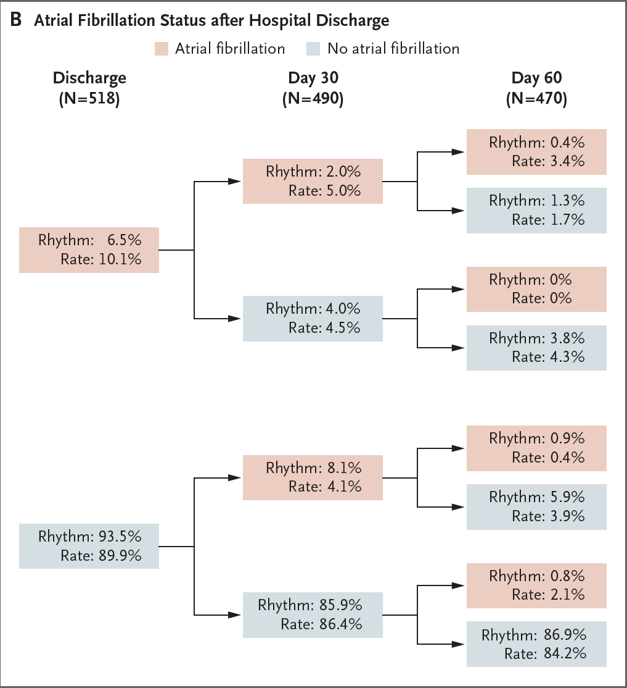
Rhythm at 30 & 60 days
Discharged in AF:
At 30 days
Rhythm gp: 98% NSR
Rate cont 95% NSR
At 60 days
Rhythm gp: >99% NSR
Rate cont >96% NSR
Discharged in NSR:
At 30 days
Rhythm gp: 92% NSR
Rate cont 96% NSR
At 60 days
Rhythm gp: 98% NSR
Rate cont 97% NSR
Gillinov et al. NEJM 2016;374:1911-21

Slide 119
Recommendation
We recommend that POAF might be appropriately treated with either a ventricular response rate control strategy or a rhythm control strategy (Strong Recommendation, Moderate-Quality Evidence).
Values and preferences
This recommendation places a high value on the RCTs that investigated rate control as an alternative to rhythm control for AF, including 1 trial that specifically addressed the cardiac postoperative period.
Choice of strategy should therefore be individualized on the basis of the degree of symptoms experienced by the patient.

Slide 120
Prevention and Treatment of AF following Cardiac Surgery
Assess AF Risk Factors
Low Risk
High Risk
On Beta-Blocker?
On Beta-Blocker?
No
Yes
No
Yes
Beta-Blocker
Contraindicated?
Continue BB
Beta-Blocker
Contraindicated?
Sotalol or Amiodarone or
BB plus IV Mg or Atrial Pacing
No
Yes
No
Yes
Beta-Blocker
Amiodarone
Contraindicated?
Sotalol or Amiodarone or
BB and IV Mg or Atrial Pacing
Amiodarone
Contraindicated?
No
Yes
No
Yes
Amiodarone
IV Magnesium or
Biatrial Pacing
Amiodarone with or without
IV Mg or Atrial Pacing
IV Magnesium or
Biatrial Pacing
2010 CCS AF Guidelines, LB Mitchell CJC 2011;27:90-96

Slide 121
Limiting Inflammation and Oxidative Stress
Statins: RCT of 1922 patients to perioperative rosuvastatin or placebo, showed no reduction in rates of POAF (OR, 1.04; 95% CI, 0.84-1.30), but a statistically significant increase in the rate of acute kidney injury ¹
Steroids:
A systematic review on the use of steroids suggested a beneficial effect on the basis of 14 studies. When tested in 2 definitive studies that randomized > 11,000 patients, no benefit was seen, and a potential small signal of harm was noted ^{2,3}
Poly-unsaturated fatty acides (PUFA):
Two meta-analyses of 8 trials in 2687 pts: 1 was negative (OR, 0.86; 95% CI, 0.71-1.04), the other positive (OR, 0.84; 95% CI, 0.71-0.99) as a consequence of different trial weighting.
The largest RCT, randomized 1516 patients: with no difference in sustained, symptomatic, or treated episodes of POAF ⁴

Slide 122
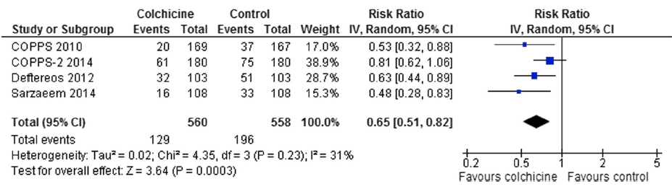
Limiting Inflammation and Oxidative Stress
Colchicine (1mg/day):
2 Systematic Reviews:
A higher rate of discontinuation of colchicine, predominantly because of gastrointestinal upset and diarrhea (OR, 2.30; 95%CI, 1.47-3.62), was also observed

Slide 123
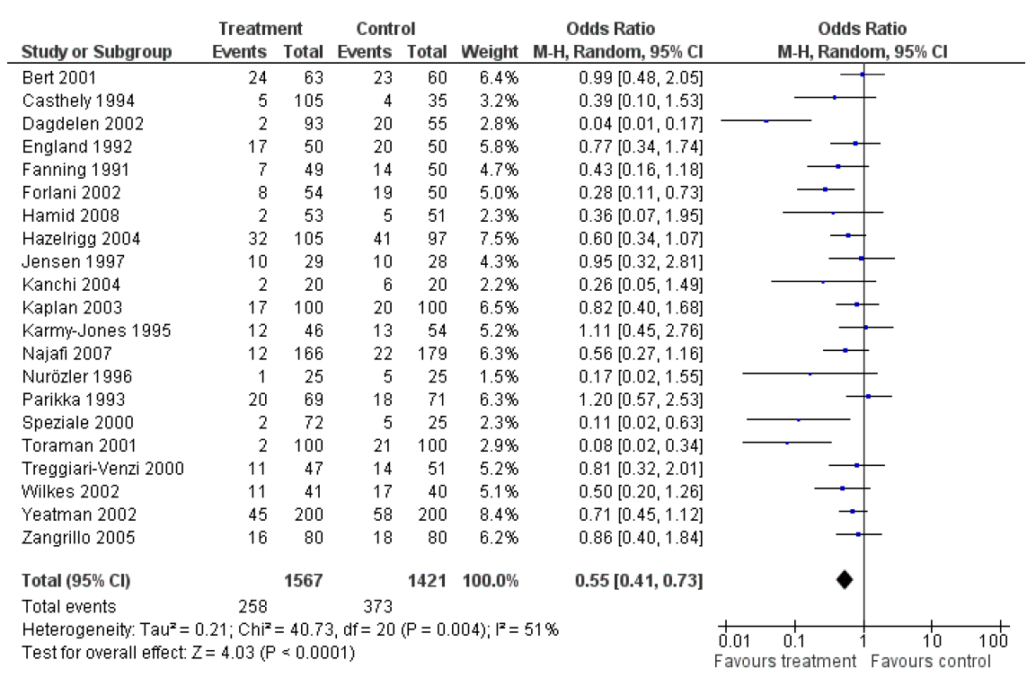
Magnesium

Slide 124
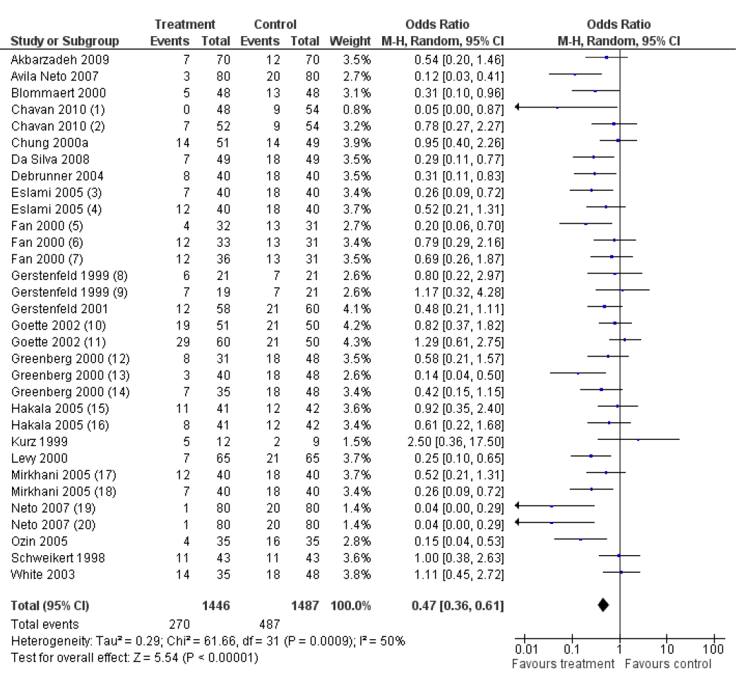
Atrial Pacing to Prevent POAF

Slide 125
Recommendation
We suggest that patients who have a contraindication to beta-blocker therapy and to amiodarone before or after cardiac surgery be considered for prophylactic therapy to prevent POAF with
Intravenous magnesium (Conditional Rec, Low-Quality Evidence) or
Colchicine (Conditional Recommendation, Low- Quality Evidence) or
Biatrial pacing (Conditional Recommendation, Low-Quality Evidence).
Values and preferences
This recommendation places a high value on preventing POAF using novel therapies that are supported by lower-quality data; with a higher value on the lower probability of adverse effects from magnesium vs colchicine. The use of biatrial pacing needs to be individualized according to patient and institution, because the potential for adverse effects might outweigh benefit according to local expertise. patient.

Slide 126
Prevention and Treatment of AF following Cardiac Surgery
Assess AF Risk Factors
Low Risk
High Risk
On Beta-Blocker?
On Beta-Blocker?
No
Yes
No
Yes
Beta-Blocker
Contraindicated?
Continue BB
Beta-Blocker
Contraindicated?
Sotalol or Amiodarone or
BB plus IV Mg or Atrial Pacing
No
Yes
No
Yes
Beta-Blocker
Amiodarone
Contraindicated?
Sotalol or Amiodarone or
BB and IV Mg or Atrial Pacing
Amiodarone
Contraindicated?
or Colchicine
No
Yes
No
Yes
Amiodarone
IV Magnesium or
Biatrial Pacing
Amiodarone with or without
IV Mg or Atrial Pacing
IV Magnesium or
Biatrial Pacing
or Colchicine
or Colchicine
or Colchicine

Slide 127
Risk factors of POAF
Patient:
  Prior AF, Age, BBl withdrawl, Hx HTN
  Low risk: none of above (young)
Surgical:
  Type of surgery, prolonged ventilation, IABP, duration of surgery and cross-clamp time

Slide 128
Prophylactic Therapies for the Prevention of Post-Operative Atrial Tachyarrhythmias
Therapy | Dosage* | Cautions | Adverse Effects
Pre-op beta blocker | any in usual therapeutic dose (i.e. metoprolol 50 mg) PO q12h or q8h for at least 2 pre-op days, day of surgery, and at least 6 post-op days | reactive airways disease, decompensated CHF | sinus bradycardia AV block hypotension bronchospasm
Pre-op amiodarone | 10 mg/kg/day (rounded to nearest 100 mg) divided into two daily PO dosages for 6 pre-op days, day of surgery, and 6 post-op days | 30%-50% reduction in the dosages of other drugs with antiarrhythmic or sinus/AV nodal effects and warfarin will be required | sinus bradycardia AV block hypotension torsade de pointes VT (rare) pulmonary toxicity (rare)
Post-op amiodarone | 900 – 1200 mg IV over 24 hrs beginning within 6 hours of surgery, then 400 mg PO tid each of the next 4 days | 30%-50% reduction in the dosages of other drugs with antiarrhythmic or sinus/AV nodal effects and warfarin will be required | sinus bradycardia AV block hypotension torsade de pointes VT (rare) pulmonary toxicity (rare)
Magnesium sulfate | 1.5 gm IV over 4 hrs first pre-op day, immediately post-op, and next 4 post-op days. Other trials have omitted the pre-op dosage | renal failure | hypotension (rare) sedation (very rare) respiratory depression (very rare)
* Dosages used in the randomized studies vary widely and the optimal dosages for this indication have not been established.
The dosages provided are those used in the largest positive trial of that therapy and are referenced to that study.

Slide 129
Anticoagulation for POAF
We suggest that consideration be given to anticoagulation therapy if postoperative continuous AF persists for >72 hours. This consideration will include individualized assessment of the risks of a thromboembolic event and the risk of postoperative bleeding
(Conditional Recommendation, Low-Quality Evidence).
Values and preferences This recommendation places a higher value on
minimizing the risk of thromboembolic events and a lower value on the
potential for postoperative bleeding. Because the risk of postoperative
bleeding decreases with time, the benefit-to-risk ratio favours a longer
period without anticoagulation in the postoperative setting than that
suggested in other settings.

